Slide 1
HPC in Python
March 17-19, 2020
hpc@usgs.gov

Slide 2
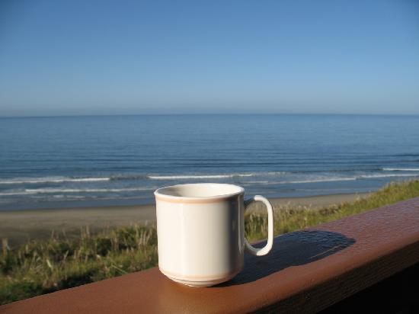
Morning Agenda
08:30 | Welcome & Introductions
08:45 | Introduction to ARC
09:00 | Lab: Login to Yeti
09:15 | Lab: Git clone class repository
09:30 | Introduction to Jupyter Hub
10:00 | BREAK
10:15 | HPC Systems Overview & Architecture
11:15 | LAB: Command Line Essentials
12:00 | LUNCH
Notes:
This Photo by Unknown Author is licensed under CC BY-NC-ND

Slide 3
Afternoon Agenda
01:00 | Job Scheduling with SLURM
02:00 | Lab: Command Line Essentials
02:30 | BREAK
02:45 | Lab: Running Jobs on Yeti
03:15 | Parallelism 101
Notes:
This Photo by Unknown Author is licensed under CC BY-NC-ND

Slide 4
Welcome & Introductions

Slide 5
Welcome & Introductions
Jeff Falgout – Technical Lead, Computer Scientist
Leon Foks – Scientific Programmer (Python, Fortran)
Janice Gordon – Team Lead
Brad Williams – Scientific Programmer, Systems Engineer
For Help: hpc@usgs.gov

Slide 6
ASK Questions
During class type your questions in the zoom chat box
After the class email us at hpc@usgs.gov
Look through our user documentation: https://hpcportal.cr.usgs.gov/hpc-user-docs/

Slide 7
Learning Objectives
Access and run HPC programs on Yeti (USGS supercomputer)
Test Python scripts with defensive programming strategies
Profile Python
Speed up Python with Numpy, Numba, and Fortran
Run MPI Python

Slide 8
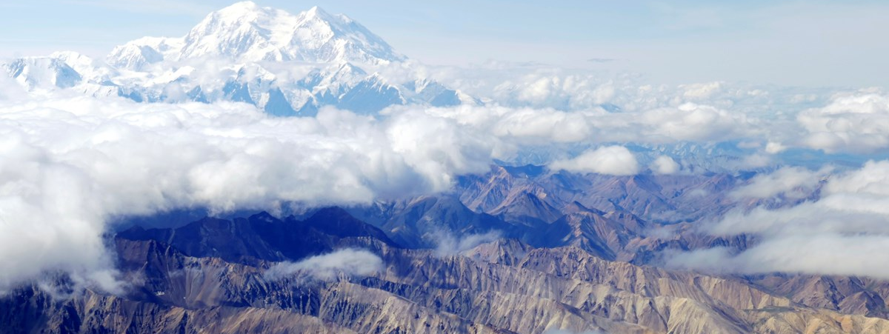
Introduction to ARC

Slide 9
Who We ARE
DOI
USGS
Core Science Systems Mission Area
FWS
NPS
Science Analytics and Synthesis Organization
Advanced Research Computing Team
...

Slide 10
Who We SERVE
DOI
USGS
Core Science Systems Mission Area
FWS
NPS
Science Analytics and Synthesis Organization
Advanced Research Computing Team
...
Currently we support over 800 users from USGS, FWS, NPS, BOR, and BLM

Slide 11
How we help researchers
Machine Access
Partnerships
Research
Training and Consulting
Notes:
Just a quick reminder of what we do in ARC:
Offer access to HPC resources, in-house and through our partners
We offer training and consulting on how best utilize HPC resources, optimizing and scaling codes, or to help you get started
Research into new technologies and methods to help scientists with computing problems: novel architecures, machine learning, edge computing
Partnerships: NSF XSEDE Program, DOE Oak Ridge National Laboratory, Rocky Mountain Advanced Computing Consortium, Colorado School of Mines, within USGS through the Advanced Computing Cooperative
I’m going to give some updates in each of these areas.

Slide 12
HPC Systems
Machine Access
Denali
Tallgrass
Caldera
Yeti
General Purpose HPC
Good place to start
CPU and GPU
143 nodes
3,728 CPU, 56,596 CUDA
100 Tflop/s
Flagship System
Large-scale Models
CPU Only
232 nodes
9,280 CPU (18,560 hyper-threads)
448 Tflop/s
Prototype System
ML and Analytics at scale
Built-in Software Stack
22 nodes, 792 CPU
122, 800 CUDA
15,360 Tensor
Tiered Storage System
4.2 PB Total
Connects to Denali & Tallgrass
Provide tiers of storage (high performance & object)
Denver
(will be replaced in 2022)
NEW!!
Hosted at EROS

Slide 13
Training and consulting
Training and Consulting
Training
HPC 101 Class
Weekly New User Webinars
HPC in R and Python
Parallel Programming Fortran/ C++
Advanced MPI
On-site training at science centers
Consulting Services
Initial Triage
Code Optimization and Tuning
Model Design
Scaling for Larger Systems
Notes:
Just as important as machine access!

Slide 14
Upcoming Classes
Training and Consulting
March 2020
Every Quarter

Slide 15
partnerships
Partnerships
Working with Experts
NSF Extreme Science and Engineering Discovery Environment (XSEDE) – signed MOU
Advanced CyberInfrastructure – Research and Education Facilitators (ACI-REF) Virtual Residency
Networking and Information Technology Research and Development Program (NITRD) USGS is an Observing Member
Rocky Mountain Advanced Computing Consortium (RMACC) – Executive Committee members
DOE Oak Ridge National Laboratory – Interagency Agreement
NSF Office of Advanced Cyberinfrastructure
Notes:
Stepping stones to larger resources, we can work through our partners to help scientists apply for allocation on larger machines.

Slide 16
Colorado School of Mines Partnership
Partnerships
Subsurface Frontiers Building
Shared vision for the new SSF building HPC Data Center and Visualization Lab
Joint NSF proposals to serve the Earth sciences community
Shared Computing Resources
Training Programs
Consulting and Knowledge Exchange
Collaborative Problem Solving
Recruiting Students

Slide 17
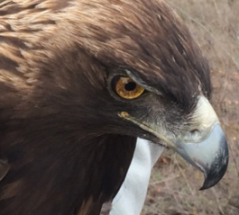
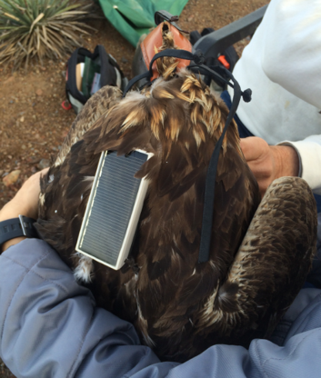
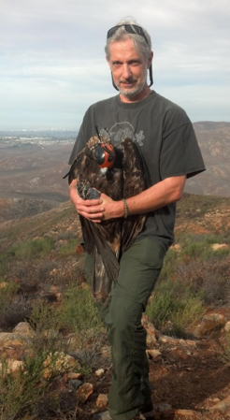
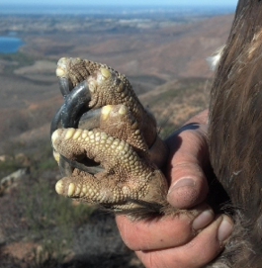
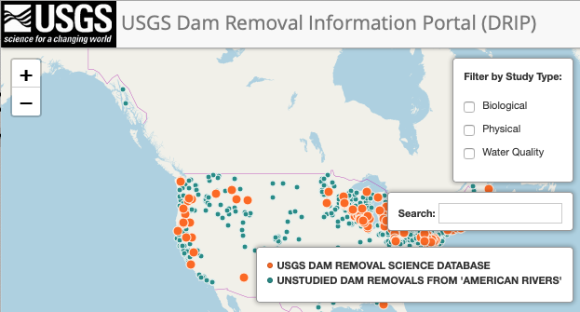
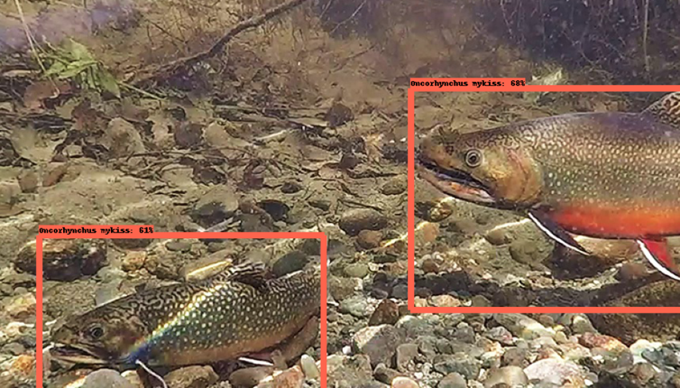
Machine Learning
Research
Data Science
Analytics
Artificial intelligence
Machine Learning
Neural Networks
Deep Learning
Evolution of wildfire risk to homes in the wildland urban interface
Todd J. Hawbaker, et al.
Classifying Golden Eagle Behavior with Telemetry Data
Jeff Tracey (WERC) and Natalya Rapstine (SAS/ARC)
NLP Aided Literature Review for the Dam Removal Information Portal
Daniel Wieferich, Brandon Serna, Jeff Duda, Sky Bristol
Deep Learning for Video Fish Identification
Ben Letcher, Nathaniel Hitt, Jeff Allenby, Natalya Rapstine, Brandon Serna

Slide 18
What we Ask from You
Cite us in your publications.
USGS Advanced Research Computing, USGS Yeti Supercomputer: U.S. Geological Survey, https://doi.org/10.5066/F7D798MJ
USGS Advanced Research Computing, USGS Denali Supercomputer: U.S. Geological Survey, https://doi.org/10.5066/P9PSW367
USGS Advanced Research Computing, USGS Tallgrass Supercomputer: U.S. Geological Survey, https://doi.org/10.5066/P9XE7ROJ

Slide 19
What we Ask from You
Share your success stories with us
We are always asked to give presentations showing our value to science.
We can use project summaries, images, information on how HPC has helped you.

Slide 20
What we Ask from You
Contribute to our Working Capital Fund
This is our savings account for the next generation of machines
We are a small program and do not get Bureau level funding
We don’t want to charge science projects to use these resources
Please pitch in when you can!

Slide 21
LAB: Login to Yeti

