Slide 1
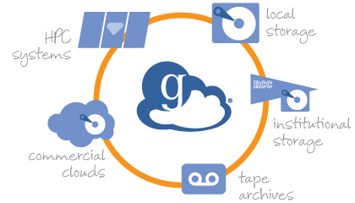
Globus
Official Introduction to the Advanced Computing Cooperative at USGS
Jeff Falgout
jfalgout@usgs.gov
Computer Scientist
Advanced Research Computing
Science Analytics and Synthesis
Core Science Systems
U.S. Geological Survey
4 February 2021

Slide 2
Disclaimer
This is a work in progress!
Information is current as of 4 Feb 2021
Almost all the background info on Globus is straight from the Globus website
www.globus.org
Things may (and will likely) change
This is also v0.02 of this slide deck
The USGS Globus subscription is an annual subscription @ ~$150k
About the cost of a single FTE
Covers all clients, endpoints, and users in usgs.gov
Points of Contact
Jeff Falgout (CSS/SAS) jfalgout@usgs.gov
Al Pedraza (ACIO/CHS) apedraza@usgs.gov
Support hpc@usgs.gov
we are the first point of contact for support, we will escalate to Globus as necessary

Slide 3
What is Globus?
"Research Data Management Simplified"
Transfer
Share
Build
Non-profit out of University of Chicago
Started out as National Science Foundation grant
De facto standard within research computing community for data transfer
"Unifies access to research data across all systems"
https://www.globus.org

Slide 4
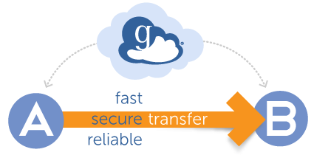
What is Globus: Transfer
Unified interface to research data
Laptop/desktop, supercomputers, tape storage, cloud storage
Web interface, cli, or api
Optional encryption of transfer, sync destination with source, etc
Monitor transfers in progress
Data transferred directly between source and destination
'Set it and forget it' – Globus service monitors transfer at each endpoint
Automatically tunes transfer/network parameters on the fly – much higher transfer rates than other protocols (when using GridFTP protocol)
Recover from network or endpoint failures (up to 3 days) with notifications if action is required

Slide 5
Notes:
I shamelessly stole this from the googles – do not release this and get me In trouble. This is for internal meeting use only. https://imgur.com/gallery/ZK9vQtt I deny everything.

Slide 6
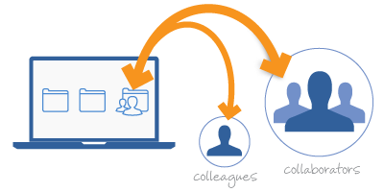
What is Globus: Share
Allows easy and secure data sharing directly by users from source storage system
Depends on configuration for non DOI collaborators (intranet vs internet)
Eliminates need for intermediate storage location
no need to upload to web/ftp server or cloud and then download
Able to control permissions on shared files
read vs read/write
Collaborators receive email with link and use Globus transfer files
No need to establish collaborator account in USGS

Slide 7
What is Globus: Build
Enables development of applications and services that capitalize on transfer and sharing features
Data portals, Science Gateways, Web/Mobile apps can take advantage of exposed APIs (same ones used for Globus Web Application)
ReST api
https://docs.globus.org/modern-research-data-portal/

Slide 8
USGS Globus Subscription
Unlimited managed endpoints
Integration with organizational authentication
InCommon, OpenID, etc
DOI has enabled Active Directory Federated Service (ADFS) for USGS
Familiar login – multifactor authentication
Unlimited users under usgs.gov domain
Client to client transfers
File sharing
Usage reports
Management console
Application integration options (ReST API or Globus user-interface widgets)

Slide 9
USGS Globus Subscription: Connectors
A connector allows endpoints to access non-POSIX filesystems
Globus, without a connector, can access POSIX filesystems
Lustre, CXFS, NFS, ext4, etc
USGS subscription includes:
Globus for AWS S3
Globus for Spectra Logic BlackPearl
Other connector options include
iRods – https://irods.org
HPSS - http://www.hpss-collaboration.org
Ceph RADOS Gateway – https://ceph.io
Hadoop HDFS – https://hadoop.apache.org

Slide 10
Logging in to the Globus Web Interface
https://www.globus.org

Slide 11
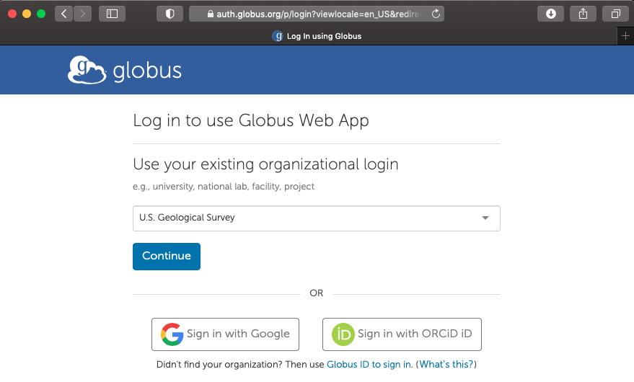
Logging in to the Globus Web Interface

Slide 12
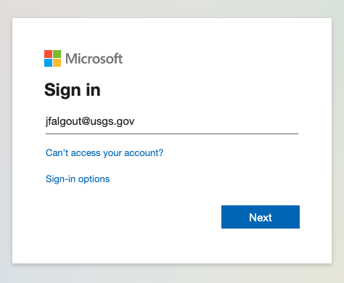
Logging in to the Globus Web Interface

Slide 13
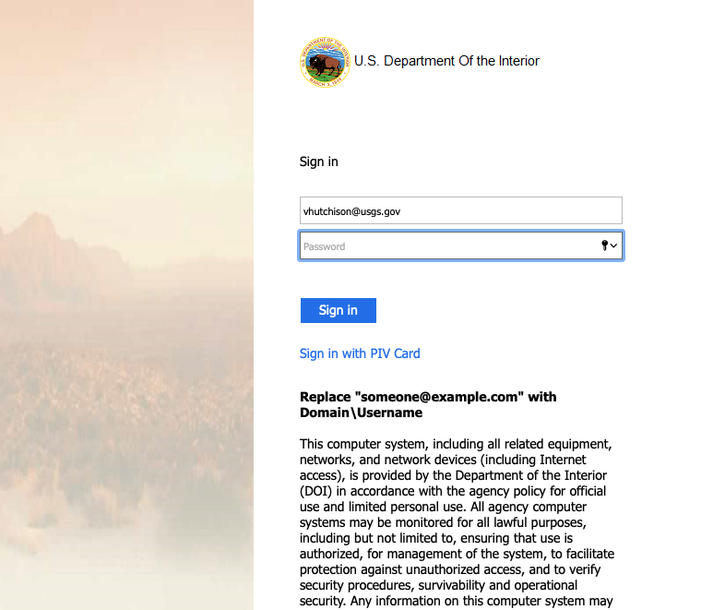
Logging in to the Globus Web Interface

Slide 14
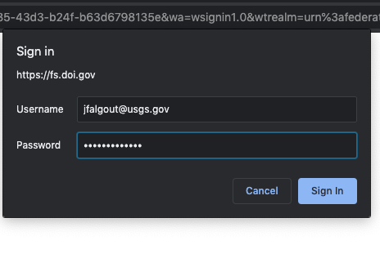
Logging in to the Globus Web Interface

Slide 15
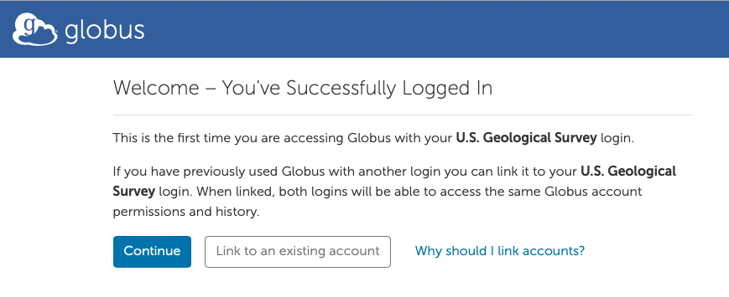
Logging in to the Globus Web Interface

Slide 16
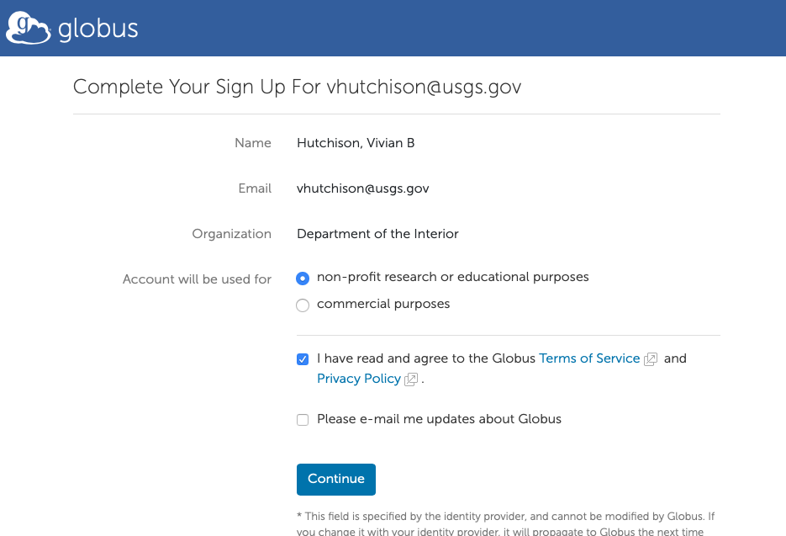
Logging in to the Globus Web Interface
jfalgout@usgs.gov
Falgout, Jeff T
jfalgout@usgs.gov

Slide 17
Consents

Slide 18
Once Logged In – The File Manager

Slide 19
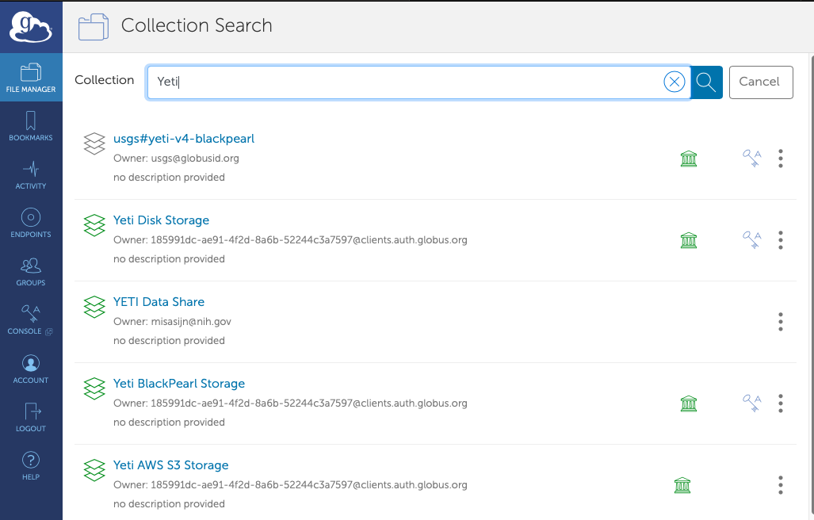
Collections
Deprecated, eventually going away
Not a USGS Share
As we move forward, we will refine descriptions and keywords

Slide 20
Transfer from Yeti Disk to Caldera Disk
Default path is your home directory

Slide 21
Transfer from Yeti Disk to Caldera Disk
Default path is your home directory

Slide 22
Transfer from Yeti Disk to Caldera Disk

Slide 23
Transfer from Yeti Disk to Caldera Disk

Slide 24
Transfer from Yeti Disk to Caldera Disk

Slide 25
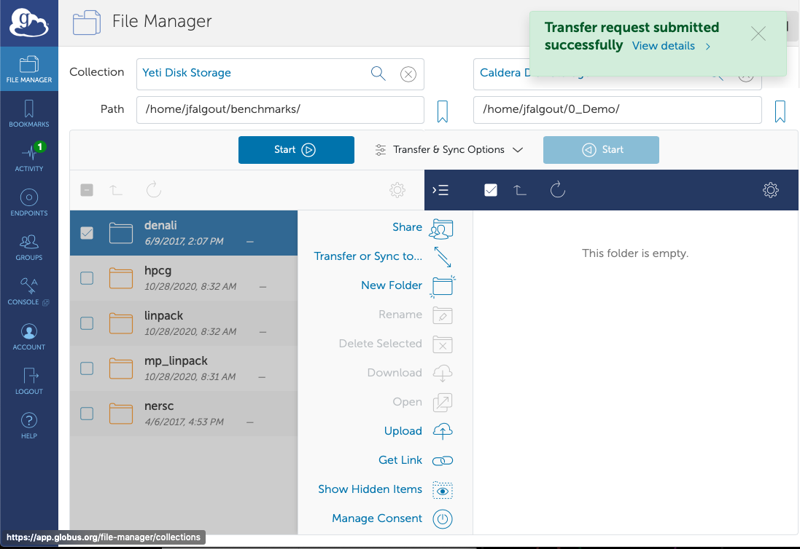
Transfer from Yeti Disk to Caldera Disk

Slide 26
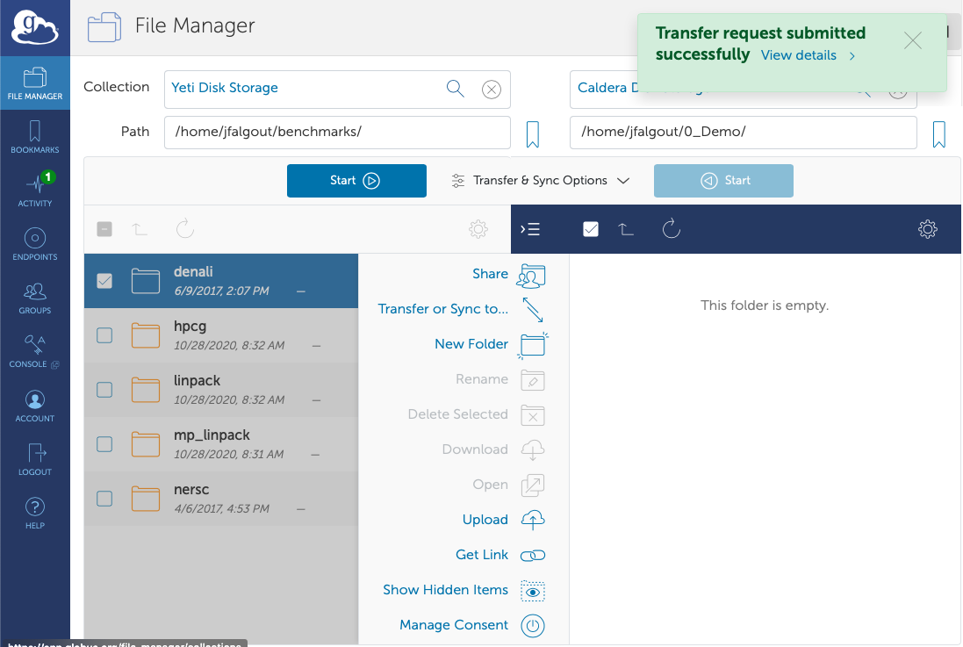
Transfer from Yeti Disk to Caldera Disk

Slide 27
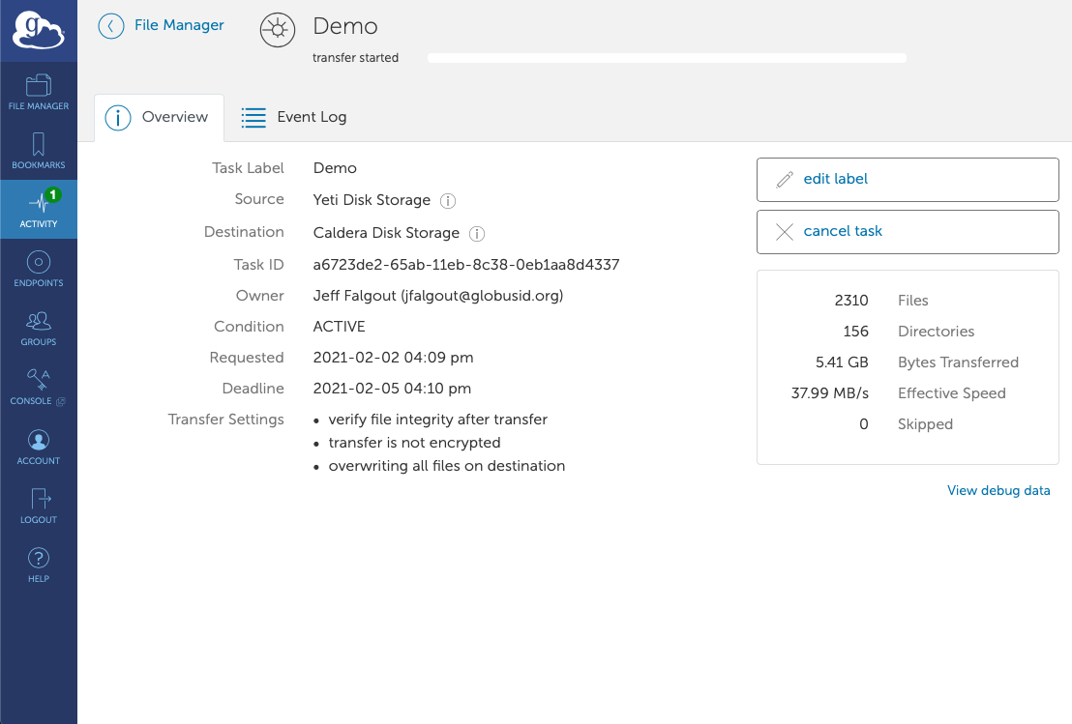
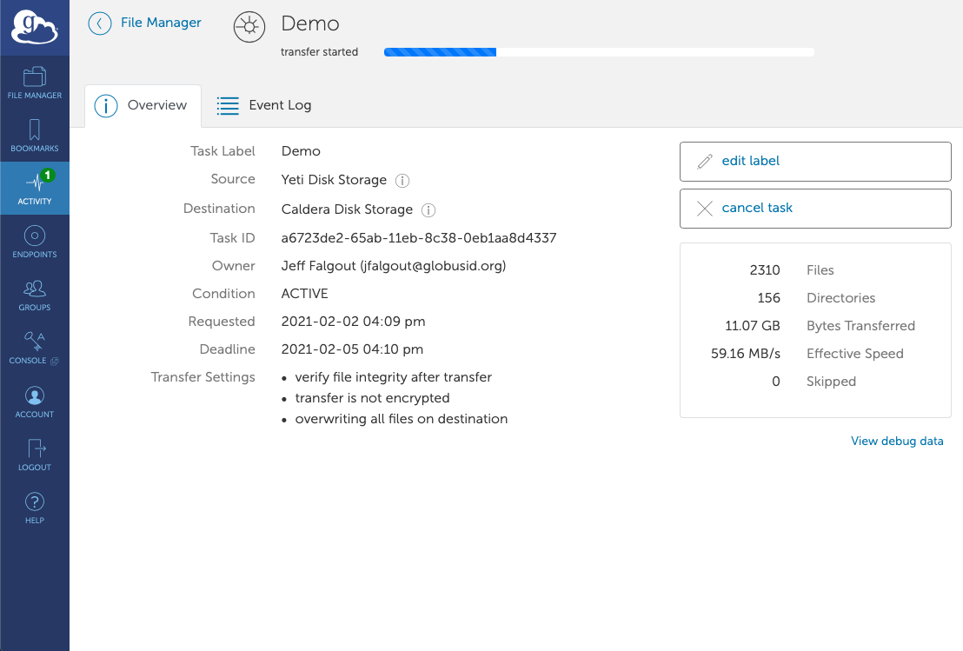
Transfer from Yeti Disk to Caldera Disk

Slide 28
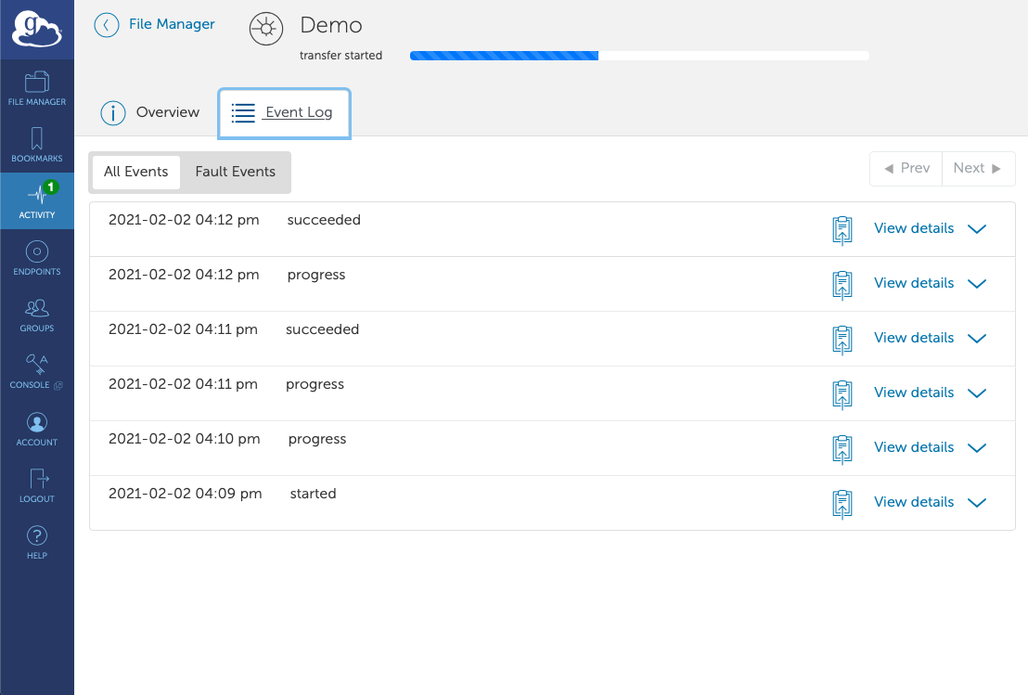
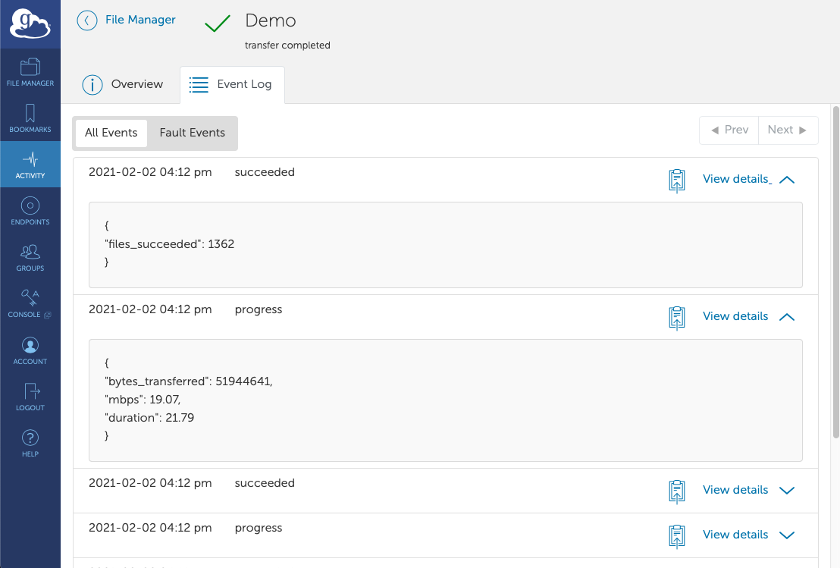
Transfer from Yeti Disk to Caldera Disk

Slide 29
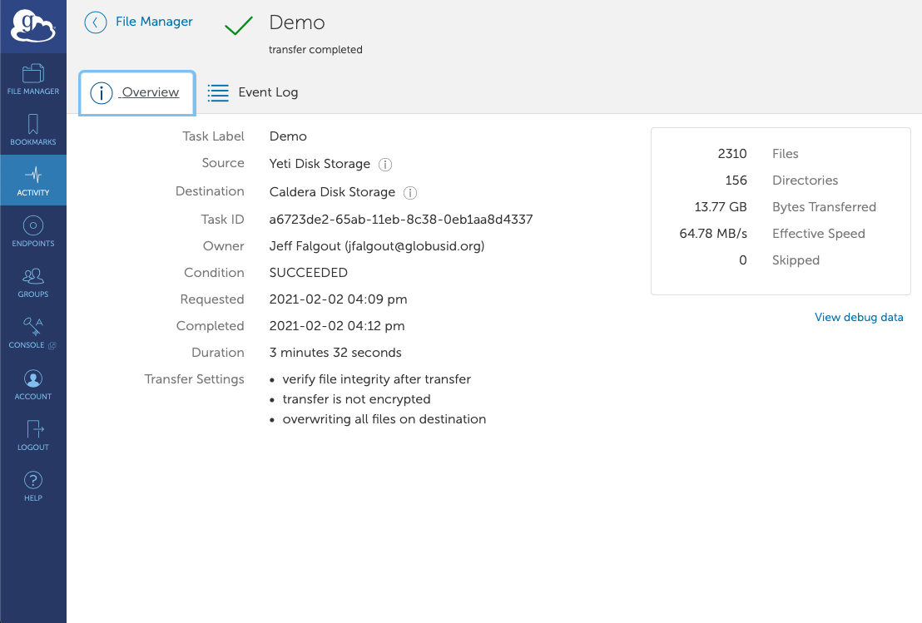
Transfer from Yeti Disk to Caldera Disk

Slide 30
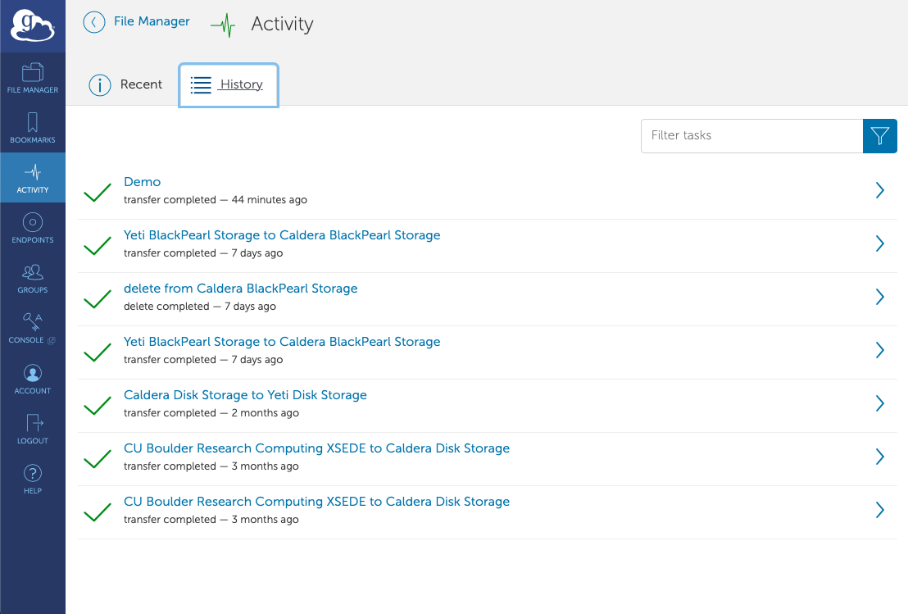
Transfer from Yeti Disk to Caldera Disk

Slide 31
Sharing Data – Creating a Guest Collection

Slide 32
Sharing Data – Creating a Guest Collection

Slide 33
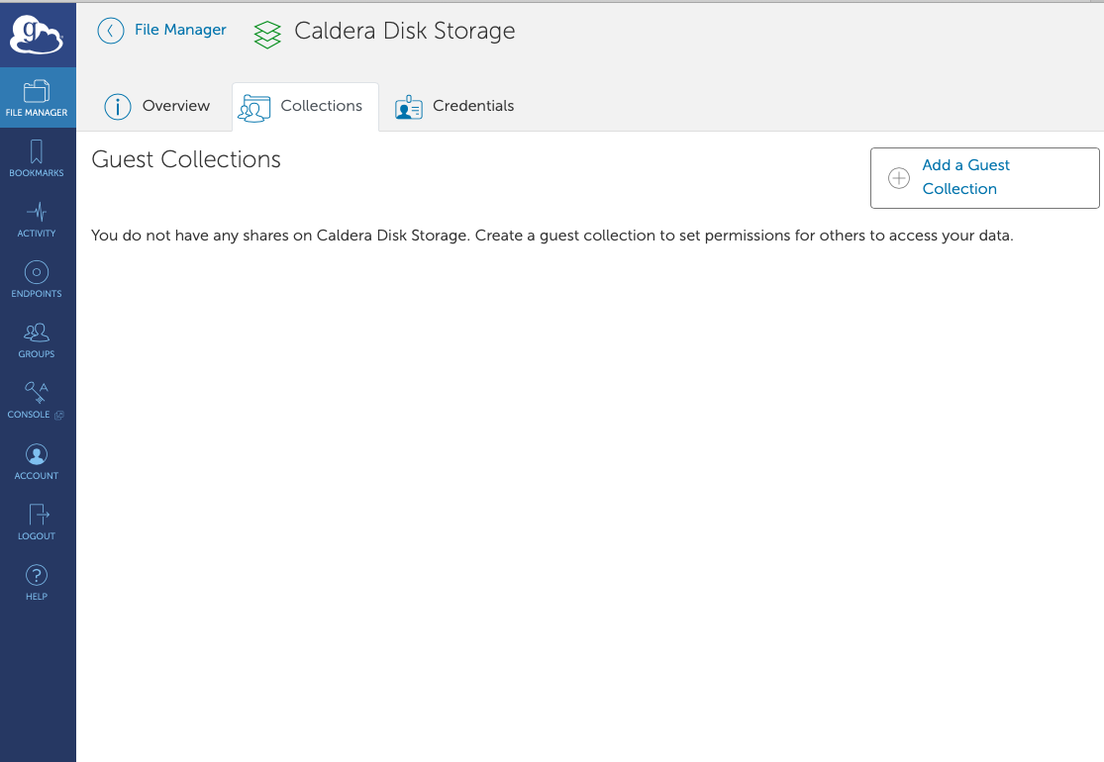
Sharing Data – Creating a Guest Collection

Slide 34
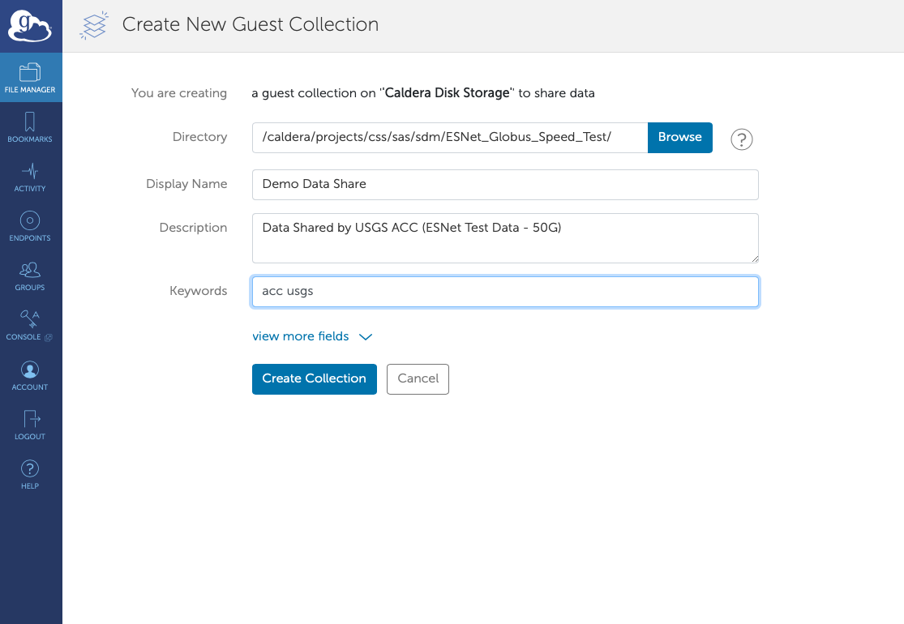
Sharing Data – Creating a Guest Collection

Slide 35
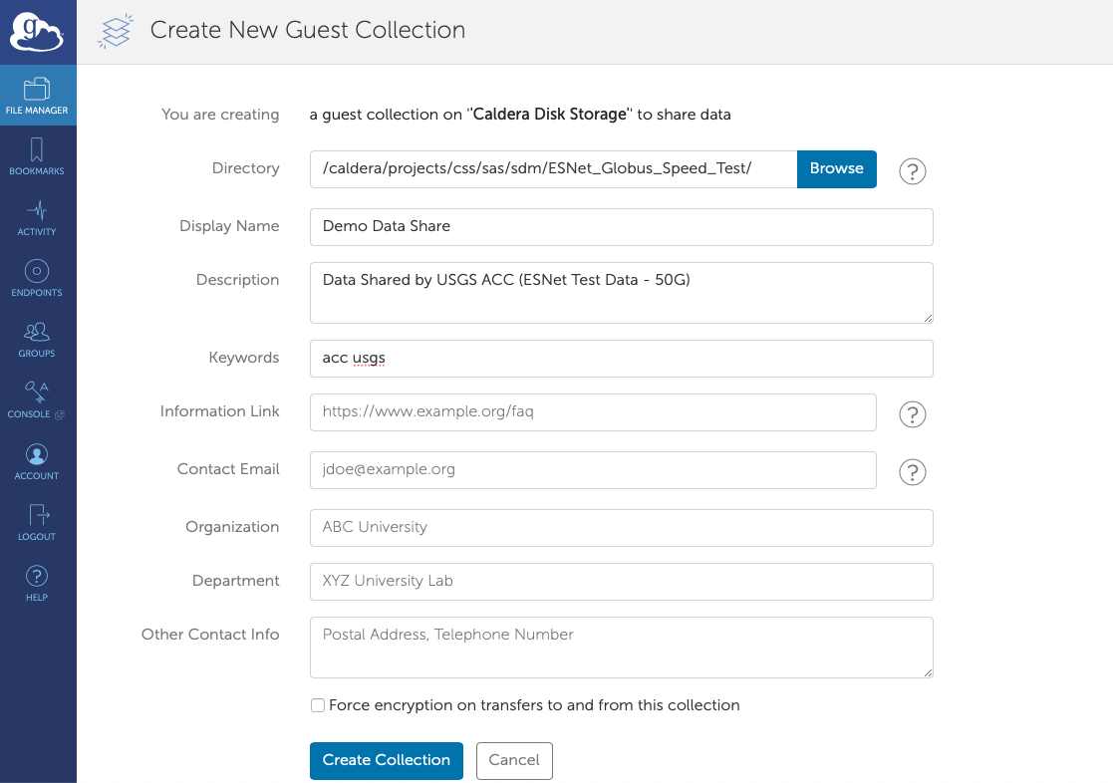
Sharing Data – Creating a Guest Collection

Slide 36
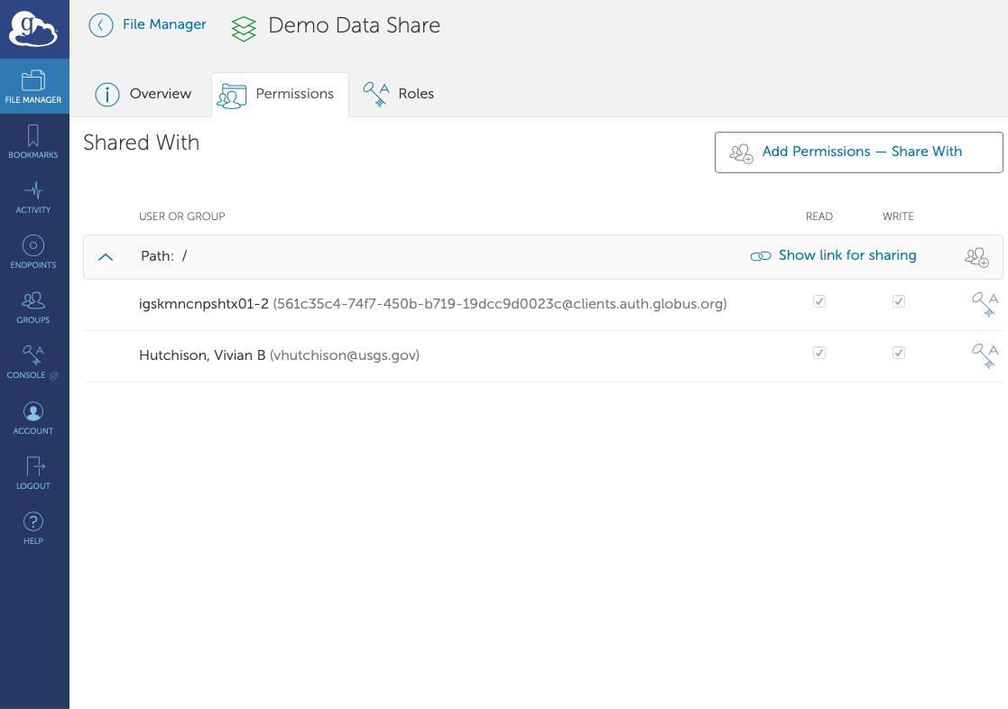
Sharing Data – Managing a Guest Collection

Slide 37
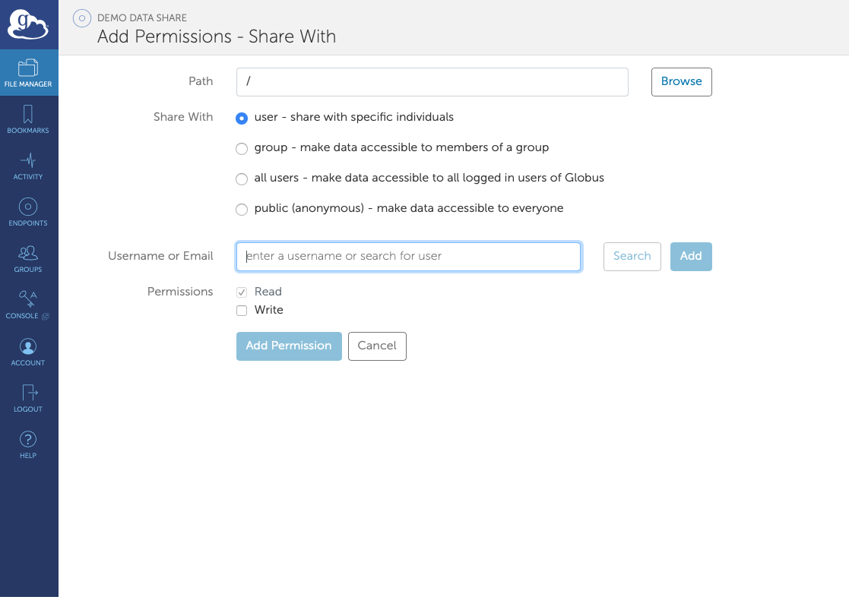
Sharing Data – Managing a Guest Collection

Slide 38
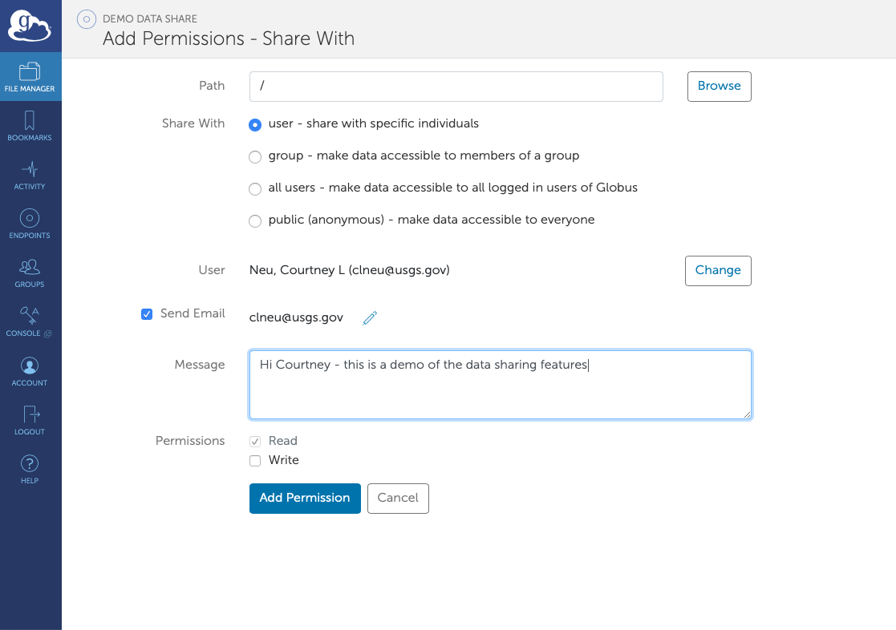
Sharing Data – Managing a Guest Collection

Slide 39
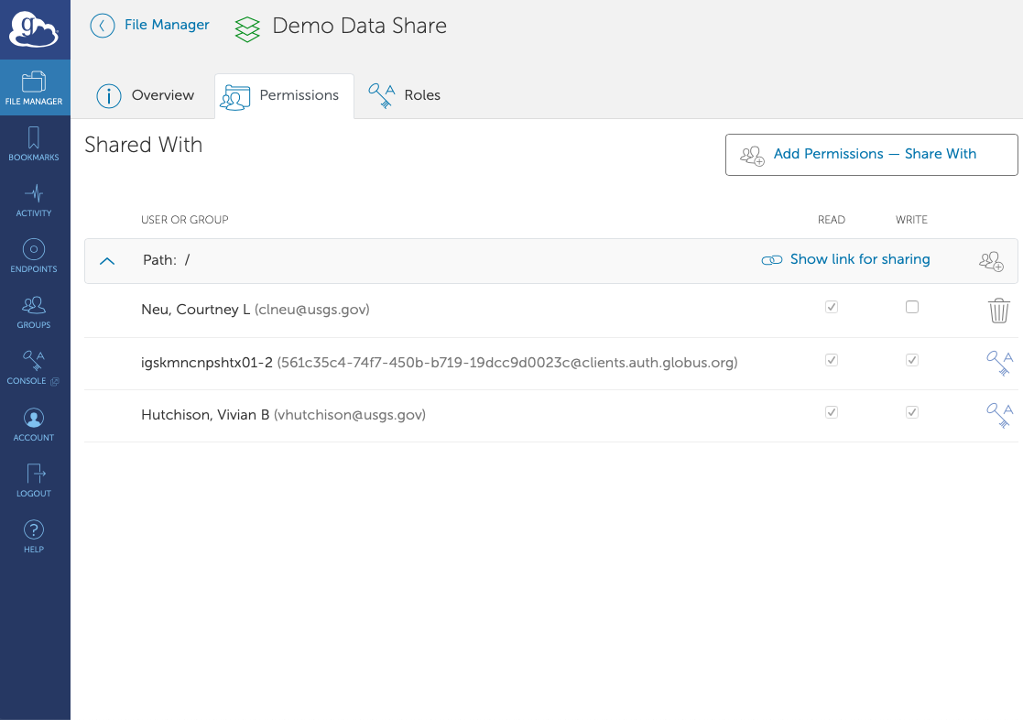
Sharing Data – Managing a Guest Collection

Slide 40
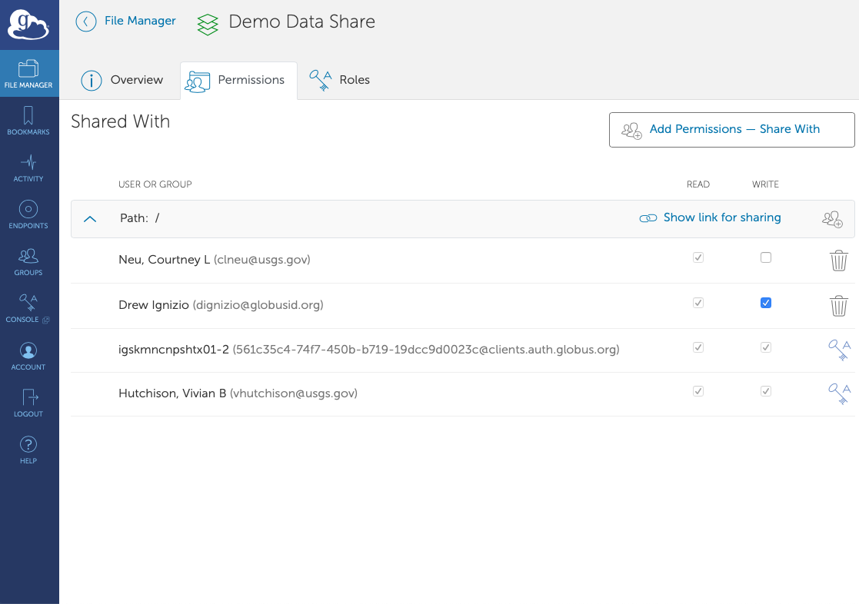
Sharing Data – Managing a Guest Collection

Slide 41
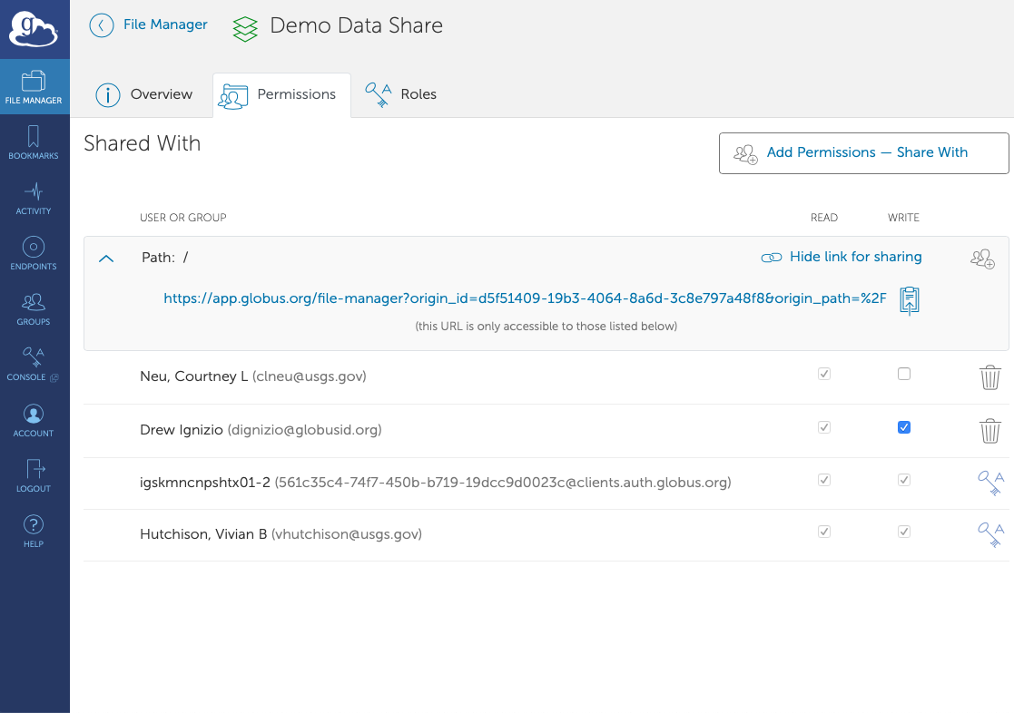
Sharing Data – Managing a Guest Collection

Slide 42
Sharing Data – Administrator View

Slide 43
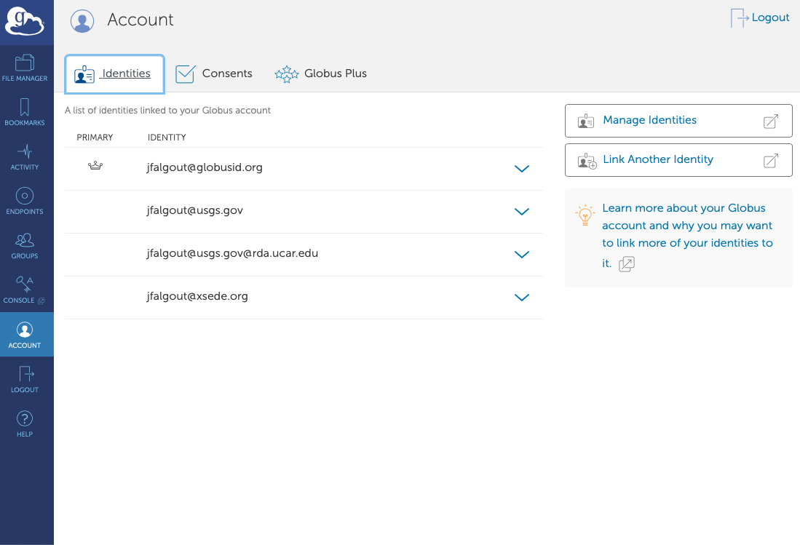
Globus Identities
Multiple identities can be linked to a single person
Why should I link accounts?
Globus allows users to link their many identities (e.g., university login, facility logins, Google, Globus ID) into a single Globus account. This allows the user to have a single account to manage their resources across these multiple identities. For example, a user with a University of Chicago account, might also have XSEDE account. By linking those together into a single Globus account, use of services such as Globus transfer and groups using either identity is consolidated under that single Globus account.

Slide 44
Globus Connect Personal – The Client
Creates a Globus endpoint on laptop, desktop, or other computer
Allows transfer/share from local machine to other Globus endpoints
No administrator privileges required for install or to run
Windows, Mac, and Linux supported
Quick install
Traverses NAT
Uses Globus platform for security and authentication
https://www.globus.org/globus-connect-personal
Be sure to follow all instructions, notably "Configuration" <-- windows doc link

Slide 45
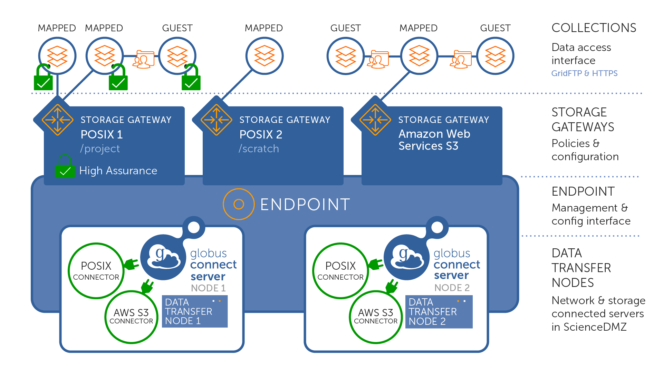
Globus Connect Server Architecture

Slide 46
Endpoint
A deployment of Globus Connect Server v5 (or Globus Connect Personal)
May include multiple data transfer nodes (physical servers)
Provides interface for server management and configuration

Slide 47
Storage Gateway
Provides storage access policies for endpoint's connected storage systems
Named, discoverable interface by which authorized users can create and manage collections on a connected storage system
Connected storage system may have multiple storage gateways

Slide 48
Collection
Provide data access interfaces
HTTPS – client/server access
GridFTP – asynchronous bulk transfer
ReST API –advanced operations
Named set of files (blobs) hierarchically organized in folders associated with a specific storage gateway
Access granted with Globus Auth issued OAuth2 access tokens
Data policies defined in the collection itself
Mapped collection – user must have an account on storage system
Guest collection – user can access collection without local account on storage system but must be granted by authorized user via Globus

Slide 49
USGS Endpoints
USGS ACC has two endpoints today
Yeti
Caldera (Denali and Tallgrass)
Centers interested in standing up their own endpoints can contact me

Slide 50
Yeti Endpoint
Yeti Disk Storage
/home
/lustre
/cxfs/projects
/cxfs/projects2
Yeti BlackkPearl Storage (6PB Tape)
Buckets are shown as top-level directories
Yeti AWS S3 Storage
Buckets are shown as top-level directories

Slide 51
Caldera Endpoint
Caldera Disk Storage
/home
/caldera/projects
Caldera BlackPearl Storage (4 PB: 3PB Tape, 1PB Disk)
Buckets are shown as top-level directories
Caldera AWS S3 Storage
Buckets are shown as top-level directories

Slide 52
BlackPearl and Globus
BlackPearl with Globus requires per account setup
We need to map your BlackPearl credentials with your Globus ID
Login to the BlackPearl interface (gs\username), logout, send an email to hpc@usgs.gov stating you would like your BlackPearl account mapped to your Globus ID.
By default, we will configure buckets to go to tape (Glacier style)
We do have the option to write to archival disk on Caledera's BlackPearl
Limited disk capacity vs tape
Must be set before files are written to the bucket
Email hpc@usgs.gov to have the policy set

Slide 53
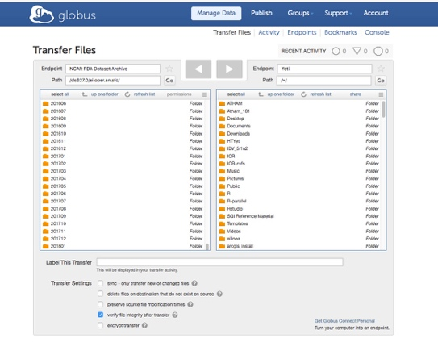
Globus Transfers at a High Level
Remote Endpoint
Yeti
(Denver)
Caldera(EROS)
Data
Control
Control
Control
Control
Data
Data
Control
Control
Desktop
Laptop
www.globus.org

Slide 54
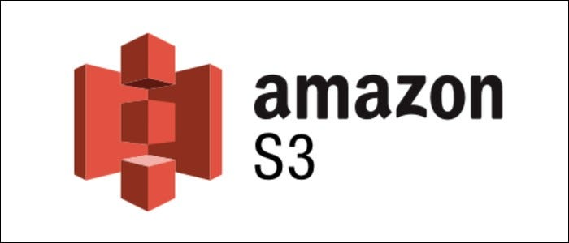
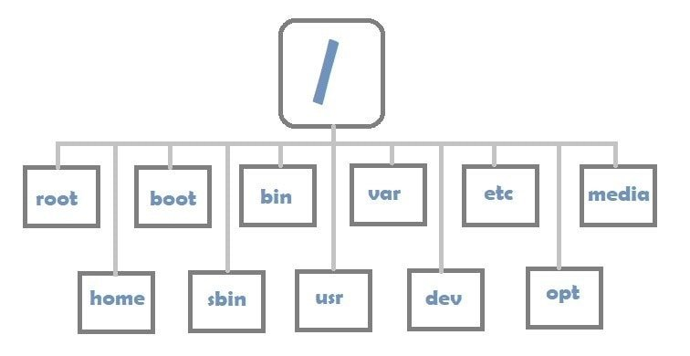
Yeti Globus Endpoint
Caldera BlackPearl Storage
Caldera Amazon AWS S3 Storage
USGS Network
Caldera Disk Storage
Yeti Globus Endpoint
BLM Data Center
Denver, CO
Notes:
"File:Linux file system foto no exif (1).jpg" by Dhanusha Dhananjaya is licensed under CC BY-SA 4.0

Slide 55
Caldera Globus Endpoint
Caldera BlackPearl Storage
Commodity Internet
Caldera Amazon AWS S3 Storage
Caldera Disk Storage
USGS Network
Caldera Globus Endpoint
Internet2
(planned)
EROS Data Center
Sioux Falls, SD
Notes:
"File:Linux file system foto no exif (1).jpg" by Dhanusha Dhananjaya is licensed under CC BY-SA 4.0

Slide 56
Globus Connect Server Architecture

Slide 57
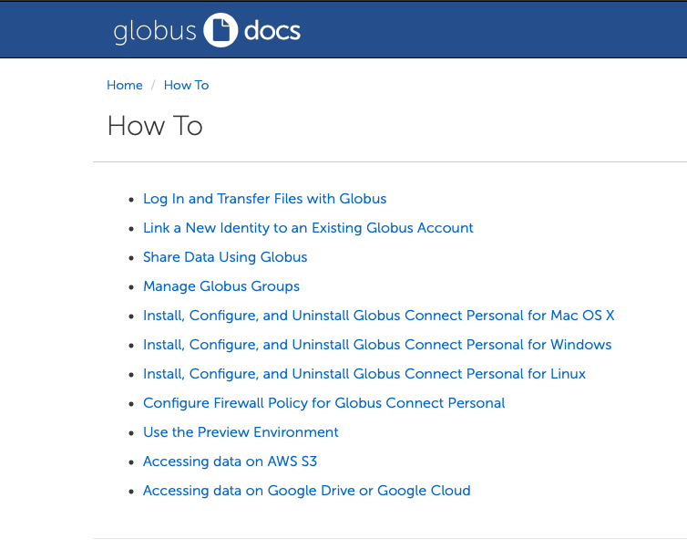
Globus Documentation
https://docs.globus.org

Slide 58
Work In Progress: Hybrid S3 Storage Ecosystem
Hybrid on prem/cloud object storage solution that enables policy driven data flows
Single name space
Local on prem S3 to remote on prem S3
Local on prem S3 to AWS S3
AWS S3 to on prem (local or remote) S3
Local on prem S3 to on prem S3 Glacier
Field to AWS S3 to on prem S3 and on prem S3 Glacier
Read and write via standard S3 clients (including awscli)

Slide 59
Work In Progress: Hybrid S3 Storage Ecosystem
An early architectural diagram,
but conveys the intent.
This is in active development and still has many details to be ironed out, including how Globus will fit into the architecture.

Slide 60
Questions?
Jeff Falgout – jfalgout@usgs.gov
Al Pedraza – apedraza@usgs.gov

