Slide 1
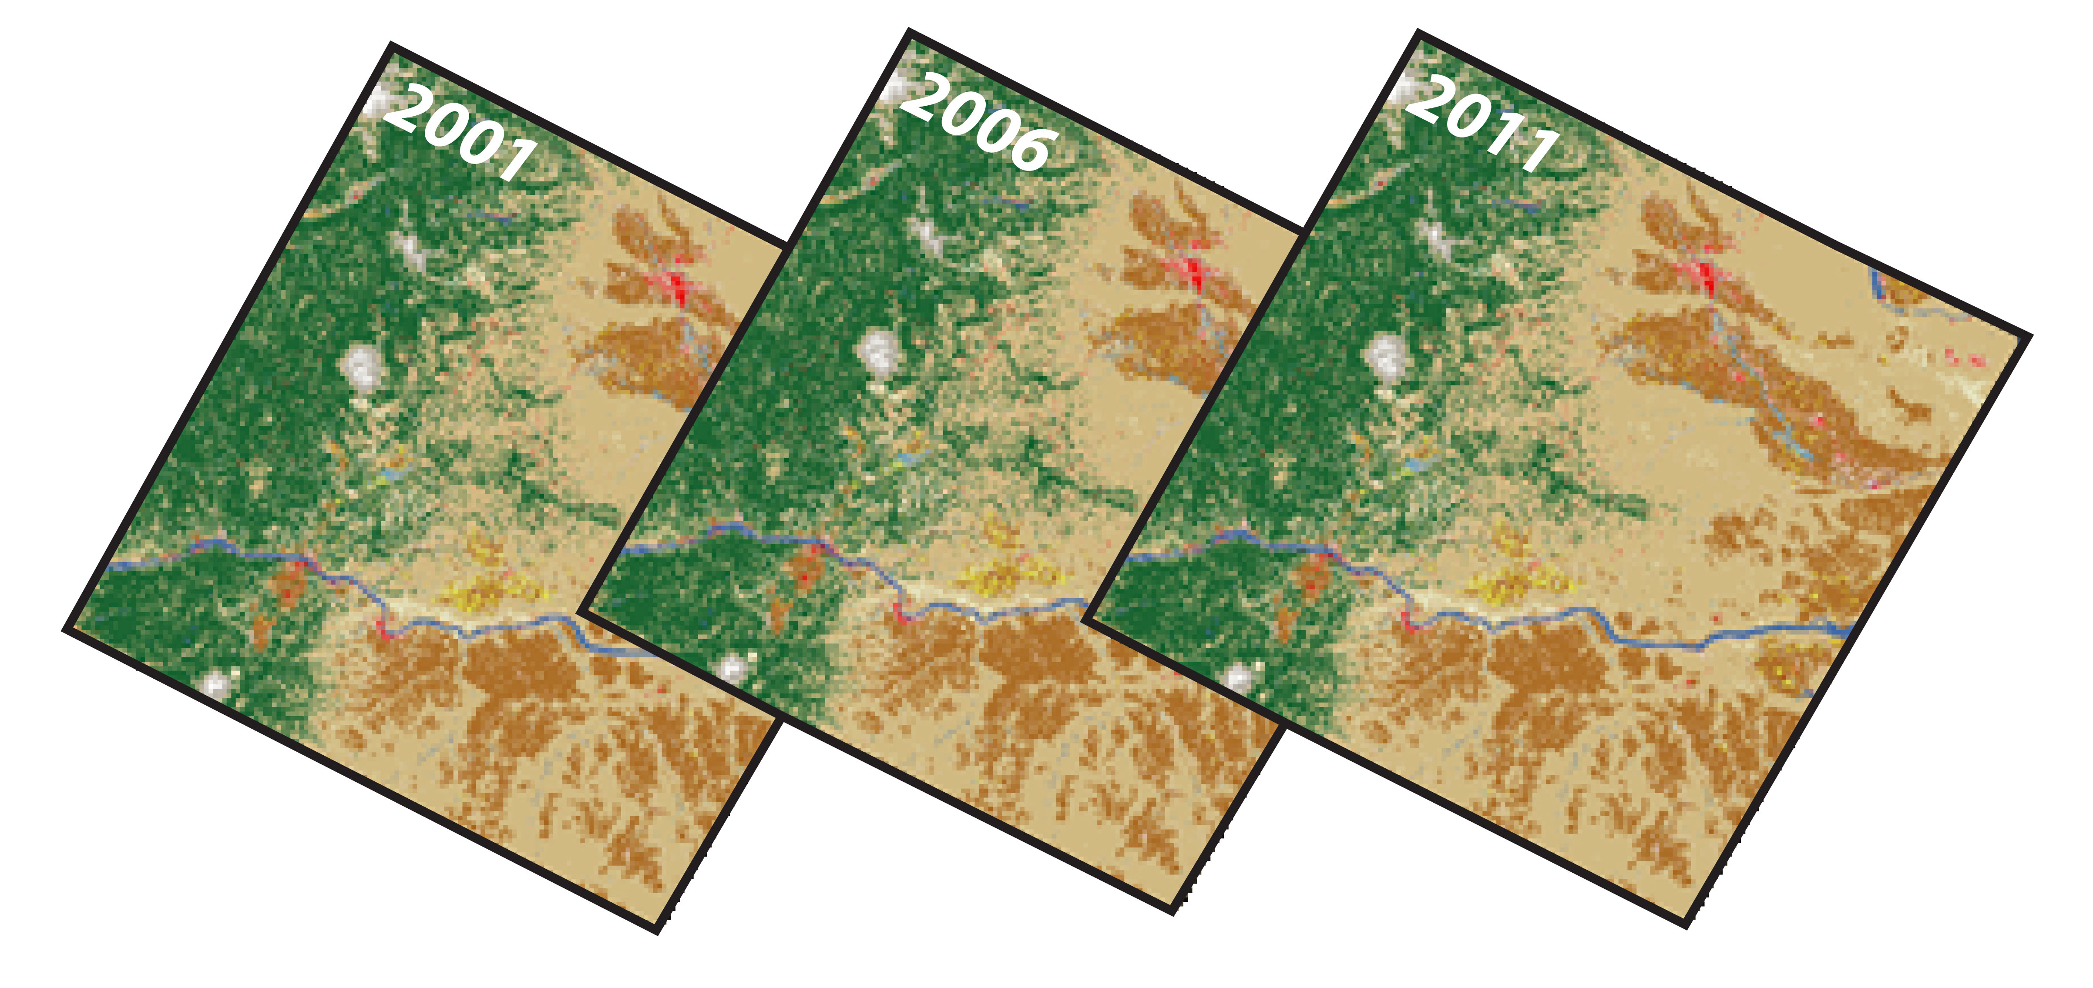
Figure 1. Three epochs of land cover from the National Land Cover Database.

Slide 2
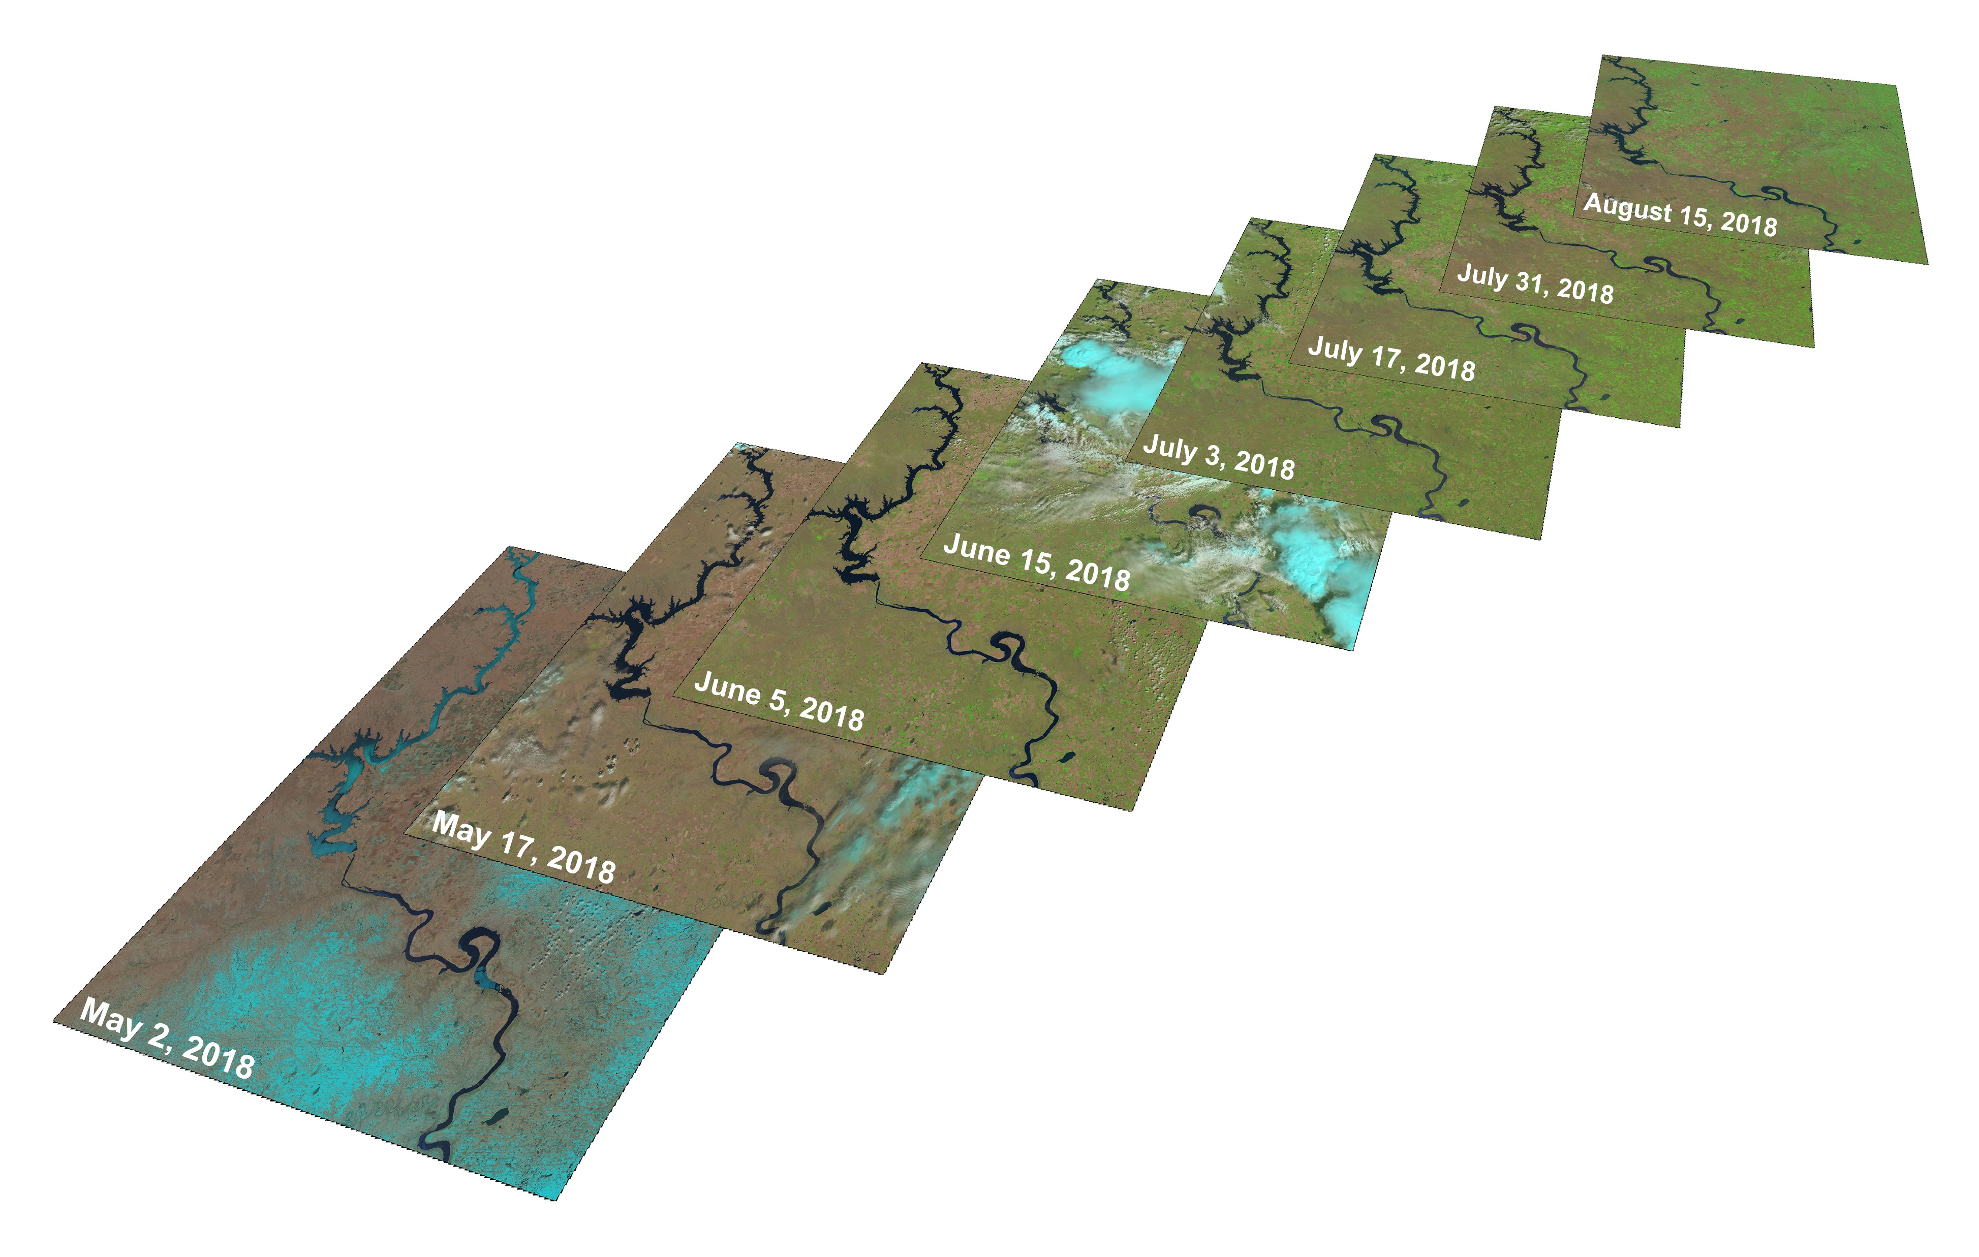
Figure 2. Detecting land cover change by analyzing dense stacks of pixels is at the core of the Land Change Monitoring, Analysis, and Projection project.

Slide 3
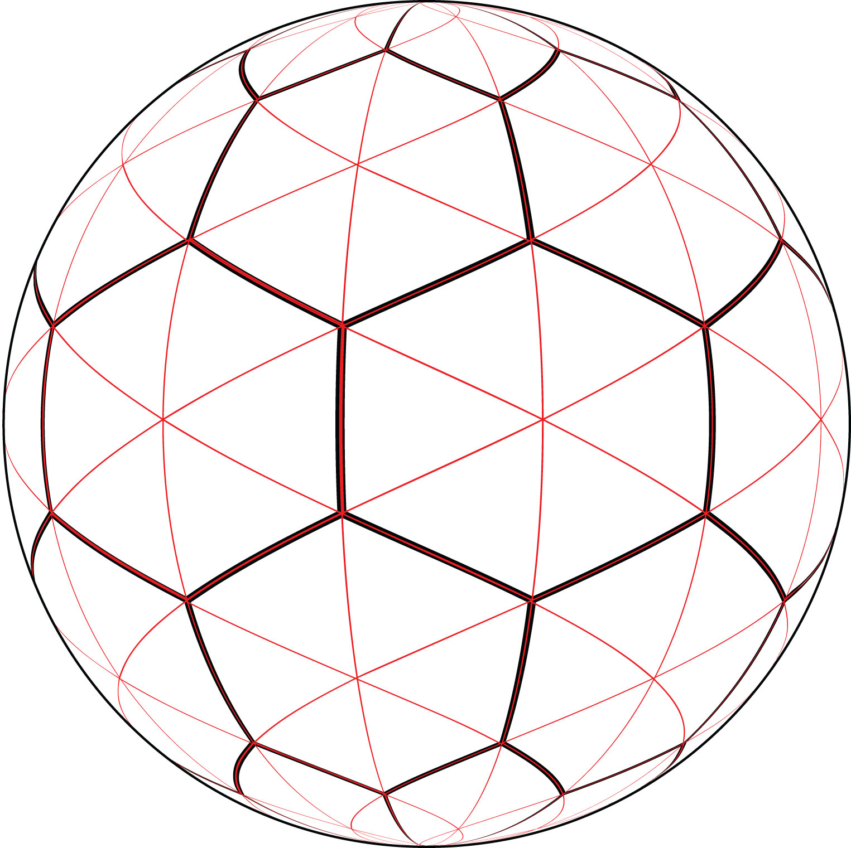
Figure 3. Hexagons and triangles — one of many possible frameworks and subdivisions, or tessellations, for a Discrete Global Grid System.

Slide 4
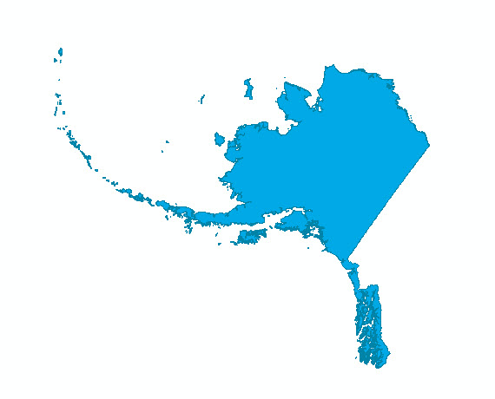
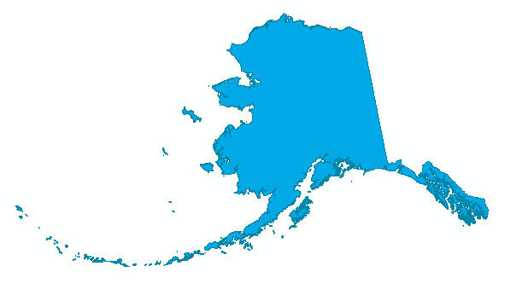
Albers Equal-Area Conic
Area: 1,507,484.74 sq km
Lambert Azimuthal Equal Area
Area: 1,507,485.19 sq km
Sinusoidal
Area: 1,507,484.41 sq km
Figure 4. A coastline for Alaska projected to three equal-area projections will have the same area despite differences in shape.

Slide 5
L48 | 29.5 | standard parallel 1
 | 45.5 | standard parallel 2
 | -96 | central meridian
 | 23 | latitude of origin
Alaska | 55 | standard parallel 1
 | 65 | standard parallel 2
 | -154 | central meridian
 | 50 | latitude of origin
Hawaii | 8 | standard parallel 1
 | 18 | standard parallel 2
 | -157 | central meridian
 | 3 | latitude of origin
Puerto Rico / | 8 | standard parallel 1
Virgin Islands | 18 | standard parallel 2
 | -66.5 | central meridian
 | 15 | latitude of origin
Table 1. Parameters for the Albers Equal-Area Conic projection used by the U.S. Geological Survey for small scale maps of the United States.

Slide 6
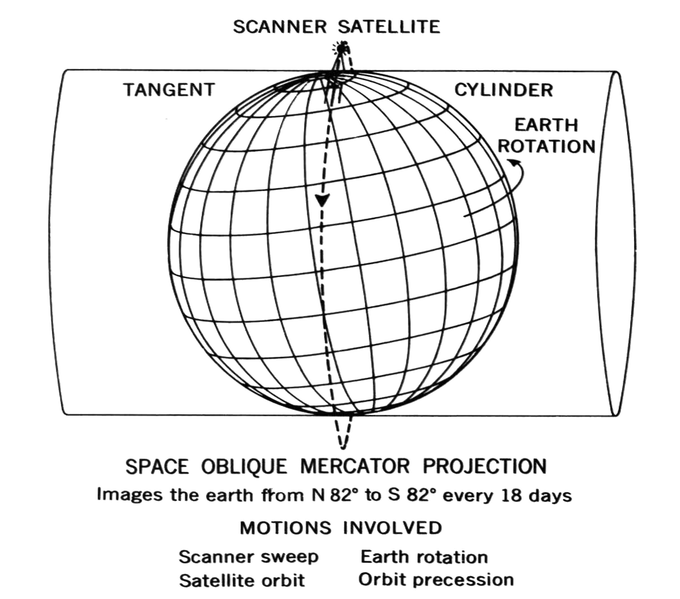
Figure 5. The Space Oblique Mercator projection was envisioned by USGS cartographer Alden Colvocoresses in 1974 and formulated by John Snyder in 1978, and follows the ground track of the Landsat satellite.

Slide 7
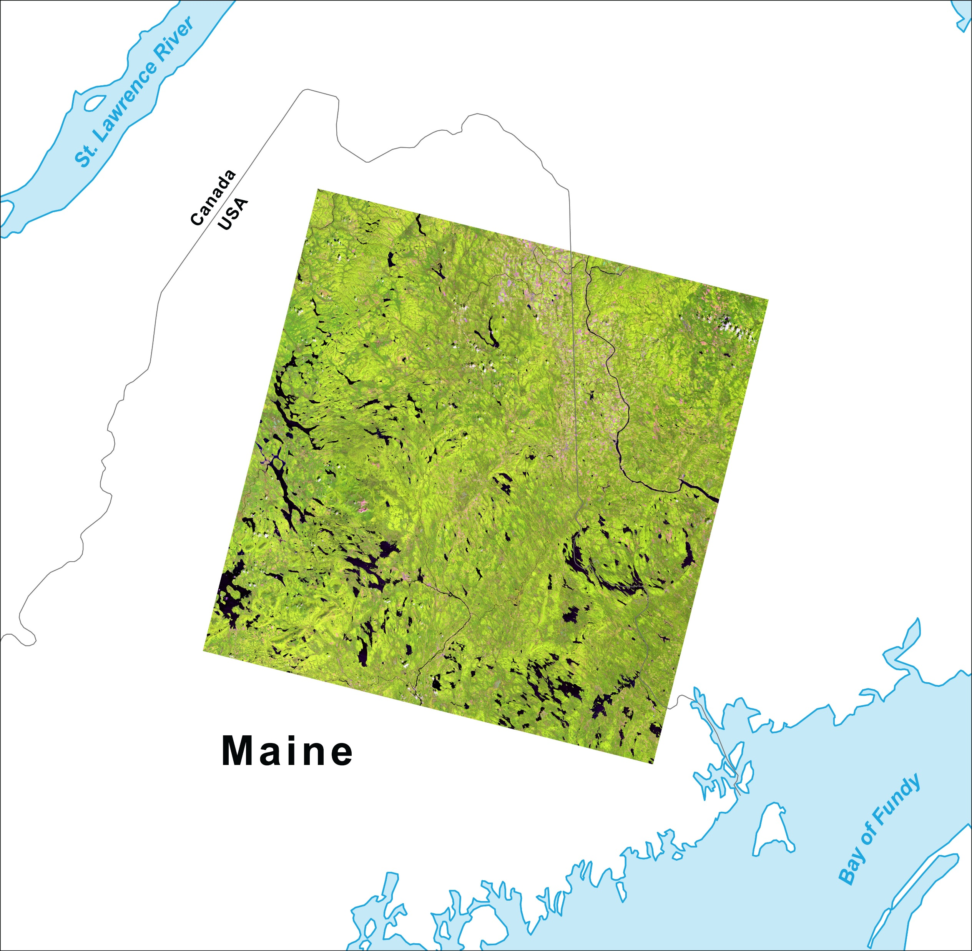
Figure 6. Landsat 8 image of Maine, in UTM.

Slide 8
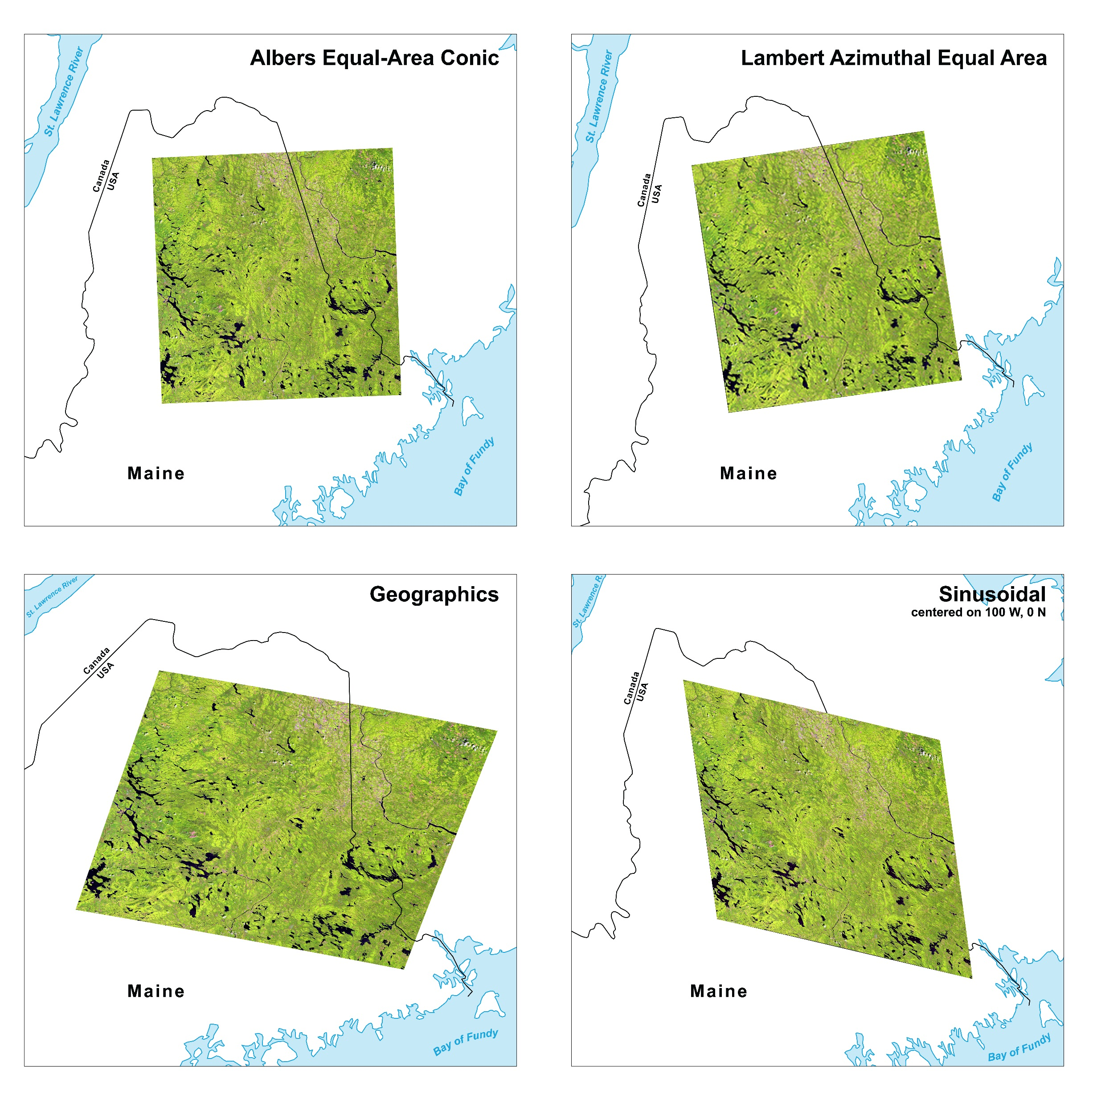
Figure 7. Four reprojections of a Landsat 8 image of Maine.

Slide 9
Figure 8. Tissot indicatrices for Albers Equal-Area Conic, Lambert Azimuthal Equal Area, Mercator, and Azimuthal Equidistant projections.

Slide 10
Figure 9. Grid squares show distortion caused by reprojection from Geographics to Lambert Azimuthal Equal Area.

Slide 11
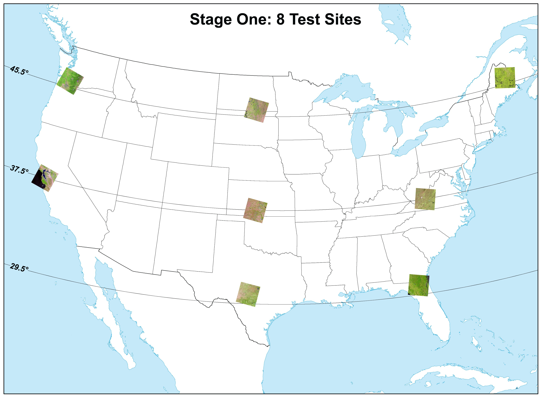
Figure 10. Eight sites selected for stage one tests.

Slide 12
Path | Row | Location | Scene ID
11 | 28 | Maine | LC80110282016236LGN00
17 | 34 | Virginia | LC80170342016310LGN00
17 | 39 | Florida / Georgia | LC80170392016118LGN00
31 | 28 | North Dakota / South Dakota | LC80310282016168LGN00
29 | 34 | Kansas | LC80290342016266LGN00
28 | 39 | Texas | LC80280392016195LGN00
46 | 28 | Washington / Oregon | LC80460282016257LGN00
44 | 34 | California | LC80440342016243LGN00
Table 2. Eight test images in L48 selected for stage one tests.

Slide 13
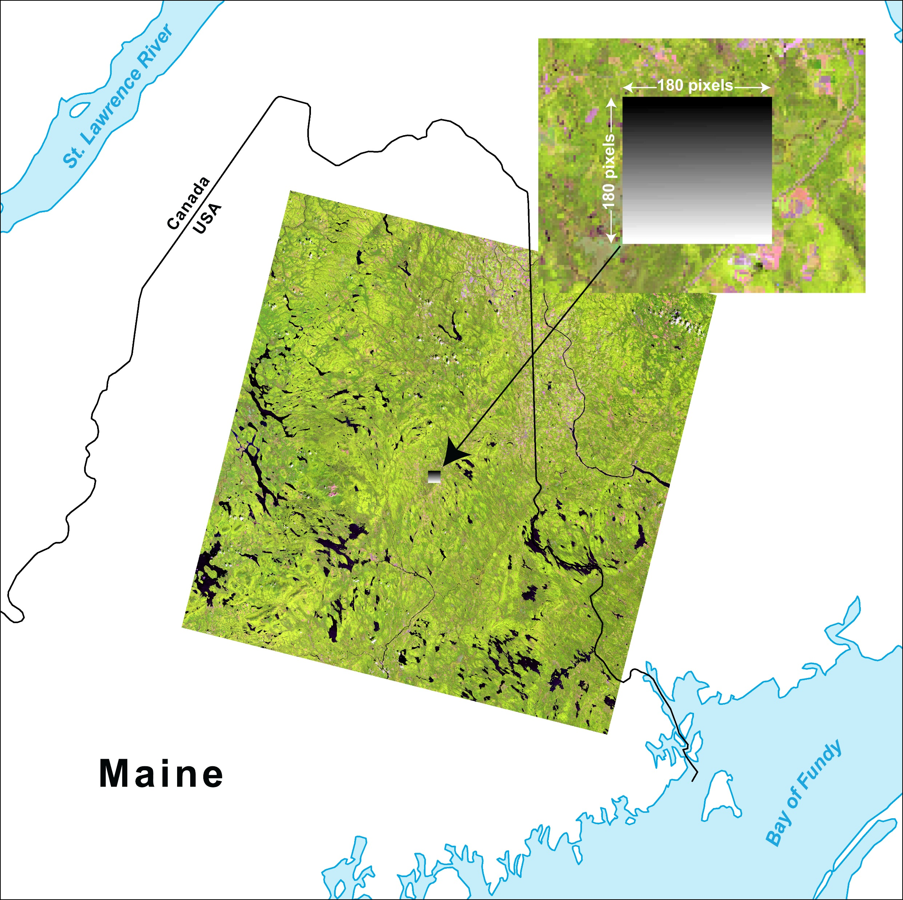
Figure 11. Test image, 180 rows by 180 samples. Each pixel has a unique value from 1 to 32,400.

Slide 14
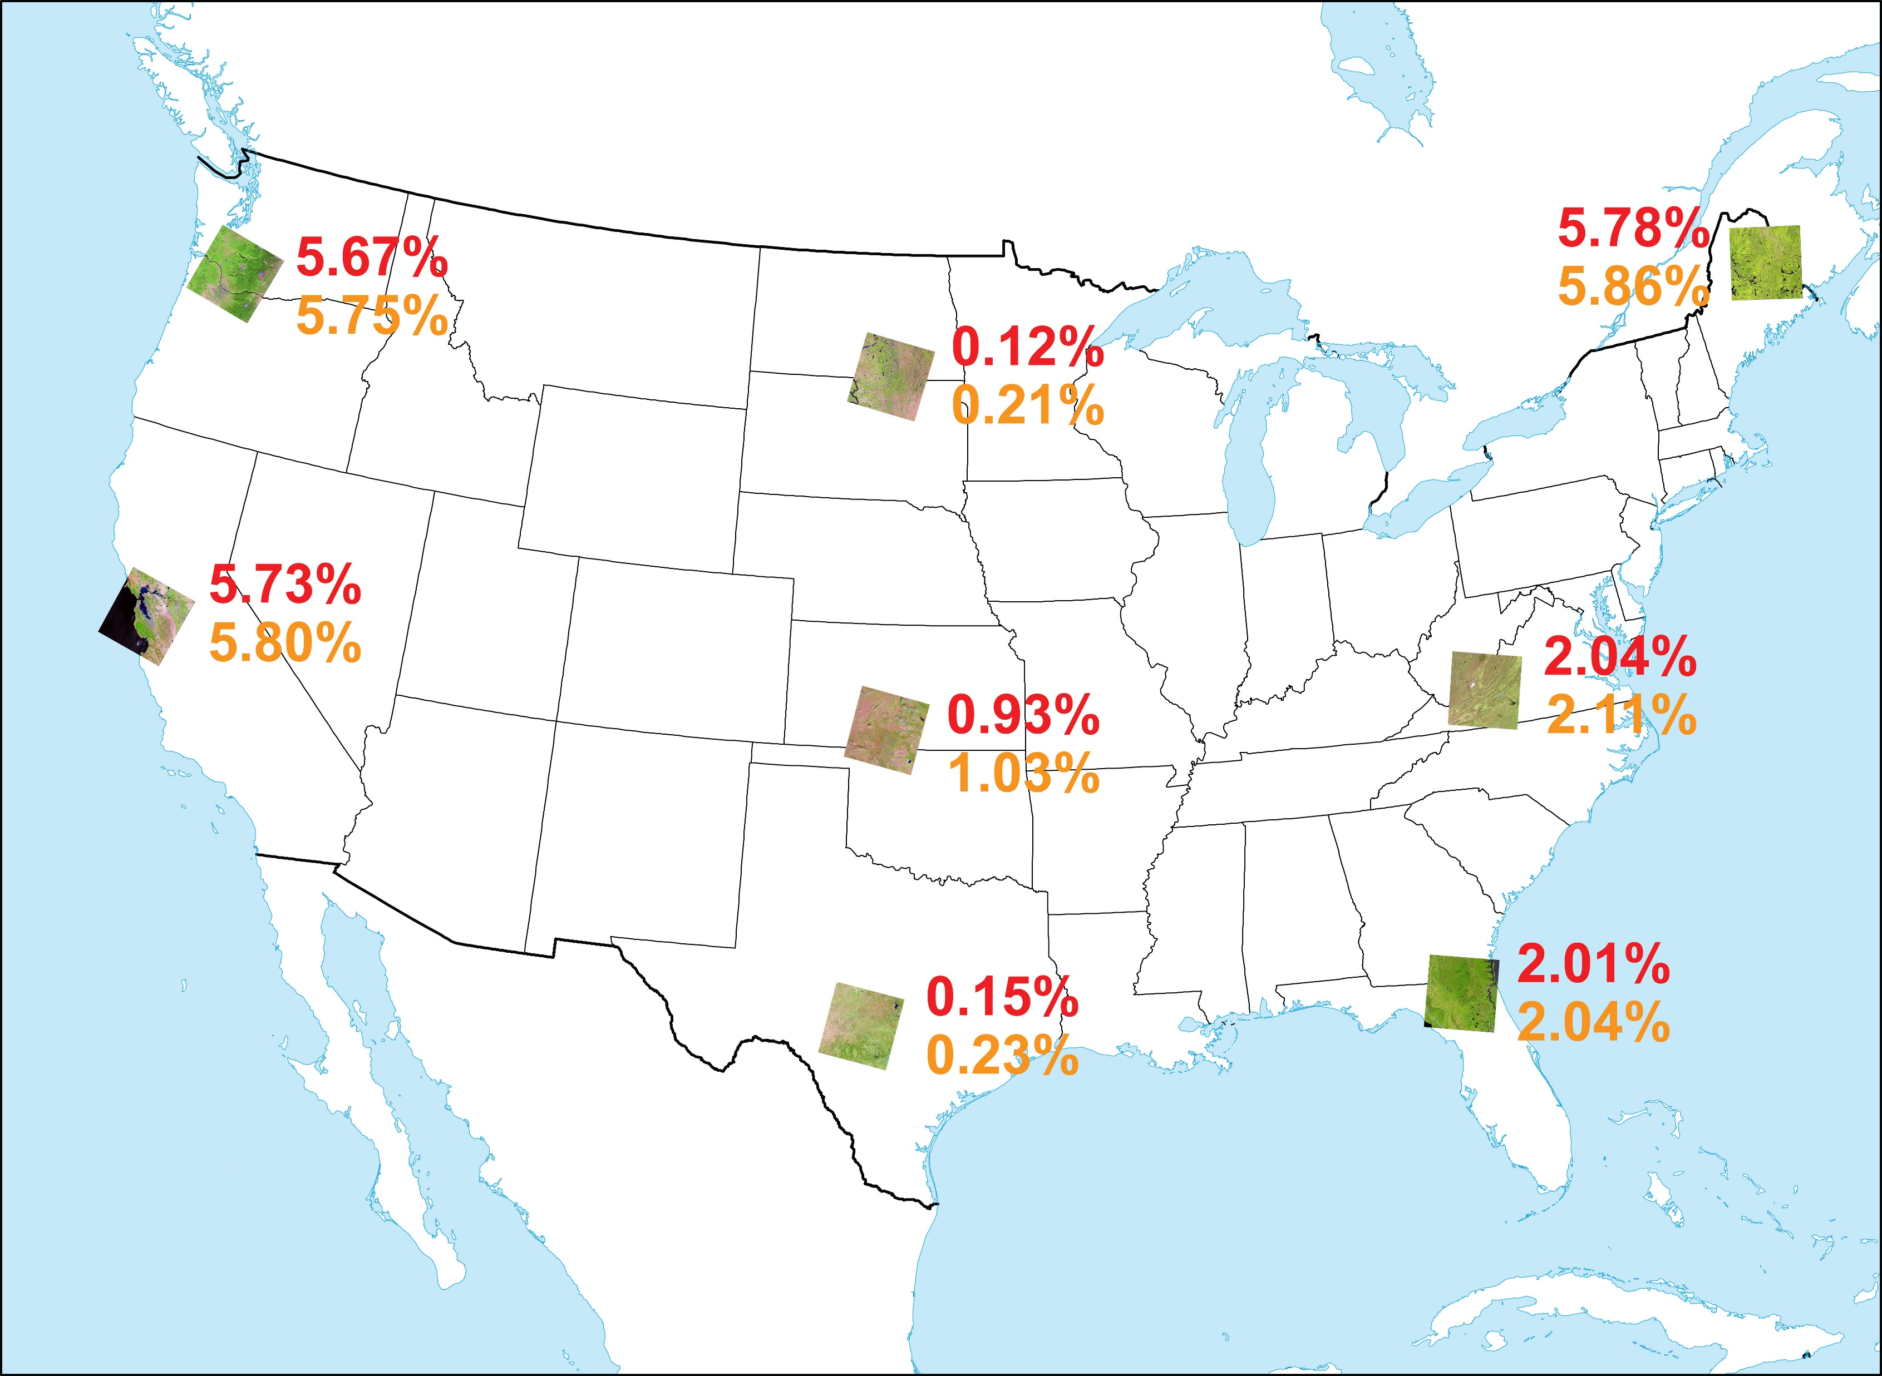
Figure 12. Undersampling (red) and oversampling (orange) results for Albers Equal-Area Conic.

Slide 15
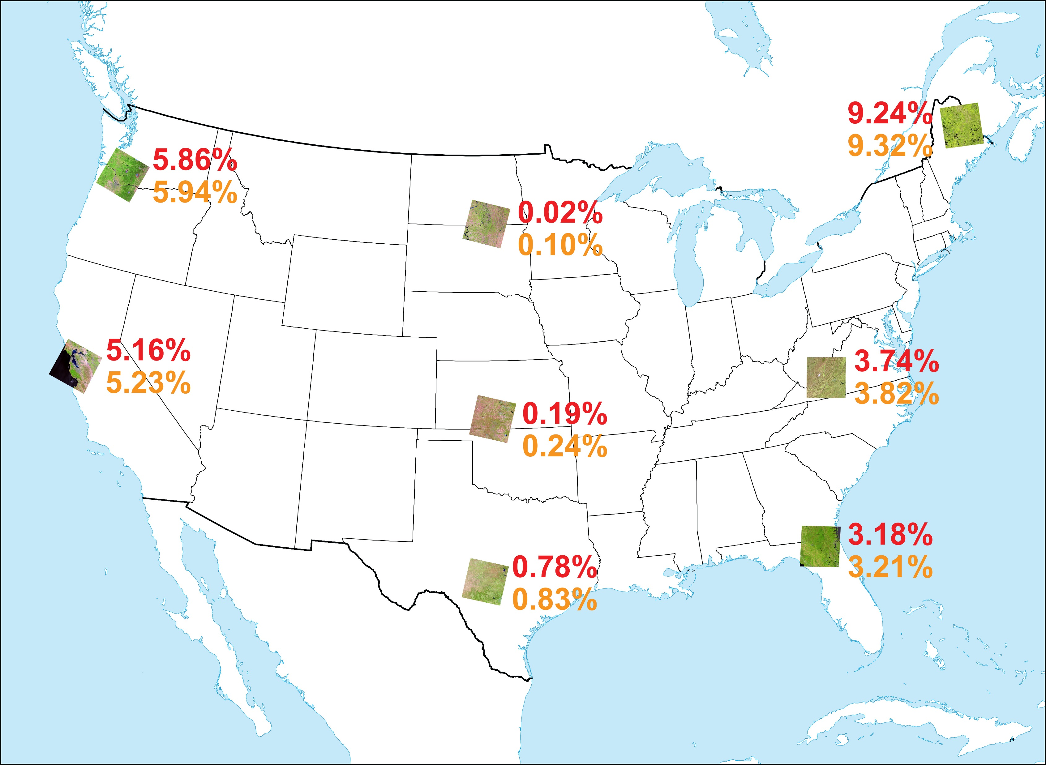
Figure 13. Undersampling (red) and oversampling (orange) results for Lambert Azimuthal Equal Area.

Slide 16
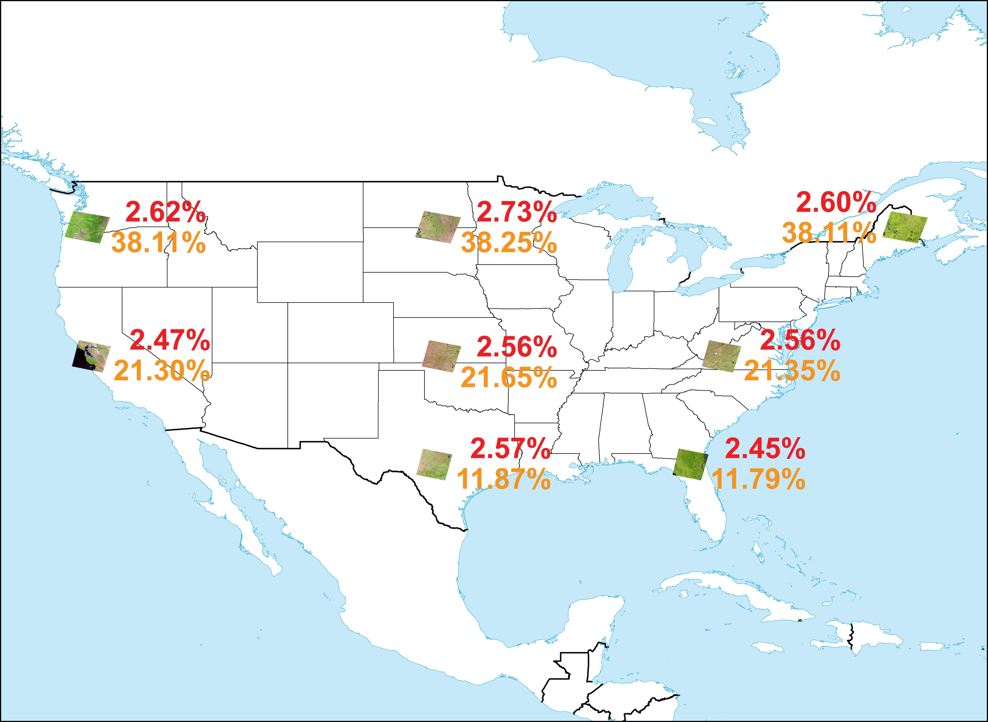
Figure 14. Undersampling (red) and oversampling (orange) results for Geographics.

Slide 17
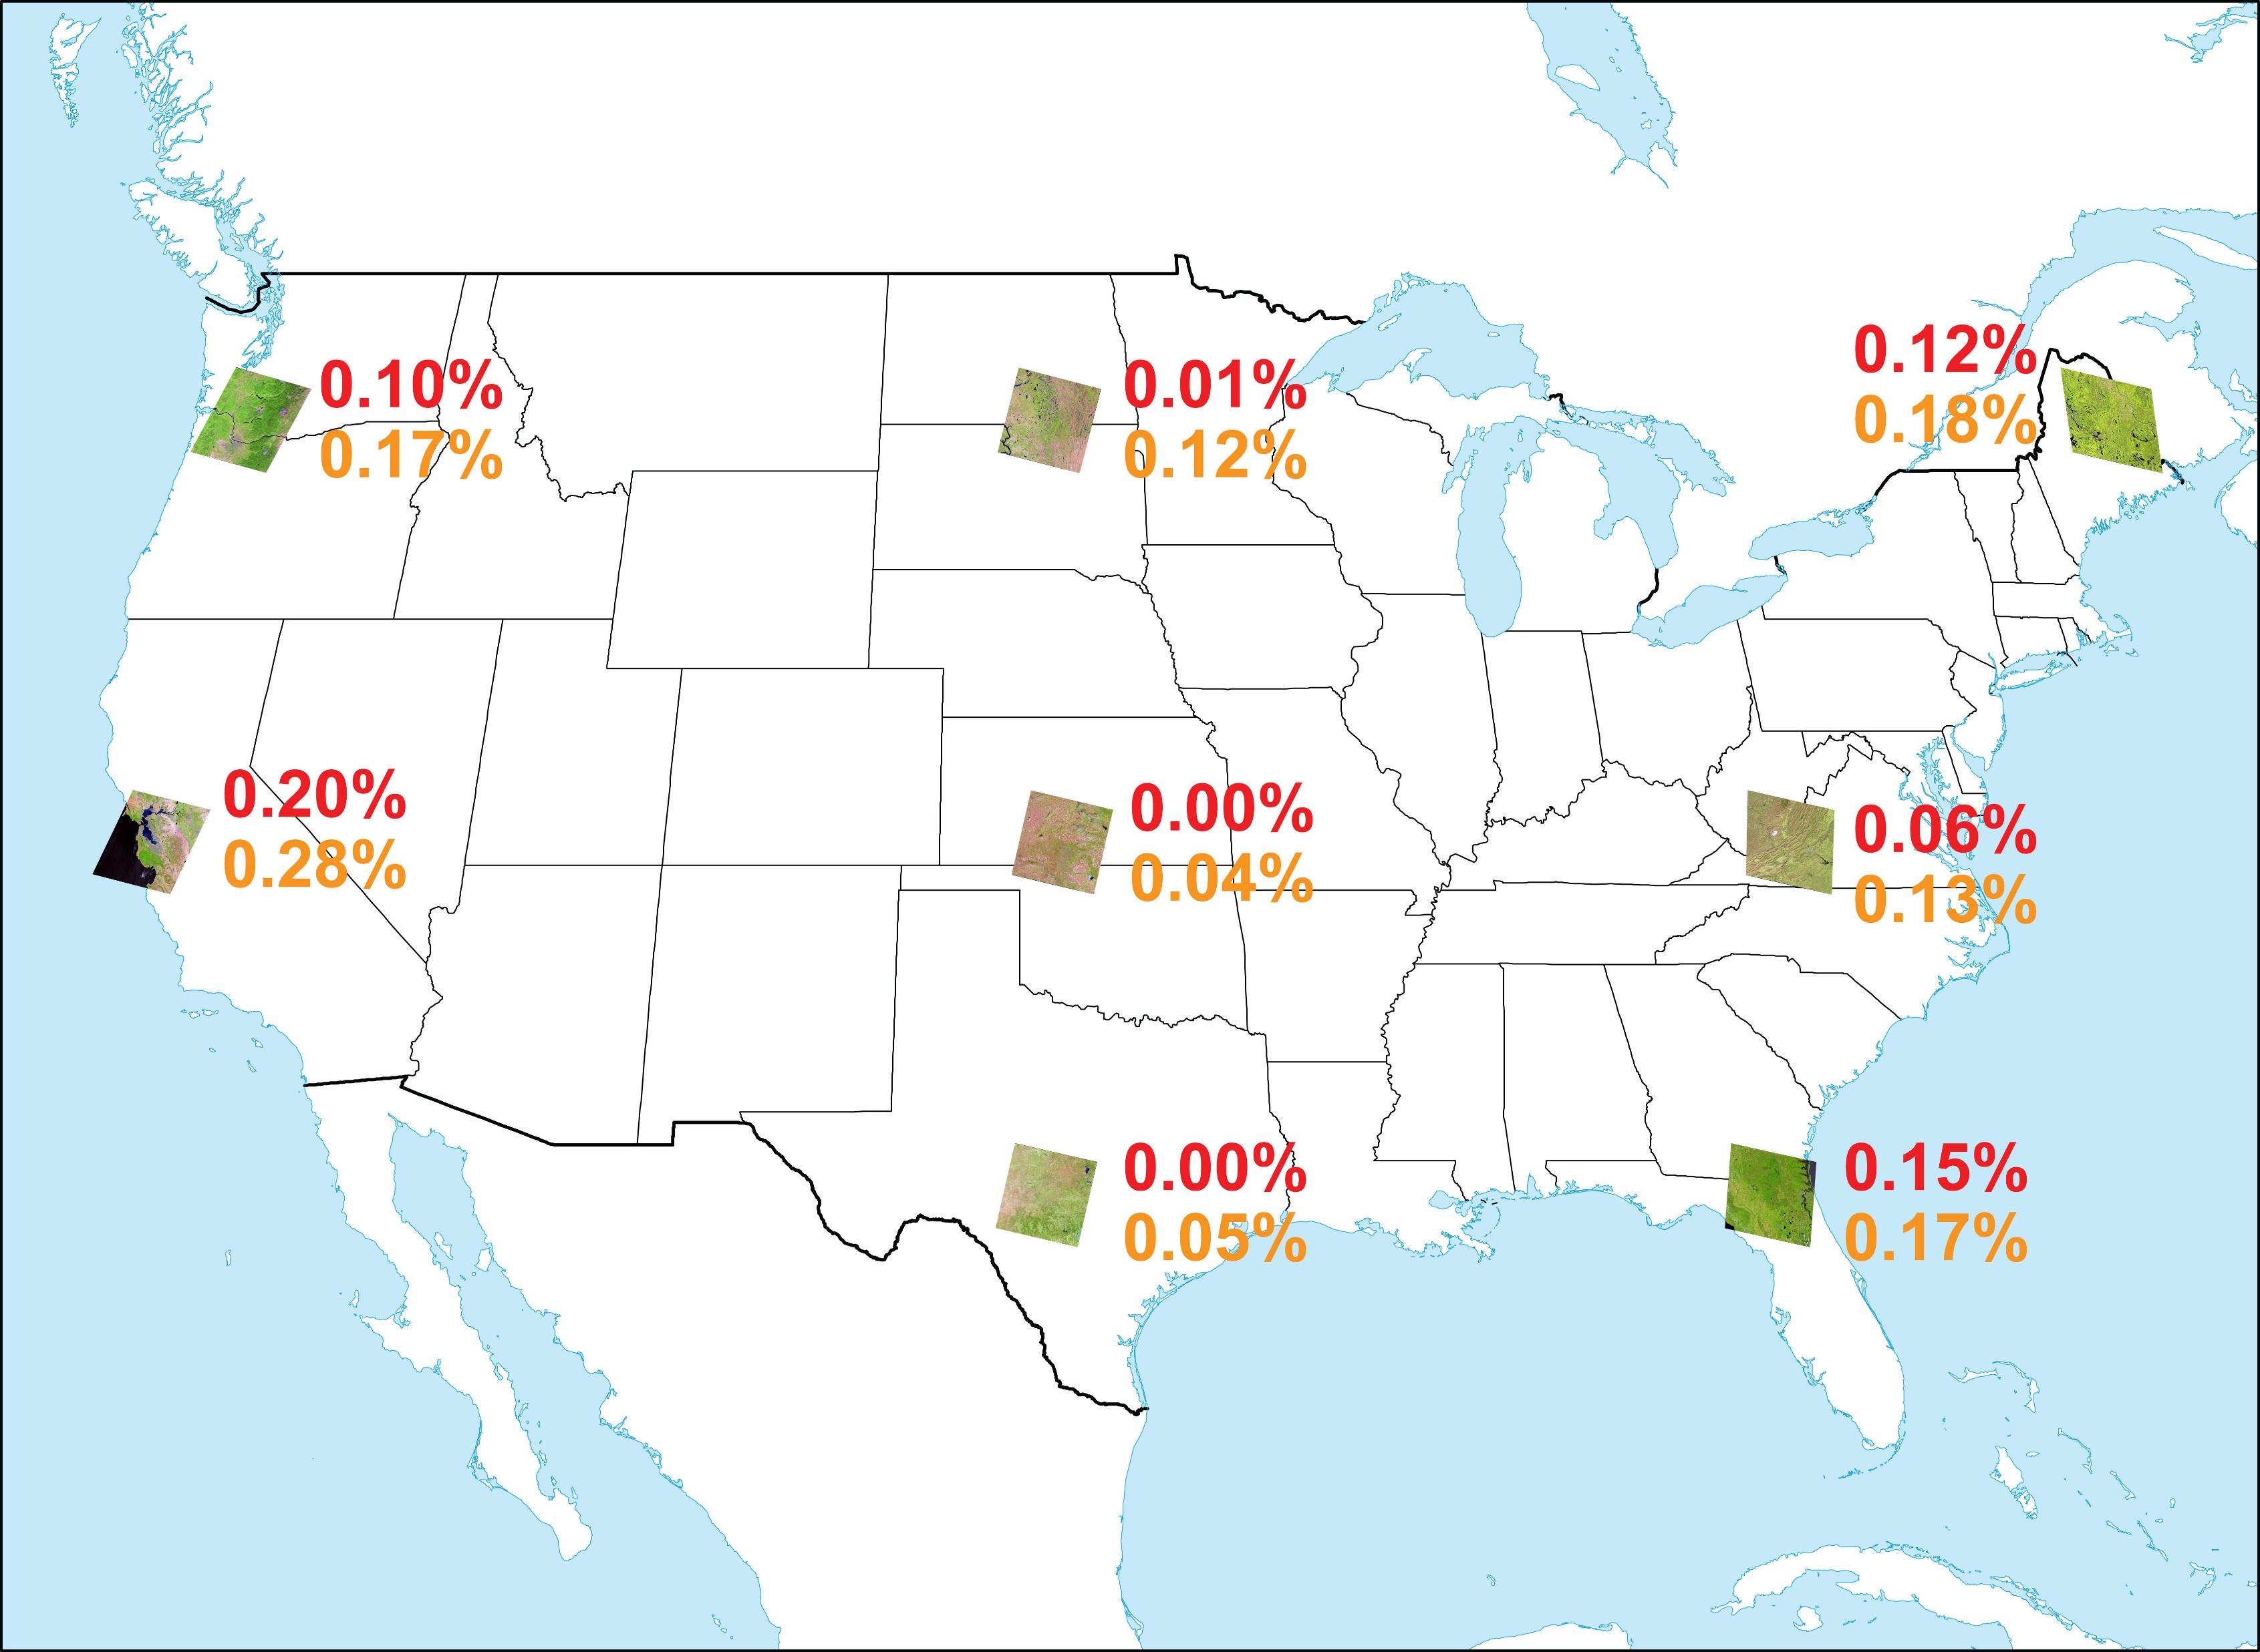
Figure 15. Undersampling (red) and oversampling (orange) results for Sinusoidal centered on 100 West, 0 North.

Slide 18
Region | Center Longitude | Center Latitude
North America* | 100 W | 50 N
South America | 60 W | 15 S
Europe | 20 E | 55 N
Africa | 20 E | 5 N
Asia | 100 E | 45 N
Australasia | 135 E | 15 S
Antarctica | South Pole | -
*Also recommended: | Oblated Equal-Area with center 95 W, 48 N,
 | shape constants m = 1.33, n = 2.27,
 | rotation = 13.95 degrees
Table 3. Lambert Azimuthal Equal Area projection centers for seven continents, proposed by Steinwand and others (1995).

Slide 19
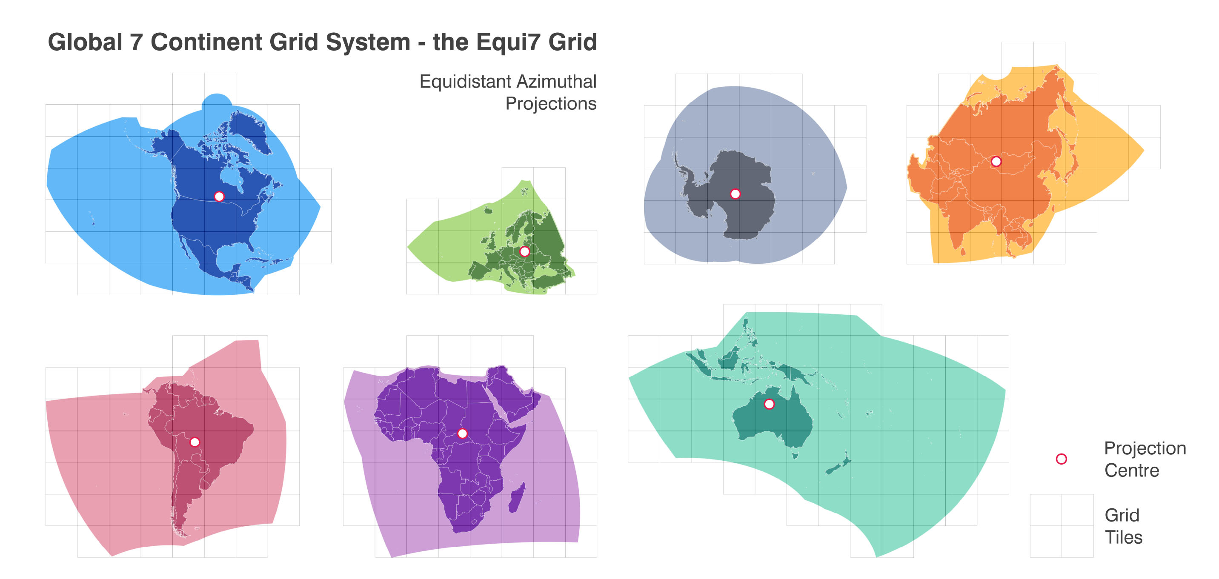
Figure 16. Equi7 zones

Slide 20
Region | Center Longitude | Center Latitude | False Easting (m) | False Northing (m)
North America | 111 W | 47.5 N | 8,264,722.18 | 4,867,518.35
South America | 60.5 W | 14 S | 7,257,179.24 | 5,592,024.45
Europe | 24 E | 53 N | 5,837,287.82 | 2,121,415.70
Africa | 21.5 E | 8.5 N | 5,621,452.02 | 5,990,638.42
Asia | 94 E | 47 N | 4,340,913.85 | 4,812,712.92
Oceania | 131.5 E | 19.5 S | 6,988,408.54 | 7,654,884.54
Antarctica | South Pole | - | 3,714,266.98 | 3,402,016.51
Table 4. Equi7 centers, false eastings, and false northings, proposed by Marschellinger and others (2014).

Slide 21
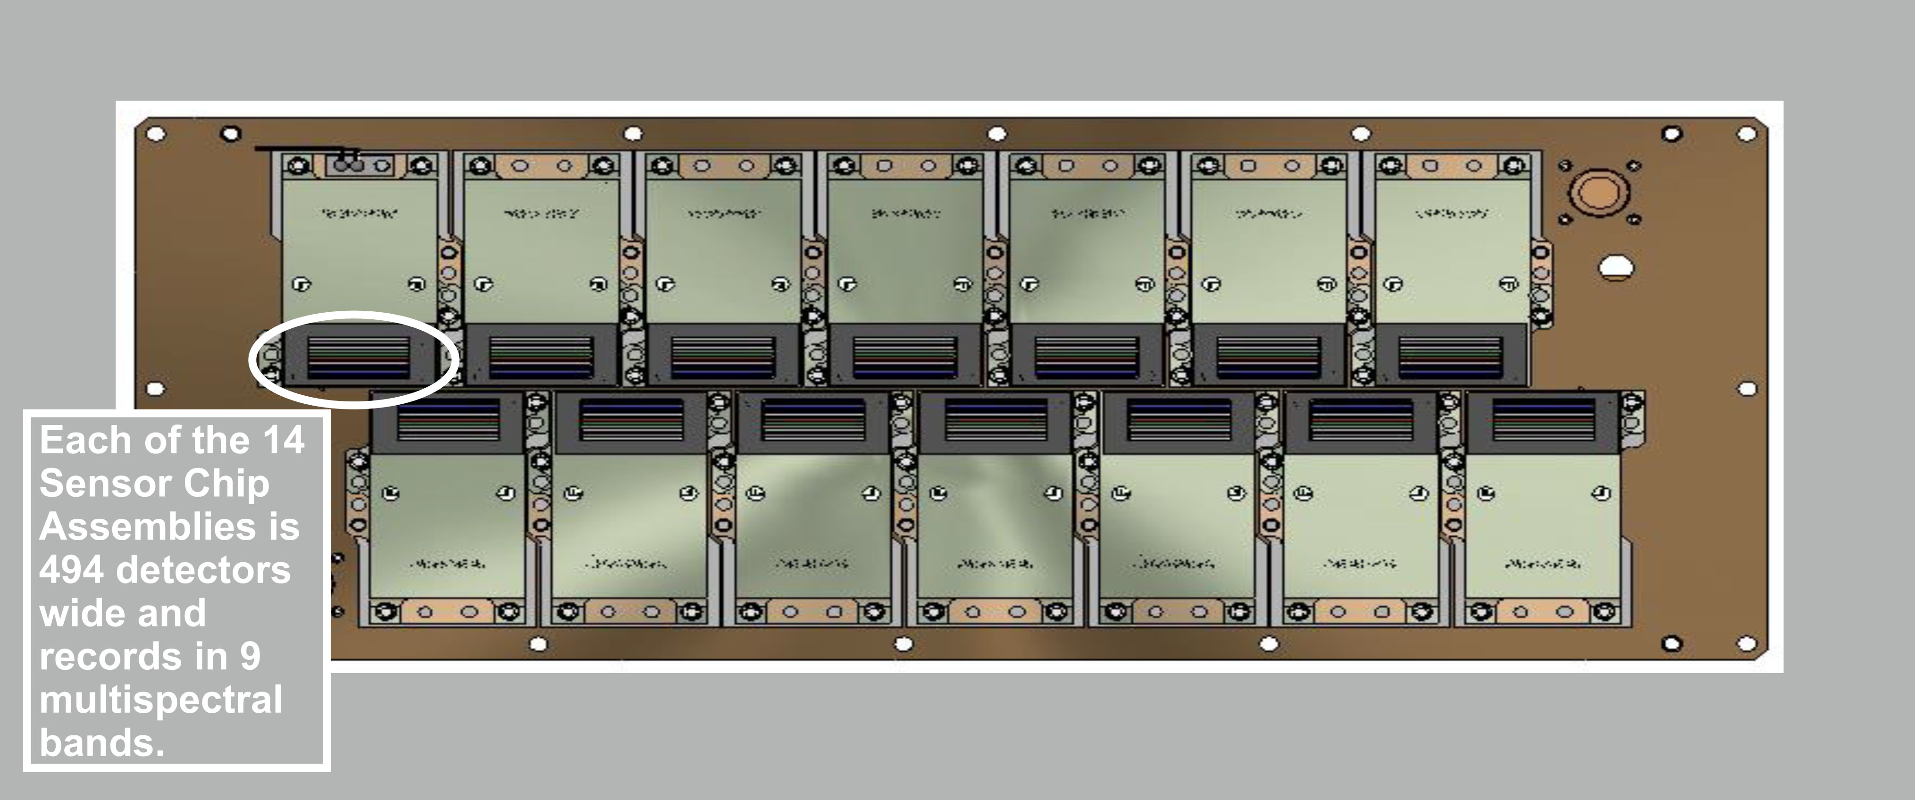
Figure 17. Landsat’s Operational Land Imager Sensor Chip Assemblies.

Slide 22
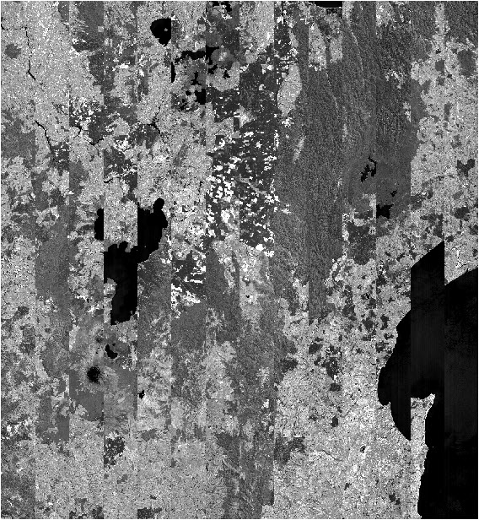
Figure 18. Band 6 of raw Landsat image, path 72 / row 87 in New Zealand.

Slide 23
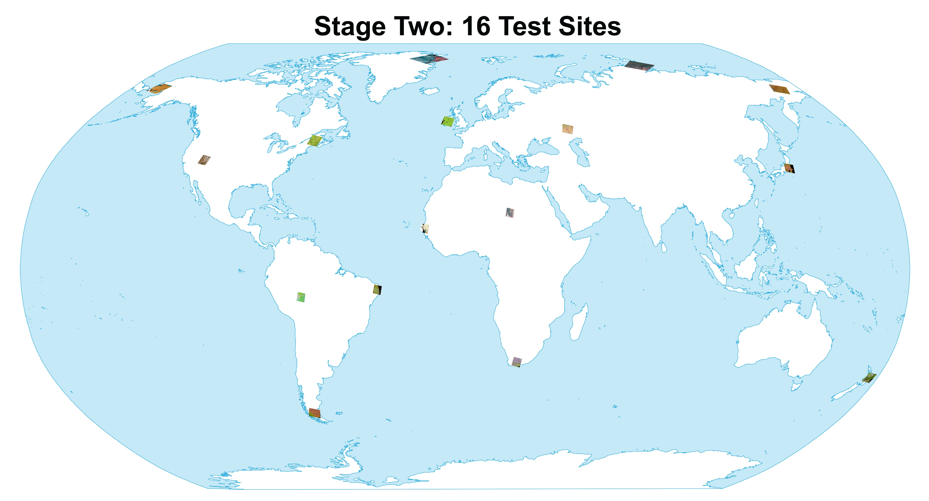
Figure 19. Sixteen sites selected for stage two tests.
Image footprints were enlarged for clarity.

Slide 24
Site number | Path | Row | Location | Scene ID
1 | 72 | 87 | New Zealand | LC80720872016087LGN01
2 | 107 | 35 | Japan | LC81070352017047LGN00
3 | 98 | 14 | Russia - Siberia | LC80980142017272LGN00
4 | 150 | 6 | Russia - northern | LC81500062017060LGN00
5 | 8 | 3 | Greenland | LC80080032017265LGN00
6 | 81 | 14 | Alaska | LC80810142016150LGN01
7 | 11 | 28 | Maine | LC80110282016236LGN02
8 | 39 | 33 | Nevada | LC80390332017290LGN01
9 | 1 | 67 | Bolivia | LC80010672017264LGN00
10 | 214 | 65 | Brazil | LC82140652016042LGN01
11 | 229 | 96 | Argentina | LC82290962016339LGN01
12 | 173 | 83 | South Africa | LC81730832016139LGN01
13 | 205 | 50 | Senegal | LC82050502017013LGN01
14 | 183 | 46 | Chad | LC81830462017291LGN00
15 | 170 | 25 | Kazakhstan | LC81700252017264LGN01
16 | 207 | 23 | Ireland | LC82070232016153LGN01
Table 5. Sixteen test sites for stage two of study.

Slide 25
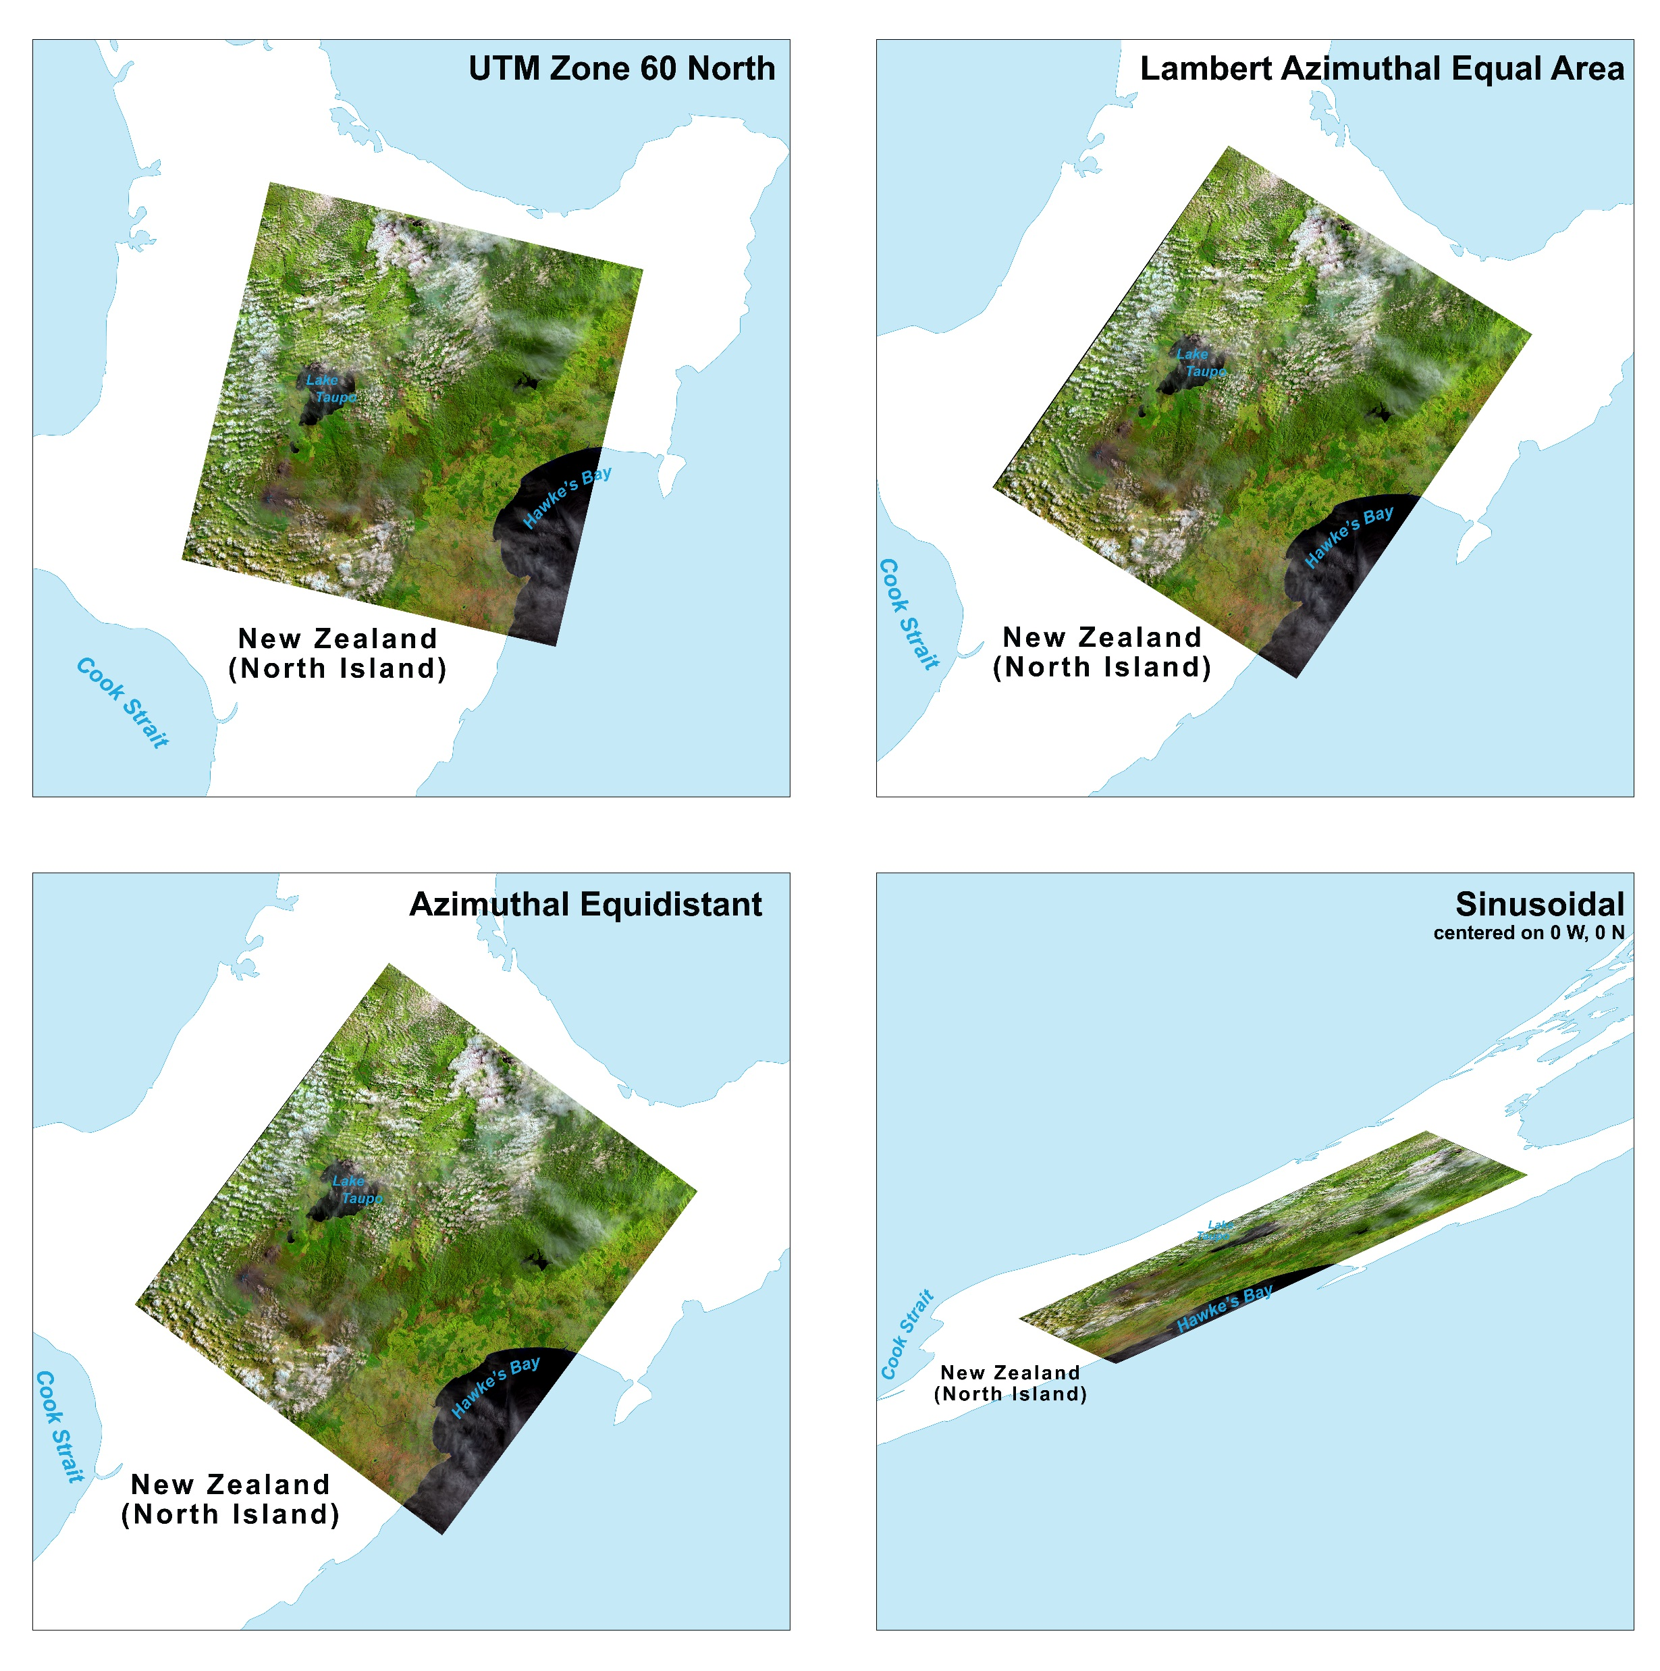
Figure 20. Four reprojections of a Landsat 8 image of New Zealand.
(Sinusoidal generated at smaller map scale to fit in frame.)

Slide 26
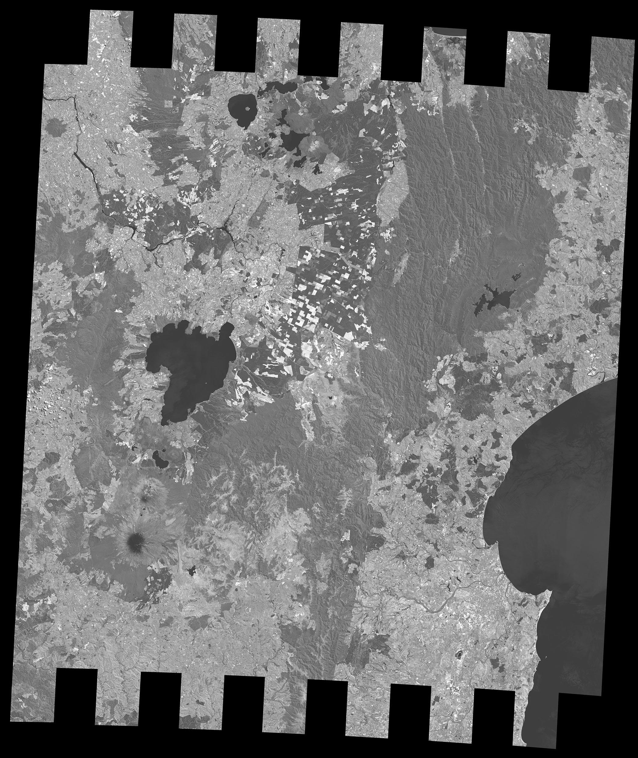
Figure 21. New Zealand raw image projected to Space Oblique Mercator. This image has approximately 10.4 percent fewer data pixels than the raw version.

Slide 27
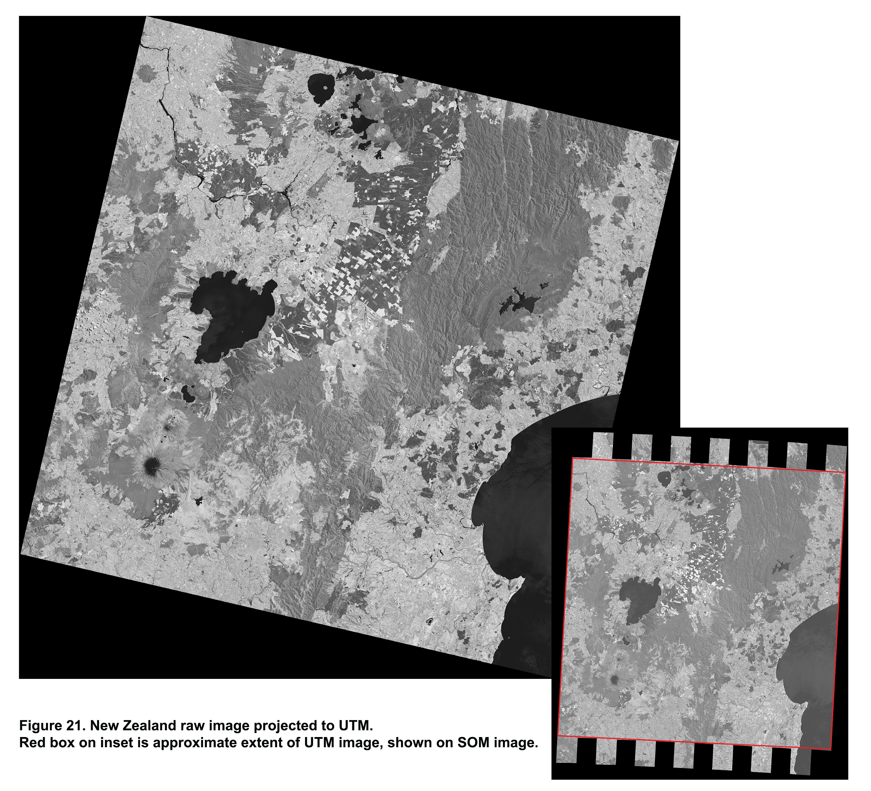
Figure 22. New Zealand raw image projected to UTM.
Red box on inset is approximate extent of UTM image, shown on SOM image.

Slide 28
Site number | Location | Percent reduction
1 | New Zealand | 19.22%
2 | Japan | 20.08%
3 | Russia - Siberia | 19.63%
4 | Russia - northern | 19.49%
5 | Greenland | 19.50%
6 | Alaska | 19.61%
7 | Maine | 19.89%
8 | Nevada | 20.05%
9 | Bolivia | 19.83%
10 | Brazil | 19.90%
11 | Argentina | 18.78%
12 | South Africa | 19.42%
13 | Senegal | 20.10%
14 | Chad | 20.15%
15 | Kazakhstan | 19.72%
16 | Ireland | 18.78%
Table 6. Reduction in number of image data pixels from resampling and trimming during projection of raw Landsat imagery to UTM.

Slide 29
Site number | Location | Percent reduction
1 | New Zealand | 19.21%
2 | Japan | 20.08%
3 | Russia - Siberia | 19.68%
4 | Russia - northern | 19.44%
5 | Greenland | 19.48%
6 | Alaska | 19.57%
7 | Maine | 19.85%
8 | Nevada | 20.14%
9 | Bolivia | 19.90%
10 | Brazil | 19.97%
11 | Argentina | 18.77%
12 | South Africa | 19.39%
13 | Senegal | 20.14%
14 | Chad | 20.21%
15 | Kazakhstan | 19.75%
16 | Ireland | 18.77%
Table 7. Reduction in number of image data pixels from resampling and trimming during projection of raw Landsat imagery to Lambert Azimuthal Equal Area.

Slide 30
Site number | Location | Percent reduction
1 | New Zealand | 10.98%
2 | Japan | 14.66%
3 | Russia - Siberia | 11.92%
4 | Russia - northern | 15.82%
5 | Greenland | 11.19%
6 | Alaska | 14.82%
7 | Maine | 16.34%
8 | Nevada | 19.81%
9 | Bolivia | 19.68%
10 | Brazil | 17.19%
11 | Argentina | 12.30%
12 | South Africa | 11.87%
13 | Senegal | 13.98%
14 | Chad | 19.62%
15 | Kazakhstan | 15.88%
16 | Ireland | 12.30%
Table 8. Reduction in number of image data pixels from resampling and trimming during projection of raw Landsat imagery to Azimuthal Equidistant.

Slide 31
Site number | Location | Percent reduction
1 | New Zealand | 19.53%
2 | Japan | 20.37%
3 | Russia - Siberia | 19.76%
4 | Russia - northern | 19.47%
5 | Greenland | 19.65%
6 | Alaska | 19.70%
7 | Maine | 19.89%
8 | Nevada | 20.25%
9 | Bolivia | 20.05%
10 | Brazil | 20.00%
11 | Argentina | 18.85%
12 | South Africa | 19.39%
13 | Senegal | 20.11%
14 | Chad | 20.21%
15 | Kazakhstan | 19.80%
16 | Ireland | 18.85%
Table 9. Reduction in number of image data pixels from resampling and trimming during projection of raw Landsat imagery to Sinusoidal.

Slide 32
Site number | Location | Percent reduction
6 | Alaska | 19.56%
7 | Maine | 19.84%
8 | Nevada | 20.13%
Table 10. Reduction in number of image data pixels from resampling and trimming during projection of raw Landsat imagery to Albers Equal-Area Conic.

Slide 33
Site number | Location | Percent Resampled | Percent Oversampled
1 | New Zealand | 6.94% | 0.00%
2 | Japan | 7.93% | 0.00%
3 | Russia - Siberia | 12.73% | 5.37%
4 | Russia - northern | 18.79% | 11.59%
5 | Greenland | 19.90% | 12.71%
6 | Alaska | 11.43% | 4.09%
7 | Maine | 7.74% | 0.00%
8 | Nevada | 7.82% | 0.00%
9 | Bolivia | 7.69% | 0.00%
10 | Brazil | 7.78% | 0.00%
11 | Argentina | 6.73% | 0.50%
12 | South Africa | 7.10% | 0.00%
13 | Senegal | 8.04% | 0.00%
14 | Chad | 8.13% | 0.06%
15 | Kazakhstan | 7.50% | 0.00%
16 | Ireland | 6.73% | 0.50%
 | Average | 9.56% | 2.18%
Table 11. Pixel loss and replication results for test grids projected to UTM.

Slide 34
Site number | Location | Percent Resampled | Percent Oversampled
1 | New Zealand | 16.91% | 10.07%
2 | Japan | 9.88% | 2.00%
3 | Russia - Siberia | 18.82% | 11.56%
4 | Russia - northern | 17.02% | 9.94%
5 | Greenland | 13.75% | 6.59%
6 | Alaska | 7.39% | 0.06%
7 | Maine | 7.68% | 0.00%
8 | Nevada | 12.68% | 4.77%
9 | Bolivia | 7.77% | 0.00%
10 | Brazil | 9.62% | 1.79%
11 | Argentina | 9.51% | 3.31%
12 | South Africa | 10.44% | 3.41%
13 | Senegal | 12.29% | 4.25%
14 | Chad | 8.20% | 0.00%
15 | Kazakhstan | 18.52% | 10.87%
16 | Ireland | 9.51% | 3.31%
 | Average | 11.87% | 4.50%
Table 12. Pixel loss and replication results for test grids projected to Lambert Azimuthal Equal Area.

Slide 35
Site number | Location | Percent Resampled | Percent Oversampled
1 | New Zealand | 14.65% | 17.30%
2 | Japan | 7.42% | 5.80%
3 | Russia - Siberia | 16.20% | 17.87%
4 | Russia - northern | 12.47% | 9.54%
5 | Greenland | 14.87% | 17.37%
6 | Alaska | 9.26% | 7.37%
7 | Maine | 7.21% | 3.61%
8 | Nevada | 7.77% | 0.21%
9 | Bolivia | 7.53% | 0.00%
10 | Brazil | 7.35% | 2.74%
11 | Argentina | 5.29% | 6.51%
12 | South Africa | 4.54% | 6.18%
13 | Senegal | 8.23% | 7.25%
14 | Chad | 7.47% | 0.01%
15 | Kazakhstan | 17.77% | 14.70%
16 | Ireland | 5.29% | 6.51%
 | Average | 9.58% | 7.69%
Table 13. Pixel loss and replication results for test grids projected to Azimuthal Equidistant.

Slide 36
Site number | Location | Percent Resampled | Percent Oversampled
1 | New Zealand | 6.87% | 0.00%
2 | Japan | 10.10% | 2.23%
3 | Russia - Siberia | 13.92% | 6.65%
4 | Russia - northern | 18.79% | 11.67%
5 | Greenland | 13.30% | 6.27%
6 | Alaska | 9.72% | 2.41%
7 | Maine | 7.64% | 0.00%
8 | Nevada | 10.63% | 2.53%
9 | Bolivia | 7.77% | 0.00%
10 | Brazil | 7.83% | 0.00%
11 | Argentina | 7.53% | 1.34%
12 | South Africa | 9.02% | 1.99%
13 | Senegal | 8.32% | 0.29%
14 | Chad | 8.21% | 0.00%
15 | Kazakhstan | 10.88% | 3.37%
16 | Ireland | 7.53% | 1.34%
 | Average | 9.88% | 2.50%
Table 14. Pixel loss and replication results for test grids projected to Sinusoidal.

Slide 37
Site number | Location | Percent Resampled | Percent Oversampled
6 | Alaska | 16.93% | 9.67%
7 | Maine | 7.67% | 0.00%
8 | Nevada | 13.30% | 5.38%
 | Average | 12.63% | 5.01%
Table 15. Pixel loss and replication results for test grids projected to Albers Equal-Area Conic (3 sites in U.S. only).

