Slide 1
Landsat 9 Development Status
Landsat Science Team
August 9, 2018
Del Jenstrom
NASA Landsat 9 Project Manager
Brian Sauer
USGS Landsat 9 Project Manager

Slide 2
NASA Landsat 9 Development Status
Del Jenstrom
NASA Landsat 9 Project Manager

Slide 3
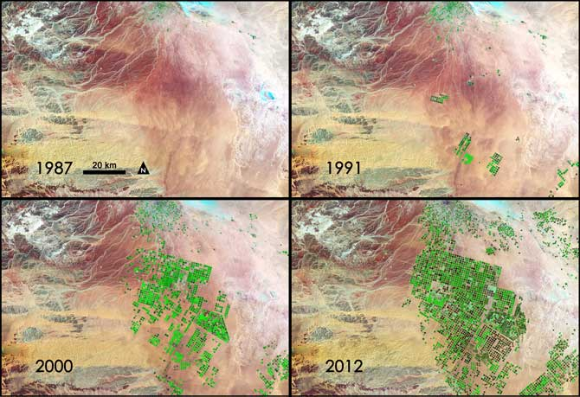
Landsat 9 Mission Overview
  Mission Objectives
Provide continuity in multi-decadal Landsat land surface observations to study, predict, and understand the consequences of land surface dynamics
  Core Component of Sustainable Land Imaging program
  Mission Parameters
Single Satellite, Mission Category 1, Risk Class B
  5-year design life after on-orbit checkout
  At least 10 years of consumables
Sun-synchronous orbit, 705 km at equator, 98°inclination
16-day global land revisit
Partnership: NASA & USGS
  NASA: Flight segment & checkout
  USGS: Ground system and operations
Category 3 Launch Vehicle
Launch: Management Agreement - December 2020
Agency Baseline Commitment – November 2021
  Mission Team
NASA Goddard Space Flight Center (GSFC)
USGS Earth Resources Observation & Science (EROS) Center
NASA Kennedy Space Center (KSC)
Instruments
Operational Land Imager 2 (OLI-2; Ball Aerospace)
    Reflective-band push-broom imager (15-30m res)
    9 spectral bands at 15 - 30m resolution
    Retrieves data on surface properties, land cover, and vegetation condition
Thermal Infrared Sensor 2 (TIRS-2; NASA GSFC)
  Thermal infrared (TIR) push-broom imager
  2 TIR bands at 100m resolution
  Retrieves surface temperature, supporting agricultural and climate applications, including monitoring evapotranspiration
Spacecraft (S/C) & Observatory Integration & Test (I&T)
Northrop Grumman Innovation Systems (NGIS), formerly Orbital ATK (OA)
Launch Services
United Launch Alliance (ULA) Atlas V 401
Mission Operations Center (MOC) and Mission Operations
General Dynamics Mission Systems (GDMS)
Increase in pivot irrigation in Saudi Arabia from 1987 to 2012 as recorded by Landsat. The increase in irrigated land correlates with declining groundwater levels measured from GRACE (courtesy M. Rodell, GSFC)

Slide 4
NASA-USGS Partnership
Independently-funded Agency partnership
  Not reimbursable like NASA/NOAA missions
Partnership is codified in a NASA-Department of the Interior (DOI) interagency agreement for Sustainable Land Imaging with a NASA-USGS annex for Landsat 9
  NASA is responsible for the space segment (instruments and spacecraft/observatory), mission integration, launch, and on-orbit checkout
    Support for anomaly resolution during operations on a reimbursable basis, if necessary
  USGS is responsible for the ground system, flight operations, data processing and distribution
    Operational control/leadership of mission after on-orbit checkout and handover from NASA
NASA/GSFC and USGS/EROS Project Offices enjoy a highly integrated and trusting relationship
  The Annex Implementation Plan (AIP) written by GSFC Landsat 9 project office and USGS EROS Landsat 9 project office defines detailed plans for project coordination

Slide 5
Major Milestones
Project ATP March 4, 2015
SRR/MDR June 1-3, 2016
KDP-B August 17, 2016
PDR September 12-15, 2017
KDP-C December 6, 2017
CDR April 2018
SIR August 2019
KDP-D December 2019
ORR September 2020
KDP-E November 2020
Launch December 2020

Slide 6
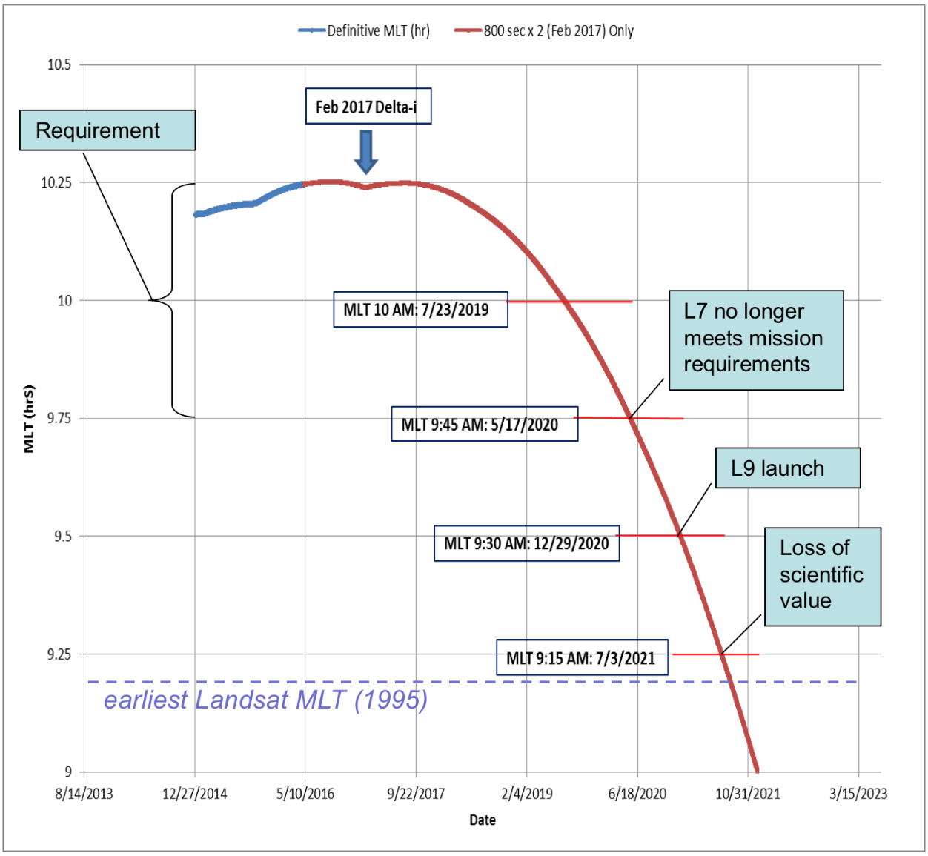
Context for Mission Schedule Challenge
Important to USGS/NASA/community to maintain two healthy Landsat satellites on-orbit for 8-day coverage
  Landsats 7 and 8 currently operating
Landsat 7 End of Mission planning – goal is to align with launch of Landsat 9
  Landsat 7 science data will degrade once outside mission equatorial crossing requirement of 10:00 AM +/- 15 min MLT in May 2020
    Acceptance by Landsat Science Team that science data retains some value until 9:15 AM MLT
  December 2020 LRD with 3-month commissioning period completed in March 2021 supports 2021 northern hemisphere growing season with Landsat 9
Congressional direction to launch Landsat 9 in 2020
Risk-informed estimates show Project has approximately a 50/50 chance of launching in 2020
Landsat 9 KDP-C Agency direction in December 2017 recognized this challenge, but also provided substantial schedule and budget resources if challenge can’t be met
  Management Agreement LRD: December 2020
  Agency Baseline Commitment LRD: November 2021
Landsat 9 Project recognizes that S/C and ground schedules are the most challenging aspect of satisfying target December 2020 LRD
Project well-positioned to face this challenge
Landsat 7 Equatorial Crossing Time
Impact on End of Mission
Planning

Slide 7
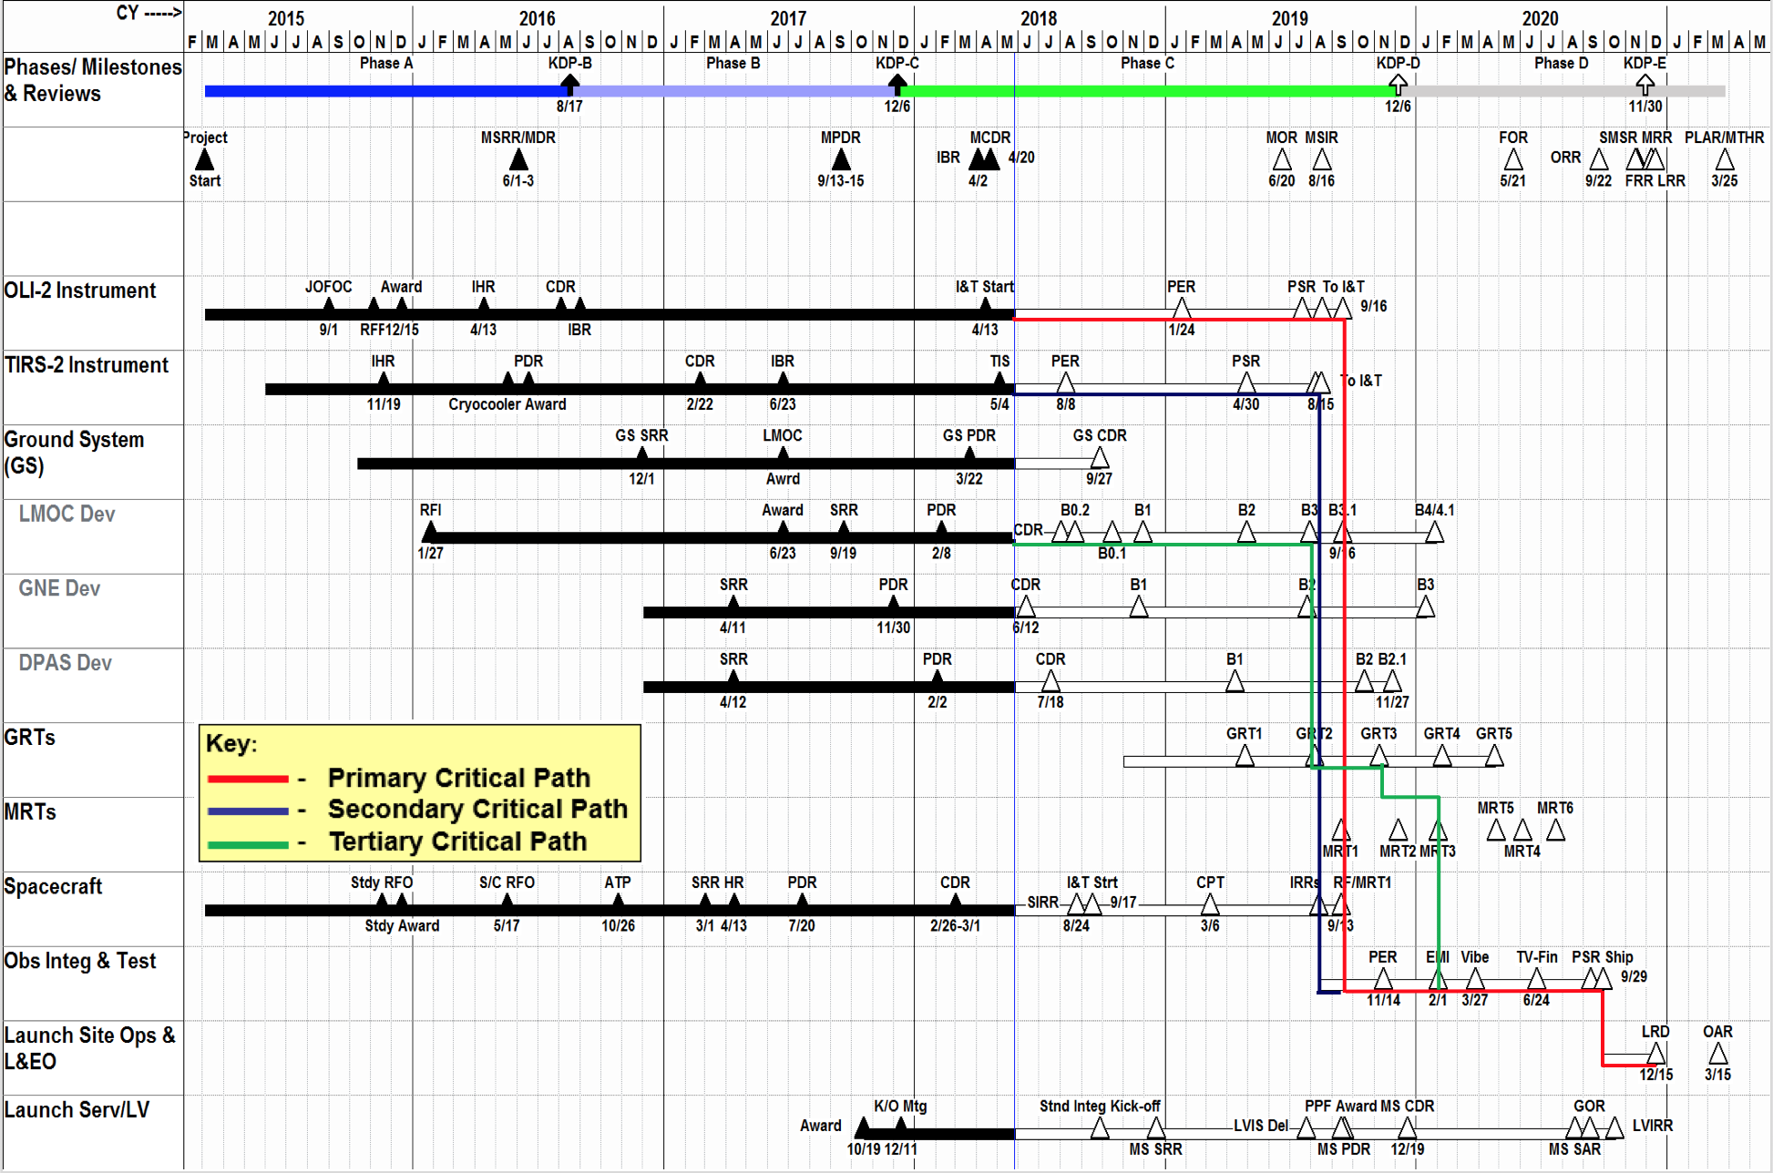
Landsat 9 Master Schedule
December 15, 2020 LRD
Status: 4/30/18
Notes:
Master Schedule Specs
1st Column Width: 22
Timescale: 90
POP: 2/1/15 - 4/30/21
View: MASTER SCHEDULE
Filter: Master/Intermed/Sched Code
Bar Text: Ariel 8pt Bold
Code: Master

Slide 8
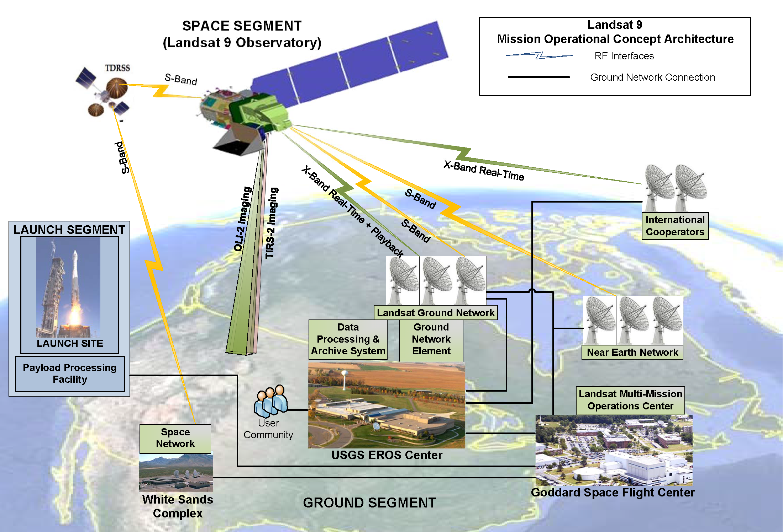
Landsat 9 Mission Architecture

Slide 9
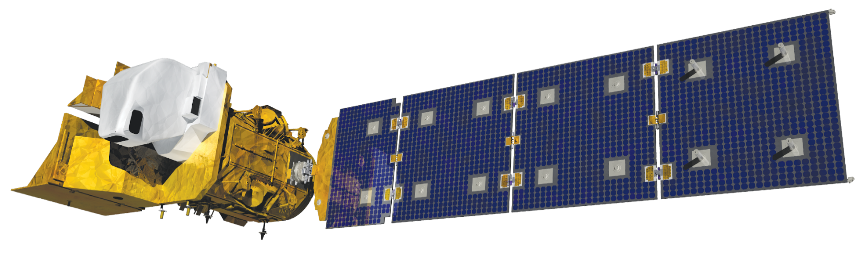
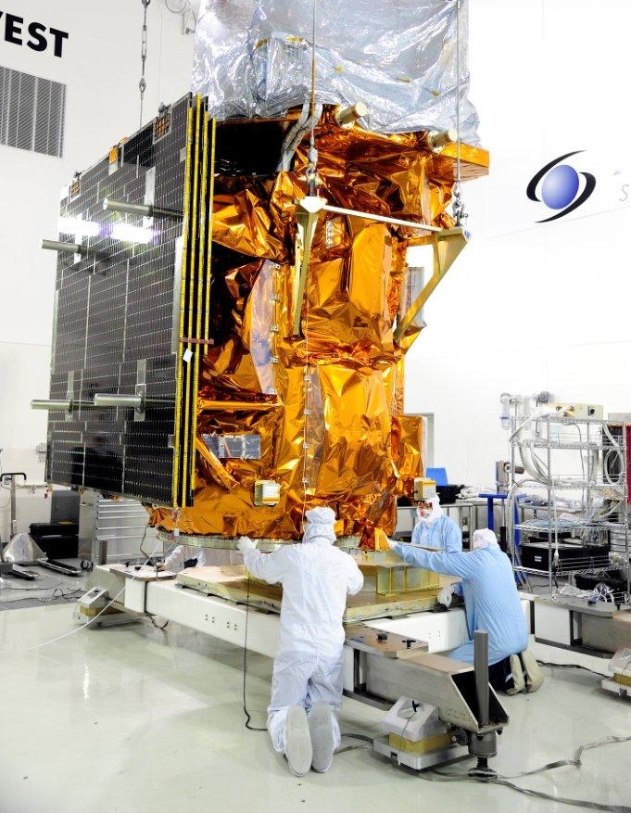
Spacecraft Bus
Landsat 9 spacecraft will be similar to that of Landsat 8, and it will also draw on component heritage from ICESat-2 and JPSS-2 missions
Contract competitively awarded to then Orbital ATK in Gilbert, AZ in October 2016 (now NGIS)
Spacecraft successfully completed
  System Requirements Review in February 2017
  Preliminary Design Review in July 2017
  Critical Design Review in February 2018
All components and subsystems in development
Targeting readiness to integrate OLI-2 and TIRS-2 in mid-2019
Landsat 8 Spacecraft at launch facility

Slide 10
First Spacecraft Hardware Glamour Shot
Landsat 9 spacecraft bus structure being assembled at Northrop Grumman Innovation Systems in Gilbert, AZ

Slide 11
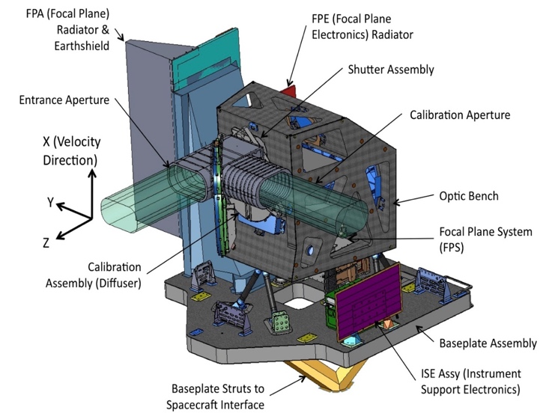
Operational Land Imager 2 (OLI-2) Status
OLI-2 will, to the extent possible, be a copy of OLI for Landsat 9 to maintain data continuity with Landsat 8 and to minimize cost and risk
Contract with Ball Aerospace in Boulder CO
established in December 2015
Instrument in single flow integration at Ball Aerospace
  Telescope and calibration assembly completed
  stray light testing and are integrated for flight
  Focal plane integrated into telescope
  Instrument Support Electronics and Focal Plane Electronics completed environmental testing and delivered to I&T
  Instrument assembly integrated and ready for spatial testing
  Baseplate assembly and radiators in storage and ready for integration
Instrument spatial testing (SPATS) begins in August 2018, to be followed by calibration testing (CATS) in the fall
OLI-2 PER planned for January 2018
On target for mid-2019 delivery to spacecraft

Slide 12
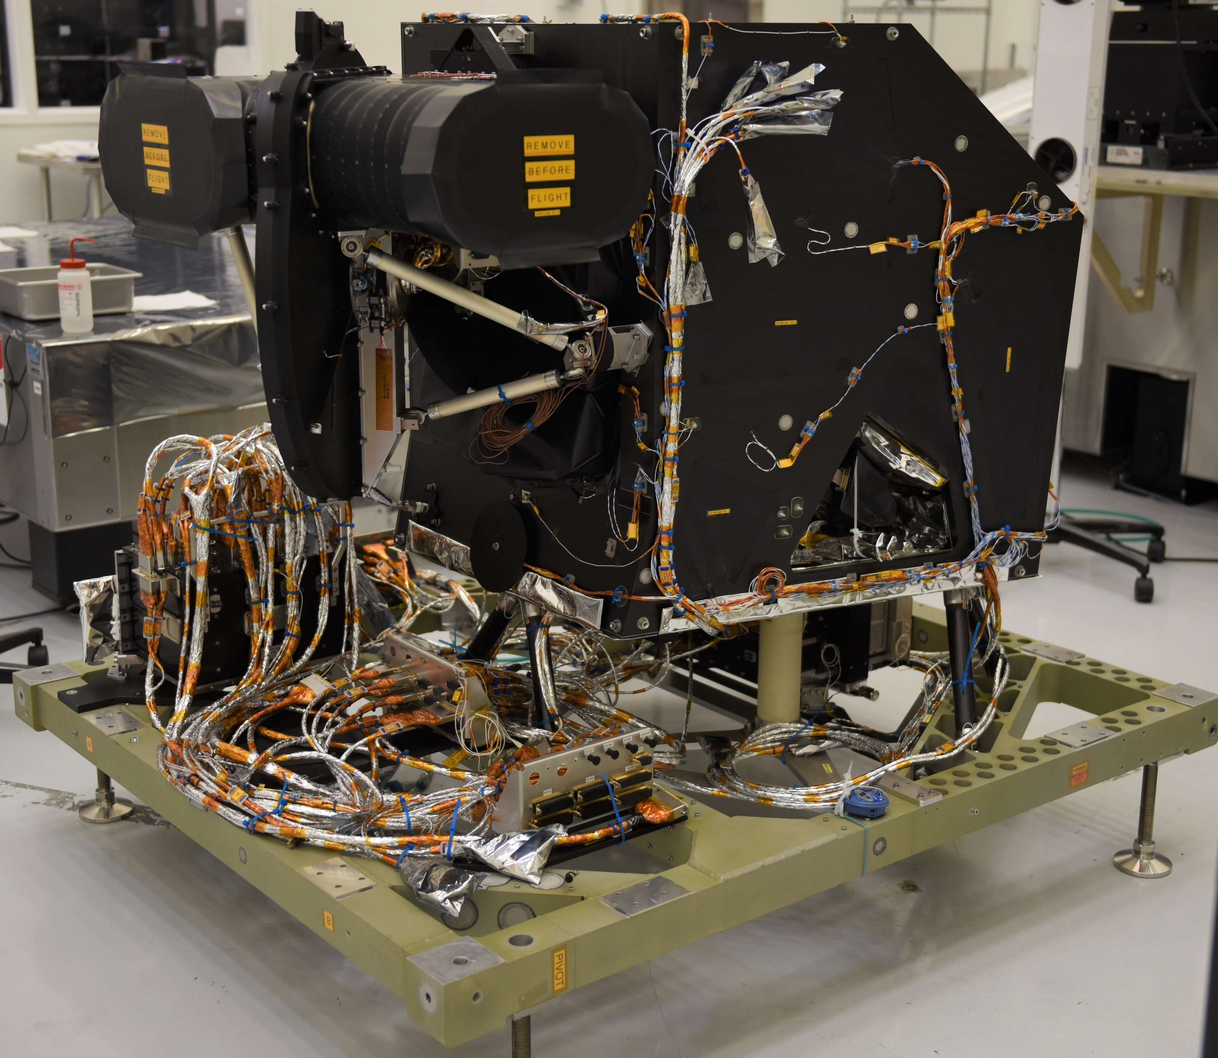
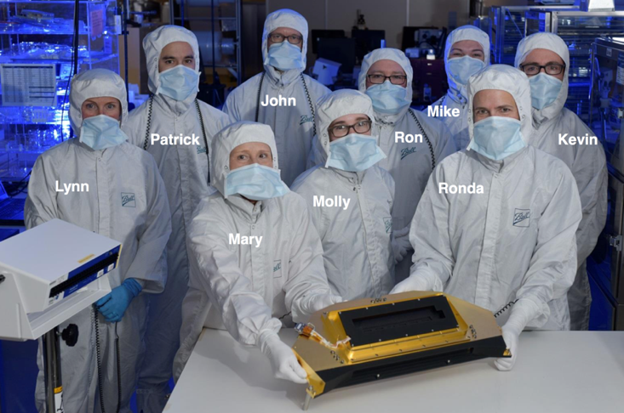
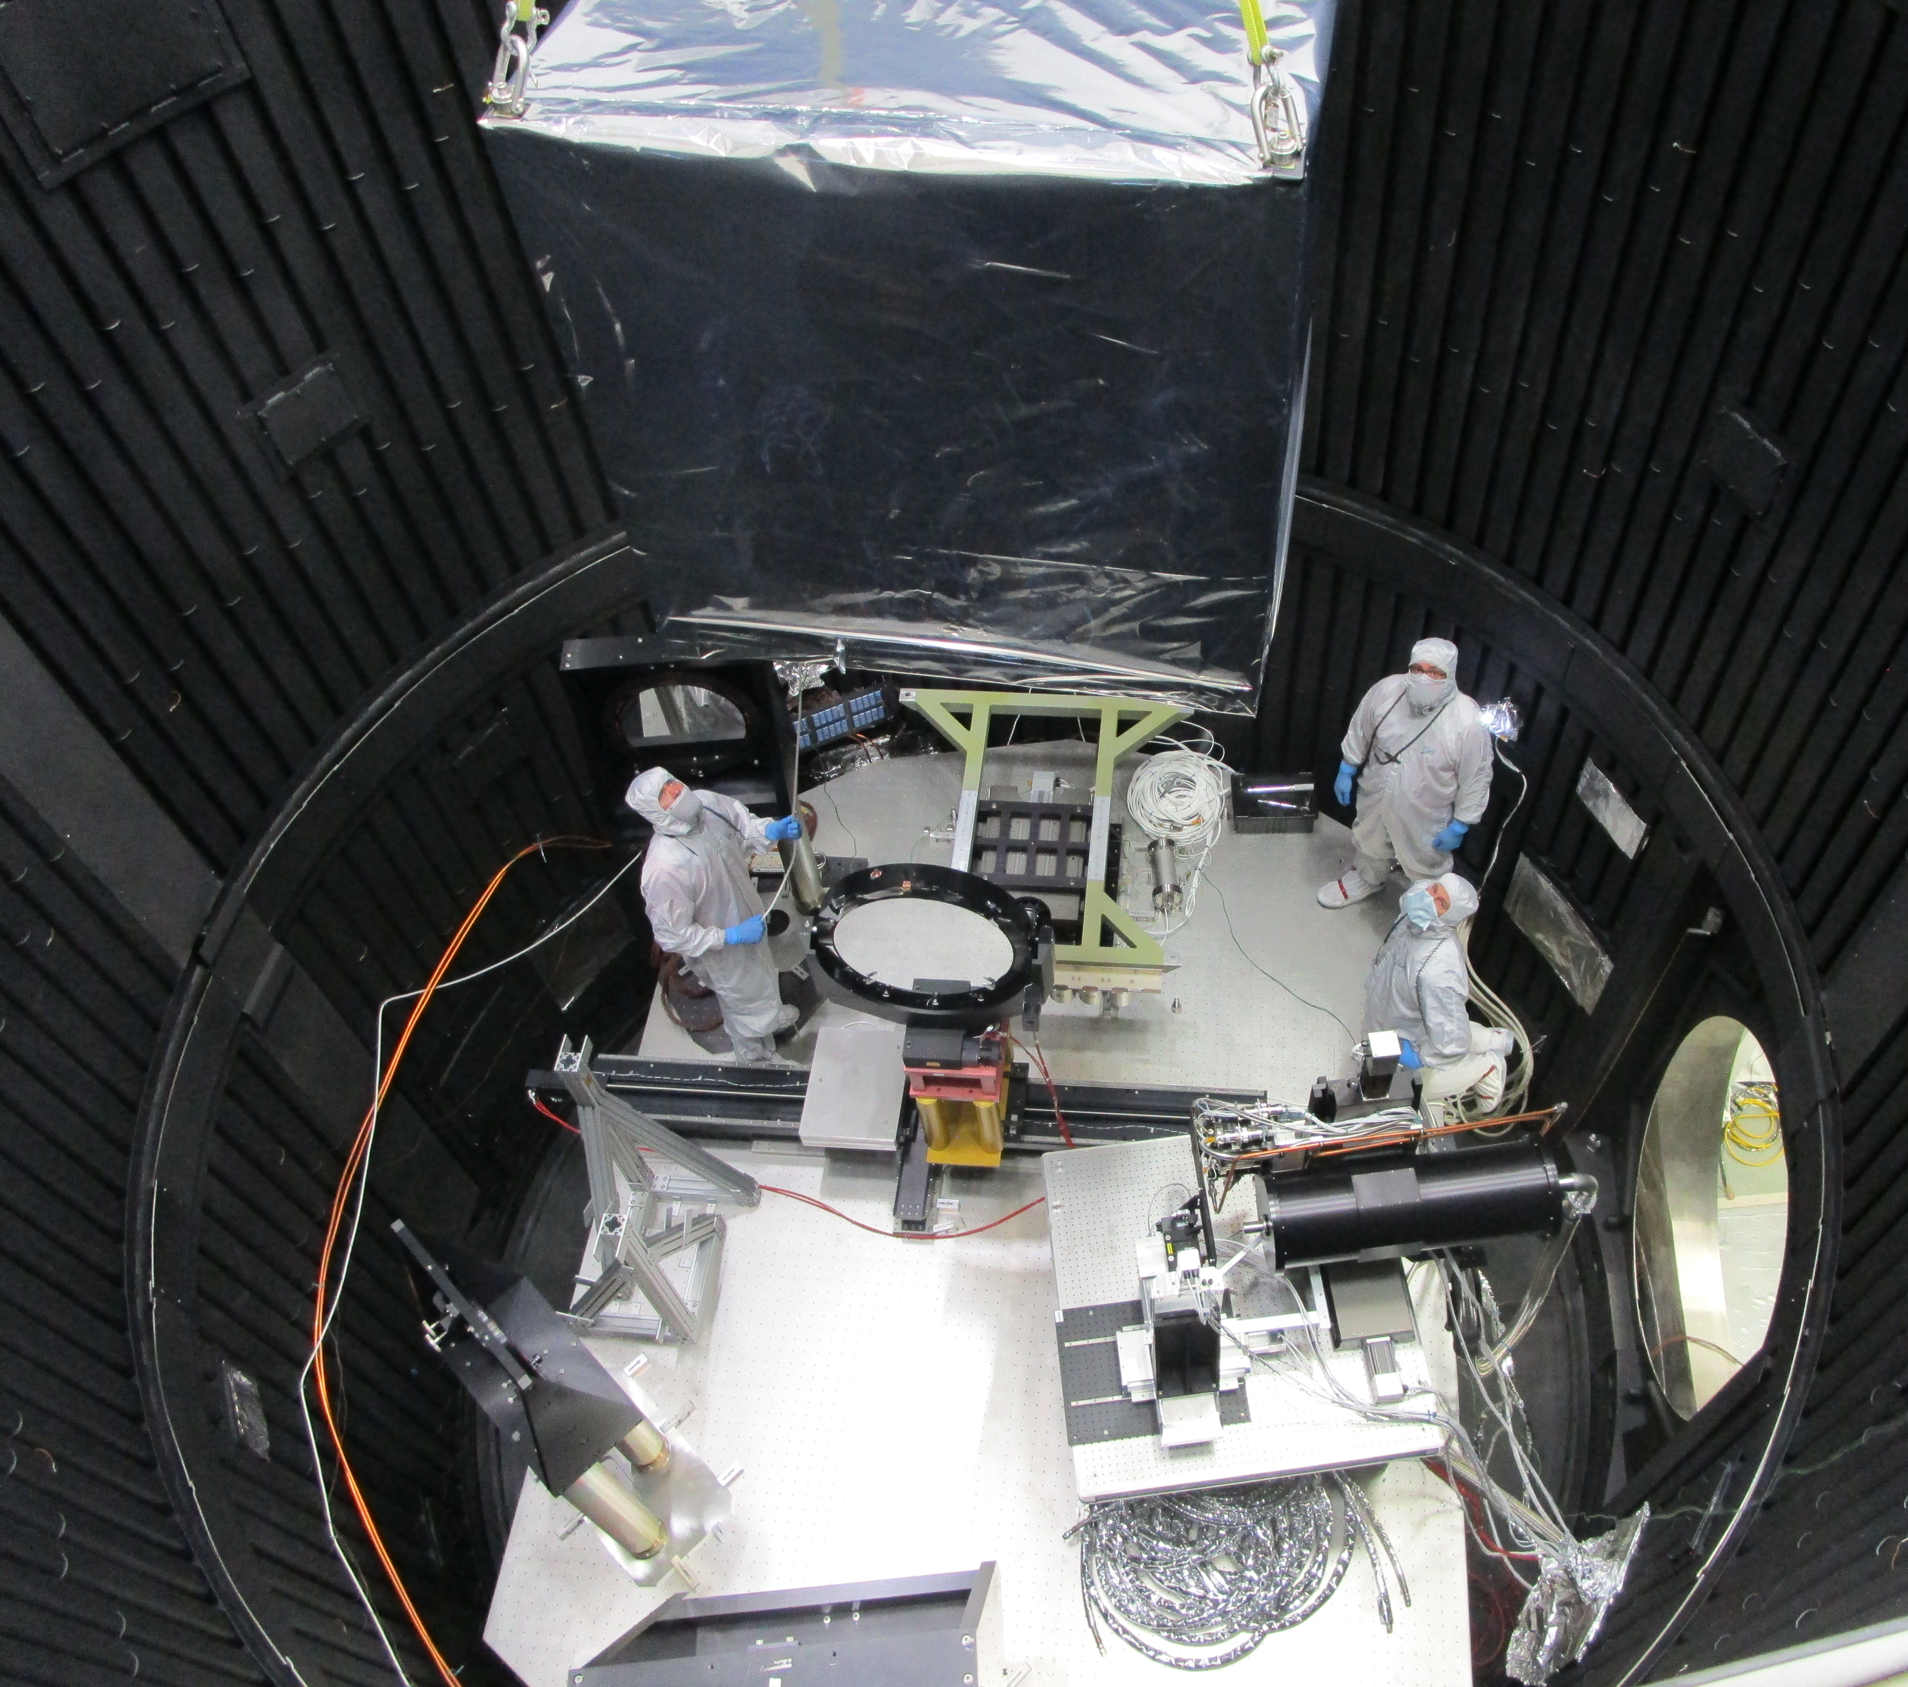
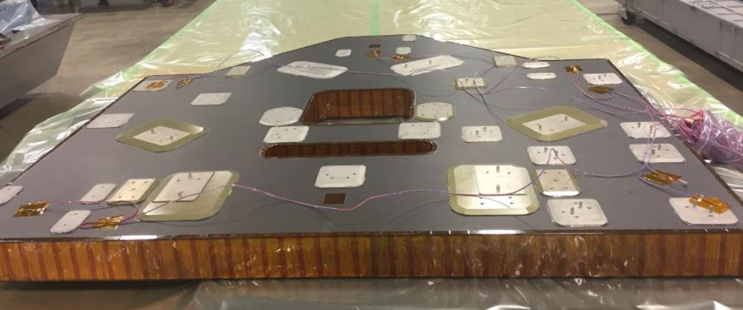
OLI-2 Hardware Glamour Shots
Ball Aerospace FPA Assembly Team, and fully integrated FPA
OLI-2 being lowered into Brutus chamber for spatial testing
OLI-2 configured for spatial testing at Ball Aerospace, Boulder CO
OLI-2 Flight Baseplate

Slide 13
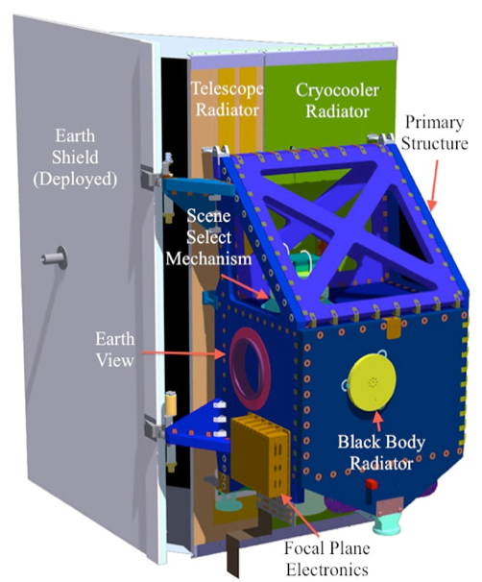
Thermal Infrared Sensor 2 (TIRS-2) Status
TIRS-2 will be a rebuild of Landsat 8 TIRS except TIRS-2 will be upgraded
from Risk Class C to Class B for Landsat 9
TIRS-2 image performance and cryogenic evaluation (TIPCE) testing completed over winter 2017/2018
  Image quality, focus, and stray light performance very good
Instrument in single flow integration at NASA GSFC
  All subsystems have completed assembly and environmental test.
  All major elements have been integrated in to the Sensor Unit, with final harnessing and blanketing in work.
  Sensor Unit elements undergoing testing together with the electronics boxes in ambient. The environmental test program will begin in the fall with EMI/EMC testing, followed by Thermal Vacuum Test 1, Sensor Unit Vibration Test, and Thermal Vacuum Test 2.
  The Flight Cryocooler completed all assembly and test activities and was delivered to GSFC ahead of schedule. The Flight Cryocooler has been integrated in to the TIRS-2 Sensor Unit.
Successful TIRS-2 PER held August 7-8, 2018
On target for mid-2019 delivery to spacecraft
TIRS-2 Improvements
  Increased redundancy to satisfy Class B reliability standards
  Improved stray light performance through improved telescope baffling
  Improved position encoder for scene select mirror to address problematic encoder on Landsat 8 TIRS
Notes:
13

Slide 14
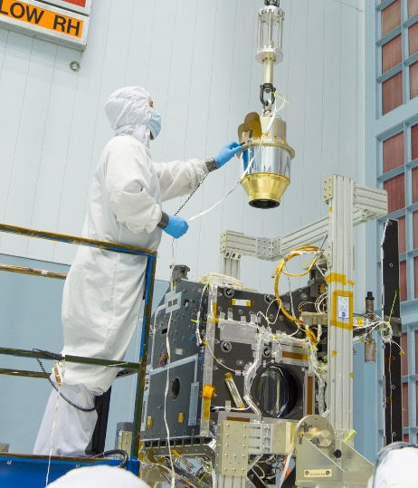
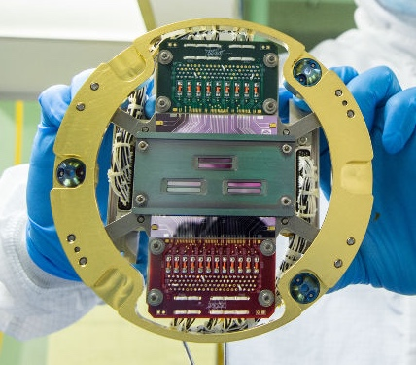
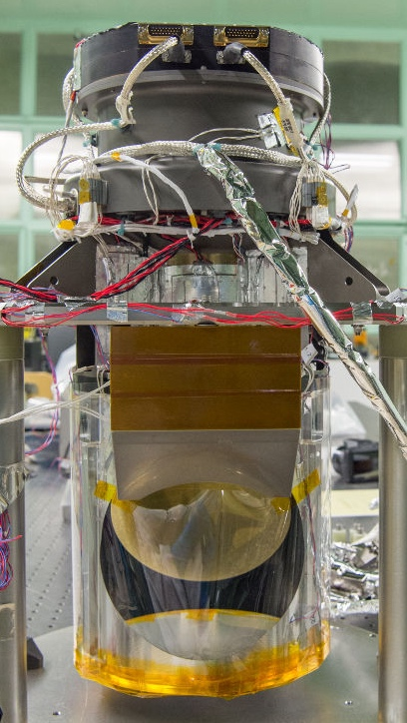
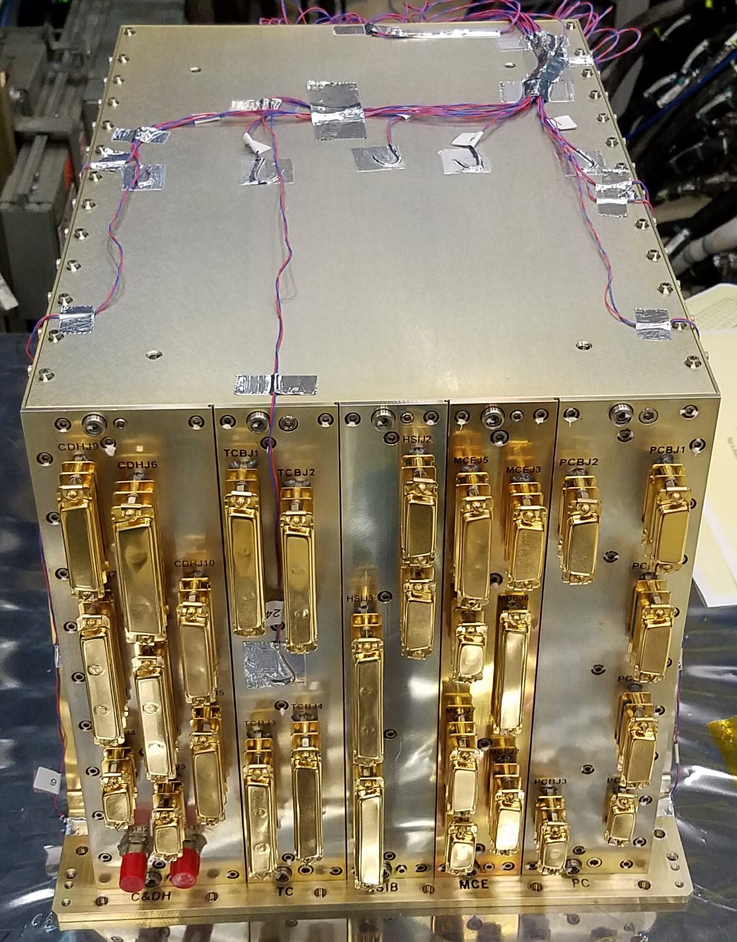
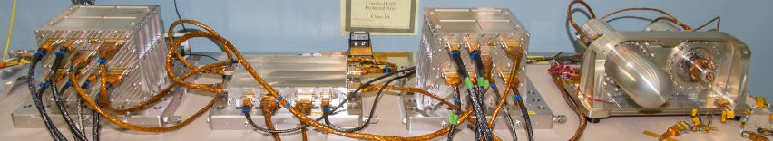
TIRS-2 Hardware Glamour Shots
Installation of the Telescope and
Detector into the Structure
Flight Detector With Filters
Flight Scene Select Mechanism
Flight Main Electronic Box No. 1
Ball Aerospace Flight Cryocooler Control Electronics, Redundancy Switch Electronics, and Thermal Mechanical Unit at GSFC

Slide 15
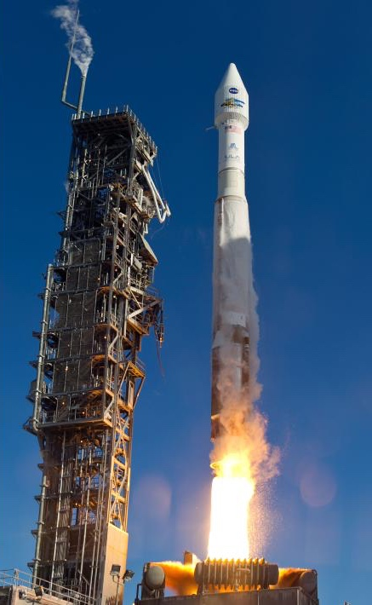
Launch Services
Landsat 9 launch services awarded to same provider for same LV as Landsat 8
Awarded October 2017 to United Launch Alliance (ULA)
Vehicle: Atlas V 401 from Vandenberg AFB SLC-3
LRD Range at award: Dec 15, 2020 through June 1, 2021
  LRD solidified to Dec 15, 2020 at Flight Planning Board on
  July 12, 2018
L9 launch services task order includes option to add an ESPA
  Air Force has officially requested to fly an ESPA with secondary
  payloads on L9 launch
  ULA analysis indicates no impact to Landsat 9
    Preliminary coupled loads analysis with and without ESPA complete
    Preliminary configuration study complete showing ESPA configuration
    requires longer payload fairing (XEPF vs. EPF used on L8)
  Launch segment interface requirements levied on NGIS
  observatory design not impacted by ESPA decision
  NASA Science Mission Directorate and Flight Planning Board
  approved AF ESPA rideshare for Landsat-9 in April 2018
  AF “Do No Harm” criteria are in place
  Implementation agreement in work between NASA and AF
Routine integration/coordination between Landsat 9 and ULA underway

Slide 16
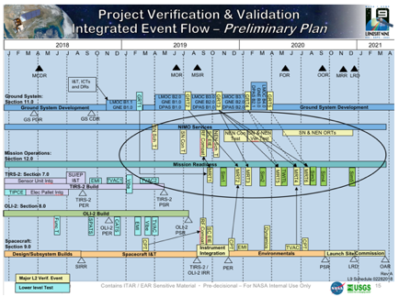
Mission Operations Readiness Status
Closely coordinated between NASA and USGS
Mission Readiness Tests (MRTs) and Mission Sims
scoped and scheduled
  Established in IMS
Key mission ops documentation at
appropriate level
Mission Operations Readiness Team is active
and coordinating multiple working groups
  MRT WG, Ops Procedure WG, Connectivity Test WG, etc.
Launch support room design maturing
L&EO/Commissioning operations planning
is maturing
Launch Support Room Planning

Slide 17
USGS Landsat 9 Development Status
Brian Sauer
USGS Landsat 9 Project Manager

Slide 18
Ground System Architecture

Slide 19
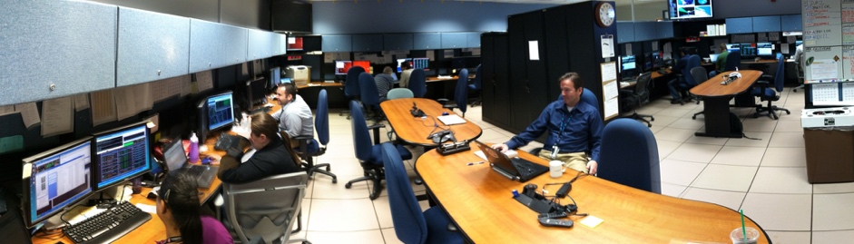
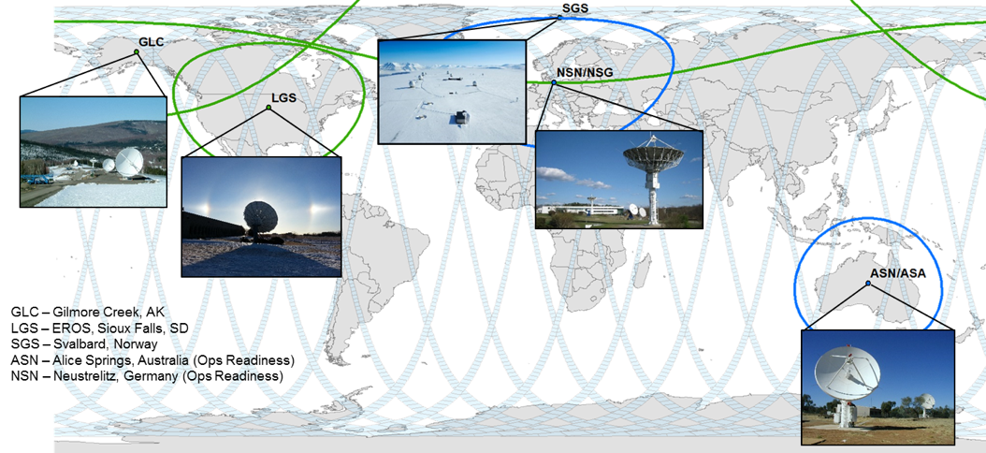
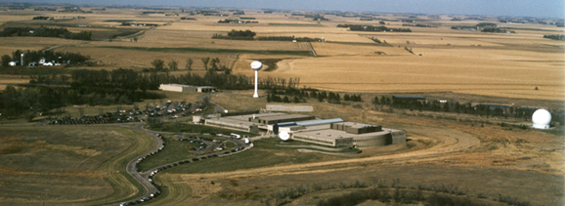
Landsat 9 Ground System
Landsat Multi-satellite Operations Center (LMOC)
  The facility, functional capability, and personnel needed to operate the Landsat 9 observatory
  Landsat Multi-satellite Operations Center (LMOC) facilities at GSFC (L8 & L9)
    Observatory Telemetry & Commanding
    Orbit and Attitude Flight Dynamics
    Management of Image and Calibration Acquisitions
    Long-Term Trending, Modeling, and Analysis
  Backup LMOC (bLMOC) facility location study is in process
Ground Network Element (GNE)
  Provides highly reliable S-Band and X-Band communication services with the observatory and routes the data appropriately within the Ground System (GS)
  Leverages current operational Landsat Ground Network (LGN)
  LGN stations in Sioux Falls, SD; Fairbanks, AK; and Svalbard, Norway
  Neustrelitz, Germany and Alice Springs, Australia for use after commissioning
  Data Collection and Routing Subsystem (DCRS) gathers mission data from LGN stations into complete intervals to transfer to the DPAS
Data Processing and Archive System (DPAS)
  Ingest, archive, catalog, process, and distribute Landsat 9 data (through Level 2/ARD) to the public
  Includes interfaces to the LMOC (e.g. special acquisition requests)
  Leverages mature, multi-mission system
  DPAS facility at USGS EROS Center
GSFC, Greenbelt, MD
EROS, Sioux Falls, SD

Slide 20
Ground System Major Milestones
Ground System nearing critical design completion; hardware acquisition and subsystem development underway
GSRR December 2016
GPDR March 2018
GCDR September 2018
  GNE CDR June 2018
  DPAS CDR July 2018
  LMOC CDR August 2018
Ground Readiness Tests Begin February 2019
Mission Operations Readiness June 2019
Flight Operations Readiness May 2020
  Launch December 2020
  Mission Transition & Handover March 2021

Slide 21
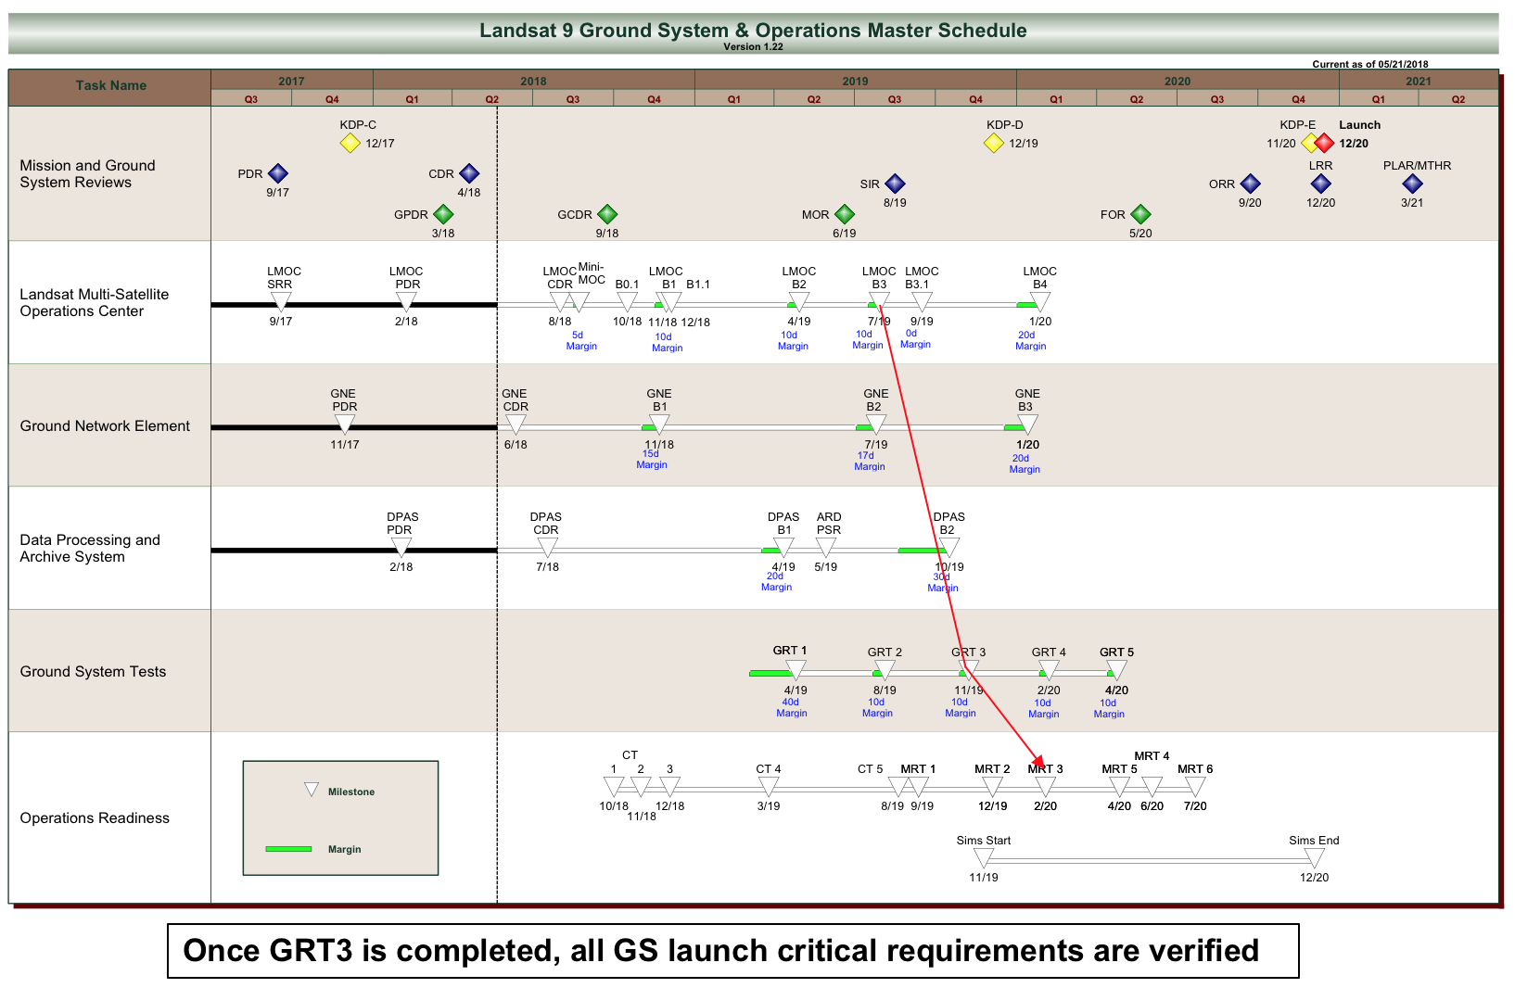
Ground System Schedule
Once GRT3 is completed, all GS launch critical requirements are verified!

Slide 22
DPAS: Landsat Data Products and ARD
USGS is now adopting Level-2 / Analysis Ready Data (ARD) as the standard product for L9
  Gridded, tiled, “stackable” images
  Processed to surface reflectance (SR) and surface temperature (ST)
  Will continue to produce the Level-1 product
Landsat 9 project is building the Landsat 4-9 (TM, ETM+, OLI / TIRS) operational capability for Level-2 / ARD and will produce L9 Level-2 / ARD as a standard product during commissioning.
  The USGS Landsat Science Information System (LSIS) project receives the ARD capability, modifies it to run at scale, and processes the L4-8 archive as well as new L8 acquisitions
The DPAS Critical Design Review resulted in an RFA on latency for Level-2 products.
  Soliciting science team discussion / feedback during Chris Engebretson and Steve Labahn’s Landsat Archive and Product Collections presentation that discusses plans for Level-2 / ARD

Slide 23
DPAS Build Approach and Status
Incremental approach towards building the DPAS
Leverages the heritage multi-mission (L1-9) system
Currently performing integration and test for the DPAS B0.5 Subsystems; DPAS ARD and B1.0 in development

Slide 24
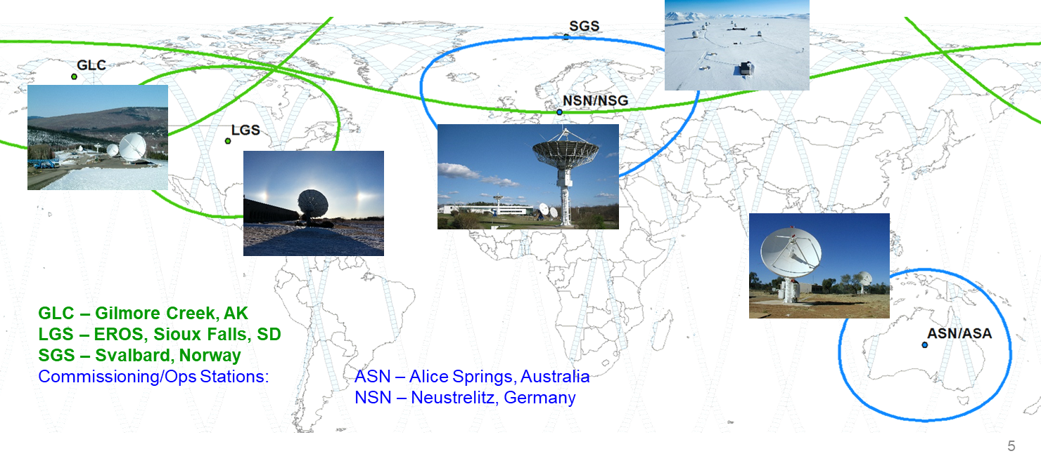
GNE Progress
Minor changes to support L9
  Add new Landsat 9 presets to existing LGN equipment (antenna, RXs, exciters, demods, automation, etc.)
  Modify data routing systems for Landsat 9 interval assembly, interfaces to LMOC, and expand 90-day cache
  Build new command & telemetry processor desktops for Landsat 9
Design is complete; in build, integration and test
Established plans for station modifications, integration and test
Currently testing the routing system and working changes necessary at the stations

Slide 25
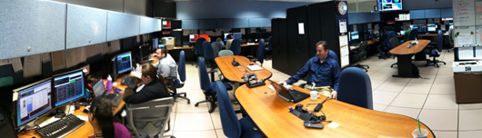
LMOC Progress
Design is complete
  Leverages Landsat 8 heritage but modified to meet L9 requirements and provide efficiencies for L8 and L9 multi-operations
  Also leverages incremental capability and build approach
Construction build-out nearly complete (moved L7 MOC)
Integration and Test (I&T) hardware and software purchased
Operational hardware and software procurement awarded to the vendor
Development of early software modifications in process and working subsystem integration test
  Build 1.0 (Hardware installed + initial telemetry, command, trending) in October

Slide 26
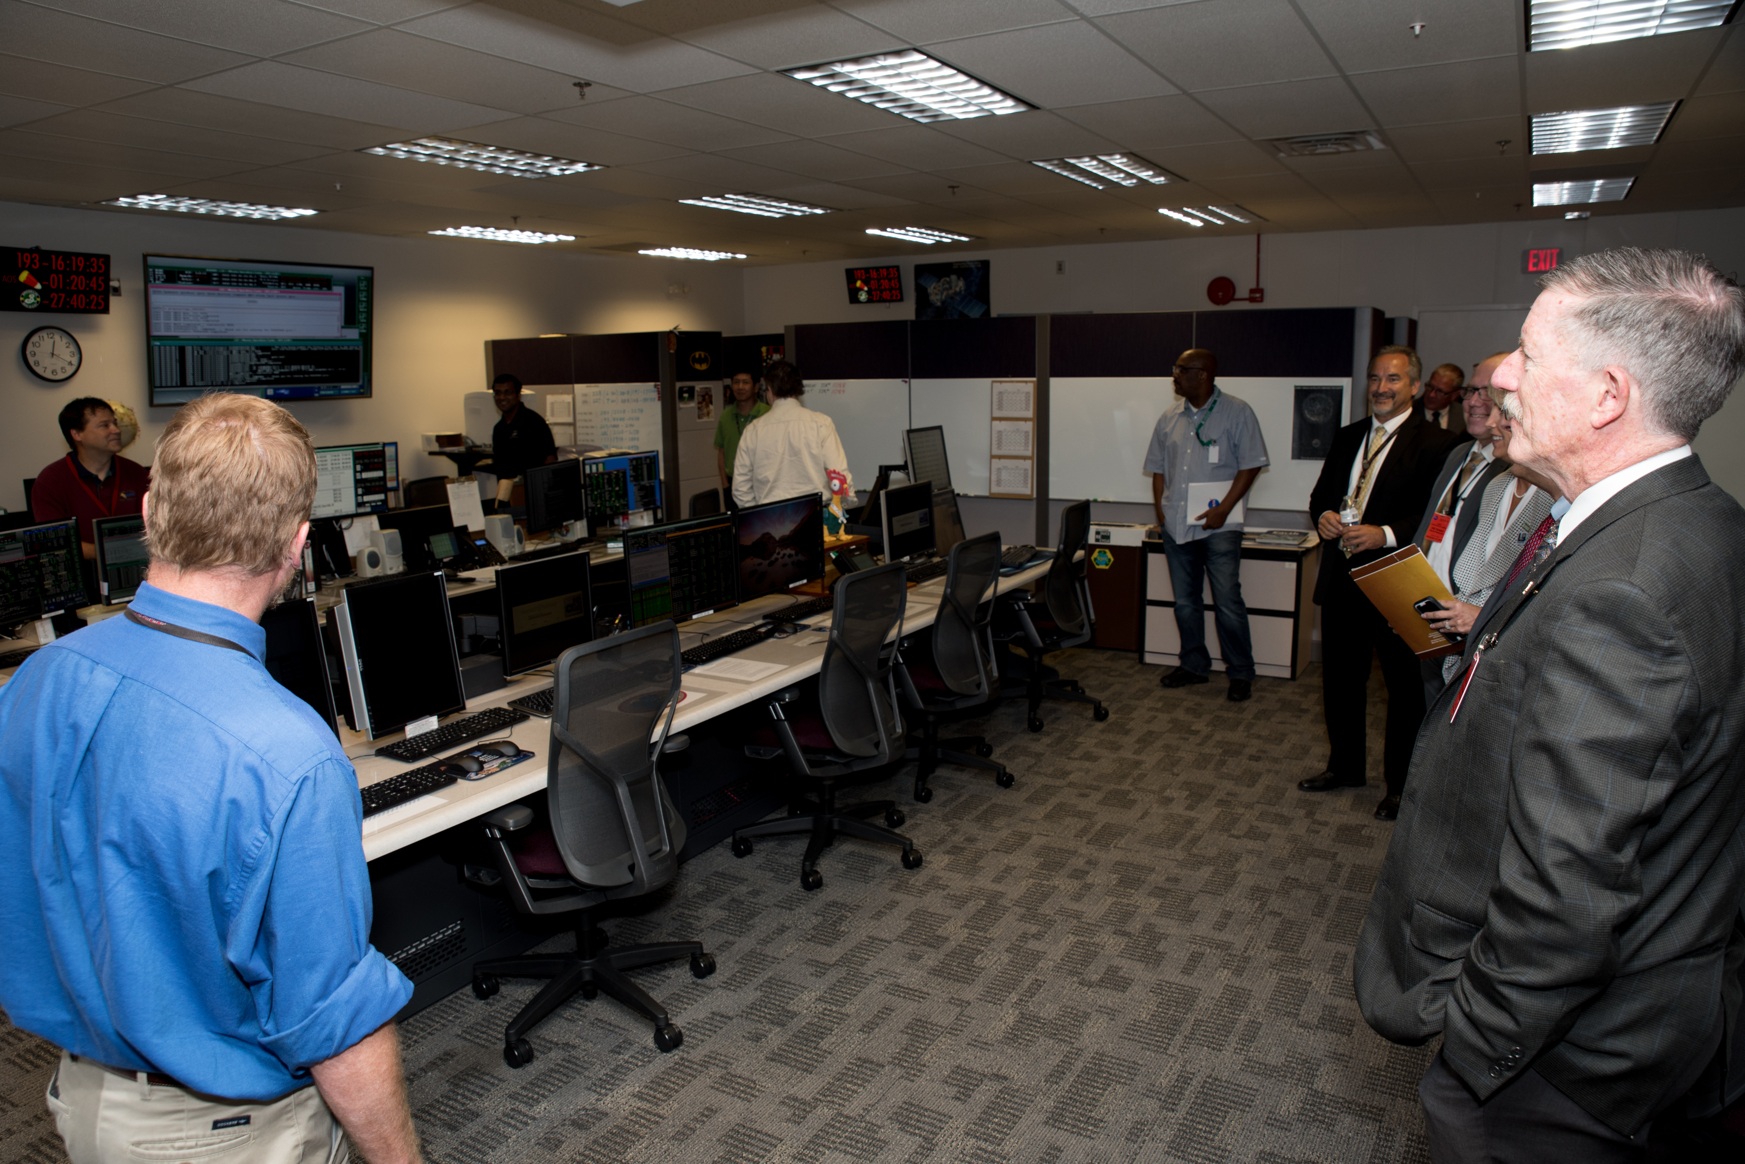
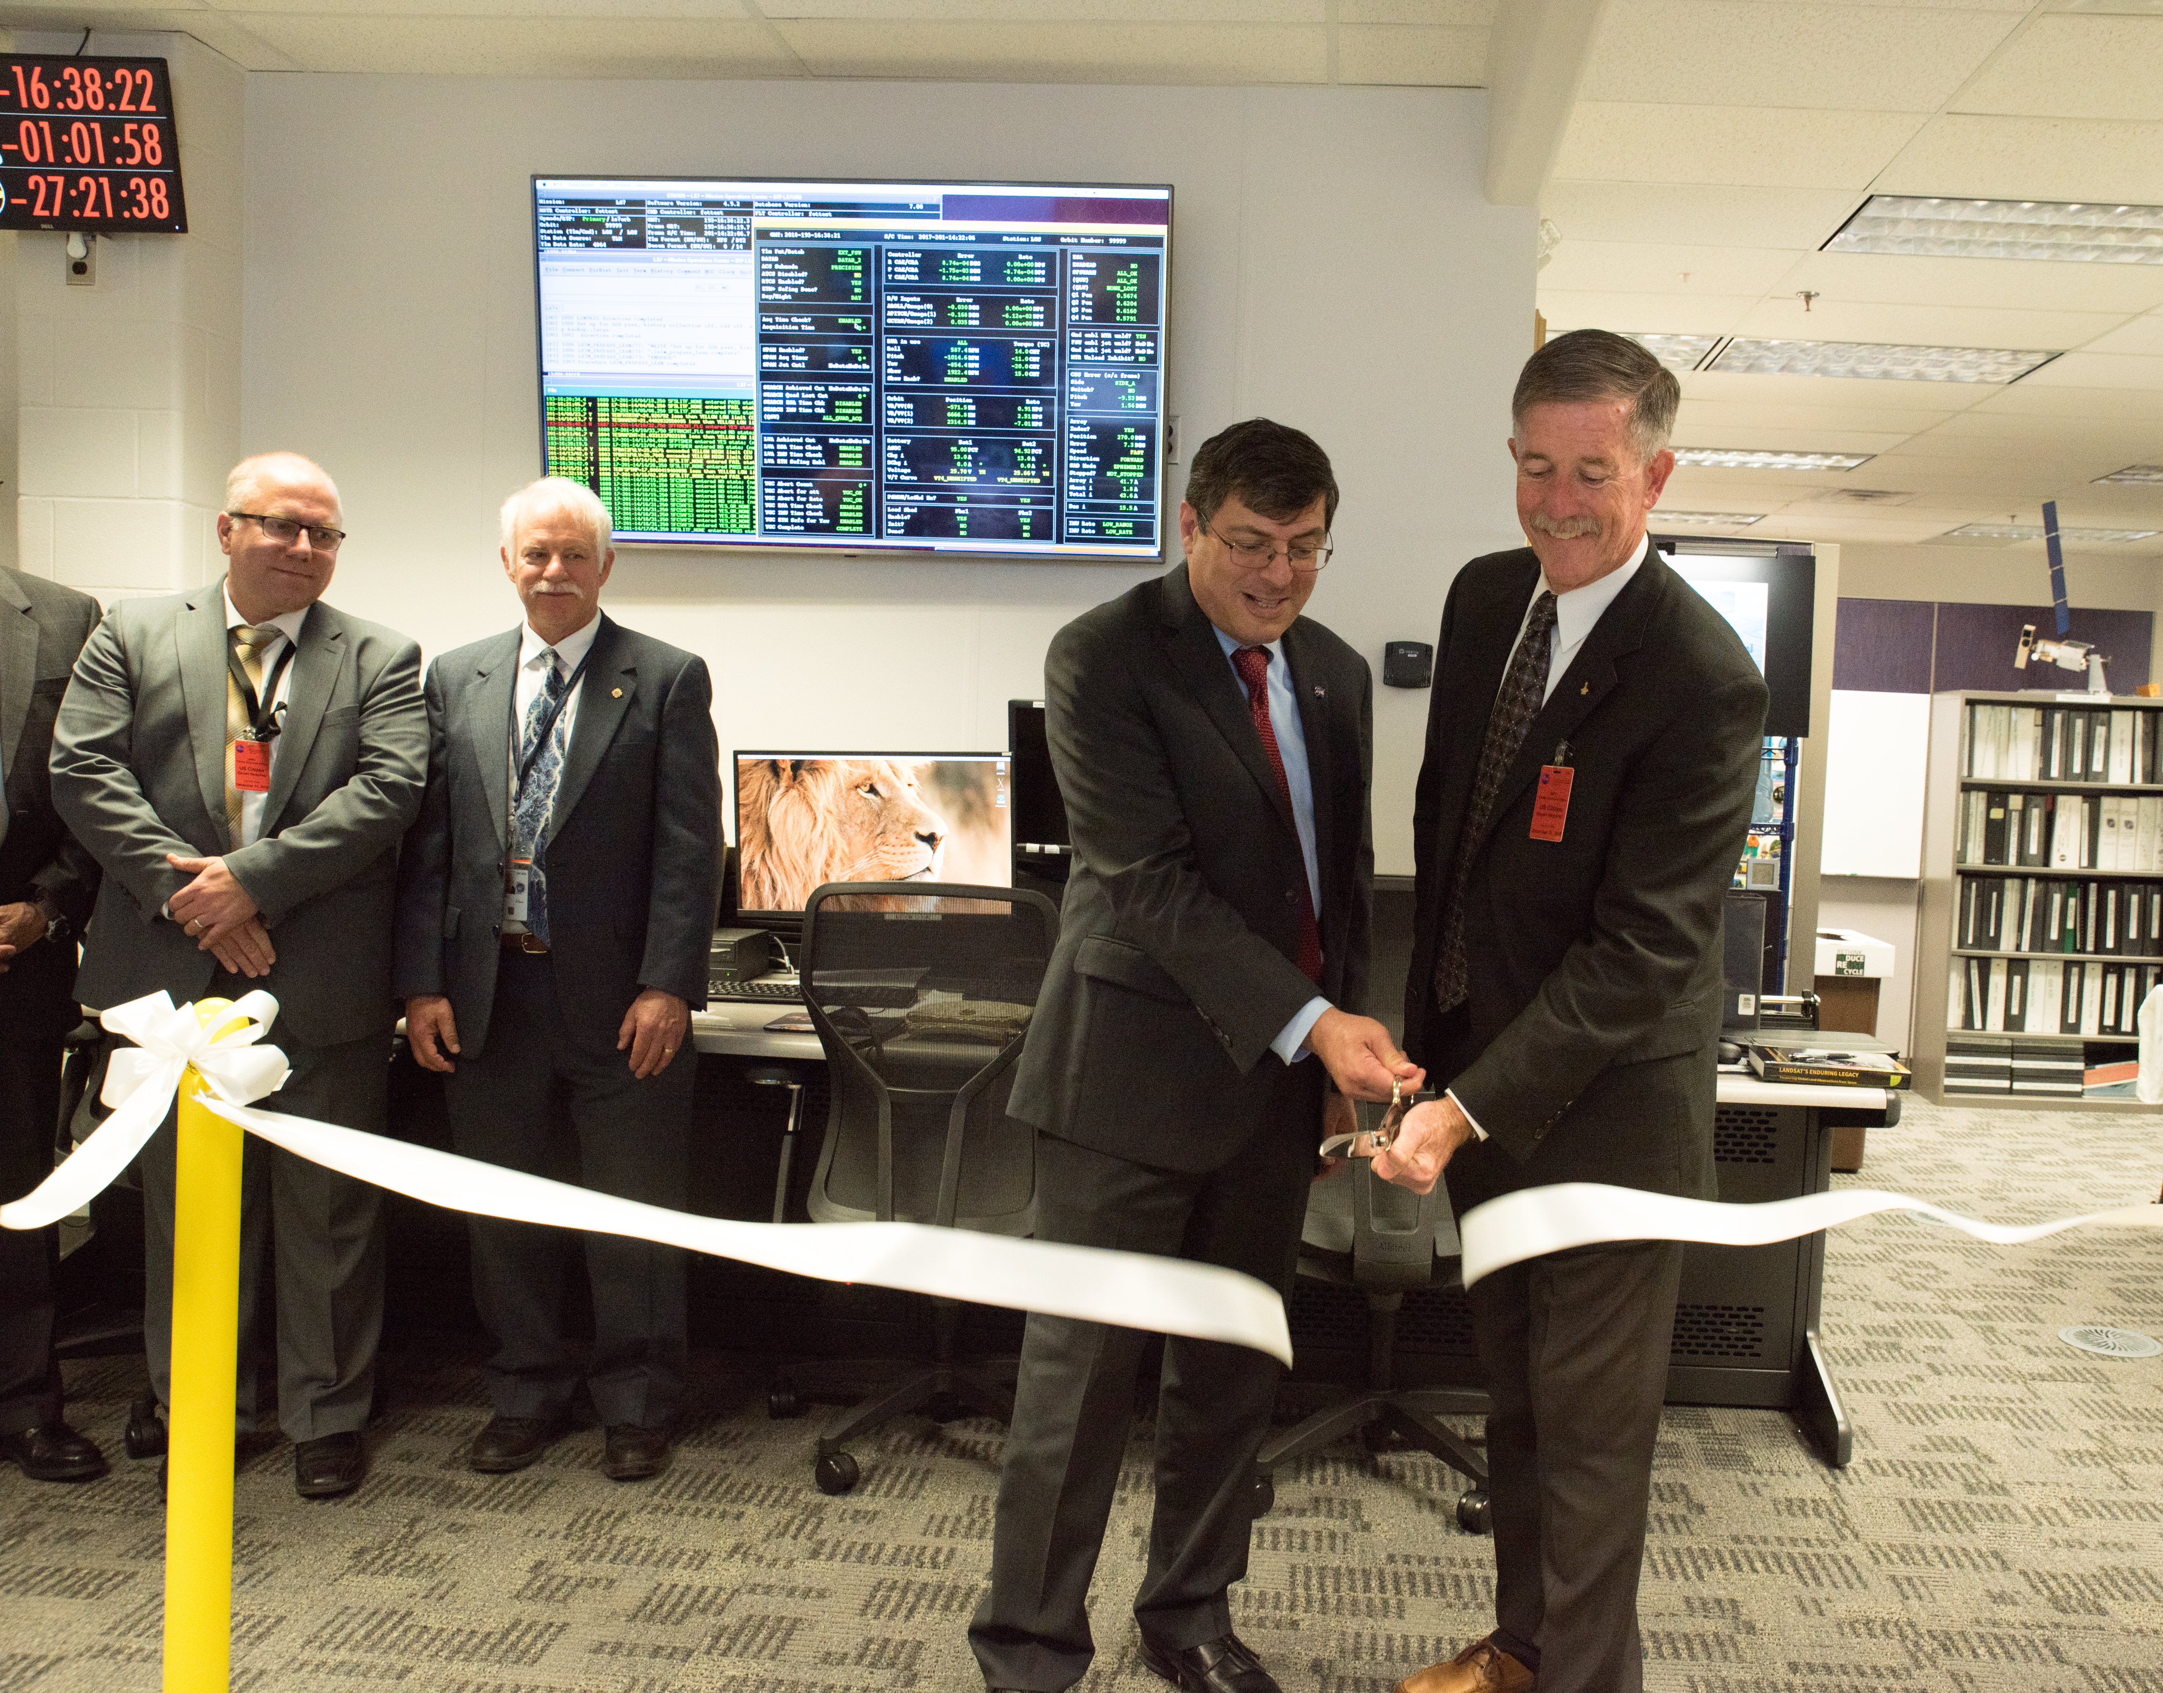
New Landsat 7 MOC Makes Way For New LMOC
July 12, 2018: GSFC Director Chris Scolese and USGS Director James Reilly cut the ribbon for the new Landsat 7 MOC
Successfully moved Landsat 7 operations from GSFC Building 32 to a new facility in Building 25
The move enables refurbishment of the Building 32 space for the new Landsat Multi-satellite Operations Center (LMOC) to operate Landsats 8, 9, and beyond

Slide 27
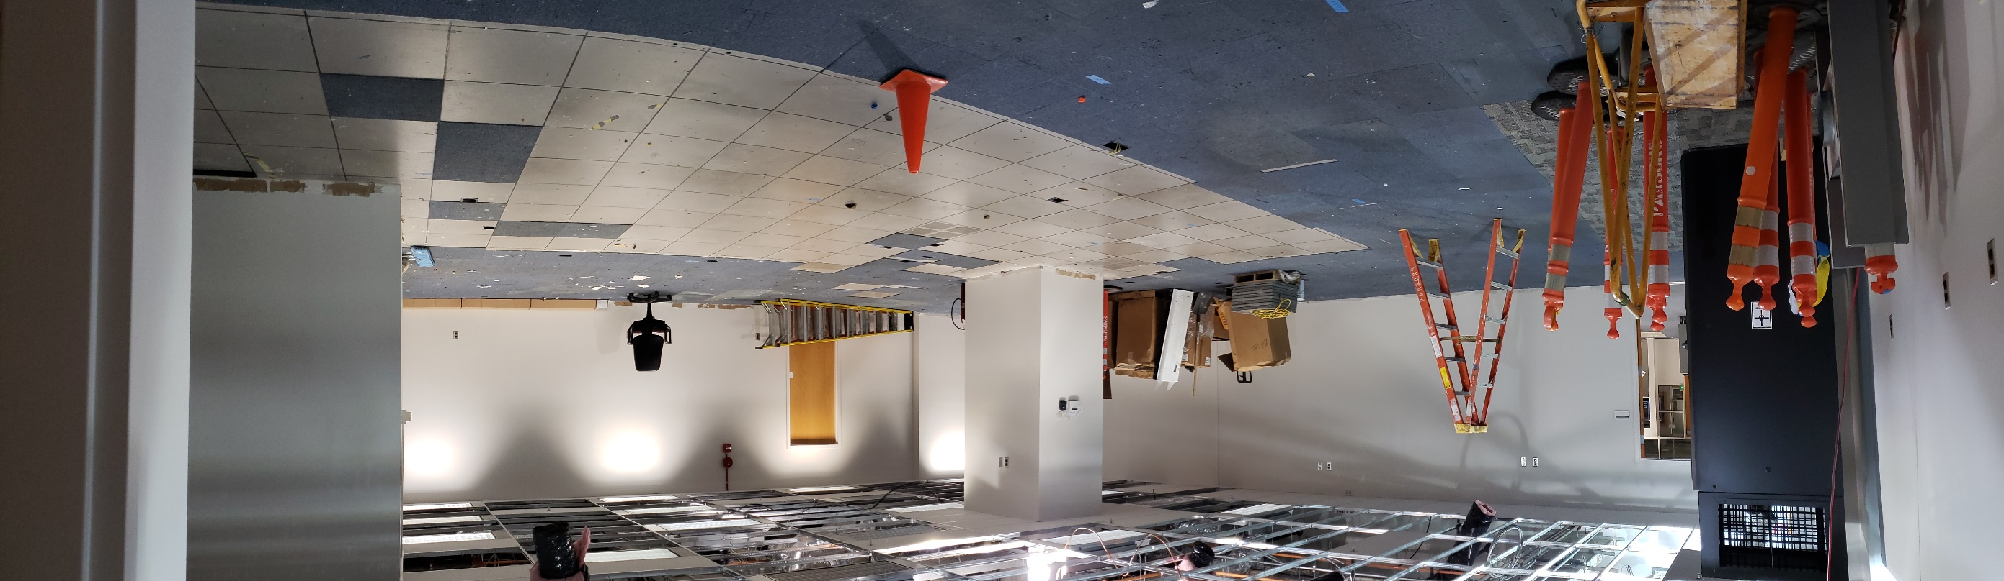
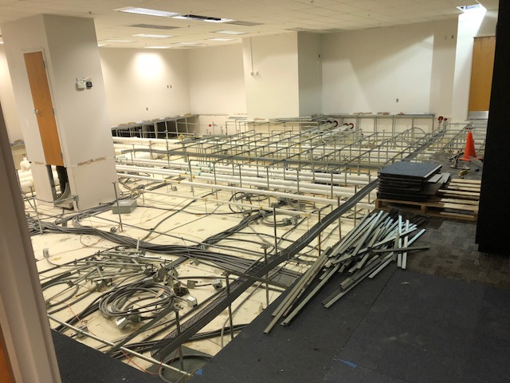
LMOC Facilities Construction Progress
LMOC at GSFC Building 32 on 7/26/2018 and 8/7/2018
Construction to be completed by 8/15/2018

Slide 28
Wrap Up
Del Jenstrom
NASA Landsat 9 Project Manager

Slide 29
Landsat 9 Project Summary
Mission design uses proven Landsat 8 architecture and and elements to satisfy agency mission requirements
Utilizes well established and strong NASA/USGS relationship
NASA and USGS major acquisitions successfully completed and development underway
Key lessons learned are being applied at all Project levels
  Process has been established for the collection of new Lessons Learned
Schedule challenges are understood and being mitigated to the degree possible
Mission development continues on solid footing and manageable pace
  All project elements are in excellent technical shape
  Mission design heritage/maturity provides high confidence in satisfying performance requirements and reduces schedule/cost risk
  Mission design is achievable within allotted budget and schedule
Team leadership heavily focused on preparing for efficient mission integration

Slide 30
Backup Slides

Slide 31
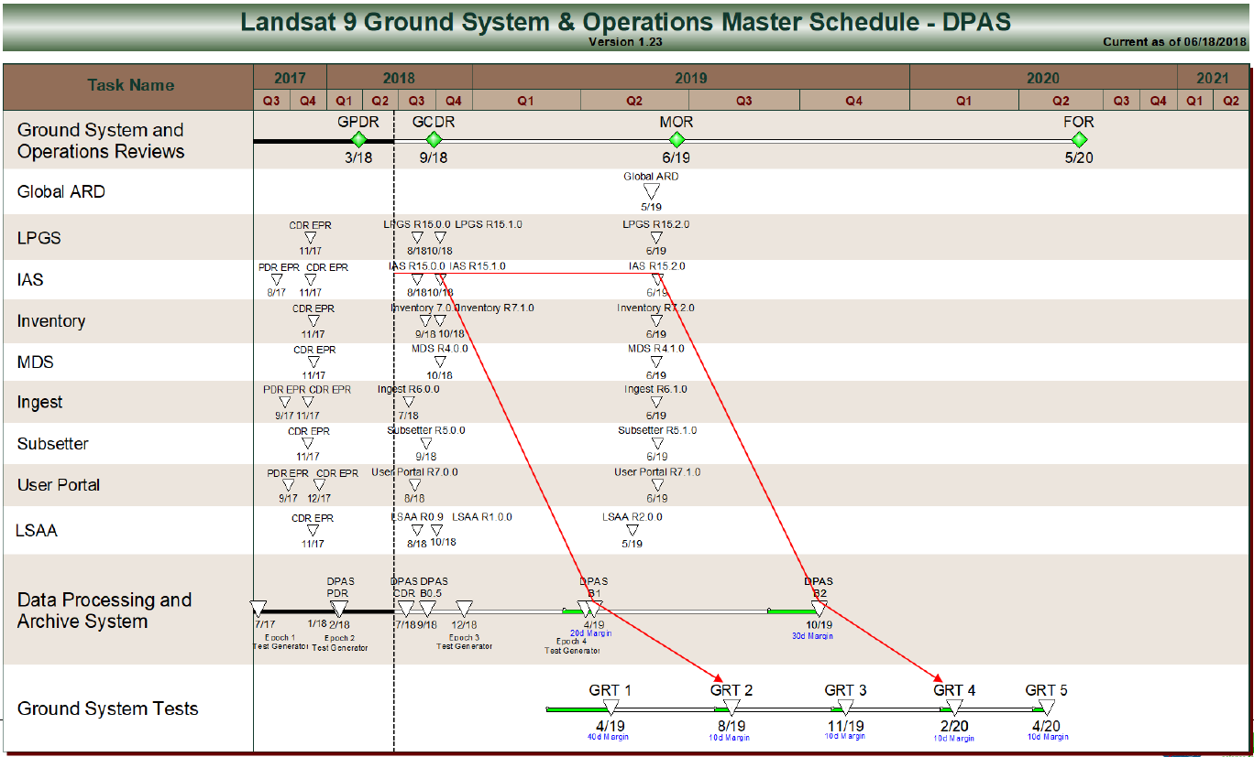
DPAS Schedule including Subsystem Deliveries

