Slide 1
NLCD 2019 Products and Status
Jon Dewitz
NLCD Production Manager
dewitz@usgs.gov
Notes:
Hello everyone. Evidently it’s my turn. Currently, we are in the middle of finalizing NLCD 2019 production, preparing for the yearly MR LC consortium meeting, two papers, etc. etc. etc. but I know everybody else is busy too. Going to try and keep this as short and brief as I can so that hopefully we can have some discussion towards the end.

Slide 2
What have we done for you lately…….
Published NLCD 2016?
Notes:
So, what have you done for us lately? NLCD 2016 seems like a long time ago, but it was a very large effort for us. Going to touch on what made it different than everything else we’ve done, and everything else we’ve done recently.

Slide 3
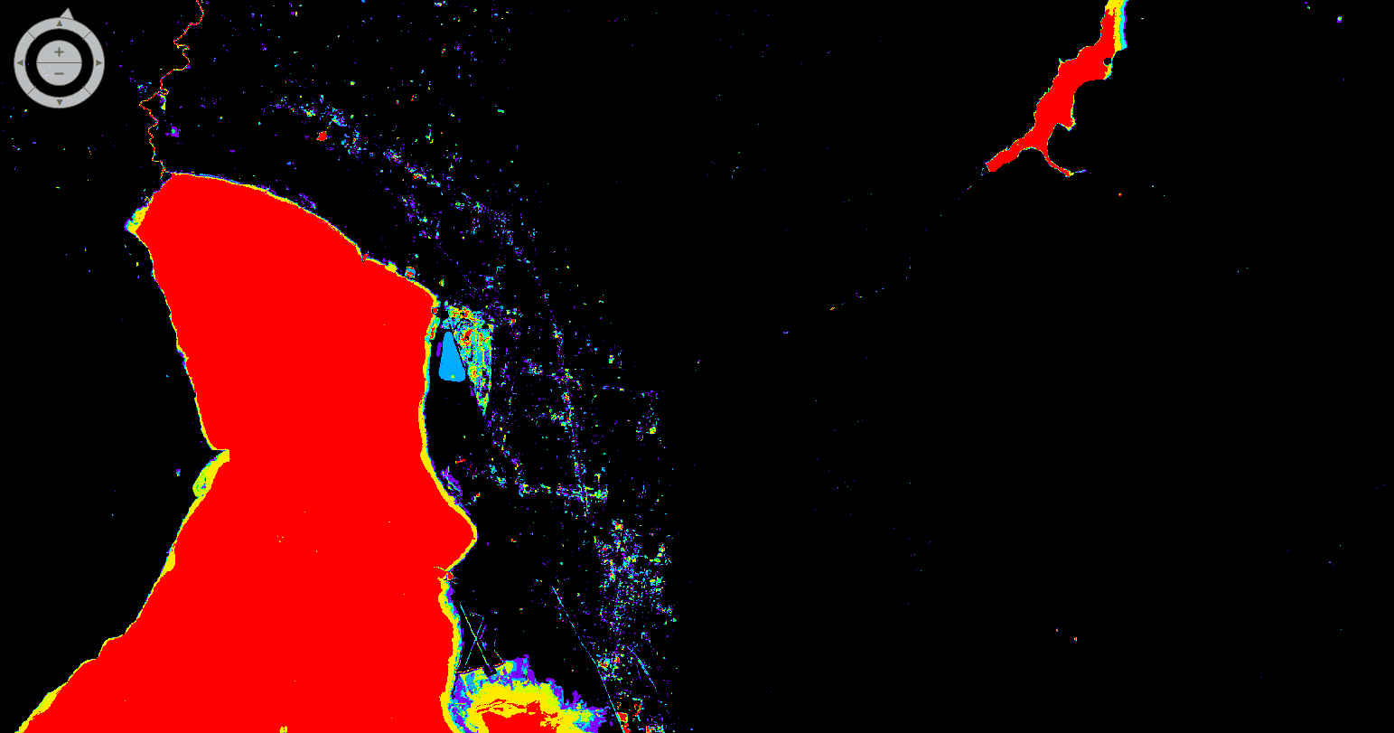
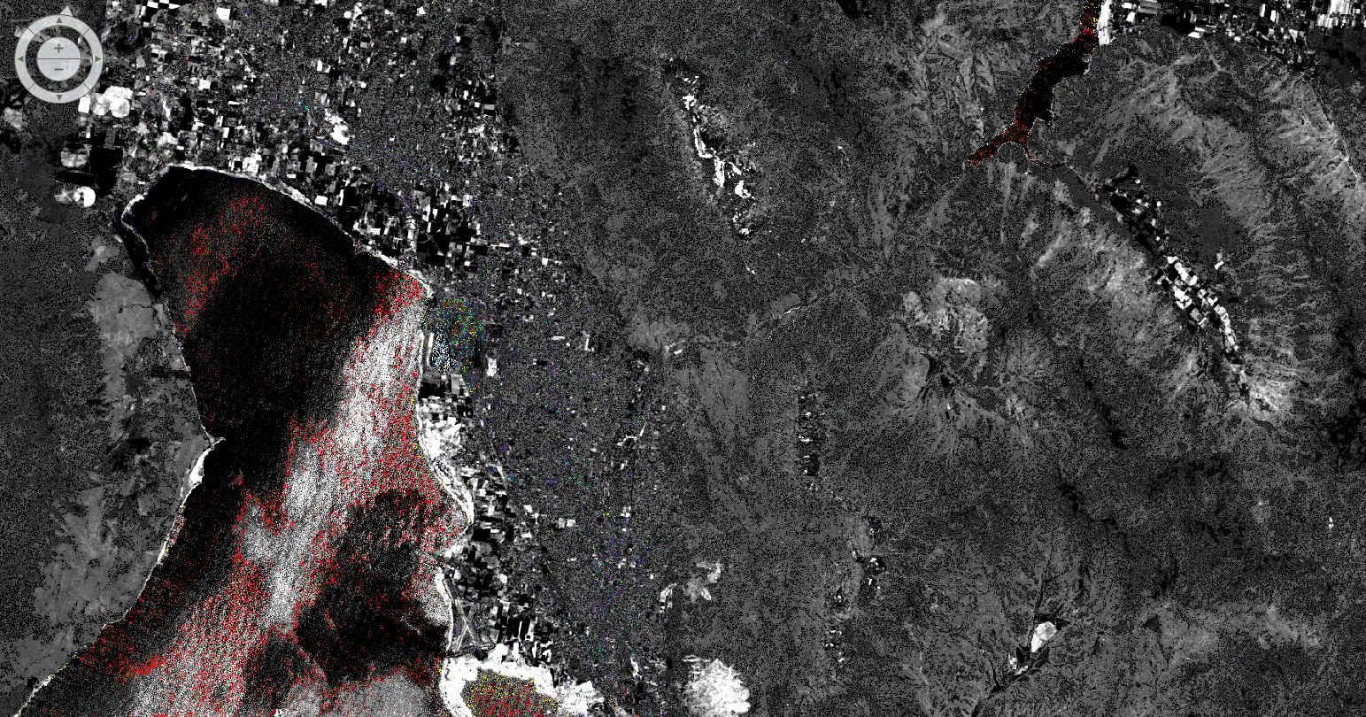
NDWI(seven years) water frequency (seven years) change vector (seven years) DNBR (seven years) DNDVI (seven years) MIICA (seven years) RCV Max (between each year) NSD forest (seven years) NBR (seven years) forest disturbance (seven years) compactness (seven years) Majority training( seven years)
Notes:
So just quickly, NLCD 2016 was redone front to back. We used many models a few of which are listed here, and pulled those together with true succession and trajectory mapping through all years. NLCD 2001 was the original base, and NLCD 2006 and 2011 were change based add-ons to that original 2001 product. NLCD 2016 took the best pieces from those earlier publications, sought out areas through an abundance of evidence that we were sure could be improved, improve those, and kept the best parts.

Slide 4
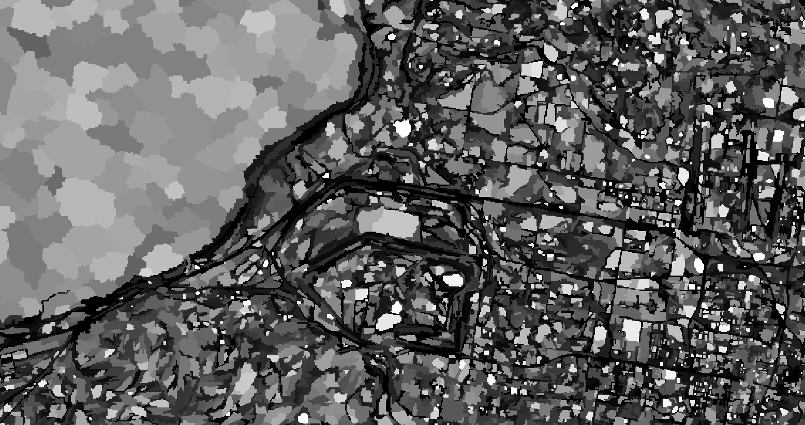
Notes:
One of the key components we incorporated from the beginning of our Landcover mapping process was defining areas or patches that were consistent through time. We use these as the foundational layers for any change that occurred on the mapping service. This eliminated single pixel change and other noise in the classification that usually doesn’t happen on the landscape at a 30 m scale.

Slide 5
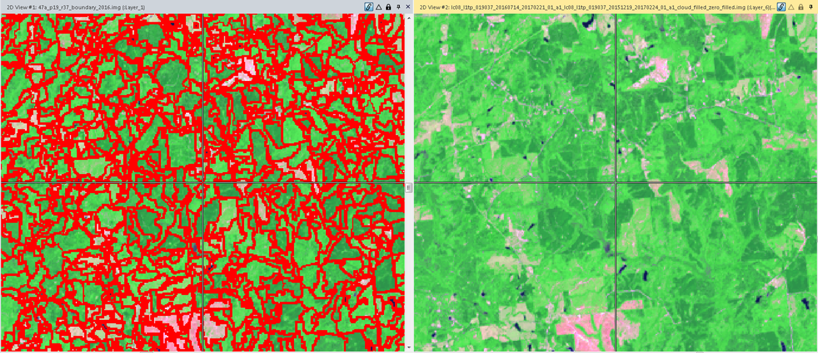
Edge Pixels
Notes:
Using these patches, we also eliminated edge pixels from training data. These edge pixels were bound to the majority patch to limit change from year to year. Ortho rectification, sun angle, and time of year can all create slight differences in these edge pixels. We wanted to limit this or at least bind it to the neighboring patches.

Slide 6
LCMAP ARD Imagery
Notes:
Imagery is the root of all classifications, and for the 2016 release NLCD partnered with lcmap to use a standardized set of imagery between the two projects. NLCD will continue this collaboration with the 2019 publication and additional collaboration to produce composites along with other derivative usage.

Slide 7
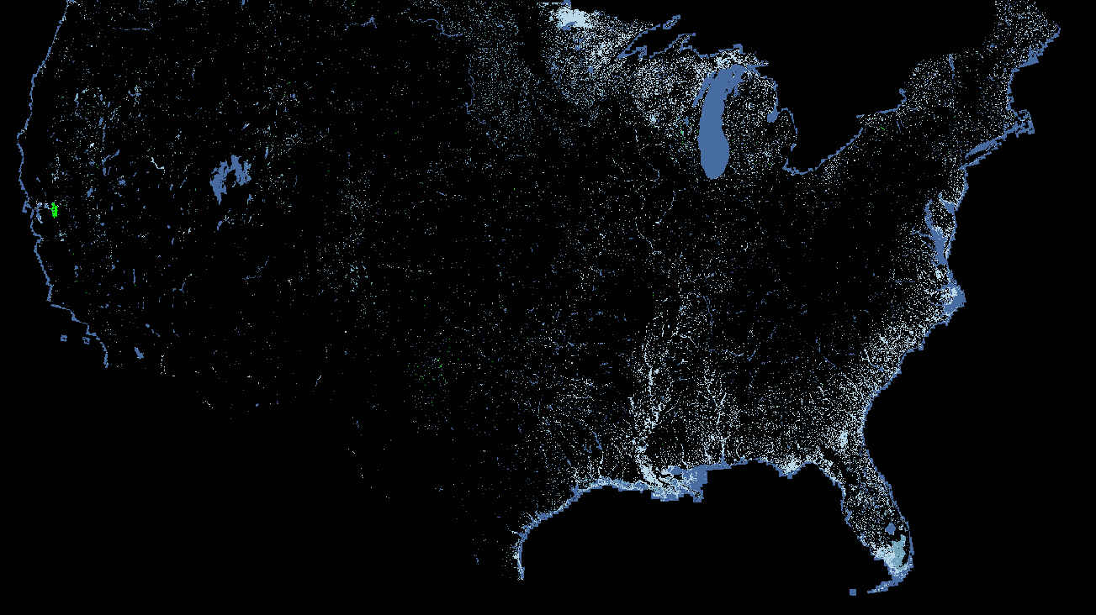
NOAA
Notes:
We also directly integrated multiple data sets from our MR LC partners. These include Noah, whose wetlands and change products are coastal foundation

Slide 8
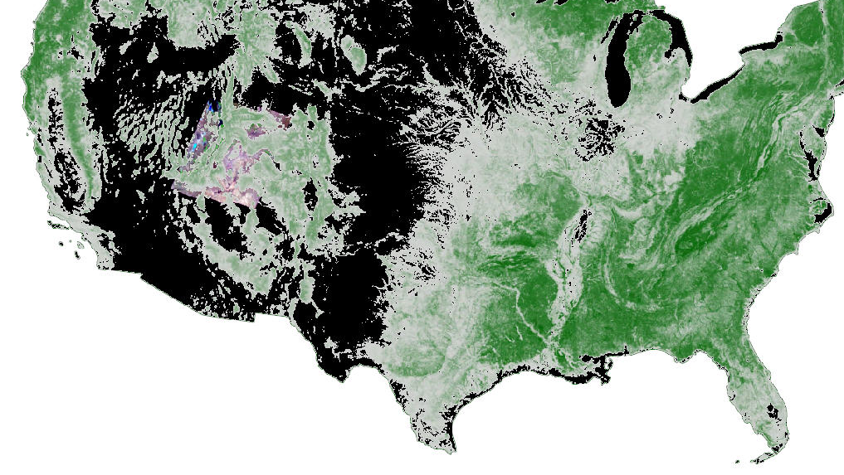
Forest Service Canopy
Notes:
The for service canopy product is generated for 2011 and 2016 using the forest inventory analysis points. These provide the base for the classification,. This product spans many NLCD classes and provides both input into the initial NLCD Landcover classifications, along with bridging many NLCD classes. These include providing canopy estimates over developed areas, canopy estimates over orchard areas, and continuous fields across other areas like shrub and pasture where forest is present but is not the dominant class.

Slide 9
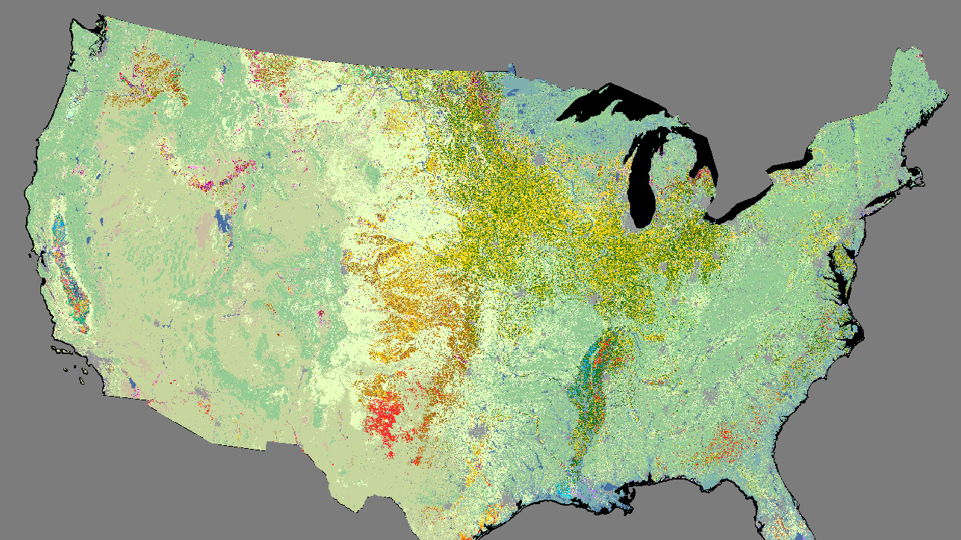
NASS
Notes:
Nass provides the basis for all NLCD agriculture. This agriculture product is used both directly in some cases in the Landcover, and indirectly to cultivate training data across time frames.

Slide 10
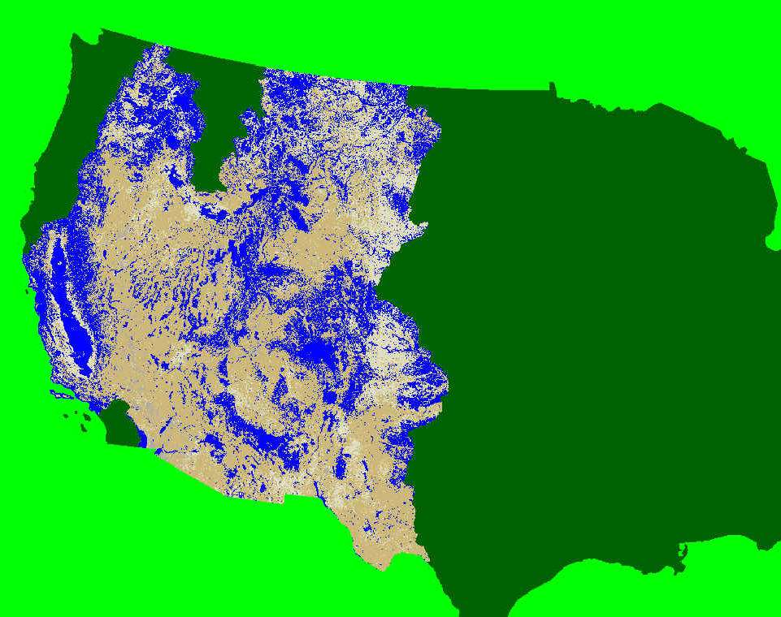
BLM USGS Shrub Products
Notes:
You’ll hear about the NLCD shrub products that are funded by the BLM from Matthew at another point, so I won’t spend a lot of time going over that. These six continuous field products accurately map the range lands in the Western part of the United States and directly correspond to NLCD cover types in these areas

Slide 11
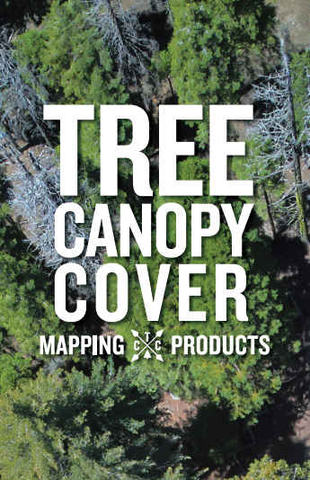
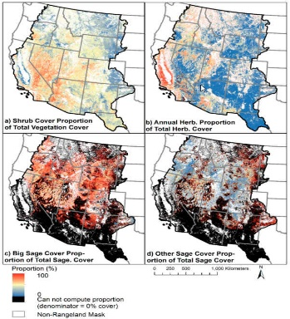
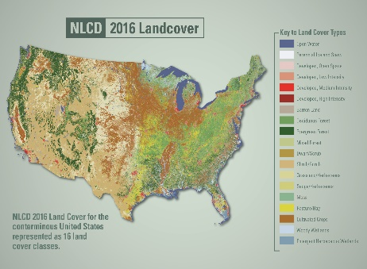
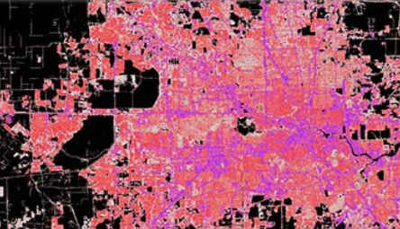
DIRECT USAGE
CONTRIBUTOR AND DIRECT INTEGRATION
Rangeland Monitoring
Landcover
Developed Impervious Surface
Notes:
These are our MLC partners. All contribute directly through products, funding, or both in generating our four base products of tree canopy, rangeland products, impervious surface, and Landcover.

Slide 12
Notes:
We also spent a very large amount of time on our impervious surface generation. Like Landcover, impervious surface had only seen add-ons since 2001. We started again from the 2001 base, removed all previous ancillary data, and Incorporated new data. This allowed for creation of a secondary product called our impervious descriptor. These two products correspond directly to each other. They label different categories of roads, urban areas, energy production sites, and integrate these into a single readable file.

Slide 13
Notes:
We created additional Landcover classes for 2016 publication. These classes split change between rangeland grass and shrub and forest grass and shrub so that rangeland areas could be attribute it from forest areas in their change cycles and vice versa. Additionally, change disturbance data, forest disturbance data, and a universal change index that helps users simply and easily understand change across seven Landcover dates was also created.

Slide 14
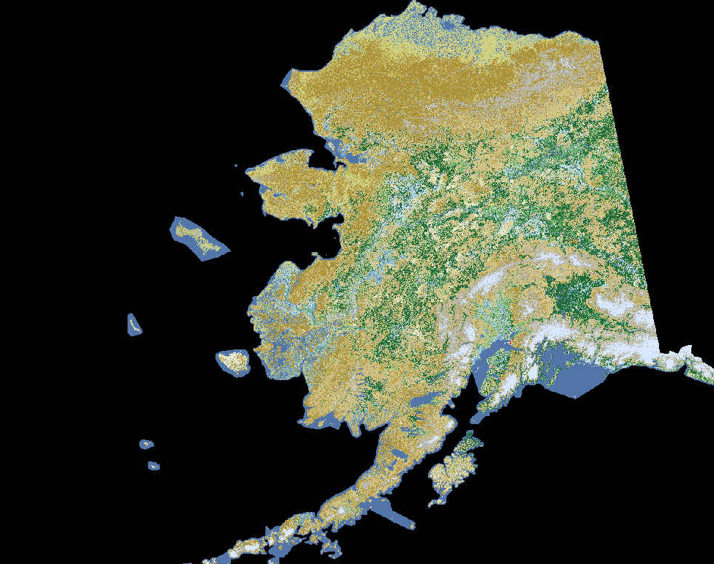
ALASKA
Published 2001, 2011, and 2016
Full canopy and impervious suite
Notes:
We also published NLCD 2016 for Alaska. This was done through limited change mapping and fieldwork.

Slide 15
Notes:
Our Landcover in both conus and Alaska form the basis for another partnership, the North American land change monitoring system.

Slide 16
Notes:
This try national collaboration combines multiple dates of products from NLCD, Canada, and Mexico to provide the basis for the majority of North American policy regarding carbon, climate risk,

Slide 17
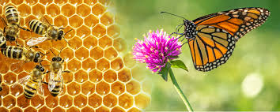
World Policy
World Meteorological Organization (WMO)| An Integrated Global Greenhouse Gas Information System (IG3IS) Science Implementation Plan
United Nations Environment Programme (UNEP)| A Framework for Freshwater Ecosystem Management Volume 4: Scientific Background
Food and Agriculture Organization of the United Nations| The pollination services of forests
Food and Agriculture Organization of the United Nations| Proceedings of the Global Symposium on Soil Organic Carbon 2017
Notes:
, greenhouse gas emissions, UNEP uses us as a framework for freshwater ecosystem management food and agriculture uses us for pollination information along with soil organic carbon.

Slide 18
The last 5 years of citations
Notes:
NLCD continues to have a very high following. I’ve excluded all of our previous work which is over 7000 citations. In the last five years we have over 2000 research citations using alt metric.

Slide 19
Notes:
Since the publication of NLCD 2016 not quite two years ago, we’ve had hundred and 35,000 downloads that contained 2 ¼ million separate products.

Slide 20
Conterminous United States overall accuracies (OA; %) and (standard errors) by NLCD product year. Agreement is based on a match between the map and primary or alternate reference labels. Accuracy trends for land cover components (Year of Land Cover) are reported column-wise.
NLCD Product | Year of Land Cover
Year | 2001 | 2006 | 2011 | 2016
 | Level II
2001* | 78.8 (2.1)
2006 | 79.0 (0.8) | 78.0 (0.8)
2011 | 83.2 (0.5) | 82.8 (0.5) | 82.0 (0.5)
2016 | 83.7 (0.5) | 83.6 (0.5) | 86.8 (0.7) | 86.4 (0.6)
 | Level I
2001* | 80.4 (1.9)
2006 | 85.0 (0.4) | 84.0 (0.7)
2011 | 89.3 (0.4) | 89.0 (0.4) | 88.0 (0.4)
2016 | 89.2 (0.5) | 89.2 (0.5) | 90.5 (0.6) | 90.6 (0.6)
Notes:
In addition to getting all that done, we continue to increase our accuracy. Each subsequent publication of NLCD has seen an increase in accuracy. We’ve shown and over 10% increase since our initial 2000 one publication at Anderson level I, and an 8% at Anderson level II. At this point in our accuracy assessment, are statistical guru Steve stamen feels we are nearing the point where reviewer accuracy is starting to meet Landcover accuracy this is a very hard thing to quantify, but essentially it means improvements in accuracy are going to be very hard to come by without some dramatic change in accuracy assessment methodology. One other thing I’d like to point out since NLCD is the basis for many products is that any product will likely not exceed the accuracy of its training data

Slide 21
What are we doing tomorrow…..
NLCD 2019, ~1 year turn around from imagery acquisition
Currently set up to enable landcover publication every year
Notes:
So, that’s what we’ve been doing the last two years. Here’s what we have in store in the next few months. We completed our NLCD 2019 methodology and are set up to be able to publish Landcover on a yearly basis using that methodology.

Slide 22
2019 Impervious Surface
Creation of new impervious layer for 2019
Intergration of 6 additional layers for increased accuracy
Generation of impervious for every Landcover period and integration into previous landcover product, total of 16 CONUS impervious layers
Increased attributation for Impervious Descriptor
Notes:
For 2019 publication, we continue to improve our impervious surface as we have every publication period. We batted six additional ancillary layers to increase our accuracy, and have generated impervious surface products to match every year of our Landcover publication.

Slide 23
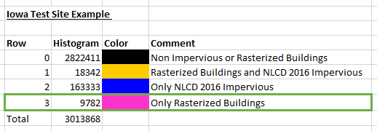
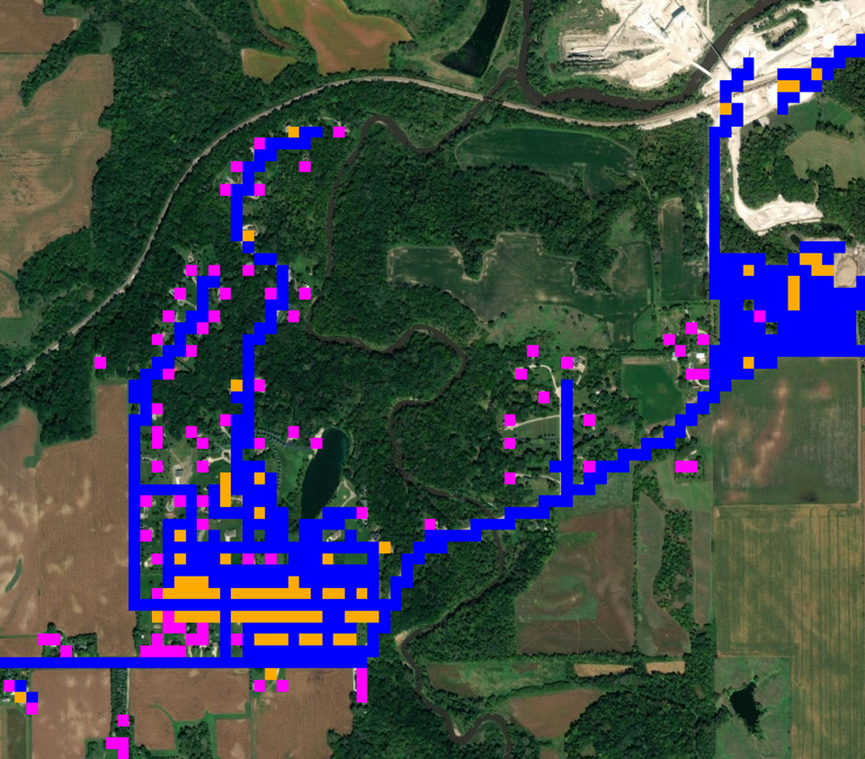
Notes:
One of these database layers is a Microsoft buildings database, which will add detail to our impervious surface in areas such as full canopy that we couldn’t accurately classify before.

Slide 24
Notes:
For 2019, our Landcover is based on compositing made possible through lcmap’s ARD. Compositing has its own set of trials and tribulations. Both seen base and compositing still suffer from lack of imagery as you approach the end of the year and the publication date. We’ve overcome most of this through some synthetic filling and generation in these composite areas of poor image availability.

Slide 25
E.V.A.
Enhanced visualization and analysis
Notes:
Another soon to be released product is our new Eva tool, which stands for enhanced visualization and analysis. This tool was created in partnership with NOAA. It fills a need that we’ve seen since before our 2016 release of having simple and ready Landcover analysis for users who don’t want to deal with GIS.

Slide 26
Notes:
This tool provides summaries of change to and from for each land cover type, and provides overviews of what these general changes mean on the landscape.

Slide 27
Notes:
This all comes in a tabulated downloadable format showing change and likely change drivers

Slide 28
Notes:
It also provides some key overviews for specific theme types like developed areas which will help users understand what’s behind these changes.

Slide 29
What opportunities exist for partnership

Slide 30
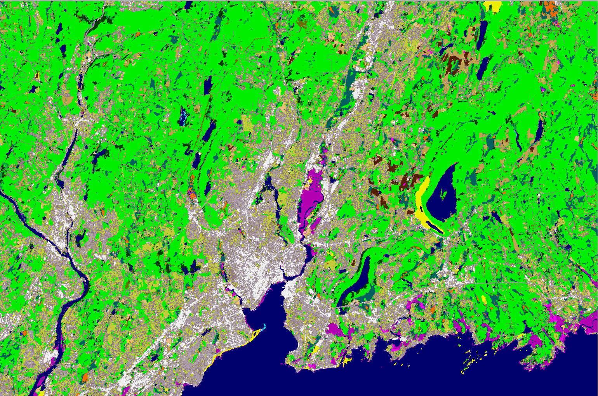
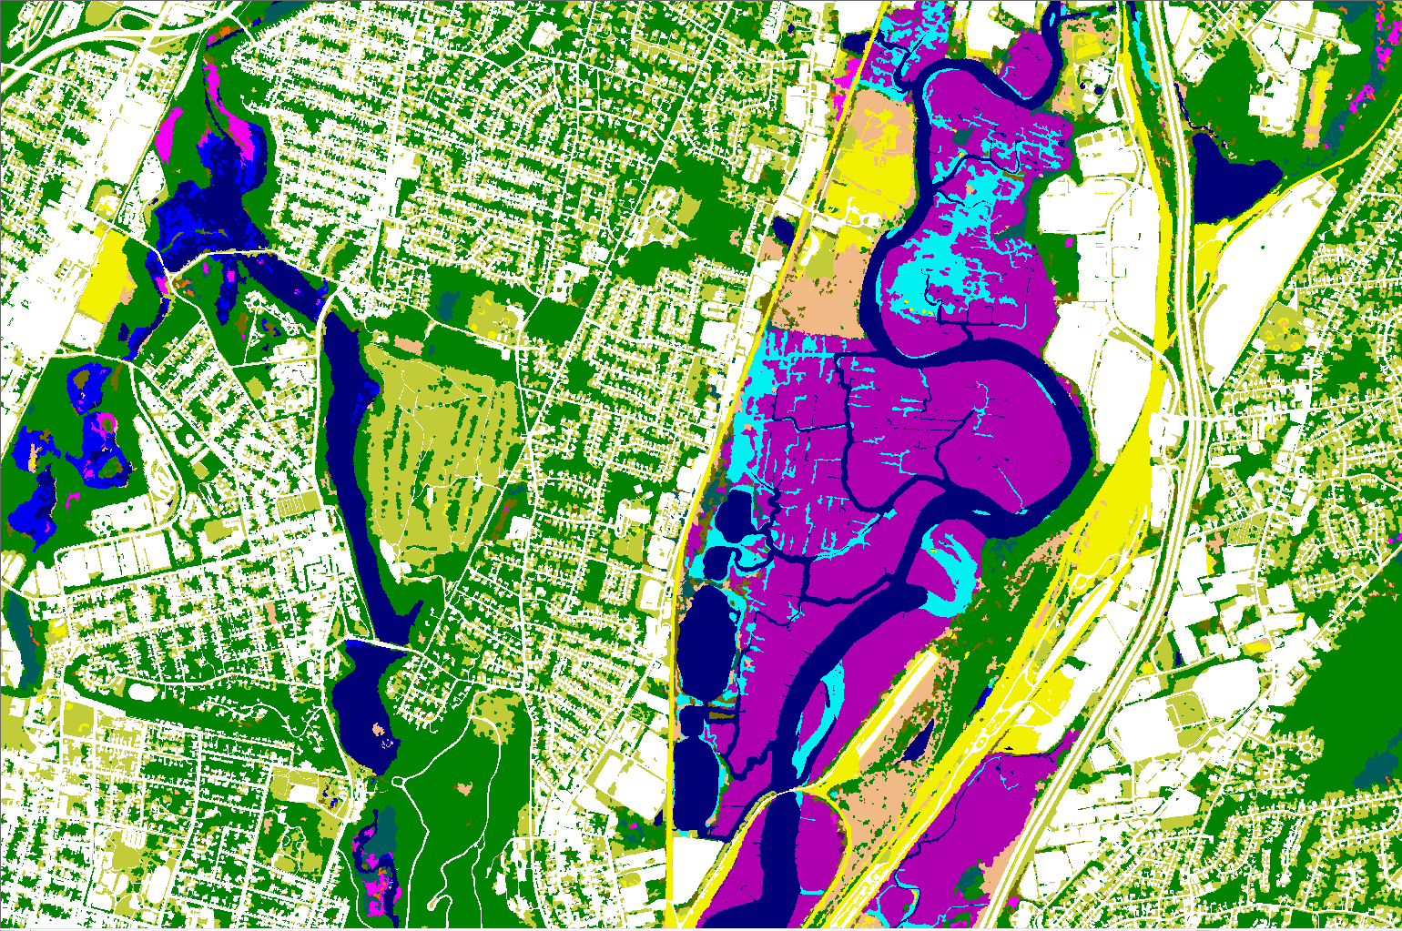
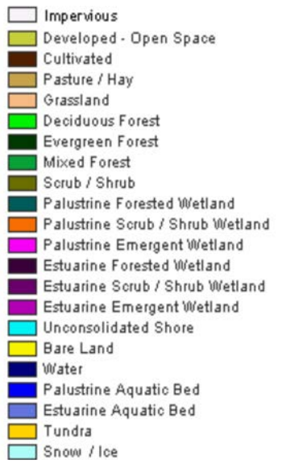
Past and Future C-CAP
2016 Regional C-CAP (30-meter)
2016 C-CAP (1-meter)
Notes:
Through the consortium, we have many partnerships. I’d like to mention briefly NOAA’s push to provide 1 m land cover for the coastal areas and potentially the nation.

Slide 31
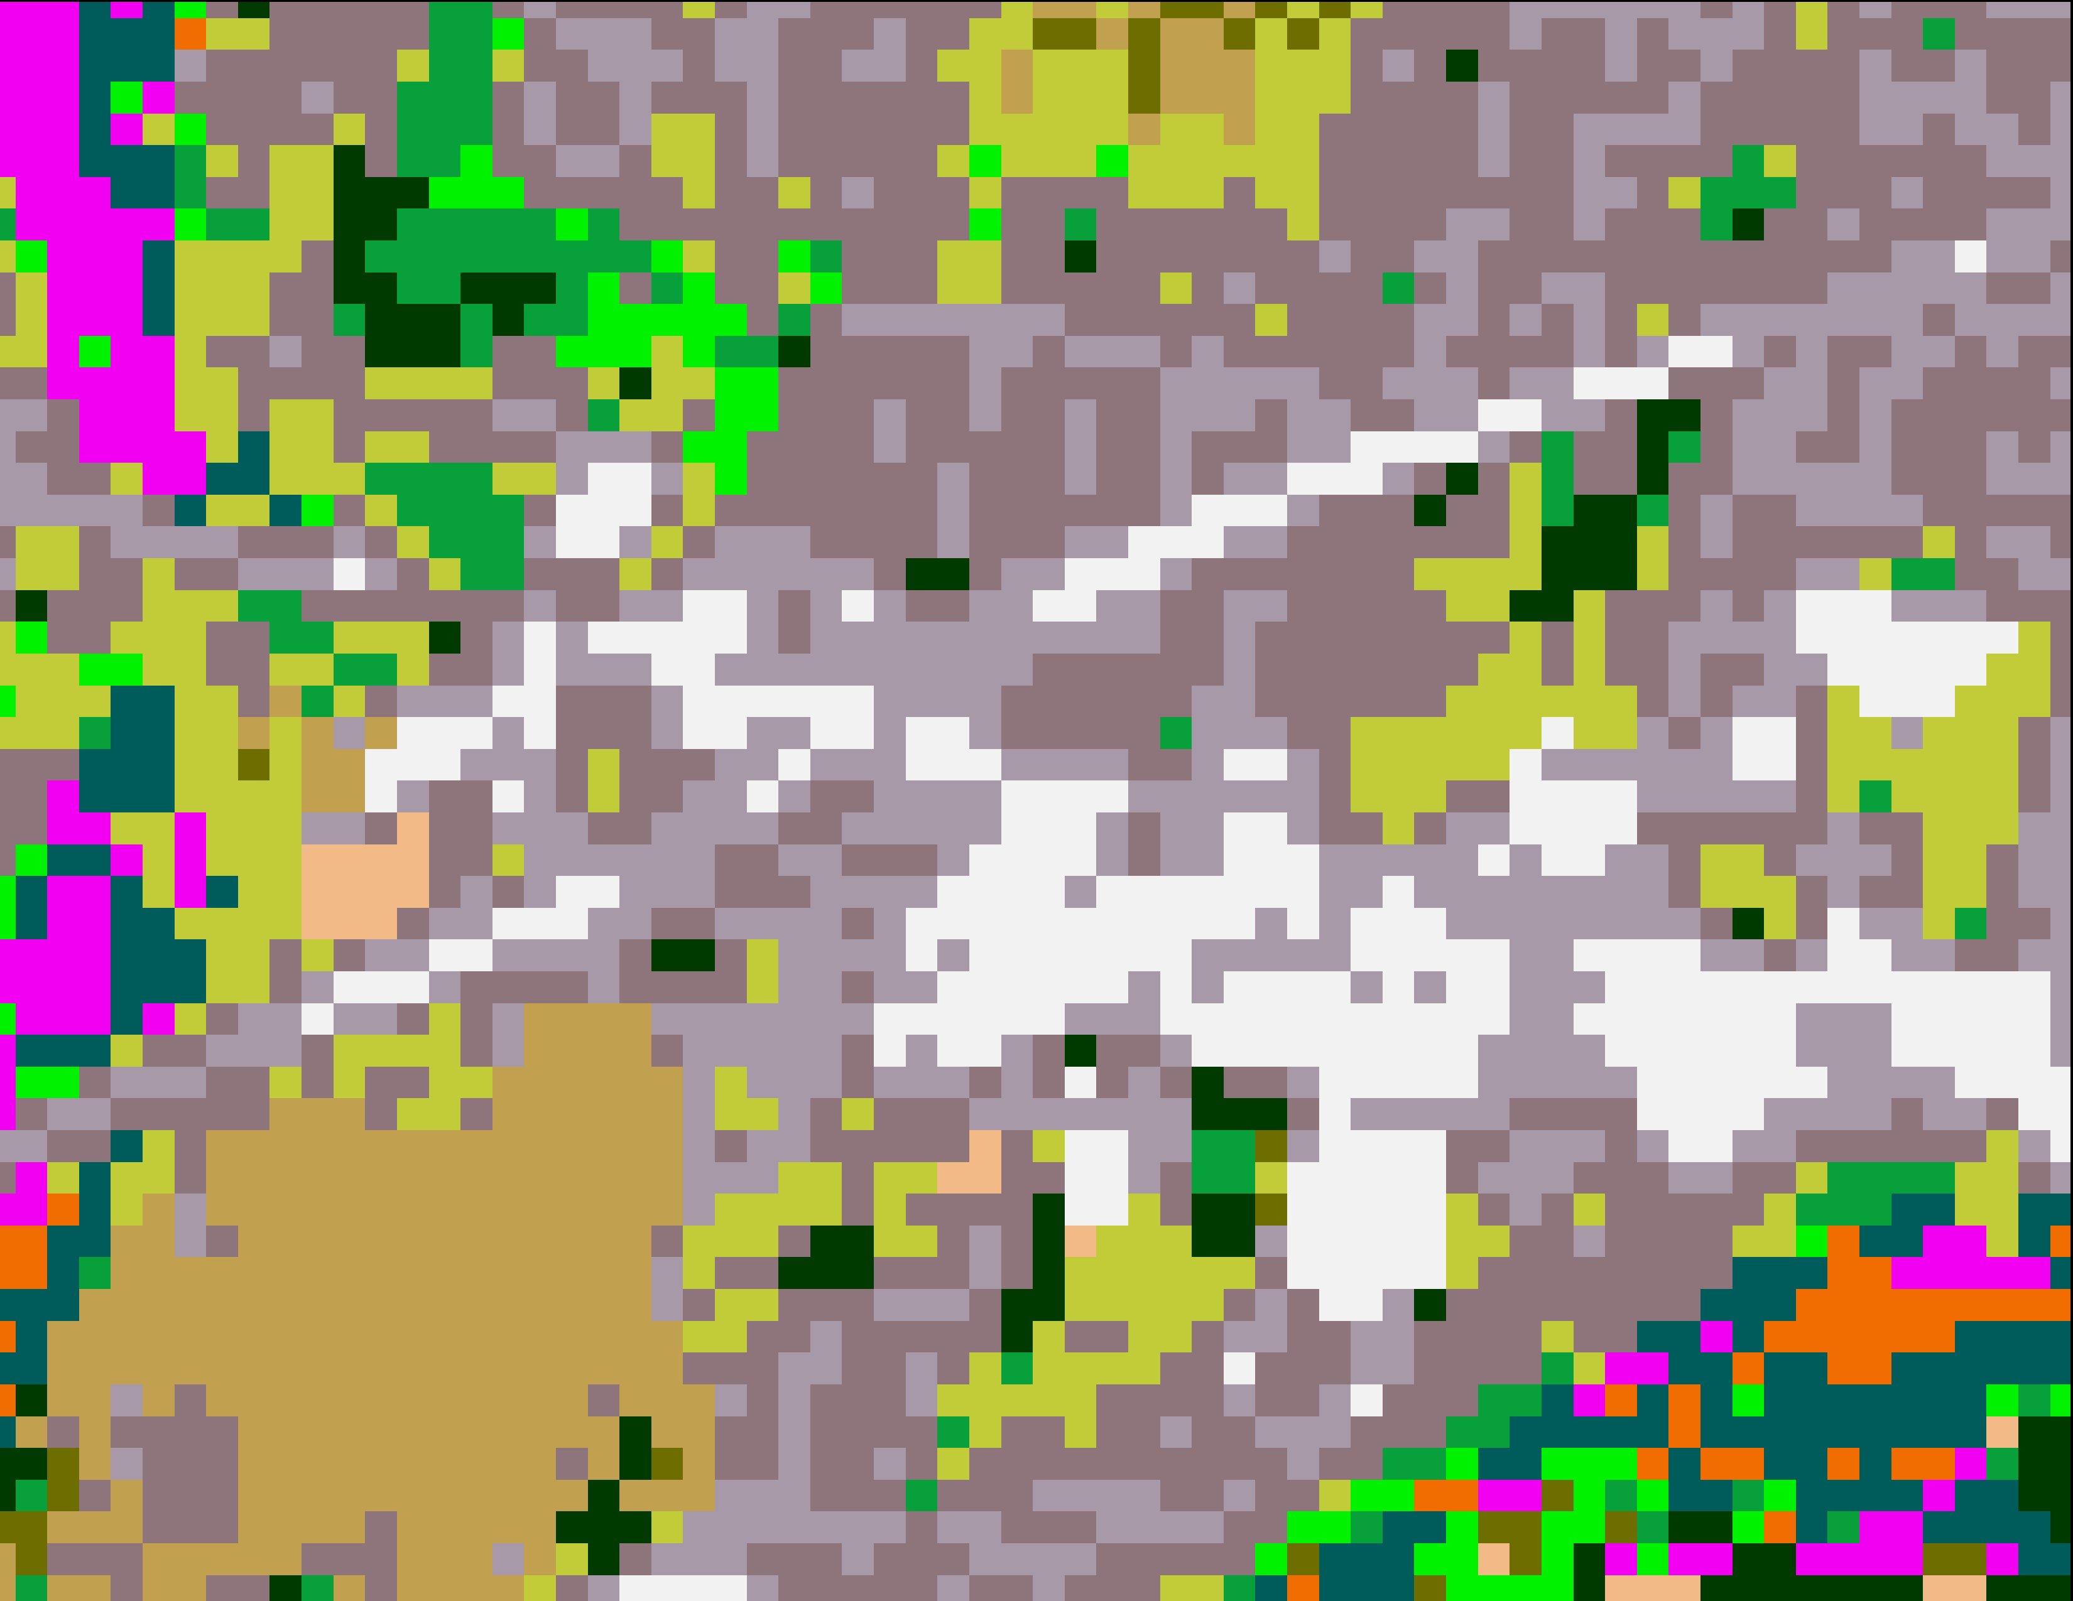
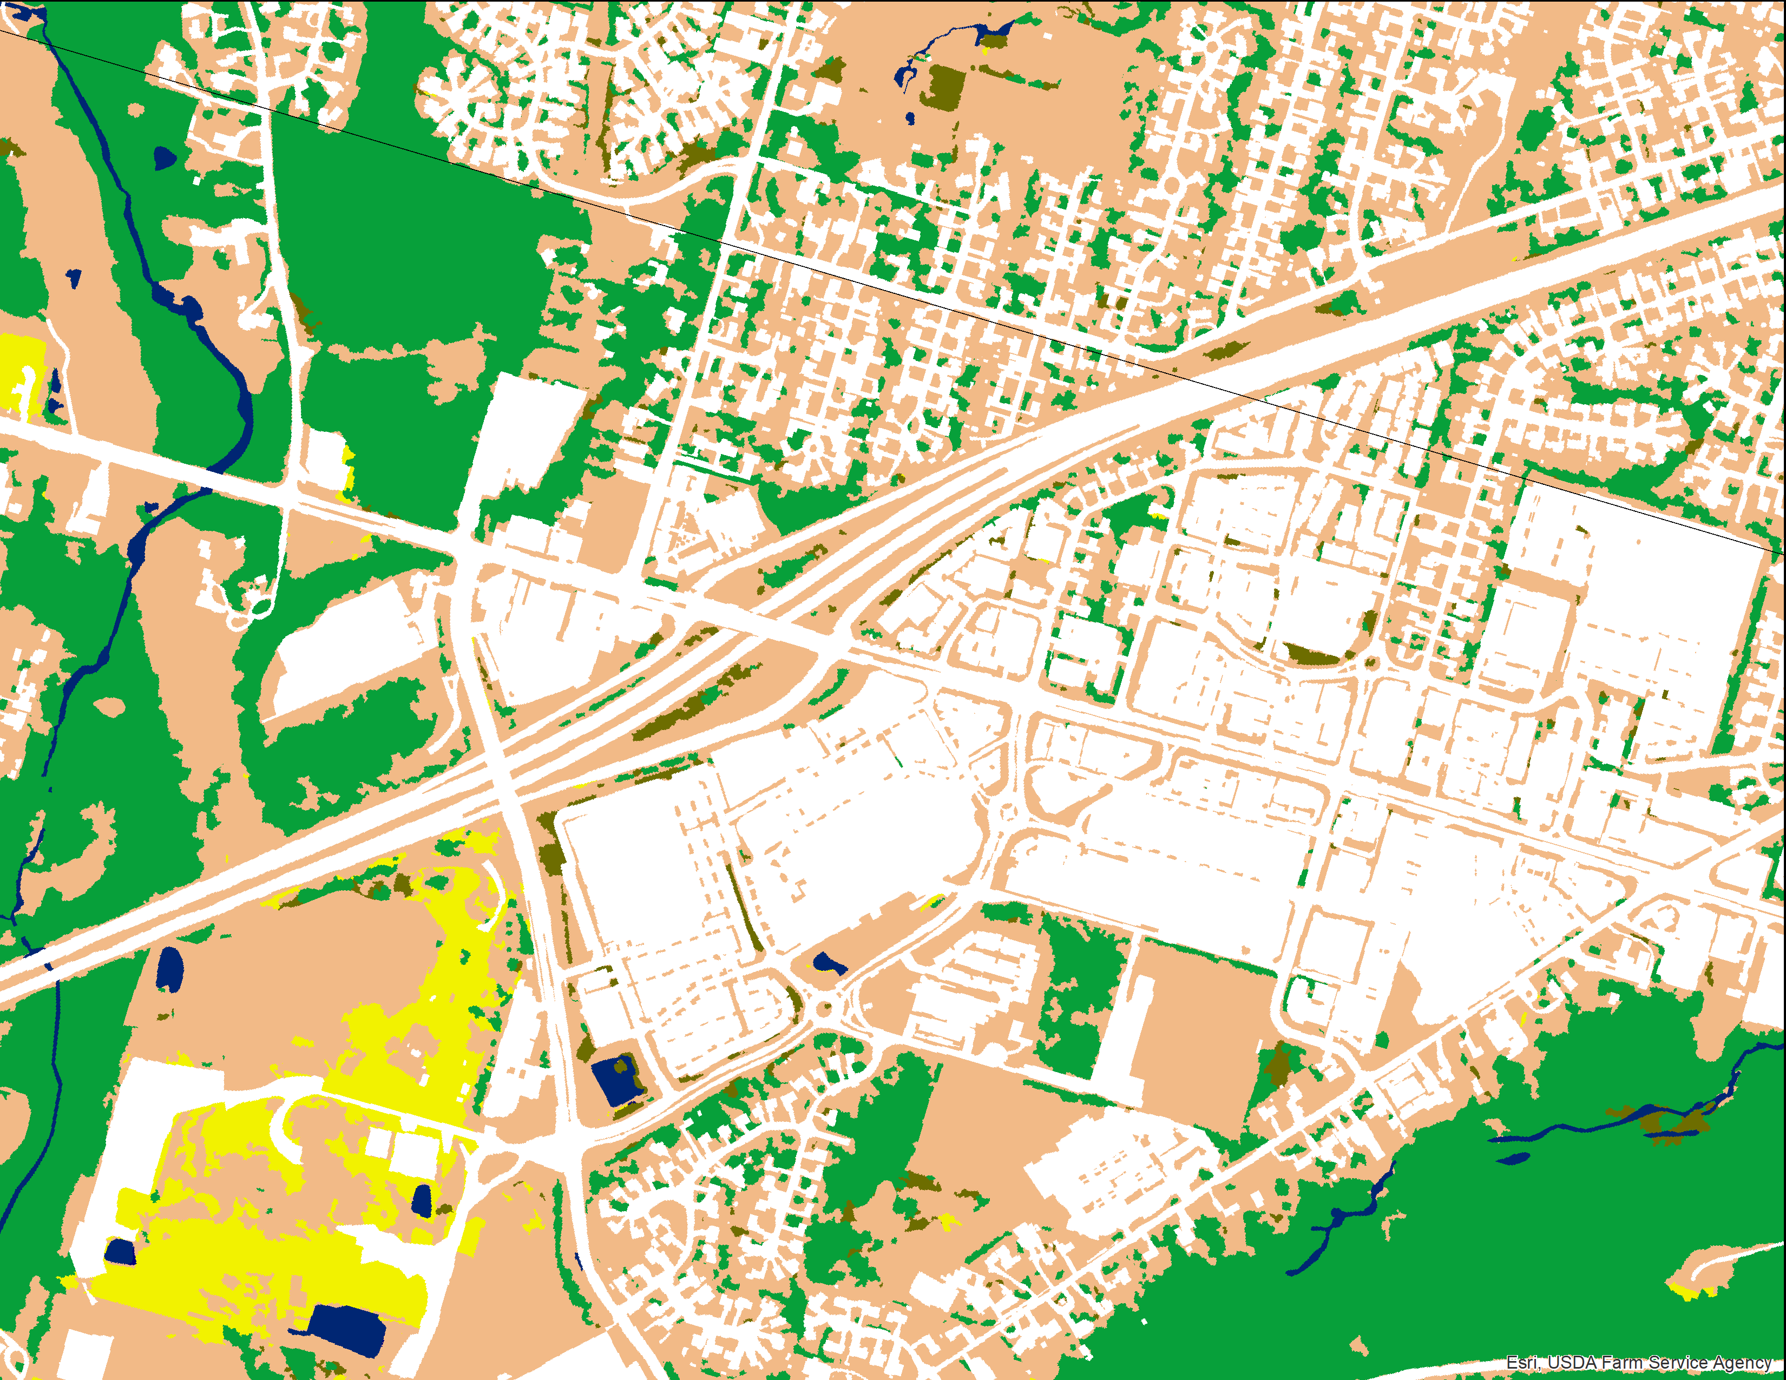
Past and Future C-CAP
2016 Regional C-CAP (30-meter)
2016 C-CAP (1-meter)
Notes:
This example in King County, WA (Seattle area). is highlight as an area currently under development with NOAA and is an example of what a 30 m classification versus a 1 m classification might look like. 1 m impervious surface for the nation could be contracted for $10 million, with NOAA paying half of that. A partner contribution of 5 million would realize this for the nation.

Slide 32
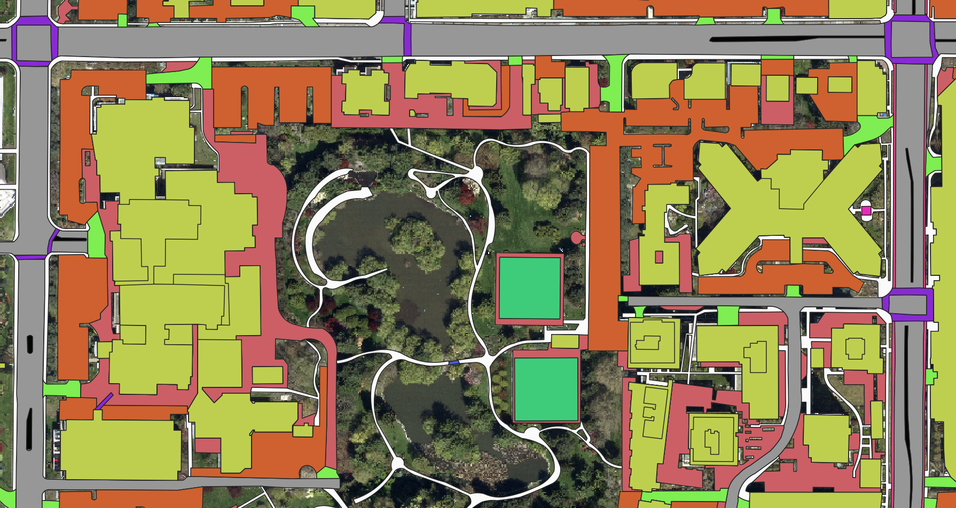
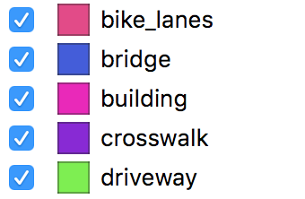
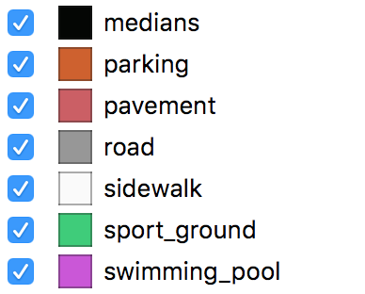
Detailed High Resolution Impervious
Vector Mapping Example
*
*
*
*
* Highlights Categories not seen by NOAA
Notes:
The county is buying into an option that one of our contractors (Ecopia) offers (and we can help facilitate) for a suite of impervious related classes.
6 categories standard, more possible. Can include road, sidewalk, railroad centerlines.
Not perfect (canopy can still cause issue, if there is not leaf off imagery), but very good for automated and a fraction of the standard (manual) cost.
Note that these additional categories can support additional issues/applications that even 1-meter C-CAP cannot.
For instance driveway access for 911 response, walkability studies, etc.

Slide 33
What do we need help with…..
Notes:
We have a lot of places we need support. NLCD puts out 30 times the amount of products we did just a few years ago on the same funding and in ¼ of the timeframe. Support doesn’t mean telling us there’s better ways to do things. Support means funding to get people on board to learn inside our project so that we can have enough time to do research. Research that is needed to both keep up with production of all our current products, along with staying relevant technologically. It also means enough freedom to create new methodologies as we have done in the past consistently. The biggest place we need room to breathe is

Slide 34
Notes:
Alaska.
NLCD is currently overtasked with integration. This changed our five year plan for working up an Alaska remap for 2021 that would be published as close to 2021 as possible. All current research is currently directed toward integration. Alaska is a very difficult place to map. There is scarce imagery, scarce high-res imagery for ground truth, and classes that cannot be discerned from high-res imagery even if it’s available.

Slide 35
Notes:
Alaska mapping requires flights to label ground data, and many days in the field.

Slide 36
Notes:
This work takes patience, a lot of resources, and localize knowledge.

Slide 37
Notes:
It also provides excellent accommodations and first-class meals

Slide 38
Notes:
Many nights, we had lakefront bed-and-breakfast service.

Slide 39
Notes:
It also provides lots of opportunities for photographs that you’d rather not take.

Slide 40
Notes:
NLCD spent

Slide 41
Notes:
Mapping Alaska at Anderson level II for 2021 is a necessity. Landsat collection two will provide an offset of 2 to six pixels from the 2001 classification that is currently the base for Alaska. Alaska needs to be reclassified in much the same way as the lower 48 was for NLCD 2016. This means collection of Anderson level II training, fieldwork, and an accuracy assessment utilizing fieldwork that will likely cost as much as 1/3 to half of the overall budget. This remains a very large risk for degradation of Landcover. It also will be a very large risk for breaking our international agreements with the North American land change monitoring system which relies on our classification for this. NLCD has not had dedicated Alaska funding in 15 years. I also want to remind again that any product using NLCD for training can only be as accurate as NLCD, and with imagery mismatch will likely suffer classification errors.

Slide 42
Research and integration
Augmented machine learning
Hi-res
Cross project integration
Notes:
The last thing I want to touch on is our research and integration going into the future. We currently are exploring neural nets and other algorithms to more efficiently integrate and extrapolate our data products. We started this for impervious surface with promising results, and hope to move to it for Landcover classifications . We recently published all of our NLCD code on to get hub, and are working towards open source algorithms for future NLCD work.

Slide 43
Sentinel Left, Landsat right
Notes:
NLCD will be exploring a prototype using Sentinel 10 m imagery to map Landcover. The additional features able to be delineated are fairly evident here. This will only be a prototype to gauge interest, but could have promise. NLCD would have to rely on compositing for creation of this imagery, and the source for that does remain elusive with Google Earth engine not available to the USGS.

Slide 44
Sentinel Left, Landsat right

Slide 45
Notes:
The largest priority handed down to us is integrating NLCD as above

Slide 46
Notes:
With land fire

Slide 47
Notes:
And lcmap.

Slide 48
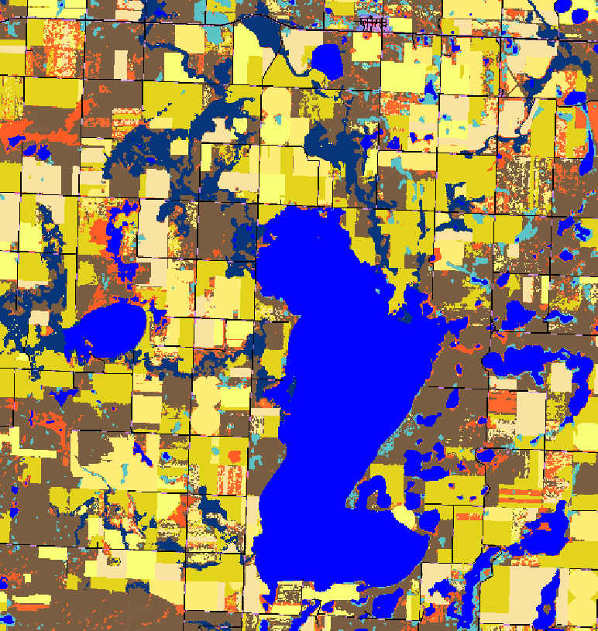
Notes:
Jumping right into some thoughts on this, above is North Dakota with NLCD on the left and land fire on the right. With land fires release of their 2016 products, both NLCD and land fire have a nearly common base in almost all areas.

Slide 49
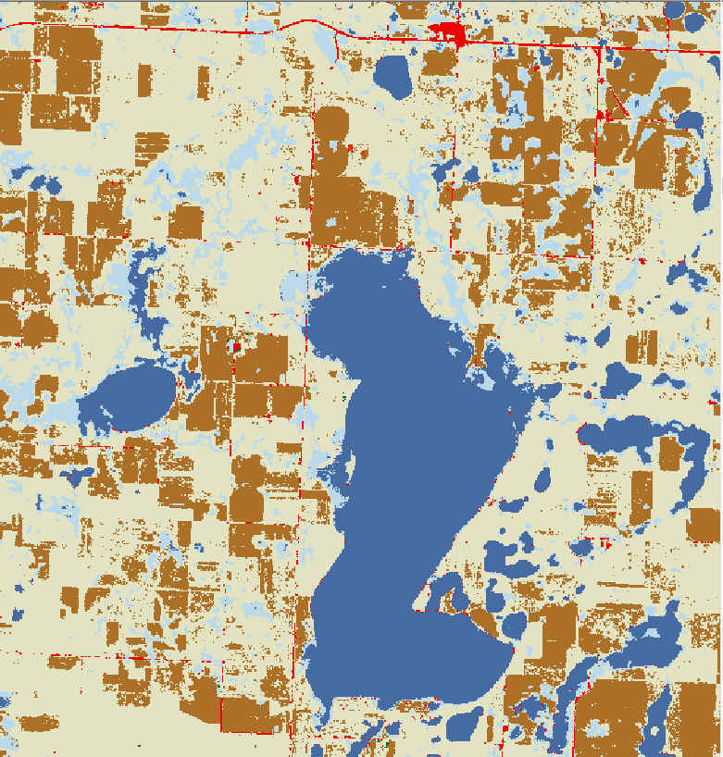
Notes:
Above is NLCD and lcmap, and these have a fairly common area when accounting for the difference in class structure between Anderson level I and Anderson level II

Slide 50
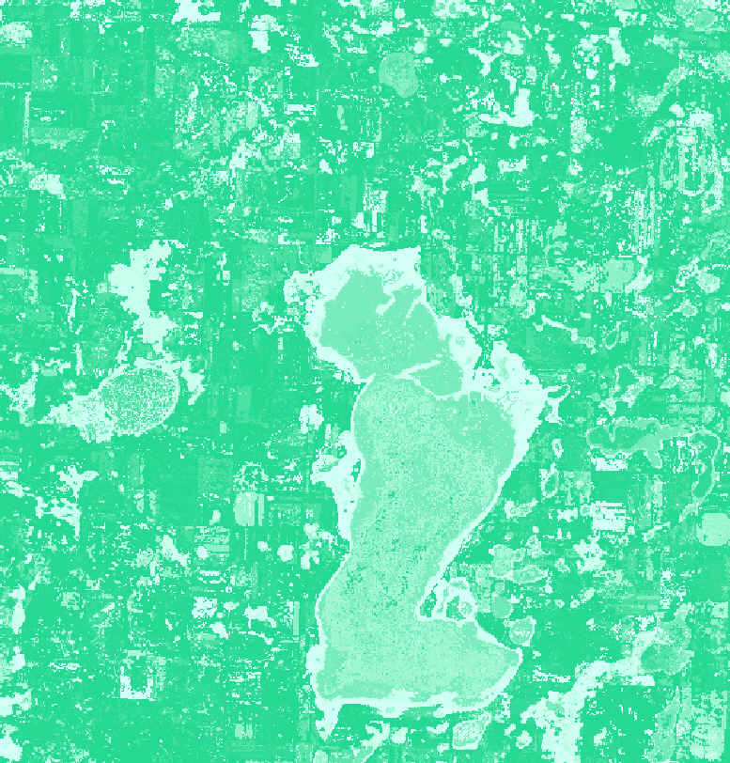
Notes:
NLCD will likely be using lcmap’s change detection to revisit our change classes throughout the spread of NLCD years. We hope to also use many of the additional change features like the one shown above, spectral stability to augment our Anderson level II classes.

Slide 51
Notes:
Moving to this area in Texas, will walk through the three products again

Slide 52
Notes:
NLCD

Slide 53
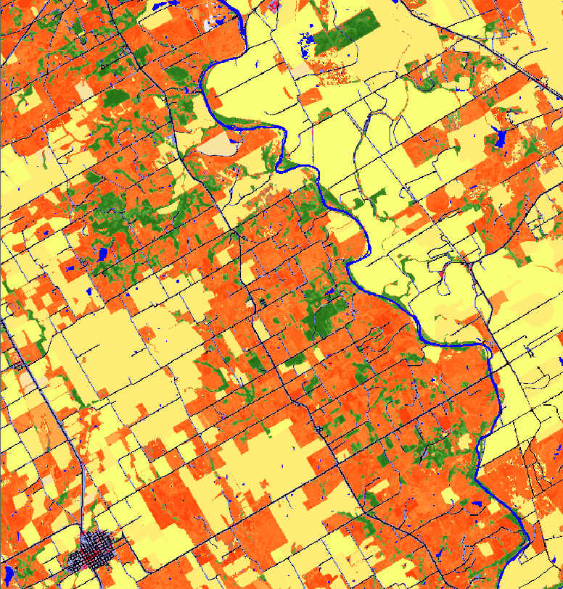
Notes:
NLCD and land fire, which share nearly the same area

Slide 54
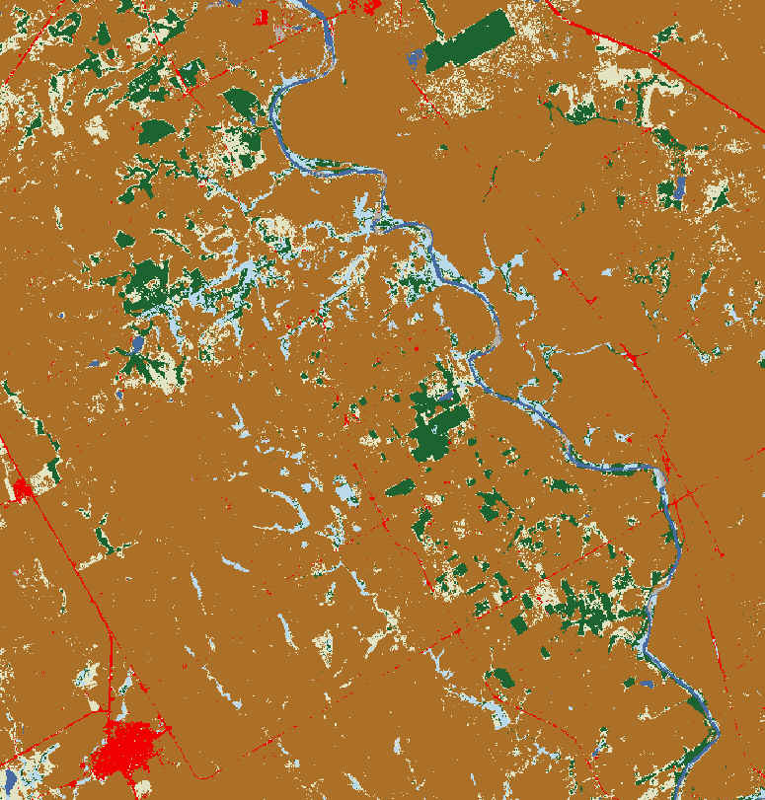
Notes:
And NLCD and lcmap. You can see the difference with Anderson level II class of a pasture and yellow for NLCD.

Slide 55
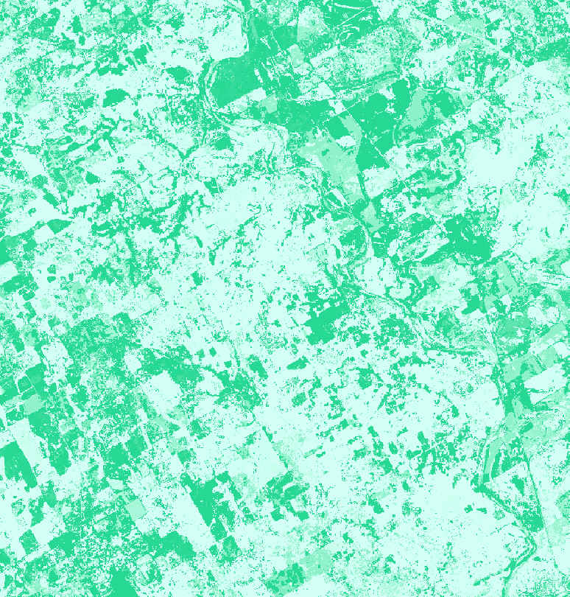
Notes:
With the addition of theLCMAP spectral stability, the same he pasture areas tend to correspond very well.

Slide 56
Notes:
Moving onto the last area highlighted in Utah, I want to highlight the real difference between our three classifications. This is definitions.

Slide 57
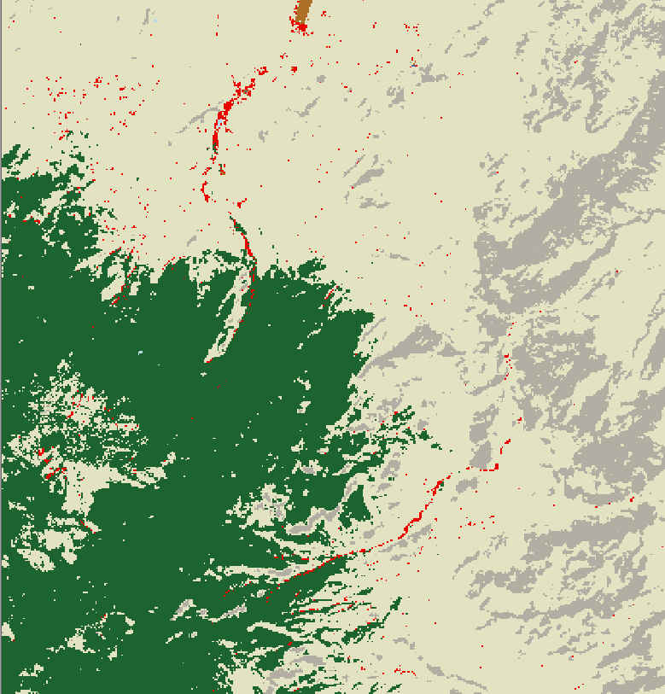
Notes:
Looking at the comparison between NLCD and lcmap, LCMAP shows much more Baron than NLCD.

Slide 58
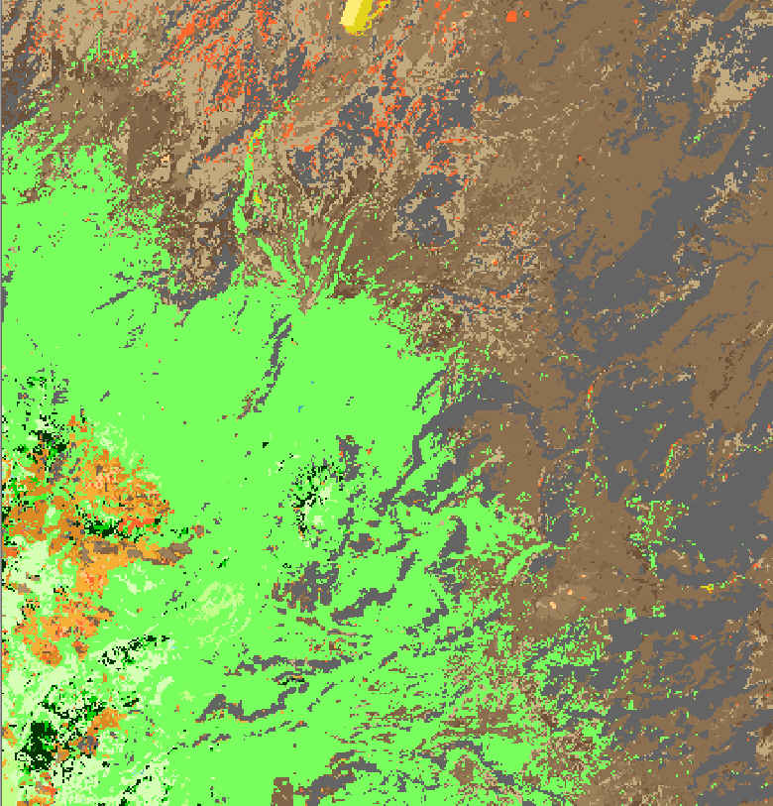
Notes:
This barren closely matches land fires class over the same area. This is also represented by a very dark charcoal.

Slide 59
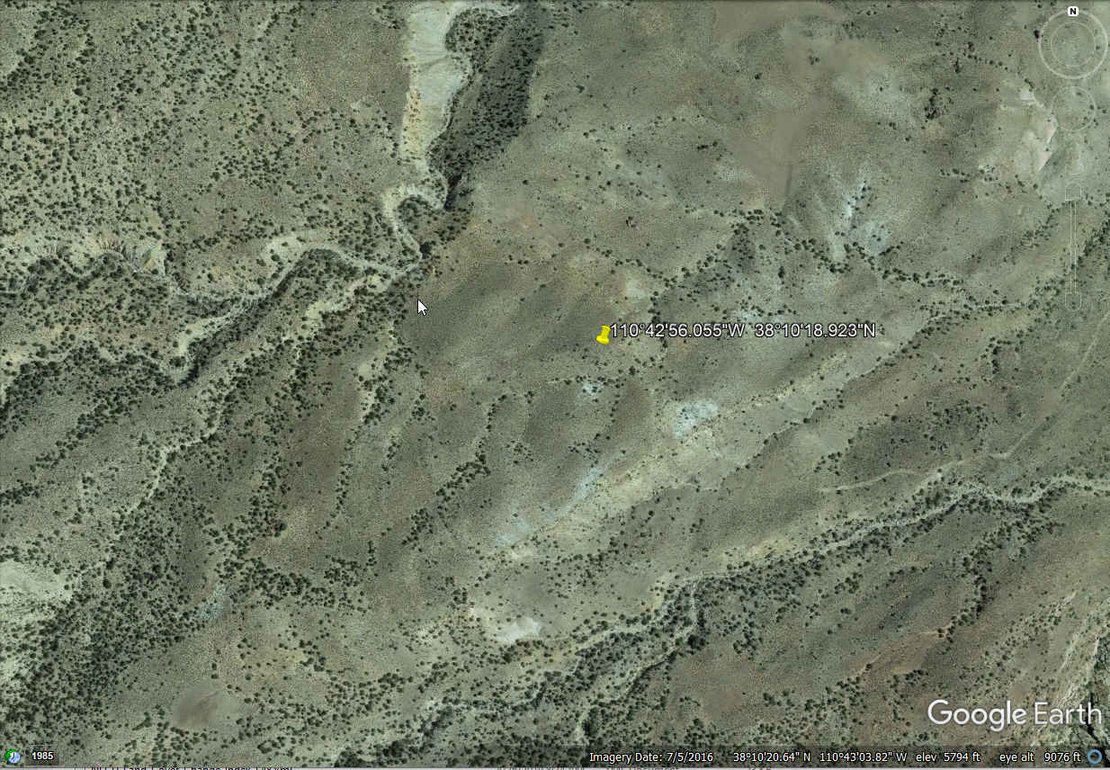
Notes:
This is the area I’ve zoomed into and will focus on for this comparison. NLCD relies on our rangeland mapping products to distinguish forest from grass, shrub, and Baron. You can see in this area that there is sparse shrub and that shrub is represented in tan by NLCD.

Slide 60
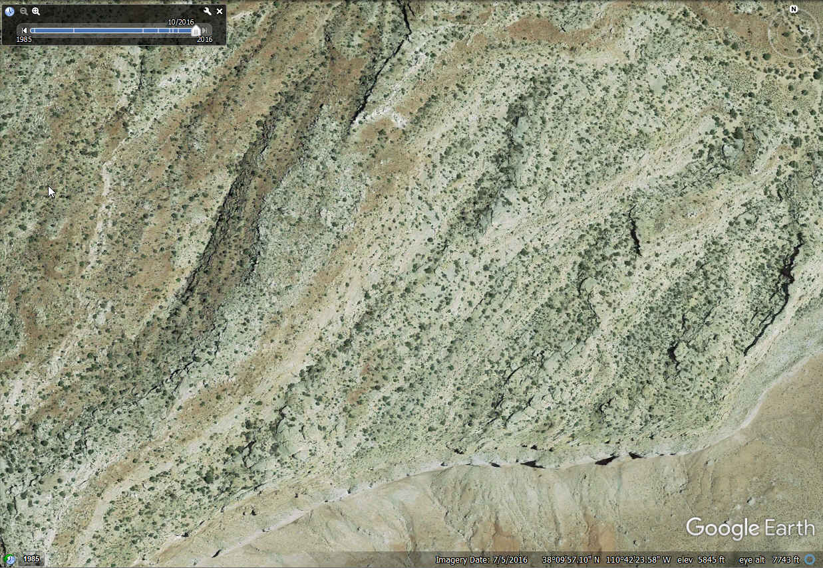
Notes:
This area is particularly bright spectrally, and likely lacks as much herbaceous vegetation as the surrounding area. This likely meets lcmap’s definition for Baron. Following our range land mapping, there is enough shrub that it does not meet a barren definition.

Slide 61
Notes:
The same area shown in land fire.. The charcoal class is labeled sparsely vegetated Colorado Plateau mixed bedrock canyon and tableland. This seems appropriate.

Slide 62
Notes:
This barren closely matches land fires class over the same area. This is also represented by a very dark charcoal.

Slide 63
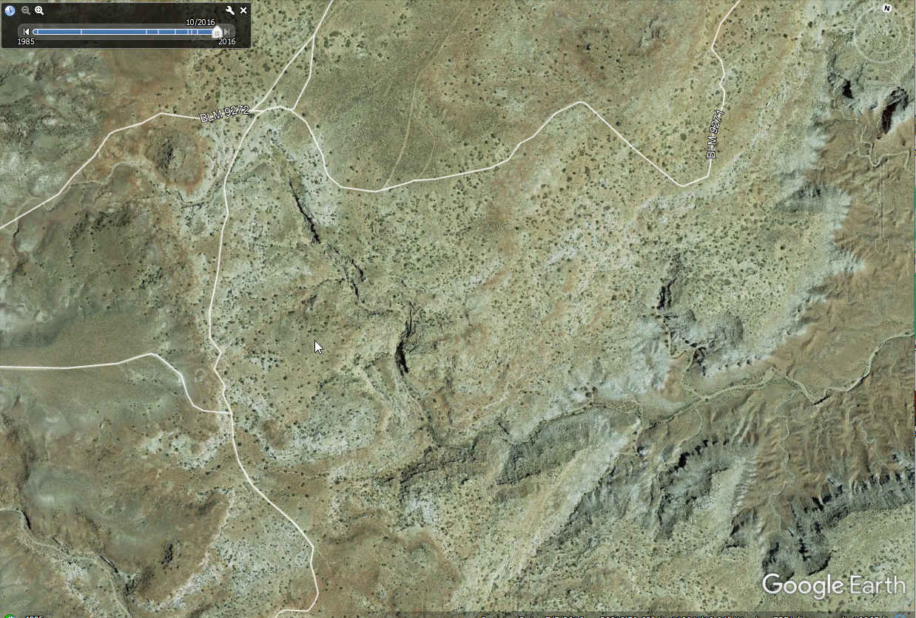
Notes:
Looking at lcmap in the same area, it again likely reaches the definition of Baron. With our rangeland mapping, it did not fall to the amount of Baron needed.

Slide 64
Notes:
Looking at landfire in the same area, this again corresponds well with the mapped definition. With our rangeland mapping, it did not fall to the amount of Baron needed.

Slide 65
Notes:
Looking at forest cover, which are represented by the greens in both images, land fire has a greater extent of forest. This is also definitionally different. Land fire maps these areas and labels them explicitly in their EvC, existing vegetation cover, as 10 to 20% forest. NLCD requires 20% to be called forest.
Land fires mapping methodology and consistency has dramatically improved with their 2016 release. NLCD currently used land fires previous classes for some distinction between our shrub and forest transition in rangeland areas. With land fire and NLCD using a common developed area, very similar agricultural areas, and consistently mapped rangeland and forest areas, NLCD will focus on trying to integrate or more closely resembling landfire features.

Slide 66
Notes:
Likewise, there are many pieces of lcmap that would complement NLCD with some research. This includes robust change detection, and areas of both agriculture and forest that are more accurate where high change occurs. These will also be a focus for 2021 research for integration.

Slide 67
Summary
NLCD production is relatively on track for an on-time release with a year turnaround
NLCD is setting production up for a relatively quick turn around on a 2021 product using lessons learned with the 2019 release
NLCD continues to incorporate additional data sets and improve the efficiency of production, along with continued partnership collaboration
NLCD processing remains nimble and efficient and will continue to utilize the most efficient landcover production methods available

Slide 68
Thank you!
Questions?
Dewitz@usgs.gov

Slide 71
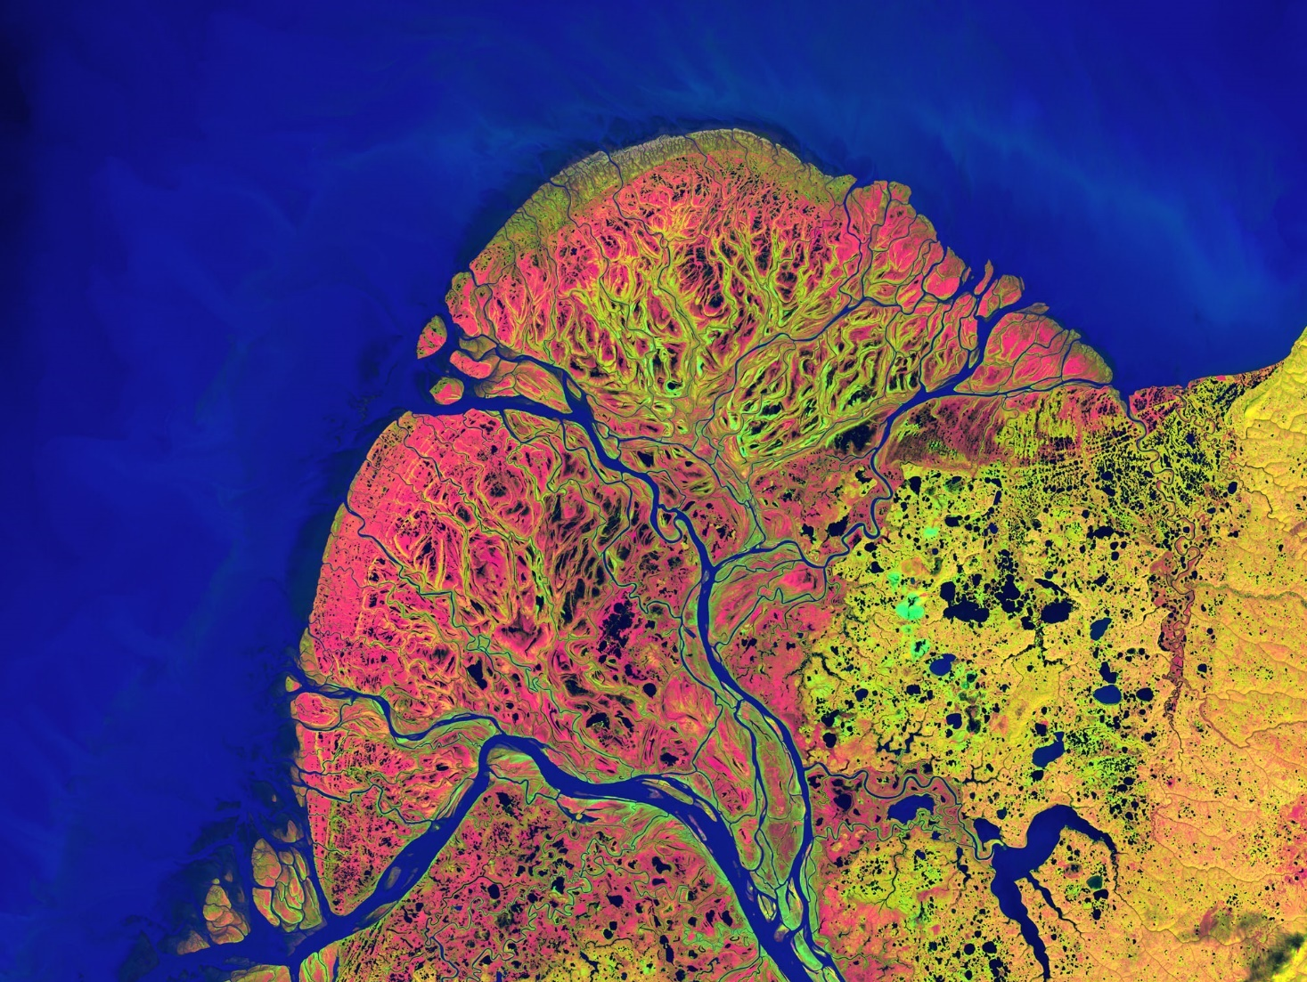
Deep learning on the Landsat archive: challenges, opportunities and promising early results
Giorgos Mountrakis, Professor, SUNY ESF
Shahriar Heydari
Yukon Delta in southwest Alaska: river's sinuous waterways seem like blood vessels branching out to enclose an organ. (Credit: NASA's Goddard Space Flight Center/USGS)
Notes:
71

Slide 72
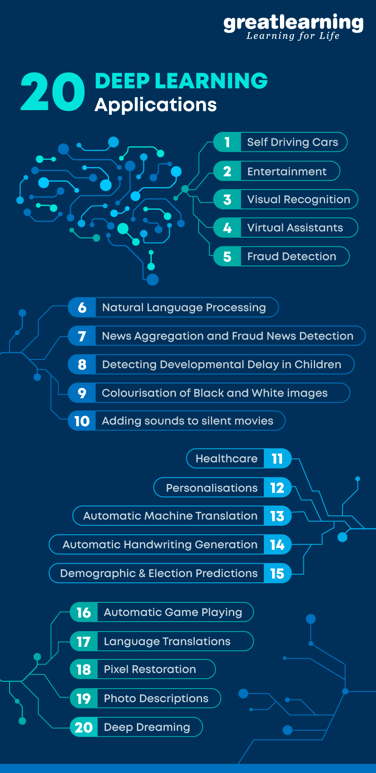
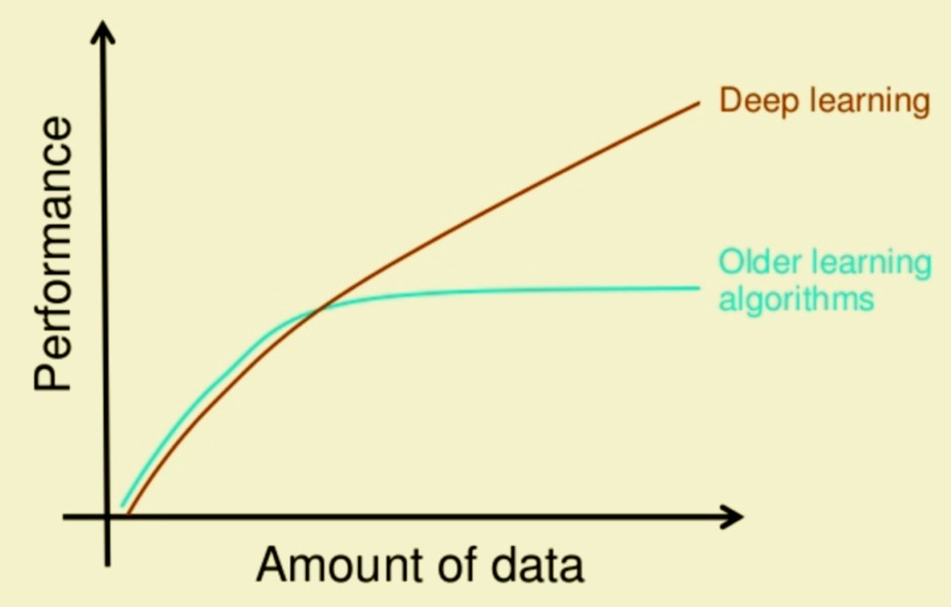
Deep Learning: Promise
Big Data Volumes
+
Higher algorithmic complexity
->
Improved results
https://www.mygreatlearning.com/blog/deep-learning-applications/
Notes:
72

Slide 73
Problem: Small reference datasets are reaching accuracy saturation
Solution: Our lab has spent two years manually digitizing millions of LCLU reference pixels
73
Notes:
Map shows 85 ecoregions but we had 84 ecoregions worked on.
73

Slide 74
Reference dataset generation
Class
Water
Impervious
Grass/Shrub
Forest
Bare
Cultivated
Wetlands
74
Notes:
74

Slide 75
Reference dataset generation
Class
Water
Impervious
Grass/Shrub
Forest
Bare
Cultivated
Wetlands
Fundamental foundational mapping problem, great classification algorithm, NO landcover definitions, NO true training evaluation criteria, NO useful foundation to improve knowledge of Natural systems, just run and done.
75
Notes:
75

Slide 76
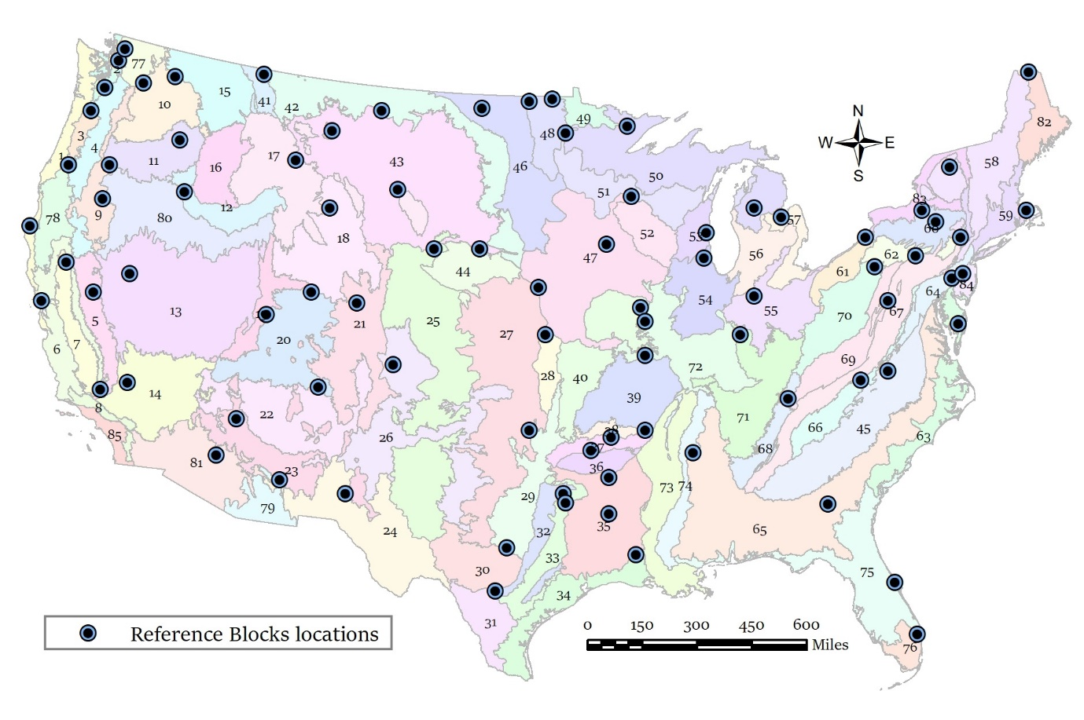
Reference dataset generation
84 USGS land cover trends 333x333 pixel blocks, one block per ecoregion
76
Notes:
Map shows 85 ecoregions but we had 84 ecoregions worked on.
76

Slide 78
Four Pillars of NLCD Land Cover
Spectral Analysis (ARD pixels)
Partner Data (specialized Land Cover)
Shape and Context
Succession And Trajectory

