Slide 1
USGS Data and Tools for Wildfire Preparedness, Response, and Recovery
Kurtis Nelson
USGS Earth Resources Observation and Science Center
Sioux Falls, SD

Slide 2
USGS EROS Wildland Fire Science Team
Birgit Peterson – Geographer
  PI, lidar, fuels research, fire response
Kurtis Nelson – Physical Scientist
  Burn severity, fuels research, fire danger, fire response
Jennifer Rover – Geographer
  Burn severity, SAR, fuels research
Jon Dewitz – Geographer
  LANDFIRE
Josh Picotte – Biologist
  LANDFIRE, burn severity, fuels research
Chris Woody – Physical Scientist
  Fire danger, fuels research, fire response

Slide 3
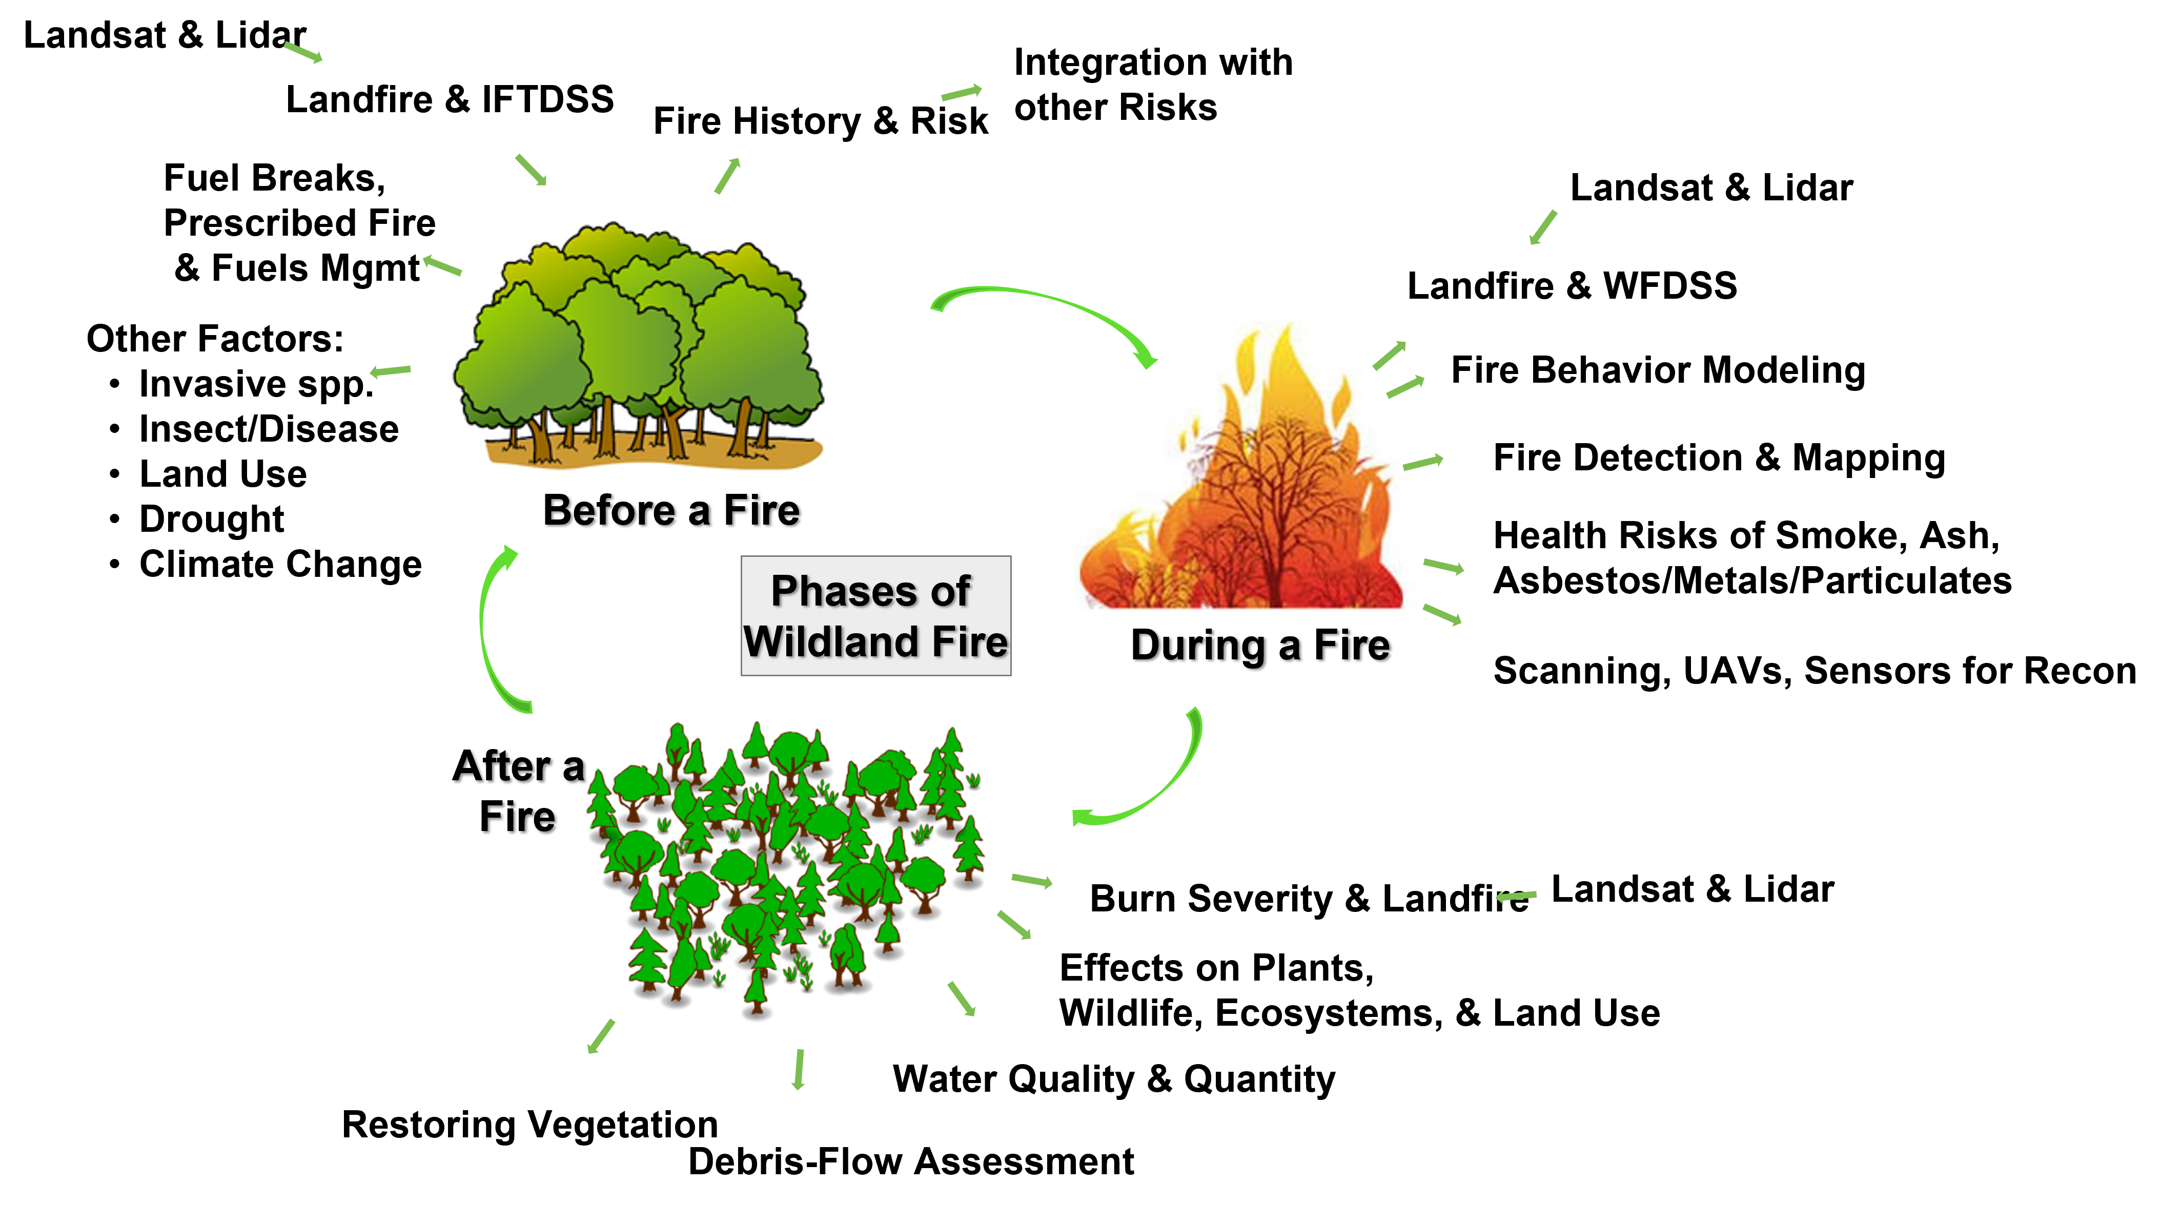
Phases of Fire
Source: P. Steblein, USGS

Slide 4
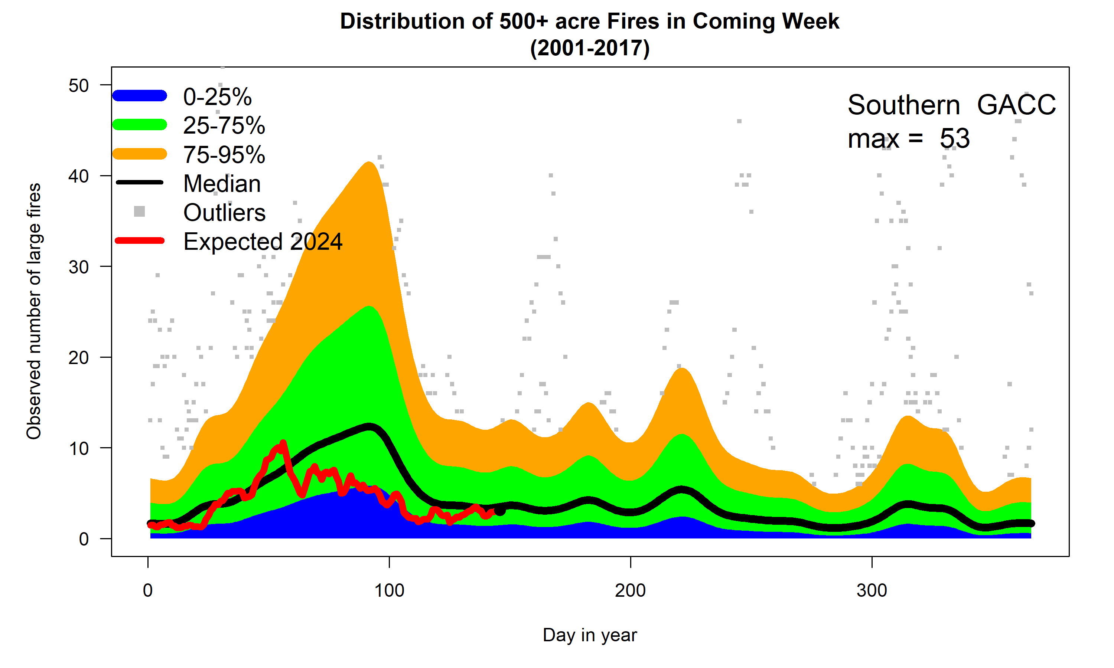
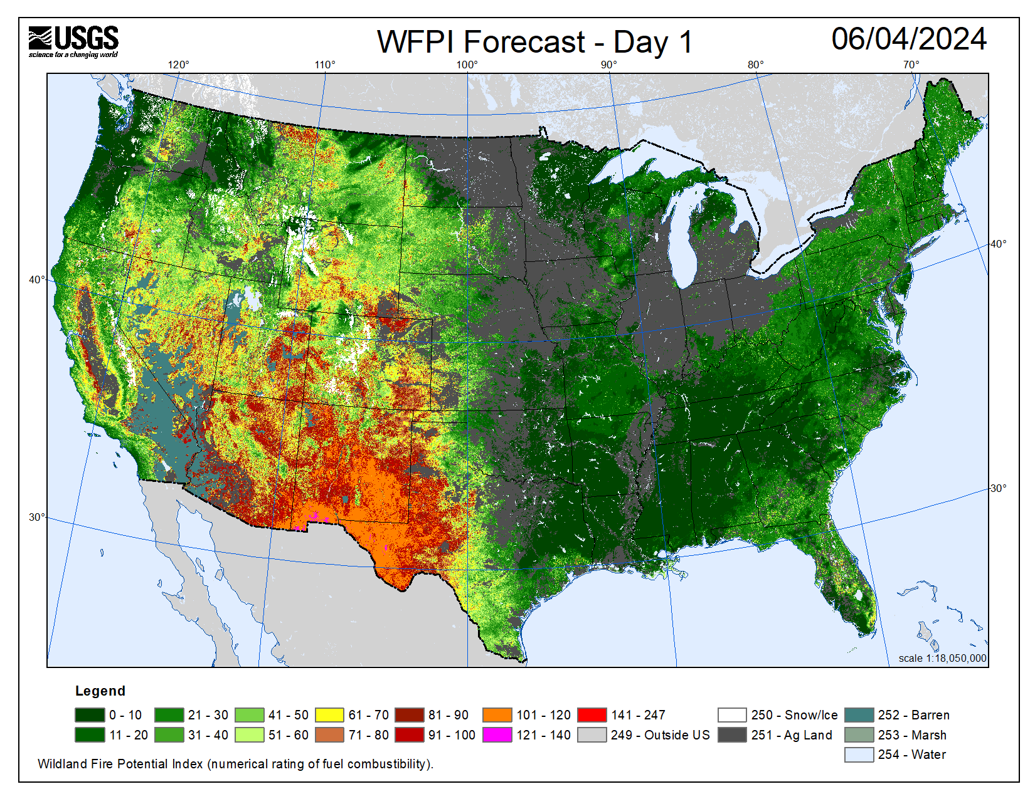
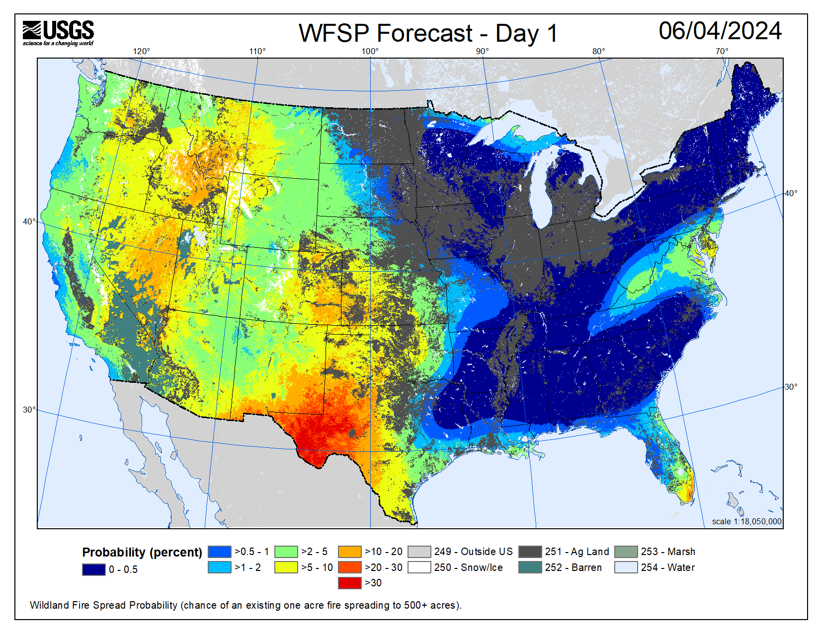
Before a Fire
Fire Danger Forecast
  Large fire potential
  Daily 7-day forecast
  1km resolution
  CONUS domain
  20+ year archive
https://www.usgs.gov/fire-danger-forecast

Slide 5
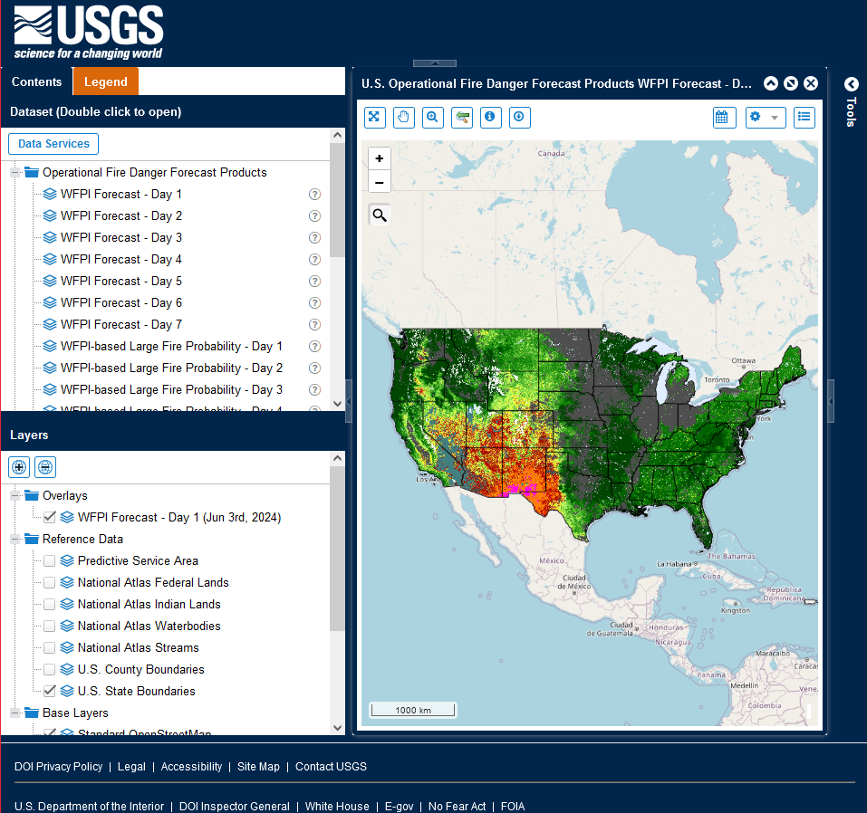
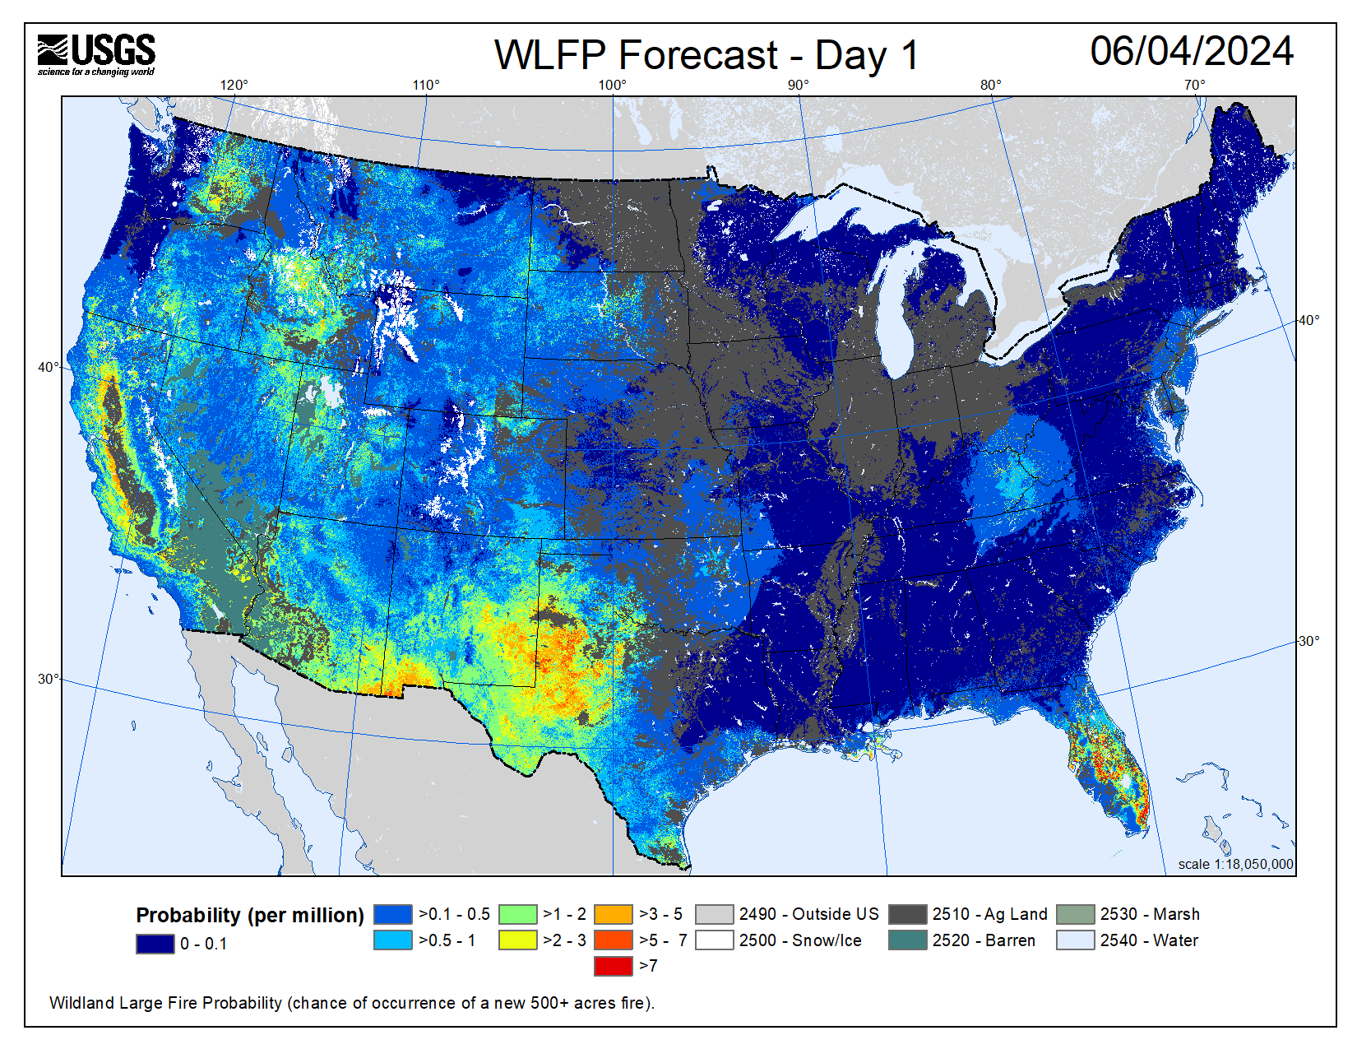
Before a Fire
Fire Danger Forecast
  Large fire potential
  Daily 7-day forecast
  1km resolution
  CONUS domain
  20+ year archive
https://www.usgs.gov/fire-danger-forecast

Slide 6
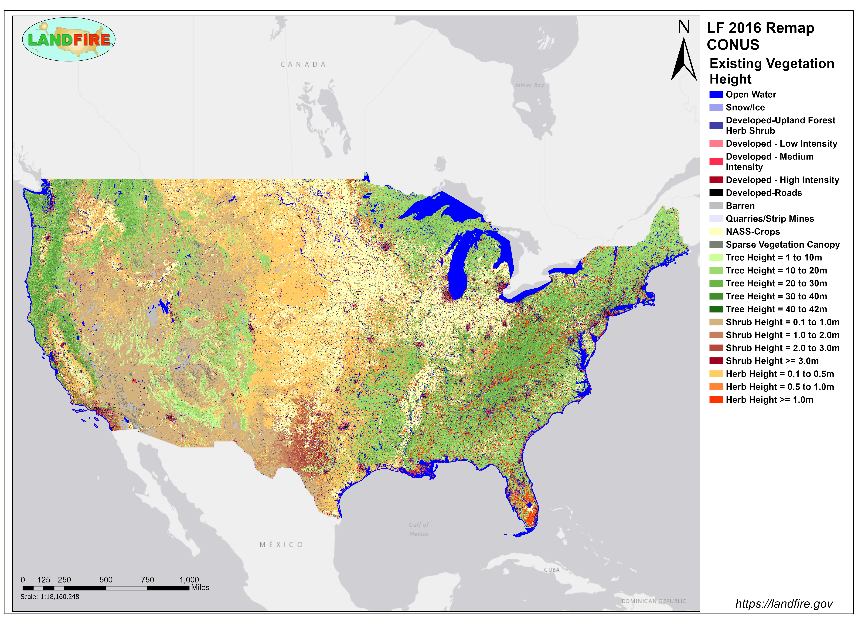
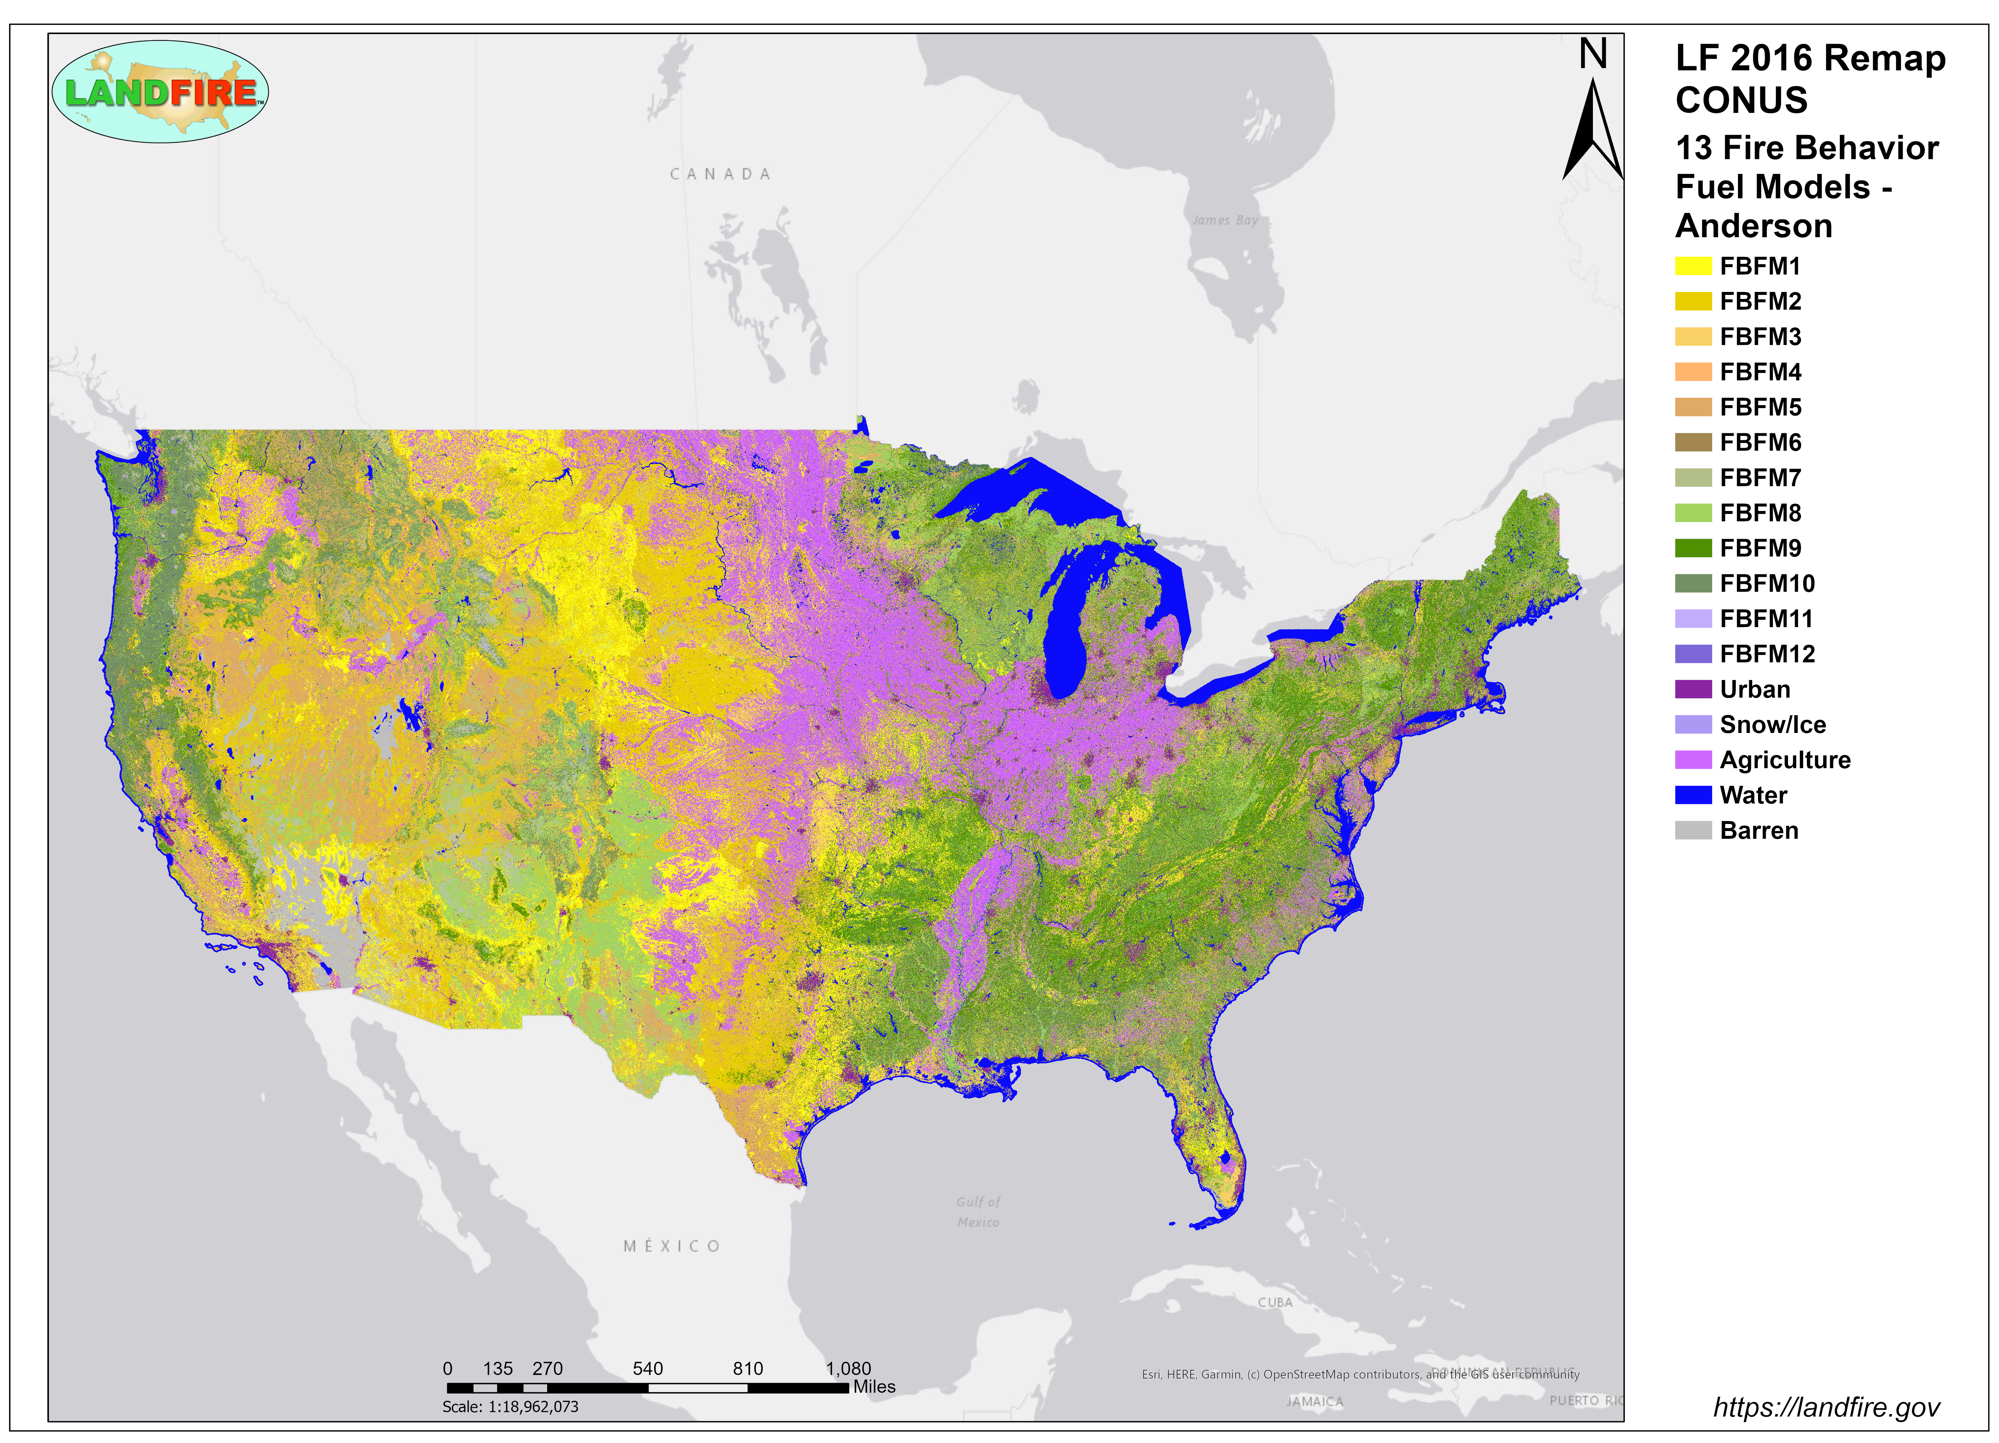
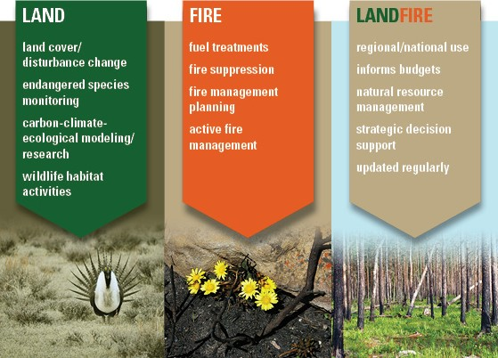

Before/During a Fire
https://www.landfire.gov
LANDFIRE
  46 total products
  30m resolution
  50 states + insular areas
  Annual updates

Slide 7
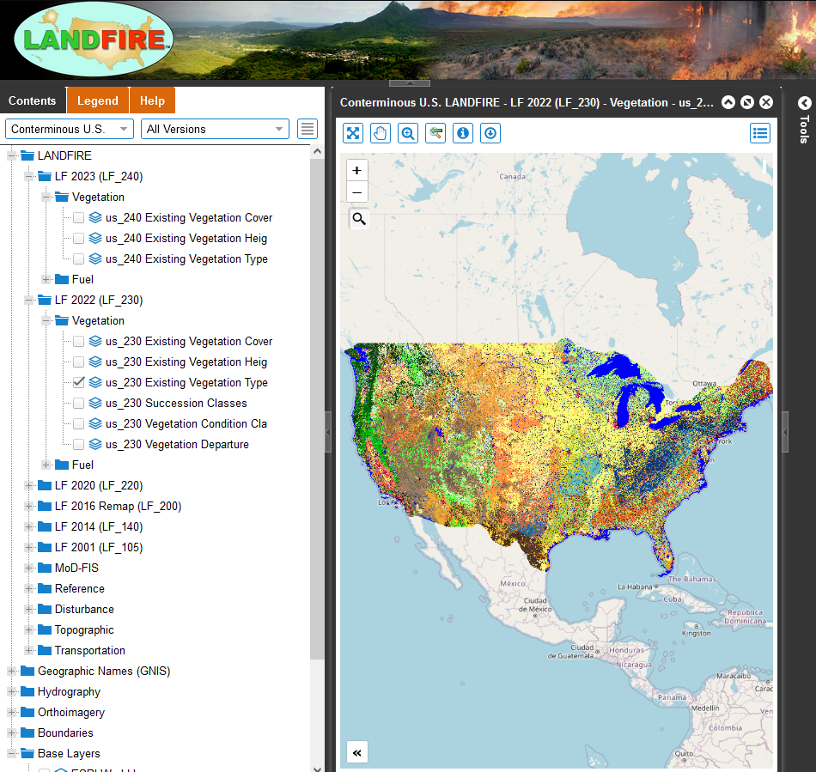
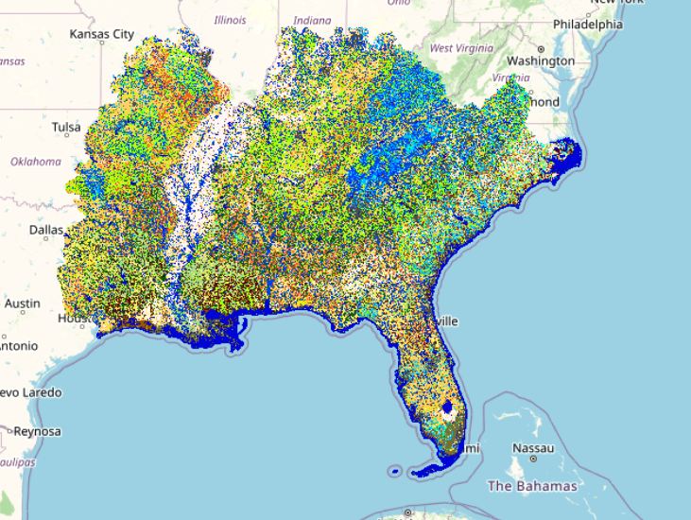
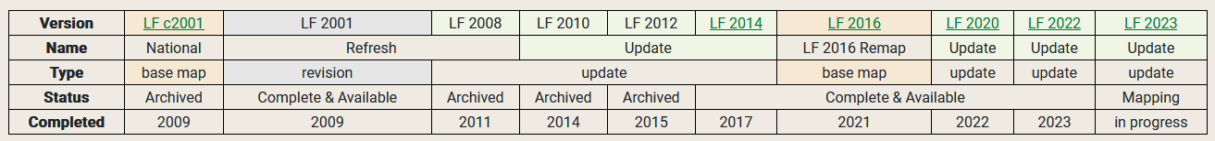
Before/During a Fire
https://www.landfire.gov
LANDFIRE
  46 total products
  30m resolution
  50 states + insular areas
  Annual updates

Slide 8
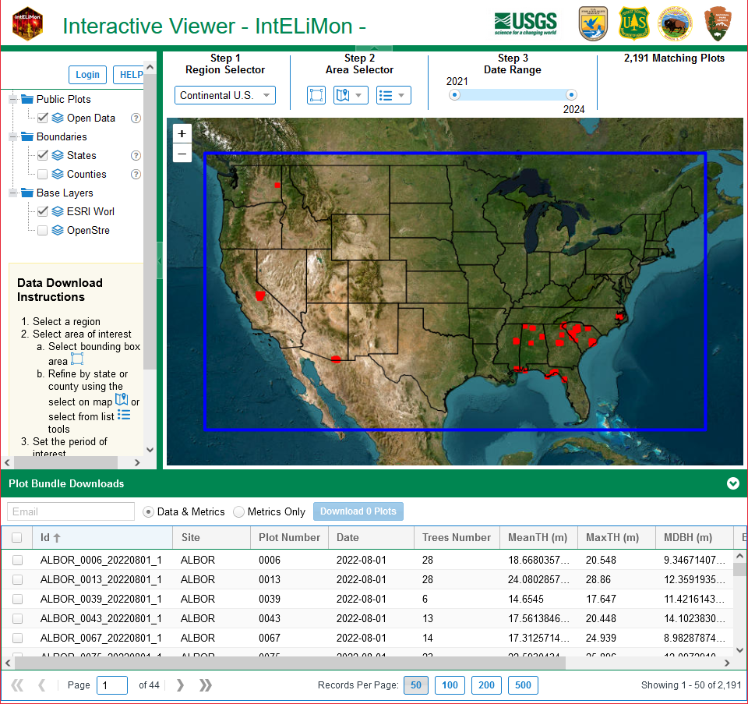
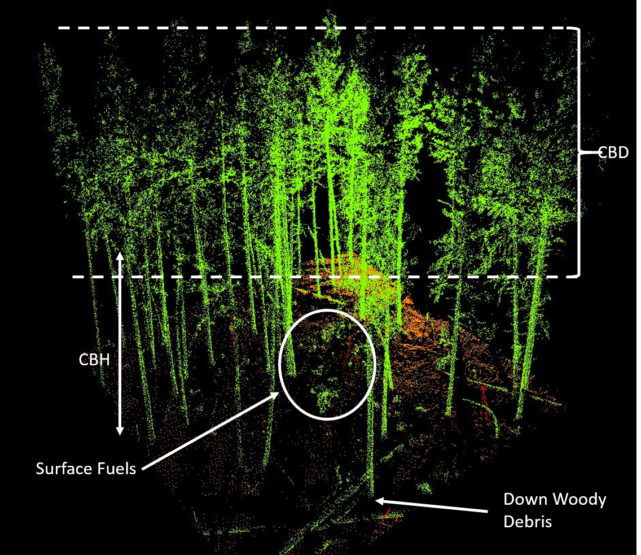
Before/After a Fire
https://dmsdata.cr.usgs.gov/lidar-monitoring/viewer/
IntELiMon
  Characterize 3D fuels
  Support next generation fire modeling
  Monitor fuel treatments over time

Slide 9
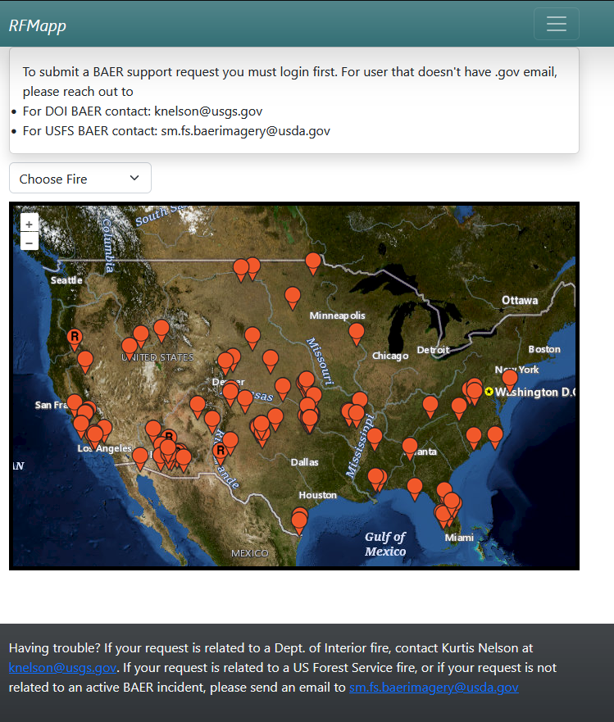
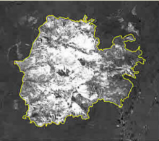
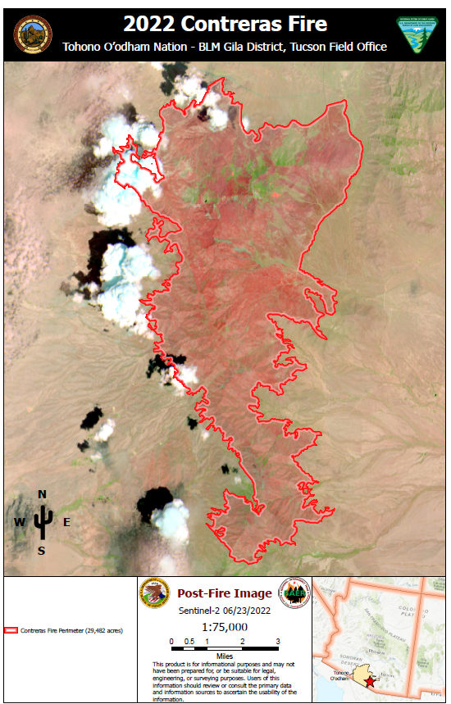
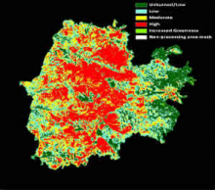
After a Fire
https://burnseverity.cr.usgs.gov/products/baer
Burned Area Emergency Response
  Emergency stabilization
  Burned area rehabilitation
  Burn severity mapping support

Slide 10

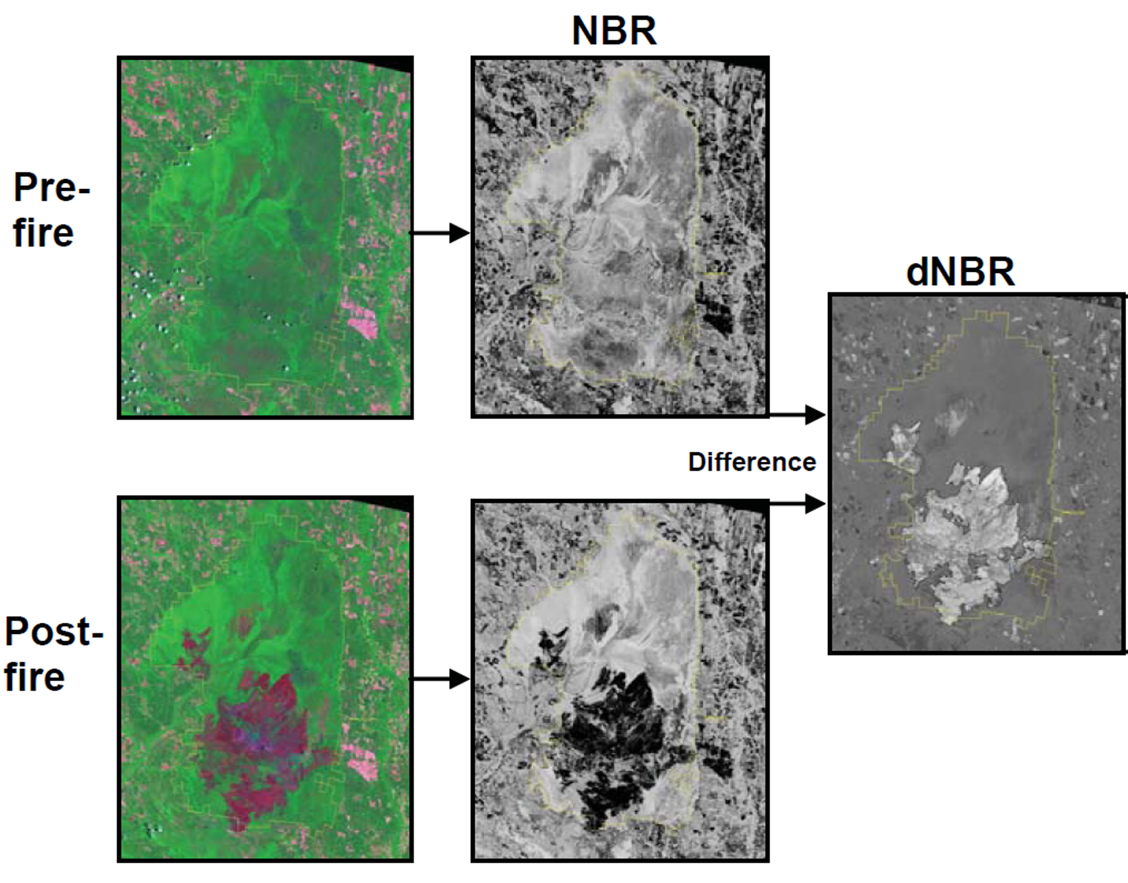
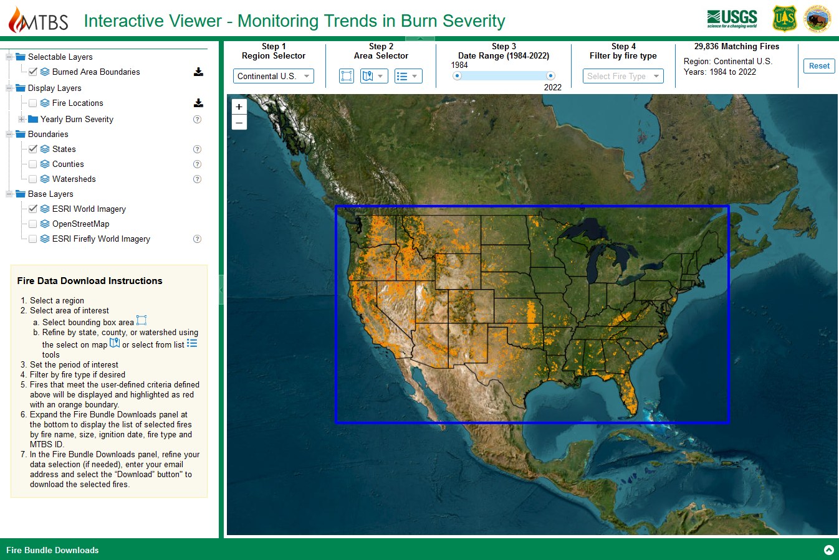
After a Fire
https://www.mtbs.gov
Monitoring Trends in Burn Severity
  Historical fire perimeters
  Burn severity
  All large fires in US, 1984-present

Slide 11
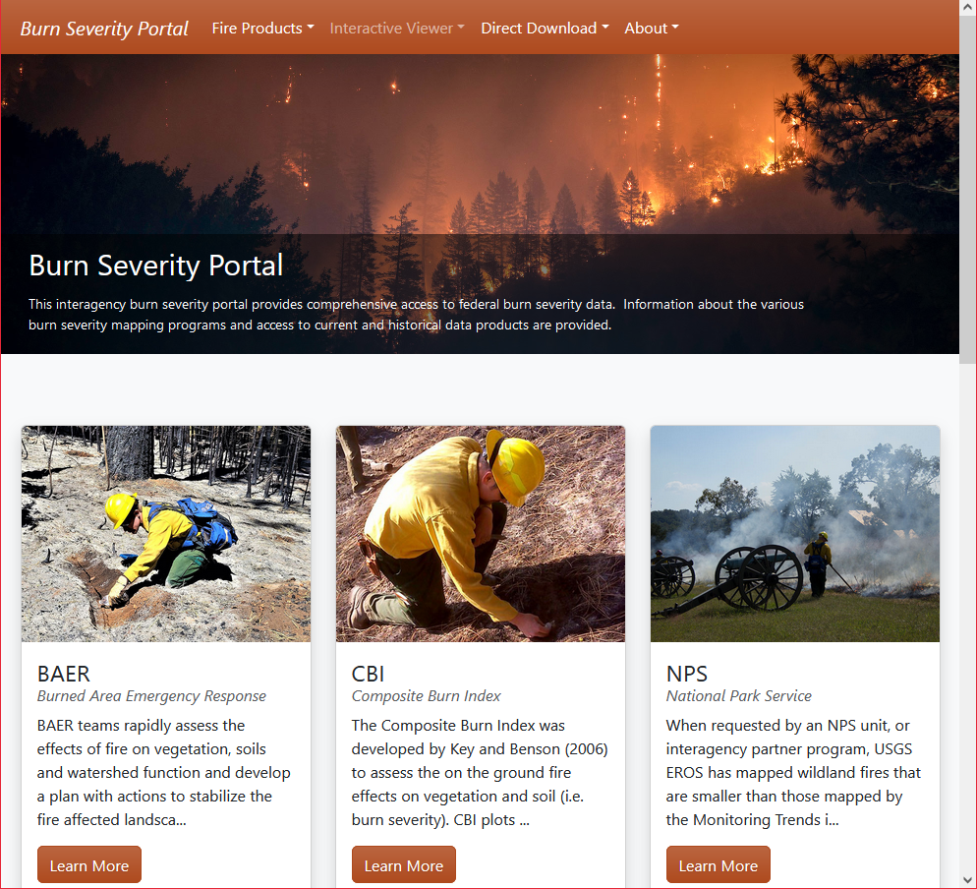
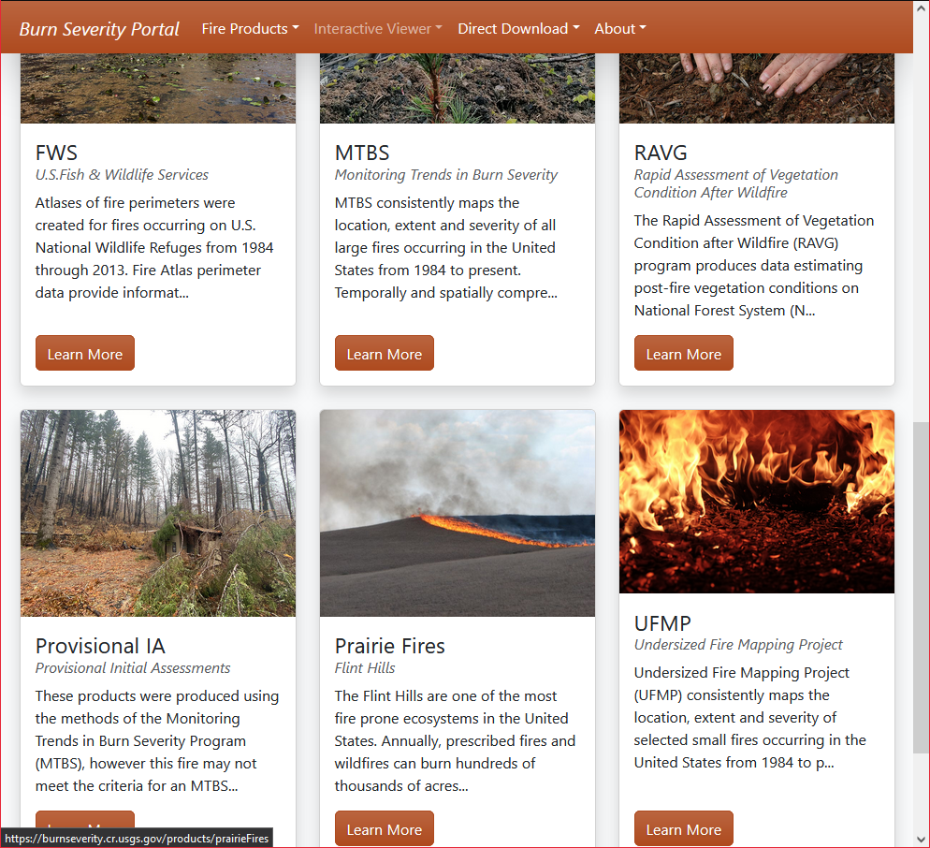
After a Fire
Burn Severity Portal
  Interagency collaboration
  Access to multiple fire mapping programs
https://burnseverity.cr.usgs.gov

Slide 12
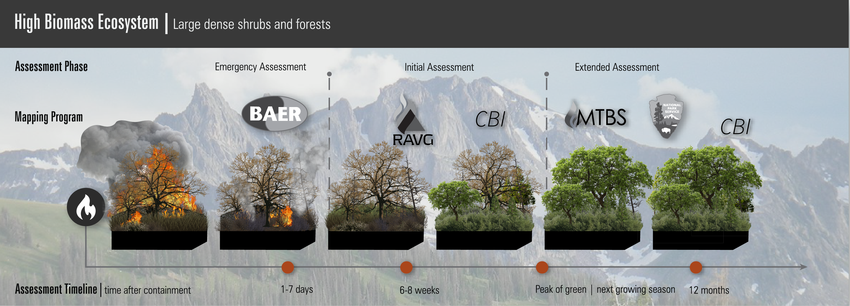
After a Fire
Burn Severity Portal
  Interagency collaboration
  Access to multiple fire mapping programs
https://burnseverity.cr.usgs.gov

Slide 13
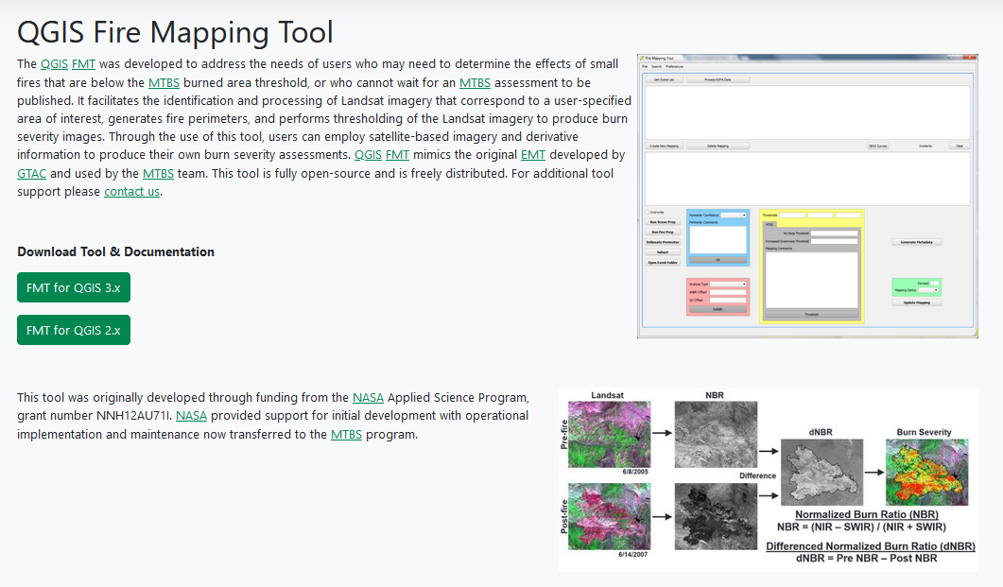
After a Fire
https://mtbs.gov/qgis-fire-mapping-tool

Slide 14
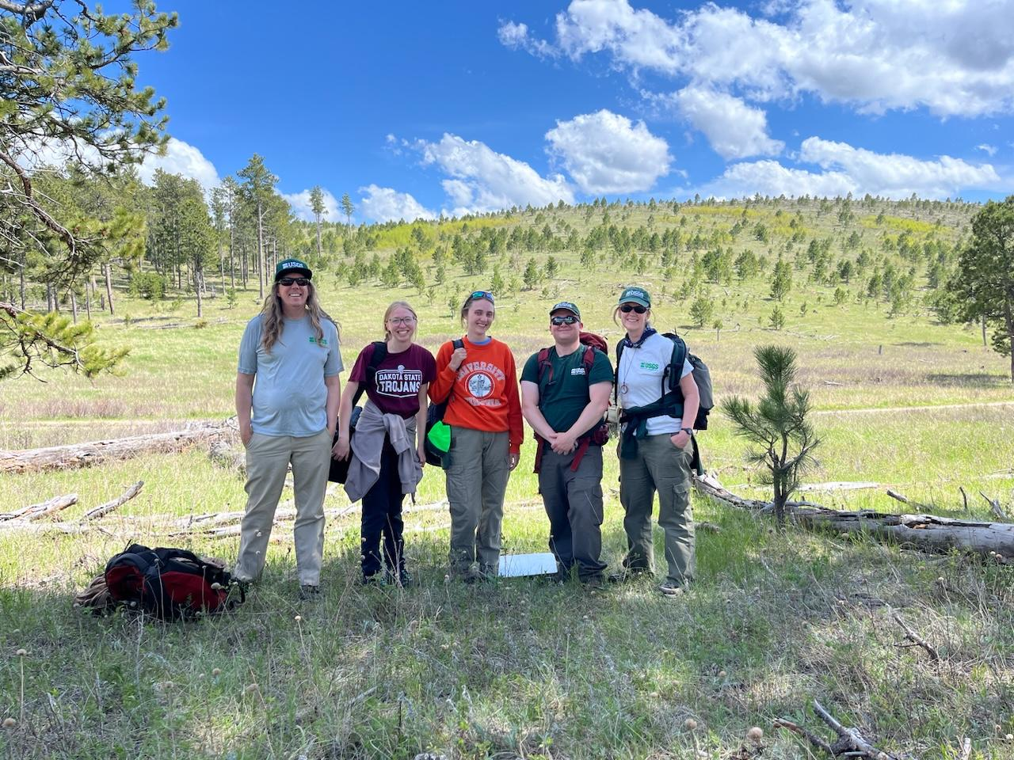
Questions – knelson@usgs.gov

