Slide 1
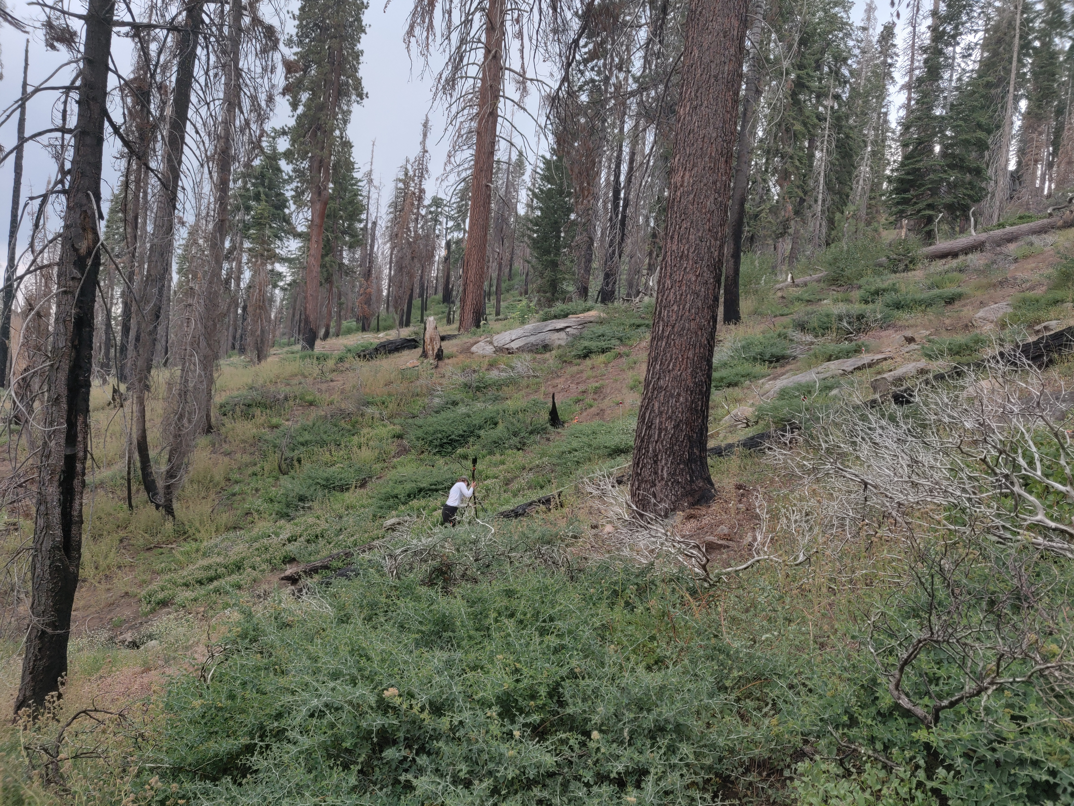
Leveraging Cross-Scale Lidar: Scaling Vegetation Structure Metrics Between Terrestrial Lidar and GEDI Observations for Wildfire Applications
Birgit Peterson, Josh Picotte, Grace Parrott, Kurtis Nelson
US Geological Survey, Earth Resources Observation and Science Center
Hazel Mebius, Katelyn Woolfrey
KBR – contractor to US Geological Survey

Slide 2
What we have
Lots of stuff
Not much stuff
Notes:
Typical of the 2-dimensional view we have of the world and its vegetated surface, typically achieved through the interpretation of passive optical data. Works relatively well and reliably for showing how much vegetative “stuff” there is in a given location

Slide 3
What we need
?
Notes:
But, what we don’t know is how the stuff is arranged. Do we have lots of little stuff? Tall stuff? Is it a more complex mixture?

Slide 4
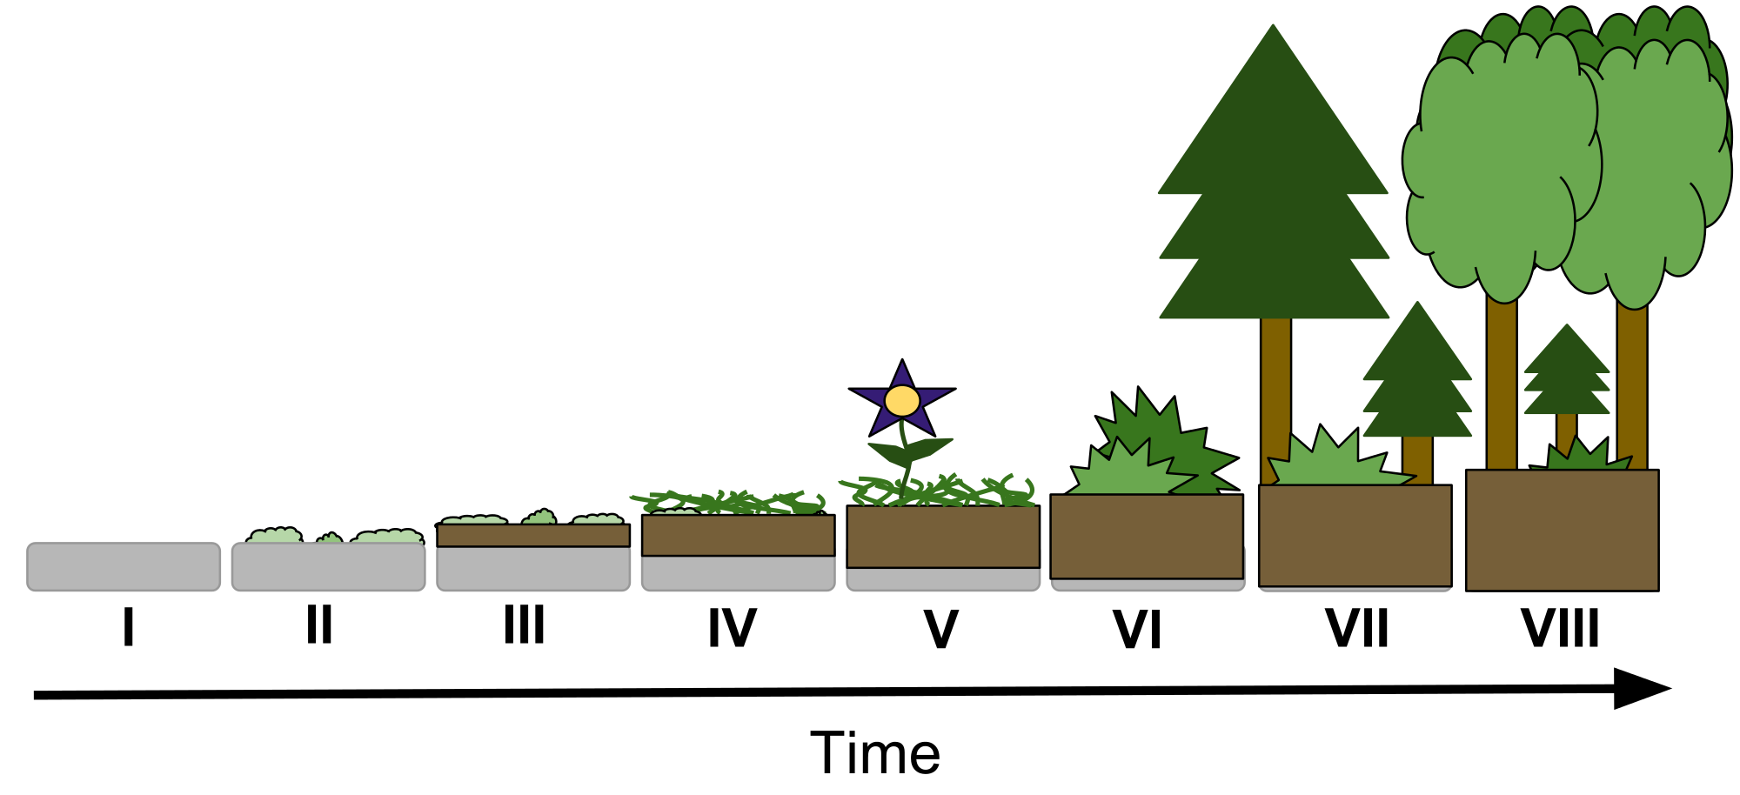
Why we need it
Notes:
Capturing the structure of the stuff is important to a variety of applications. My team’s focus is on wildland fire, but applications such as understanding successional pathways, mapping potential species habitat and even managing recreational opportunities make use of structure information. The high importance of capturing the 3-dimensional structure of vegetation within the wildfire community was highlighted earlier this week by Andy Hudak and Susan Pritchard in a session focused on wildland fire. Along with other factors, the structural arrangement of vegetation, or fuel, can help predict how a fire might transition to or propagate through the canopy.

Slide 5
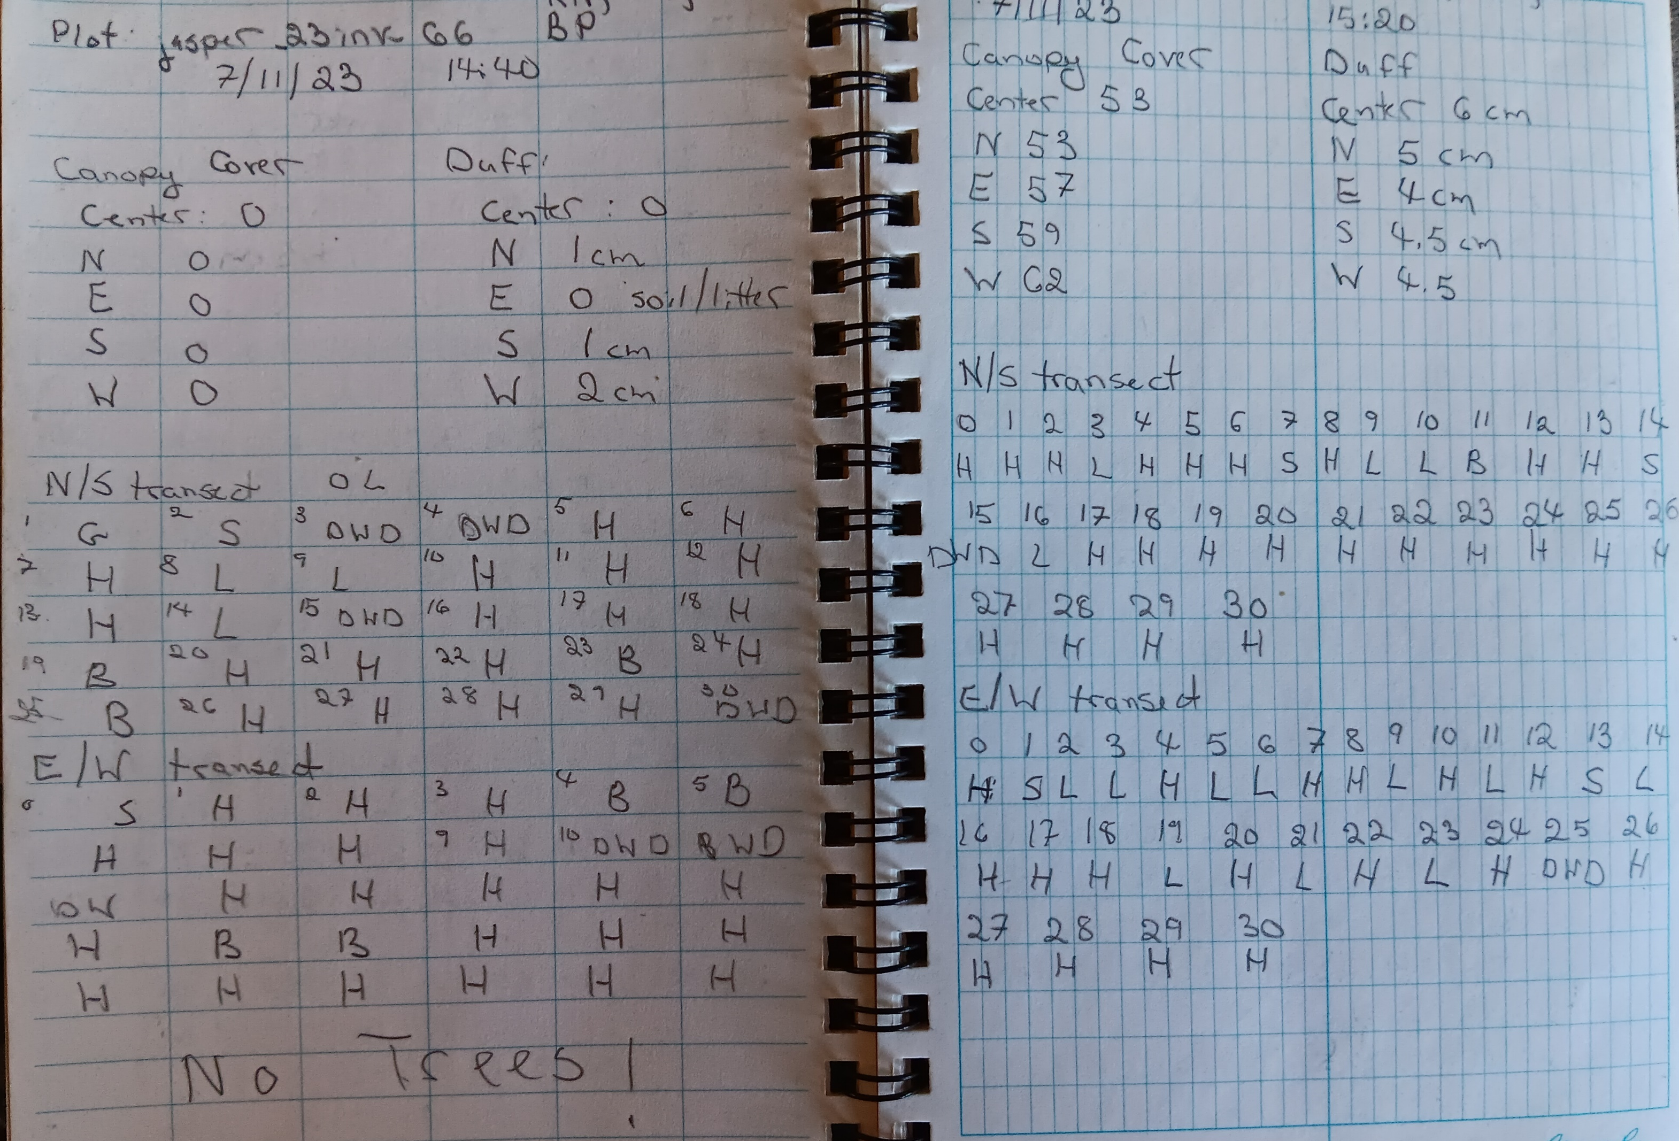
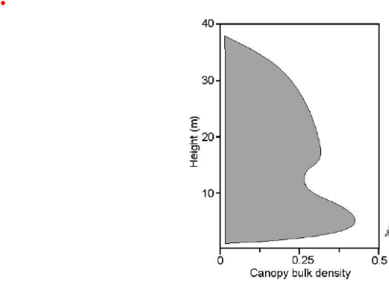
Canopy fuels estimation
Operational models:
- FARSITE
- FlamMap
Canopy
Base
Height
- QUIC-Fire
Notes:
Plot-based inventory data, collected by people on the ground and measuring tree by tree have provided the detailed structure metrics needed to parameterize fuels.
Operationally, these tree list data are used to derive canopy base height and canopy bulk density metrics, which greatly oversimplify the structure but are easy to interpret. This process essential creates a canopy density profile from the field observations and estimates of foliar biomass based on species as described in Scott and Reinhardt.
The LANDFIRE program extrapolates from these plot-based observations using Landsat imagery and other geospatial data layers to arrive at spatially continuous maps. These data layers then feed fire behavior models that are currently operational, such as FARSITE or FlamMap.
However, the tree list data can also be used to voxelize the depiction of vegetation and be used as input into new, next-generation, physics-based models such as QUIC-Fire.

Slide 6
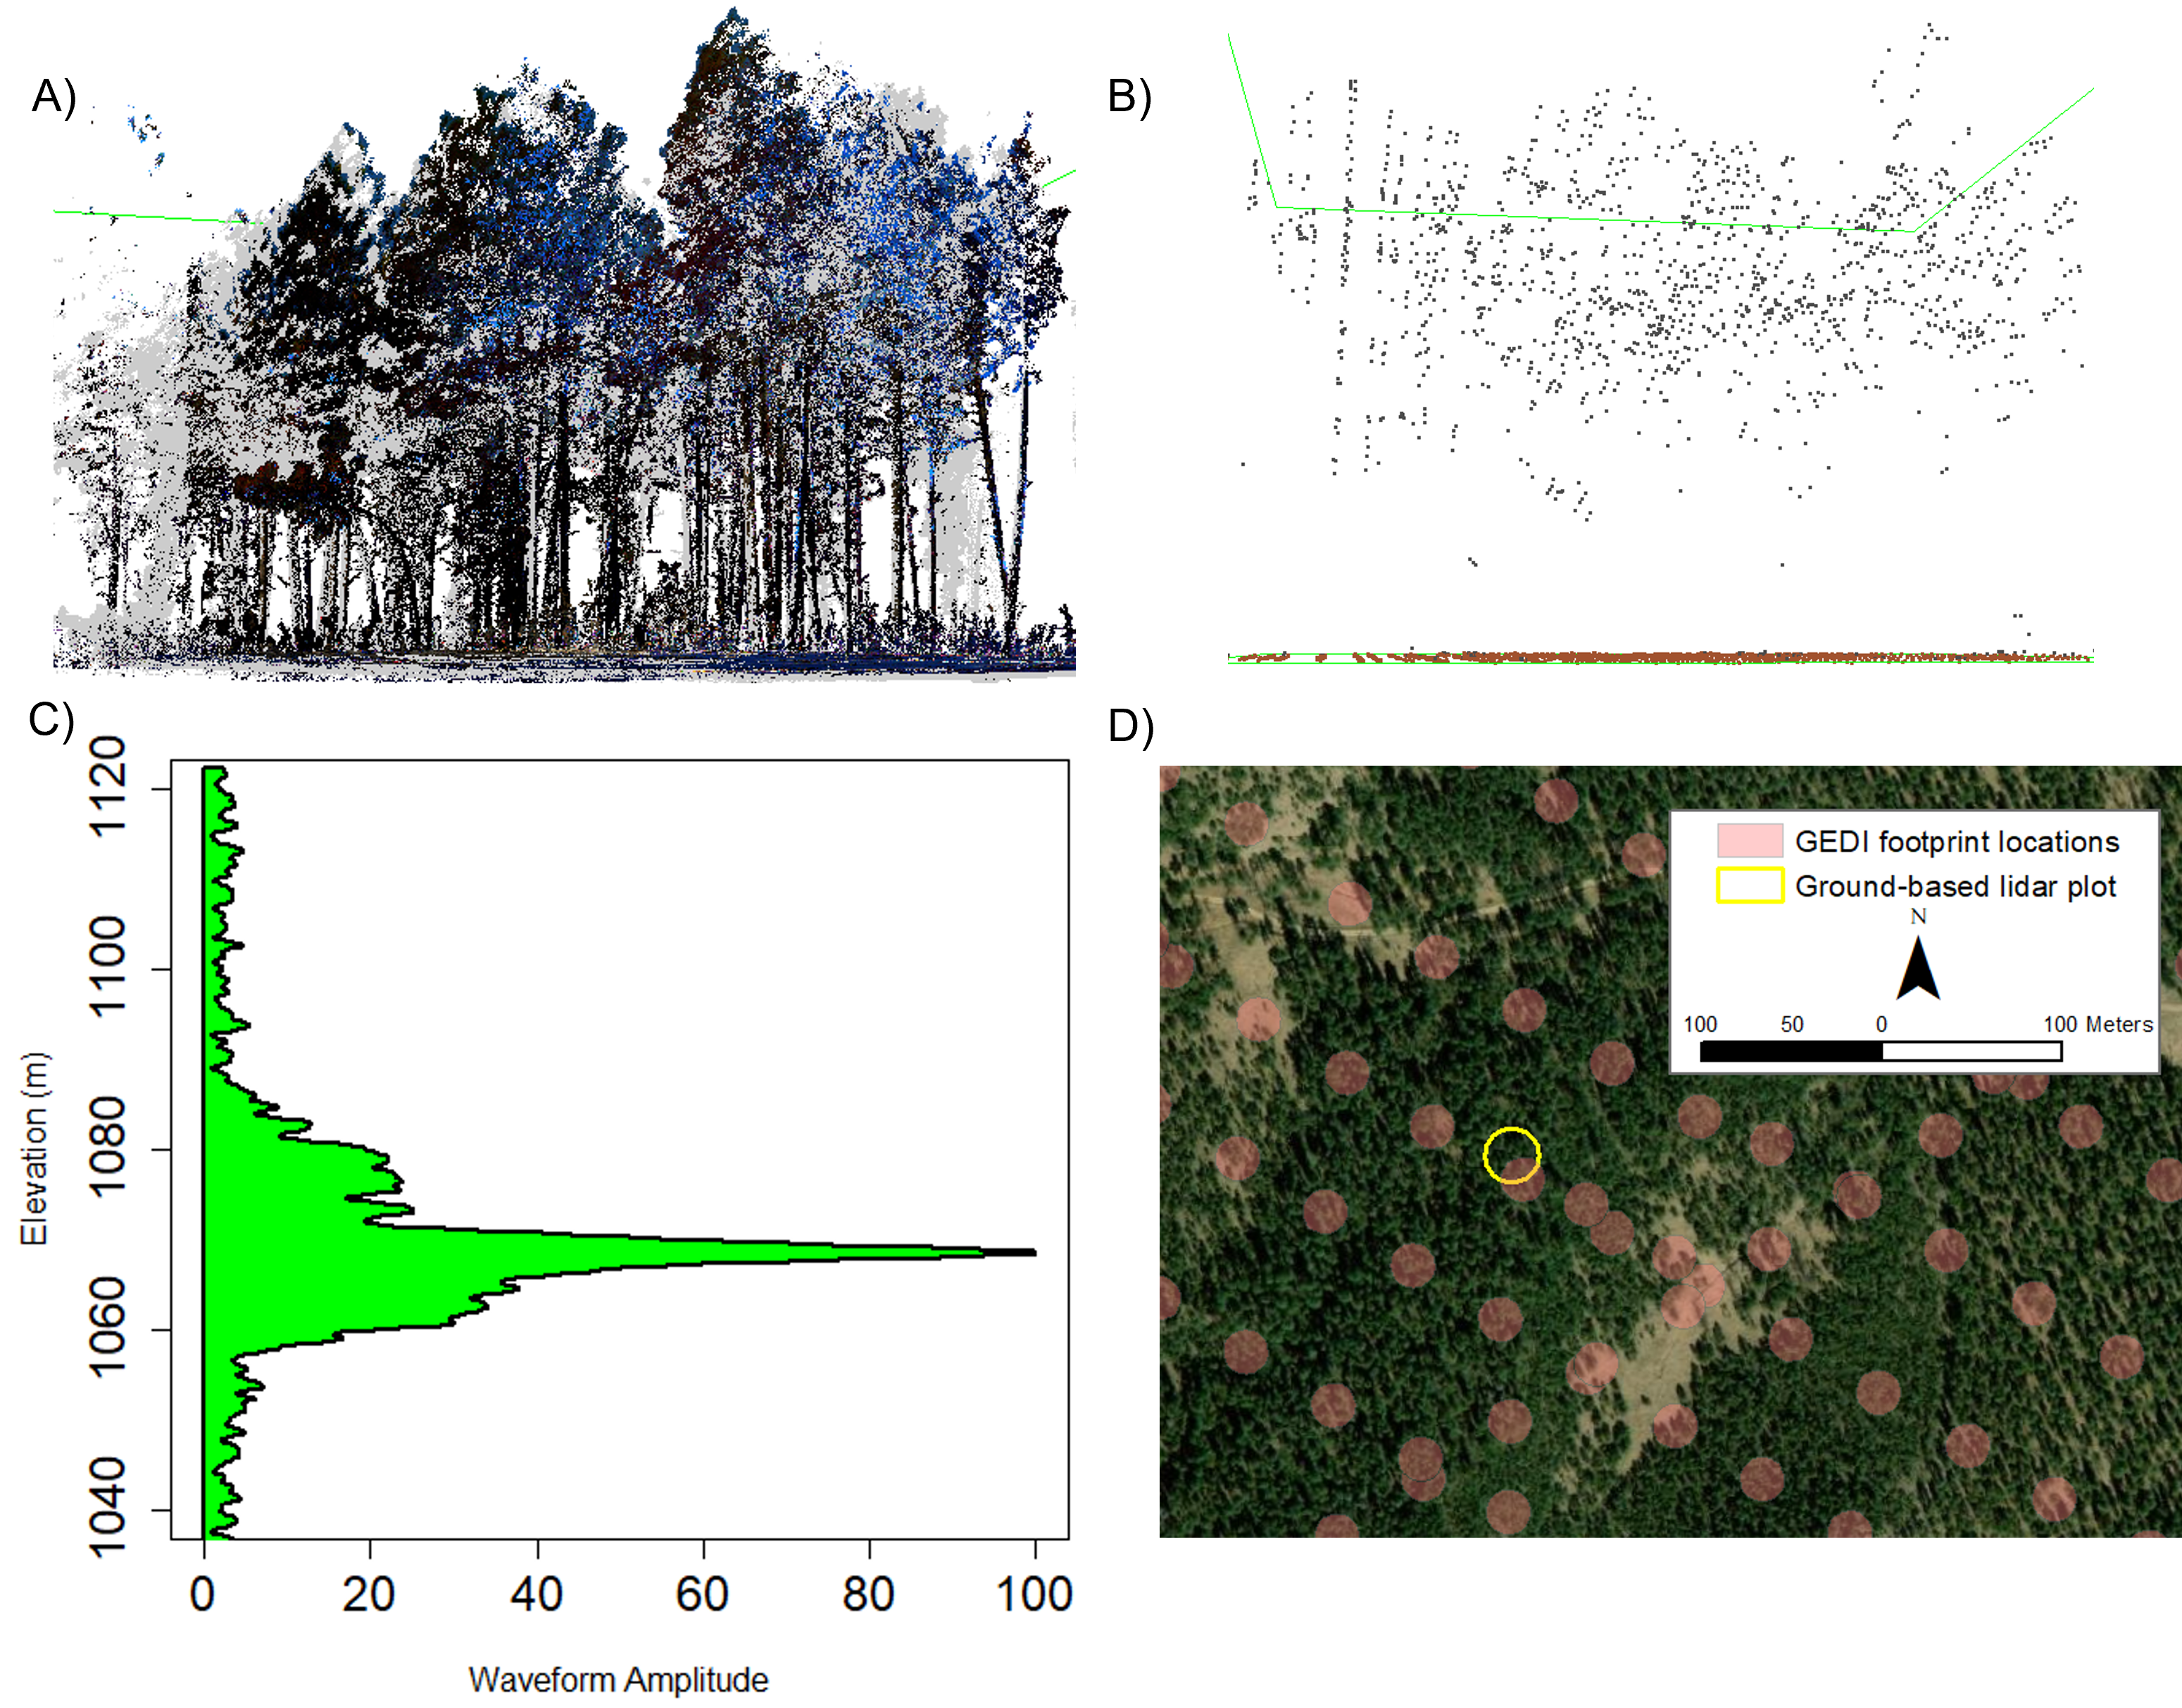
Lidar-based approaches
Terrestrial lidar
Airborne lidar
GEDI
GEDI
15
10
5
Height (m)
0
-5
Notes:
Our team has been exploring how to leverage lidar data collected at different scales to derive canopy fuels data – both the metrics used operationally now and into the foreseeable future, so CBD and CBH, but also how we can derive tree lists repeatedly over large areas to capture regional differences and disturbances. In this short talk I’ll present a little of how we have used terrestrial lidar and GEDI for fuels estimation in the Sequoia National Park. Our long-term goal is to leverage lidar data across all scales, from point-based terrestrial observations to space-based GEDI metrics. The TLS data provide the fine-scale detail but are still limited by spatial extent, while GEDI provide observations at a regional level but lack the fidelity of the TLS data.

Slide 7
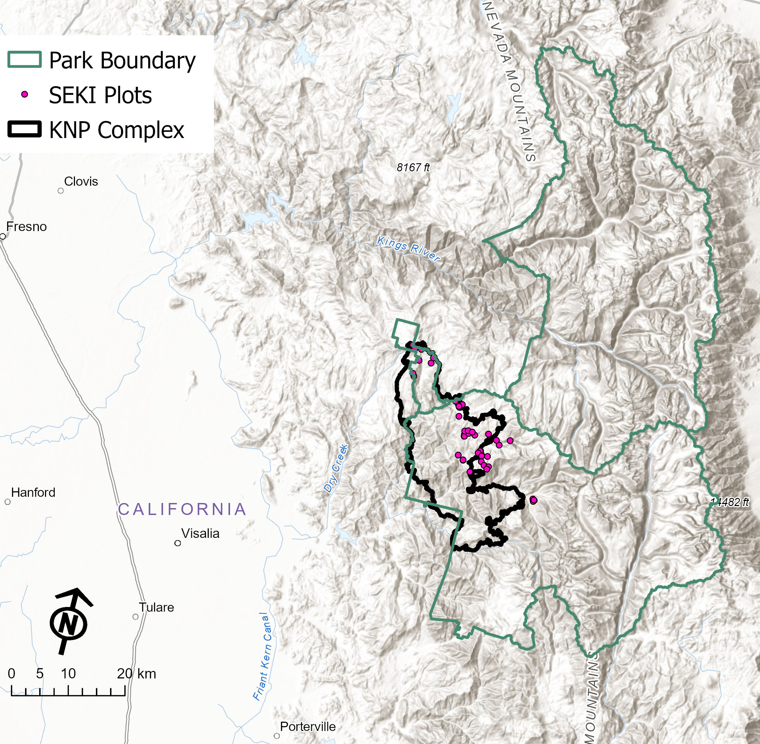
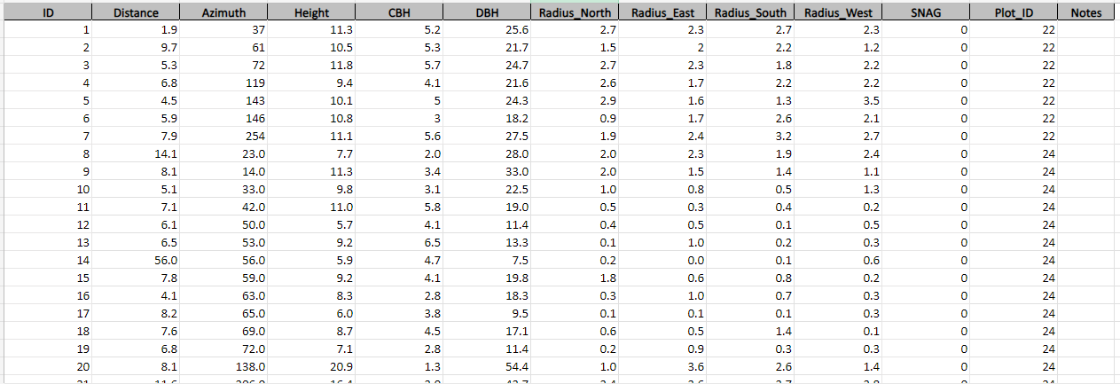
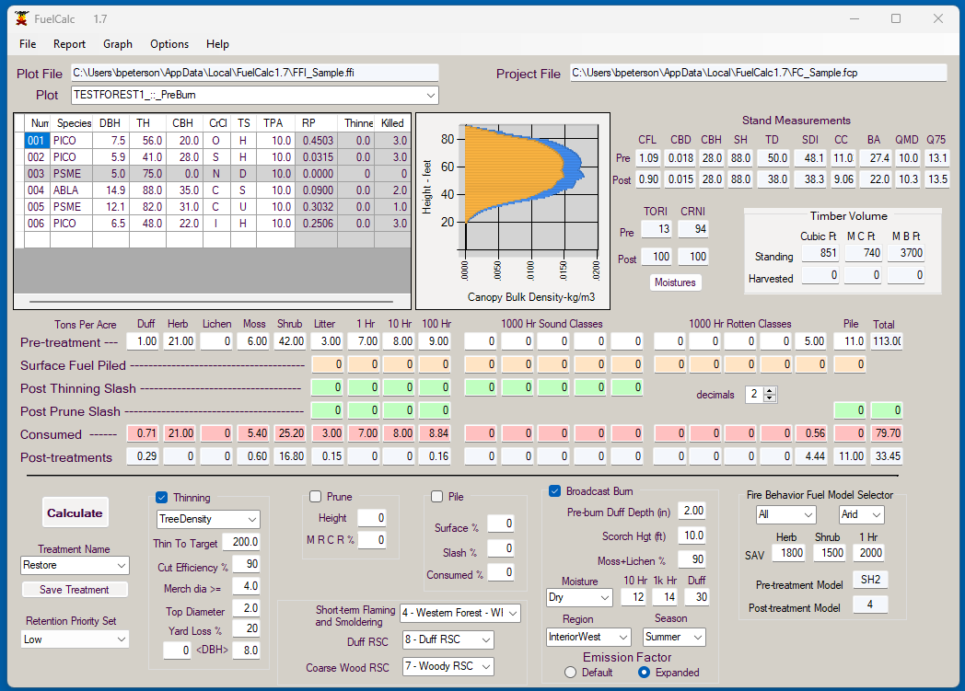
Data flow
Derived tree list
Terrestrial lidar
FuelCalc
Plot-level canopy fuel metrics
1
2
3
4
5
Notes:
So, our first task was to generate maps of CBH and CBD from TLS based observations. We collected TLS data at 30 plots withing the Sequoia National Park all within or just outside of the KNP Complex perimeter. KNP burned 80,000+ acres in 2021. The plots were co-located with sites were other tree demographic or previous TLS data had been collected. We adapted existing tree-extraction algorithms to generate tree lists from the TLS point clouds. These tree list were then fed into the FuelCals model to generate estimates of CBH and CBD for the plots.

Slide 8
CBD and CBH estimates
Notes:
Using a regression tree approach with the point based CBD and CBH values along with Landsat imagery, topographic, and other ancillary data as training data, we generated maps of CBD and CBH for the study area. These still need to be validated with other field observations and compared to existing data sets such as LANDFIRE, but initial results are looking decent.

Slide 9
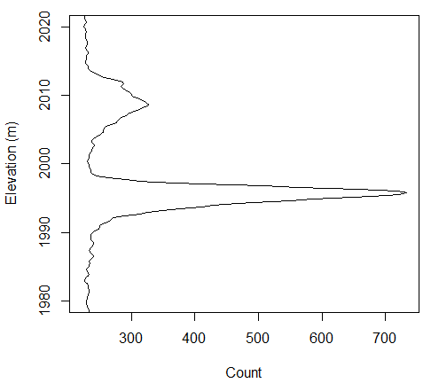
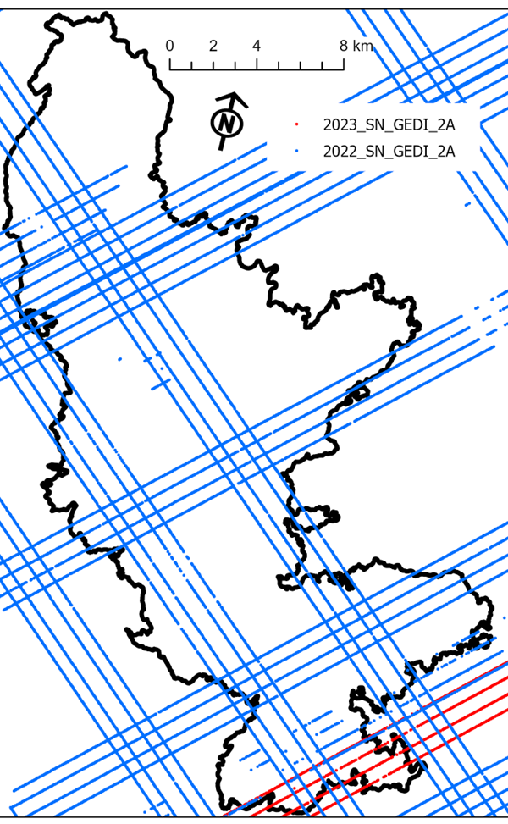
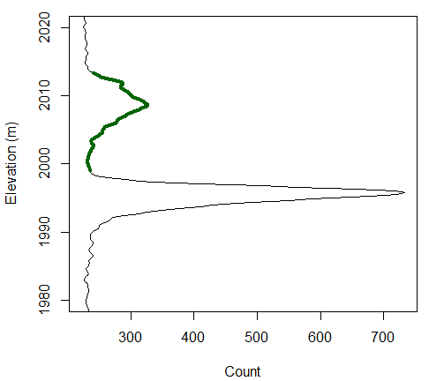
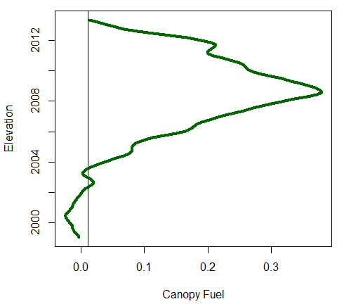
GEDI-derived CBD
GEDI 1b and 4a products
Landsat, topographic layers
Post-fire data only
Notes:
Our next step was looking at how we might be able to derive CBH and CBD more directly from GEDI. We can reliable estimate 2 other key canopy fuel variables, canopy height and canopy cover from GEDI, so deriving all 4 would be beneficial from an operational perspective. This approach used the canopy portion of waveform, GEDI 1b product, as a proxy for vertical fuels distribution and using the GEDI 4B footprint-level biomass to estimate foliar mass. We used post-fire data only from the full power beams, giving us approximately 12,500 points to build a regression tree model. This is a very preliminary products, estimates of CBD are somewhat higher than using the TLS method, but patterns are similar – some of that may be attributed to using the same Landsat and topographic data to inform the models.

Slide 10
Tree lists from GEDI?
?
Notes:
The next thing we are planning to investigate is if we can use GEDI with a combination of other RS data such as high spatial resolution imagery to derive the tree lists necessary to inform next generation models such as QUIC-fire. The first step will actually be using TLS or ALS data to simulate waveforms and then manipulate the point clouds to selectively add or remove trees to better understand how the changing structure will influence waveform shape.

Slide 11
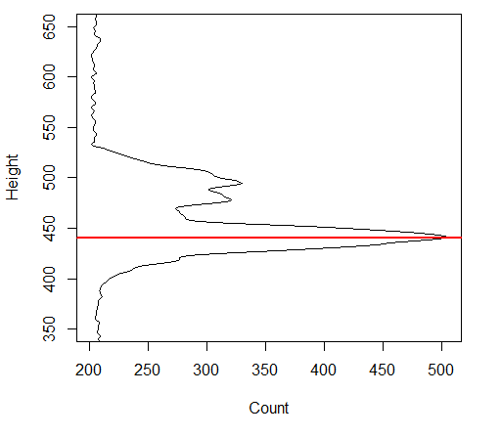
Tree lists from GEDI?
Time
Zhou et al (2021) IEEE Journal of Selected Topics in Applied Earth Observations and Remote Sensing, vol 14
Notes:
The next step would be to decompose the waveforms into individual crowns and estimate tree-level parameters. High resolution imagery would help parameterize the number of individual stems expected. We haven’t even begun this step of the research. While were are not expected to accurately depict every individual tree in a footprint we hope to generate a tree list that is realistic enough to inform the fire behavior models sufficiently enough to output meaningful results.

Slide 12
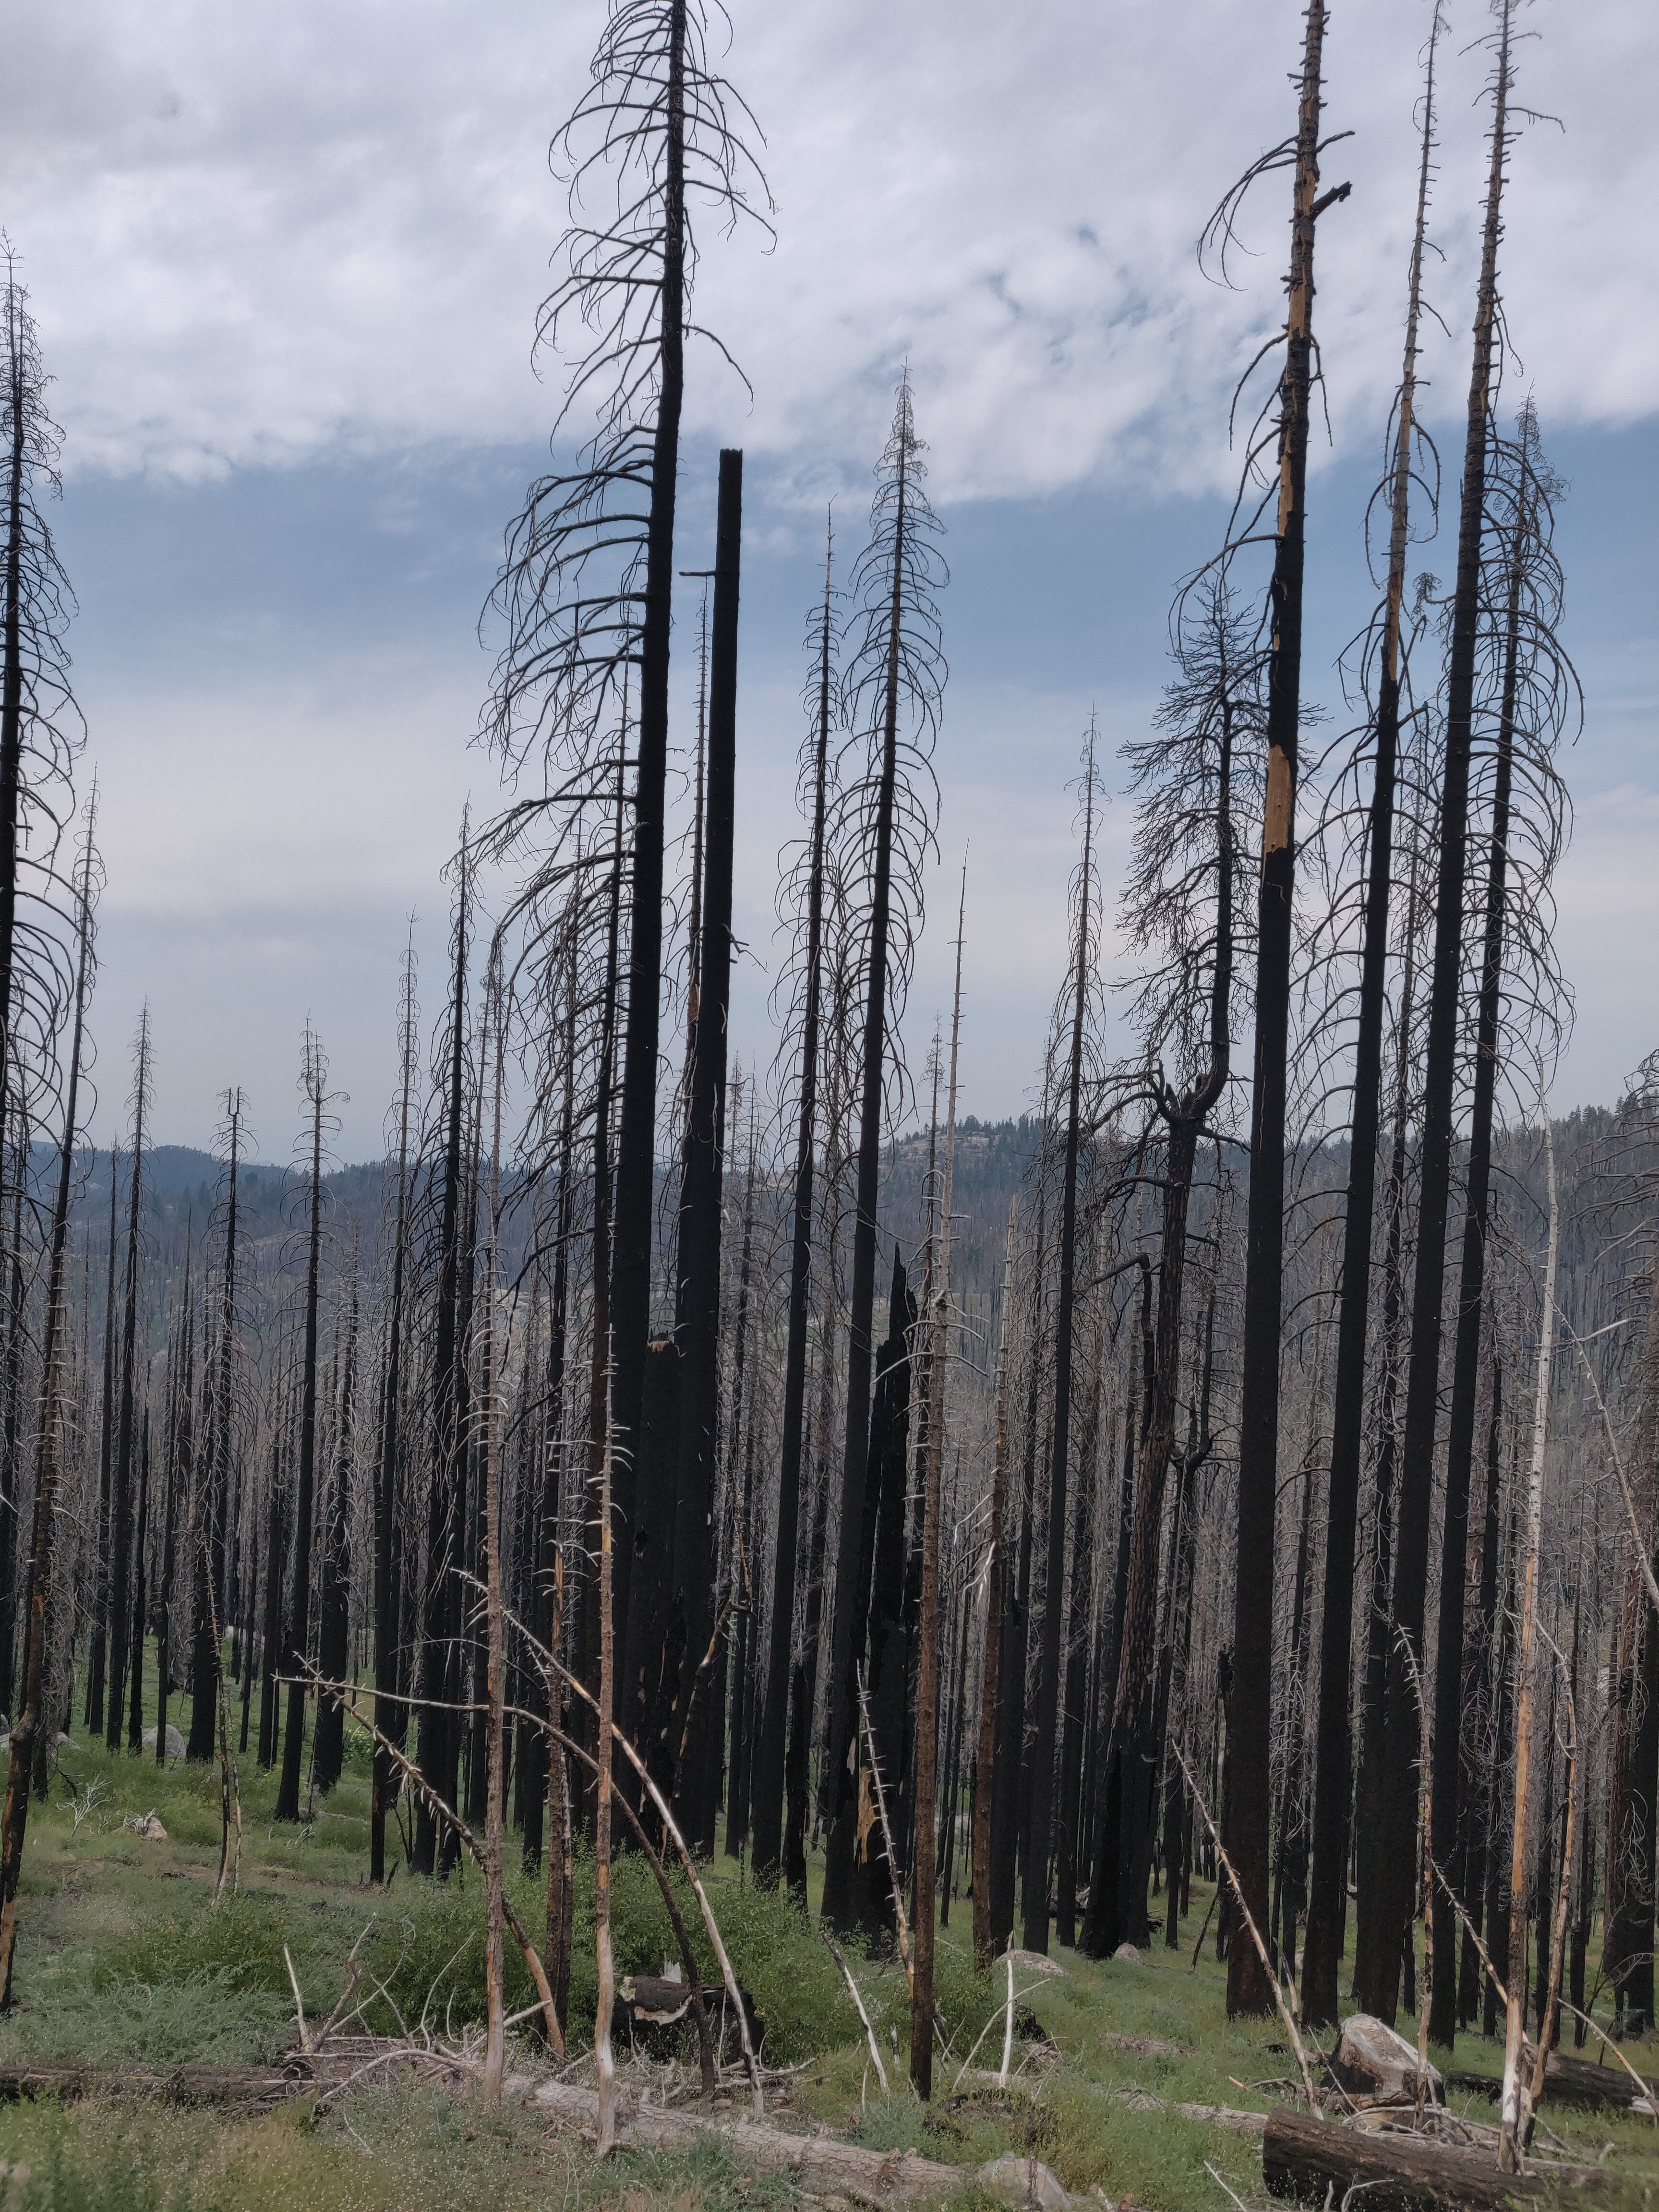
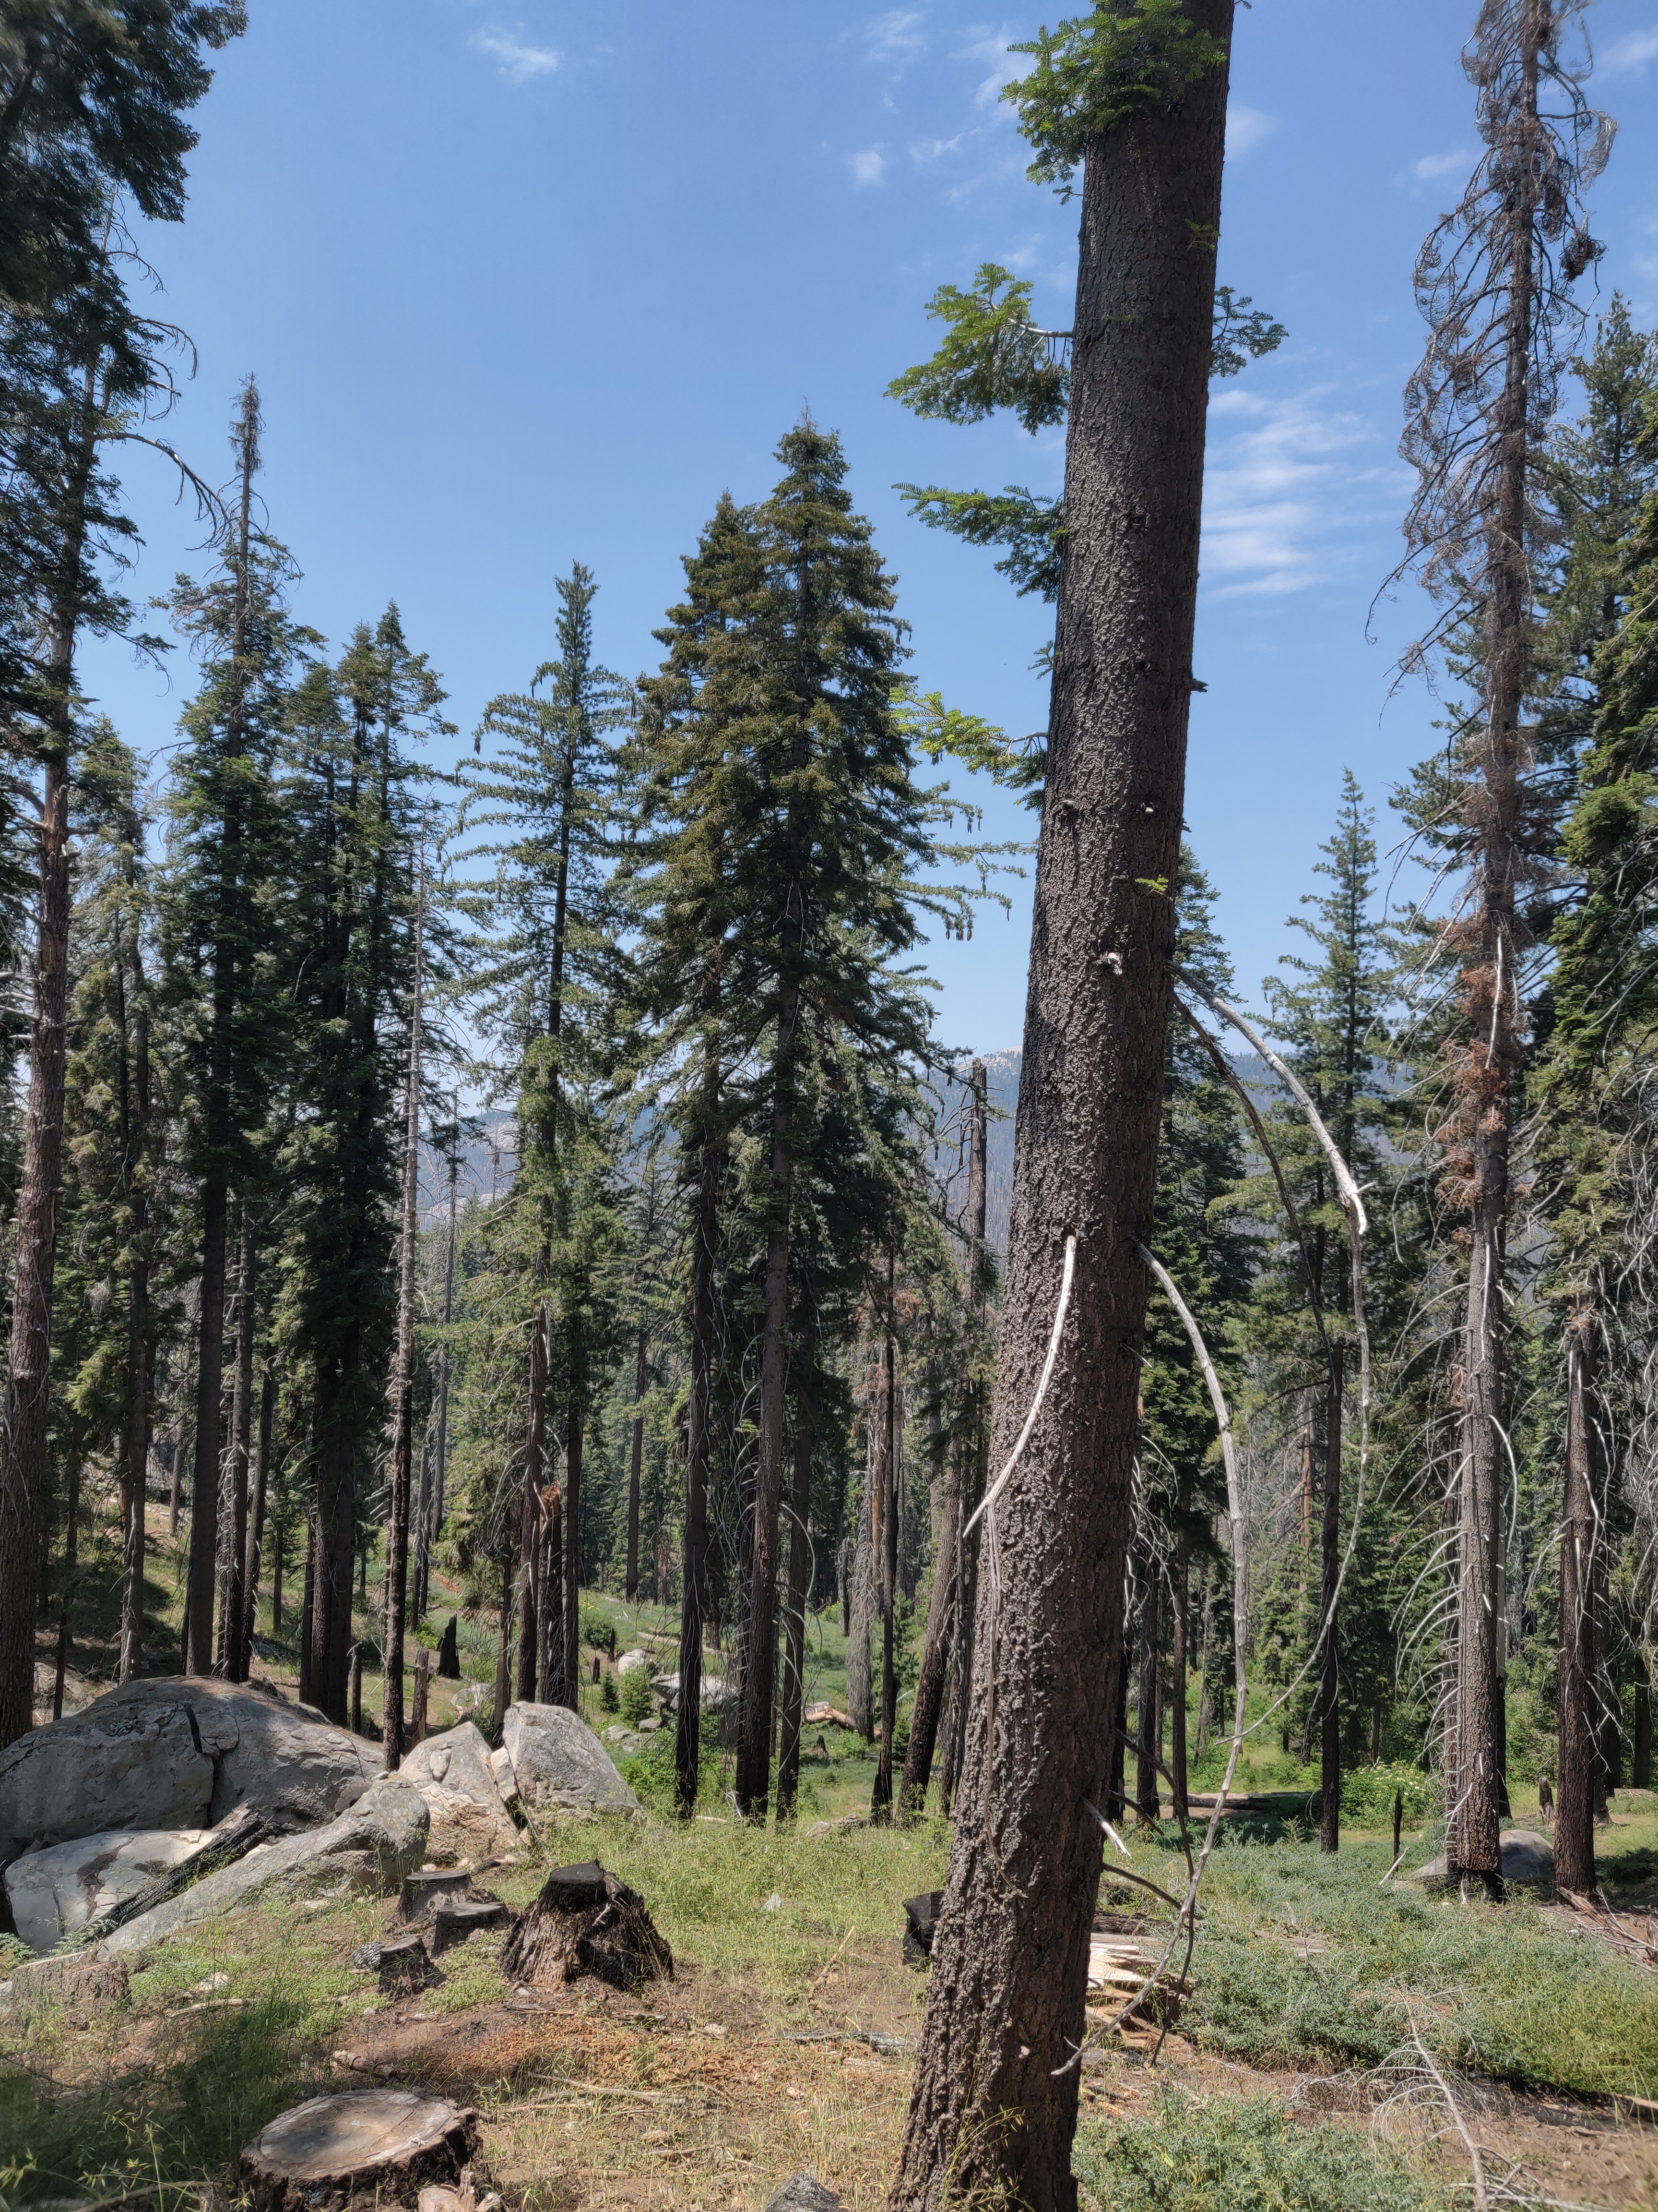
Thank you
Contact info
bpeterson@usgs.gov
Acknowledgements
Chris Woody
Jennifer Rover
Jon Dewitz
Recruitment
https://careers.state.gov/interns-fellows/virtual-student-federal-service/
https://www.usgs.gov/youth-and-education-in-science

