Slide 1
Open-source burn severity mapping tool
Kurtis Nelson* and Josh Picotte
^{*knelson@usgs.gov}
U.S. Geological Survey (USGS), Earth Resources Observation and Science (EROS) Center, Sioux Falls, SD 57198, USA.
11th International Fire Ecology and Management Congress
12/02/2025

Slide 2
Presentation Outline
Burn severity
Remote sensing
Remotely assessing burn severity
Fire Mapping Tool (FMT)
Questions

Slide 3
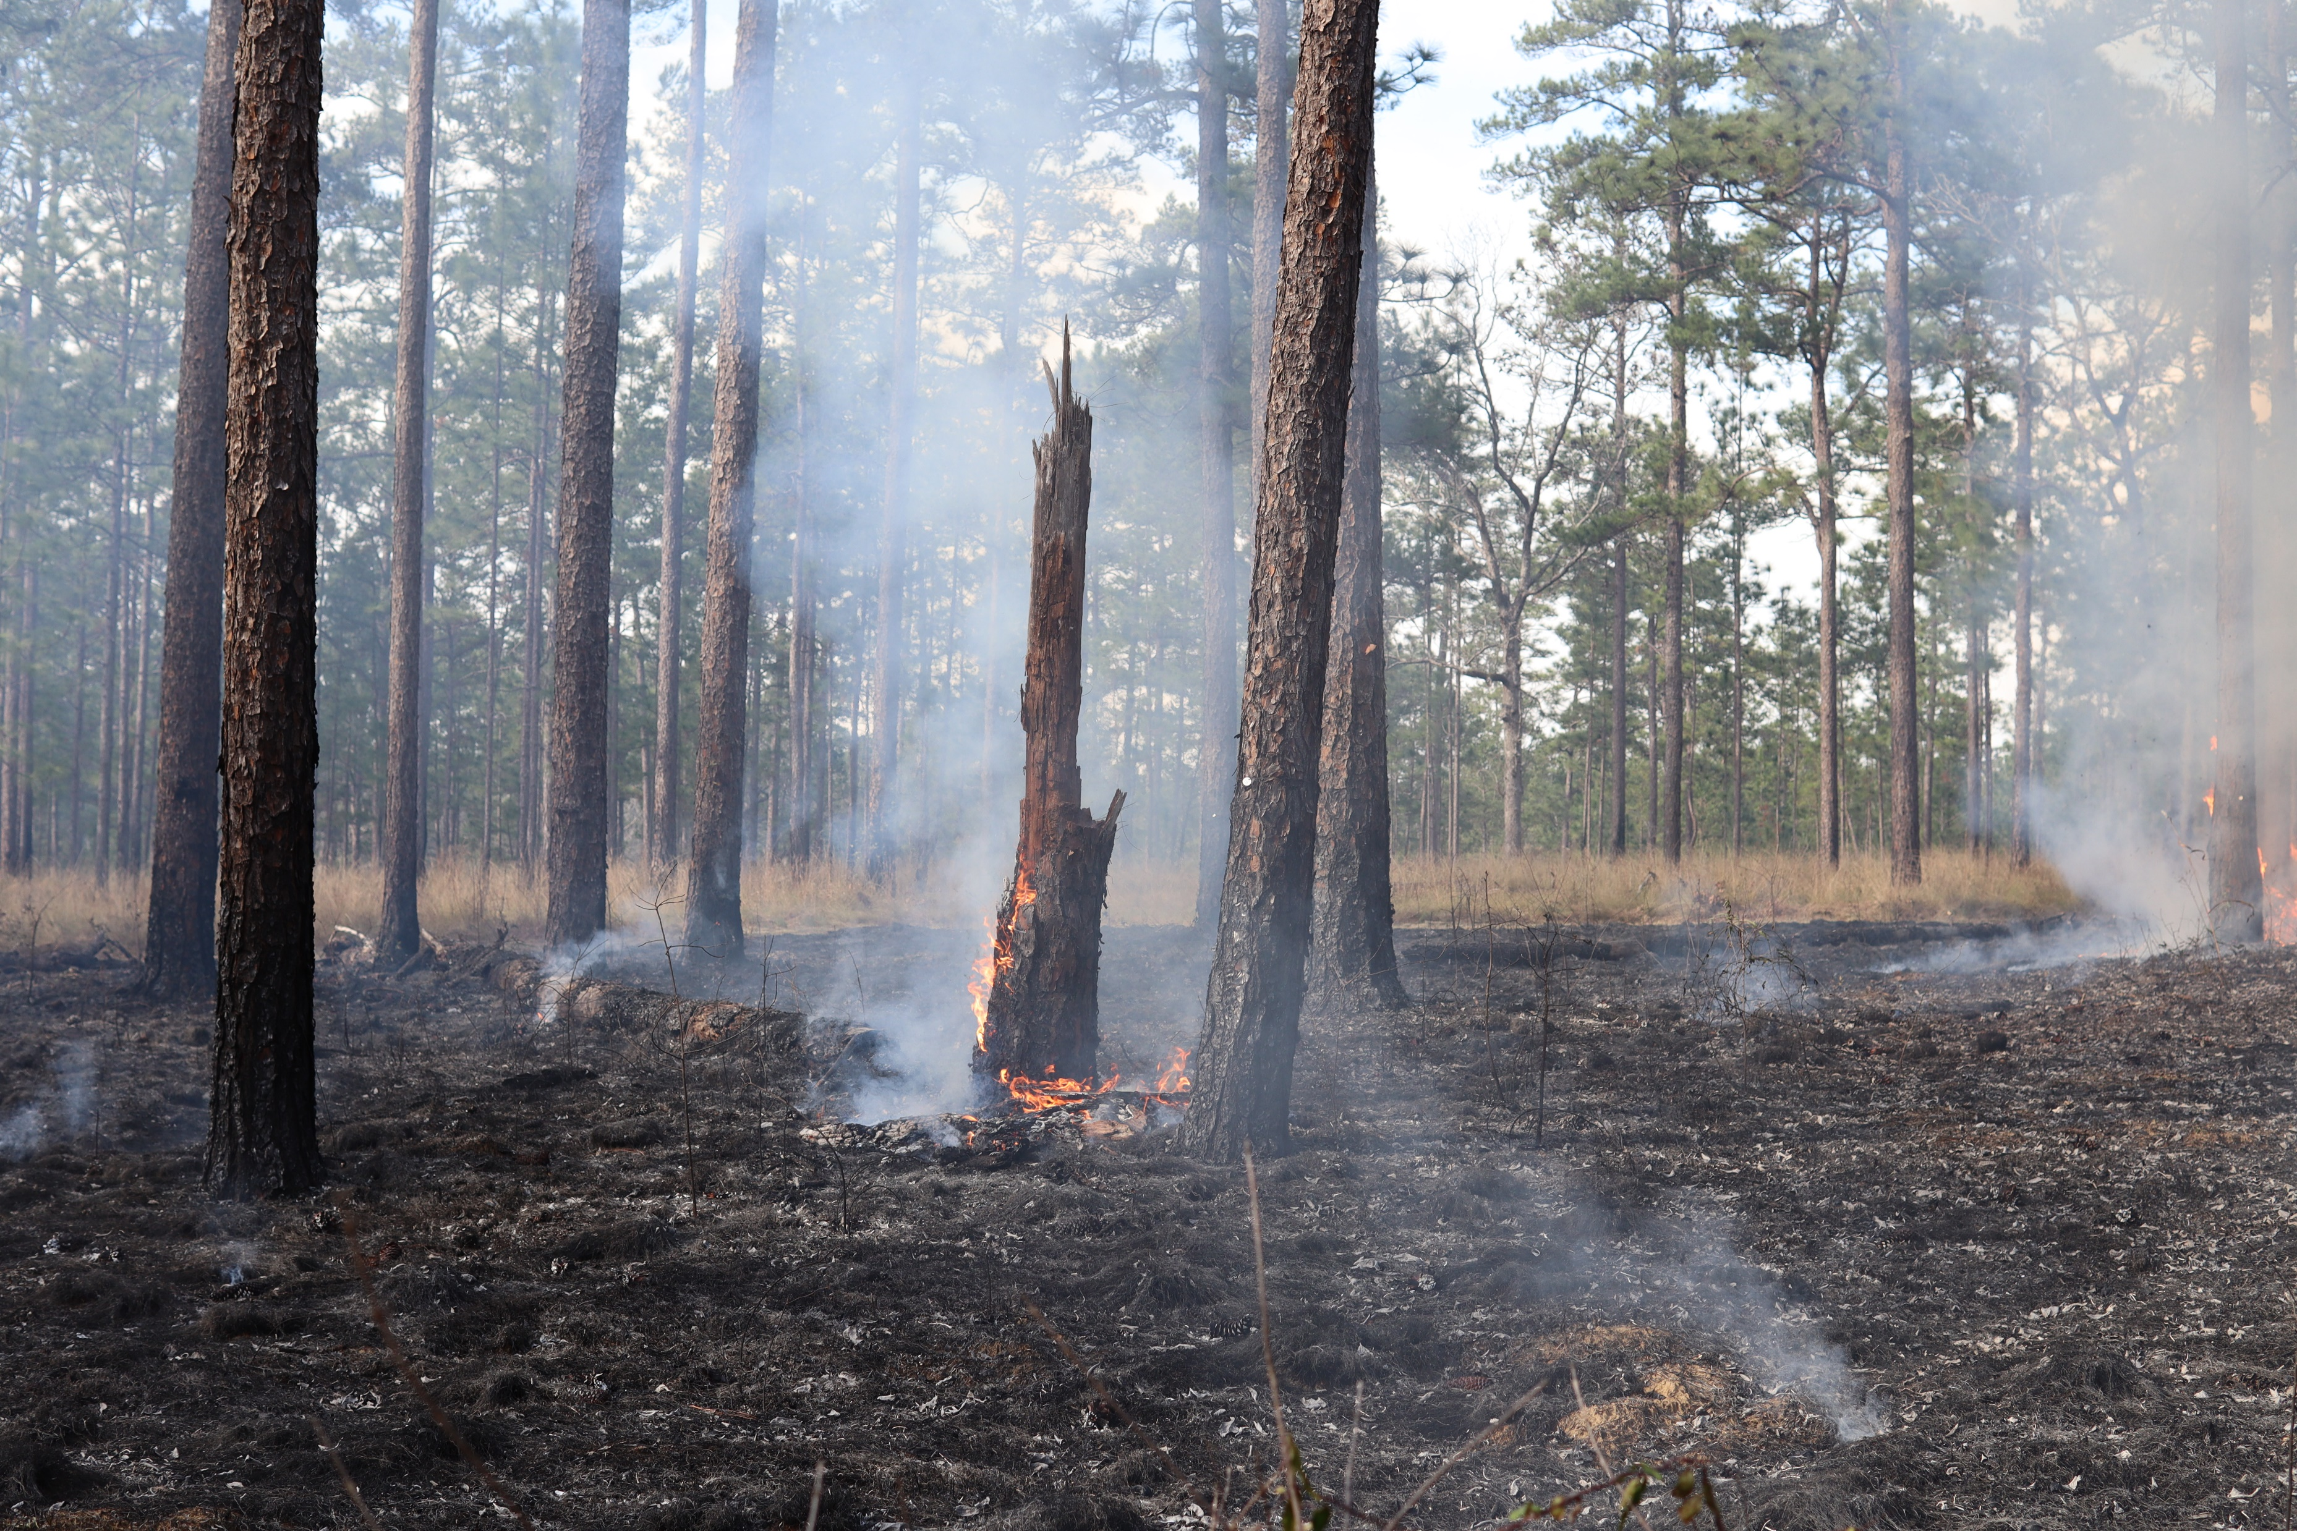
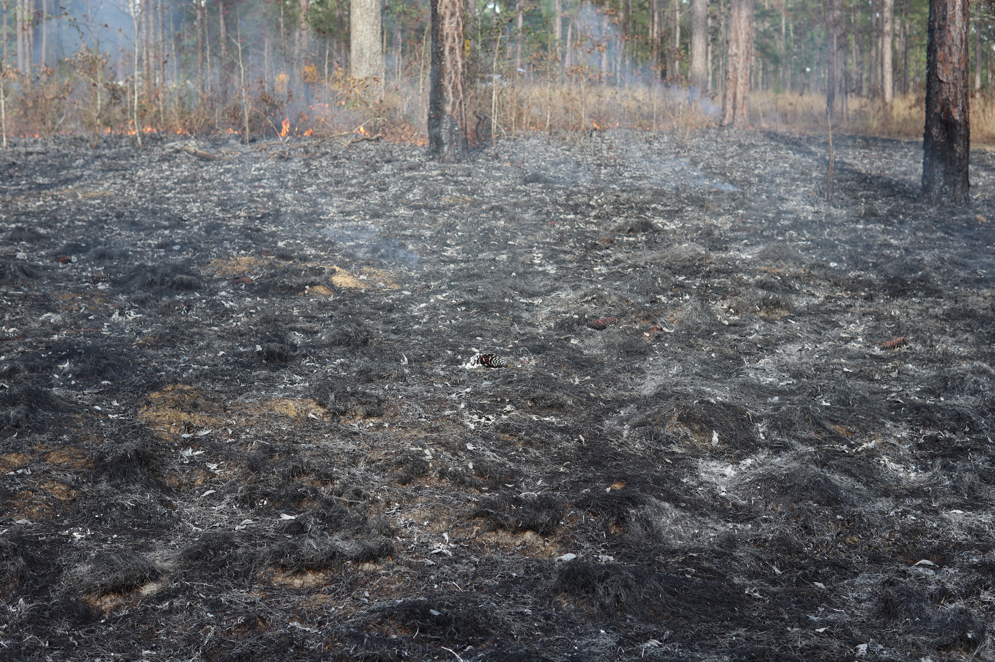
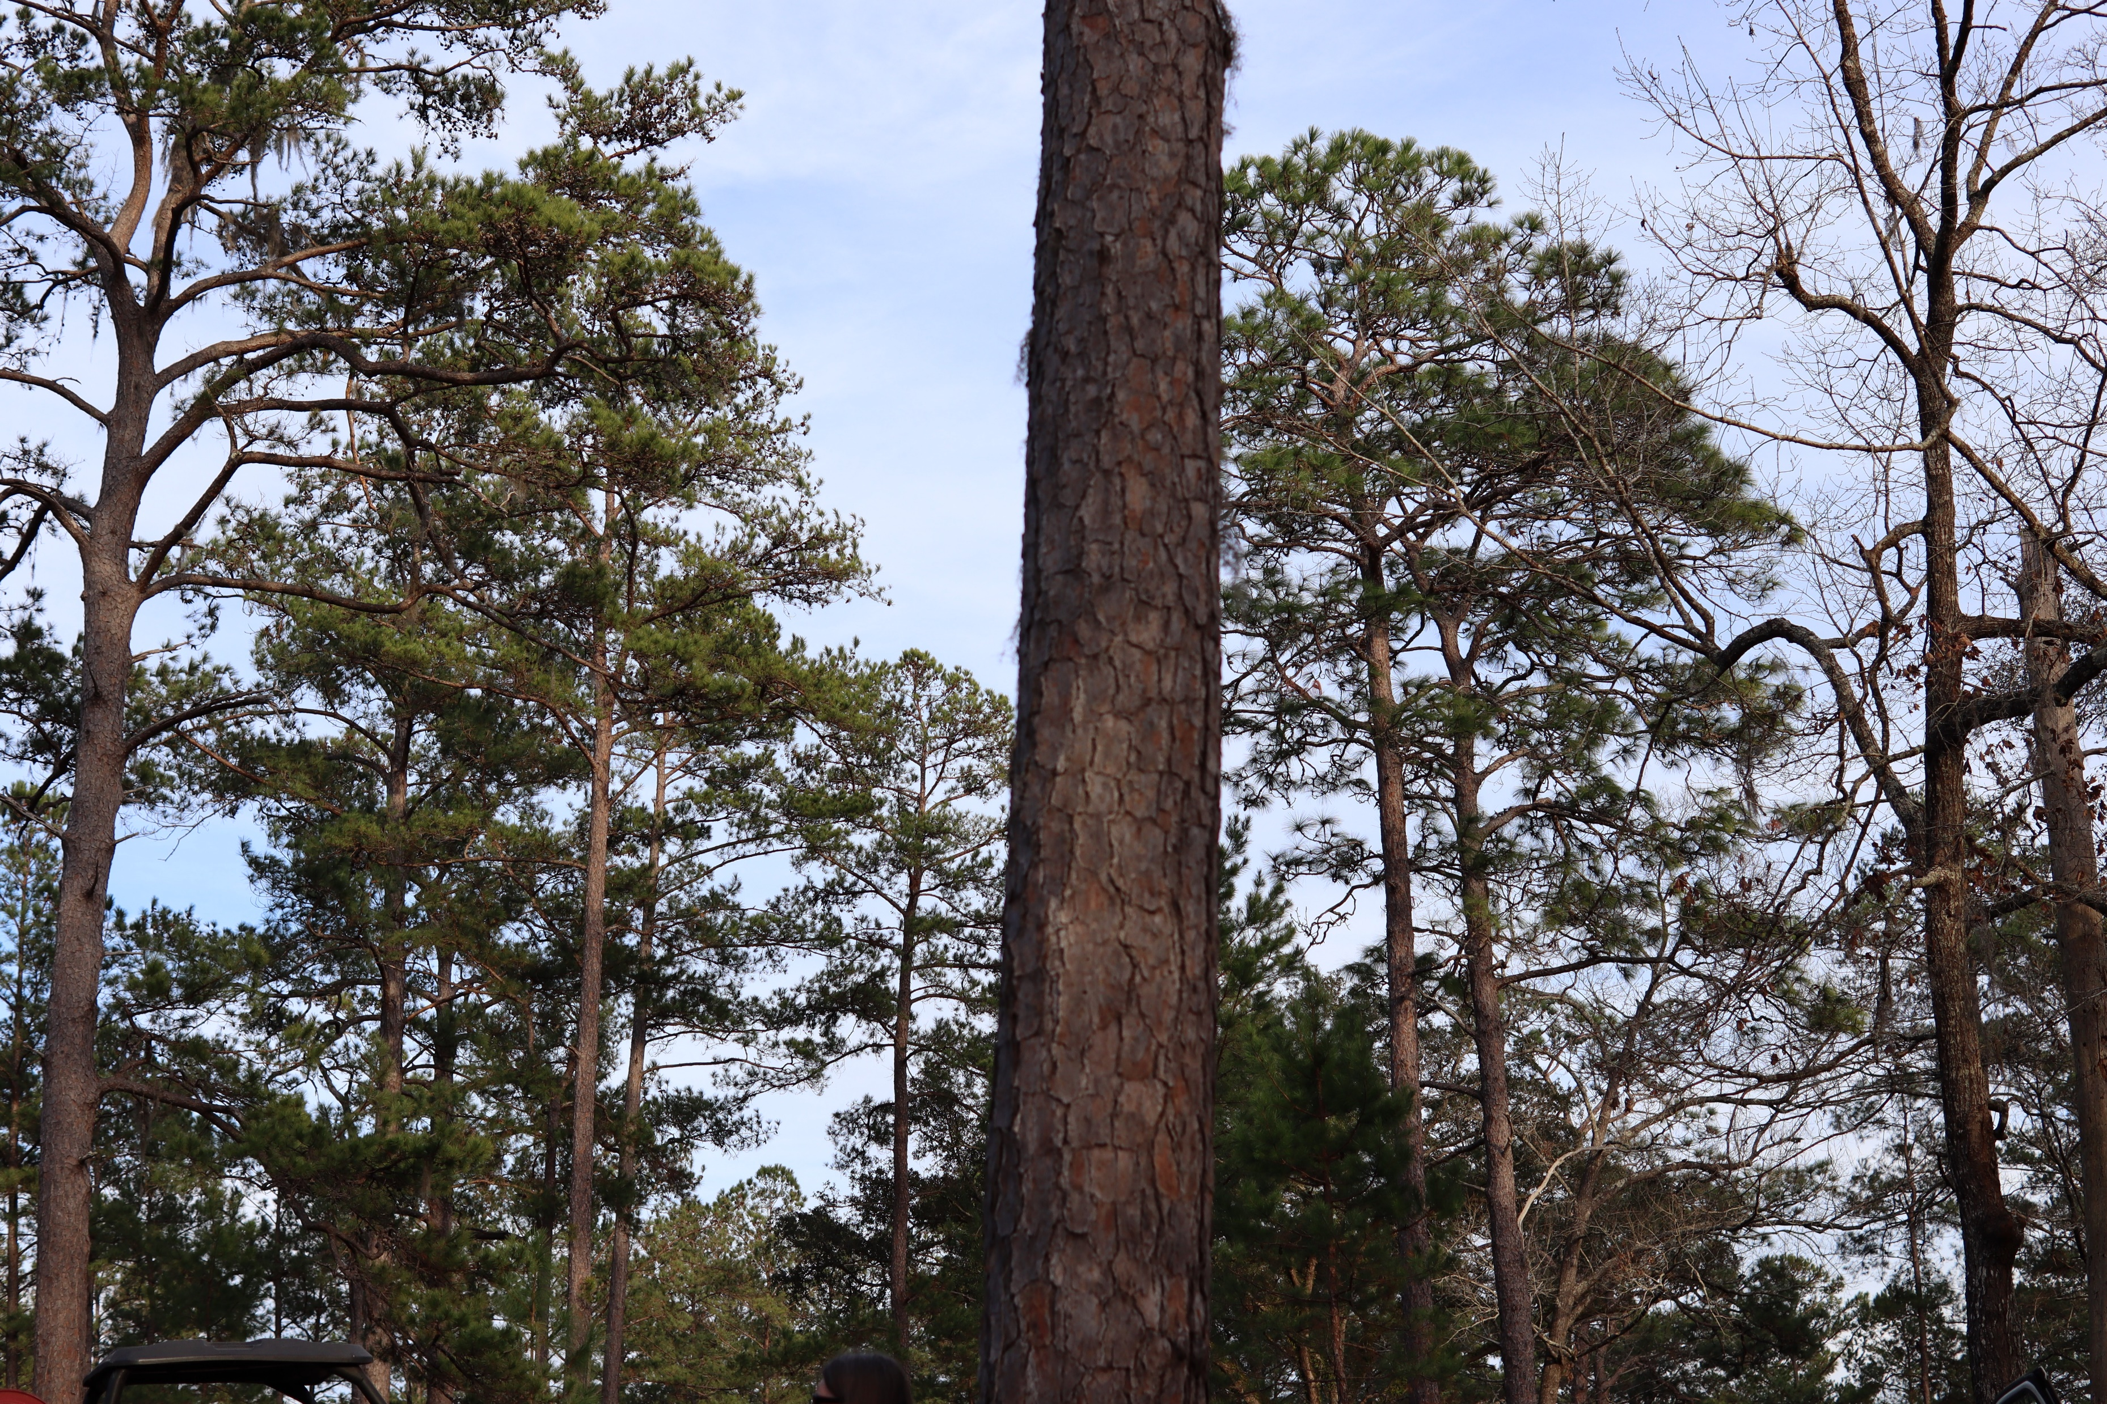
What is burn severity and why is monitoring it important?
Photos taken by Joe Noble

Slide 4
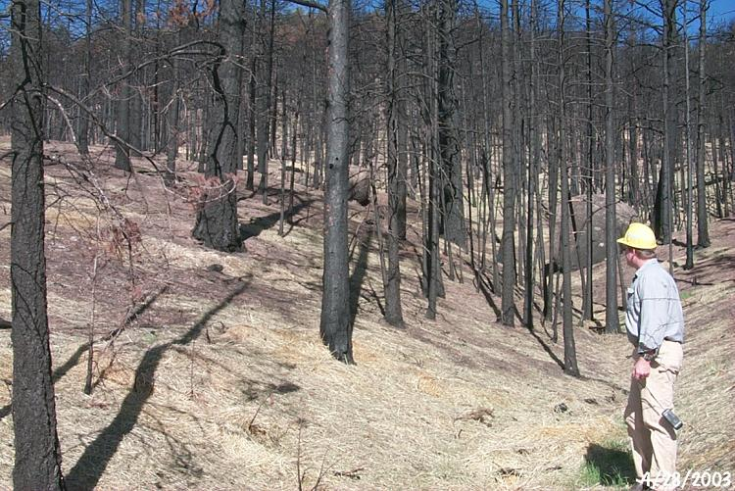
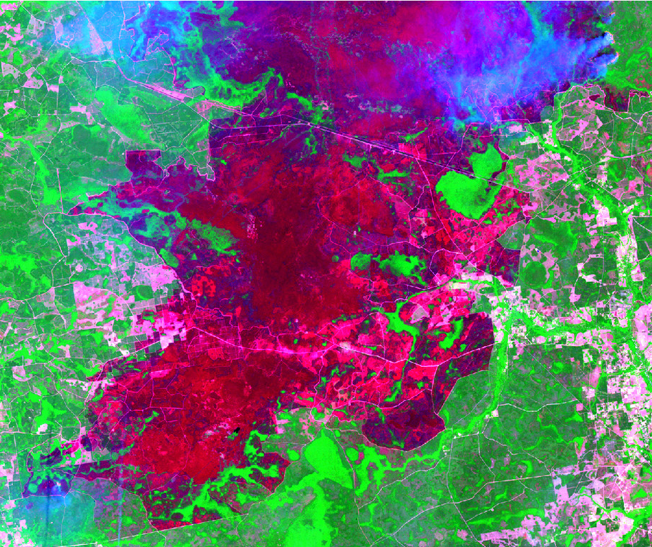
Remotely Monitoring Fire

Slide 5
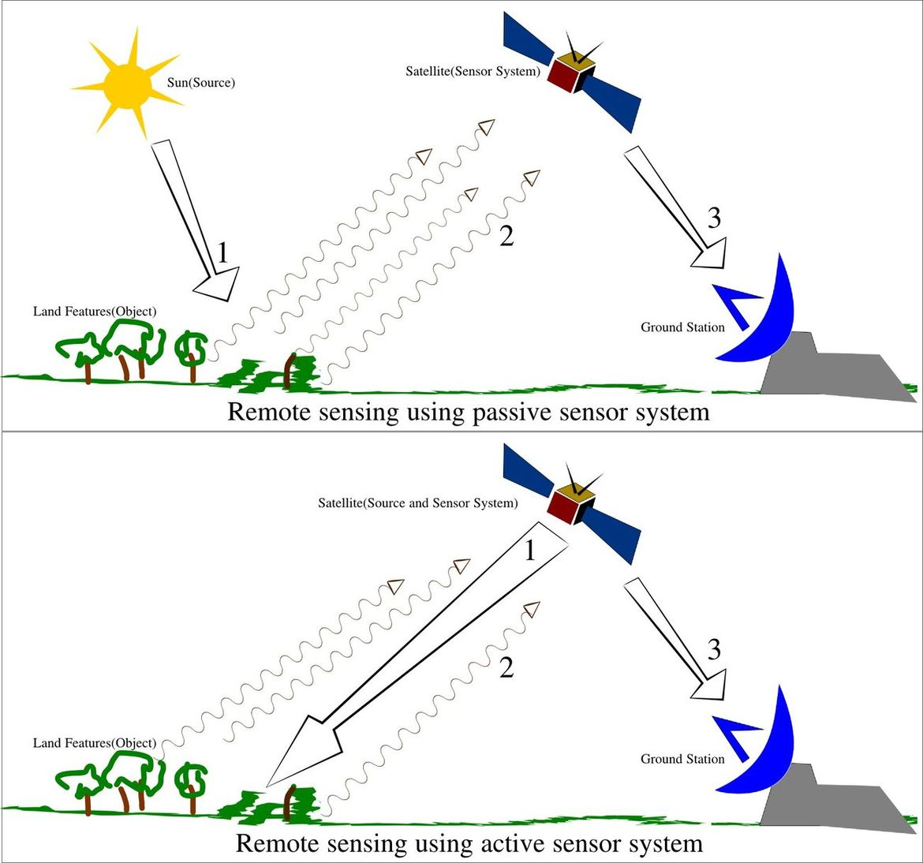
Remote Sensing Theory
Source: University of Calgary

Slide 6
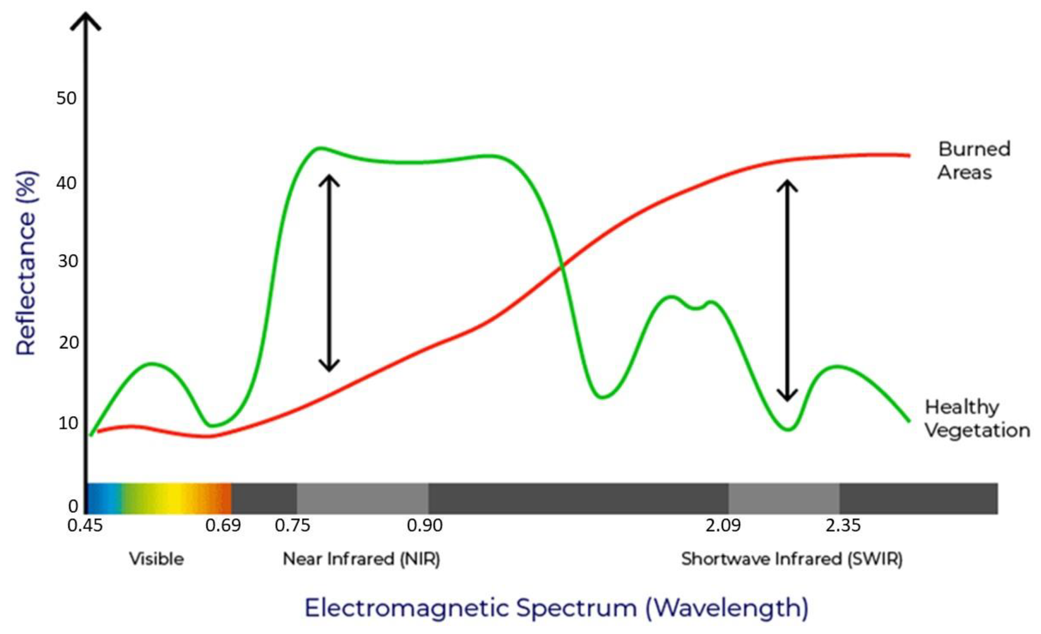
Remote Sensing Theory
Source: Alcaras, E.; Costantino, D.; Guastaferro, F.; Parente, C.; Pepe, M. Normalized Burn Ratio Plus (NBR+): A New Index for Sentinel-2 Imagery. Remote Sens. 2022, 14, 1727.

Slide 7

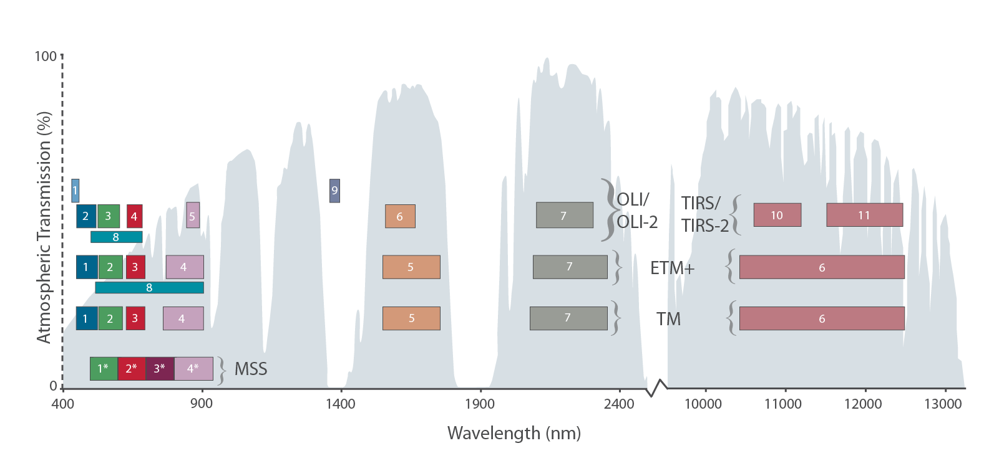
Satellite Imagery
Landsat
30m spatial resolution
16 day repeat observations
8-11 spectral bands
Cross-calibrated archive back to 1984
Notes:
Landsat data most used for burn severity due to archive availability
L1-4 shorter time frame, data not consistent
L5-9 consistent data, cross calibrated so can be used together
L5, 7 had 8 spectral bands including one thermal and one panchromatic
L8, 9 have 11 spectral bands with 2 thermal, 1 panchromatic, 1 cirrus
L7 no longer imaging; orbits of 8 and 9 offset reducing repeat time to 8 days

Slide 8
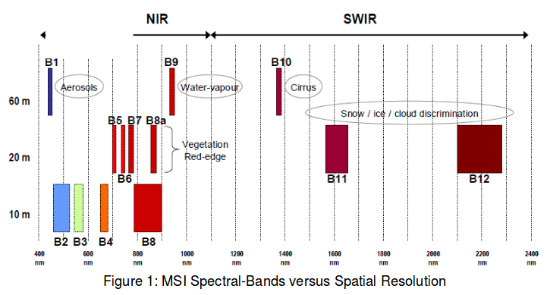
Satellite Imagery
Sentinel
10, 20, 60m resolution
5 day repeat observations
12 spectral bands
Archive back to 2015
Source: ESA
Notes:
Sentinel-2 data used often for near real-time mapping due to higher temporal resolution
Currently 2A and 2B available; 2C and 2D awaiting launch
Nested spatial resolutions; VNIR highest resolution, can create 20m dNBR
12 spectral bands including several between red and NIR; plus aerosols, water vapour, and cirrus bands

Slide 9
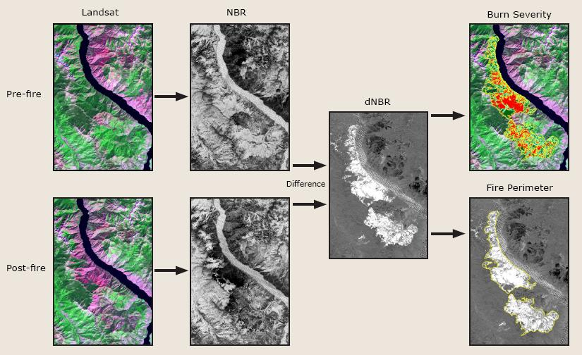
Using Satellite Data to Map Fires

Slide 10
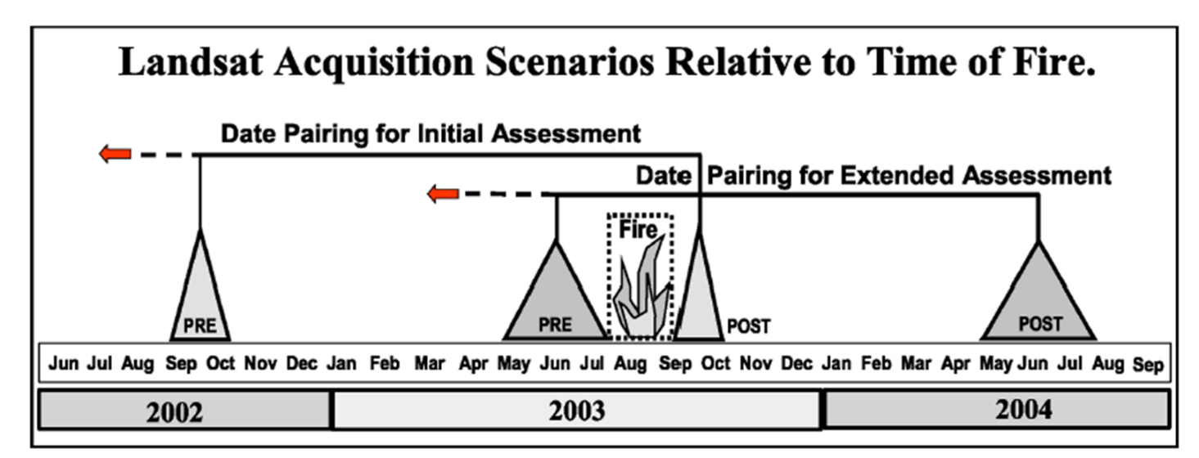
Burn Severity Assessment Considerations
It is imperative that image pairs are selected that minimize phenological change and other disturbance events
Ideally, scene pairs should be within 45 days of each other, even if across years, to minimize differences in phenology and illumination angle
It is acceptable to select pre-fire imagery from 2-3 years, and in some areas 4-6 years, pre-fire provided phenology is matched between scenes and subsequent disturbances are not present
If a suitable scene pair cannot be found then a single scene NBR assessment can be performed

Slide 11
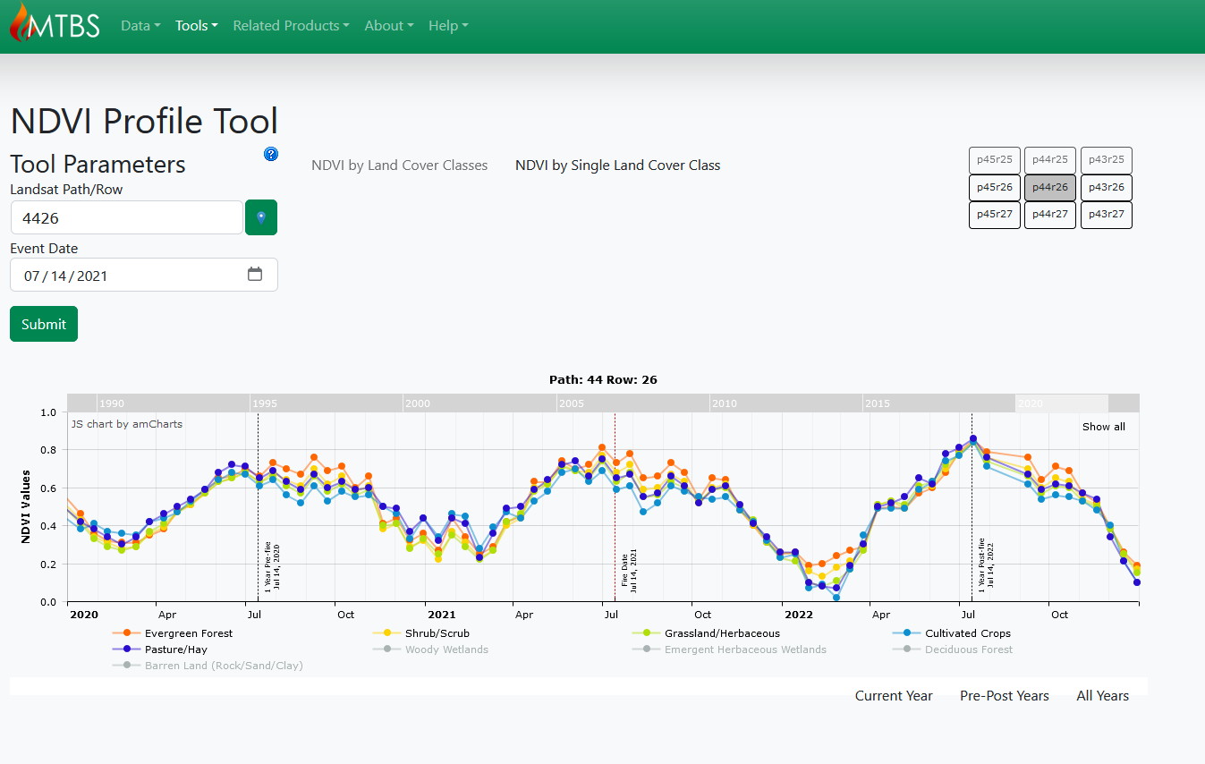
Burn Severity Assessment Considerations
https://mtbs.gov/index.php/ndvi-graphs

Slide 12
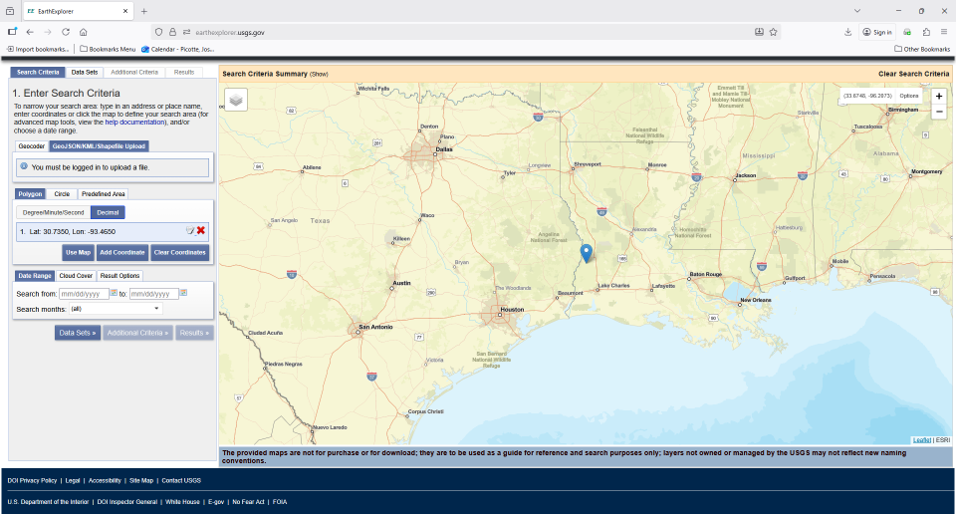
Where to Get Imagery
Earth Explorer: https://earthexplorer.usgs.gov/

Slide 13
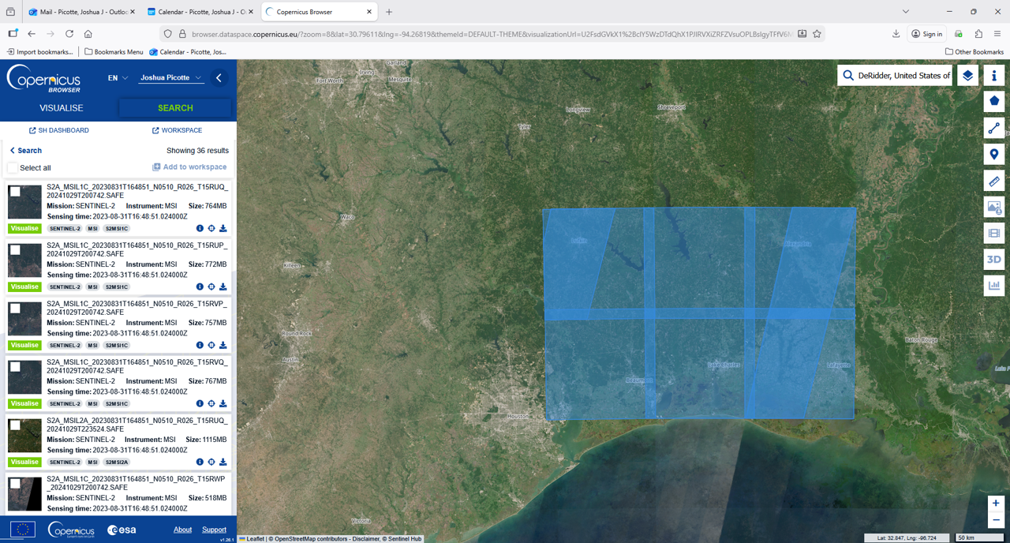
Where to Get Imagery
Copernicus: https://browser.dataspace.copernicus.eu/

Slide 14
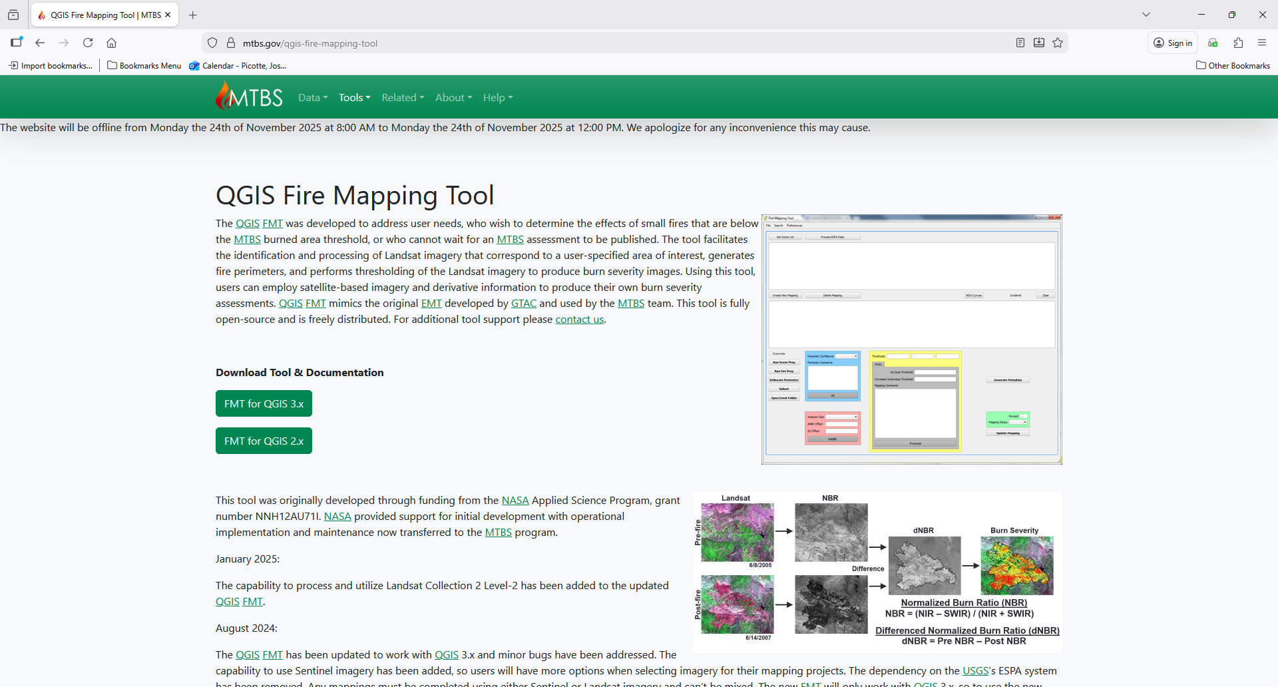
FMT Tool
https://mtbs.gov/qgis-fire-mapping-tool

Slide 15
Questions/Comments?
knelson@usgs.gov

Slide 16
Extra Slides

Slide 17
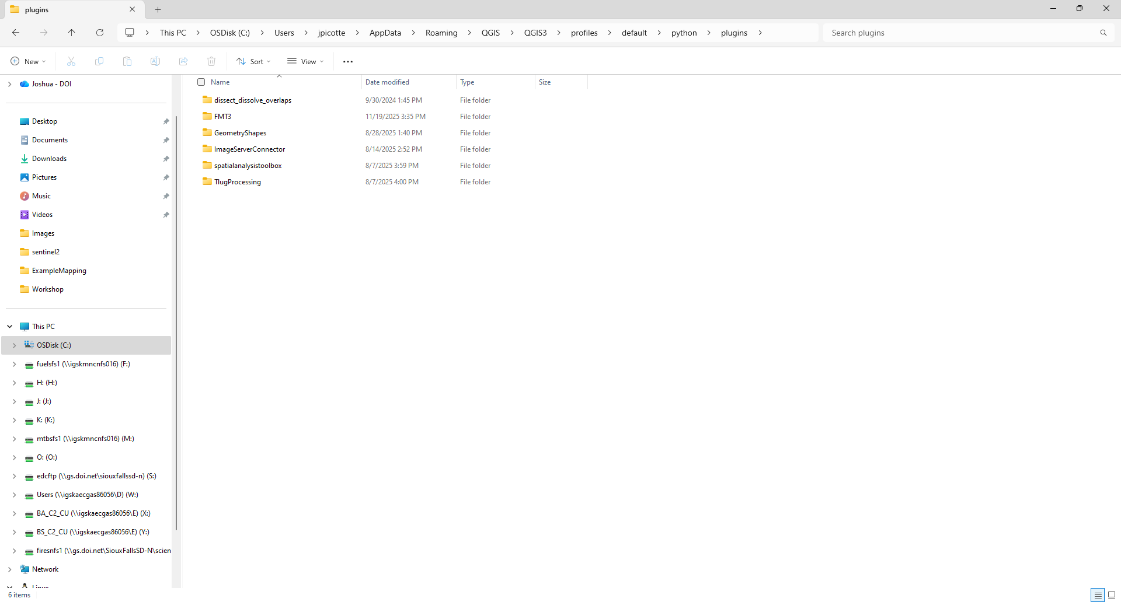
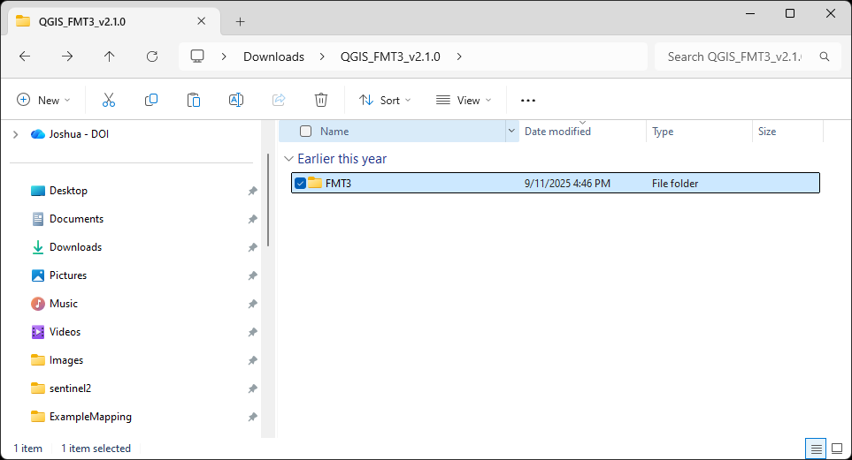
FMT Tool Setup
Move FMT3 folder into your QGIS plugins folder

Slide 18
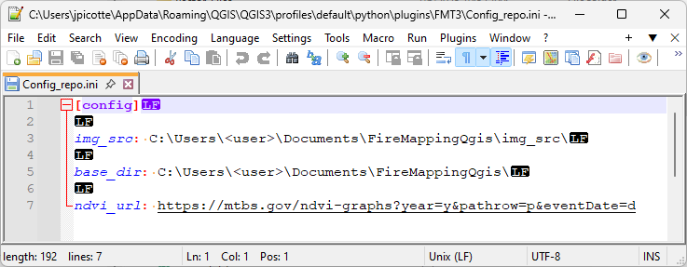
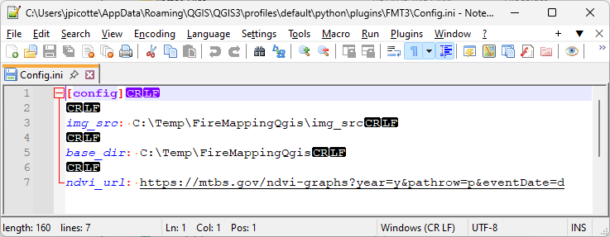
FMT Tool Setup
Edit Config_repo.ini with your setup
Save as Config.ini

Slide 19
FMT Tool Setup
Edit Config_repo.ini with your setup
Save as Config.ini

Slide 20
FMT Tool Setup
Make a copy of the “FireInfo_repo.sqlite” file
Save as “FireInfo.sqlite”

Slide 21
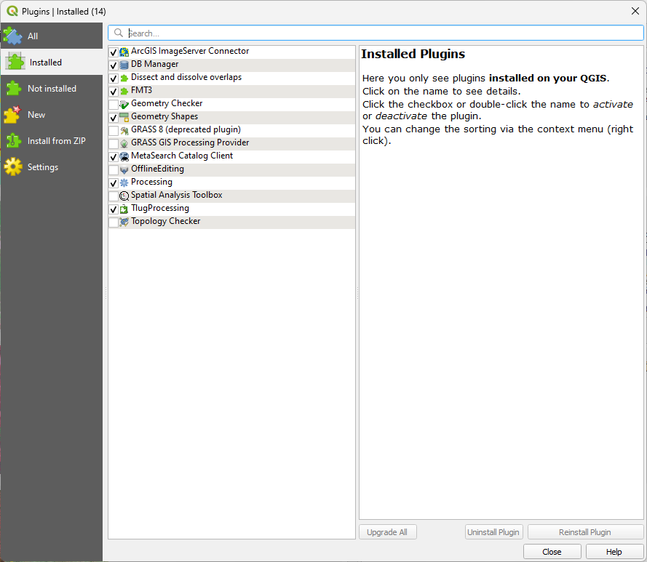
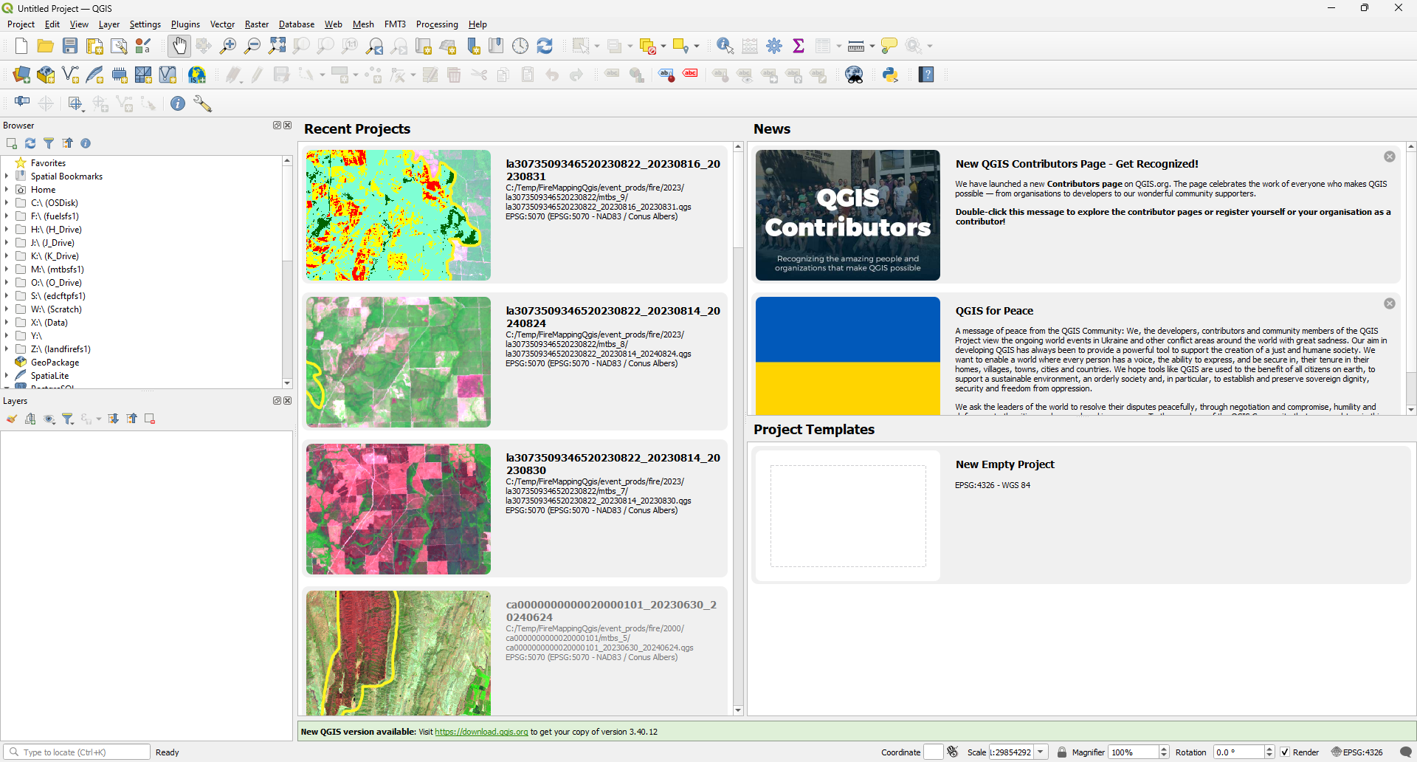
FMT Tool Setup

