Slide 1
Normalized Difference Vegetation Index (NDVI) MODIS to VIIRS Transition
Mike Budde
Science Meeting – Boulder, CO
13-15 June 2023

Slide 2
TERRA
Launched Dec 1999
6-year design life
Morning – 10am overpass
AQUA
Launched May 2002
6-year design life
Afternoon – 1pm overpass
The MODIS instruments aboard both EOS satellite platforms has provided NDVI source data for more than 20 years.
Both platforms will be decommissioned over the course of the next year – therefore an alternative source for these data was needed.
EROS stopped processing eMODIS as of September 2022.

Slide 3
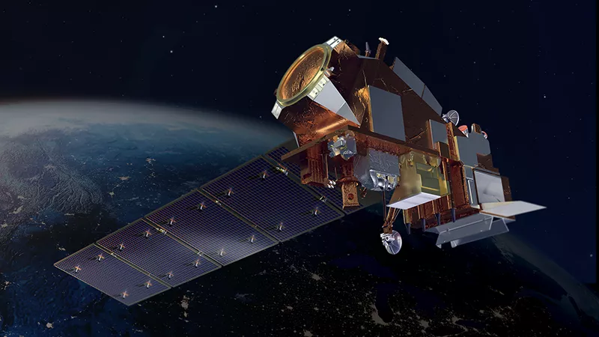
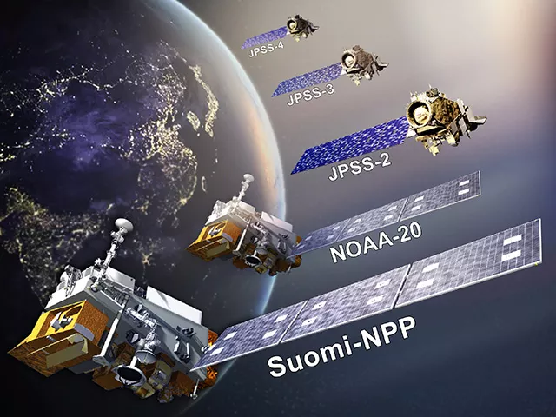
Joint Polar Satellite System (JPSS) Program
JPSS is the next generation of polar-orbiting Earth observing satellites and will ultimately include 5 satellites with varied instrumentation.
Suomi National Polar-orbiting Partnership (Suomi-NPP)
Launched Oct 2011
NOAA-20 (JPSS-1)
Launched Nov 2017
JPSS-2
Launched Nov 2022
JPSS-3 – Launch 2028
JPSS-4 – Launch 2032
Each of these satellites will include an instrument called Visible Infrared Imaging Radiometer Suite (VIIRS) which is the replacement for MODIS.

Slide 4
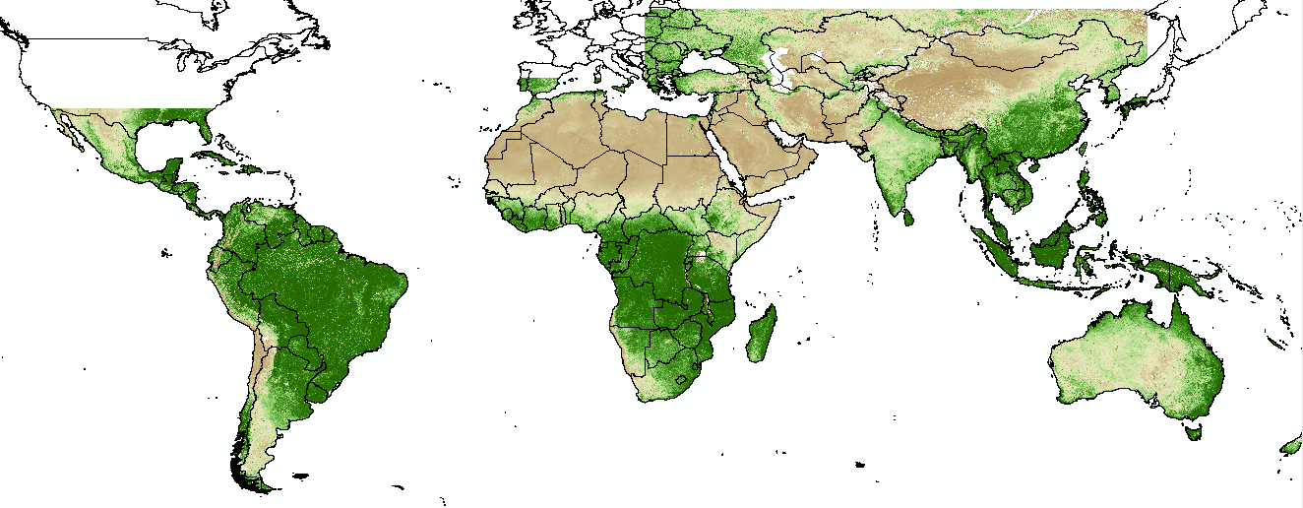
eVIIRS NDVI – Operational Monitoring
FEWS NET Regional Windows – Africa, Central Asia, Central America/Hispaniola, South America, & Australia/Indonesia

Slide 5
Sensor Characteristics Comparison
Spatial:
250m pixel resolution
Global daily coverage
Temporal:
10-day (dekadal) composite
Updated every 10 days
Afternoon overpass
Spatial:
375m pixel resolution
Global daily coverage
Temporal:
10-day (dekadal) composite
Updated every 5 days
Afternoon overpass
eMODIS (2003-Sept 2022)
eVIIRS (2012-present)
Accuracy:
Cloud – smoothing
Accuracy:
Cloud – modified smoothing
Higher quality in general

Slide 6
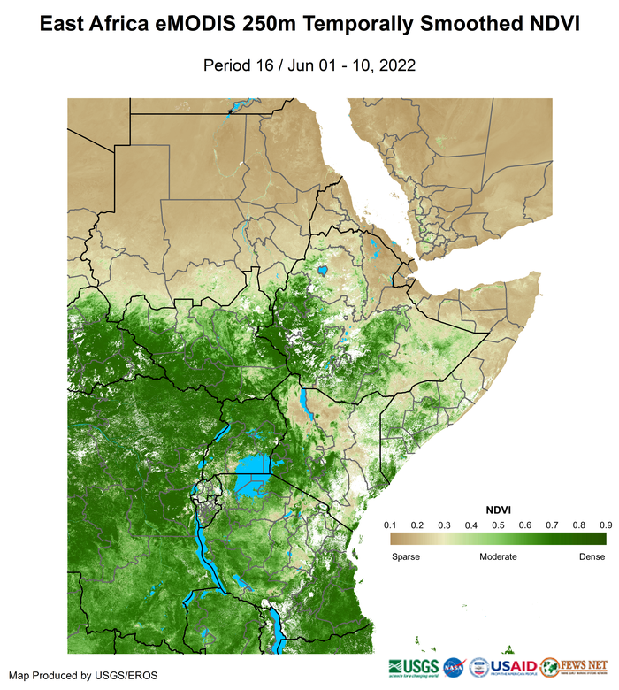
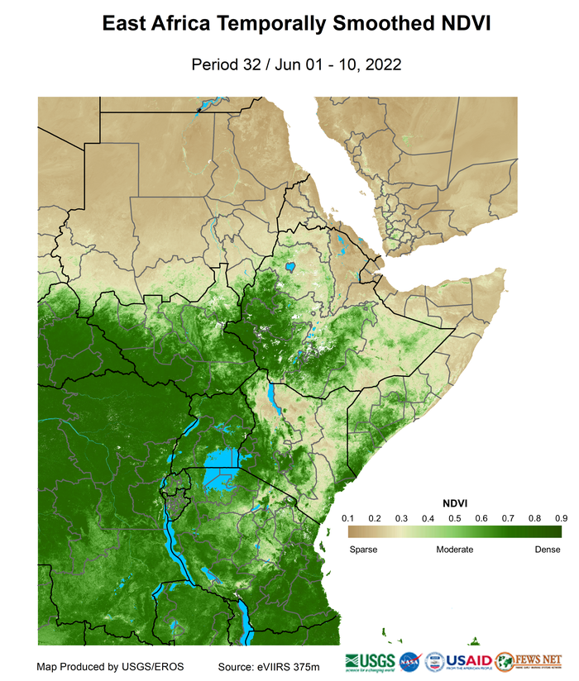
NDVI Dekad 16/Pentad 32

Slide 7
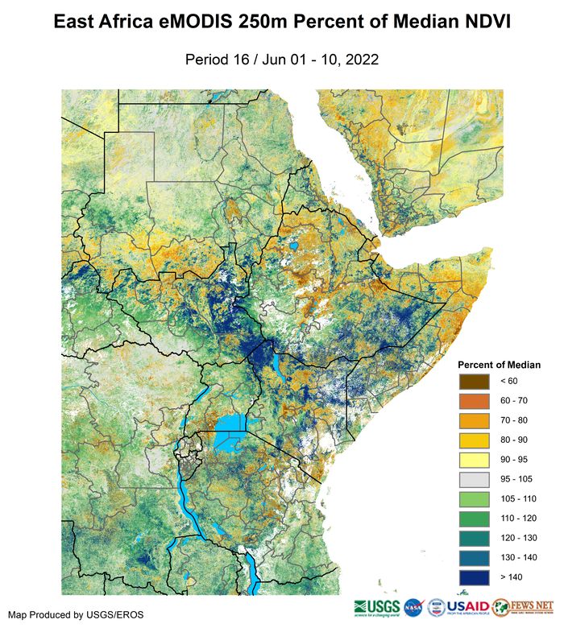
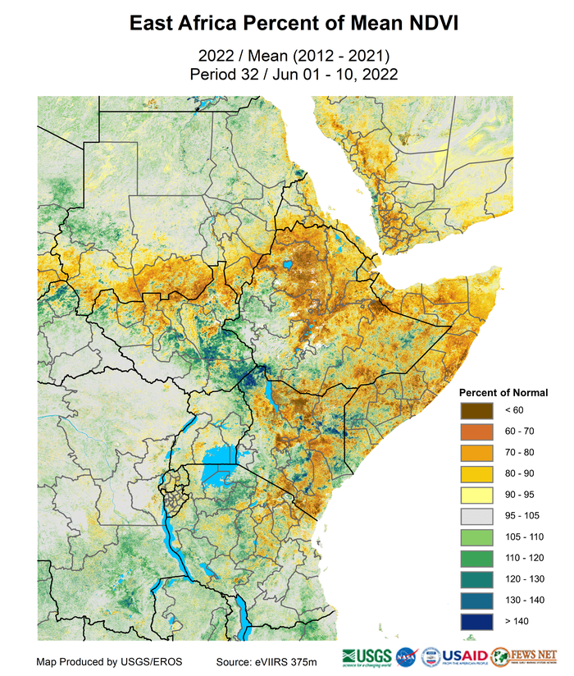
NDVI Percent Anomaly Dekad 16/Pentad 32
2022 / Median (2003-2017)
Period 16 / Jun 01-10,2022
2022 / Mean (2012-2021)
Period 32 / Jun 01-10,2022

Slide 8
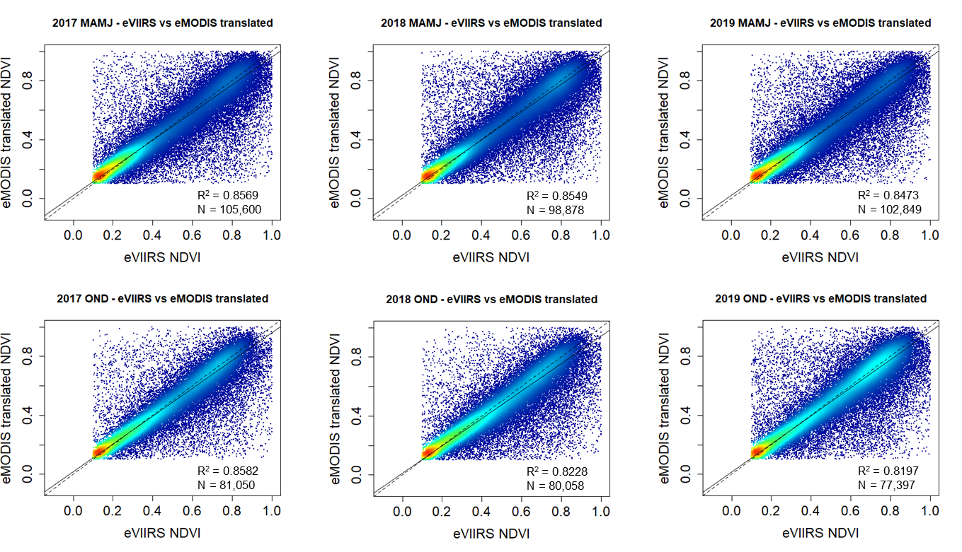
Extending our NDVI History of Record Translated eMODIS to match eVIIRS – Geometric Mean Regression
Greater Horn of Africa Seasonal Comparisons 2017-19

Slide 9
Extending our NDVI History of Record Translated eMODIS to match eVIIRS – Geometric Mean Regression
The entire eMODIS record from 2003-2011 has been transformed to match eVIIRS and is being referred to as eVMOD.
eVMOD has been used along with the 2012-2022 record of eVIIRS to generate a 20-year mean period (2003-2022).
The eVMOD/eVIIRS 20-year mean is operational in EWX as a secondary mean source when viewing NDVI time series.
The eVMOD/eVIIRS is also being developed as a stand alone NDVI product that generates our standard anomaly and percent of mean anomaly based on the 20-year period.

Slide 10
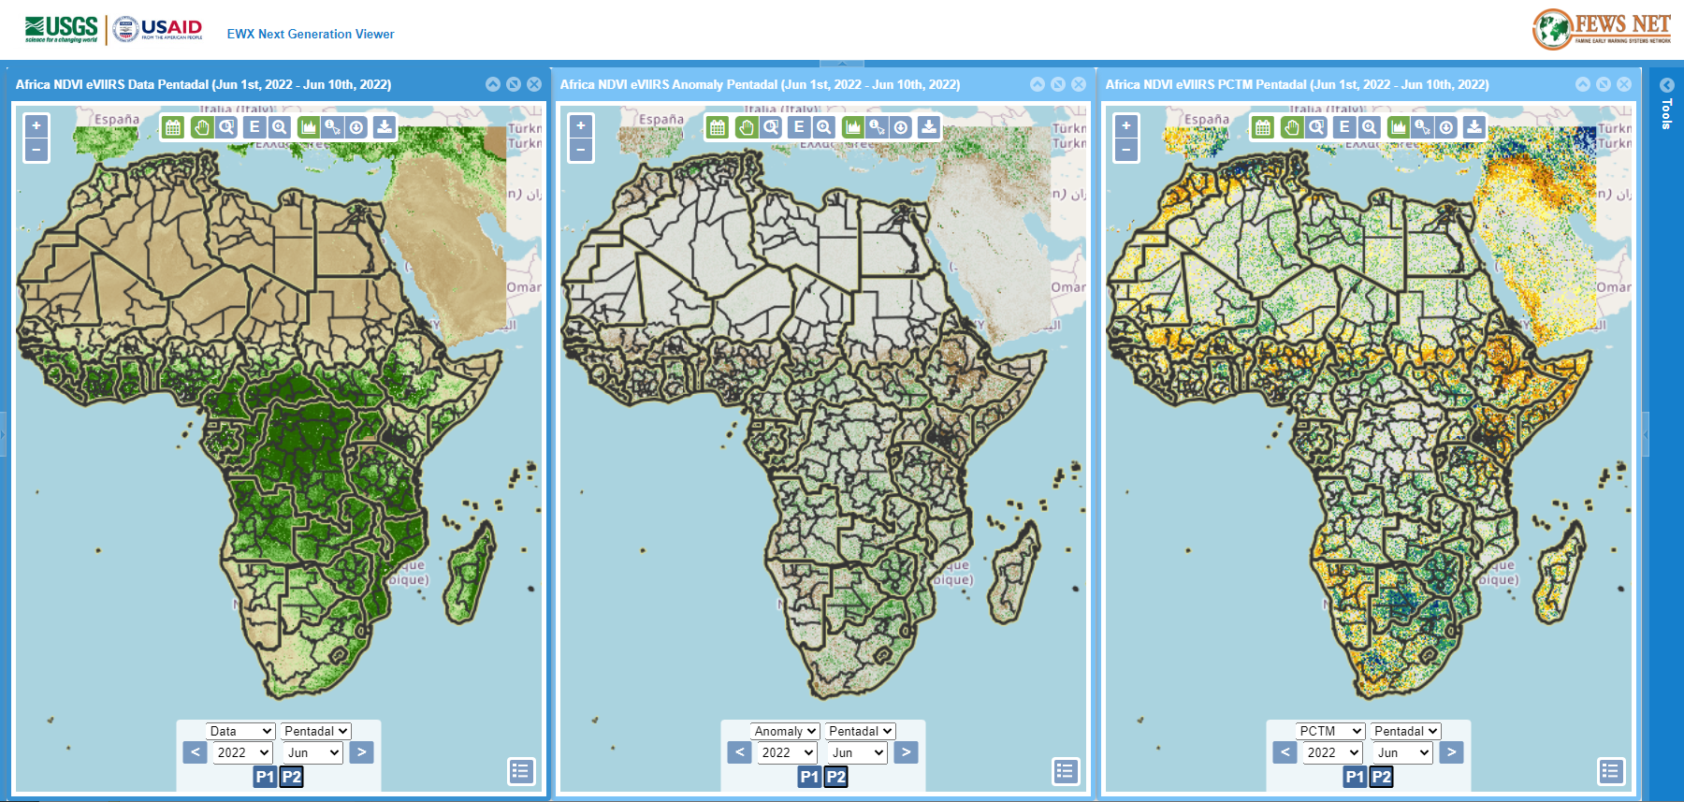
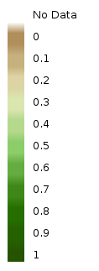
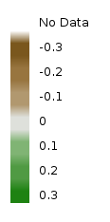
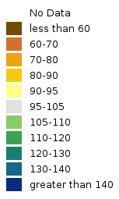
eVIIRS in EWX Time series plots have both a 20-year and 10-year mean option

Slide 11
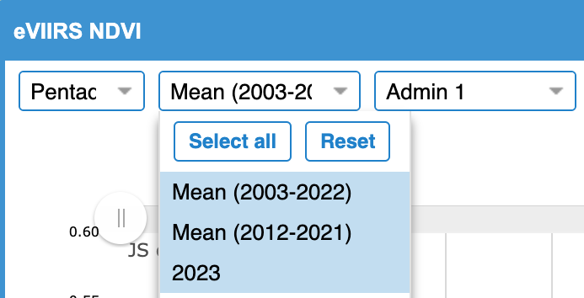
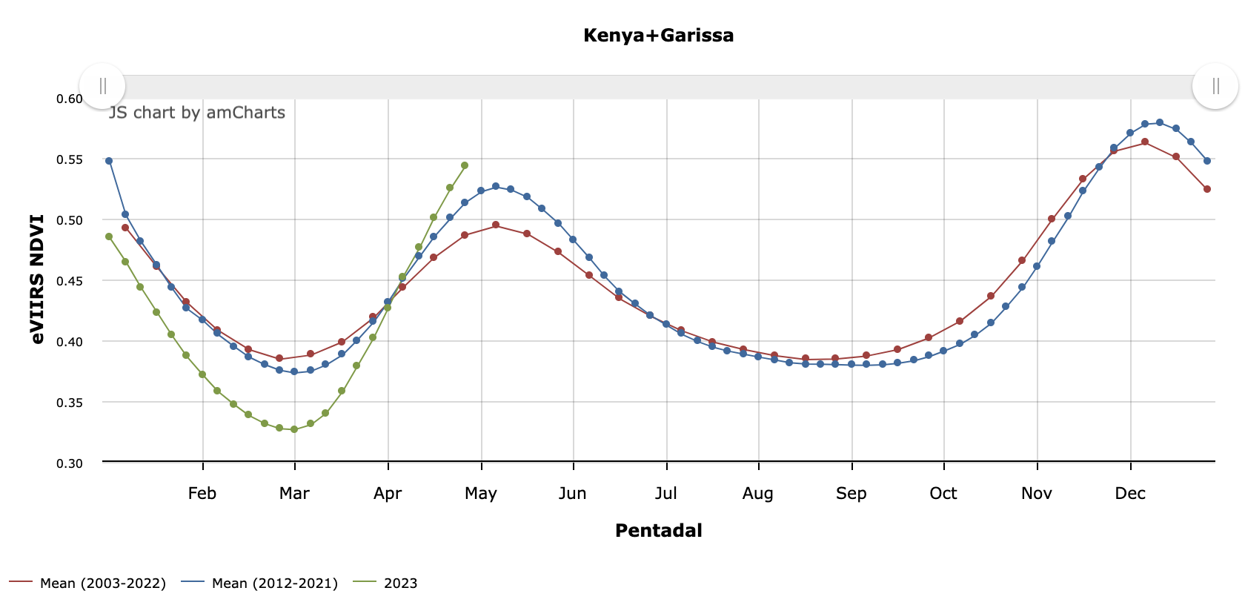
Extending our NDVI History of Record 10-Year Mean (2012-2021) and 20-Year Mean (2003-2022)

Slide 12
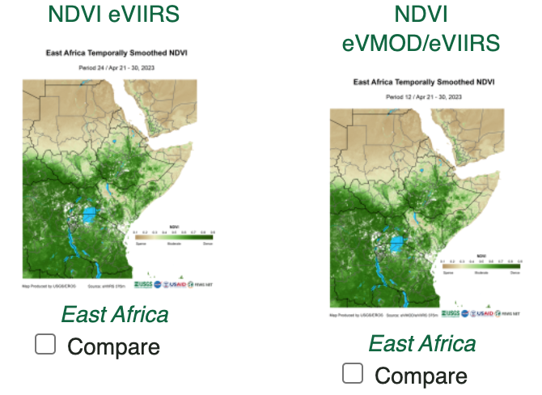
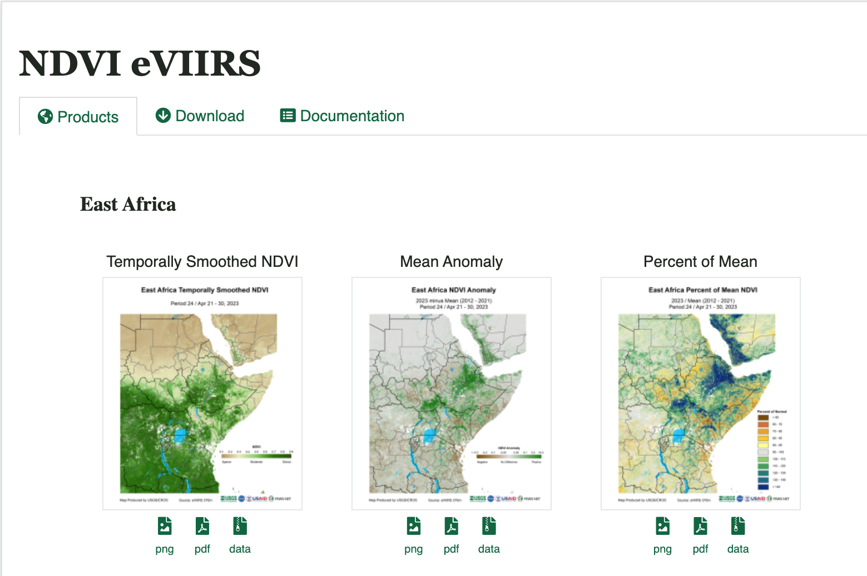
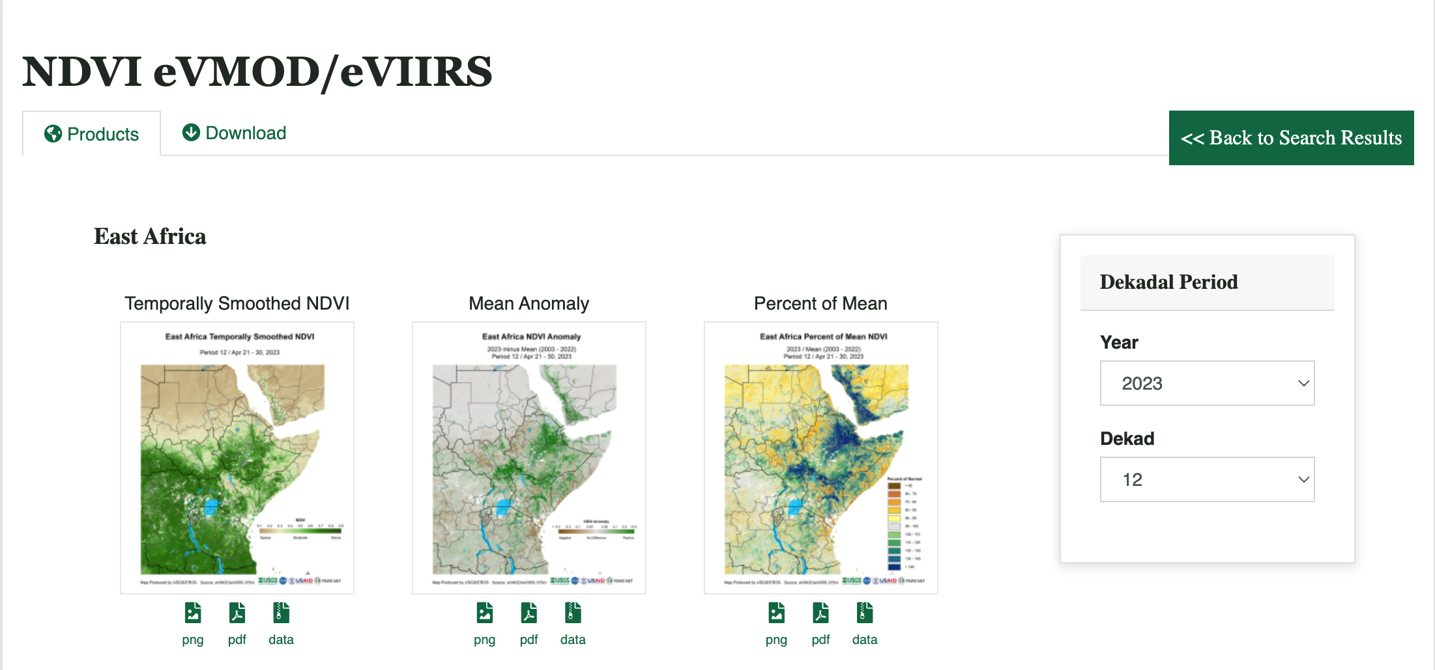
Extending our NDVI History of Record 10-Year Mean (2012-2021) and 20-Year Mean (2003-2022)

Slide 13
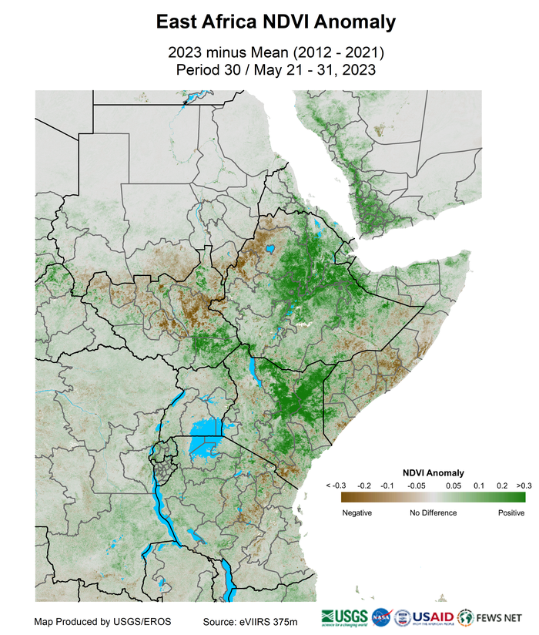
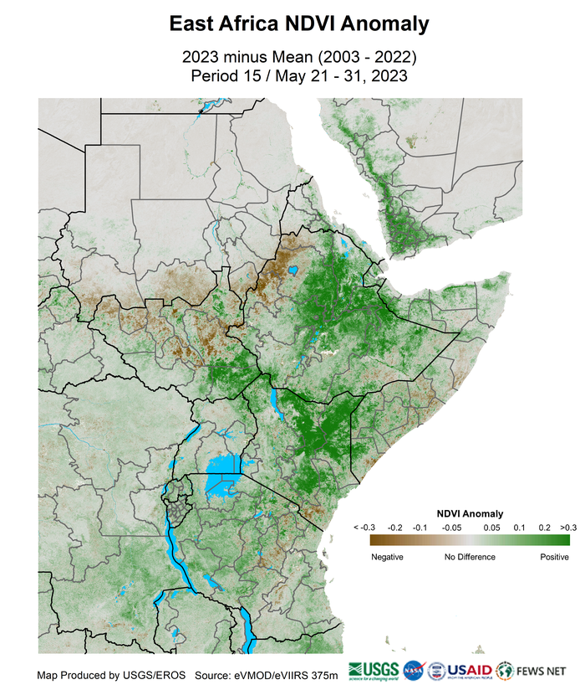
Extending our NDVI History of Record 10-Year Mean (2012-2021) and 20-Year Mean (2003-2022)

Slide 14
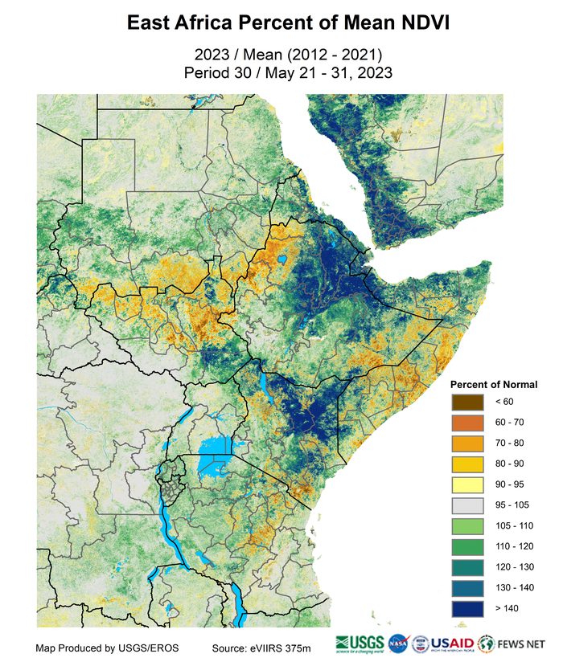
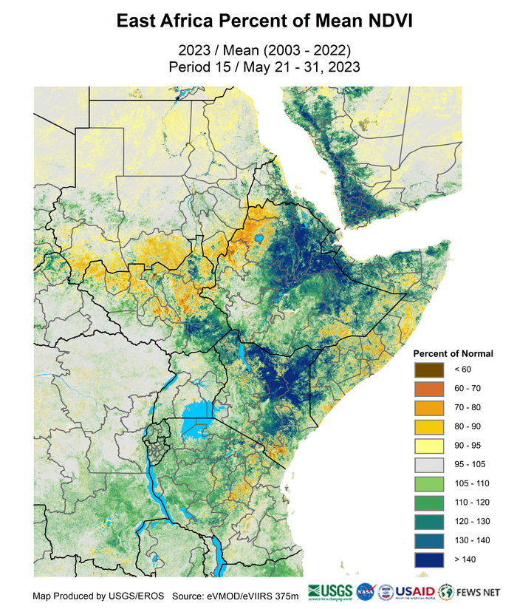
Extending our NDVI History of Record 10-Year Mean (2012-2021) and 20-Year Mean (2003-2022)

Slide 15
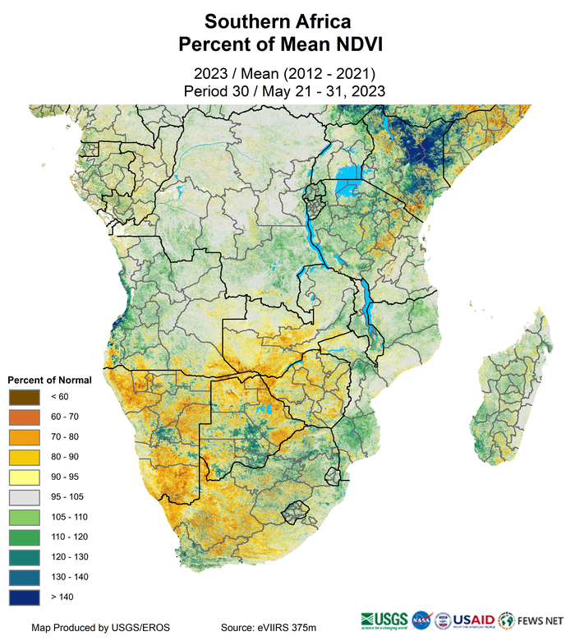
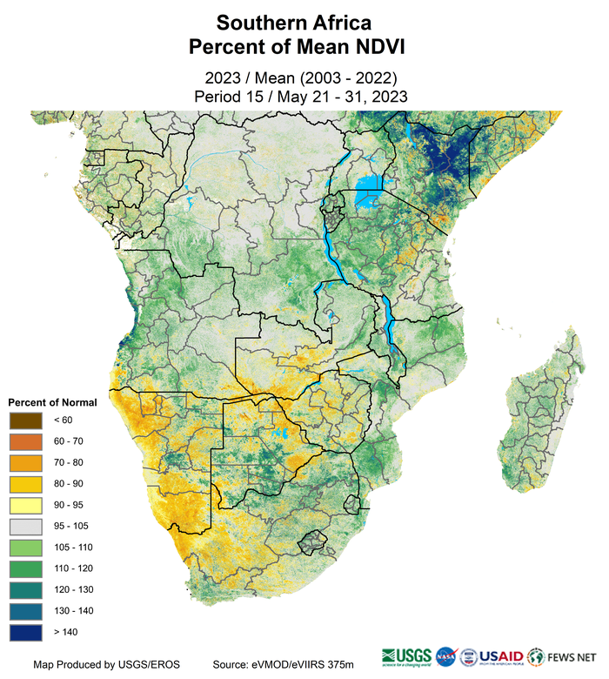
Extending our NDVI History of Record 10-Year Mean (2012-2021) and 20-Year Mean (2003-2022)

Slide 16
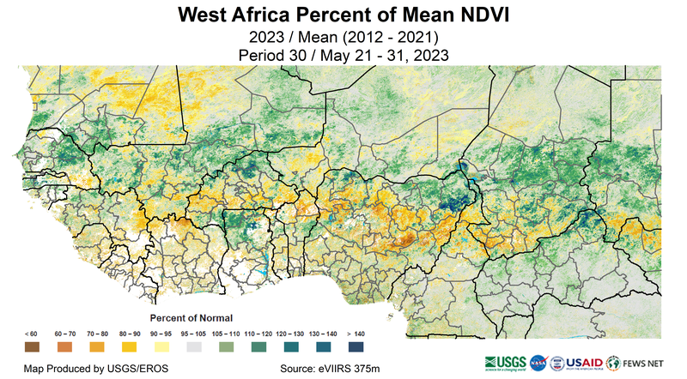
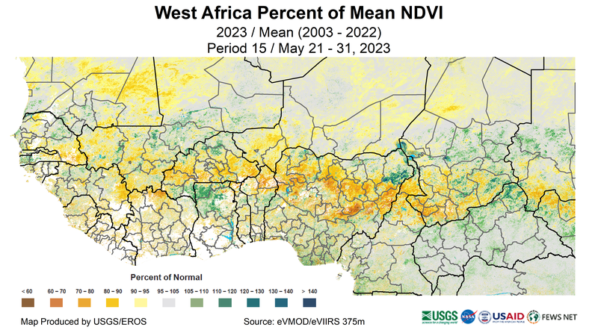
Extending our NDVI History of Record 10-Year Mean (2012-2021) and 20-Year Mean (2003-2022)

Slide 17
Summary
Two NDVI data streams will be maintained.
- VIIRS only that currently uses a 10-year mean
- Translated MODIS/VIIRS that uses a 20-year mean
EWX and EWX Lite tools both provide the two mean periods for time series analysis.
Time series for the two mean periods can identify changes in timing of start of season as well as changes in the amplitude of the seasonal signal.
With the scheduled follow-on missions for the satellites carrying the VIIRS sensor, we should be able to utilize these data to provide NDVI for FEWS NET well into the next decade.

Slide 18
Thank You

