Slide 1
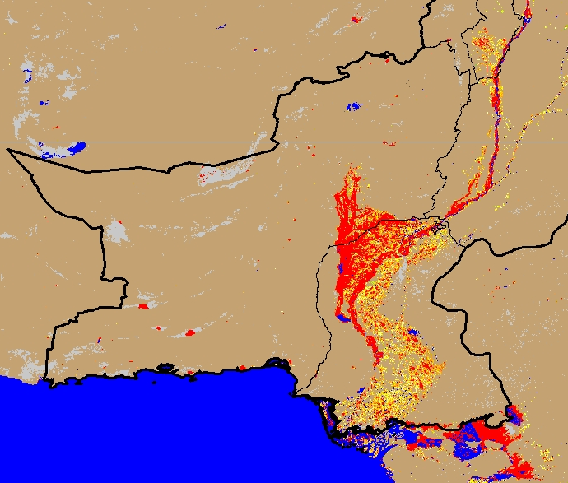
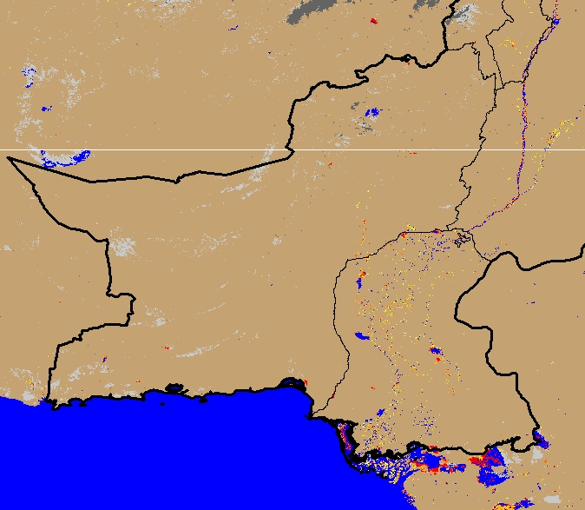
Comparison Between Aug 2022 and Current Flooding Extent
(% of the pixel)
(% of the pixel)
NOAA VIIRS 5-day comp. 26 - 31 Aug 2022
NOAA VIIRS 5-day comp. 25 - 29 Mar 2023

