Slide 1
Temperature Data GFS - CHIRTS
Applications of FEWS NET Remote Sensing products for Agro-climatological Analysis Workshop
10 – 14 July 2017 | Kathmandu Nepal

Slide 2
Current and Future Opportunities
Temperature data currently utilized by FEWS NET is quite limited – but there is a new data set being generated that will provide a 30+ year history and operational data at a quasi-global scale.
Current: The only source of temperature data that is currently being used by FEWS NET for the region is the Global Forecast System (GFS) temperature provided by NOAA/CPC.
Future: USGS and colleagues at UC Santa Barbara are creating a Climate Hazards InfraRed Temperature with Stations (CHIRTS) data set for 1981-present.

Slide 3
GFS Temperature Data
The Global Forecast System (GFS) is a weather forecast model produced by the National Centers for Environmental Prediction (NCEP). Dozens of atmospheric and land-soil variables are available through this dataset, from temperatures, winds, and precipitation to soil moisture and atmospheric ozone concentration. The entire globe is covered by the GFS at a base horizontal resolution of 18 miles (28 kilometers) between grid points, which is used by the operational forecasters who predict weather out to 16 days in the future.

Slide 4
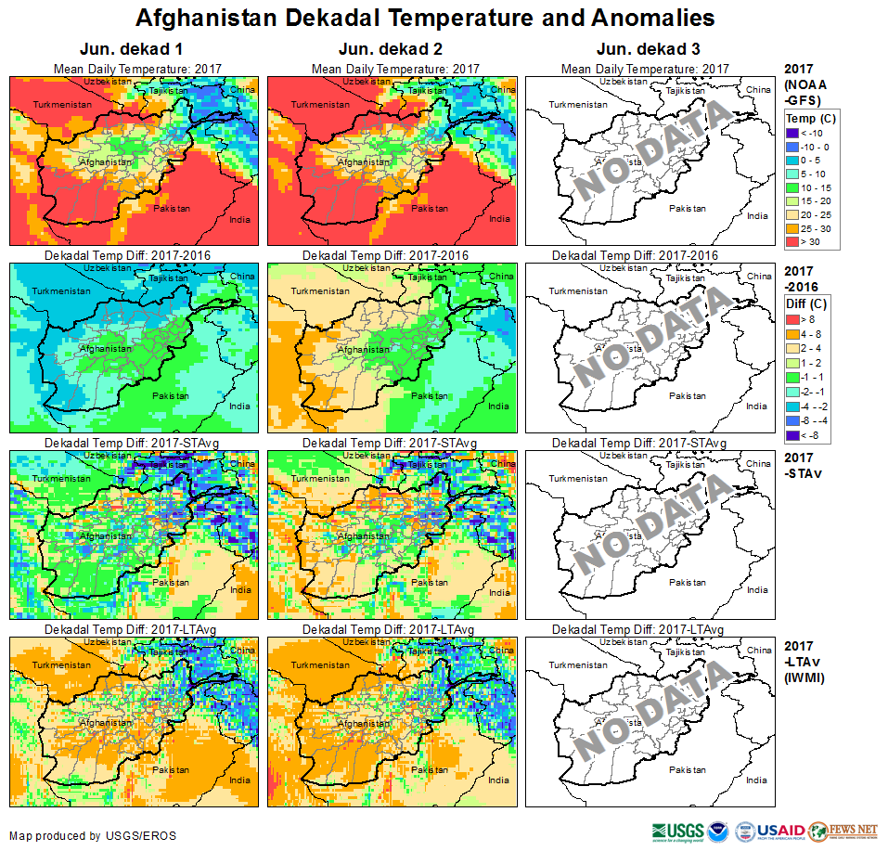
GFS Temperature Data
Dekadal Mean Daily
Dekadal Mean Daily Difference w/Previous Year
Dekadal Mean Daily Difference w/STAvg (2004-2008)
Dekadal Mean Daily Difference w/LTAvg (IWMI)

Slide 5
Toward a CHIRTS product
Basic goal is to find a relationship between satellite thermal IR brightness temperature and ground station daily maximum air temperature (Tmax) data
Using thermal IR data at 8km pixels, 70N to 70S, 1980-2015, 8 times/day (0hr, 3hr, 6hr, 9hr, 12hr, 15hr, 18hr, 21hr)
Pixel scale algorithm development/tuning/validation using CRU gridded temperature data
Global scale validation using gridded datasets of station data at 0.5 degree resolution – CRU, CFS Reanalysis, MERRA, NOAA GHCN-M v3.1.0
Notes:
Thermal IR brightness temperature and emissivity relate to surface temperature
CRU: Climatic Research Unit (Univ. of East Anglia, UK)
MERRA: NASA Global Reanalysis Modeling…
GHCN-M: Global Historical Climatology Network--Monthly

Slide 6
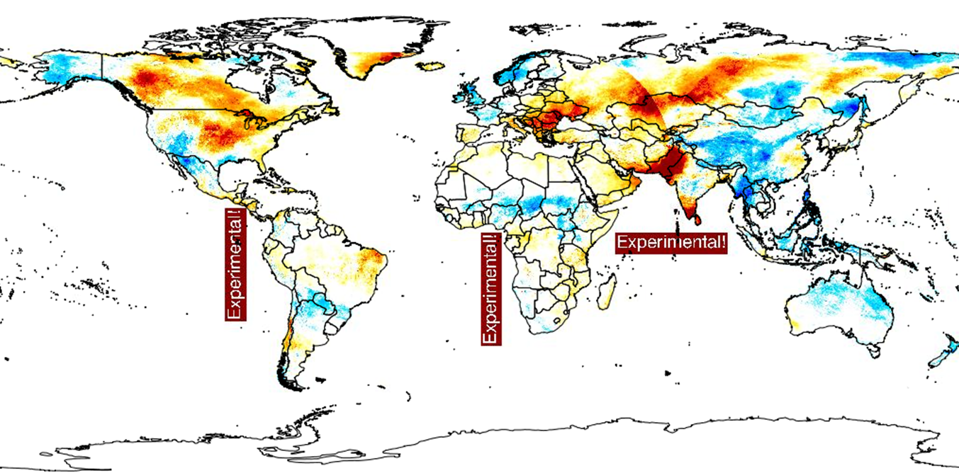
Toward a CHIRTS product
As with CHIRP, CHIRT is calculated using a climatology and anomalies
CHIRTS blends in station data (July 2015)

Slide 7
Methods
Step 1 get as much of the clouds out of the hourly satellite data as possible
Step 2 use the 3-hourly data values to get the best possible daily IRTmax
Step 3 aggregate daily IRTmax to monthly time scale, convert average monthly values to anomalies
Step 4 CHIRT_{month,year} = CHTclim_{month} + IRTmax anomaly_{(month, year)}

Slide 8
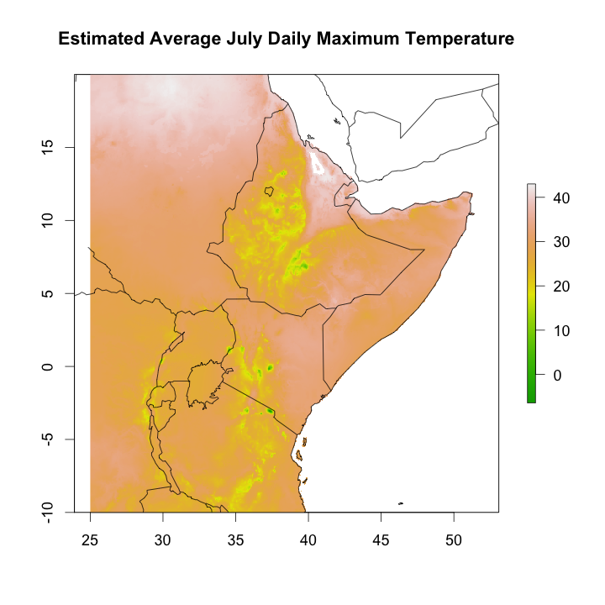
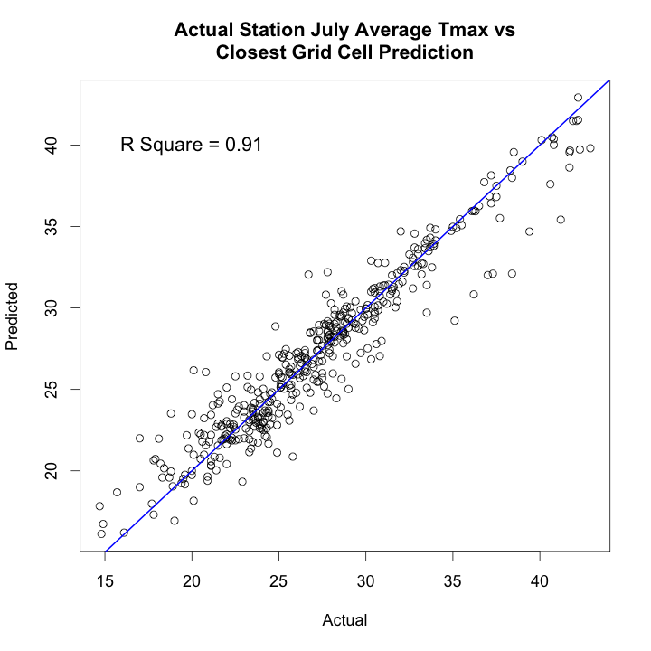
Tmax Climatology

Slide 9
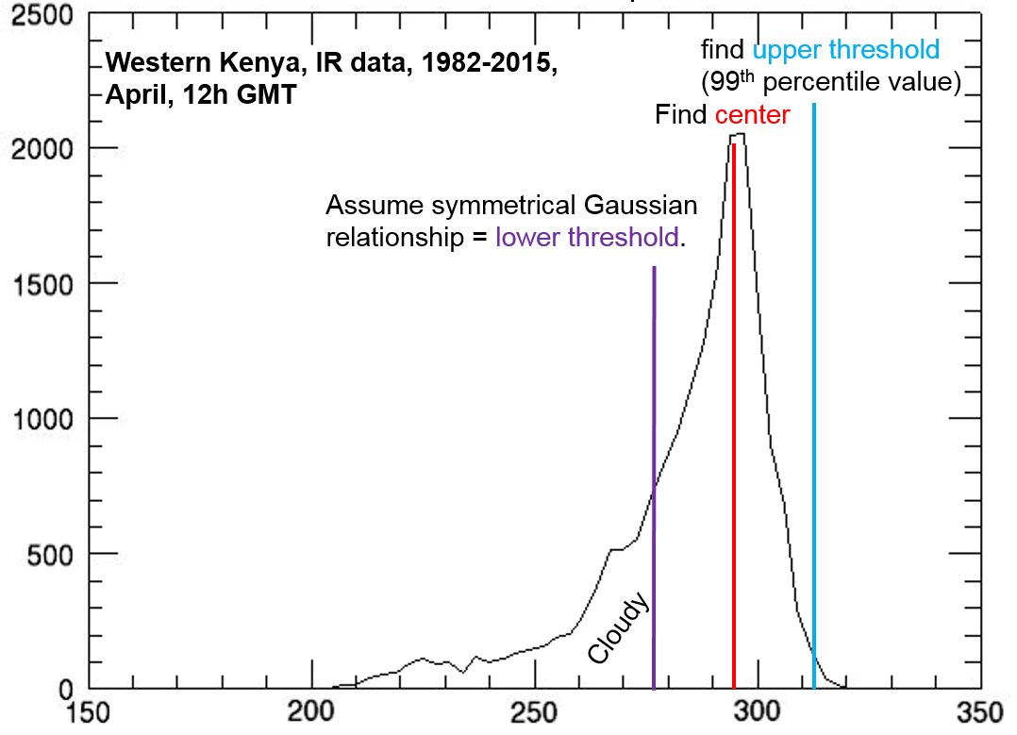
IRTmax - Step 1
Notes:
Lower threshold is determined from the mode (center) of the “gaussian” distribution and the upper threshold
Distribution is for pixels (western Kenya) through one month (30 days of April) for 3-hourly data from 12p-3p GMT for all years
295 K = 71 F = 22 C; 312 K = 102 F = 39 C; 278 K = 41 F = 5 C

Slide 10
IRTmax - Step 2
Once as many clouds as possible have been removed, hourly data can be used to calculate daily IRTmax
Notes:
Climatology = 34 years 3-hourly IRT data
X-axis: 3-hourly period(s)

Slide 11
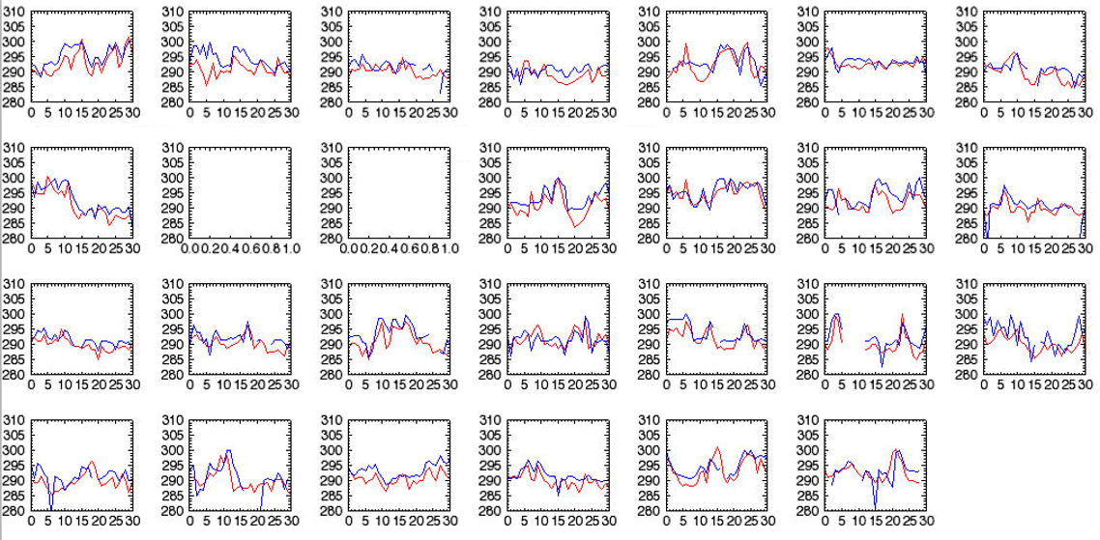
January daily IRTmax – Santa Barbara
Daily air Tmax, IRTmax for Goleta, CA for December, 1980-2014 minus 83, 89-95 (and in this case no data 96, 97). Pretty good agreement! But goal for this project is not daily predictions but monthly predictions – is the current month anomalously warm or cool based on the record.
Notes:
27 years of January daily Tmax (IRT vs. station) data

Slide 12
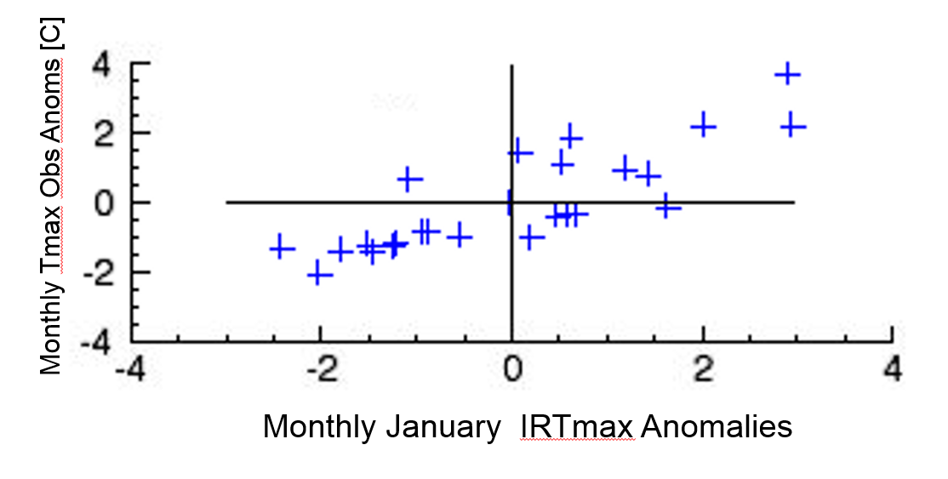
January Monthly IRTmax – Santa Barbara
Data from previous slide, daily data converted to monthly average, plotting that data in anomaly space. Each data point is the station (Y), satellite (X) anomaly in January for a given year. R = 0.831.
Notes:
27 years IRT and air temperature compared to long-term average

Slide 13
Validation Study
Based on 1983-2014 comparison with monthly CRU Tmax data (0.5 degree resolution)
Compared to IRT 0.05 degree cells, CRU data screened for grids with at least 1 station observation for each year
Chose CRU grid cells with lots of station observations
Looked at histograms and maps of correlations
Notes:
CRU: Climate Research Unit at Univ. of East Anglia

Slide 14
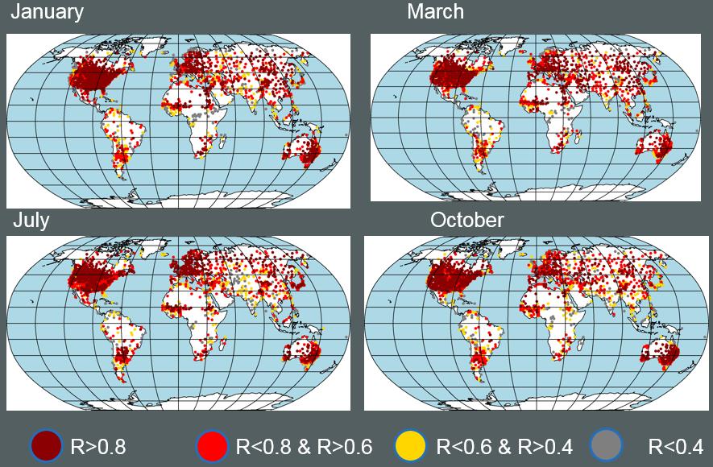
Correlation Histograms

Slide 15
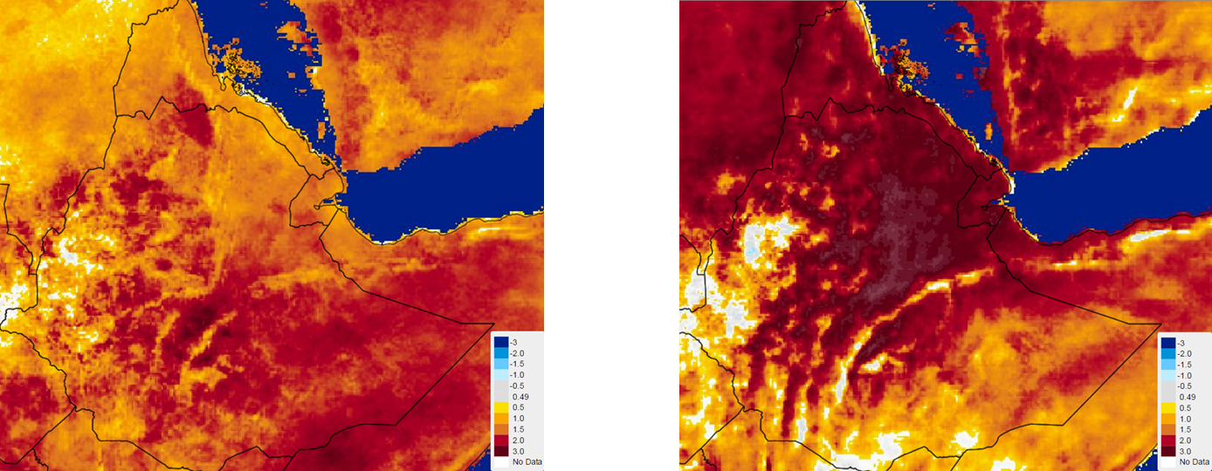
IRTmax Zscores – July 2015 very hot in Ethiopia
JJAS 2002
JJAS 2015
Notes:
JJAS IRTmax anomaly: 4-month (seasonal) average

Slide 16
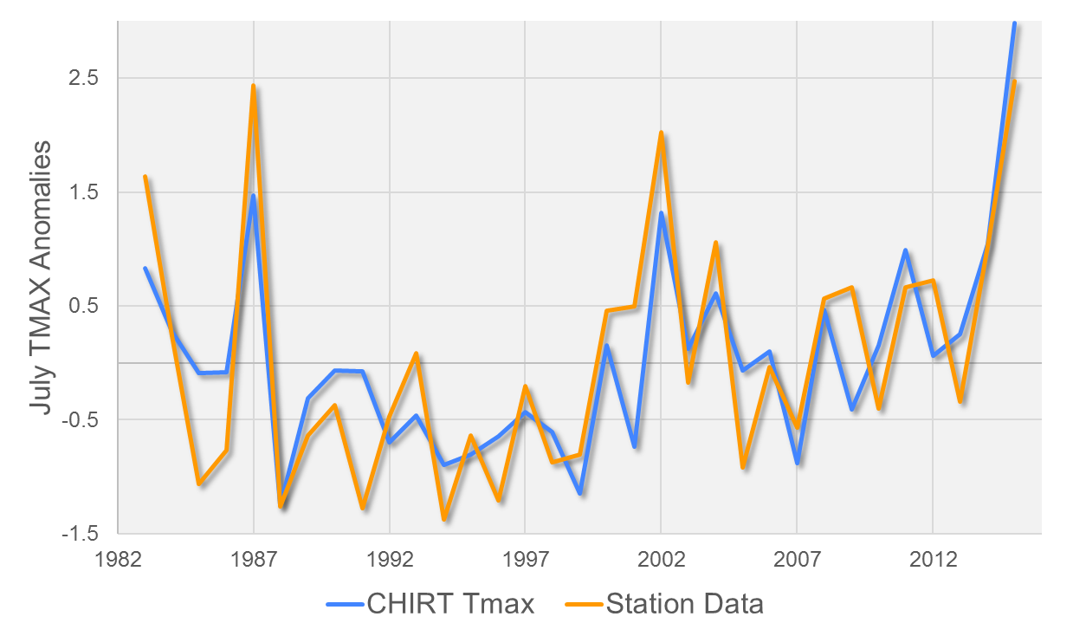
Northeastern Ethiopia Validation Study
Notes:
N = 3 (station data, about 1.5 degrees apart), in NE Ethiopia,

Slide 17
Conclusion
Skills for Tmax retrievals are very promising
Monthly 1983-2014 Correlations of ~0.8 in many places
Great source of information since many areas have almost no observations
Skill levels for trends probably higher than for inter-annual variations

Slide 18
Questions?

