Slide 1
Satellite Rainfall Estimates RFE & CHIRPS
Applications of FEWS NET Remote Sensing products for Agro-climatological Analysis Workshop
10 – 14 July 2017 | Kathmandu Nepal

Slide 2
Rainfall Monitoring – 2 Primary Sources
1) NOAA CPC/Rainfall Estimates (RFE2.0)
Coverage: Africa, South/Central Asia
RFE 2.0 (daily estimates) from 2001-present
GOES Precipitation Index (GPI) from Infra-red cold cloud duration)
Incorporation of microwave from AMSU-B and SSM/I
Incorporation of GTS rain gauge data
2) USGS/UCSB CHIRPS (Climate Hazards Group InfraRed Precipitation with Stations)
Coverage: Global – 50 deg N to 50 deg S
CHIRPS 2.0 (pentadal estimates) 1981-present
CHPClim monthly rainfall long-term averages
Cloud top temperatures (Satellite thermal-infrared data from NOAA)
Rain gauge data from a variety of sources

Slide 3
NOAA CPC RFE2: Basic Assumptions
Much of the rainfall in the tropics comes from convective storm clouds
These clouds precipitate when their tops have reached a certain optimal temperature or height
The cloud top temperature (related to height) can be computed from satellite infra-red (IR) images derived from observational data

Slide 4
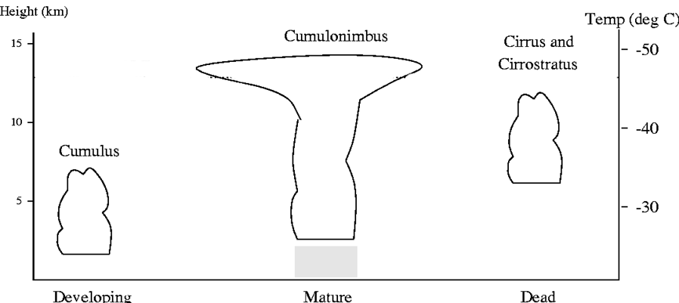
RFE: GOES Precipitation Index Technique
Cold cloud duration threshold (235K or -38deg. C)
Assumed rate of 3 mm/hour

Slide 5
RFE: Microwave Inputs (SSM/I & AMSU-B)
SSM/I (stratospheric sounding microwave/imager)
2 instruments estimate precipitation daily at ~6 hourly frequency
Tends to sharply overestimate detected convective rainfall
Fails to catch other rainfall in temporal gaps
AMSU-B (advanced microwave sounder)
Data available 4 times daily, staggered temporally
Tends to overestimate most precipitation, but does well with highly convective systems
Pre-processing of data; conversion from HDF format and resampling to 0.1 deg resolution

Slide 6
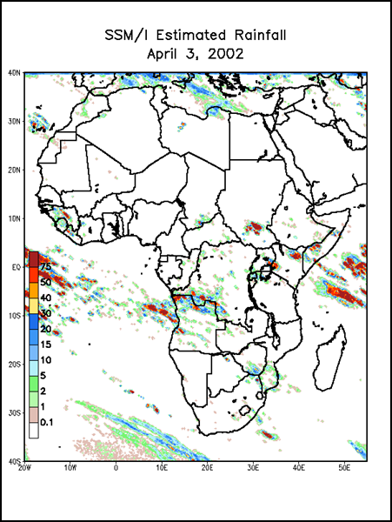
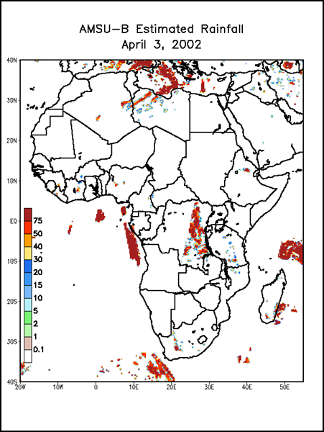
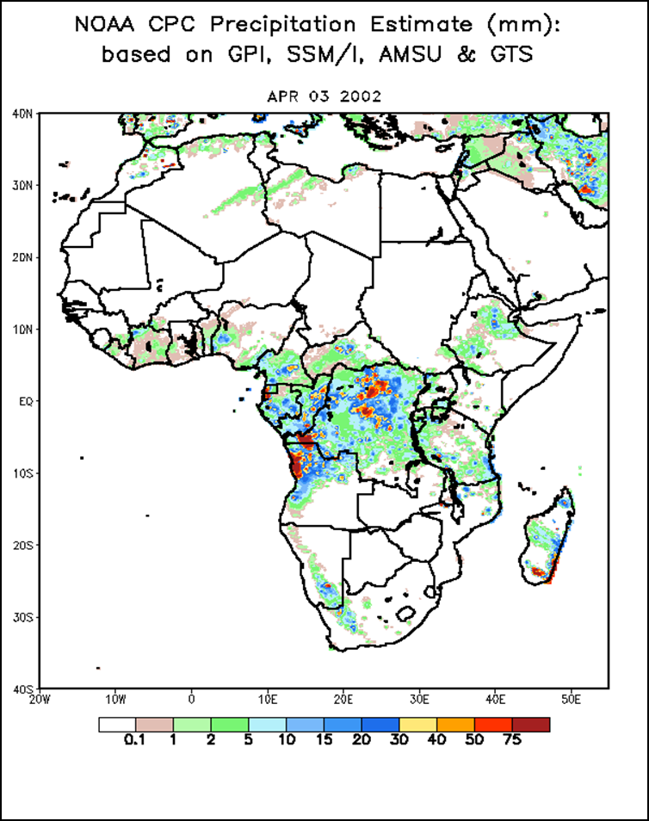
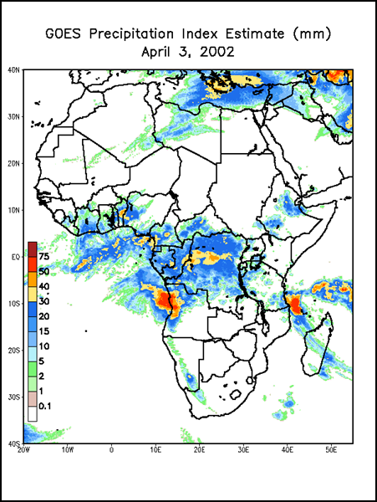
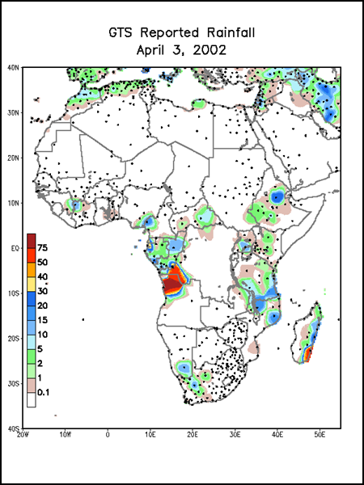
The three satellite estimates are combined linearly using predetermined weighting coefficients, then merged with the GTS station data.
Synergy of Outputs for
Final Product

Slide 7
RFE: Characteristics
Spatial:
0.1 degree (~10km) pixel resolution
Africa, Central Asia, South Asia coverage
Temporal:
Daily estimates, summed to dekadal (approx 10-day) totals
2001-present
Quantities:
Units: mm
Typical Presentation:
Actual, Diff-Avg, Pct-Avg, graphs, 30-day rain/dry day
Accuracy:
Estimates convective rainfall best
Good when rain gauges available on GTS

Slide 8
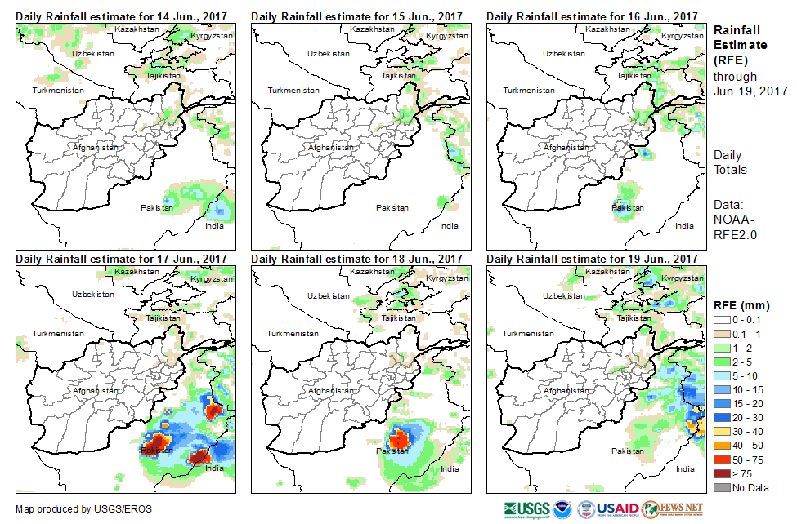
Daily RFE

Slide 9
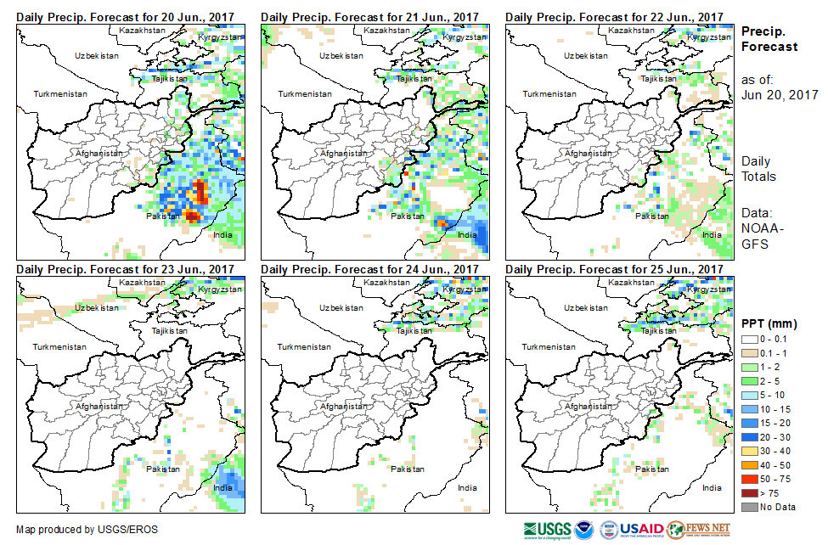
Daily GFS Forecast

Slide 10
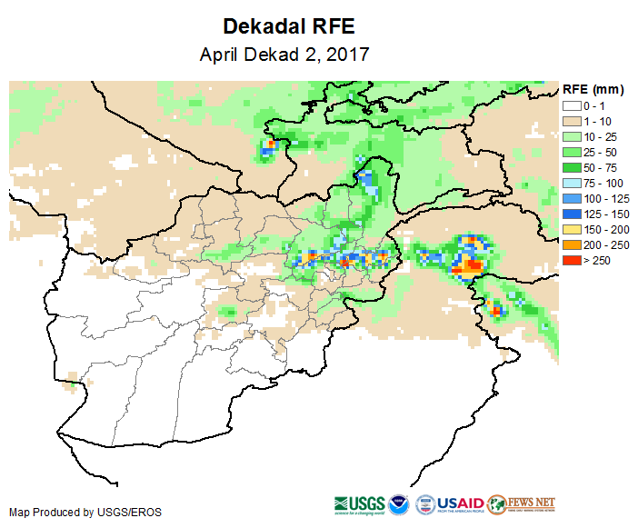
Dekadal (10-day) RFE

Slide 11
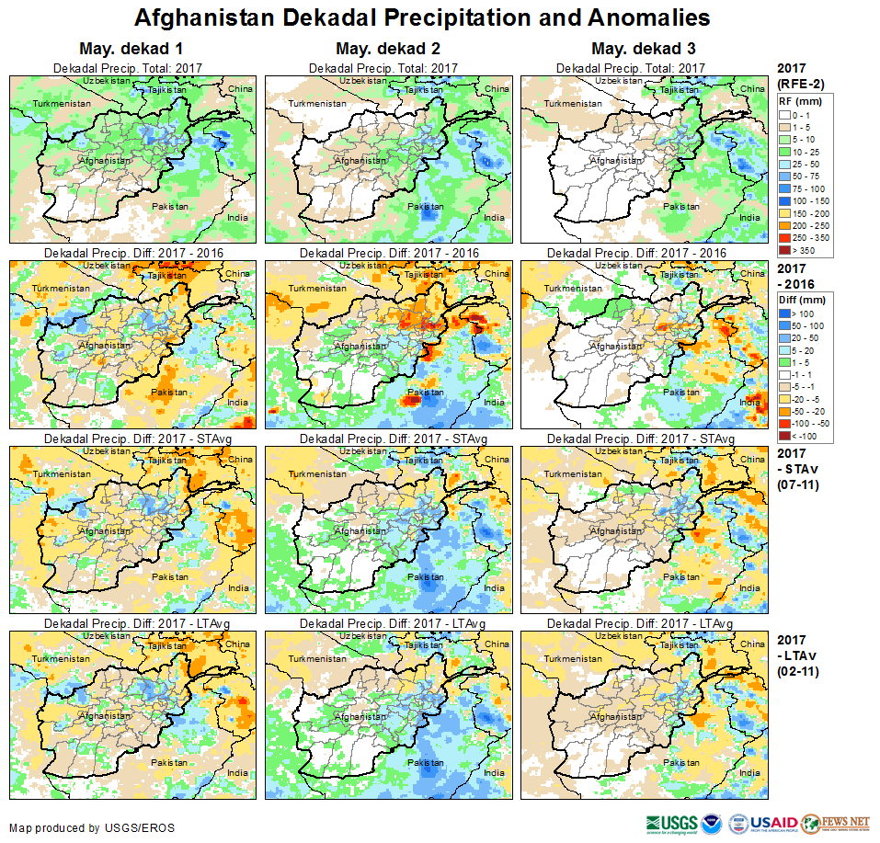
Dekadal (10-day) RFE

Slide 12
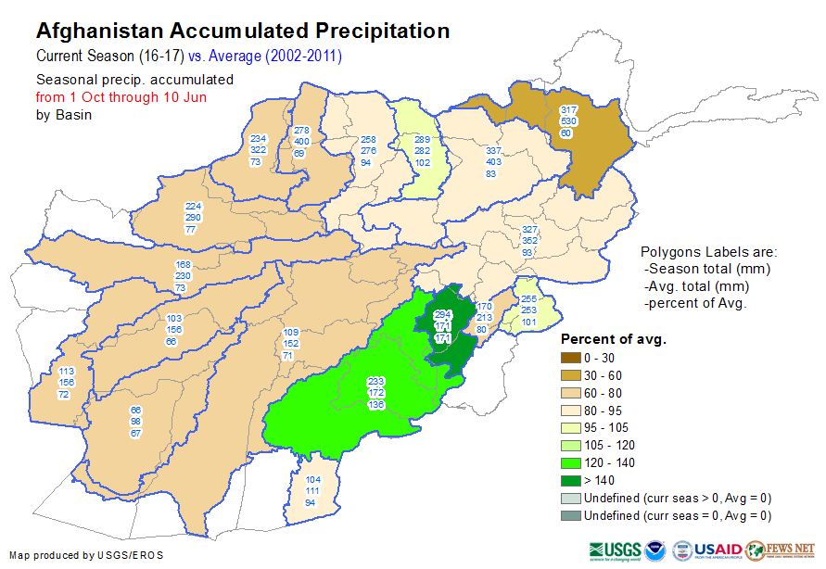
Dekadal Cumulatives

Slide 13
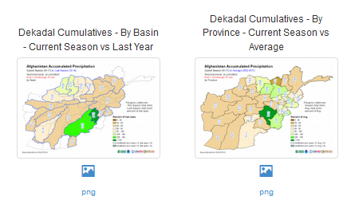
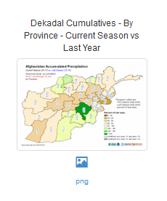
Other Dekadal Cumulatives

Slide 14
RFE– strengths and limitations
Strengths:
Provides good spatial representation of rainfall performance
High native temporal resolution (daily): allows further analysis at a daily time step (e.g. dry spells)
Can be improved after the final product using locally available rain gauge data

Slide 15
RFE– strengths and limitations
Limitations:
Cirrus clouds (cold and non-raining clouds)
Coarse resolution – misses very isolated storms
Does not perform very well where there are no rain gauges reporting on the GTS network or when GTS station reporting is irregular

Slide 16
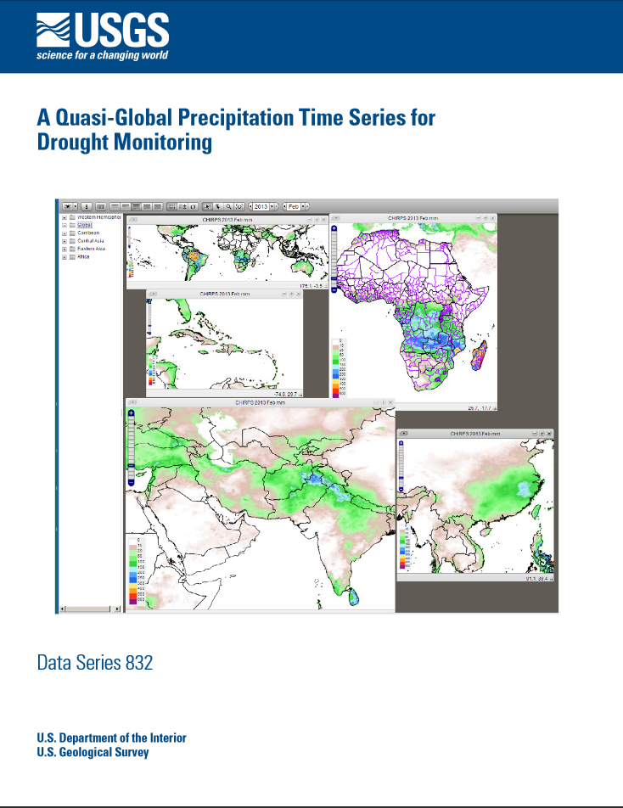
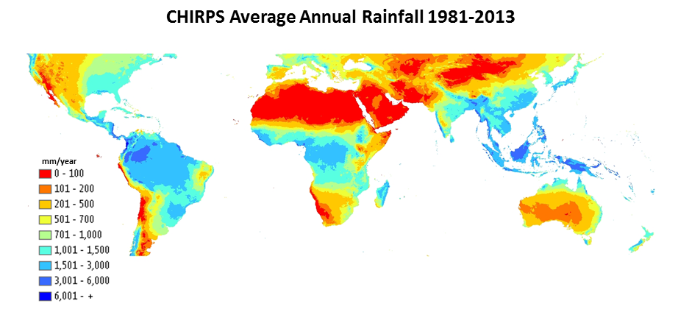
Climate Hazards Group InfraRed Precipitation with Stations (CHIRPS) Dataset
https://pubs.er.usgs.gov/publication/ds832

Slide 17
CHIRPS Process
Create historic precipitation climatology CHPclim
Convert IR data to precipitation estimate IRP
IRP = b0 + b1 *(Cold Cloud Duration percent)
Apply time variability of IRP to CHPclim to make CHIRP
CHIRP = CHPclim * (IRP %normal)
Blend in stations with CHIRP to make CHIRPS

Slide 18
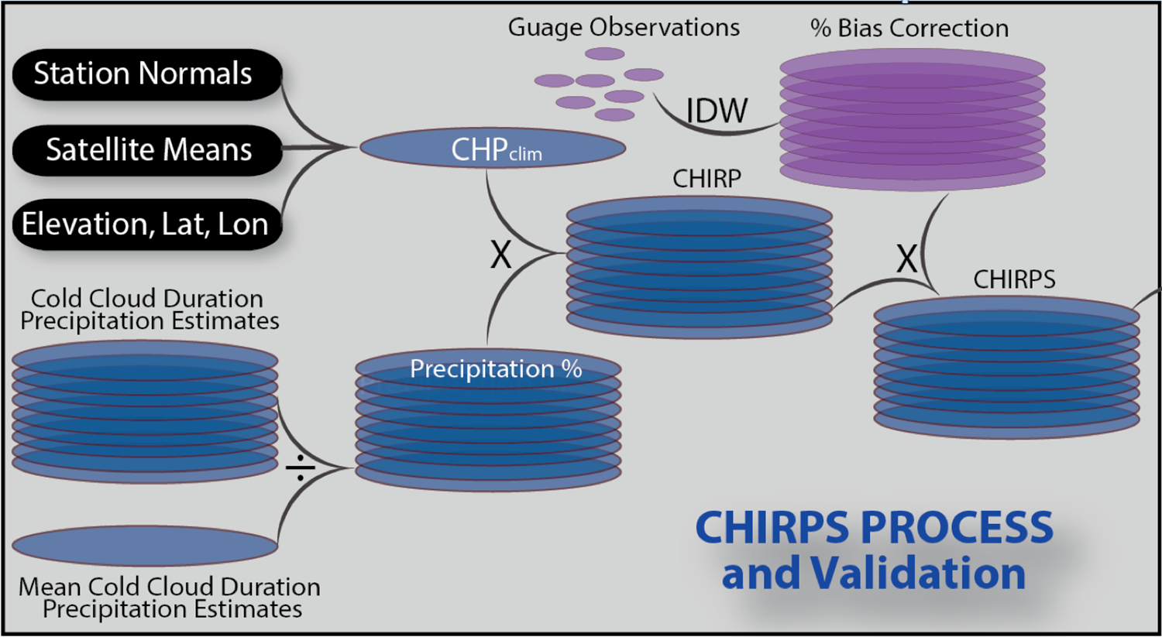

Slide 19
Station density

Slide 20
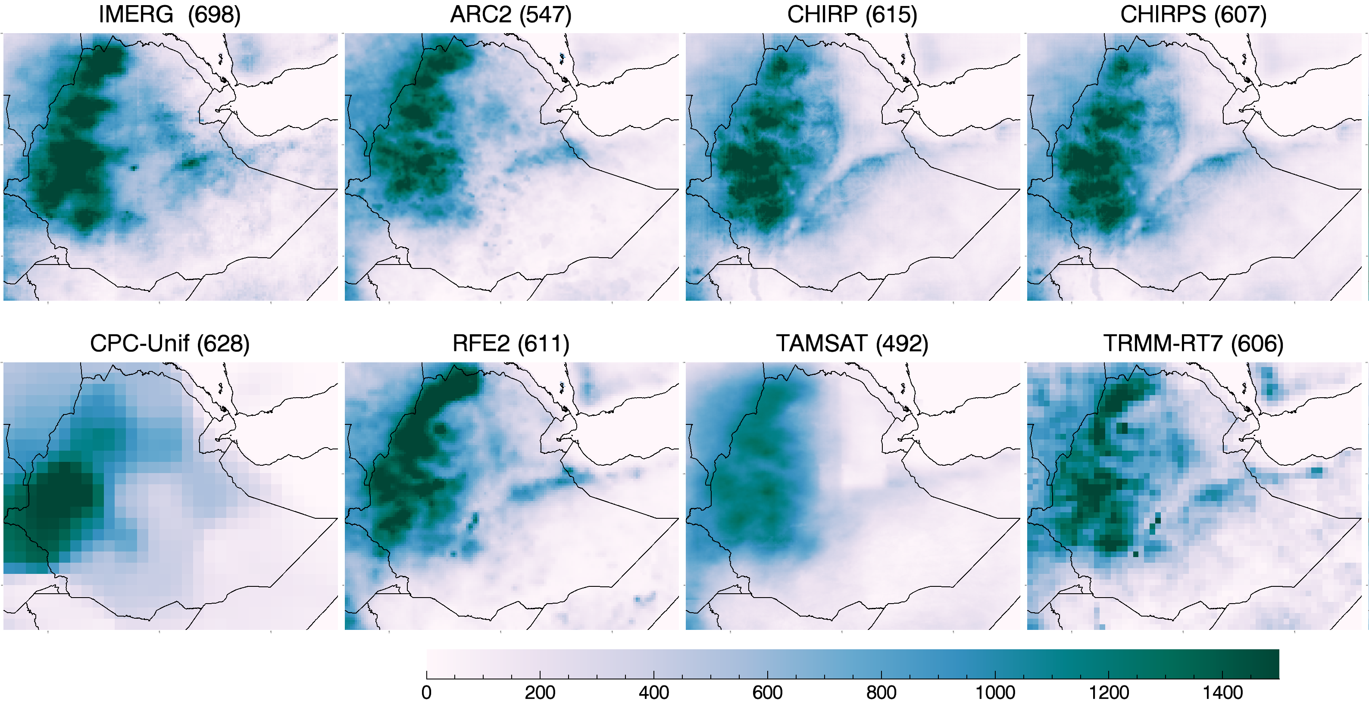
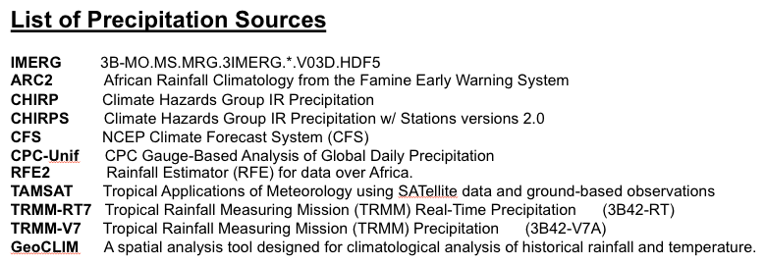
Total rainfall from Apr-Sep 2014 (Ethiopia mean [mm])
Precipitation Sources:

Slide 21
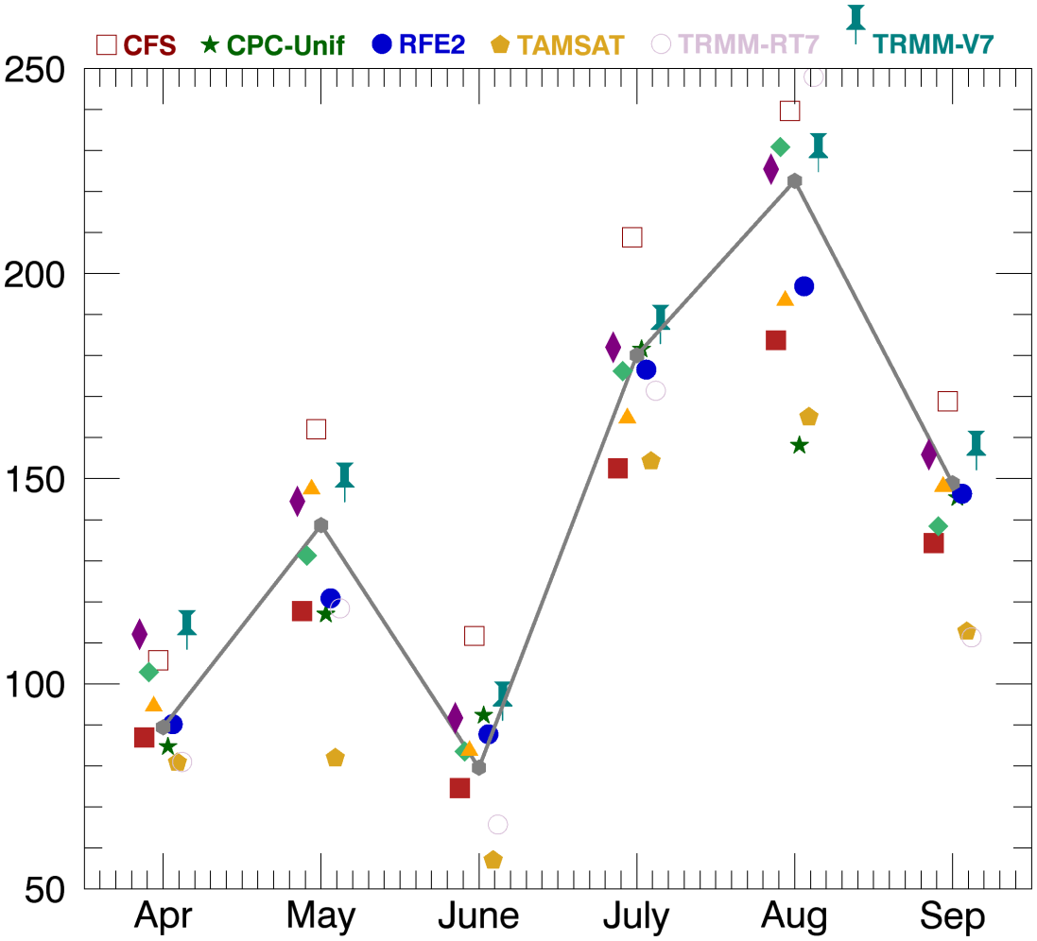
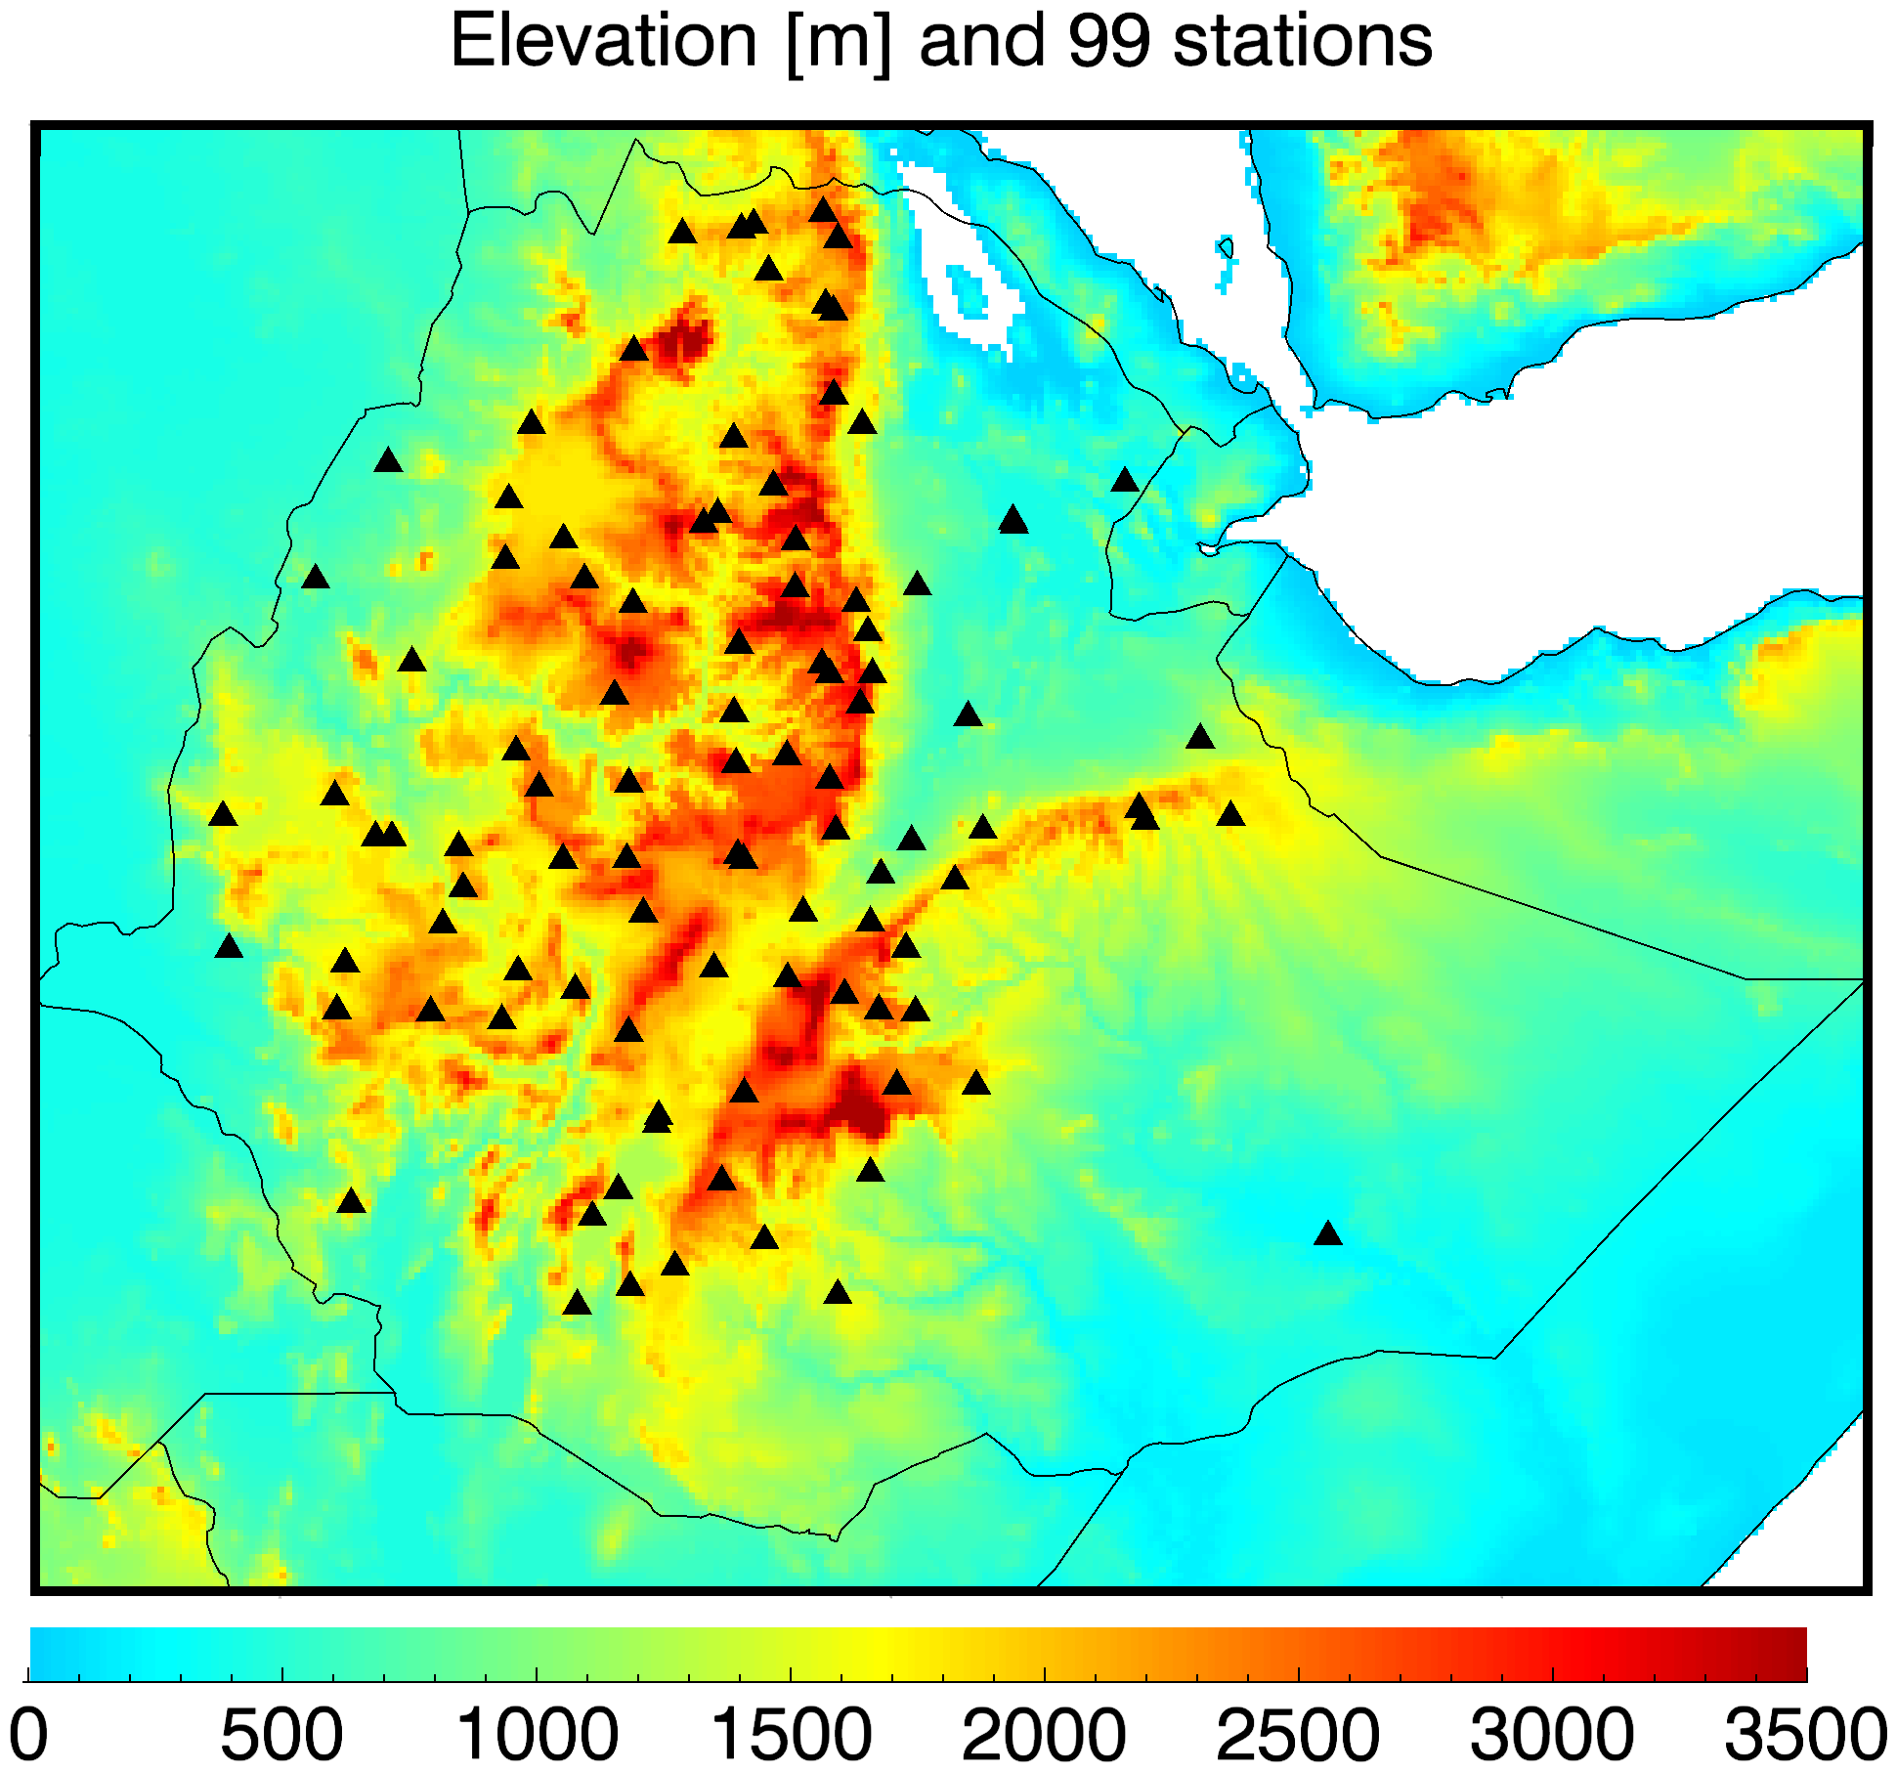
Comparison with Independent stations.

Slide 22
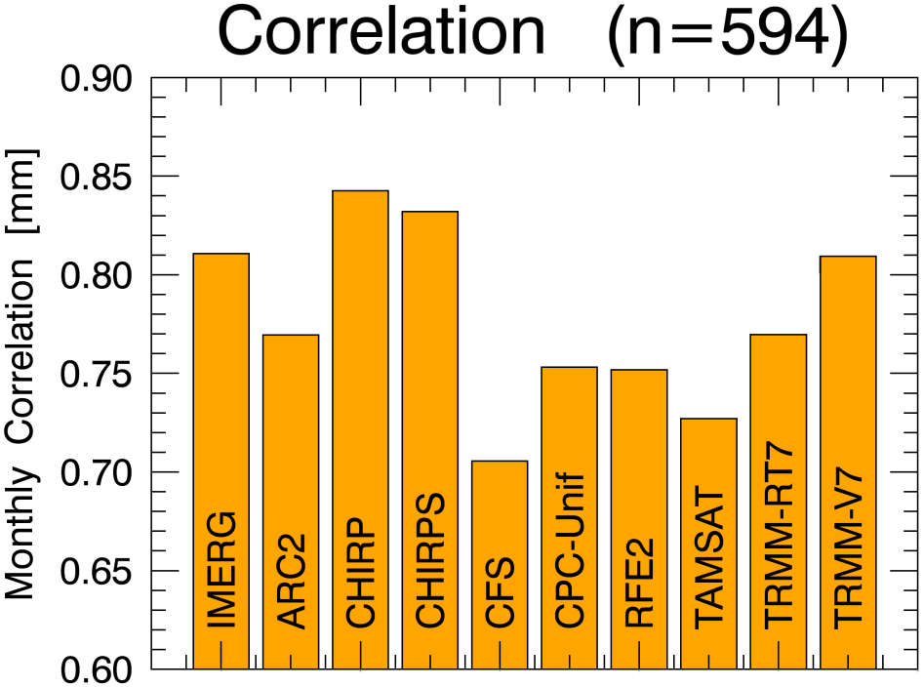
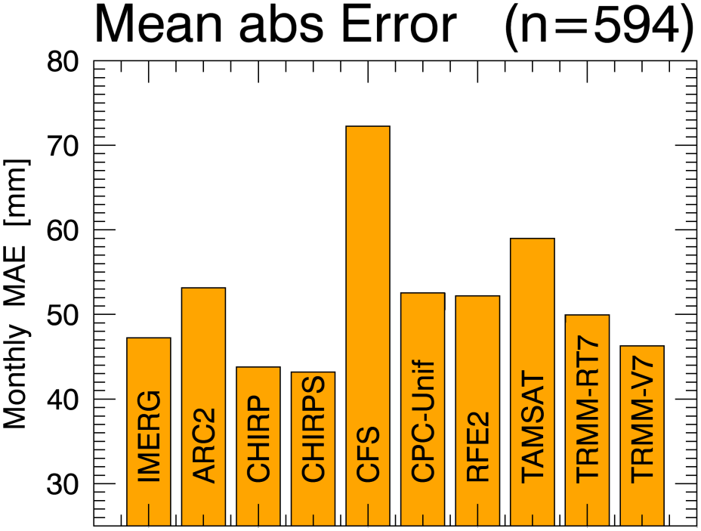
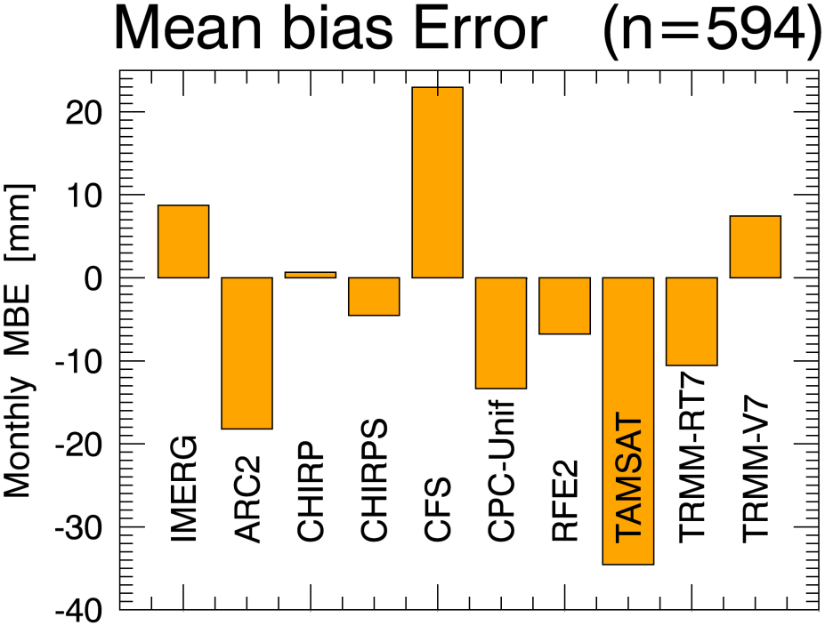
Monthly Station Stats by Source

Slide 23
CHIRPS: Characteristics
Spatial:
0.05 degree (~6km) pixel resolution
Global coverage, with windows available for select geographical areas (including Africa, Central Asia, Central America, Caribbean, SE Asia)
Temporal:
Pentadal, dekadal and monthly estimates available
1981-present
Quantities:
Units: mm
Typical Presentation:
Actual, Diff-Avg, Pct-Avg, SPI, graphs
Accuracy:
Improves with more rain gauge data available

Slide 24
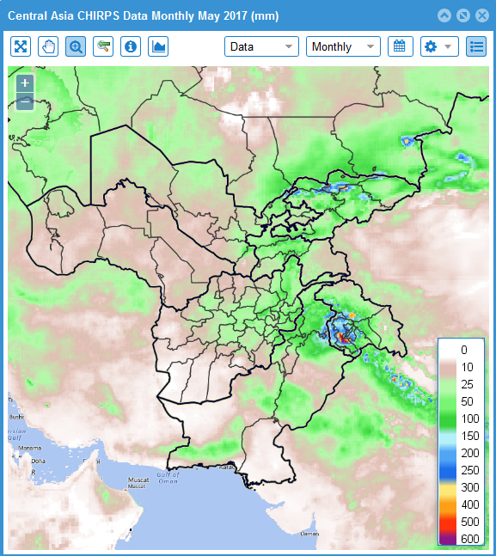
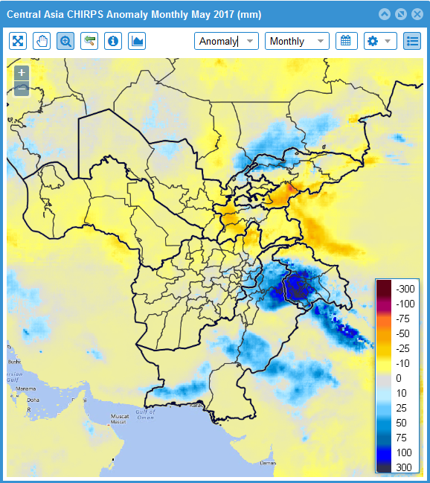
CHIRPS Products
Monthly Precipitation – May 2017
Monthly Anomaly – May 2017

Slide 25
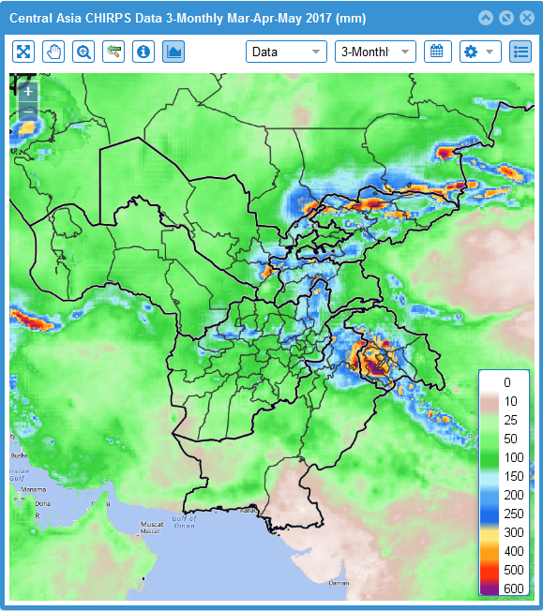
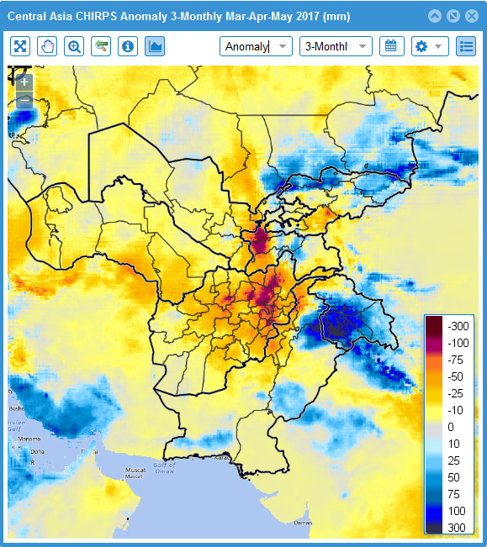
CHIRPS Products
3-Monthly Prec. – MarAprMay 2017
3-Monthly Anom – MarAprMay 2017

Slide 26
CHIRPS – strengths and limitations
Strengths:
Provides good spatial representation of rainfall performance
Provides superior spatial resolution (0.05 deg) in comparison to other rainfall datasets
Global extent
Based on a long-term (1981-present) climatology, allowing for rainfall trend analysis
An abundance of station data is incorporated

Slide 27
CHIRPS – strengths and limitations
Limitations:
Pentadal (5-day) data disaggregated to daily observations
Timeliness of “final” data – prelim for operational
Tends to miss high rainfall events due to being tuned as a drought indicator

Slide 28
Rainfall data and tools: where to access
USGS FEWS NET Data Portal
http://earlywarning.usgs.gov/fews
GIS Data, graphics, charts,
Early Warning Explorer:
http://earlywarning.usgs.gov/fews/
Web-mapping, charts, graphics
GeoWRSI and GeoCLIM (variable accumulation periods, country specific windows)
http://chg.geog.ucsb.edu/tools/
CHIRPS data downloads
ftp://chg-ftpout.geog.ucsb.edu/pub/org/chg/products/CHIRPS-2.0/

Slide 29
Questions?

