Slide 1







Overview of SERVIR-HKH Activities
Training on
Applications of FEWS NET Remote Sensing products for Agro-climatological Analysis
10-14 July 2017
Rajesh Bahadur Thapa, PhD.
Capacity Building Specialist
Geospatial Solutions, ICIMOD

Slide 2
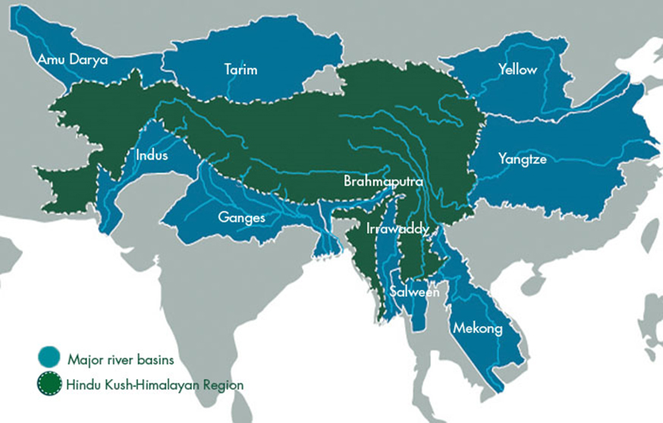
ICIMOD - Regional Intergovernmental Learning and Knowledge Centre
210 million people in the HKH
1.3 billion people downstream
Afghanistan, Bangladesh, Bhutan, China,
India, Myanmar, Nepal, Pakistan

Slide 3
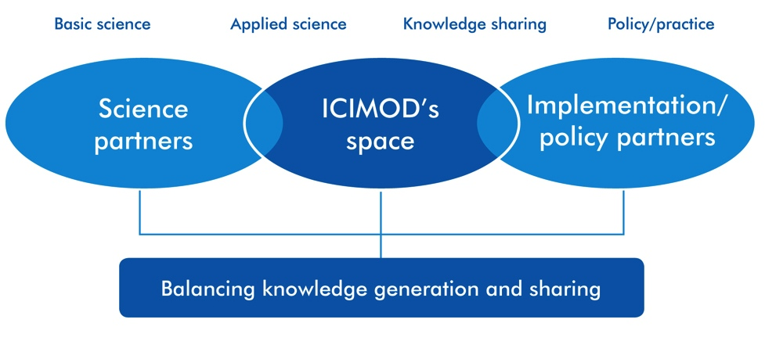
Linking Science-Policy-Practice

Slide 4
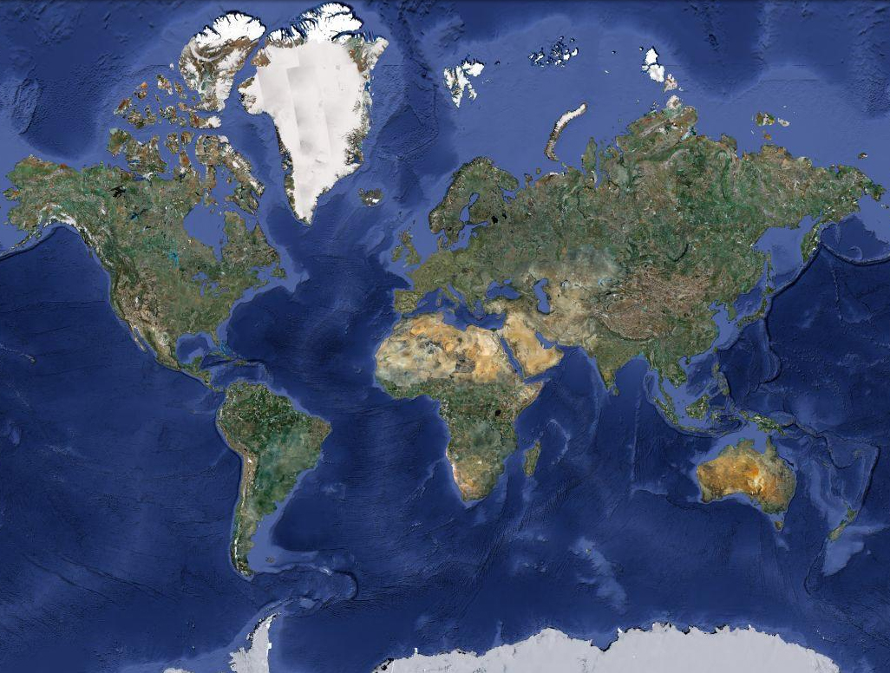
SCO NASA
HKH
West Africa
East Africa
Mekong
A flagship NASA-USAID partnership to improve environmental management and resilience to climate change by strengthening the capacity of governments and other key stakeholders to integrate Earth observation information and geospatial technologies into development decision-making

Slide 5
SERVIR–HKH
SERVIR–HKH Initiative aims to
strengthen the ability of governments and other development stakeholders to incorporate EO data and GT into decision making;
advance free and open information sharing through national and regional platforms and collaborations;
develop innovative, user-tailored analyses, decision-support products, and trainings that advance scientific understanding and deliver information to those who need it.

Slide 6
SERVIR–HKH
Global and regional collaboration
Technical backstopping, connect to scientific communities, access to data and methods
Exchange technical knowledge, joint product development
Leverage global development mandate; coordinate among its bilateral and regional missions
Other SERVIR hubs
Other SERVIR hubs
NASA
Other SERVIR hubs
USAID
Develop tools and provide training on hub functions, facilitate hub exchange, maintain global web site
Joint research, product co-development, training
Applied Science Team
SERVIR HKH
Support Team
AST Projects
Small Grants
Capacity Building
Access to data and tools
Customized products, tools and services

Slide 7


SERVIR HKH Focus
Improved hub capacity
Water resources
Ecosystems, land cover and land use
Improved capacity to use geospatial information
SERVIR-HKH
Agriculture and food security
Improved access to geoinformation
Hydroclimatic disasters
Provision of user-tailored data, products, tools and services
Climate services

Slide 8
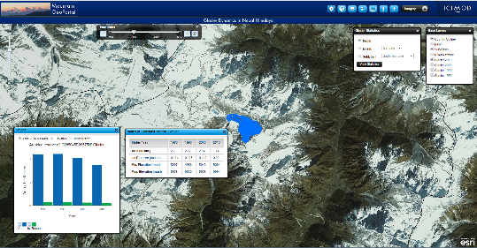
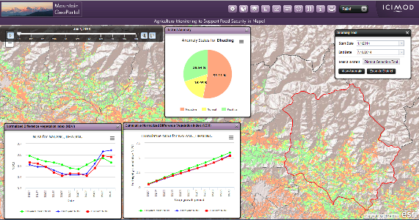
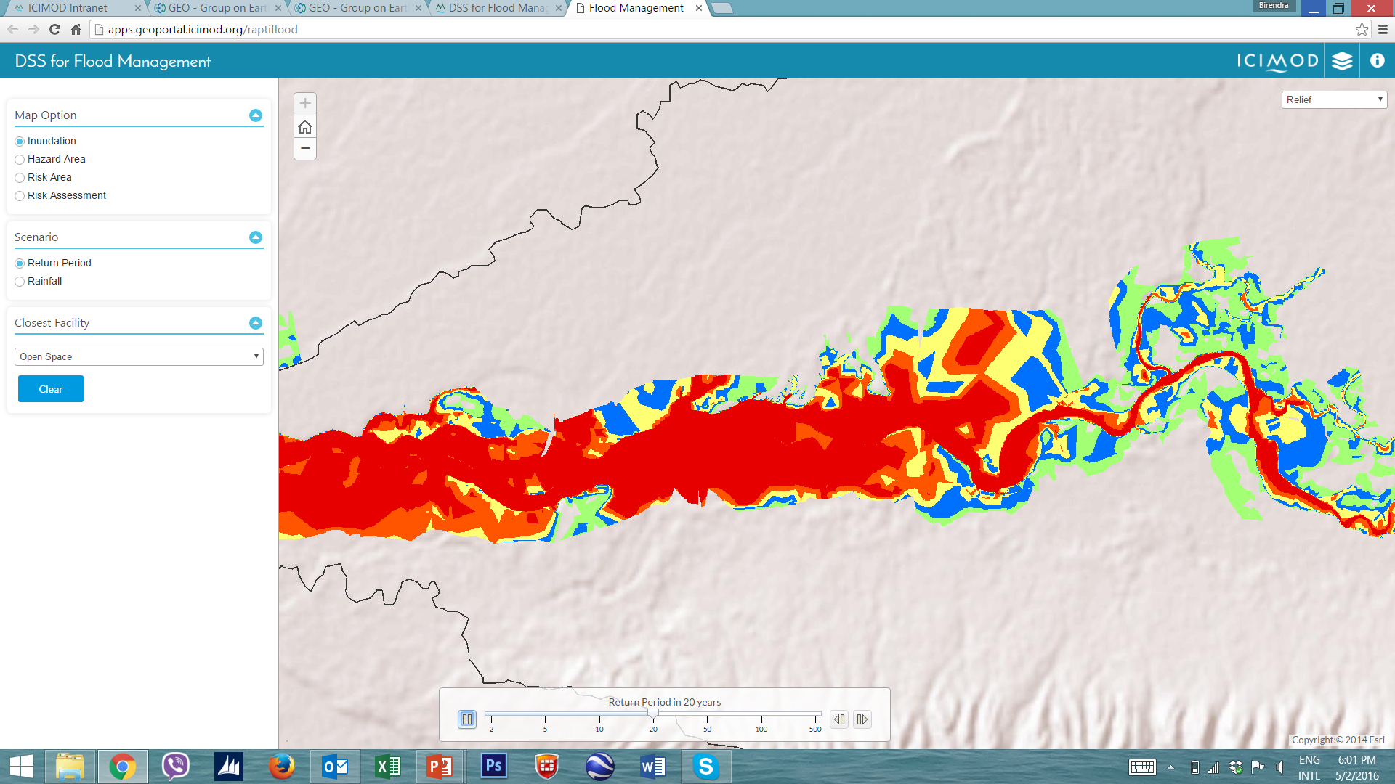
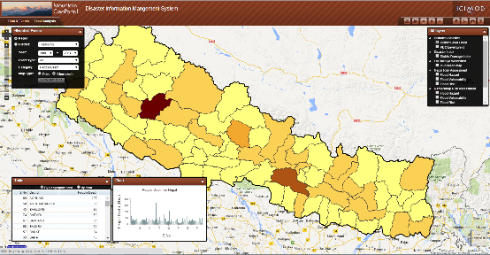
  Earth Observation
  Application Examples
Water Resources
Agricultural drought and crop monitoring
Landscape Conservation
Disaster Risk Reduction
Air Quality Monitoring

Slide 9
Ongoing efforts
Water Resources and Hydro-climatic Disasters
Enhancing existing Flood EWS in western Nepal | MercyCorps
Enhancing Flood Early Warning in Bangladesh | FFWC
Piloting landslide early warning system | NASA Space App Challenge participants
Development of flood plain management system in Nepal | DIWDM
Comprehensive Streamflow Prediction and Visualization to Support Integrated Water Management in the Himalaya Region | DHM Nepal, FFWC Bangladesh
Managing the Changing Water Resources South of the Himalayas | Hydromet agencies in Nepal, Bhutan, Bangladesh, Pakistan

Slide 10
Ongoing efforts
Land Cover and Land Use Change and Ecosystems
Regional and national level annual automatic forest and land cover monitoring (HKH level) | DFRS-Nepal, Silva Carbon, UMD, GFW, DoF Bangladesh, Bhutan
Climate change vulnerability and adaptation planning for forest ecosystems (Nepal and Bangladesh) | ICIMOD programs (HICAP, HI-AWARE, KAILASH), DoF Nepal, DoF Bangladesh
Assessment of Ecosystem services using ARIES platform (Nepal) | ICIMOD Program (Transboundary Landscape), Dept of Tourism, Nepal, Ministry of Hill Tract Affairs Bangladesh

Slide 11
Ongoing efforts
Weather and Climate Services
South Asia LDAS Implementation and Integration | JHU, ICIMOD Program HYCOS
Seasonal prediction of HKH Hydrological Extremes with the South Asia Land Data Assimilation System - Benjamin Zaitchik, JHU | JHU, Agriculture departments in regional countries, Met Dept. of Regional countries
Monitoring Intense Thunderstorms in the Hindu-Kush Himalayan Region | DHM Nepal

Slide 12
Ongoing efforts
Agriculture and Food Security
Agriculture advisory System in Nepal | MoAD, NARC, DoA WFP, ICIMOD RPs
Food security vulnerability information system – Nepal | WFP, MoAD, NPC
Afghanistan Irrigation Information Portal – Afghanistan | MAIL, MEW, AMA
Seasonal wheat crop sown area mapping – Afghanistan | MAIL, FEWS-NET, WFP
Drought monitoring and early warning system – Afghanistan, Pakistan and Bangladesh | MAIL, MEW (AFG) PMD (PAK), BARC, BMD (BAN)

Slide 13
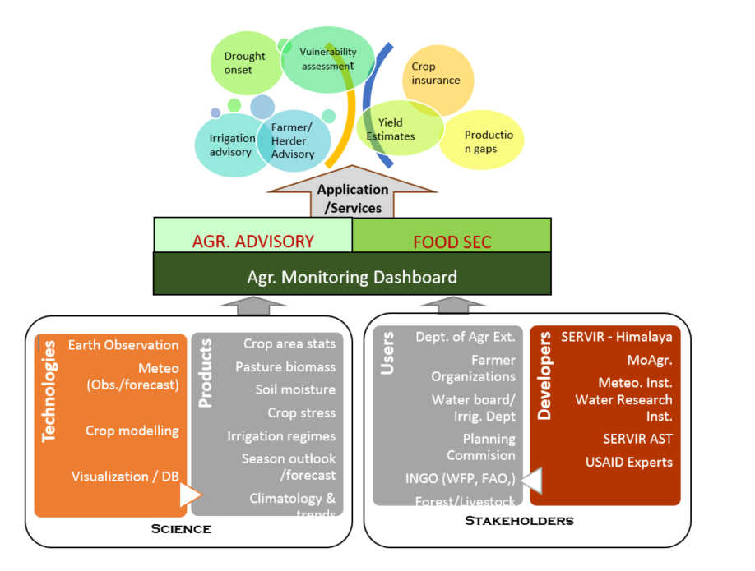
SIREVIR HKH - Framework for Agriculture and Food Security Services
( Afghanistan, Bangladesh, Nepal and Pakistan)

Slide 14
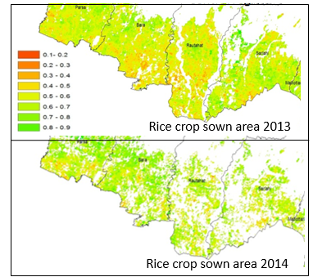
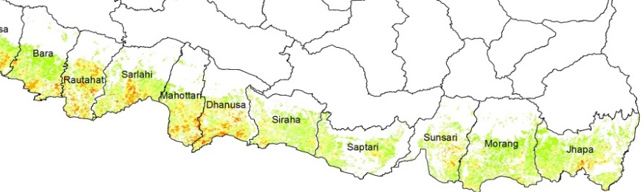
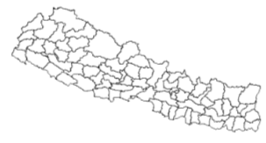
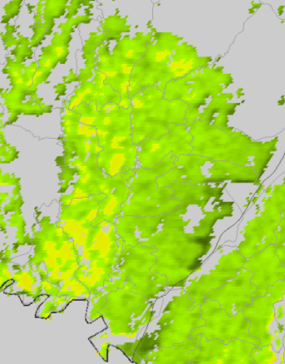
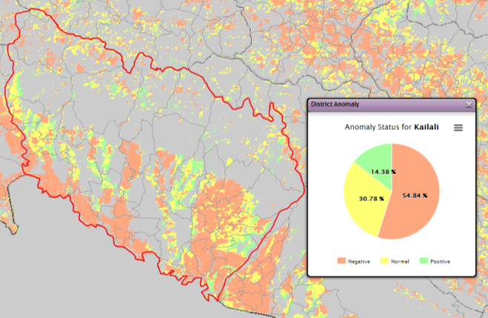
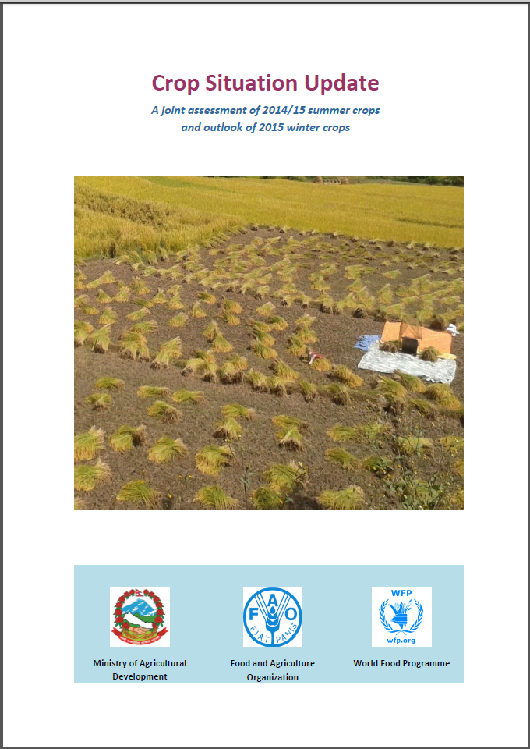
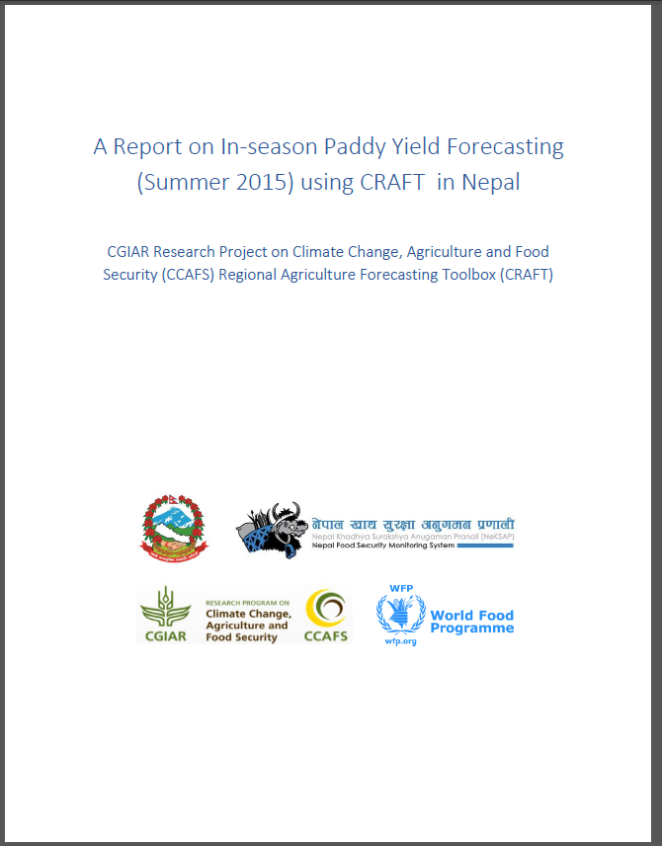
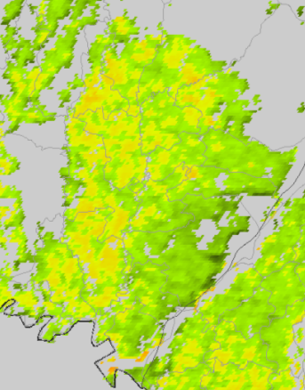
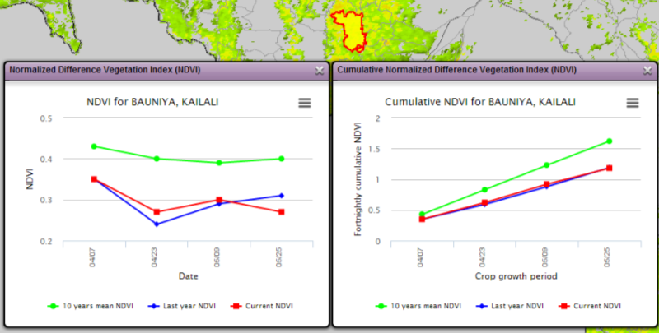
In-season crop status assessment
Rice Crop sown area –as on 28 July 2015
The preliminary assessment of paddy crop sown area based on MODIS NDVI data of 177 and 193 Julian days of 2015 shows that there is 3% increase in area as compared to that of 2014 and 12% decrease as compared to 2013. An additional image of August 12 can give more clear result since the transplantation process is still going on.
Vegetation conditions Anomaly
Crop
condition
Good
Poor
Historic average
10-25 June
Current
10-25 June, 2015

Slide 15
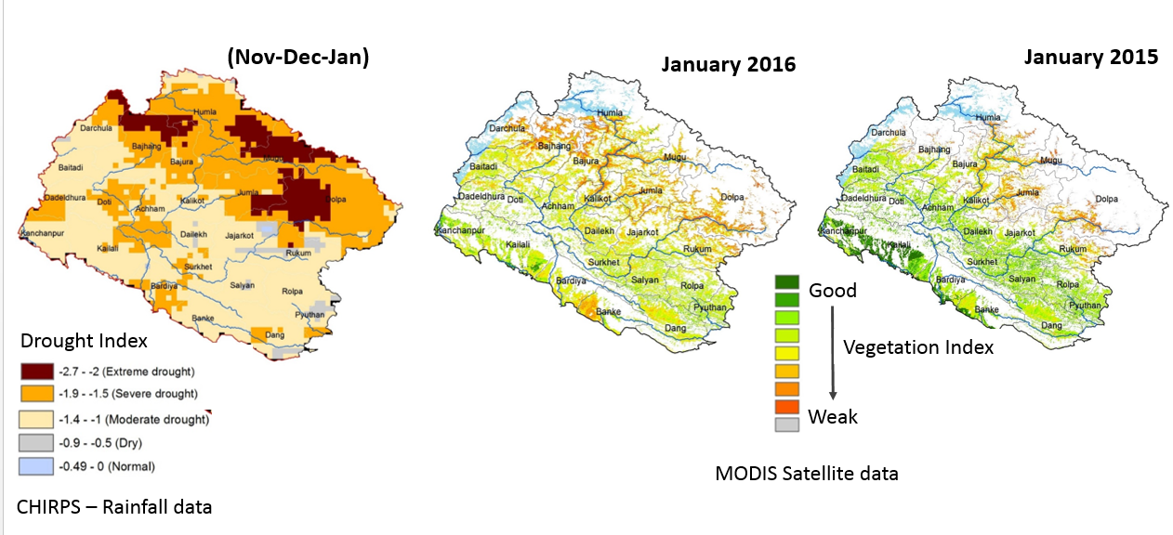
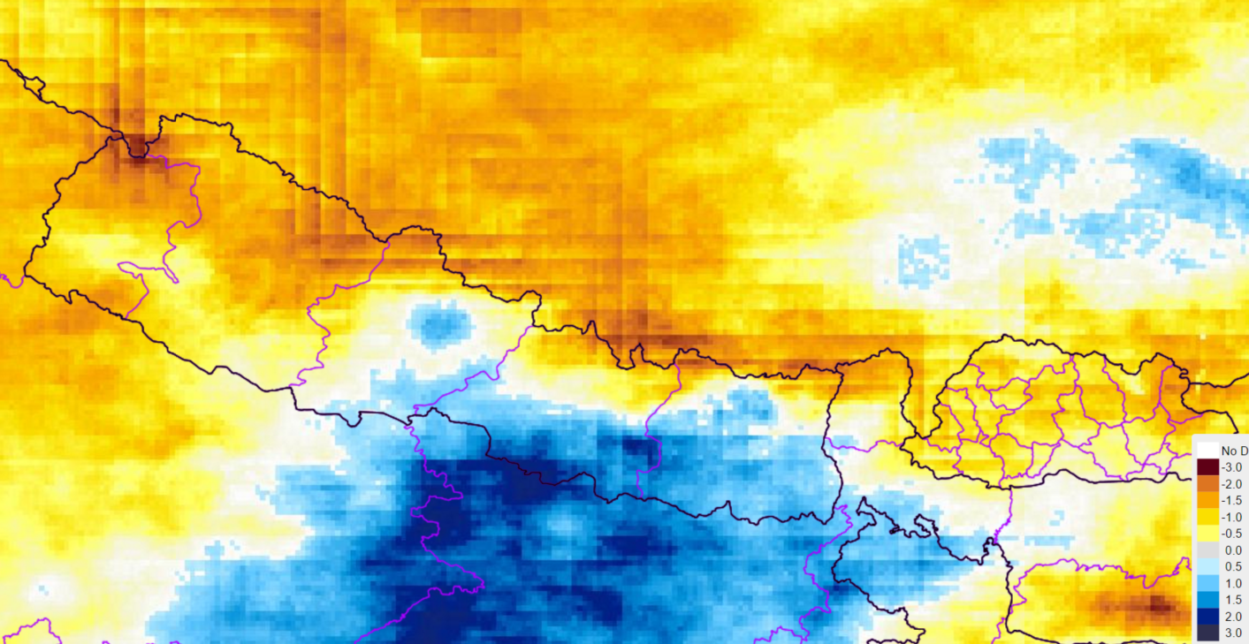
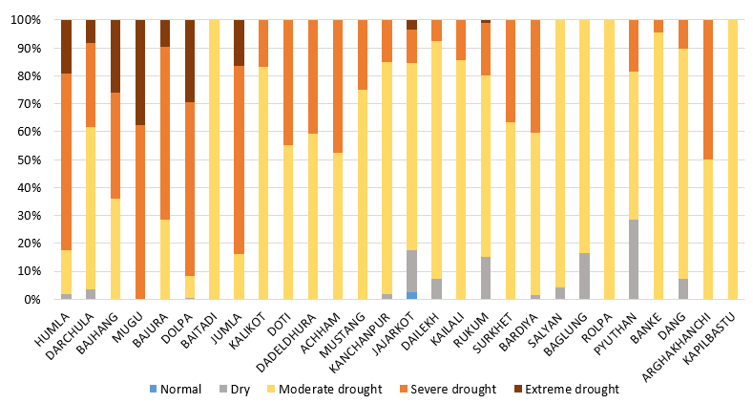
Winter drought (2015-2016) Conditions in Western Nepal
Drought SPI – Sep., 2016
Area under drought(%)

Slide 16
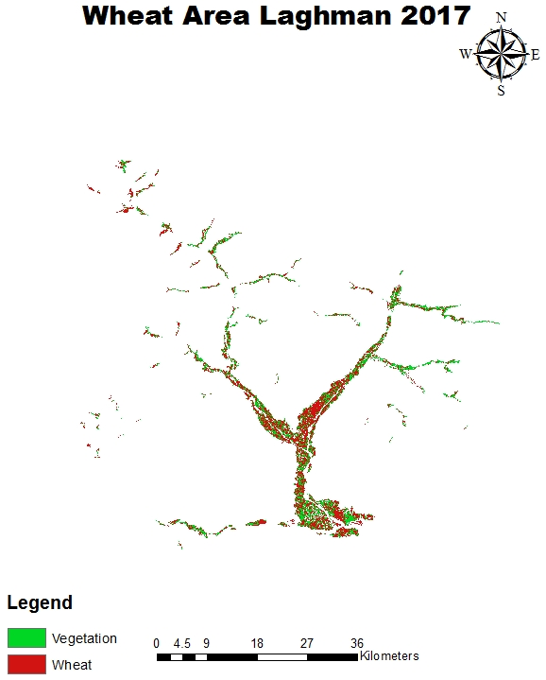
Wheat area mapping in Afghanistan

Slide 17
Strengthening Agriculture Advisory by Establishing Agriculture Information Dashboard

Slide 18
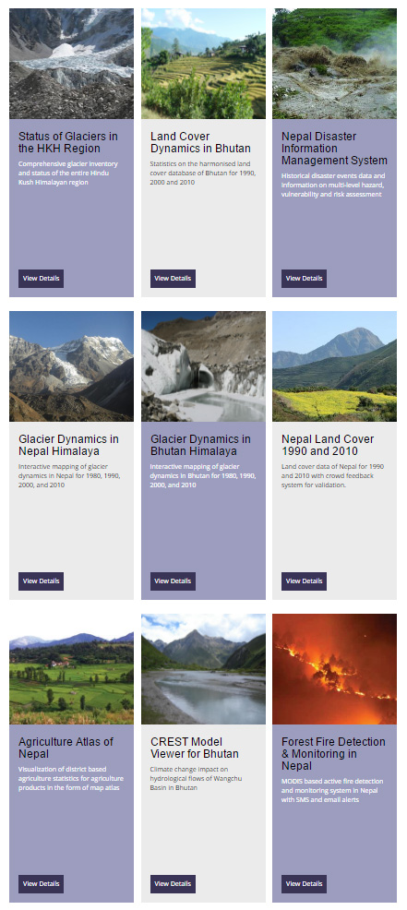
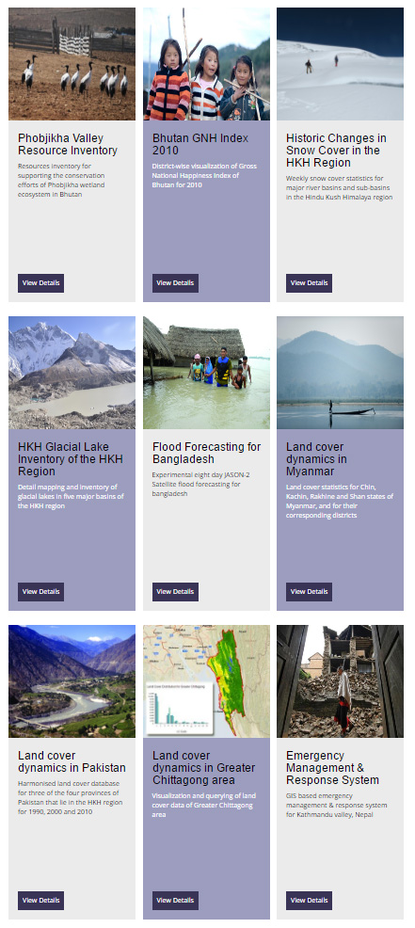
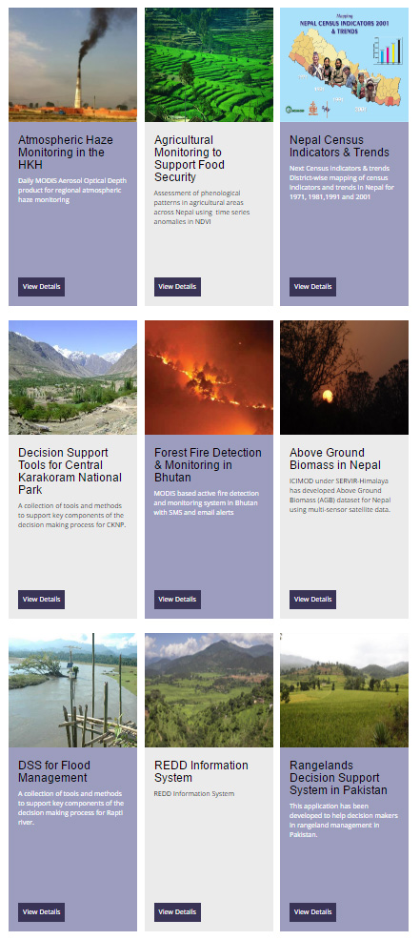
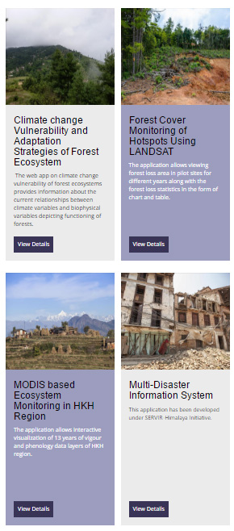
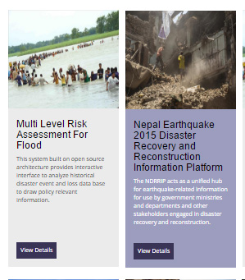
Science Applications geoportal.icimod.org/Home/ScienceApps

Slide 19
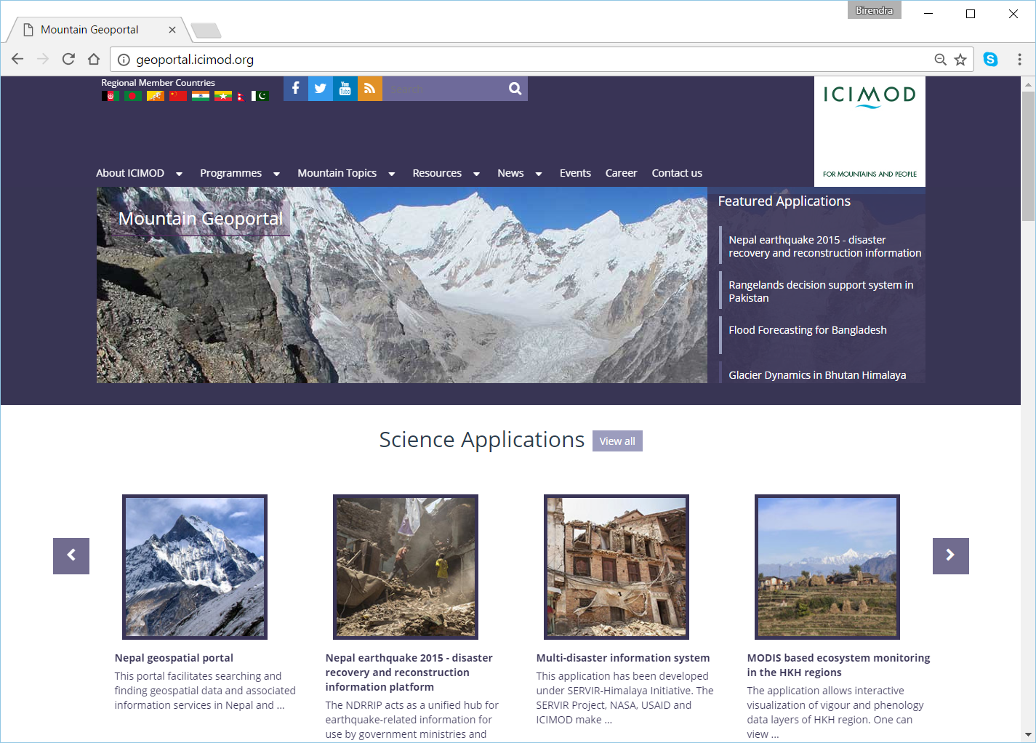

Slide 20
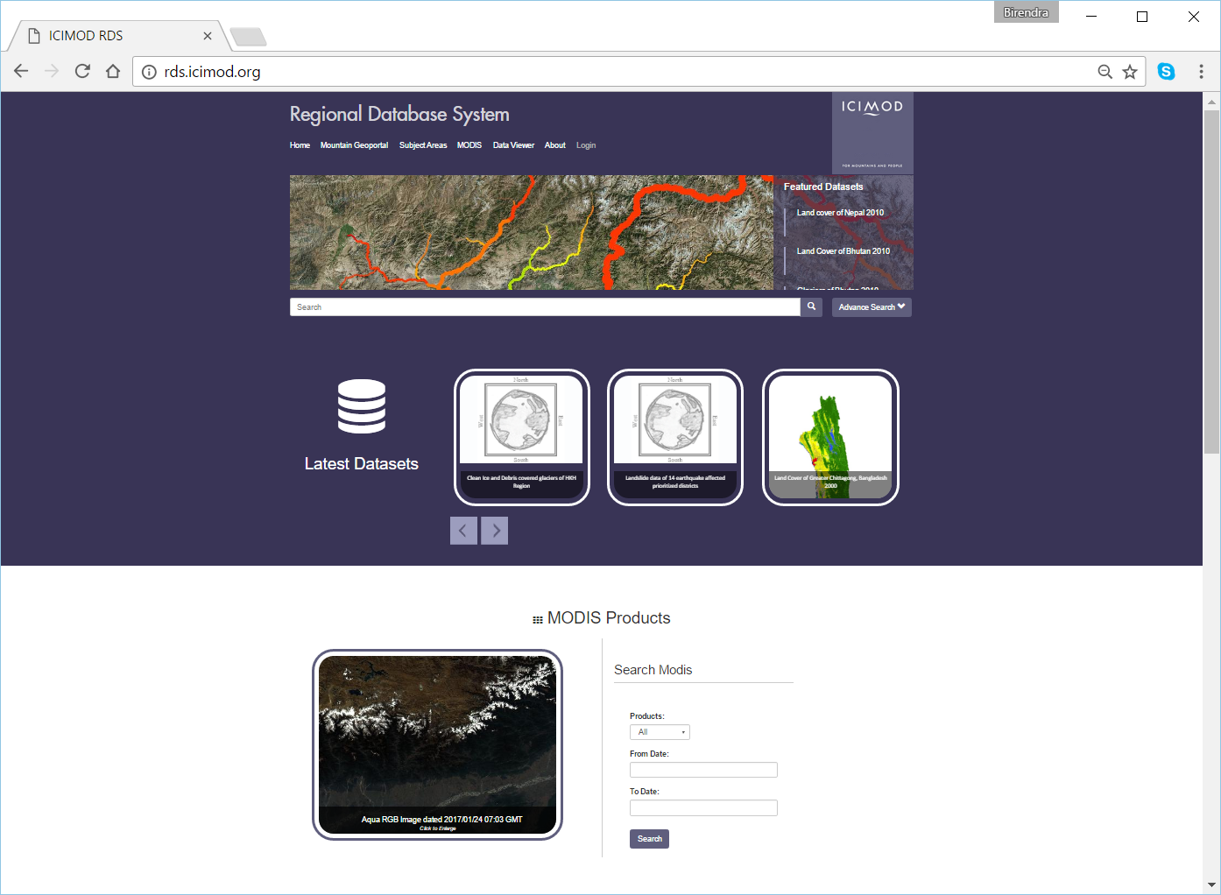

Slide 21
Thank you
Contact:
Dr. Rajesh Bahadur Thapa
Capacity Building Specialist
Geospatial Solutions, ICIMOD
rajesh.thapa@icimod.org

