Slide 1
Normalized Difference Vegetation Index (NDVI)
Applications of FEWS NET Remote Sensing products for Agro-climatological Analysis Workshop
10 – 14 July 2017 | Kathmandu Nepal

Slide 2
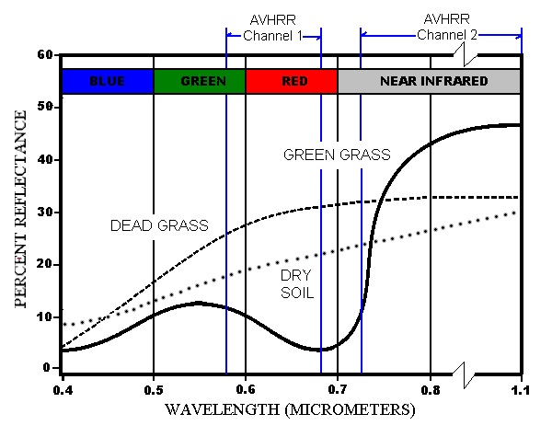
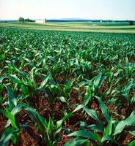
Normalized Difference Vegetation Index (NDVI)
A ratio of the intensity of light reflected off the Earth’s surface in the visible and near-infrared spectral wavelengths which quantifies the photosynthetic capacity of the vegetation in a given pixel of land surface.
Surfaces containing large amounts of chlorophyll have high reflectivity in the NIR band and low reflectivity in the red.
Notes:
What is it, and what does it represent
What are its characteristics: time, space, accuracy, other
How is it made: math/technical/theoretical background
What are it’s strengths and limitations
Where can it be accessed
How can it be used for monitoring the growing season;
How should it be used
When should it be used
When should it NOT be used
What other forms can it have (e.g. anomalies, what do the mean
What sort of inferences can be made about the actual situation

Slide 3
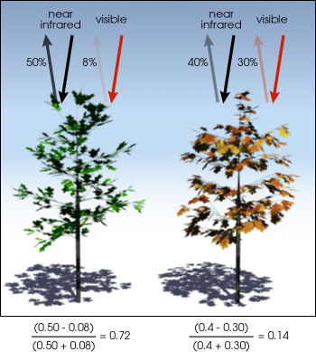
Vegetation Monitoring (Crop & Rangeland):
Normalized Difference Vegetation Index
NDVI = (NIR – Red) / (NIR + Red)
Healthy green vegetation (left) absorbs most of the visible light that reaches it, and reflects a large portion of the near-infrared light.
Unhealthy or senescing vegetation (right) reflects more visible light and less near-infrared light.
What about atmospheric affects?

Slide 4
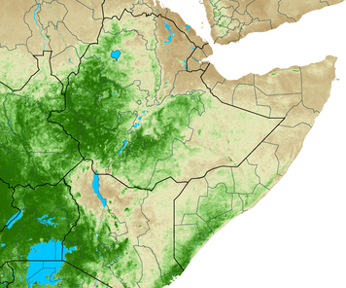
Maximum Value Compositing (MVC)
MVC for a dekad (10 days) is used to address the problem of atmospheric contamination while still allowing for detection of subtle vegetation differences through time.
The maximum value for each pixel of a composite period is used as the value for that pixel.
Since cloud and other atmospheric contaminants reduce NDVI values, this process helps to minimize (but not eliminate) these effects in the final composite product.
Day 1
Day 10

Slide 5
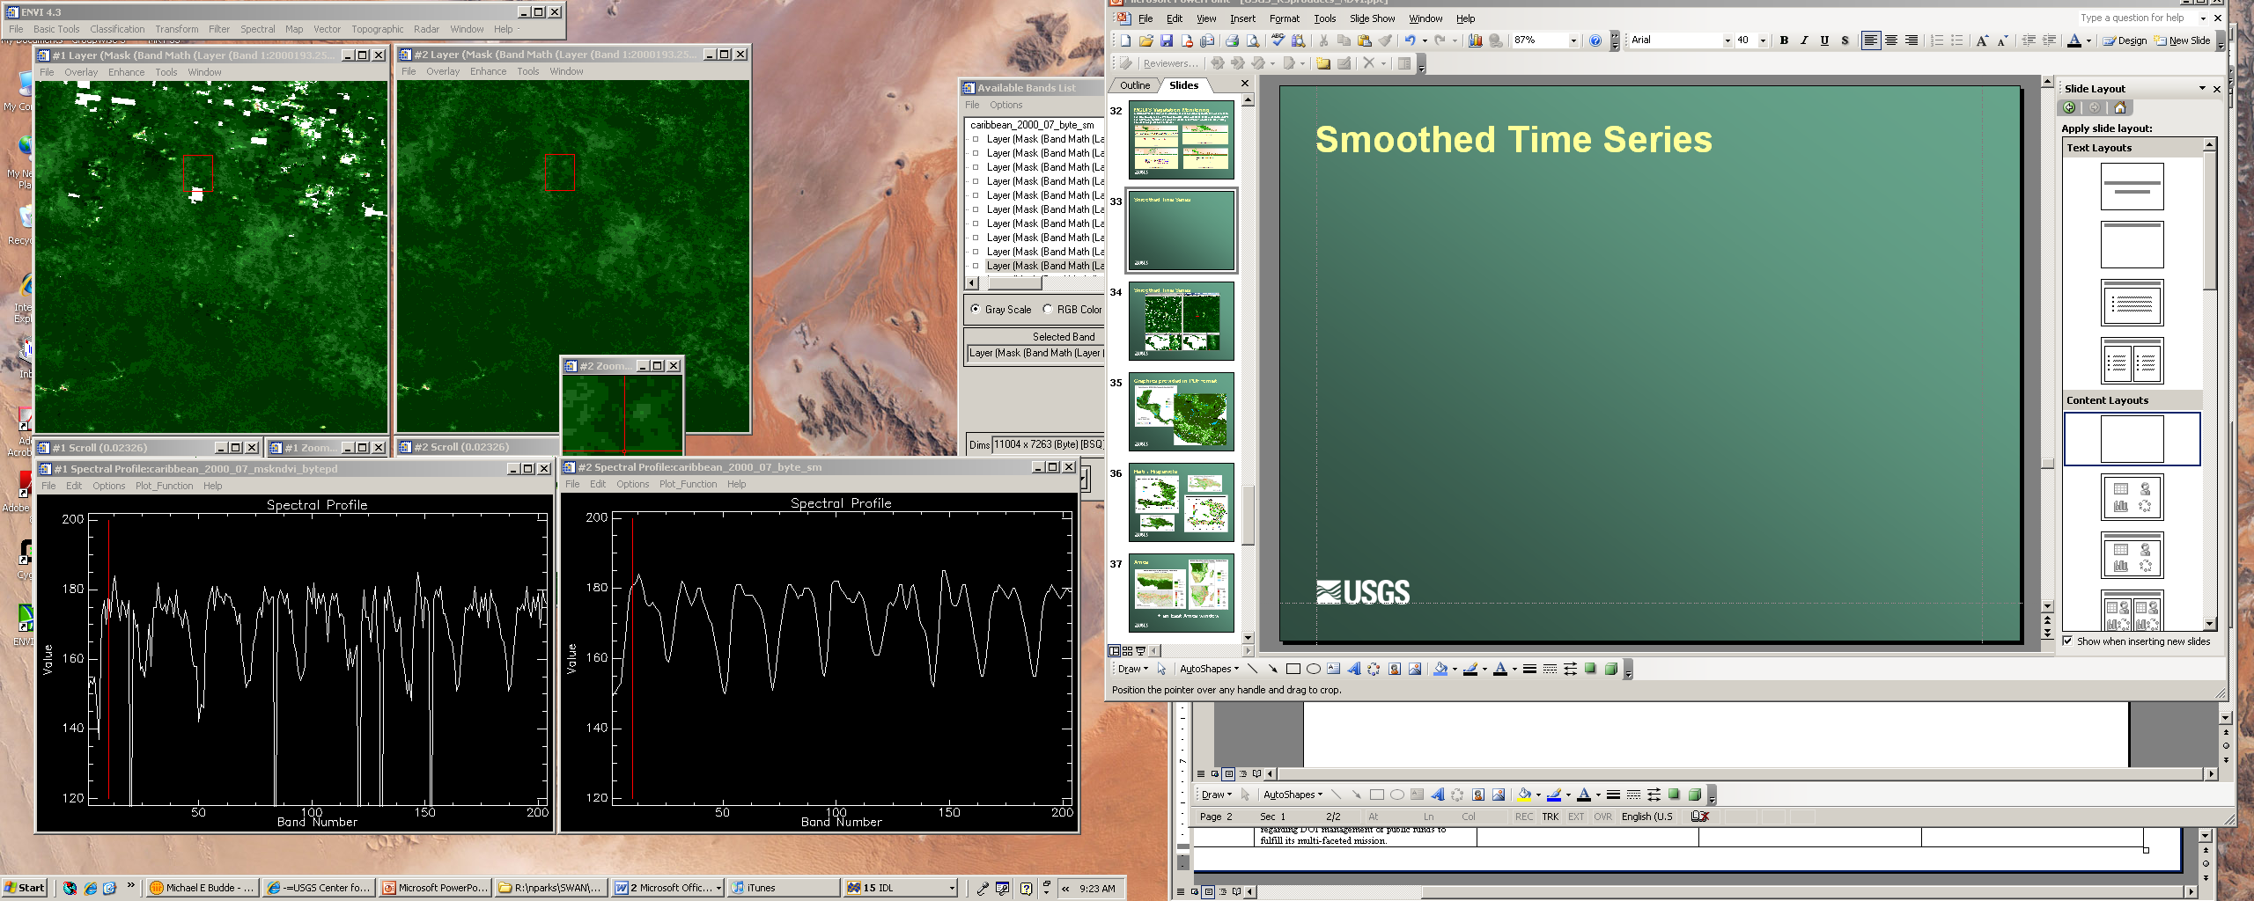
Temporal Smoothing of NDVI Time Series
(A)
(B)
A
Example of an unsmoothed MODIS NDVI time series pixel (A) and the same temporally smoothed pixel profile (B).
B

Slide 6
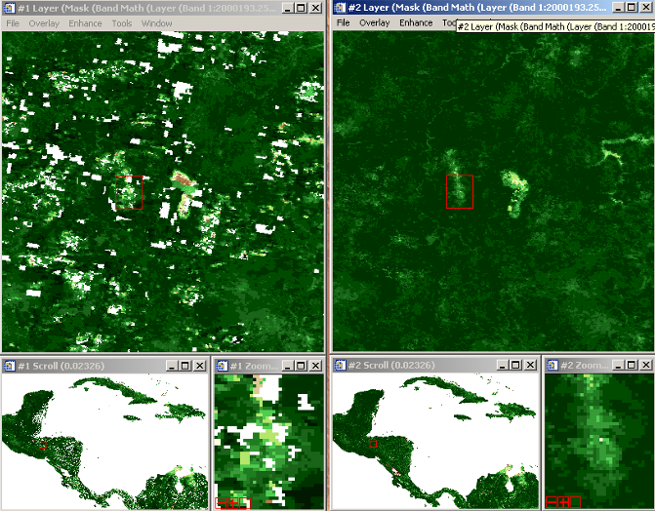
Smoothed NDVI – C.America
Un-smoothed
Smoothed

Slide 7
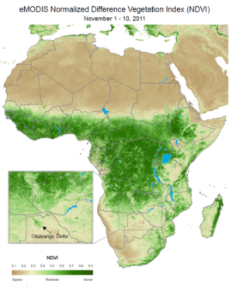
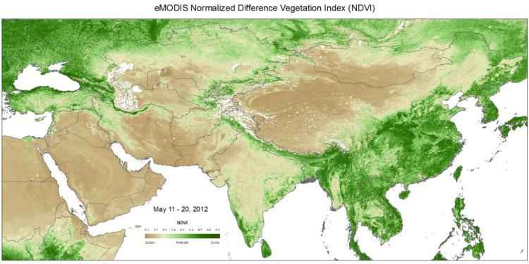
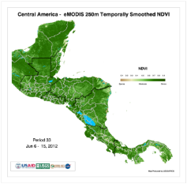
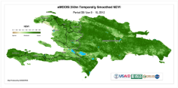
eMODIS NDVI – Operational Monitoring
eMODIS (EROS/Expedited MODIS)
  Developed by the LP DAAC at EROS in 2007
  Africa, Central Asia, C. America/Caribbean, CONUS, & Alaska
  Ability to customize compositing periods
  Consistent and timely processing
  Minimized Re-sampling
  Application of MODIS science team algorithms

Slide 8
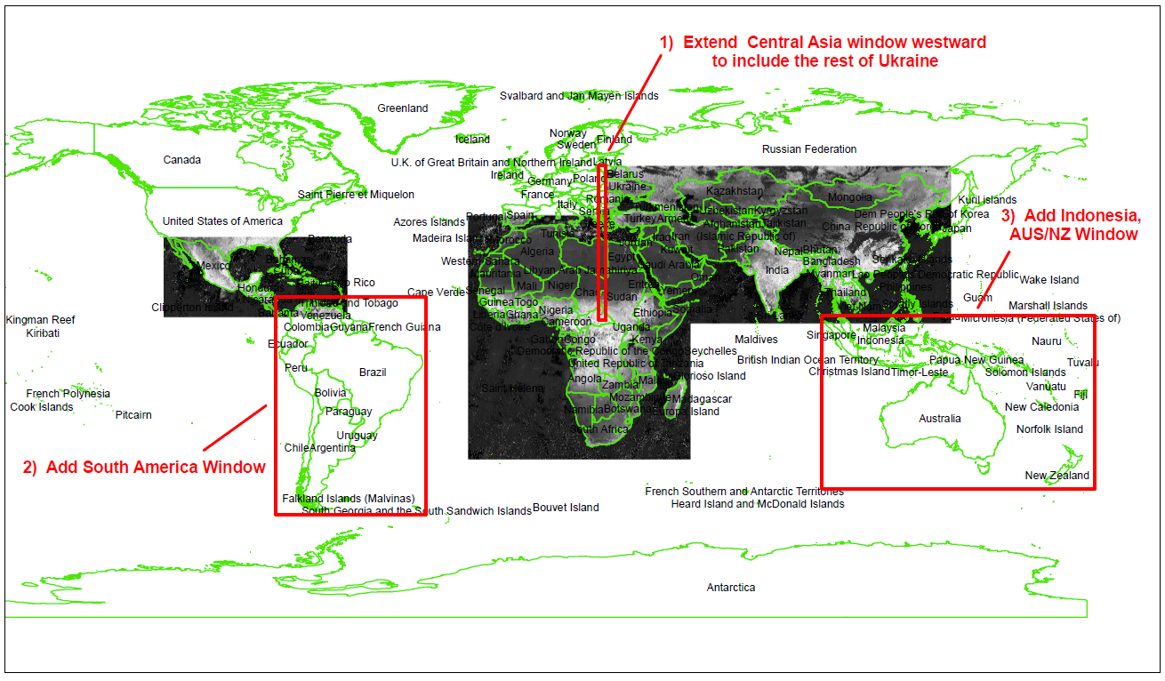
Expanded Coverage

Slide 9
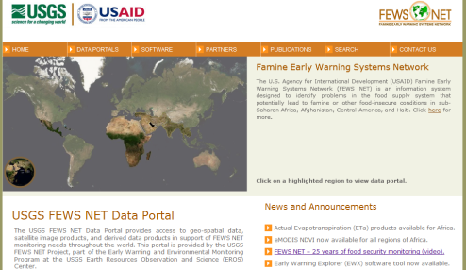
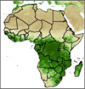
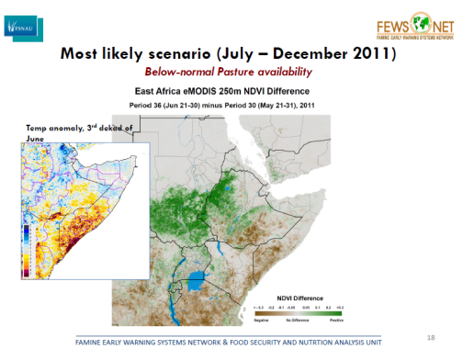
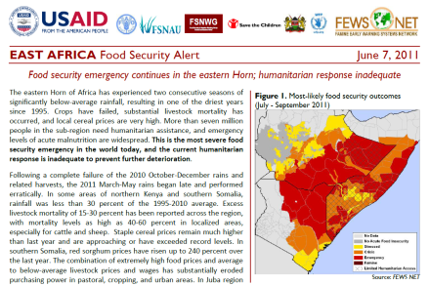
Expedited MODIS Data Flow
FEWS NET eMODIS NDVI and Anomaly Maps
T+15hrs
Processing System (project, mosaic, composite)
Terra MODIS
USGS
FEWS NET
Processing System (stack, smooth, create products)
T+9hrs
EDOS
eMODIS System
USGS/EROS
FEWS NET Decision Support System (USAID FFP)
MODIS L0 Data
T+3hrs
MODIS
L2 Data
LANCE
Input to Impact Assessments

Slide 10
eMODIS: Characteristics
Spatial:
  250m pixel resolution
  Five regional windows covering food insecure areas of the world
Temporal:
  10-day (dekadal) aggregates (Max Value Composites)
Quantities:
  Units: unitless (ratio of reflectances)
Typical Presentation:
  Actual, Diff-Avg, Diff-Prev, Pct-Avg, time series graphs
Accuracy:
  NDVI affected by clouds
  eMODIS reduces cloud effects by temporal smoothing

Slide 11
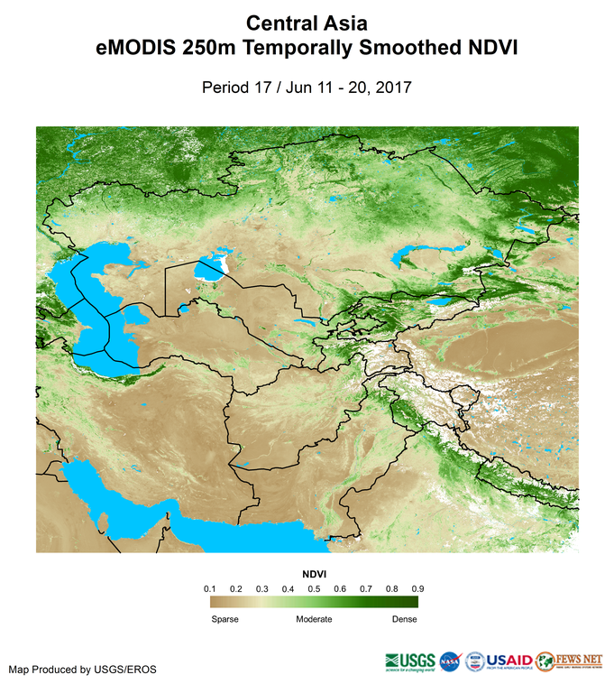
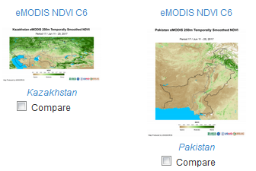
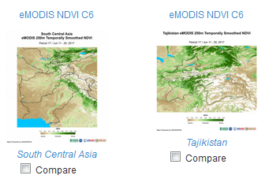
NDVI Products – Regional and National

Slide 12
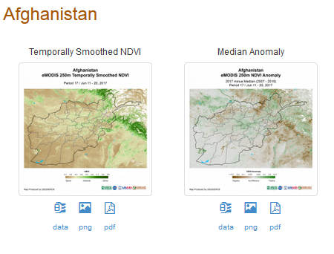
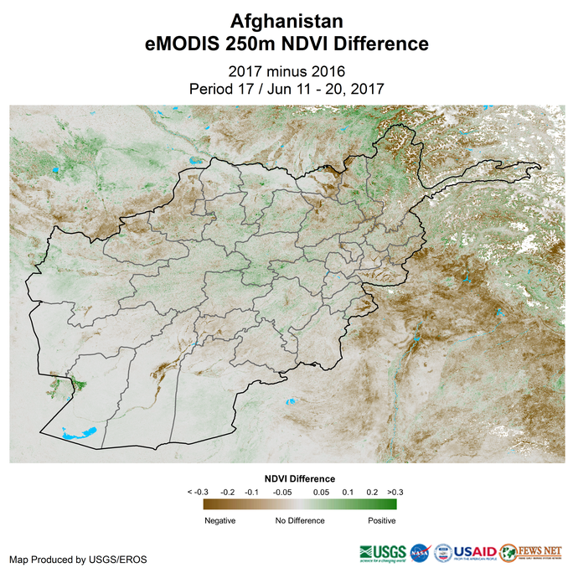
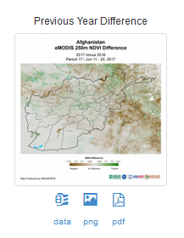
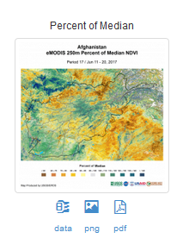
NDVI Products - National

Slide 13
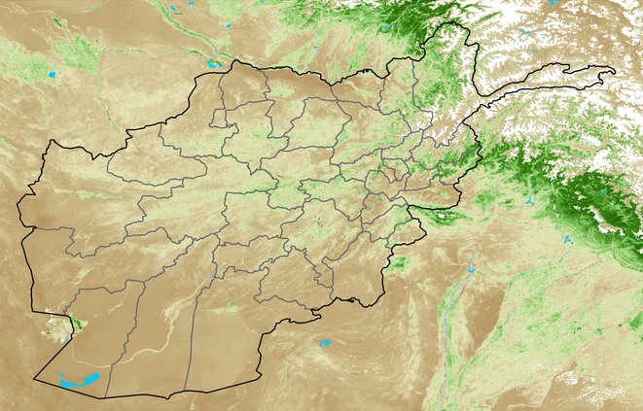
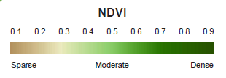
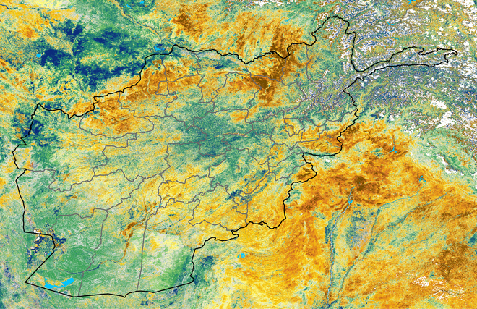
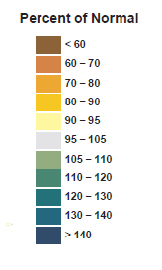
eMODIS NDVI – 250m resolution example
June 11 – 20, 2017

Slide 14
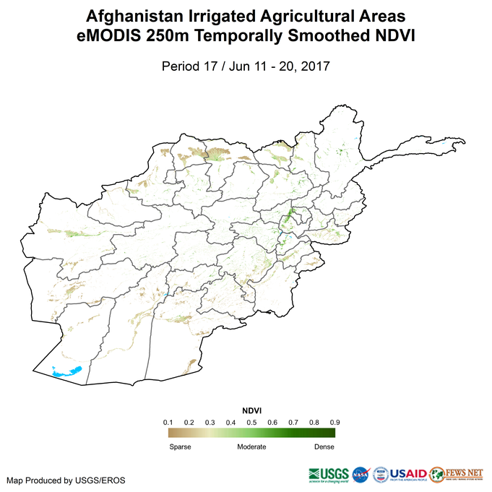
NDVI Products – Irrigated Areas

Slide 15
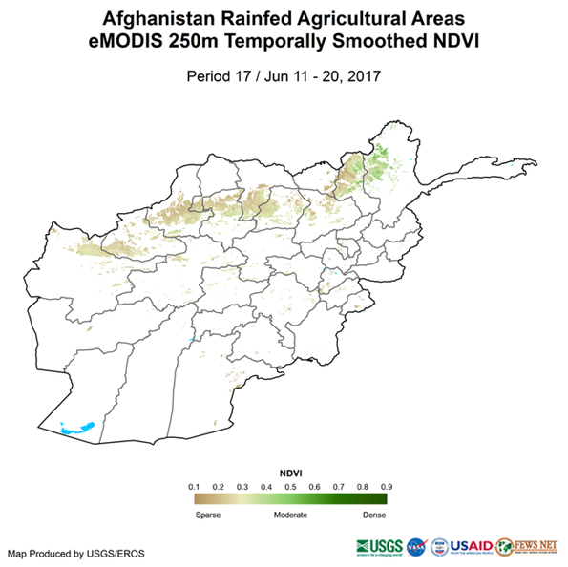
NDVI Products – Rainfed Areas

Slide 16
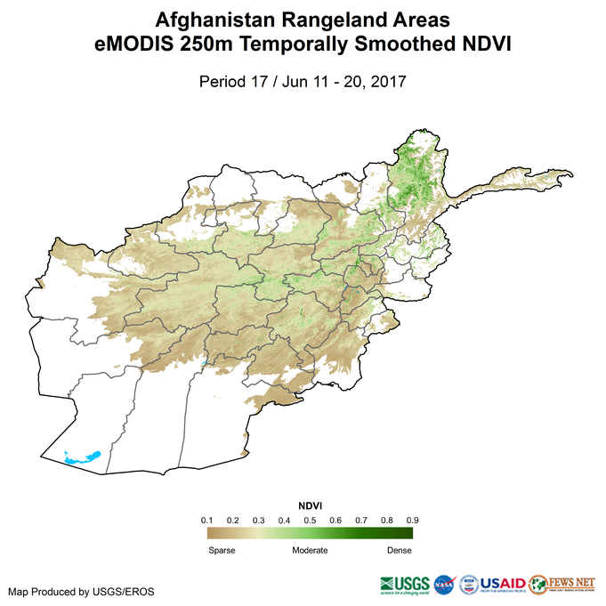
NDVI Products - Rangelands

Slide 17
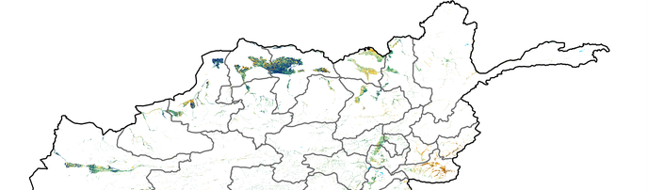

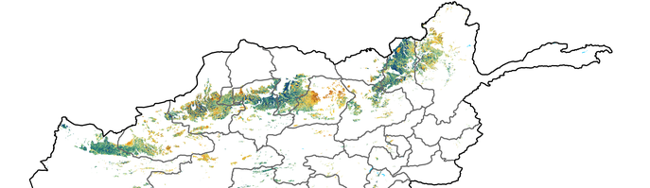
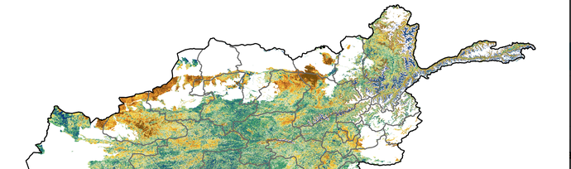
NDVI Percent of Median as of 21-31 May 2017
Below Normal Normal Above Normal
Irrigated Crops
Above average across most of the northern provinces with the exception of Kunduz which is near normal.
Rainfed Crops
Mostly positive conditions at this point in time with the exception of parts of Samangan & Badghis.
Rangeland
Grazing areas show the poorest conditions, primarily Kunduz, Badghis, and parts of Samangan, Faryab,
*Irrigated, Rainfed, & Rangelands derived from 2001 FAO Land Cover

Slide 18
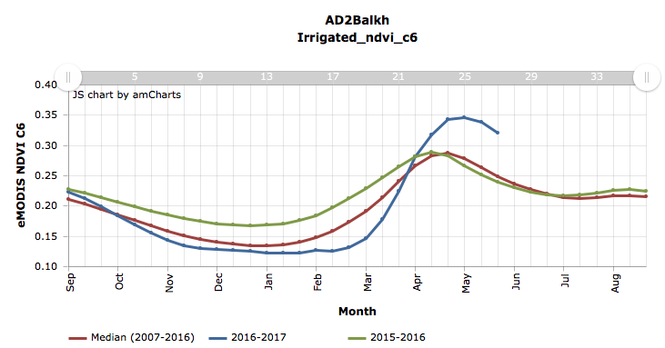
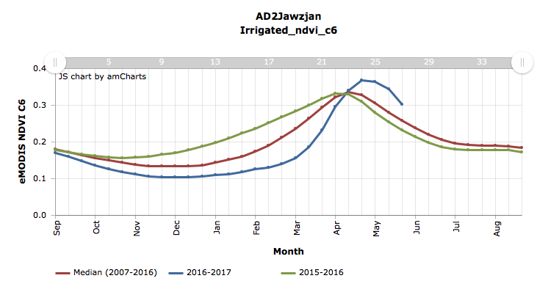
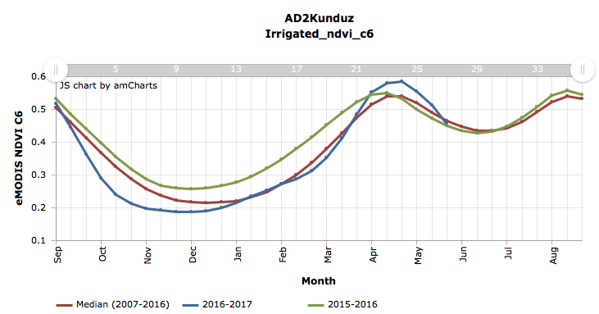
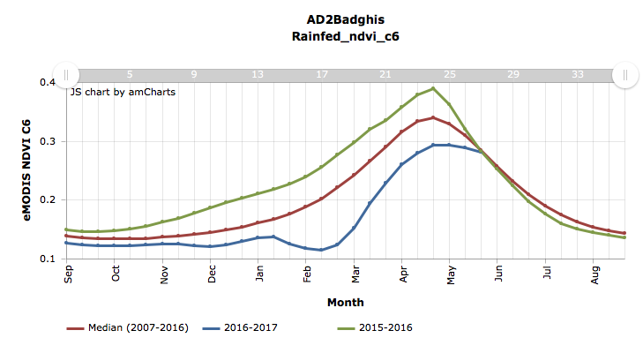
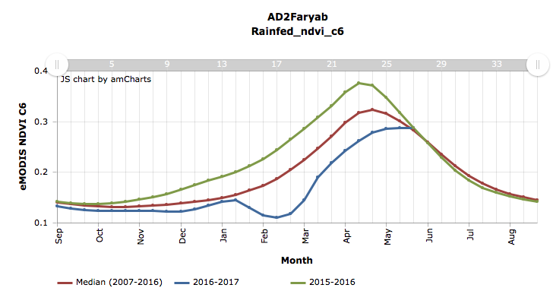
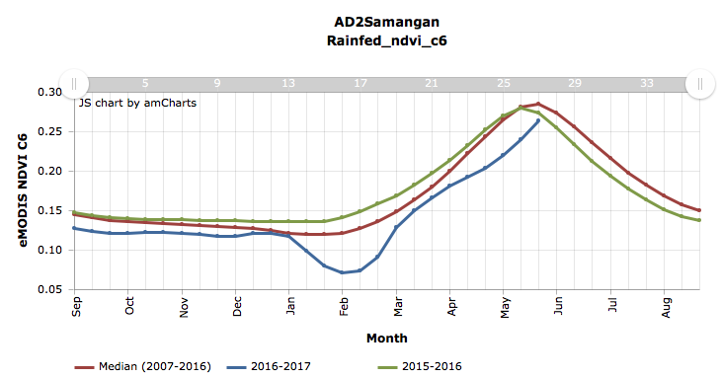
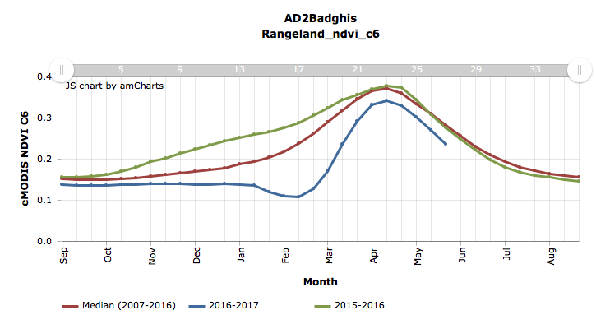
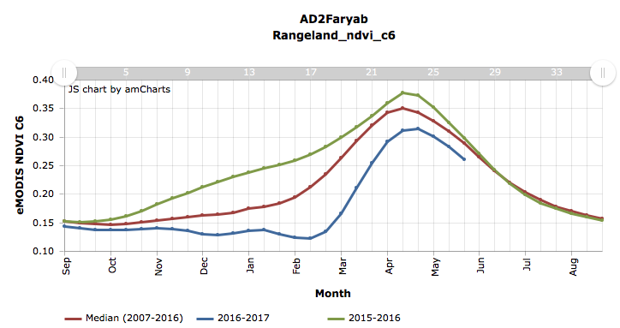
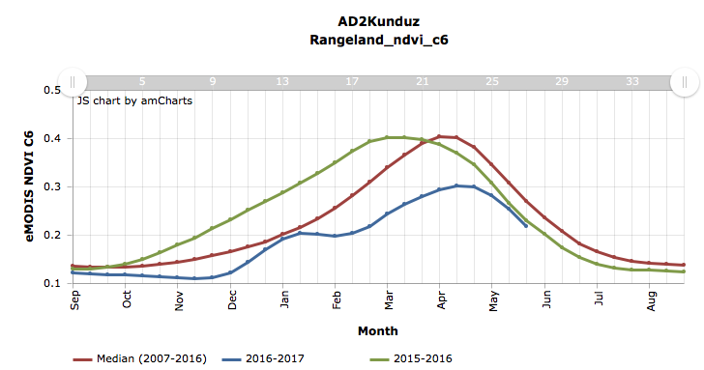
Irrigated NDVI time series
After a somewhat delayed start in Balkh and Jawzjan, vegetation conditions have remained above normal. In Kunduz, the start was near normal and slightly above normal at peak NDVI, but vegetation is now at near normal conditions.
Rainfed NDVI time series
Both the delays in the start of the 2016-17 season and below average seasonal conditions are evident in the areas below.
Rangeland NDVI time series
Vegetation conditions are below normal in the areas shown below, with Kunduz showing the least amount of seasonal productivity.

Slide 19
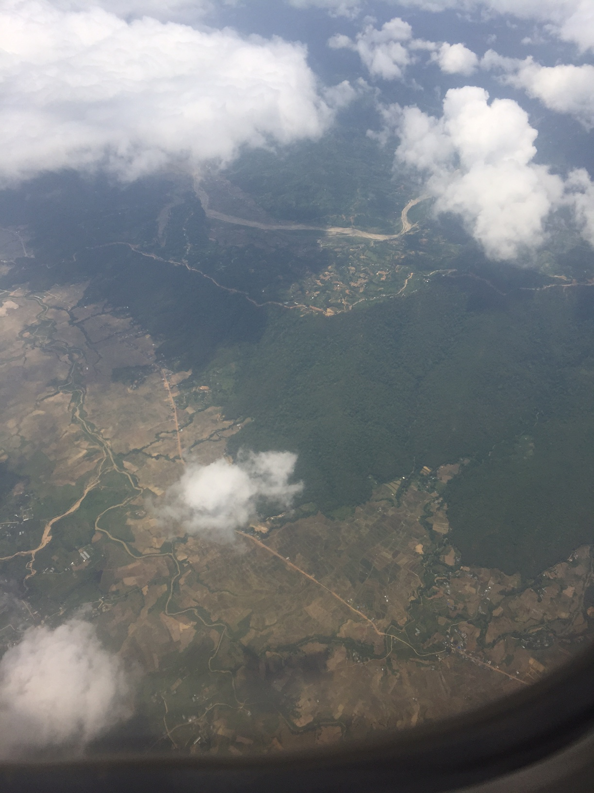
Near Kathmandu:
Two factors in this photo could negatively impact NDVI values or in other words contaminate the signal?
What specific land features would result in varied NDVI values across this portion of the landscape?

Slide 20
eMODIS NDVI – strengths and limitations
Strengths:
  Good at tracking change in vegetation due to seasonal trends, planting, burning, water deficits etc
  Identification of hotspots
  High resolution images (250m)
  Good for analyzing agricultural conditions for crop and pasture especially where agricultural activity is the dominant land cover
  NDVI affected by clouds, but eMODIS NDVI minimizes impacts of clouds by smoothing
  No assumnptions about agricultural practices required

Slide 21
eMODIS NDVI – strengths and limitations
Limitations:
  Cannot detect vegetation conditions under continuous cloud cover
  Can provide misleading agricultural interpretations when analyzed where non-agricultural land-cover is dominant
  Needs to only be considered during the active growing season – not meaningful when crops or rangelands are not actively growing.

Slide 22
eMODIS NDVI: where to access it
USGS FEWS NET Data Portal
  http://earlywarning.usgs.gov/fews
  GIS Data, graphics, charts, High resolution PDFs
Interactive Map Viewer
  https://earlywarning.usgs.gov/fews/mapviewer/index.php?region=ag
  Time series for irrigated, rainfed, and rangeland areas
Early Warning Explorer:
  http://earlywarning.usgs.gov/fews/ewxindex.php
  Web-mapping, charts, graphics

Slide 23
Questions?

