Slide 1
Irrigated Area Modeling & Mapping
Applications of FEWS NET Remote Sensing products for Agro-climatological Analysis Workshop
10 – 14 July 2017 | Kathmandu Nepal

Slide 2
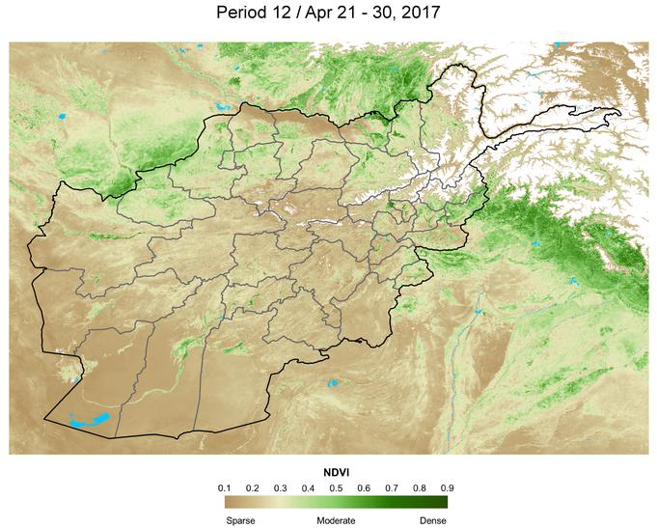
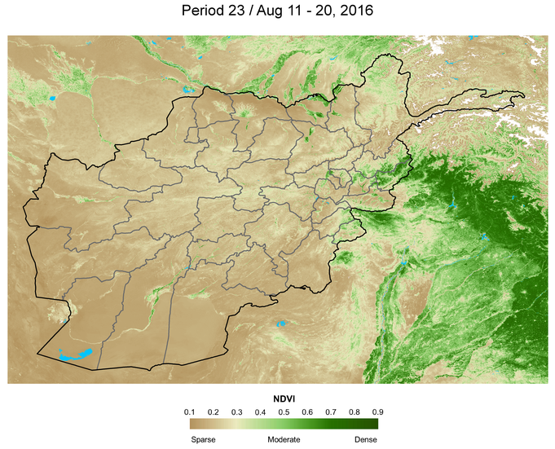
Irrigated Area Model
Two major growing seasons for irrigated crops
Irrigated area in eMODIS Normalized Difference Vegetation Index (NDVI)
Can we use NDVI to map irrigated area?

Slide 3
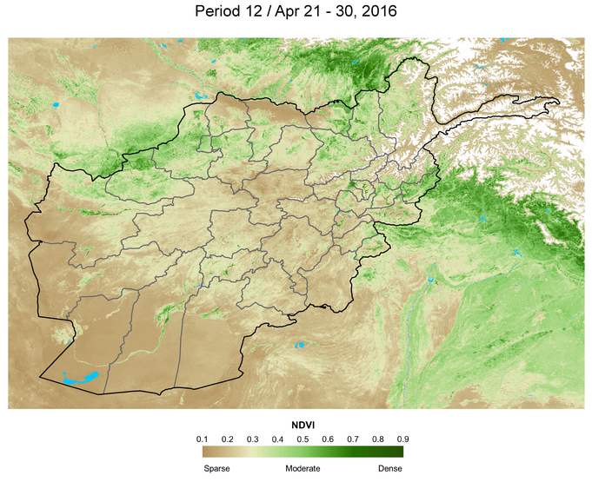
Irrigated Area Model
We developed a geospatial model which thresholds the seasonal NDVI in a decision tree algorithm
Thresholds vary by location/province
Pervez et al., 2014
http://www.sciencedirect.com/science/article/pii/S0034425714001461?via%3Dihub

Slide 4
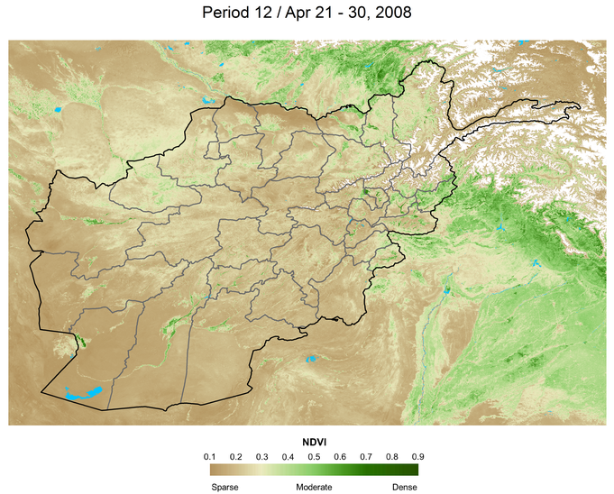
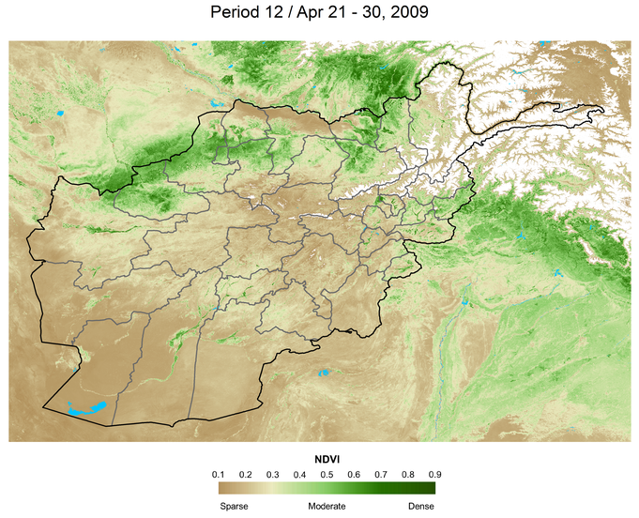
NDVI response to water availability
Dry condition
Wet condition

Slide 5
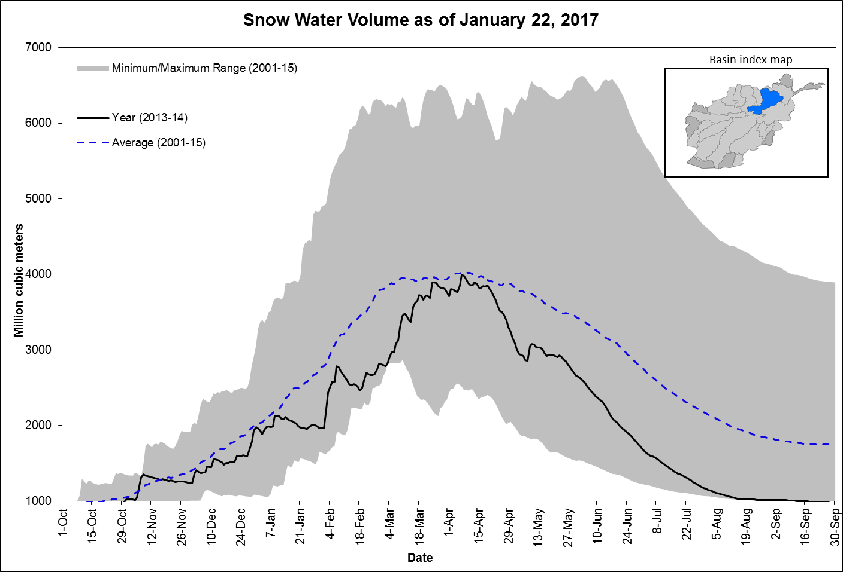
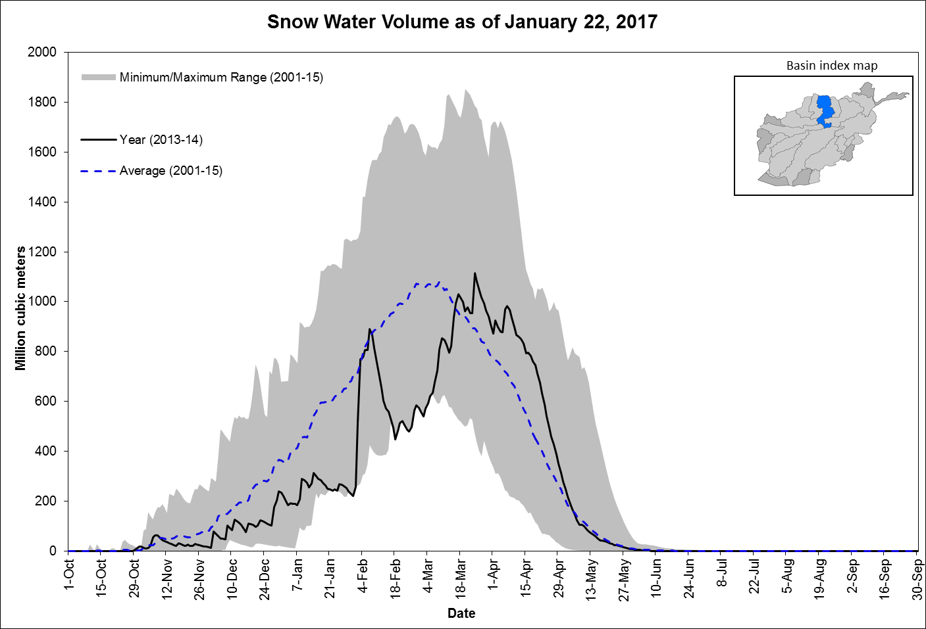
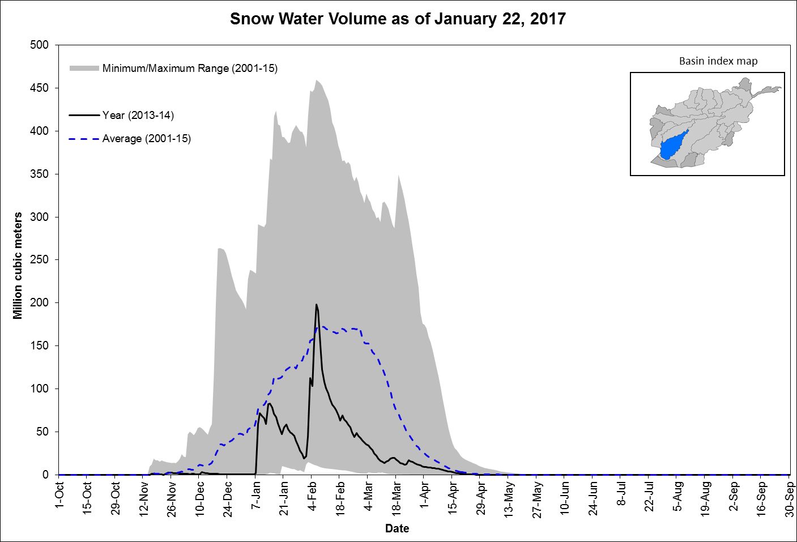
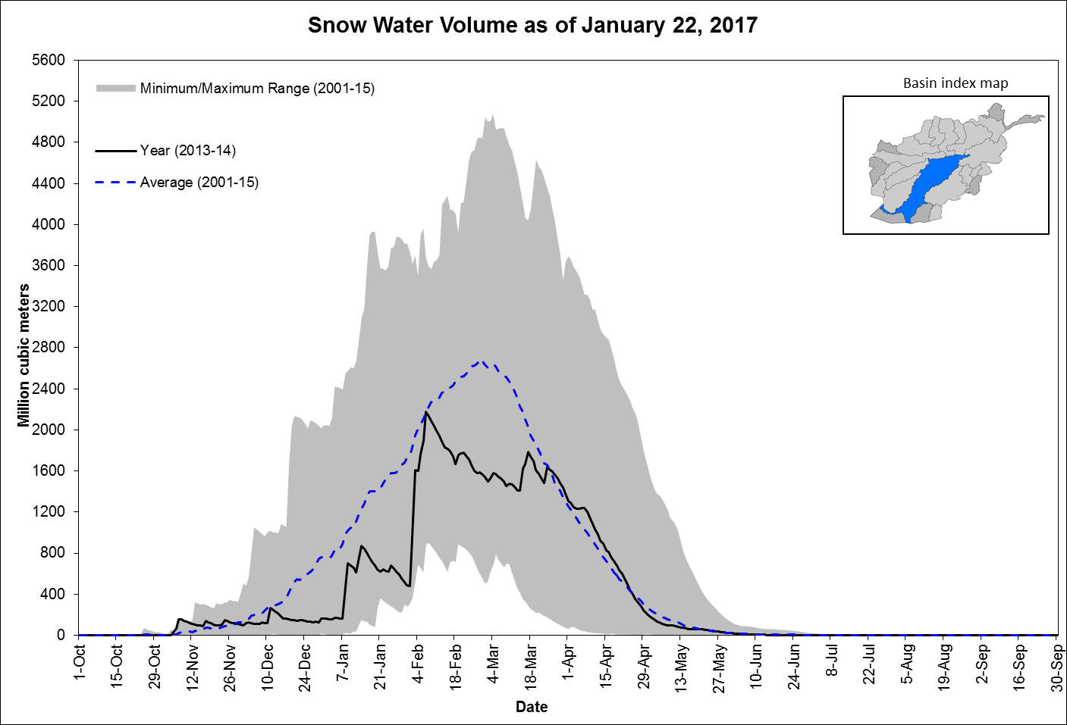
Spatial variability of water availability
2013-2014 snow water volume by basin

Slide 6
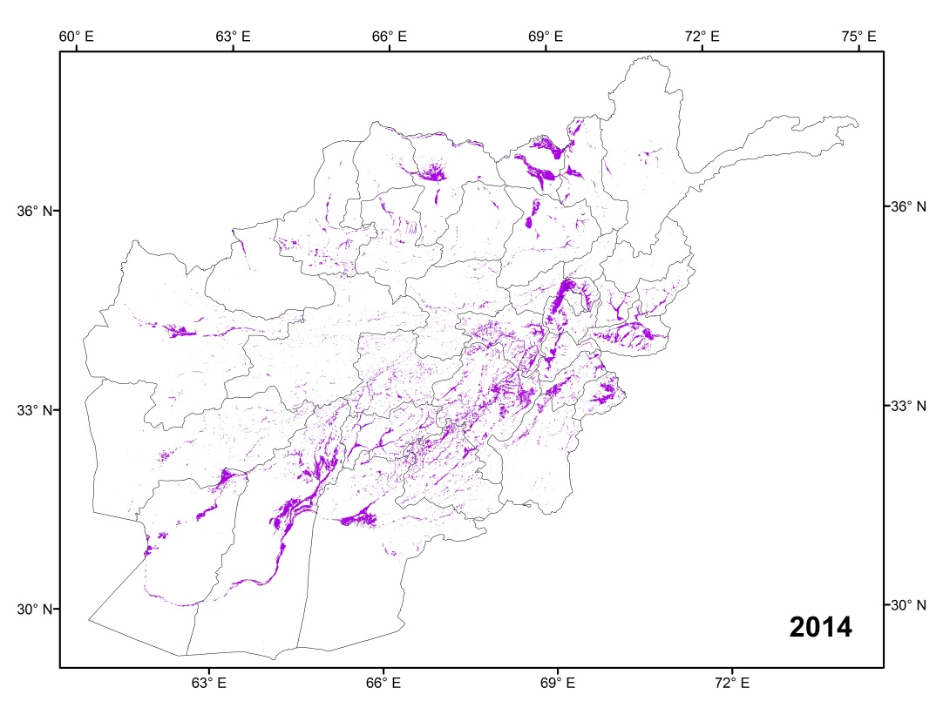
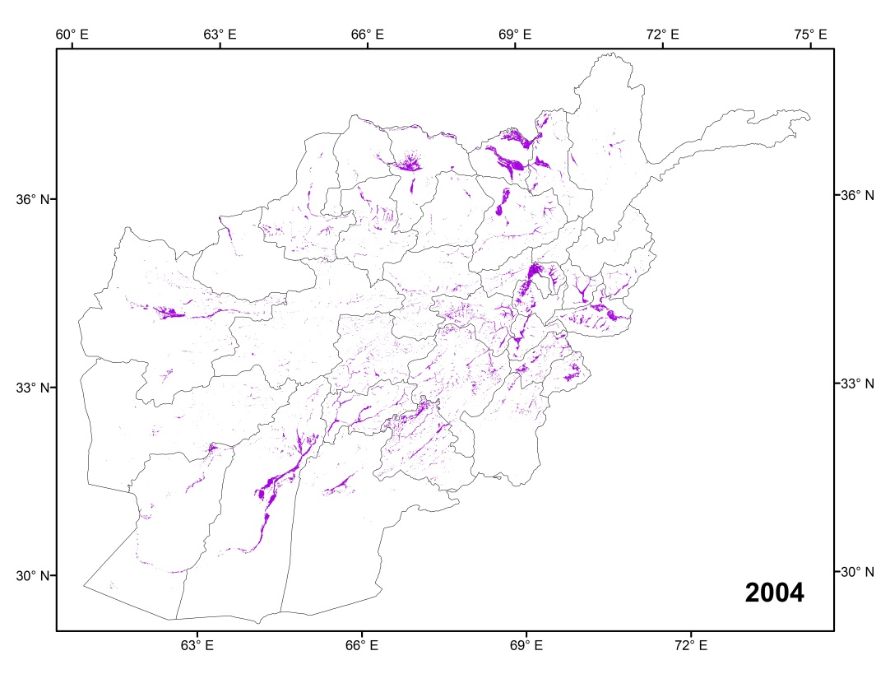
Irrigated Area Model Optimization
Model was optimized for normal, wet, and dry conditions specific to the sub-basin level
Run time: beginning of October
Irrigated area map was produced for the years 2002 to 2016

Slide 7
How Accurate were the Maps?
Comparison with irrigated area derived from Landsat
Landsat image, April 2010
Landsat derived irrigated areas, 2010

Slide 8
Correlation with Cereal Production
Total cereal production was highly correlated with the amount of area irrigated each year

Slide 9
Early Estimation of Crop Production
Crop production estimate was possible by October for the current year
Year | Irrigated Areas (mHa) | Estimated Cereal Production (mMT) | Reported Cereal Production (mMT)
2001 | 1.34 | 1.95 | 1.98
2002 | 1.64 | 3.74 | 3.59
2003 | 1.93 | 5.05 | 5.37
2004 | 1.52 | 3.07 | 3.06
2005 | 2.15 | 5.77 | 5.24
2006 | 1.73 | 4.17 | 4.80
2007 | 2.15 | 5.78 | 5.64
2008 | 1.71 | 4.05 | 3.65
2009 | 2.27 | 6.08 | 6.33
2010 | 2.05 | 5.48 | 5.59
2011 | 1.92 | 5.01 | 4.44
2012 | 2.10 | 5.64 | 6.32
2013 | 2.42 | 6.46 | 6.51
2014 | 2.54 | 6.10 | 6.74
2015 | 2.41 | 6.31 | 5.80
2016 | 2.51 | 6.3
Estimated cereal production for 2016: 6.3 M MT

Slide 10
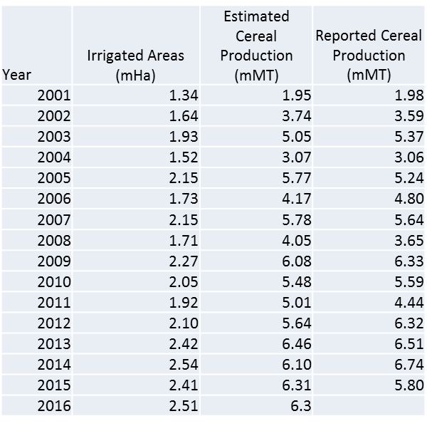
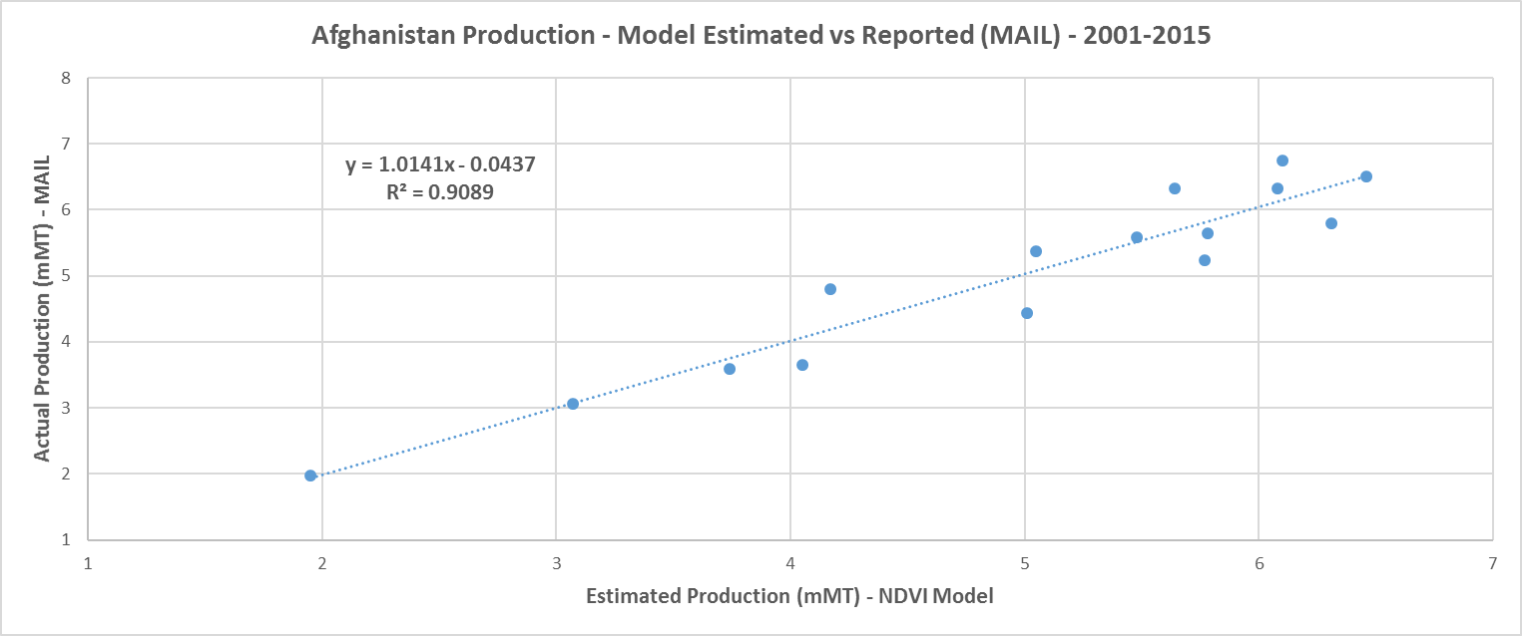
Modeled vs Reported Production

Slide 11
Early Estimate of Crop Production
Currently provides production estimate by October
It is fair to assume that most areas irrigated in the second season was irrigated in the first season (True?)
Can we map irrigated areas after the first season?

Slide 12
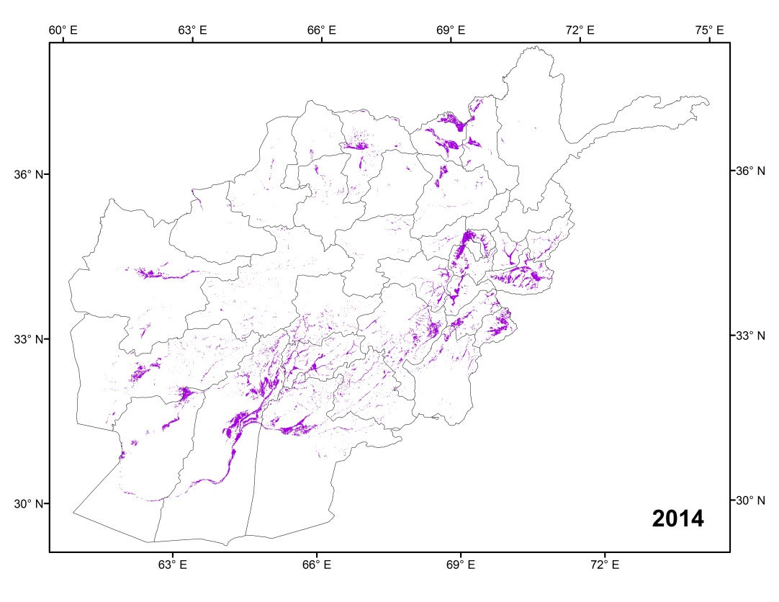
First Season Irrigated Area Map
Irrigated area model was recalibrated
Run time: early June
Season’s end (October)
After first season (June)

Slide 13
First Season Irrigated Area
First season irrigated area in comparison with season end irrigated area and cereal production

Slide 14
Early Estimation of Crop Production
A regression equation relating crop production estimates by June to historical cereal production was applied for estimating 2017 production.
Estimated cereal production for 2017 is 6.36 M MT

Slide 15
Questions?

