Slide 1
Introduction to Remote Sensing
Applications of FEWS NET Remote Sensing products for Agro-climatological Analysis Workshop
10 – 14 July 2017 | Kathmandu Nepal

Slide 2
Remote Sensing Defined
“…the science of acquiring information about the Earth’s surface without being in direct contact with it”
Remote sensing involves the detection and measurement of phenomena with devices sensitive to electromagnetic energy such as:
    hand-held sensors
    aircraft sensors and cameras
    satellite sensors

Slide 3
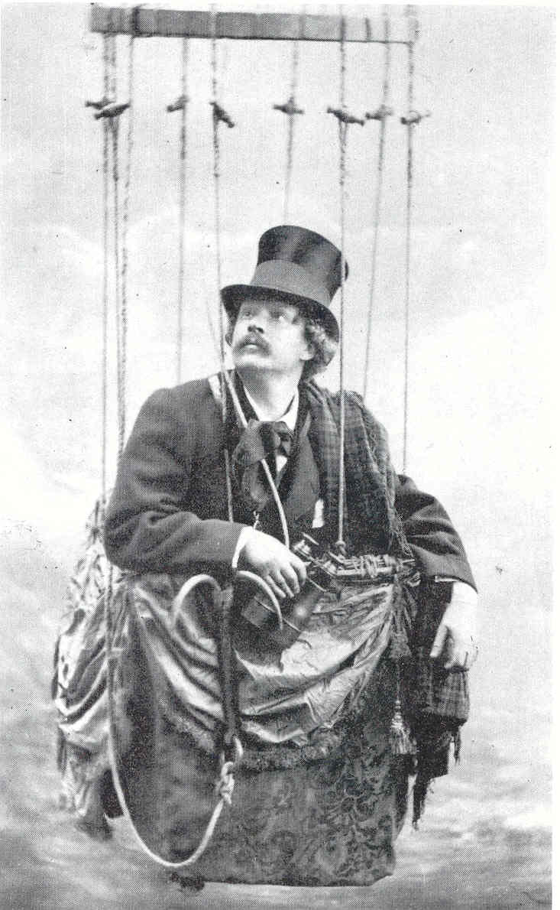
First Aerial Photograph
• The first known aerial photograph was obtained by Gaspard Felix Tournachon (Nadar) from a tethered balloon 1,700-ft. above Paris, France in 1858.
Jensen, 2000

Slide 4
Balloon Photography
• Oblique aerial photograph of downtown Boston obtained by Samuel A. King and J. W. Black from a balloon at an altitude of 1,200 ft. on October 13, 1860.
• First aerial photograph taken from a captive balloon in the United States.
Jensen, 2000

Slide 5
Non-satellite based Remote Sensing
Pigeons
• In 1903, Julius Neubronner patented a breast-mounted camera for carrier pigeons that weighed only 70 grams.
• A squadron of pigeons
is equipped with light-weight aerial cameras.
Jensen, 2000

Slide 6
Non-satellite based Remote Sensing
Jensen, 2000
Oblique aerial photograph obtained from a camera mounted on a carrier pigeon.
The pigeon’s wings are visible in the foreground.

Slide 7
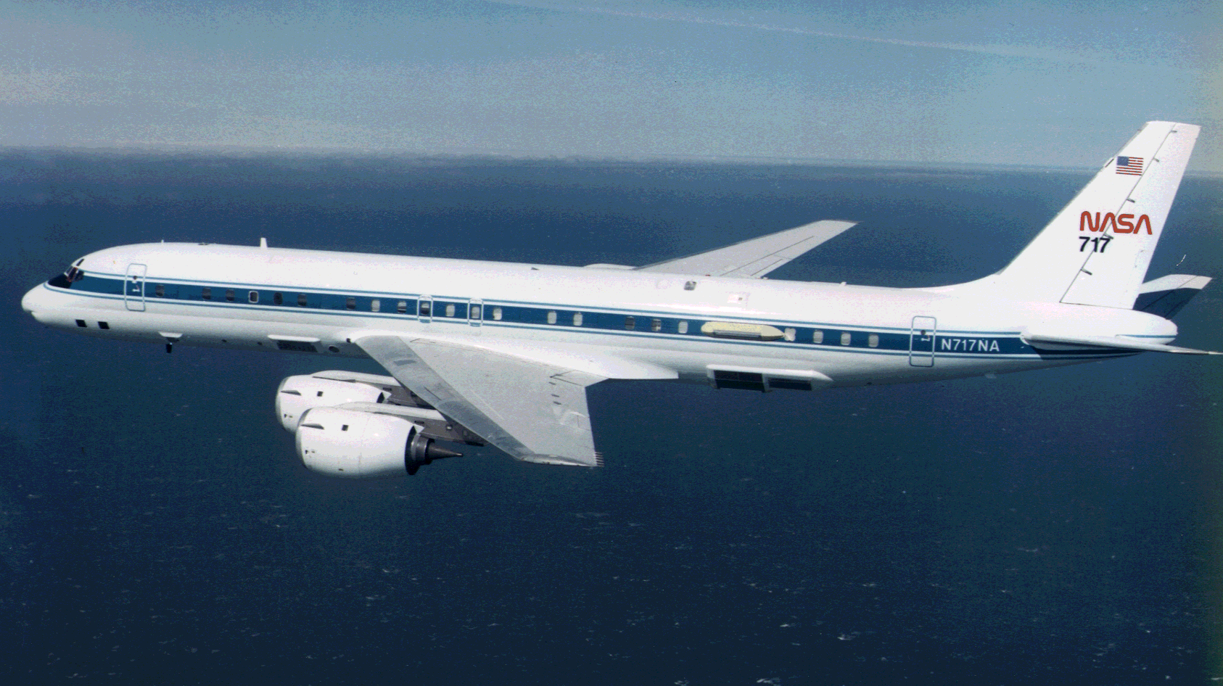
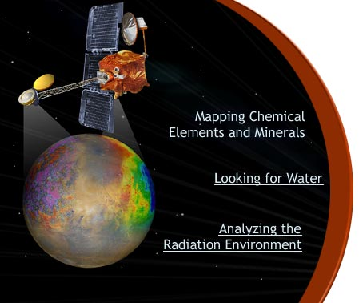
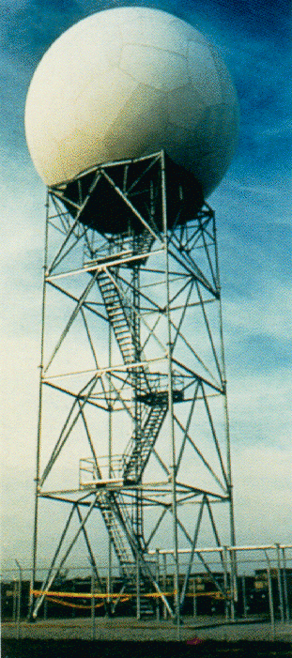
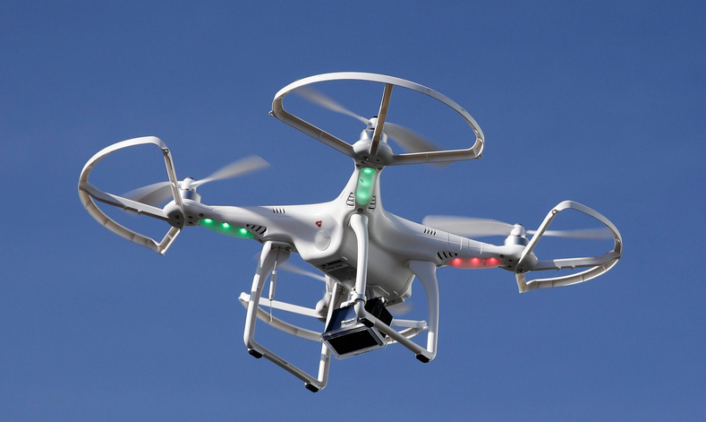
Modern Remote Sensing Platforms
Ground-based
Aerial-based
Satellite-based

Slide 8
Why satellite remote sensing?
Need for timely, frequent and comprehensive observations of Agro-Hydro-Climatic indicators to support FEWS NET activities.
FEWS NET is NOT a primary data collector and works through local NETWORK partners who have sparse field observational network.
Remotely sensed data, products and analysis tools are readily available – via dedicated USGS/FEWS NET and implementing partners.

Slide 9
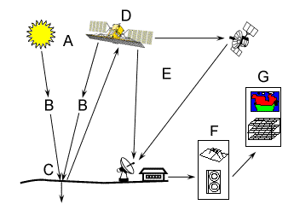
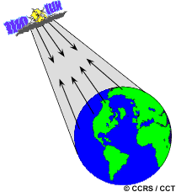
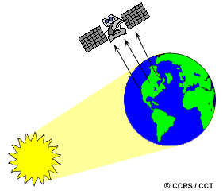
Satellite Remote Sensing
Schematic of the Satellite Data Acquisition Process
Active
vs
Passive

Slide 10
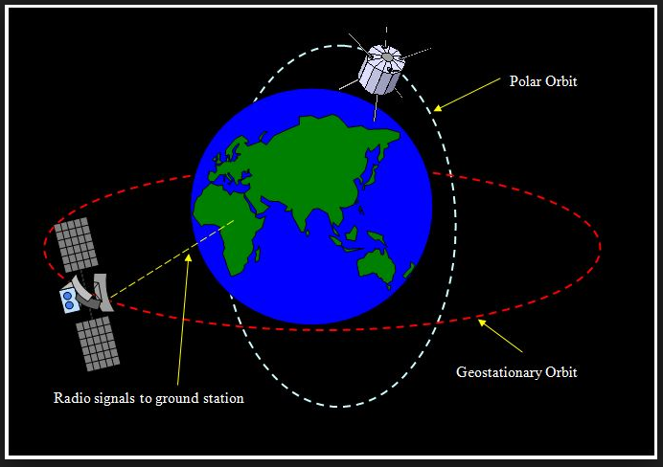
Satellite Orbits

Slide 11
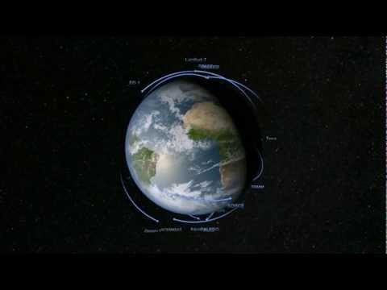
NASA Fleet - 2015

Slide 12
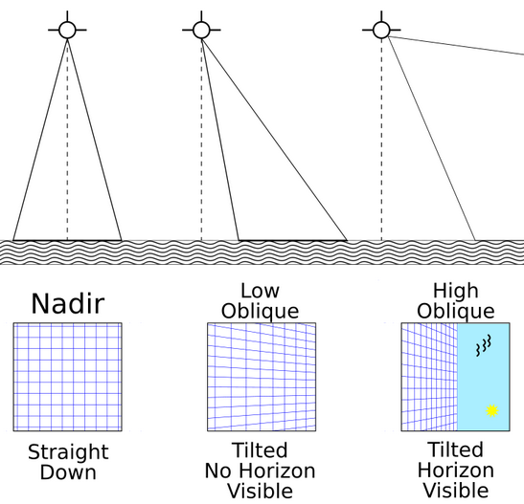
Nadir vs Oblique viewing
{
Swath width or Field of View

Slide 13
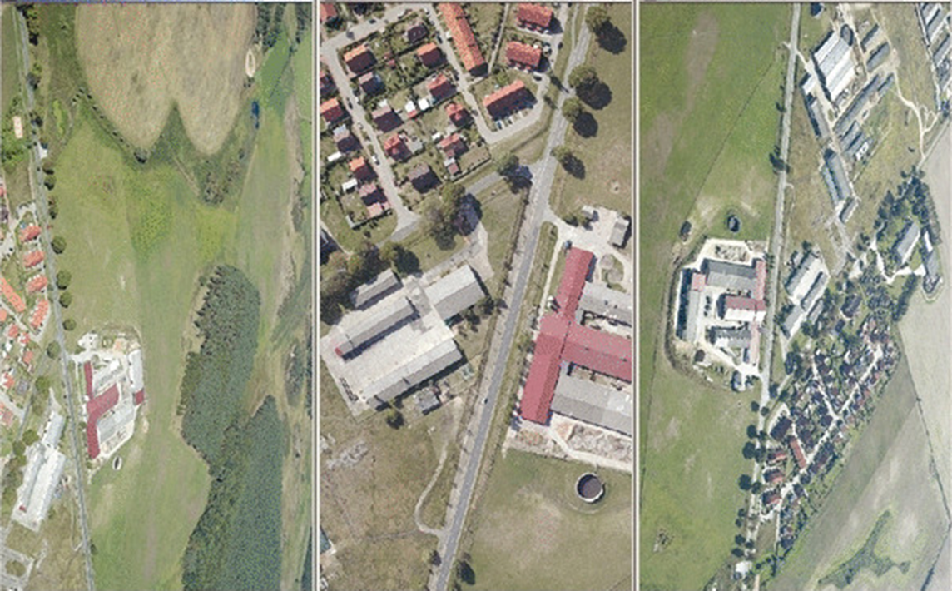
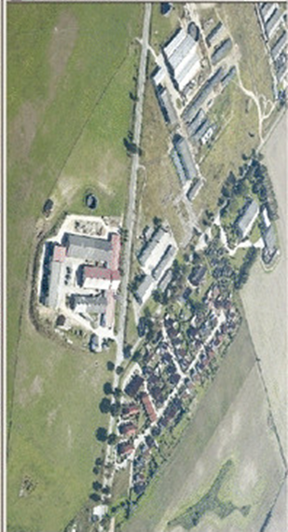
Nadir vs Oblique viewing
Nadir
Low Oblique
High Oblique

Slide 14
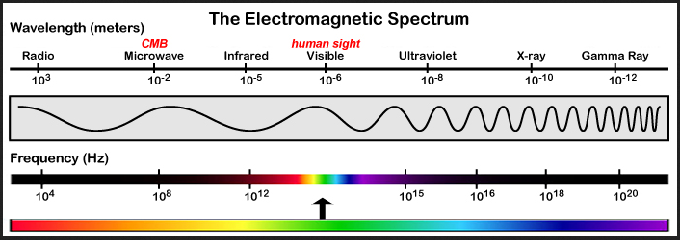
What are we measuring?
Low frequency
Long Wavelength
Low quantum energy
High frequency
Short Wavelength
High quantum energy

Slide 15
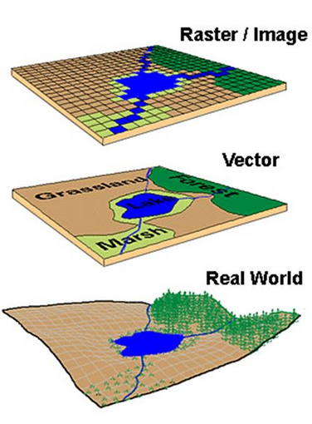
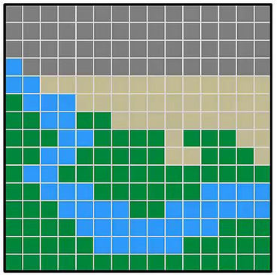
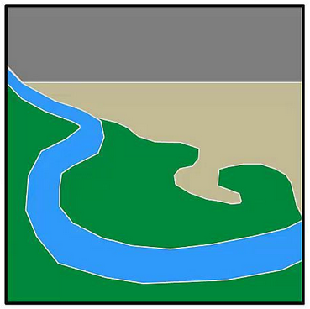
Spatial Data: Vector (shapefile) vs Raster (image)
Raster
Vector

Slide 16
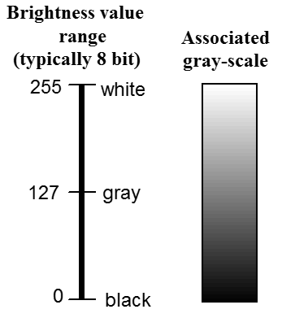
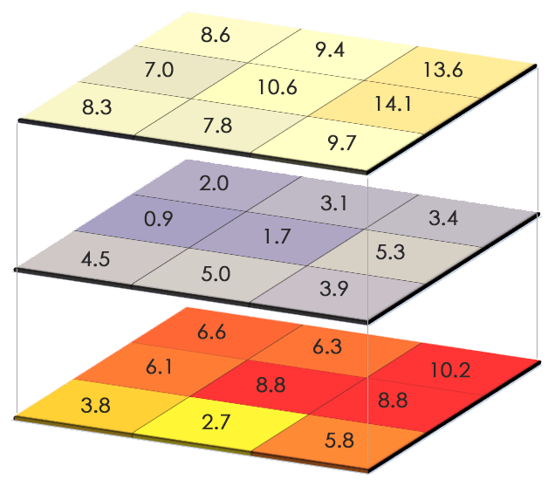
Raster Data Format
Lines or rows
Columns
1
1
2
2
3
3
1
2
Bands
Images can be gray-scale or have color applied to distinguish values.
Each pixel or picture element in an image has an X,Y coordinate and an associated value for each band.
Line 3, Column 2 has values of 7.8, 5.0, and 2.7 for bands 1, 2, & 3 respectively.
3

Slide 17
Satellite Resolution Concepts
We will discuss three types of satellite resolution:
Spectral Resolution – refers to the degree to which a satellite sensor can distinguish or resolve features of the electromagnetic spectrum
Spatial Resolution – refers to the number of pixels utilized in construction of a digital image. Images having higher spatial resolution are composed of a greater number of pixels than those of lower resolution.
Temporal Resolution – refers to the frequency of a measurement with respect to time. Often there is a trade-off between temporal and spatial resolution.

Slide 18
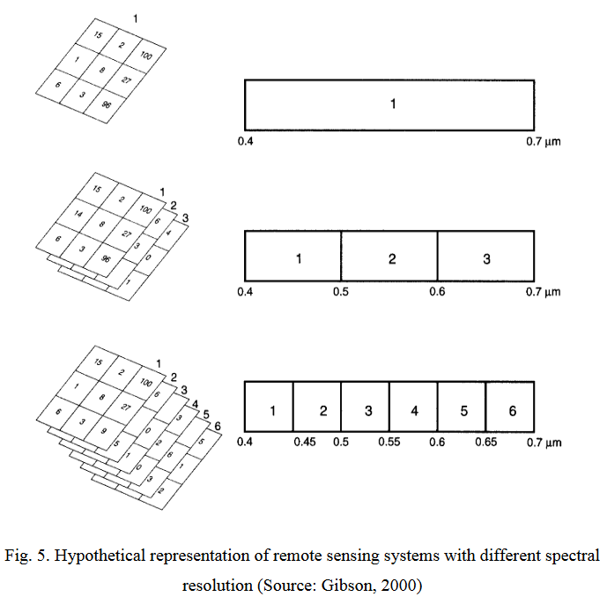
Spectral Resolution

Slide 19
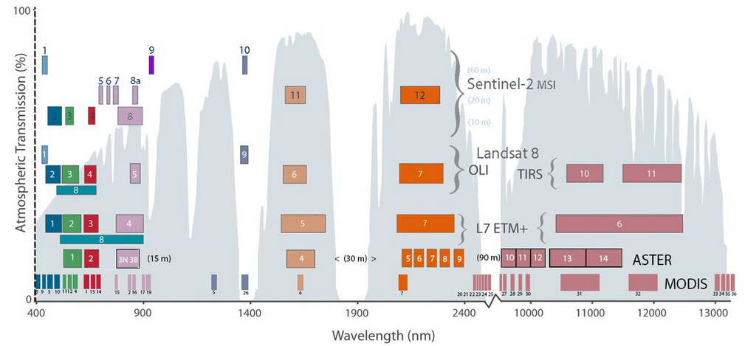
Spectral Resolution

Slide 20
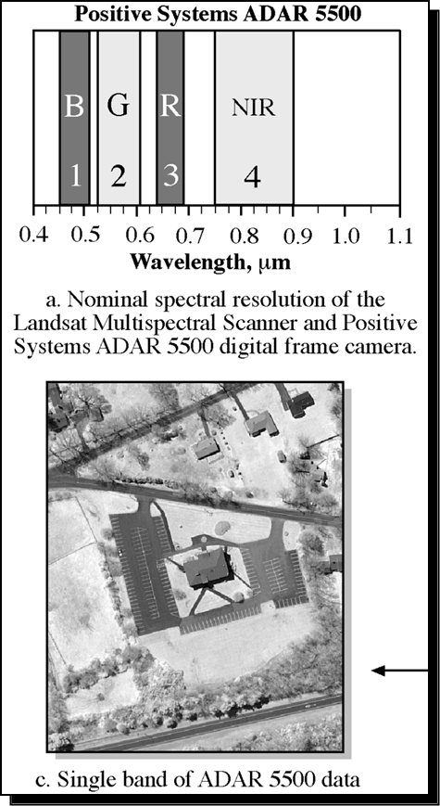
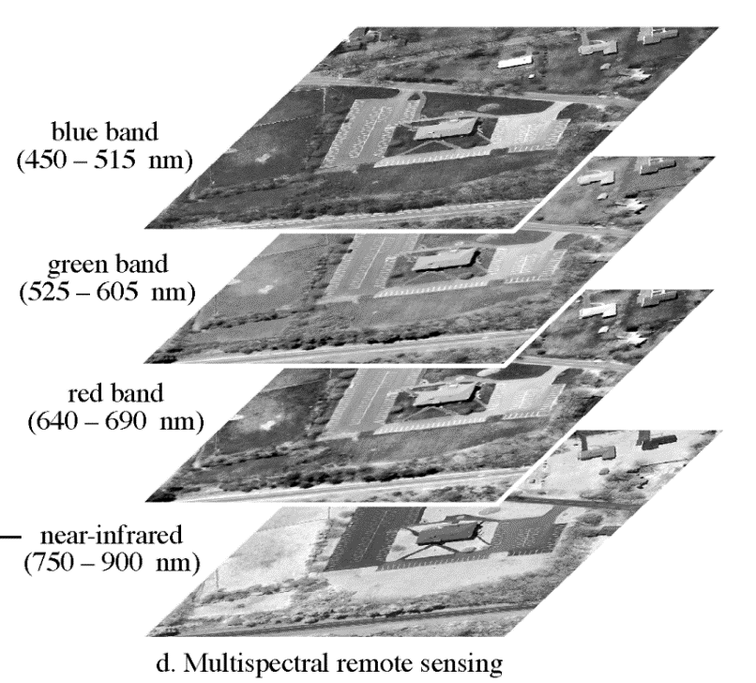
Spectral Resolution
The image stack below shows gray-scale images of different parts of the electromagnetic spectrum.
The gray scale bands can be combined to create color images that help to illustrate different features of the landscape.

Slide 21
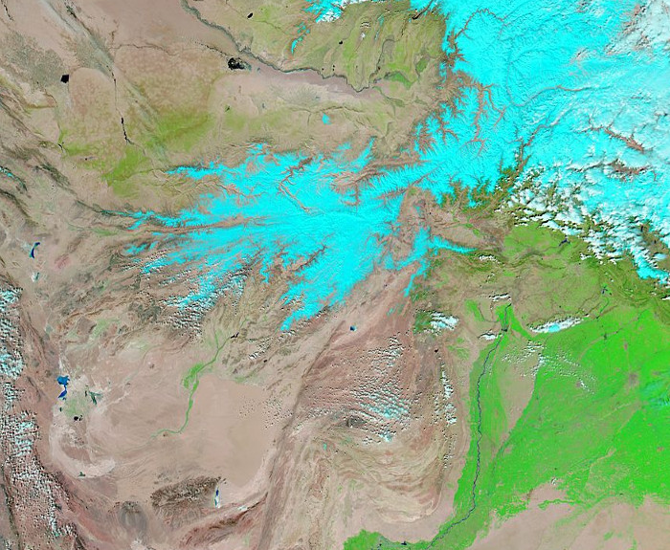
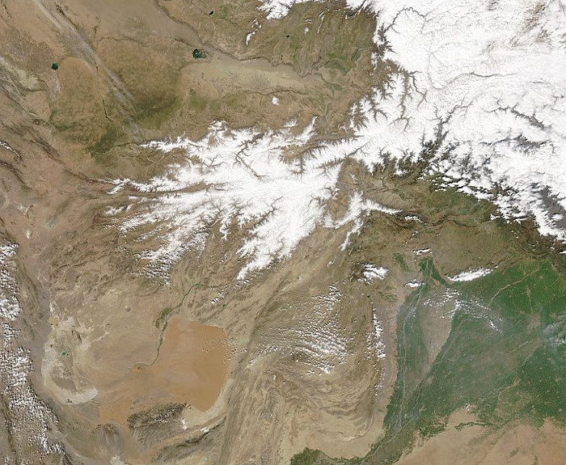
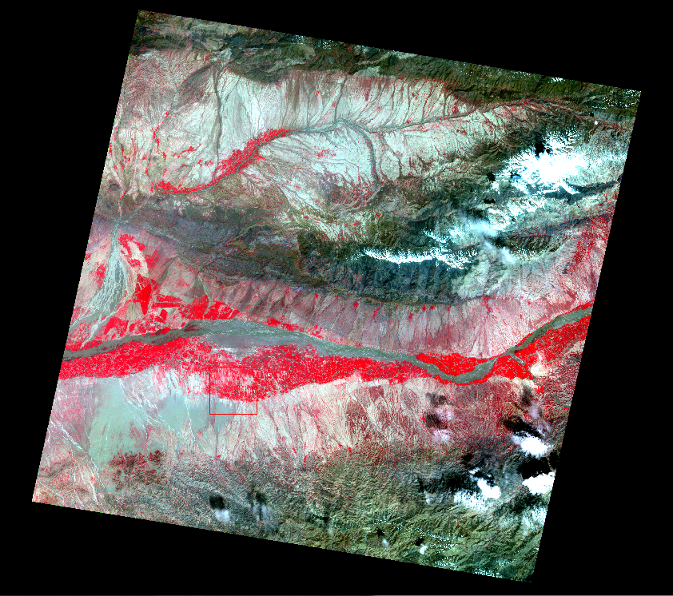
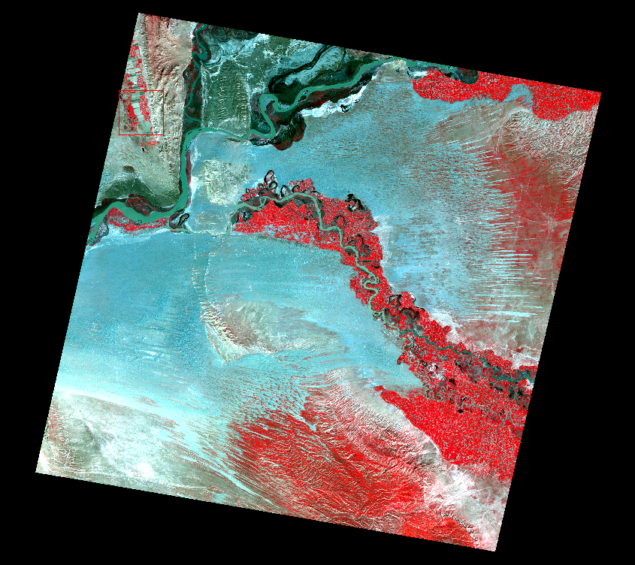
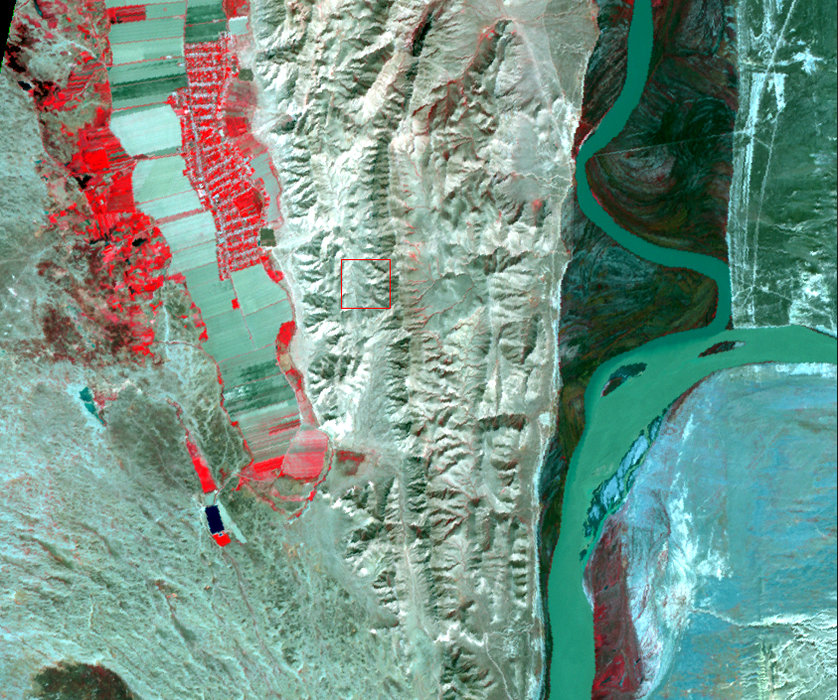
Spectral Resolution

Slide 22
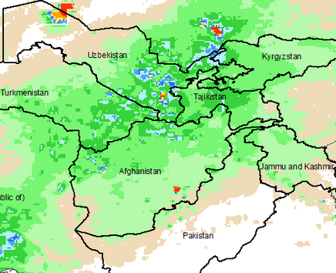
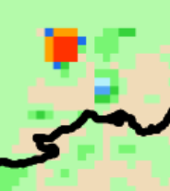
Spatial Resolution
An Image is made up of cells called “pixels” (picture elements)
Spatial resolution refers to the number of pixels utilized to construct a digital image – pixel size varies between satellites

Slide 23
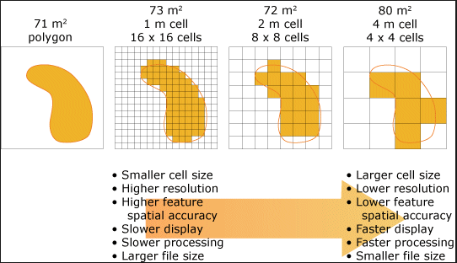
Spatial Resolution

Slide 24
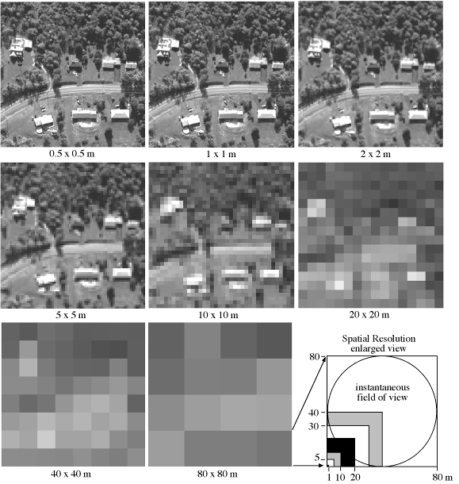
Spatial Resolution
Jensen, 2000

Slide 25
Pixels and Image (spatial) Resolution
Pixels are different sizes e.g.
  RFE pixel = 0.1 degrees ~ 10 km
  eMODIS ETa pixel = 1 km
  eMODIS NDVI pixel = 250m
The smaller the pixel, the finer the image, the more spatial information is in the image, and the closer you can zoom into the image
Images with smaller pixels have higher resolution.

Slide 26
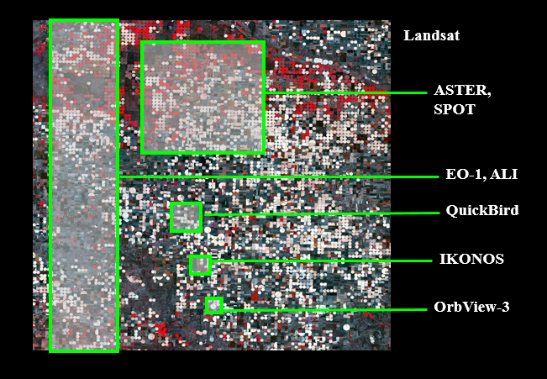
Spatial Resolution and Geographic Coverage

Slide 27
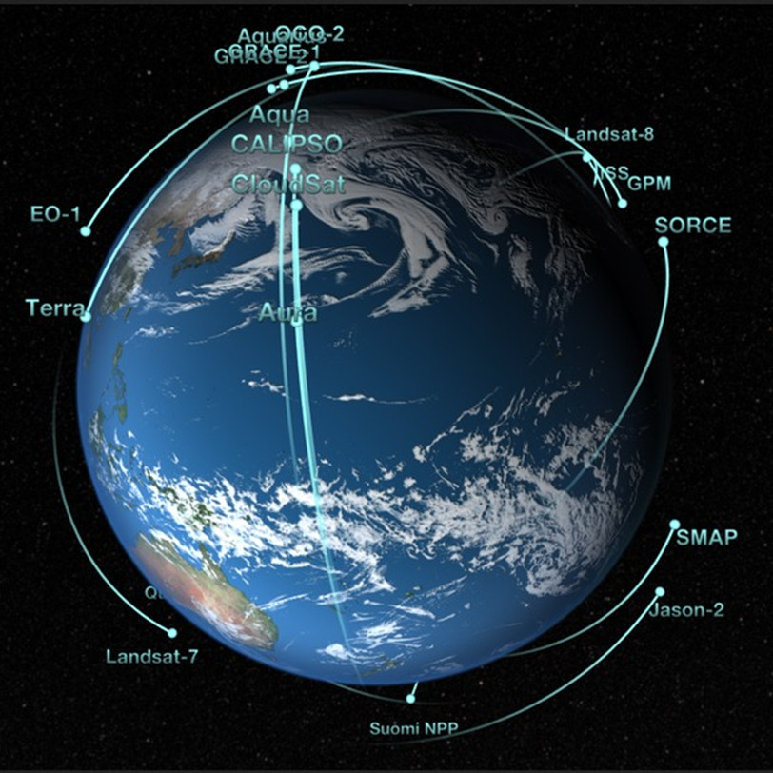
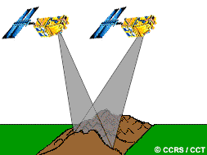
Temporal Resolution
The temporal resolution specifies the revisiting frequency of a satellite sensor for a specific location.
High temporal resolution: < 24hours – 3days
Medium temporal resolution: 4-16 days
Low temporal resolution: > 16 days

Slide 28
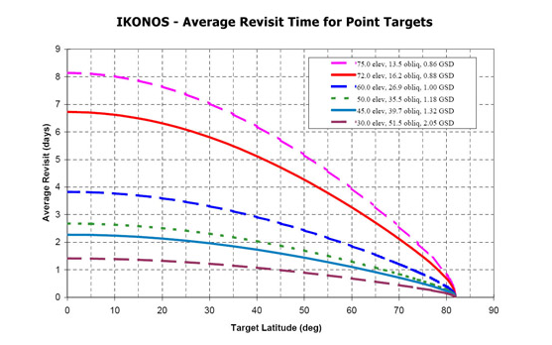
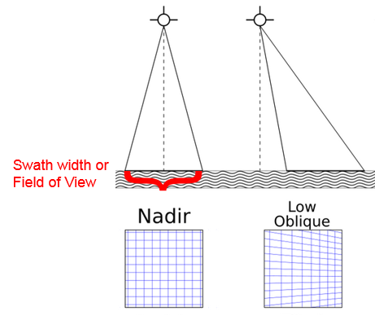
Temporal Resolution
Actual temporal resolution of a sensor depends on a variety of factors, including the satellite/sensor capabilities, the swath overlap, and latitude.
Shorter revisit time at lower elevation angle & higher latitude.

Slide 29
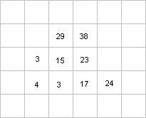
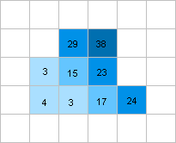
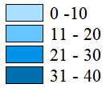
Pixel values and legends
Each pixel on an image has a number or value associated with it.
This number can represent various quantities such as rainfall (mm), temperature (degrees), etc
We can group the image into ranges and associate each range of values with a specific colour
This allows us to have a more visually impactful and easy to understand image

Slide 30
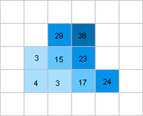
Spatial vs Temporal Averages
A spatial average is the average of all the pixels in a given area.
  e.g. the average rainfall for District X in January Dekad 3 2014 is the spatial average of all the rainfall pixels in district X:
Average = (29+38+3+15+23+4+3+17+24) / 9 = 17.3mm

Slide 31
Spatial vs temporal average
A temporal average or mean is an average of the values of each pixel over time.
Therefore, each pixel in an image, will have its own temporal mean, to create an image of the temporal average of each pixel.
It is often referred to as the long term mean or short term mean, depending on the length of the time series used to create the average image.

Slide 32
Spatial vs temporal average
Example: Temporal mean for 1 pixel location
Date | Pixel Value
Dekad 3 Jan 2001 | 35
Dekad 3 Jan 2002 | 7
Dekad 3 Jan 2003 | 41
Dekad 3 Jan 2004 | 10
Dekad 3 Jan 2005 | 25
Dekad 3 Jan 2006 | 56
Dekad 3 Jan 2007 | 0
Dekad 3 Jan 2008 | 12
Dekad 3 Jan 2009 | 27
Dekad 3 Jan 2010 | 3
Short term mean (2001-2010):
for Jan Dekad 3 Average:
= 35+7+41+10+25+56+0+12+27+3)/10
= 24.4mm

Slide 33
Anomalies
We typically use two types of anomalies from baselines:
  Difference from average
    The actual observation Minus the average
    0 = no difference; +ve means above average; -ve means below average
    E.g. a rainfall diff. from average value of -20 means 20mm less than the average
    Good for quantifying deficits and surplus in same units as original observation
  Percent of average
    The actual observation Divided by the average, and multiplied by 100 (to convert to percent)
    100 = same as average; >100 means above average, <100 means below average
    Good for normalizing anomalies across the whole image

Slide 34
Questions?

