Slide 1
Introduction to Making Agro-climatology Assumptions
Applications of FEWS NET Remote Sensing products for Agro-climatological Analysis Workshop
10 – 14 July 2017 | Kathmandu Nepal

Slide 2


Steps to developing
agro-climatology assumptions
1. Understand the climatology for the area
of concern
After each step, develop assumptions about temporal and spatial distribution of rains and cumulative seasonal rainfall
2. Evaluate current climate modes
3. Interpret available forecasts
4. Incorporate monitoring data from remote sensing and other sources
________________________________________
FAMINE EARLY WARNING SYSTEMS NETWORK

Slide 3
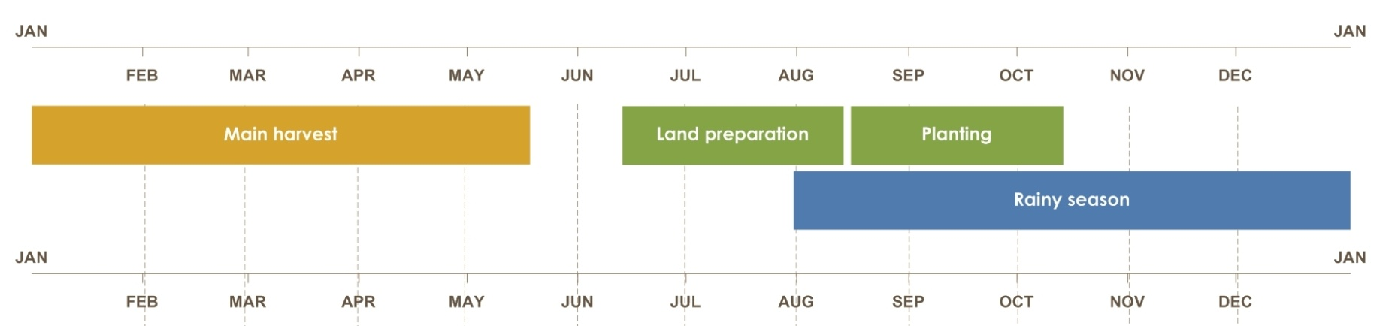
Developing agro-climatology assumptions
1. Understand the climatology for the area of concern (well in advance of SOS and as
necessary)
2. Evaluate current climate modes (~3 months before SOS
and until EOS)
3. Interpret available forecasts (~2 months before
SOS and through EOS)
4. Incorporate monitoring data from
remote sensing and other sources
(SOS through EOS)
________________________________________
FAMINE EARLY WARNING SYSTEMS NETWORK

Slide 4
Step 1 Understanding Climatology Summary
Use rainfall data sets to graph historical data to determine typical start/end of season and periods of peak rainfall
Calculate mean cumulative rainfall for a season, maximum dekadal rainfall, identify seasons that had the most and least rainfall
Evaluate spatial and temporal variability: calculate the standard deviation, coefficient of variation, and describe the variability
Develop assumptions about rainfall performance given your understanding of climatology

Slide 5
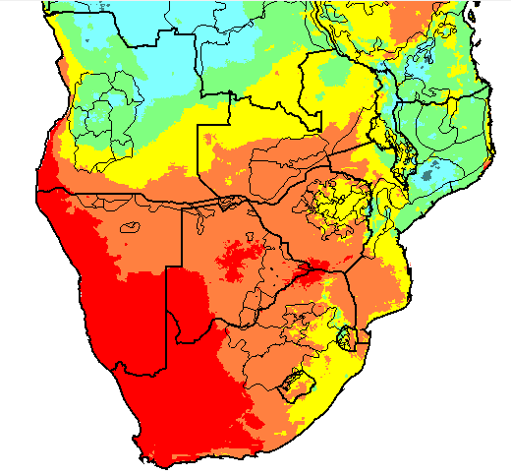
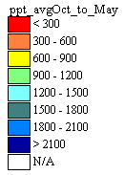
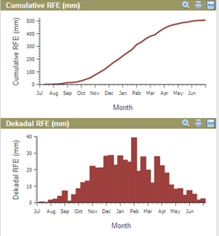
Basics of climatology
Average weather over a long period of time
Average rainfall, October to May, 1981-2012
Spatial variability
Temporal variability
Cumulative rainfall and annual dekadal rainfall
________________________________________
FAMINE EARLY WARNING SYSTEMS NETWORK
Notes:
This refers to the fluctuation of climate over seasons and years (e.g., from year to year). When talking about climate variability we need to take into account two dimensions, one is the spatial variability which refers to the changes of the climate across a landscape it could be a crop region, a country or so on. This map shows how average rainfall values (one of the climate variables) change from one place to another across southern Africa. Spatial variability could also be analyzed across all time scales, daily, dekads, months, etc.
Spatial variability: changes of a climate variable (e.g., rainfall, temperature) over a landscape (region, country, state); this applies to any time scale (daily, monthly, annual, etc.)
Another dimension of the climate variability is time. This refers to changes of climate over time; it could be changes within a season/year, or changes from season to season (or year to year). It can refer to changes in the mean value, the minimum or maximum, or the range (maximum minus minimum). We refer to changes within a season or year as INTRA-annual variability (e.g., changes in rainfall from May to June to July) and changes between years as INTER-annual variability (e.g., changes from 2001 to 2002 to 2003, etc). Over the long term, inter-annual variability can also provide a trend or tendency (e.g., decreasing rainfall over the period 1981 – 2013).

Slide 6
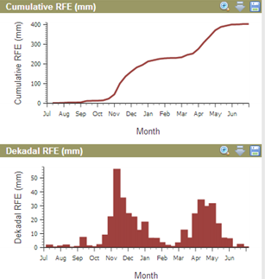
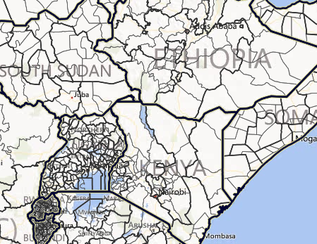
Building blocks for an assumption
Based on climatology, rainfall during the first rainy season will begin in October and end in January, with average cumulative rainfall of approximately 250 mm. Most rainfall is received in November and December.
________________________________________
FAMINE EARLY WARNING SYSTEMS NETWORK
Notes:
With this information that we are gathering about our area of concern, we are building our knowledge about the area so that we can start making initial assumptions. So, an initial assumption would be:
“Based on climatology, rainfall during the first rainy season will begin in October and end in February, with average cumulative rainfall of approximately 250 mm. Most rainfall is received in November and December. “

Slide 7
Building Blocks for an Assumption
In Zimbabwe, Mashonaland East maize cropping area, over the 1981-2012 period, the wettest year was 1998 with slightly more than 1000 mm of rainfall during the season. The driest year was 1991 with 400 mm.
________________________________________
FAMINE EARLY WARNING SYSTEMS NETWORK
Notes:
Before starting to measure variability let’s use what we have to continue building our agroclimatological knowledge base about our area of concern.
EXPLAIN THAT SD AND CV ARE USED TO MEASURE INTER-ANNUAL VARIABILITY, BUT THAT THOSE TOPICS ARE COVERED IN THE FULL/ADVANCED TRAINING ON BUILDING AGROCLIMATOLOGY ASSUMPTIONS.

Slide 8
Step 2 Evaluating Climate Modes Summary
Understand key climate modes and their impacts on the area of concern
Use SST anomalies to identify climate mode(s) impacting the area of concern
Indicate the typical impacts of the climate mode(s)
Revise rainfall assumptions given current and projected climate modes

Slide 9
What is a Climate Mode?
A description of one aspect of the way Earth’s climate behaves
Identifiable characteristics: variations in temperature, precipitation + wind speed/direction
Simplified numerical indices measure strength and temporal changes. These indices incorporate changes in the identifiable characteristics.
Example: El Niño – Southern Oscillation
Notes:
A climate mode describes one aspect of the way Earth’s climate behaves. Since Earth’s climate is complex and behaves in many different ways that vary temporally and regionally we can understand the behavior of Earth’s climate in terms of many different climate modes.
Climate modes are identified and measured using variations of variables such as temperature and precipitation. Other examples are wind direction and wind speed.
The identifiable characteristics of climate modes, such as temperature and precipitation, are used to understand the temporal changes and strength of the climate mode
There are many climate modes. The most important climate mode is perhaps ENSO. Other climate modes important to us are the Indian Ocean dipole.

Slide 10
Changes in Sea Surface Temperatures (SST) Have Major Influence on Climate
The most energy enters the atmosphere in the tropics, within 10 degrees of the equator
Variations in tropical SST largely control the amount of energy entering the tropical atmosphere. As a result:
Changes in energy input in the tropical atmosphere
MAJOR CHANGES TO THE GLOBAL CLIMATE
Notes:
Sea Surface Temperatures (SST) exhibit some of the most regular and predictable changes in the Earth’s climate system. ENSO and IOD are two great examples of regular and predictable changes in SSTs.
SSTs are also one of the main controls on how much energy makes it’s way into the atmosphere.
The amount of energy going into and out of the atmosphere as a result of SST changes is very important to the global atmospheric circulation which in turn are responsible for the behavior of the atmosphere and precipitation in your areas of focus.
Therefore, the regularity of the changes in SSTs and the important of SSTs with respect to changes in atmospheric circulation and precipitation make understanding the behavior of SST-based climate modes very important.

Slide 11
Climate Modes Most Relevant to Our Work
ENSO
  El Niño – Southern Oscillation
IOD
  Indian Ocean Zonal Dipole
SIOD
  Subtropical Indian Ocean Meridional Dipole
MJO
  Madden Julian Oscillation
WP
  Variability of the West Pacific Ocean
Notes:
Here, we discuss five climate modes with strong influences on regions that we are interested in, namely, Africa, Central Asia and CAC.
Since these five climate modes can be predicted with some certainty, we can predict the future climate of our regions of interest.

Slide 12
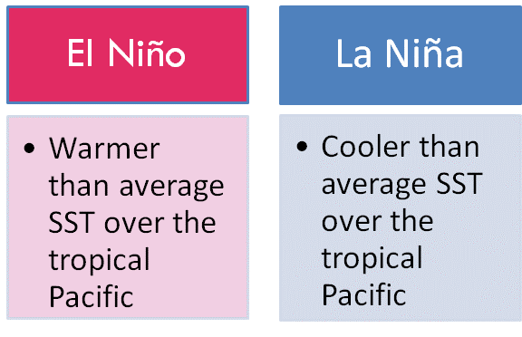
El Nino South Oscillation (ENSO)
ENSO events most easily identified by variations in SST over the tropical Pacific
El Niño and La Niña associated with close to opposite atmospheric circulations

Slide 13
Basic ENSO Metrics
Nino 3.4 Index: average SST anomaly in the red area on the map
Niño Indices: Area Average SST Anomaly
For El Niño/La Niña to occur, anomalies have to be persistent and atmospheric conditions have to be consistent
Niño3.4 Index 1950-2010
El Niño:
Nino3.4 > +0.5ºC
La Niña:
Nino3.4 > -0.5ºC
Notes:
- The simplest way to measure the strength of an El Nino or La Nina is by calculating averages of SST over the tropical Pacific Ocean
These averages are calculated over certain areas of the ocean, defined as regions, Nino4, Nino34 and Nino3
The most commonly used index is Nino34, shaded in red and plotted for 1950-2010
Positive Nino34 (red) show El Nino events. Negative Nino34 (blue) show La Nina events.
El Nino and La Nina events typically last for 1-2 years

Slide 14
Indian Ocean Dipole
IOD Regions
IOD Index =
West - East
IOD Index 1950-2010
Notes:
IODZ quantifies the difference in SST between the west and east Indian Ocean
The IODZ is known as Indian Ocean ENSO because it’s influences are similar over that region of the world
The IODZ is an irregular oscillation
The IODZ is strongest during August-November
The IODZ does not have to be strong during ENSO events
The IODZ can only be positive during El Nino and the IODZ can only be negative during La Nina. In other words, IODZ cannot work against ENSO.

Slide 15
Step 3 Interpreting Forecasts Summary
Obtain available forecast information from NOAA, IRI, ECMWF, COFs
Obtain forecasts from regional and national meteorological agencies
Interpret forecasts with support from regional USGS scientist and monthly seasonal forecast call
Revise rainfall assumptions based on forecast information and monthly seasonal forecast call

Slide 16
Types of forecasts we generally use in FEWS NET
Probabilistic forecasts: indicates the probability of forecast climate being in a certain range.
  E.g. a 60% chance that seasonal rainfall will be less than 300mm
Dynamical forecast: use physics equations governing how air particles behave to forecast how weather/climate will evolve over next few hours to next few months
  E.g. most international forecasting centres use supercomputers to produce these forecasts
Statistical forecast: uses historical relationship between climate variable to be forecast and a predictor
  E.g. if July sea surface temperatures (SST) in Indian Ocean are directly proportional to JFM rainfall in Malawi: July 2015 SST →JFM 2016 rainfall. Many RCOF forecasts are statistically based
Ensemble forecast: run dynamical forecast many times using slightly different initial conditions to determine strength of fcst
________________________________________
FAMINE EARLY WARNING SYSTEMS NETWORK

Slide 17
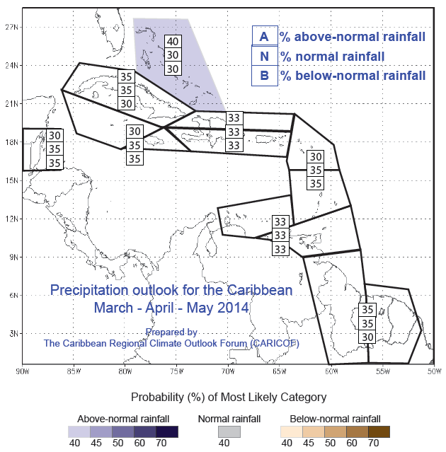
Example of Probabilistic Forecasts
________________________________________
FAMINE EARLY WARNING SYSTEMS NETWORK

Slide 18
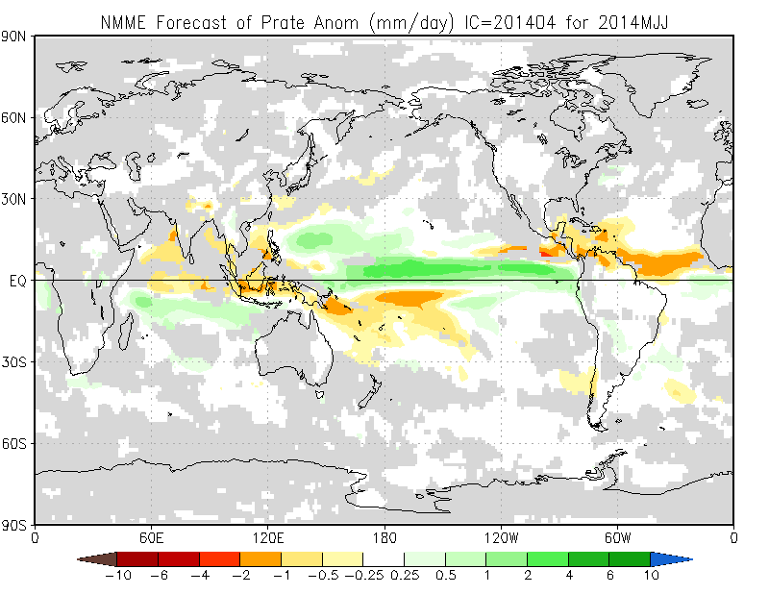
Climate Forecast Interpretation: NMME
Always use skill masks applied
This forecast is given in terms of anomalies in rainfall with units of mm/day
________________________________________
FAMINE EARLY WARNING SYSTEMS NETWORK
Notes:
A model has skill when it has been shown to make a good forecast over a given region for a given season
Always use the forecasts with “skill masks applied” otherwise you might be using a poor forecast

Slide 19
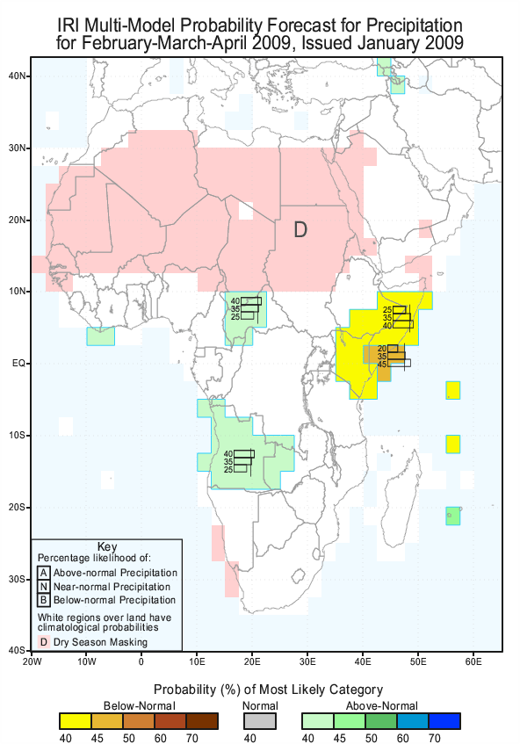
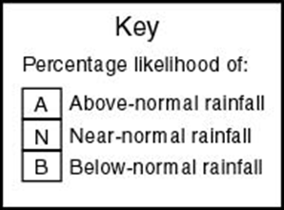
Seasonal Forecasts
Seasonal forecasts can also be expressed in terms of the likelihood that 3-month rainfall totals (or mean temperature) will fall within each of the tercile ranges
Where there is no forecast (white areas), percentage likelihoods assumed to be:
33% - 33% - 33%
________________________________________
FAMINE EARLY WARNING SYSTEMS NETWORK
Notes:
Pink areas marked “D” are in their normal dry season, and are therefore not forecast.

Slide 20
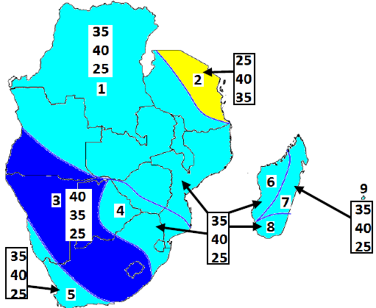
Climate Forecast Interpretation:
Climate Outlook Forums (COF)
Consensus forecast produced as the outcome of a regular meeting of experts
Standards and process vary among regions
Numbers represent the probability of above average, average, and below average rainfall
________________________________________
FAMINE EARLY WARNING SYSTEMS NETWORK

Slide 21
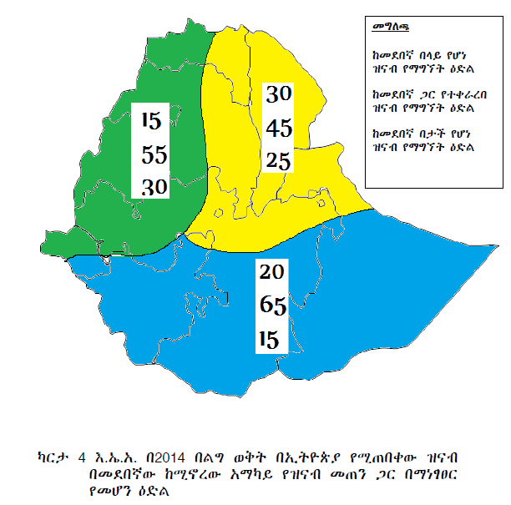
National Climate Outlooks
________________________________________
FAMINE EARLY WARNING SYSTEMS NETWORK

Slide 22
Step 4 Incorporating Monitoring Data Summary
Assess when the season started and how that compares to usual
Monitor observed rainfall to date and assess how rainfall aligns historically
Use information from remote sensing and from the ground on seasonal progress
Examine the changing probability of rainfall events over the course of the season
Continually revise assumptions based on remote sensing observations, updated forecast information, and field data

Slide 23
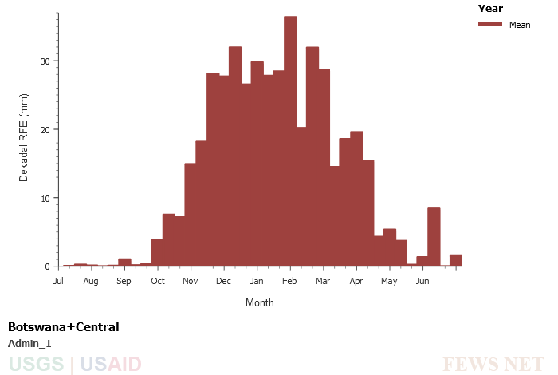
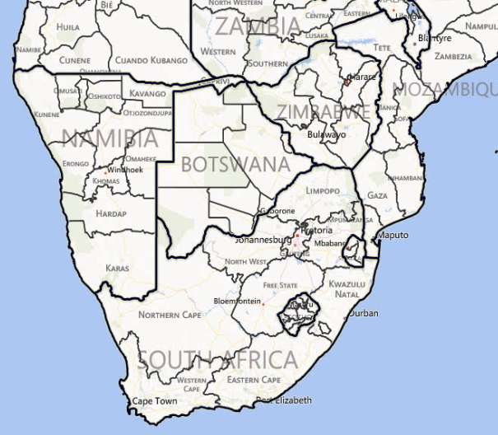
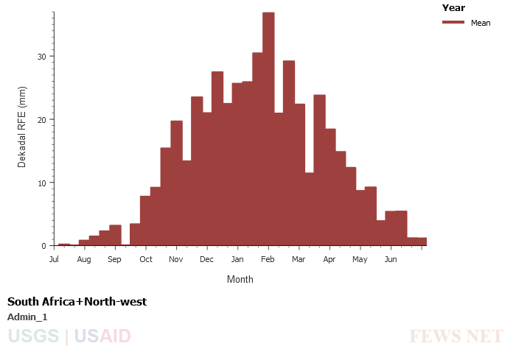
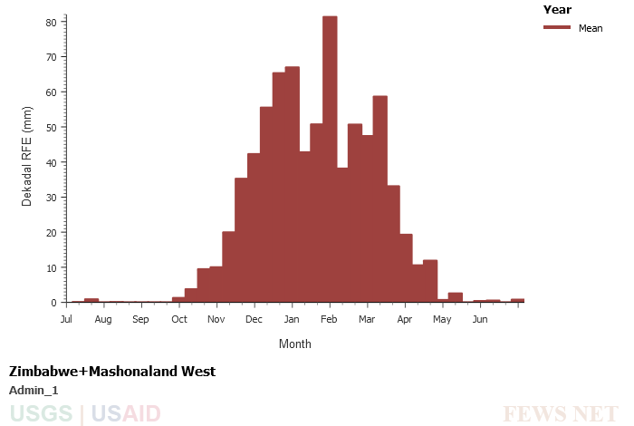
Climatology
Mean Dekadal Rainfall Distribution
Notes:
Dekadal rainfall series from the map viewers shows seasonal distribution of rainfall and general consistency in the seasonality for each region.

Slide 24
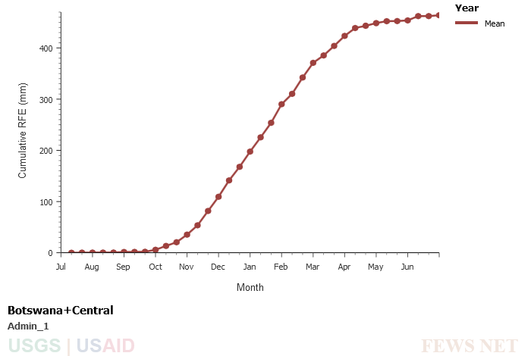
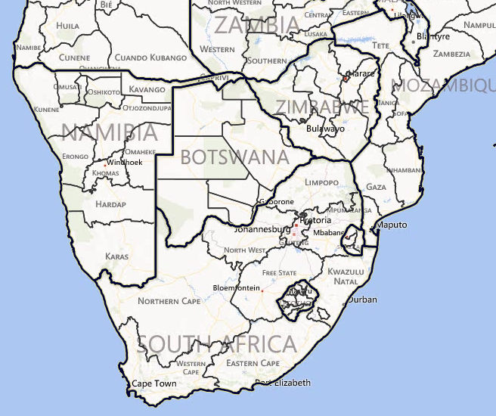
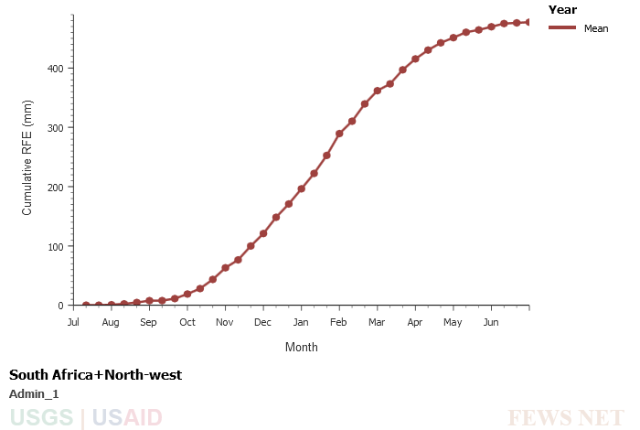
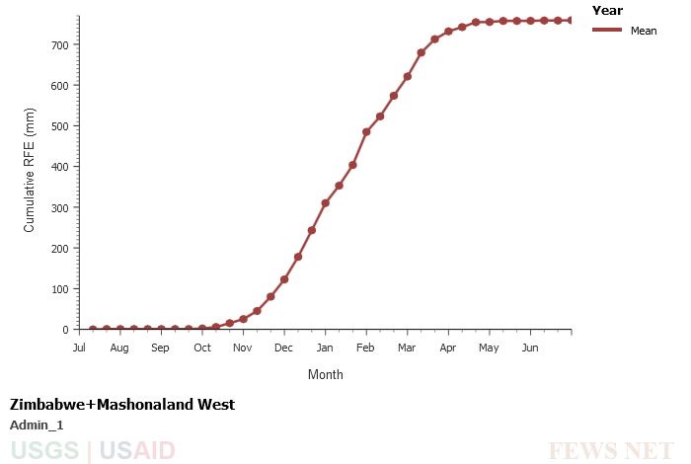
Climatology
Mean Cumulative Rainfall
Notes:
Primary increases in seasonal cumulative rainfall occur between Dec and Mar for all regions.

Slide 25
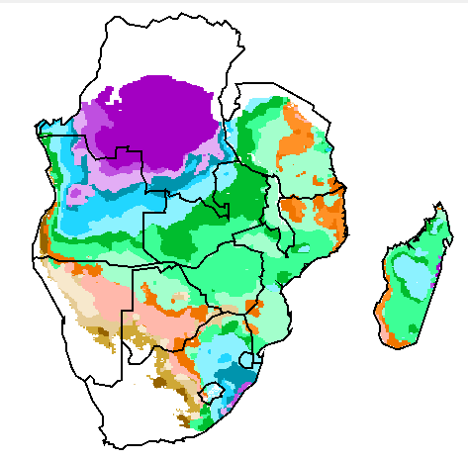

Climatology
Mean Start of Season (SOS)
Botswana - Central
Zimbabwe – Mashonaland West
South Africa – Northwest
Notes:
Shows consistency in SOS timing for northern Zimbabwe, but more variability throughout the other two regions.

Slide 26
Climatological Assumption
Based only on Climatology:
In Mashonaland West State, as is typical, the rains will likely start in October, but in October and November, the rains tend to be fairly light. They will intensify from December to March, but by April, there will only be light rains. Cumulative October to April rainfall is likely to be near normal, between 600 and 800 millimeters (mm), over the course of the season.

Slide 27
Assessing the state of the SIOD climate mode
Nov. 2013 Sea Surface Temperature Anomaly
Warm SSTs east of Madagascar in Southern Indian Ocean
Slightly negative SIOD
Cooler southwest SSTs in Southern Indian Ocean
Notes:
Nov 2013 SST anomalies show a slightly negative SIOD.

Slide 28
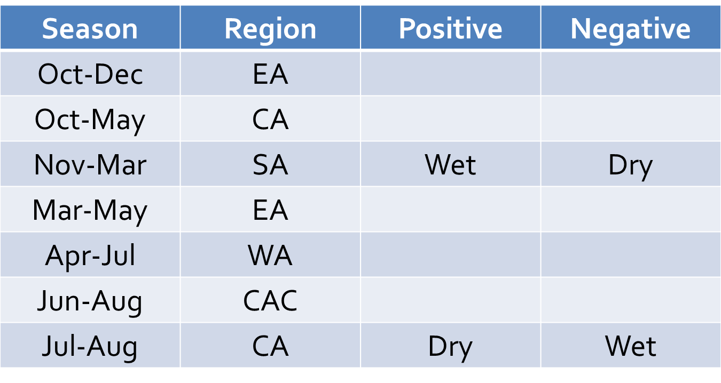
SIOD impact on southern Africa rainfall
Southern Indian Ocean Sea Surface Temperatures
  Slightly negative SIOD indicates southern Africa rainfall deficits
Notes:
The slightly negative SIOD would be indicative of a likelihood for dry conditions over southern Africa.

Slide 29
Climatology and climate mode assumption
Based on Climatology & Current Climate Mode:
In Mashonaland West State, as is typical, the rains will likely start in October, but in October and November, the rains tend to be fairly light. They will intensify from December to March, but the rains will be slightly less intense than usual due to the presence of the negative Southern Indian Ocean Dipole. By April, there will only be light rains. Cumulative October to April rainfall is likely to be moderately below normal over the course of the season, but still over 500 millimeters.

Slide 30
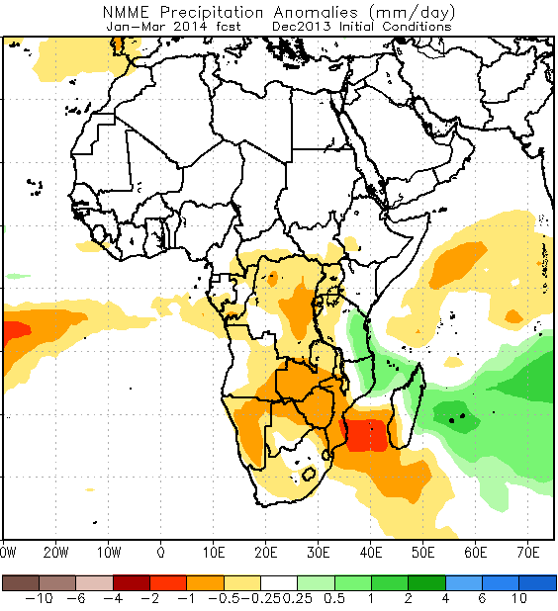
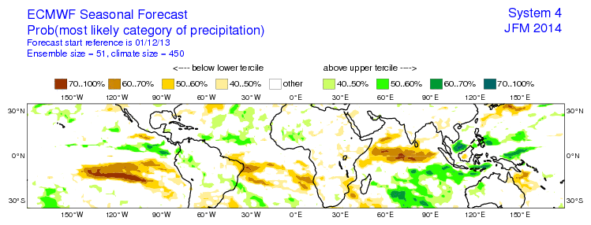
Extended forecasts
JFM 2014
Below average rainfall forecast by NOAA NMME of similar pattern to the early season rainfall anomalies over Southern Africa.
ECMWF forecast showing normal to slightly below normal for the same forecasts period.

Slide 31
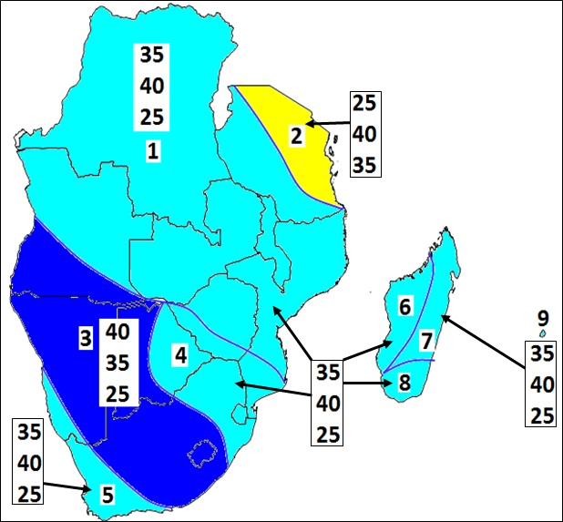
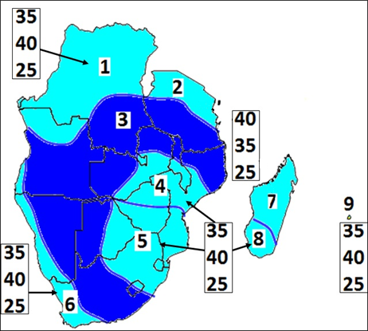
SARCOF: Southern African Regional COF
OND 2013
JFM 2014
A Regional COF brings together national, regional, and international climatologists and forecast users to produce a consensus probabilistic forecast.

Slide 32
Climatology, climate mode, and forecast assumption
In Mashonaland West State, as is typical, the rains will likely start in October, but in October and November, the rains tend to be fairly light. They will intensify from December to March, but the rains will be slightly less intense than usual due to the presence of the negative Southern Indian Ocean Dipole. By April, there will only be light rains. Cumulative October to April rainfall is likely to be near normal to moderately below normal over the course of the season, but still over 500 millimeters.

Slide 33
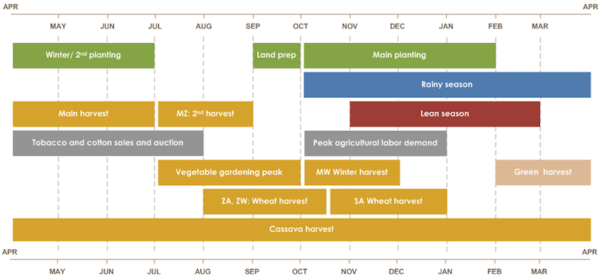
Transition to observational monitoring
At this point, the rainy season is underway, and we’ll look at supplementing our knowledge of climatology, climate modes, and forecasts with observational products as of late November / early December.

Slide 34
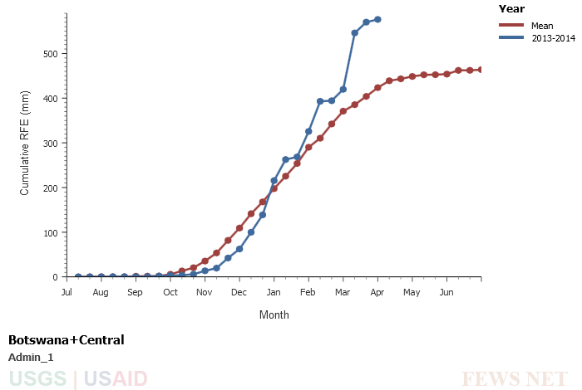
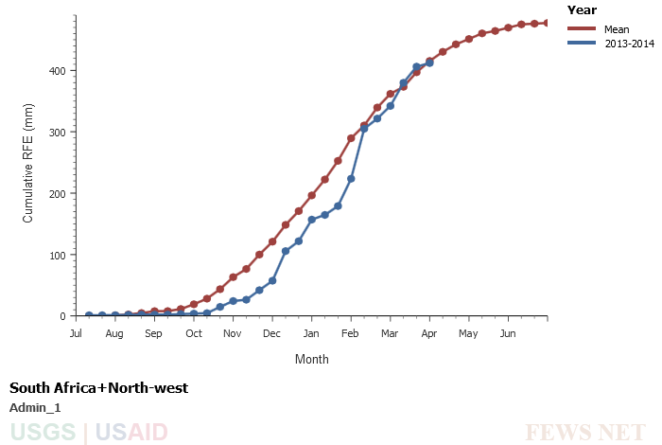
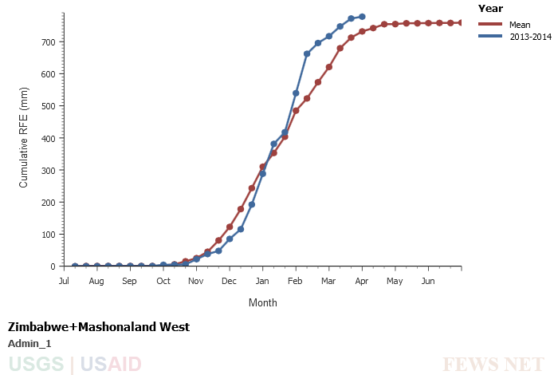
2013-14 cumulative rainfall below the mean, lower deficit in Zimbabwe
Notes:
In the December time frame, we can see that our knowledge of the start of season would lead us to believe that a delayed start was prevalent in all three regions with closer to normal in northern Zimbabwe

Slide 35
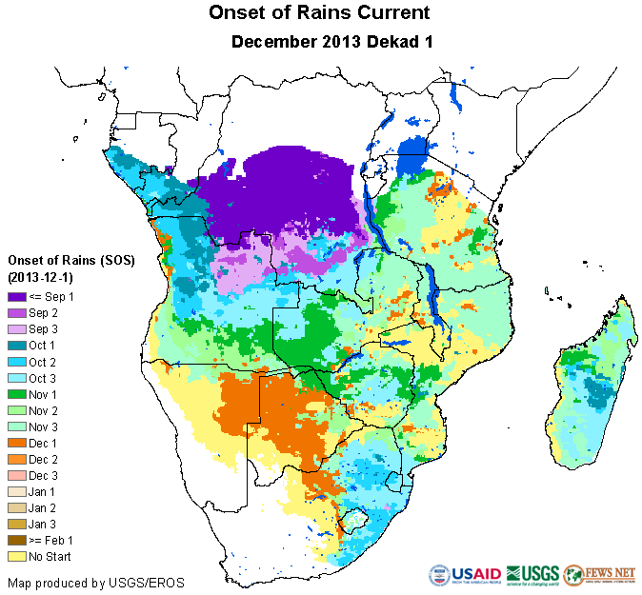
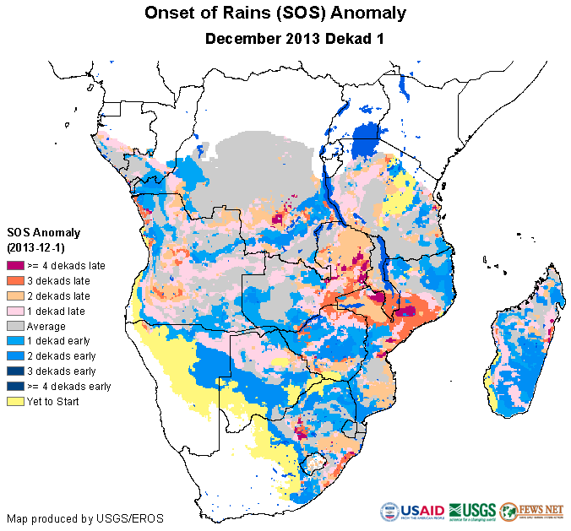
Onset of Rains (SOS) Observations
Notes:
SOS anomalies show a mixed bag with 1 to 2 dekads late and 1 dekad early in eastern Botswana and northern Zimbabwe, while the north west province of SAfrica shows more dramatic delays (up to 4 dekads) in areas

Slide 36
What do we know at this point?
We’ve assessed climatology of rainfall, the SOS, the state of important climate modes, the short-term and medium range rainfall forecasts, and know the current state of rainfall/SOS observations
  We can assume that if the weak south Indian Ocean dipole persists, that will further influence the pattern of below normal precipitation in the region.
  Due to the rainfall and SOS observations showing that the season is delayed, we can conclude that if the weak SIOD comes to fruition, the season would most likely be normal to below normal.
  Are there other remote sensing-based products that you think may be useful at this stage of the season?

Slide 37
Other remote sensing products?
WRSI – crop water requirements early in the season are not significant and can often be met with minimal rainfall. Actual WRSI will become more useful as the season progresses, at this point, the derivative start of season (SOS) and SOS anomaly are very useful.
ETa – the seasonal cumulative anomalies can be highly variable early in the season as the vegetation becomes established, they too will become more useful as the season progresses. Monthly ETa anomalies can be useful to assess early season soil moisture conditions.
NDVI – early in the season, NDVI can be useful to further establish the status of the start of season. NDVI time series can also provide the temporal characteristics of season onset.
SPI – standardized precipitation index provides a method for assessing rainfall anomalies in terms of their probabilistic occurrence and can be useful during this period.

Slide 38
Local knowledge and field observations
A critical piece to bring to the development of assumptions during this time frame is any field-based information that could alter how knowledge of climatology and remote sensing observations are interpreted.
Such as:
  Knowledge of actual planting dates
  Seed availability
  Limitations on land preparation
  Etc.
The best rule of thumb is that if you have reliable field information, it should be given stronger weight than remote sensing products in developing assumptions.
If the reliability of field information is suspect, remote sensing/modeling should be given comparable weight in developing assumptions.

Slide 39
Building Assumptions - southern Africa 2013-14 Growing Season as of December
What was known one to two months into the season after taking climatology, climate modes, forecasts, & monitoring data into account.
  Weak SIOD signals dry conditions
  Climatology of rainfall, onset of rains, and NDVI compared to early season remote sensing observations indicate a delayed start to the season.
  Global forecasts indicate normal to below normal precipitation to persist.
  SARCOF predicted a greater chance of normal to above normal precipitation.

Slide 40
Regional Assumption After Monitoring
Based on Climatology, Current Climate Modes, Forecasts, and early monitoring data:
In northern South Africa, most of Zimbabwe, and central and southern Mozambique, from October to March, cumulative rainfall is likely to be somewhat below average. Due to the current presence of a negative Southern Indian Ocean Dipole, the season started a little late in some areas, and rainfall through December was somewhat below average. The remainder of the season through March/April is expected to be similarly below average.

Slide 41
Step 9: What could change our assumption?
What about climate modes could change our assumption?
Change to a positive or neutral Southern Indian Ocean Dipole could lead to much more rain
What about forecasts could change our assumption?
Change to the longer-term or shorter term forecasts to be closer to the SARCOF’s above-average forecast
What from monitoring could change our assumption?
Increased rainfall or normal rainfall over the course of the season

Slide 42
Questions?

