Slide 1
GEOGLAM - Early Warning Crop Monitor for Countries at Risk
Applications of FEWS NET Remote Sensing products for Agro-climatological Analysis Workshop
10 – 14 July 2017 | Kathmandu Nepal

Slide 2
GEOGLAM Initiative Structure
GEOGLAM is a coordination program aiming to:
  Support, strengthen and articulate existing monitoring efforts
  Develop capacities and awareness at national and global levels
  Disseminate agricultural monitoring information
Component 1
Global/Regional Agricultural Monitoring
Main producer countries and main commodities
Component 2
National Capacity Building
For agricultural monitoring using earth observation
Component 3
Monitoring Countries at Risk
Food security assessment
Component 4 – EO Data Coordination
Component 5 – Method improvement through R&D coordination (JECAM)
Component 6 – Data Products and information dissemination

Slide 3
Countries at Risk Component Scope
Countries who need agricultural monitoring for food security assessment and early warning of emergencies
Improved datasets for monitoring (rainfall, vegetation, ET) and context (crop area masks, seasonal crop calendars)
Building collaborative processes among monitoring partners
Building capacity of national and regional partners

Slide 4
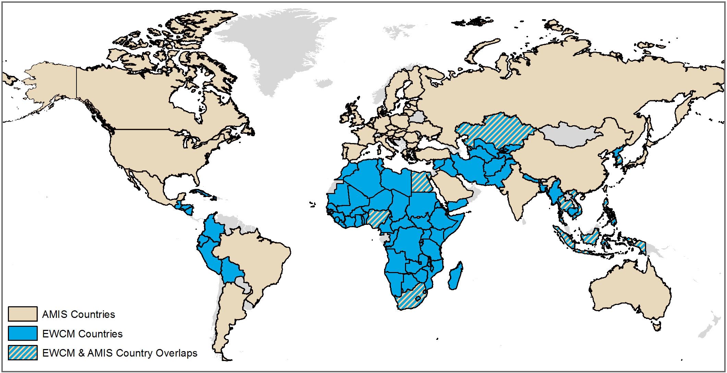
EWCM for Countries at Risk

Slide 5
Key Partners & Strategic Linkages
USGS - USAID Famine Early Warning Systems Network
EC Joint Research Center- Monitoring Agricultural ResourceS (MARS) Unit
NASA/University of Maryland – Geographical Sciences
World Food Program - Vulnerability Analysis and Mapping
Food and Agriculture Organization - Global Information and Early Warning System (GIEWS)
World Meteorological Organization - Agricultural Meteorology Program

Slide 6
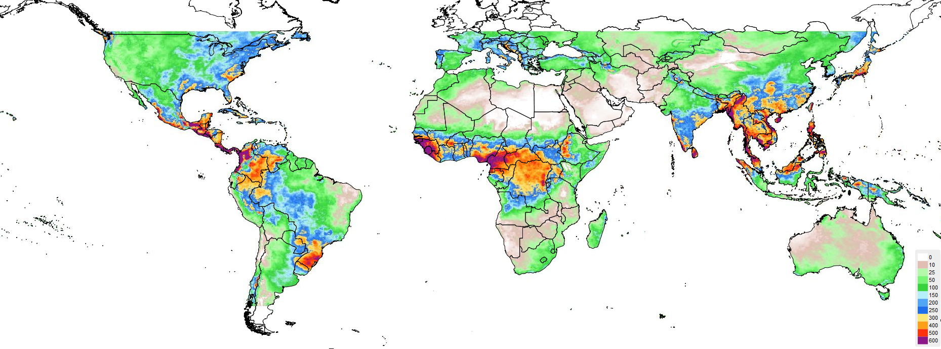


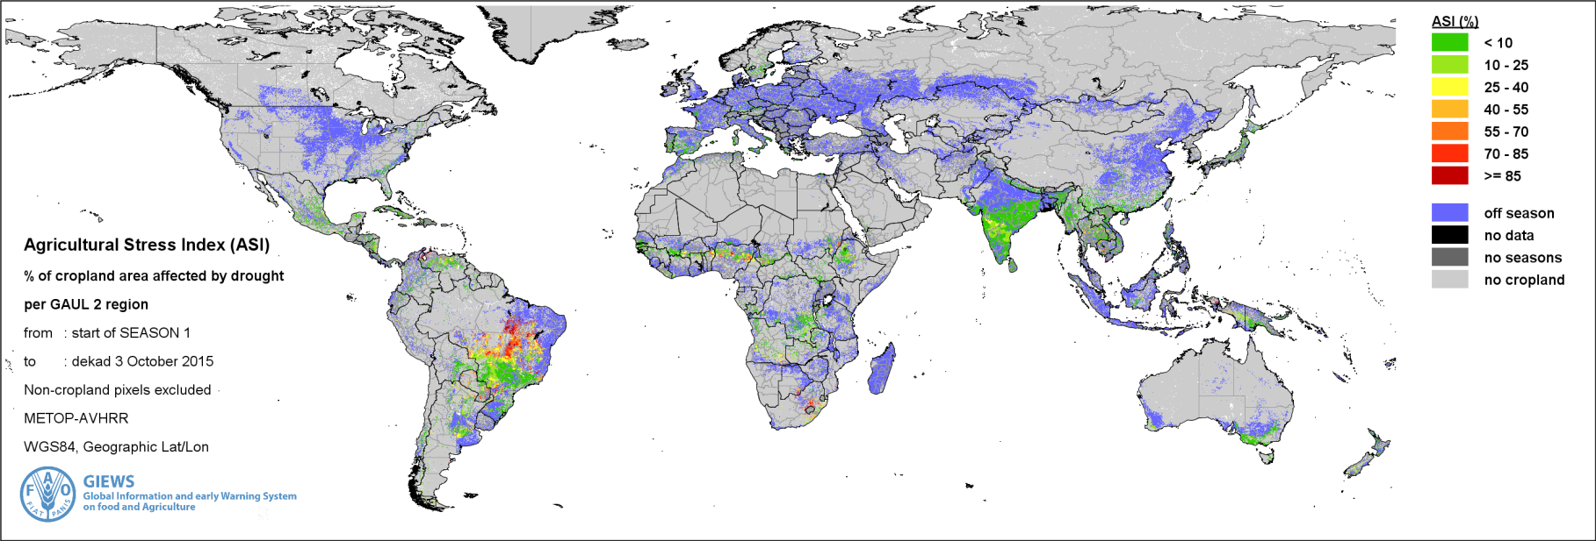
Newly Released Data
CHIRPS 2.0 Rainfall
FEWS NET
Cumulative 2-month Precipitation Sep – Oct, 2015
Agricultural Stress Index
FAO GIEWS

Slide 7

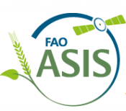

Software Tools and Training
JRC MARS – SPIRITS (right) and CGMS Statistical Tool
FAO GIEWS – Stand-alone ASIS (right) and AgroMetShell
FEWS NET – GeoCLIM (right), GeoWRSI, and GeoCOF

Slide 8
IMAAFS conference session
Full session organized by GEOGLAM and side meeting specific to Countries at Risk.
Led to initial commitment by partners to move forward with development of a Early Warning Crop Monitor (EWCM) for Countries at Risk.

Slide 9
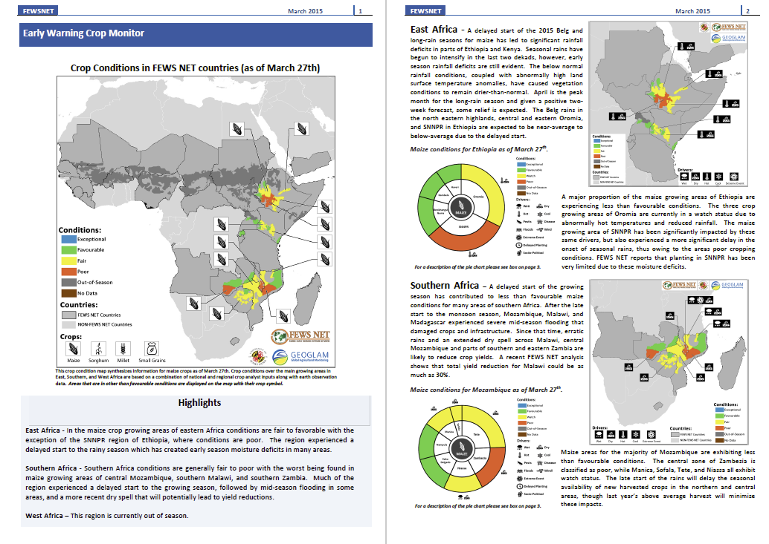
Milestones
UMD/FEWS NET initiate prototype
FAO hosts EWCM meeting with partners
First public release of a joint assessment (week of Jan 25th)
UMD hosts EWCM meeting with FEWS NET
First experimental joint assessment
Sep 2014
Oct 2014
Mar 2015
Apr 2015
May 2015
Jul 2015
Sep 2015
Nov 2015
Jan 2016
2016
IMAAFS Conference Countries at Risk side meeting
Draft Standards Document reviewed by partners
Regular monthly distribution of EWCM for Countries at Risk
Experimental EWCM for FEWS NET countries
EWCM presented at the GEO Plenary and Ministerial Summit held in Mexico City

Slide 10
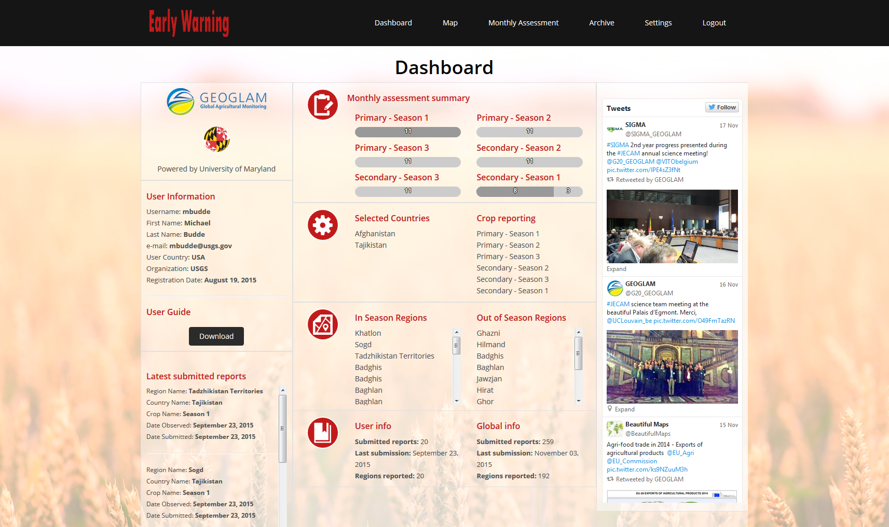

Slide 11
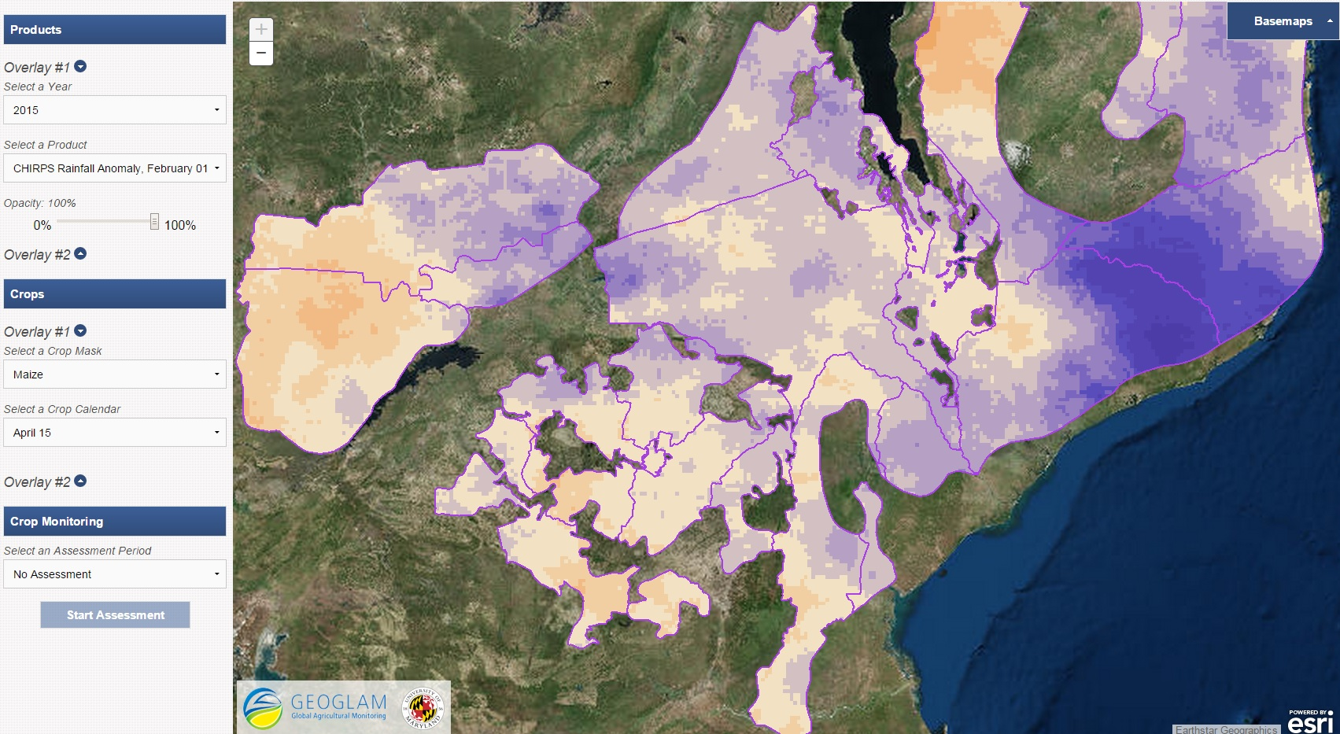
Map Interface
Access to multiple EO datasets is given to analysts via the map interface.

Slide 12
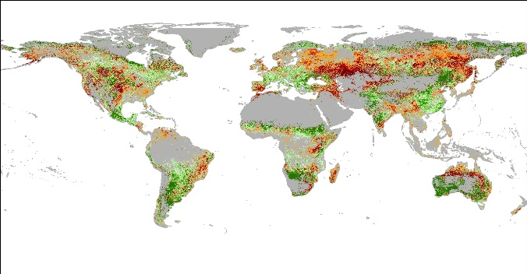
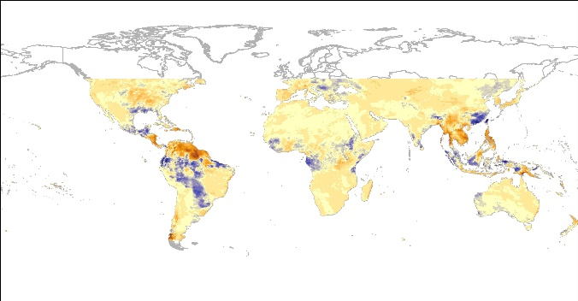
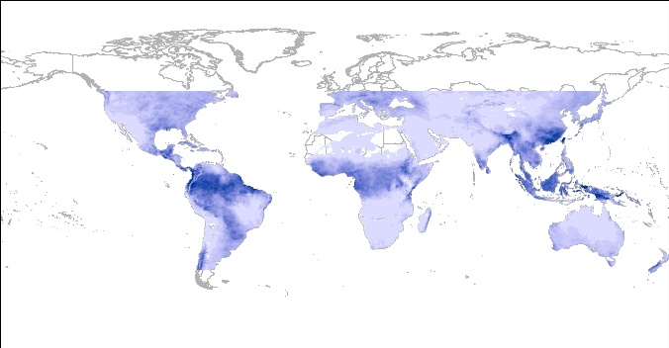
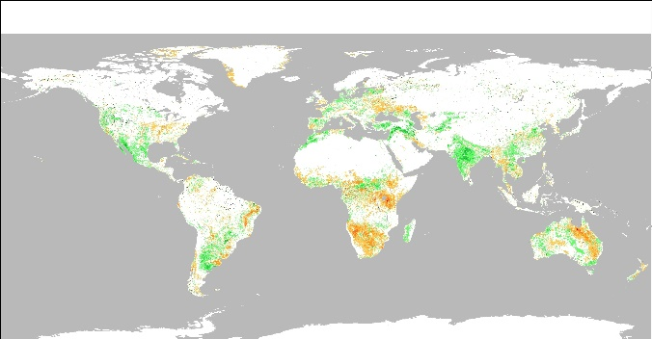
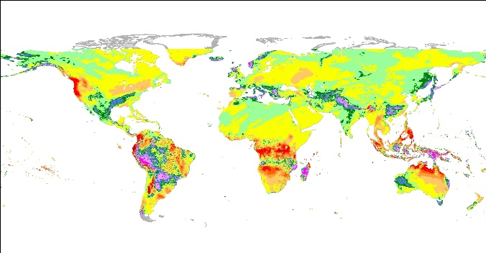
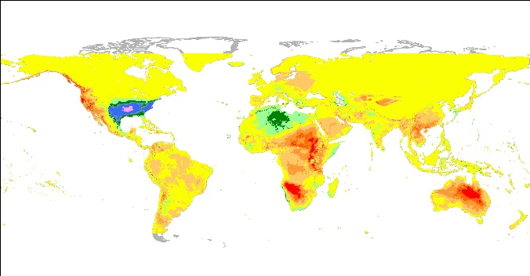
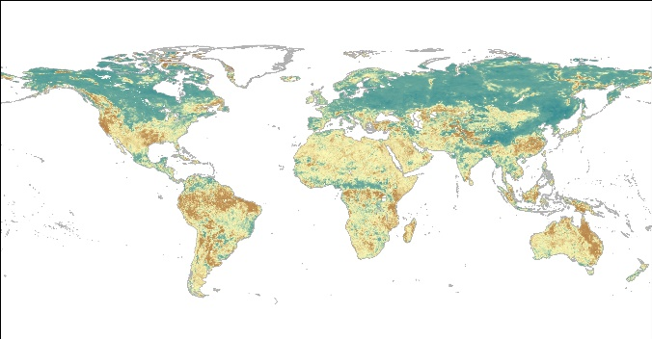
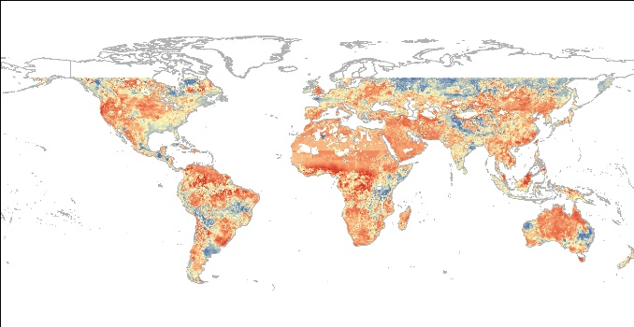
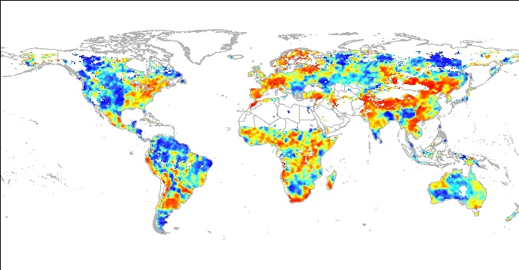
EO Data Layers
USGS – Actual ET Anomaly
USGS/CHG – CHIRPS Rainfall Anomaly
USGS/CHG – CHIRPS Total Rainfall
UMD/NASA – NDVI Anomaly
JRC – Rainfall Sum Anomaly
JRC – Temp Sum Anomaly
TU WIEN – Soil Water Index Anomaly
USDA– Soil Moisture Anomaly
NOAA – Evaporative Transpiration

Slide 13
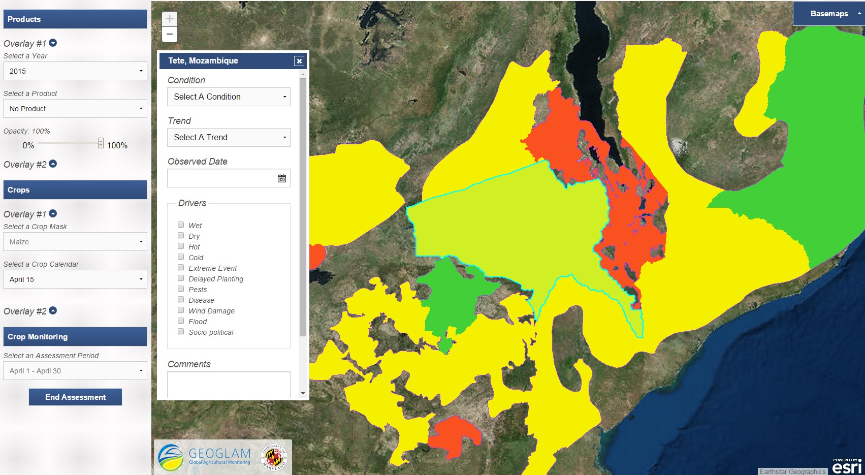
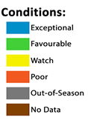
Monthly Assessments
Analysts enter crop condition information via a map interface or assessment tab.

Slide 14
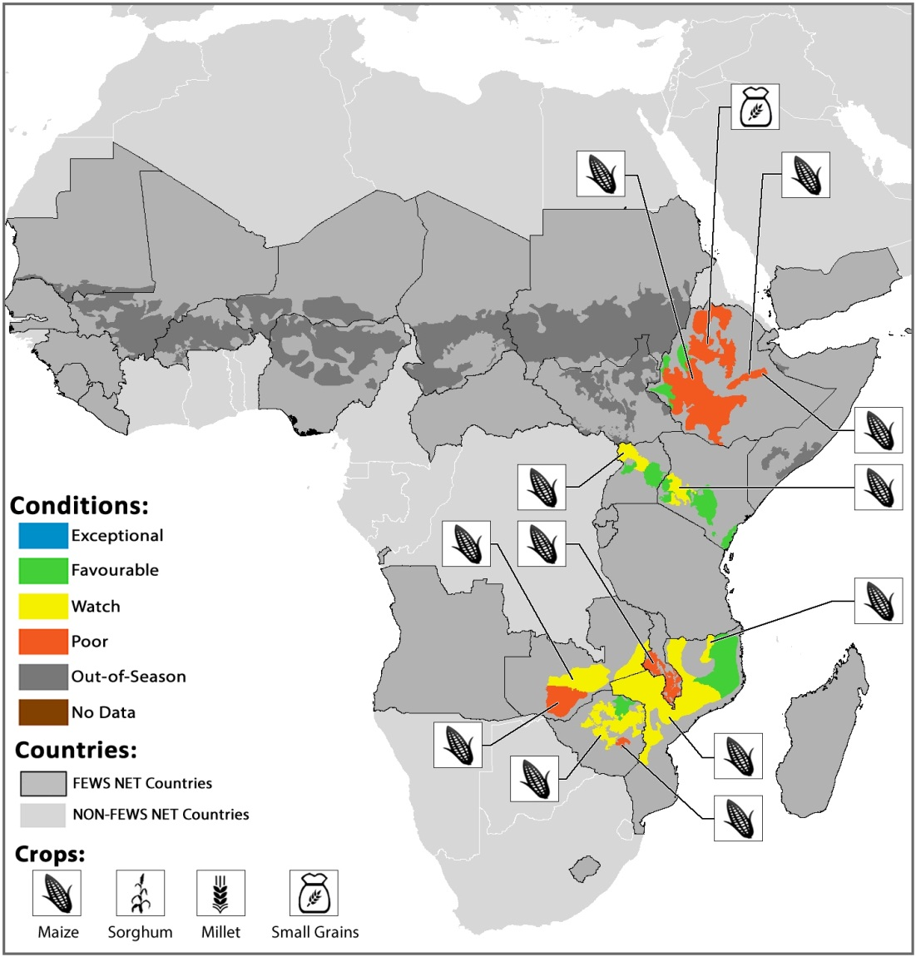
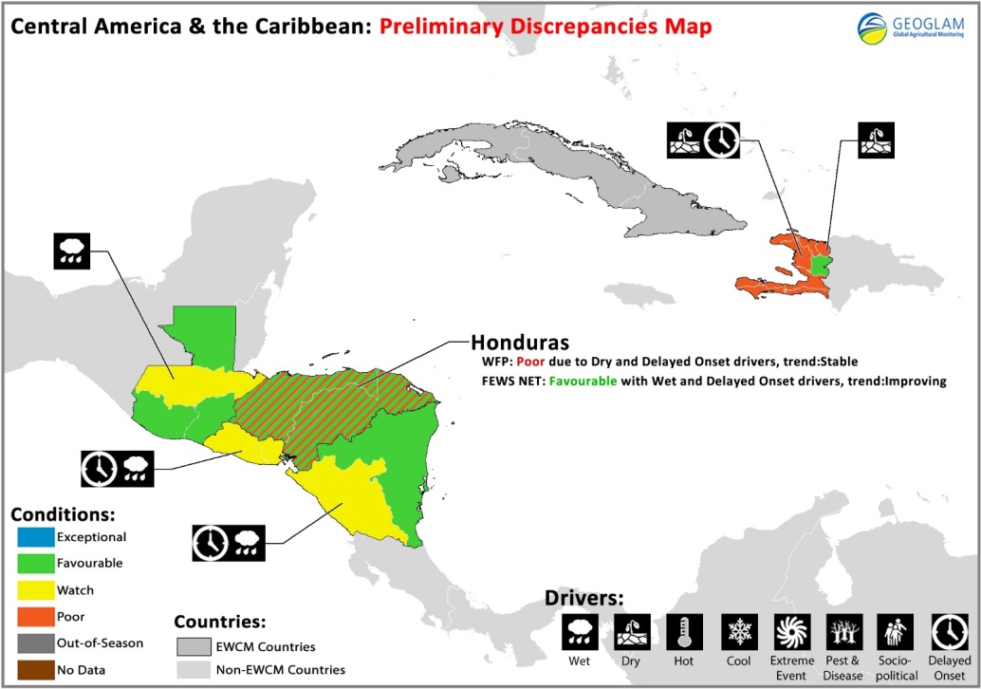
Experimental Crop Condition Maps
April 2015 Synthesis - Africa
September 2015 Assessment with Discrepancies – C.America/Caribbean

Slide 15
Component-specific Strategic Issues
Advancement of harmonized reporting on crop conditions
Build on existing capacities of regional and national partner organizations
Link with other cooperative frameworks and projects:
  Monitoring for Environment and Security in Africa (MESA) of the African Union and European Union
  SERVIR Program of USAID and NASA (hubs in Nairobi, Kathmandu, Bangkok, and soon in West Africa)
  Middle East-North Africa Regional Drought Management System of USAID and FAO (implementation led by ICBA in Dubai)

Slide 16
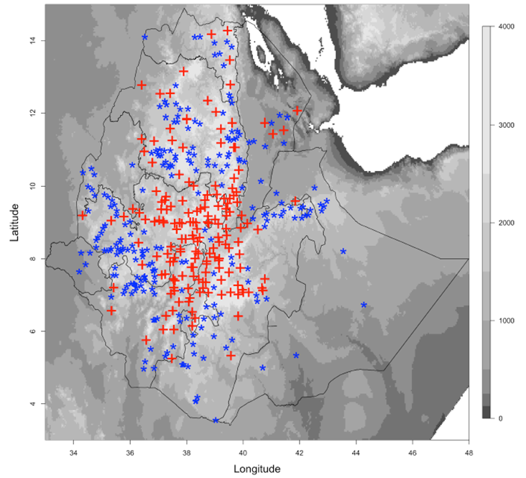
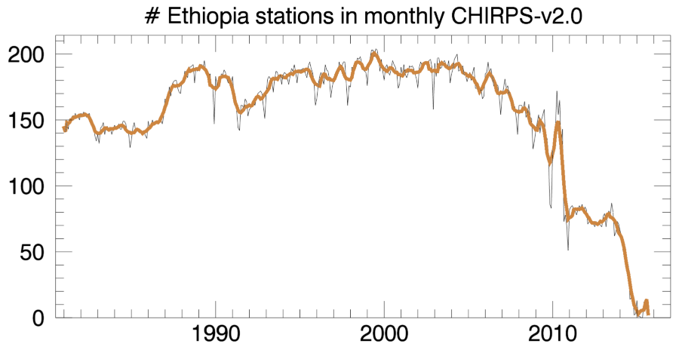
Component-specific Strategic Issues
Reduction in country reporting of rainfall observations
Considerable declines during the last 10 years
Need to raise awareness with development banks, donors, WMO so that mitigating technical and policy actions can be identified.
CHIRPS (red) and Other (blue) stations,
July 2006

Slide 17
Conclusions
Countries-at-Risk Partners
Apply their talents and resources to help protect the food security of some of the world’s most vulnerable people
Enjoy broad, positive working relationships
Contribute to a platform for building partner consensus
Could be even more effective if assisted with:
  Improved linkages among programs and cooperative frameworks with common interests
  Improved policies for climate data reporting and collection

Slide 18
Questions?

