Slide 1
FEWS NET Agroclimatology Decision Support Products and Processes
Applications of FEWS NET Remote Sensing products for Agro-climatological Analysis Workshop
10 – 14 July 2017 | Kathmandu Nepal

Slide 2
Outline
Seasonal Monitors
Weekly Weather Hazards Call and Global Weather Hazards Summary
Monthly Seasonal Forecast Review
________________________________________
FAMINE EARLY WARNING SYSTEMS NETWORK

Slide 3
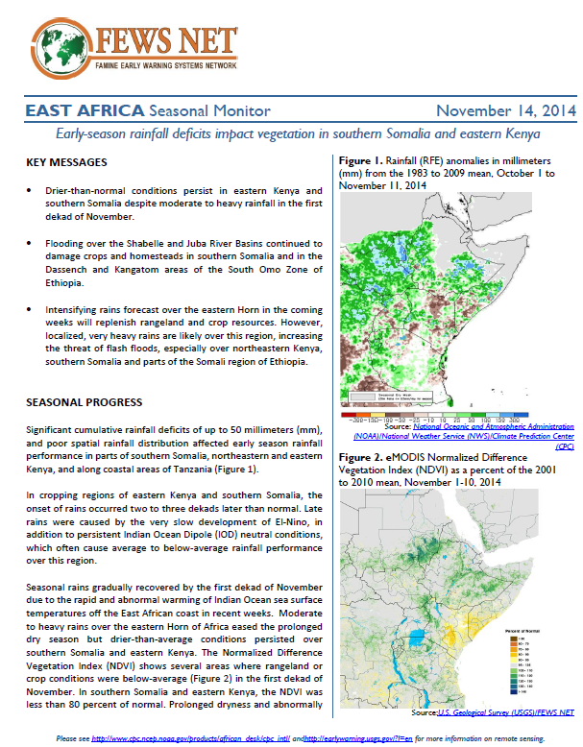
FEWS NET Seasonal Monitors
Produced every 20 days during the production season only
Provides an update on rainfall totals, impact on production, and the short-term forecast (long-term forecast not discussed)
Meant to be succinct, direct product on seasonal progress
________________________________________
FAMINE EARLY WARNING SYSTEMS NETWORK
Notes:
Straight-forward update on a specific period within a season. It should be easy to read and easy to produce.
IMPORTANT TO NOTE: Analysis and interpretation should be kept to a minimum—mostly just facts. (Not a lot of discussion on inputs, government programs, etc)
Note that in Southern Africa the Agromet report is posted instead of a seasonal monitor b/c the USGS Regional Scientist supports this product, which is essentially the same.

Slide 4
FEWS NET Seasonal Monitors
FEWS NET USGS regional scientist and FEWS NET Regional Technical Manager develop drafts
Review process with DSG should be relatively quick, ~1-2 days
Content typically includes: amount, temporal distribution and spatial distribution of rainfall in relevant areas of the region; impact of rains on crop and/or livestock production; temperature (if necessary); summary of short-term forecast
Refer to seasonal monitor guidance (in orientation binder) for more details on content and formatting
________________________________________
FAMINE EARLY WARNING SYSTEMS NETWORK
Notes:
Long-term forecasts can be briefly referred to, but are NOT to be discussed in any detail – this is just an update on seasonal progress, not a consideration of long-term seasonal prospects

Slide 5
FEWS NET Weekly Weather Hazards Call
One-hour weekly conference call held Tuesdays at 12 pm (EST), led by NOAA CPC
Participants include NOAA CPC, USGS, UCSB, DSG
Call covers seasonal rainfall progress by region, including rainfall totals and temporal/spatial distribution, over the previous week, and over the course of the season to date
________________________________________
FAMINE EARLY WARNING SYSTEMS NETWORK

Slide 6
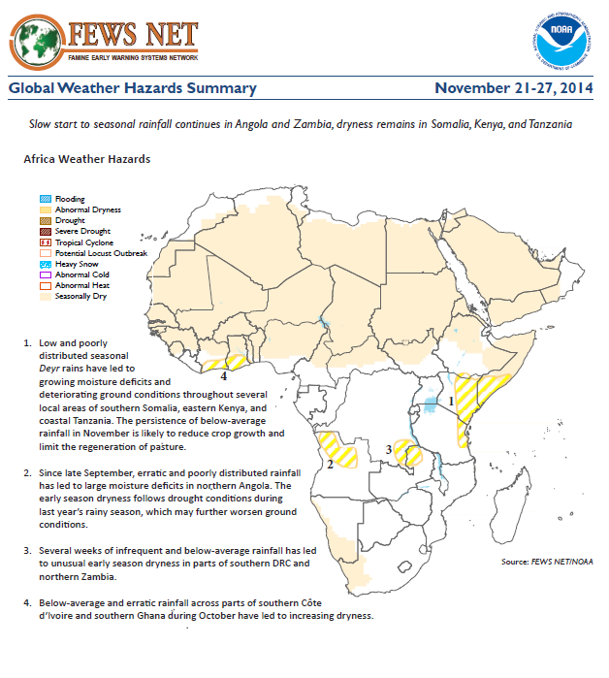
FEWS NET Global Weather Hazards Summary
Output from weather hazards call
Includes “hazard maps” that depict areas of concern
Hazard maps based on current weather/climate information, short and medium range weather forecasts (up to 1 week) and potential impacts on crop and pasture conditions
NTMs/ANTMs should always review to ensure consistency with monthly reports
________________________________________
FAMINE EARLY WARNING SYSTEMS NETWORK
Notes:
Suggest that people read through a full weather hazards product to familiarize themselves
NTMs should review the document every week – the content may not align with field reports, assessments, or ground observations. If that’s the case, contact the regional scientist to be sure that they are aware that field reports differ from the content reflected in the global hazards product. Discussion may be needed to determine with greater certainty how seasonal progress is going. (In other words, global hazards product not necessarily 100% accurate)

Slide 7
FEWS NET
Monthly Seasonal Forecast Review
Started: November 2012 to support food security scenario building
Purpose: to help with development of agroclimatology assumptions
Committee: regional scientists and scientists at NOAA CPC, USGS, UCSB, and NASA
Occasional participants: Caribbean Institute of Meteorology and Hydrology, Princeton University, and others
________________________________________
FAMINE EARLY WARNING SYSTEMS NETWORK

Slide 8
FEWS NET
Monthly Seasonal Forecast Review
November
M | T | W | T | F | S | S
 |  |  |  |  |  | 1
2 | 3 | 4 | 5 | 6 | 7 | 8
9 | 10 | 11 | 12 | 13 | 14 | 15
16 | 17 | 18 | 19 | 20 | 21 | 22
23 | 24 | 25 | 26 | 27 | 28 | 29
30 | 31
#1 Climate model
forecasts released
#2 HO distributes draft assumptions to review committee
#3 Climate Scientist Webinar
#4 Science Partners + FS Analysts Webinar
________________________________________
FAMINE EARLY WARNING SYSTEMS NETWORK
Notes:
This is a sample month
Climate model forecasts always released on the 11th of the month
Once assumptions are distributed, the Wed/Thursday after that, the webinars are held

Slide 9
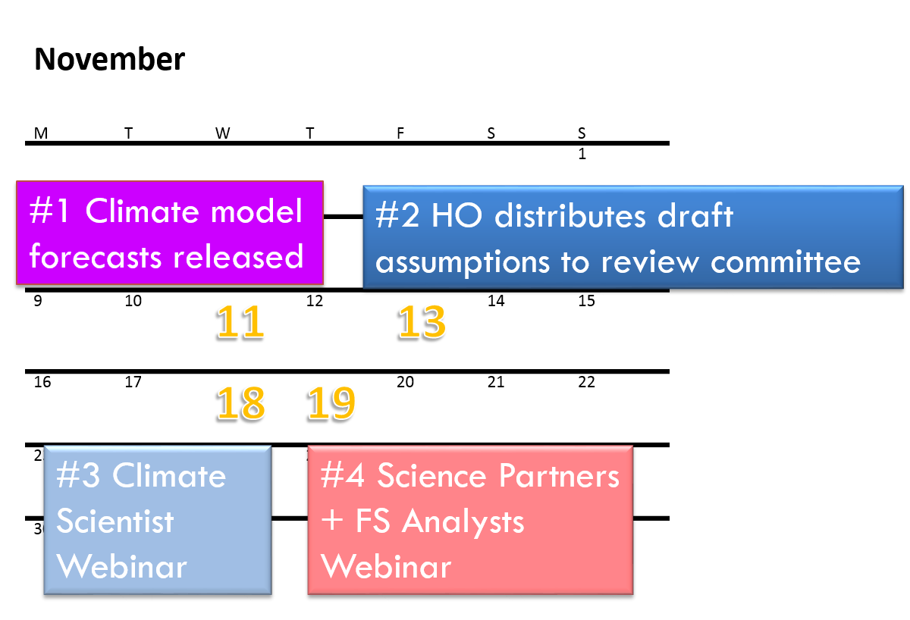
FEWS NET
Monthly Seasonal Forecast Review
Wednesday Webinar
Purpose: climate scientists review draft working assumptions in light of:
climatology
current climate modes
seasonal forecasts
observational data
________________________________________
FAMINE EARLY WARNING SYSTEMS NETWORK
Notes:
Purpose of meeting
Relative importance of climatology, climate modes, seasonal forecasts and observational data depends on where we are in the season

Slide 10
FEWS NET
Monthly Seasonal Forecast Review
Process (Wednesday Webinar):
NOAA CPC presents on current state of global climate
Regional scientists present on evidence to support confirmation or revision of the draft working assumptions
All participants comment and debate
Consensus assumptions compiled
________________________________________
FAMINE EARLY WARNING SYSTEMS NETWORK
Notes:
Purpose of meeting
Relative importance of climatology, climate modes, seasonal forecasts and observational data depends on where we are in the season

Slide 11
FEWS NET
Monthly Seasonal Forecast Review
Thursday Webinar
Purpose: climate scientists present draft assumptions to FEWS NET food security analysts
Process
Confirmed or revised working assumptions presented, with supporting evidence (maps, graphs, tables and text)
Summary presentation made by Andy Hoell (NOAA ESRL climate scientist)
________________________________________
FAMINE EARLY WARNING SYSTEMS NETWORK
Notes:
Purpose of meeting
Relative importance of climatology, climate modes, seasonal forecasts and observational data depends on where we are in the season

Slide 12
FEWS NET
Monthly Seasonal Forecast Review
Following the intensification of rains in December, near normal amounts of rainfall are likely to continue from January to March in much of Namibia, parts of Botswana, southeastern Angola, and southern Zimbabwe.
________________________________________
FAMINE EARLY WARNING SYSTEMS NETWORK
Notes:
An example working assumption for Southern Africa (original text).
NOTE THAT THESE ARE THE ASSUMPTIONS THAT ARE INCLUDED IN MONTHLY REPORTS; IMPORTANT THAT DSG SHARE THE OUTCOMES OF THE FORECAST CALL WITH NTMS SO THAT THEY ARE AWARE OF ANY CHANGES TO ASSUMPTIONS FOR MONTHLY REPORTS

Slide 13
FEWS NET
Monthly Seasonal Forecast Review
Following the intensification of rains in December, near normal to below normal amounts of rainfall are likely to occur continue from January to March in much of Namibia, parts of Botswana, southeastern Angola, and southern Zimbabwe.
________________________________________
FAMINE EARLY WARNING SYSTEMS NETWORK
Notes:
An example working assumption for Southern Africa (revised text).
Note that these minor modifications are important to our scenarios and scenario development process

Slide 14
FEWS NET
Monthly Seasonal Forecast Review
The June to September main rainy season in South Sudan is likely to be near normal in terms of cumulative rainfall based on recent long-range forecasts from the European Center for Medium Range Forecasts (ECMWF) and others.
________________________________________
FAMINE EARLY WARNING SYSTEMS NETWORK
Notes:
An example working assumption for East Africa (original text).

Slide 15
FEWS NET
Monthly Seasonal Forecast Review
The June to September main rainy season in South Sudan is likely to be near normal average to below average in terms of cumulative rainfall based on the observed regional precipitation relationship with El Nino. recent long-range forecasts from the European Center for Medium Range Forecasts (ECMWF) and others.
________________________________________
FAMINE EARLY WARNING SYSTEMS NETWORK
Notes:
An example working assumption for East Africa (revised text).

Slide 16
Questions?

