Slide 1




1. Operationalizing Agriculture drought monitoring system in Nepal
2. Rangelands Decision Support System in the Himalayan region of Pakistan
Faisal M. Qamer, ICIMOD

Slide 2
Operationalizing Agriculture drought monitoring system in Nepal
Crop monitoring system in Nepal
Rainfall patters & drought onset
Preliminary Crop sown area
Crop cutting experiment in major food crops (10-15 per district) with std methods
Regular field inspection by extension workers, & FGD with farmers’ group & cooperatives
Crop growth patterns
Crop sown area
Regional & district level workshop to finalize crop status
DFSN meeting & other information from media & I/NGOs etc
Publication of crop situation update booklet

Slide 3
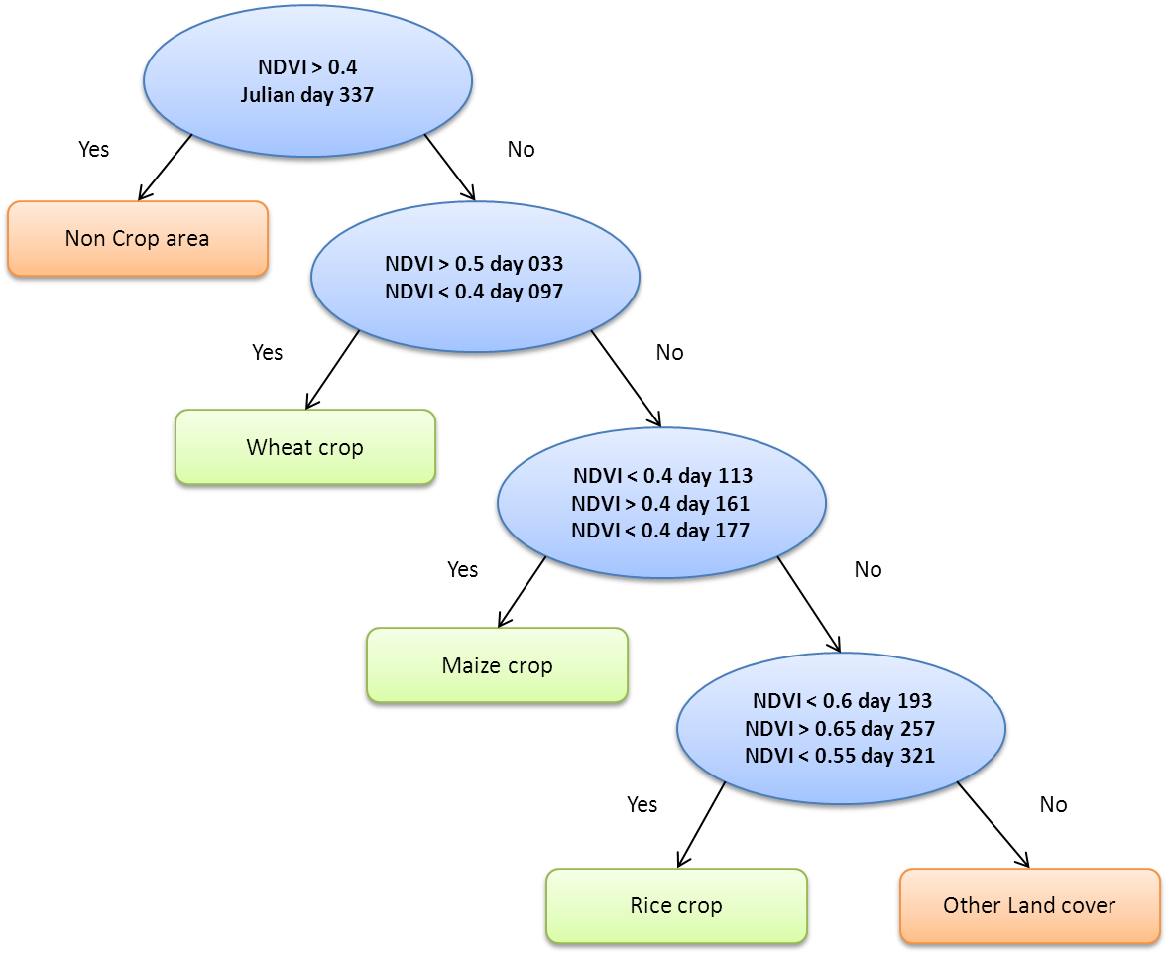
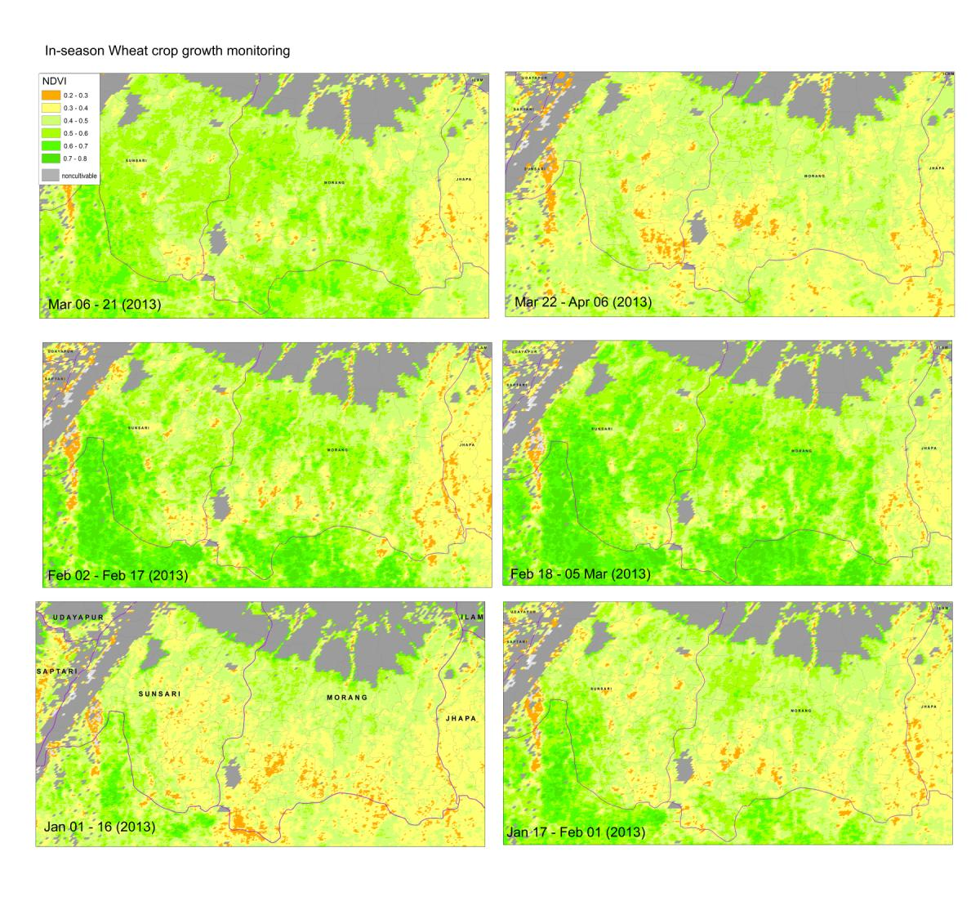
Crop sown area and
in season crop growth monitoring
Hierarchical decision tree for crop sown area based agriculture area mask and crop calendar
In season crop growth monitoring using MODIS data product MOD13Q1
Other crops

Slide 4
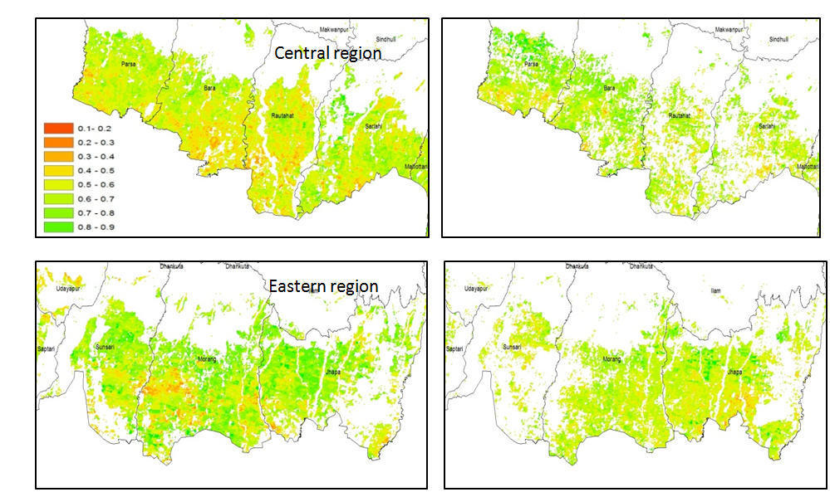
Rice crop area and vegetation growth during El Nino conditions (12 August – 2014)
2013
2014
2013
2014

Slide 5
Comparison in district-wise paddy crop sown area of 2014 and 2015 (Terai Districts)
Districts | Rice Crop Sown Area (MODIS)
 | 2015 Area (ha) | 2014 Area(ha) | % Change of 2015 from 2014 | 2013 Area (ha) | % Change of 2015 from 2013
Jhapa | 78,903 | 89,067 | -11 | 77,524 | 2
Morang | 69,276 | 82,381 | -16 | 80,492 | -14
Saptari | 41,134 | 47,729 | -14 | 59,745 | -31
Siraha | 51,099 | 41,708 | 23 | 58,344 | -12
Sunsari | 30,948 | 27,476 | 13 | 41,536 | -25
E.Terai | 271,361 | 288,362 | -6 | 317,641 | -15
Bara | 51,454 | 39,969 | 29 | 56,815 | -9
Chitawan | 6,740 | 6,193 | 9 | 15,316 | -56
Dhanusa | 47,568 | 33,353 | 43 | 49,538 | -4
Mahottari | 43,377 | 28,389 | 53 | 45,599 | -5
Parsa | 45,475 | 34,496 | 32 | 48,137 | -6
Rautahat | 46,597 | 26,253 | 77 | 48,701 | -4
Sarlahi | 51,894 | 33,471 | 55 | 51,561 | 1
C.Terai | 293,106 | 202,123 | 45 | 315,666 | -7
Nawalparasi | 34,780 | 33,755 | 3 | 38,875 | -11
Rupandehi | 77,288 | 78,227 | -1 | 85,214 | -9
Kapilbastu | 70,698 | 80,395 | -12 | 79,112 | -11
W.Terai | 182,766 | 192,377 | -5 | 203,201 | -10
Bardiya | 41,166 | 40,501 | 2 | 43,887 | -6
Dang | 15,616 | 19,711 | -21 | 18,450 | -15
Banke | 38,676 | 38,064 | 2 | 36,996 | 5
MW.Terai | 95,459 | 98,276 | -3 | 99,333 | -4
Kailali | 51,132 | 54,904 | -7 | 54,818 | -7
Kanchanpur | 13,722 | 14,457 | -5 | 14,227 | -4
FW.Terai | 64,854 | 69,362 | -6 | 69,045 | -6
Total | 907,545 | 850,499 | 7 | 1,004,887 | -10
The preliminary assessment of paddy crop sown area based on MODIS NDVI data of 177 and 193 Julian days of 2015 shows that there is 7% increase in area as compared to that of 2014 (10% decrease as compared to 2013).

Slide 6
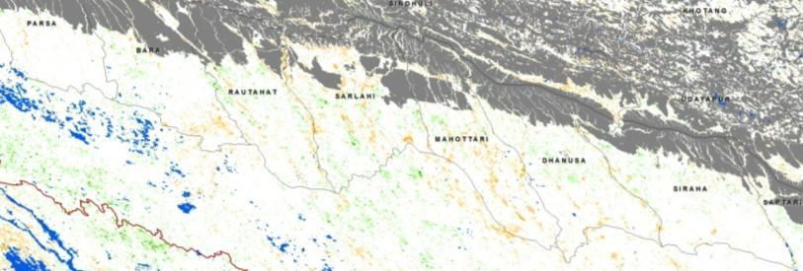
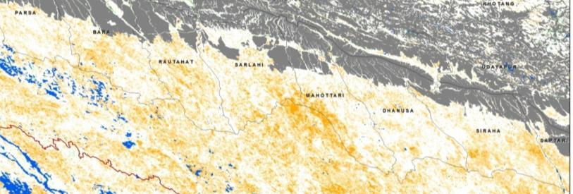
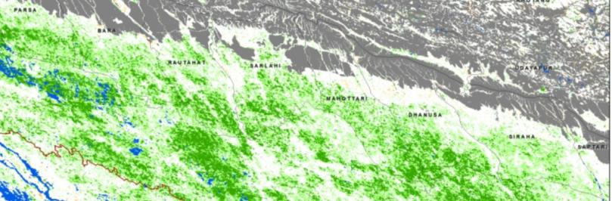
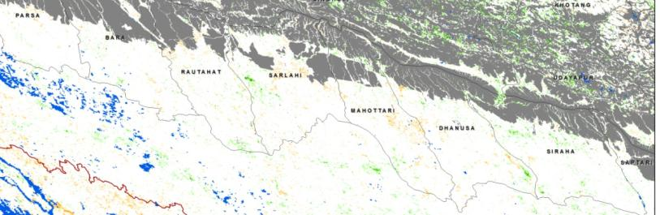
Use of time series NDVI data as proxy of production in Nepal
Inter-annual changes in wheat crop production and its spatial pattern
2005
y = 91214x - 3830.8
R² = 0.6822
Production
2006
NDVI
2007
ANOMALY (Z Score)
Worst than normal
Normal (stable)
Z = (Current - mean) / stdev.
2008
Better than normal
Grey :forested areas , Blue : water bodies
Notes:
For our study we have compiled 11 years inter-annual phenological changes of three major crops (Rice, wheat and maize) and their relationship with crop production compiled from agriculture statistics data. For the Wheat crop here we can see above average production in 2007 and drought situations in 2006 and 2008.

Slide 7
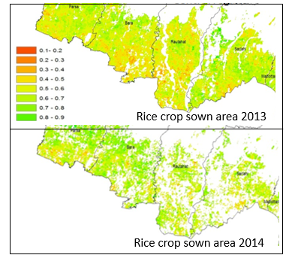
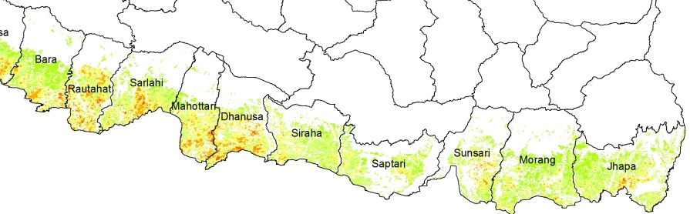
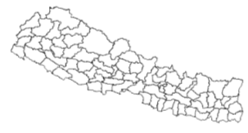
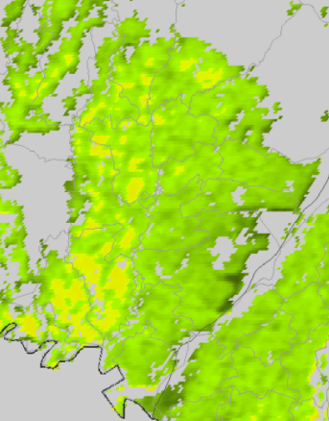
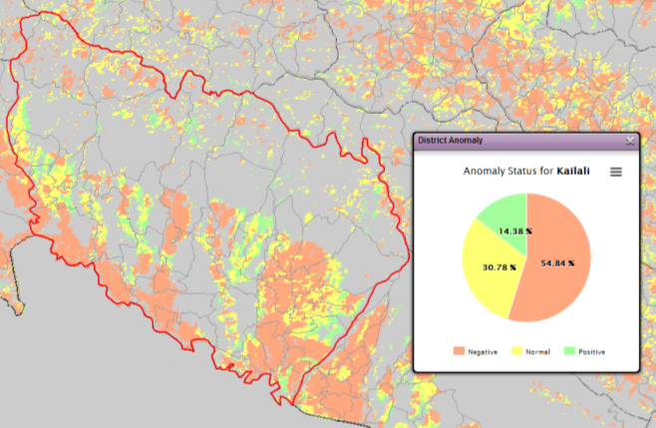
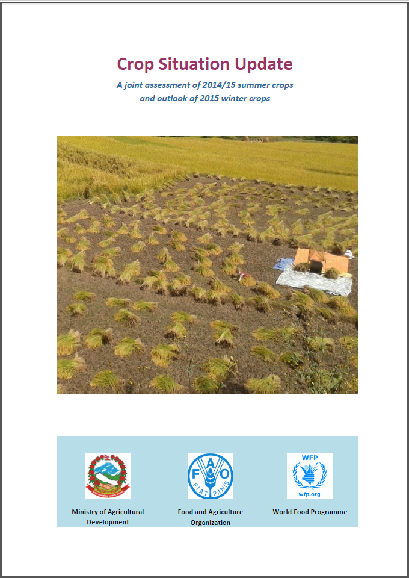
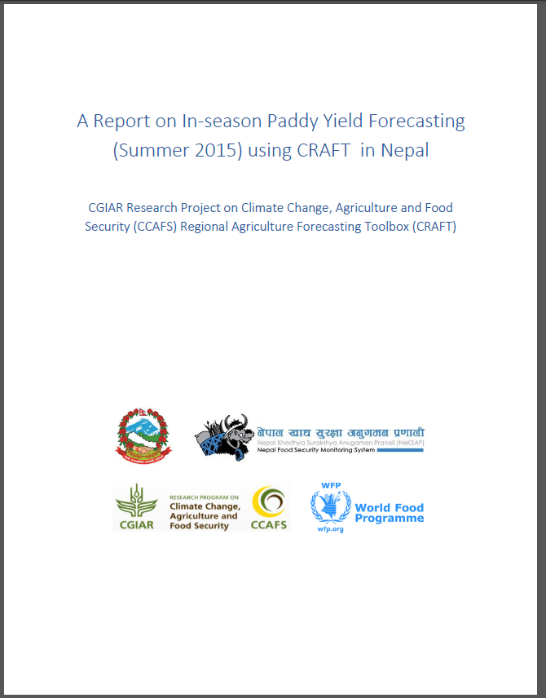
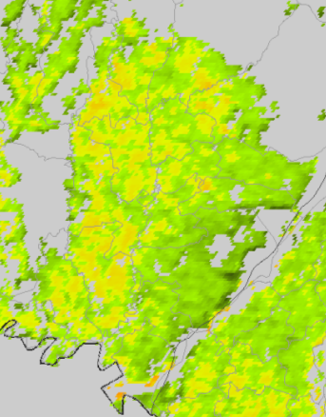
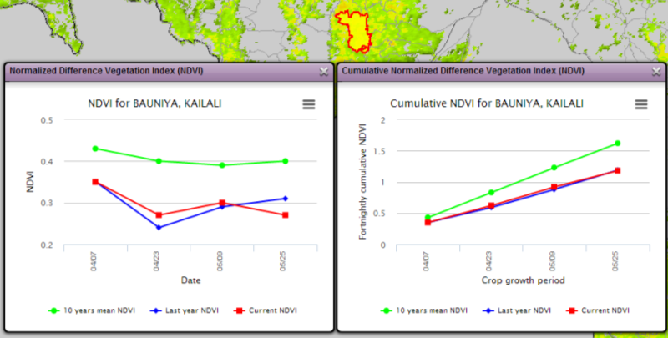
http://apps.geoportal.icimod.org/
In-season crop status assessment
Rice Crop sown area –as on 28 July 2015
The preliminary assessment of paddy crop sown area based on MODIS NDVI data of 177 and 193 Julian days of 2015 shows that there is 3% increase in area as compared to that of 2014 and 12% decrease as compared to 2013. An additional image of August 12 can give more clear result since the transplantation process is still going on.
Vegetation conditions Anomaly
Crop
condition
Good
Poor
Historic average
10-25 June
Current
10-25 June, 2015

Slide 8
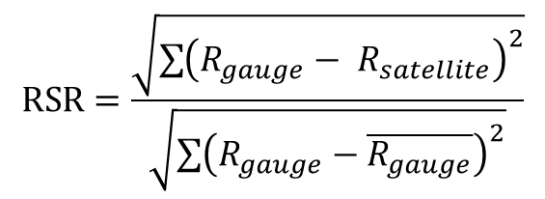
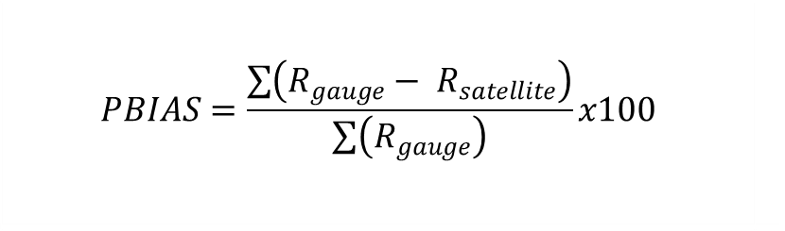
I. Rainfall patterns and drought onset conditions
Evaluating accuracy of the GHG rainfall products with ground station data
$$PBIAS=\frac{\sum{\left(R_{gauge}− R_{satellite}\right)}}{\sum{\left(R_{gauge}\right)}}x100$$
$$RSR=\frac{\sqrt{{\sum{\left(R_{gauge}− R_{satellite}\right)}}^{2}}}{\sqrt{{\sum{\left(R_{gauge}−\overline{R_{gauge}}\right)}}^{2}}}$$
Notes:
the percentage bias – PBIAS
the ratio of the root mean squared error to the standard deviation of the observations – RSR
Goodness of fit test

Slide 9
Scatter Plots of Raingauge and CHG data (Physiographic Region Wise)
Pixel to pixel comparison of average monthly rainfall estimates from two CHG products over the Kosi basin splitting in period before and after 1991

Slide 10
Goodness-of-fit-statistical Table for Selected Stations
Notes:
Middle Mountain region performed worse than other regions (refer Figure 7). In average, CHIRPS product seemed to performed better as there has been positive change (or no change) in overall rating (refer Table 3) for all stations except at Leguwa Ghat and Taplejung where CHIRP product performed better which comparing it with ground based rainfall product.
While analyzing the same foe periods before and after 1991, it was evident that CHIRPS tend to overestimate significantly (as all the data points are below 1:1 line), especially the higher rainfall values. But the case after 1991 seems to be normal as both products are fairly comparable although CHIRP product tends to overestimate in this case.

Slide 11
  Variation of Goodness-of-fit Statistics of Raingauge vs CHG data (Physiographic Region Wise Analysis)
Performance Rating
PBIAS (%)
RSR
Very Good
< ±15
0 to 0.5
Good
±15 to ±30
0.5 to 0.6
Satisfactory
±30 to ±55
0.6 to 0.7
Unsatisfactory
> ±55
> 0.7

Slide 12
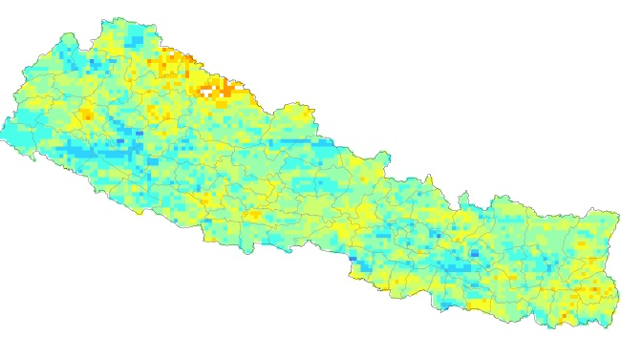
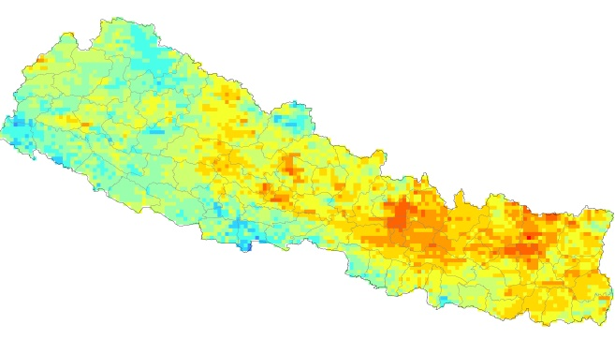
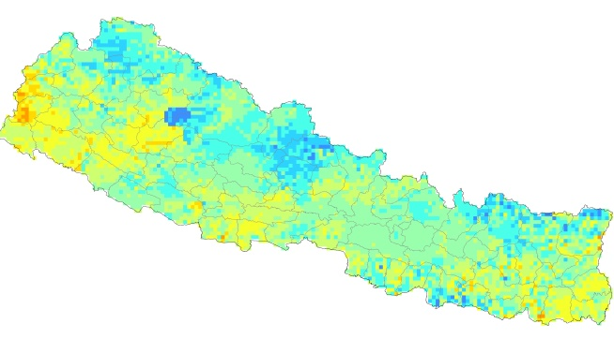
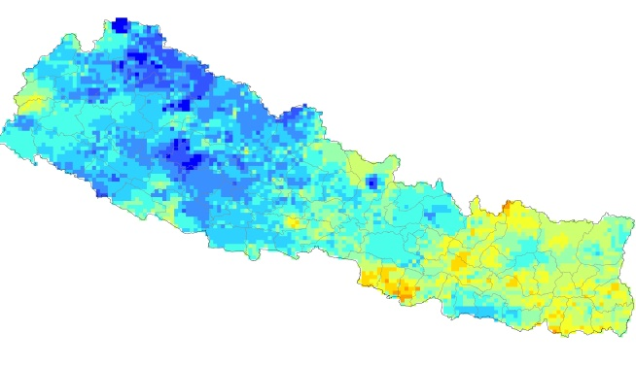
Interannual Variability of Area Under Drought
(30 selected Districts)
Drought Frequency
AUD: Wheat Crop
AUD: Paddy Crop
Paddy (Jun-Jul-Aug)
Maize (Feb-Mar-Apr)
AUD: Maize Crop
AUD: Barley Crop
(1981-2014)
SPI <= -1.0
0
Wheat (Nov-Dec-Jan)
1
2
3
4
5
6
7
3-monthly SPI layer of each year from 1981-2014 were reclassified into moderate (-1 to -1.5) and severe drought (< -1.5). The total no. of pixels falling under these categories were then obtained for the selected area (i.e. 30 districts with highest crop sown area)
8
Barley (Oct-Nov-Dec)
9
10
11

Slide 13
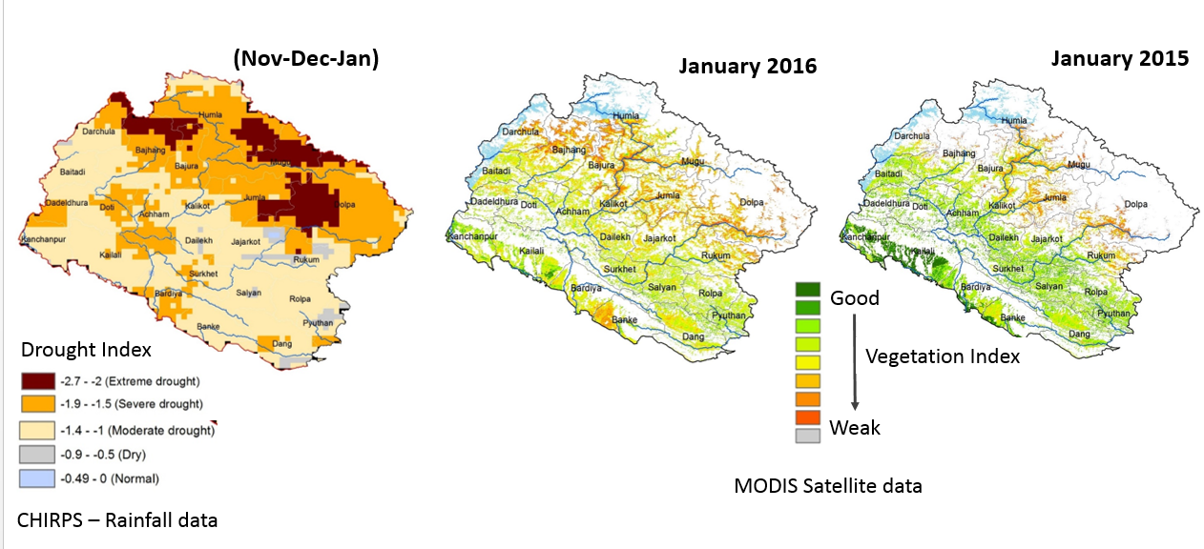
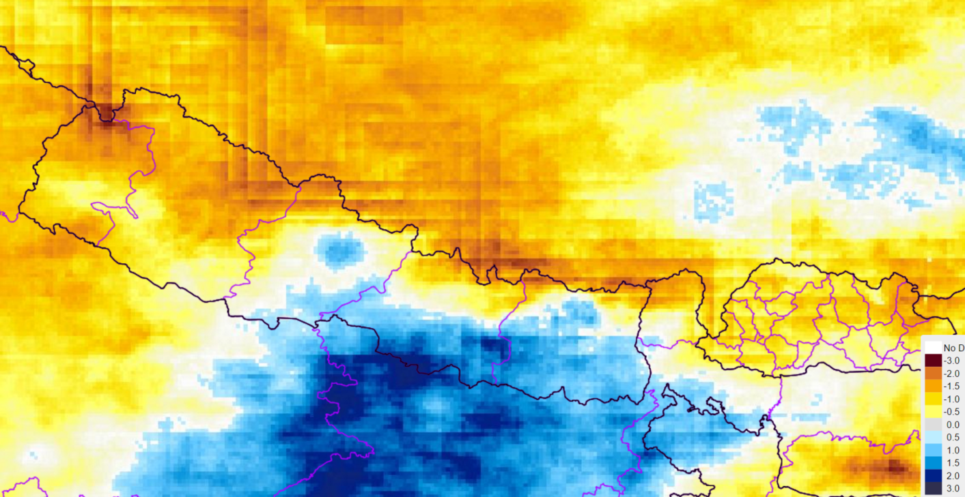
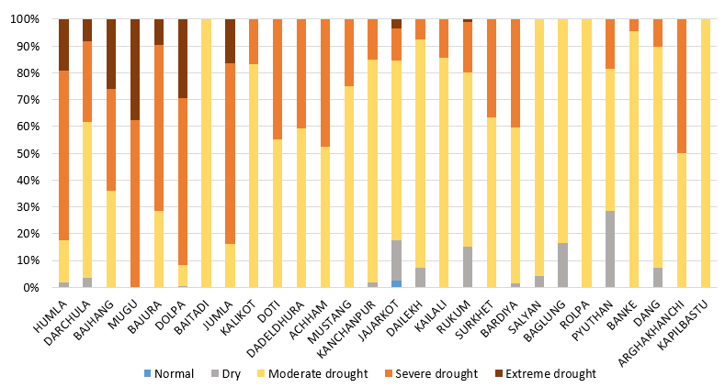
Winter drought (2015-2016) Conditions in Western Nepal
Drought SPI – Sep., 2016
Area under drought(%)

Slide 14
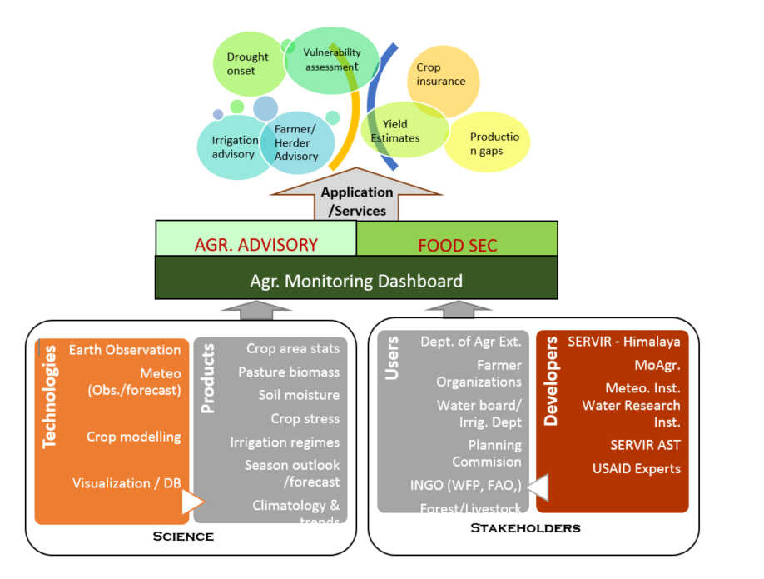
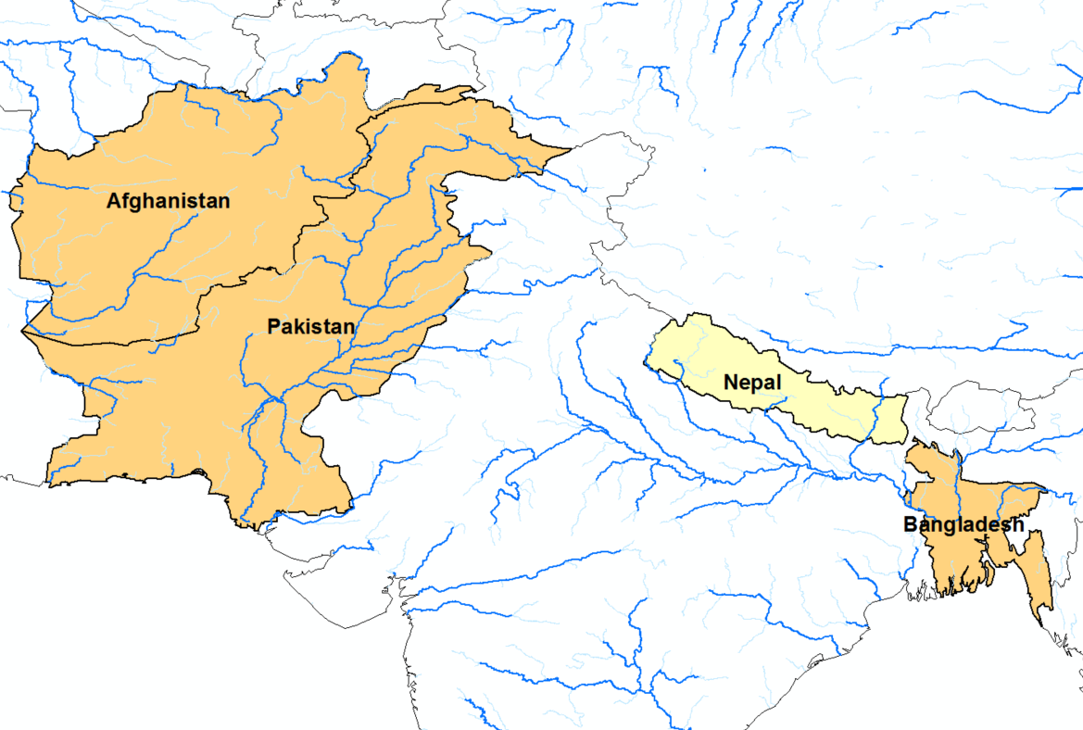
Establishing drought monitoring system through integration of Earth Observation data products
Objective
Operationalize a drought monitoring service, in collaboration with key agencies in meteorology and agriculture sector, to promote effective use of earth observation data products in agriculture and food security sectors.
Approach
Joint review of existing systems
Joint design and co-development of data products with national institutions related to agriculture and hydrometeorology
Linking monitoring data products with local cropping systems and farming practices.
Linking products with Advisory Services
SERVIR HKH Food Security SERVICES - Framework
Countries Drought Monitoring Activities

Slide 15
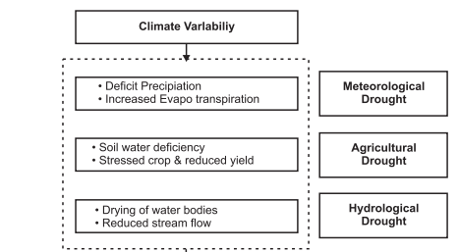
Key data products across the crop cycle
Drought:
“ A persistent abnormal moisture deficiency having adverse impacts on vegetation, animals, and people”.
Operationalizing Climate Hazards Group InfraRed Precipitation (CHIRP) data products
Operationalizing MODIS data products at higher spatial and temporal resolution
  Crop growth monitoring
  Heat stress monitoring
Evaporative Stress Monitoring
Linking monitoring data products with local cropping systems and farming practices through field based studies in the three districts
Spatial/time domain
Standardized Precipitation Index (SPI)
Vegetation Condition Index (VCI)
Temperature Condition Index (TCI)
Soil Moisture Condition Index (SMCI)
Evaporative Stress Index (ESI)

Slide 16
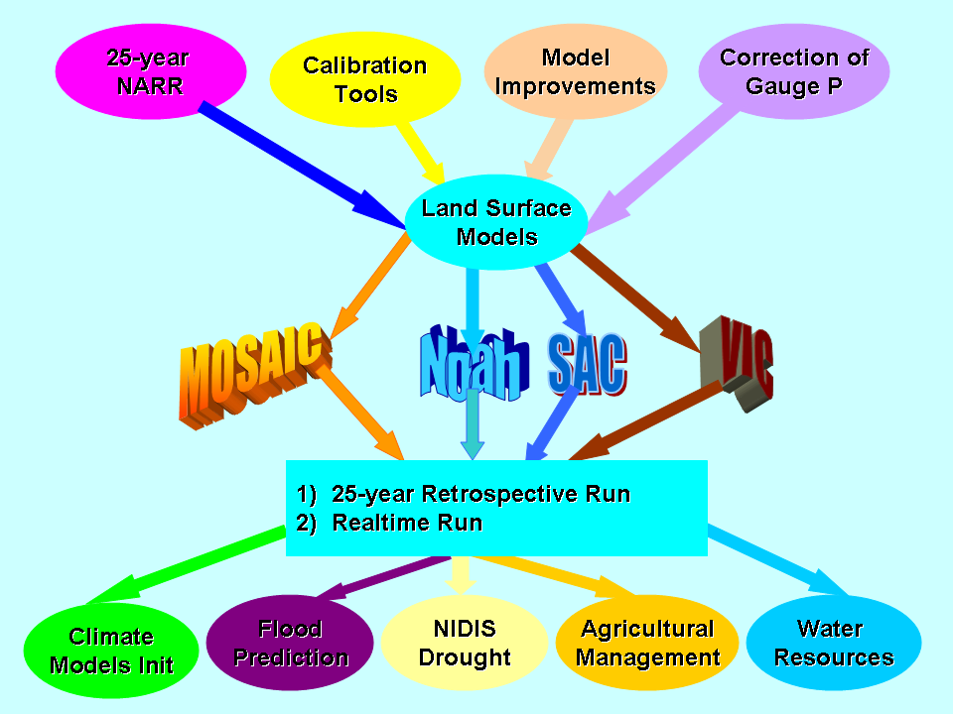
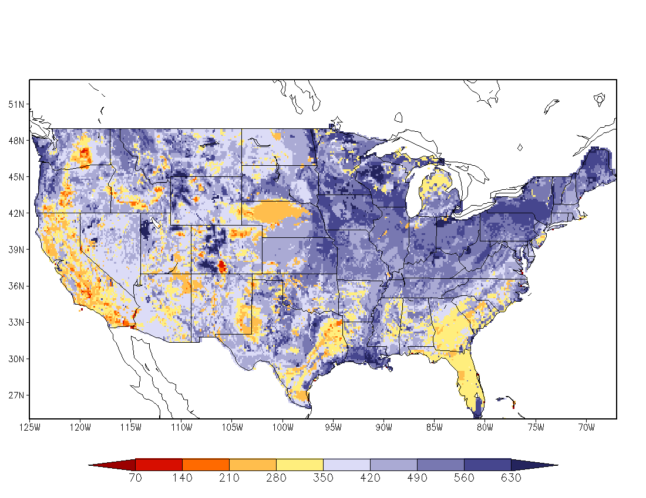
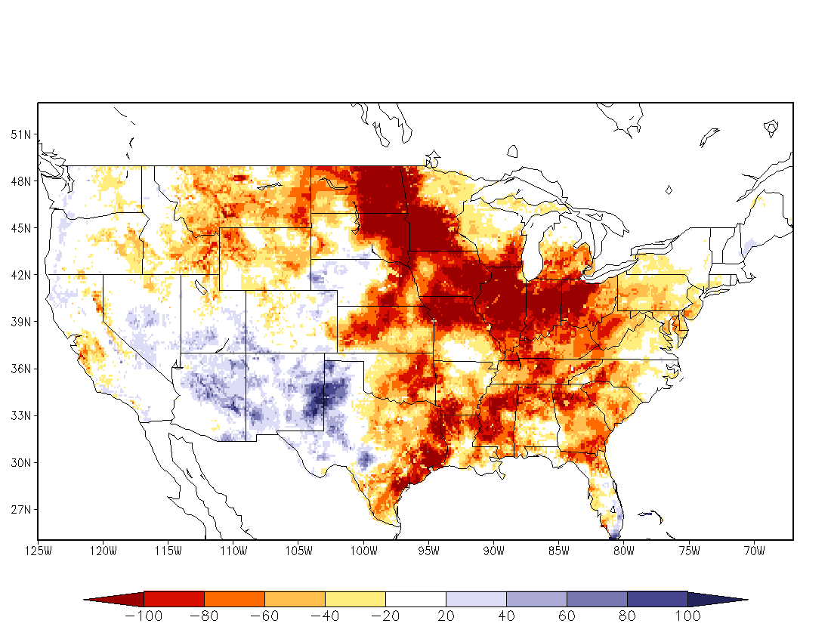
South Asian Land Data Assimilation System (SLDAS) – JHU AST
Noah, SAC, VIC, Mosaic land models run uncoupled, driven by CPC observed precipitation and atmos. forcing from NCEP North American Regional Climate Data Assimilation System; output: 1/8-deg. land & soil states, surface fluxes, runoff & streamflow.
Land model runs provide a 30-year climatology.
Anomalies used for drought monitoring; supports National Integrated Drought Information System.
July 30-year climo.
July 1988 (drought)

Slide 17
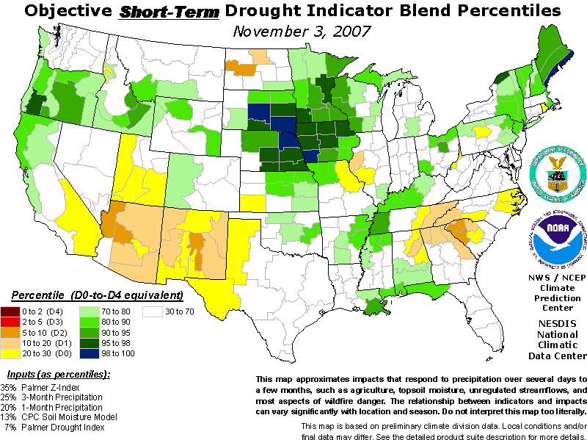
Development of Integrated drought index based on studies in two representative districts
Develop a new drought index combining optical remote sensing with local rainfall data from ground stations and satellites
Evaluate the reliability of satellite-based rainfall data from the CHIRPS for use in drought index as a substitute for ground station data in remote areas
Use drought index to understand spatio-temporal patterns, duration, and severity of drought in the two selected districts.
Compare/Validate the drought index result with the rainfall data to understand the lag response of different crops/ecosystems in the study area
Based on archived image and ground data of past drought periods (hindcasting), evaluate the ability of proposed drought index to predict future droughts
Recommend optimum land use practices in context of recently observed reduced rainfall in the study area
Blende
Drought Index

Slide 18
Monitoring crop conditions across the growing season
3- 5 Years
Base Crop Type Map
1 year
Crop Sown area
(Seasonal)
3 Months
Crop growth anomaly
Temporal Scale
1 Month
Vegetation stress
Water stress
Clim. Water balance WRSI
5-15 Days
Weather conditions/ forecast
Sentinel-2/ SPOT-5
Landsat/AWiFS
MODIS/MERIS
MODIS ET
CHIRPS/
WRF mod.
5-10 m
30-50 m
250 m
1 km
5-10 Km
Spatial Scale
Sentinel-2/ SPOT5
Landsat/AWiFS
MODIS/MERIS
MODIS ET
CHIRPS/WRF Models

Slide 19
Notes:
The drought assessments supported through earth observation data products will provide actionable information to support emergency response in short term and contribute in climate resilient farming policies and in the long term.
The enhanced capacity of professional in agriculture sector will promote effective use of global earth observation technologies and resources for local level issues.

Slide 20
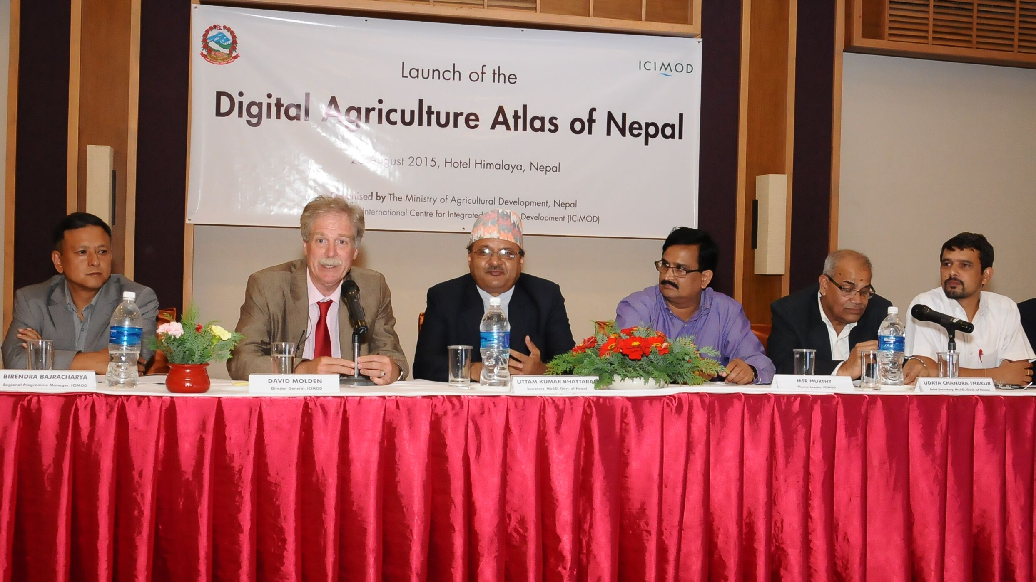
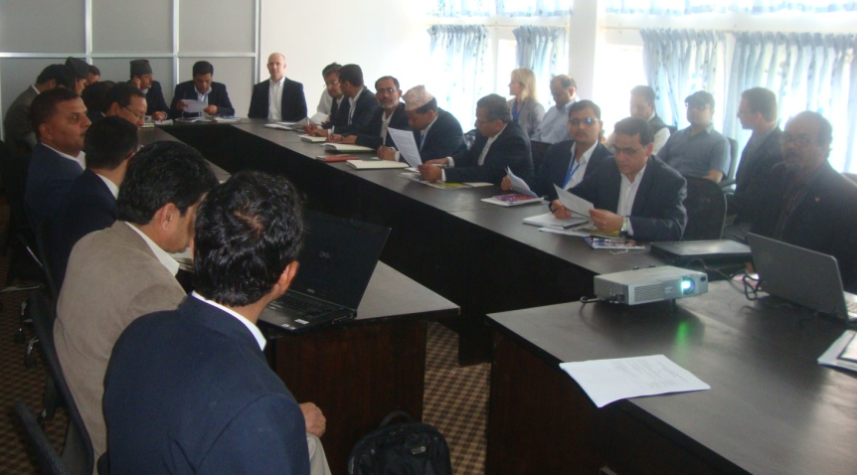
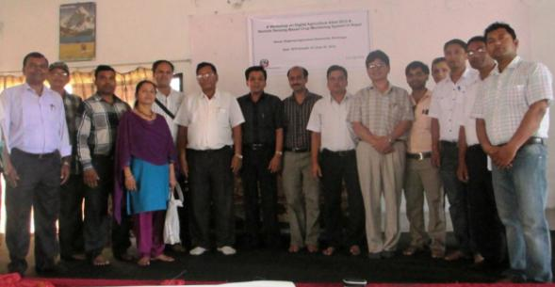
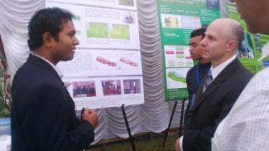
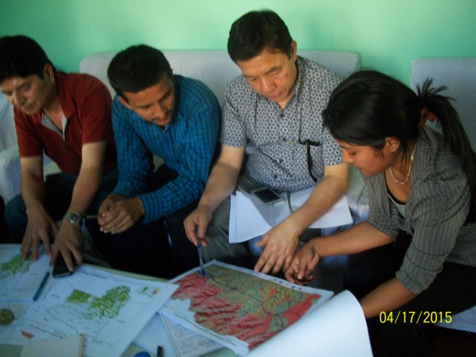
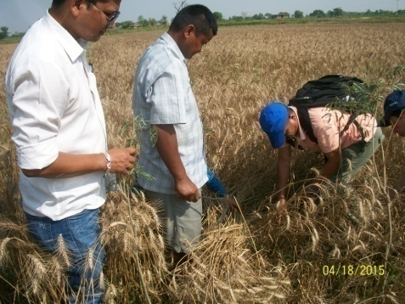
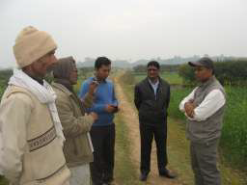
Cooperation and consultations

