Slide 1
An Overview of the
Earth Resources Observation and Science (EROS) Center,
Sioux Falls, South Dakota
January 2017

Slide 2
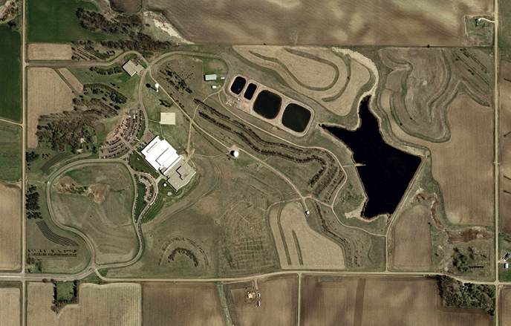
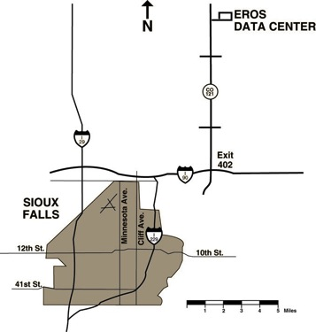
EROS Campus
Warehouse/Maintenance
GOES
Antenna
Heavy Equipment
and Fuel Storage
SCAN
Back-up
Generator Plant
Landsat
10M Antenna
1973
Lake EROS
AVHRR Antenna
1996
Future
Antenna
AERONET
RCS
PHENOCAM
ANSS
CRN
10M GEOS
Antenna
SURFRAD
CORS/GSOS
Landsat
5.4M Antenna
Security
2 acres
N
AERONET: Aerosol Robotic network CRN: US Climate Reference Network
SCAN: Soil Climate Analysis Network - USDA SURFRAD: Surface Radiation Network
RCS: Reference Climate Station – Canada PHENOCAM: Near-surface Phenology
ANSS: Advanced National Seismic Station – USGS
CORS/GSOS: Constantly Operating Reference Station / GPS Surface Observing System
2004 aerial imagery

Slide 3
Fast Facts About The EROS Campus
EROS is on a 318-acre Federal Reserve.
The USGS-owned facility contains 9 buildings totaling 307,000 sq. ft.
We have our own 19,000 sq. ft. shipping and receiving warehouse, an earthen dam, and a waste water treatment facility.
We have 697 physical servers and 19.76 Petabytes of disk in three raised-floor computer rooms with battery and generator backup power.

Slide 4

EROS Mission
… contributing to the understanding of a changing Earth.
Vision:
  The world’s primary source of remotely sensed land images of the Earth;
  Authoritative providers of land change science information and knowledge;
  Leaders in understanding how changes in land use, cover, and condition affect people and nature.
4

Slide 5
The EROS Center is…
A USGS science center and one of the world’s largest land remote sensing centers
Landsat satellite mission ground segment – developer and operator
National Satellite Land Remote Sensing Data Archive (NSLRSDA)
NASA Land Processes Distributed Active Archive Center (LPDAAC)
Member of the International Charter for Space and Major Disasters
Co-leader of the USGS-South Dakota State University Geographic Information Sciences Center of Excellence (GIScCE)
United Nations Environment Programme Global Resources Information Databases (UNEP GRID) ongoing collaboration
One of six Dept. of the Interior Core Data Centers - FITARA
5

Slide 6
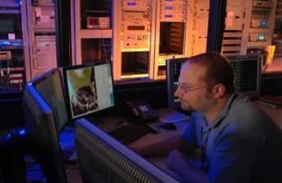
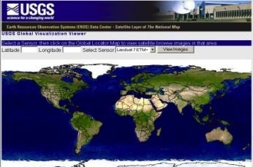
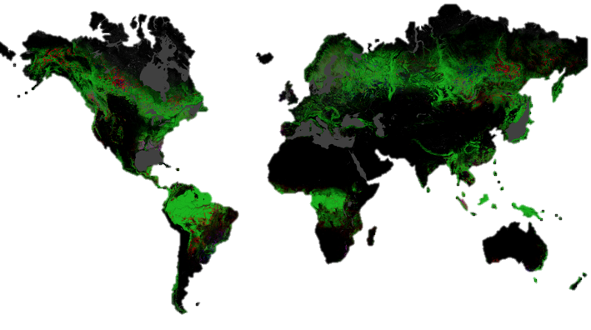
Key EROS Mission Functions…
Acquisition: Development and Operations
of Ground Systems: Satellite mission
ground system designer, developer and
operator
Data Archiving and Access:
Expand and safeguard
the archive and ensure that
anyone, anywhere and at anytime
have ready access to land information
Science: Conduct research and
develop applications and promote
knowledge and use of land
information to better understand
the Earth
6

Slide 7
Current EROS Staff
127 Government Employees
~500 Contract Positions via 8 Contracts
USGS OAG HQ, NOAA, and BIA have staff at EROS.
Education - Post-Secondary Degrees - 75% of the workforce
    PhDs 11%
    Masters 37%
    Bachelors 39%
    Associates 13%
Examples of the Skill Sets at EROS
  Remote Sensing science Environmental modeling
  Application development Product/Information development
  Systems engineering Satellite systems operation and management
  Systems development Archive management/preservation
  Information science Network architecture, design and operations
  Budget and finance Facility operations and maintenance
~627 positions

Slide 8
EROS Government Organization
USGS Associate Director
Climate and Land Use Change
Common Services
Office of the Director
Policy & Communications
Admin Services Branch,
Facilities,
Center Information Technology
EROS Policy, Comm. And Outreach
Records Management
USGS Contracts - OAG
Coordination Requirements
Center-wide coordinate & req.
Land Satellites Data System (LSDS) Project Office (LPO)
Science and Application Branch
Data Services Branch
Observing Systems Branch

Slide 9
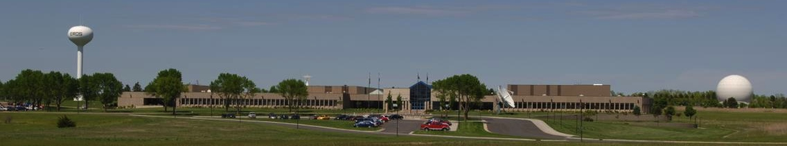
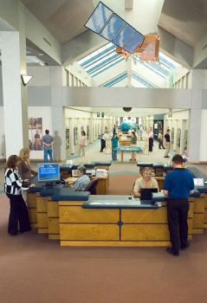

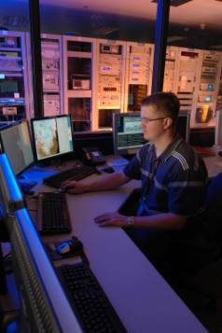
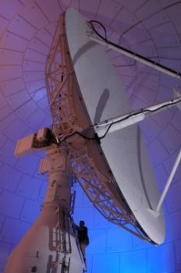
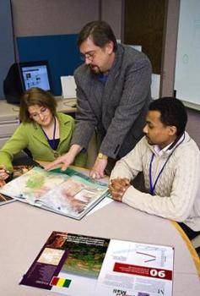
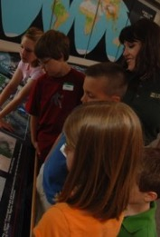
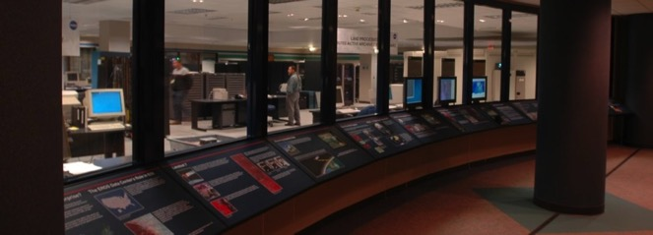
EROS Center Overview

Slide 10
Questions? http://eros.usgs.gov

Slide 11
Observing Systems Branch
Mission and Scope
Collect and populate the archive with data that positions EROS as the world’s primary source of imagery and fulfills scientific requirements, allowing land change monitoring, assessment and projection
Operate satellite missions
Perform USGS development responsibilities for new missions
Oversee all acquisition of data
  Including antennas and supporting hardware, development of processing
Develop new partnerships to receive data
  Commercial data buy contracts, future partnerships
  International Cooperators
Develop systems to support Earth Observation Requirements
Processing of Landsat data for distribution to our users
  Level 1, Level-2 products (ARD), and the information system for LCMAP and higher-level (L3+) products
Radiometric, geometric, and spatial characterization, calibration, and cross calibration of optical remote sensing systems
11

Slide 12
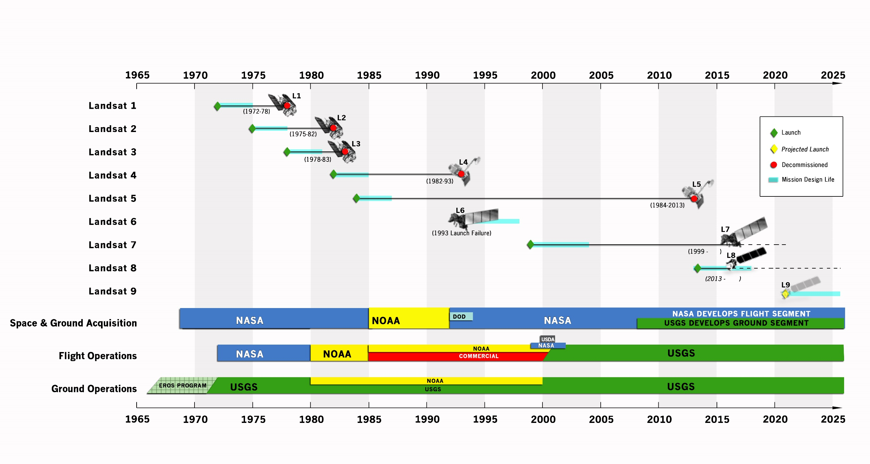
Landsat Series Timeline

Slide 13
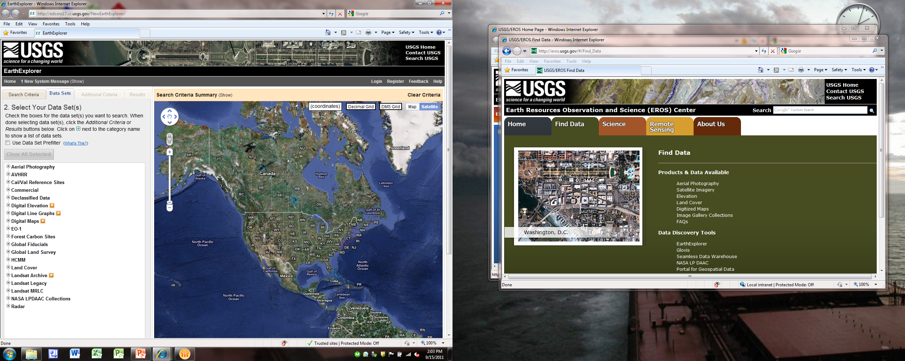
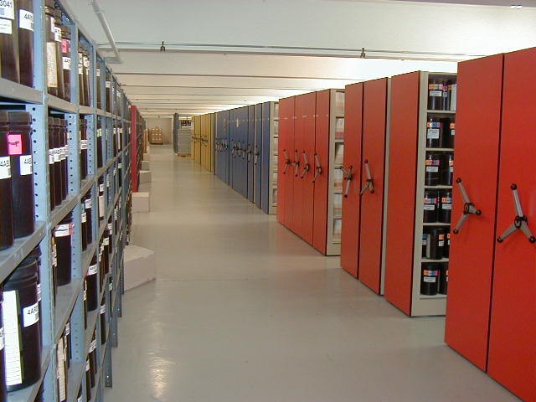
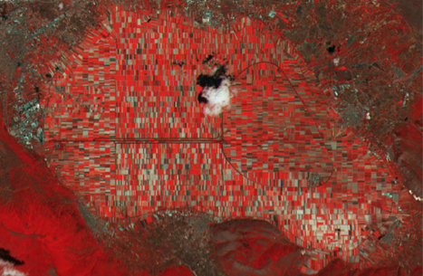

Data Services Branch
DSB Projects
Landsat Sentinel Access/Archive
Spatial Data Warehouse
Long Term Archive
Emergency Operations
NASA Land Processes Distributed Active Archive Center
User Services
Key Branch Functions
Data Archive
Data Distribution
Geo-spatial services
Web interface operations
User services
Natural hazard support

Slide 14
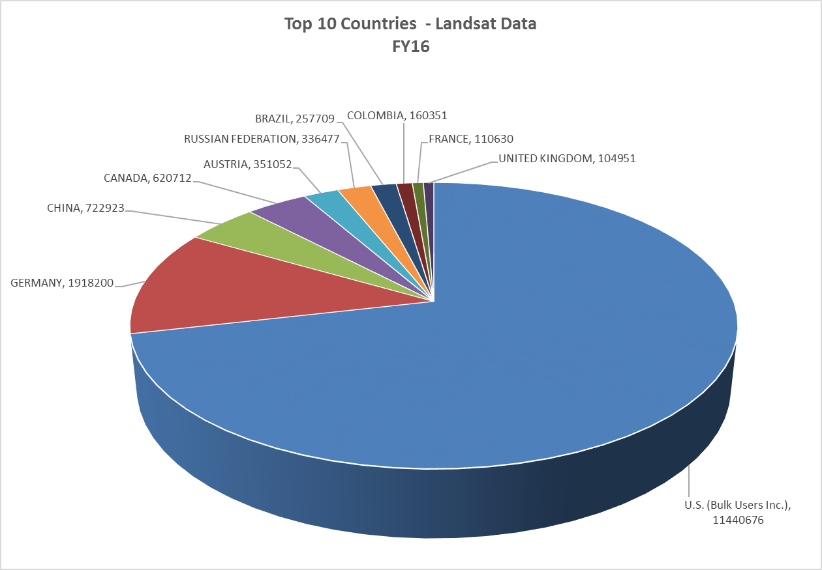
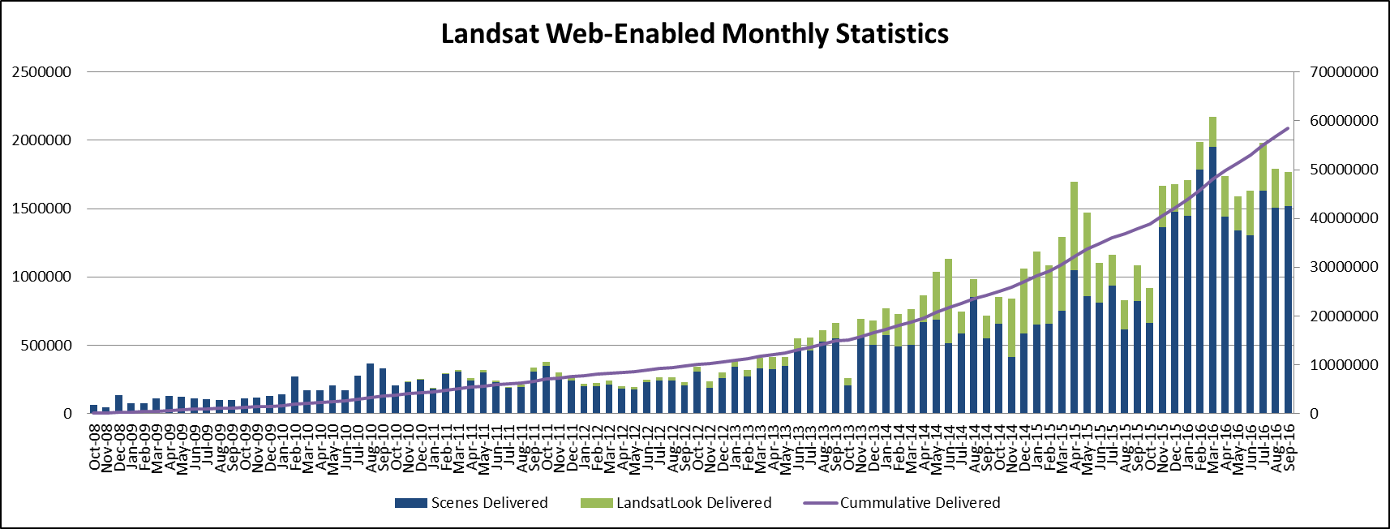
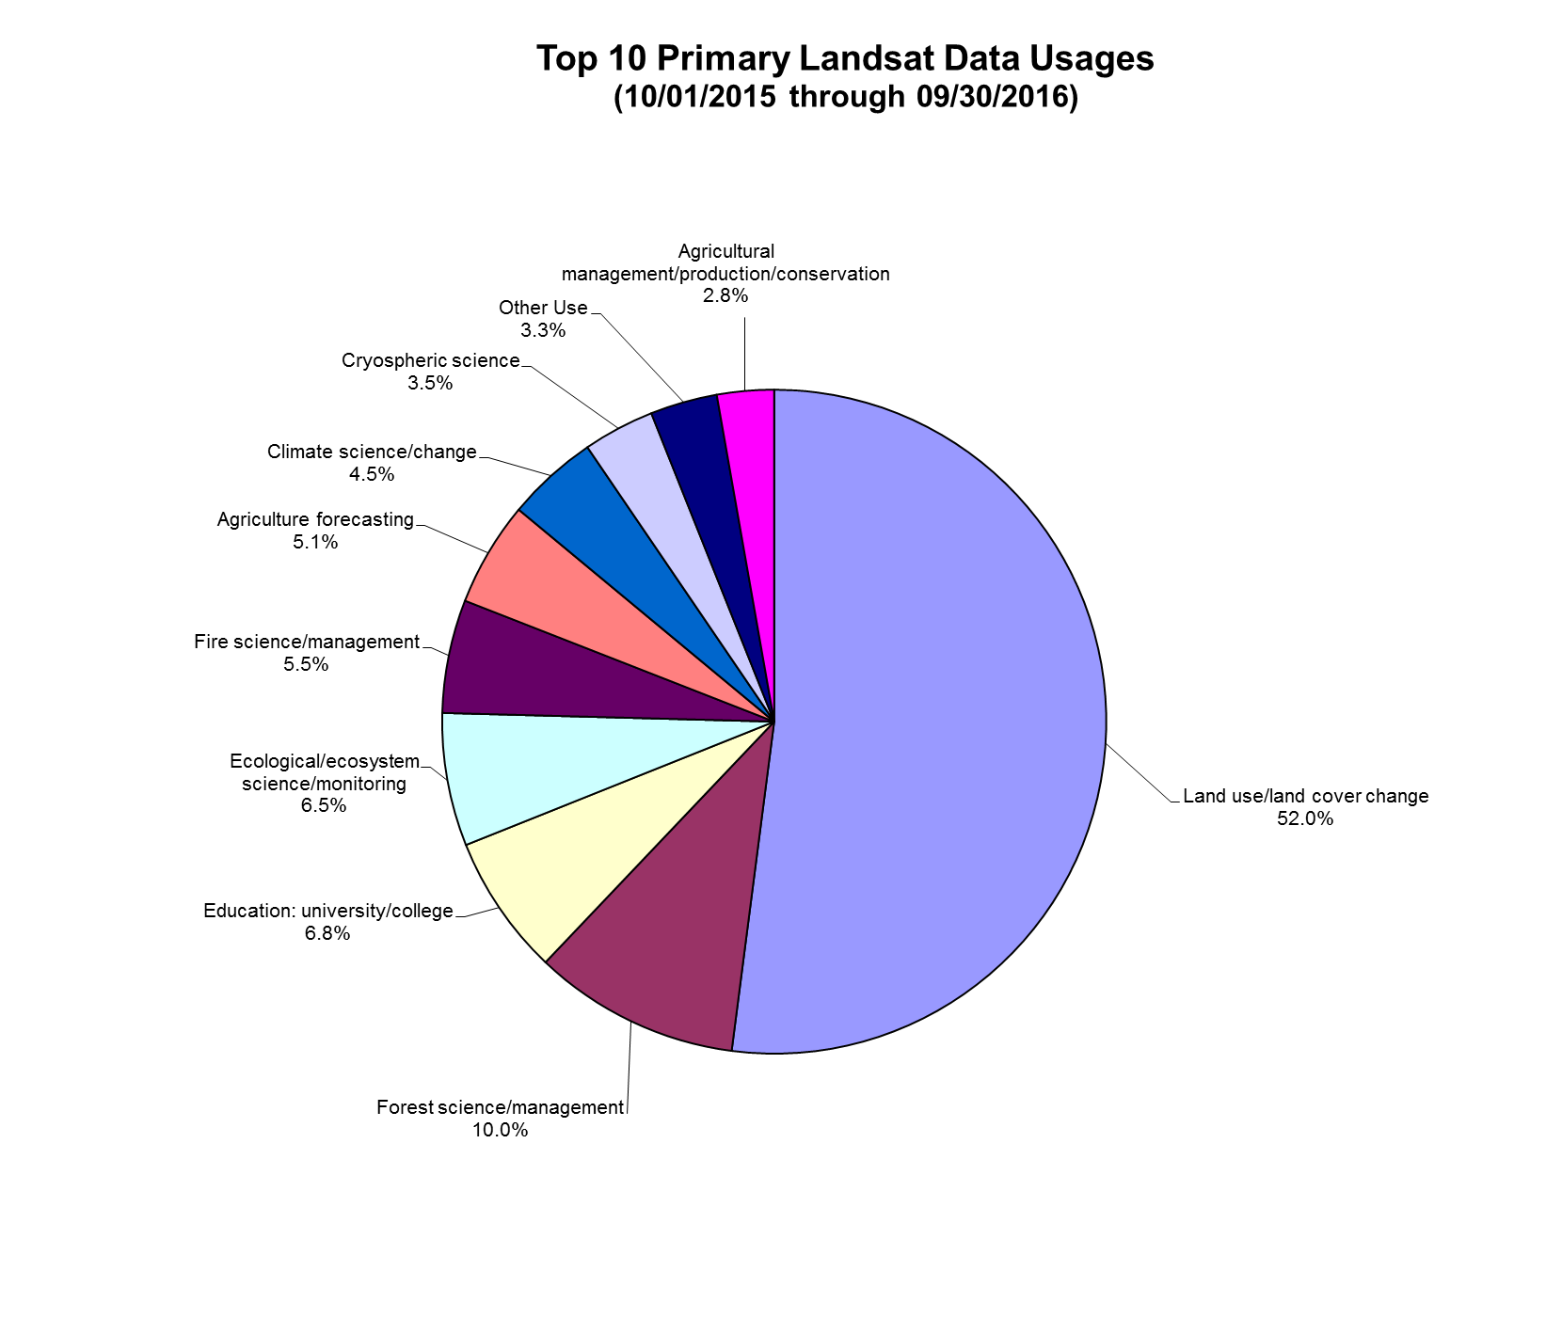
Landsat Distribution
Exponential growth in outgoing data delivery
  2x increase between FY15 & FY16
Currently reprocessing entire Landsat archive to improve data quality
Serves as a significant scientific resource within the user community

Slide 15
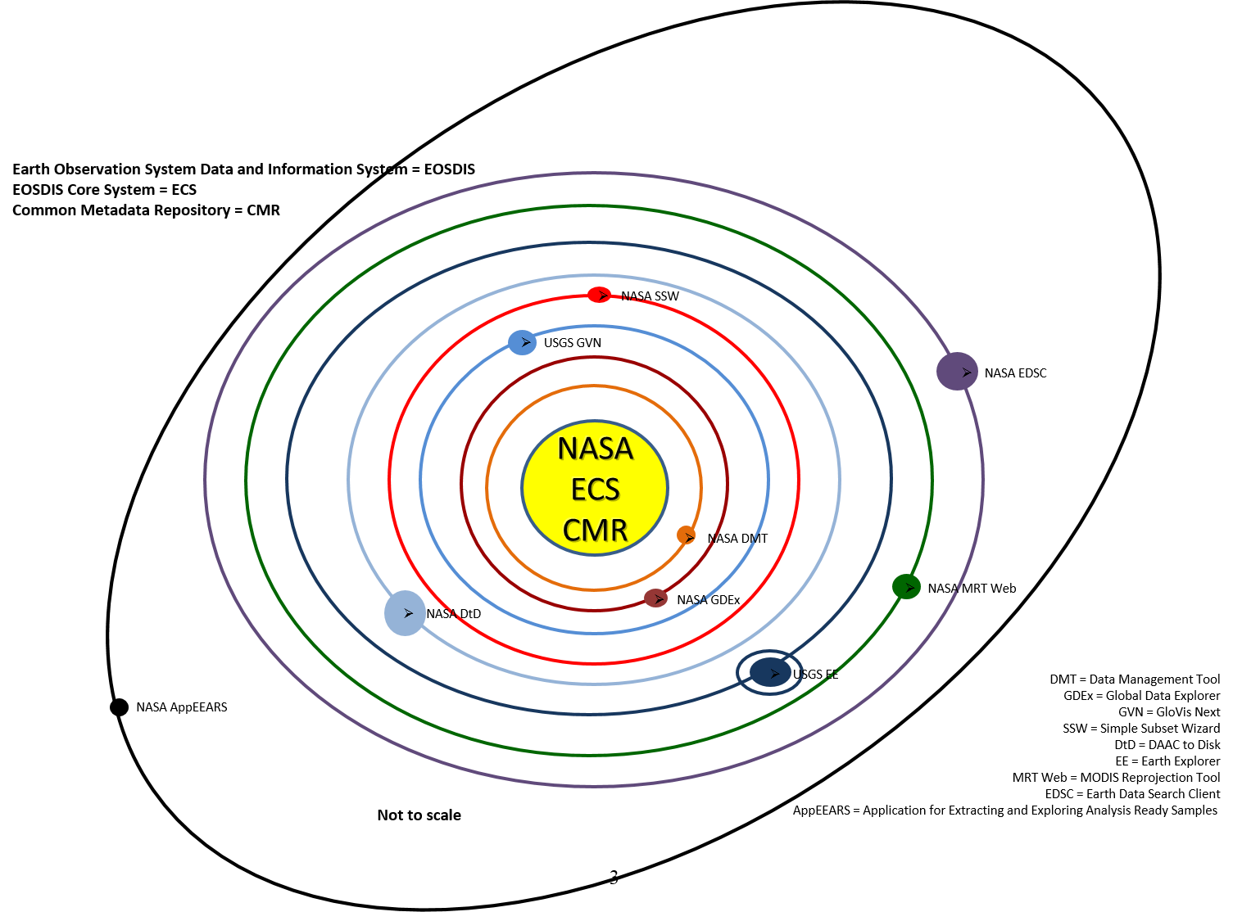
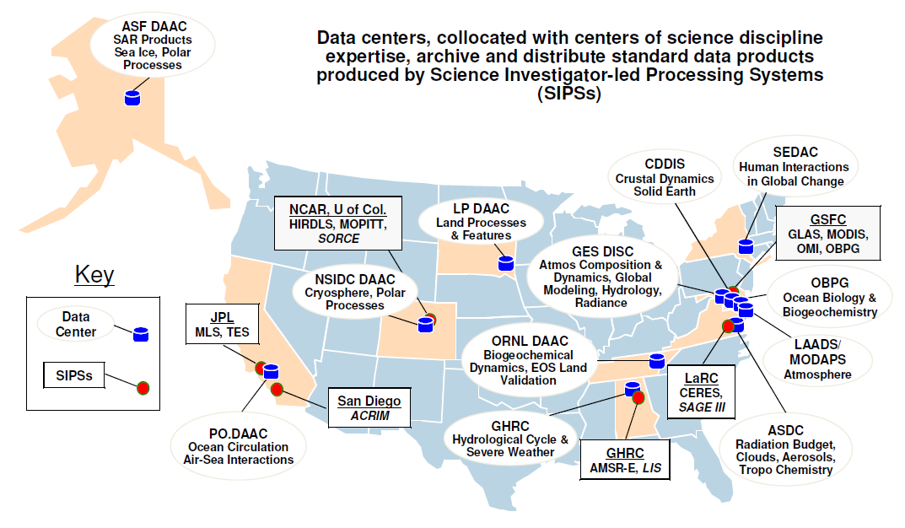
NASA LP DAAC @ USGS EROS
LP DAAC = Land Processes Distributed Active Archive Center
Vision (objective) Statement – ingest, archive, process and distribute NASA Earth Science land products and information to NASA principal investigators and DOI land managers. And 100,000’s of other general users
Background:
The National Satellite Land Remote Sensing Data Archive (NSLRSDA) resides at the U.S. Geological Survey’s (USGS) Earth Resources Observation and Science (EROS) Center. Through the Land Remote Sensing Policy Act of 1992, the U.S. Congress directed the Department of the Interior (DOI) to establish a permanent Government archive containing satellite remote sensing data of the Earth’s land surface and to make the data easily accessible and readily available. This unique DOI/USGS archive provides a comprehensive, permanent, and impartial observational record of the planet’s land surface obtained throughout more than five decades of satellite remote sensing.

Slide 16
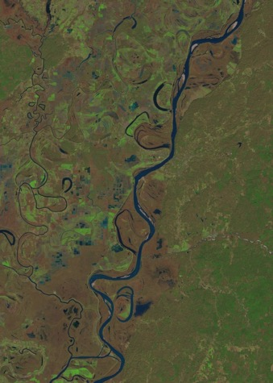
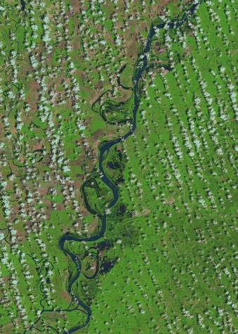
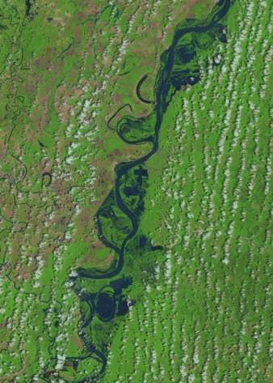
Science and Applications Branch
USGS EROS Mission and Science Focus
EROS mission: We contribute to the understanding of a changing Earth…
EROS science emphasis: Understanding the patterns, processes, and consequences of changes in land-use, land-cover, and land condition that are associated with the interaction between human activities and natural systems.
Mississippi River Flooding in the Natchez, MS Area (Landsat 5 images)
January 2, 2011
April 24, 2011
May 10, 2011
Notes:
Land change is typically motivated by economic goals which are important for the growth of personal income and expanding the economies of communities, states, and nations.
Land changes are local phenomena with impacts that can reach beyond the local scale, and can accumulate and have global impacts.
Land changes are, to a certain extent, driven by natural events, but are mostly attributed to human activities on the earth.

Slide 17
EROS Center Science and Applications Science Goals
Improving global land change monitoring through remote sensing research.
Understanding the temporal and geographic dimensions of land change.
Improving the understanding of the connections between climate and land change (e.g., land use, cover, and condition) and their combined impacts on human and natural systems.
17

Slide 18
Science Focus Areas
Science Focus Areas | Definition
Remote sensing R&D for Land Change | Research addressing remote sensing data quality and consistency, algorithms and strategies for characterizing geo- and biophysical surface properties and dynamics including land change, and strategies for validation of remote sensing and environmental products.
Land Change Products – Land Cover | Planning, implementation, and production of change detection and land cover change products.
Land Change Products – Fire | Planning, implementation, and production of land data sets needed to characterize vegetation related to fire fuels and fuel conditions, and the analysis and monitoring of burn severity.
National & Regional Assessments | Research, analysis, and synthesis of data leading to the development of assessments of the rates, causes, and consequences of land change.
Vegetation, Water and Climate Dynamics | Quantification and monitoring of the impacts of weather, climate, and land use on vegetation condition and water resources.
Coastal Changes and Impacts | Regional to national assessments of the complex interactions between coastal communities and natural landscapes associated with climate change, sea-level rise, and human development.
Early Warning for Food Security | Research and analysis leading to operational early warning forecasts and assessments of acute food insecurity.

Slide 19
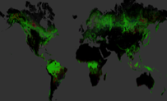











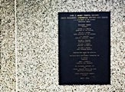






Strengthening the Future of EROS
2016 to 2021 Strategic Plan – Future Directions
Land Change Monitoring, Assessment, and Projection
Sustainable Land Imaging and Ground System Optimization
Center for Calibration and Validation
EROS Enterprise Architecture
Mundt Federal Center Consolidation
EROS Workforce: Recruit, Retain, and Train

Slide 20
LCMAP Land Change Assessments and Projections
A USGS science initiative implemented at the USGS EROS Center to harness the Landsat record in order to provide state-of-the-art land change capabilities needed by scientists, resource managers, and decision makers.
A modernized, integrated approach to mapping, monitoring, synthesizing, and understanding the complexities of land use, cover, and condition change.
Basic foundational elements include:
  “Analysis-ready” Landsat archive (ARD).
  Land change and land cover data derived from all available cloud- and shadow-free Landsat pixels.
  Independent reference data for validation and area estimation.
  Scenario driven projections of future LULC extents and patterns.
  Assessments focused on land change processes, characteristics, and consequences.
Notes:
Objective science-quality data and information.
Ongoing monitoring of changes in land and water resources.
Understanding of past, present, and future land use, cover, and condition change.
Assessments of the combined impacts of climate and land change on people and natural systems.

Slide 21

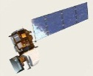
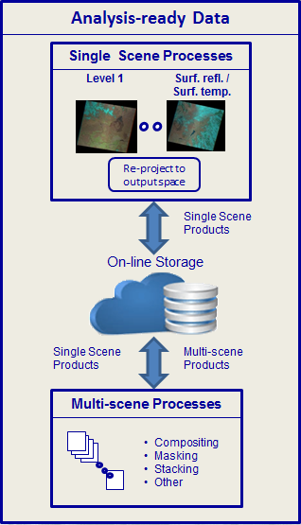
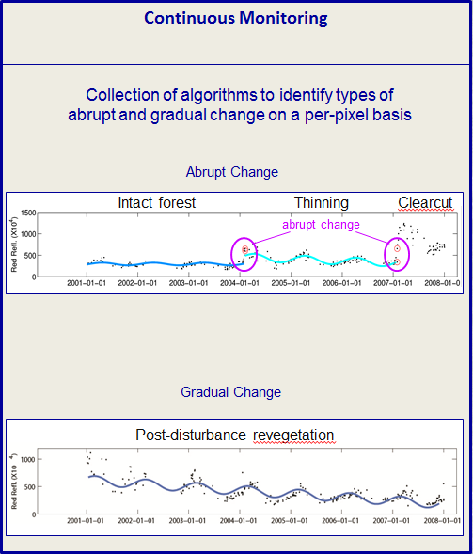
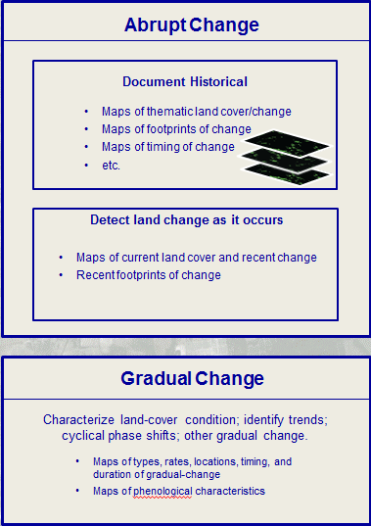
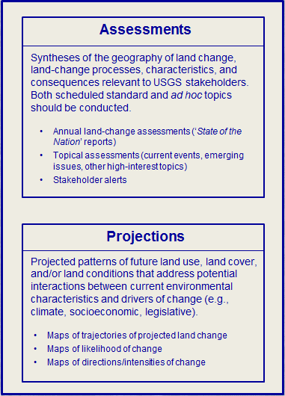

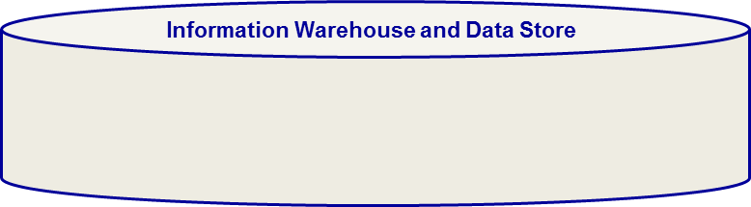
LCMAP Conceptual Framework and Flow
Stakeholder interests and info needs
External data
Communications, applications services, outreach, and other users and stakeholder support
Communications & outreach
Web-based access to all products
Web-based analysis portal
Applications support
External research
R&D
Continuous Monitoring
Spatial analyses of change
External data
Federal partners
Metadata
Land cover change/condition products
Outputs from assessments
Non-Landsat remote sensor data
Satellite data
Airborne
Non-Landsat rem. sens. prods.
DEMs & derivatives
Orthoimagery
Evapotranspiration
Vegetation phenology
Others
Ground-based data
Cal/Val data
Land cover accuracy/valid.
Others
External data
Notes:
Framework that ties together our operations through research activities and enables greater focus on producing needed land change knowledge (vs. our historical emphasis on data and information).

Slide 22
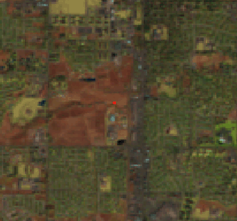
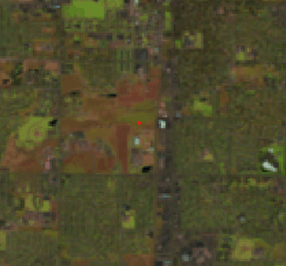
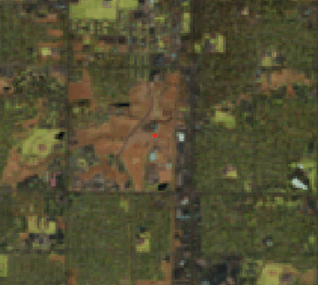
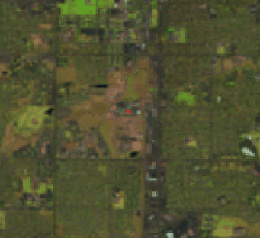
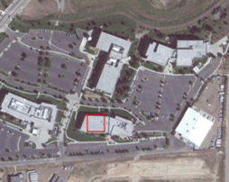
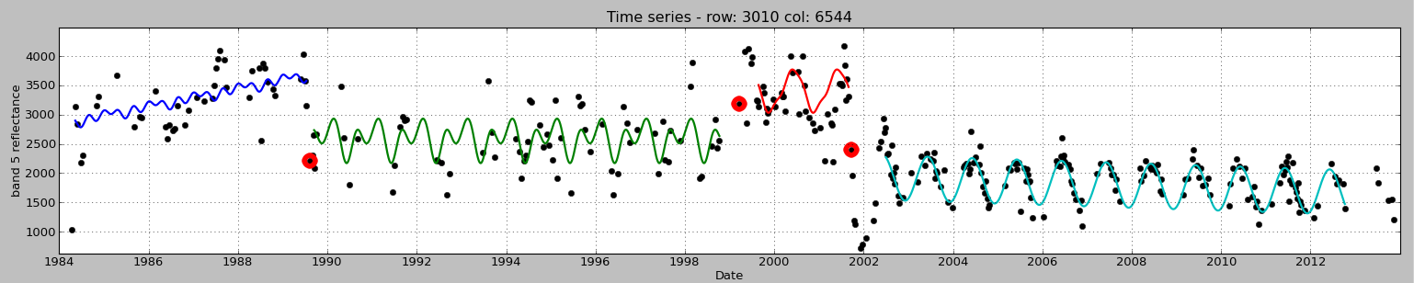

Crop field
Spectral history of a location in Fort Collins, Colorado
Hay field
In conversion
Developed
Ft. Collins USGS
Ft. Collins USGS
Landsat Band 5
1984 1986 1988 1990 1992 1994 1996 1998 2000 2002 2004 2006 2008 2010 2012
Date
Zhu, Z. and C.E. Woodcock. 2014. Continuous change detection and classification of land cover using all available Landsat data. Remote Sensing of Environment 144:152–171.
Notes:
Example of a time series for a single pixel in the Fort Collins, CO area. It is based on all available cloud- and shadow-free Landsat 5, 7, and 8 data. The unique trajectories (seasonal harmonices) of different cover types are distinguishable, the times of conversion to different land cover types are obvious, and the slope of each tend provides an indication of the stability, decline, or improvement of the condition of each cover type.
Traditionally, we would use single or small sets of data points to classify cover or detect change. With the CCDC approach, we are able to understand a wider range of land use, cover, and condition properties.

Slide 23
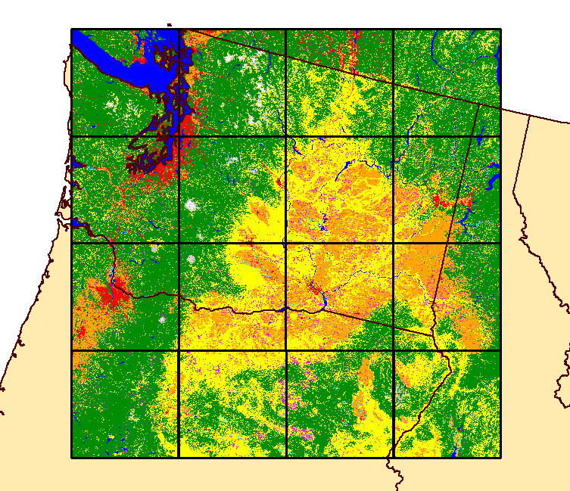
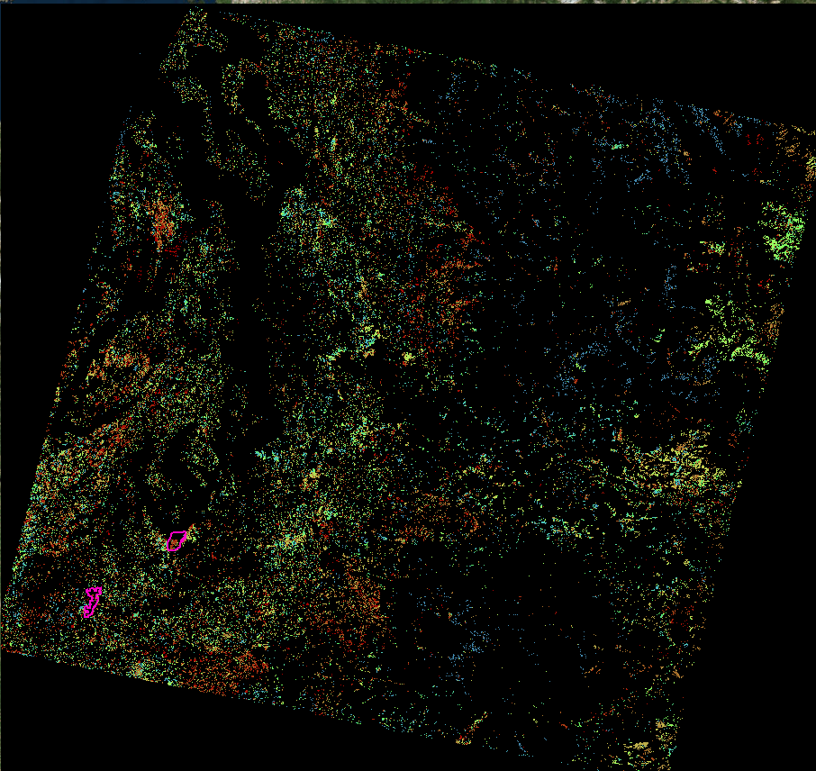
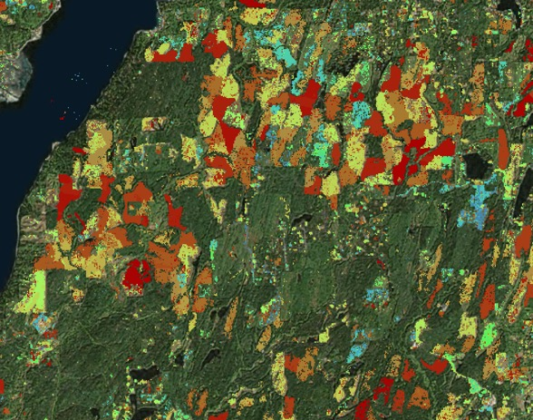
Pacific Northwest Land Cover and Change
  Land Cover Classes
  Tree cover
  Grassland/shrubland
  Agricultural land
  Developed land
  Water
  Wetlands
  Snow/ice
  Barren
  Mechanical disturbance
  Non-mechanical disturbance
  Burned
Year of Most
Recent Change
1986
1987
1988
1989
1990
1991
1992
1993
1994
1995
1996
1997
1998
1999
2000
2001
2002
2003
2004
2005
2006
2007
2008
2009
2010
2011
2012
2013
2014
Zhu et al., ISPRS (in press)
Notes:
This represents the classification of a 20,000 by 20,000 pixel area in western US (Pacific North West). It is for a single year, but the classification process generated 30 annual LC products spanning 1985-2015. The training used land cover interpretations produced in a previous US project. No special conditioning of the training data was required. The map includes 12 classes (9 cover types, 3 disturbance types).
Level of agreement with an independent manually interpreted land cover sample (independent of the training data) approaches 88% (the independent reference sample accuracy was around 91%). Testing has shown the importance of training data quality and use in achieving consistent results.

Slide 25
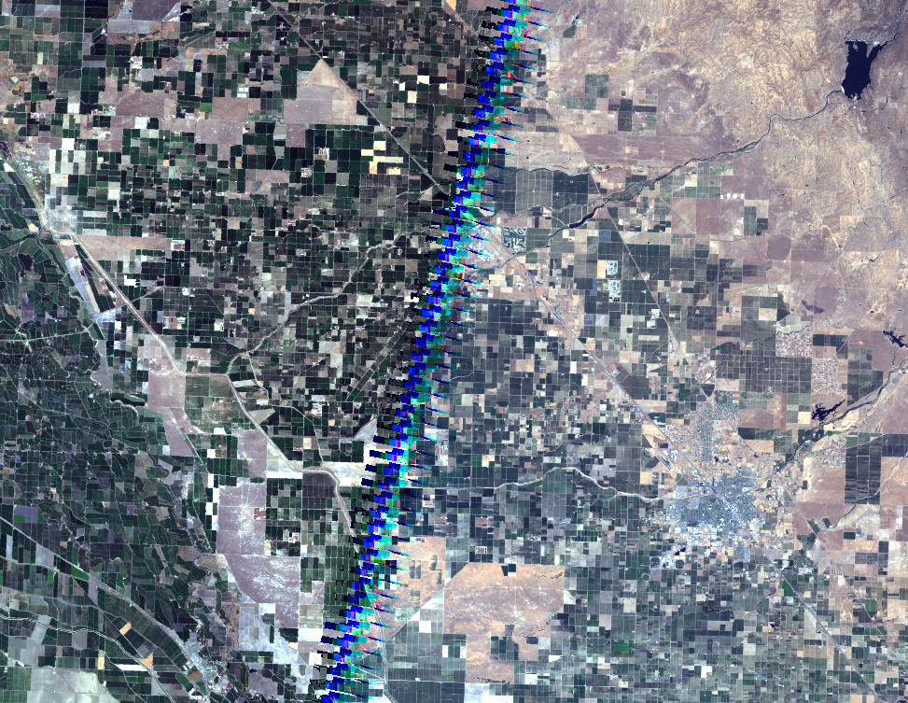
Remote Sensing R&D for Land Change
Landsat Surface Reflectance
43/34
JUL 22 07
42/34
JUL 28 06

Slide 26
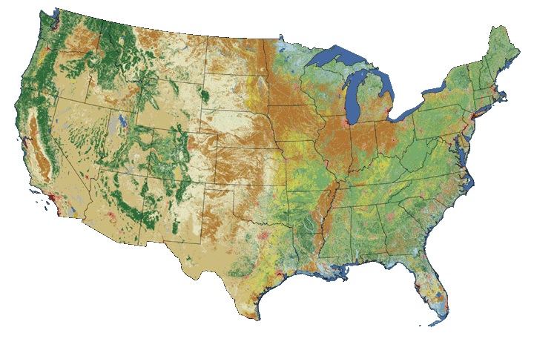
Land Change Products – Land Cover
2011 National Land-Cover Dataset (NLCD)
Sponsored by the Federal Multi-Resolution Land Characterization (MRLC) Consortium
Notes:
NLCD 2006

Slide 27
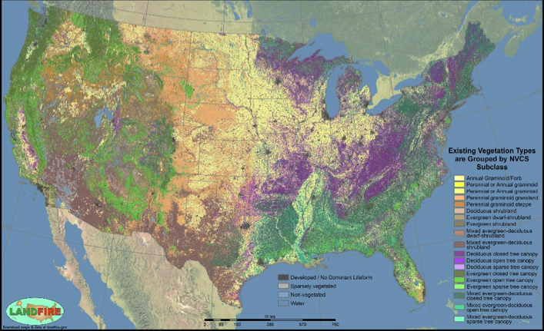
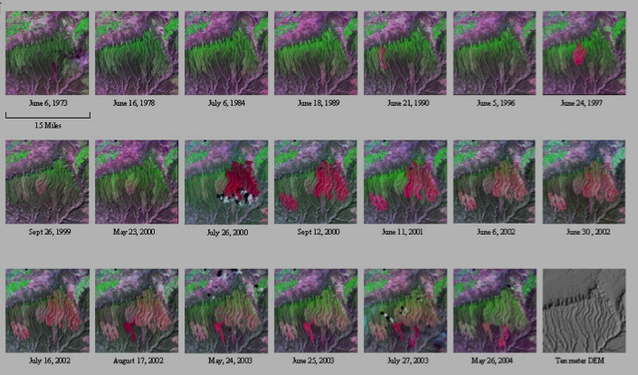
Land Change Products - Fire
LANDFIRE: Existing Vegetation Type
Fire Potential Index forecast
Post Fire Impacts
Expected Number of Large Fires

Slide 28
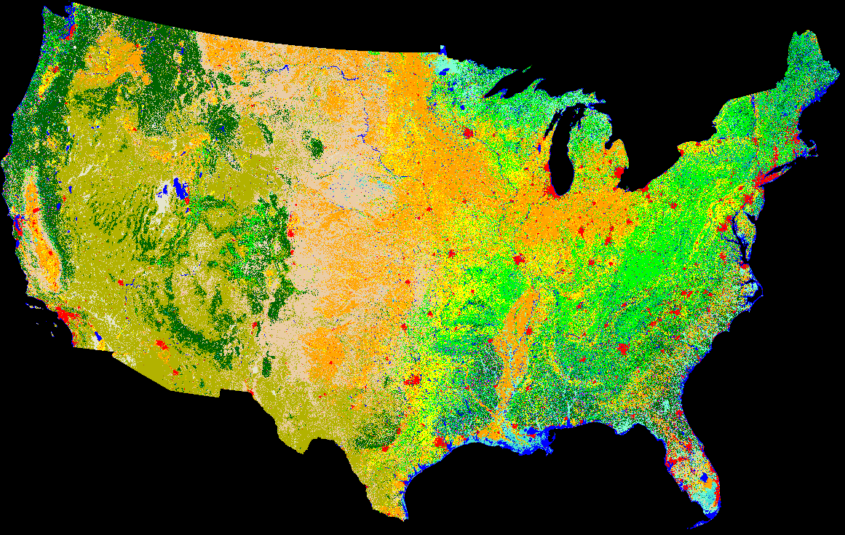

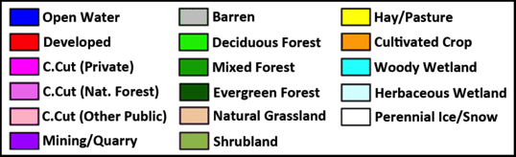
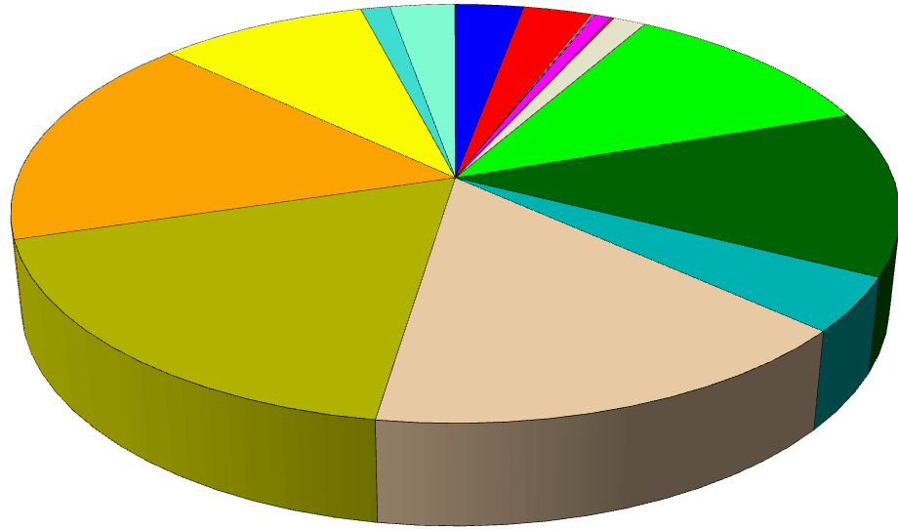
National and Regional Assessments
Future Land Cover – 2006 to 2100 – A1B Scenario
Source: Terry Sohl, USGS

Slide 29
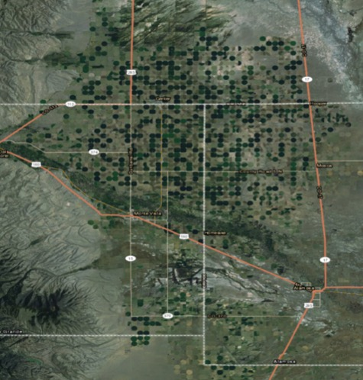
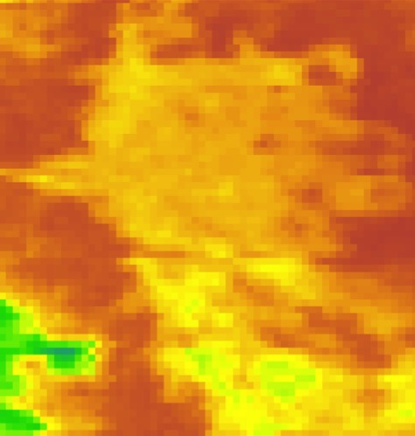


Vegetation, Water & Climate Dynamics
Transitioning to water use monitoring at management scale
Base Map
MODIS ET
Landsat ET
0
1000 mm

Slide 30





Coastal Changes & Impacts
Beaufort County, North Carolina
Elevation source for SLR modeling: NED from 30-m DEM
Elevation source for SLR modeling: NED from 3-m lidar data

Slide 31

Early Warning for Food Security
Notes:
EROS provides climate analysis, drought monitoring, and rainfall assessment.

Slide 32
LCMAP Land Change Assessments and Projections
  Assessments focused on land change processes, characteristics, and consequences. These include:
    Annual land change assessments – e.g., rates and characteristics of 2016 land change and an outlook for the next 10 years
    On-demand topical assessments – e.g., the impacts of the 2012 drought on land use and land condition
Stakeholders alerts identifying important or emerging land-change events in their jurisdictions.
LULC projections:
    Scenario driven projections of future LULC extents and patterns
    Projections based on sectoral land requirements (e.g., what are the land requirements needed to meet future food, fiber, and fuel demands given climate and water constraints?)
    Forecasts on the impacts of LULC change on ecosystem health, water availability, carbon dynamics, climate change adaptation, etc.
Notes:
This is the motivation for LCMAP. It is a science initiative.

Slide 33




Analysis Ready Data (ARD)
Landsat data processed to a level that enables direct use in applications
  Allows geospatial, multi-spectral, and multi-temporal manipulations for the purposes of data reduction, analysis, and interpretation
  Consistent radiometric processing scaled to top-of-atmosphere (TOA) and surface reflectance
  Consistent geometry including spatial coverage and cartographic projection – e.g., pixels align through time, <12m RMSE.
  Metadata on data provenance, geographic extent, and data quality.
Initial ARD production is focused on the TM through OLI record (1982 – present), but will eventually include MSS (1972) and span the globe. US ARD completed by Spring 2017.
Albers-based 5000x5000 pixel tiles (From SDSU WELD, Roy et al., 2010)
Notes:
LCMAP is founded on the principle that the use of all available Landsat data will enable the automated generation of accurate land cover and land change products. The Landsat archive, currently organized as path rows, is not sufficiently efficient for time series studies. Moving to a grid-based data cube approach with API’s that condition and serve data per user specification will reduce data preparation time.
The current plan is to begin working toward a global ARD as soon as the US ARD processing is completed. However, a consensus global projection/tiling specification has not been developed. That must be one ASAP if the global ARD is to be available within the next 2 years.

Slide 34
EROS Science and Applications Partners
Five USGS mission areas (Climate and Land Use, Core Science Systems, Water, Ecosystems, Energy and Minerals) and 14 USGS programs
DOI bureaus – BLM, NPS, USFWS, BIA, OWFC
Other federal agencies – NASA, NOAA, EPA, USFS, NASS, NRCS, FAA, SERDP, FEMA, USAID
Academic institutions - South Dakota State University, University of California-Santa Barbara, University of Nebraska, University of Maryland, University of Minnesota, Boston University, SUNY-Environmental Science and Forestry
International organizations and agencies – UNEP, FAO, ESA, Mexico INEGI, Canada Center for Remote Sensing, CEOS, GEO

Slide 35
Landsat Highlights – Additional Reading
Title: Fact Sheets Highlighting Landsat’s Monitoring Mission Now Available
What: Series of fact sheets detailing Landsat’s value in mapping and monitoring land cover changes on Earth.
Background: A series of USGS fact sheets detailing Landsat’s value in mapping and monitoring land cover change consistently and historically across the globe are now available in the USGS Publications Warehouse. The series of articles looks at Landsat’s crucial role in water mapping, urban growth, industrial growth, forest health, wildfire mapping, agriculture, and food security. The topics capture the vision of former Interior Secretary Stewart Udall, who announced 50 years ago—on Sept. 21, 1966­—a plan to use satellite data as a way to monitor and manage the Earth’s natural resources. The fact sheets are also available online at http://eros.usgs.gov/udall50thanniversary/ under the Benefits of Landsat tab.
Hill Interest: Interior Secretary Stewart Udall’s vision 50 years ago to use satellite technology for monitoring Earth and its natural resources is an important tool today that is captured in this series of fact sheets that details Landsat’s value in tracking land use/land cover changes.
POC: For more information, contact Janice Nelson, jsnelson@usgs.gov or 605-594-6173
  USGS FS 2016-3037: Mapping water use – Landsat and water resources in the United States - https://pubs.er.usgs.gov/publication/fs20163037
  USGS FS 2016-3044: When wildfire damage threatens humans, Landsat provides answers- https://pubs.er.usgs.gov/publication/fs20163044
  USGS FS 2016-3045: Landsat – The watchman that never sleeps - https://pubs.er.usgs.gov/publication/fs20163045
  USGS FS 2016-3054: Landsat Brings Understanding to the Impact of Industrialization- http://dx.doi.org/10.3133/fs20163054
  USGS FS 2016-3056: Urban Planners and Urban Geographers Turn to Landsat for Answers- http://dx.doi.org/10.3133/fs20163056
  USGS FS 2016-3059: Landsat Plays a Key Role in Reducing Hunger on Earth - http://dx.doi.org/10.3133/fs20163059
  USGS FS 2016-3060: Landsat Helps Bolster Food Security - http://dx.doi.org/10.3133/fs20163060

Slide 36
Landsat Highlights – Additional Reading (continued)
Title: Landsat Science Team Presentations Now Available
What: Presentations made July 26-28, 2016, at the USGS-NASA Landsat Science Team meeting in Brookings, SD, are now available online.
Background: All presentation materials from the recent USGS-NASA Landsat Science Team meeting are now available at the following: http://landsat.usgs.gov/landsat-science-team-meeting-july-26-28-2016.php. The presentations include a current summary of Landsat 7 and 8 operations, and the status of the Landsat archive and Landsat 9 development. Also included are Science Team member perspectives on capabilities for future Landsat missions (beyond Landsat 9). In addition, presentations on the science, applications, and engineering research of the Science Team members are available. The team member presentations represent a cross-section of state-of-the-art Landsat investigations.
Hill Interest: Presentations at the USGS-NASSA Landsat Science Team meeting summarized Landsat 7 and 8 operations, looked at the status of the Landsat archive and Landsat 9 development, and included Science Team perspectives on capabilities for future Landsat missions.
POC: For more information, contact Thomas Loveland, loveland@usgs.gov or 605-594-6066

Slide 37


EROS Project Fact Sheets 2010-2016 – Additional Reading

Slide 39
Briefing Topics
EROS Overview
  Mission, Roles, Functions, Staffing, and Funding
Observing Systems Branch
  Mission/Scope, Projects/Organization, and Landsat Series
Data Services Branch
  Projects, Functions, Landsat Distribution, and NASA LP DAAC
Science and Applications Branch
  How EROS Scientists Use Landsat Data
  National Land Cover Database
Questions
  Landsat Highlights; Project Fact Sheets – Addt’l Reading

Slide 40
EROS Funding and Support
In FY 2016, our gross budget was approximately $90.1M: 74% ($66.4M) appropriated funding and 26% ($23.7M) reimbursable/revenue funding.
  The EROS Administrative Services Branch (ASB) utilizes the Financial and Business Management System (FBMS) and the Budget and Science Information System Plus (BASIS+) to monitor and report on the EROS income, budgets, and expenses.
  In a fiscal year, EROS receives funds from approximately 20 different USGS program element codes. Each type of funding also requires that its overhead is tracked separately.
  EROS does not receive its own separate line of funding.
  EROS receives many Change of Allocations and Reimbursable Sub-allocations from various cost centers.
  EROS processed over 60 reimbursable agreements in FY16.
  We work with a wide array of cooperator types including but not limited to foreign governments, international (non-government) cooperators, the United Nations, and many other US federal agencies.

Slide 41
OSB Organization
Projects:
Requirements Capabilities Analysis for Earth Observations (RCA-EO)
Science Information System (SIS)
Landsat Mission Operations
Landsat 9 Development
3

