Slide 1
NASA’s Land Information System (LIS) products for Central Asia Snow Modeling
A. McNally amy.l.mcnally@nasa.gov, J. Jacob,
C. Peters-Lidard, K. R. Arsenault, S. Kumar, J.P Verdin
UMD ESSIC, NASA GSFC HSL, USGS, USAID, UC Santa Barbara

Slide 2
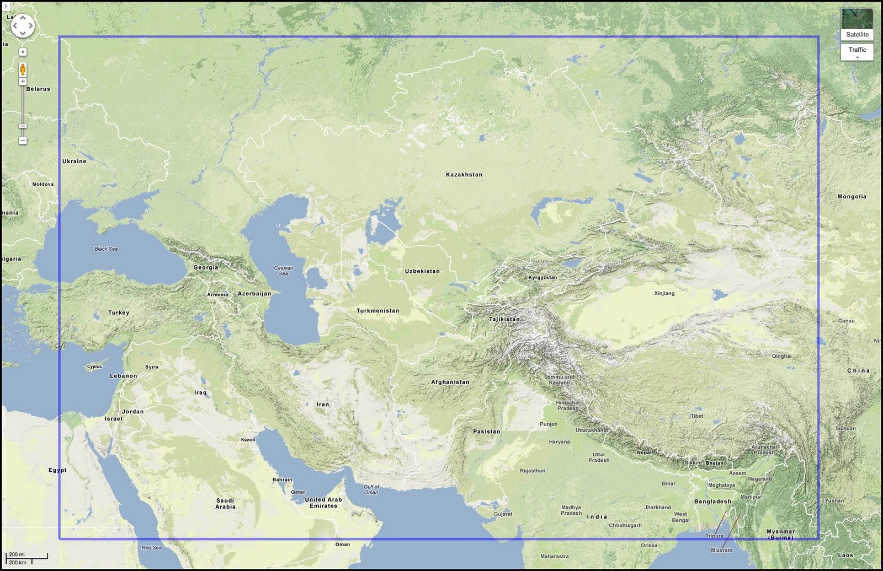
NASA Land Information System (LIS) Central Asia run
Land surface models:
Noah3.2,CLM2,
1km x 1km resolution,
1 hr model timestep,
No snow assimilation
Parameters:
UMD landmask, UMD-AVHRR landcover, FAO soils, GTOPO30 elevation, NCEP albedo (quarterly/seasonal)
Meteorological Inputs:
6 hourly GDAS - NCEP Global Data Assimilation System Final (FNL) Operational Global Analysis
Daily - near real time outputs:
Snow water equivalent
Snow covered area
Snow depth
Air temperature
Data delivery:
LIS Data Portal,
USGS Early Warning Data Portal
Evaluation
remote sensing
(e.g. MODIS & Landsat Snow Cover Fraction, SSM/I & AMSR-2 snow depth)
Analysis period: 2000-Oct-01 to present, 16 years
Notes:
UMD landcover http://glcf.umd.edu/data/landcover/
UMD Landmask The LIS group produced UMD land masks at the other grid spacings by counting the number of land and the number of water 1km grid points within the larger grid size from the 1km UMD data. If there are more 1km land points, the grid point is land; if there are more 1km water points, the grid point is water.
FAO Soils: http://webarchive.iiasa.ac.at/Research/LUC/External-World-soil-database/HTML/index.html
GDAS meteorological inputs http://www.emc.ncep.noaa.gov/index.php?branch=GFS
GTOPO30 https://lta.cr.usgs.gov/GTOPO30
The background (snow-free) surface albedo files named "albedo_NCEP"
are from the NESDIS/NOAA 0.144-degree climatology values from NCEP.
The data is available either monthly or seasonally (3-month ave).
The data is a composite of a 5-year (1985-1989) dataset using the
AVHRR satellite. For further documentation, please see the
"Background Surface Fields" section on this webpage:
http://www.ral.ucar.edu/research/land/technology/lsm.php
http://nsidc.org/data/MOD10A1/versions/5 and http://nsidc.org/data/MOD10A1/versions/6

Slide 3
NASA Land Information System (LIS) Central Asia run
9 year LIS spinup
1 Oct 2000 –
29 Aug 2009
Retrospective analysis
10/1/2016-10/1/2017
10/1/2015-10/1/2016
Real time run snow water equivalent (SWE) compared with 16 years of retrospective analysis
29 Aug 2009-1 Oct 2009 – MODIS adjustment
10/1/2014-10/1/2015
….
10/1/2001-10/1/2002
Restart for 1 Oct
SWE, Snow Cover, Snow Depth
10/1/2000-10/1/2001

Slide 4
Afghanistan comparison of GDAS rainfall inputs vs GPCP, MERRA2 & MERRA2+CPC rainfall
GDAS and MERRA2 compared well.
GDAS/MERRA2 PRECTOT overestimate PRECIP compared to GPCP.
Note that GPCP coarser resolution data
CPC corrected MERRA2 precipitation is lower than the other estimates, possibly due to low density station data.
Afghanistan Region

Slide 5
Monitoring SWE https://lis.gsfc.nasa.gov/projects/fewsnet-central-asia

Slide 6
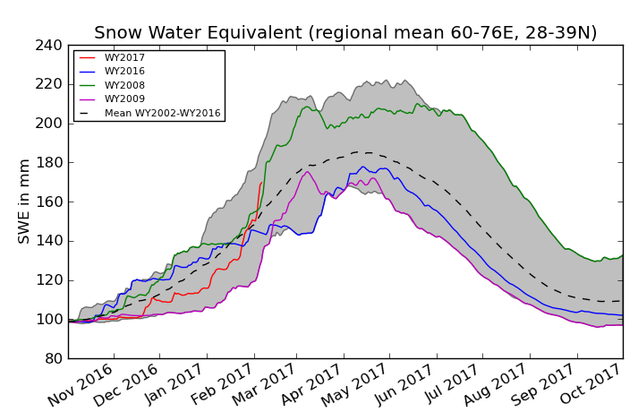
Evaluation
Spatial distribution of SWE for 02062017 compared to last year 02062016
SWE for 2017 with climatology
Snow Water Equivalent and snowfall for the WY 2016-2017 shows that for months Oct, Nov & December, the SWE was less than normal/ or climatological mean. After ~Jan 20, heavy snowfall caused SWE to increase for the last ~20 days. The spatial snow distribution shows that the snowfall is widespread, compared to last year.

Slide 7
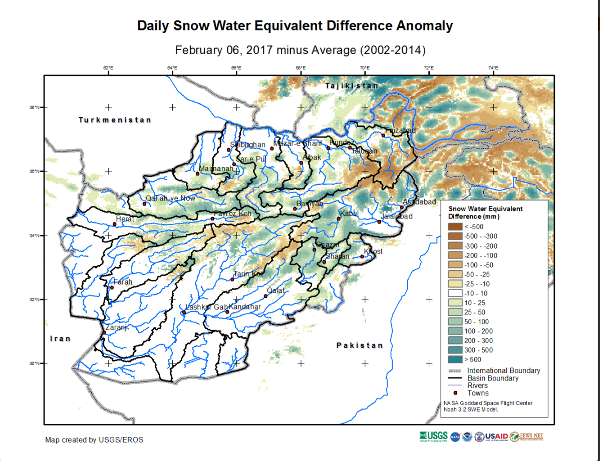
Spatial distribution of SWE for 02062017 compared to last year 02062016
SWE anomaly map from USGS shows that SWE is generally above average compared to the 2002-14 mean (in addition to greater than last year).

Slide 8
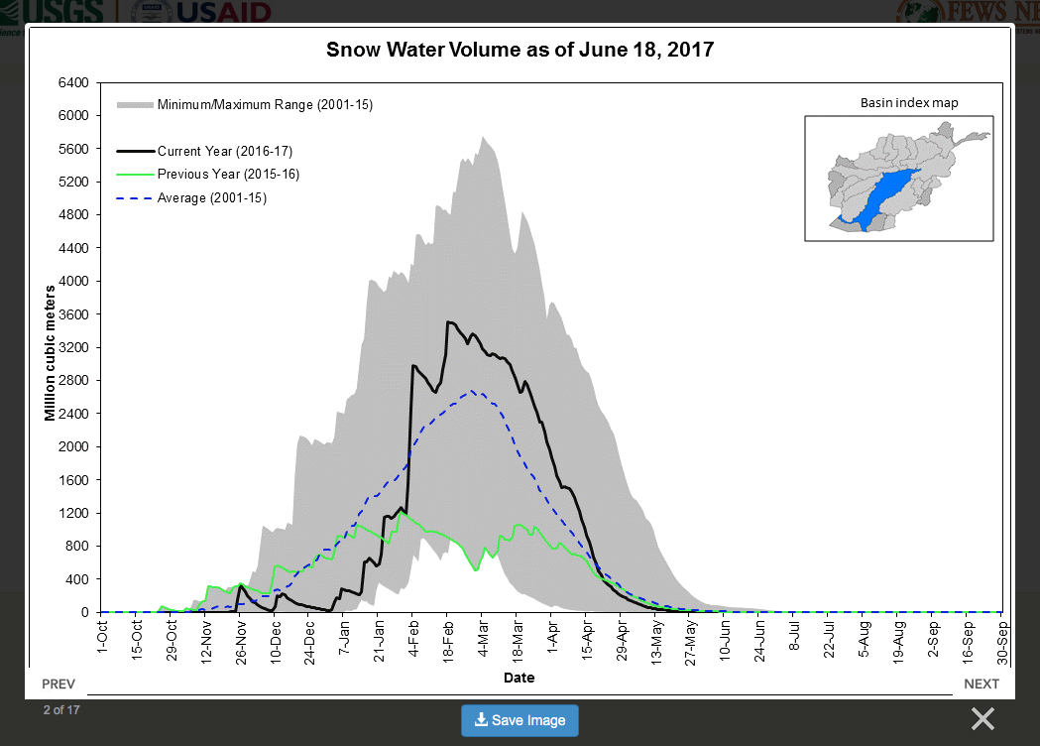
https://earlywarning.usgs.gov/fews/imagemap/144

Slide 9
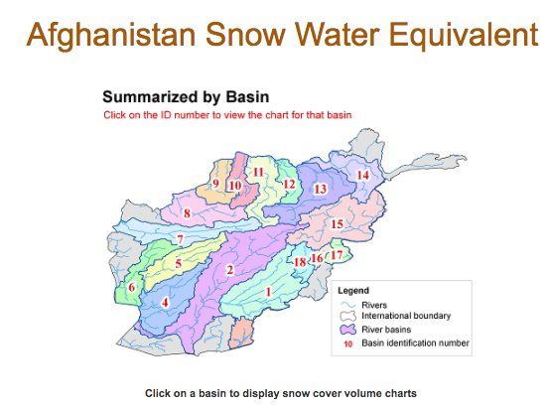
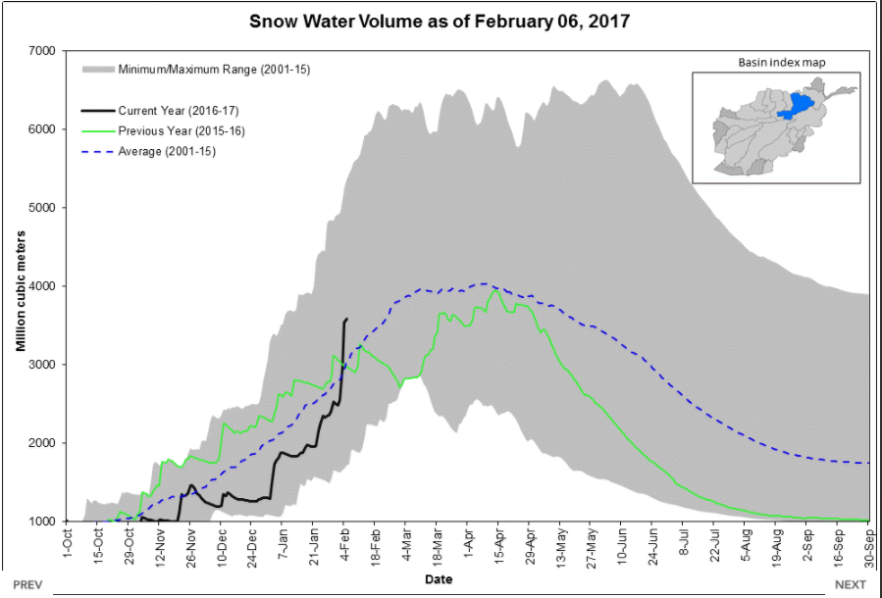
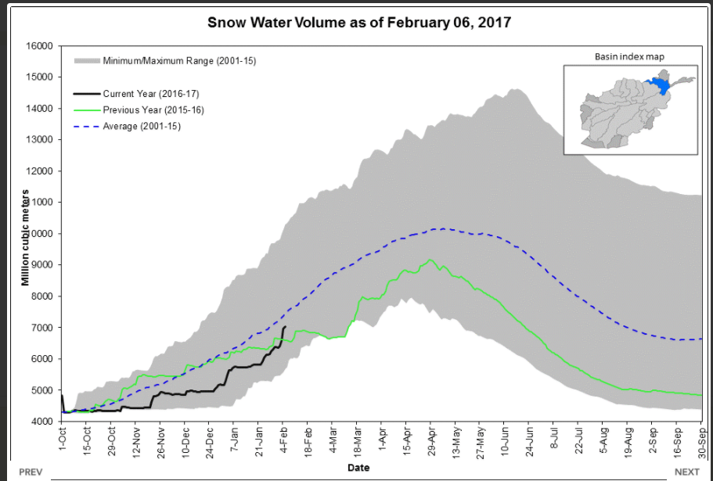
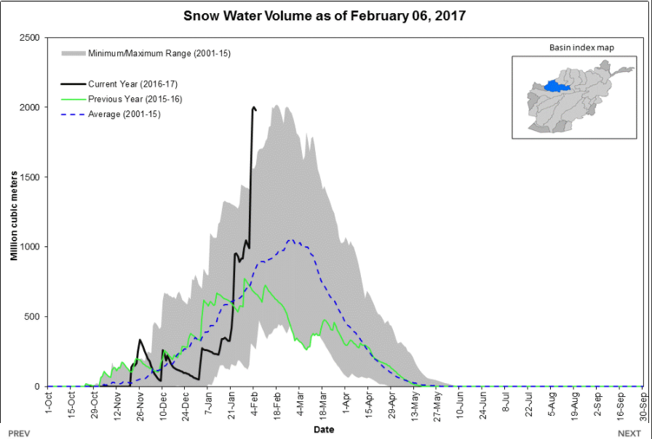
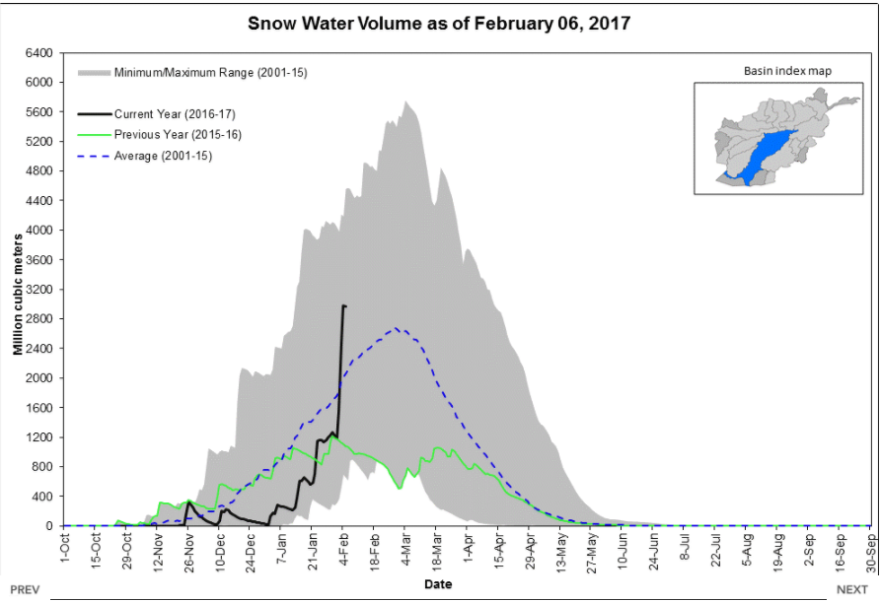
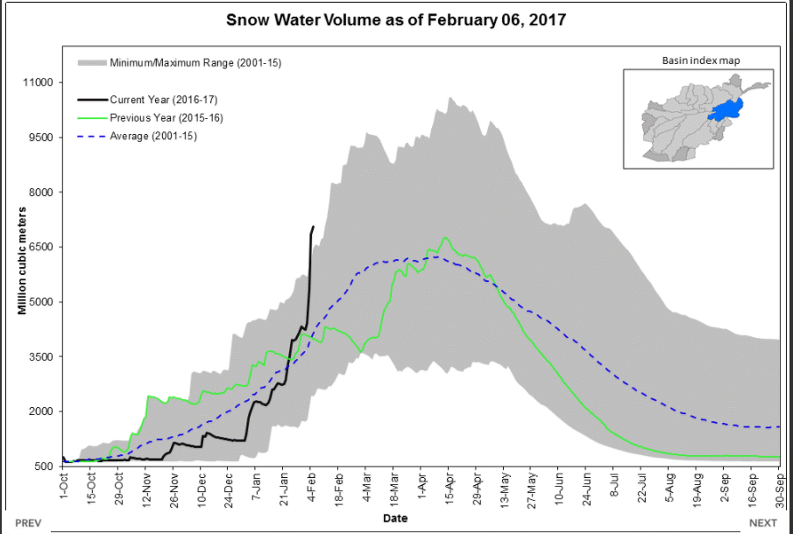
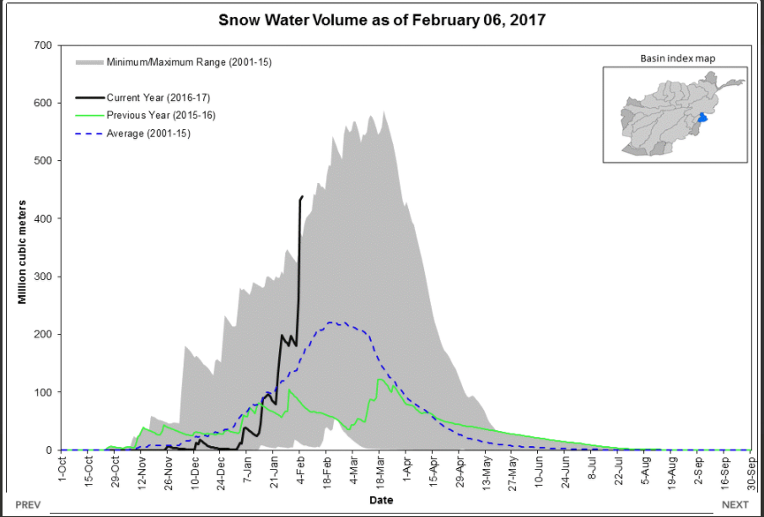
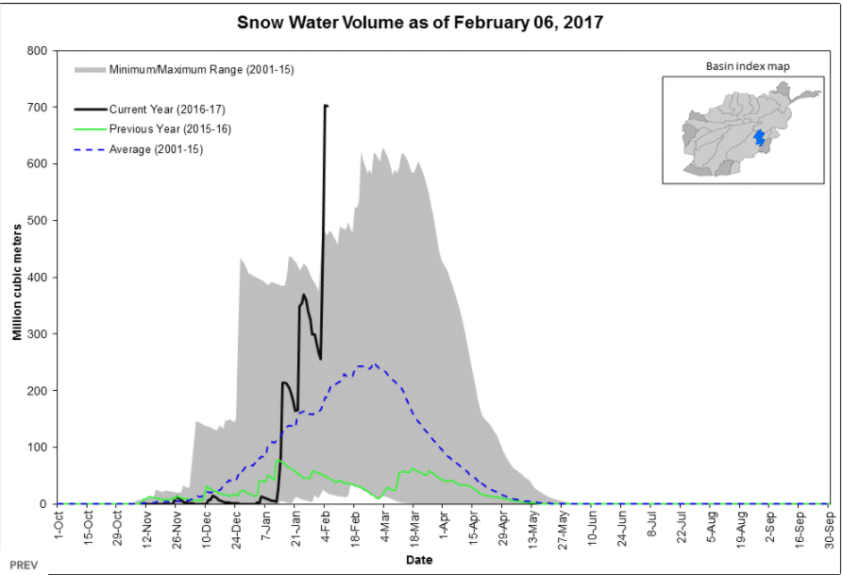
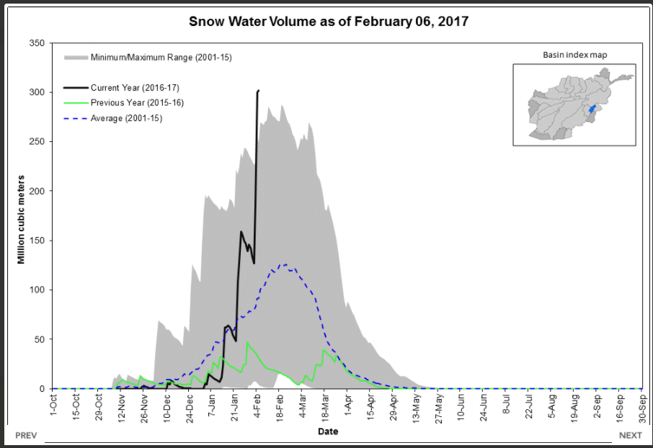
13
14
8
15
2
17
18
16
The Daily SWE by basin’s tool allows us to compare the current season’s evolution to historic season time series.

Slide 10
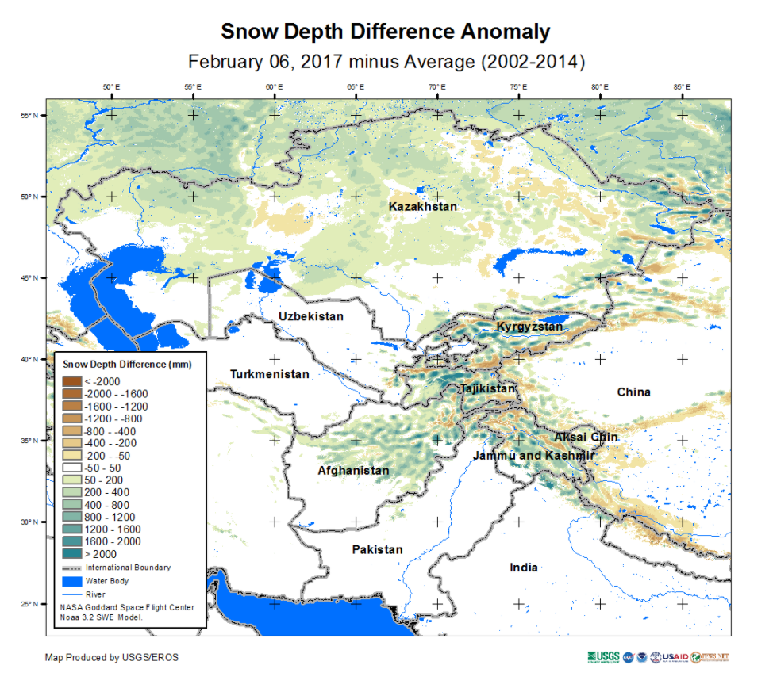
Spatial distribution of SWE for 02062017 compared to last year 02062016
Snow depth anomaly map from USGS shows that depth is generally above average compared to the 2002-14 mean. Spatial patterns are similar to the SWE, but provides some additional information e.g. given the below average temperatures snow depth may be high, even with average SWE.

