Slide 1
Assessing Impacts of the 2008 Drought on Afghanistan Winter Wheat Production using MODIS 250m NDVI Time Series
National-level and Primary Wheat Growing Areas in Northern Afghanistan
Analysis performed at USGS Earth Resources Observation and Science (EROS)

Slide 2
Background of the 2007-08 Season
Things we know:
  Below normal snowpack (extent and water volume)
  Abnormally high temperatures during much of the Spring
  Early snowmelt
  Poor rainfall during the Spring
Unknowns:
  How does the 2007-08 season rank in terms of previous growing seasons?
  Were irrigated and rainfed areas equally impacted?
  Are the differences quantifiable? If so, to what degree?

Slide 3
Data Inputs
MODIS 250m Normalized Difference Vegetation Index (NDVI) 2000-2008
  Temporally Smoothed
  Masked for Irrigated and Rainfed Agriculture
  Spatially averaged, ranked, by year, at national and provincial levels
Irrigated/Rainfed Agricultural Map (1993)
  FAO / UNDP / Afghan Geodesy & Cartography Office - Kabul
FAO/WFP CFSAM National Yield Estimates (2000-04)

Slide 4
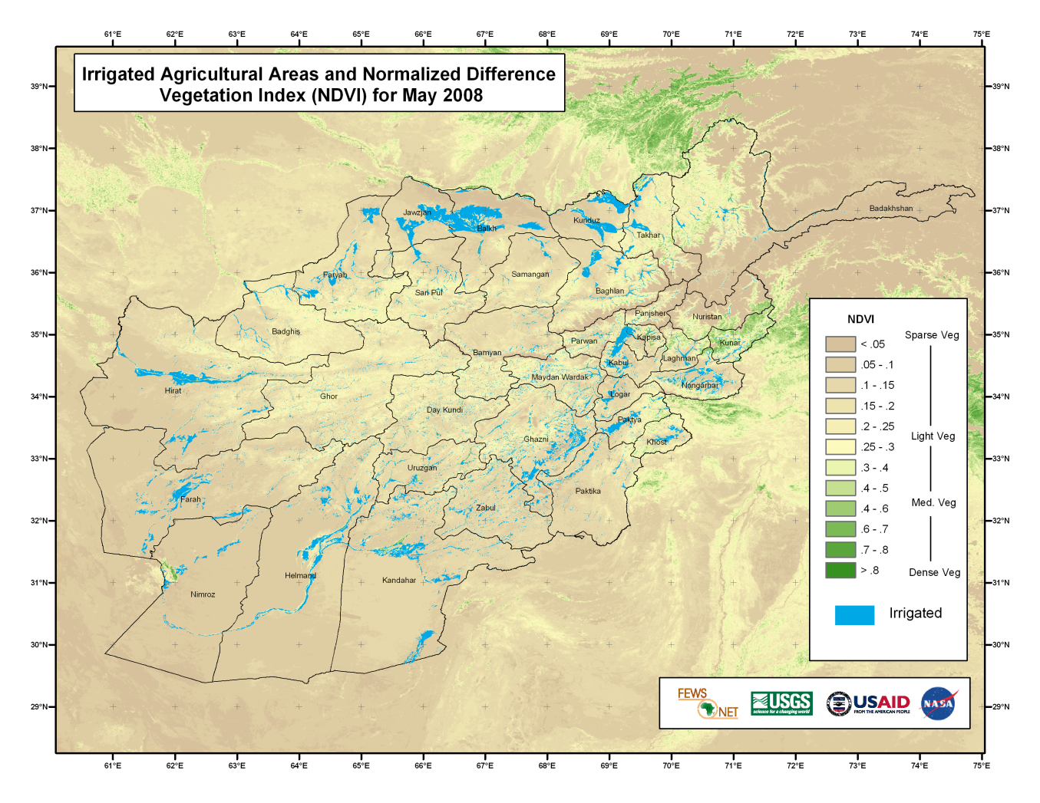
National Irrigated Areas Analysis
Analysis looked only at irrigated areas
At two levels:
  National
  Northern Provinces

Slide 5
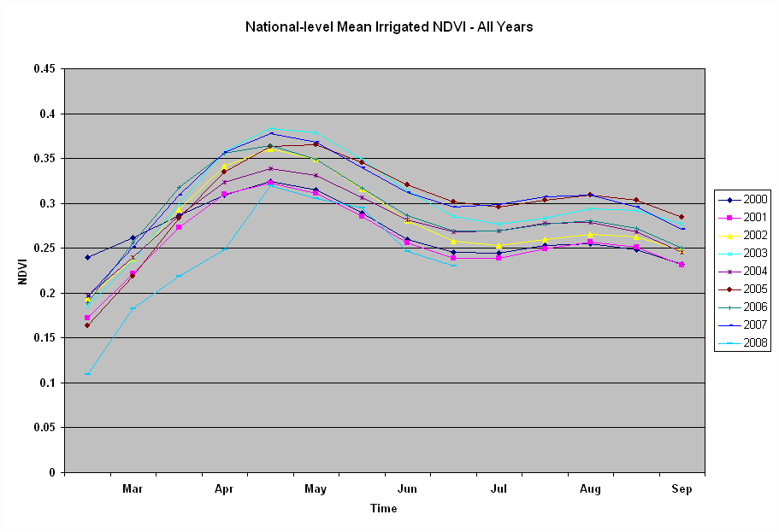

Slide 6
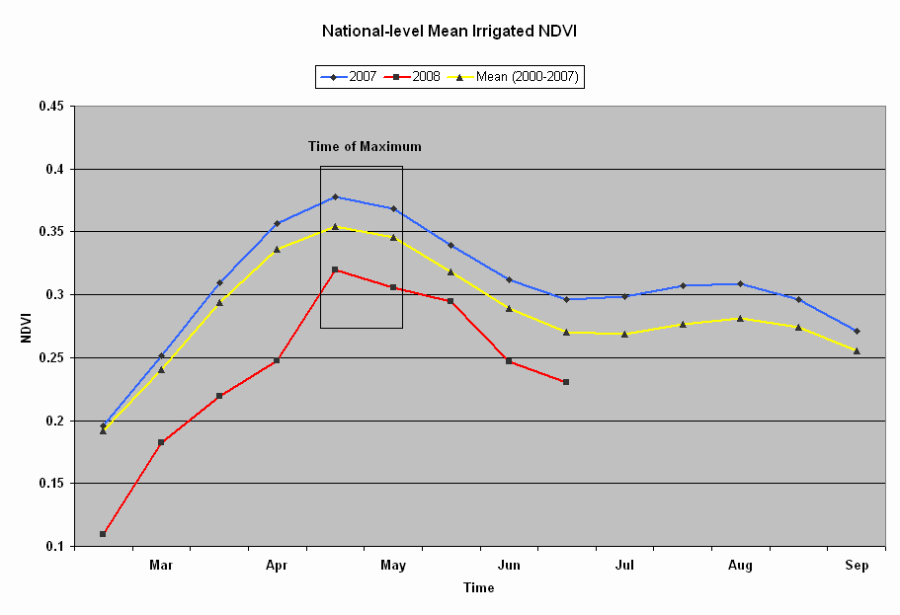
Afghanistan maximum NDVI
Maximum NDVI consistently found during periods 113 and 129 (Late April – mid/late May).
National-level analysis used the average of these two periods.

Slide 7
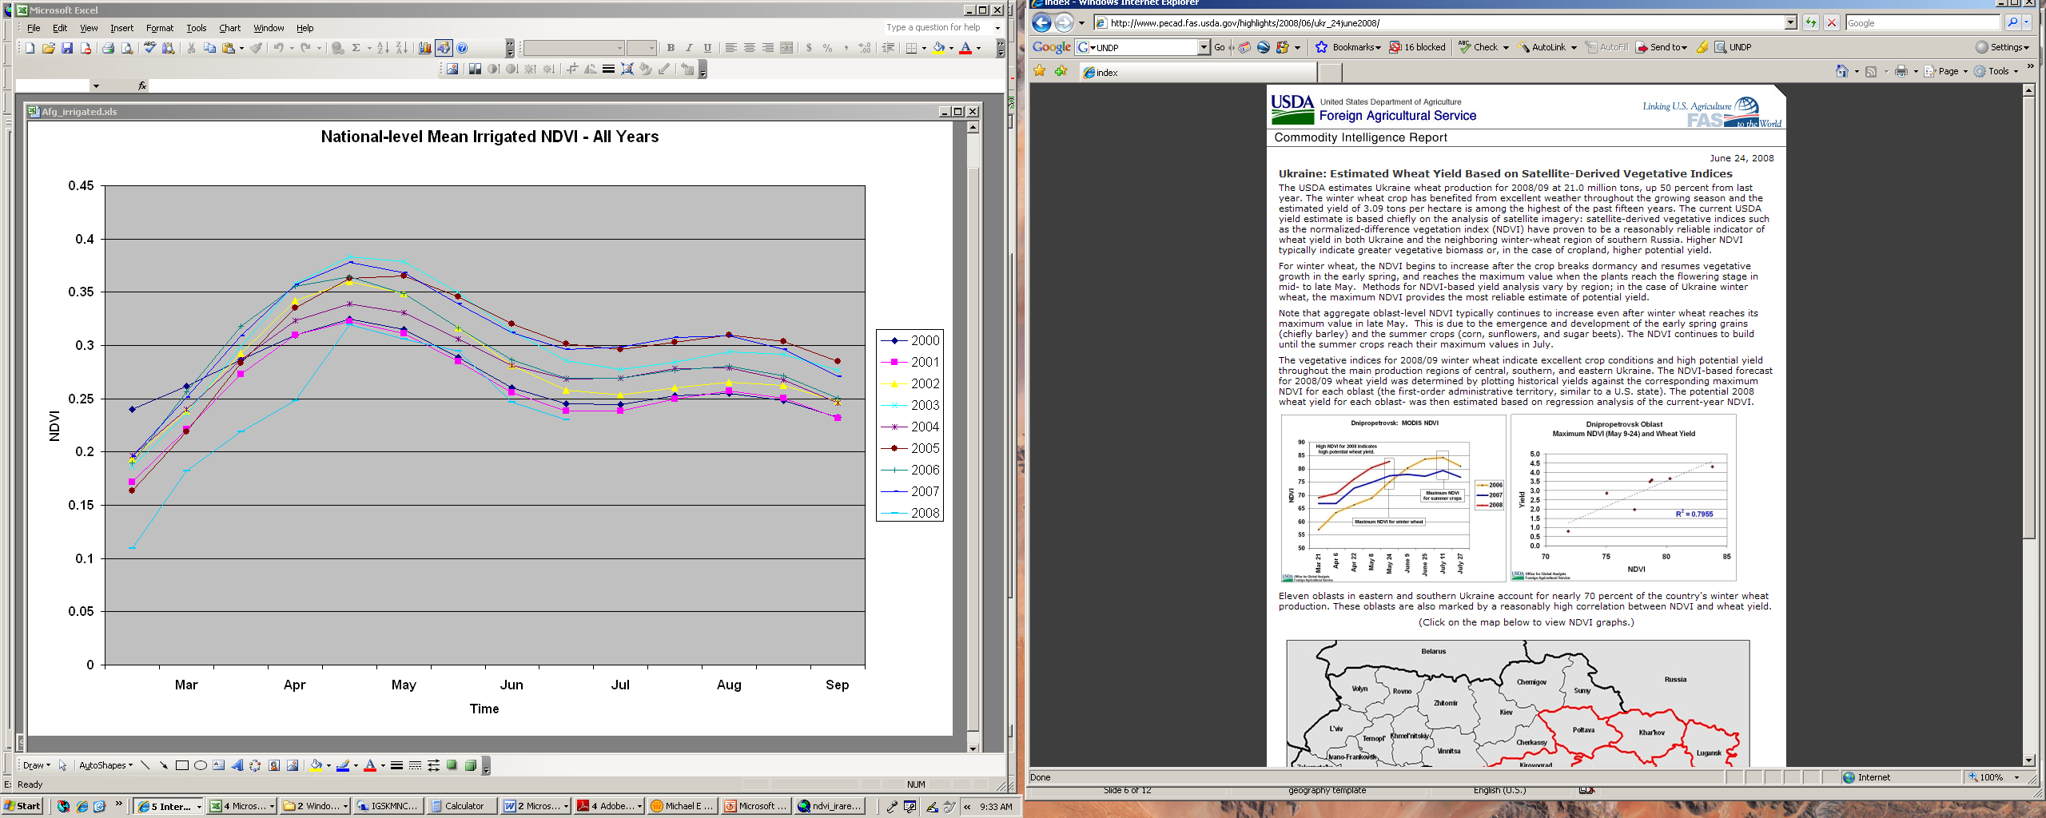
Max NDVI and Winter Wheat Yield
Period 129
USDA FAS report identifies strong correlation between maximum NDVI and Winter Wheat Yields in the Ukraine.

Slide 8
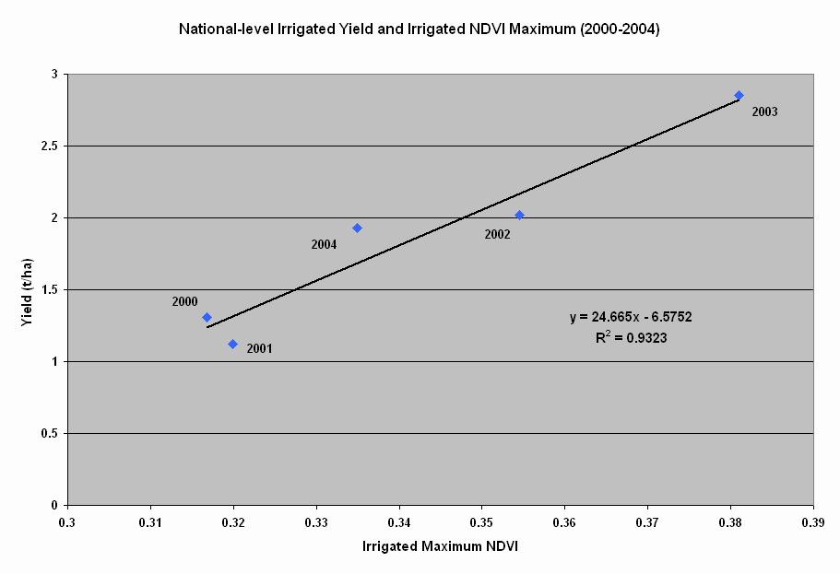
CFSAM Irrigated Yield and Max NDVI
2001
2000

Slide 9
Nationally, 2008 ranks as worst year since 2000
Irrigated Areas
Year | Maximum NDVI | Yield (t/ha)
2003 | 0.381 | 2.85
2007 | 0.373 | 2.69
2005 | 0.364 | 2.51
2006 | 0.357 | 2.58
2002 | 0.355 | 2.02
2004 | 0.335 | 1.93
2000 | 0.320 | 1.12
2001 | 0.317 | 1.31
2008 | 0.313 | 1.14*
* Estimated based on regression of maximum NDVI and historical yield figures

Slide 10
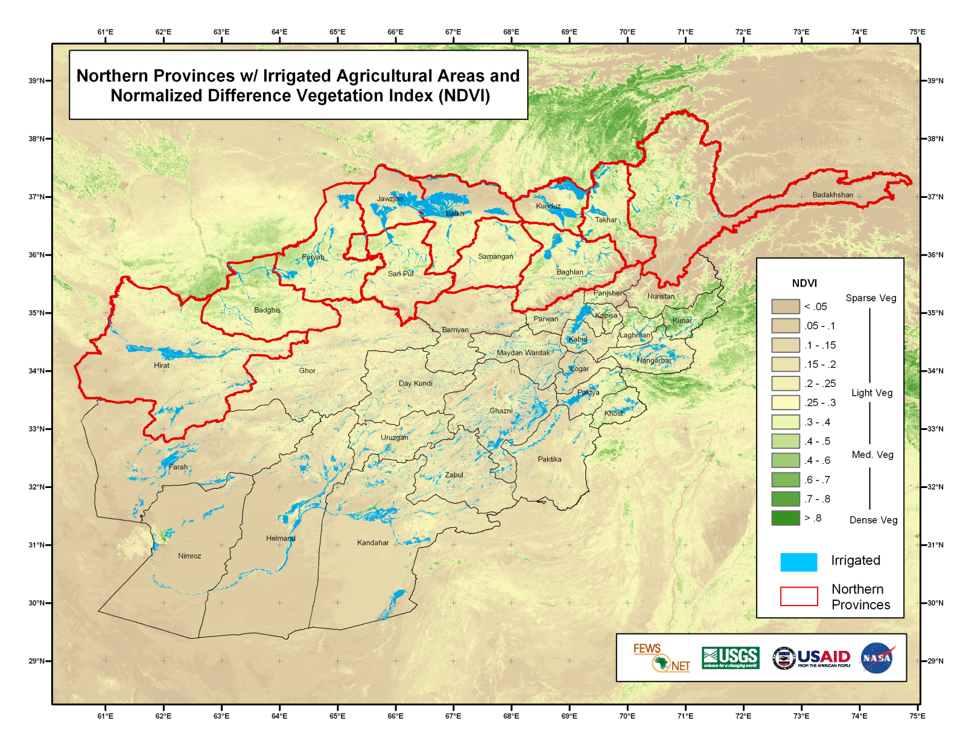
Northern Irrigated Area Analysis
Badakhshan
Badghis
Baghlan
Balkh
Faryab
Hirat
Jawzjan
Kunduz
Samangan
Sari Pul
Takhar

Slide 11
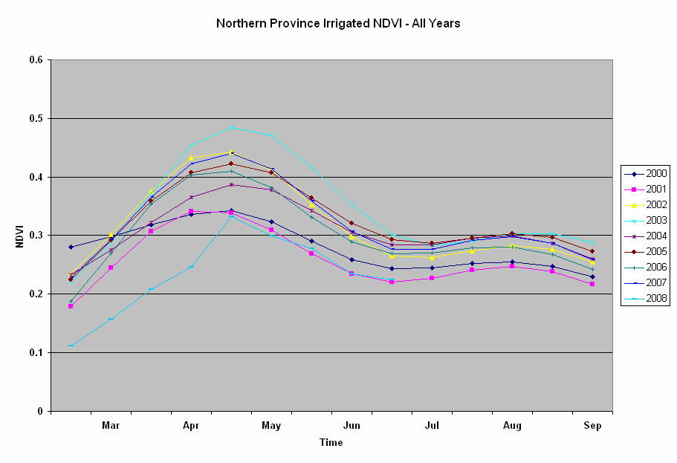
Similar problematic situation in 2008

Slide 12
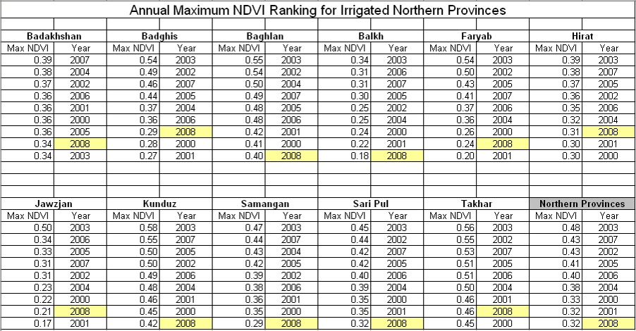
All 2008 irrigated provincial results among worst

Slide 13
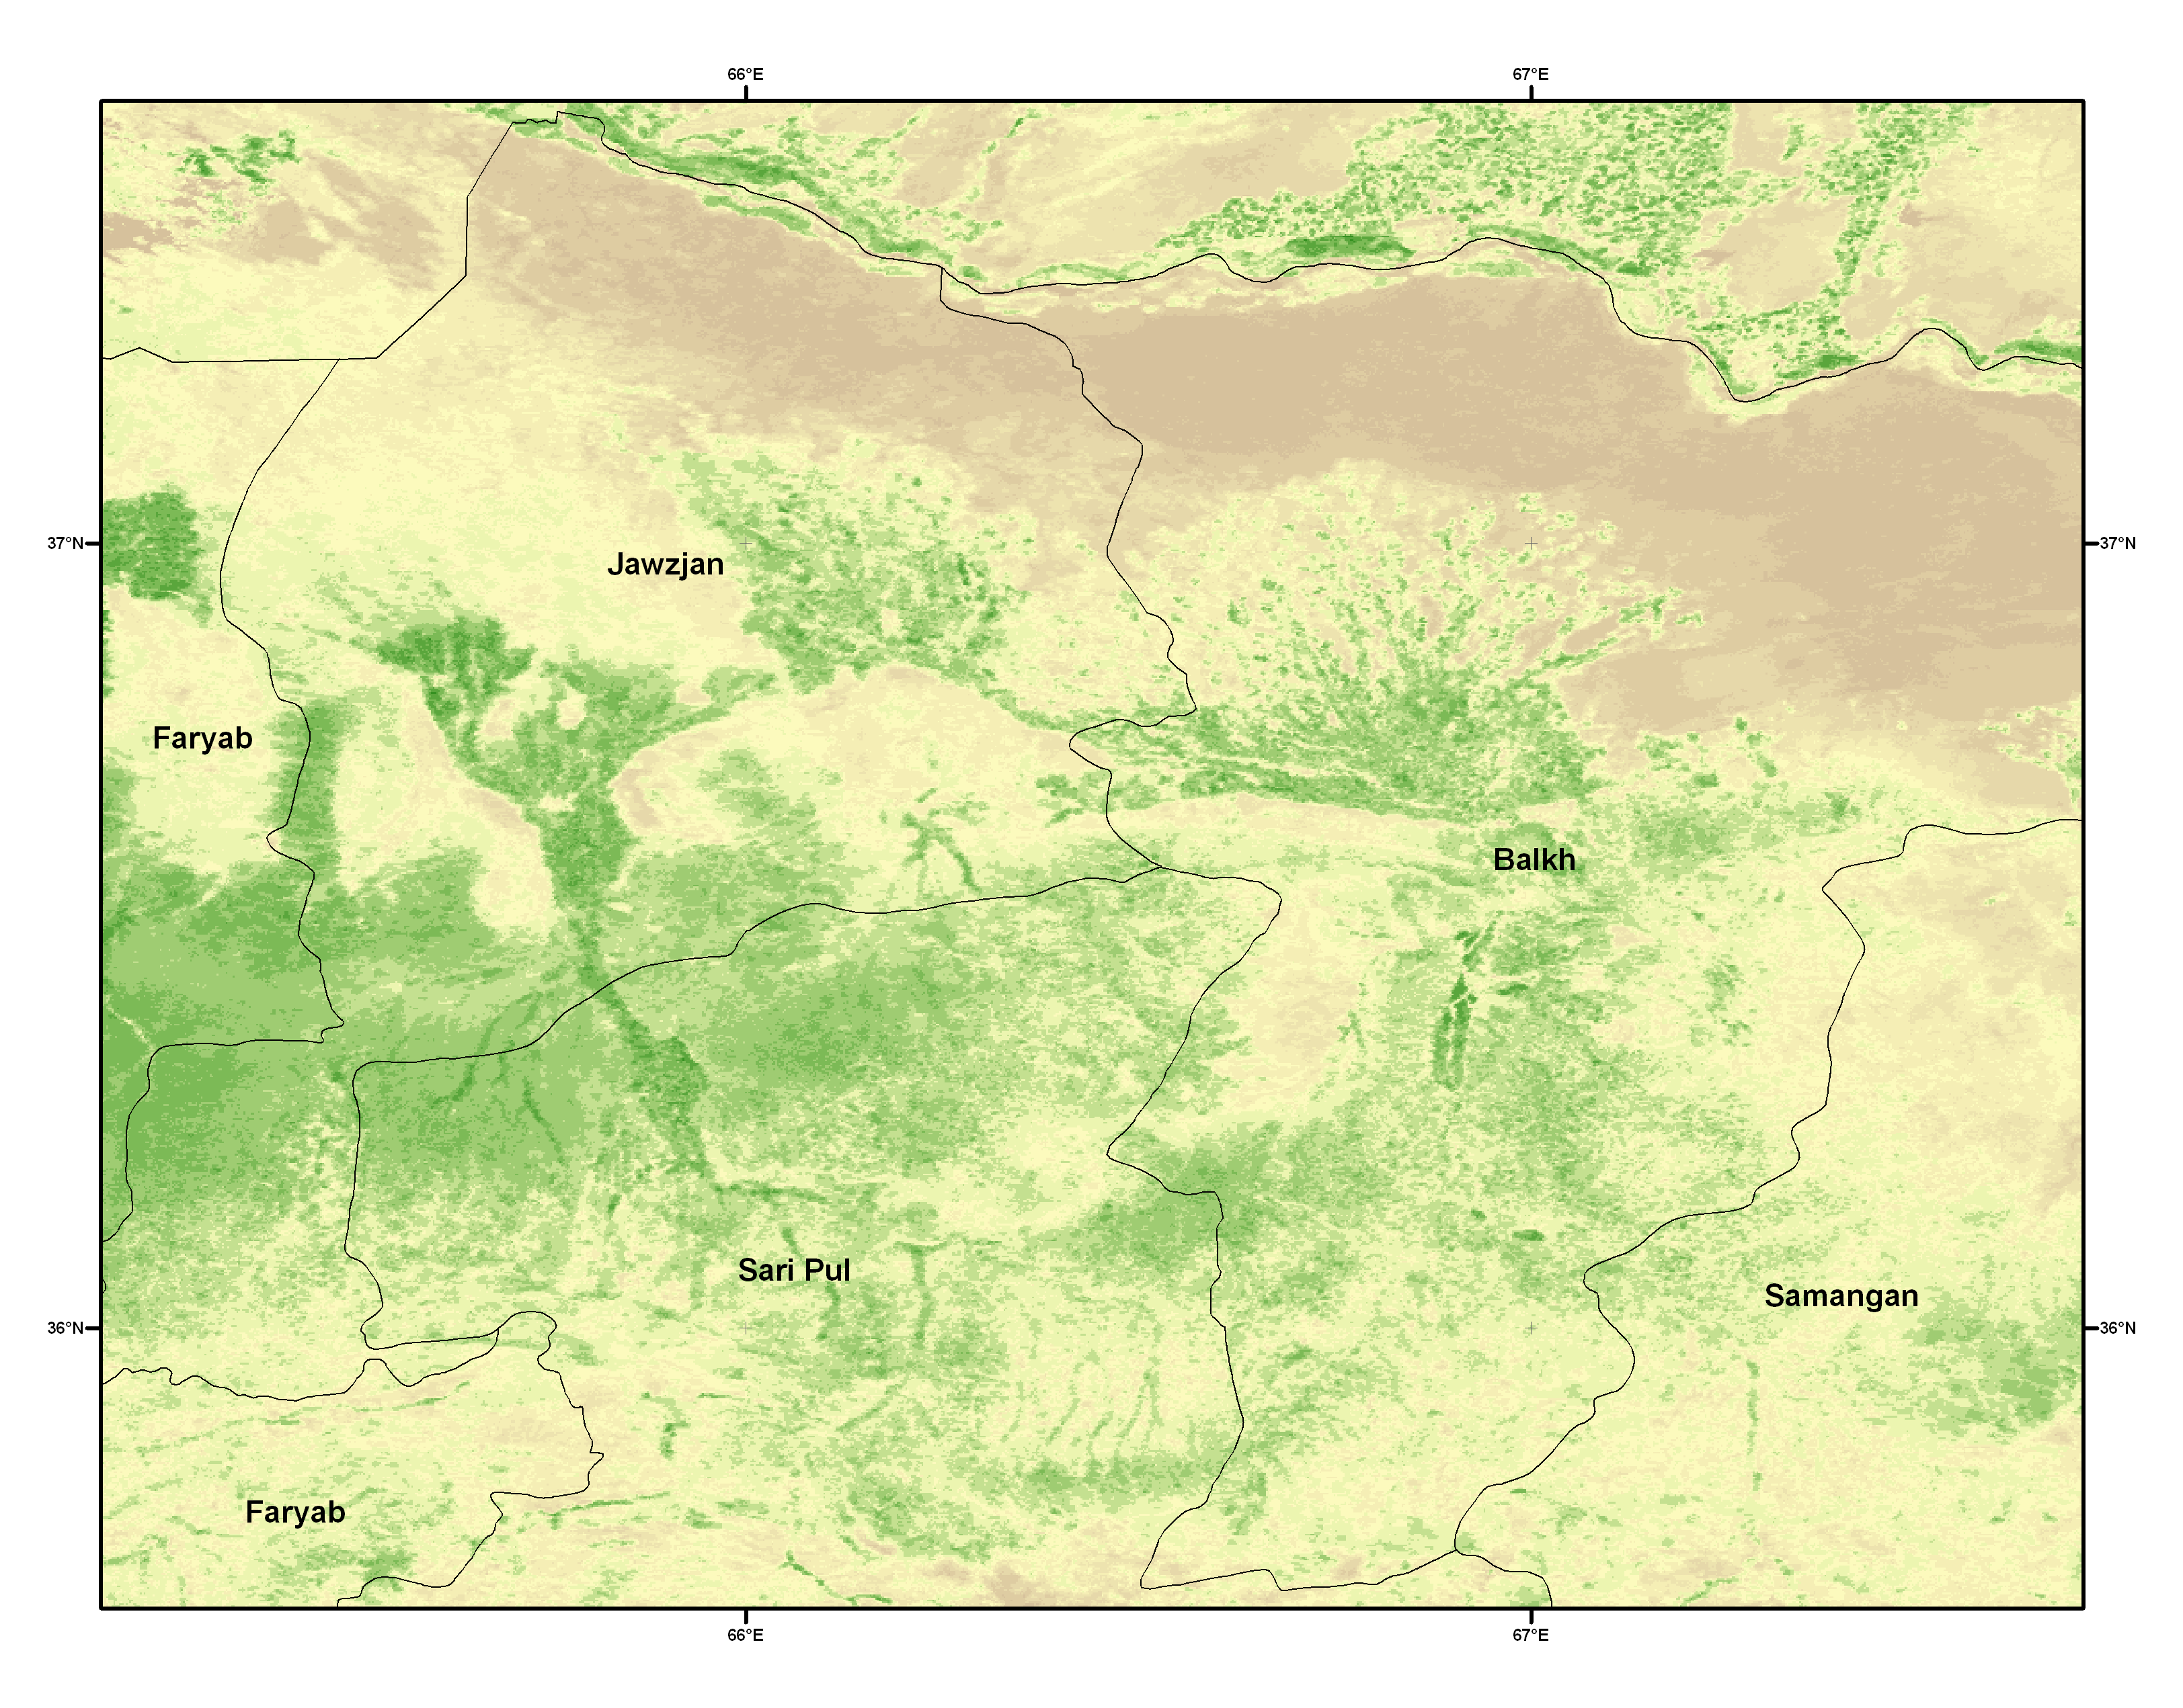

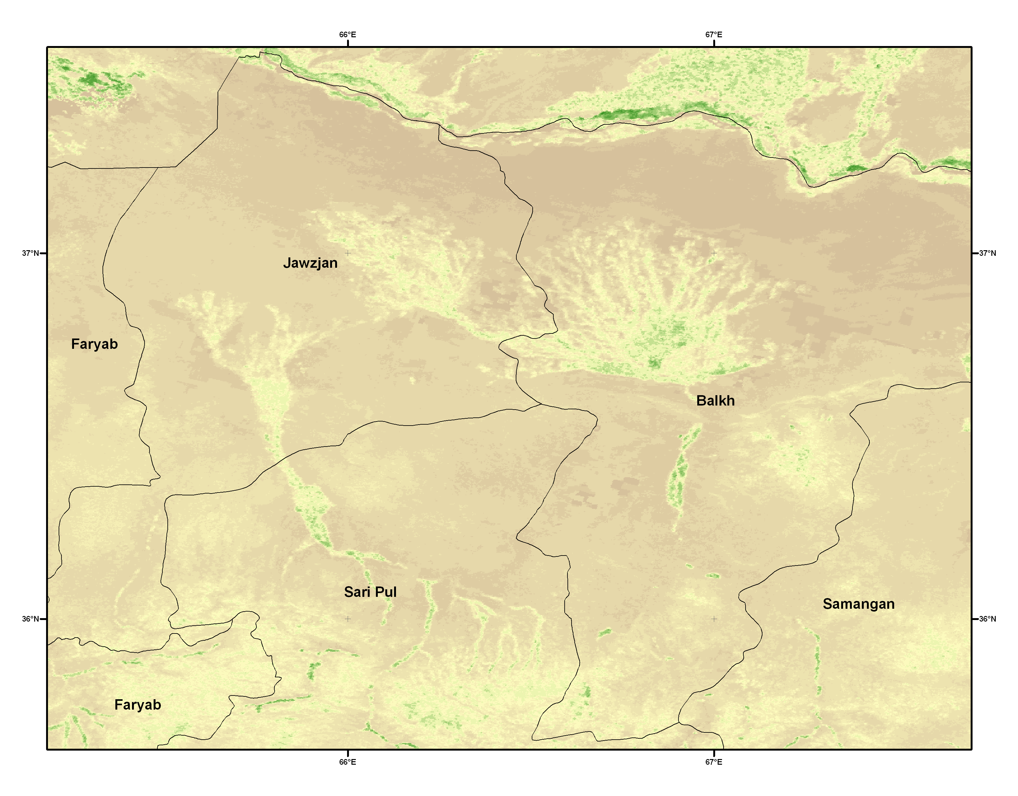
Rainfed agriculture similarly very poor
Maximum NDVI 2003 vs. 2008
2003
2008

Slide 14
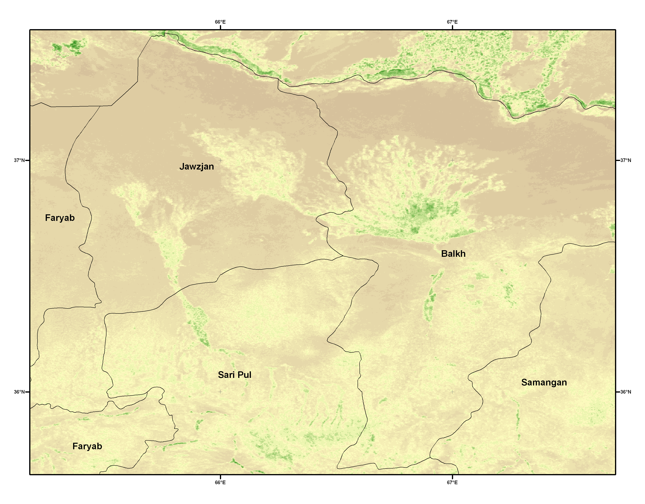
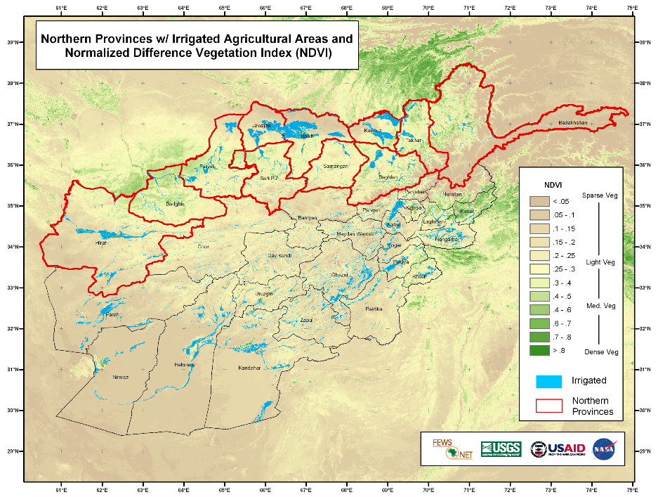
Annual Maximum NDVI
2000 vs. 2008 – Jawzjan & Balkh
2000
2008

Slide 15
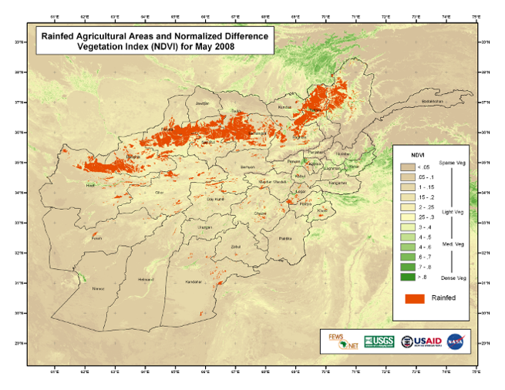
Rainfed Yield and Max NDVI

Slide 16
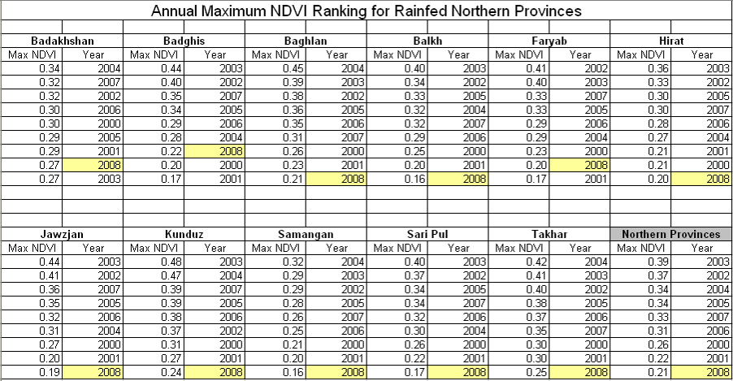
All 2008 rainfed provincial results among worst

Slide 17
Nationally, 2008 ranks as worst year since 2000
Rainfed Areas
Year | Maximum NDVI | Yield (t/ha)
2003 | 0.39 | 1.2
2002 | 0.37 | 0.81
2004 | 0.34 | 0.52
2005 | 0.34
2007 | 0.33
2006 | 0.31
2000 | 0.26 | 0.17
2001 | 0.22 | 0.13
2008 | 0.21 | ???*
* estimated

Slide 18
Ag Stats Reports / 2005-07
Source: FAAHM/MAAHF
Yield numbers for 2005-07 were incorporated into the regression
National-level irrigated areas still gave good results (R² = 0.92), but the northern irrigated areas alone did not correlate as well (R² = 0.76).
Rainfed area results showed much worse correlation with additional years added (R² = 0.52) and identified a substantial upward bias in rainfed yields for those years.

Slide 19
Northern Irrigated (2000-07)
Northern Rainfed (2000-07)

Slide 20
Time series of Northern Irrigated Yields (2000-2007)
Yields are similar to the regression- based estimates for 2005 and 2007
Difference of ~ 14% in 2006

Slide 21
Time series of Northern Rainfed Yields (2000-2007)
High 2005-07 yields
Regression-based yields ~50% less for rainfed areas
CFSAM was last conducted in 2004 – since then, ag stats based on Min Ag surveys (???)
(Shukri Ahmed FAO/GIEWS)

Slide 22
CFSAM vs. Ag Stats Reports
N. Provinces Increase
2004
Area > 2x
Yield > 3x
Prod. > 5x
2005

Slide 23
Delineating Productive Areas
NDVI productivity threshold
0.35

Slide 24
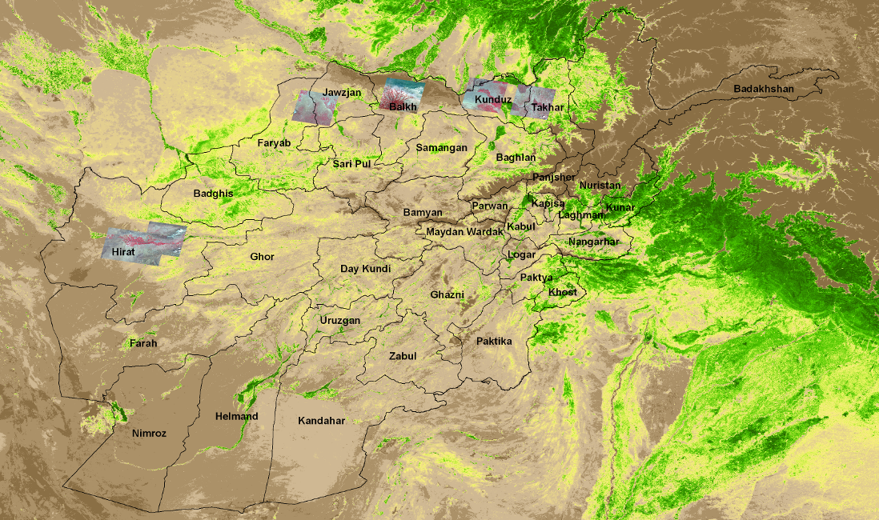
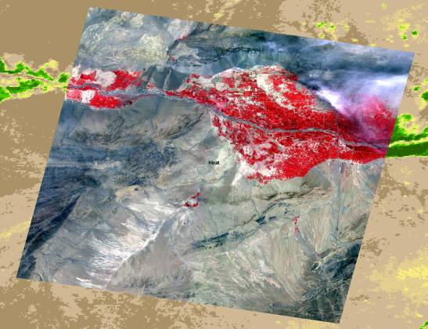
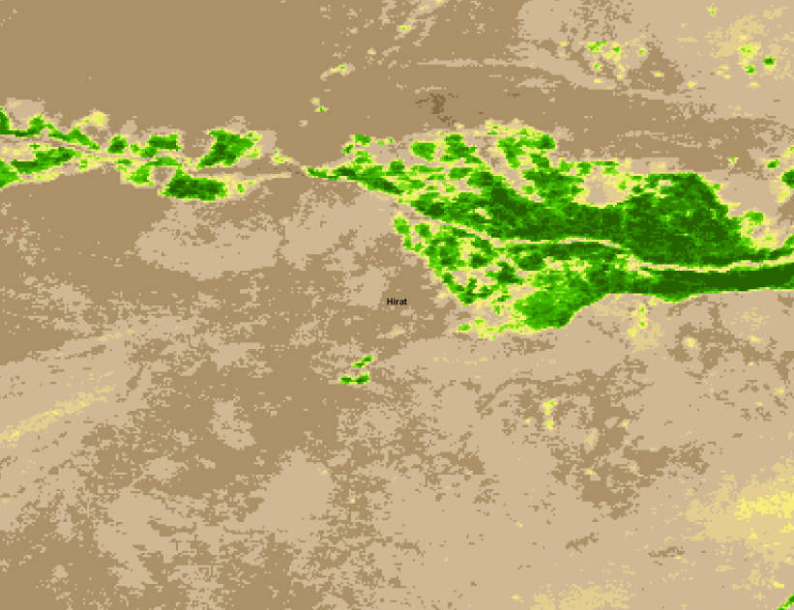
ASTER Data for time of Max NDVI
Seven ASTER 15m images were acquired for the time of maximum NDVI (Apr- May).
Used as a guide to identify a productivity threshold value and to ‘validate’ the NDVI magnitude differences with higher resolution data.
MODIS 250m NDVI was very effective at capturing this variability.
ASTER – May 20, 2008
Max NDVI – May 8 - 23, 2008

Slide 25
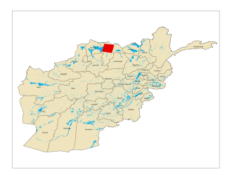
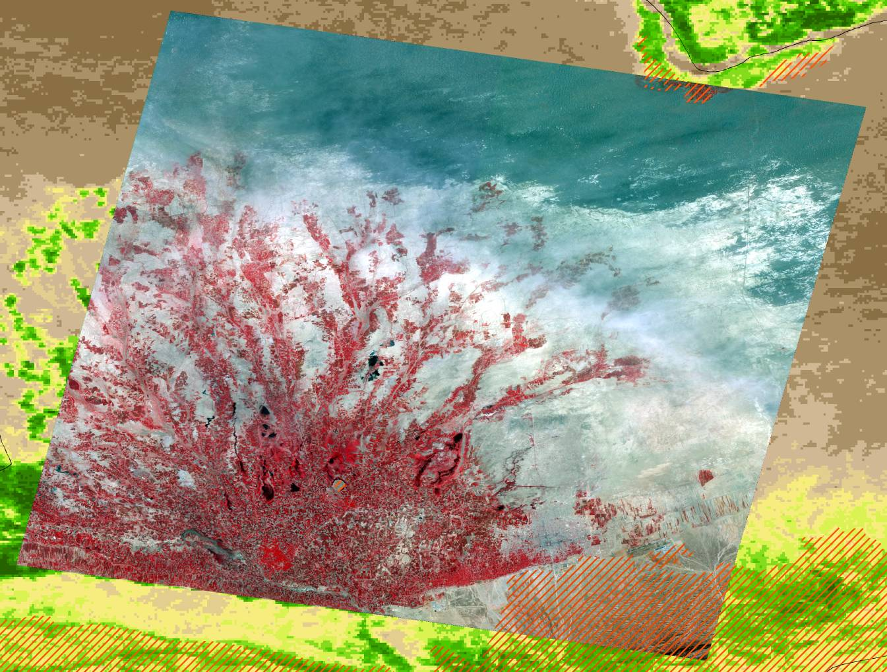
Productive area based on 0.35 Max NDVI
Large irrigation area in Balkh Province
ASTER 15m May 15, 2007
Mazar-e Sharif
Rangeland/Rainfed

Slide 26
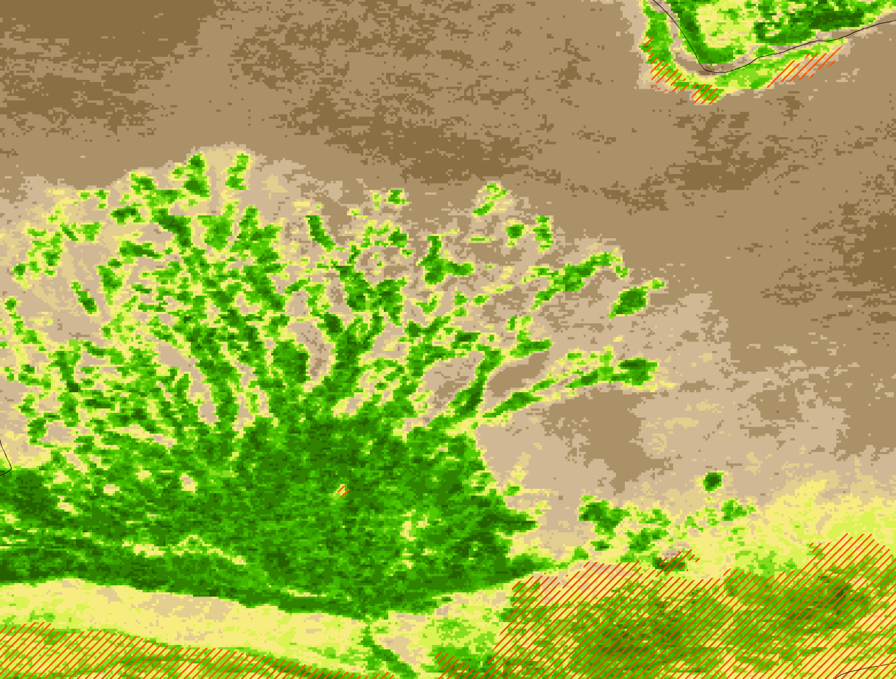
Productive area based on 0.35 Max NDVI
Large irrigation area in Balkh Province
NDVI Maximum May 2007
Mazar-e Sharif
Rangeland/Rainfed

Slide 27
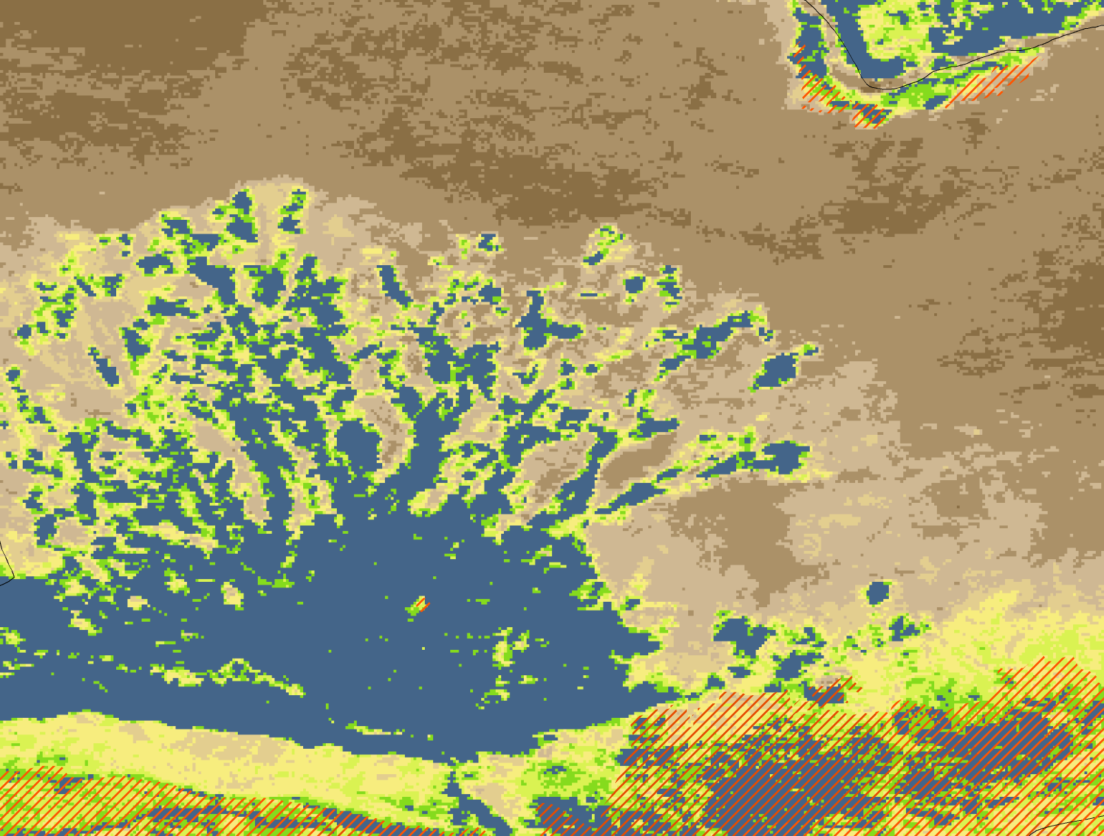
Productive area based on 0.35 Max NDVI
Large irrigation area in Balkh Province
NDVI Maximum w/ 0.35 threshold May 2007
Mazar-e Sharif
Rangeland/Rainfed
> 0.35 NDVI Max

Slide 28
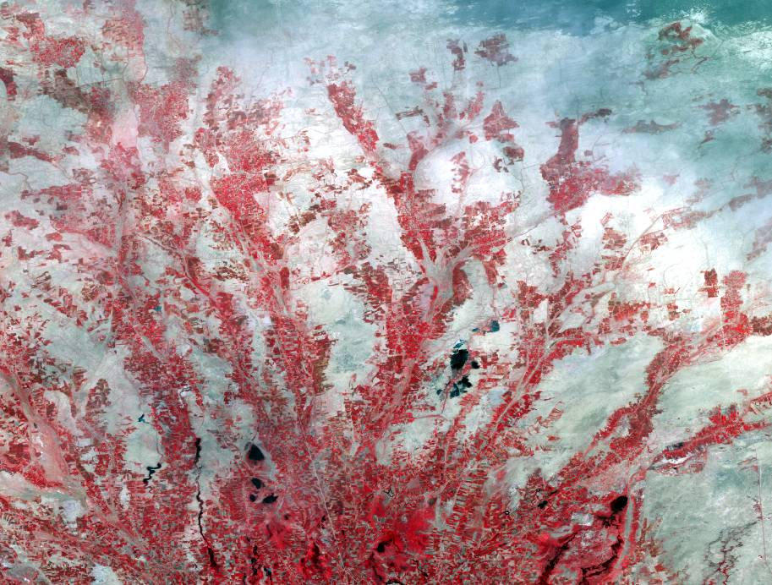
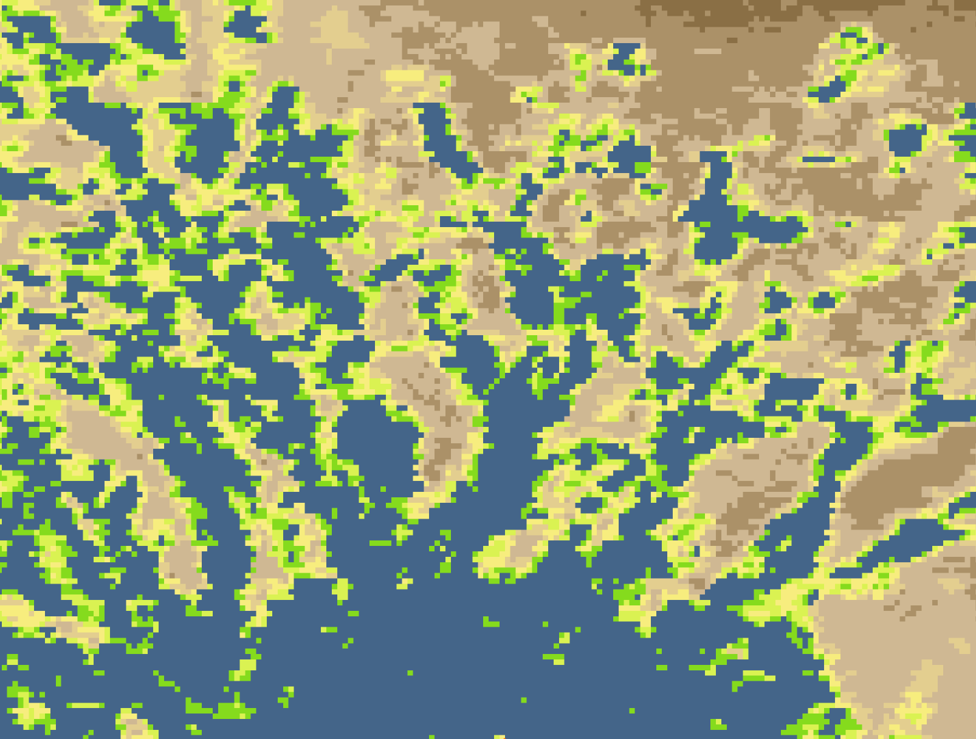
Productive area based on 0.35 Max NDVI
ASTER 15m May 15, 2007
NDVI Max w/ 0.35 threshold- May 2007
NDVI threshold values of > 0.35 show good spatial agreement with the productive areas in the ASTER scene.
Productive area measurements were calculated for each province within the 1993 defined irrigated and rainfed areas and summarized for each year.

Slide 29
Productive Area by Province (Irrigated)
Somewhat consistent productive areas are found in the NE provinces

Slide 30
Productive Area by Province (Irrigated)
Much greater interannual variability in N. Central and NW provinces

Slide 31
Productive Area by Province (Rainfed)
In contrast to the NE irrigated areas, interannual variability of productive area is high for rainfed areas with 2008 showing very poor conditions

Slide 32
Productive Area by Province (Rainfed)
The N. Central and NW provinces……….

Slide 33
Conclusions 1
Analysis of the irrigated winter wheat crop, using satellite imagery for the period 2000-2008, shows that 2008 ranks last for the country as a whole, and last or second to last in 9 of the 11 most productive northern provinces.
An estimate of 2008’s average irrigated winter wheat yield, based on satellite image correlations with CFSAM yields, suggests that 2008 is as bad as the worst year in that record (2000).
While this analysis focused on irrigated winter wheat (~ 80% of the country’s production), the findings strongly suggest failure of the rainfed winter wheat crop as well.

Slide 34
Conclusions 2
Unknowns:
  How does the 2007-08 season rank in terms of previous growing seasons?
    Toward the bottom – on par with 2000
  Were irrigated and rainfed areas equally impacted?
    Both irrigated and rainfed areas show poor conditions in 2008
    Irrigated productive area varied by region (NE vs. NC/NW)
    Dramatic reductions in productive area in rainfed areas
  Are the differences quantifiable? If so, to what degree?
    Yes, quantifiable in relation to CFSAM yields (2000-04)
    Small sample size – need clarification on 2005-07 Ag Stats
    Very quantifiable in a relative sense and timely

Slide 35
Conclusions 3
Conclusions made in cooperation with USGS FEWS NET.
Additional productive area analysis aids in answering questions related to whether irrigated/rainfed wheat areas have declined

