Slide 1
Actual Evapotranspiration (ETa)
Applications of FEWS NET Remote Sensing products for Agro-climatological Analysis Workshop
10 – 14 July 2017 | Kathmandu Nepal

Slide 2
Actual Evapotranspiration (ETa)
An estimate of the actual evapotranspiration occurring on the earth’s surface
Measures combination of transpiration from vegetation and evaporation from the soil.
Actual evapotranspiration is proportional to net primary production, which is a good indicator of crop yields and pasture condition
As a percent of average, it can provide a good relative yield indicator when seasonally accumulated

Slide 3
Summary of SSEBop
The Operational Simplified Surface Energy Balance (SSEBop) model computes daily total actual evapotranspiration (ETa) using land surface temperature (Ts), maximum air temperature (Ta) and reference ET (ETo).
The SSEBop model does not solve all the energy balance terms explicitly; rather, it defines the limiting conditions based on clear-sky net radiation balance principles. This approach predefines unique sets of “hot/dry” and “cold/wet” limiting values for each pixel and is designed to reduce model operator errors when estimating ET routinely.

Slide 4
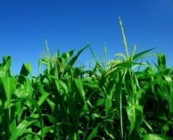
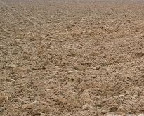
Simplified Surface Energy Balance (SSEBop) Operational Modeling Approach
Land Surface Temp
Weather Data
LST (Ts)
1.0
Well-watered fields/pixels
Air Temp
Radiation, Temp, Wind, RH, Pressure
Ta
ET_{f}
Bare/dry fields/pixels
ET_{fraction}
ET_{o}
0.0
Ts cold
Ts
Ts hot
ET_{a}
dT
Adapted the “hot” and “cold” pixel concept from SEBAL (Bastiaanssen et al., 1998) and METRIC (Allen et al., 2005) to calculate ET fraction and combine it with ETo.
Senay, et al., 2007 sensors; 2011 AWM; Hydrological Processes 2011, 2012 JAWRA (In Press)
Notes:
Actual air temperature establishes the Ts cold pixel and is used to estimate a theoretical Ts hot pixel based on the maximum temperature that would be achieved for clear-sky conditions and non-vegetative surfaces. The difference Temperature (dT) between the Ts cold and Ts hot establishes the boundary conditions between bare/dry surfaces and well-watered surfaces. Satellite based LST varies linearly within this range and is used to calculate the ETf, where well-watered fields or bare surfaces have an ETf near 1.0 and bare/dry surfaces have an ETf near 0.0.
A 1km DEM is used to adjust theoretical maximum temperature based on elevation. This procedure is described in the 2012 JAWRA publication.

Slide 5
SSEBop Basic Steps
1) Pre-define dT (Th-Tc): based on clear sky energy balance, using air temperature data
2) Define scene-based Tc (cold boundary from air temp) using model correction coefficient: Tcorr
3) Use Ts (LST) from satellite to estimate ETf
4) Use weather data to calculate ETo (potential ET)
5) Estimate ETa = ETf * ETo
Gridded Raster
Scene Calibration
Thermal Image
Gridded Raster
Gridded Raster
Notes:
Median dT dataset:
predefined temperature difference between Th and Tc for each pixel
Tcorr is based on a percentile and count reduction of all Landsat pixels in the scene based on a few different thresholds from NDVI, Ts, air temperature

Slide 6
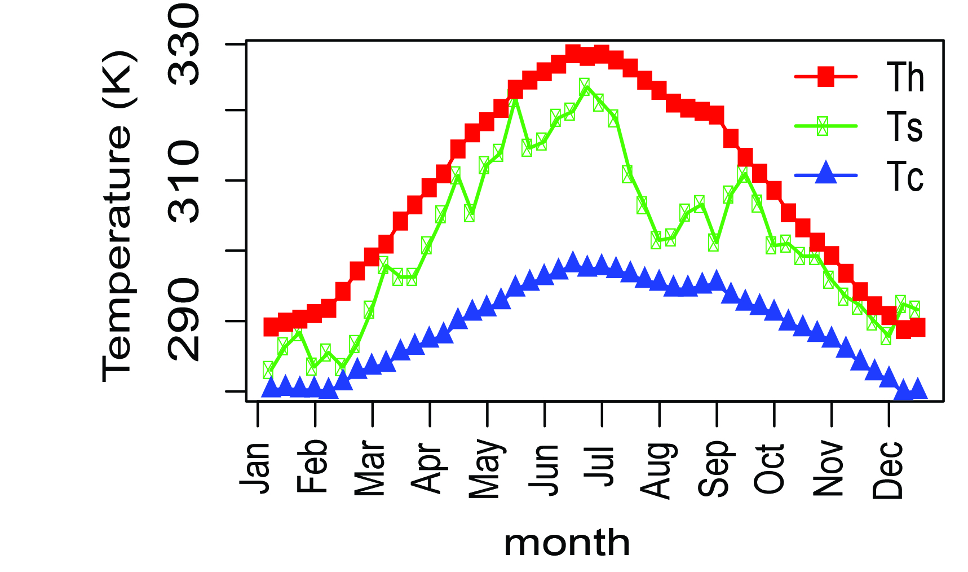
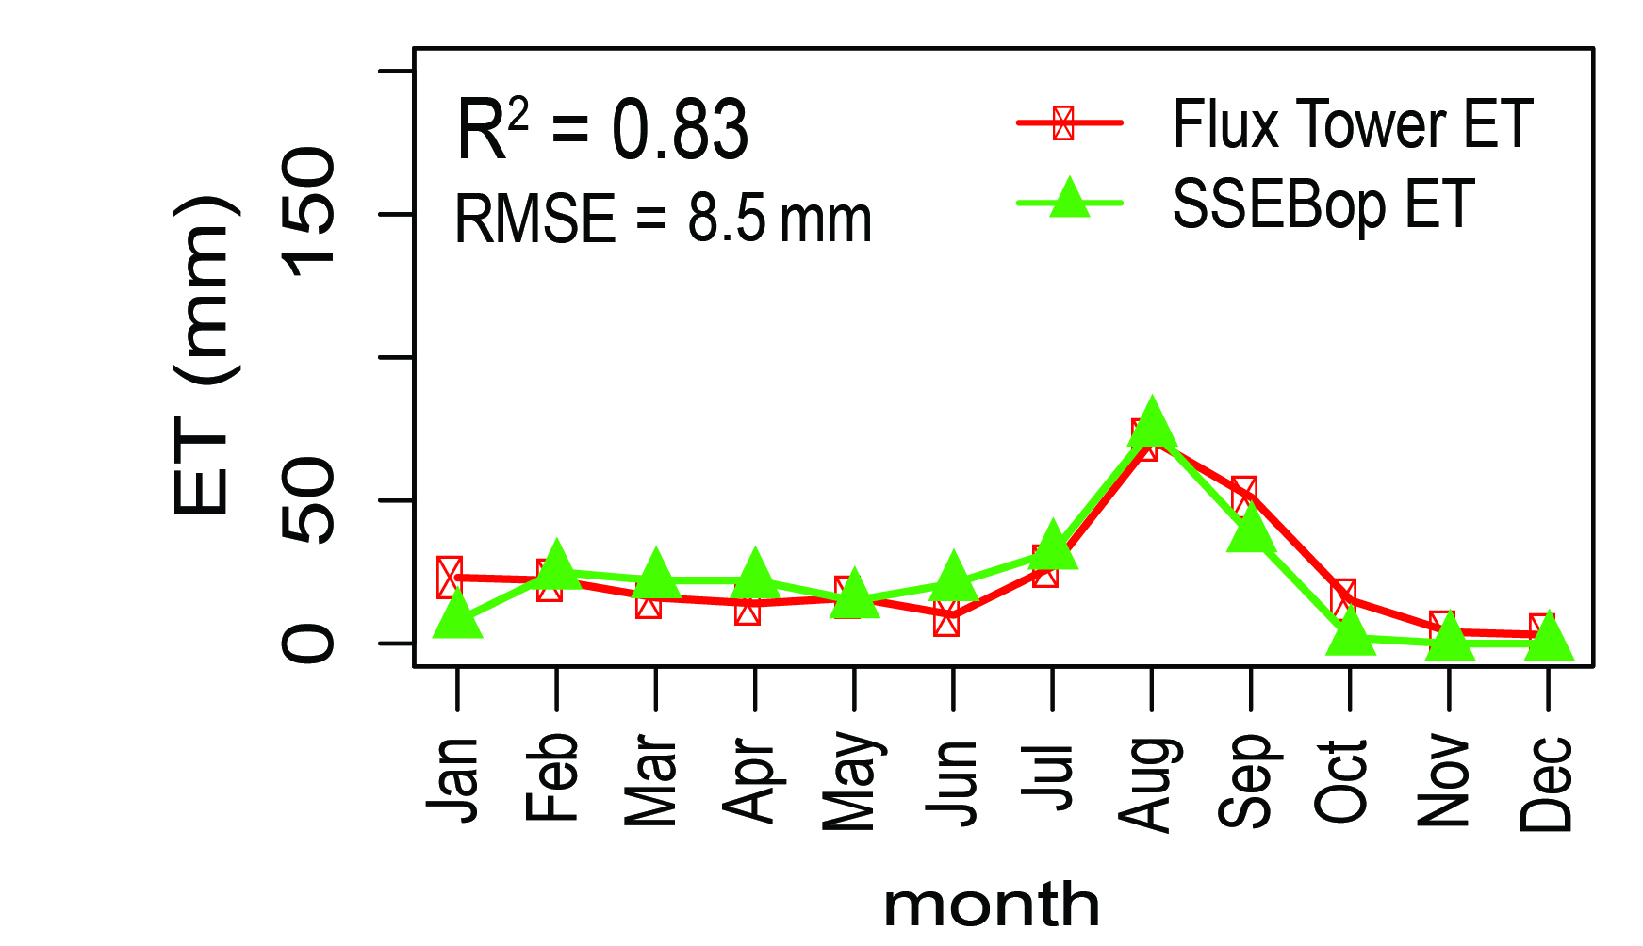
Validation with Flux Tower
Flux Tower: Audubon, AZ, 2005

Slide 7
ETa from Energy Balance: Principles
Uses principle that when evapotranspiration occurs, heat (energy) is used up to convert liquid water to vapor.
This energy is taken from the atmosphere and results in cooling taking place where the ET is occurring
By estimating the change in temperature due to ET, the ETa can be calculated

Slide 8
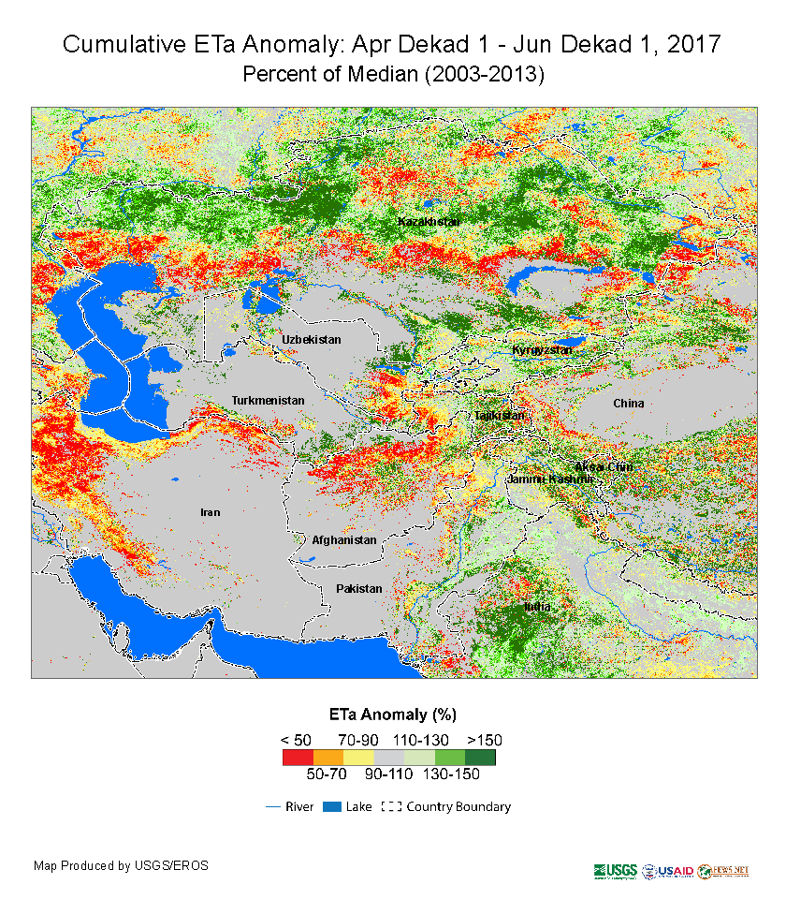
Annual, Seasonal, & 10-day Cumulative ET Anomalies (%)
Available for Africa, Central Asia, and CONUS – based on MODIS LST

Slide 9
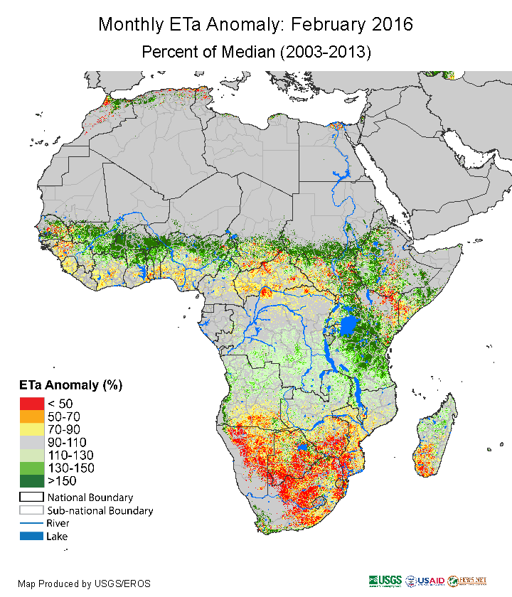
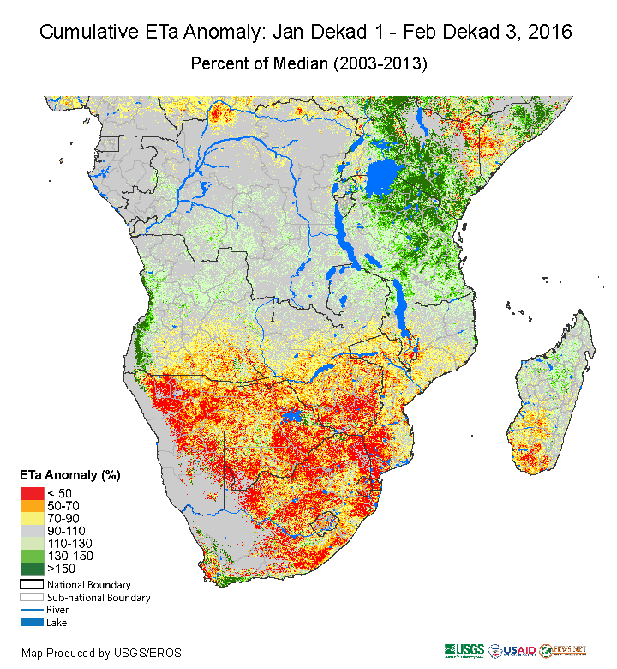
Primary ETa products

Slide 10
ETa: Characteristics
Spatial:
1km pixel resolution
Global – Regional – National (monthly, annual, seasonal)
Temporal:
(1) 10-day cumulative, (2) monthly, (3) annual
Quantities:
Units: mm and percent of median
Typical Presentation:
Pct of average (seasonal cumulative and monthly)

Slide 11
ETa – strengths and limitations
Strengths:
ETa is a good indicator of crop yield in areas where crop is the dominant landcover, and pasture productivity in predominantly grassland covered areas
Is independent of various cropping assumptions (water holding capacity, planting dates)
Independent of errors associated with rainfall data
Useful measure of ETa over irrigated areas

Slide 12
ETa – strengths and limitations
Limitations:
Periods of accumulation may not coincide with actual cropping periods.
Susceptible to continuous cloud cover as it is dependant on LST estimates

Slide 13
Future Directions
ArcGIS
Python
arcpy
Cloud Computing
Developing using Google Earth Engine API and Google Cloud Platform
Desktop Tools
Geoprocessing scripts using Python and Arcpy

Slide 14
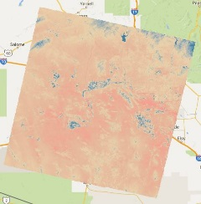
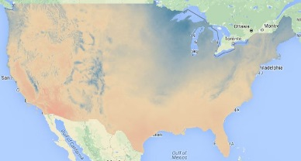
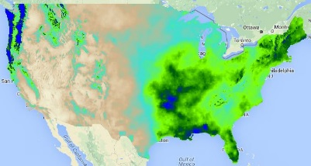
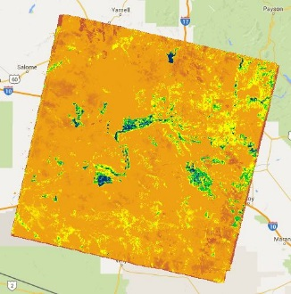
Landsat-based thermal information
Surface Temp
The main driver of SSEBop is the thermal signal from the land surface:
MODIS (1km)
Landsat (60-120m)
Weather Data
Ts
Radiation, Temp, Wind, RH, Pressure
Air Temp
Ta
ET_{fraction}
ET_{o}
ET_{a}

Slide 15
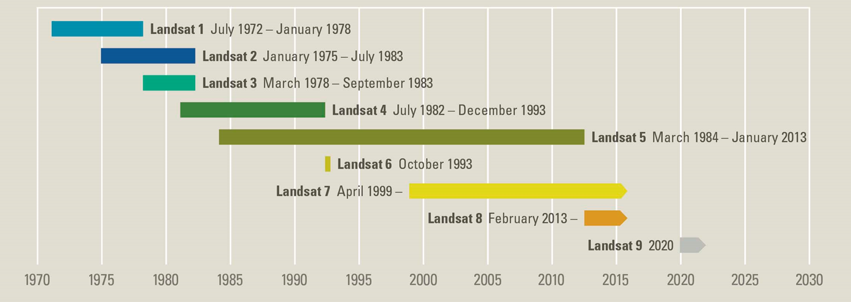
Landsat Missions Timeline
Provides a long-term opportunity for high-spatial resolution ETa modeling, which can provide field-level information on water use and vegetation condition

Slide 16
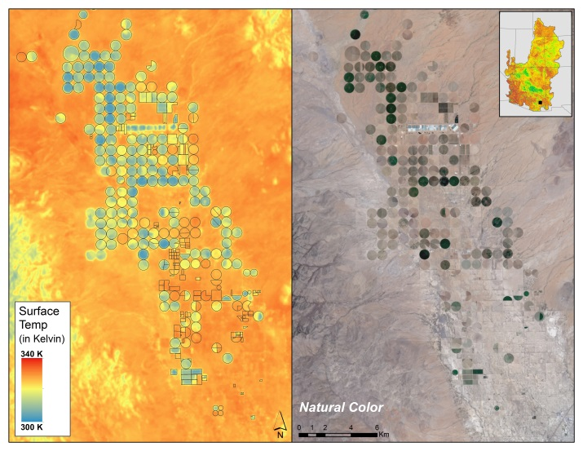
Example day of overpass ETa
Day 155
6/4/2013
p35r38
Surface Temperature from Landsat 8
Southern Arizona, USA

Slide 17
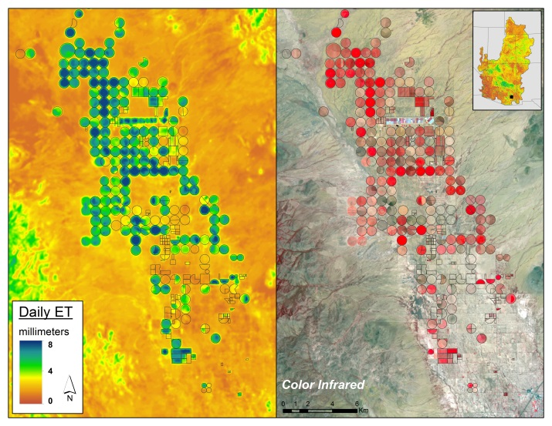
Example day of overpass ETa
Day 155
6/4/2013
p35r38
SSEBop Actual ET
Southern Arizona, USA

Slide 18
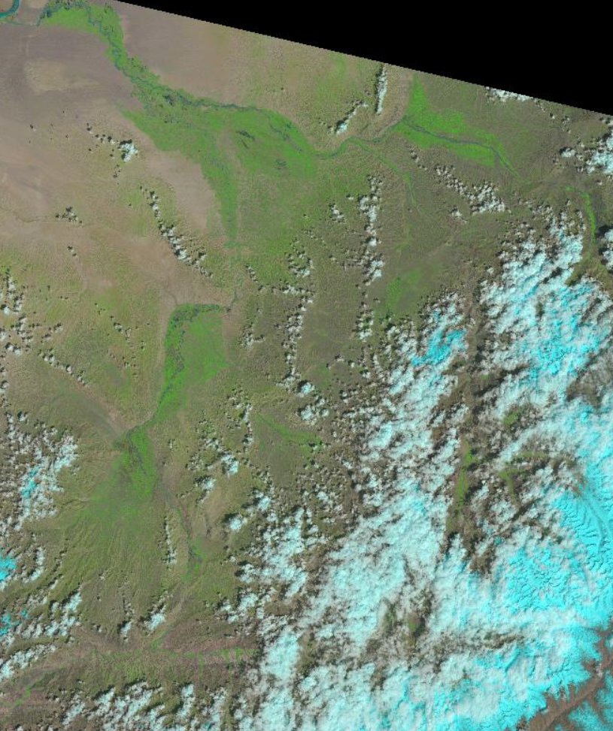
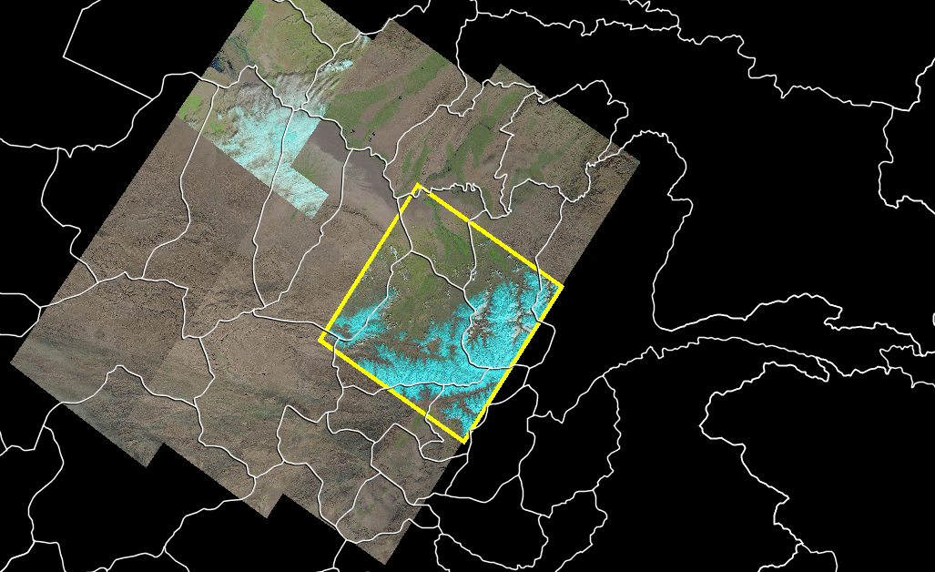
Landsat-based ET ?
Irrigation
Irrigation
The availability of free Landsat data could offer the potential for focused modeling of ET for irrigated areas of Afghanistan.

Slide 19
Questions?

