Slide 1
Introduction to Agro-climatology in
FEWS NET Monitoring
2023 All FEWS NET Workshop
4 May 2023

Slide 2
What’s Covered
Timing of the Agroclimatological monitoring cycle
Products and tools used in monitoring and developing assumptions

Slide 3


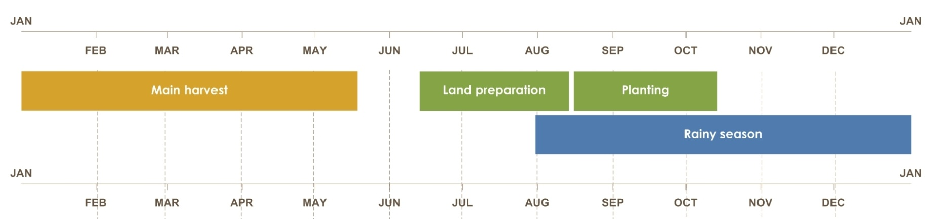
Developing agro-climatology assumptions
1. Understand the climatology for the area of concern (well in advance of SOS and/or as
necessary)
2. Evaluate current climate modes (~3 months before SOS
and until EOS)
3. Interpret available forecasts (~2 months before
SOS and through EOS)
4. Incorporate monitoring data from
remote sensing and other sources
(SOS through EOS)
________________________________________
FAMINE EARLY WARNING SYSTEMS NETWORK
Notes:
After each step, develop assumptions about temporal and spatial distribution of rains and cumulative seasonal rainfall

Slide 4
Main products we will discuss
eVIIRS NDVI* ----------------------------- Vegetation
ETa ---------------- Crop Condition/Soil Moisture
RFE/CHIRPS------------------------------------- Rainfall
WRSI ----------------------------------- Crop Condition
FLDAS -------------------- Snow/Water Availability
* Presented during the “new products” rotation on Thursday 4 May.

Slide 5
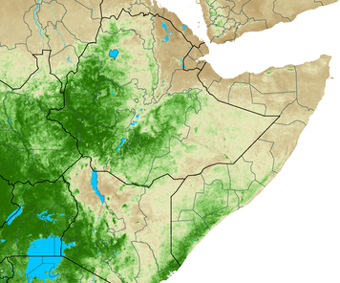
Maximum Value Compositing (MVC)
MVC for a dekad (10 days) is used to address atmospheric contamination while still allowing for detection of subtle vegetation differences through time.
The maximum value for each pixel of a composite period is used as the value for that pixel.
Since cloud and other atmospheric contaminants reduce NDVI values, this process helps to minimize (but not eliminate) these effects in the final composite product.
Day 1
Day 10
Notes:
NDVI works because is it a ratio of NIR-Red/NIR+Red; healthy (dense or very green) plants and soil (or non-green plants) reflect very differently in the NIR bands (wavelengths)

Slide 6
eVIIRS NDVI: Characteristics
Spatial:
    375m pixel resolution
    Global coverage (with specific domains for FEWS NET)
Temporal:
    10-day (dekadal) aggregates (Max Value Composites)
    Updated every 5 days
Quantities:
    Units: unit-less (ratio of reflectance)
Typical Presentation:
    Actual, Diff-Mean, Diff-Prev. Year, Pct-Mean, time series
Accuracy:
    NDVI affected by clouds
    eVIIRS reduces cloud effects by temporal smoothing
    Direct observations – no modeling

Slide 7
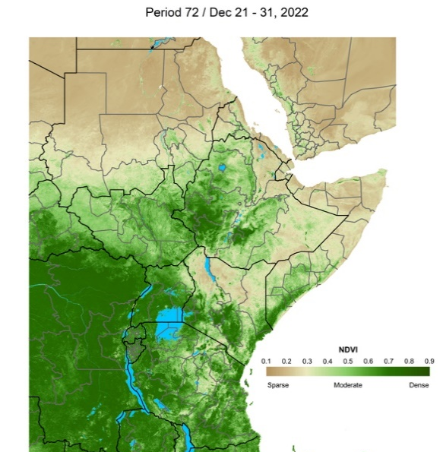
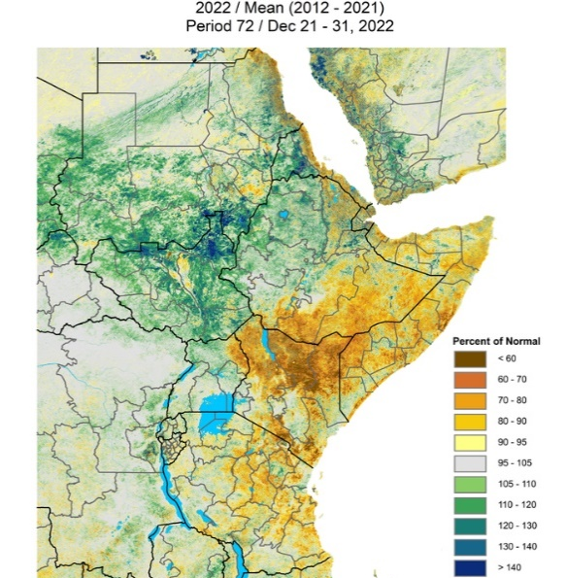
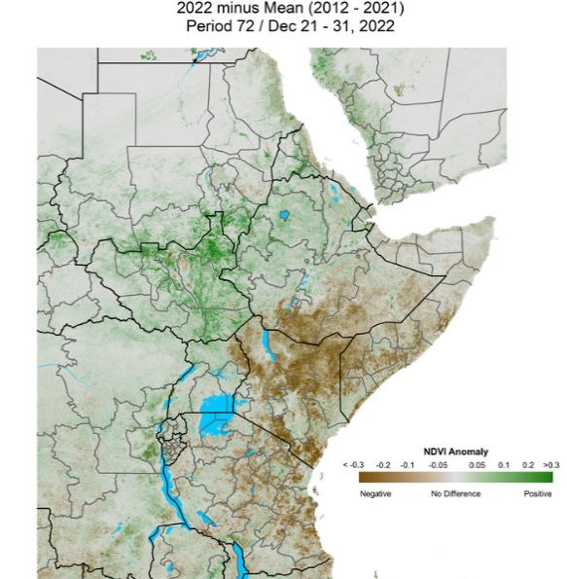
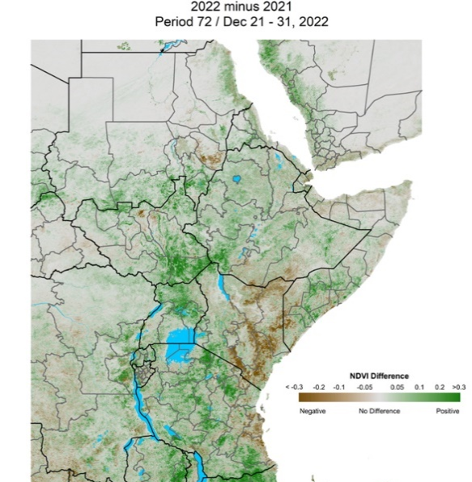
eVIIRS NDVI Products
NDVI Dec 21-31,2022
Percent of Mean
2022 / Mean (2012 – 2021)
Mean Anomaly
2022 – Mean (2012-2021
Prev. Year Difference 2022-2021

Slide 8
eVIIRS NDVI – strengths and limitations
Strengths:
  Good at tracking change in vegetation due to seasonal trends, planting, burning, water deficits, etc.
  Relatively high-resolution images (375m)
  Good for analyzing agricultural conditions for crop and pasture, especially where agricultural activity is dominant
  NDVI is affected by clouds, but eVIIRS minimizes those impacts by temporal smoothing
  No assumptions about agricultural practices required

Slide 9
eVIIRS NDVI – strengths and limitations
Limitations:
  Cannot detect vegetation conditions under continuous cloud cover
  Can provide misleading agricultural interpretations when analyzed where non-agricultural land cover is dominant (e.g., natural vegetation)
  Should be considered only during the active growing season – not meaningful when crops or rangelands are not actively growing.

Slide 10
Main products we will discuss
eVIIRS NDVI -------------------------------- Vegetation
ETa* ------------- Crop Condition/Soil Moisture
RFE/CHIRPS -------------------------------------- Rainfall
WRSI ----------------------------------- Crop Condition
FLDAS -------------------- Snow/Water Availability
* Booth presentation throughout the week.

Slide 11
Actual Evapotranspiration (ETa)
  An estimate of the actual evapotranspiration occurring at the earth’s surface
  Measures combination of transpiration from vegetation and evaporation from the soil
  Actual evapotranspiration is proportional to net primary production, which is a good indicator of crop yields and pasture
  As a percent of average, it can provide a good relative yield indicator when seasonally accumulated

Slide 12
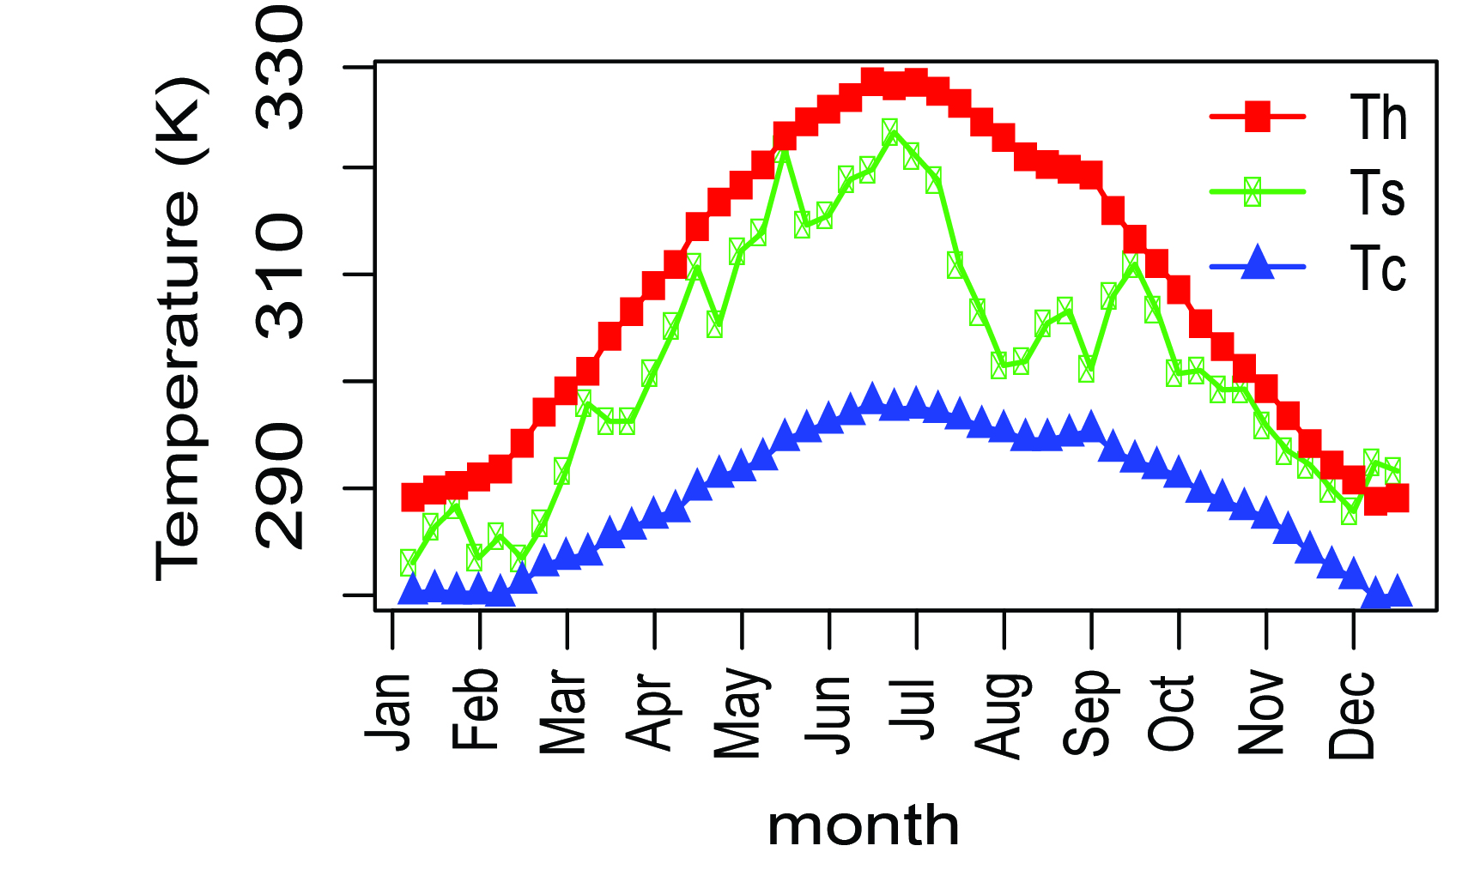
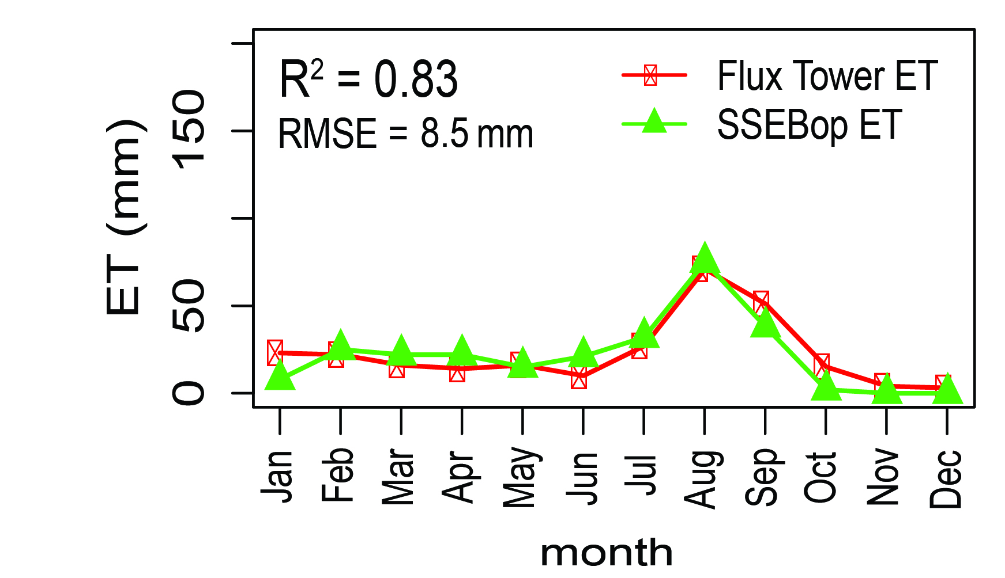
SSEBop Basic Steps:
1) Establish temperature difference (dT)
2) Use LST (Ts) from satellite (VIIRS, Landsat, etc.) to estimate ETf
3) Use weather data to calculate ETo (potential ET)
4) Estimate ETa
Flux Tower: Audubon, AZ, 2005

Slide 13
ETa from Energy Balance: Principles
Uses principle that when evapotranspiration occurs, heat (energy) is used up to convert liquid water to vapor.
This energy is taken from the immediate environment and results in cooling where ET is occurring (i.e., at the Earth’s surface).
By estimating the change in surface temperature, the actual evapotranspiration (ETa) can be calculated.

Slide 14
ETa: Characteristics
Spatial:
  1km pixel resolution
  Continental (monthly) and Regional (seasonal) coverage: West, East, and Southern Africa; Central America, Caribbean (Hispaniola)
Temporal:
  10-day cumulative, monthly
Quantities:
  Units: unit-less (ratio, percent of normal)
Typical Presentation:
  % of average (seasonal cumulative and monthly)

Slide 15
ETa – strengths and limitations
Strengths:
  ETa is a good indicator of crop yield in areas where crop is the dominant land cover, and pasture productivity in predominantly grassland covered areas
  Is independent of various cropping assumptions (water holding capacity, planting dates) required by WRSI
  Independent of errors associated with rainfall data
  Useful measure of ETa over irrigated areas

Slide 16
ETa – strengths and limitations
Limitations:
  Periods of accumulation may not coincide with cropping periods.
  Anomaly image may not relate to the same growing phenology stage
  Susceptible to frequent or continuous cloud cover as it depends on (optical) land surface temperature (LST) estimates

Slide 17
Main products we will discuss
eVIIRS NDVI ---------------------------------- Vegetation
Eta ------------------- Crop Condition/Soil Moisture
RFE/CHIRPS* -------------------------------------- Rainfall
WRSI ------------------------------------- Crop Condition
FLDAS -----------------------Snow/Water Availability
* Presented during the “new products” rotation on Thursday 4 May.

Slide 18
Rainfall Monitoring – 2 Primary Sources
1) NOAA CPC/Rainfall Estimates (RFE2.0)
  Coverage: Africa, South/Central Asia
  RFE 2.0 (daily estimates) from 2001-present
    GOES/Global Precipitation Index (GPI) from Infra-red cold cloud duration)
    Incorporation of microwave from AMSU-B and SSM/I
    Incorporation of GTS rain gauge data
2) CHIRPS (Climate Hazards InfraRed Precipitation with Stations)
  Coverage: Quasi-global: 50 deg N to 50 deg S
  CHIRPS 2.0 (pentadal estimates) 1981-present
    CHPClim monthly rainfall long-term averages
    Cloud top temperatures (Satellite thermal-infrared data from NOAA)
    Rain gauge data from a variety of sources
Notes:
Geostationary Operational Environmental Satellite

Slide 19
Rainfall Estimation: Basic Assumptions
Much of the rainfall in the tropics comes mainly from convective storm clouds
These clouds precipitate when their tops have reached a certain optimal temperature or height
The cloud top temperature (related to height) can be computed from satellite infra-red (IR) images derived from observational data

Slide 20
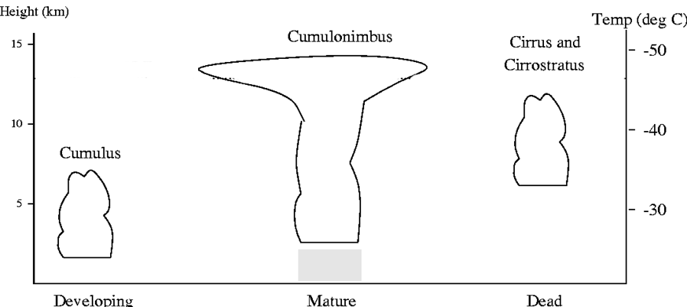
GOES Precipitation Index Technique
Cold cloud duration threshold (235K or -38deg. C)
Assumed rate of 3 mm/hour
Notes:
GOES: Geostationary Operational Environmental Satellite (NOAA); half hourly reporiting

Slide 21
NOAA RFE: Microwave Inputs (SSM/I & AMSU-B)
SSM/I (stratospheric sounding microwave/imager)
2 instruments estimate precipitation daily at ~6 hourly frequency
Tends to sharply overestimate detected convective rainfall
Fails to catch other rainfall in temporal gaps
AMSU-B (advanced microwave sounder)
Data available 4 times daily, staggered temporally
Tends to overestimate most precipitation, but does well with highly convective systems
Pre-processing of data; conversion from HDF format and resampling to 0.1 deg resolution

Slide 22
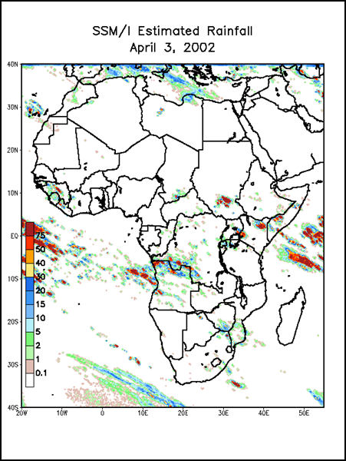
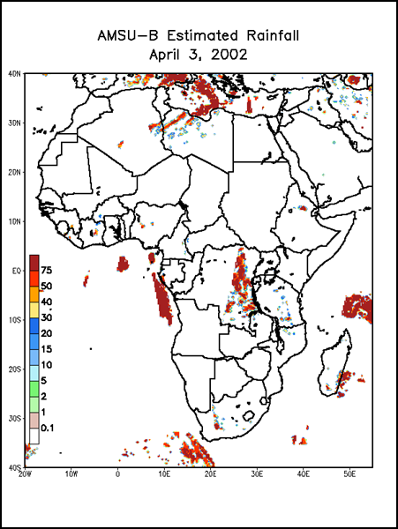
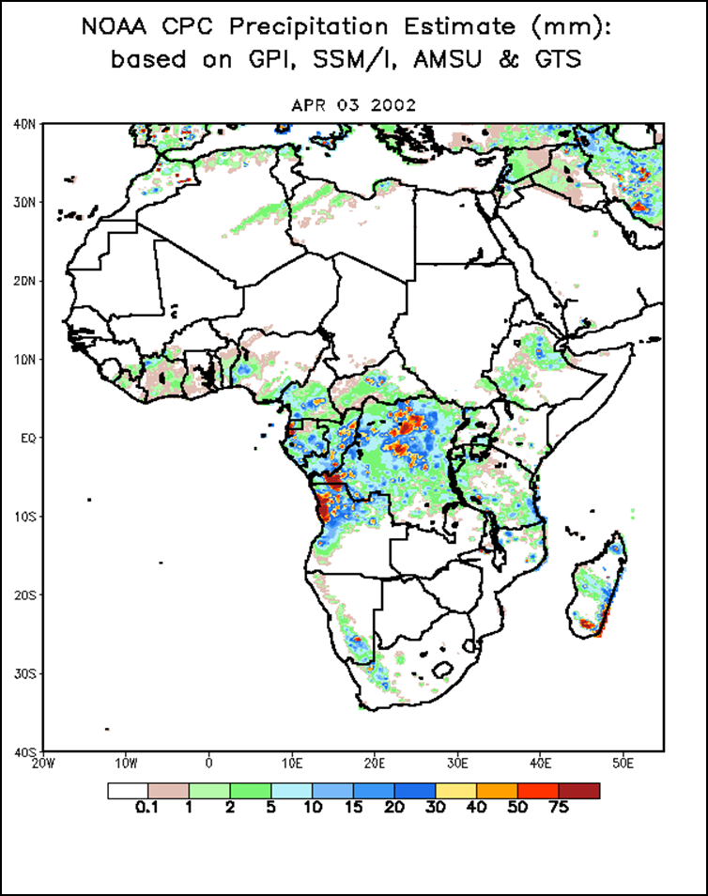
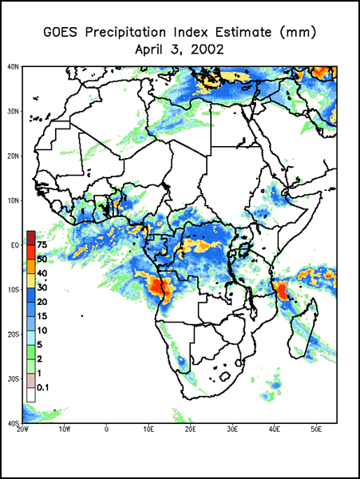
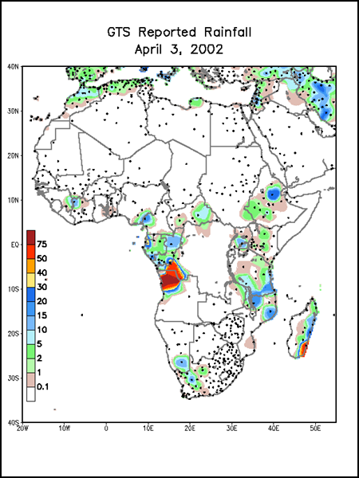
Synergy of Outputs for
Final Product

Slide 23
RFE2: Characteristics
Spatial:
  0.1 degree (~10km) pixel resolution
  Africa-wide coverage, Central and Southeast Asia
Temporal:
  Daily estimates, summed to dekadal (10-day) totals
  2001-present
Quantities:
  Units: mm
Typical Presentation:
  Actual / Diff-Avg, Pct-Avg, time series graphs, 30-day rain/dry day
Accuracy:
  Best estimates convective rainfall
  Good when rain gauges available via GTS

Slide 24
RFE – strengths and limitations
Strengths:
  Provides good spatial representation of rainfall performance
  High native temporal resolution (daily): allows further analysis at a daily time step (e.g. dry spells)
  Can be improved after the final product using locally available rain gauge data

Slide 25
RFE – strengths and limitations
Limitations:
  Cirrus clouds (cold and non-raining clouds)
  Coarse spatial resolution – misses very isolated storms
  Rainfall estimate may be biased where there are no rain gauges reporting on the GTS network

Slide 26
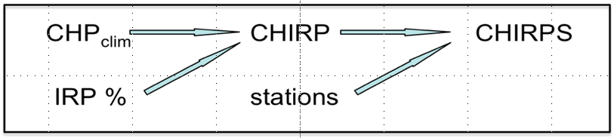
CHIRPS Process
Create historic precipitation climatology CHPclim
Convert IR data to precipitation estimate IRP
  IRP = b0 + b1 *(Cold Cloud Duration percent)
Apply time variability of IRP to CHPclim to make CHIRP
  CHIRP = CHPclim * (IRP %normal)
Blend in stations with CHIRP to make CHIRPS

Slide 27
Climatology (CHPClim)
Climatology is the average, or expected, rainfall during a period
Developed using:
    All available station data
    Topographic information
    Satellite data
    Statistical techniques for interpolation
Just understanding the mean dramatically improves estimates
CHPClim has been adopted by other groups (TAMSAT3)

Slide 28
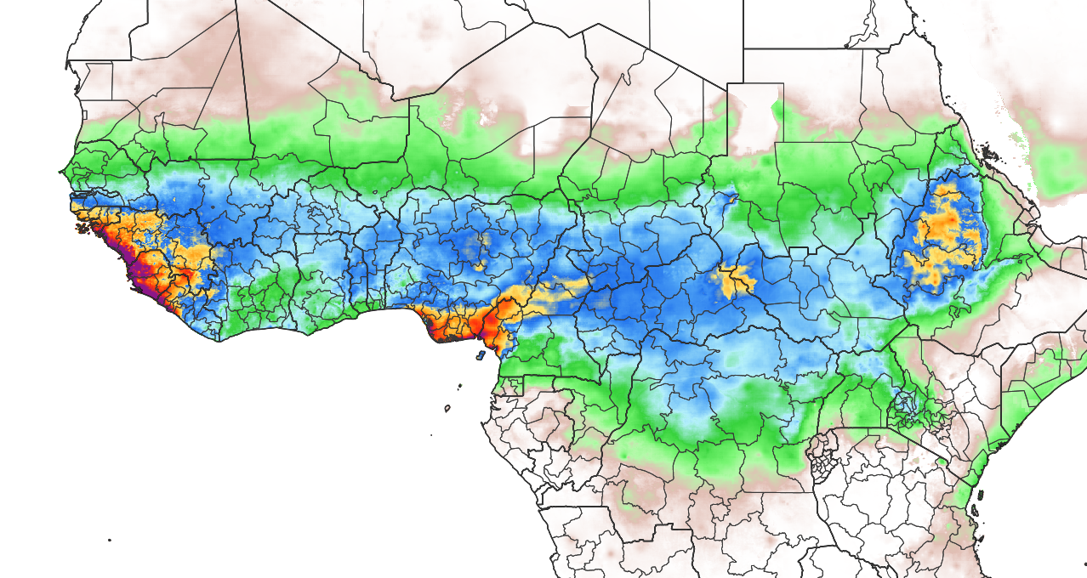

CHPClim (September)

Slide 29
Satellite Infrared Data
Use satellite cloud-top temperatures to adjust the climatology
An improvement over some other methods is that we do this as a percent-of-average, so relative relationships are maintained
Gives updated information in both time (how does this year compare to this time in previous years) and space (were there clouds here, but not over there)
This produces the CHIRP (no “S”)
    Available 2-days after each pentad
    Sum to make a month

Slide 30
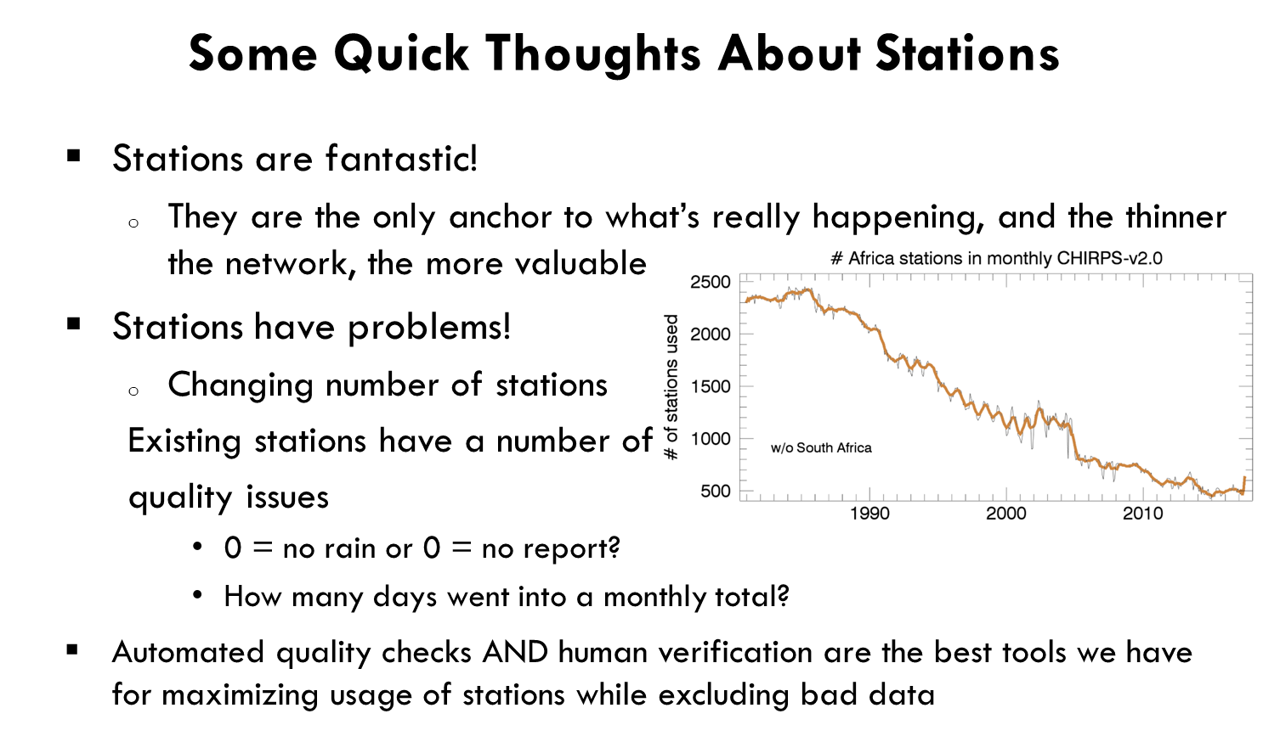

Slide 31
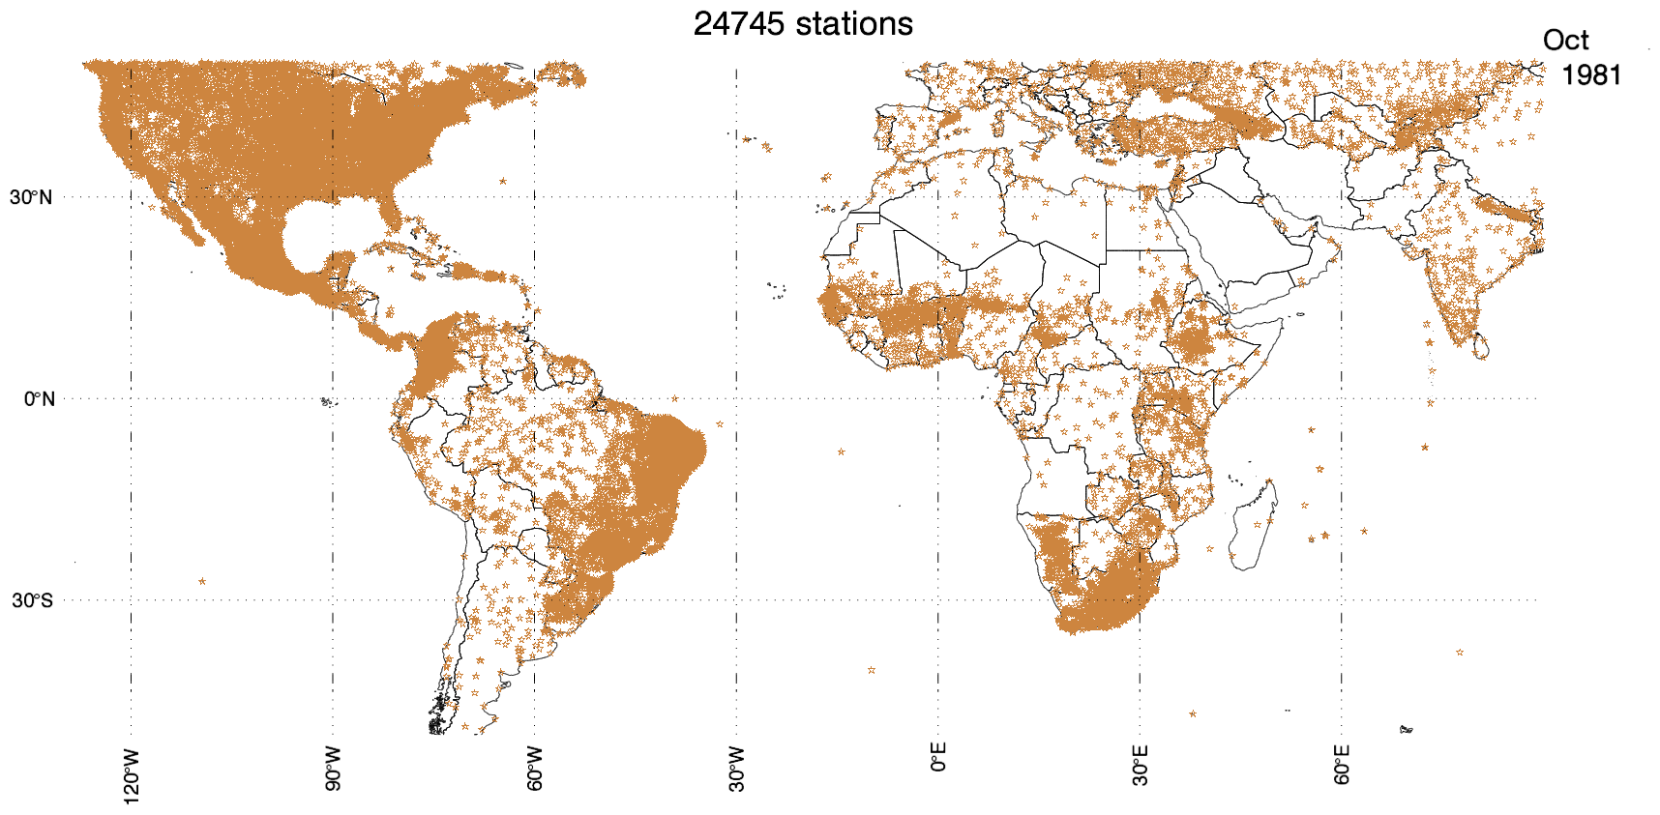
The Case of the Missing Stations
Notes:
https://data.chc.ucsb.edu/people/pete/chirps.monthly.station.density.Oct.Loop.gif

Slide 32
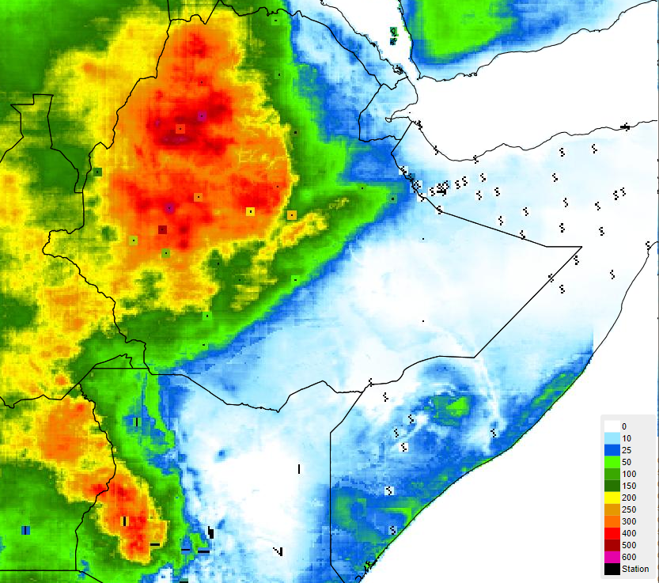
Checking Stations

Slide 33
Conclusions
  CHIRPS blends three different data products to create the rainfall estimate
  Understanding the climatology is very important
  Satellite information informs this in both time and space
  Stations add a final layer of adjustment
    Human and automatic screening identify problematic stations
    CHIRPS performs well when compared to independent station data
    Temporal consistency of the product is a vital tool in contextualizing events

Slide 34
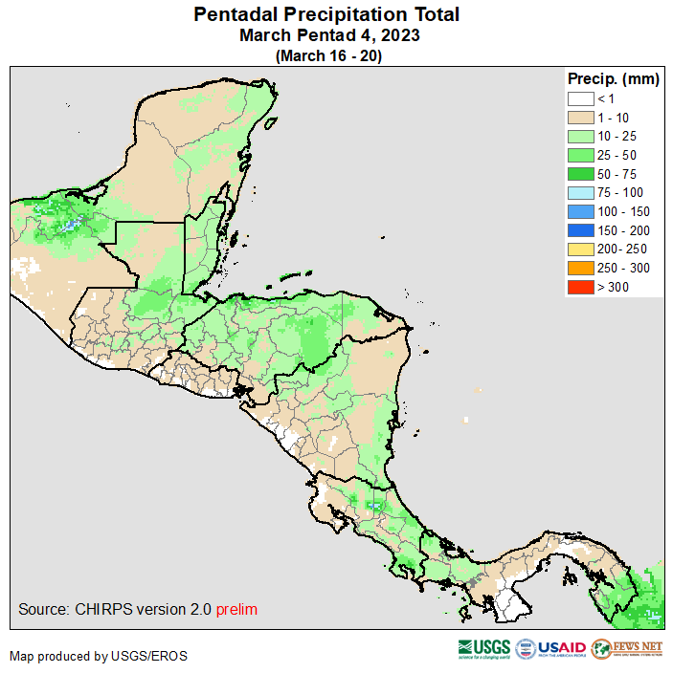
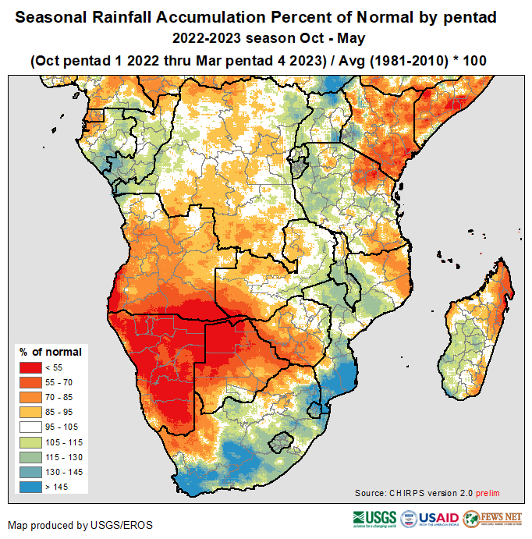
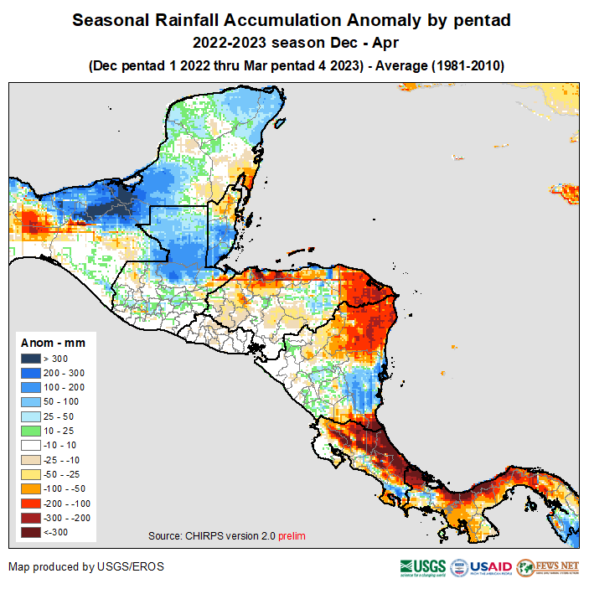

Slide 35
CHIRPS: Characteristics
Spatial:
  0.05 degree (~5km) pixel resolution
  Quasi-global coverage, with windows available for select geographical areas (including Africa, Central America, Caribbean, SE Asia
Temporal:
  Pentadal, dekadal, and monthly estimates available
  Daily data available after the pentadal estimates
  1981-present
Quantities:
  Units: mm
Typical Presentation:
  Actual, Diff-Avg, Pct-Avg, SPI, time series graphs
Accuracy:
  Improves with more rain gauge data available

Slide 36
CHIRPS – strengths and limitations
Strengths:
  Provides good spatial representation of rainfall performance
  Provides higher spatial resolution (0.05 deg) in comparison to other rainfall datasets
  Quasi-global extent
  Based on a long-term (1981-present) climatology, allowing for rainfall trend analysis
  An abundance of station data are incorporated

Slide 37
CHIRPS – strengths and limitations
Limitations:
  Pentadal (5-day) data disaggregated to daily observations
  Timeliness of “final” data – prelim for operational
  Tends to miss high rainfall events due to being tuned as a drought indicator, and limited by long-term CHPclim

Slide 38
Main products we will discuss
eVIIRS NDVI --------------------------------- Vegetation
ETa ---------------- Crop Conditions/Soil Moisture
RFE/CHIRPS-------------------------------------- Rainfall
WRSI ----------------------------------- Crop Condition
FLDAS --------------------- Snow/Water Availability

Slide 39
Water Requirement Satisfaction Index (WRSI)
  A crop specific water-balance model identifies the impact of temporal rainfall distribution (timing/quantity) on crops
  A supply/demand ratio between soil water required by the crop during the season and the amount of water available (or actually used).
  Several by-products available from this process including start of season, soil water index, and anomalies

Slide 40
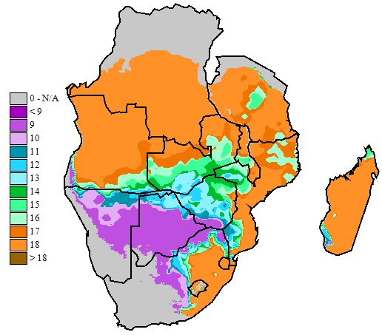
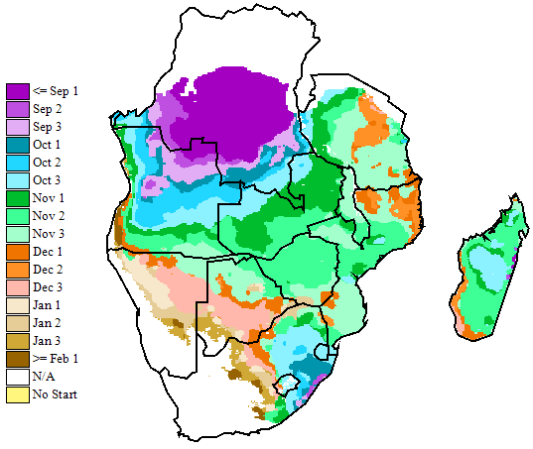
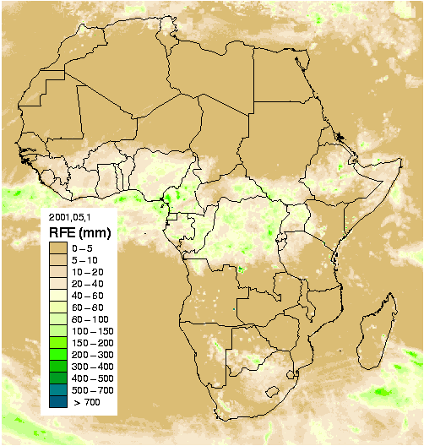
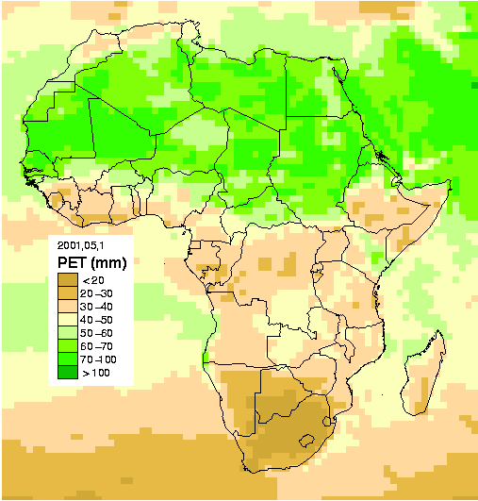
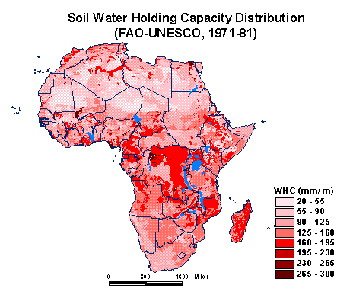
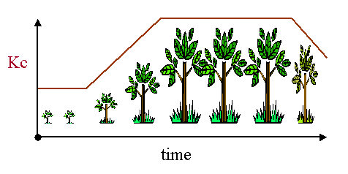
WRSI model inputs
WRSI = f (ppt, pet, WHC, Crop Type, SOS, LGP)
Climatological
PPT/PET
analysis
Rainfall
Accounting
RFE (NOAA) / CHIRPS (UCSB)
NOAA GDAS / NOAA RefET
FAO soils map
of the world
Kc (FAO)
Notes:
GDAS GCM; RefET from PSL

Slide 41
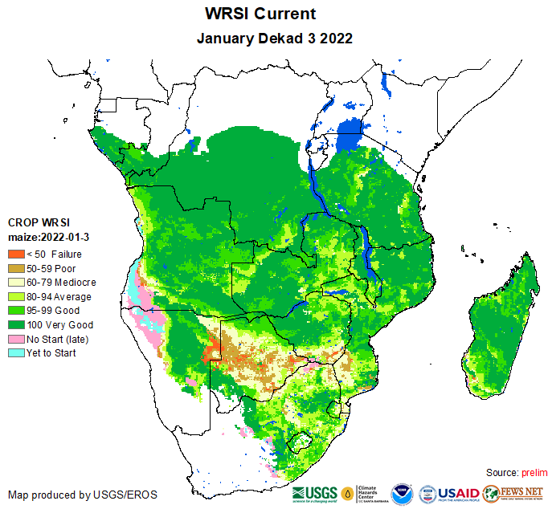
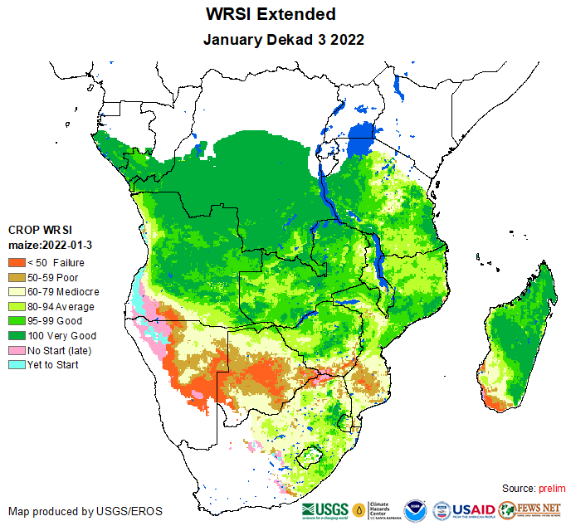
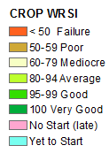
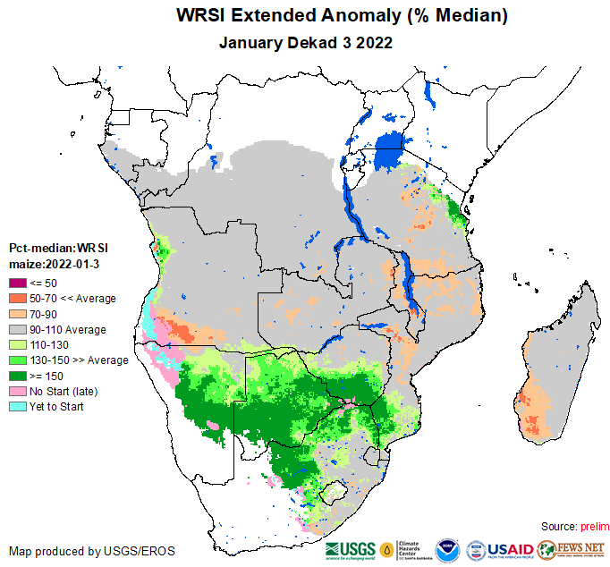
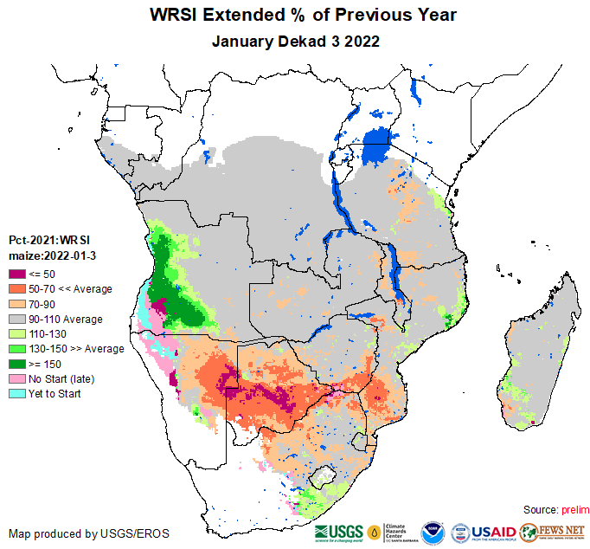
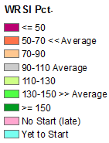
WRSI products
WRSI Current
WRSI Extended
WRSI Anomaly (Median Year)
WRSI Percent of Previous Year

Slide 42
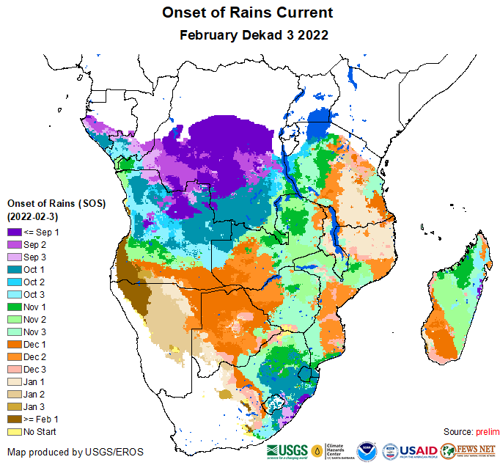
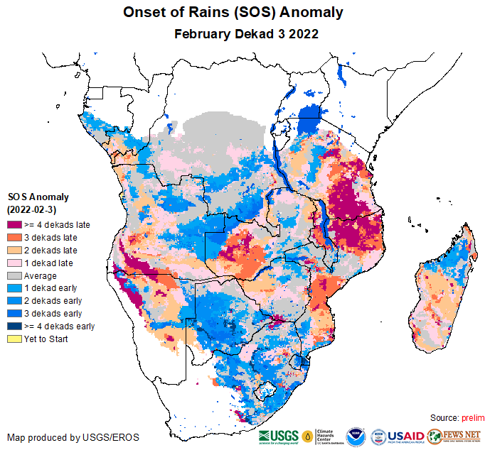
Assessing current cropping conditions

Slide 43
WRSI: Characteristics
Spatial:
  0.1 degree (~10km) pixel resolution
  Regional coverage (Southern, East, and West Africa; C. America, Caribbean
Temporal:
  10-day, Updated every 10 days (5-day timestep for C.A/Carribean)
Quantities:
  Units: unit-less (ratio of water quantities)
Typical Presentation:
  Current, % of Median, % of Previous Year, Extended
Accuracy:
  Affected by accuracy of rainfall estimates
  Depends on accuracy of assumptions regarding time of planting, crop cycle length, and soil characteristics (WHC)

Slide 44
WRSI – strengths and limitations
Strengths:
  Shown to be good predictor of yield where water is the limiting factor in cropping
  Can show impacts of temporal rainfall distribution (deficits) on cropping
  Can be used for several different crops and to model different conditions (e.g different planting times)
  Detects growing areas negatively impacted by water deficits through growing season

Slide 45
WRSI – strengths and limitations
Limitations:
  Dependent on accuracy of assumptions on planting date and crop cycle length
  Model is reliant on quality rainfall inputs
  Yield modeling capability:
    limited to areas where water availability is the main limiting factor
  Non-water-deficit related factors can also affect yield - excess moisture, pest/disease, input availability etc.

Slide 46
Main products we will discuss
eVIIRS NDVI ------------------------------- Vegetation
ETa ---------------- Crop Condition/Soil Moisture
RFE/CHIRPS------------------------------------- Rainfall
WRSI ----------------------------------- Crop Condition
FLDAS* ---------------- Snow/Water Availability
* Booth presentation throughout the week.

Slide 47
FLDAS* Hydrologic Modeling Products
  A water and energy balance model that calculates hydrologic storage (soil moisture, snow pack) and fluxes (streamflow, evapotranspiration).
  Snow water volume, soil moisture, streamflow are most commonly used. Evapotranspiration, Water Stress and more available.
* FEWS NET Land Data Assimilation System (FLDAS)

Slide 48
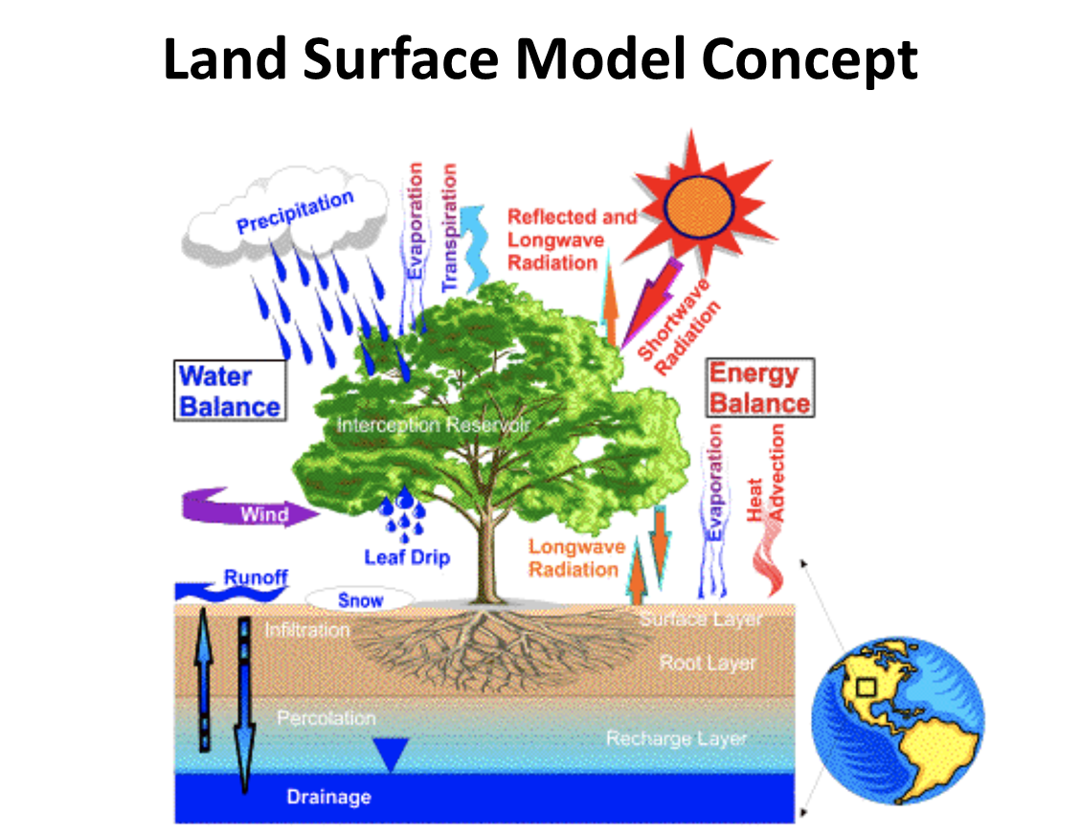

Slide 49
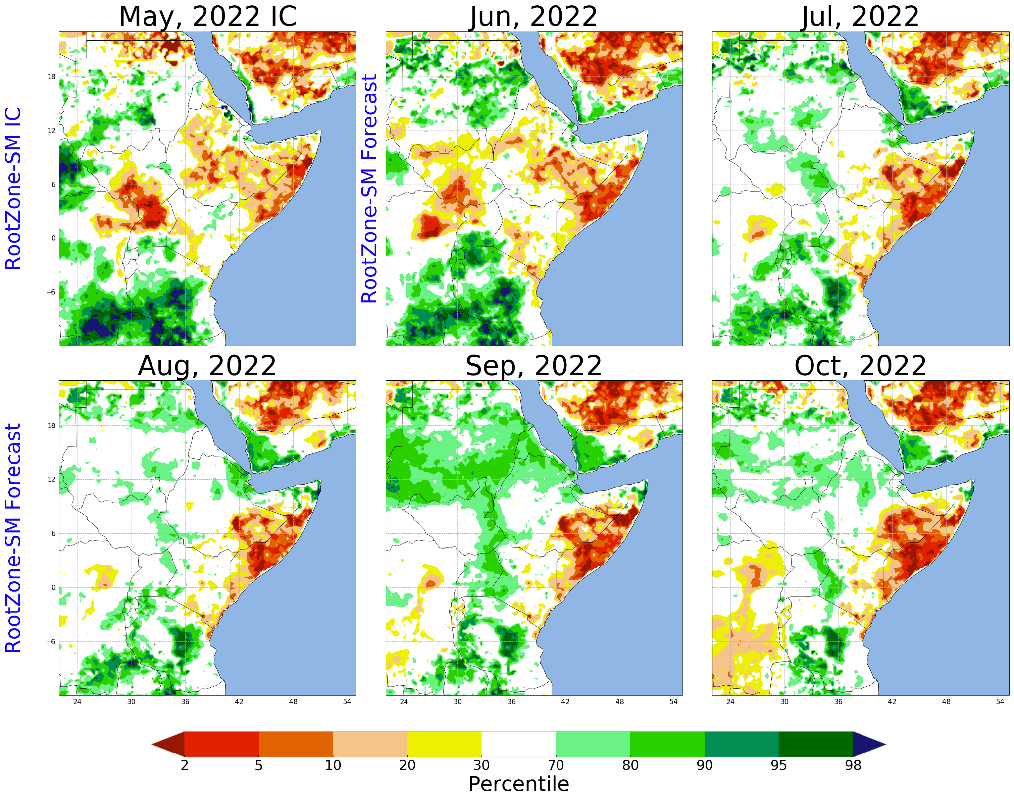
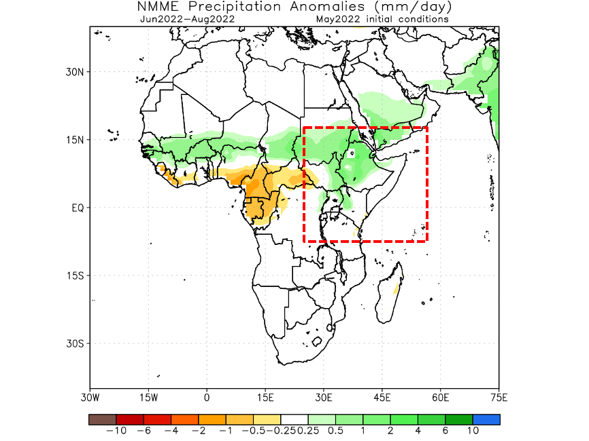
Soil Moisture Forecasts
Soil Moisture Forecasts
Precipitation Forecasts
Soil moisture forecast reflects the rainfall forecast in predicting well above average soil moisture conditions in the upper catchments of the White Nile and persistence of dry conditions in the Eastern Horn.

Slide 50
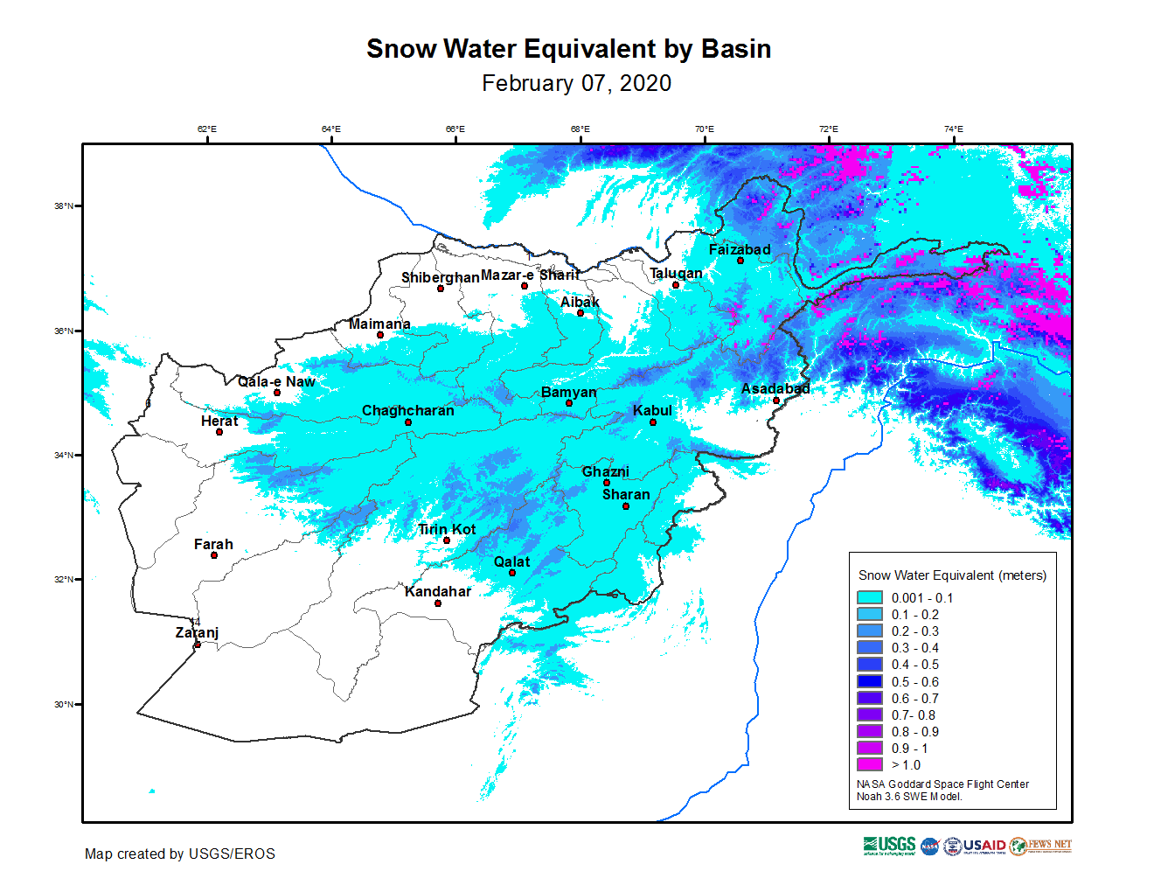
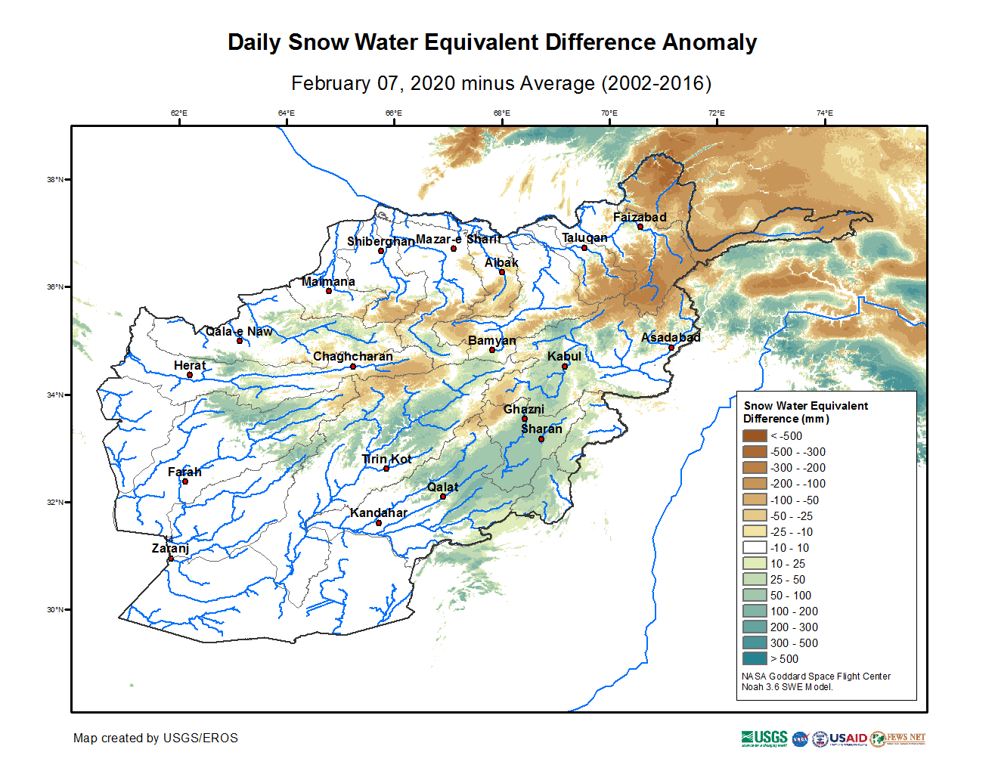
Monitoring Afghanistan
Snow Water Equivalent (Afghanistan / Central Asia)
Notes:
FLDAS: FEWS NET Land Data Assimilation System, a custom instance of NASA LIS (Land Information System)

Slide 51
FLDAS: Characteristics
Spatial:
  0.1 degree (~10 km) pixel resolution Global
  0.01 degree (~1 km) pixel resolution Central Asia
  0.25 degree (~25 km) pixel resolution Forecast
Temporal:
  1-day, Updated every days (Central Asia/Afghanistan)
  1-month, Updated early-month and mid-month with CHIRPS-prelim & final (Global, Forecast)
Quantities:
  Units are variable dependant: SWE (mm), Soil moisture (Volumetric Water Content %), Streamflow (m3/s)
Typical Presentation:
  Current, Pct of Average, Difference Anomaly (mm), tercile probability, percentile

Slide 52
FLDAS – strengths and limitations
Strengths:
  Snow estimates are shown to be good estimate compared to water and ag impacts and MODIS Snow Cover Fraction.
  Soil moisture and ET estimates are useful in pastoral regions, and compare well with NDVI and SSEBop ET.
  Forecasts soil moisture and streamflow highlight how antecedent (current) conditions may ameliorate or exacerbate forecasted rainfall anomalies.
  Captures impacts of temporal rainfall distribution (deficits) on water availability

Slide 53
FLDAS – strengths and limitations
Limitations:
  Model is reliant on quality of rainfall (CHIRPS, CHIRPS-prelim, GDAS, NMME-forecasts)
  Somewhat sensitive to assumptions on vegetation and soil characteristics.
  Does not include engineered water features (dams, irrigation), impacts streamflow and soil moisture
  ~1 month latency for global monitoring product

Slide 54
FLDAS – Usage Notes
Some notes to consider:
  Soil moisture 0-10cm particularly useful in pastoral east Africa.
  Useful for “independent” comparison with other remotely sensed vegetation, evapotranspiration, soil moisture and snow estimates (e.g. from MODIS).
  Soil moisture and streamflow forecasts, driven by NMME precipitation, are useful for indicating likely outcomes related to water resources (flooding, water storage) .

Slide 55
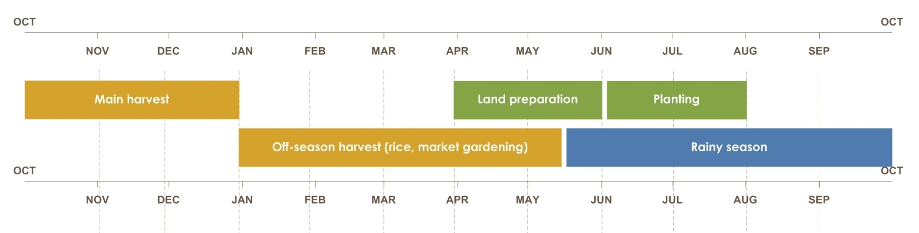
Developing agroclimatology assumptions
1. Understand climatology for the area of concern (well before of SOS and as necessary)
2. Evaluate current climate modes (~3 months before SOS and until EOS)
3. Interpret available forecasts (~2 months before SOS and through EOS)
4. Incorporate monitoring data from remote sensing, other sources (SOS through EOS)

Slide 56
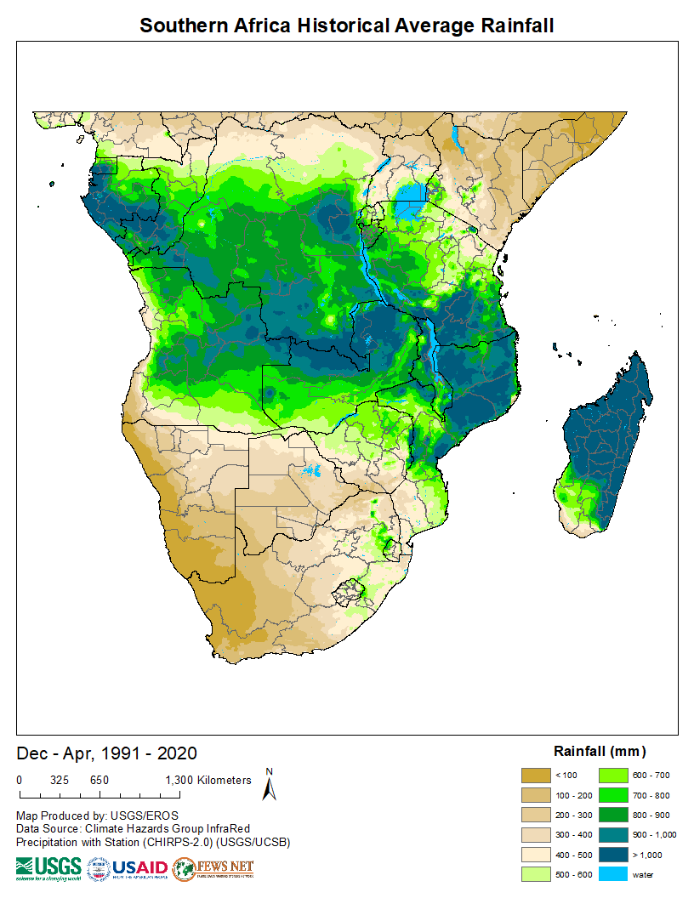
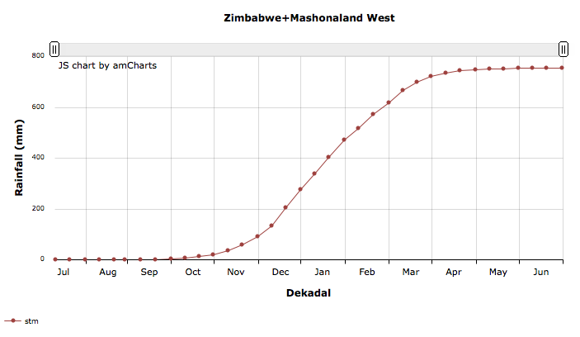
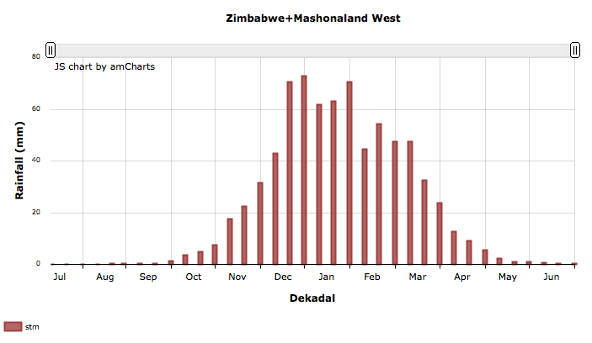
Basics of climatology
Average weather over a long period of time
Average Rainfall Dec-Apr 1991-2020
Spatial variability
Temporal variability
Cumulative rainfall and annual dekadal rainfall
________________________________________
FAMINE EARLY WARNING SYSTEMS NETWORK
Notes:
This refers to the fluctuation of climate over seasons and years (e.g., from year to year). When talking about climate variability we need to take into account two dimensions, one is the spatial variability which refers to the changes of the climate across a landscape it could be a crop region, a country or so on. This map shows how average rainfall values (one of the climate variables) change from one place to another across southern Africa. Spatial variability could also be analyzed across all time scales, daily, dekads, months, etc.
Spatial variability: changes of a climate variable (e.g., rainfall, temperature) over a landscape (region, country, state); this applies to any time scale (daily, monthly, annual, etc.)
Another dimension of the climate variability is time. This refers to changes of climate over time; it could be changes within a season/year, or changes from season to season (or year to year). It can refer to changes in the mean value, the minimum or maximum, or the range (maximum minus minimum). We refer to changes within a season or year as INTRA-annual variability (e.g., changes in rainfall from May to June to July) and changes between years as INTER-annual variability (e.g., changes from 2001 to 2002 to 2003, etc.). Over the long term, inter-annual variability can also provide a trend or tendency (e.g., decreasing rainfall over the period 1981 – 2013).

Slide 57
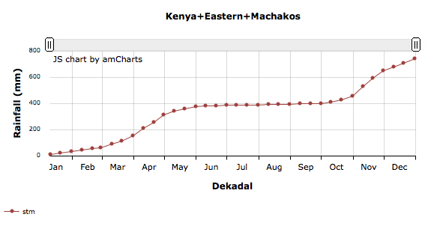
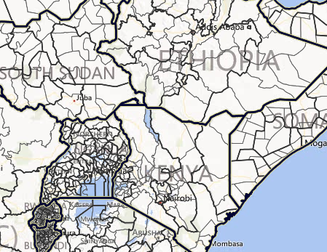
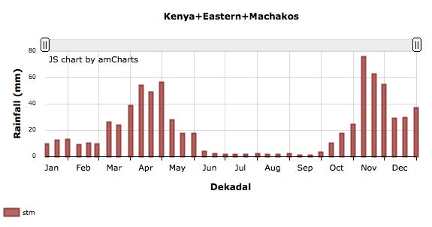
Building blocks for an assumption
Based on climatology, rainfall during the long rains season (MAM) will begin in March and end in May, with average cumulative rainfall of approximately 400 mm. Most rainfall is received in April.
________________________________________
FAMINE EARLY WARNING SYSTEMS NETWORK
Notes:
With this information that we are gathering about our area of concern, we are building our knowledge about the area so that we can start making initial assumptions. So, an initial assumption would be:
“Based on climatology, rainfall during the first rainy season will begin in October and end in February, with average cumulative rainfall of approximately 250 mm. Most rainfall is received in November.“

Slide 58
Building Blocks for an Assumption
In Zimbabwe, Mashonaland East maize cropping area, over the 1981-2012 period, the wettest year was 1998 with slightly more than 1000 mm of rainfall during the season. The driest year was 1991 with 400 mm.
________________________________________
FAMINE EARLY WARNING SYSTEMS NETWORK
Notes:
Before starting to measure variability let’s use what we have to continue building our agroclimatological knowledge base about our area of concern.
EXPLAIN THAT SD AND CV ARE USED TO MEASURE INTER-ANNUAL VARIABILITY, BUT THAT THOSE TOPICS ARE COVERED IN THE FULL/ADVANCED TRAINING ON BUILDING AGROCLIMATOLOGY ASSUMPTIONS.

Slide 59
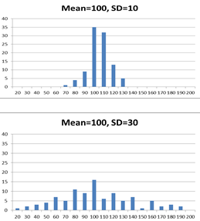
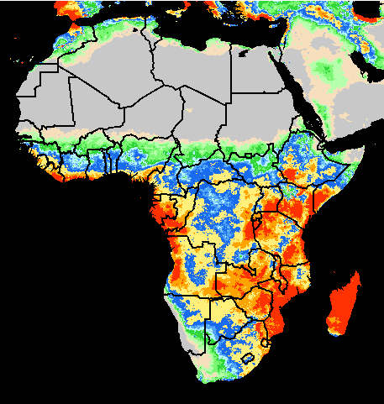


Distribution of two datasets with the same average but different standard deviation
Standard deviation for annual rainfall totals
Coefficient of variation for annual rainfall totals
 | Mean rainfall (mm) | SD | CV
Bie region (Angola) | 1153 | 69 | 6
Free State (South Africa) | 482 | 95 | 20

Slide 60




Climatology
Notes:
Dekadal rainfall series from the map viewers shows seasonal distribution of rainfall and general consistency in the seasonality for each region.

Slide 61


Climatology
Notes:
Shows consistency in SOS timing for northern Zimbabwe, but more variability throughout the other two regions.

Slide 62
Developing agroclimatology assumptions
1. Understand climatology for the area of concern (well before of SOS and as necessary)
2. Evaluate current climate modes (~3 months before SOS and until EOS)
3. Interpret available forecasts (~2 months before SOS and through EOS)
4. Incorporate monitoring data from remote sensing, other sources (SOS through EOS)

Slide 63
What is a Climate Mode?
A description of one aspect of the way Earth’s climate behaves
Identifiable characteristics: variations in temperature, precipitation + wind speed/direction
Simplified numerical indices measure strength and temporal changes. These indices incorporate changes in the identifiable characteristics.
Example: El Niño – Southern Oscillation
Notes:
A climate mode describes one aspect of the way Earth’s climate behaves. Since Earth’s climate is complex and behaves in many different ways that vary temporally and regionally we can understand the behavior of Earth’s climate in terms of many different climate modes.
Climate modes are identified and measured using variations of variables such as temperature and precipitation. Other examples are wind direction and wind speed.
The identifiable characteristics of climate modes, such as temperature and precipitation, are used to understand the temporal changes and strength of the climate mode
There are many climate modes. The most important climate mode is perhaps ENSO. Other climate modes important to us are the Indian Ocean dipole.

Slide 64
Why Climate Modes are Important
The climate modes that we consider for FEWS NET application originate either in the tropics and/or the oceans
The tropical atmosphere is very energetic and exerts a strong effect on global atmospheric circulation
These climate modes change the spatial and temporal distribution of energy in the tropical atmosphere
Variations in climate modes therefore modify the global atmospheric circulation

Slide 65
Climate Modes Offer Predictability
of Regional Conditions
Climate modes change slowly, so once established they last for months to seasons
Climate modes have preferred/typical impact patterns
Knowledge of the state of a climate mode combined with knowledge of how that climate mode impacts regional climates offers predictablity for that regional climate
Notes:
Sea Surface Temperatures (SST) exhibit some of the most regular and predictable changes in the Earth’s climate system. ENSO and IOD are two great examples of regular and predictable changes in SSTs.
SSTs are also one of the main controls on how much energy makes its way into the atmosphere.
The amount of energy going into and out of the atmosphere as a result of SST changes is very important to the global atmospheric circulation which in turn are responsible for the behavior of the atmosphere and precipitation in your areas of focus.
Therefore, the regularity of the changes in SSTs and the important of SSTs with respect to changes in atmospheric circulation and precipitation make understanding the behavior of SST-based climate modes very important.

Slide 66
Climate Modes Most Relevant to Our Work
ENSO
  El Niño – Southern Oscillation
IOD
  Indian Ocean Zonal Dipole
SIOD
  Subtropical Indian Ocean Meridional Dipole
WP
  Variability of the West Pacific Ocean
MJO
  Madden Julian Oscillation
Notes:
Here, we discuss five climate modes with strong influences on regions that we are interested in, namely, Africa, Central Asia and CAC.
Since these five climate modes can be predicted with some certainty, we can predict the future climate of our regions of interest.

Slide 67
Basic ENSO Metrics
Nino 3.4 Index: average SST anomaly in the red area on the map
Niño Indices: Area Average SST Anomaly
For El Niño/La Niña to occur, anomalies have to be persistent and atmospheric conditions have to be consistent
Niño3.4 Index 1950-2010
El Niño:
Nino3.4 > +0.5ºC
La Niña:
Nino3.4 < -0.5ºC
Notes:
- The simplest way to measure the strength of an El Nino or La Nina is by calculating averages of SST over the tropical Pacific Ocean
These averages are calculated over certain areas of the ocean, defined as regions, Nino4, Nino34 and Nino3
The most commonly used index is Nino34, shaded in red and plotted for 1950-2010
Positive Nino34 (red) show El Nino events. Negative Nino34 (blue) show La Nina events.
El Nino and La Nina events typically last for 1-2 years

Slide 68

El Niño Impacts
Notes:
El Niño conditions in the tropical Pacific are known to shift rainfall patterns in many parts of the world. Although they vary somewhat from one El Niño to the next, the strongest shifts remain fairly consistent in the regions and seasons shown on the map.

Slide 69

La Niña Impacts

Slide 70
Indian Ocean Dipole
IOD Regions
IOD Index =
West - East
IOD Index 1950-2010
Notes:
IODZ quantifies the difference in SST between the west and east Indian Ocean
The IODZ is known as Indian Ocean ENSO because it’s influences are similar over that region of the world
The IODZ is an irregular oscillation
The IODZ is strongest during August-November
The IODZ does not have to be strong during ENSO events
The IODZ can only be positive during El Nino and the IODZ can only be negative during La Nina. In other words, IODZ cannot work against ENSO.

Slide 71

IOD Impacts Map
Notes:
Similar information is available for SIOD (sub-tropical IOD) impacting southern Africa and WP variability and WPG (West Pacific Gradient), e.g., warm WP during La Niña events.

Slide 72
Developing agroclimatology assumptions
1. Understand climatology for the area of concern (well before of SOS and as necessary)
2. Evaluate current climate modes (~3 months before SOS and until EOS)
3. Interpret available forecasts (~2 months before SOS and through EOS)
4. Incorporate monitoring data from remote sensing, other sources (SOS through EOS)

Slide 73
Outline
How forecasts are communicated:
  Probabilistic vs. Categorical
Types of Forecasts:
  Dynamical
  Statistical
  Analogue
  Ensemble
Can be based on dynamical forecasts, but more often are based on historical observed relationships and are thus empirical
Notes:
Types of forecasts we generally use in FEWS NET
In the interest of time, we will focus only on probabilistic forecasts as well as the dynamical, statistical, analogue, and ensemble

Slide 74

Tercile Forecasts: Common Probabilistic Forecasts
Forecast with three numbers are common
What does this mean?

Slide 75

Tercile Forecasts: Common Probabilistic Forecasts
Arrange historical data
Separate historical data into three equal-sized groups (33%) called terciles
These groups are called:
  Below average (lower 33%)
  Average (middle 33%)
  Above average (upper 33%)
33%
33%
33%

Slide 76
Tercile Forecasts: Common Probabilistic Forecasts
35%
40%
25%

Slide 77
Outline
How forecasts are communicated:
  Probabilistic vs. Categorical
Types of Forecasts:
  Dynamical
  Statistical
  Analogue
  Ensemble

Slide 78
Dynamical Forecast Example
Notes:
Dynamical forecast: use physics equations governing how air particles behave to forecast how weather/climate will evolve over next few hours to next few months
E.g., most international forecasting centers use supercomputers to produce these forecasts

Slide 79
Benefits/Drawbacks of Dynamical Forecasts
Benefits
Drawbacks
Based on physical laws
Uncertainty quantified with large ensembles
Some physical processes are not well simulated, which will degrade the quality of forecasts

Slide 80
Outline
How forecasts are communicated:
  Probabilistic vs. Categorical
Types of Forecasts:
  Dynamical
  Statistical
  Analogue
  Ensemble

Slide 81
Statistical Forecast Example
Predict rainfall over Afghanistan During February-April w/ ENSO
Calculate an index of ENSO: Nino3.4 common
Calculate the statistical relationship between Nino3.4 and precipitation
Use the forecast index of Nino3.4 (predictor) and the model to forecast precipitation (predictand)
Notes:
Statistical forecast: uses historical relationship between climate variable to be forecast and a predictor
E.g., if July sea surface temperatures (SST) in Indian Ocean are directly proportional to JFM rainfall in Malawi: July 2015 SST →JFM 2016 rainfall. Many RCOF forecasts are statistically based
Suppose we want to predict the rainfall over Afghanistan during February-April using El Nino Southern Oscillation.
The predictor is El Nino Southern Oscillation. The predictand is precipitation.
Step 1: Calculate a measure (an index) for El Nino Southern Oscillation (Nino3.4 in this case)
Step 2: Calculate the statistical relationship between El Nino Southern Oscillation and precipitation.
Step 3: Use the forecast index of El Nino Southern Oscillation, insert that forecast into the statistical model and precipitation will be obtained.

Slide 82
Benefits and Drawbacks of Statistical Forecasts
Benefits
Drawbacks
Can be used with actual realizations of weather/climate
Capable of making very specific forecasts
Not based upon physical laws
Only useful when the relationships are strong between variables
Does not account for factors other than a subset of predictands

Slide 83
Outline
How forecasts are communicated:
  Probabilistic vs. Categorical
Types of Forecasts:
  Dynamical
  Statistical
  Analogue
  Ensemble

Slide 84




Analogue Forecast Example
Predict rainfall over Afghanistan During February-April w/ La Nina by Using Previous La Nina Seasons as Guidance
Select representative La Nina seasons
Our forecast is for below average precipitation
We do, however, recognize that this does not happen 100% of the time
Notes:
ANALOGUE forecast: assume that the current season will behave similar to a (or a collection of) past season(s)

Slide 85
Benefits and Drawbacks of Analogue Forecasts
Benefits
Drawbacks
Focuses on actual realizations of the weather/climate
Capable of making very specific forecasts
Does not account for factors other than a subset of characteristics

Slide 86
Outline
How forecasts are communicated:
  Probabilistic vs. Categorical
Types of Forecasts:
  Dynamical
  Statistical
  Analogue
  Ensemble

Slide 87
Ensemble Forecasts 1/2
Remember from before that we need observed conditions to begin running climate models
We do not know those observed conditions with great certainty
To quantify the uncertainty introduced by those observed conditions, we run models with slightly different initial conditions
Notes:
Ensemble forecast: run forecast many times using slightly different initial conditions to determine strength of forecast

Slide 88
Ensemble Forecasts 2/2
An ensemble forecast is a collection of individual model runs started from slightly different initial conditions
We create ensemble forecasts to test the strength of the forecasts (i.e., quantify uncertainty of forecasts). If ensembles give similar results then we have confidence in the forecast. This is a convergence of evidence.

Slide 89
Developing agro-climatology assumptions
1. Understand the climatology for the area of concern (well in advance of SOS and as
necessary)
2. Evaluate current climate modes (~3 months before SOS
and until EOS)
3. Interpret available forecasts (~2 months before
SOS and through EOS)
4. Incorporate monitoring data from
remote sensing and other sources
(SOS through EOS)

Slide 90

Early Season Start

Slide 91

Early Season Rains

Slide 92
Incorporating Seasonal Information
Early-Mid Season Assessment

Slide 93

Early-Mid Season Start

Slide 94

Early-Mid Season Rains

Slide 95

Early-Mid Season Vegetation

Slide 96
Incorporating Seasonal Information
Mid Season Assessment

Slide 97

Mid Season WRSI

Slide 98

Mid Season Rains

Slide 99

Mid Season Soil Moisture

Slide 100

Mid Season Vegetation

Slide 101
Summary of Seasonal Analysis
As the season progresses one learns more about seasonal conditions.
In the case of Southern Africa in 2017/18, it was a reasonably normal season until a January dry spell created widespread rainfall and soil moisture deficits, which were evident based on WRSI and NDVI.
Routine agro-climatology monitoring throughout the season provides insight into the development of such dry spells - the impacts of which are determined by building a converging story across many agro-climatology products and other data resources.

Slide 102
Questions?

Slide 103

FEWS NET Datasets: CHIRPS
Climatological Precipitation Time-Series
UCSB/USGS Climate Hazards Group
Rainfall, March 2016 (data from 1981-present

Slide 104







FEWS NET Earth Observation Data Sets
eMODIS NDVI – 250m
Evapotranspiration – 1km
Snow Water Equivalent/Depth – 1km
Soil Moisture/Runoff – 0.1 deg
Notes:
NDVI: Normalized Difference Vegetation Index; Evapotranspiration: evaporation of water from the surface and transpiration of water from plants
Snow Water Equivalent: the equivalent of water contained in a snowpack; Soil Moisture: cubic meters of water per cubic meters of soil

Slide 105

Early Warning eXplorer
Notes:
Early Warning eXplorer (EWX): Online analysis tool for FEWS NET datasets

Slide 106



Early Warning eXplorer
Notes:
EWX allows anomaly images (difference from, and % of, normal) and time series analysis; z-score for precipitation

Slide 107



Water Point Monitoring
Landsat, ASTER, SRTM, and satellite rainfall
Notes:
Water point viewer provides information on % of maximum depth compared to median depth on a daily basis.
Agro-climatology knowledge base: basic climatological information (precip, temp, vegetation, ET, WRSI) and annual anomalies for ~80 countries and regions

Slide 108

Satellite Remote Sensing

Slide 109


Normalized Difference Vegetation Index (NDVI)
A ratio of the intensity of light reflected off the Earth’s surface in the visible and near-infrared spectral wavelengths which quantifies the photosynthetic capacity of the vegetation in a given pixel of the land surface.
Those surfaces containing large amounts of chlorophyll have high reflectivity in the NIR and low reflectivity in the red.
Notes:
What is it, and what does it represent
What are its characteristics: time, space, accuracy, other
How is it made: math/technical/theoretical background
What are its strengths and limitations
Where can it be accessed
How can it be used for monitoring the growing season;
How should it be used
When should it be used
When should it NOT be used
What other forms can it have (e.g., anomalies, what do they mean)
What sort of inferences can be made about the actual situation

Slide 110

Vegetation Monitoring (Crop & Rangeland):
Normalized Difference Vegetation Index
NDVI = (NIR – Red) / (NIR + Red)
Healthy green vegetation (left) absorbs most of the visible light that reaches it, and reflects a large portion of the near-infrared light.
Unhealthy or senescing vegetation (right) reflects more visible light and less near-infrared light.
What about atmospheric effects?

Slide 111


Comparison with Independent stations

Slide 112



Monthly Station Stats by Source

Slide 113
Onset of Rains (Start of Season: SOS)
(Rainfall Accounting Method)
SOS: 25 mm + 20 mm (2 dekads)
RFE: Rainfall ( mm)
False/No Start
Real start
25 mm
20 mm
SOS
LGP
EOS
Growing Season

Slide 114
Soil Water Balance Model
ETA
PPT
PPT
Surplus
Runoff
WHC
WHC
Soil Water
Deficit
Drainage
ETa
WR
SW = SW_{i-1} + PPT - ETA

Slide 115

Caveat: How incorrect planting date can affect WRSI
MODELLED
ACTUAL
Actual planting dates (Low WRSI, affected by Feb dryness)
Modeled planting dates (High WRSI)

Slide 116
Caveat: How incorrect LGP can affect WRSI
ACTUAL
MODELLED
Modeled LGP (Low WRSI, affected by Feb dryness)
Actual Crop Cycle Length (high WRSI)

Slide 117

Dynamical Forecasts
Simulate Earth With Physical Models
Obtain a three- dimensional view of the Earth by separating the Earth into smaller pieces.
The three dimensions are latitude, longitude and height above/below Earth’s surface

Slide 118

Dynamical Forecasts
Using observed condition and governing equations to forecast future

