Slide 1


Thermal Remote Sensing of Diurnal Surface Temperature Variations Across Urban and Non-Urban Interfaces
Hua Shi
December 18, 2025

Slide 2
Background
Urbanization and the SUHI Phenomenon
Role of Landsat Thermal Remote Sensing
Applications and Needs
Scientific research in urban ecosystems and wildland-unban interface
Notes:
Good morning everyone, let me start by giving a bit of background on USGS SUHI research. Thermal remote sensing has become a key tool for studying SUHI and understanding SUHI effect. SUHI is a major biophysical impact linked to urban development. There's growing interest in this topic from various users (urban planners, policymakers, and agencies like the EPA, NIH/NIEHS, and NOAA, as well as local governments and researchers focused on the urban-wildland interface). On top of that, SUHI is an important scientific issue, especially as we think about climate change and its effects on urban ecosystems.

Slide 3
Objectives
Understand regional differences of SUHI
Measure and map SUHI
Track changes over time (trends analysis)
Analyze SUHI trends in relation to land cover changes
Compare thermal data from multiple sensors
Link SUHI to people and places
Notes:
Our objectives include: First, studying how urban warming varies across CONUS, and exploring the reasons. Second, developing methods to measure and map the SUHI effect, including its size, intensity, and hotspots. Third, analyzing how SUHI patterns change over time with land cover dynamics. Fourth, comparing LST data from multiple sensors -- like Landsat, MODIS, VIIRS, and ECOSTRESS during both day and night. Last, working on ways to connect SUHI data with land cover and population information, including census data, to better understand its environmental, social, and health impacts.

Slide 4
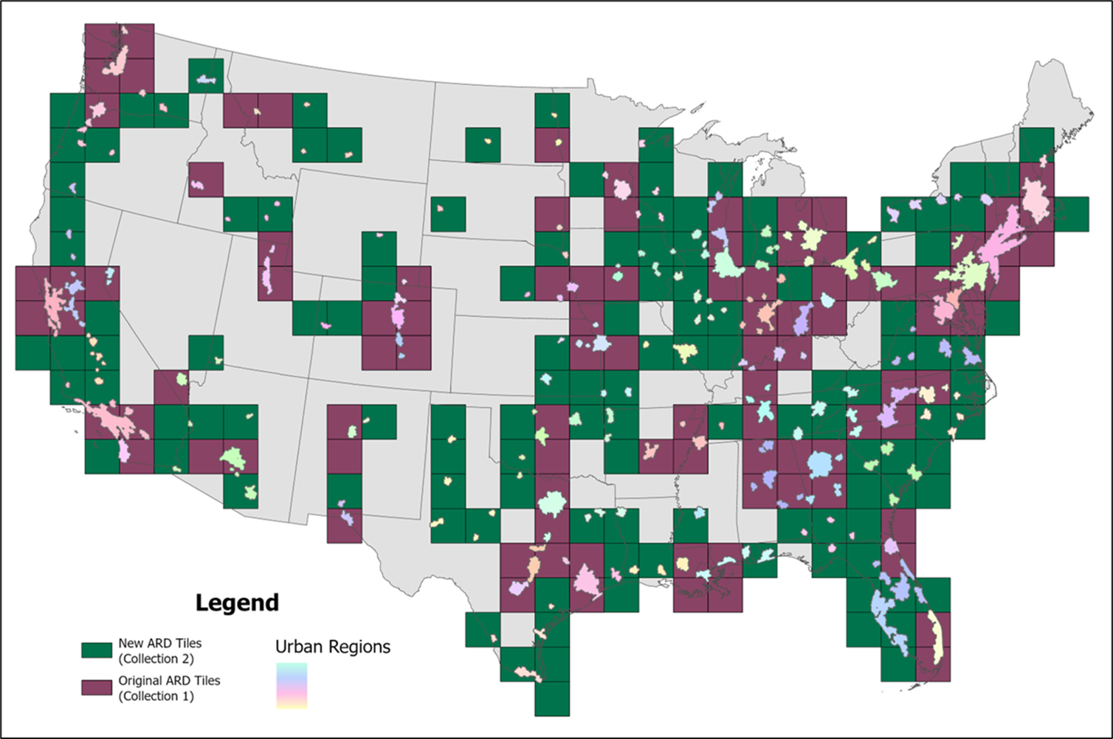
USGS SUHI products
SUHI C1 selected 50 and C2 71 major urban center in CONUS
Population > 50 k
351 urban centers in CONUS
226 ARD tiles (C1 91)
Notes:
The USGS SUHI team has created several products using Landsat data, available on USGS ScienceBase. These include land surface temperature (LST), SUHI intensity, and hotspot datasets. The first version, based on Landsat Collection 1, covers 50 urban areas in the ARD tiles, shown in maroon. The newer version, using Landsat Collection 2, expands coverage to 71 urban centers of CONUS, shown in green.

Slide 5
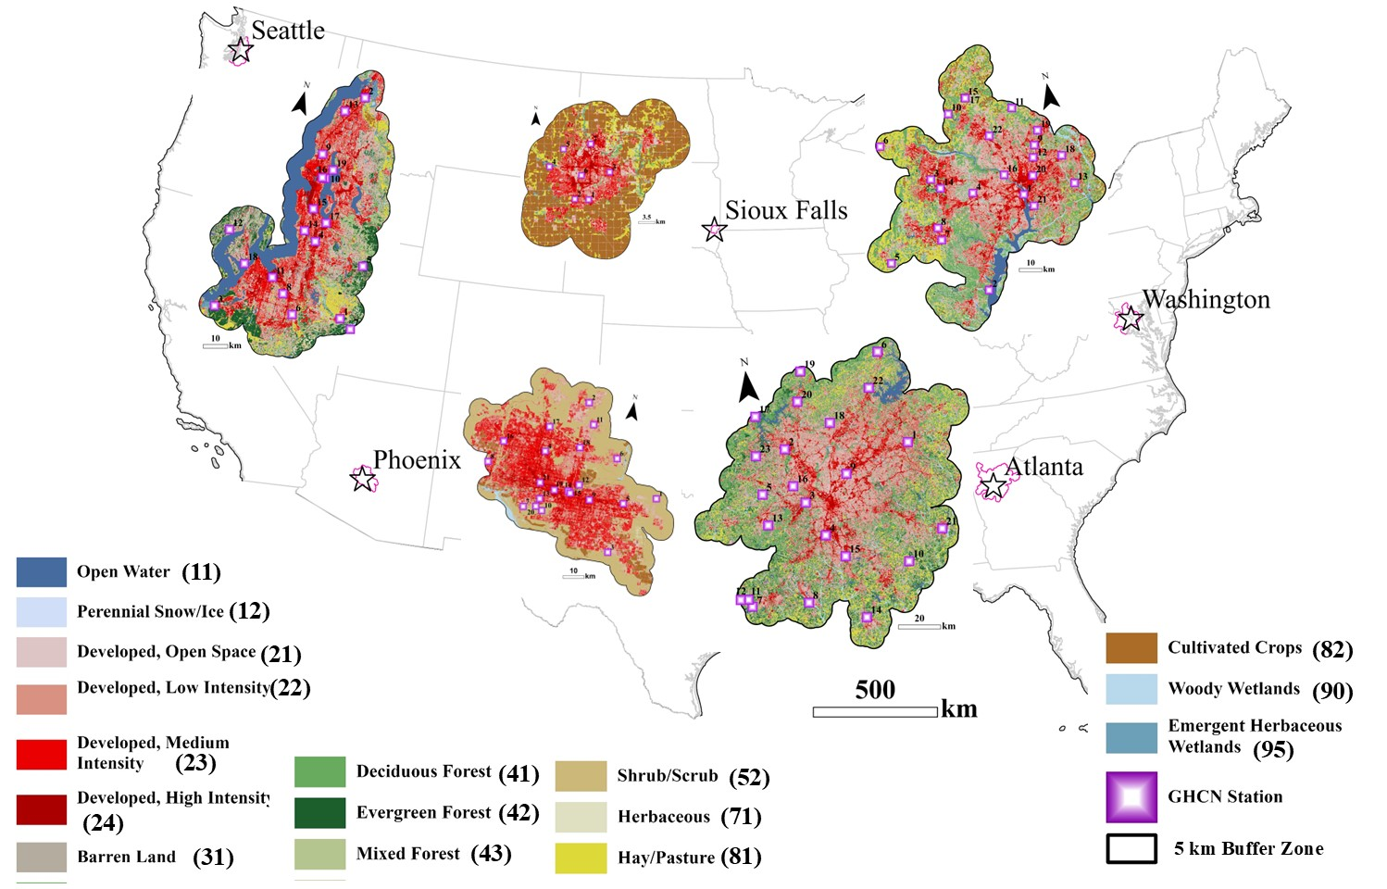
Study area
Comparison
ATL: Atlanta, GA
DCA: Washington DC
FSD: Sioux Falls, SD
PHX: Phoenix AZ
SEA: Seattle, WA
Notes:
This map highlights five representative urban centers selected across the CONUS for comparative analysis using daytime and nighttime data from multiple sensors. It displays the 2023 NLCD annual land cover, along with GHCN stations located within a 5 km buffer zone.

Slide 6
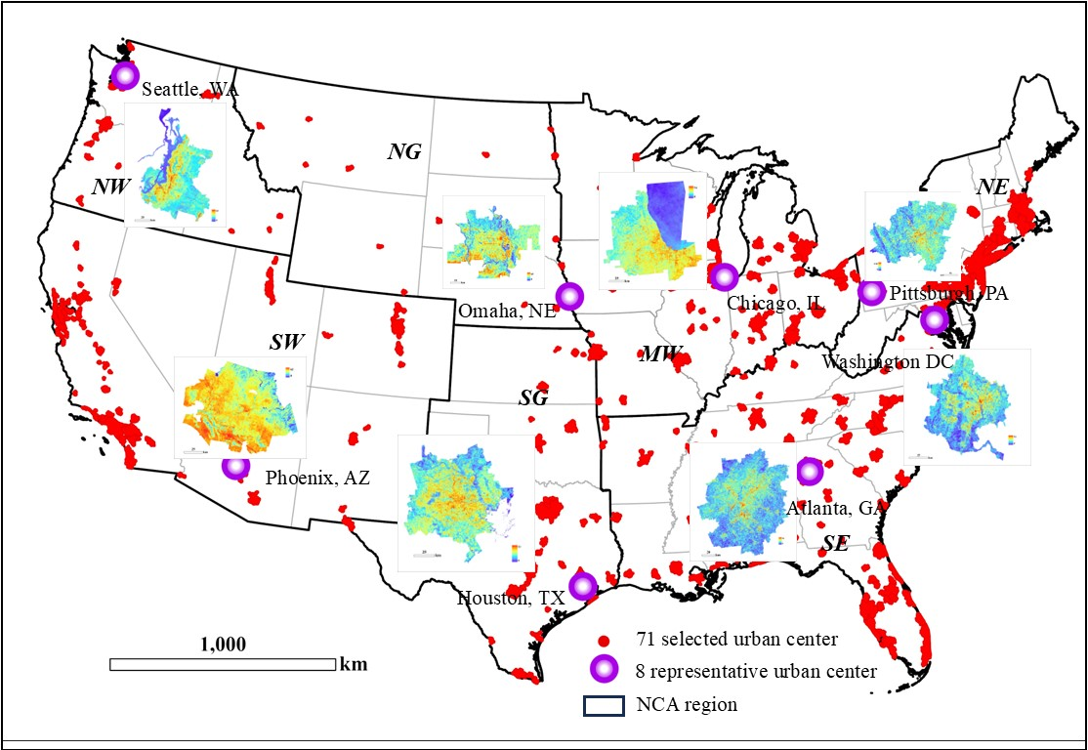
Study area
Eight urban centers
Within seven NCA zones
50 urban centers
Seattle, WA
Phoenix, AZ
Omaha, NE
Houston, TX
Chicago, IL
Atlanta, GA
Pittsburg, PA
Washington DC
Notes:
This map shows eight selected representative urban centers across the CONUS. It illustrates the meanLST in these cities for the year 2023, grouped within seven National Climate Assessment regions. The 71 selected urban centers are highlighted with red, providing a clear visual reference across the regions.

Slide 7
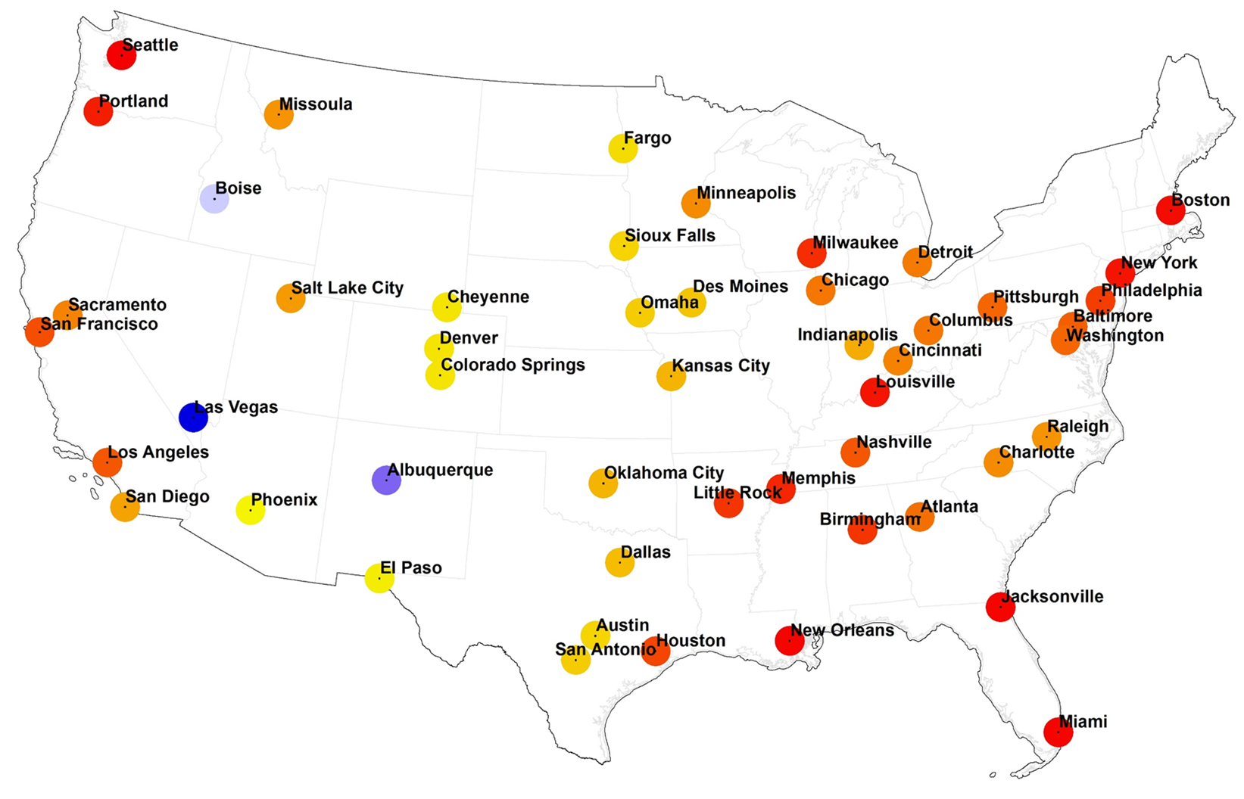
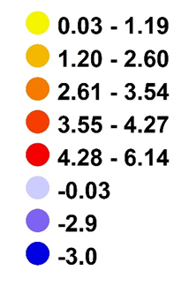
Results
SUHI meanLST average intensity
From 1985-2023
Notes:
Following slides I will show you the results. This figure displays the results of the SUHI intensity analysis, representing the mean SUHI intensity from 1985 to 2023. Red indicates positive values, while blue signifies negative values. The green circles highlight the all selected urban centers to which we have linked SUHI products with census variables.

Slide 8
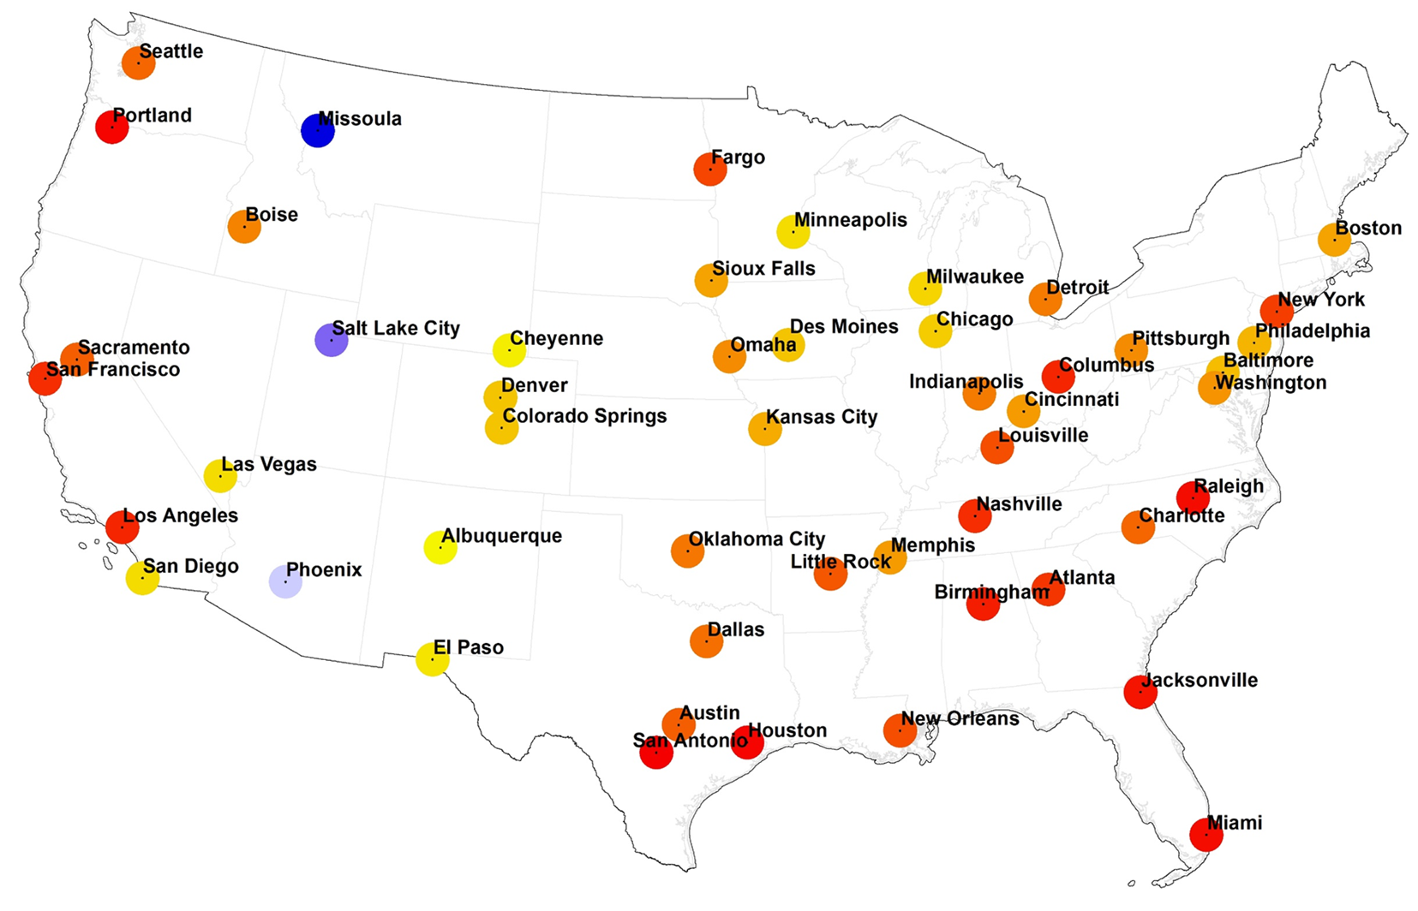
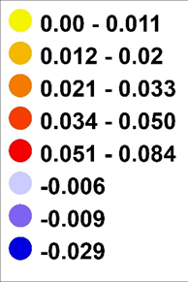
Results
SUHI meanlst intensity trends analysis (slope)
1985-20223
Notes:
This figure presents the results of the SUHI trend analysis in a different way, specifically the slope of the Mean LST from 1985 to 2023. Most major urban centers in CONUS exhibit a positive slope, indicating that the Mean LST has increased from 1985 to 2023. Only three cities experienced a decline. Phoenix and Salt Lake City, located in arid regions, exhibit cool island effects. The green circles highlight the all selected urban centers.

Slide 9
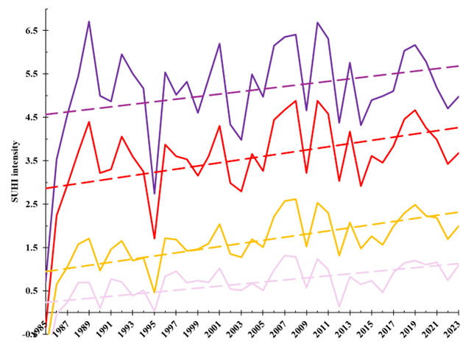
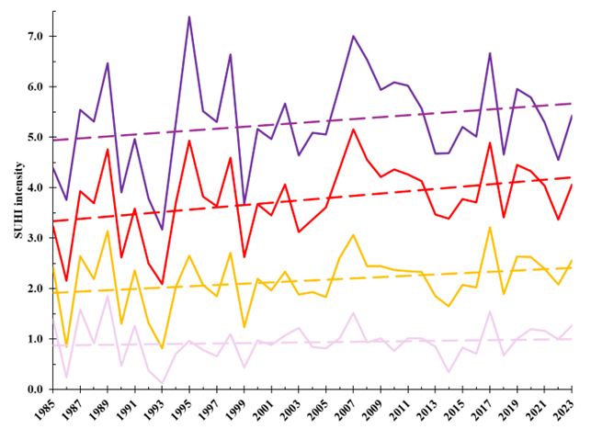
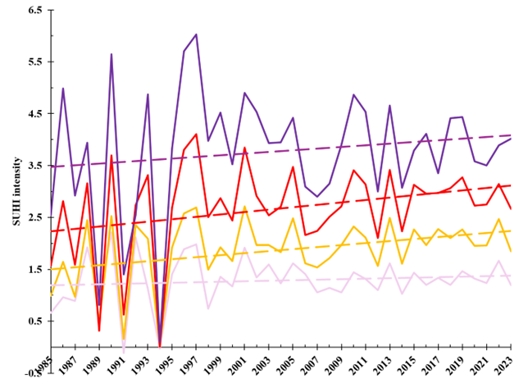
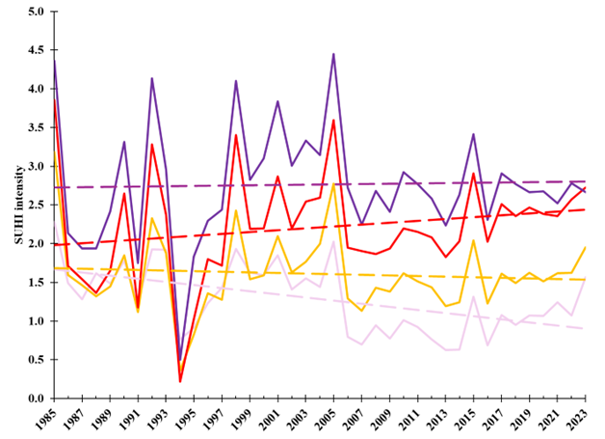
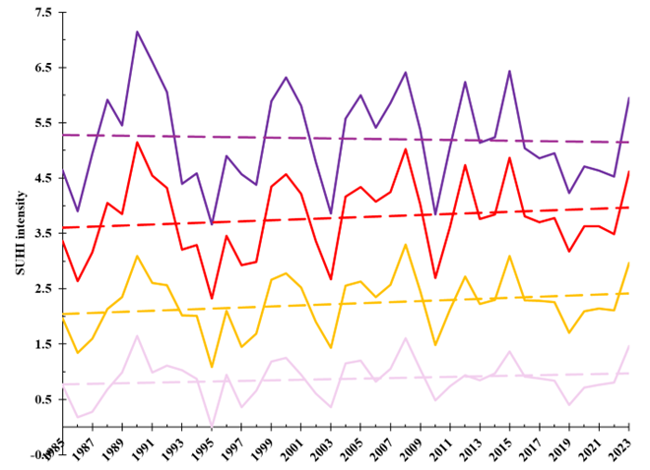

SUHI intensity of MeanLST in urban classes
Atlanta, GA
Washinton DC
Sioux Falls, SD
Phoenix, AZ
Seattle, WA
ΔT (I,t) = Tu (I,t) - ₸r (t)
Notes:
These charts show the SUHI annual mean LST intensity and its trends from 1985 to 2023 across five selected urban centers. We're focusing on how urban areas have changed over time and how those changes relate to heat intensity.

Slide 10
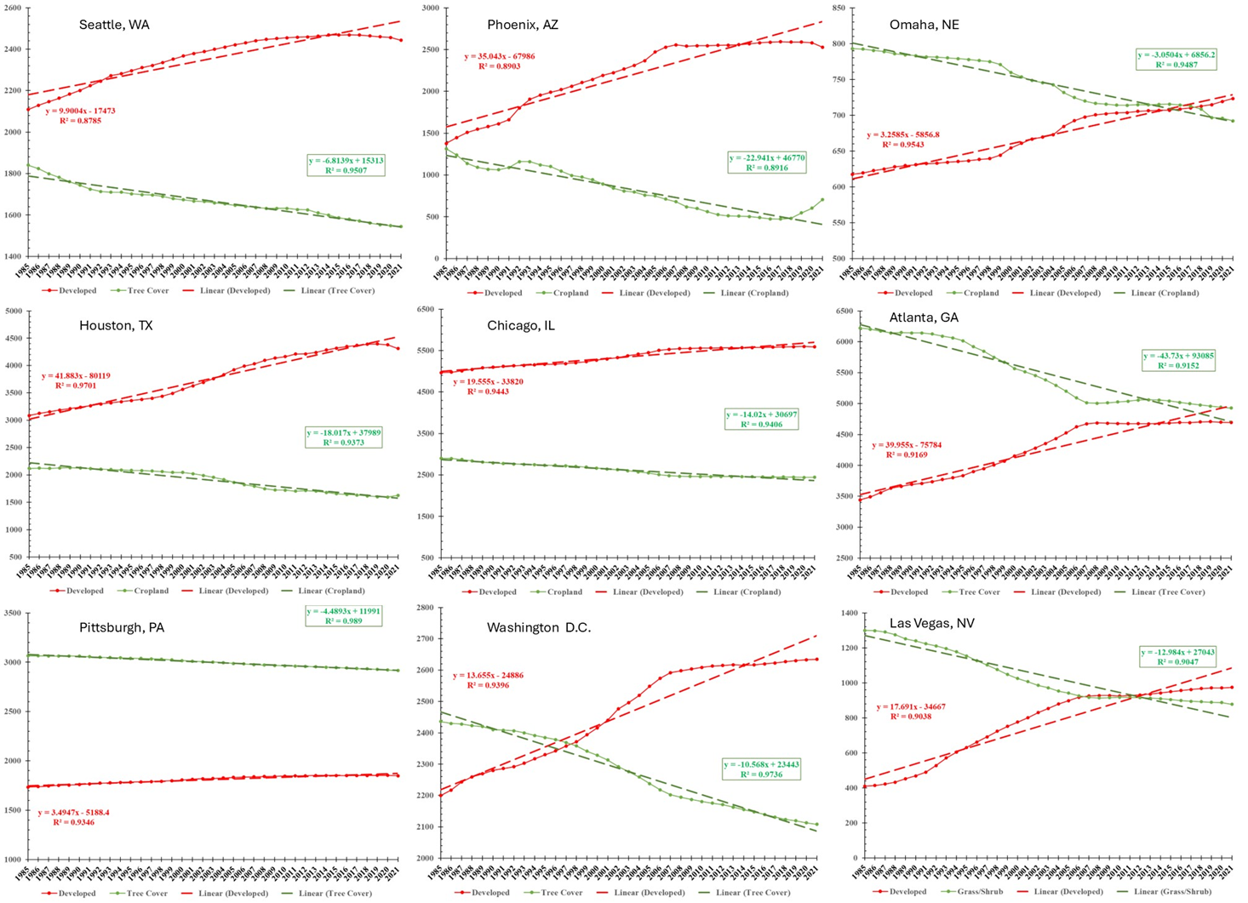
Land cover trends
Urban vs major nonurban from 1985-2023
9 selected representative urban center with 5 km buffer zone
Notes:
This plot shows the land cover trends from 1985 to 2023 for nine selected urban centers within a 5 km buffer zone. The red line indicates urban change, while the green line represents major non-urban change over the same period. Panels a) to i) correspond to Seattle, WA; Phoenix, AZ; Omaha, NE; Houston, TX; Chicago, IL; Atlanta, GA; Pittsburgh, PA; Washington, D.C.; and Las Vegas, NV.

Slide 11
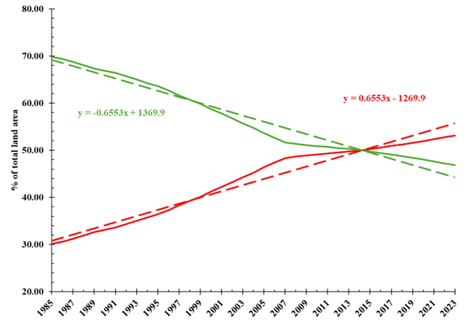
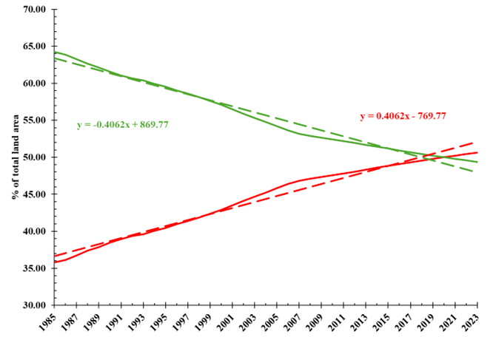
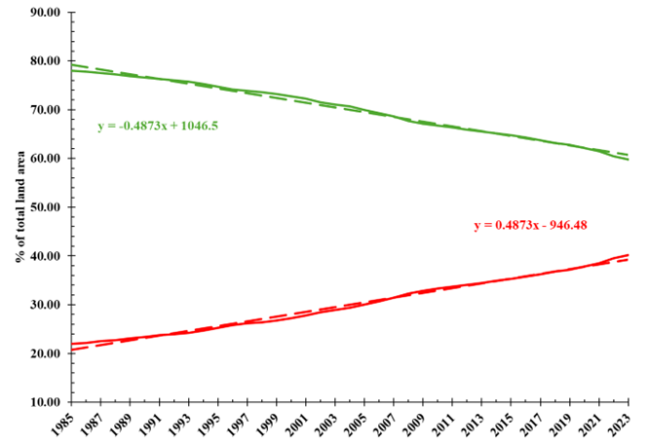
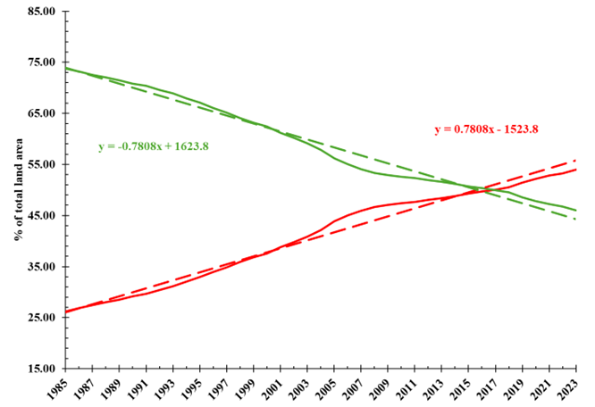
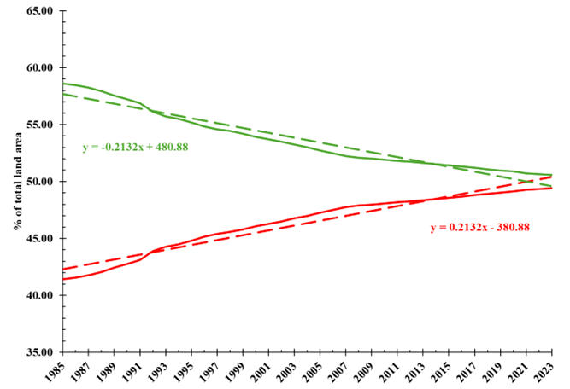

Land cover trends (1985 – 2023)
Atlanta, GA
Washinton DC
Sioux Falls, SD
Phoenix, AZ
Seattle, WA
Urban vs all non-urban
Notes:
This plot shows the land cover trends from 1985 to 2023 for nine selected urban centers within a 5 km buffer zone. The red line indicates urban change, while the green line represents all non-urban change over the same period. Panels a) to i) correspond to Atlanta, GA; Washington, D.C.; Sioux Falls, SD; Phoenix, AZ; Seattle, WA.

Slide 12
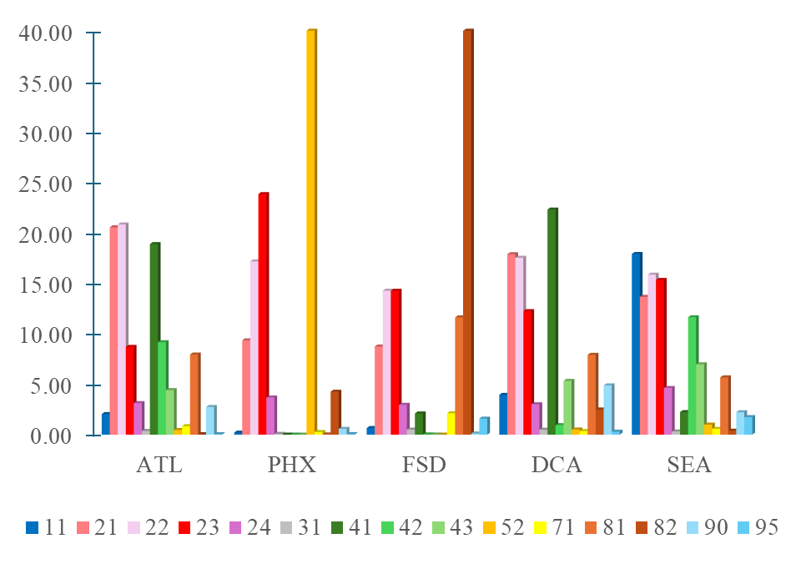
Land cover 2023 by class
11: open water;
21: dev., open space; 22: dev., L intensity; 23: dev., M intensity; 24: dev., H intensity;
31: barren land;
41: deciduous forest;
42: evergreen forest;
43: mixed forest;
52: shrub; 71: herbaceous;
81: hay/pasture, 82 crop;
90: woody wetland;
95: herb wetland
Notes:
This chart shows the percentage of land cover classes within a 5 km buffer zone surrounding five selected urban centers and give you an idea

Slide 13
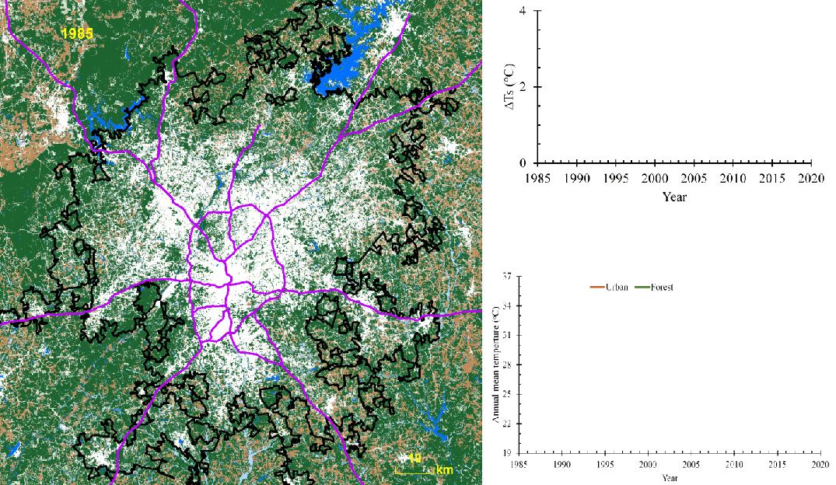
Results
Notes:
Here’s an example of how we applied our research methods in Atlanta, Georgia. On the left, you can see the land cover patterns, which help us understand how different surfaces affect temperature. In the top right, the red line shows how the urban heat island intensity changed over time, from 1985 to 2020. Below that, we compared air temperature data from two NOAA GHCN weather stations: one in the urban area near the airport (dark brown line), and one in a nearby forested area (green line).Together, these visuals show how changes in land cover relate to temperature trends, and how our satellite-based analysis aligns with ground-based observations over the same period.

Slide 14
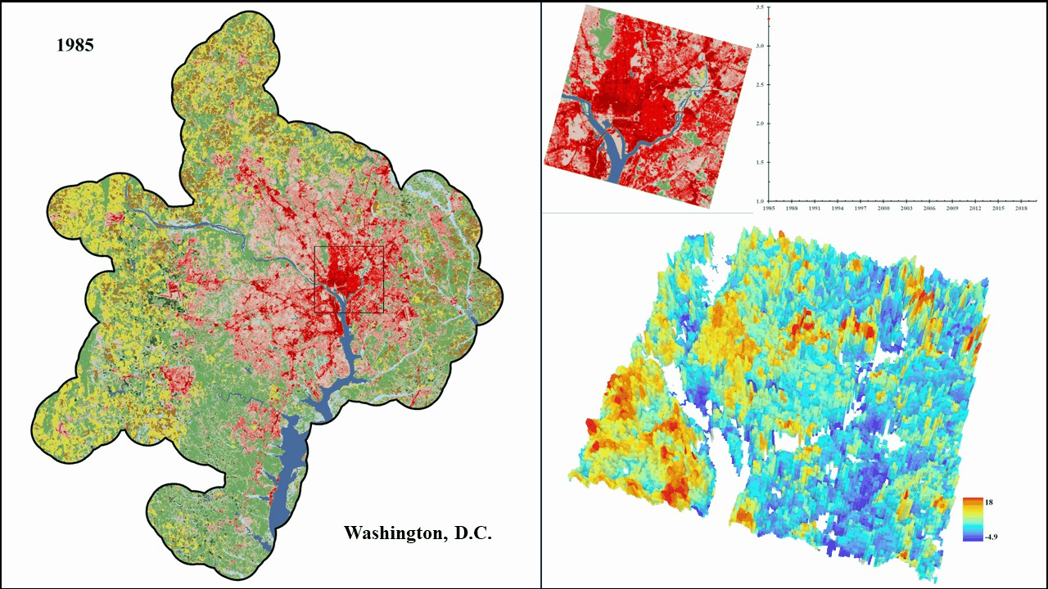
Results
Notes:
This short animation shows for Washington, D.C. area. On the left, you’ll see how land cover has changed over time. The top right graph tracks the average SUHI intensity from 1985 to 2020, with the red line showing temperature differences between urban and nearby non-urban areas. At the bottom right, there’s a 3D animation that zooms in on one area to show how SUHI intensity has changed spatially over time.

Slide 15
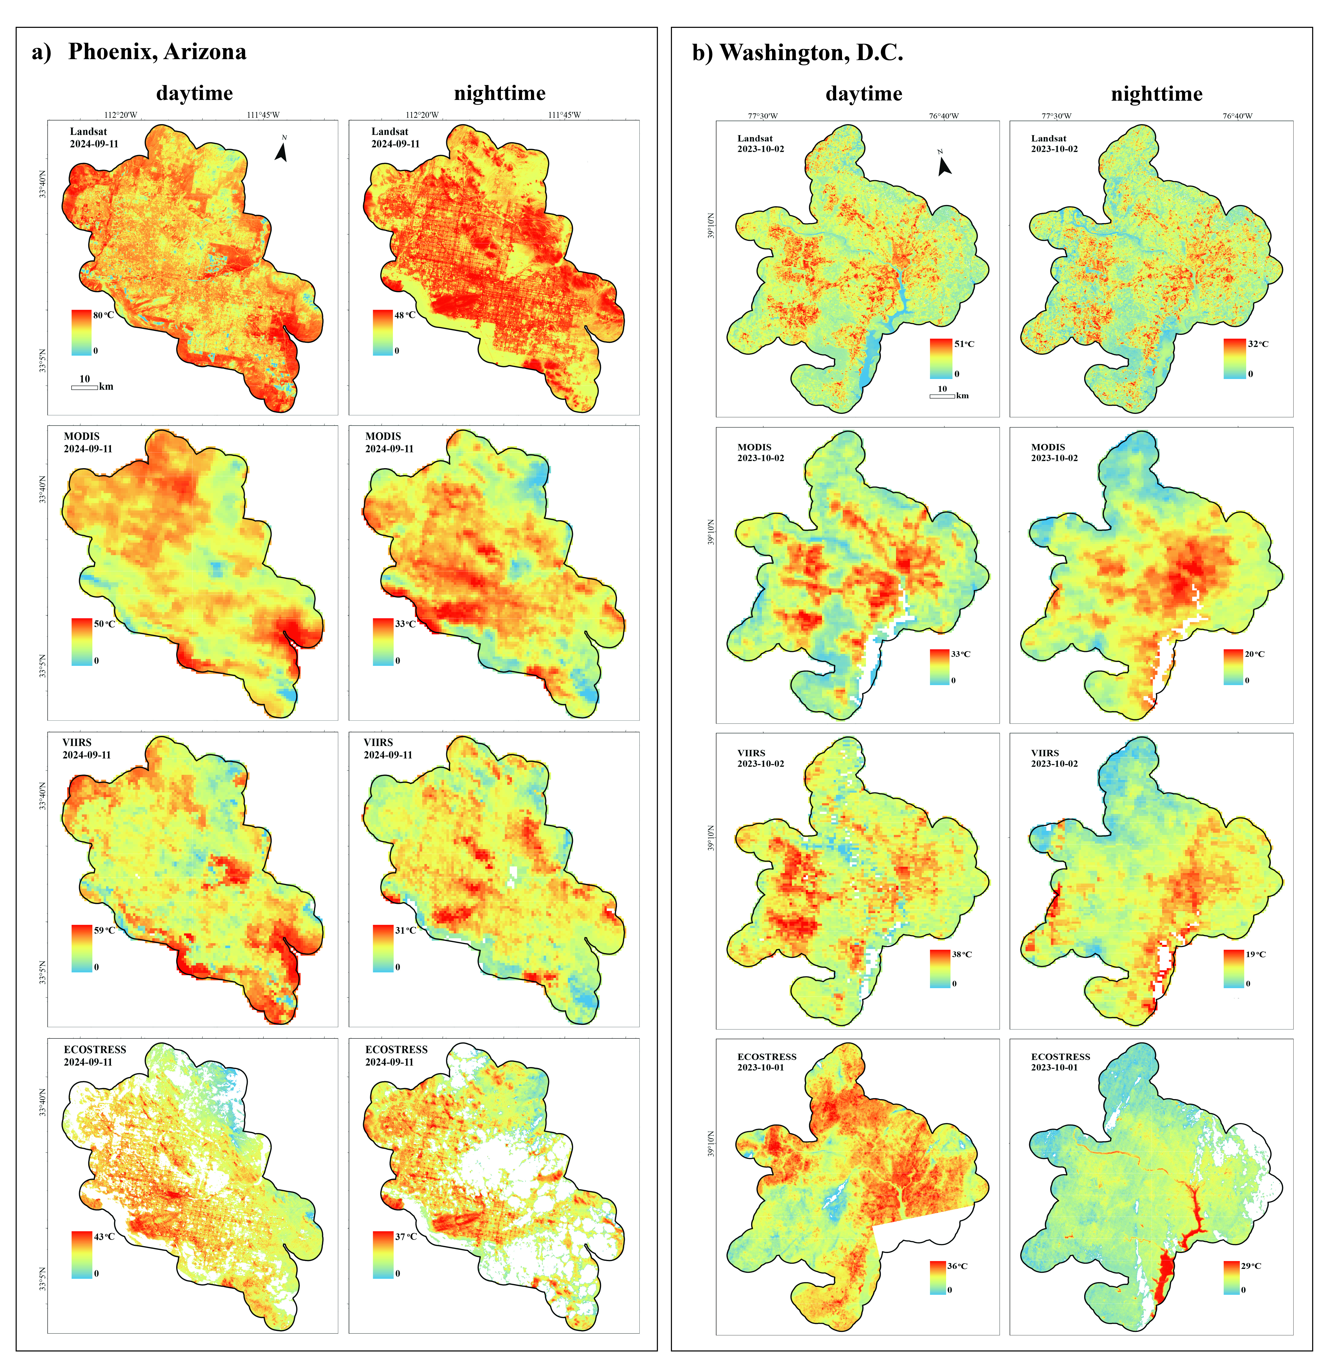
Comparison
Daytime and nighttime ST from Landsat, MODIS, VIIRS and ECOSTRESS
Phoenix: Sept. 11, 2024
Washington DC: Oct. 02, 2023
Notes:
These maps show daytime and nighttime surface temperatures for the Phoenix and Washington, D.C. areas, using data from Landsat, MODIS, VIIRS, and ECOSTRESS that arranged from top to bottom. All images were captured on the same day or very close dates to ensure consistency. For both cities, we focused our analysis within a 5 km buffer around their 2023 boundaries, which helps us compare urban and nearby non-urban temperature patterns more accurately.

Slide 16
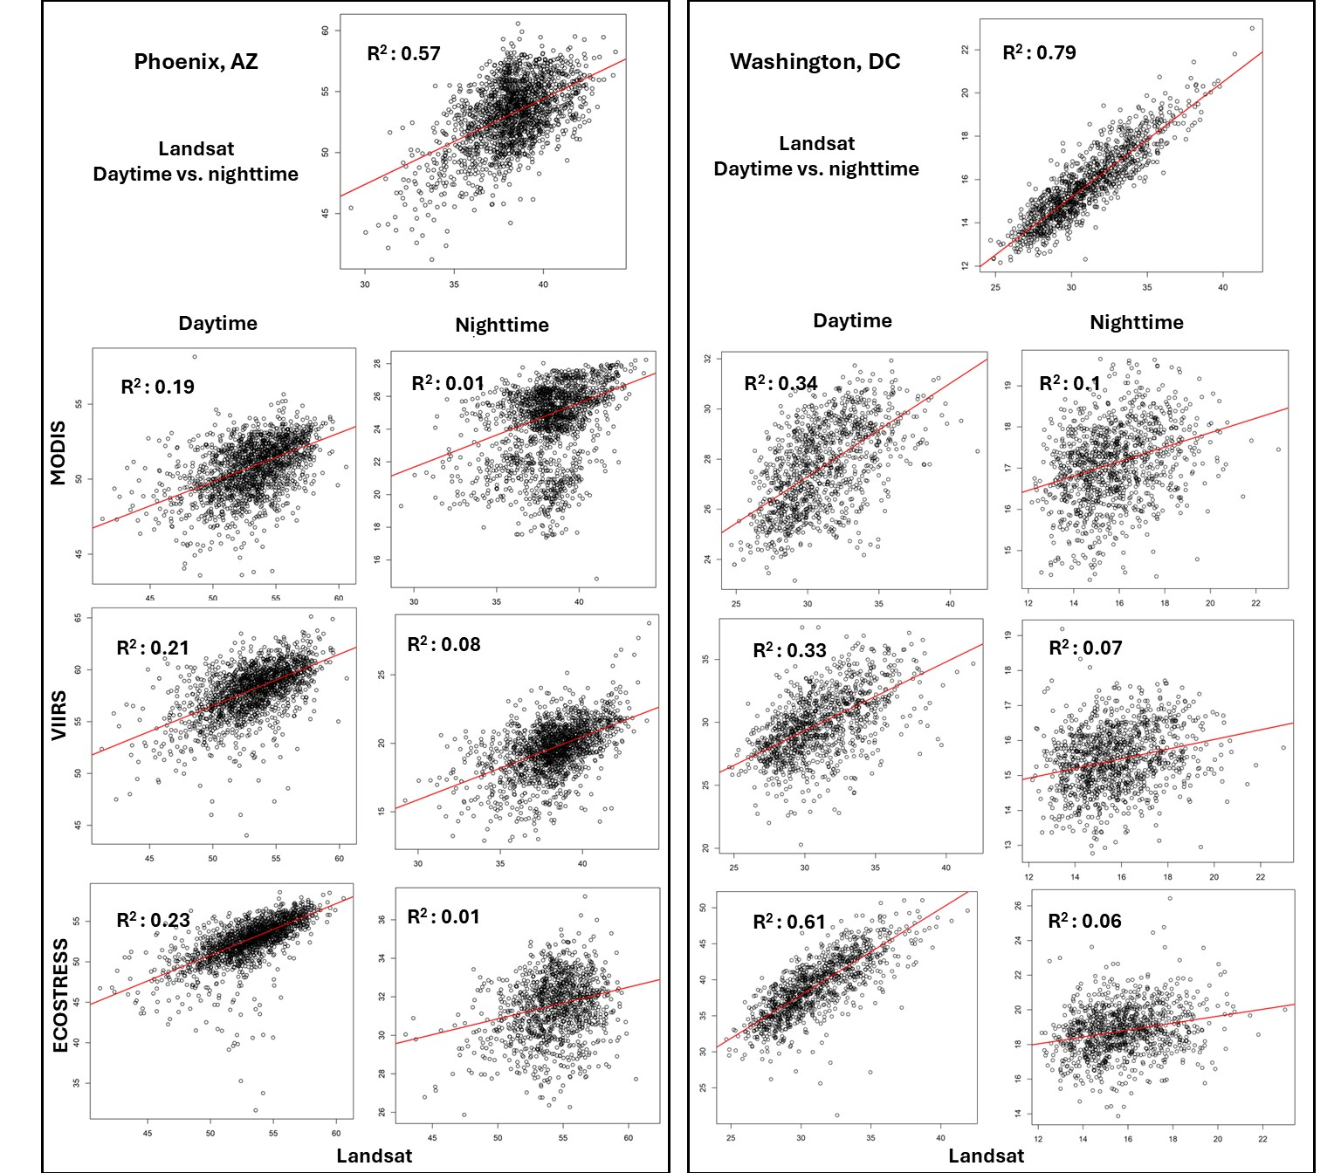
Comparison
Daytime and nighttime ST from Landsat, MODIS, VIIRS and ECOSTRESS
Phoenix: Sept. 11, 2024
Washington DC: Oct. 02, 2023
Notes:
These plots show how surface temperatures—both daytime and nighttime—correlate across four satellite sensors: Landsat, MODIS, VIIRS, and ECOSTRESS. The data is shown from top to bottom for Phoenix and Washington, D.C., using images captured on the same or closely aligned dates. For consistency, we focused on a 5 km buffer around each city's 2023 boundaries. This helps us compare how different sensors capture temperature patterns in urban and nearby non-urban areas.

Slide 17
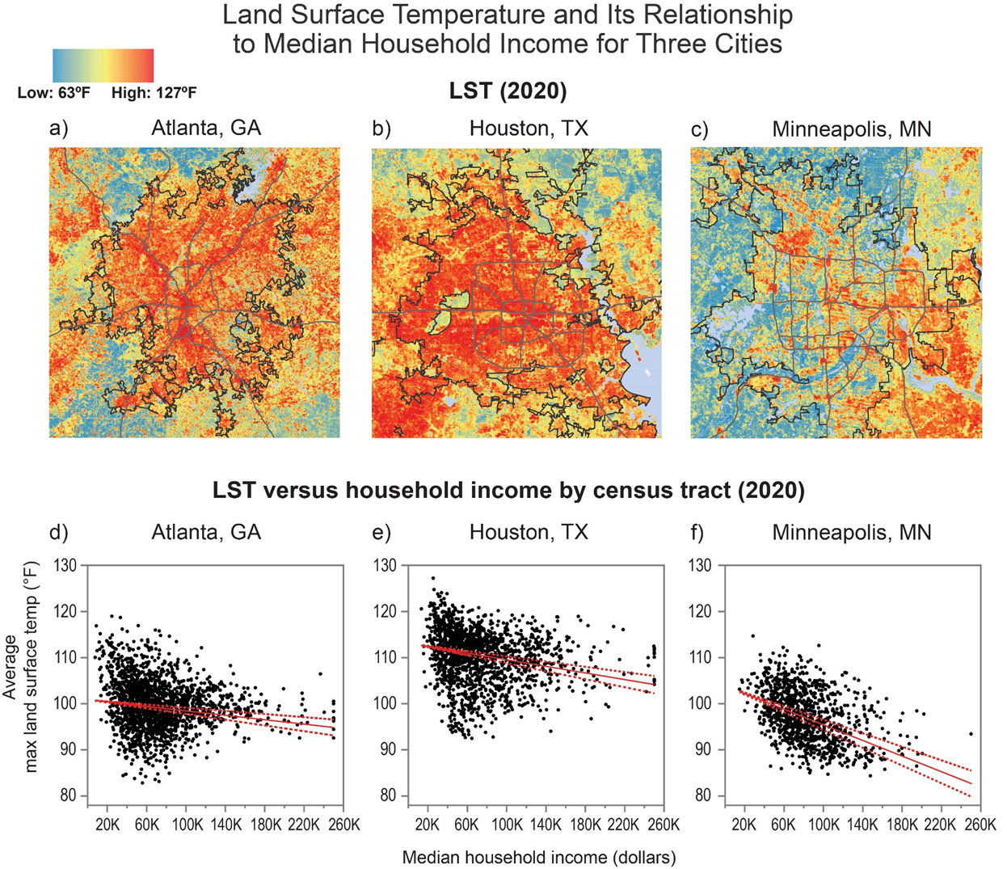
Linkage
SUHI Landsat land surface temperature (LST) and its relationship to median household incomes for three cities.
Notes:
This example shows how we connect SUHI data with census socio-economic information. The maps display the maxLST in 2020 for three cities: Atlanta (a), Houston (b), and Minneapolis (c). The plots (d, e, f) show how maxLST relates to median household income across different census tracts in each city. Our analysis found a clear trend: areas with higher income tend to have lower surface temperatures.

Slide 18
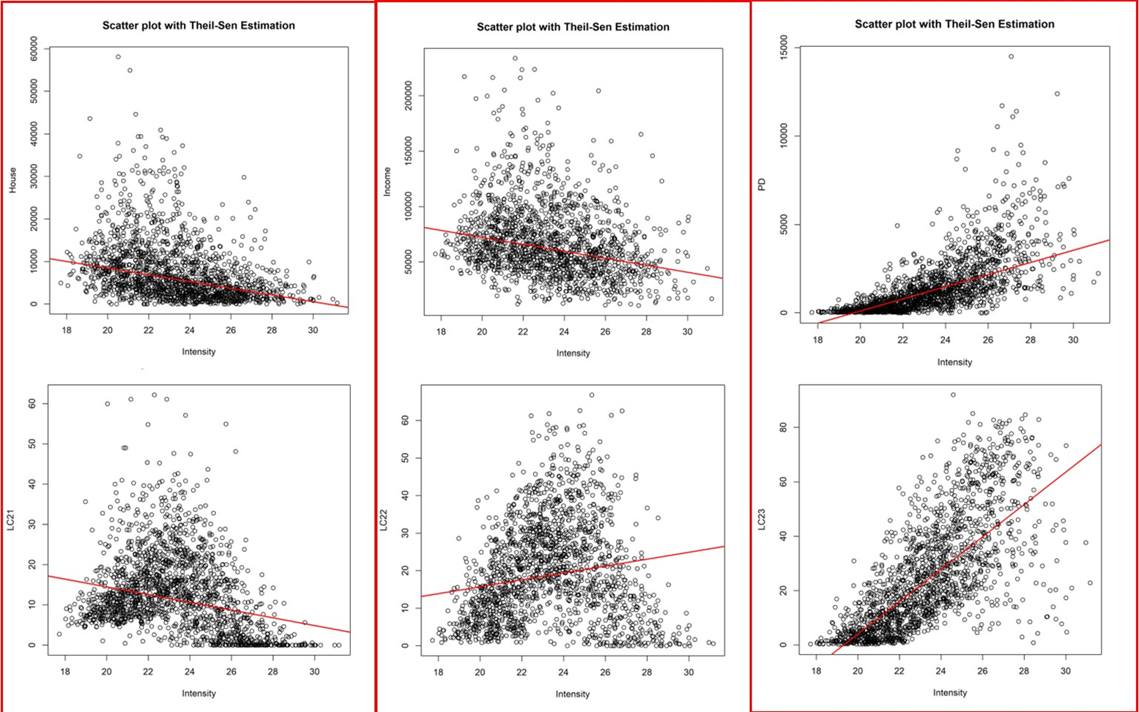
Linkage
Assessment of Increasing Temporal Frequency for Landsat-Based Time Series Land Surface Temperature Product
Notes:
These plots show similar results for Pittsburgh, Pennsylvania. On the top row, each graph compares meanLST in 2020 with different socio-economic factors: house value on the left, household income in the middle, and population density on the right. As you can see, areas with higher house values and incomes tend to have lower surface temperatures, while population density tends to decrease as temperatures rise. On the bottom row, we look at how LST relates to different types of urban land cover from the NLCD dataset. The low-intensity urban area, we see that meanLST decreases as the percentage of this land cover goes down. On the other hand, meanLST increases with higher percentages of high-intensity urban areas.

Slide 19
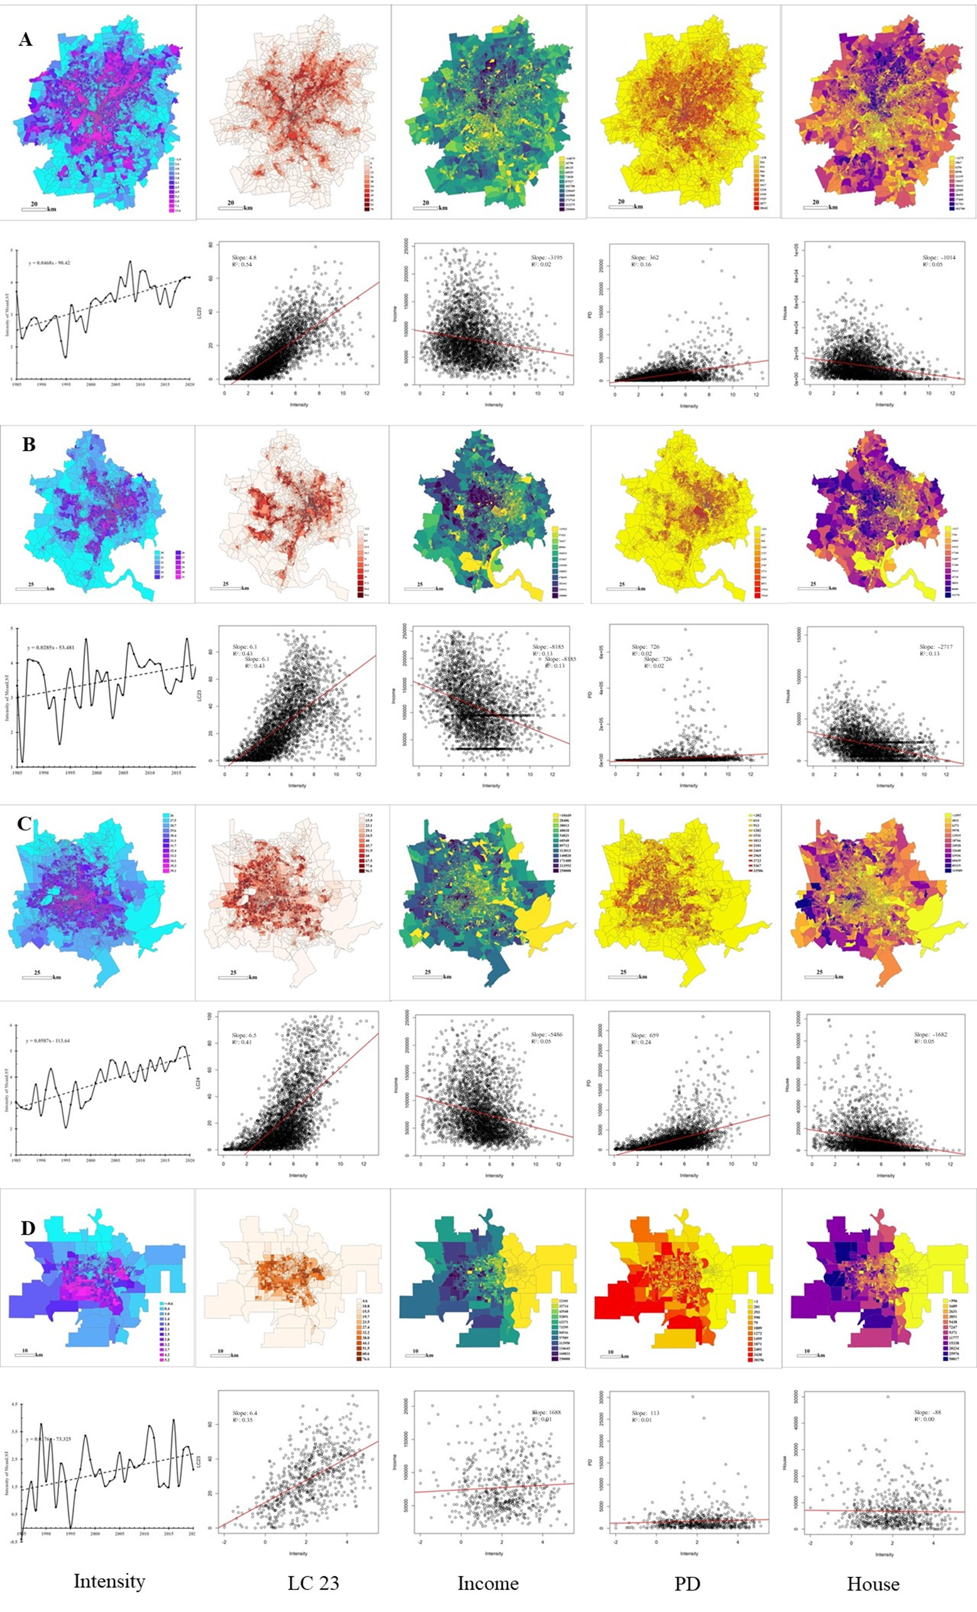
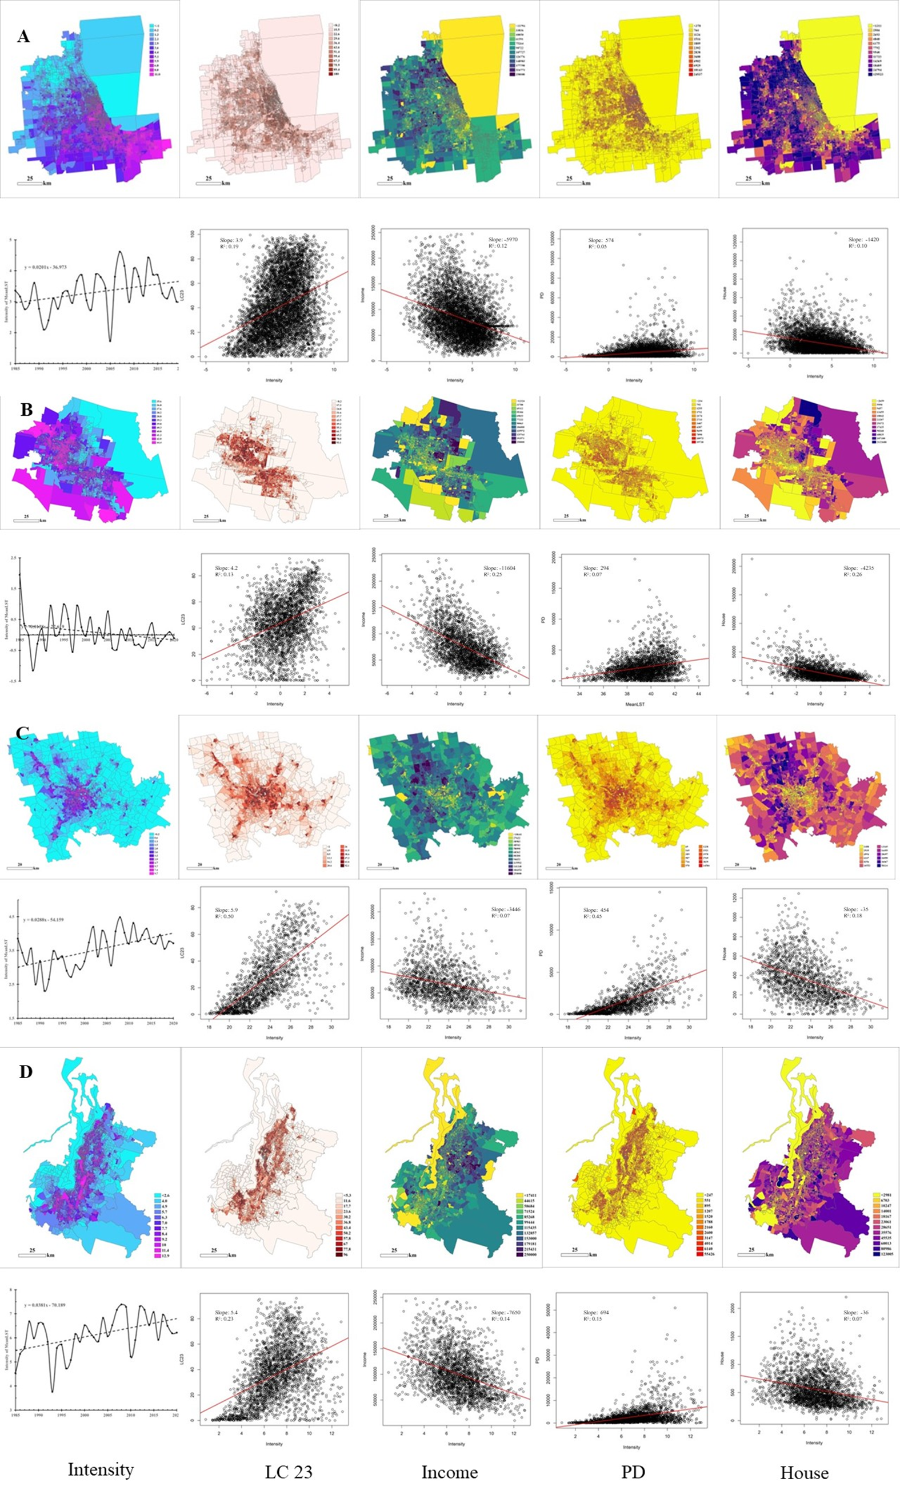
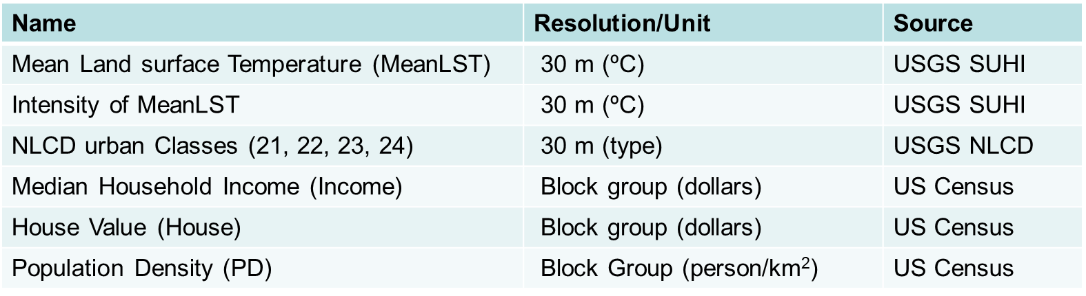
Linkage
Urbanization Related Warming: Addressing Social and Economic Aspects in Land Surface Temperature
Notes:
This figure shows how SUHI intensity relates to different factors across eight representative urban centers. We looked at land cover, income, population density, and house value at the Census block group level.
On the left, we have Atlanta, Washington D.C., Houston, and Omaha. On the right, you’ll see Chicago, Phoenix, Pittsburgh, and Seattle. The top panels show the spatial patterns of SUHI intensity and the four variables. The bottom panels highlight how SUHI intensity correlates with each one.
For example, in Atlanta, we found that areas with more urban land cover and higher population density tend to have higher surface temperatures. In contrast, neighborhoods with higher income and house values generally show lower temperatures—likely due to more green space and water features.
These patterns help us understand how social and environmental factors influence heat exposure, and they highlight the need for targeted strategies to protect vulnerable communities as cities continue to grow.

Slide 20
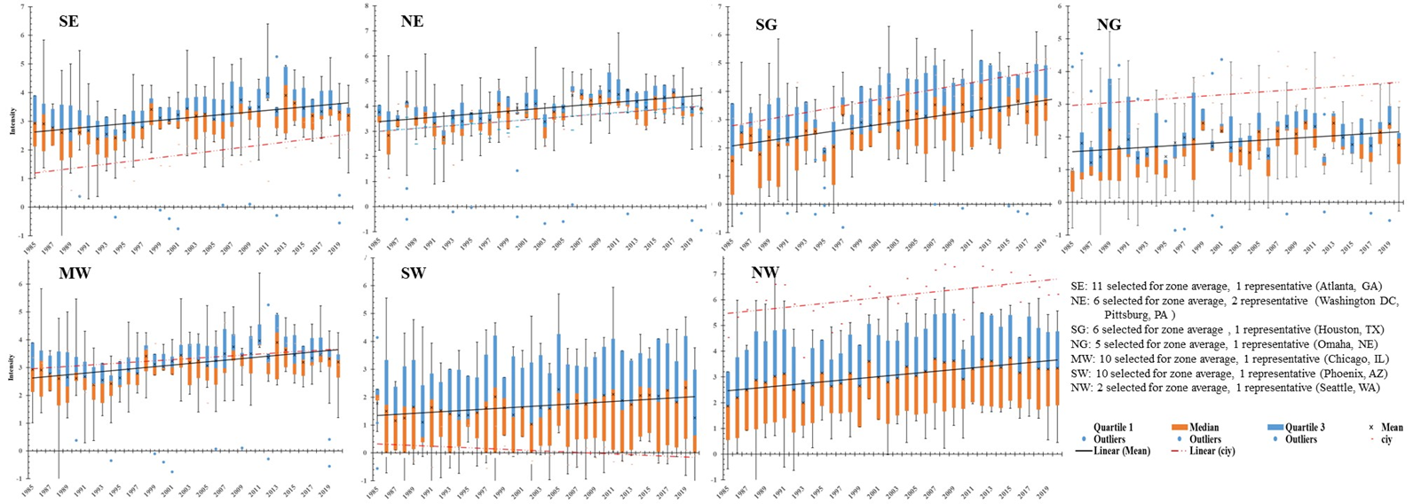
Representative urban center vs average of region
Notes:
To evaluate how well our selected urban centers represent SUHI intensity across the seven NCA climate zones, we compared their temperature trends with the average from all urban centers in each zone. In the plot, the solid line shows the average SUHI intensity for all cities in a zone, while the dashed line shows the trend for the representative city—from 1985 to 2020.
Overall, most representative cities follow similar SUHI patterns as their regions, except for Phoenix in the Southwest, which stands out. This suggests that future studies should include more cities per zone and consider regional differences more closely—especially in unique climates like arid regions. Doing so will help us better understand how urban heat varies across the country and how it may evolve with climate change.

Slide 21
Conclusion
Landsat SUHI measurement
Land cover impact
Regional SUHI trends
Multi-sensor with diurnal LST insights
Social-economical connections
Equity implications
Planning for the future
Notes:
Here are the key takeaways: 1). Landsat thermal data helps track SUHI intensity and changes over time; 2). Different urban land types show varying SUHI levels, useful for mitigation planning; 3). SUHI patterns are linked to land cover changes across regions, and our approach effectively maps SUHI across large areas. 4). Day and night satellite thermal data show consistent SUHI trends with some differences from multiple sensors; 5). SUHI is related to population, income, house value, and land cover—highlighting environmental and social disparities; 6). Hotter areas often have lower income, more impervious surfaces, and greater racial/ethnic diversity, while cooler areas tend to have more vegetation, more water bodies, and higher income within study areas. 7) Understanding SUHI is key for climate resilience and protecting vulnerable communities as urbanization grows.

Slide 22

Questions?
Thanks!

