Slide 1

Urbanization Related Warming: Addressing Social and Economic Aspects in Land Surface Temperature
Hua Shi, AFDS contractor to USGS/EROS
ASRC Federal Proprietary
Notes:
Good afternoon, everyone. Today, my talk will focus on 'Urbanization-Related Warming: Addressing Social and Economic Aspects in Land Surface Temperature.' I will approach this topic from a different perspective to discuss the linkages between SUHI products, land cover dynamics, human population density, and socio-economic factors derived from the U.S. Census. I will also showcase some results from our SUHI research.

Slide 2

Outline
1
Background
2
Objective
3
Study area
4
Data and Methods
5
Results
6
Conclusion
Notes:
My presentation will cover six key points. First, I will provide some background information. Second, I will discuss our objectives. Next, I will present the study areas we selected. Then, I will explain the data and methods used. After that, I will delve into the results. Finally, I will summarize the key takeaways and conclusions.

Slide 3
Background
Notes:
Background

Slide 4
Background
Urban areas are vital components of the landscape, offering essential social and economic functions for human habitats
  Impervious surface area (ISA) is highly connected to urban land use condition, such as the size and density of built-up areas
  ISA has been widely recognized as an important data source to describe urbanization quantitatively at both regional and national scales
Surface Urban Heat Island (SUHI) is a biophysical effect associated with urban development
  Surface temperatures in urban areas are usually higher than that in the surrounding rural areas
  Thermal remote sensing has been used over urban areas to assess the SUHI effects
  Perform land cover classifications and as input for models of urban surface atmosphere exchanges
Needs and requirements
  The research effort will provide a time series of Landsat spectral and thermal information in characterizing urban thermal characteristics
  Comparison results will describe the benefits and limitations of Landsat thermal data in characterizing urban thermal features
  requirements from EPA, NIH/NIEHS, NCA 6, and NOAA
Scientific research in urban ecosystems and wildland-unban interface
  SUHI theoretical questions (concepts), methodologies development, and its applications
Notes:
I will begin with the background of Surface Urban Heat Island (SUHI) research. Urban areas serve as crucial habitats for human beings. The expansion of impervious surfaces in urban ecosystems contributes to increased surface temperatures. SUHI is a significant biophysical effect associated with urban development. There are numerous needs and requirements from urban planners and policymakers, as well as from agencies like the EPA, NIH/NIEHS, and NOAA, along with local governments and the urban-wildland interface research community. Moreover, SUHI is an important scientific research topic in urban ecosystems, particularly in the context of climate change. This research aligns with the focus of USGS Core Science Systems and contributes to the Land Change Monitoring Capability for Climate and Global Issues (CGI). Linking SUHI products with land cover dynamics, human population density, and socio-economic factors from census data is a key area of application in SUHI research.
The National Institutes of Health (NIH)
National Institute of Environmental Health Sciences (NIEHS)

Slide 5
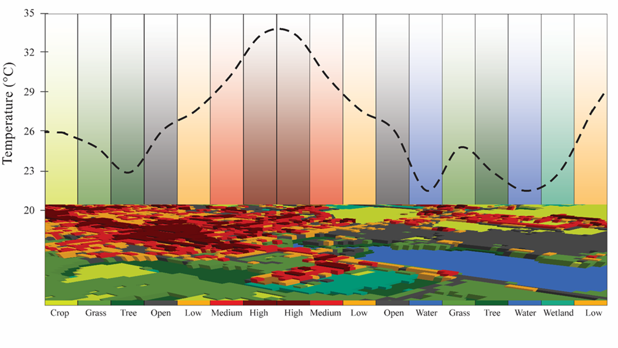
Background
Notes:
To help you better understand the effects of SUHI, we can study the spatial structure of urban thermal patterns and temporal change dynamics in both two and three dimensions, based on the fractional theory of urban ecology. The figure shows an example of SUHI and SUHI intensity profiles in Sioux Falls, SD, and the surrounding area, derived from Landsat ARD LST by land cover classes. A SUHI is the surface of a metropolitan area that is significantly warmer than the surrounding rural areas. We define Surface Urban Heat Island Intensity (SUHII) as the difference in land surface temperature between urban and suburban areas.
As we know, urbanization, coupled with climate change, drives land surface temperatures higher by intensifying heat exposure. Socioeconomic disparities contribute to unequal heat impacts, resulting in increased heat-related energy costs, illnesses, and mortality. The acceleration of climate change exacerbates these concerns, particularly for historically disadvantaged communities who faced systemic discrimination and underinvestment.

Slide 6

Objectives
Divider Subtitle
ASRC Federal Proprietary

Slide 7
Objectives
  Investigate how urban-induced warming varies across different regions in the contiguous United States (CONUS)
  Develop methods to quantify SUHI products, including the extent, intensity, and hotspots of land surface temperature (LST)
  Research changes in SUHI phenomenon and conduct trend analyses with land cover dynamics
  Establish methods to link SUHI Landsat products with land cover dynamics, population density, and census variables
  Analyze census data and selected variables to inform model inputs
  Determine the relationship between SUHI products and socio-economic factors related to population and urban land cover change.
Notes:
The primary goals of the SUHI research are as follows: First, to investigate how urban-induced warming varies across different regions in the contiguous United States (CONUS). Second, to develop methods and models to quantify SUHI extent, calculate SUHI intensity, and identify SUHI hotspots in selected urban centers within the seven North Central Assessment (NCA) climate zones. Third, to conduct research on SUHI changes and trend analyses, focusing on the effects of urban land cover dynamics on urban heat island intensity and temporal trends. Fourth, to develop methods that link SUHI Landsat products with land cover dynamics, population density, and census variables. Next, to analyze census data and selected variables to inform model inputs. Finally, linking SUHI products to specific environmental, social, and human health consequences represents a significant benefit of land change science.

Slide 8
Study Area

Slide 9
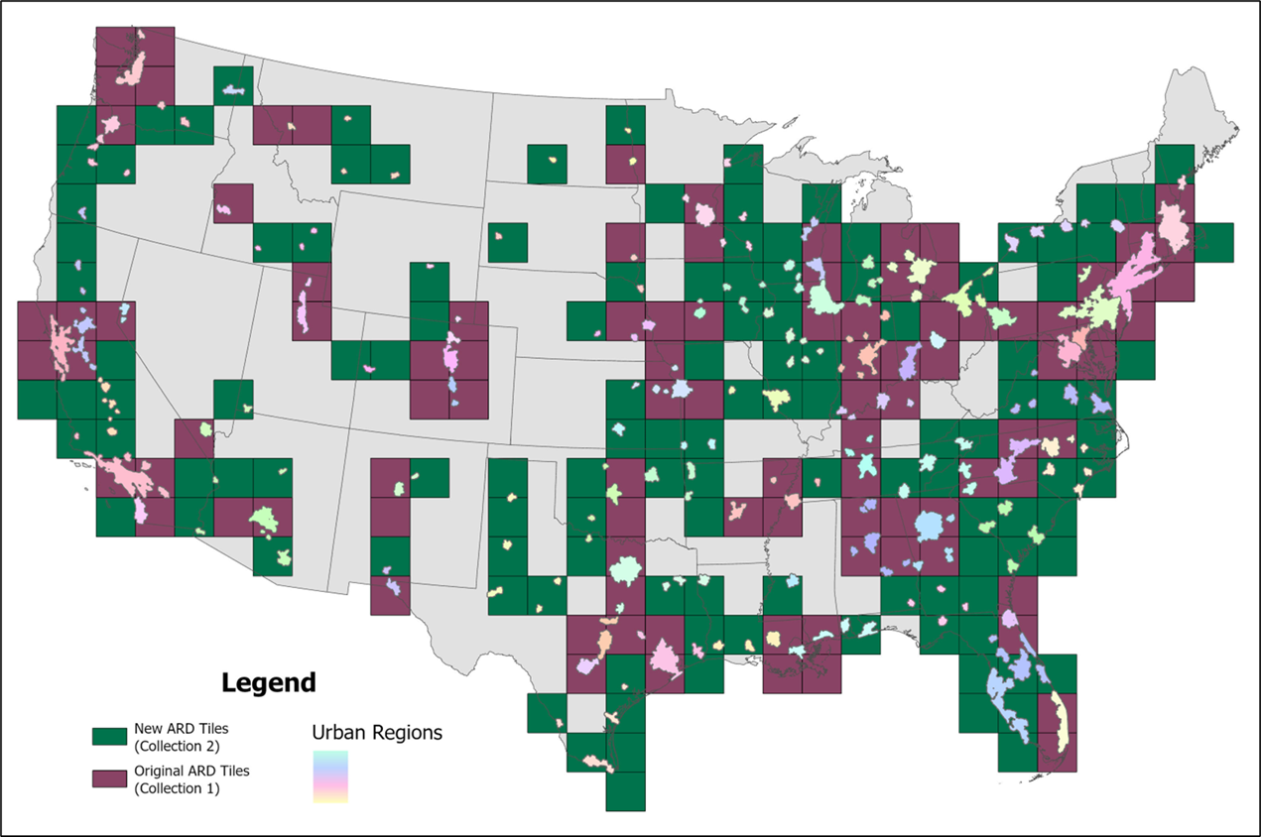
SUHI C1 selected 50 and C2 71 major urban center in CONUS
Population > 50 k
351 urban centers in CONUS
226 ARD tiles (C1 91)
Notes:
In our work with Landsat Collection 1 on the Surface Urban Heat Island (SUHI) phenomenon, we focused on 50 urban centers (highlighted in maroon). This slide presents the updated study regions for SUHI research using Landsat Collection 2 data, which has expanded from 50 to 71 urban centers. Our analysis will encompass the entire contiguous United States (CONUS), including 886 cities or towns with populations of 50,000 or more, consolidated into 351 suburban centers and integrated into the 71 major urban centers in CONUS. This figure illustrates the locations of the 71 selected urban centers and their surrounding 280 suburban centers within the Landsat ARD tiles. The dark green color indicates the newly added ARD tiles for Landsat Collection 2. In this study, we will continue to use SUHI products from Collection 1 since the work involving Collection 2 has not yet been completed.

Slide 10
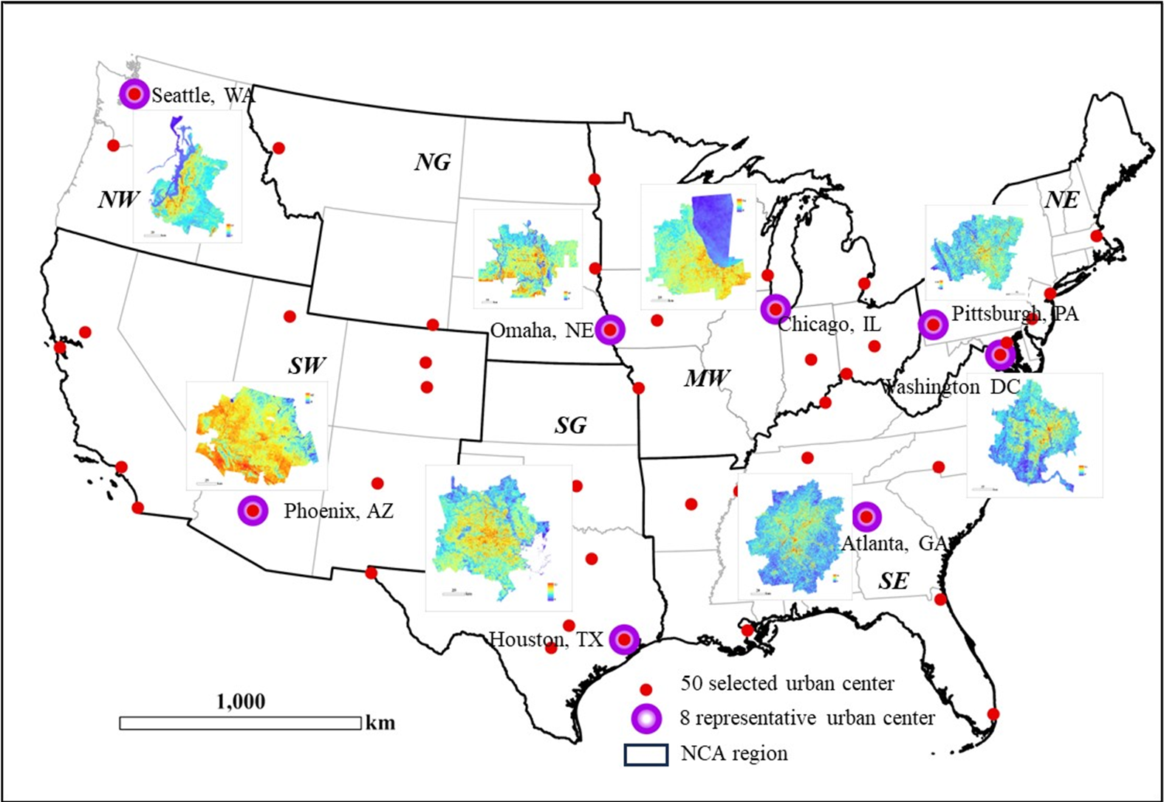
Study area
Eight urban centers
Within seven NCA zones
50 urban centers
Seattle, WA
Phoenix, AZ
Omaha, NE
Houston, TX
Chicago, IL
Atlanta, GA
Pittsburg, PA
Washington DC
Notes:
This map displays the eight representative urban centers (or pilot areas) we selected in the CONUS. It shows the mean land surface temperatures in these representative urban centers within seven National Climate Assessment (NCA) regions for 2020. The seven NCA regions include Southeast (SE), Northeast (NE), South Great Plains (SG), North Great Plains (NG), Midwest (MW), Southwest (SW), and Northwest (NW), with the selected 50 urban centers marked by red dots.

Slide 11
Data and Method
Divider Subtitle
ASRC Federal Proprietary

Slide 12
Data
Data used in the study:
  Landsat
    ARD thermal band (1984-2023)
    QA band (1984-2023)
  Annual NCLD
    Annual NLCD urban 4 urban classes (1985-2023)
    Annal NLCD nonurban classes
  U.S. census data
    City limits
    Median household incomes
    House value
    Population density
  Other
Notes:
Here is list of data we used for this study, which including Landsat thermal and QA bands, annual NLCD products, U.S. census data, and other data.

Slide 13
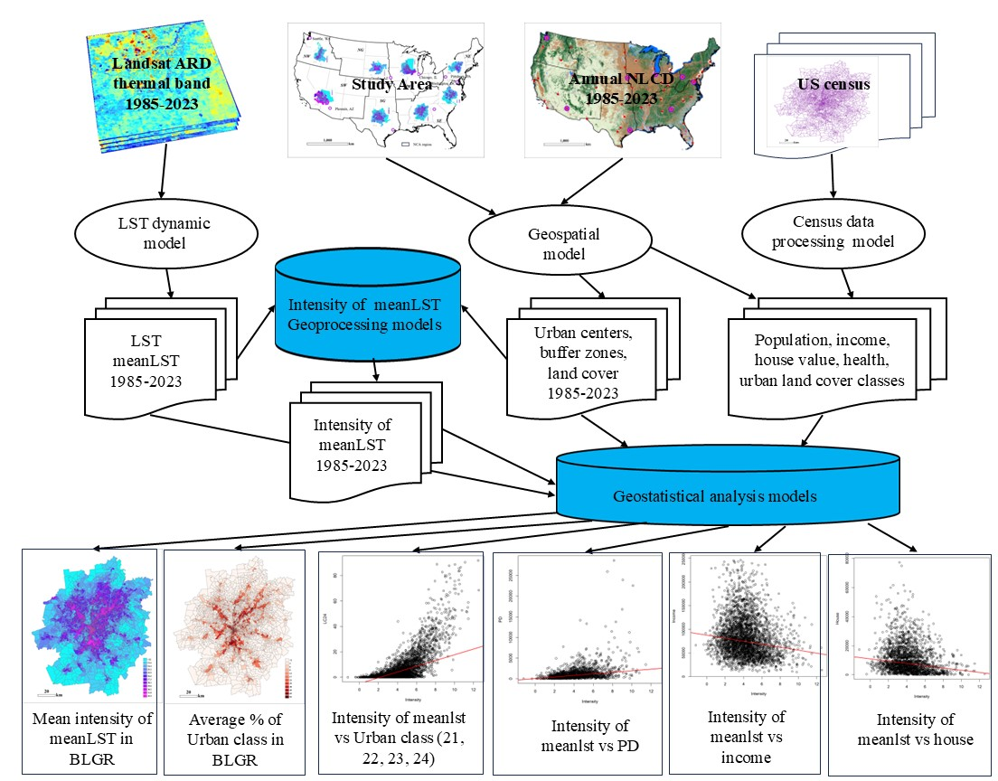
Methods
data mining and processing
sensitivity analysis of input data, including 1) census units' size (zip code area, tract, and block group) and temporal analysis; 2) Landsat LST
the statistical trend analysis (the Theil-Sen estimator)
mean intensity in seven NCA zones from 50 selected urban centers in CONUS
comparison of the intensity between the selected representative urban centers with the mean intensity of the NCA zones
Notes:
This flowchart show major procedures used in the study. Main steps including
Step 1 – data mining and processing
Step 2 – sensitivity analysis of input data, including 1) census units' size (zip code area, tract, and block group) and temporal analysis; 2) Landsat LST
Step 3 – the statistical trend analysis (the Theil-Sen estimator)
Step 4 – mean intensity in seven NCA zones from 50 selected urban centers in CONUS
Step 5 – comparison of the intensity between the selected representative urban centers with the mean intensity of the NCA zones

Slide 14
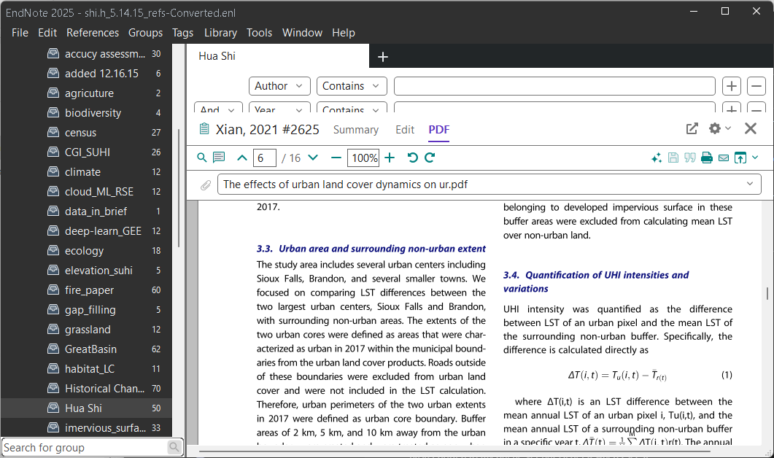
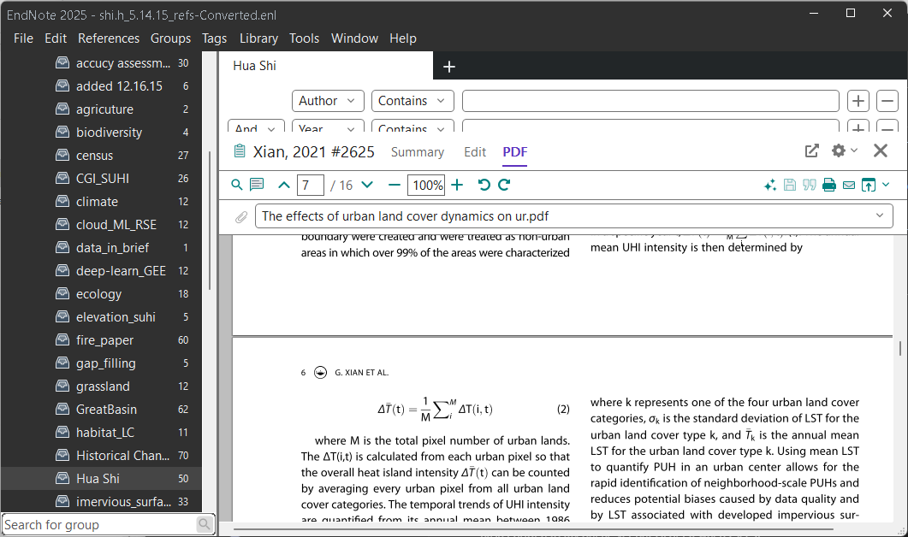
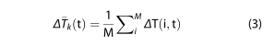
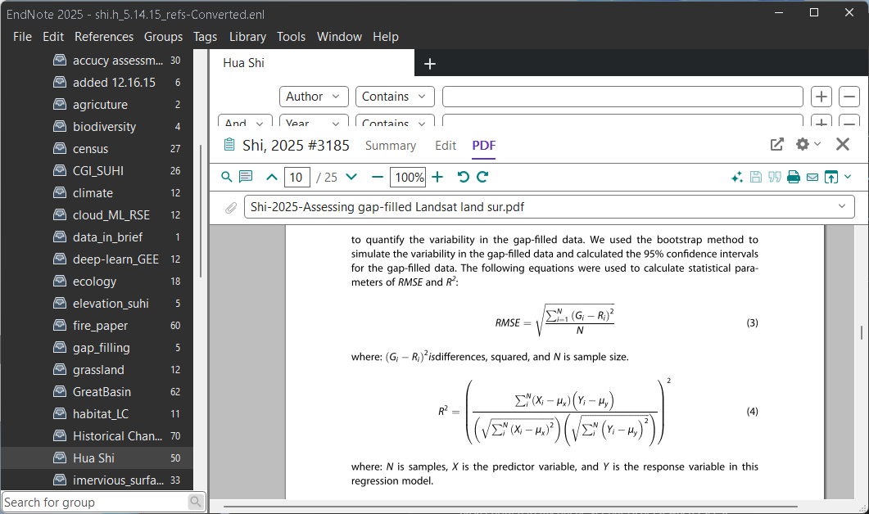
Formulars used in research
1. Quantification of SUHI intensities and variations:
2. Statistical models (Theil-Sen estimator and linear regression)
3. Sensitivity analysis: size of buffer zone (2 km, 5 km, and 10 km);
level of census units (Zip code tabulation area (ZCTA),
Census Tract, and Block Group (BG))
Notes:
This slide presents the formulas we used for calculation and analysis. SUHI intensity refers to the difference in surface temperature between urban areas and their surrounding rural or non-urban areas, providing insight into the extent of heat retention and the impact of urbanization on local climates. High SUHI intensity can have significant implications for energy consumption, air quality, and public health in urban areas. Statistical models were employed to analyze the relationship between SUHI products and socio-economic variables derived from census data. We also conducted a sensitivity analysis to assess how buffer sizes and the level of census units impact the results. Based on this analysis, we determined that using a 5 km buffer with census block group units yields the best results for the study.

Slide 15
Results

Slide 16
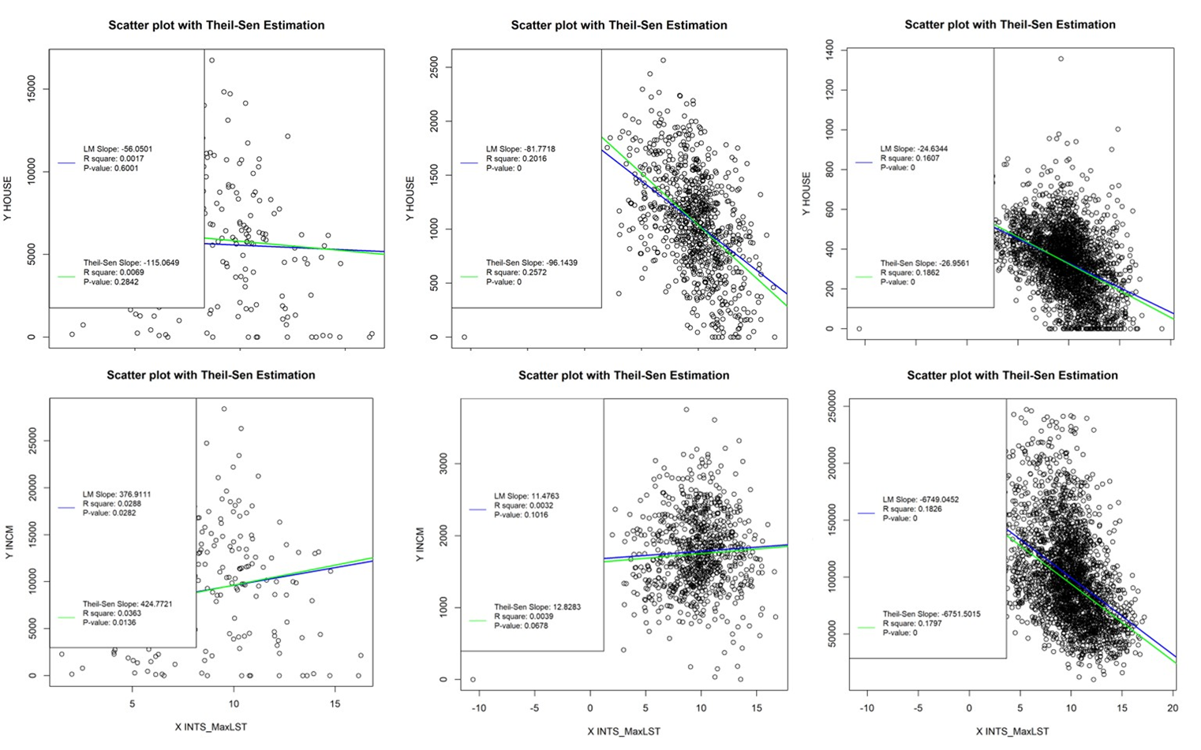
Results
Level of census units
Notes:
We conducted a sensitivity analysis focusing on two main factors: (1) the size of buffer zones and (2) the level of census units. For the buffer zones, we evaluated sizes of 2, 5, and 10 km to determine which would yield better results regarding SUHI intensity. Our findings indicate that the 5 km buffer zone is the most suitable choice for this study, as all non-urban classes should ideally be greater than or equal to 60%.
Additionally, we analyzed how the level of census units impacts the relationship between SUHI products and socio-economic variables. The figure illustrates the results of our SUHI intensity analysis, specifically comparing mean SUHI intensity with house values and income levels. As demonstrated, smaller census units provide significantly better results. The top row shows the relationship between annual maximum land surface temperature (MaxLST) intensity (X-axis) and house value (Y-axis), while the bottom row displays annual SUHI intensity (X-axis) compared to income levels (Y-axis). The left panels represent the census unit of ZIP Code Tabulation Areas (ZCTAs), the middle panels represent tracts, and the right panels represent block groups, which are the smallest size of census unit.

Slide 17
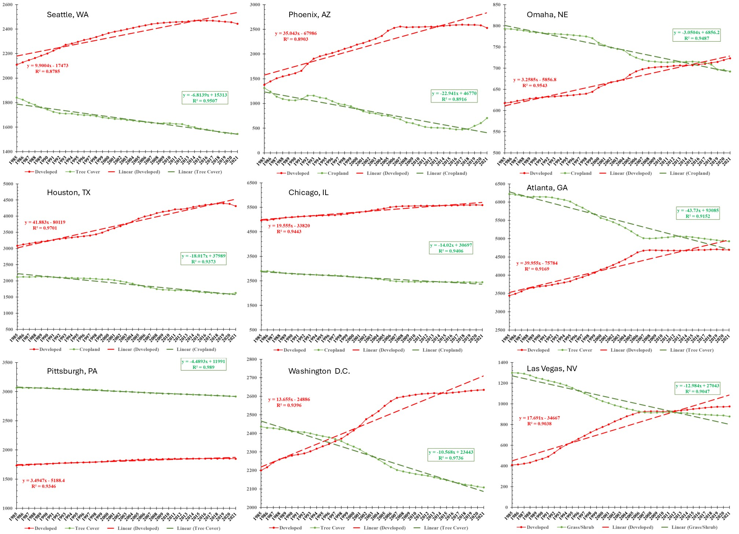
Results
Land cover trends from 1985-2023
Urban vs main non-urban class in 8 selected representative urban center with 5 km buffer zone
Notes:
This plot shows the land cover trends from 1985 to 2023 for nine selected urban centers within a 5 km buffer zone. The red line indicates urban change, while the green line represents non-urban change over the same period. Panels a) to i) correspond to Seattle, WA; Phoenix, AZ; Omaha, NE; Houston, TX; Chicago, IL; Atlanta, GA; Pittsburgh, PA; Washington, D.C.; and Las Vegas, NV.

Slide 18
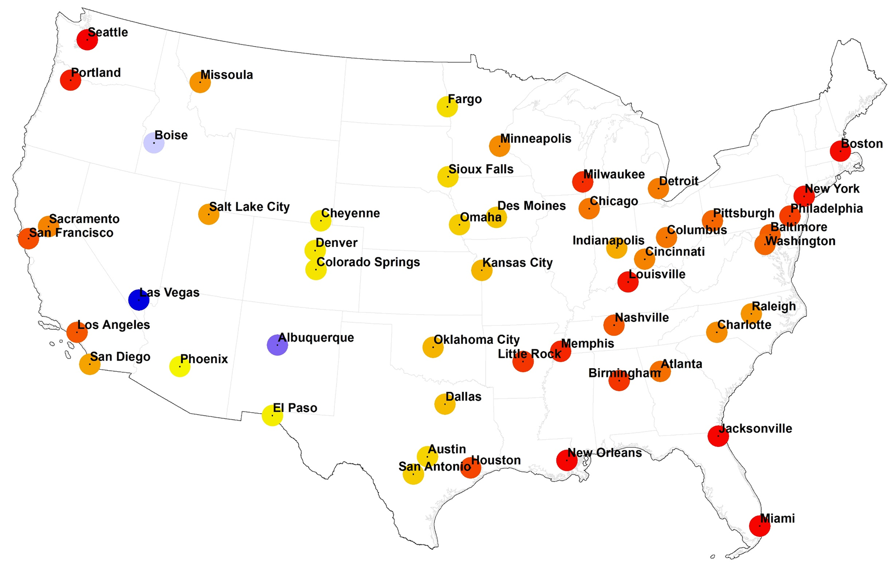
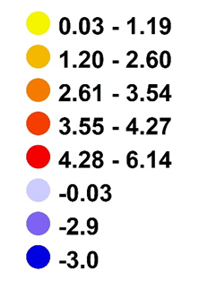
Results
50 major urban centers in CONUS
SUHI meanLST average intensity
From 1985-2023
Notes:
This figure displays the results of the SUHI intensity analysis, representing the mean SUHI intensity from 1985 to 2023. Red indicates positive values, while blue signifies negative values. The green circles highlight the eight selected urban centers to which we have linked SUHI products with census variables.

Slide 19
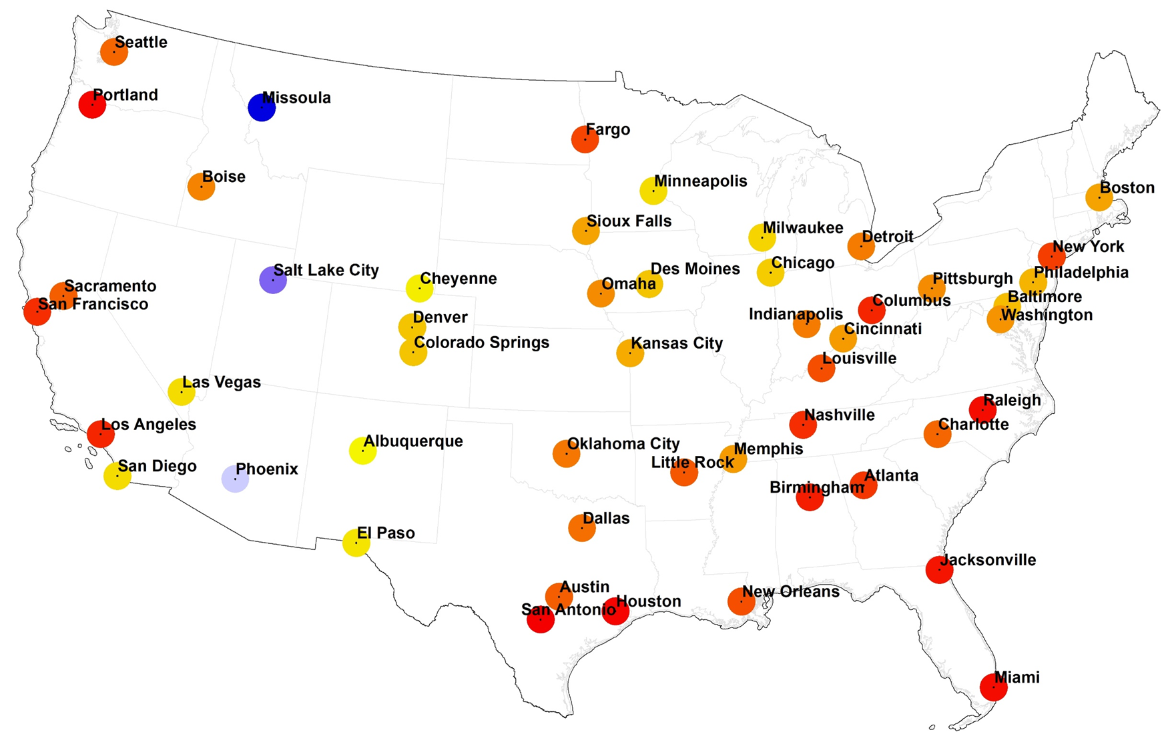
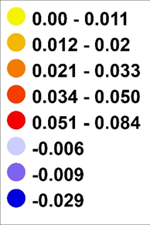
Results
50 major urban centers in CONUS
SUHI meanlst intensity trends analysis (slope)
1985-20223
Notes:
This figure presents the results of the SUHI trend analysis in a different way, specifically the slope of the Mean LST from 1985 to 2023. Most major urban centers in CONUS exhibit a positive slope, indicating that the Mean LST has increased from 1985 to 2023. Only three cities experienced a decline. Phoenix and Salt Lake City, located in arid regions, exhibit cool island effects. The green circles highlight the eight selected urban centers

Slide 20
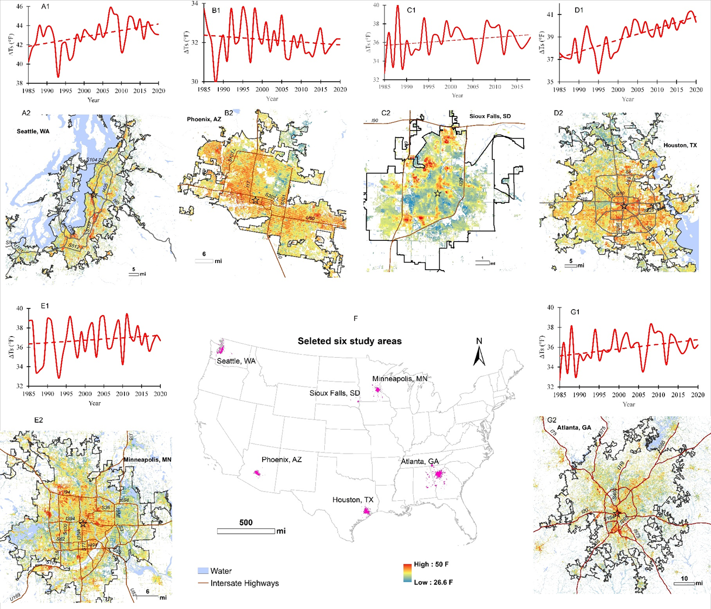
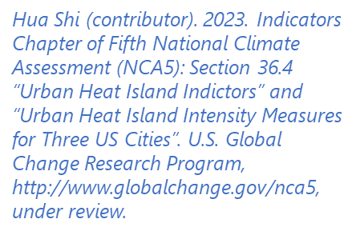
Results
SUHI Landsat ARD land surface temperature (LST) trends analysis
Notes:
We used the SUHI dataset (Landsat collection 1) released on USGS ScienceBase to calculate SUHI intensity from 1985 to 2020. We created maps and plots for six selected cities: Seattle, Phoenix, Sioux Falls, Houston, Minneapolis, and Atlanta. The maps in the figure illustrate the difference in annual mean temperature between urban and non-urban areas (at the pixel level, with a 30 m resolution) within a 5 km buffer zone from the city boundaries. We used time-series SUHI intensity data to produce the trend of UHI intensity changes (depicted in red) for each selected city from 1985 to 2020. In most cities, SUHI intensity increased from 1985 to 2020; however, only one city, Phoenix, showed a decline. Phoenix, located in an arid region surrounded by desert, has experienced urban growth accompanied by increased irrigated vegetation, which contributes to urban cool island effects.

Slide 21
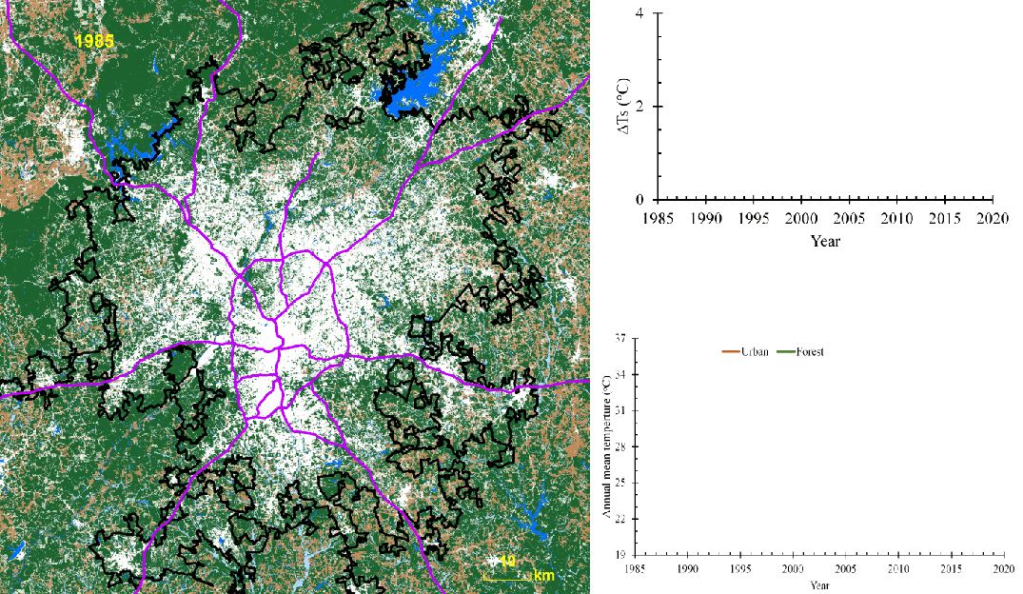
Results
Notes:
This is an example of how we applied our research methods to a selected area, specifically Atlanta, GA. We analyzed SUHI intensity, focusing on land cover dynamics (shown on the left) and land surface temperature in urban and surrounding non-urban areas (with 5 km buffer zones indicated in black) to quantify SUHI intensity (top right, represented by the red line). We also compared these results with data from two selected NOAA Global Historical Climatology Network (GHCN) stations (bottom right), where the dark brown line represents the urban station near the airport and the green line corresponds to a non-urban forest station within the 5 km buffer zone from 1985 to 2020. The X-axis of both plots on the right represents time from 1985 to 2020, while the Y-axis in the top right shows UHI intensity (the temperature difference between urban and surrounding non-urban classes). The Y-axis in the bottom right indicates air temperature observed at the NOAA GHCN stations (urban and forest). This figure illustrates how changes in land cover are associated with trends in UHI intensity, while also comparing these trends to temperature observations from the stations over the same period.

Slide 22
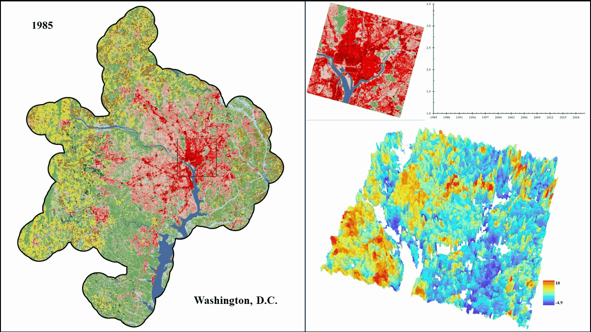
Results
Notes:
This is another example movie to illustrate how we applied our research methodologies to the Washington DC area for SUHI intensity analysis. We examined SUHI intensity, focusing on land cover dynamics (shown on the left) and land surface temperature in both urban and surrounding non-urban areas (with 5 km buffer zones highlighted in black) to quantify the SUHI intensity (top right, red line). The X-axis of the plot on the right represents the time span from 1985 to 2020, while the Y-axis indicates the mean SUHI intensity. The top section provides a zoomed-in view of land cover changes, while the bottom right showcases a 3D animation of spatial SUHI intensity changes in the zoomed-in area from 1985 to 2020.

Slide 23
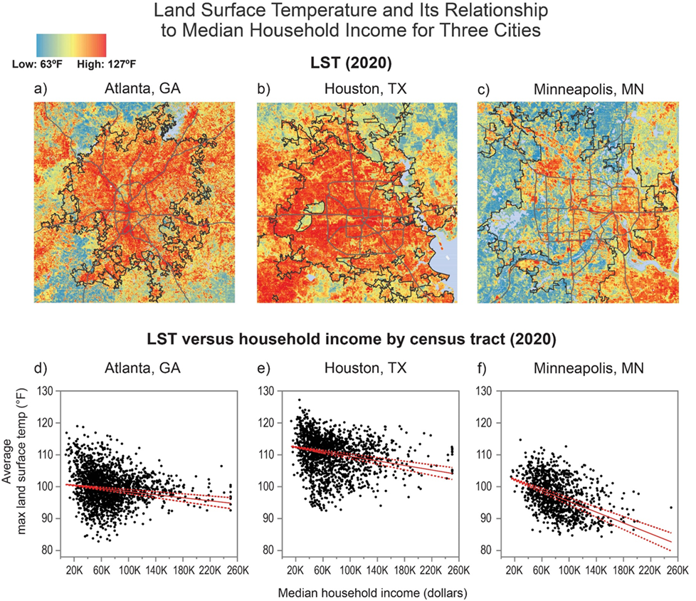
Results
SUHI Landsat land surface temperature (LST) and its relationship to median household incomes for three cities.
Three urban centers:
Atlanta, GA
Houston, TX
Minneapolis, MN
Notes:
Here is an example of our work linking SUHI products (LST and intensity) to census socio-economic data. The figure illustrates the spatial distribution of maximum land surface temperature (LST) in 2020 for Atlanta (a), Houston (b), and Minneapolis (c). Graphs (d), (e), and (f) depict the relationship between maximum LST and median household income across census tracts in each city. A statistical trend analysis using the Theil-Sen estimator yielded negative values for all three cities, indicating that LST decreases as income increases (solid red line). The dashed red lines represent the 95% confidence interval, indicating that the true slope of the trend is expected to fall within this range.

Slide 24
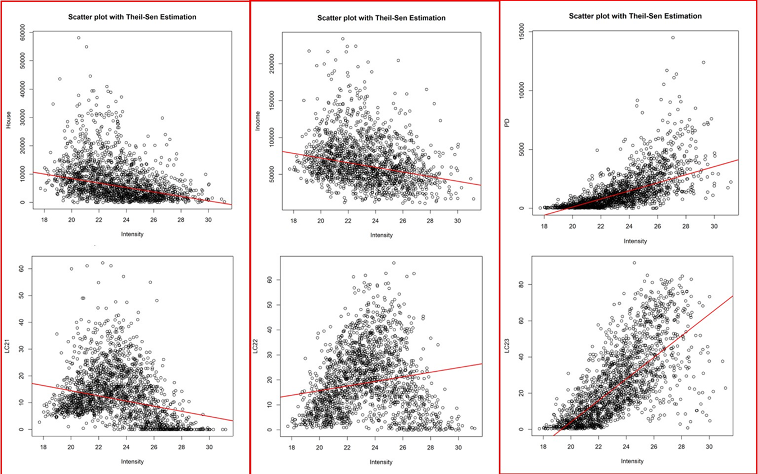
Results
Assessment of Increasing Temporal Frequency for Landsat-Based Time Series Land Surface Temperature Product
Notes:
These plots display the same exercise results for Pittsburgh, PA. The analysis uses the 2020 intensity of Mean LST (X-axis) in relation to census datasets, including house value (top left), median household income (top middle), and population density (top right), as well as NLCD land cover classes (21 - bottom left, 22 - bottom middle, and 23 - bottom right) on the Y-axis. The top plots show that Mean LST intensity (a measure related to land surface temperature) decreases as house value and income increase, while population density decreases within census block groups. The bottom plots indicate that Mean LST intensity decreases as the percentage of low urban land cover (21) decreases, but it increases with higher percentages of urban land cover (22 and 23).

Slide 25
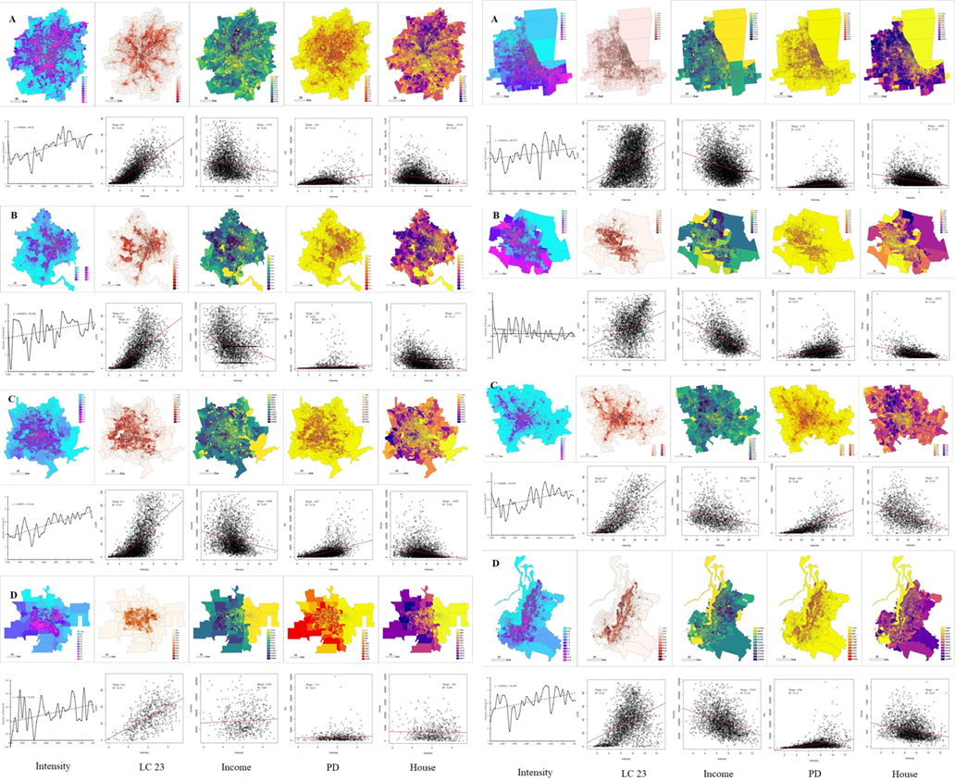
Results
A1
A2
Notes:
This figure summarizes the results of the linkage analysis models, illustrating the intensity of SUHI mean LST and its relationships with urban class (LC23), median household income (Income), population density (PD), and house value (House) at the U.S. Census block group level for eight representative urban centers.
The top panels display the spatial distribution of intensity, LC23, income, PD, and house value from left to right. The bottom panels illustrate the relationships between intensity and LC23, income, PD, and house value. Taking Atlanta as an example, the Mean LST intensity shows a positive correlation with urban land cover (LC23) and a negative correlation with income; higher income groups tend to have lower LST intensity. Additionally, Mean LST intensity has a positive correlation with population density, indicating that areas with more residents experience higher LST density. Conversely, there is a negative correlation with house values, where areas with higher house values typically exhibit lower LST intensity, suggesting the presence of more green space and proximity to water bodies.

Slide 26
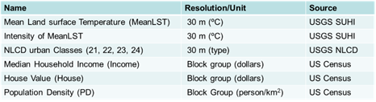
Results
A1
A2
Urbanization Related Warming: Addressing Social and Economic Aspects in Land Surface Temperature
B1
B2
C1
C2
D2
D1
Notes:
This figure summarizes the results of the linkage analysis models, illustrating the intensity of SUHI mean LST and its relationships with urban class (LC23), median household income (Income), population density (PD), and house value (House) at the U.S. Census block group level for eight representative urban centers.
On the left: A1: Atlanta, GA (SE), B1: Washington, D.C. (NE), C1: Houston, TX (SG), D1: Omaha, NE (NG).
On the right: A2: Chicago, IL (MW), B2: Phoenix, AZ (SW), C2: Pittsburgh, PA (NE), D2: Seattle, WA (NW)

Slide 27
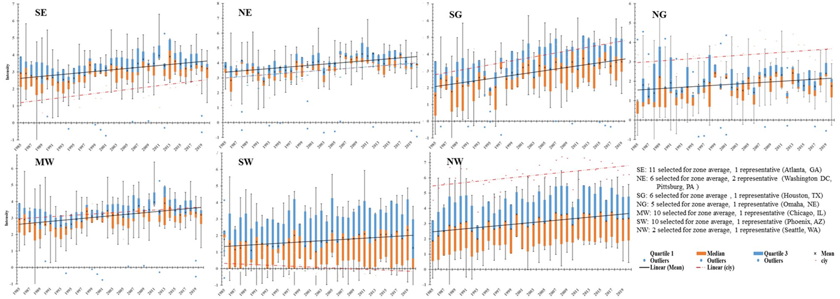
Results
Notes:
To assess how well the selected urban centers represent SUHI intensity across the seven NCA climate zones, we compared the SUHI intensity of these eight representative urban centers with the average SUHI intensity from all urban centers located within each climate zone among the 50 total urban centers. The plot displays the average Mean LST intensity from all urban centers in each NCA zone (solid line) compared to the Mean LST intensity of the representative urban centers in each zone (dashed line) from 1985 to 2020.
From this analysis, we conclude that urbanization-induced SUHI effects, evaluated at multiple levels (i.e., local and regional), generally exhibit varying spatial scales. Most representative urban centers display the same or similar intensity trends and changes from 1985 to 2020, with the exception of Phoenix (panel-SW). This suggests that future work should include more urban centers in each NCA zone, distinguishing urban centers by their regional characteristics to better capture regional differences and SUHI effects under climate change. For example, urban centers in arid land regions of the Southwest could be analyzed as a special case.

Slide 28
Conclusion
Divider Subtitle
ASRC Federal Proprietary

Slide 29
Conclusion
Landsat ARD LST data quantifies SUHI intensity and variations using land cover dynamics
Urban land cover types show different SUHI intensities, aiding in mitigation strategy development
Results offer insights into regional SUHI intensity and changes by integrating land cover
The prototype approach effectively quantifies and monitors SUHI intensity over large areas
Linking SUHI products with land cover, population, and socio-economic data reveals important relationships
As urbanization grows, understanding SUHI impacts is vital for addressing global warming and human health
Notes:
Our take home messages including: 1) The Landsat ARD LST data can be utilized to quantify SUHI intensity and spatiotemporal variations by incorporating land cover dynamic information. 2) Different urban land cover types exhibit varying SUHI intensities and temporal trends; these outcomes can inform the development of SUHI mitigation strategies for the region. 3) The results provide valuable insights into regional SUHI intensity and changes by integrating land cover dynamics. 4) Our findings demonstrate the scientific value of implementing this prototype approach as an objective framework for quantifying and monitoring SUHI intensity across large geographic areas and its applications. 5) The linkage of SUHI products with land cover, population, and socio-economic variables from census data reveals significant relationships among these factors. 6) As urbanization continues, the implications of SUHI-induced warming and scaling effects become increasingly critical for addressing global warming and protecting human health.

Slide 30

Questions?
Thanks!

Slide 31


