Slide 1
Experience with VegHydro for East Africa on AWS
Gabriel Senay, Stefanie Kagone, and Olena Boiko
April, 2022

Slide 2
All we need…..for our cloud architecture
every element here is valuable!
these are transient -- ephemeral -- disposable!
We tried to use as few AWS specific services as possible!

Slide 3
Enabling Technologies
AWS EC2 and S3
UNIX --> Linux --> Ubuntu
github --> GIT!
COGs and STAC
Python/Jupyter -- markdown
Docker and Terraform
Browser - Mosaic --> Firefox and Chrome

Slide 4
Our Journey
Project initiation –
immerse in Cloud
Port the ET model from Arcpy Libraries to
Open Source Rasterio/GDAL libraries
Wrangle all
our Inputs
into the
Cloud Bucket
Get really good
at all things
AWS cloud
Embrace
Docker and DevOps
to process the model

Slide 5
Model Implementation using AWS
Open Source
Run
VegET model
Examine Results
Refine Model Parameters
Git
ET Data
Outputs:
drainage,
runoff, ETa..
Python
Cloud Object
Storage Bucket
ET Data Inputs:
PPT, Ts, ETo
NDVI, soils
Cloud Object Storage Bucket
Scalable Elastic Cloud Compute
Cluster

Slide 6
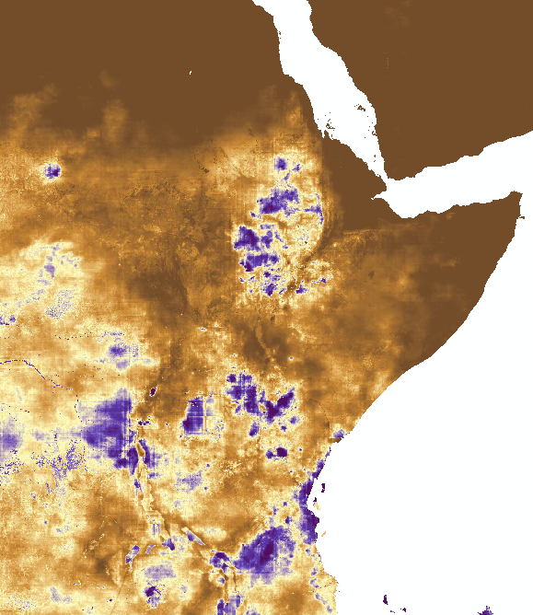
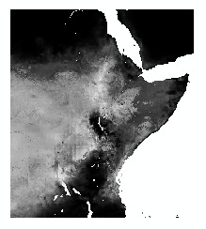
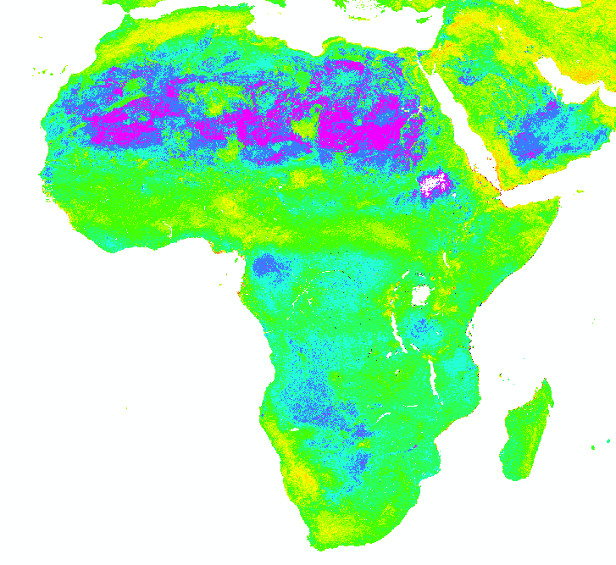
Model Implementation by the numbers
East Africa extent
~ 2.25 hours per year or 1min20sec per day
→ No snow accounting
Africa extent - Parallel processing using Docker for more tiles
It takes about the same amount of time to create a bigger mosaic using tiles
1/10th of the CONUS
1 hour per year
2.25 hour per year – no snow accounting

Slide 7
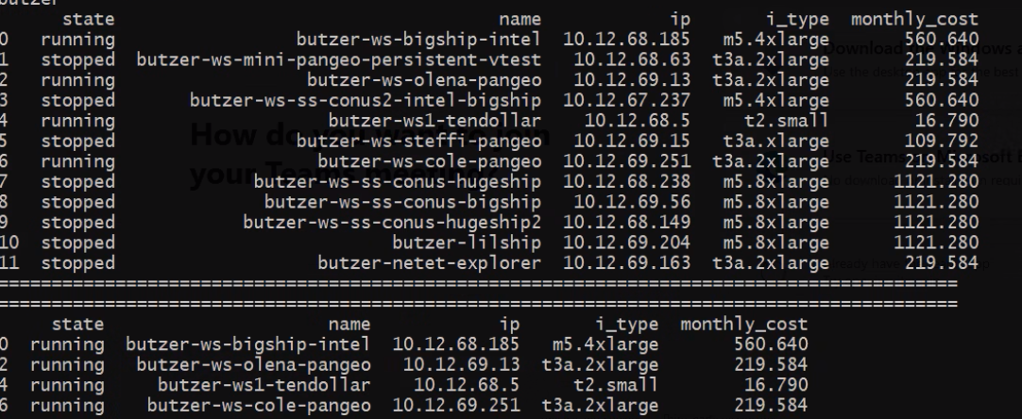

Slide 8
Why Cloud technology works for Scientists…

Slide 9
or maybe not…!

Slide 10
Most current concerns…
Increased spatial coverage = increased storage = increased cloud cost?
Open Source capabilities for big datasets!!!

