Slide 1
VegET model overview
US and Greater Horn of Africa Examples
Gabriel Senay, Stefanie Kagone, Manohar Velpuri, and Olena Boiko

Slide 2
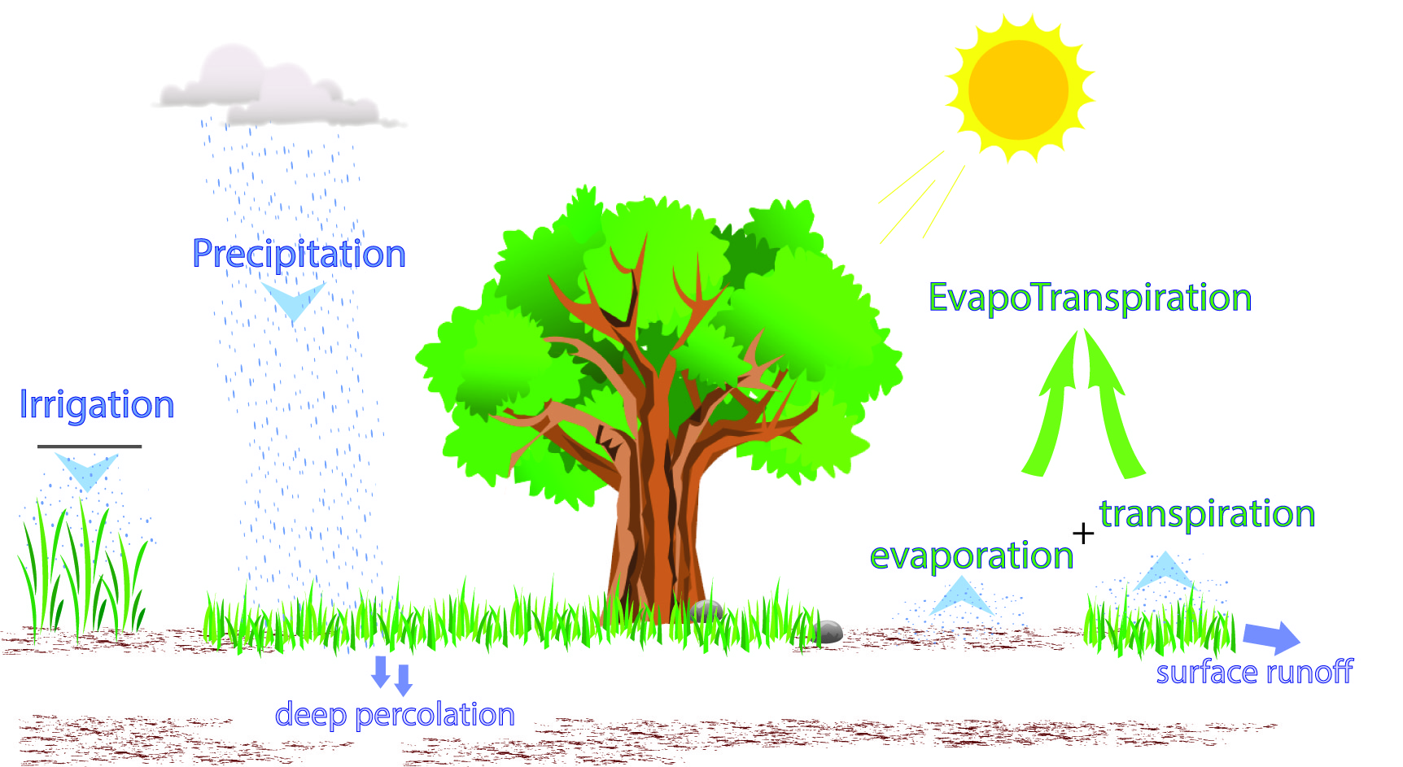
VegET model

Slide 3
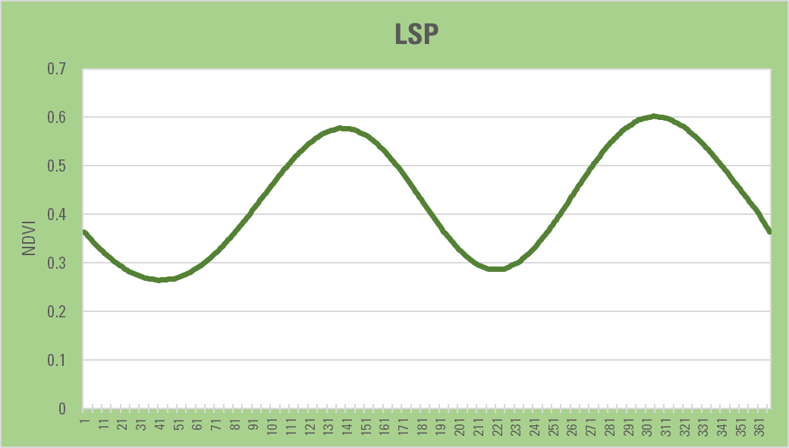
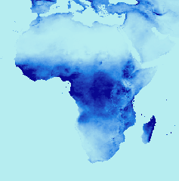
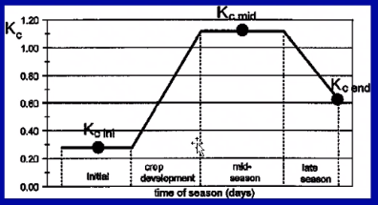
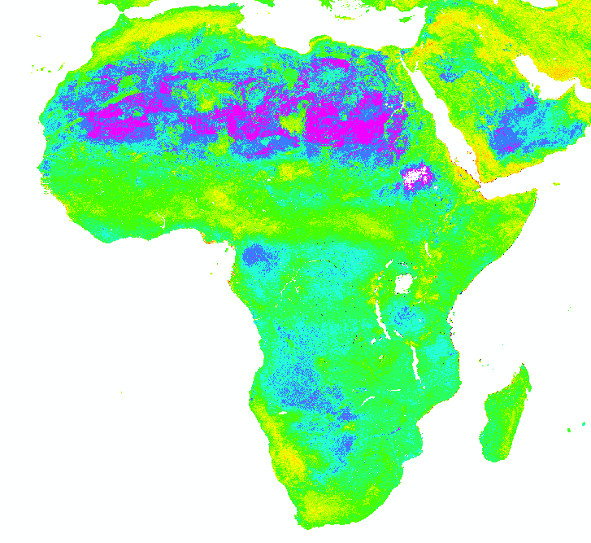
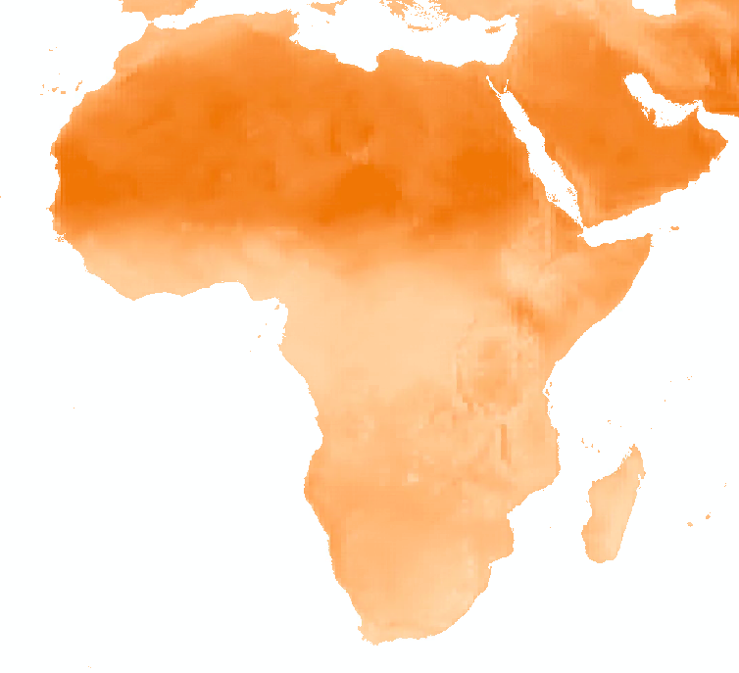
VegET
Precipitation
Model: Senay, 2008
Application:
Velpuri and Senay, 2012; 2017
Soil Conditions
ETa = Ks * Kcp * ETo
Reference ETo
Soil Stress Coefficient
PPT: CHIRPS 2018, NDVI: avg 2003-2017, median MODIS NDVI,pt 44.04629_3.362481, soil is WHC from IRSIC, Hobbins Etrs ( avg 05.12.)

Slide 4
VegET: Input datasets
No | Dataset | Temporal resolution | Source
1 | Precipitation | daily | Gridmet
2 | air temperature | Daily | Gridmet
3 | NDVI | Daily | MODIS
4 | Ref ET | Daily | Gridmet
5 | Soils: WHC, FC | Static | gNATSGO (USDA)

Slide 5
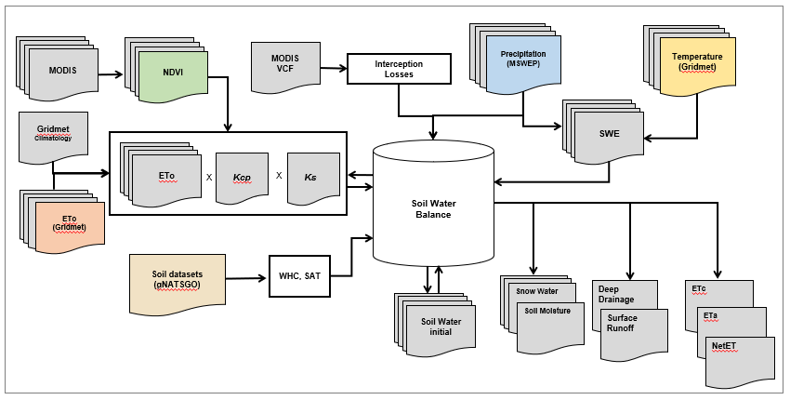
Water Balance Model - VegET

Slide 6
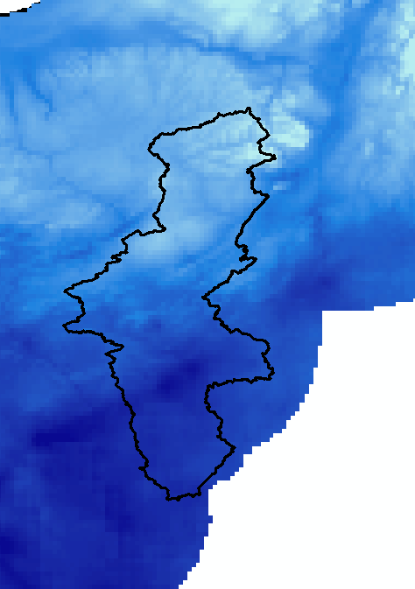
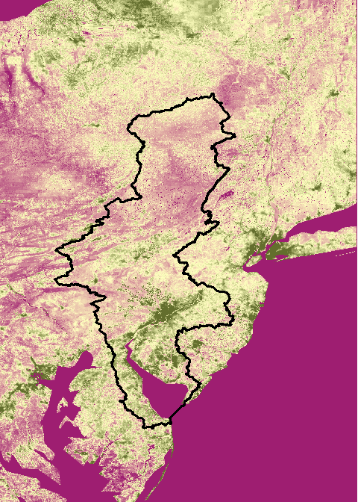
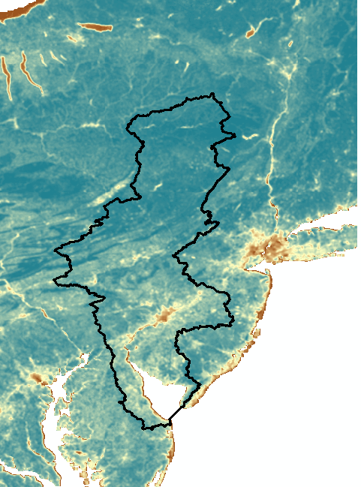
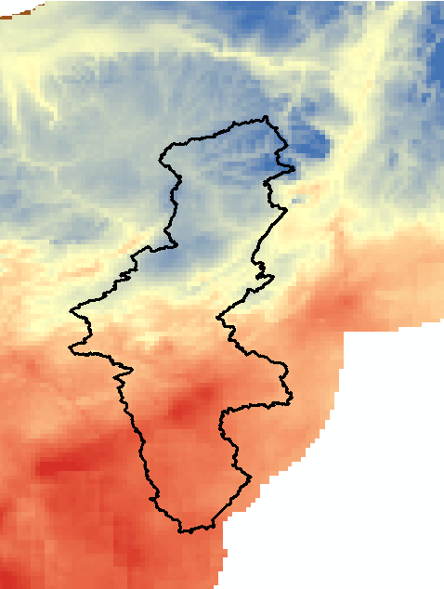
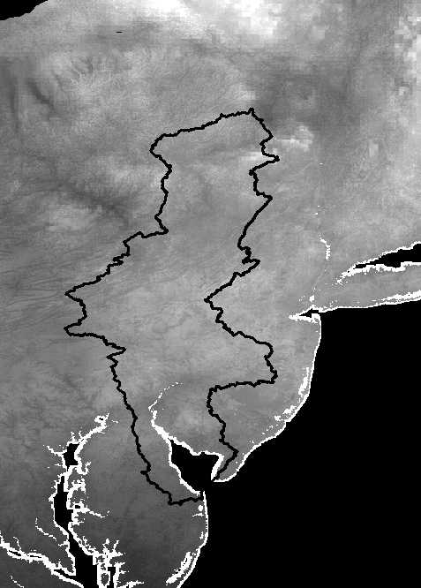
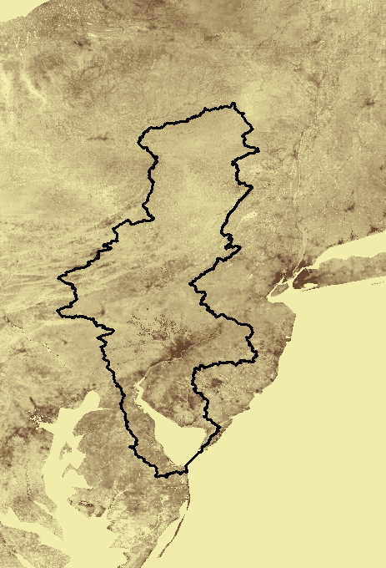
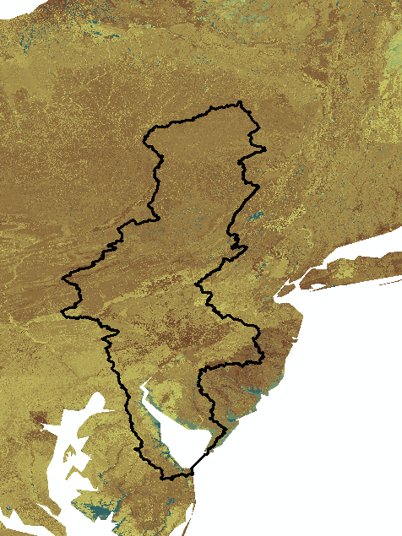
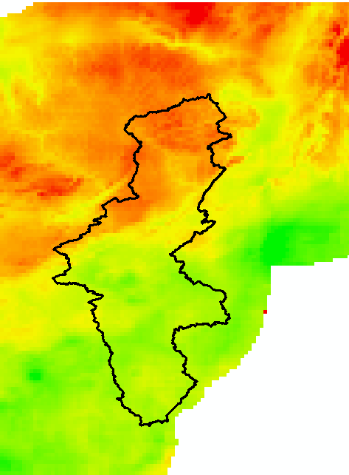
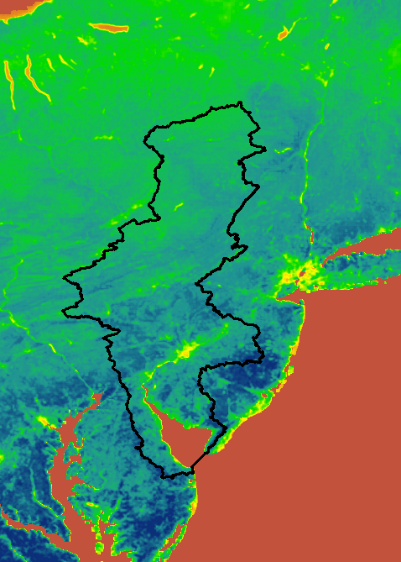
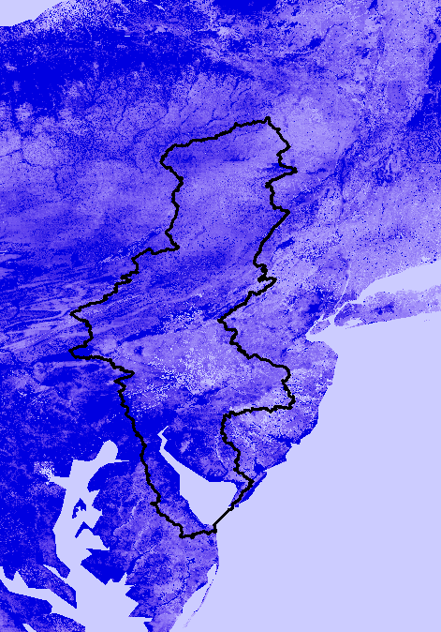
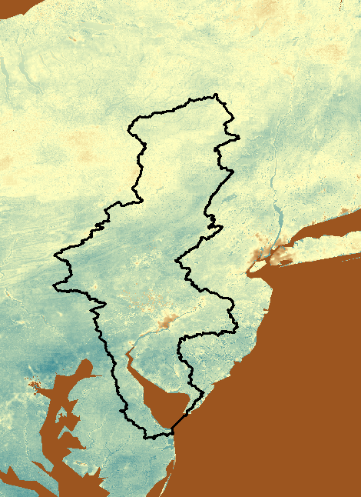
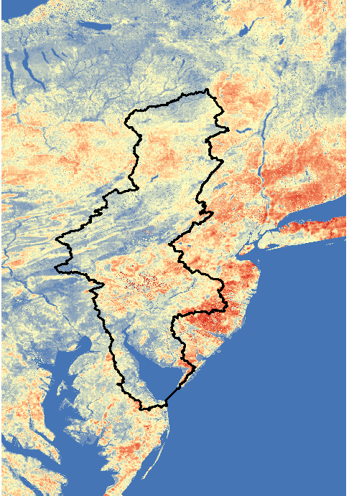
VegET Model Inputs and Outputs
INPUT
OUTPUT
Precipitation
Rainfall
NDVI
Surface Runoff
Temperature
SWE
Deep Drainage
ETc
Soil rasters
ETa
NetET
ETo
Precipitation: CHIRPS
NDVI: MODIS NDVI, median for 2003-2017
Soil Rasters: ISRIC SoilGrids
ETo: Hobbins ETo
Soil Moisture

Slide 7
VegET model
Component view
Minnesota

Slide 8
INPUT
OUTPUT
Precipitation
Rainfall
Surface Runoff
NDVI
SWE
Temperature
Deep Drainage
ETc
Soil rasters
ETa
NetET
ETo
Soil Moisture

Slide 9
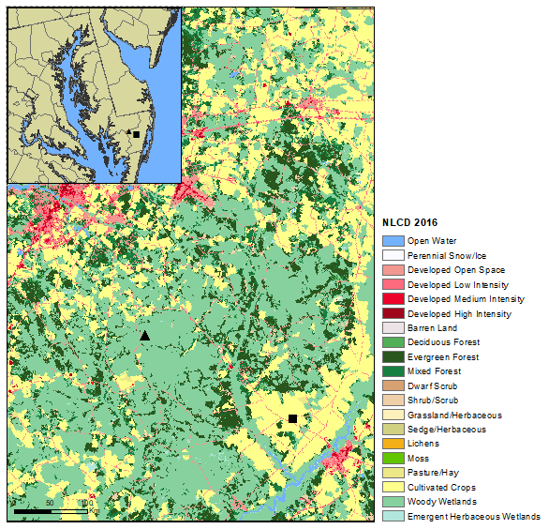
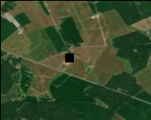
VegET Simulation Examples over Croplands..…
Cropland site

Slide 10
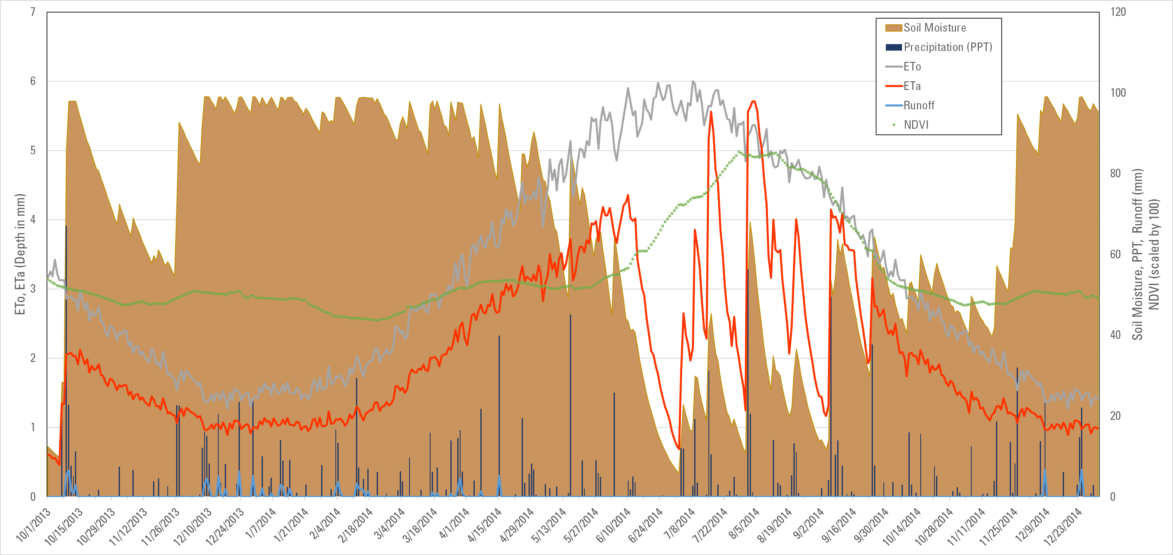
VegET Simulation over Cropland pixel..
Cropland site
Preliminary Results
Actual: ETa
Demand: ETo, NDVI
Supply: PPT, SM

Slide 11
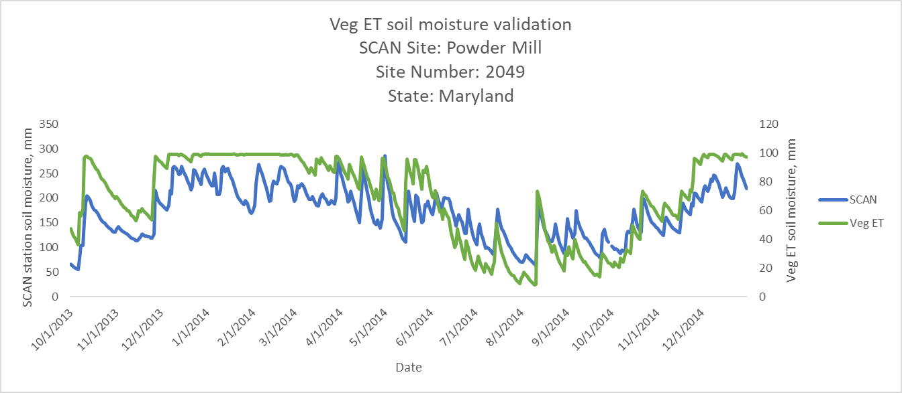
Comparison with Observed Soil moisture ….
Observed: SCAN
Simulated: VegET
Preliminary Results
Only temporal patterns are to be compared:
VegET: looks at plant available moisture; does not include drainable water, thus tends to be smaller in absolute magnitude.

Slide 12
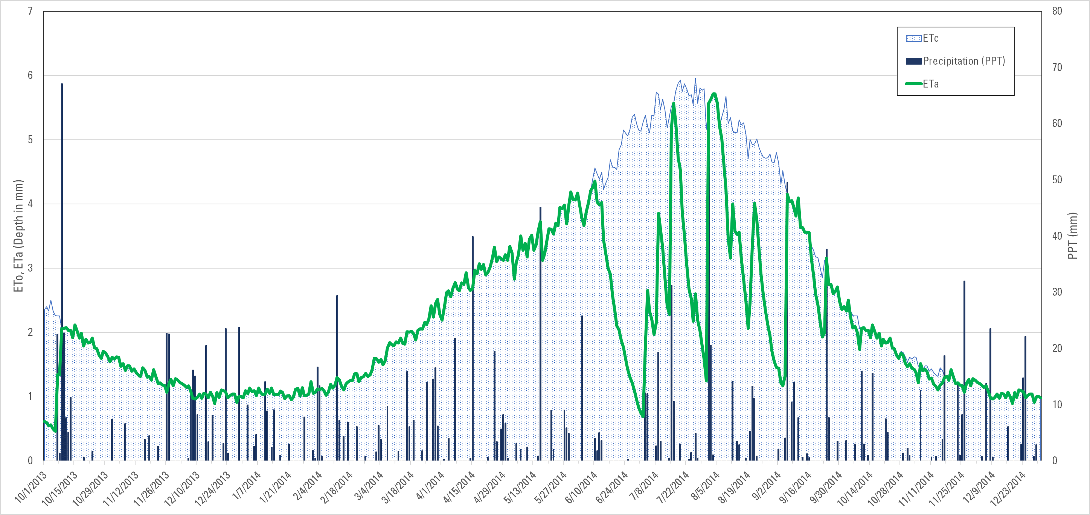
Irrigation Requirements Net ET = ETc – ETa
“Dry Spell: irrigation”
Preliminary Results

Slide 13
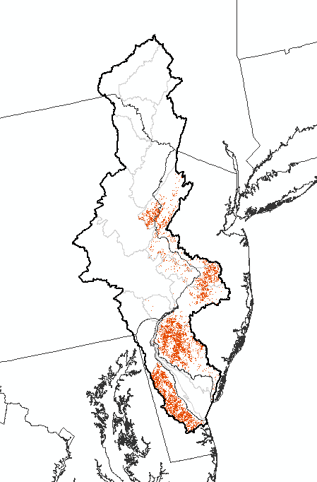
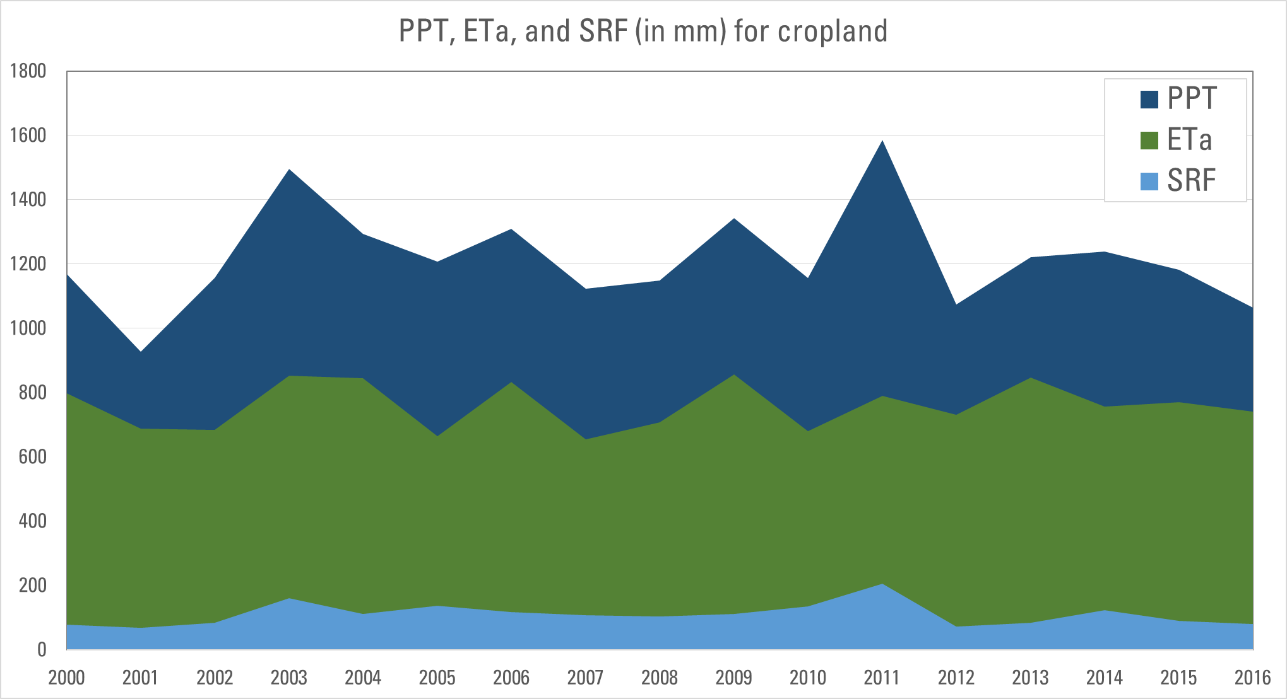
VegET: Annual Water Balance Components over Crop Lands
(deep drainage and interception not shown)
Preliminary Results
Wet (+30%) years may lead to disproportionally more runoff (+86%) than ET (+4%) from the mean as ET could be limited by energy
Changes in rainfall temporal distribution along with land cover type will have impact on water balance dynamics.

Slide 14
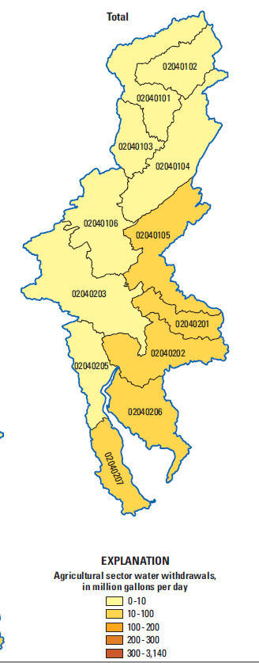
Net ET = ETc – ETa
Coastal Plains: average for cropland
Red areas = cultivated cropland in the coastal Plain region
Irrigation is practiced in this area (USGS SRI 2015-5142).
Preliminary Results
Estimated Net ET averages about 20% of Crop Water Requirements (ETc), ranging from 10% (wet) to 33% (dry year)

Slide 15
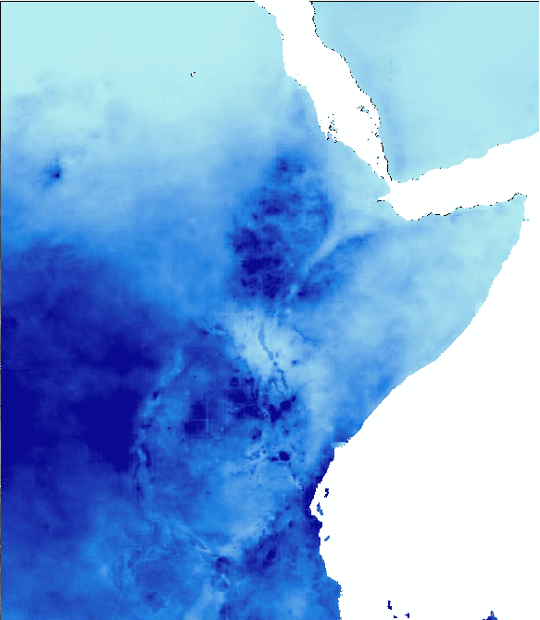
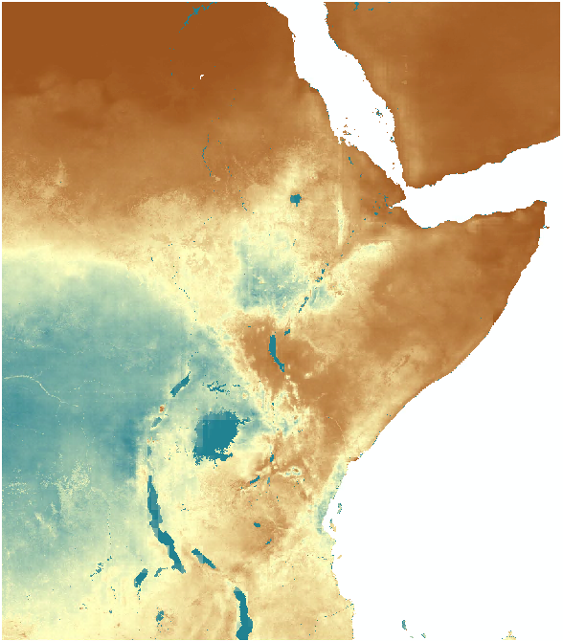
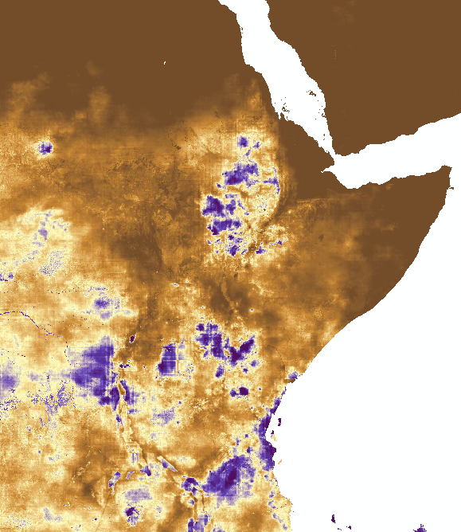
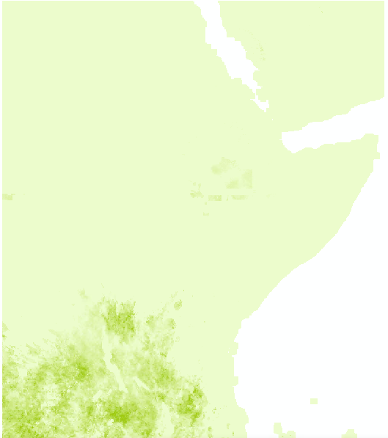
The Greater Horn of Africa Water Balance
Precipitation
ET
Runoff
Interception
PPT 2018, 0-2000mm; ET 2018, 0-1500mm; (SRF+DD) 2018, 0-1000mm, Intercept 01/30/2018, 0-4mm

Slide 16
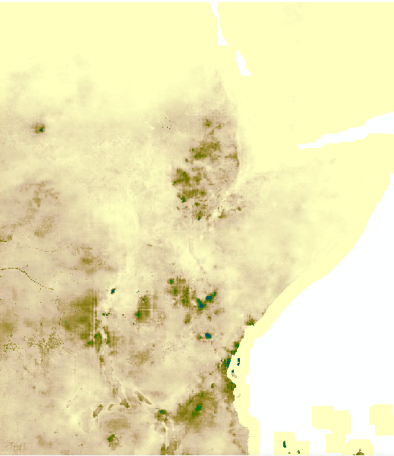
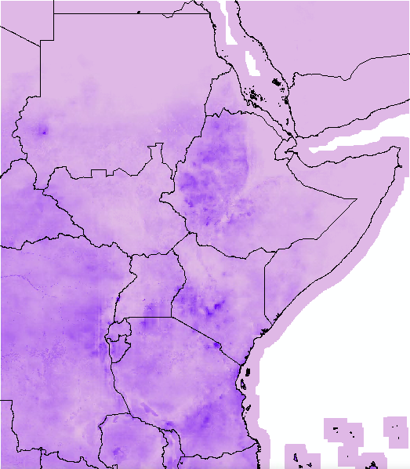
Runoff
Runoff
Surface Runoff
Deep Drainage

Slide 17
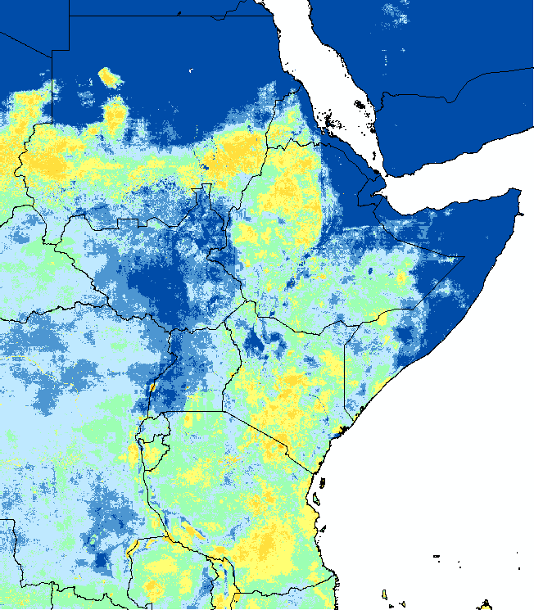
Runoff coefficient (%)

Slide 18
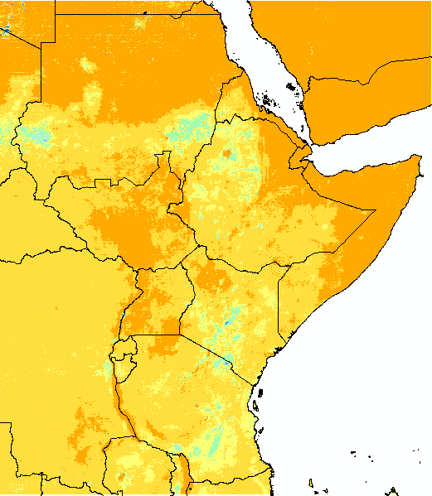
ET coefficient (%) ET/ppt

Slide 19
Landscape WRSI

Slide 20
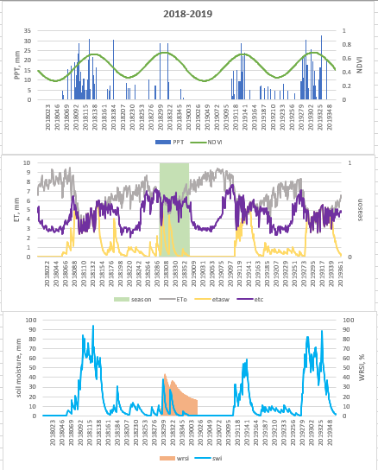
VegET model
Component view

Slide 21
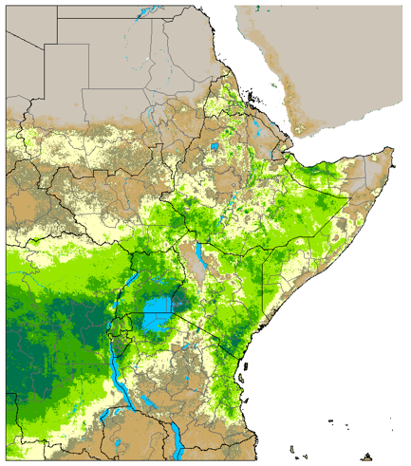
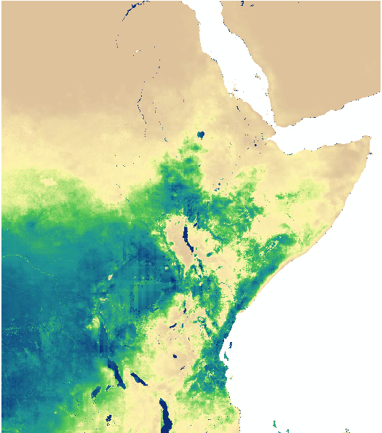
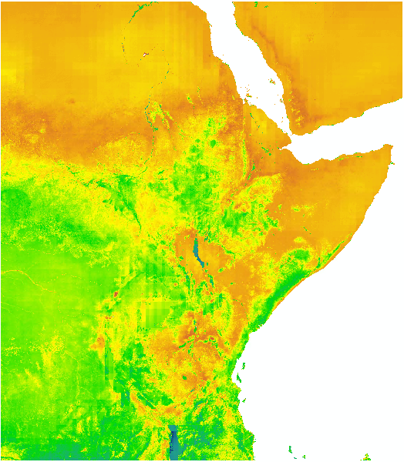
WRSI calculation
actual ET
crop ET
2019 – Oct-Dec
WRSI
"Crop" ET = water requirement

Slide 22
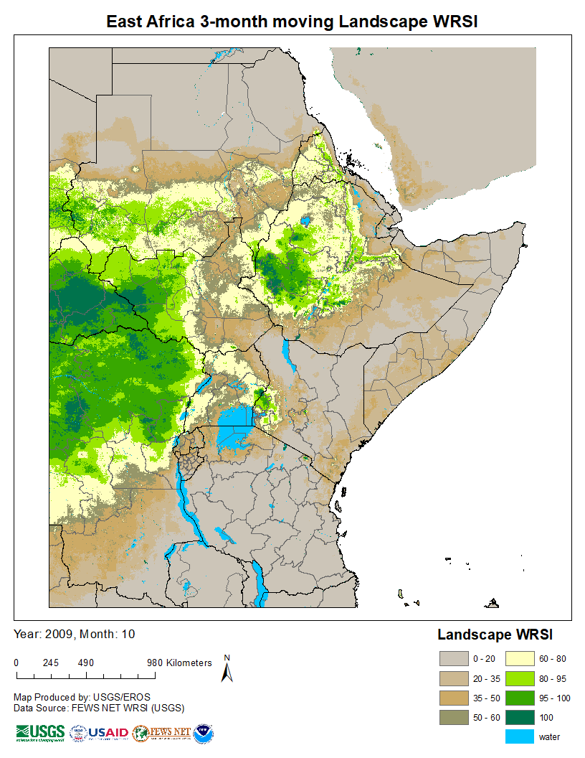
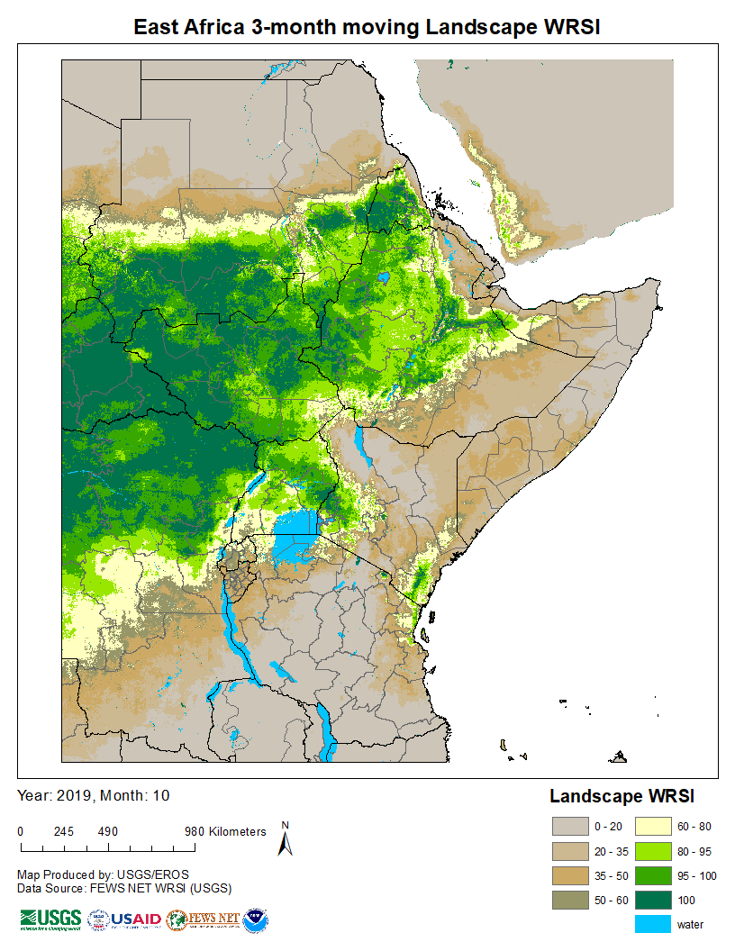
2009 – Aug-Oct
2019 – Aug-Oct

Slide 23
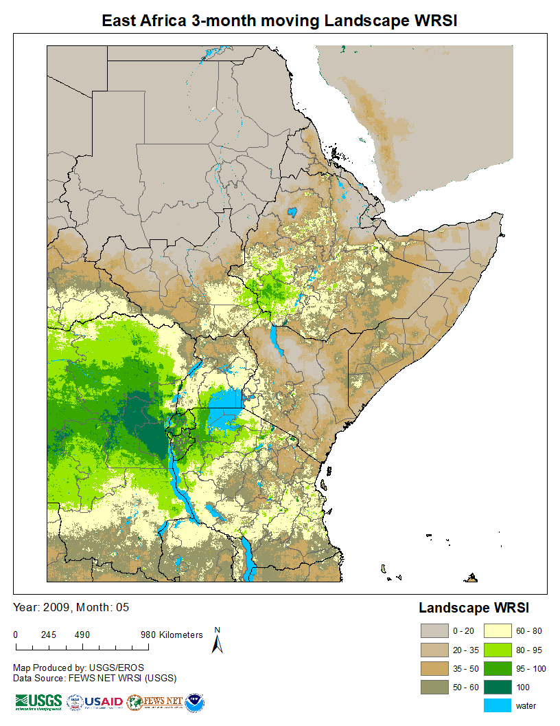
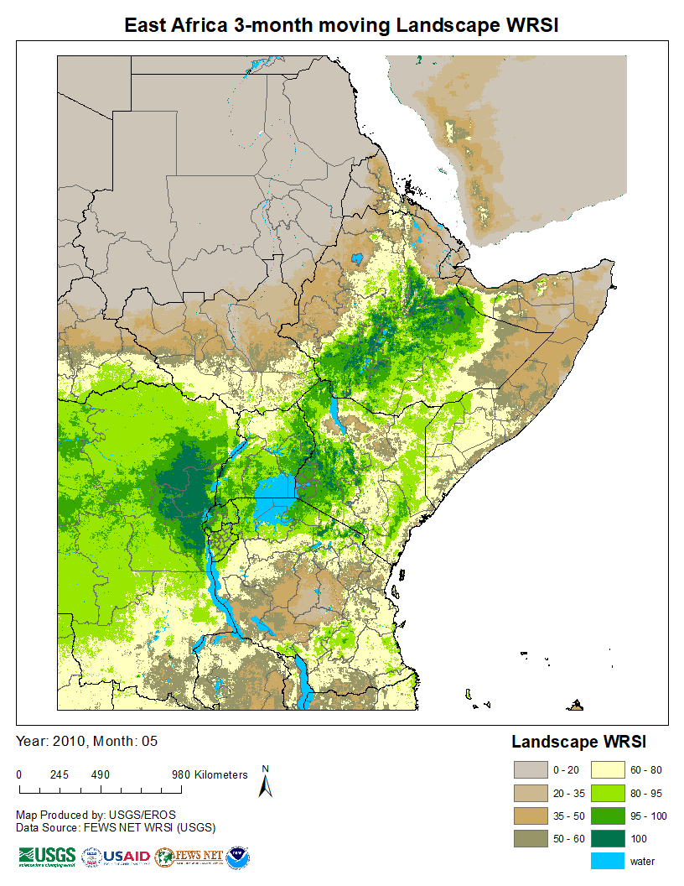
2009 – Mar-May
2010 – Mar-May

Slide 24
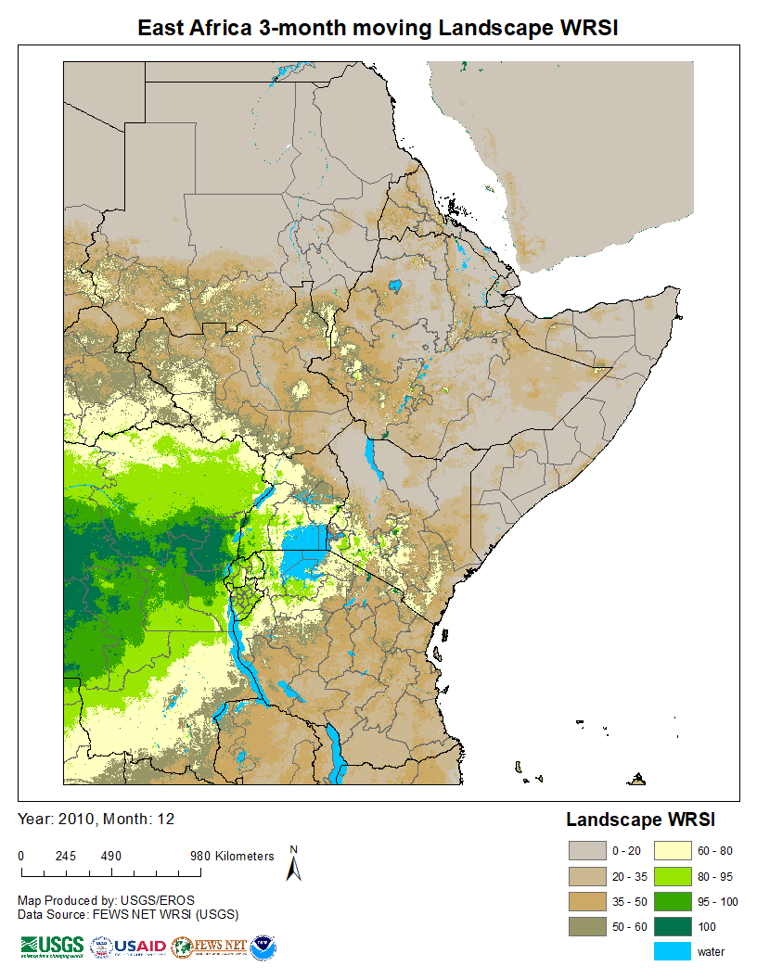
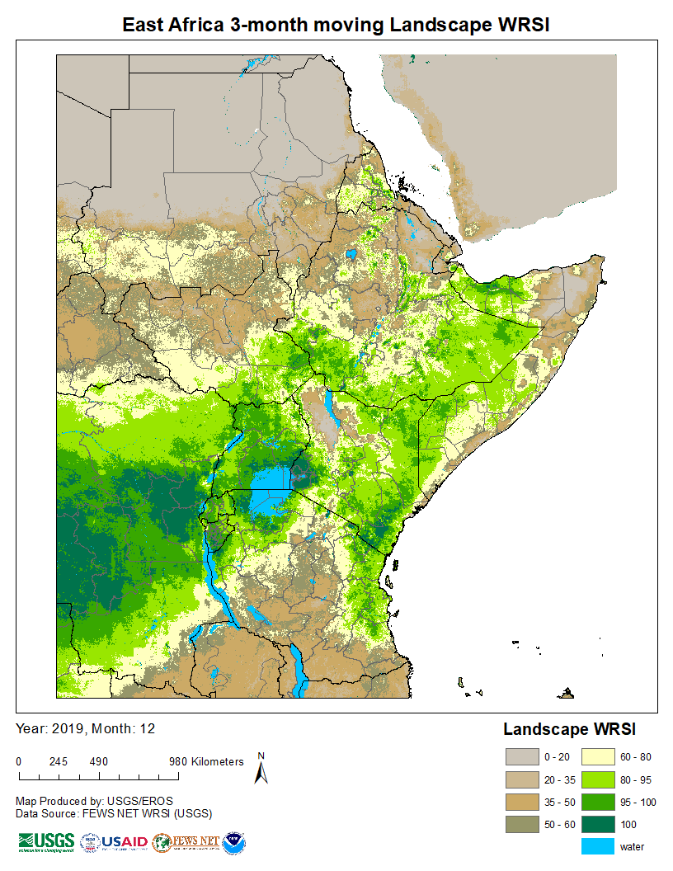
2010– Oct-Dec
2019 – Oct-Dec

Slide 25
Summary Remarks
VegET is a simple bucket model, parameterized by Land Surface Phenology (LSP) from NDVI for ET rates
Runs daily at the resolution of the LSP
Runoff is estimated daily based of the principle of saturation excess
Runoff is split into surface runoff (SRF)and deep drainage (DD), but the split is based on a constant coefficient, but is expected to vary widely in space.
However, the total runoff is expected to be reasonable, although a basin scale calibration is recommended to improve the absolute magnitude.

