Slide 1
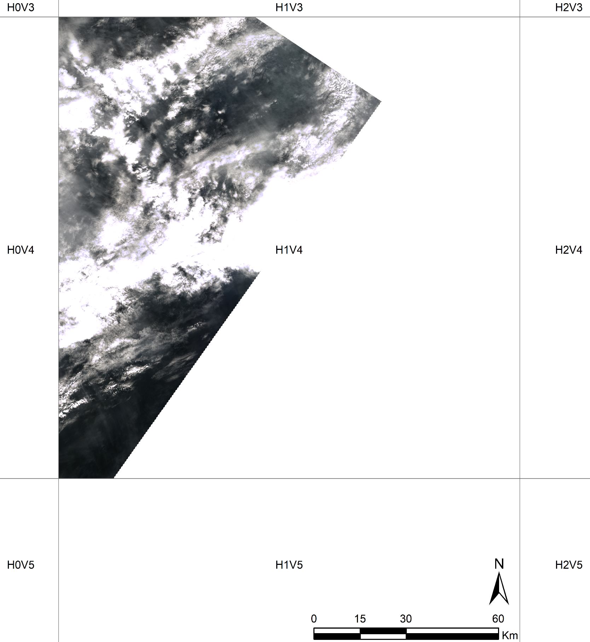
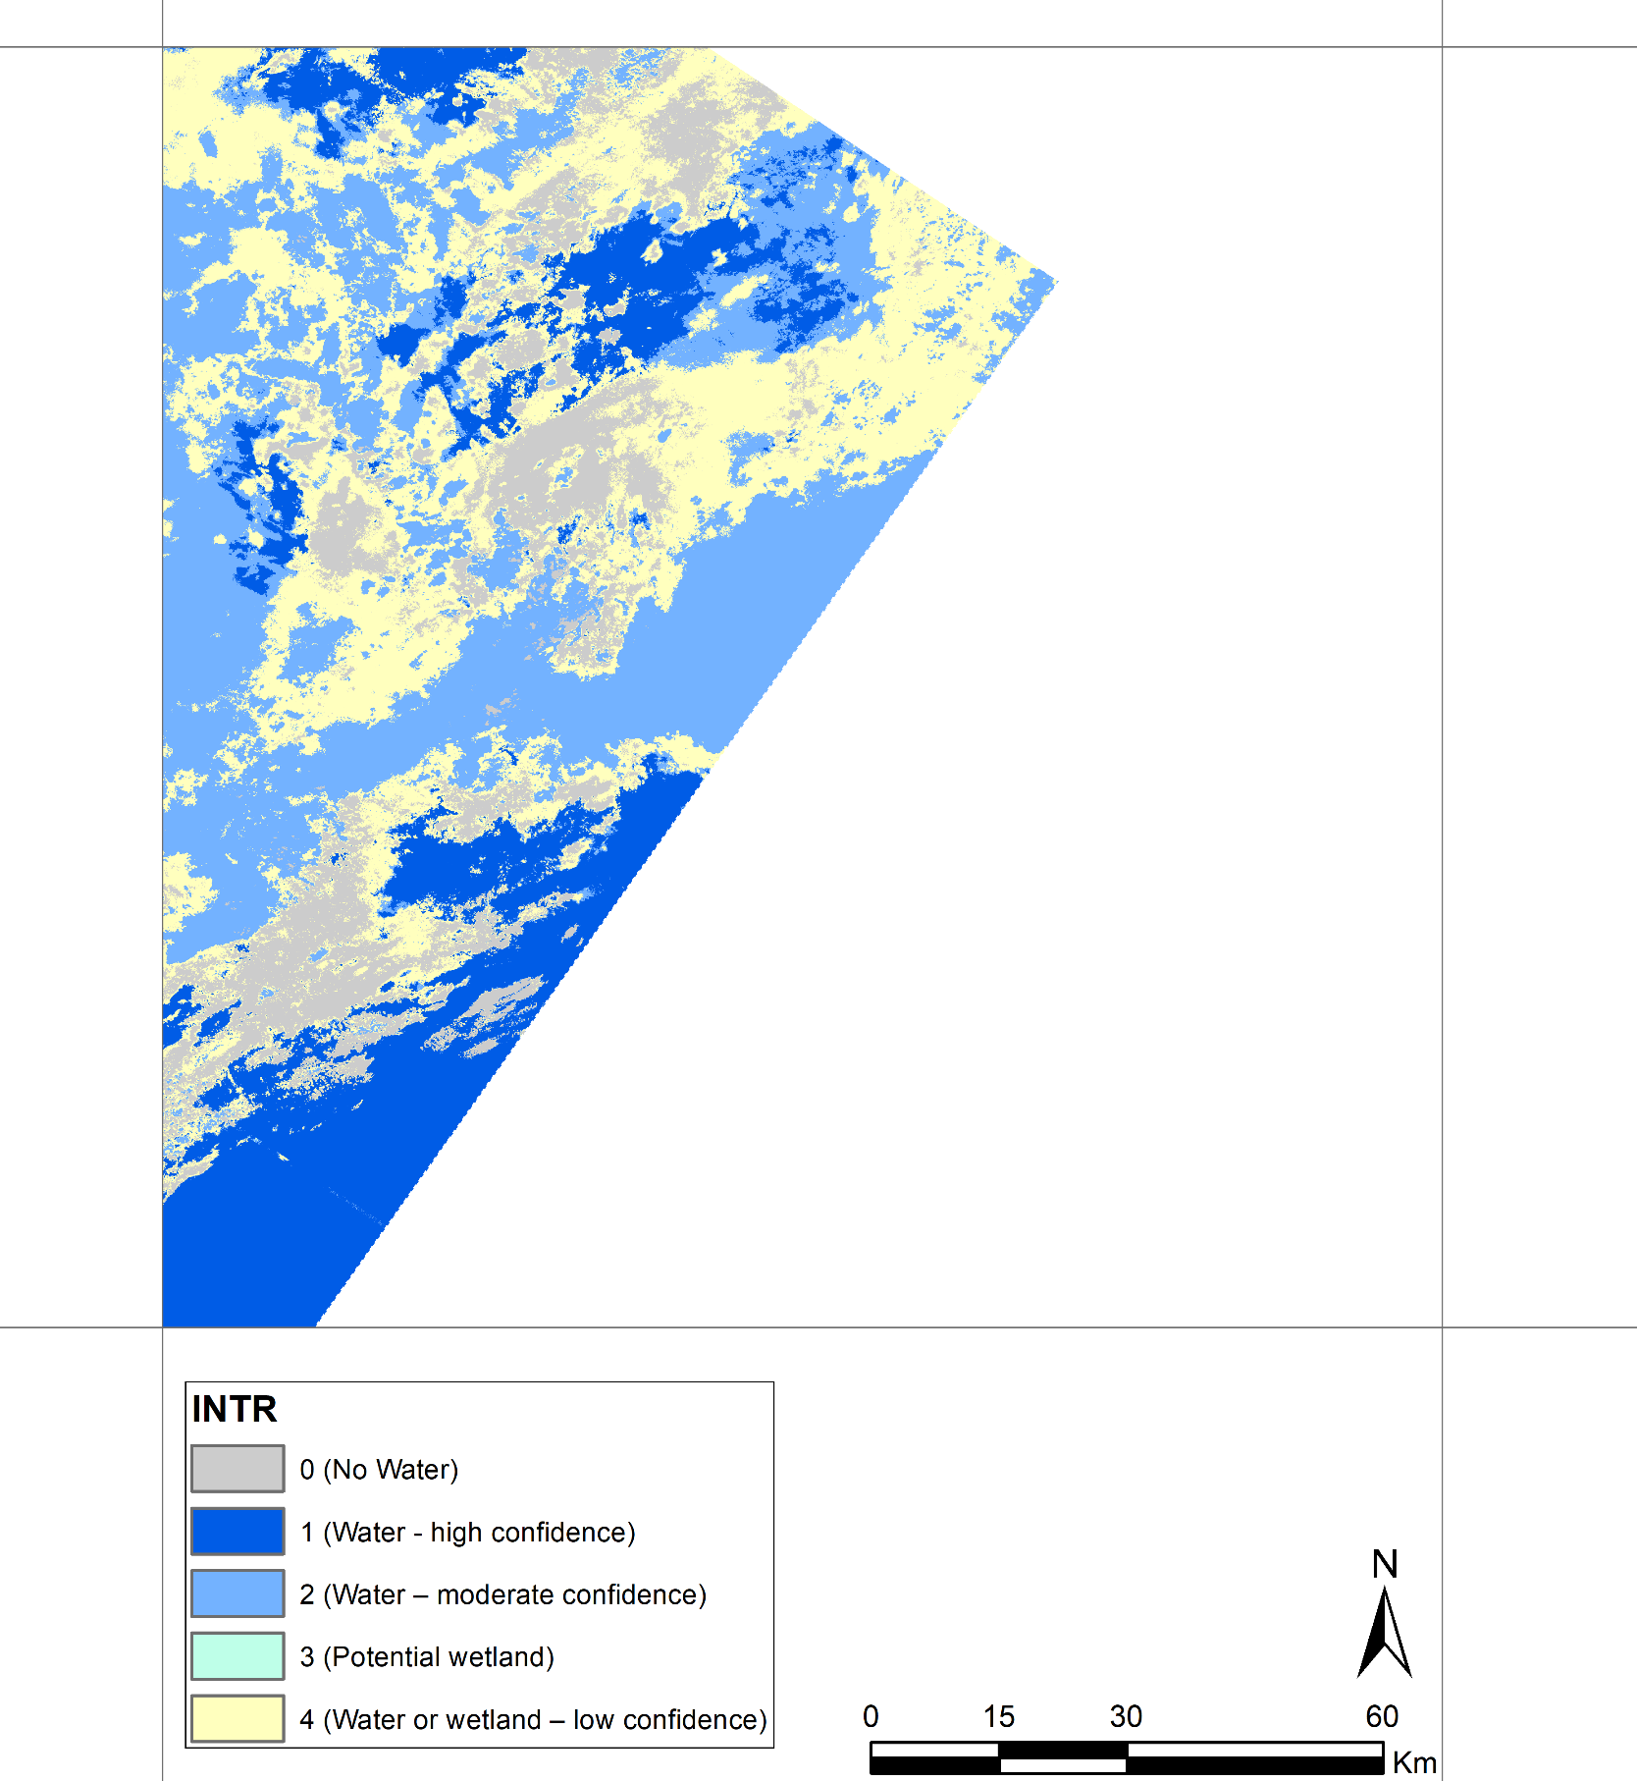
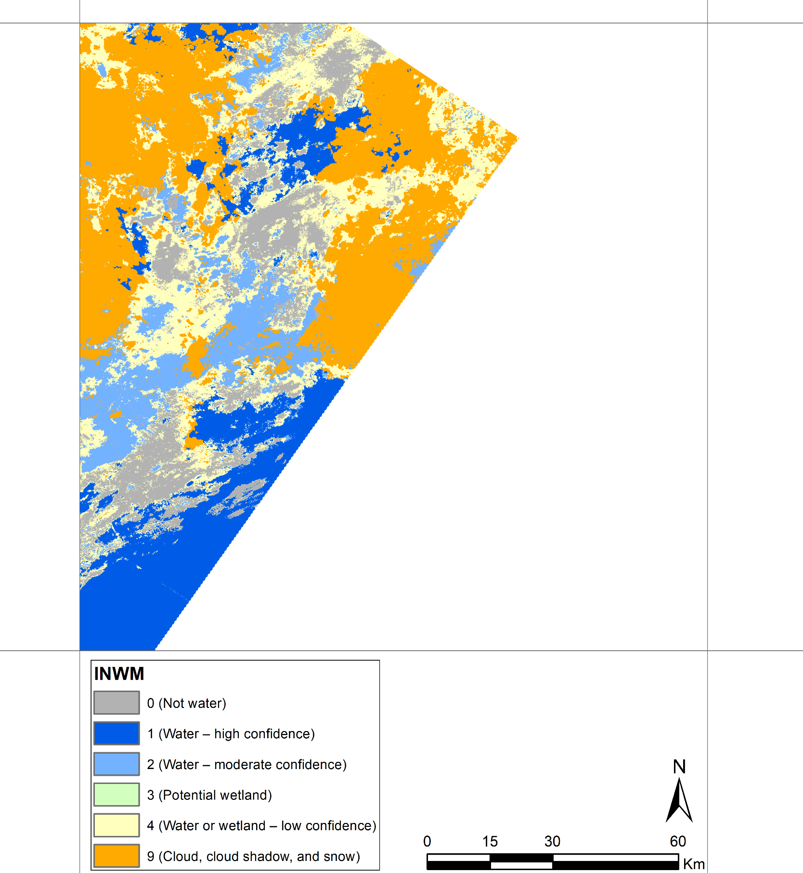
Tile ID: LE07_AK_001004_20000701_20190115_C01_V01_SW.tar
Cloud-free pixels in southern parts of the tile are correctly classified as “Water - high confidence”.
Natural Color Composite (ETM+ Band 3,2,1)
DSWE - Interpreted Layer (INTR)
DSWE - Interpreted Layer with Mask (INWM)

Slide 2
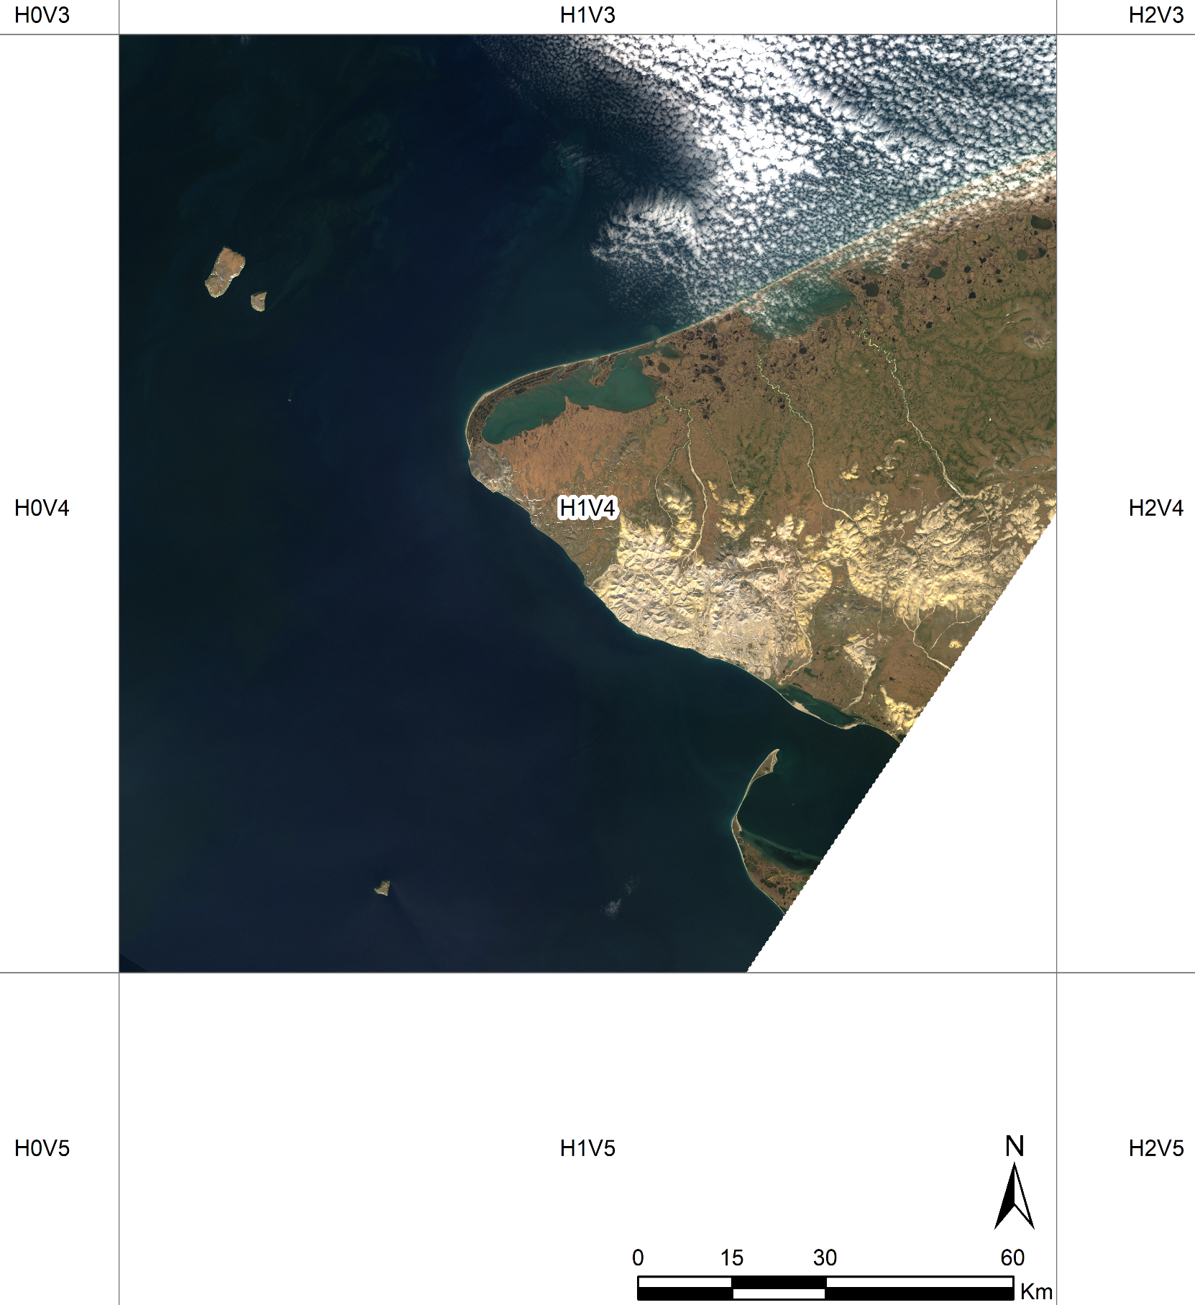
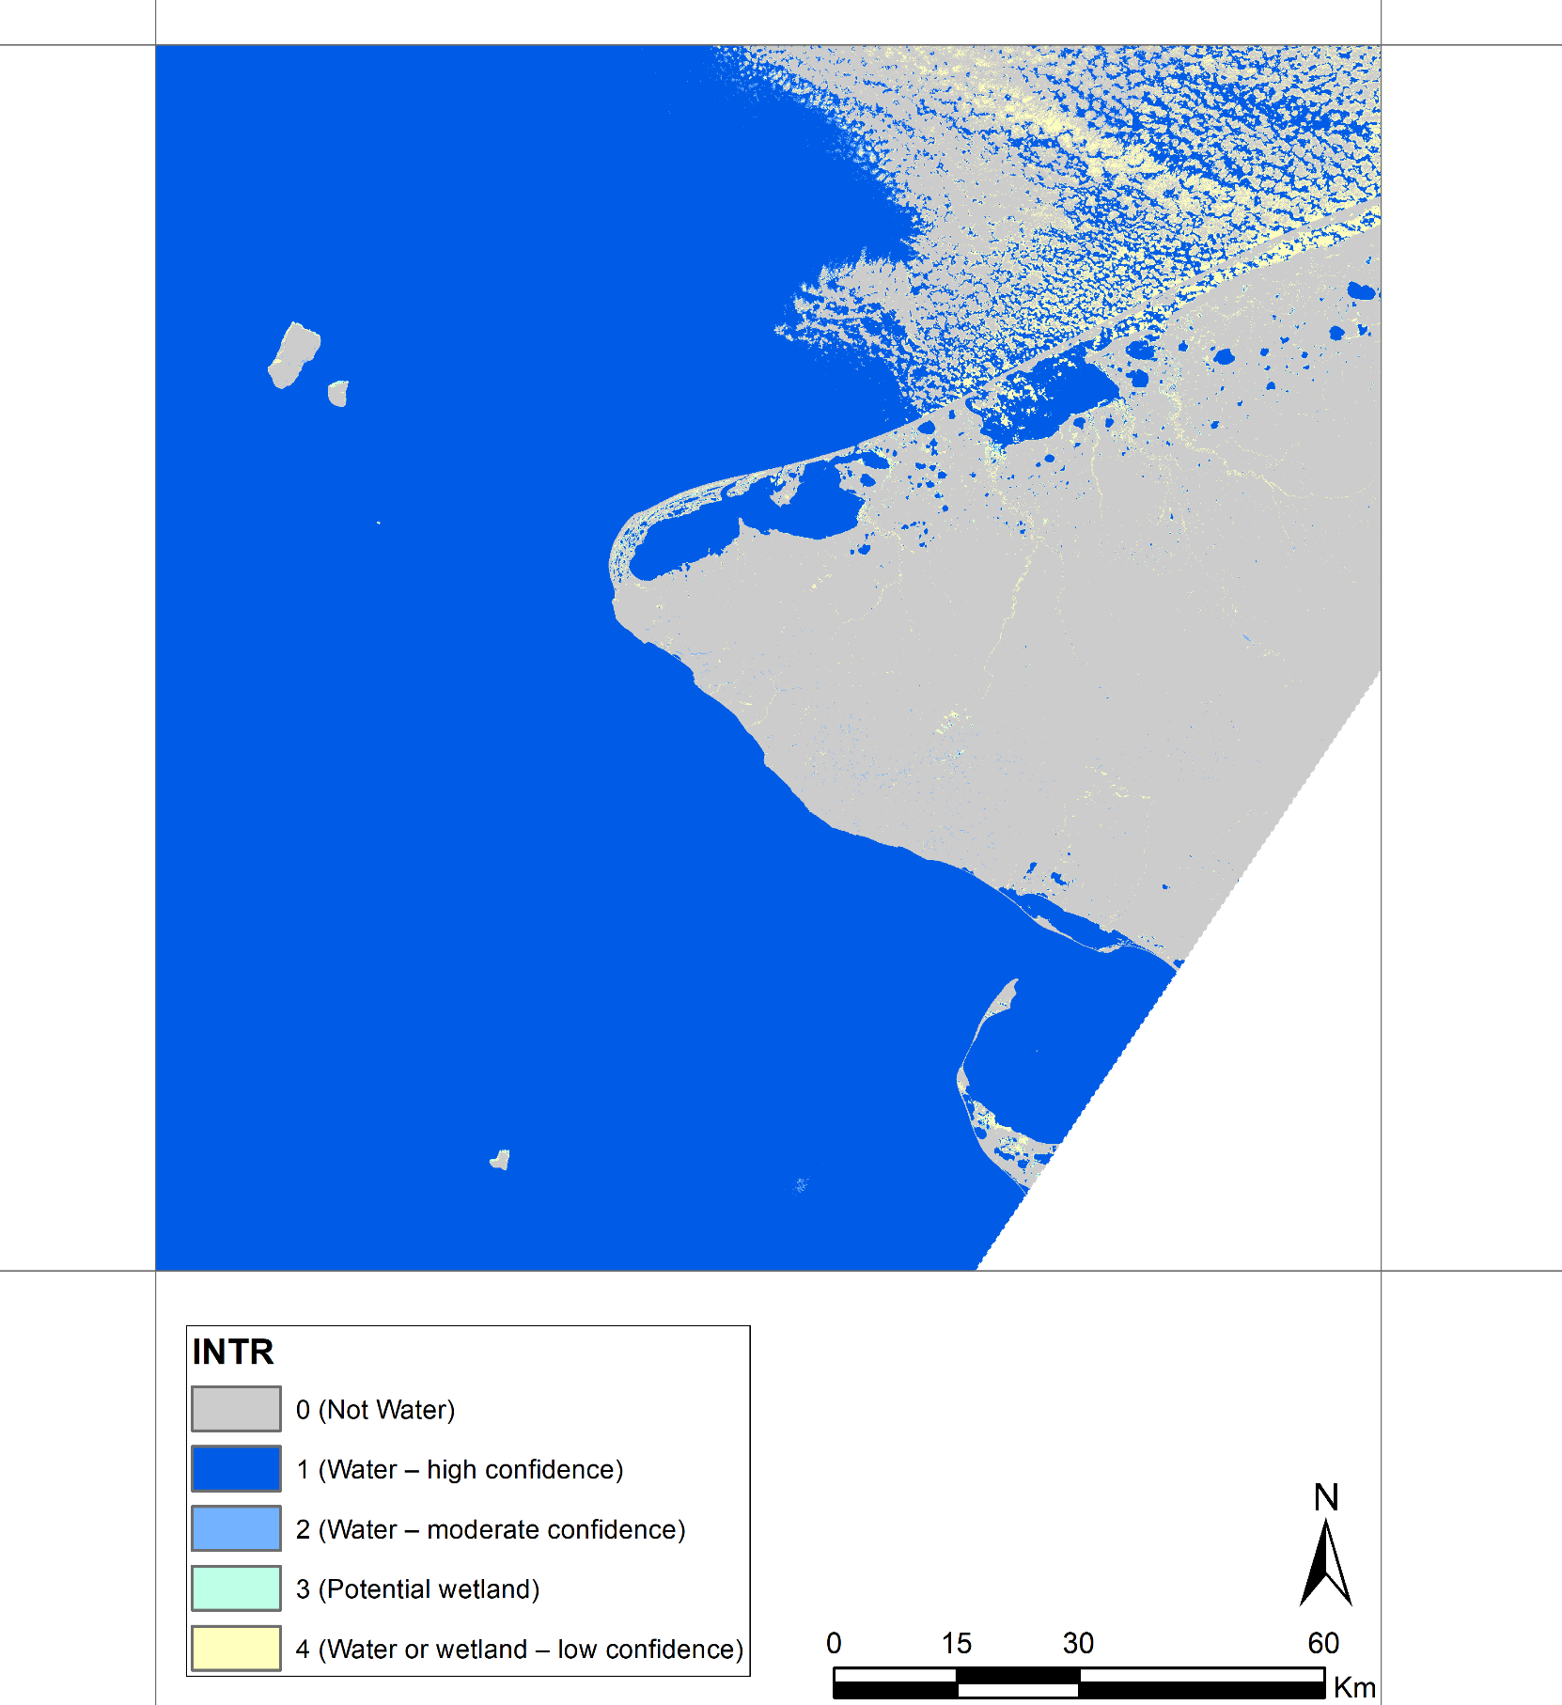
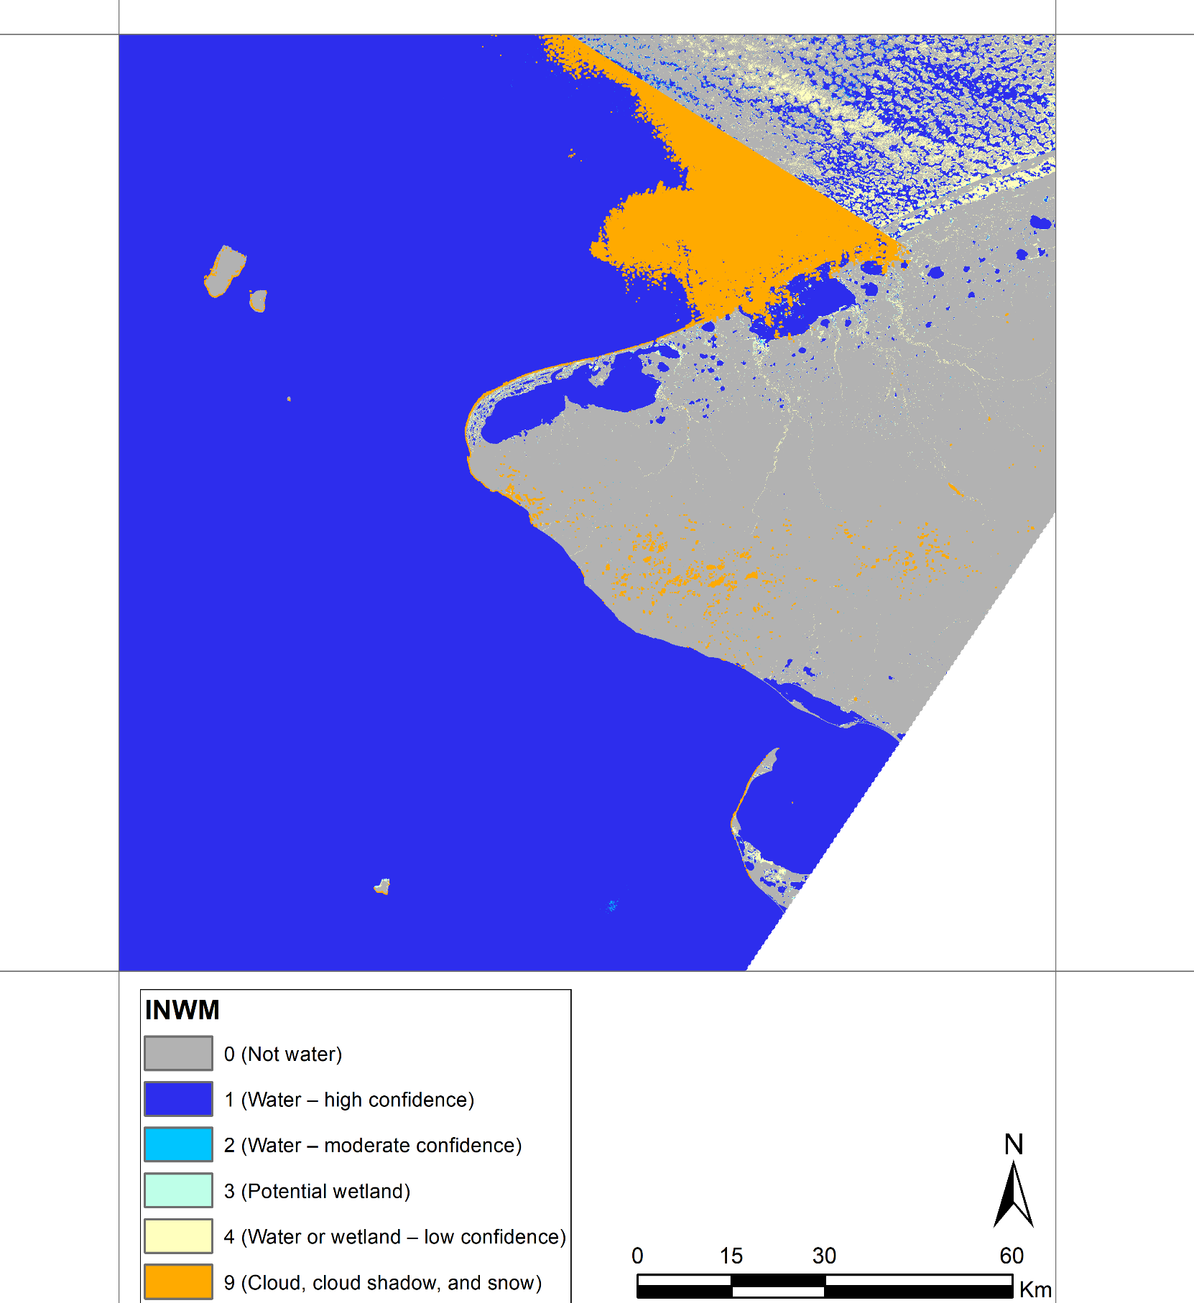
Tile ID: LE07_AK_001004_20000710_20190522_C01_V01_SW.tar
This tiles shows great performance of DSWE in cloud/shadow/snow free pixels.
The cloud pixels are screened using CFMask which uses scene-based statistics to determine cloud pixels. In the southernmost scene, clouds are identified correctly (orange color in INWM) but in northern scene they are omitted. However, these cloud pixels did not pass the DSWE diagnostic tests and are flagged as “Not water”.
Natural Color Composite (ETM+ Band 3,2,1)
DSWE - Interpreted Layer (INTR)
DSWE - Interpreted Layer with Mask (INWM)

Slide 3
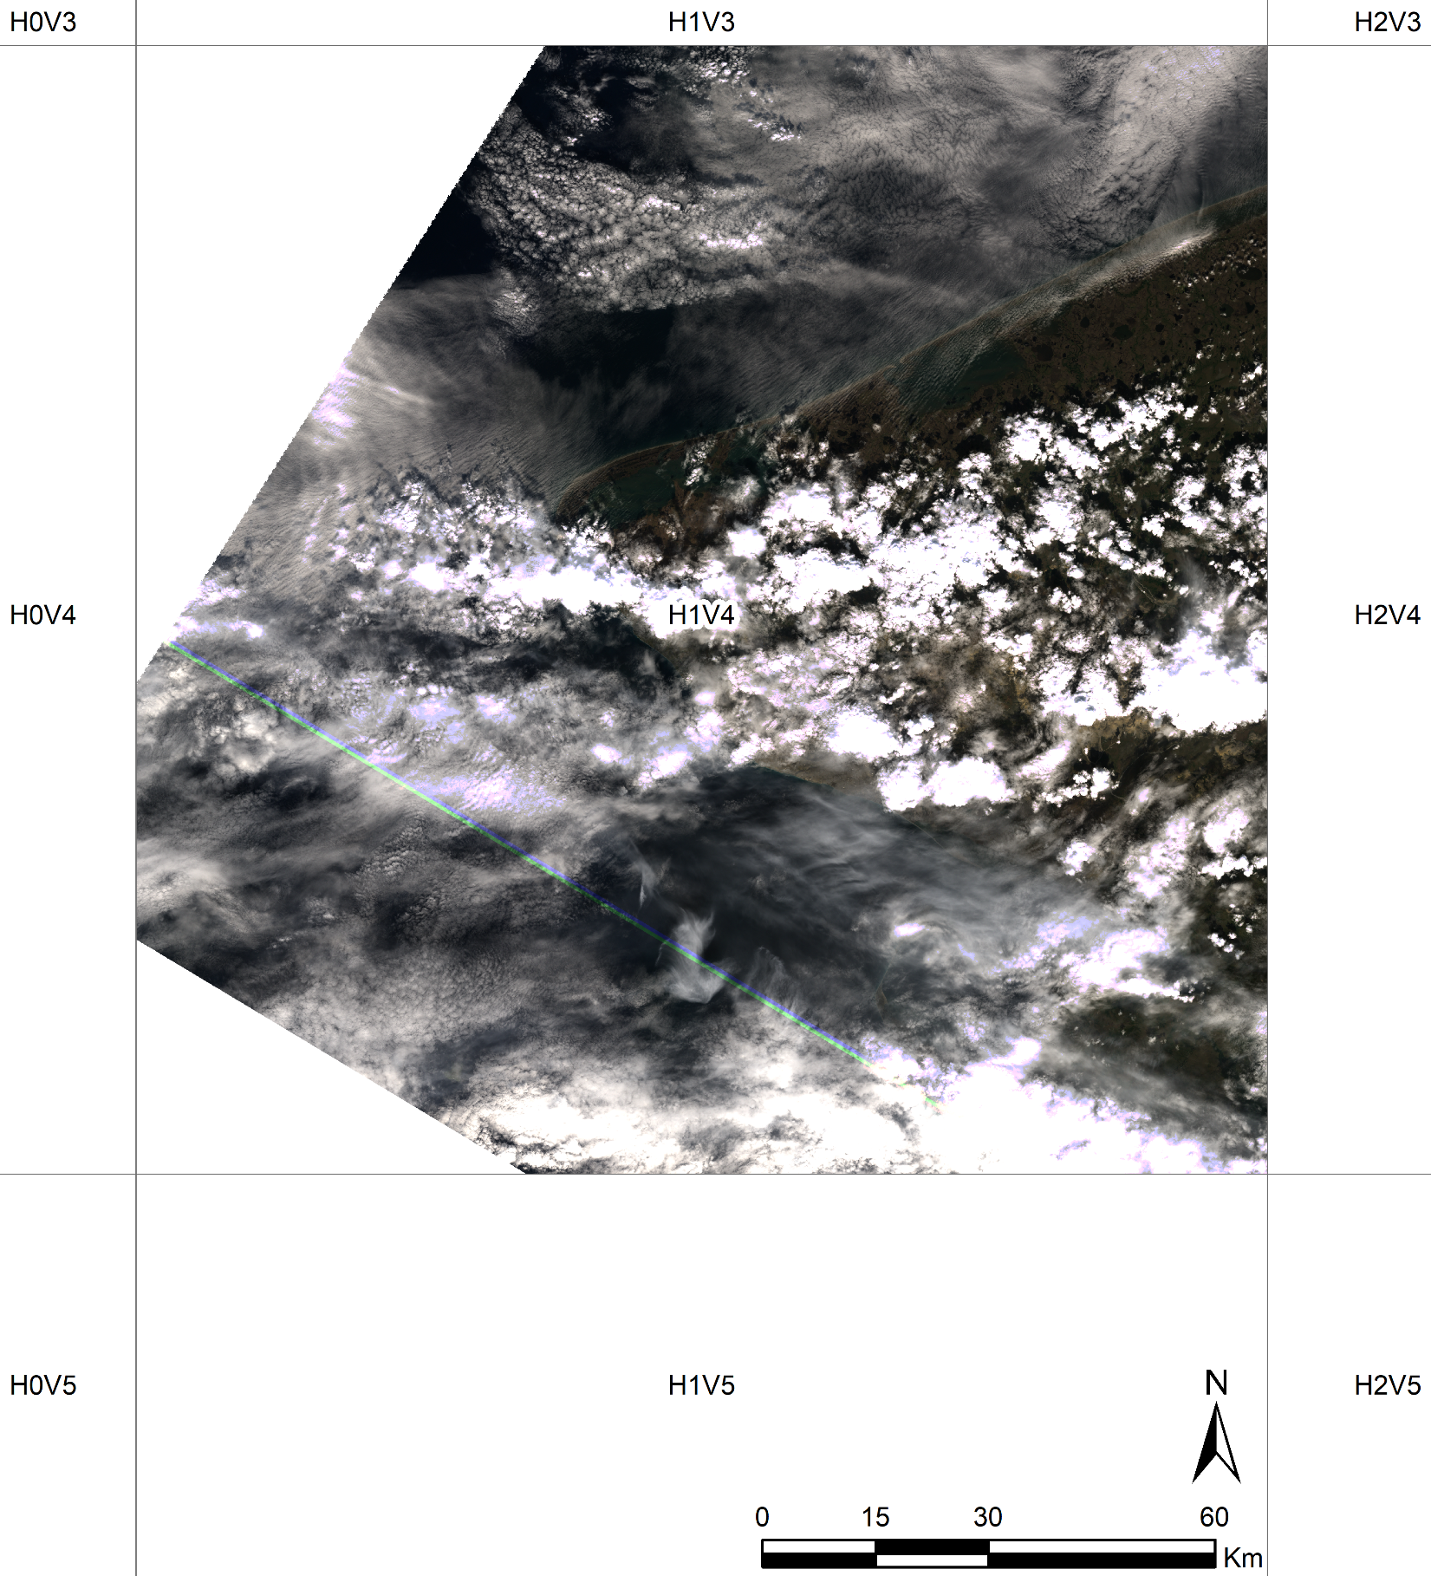
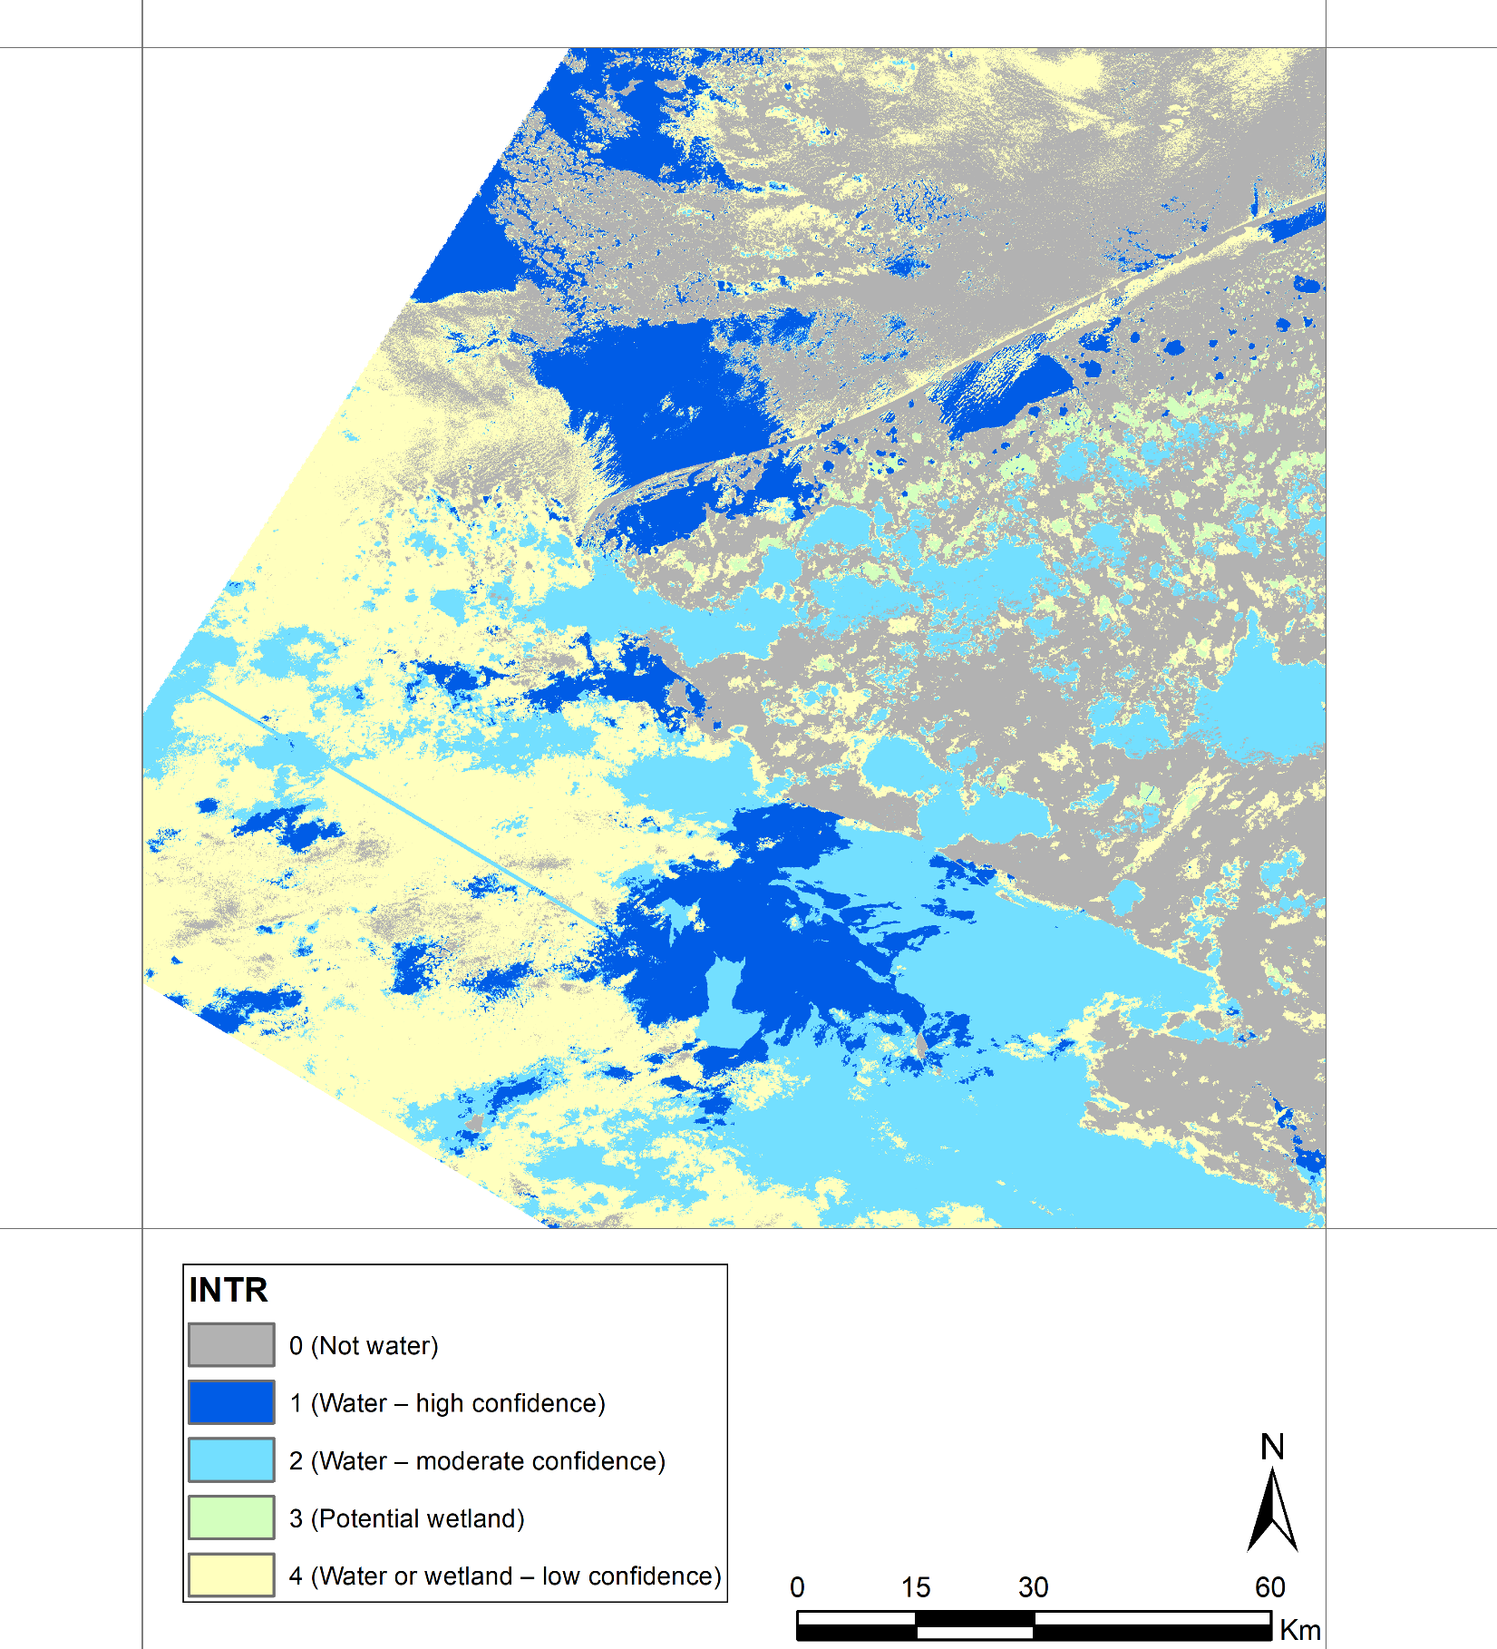
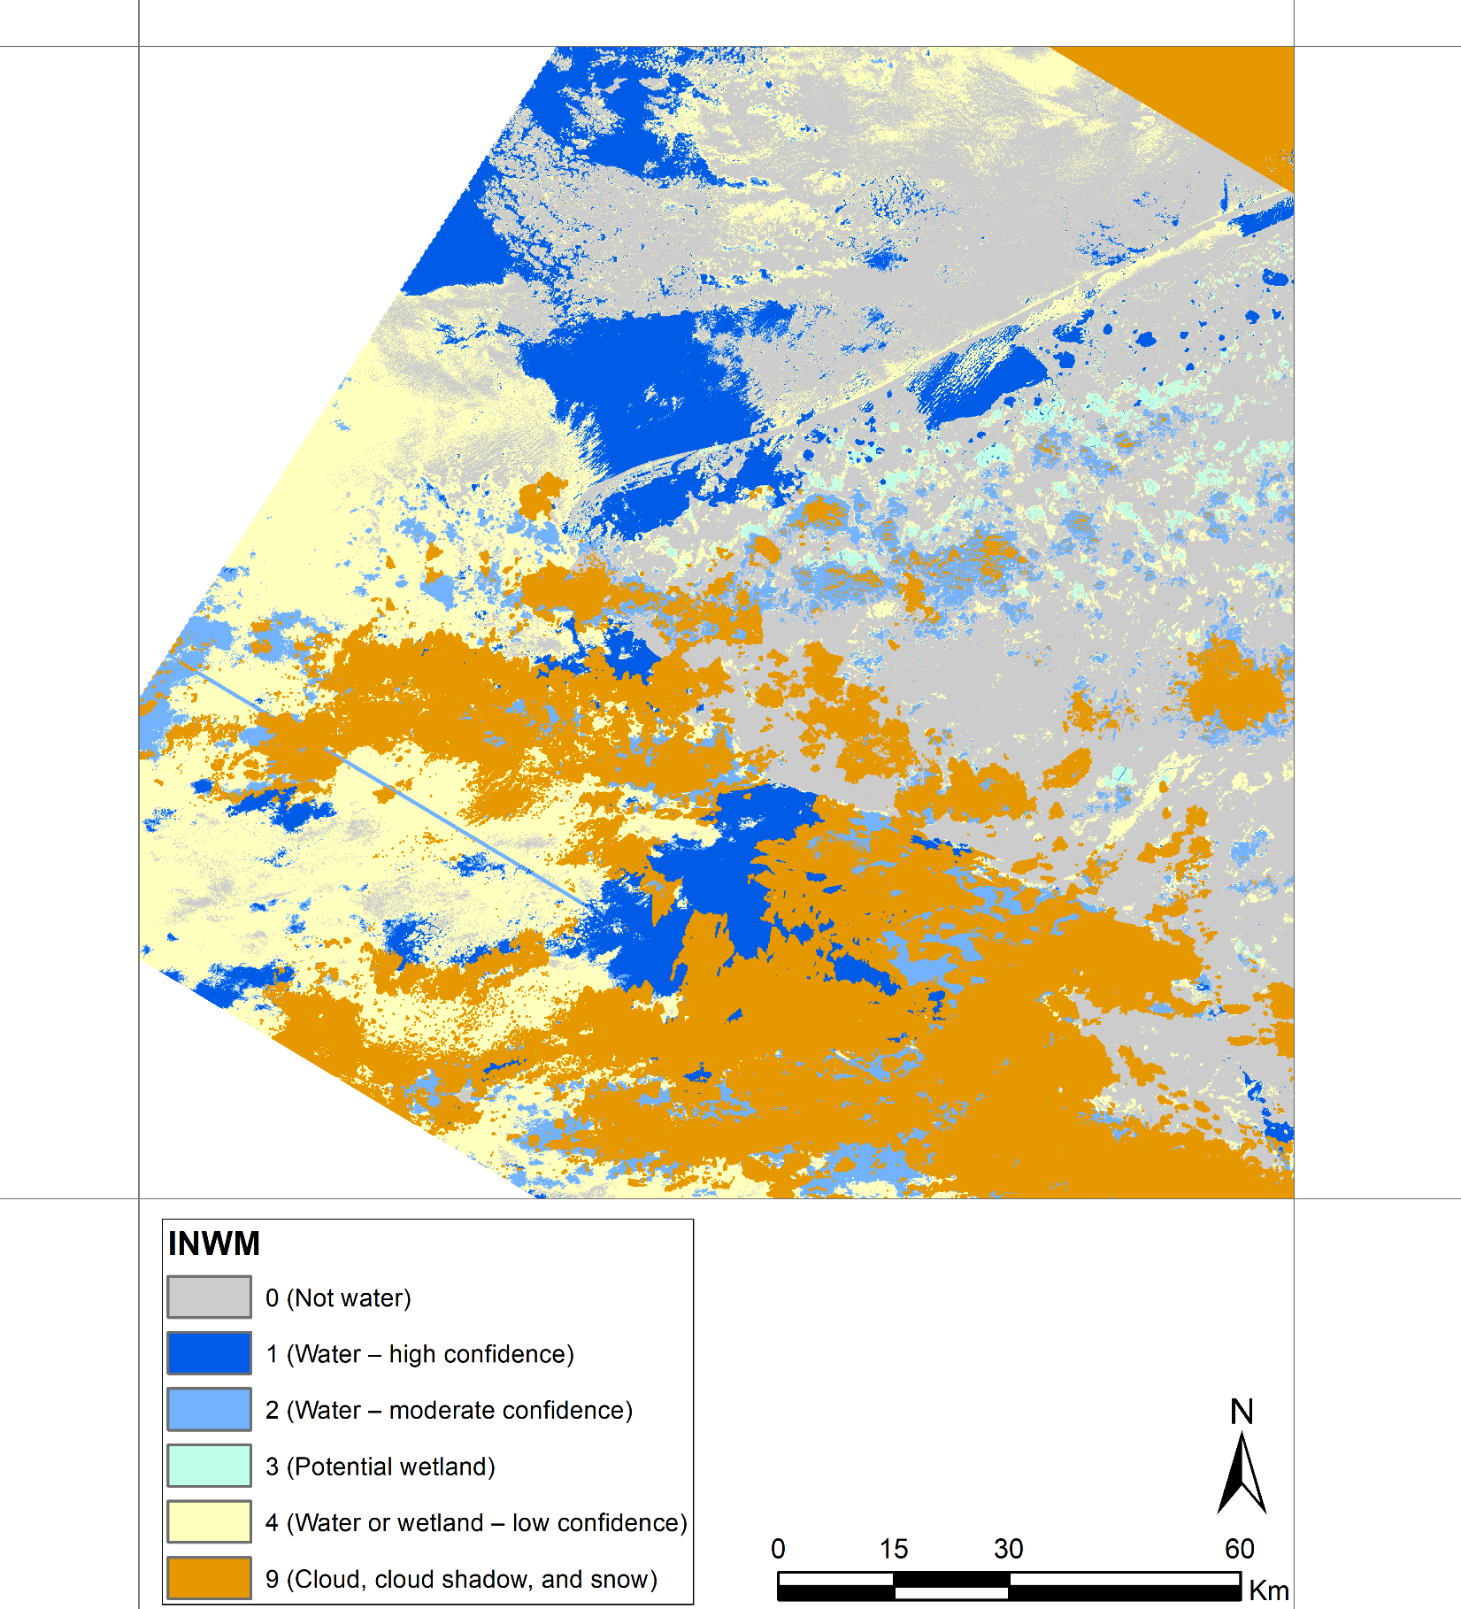
Tile ID: LE07_AK_001004_20000719_20190522_C01_V01_SW.tar
Significant areas are covered by cloud and cirrus.
The water pixels that were not impacted by clouds are correctly classified as “Water – high confidence”.
Natural Color Composite (ETM+ Band 3,2,1)
DSWE - Interpreted Layer (INTR)
DSWE - Interpreted Layer with Mask (INWM)

Slide 4
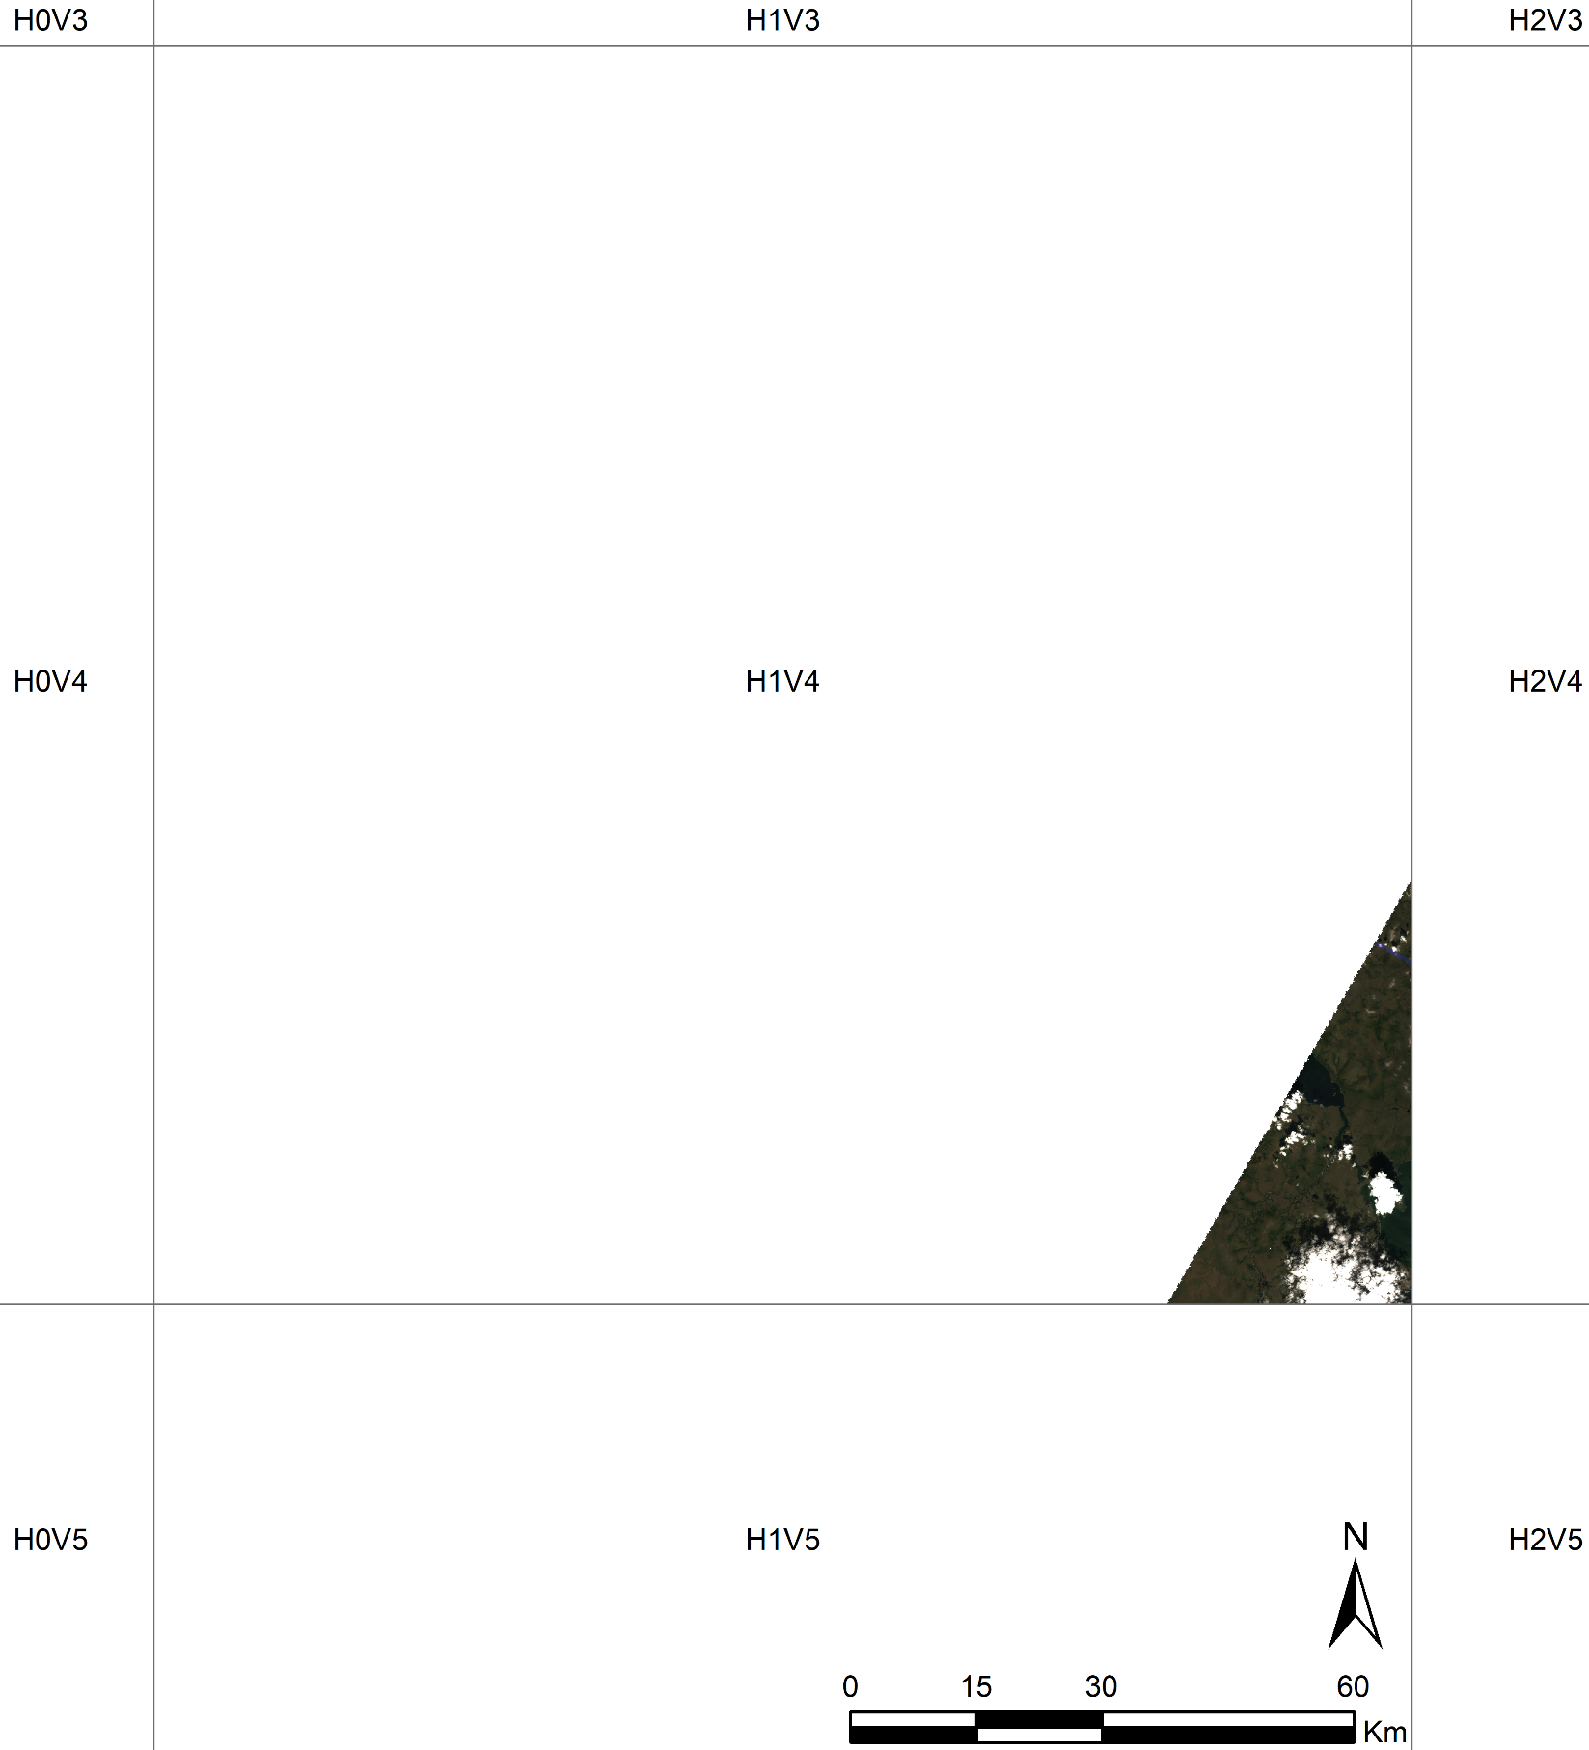
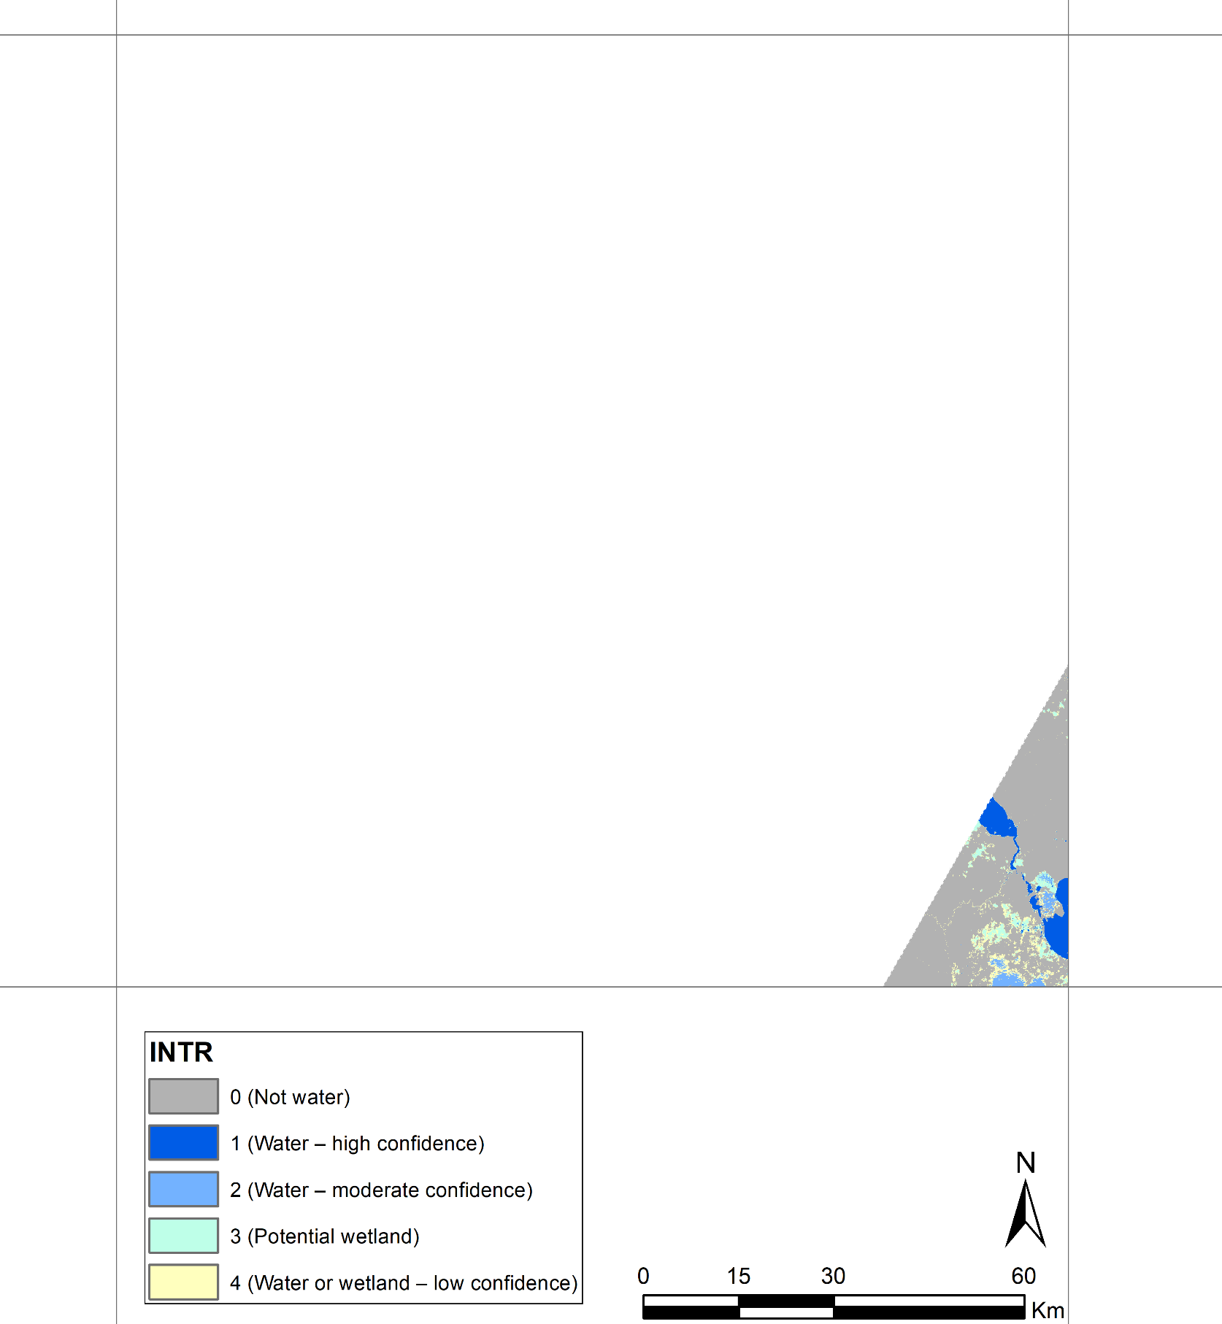
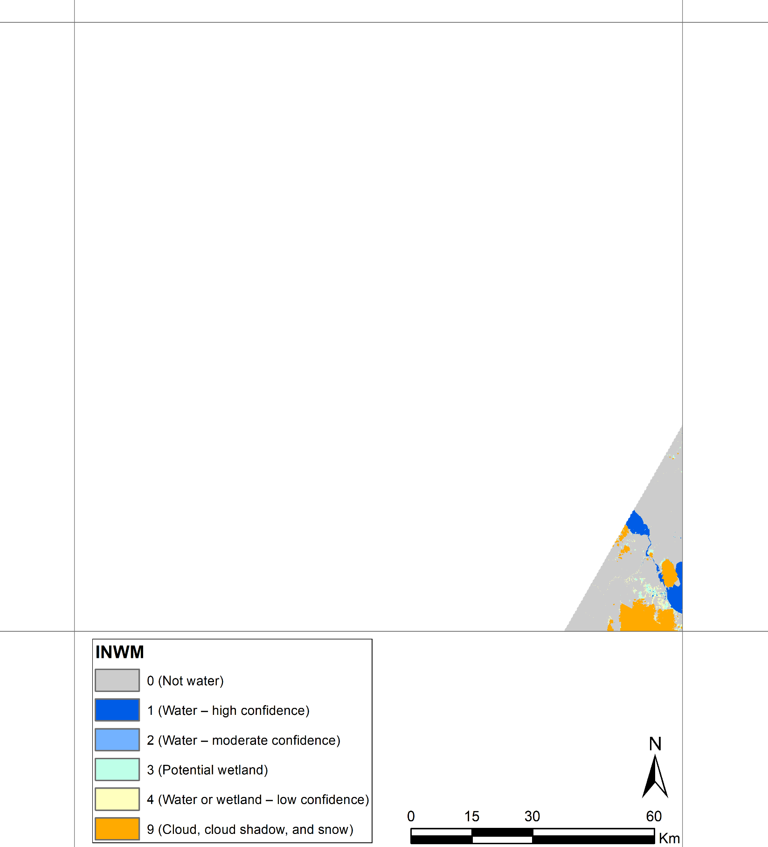
Tile ID: LE07_AK_001004_20000721_20190522_C01_V01_SW.tar
No issue was found in this tile.
Natural Color Composite (ETM+ Band 3,2,1)
DSWE - Interpreted Layer (INTR)
DSWE - Interpreted Layer with Mask (INWM)

Slide 5
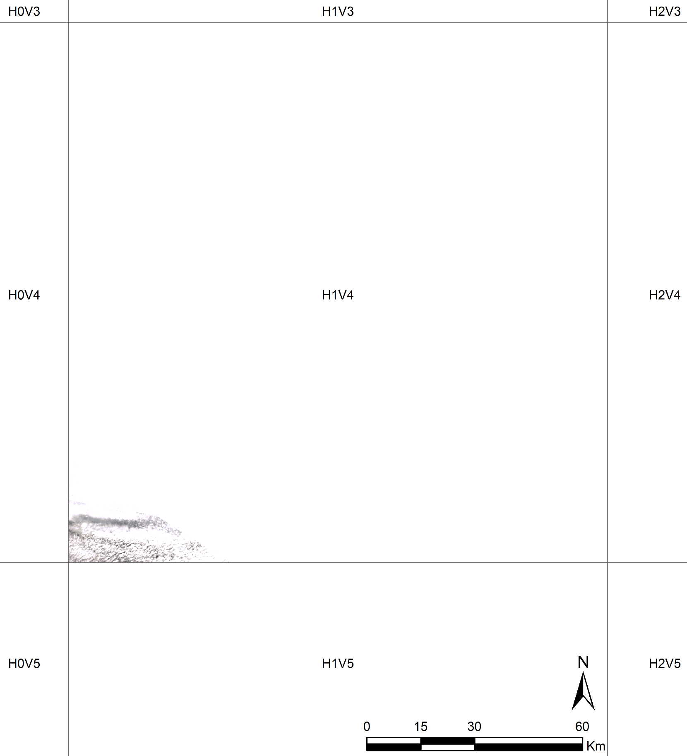
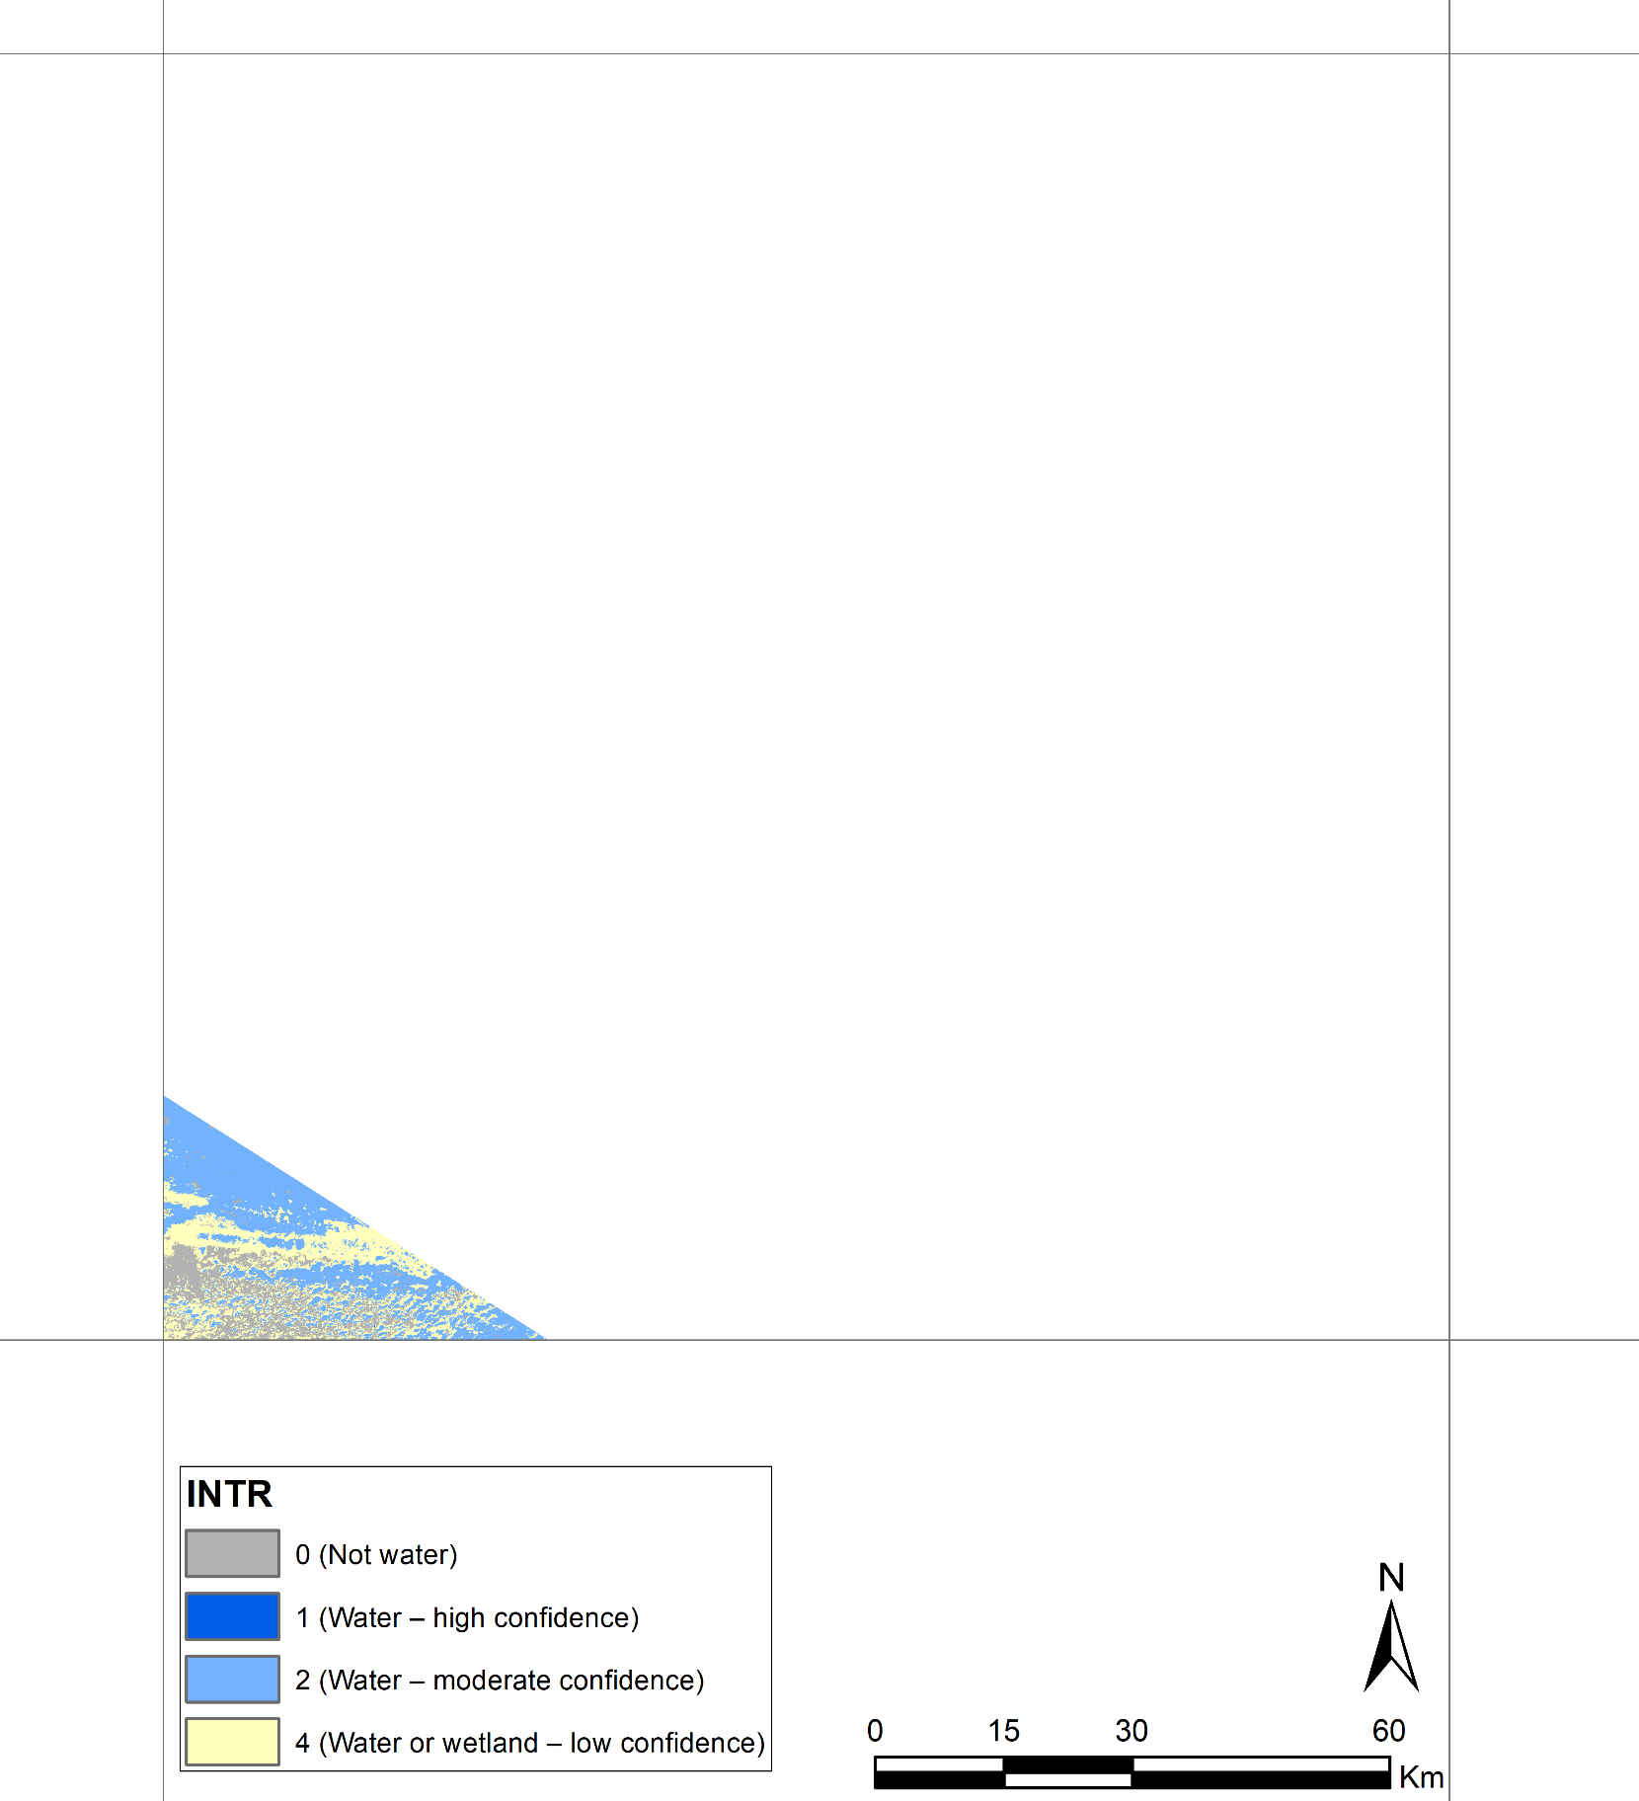
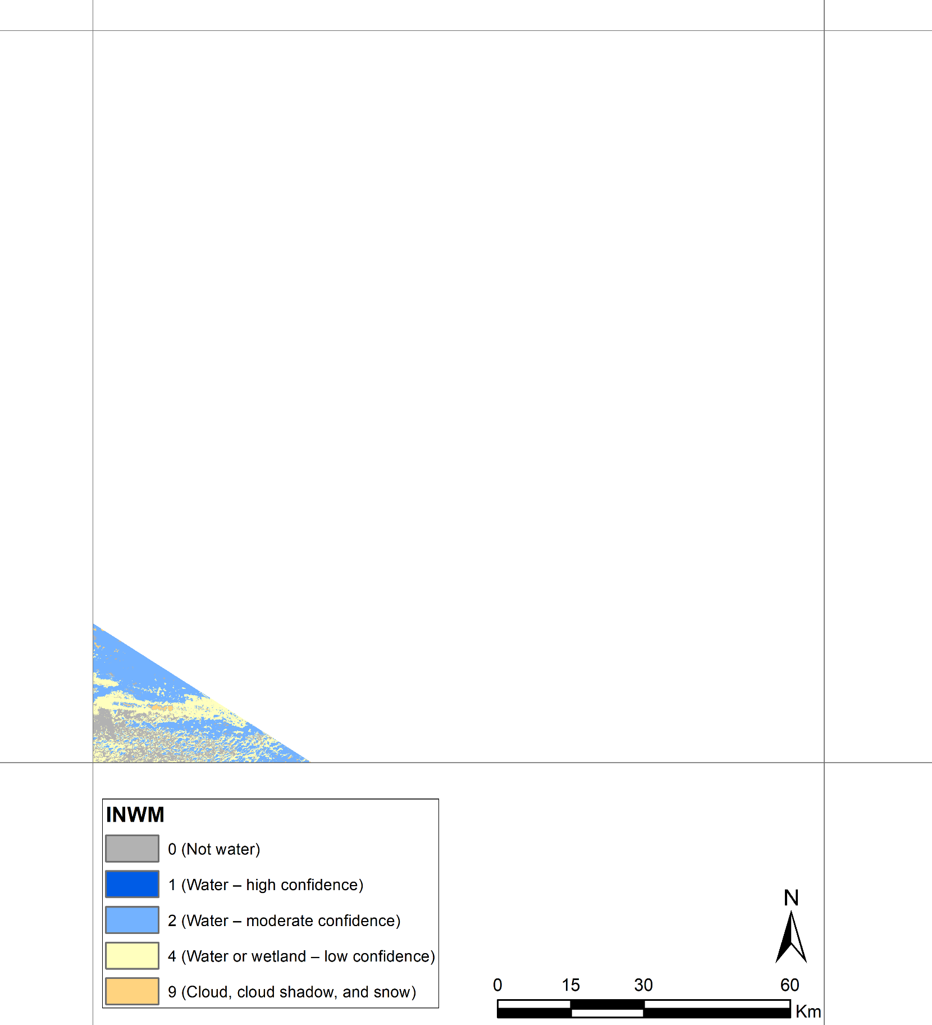
Tile ID: LE07_AK_001004_20000726_20190115_C01_V01_SW.tar
Almost all ocean pixels at the southwestern part of this tile are covered by cloud.
Natural Color Composite (ETM+ Band 3,2,1)
DSWE - Interpreted Layer (INTR)
DSWE - Interpreted Layer with Mask (INWM)

Slide 6
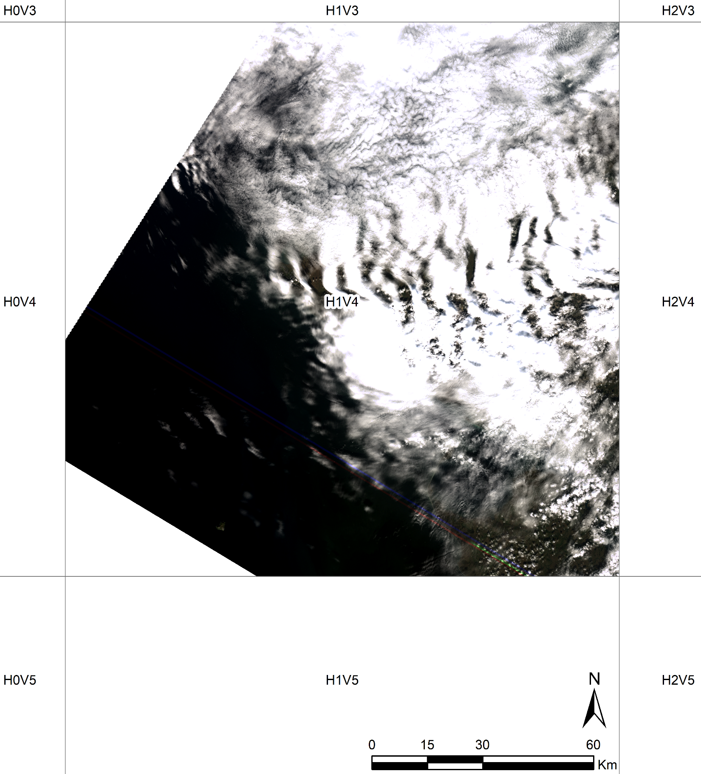
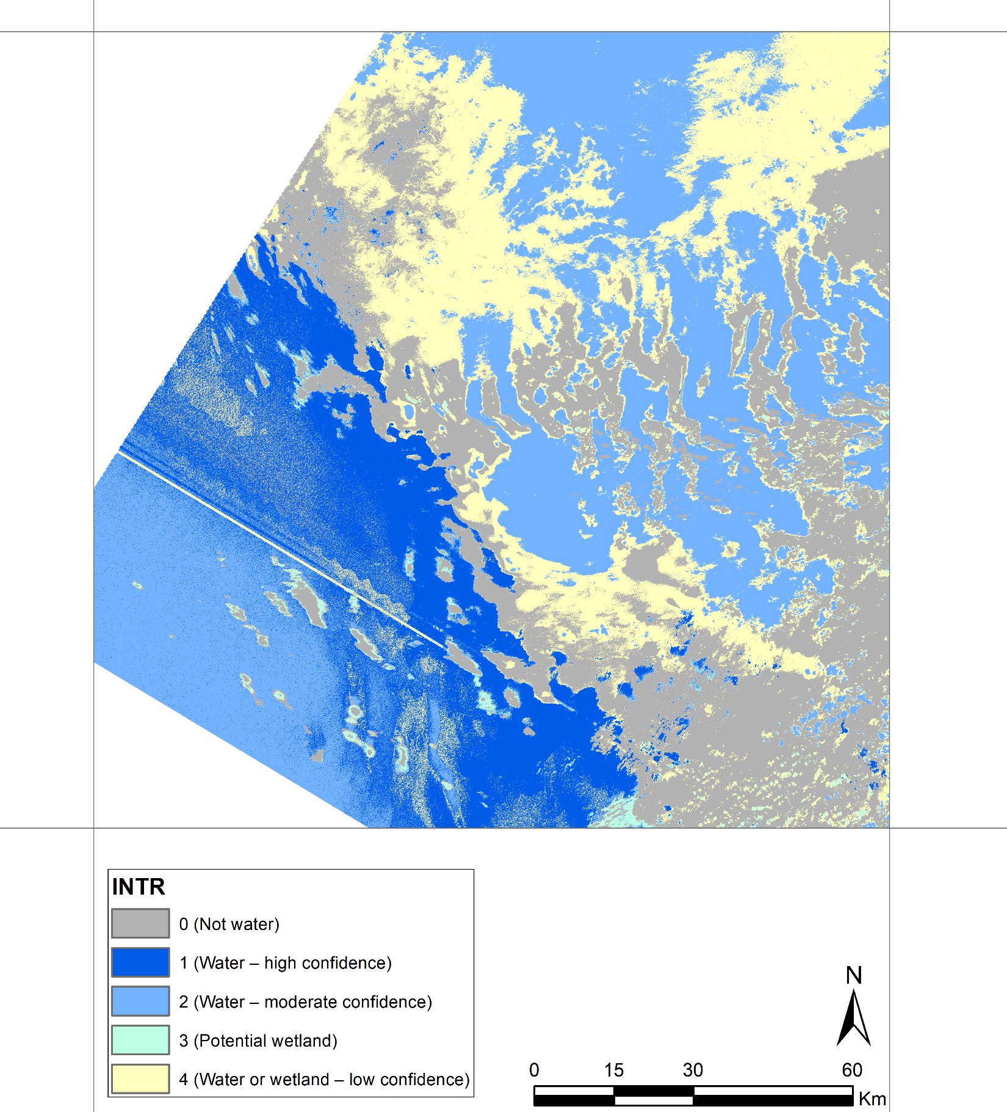
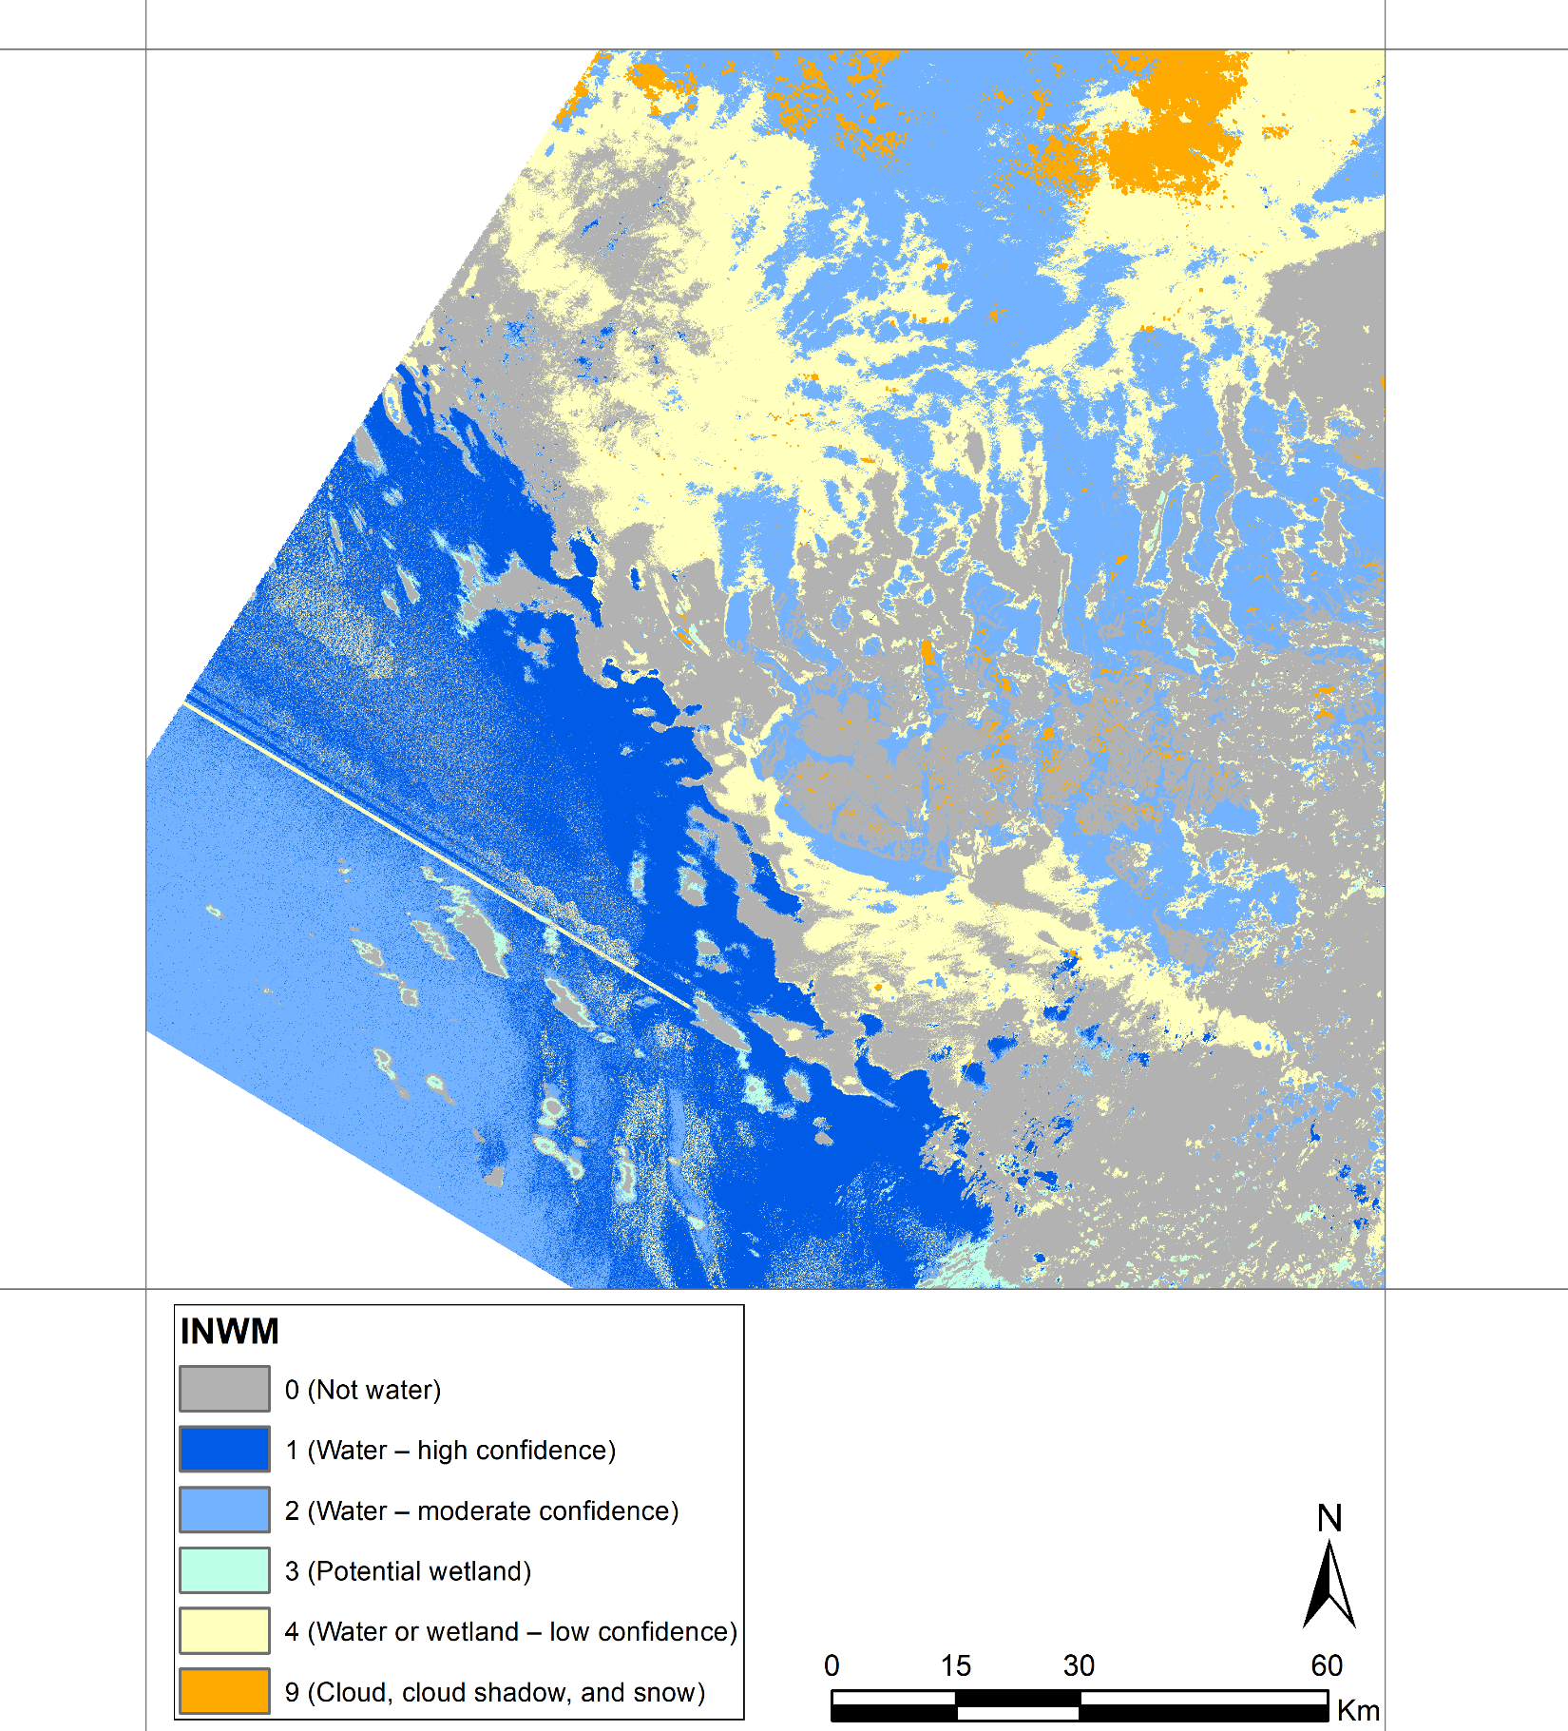
Tile ID: LE07_AK_001004_20000804_20190522_C01_V01_SW.tar
Similar to previous images, the cloud-free water pixels are correctly detected.
Natural Color Composite (ETM+ Band 3,2,1)
DSWE - Interpreted Layer (INTR)
DSWE - Interpreted Layer with Mask (INWM)

Slide 7
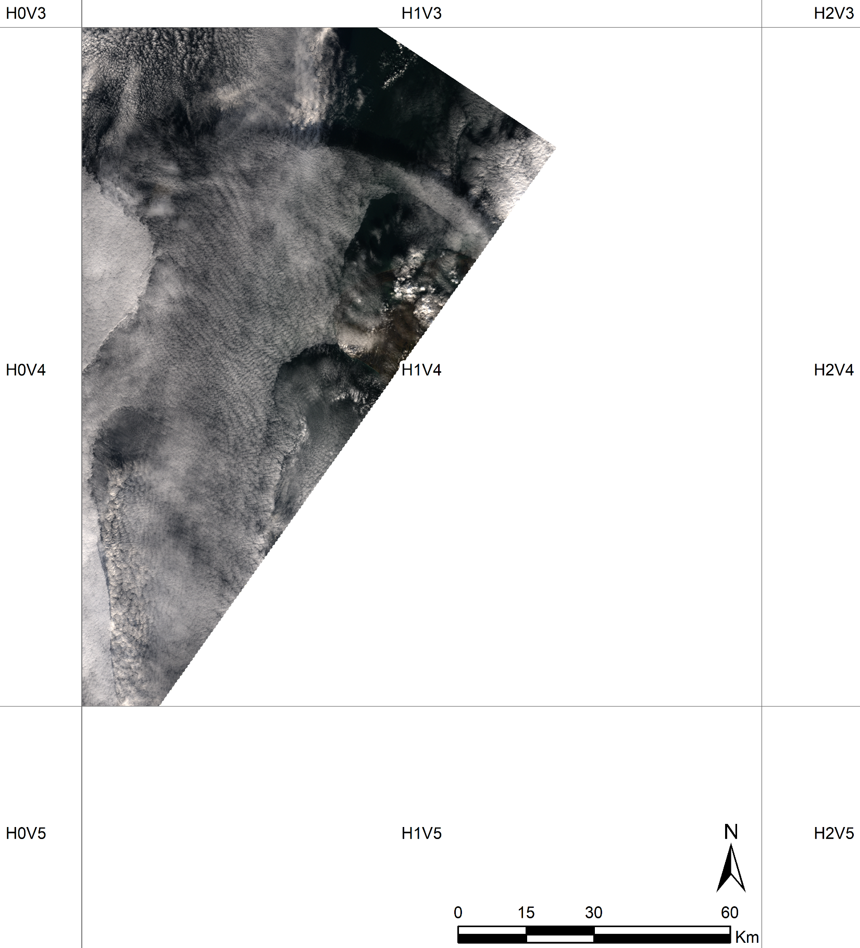
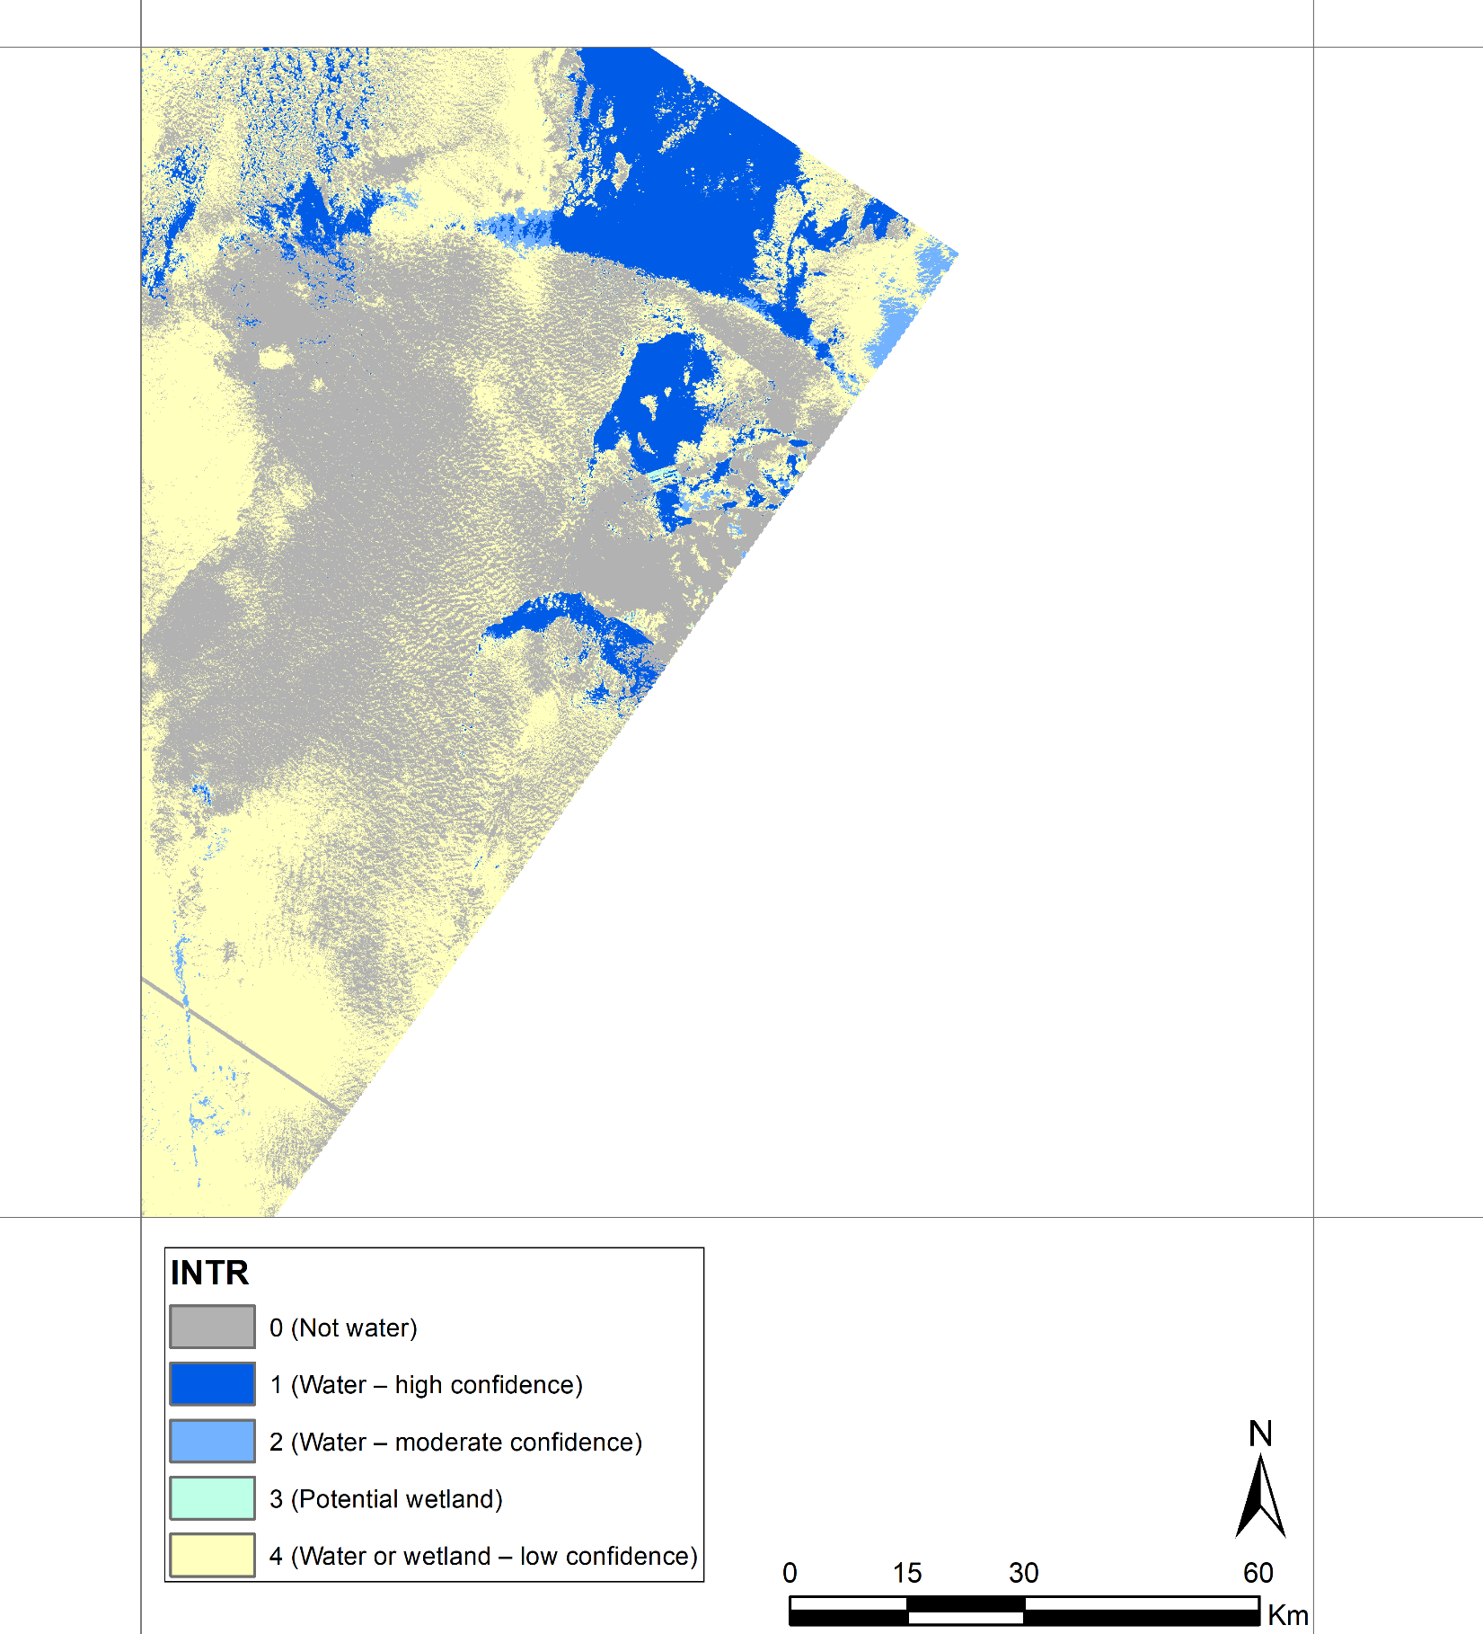
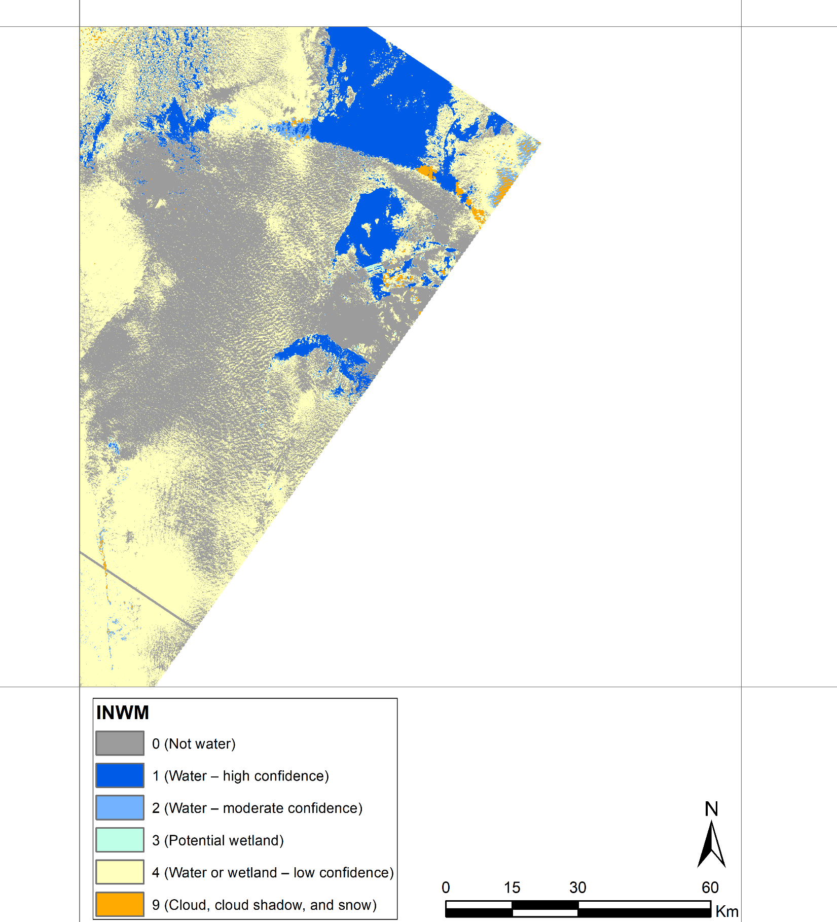
Tile ID: LE07_AK_001004_20000903_20190115_C01_V01_SW.tar
In this tile the cloud and cirrus coverage has impacted the DSWE algorithm.
Natural Color Composite (ETM+ Band 3,2,1)
DSWE - Interpreted Layer (INTR)
DSWE - Interpreted Layer with Mask (INWM)

Slide 8
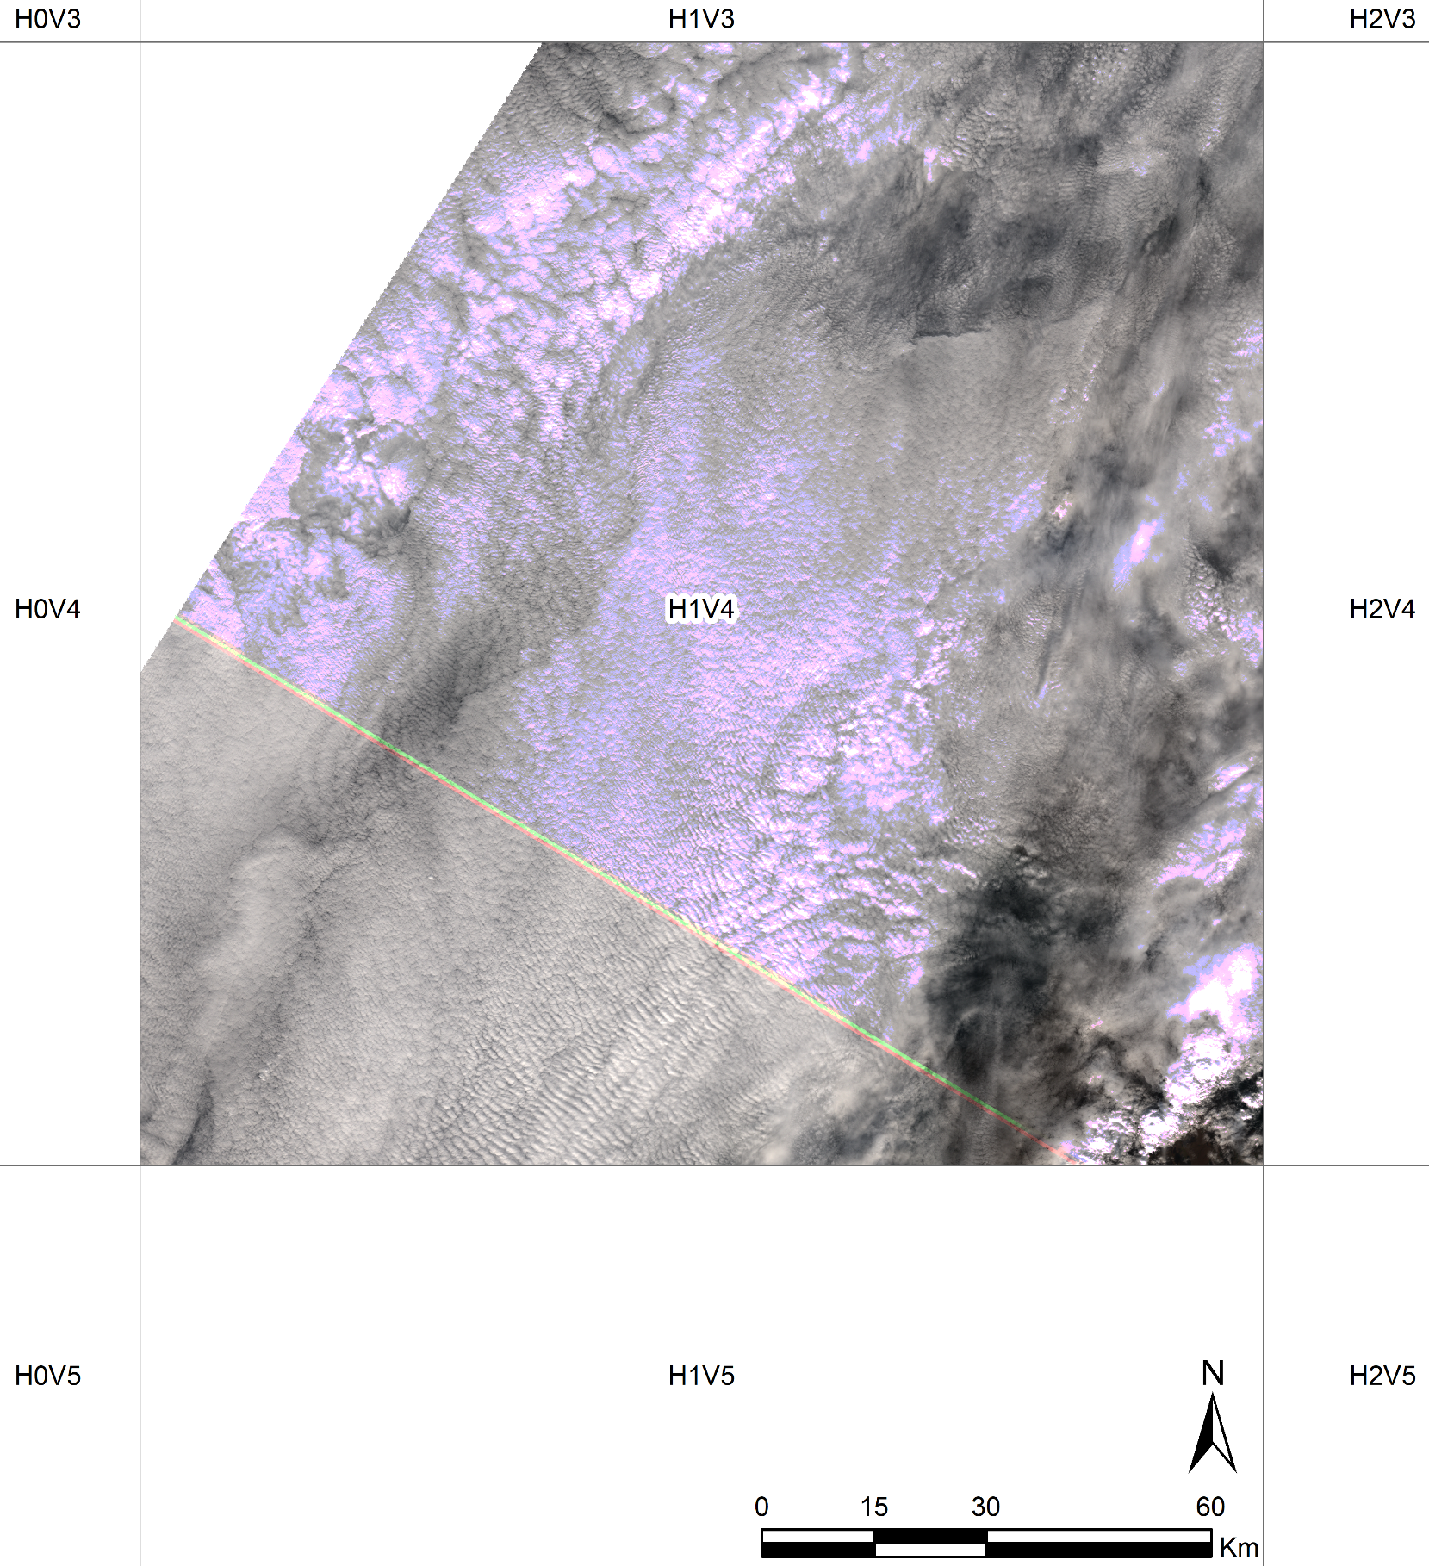
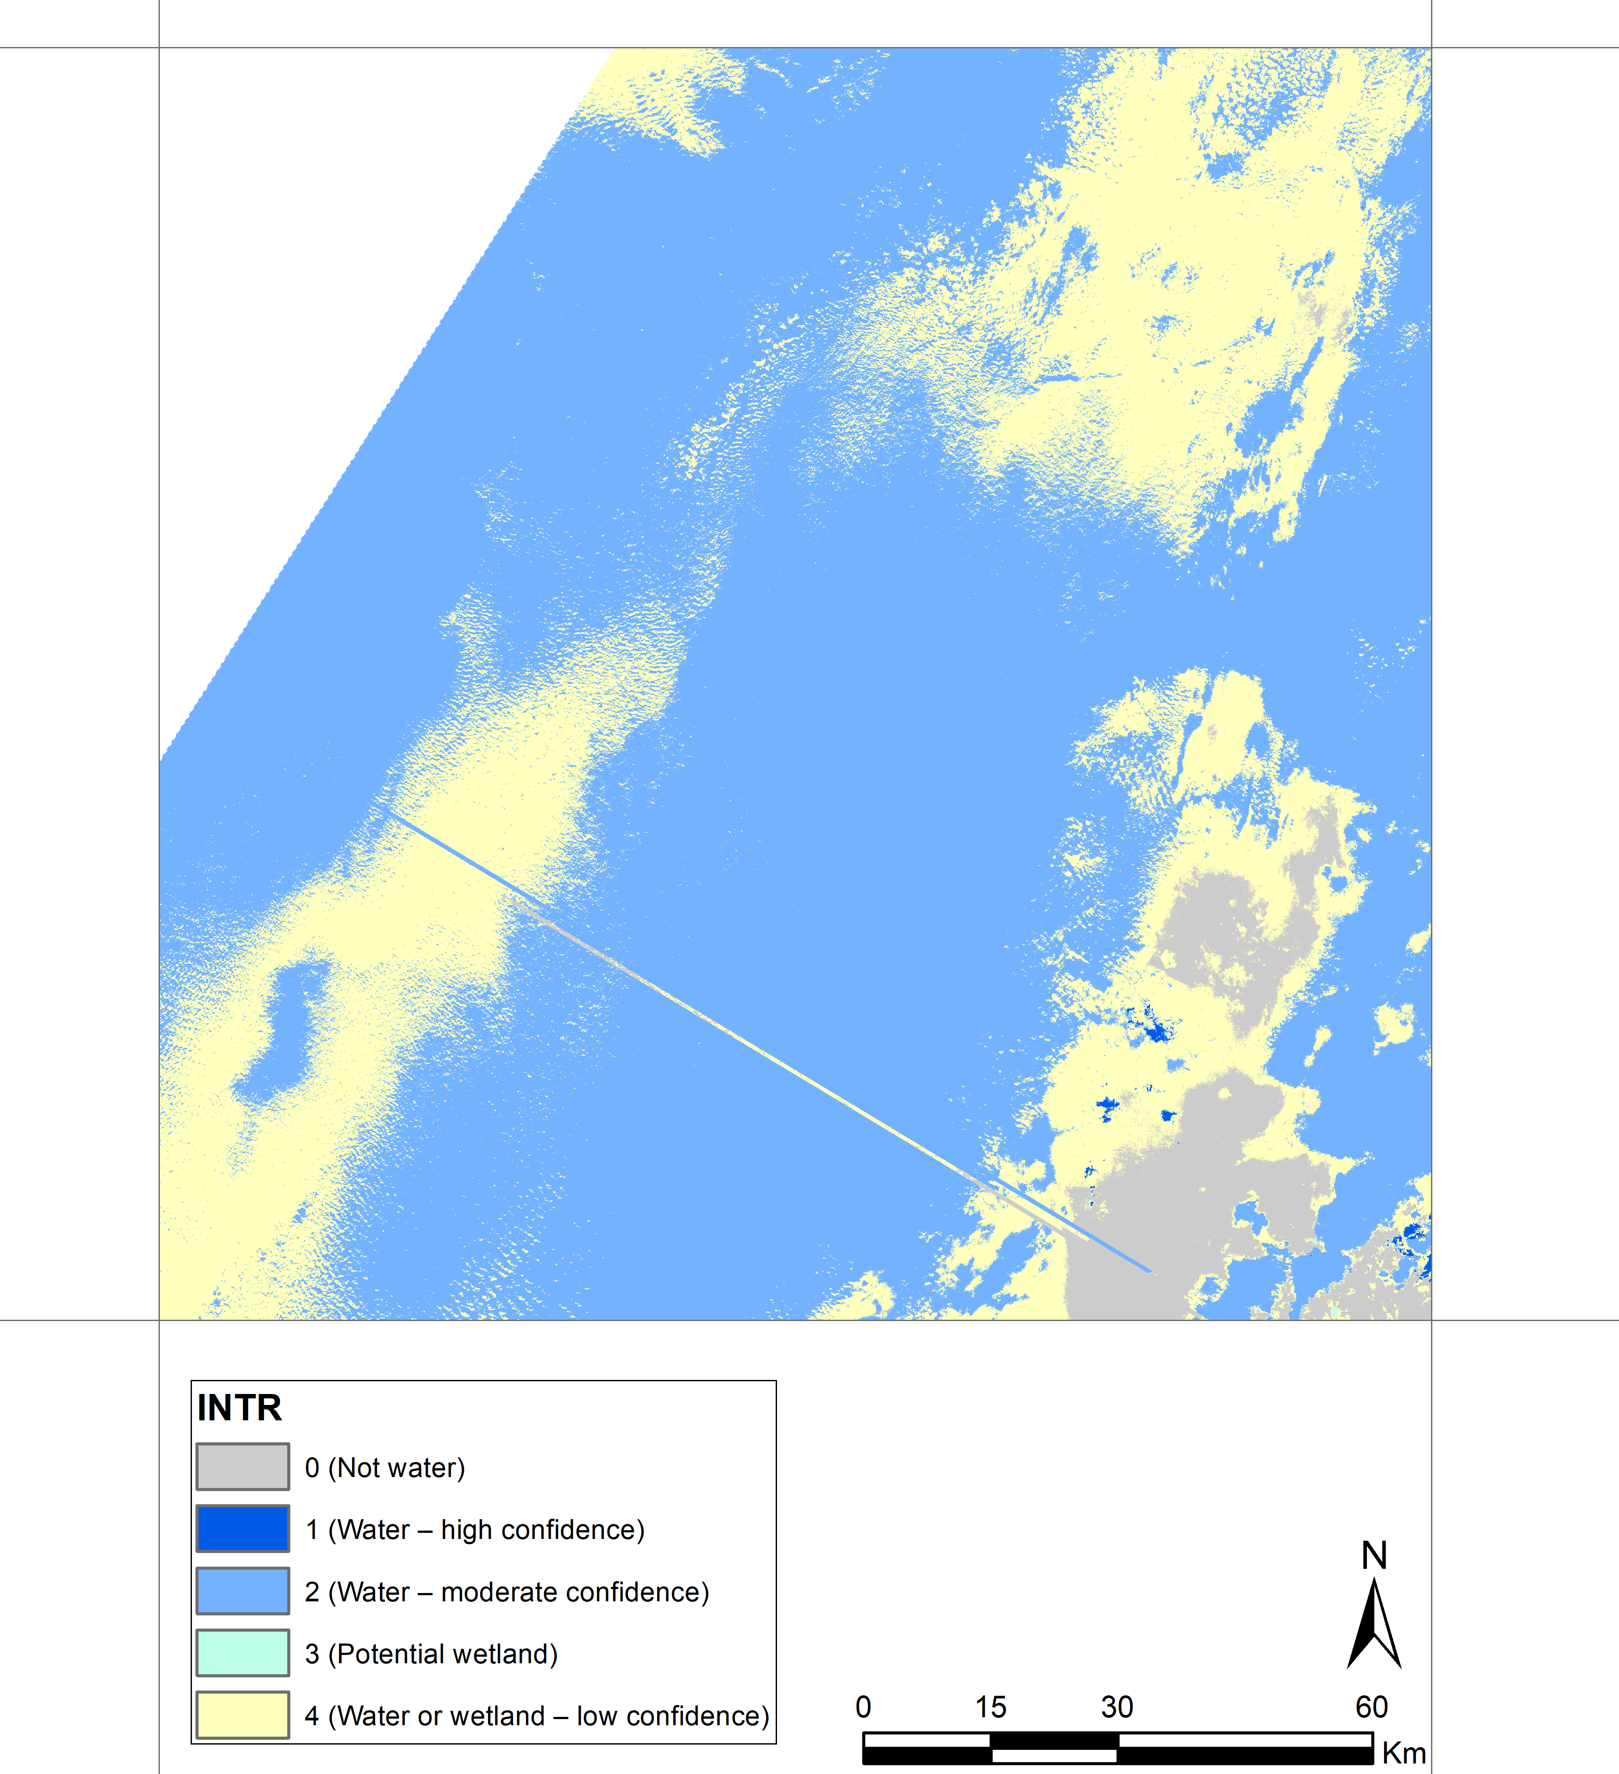
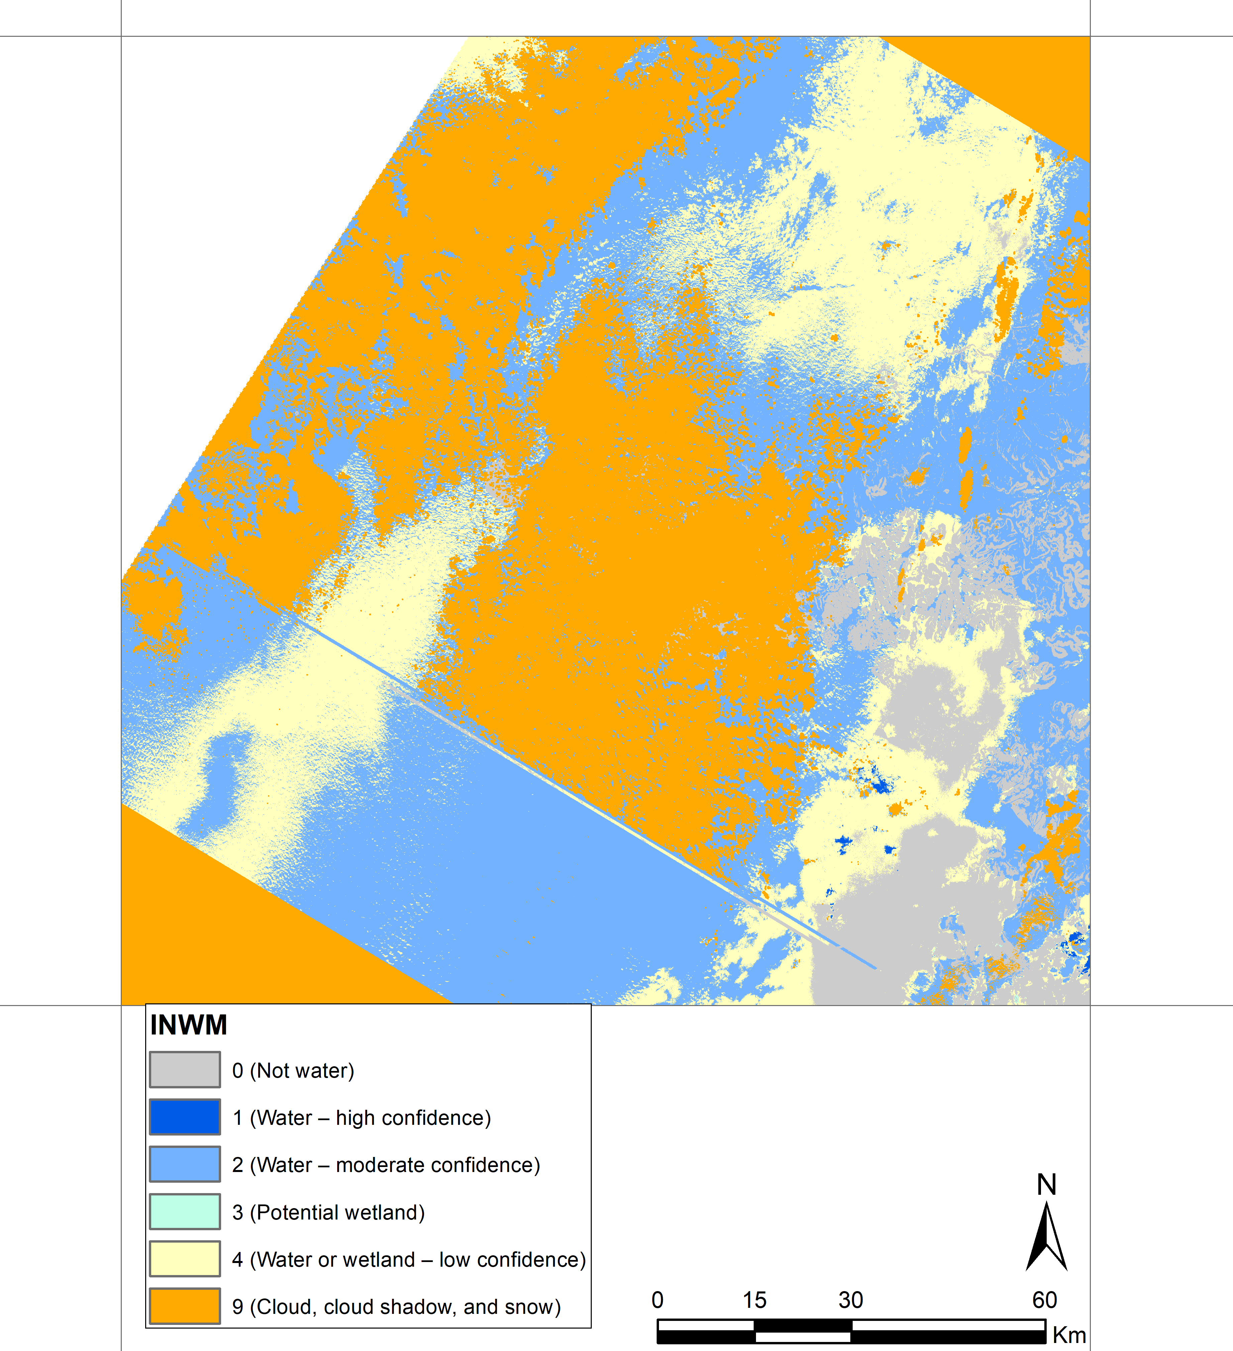
Tile ID: LE07_AK_001004_20000905_20190522_C01_V01_SW.tar
Significant cloud coverage has impacted amlost entire DSWE tile. As the name suggests, the “Water- moderate confidence” class does not always indicate surface water.
Natural Color Composite (ETM+ Band 3,2,1)
DSWE - Interpreted Layer (INTR)
DSWE - Interpreted Layer with Mask (INWM)

Slide 9
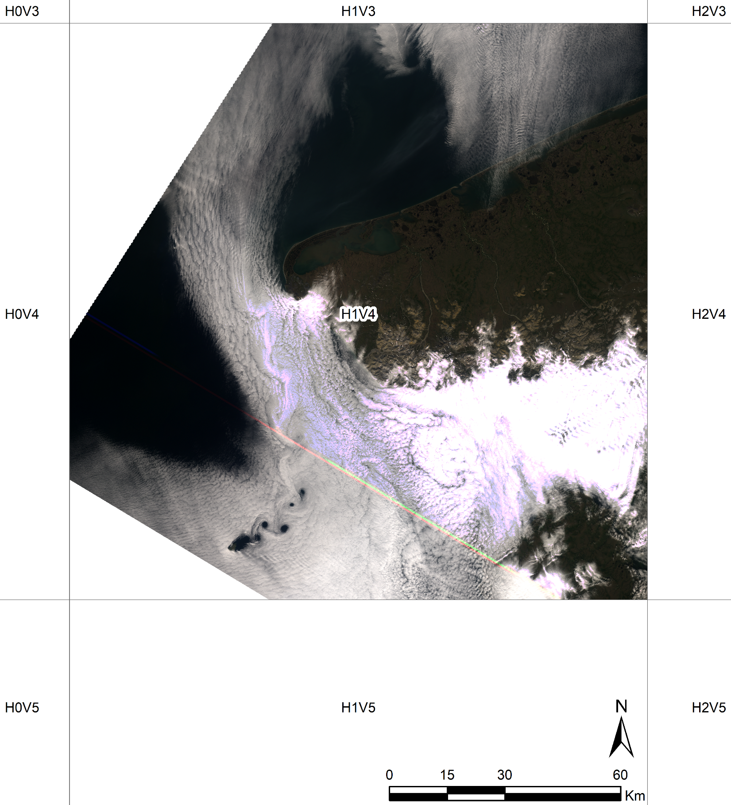
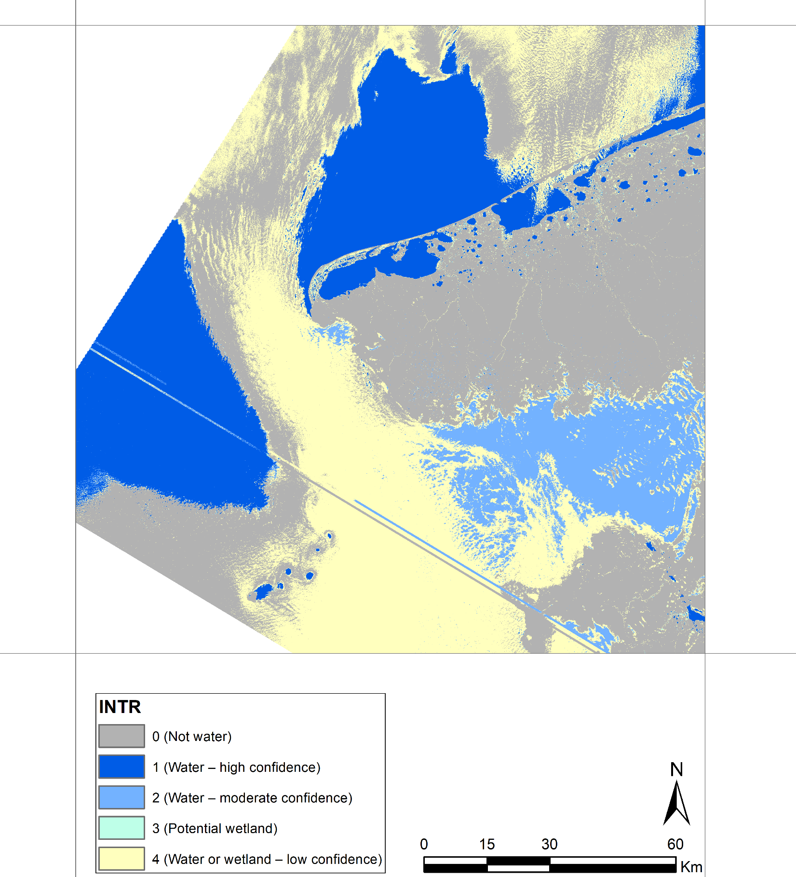
Tile ID: LE07_AK_001004_20010722_20190520_C01_V01_SW.tar
As shown in INTR and INWM the cloud free ocean water and inland water bodies are correctly classified as "Water - high confidence", while the cloud-contaminated ocean pixels are classified as either "No water" or "Water or wetland - low confidence". This is due to relatively high reflectance of the clouds, especially in NIR band. Please note that not all cloud pixels are flagged as such in INWM band.
Natural Color Composite (ETM+ Band 3,2,1)
DSWE - Interpreted Layer (INTR)
DSWE - Interpreted Layer with Mask (INWM)

Slide 10
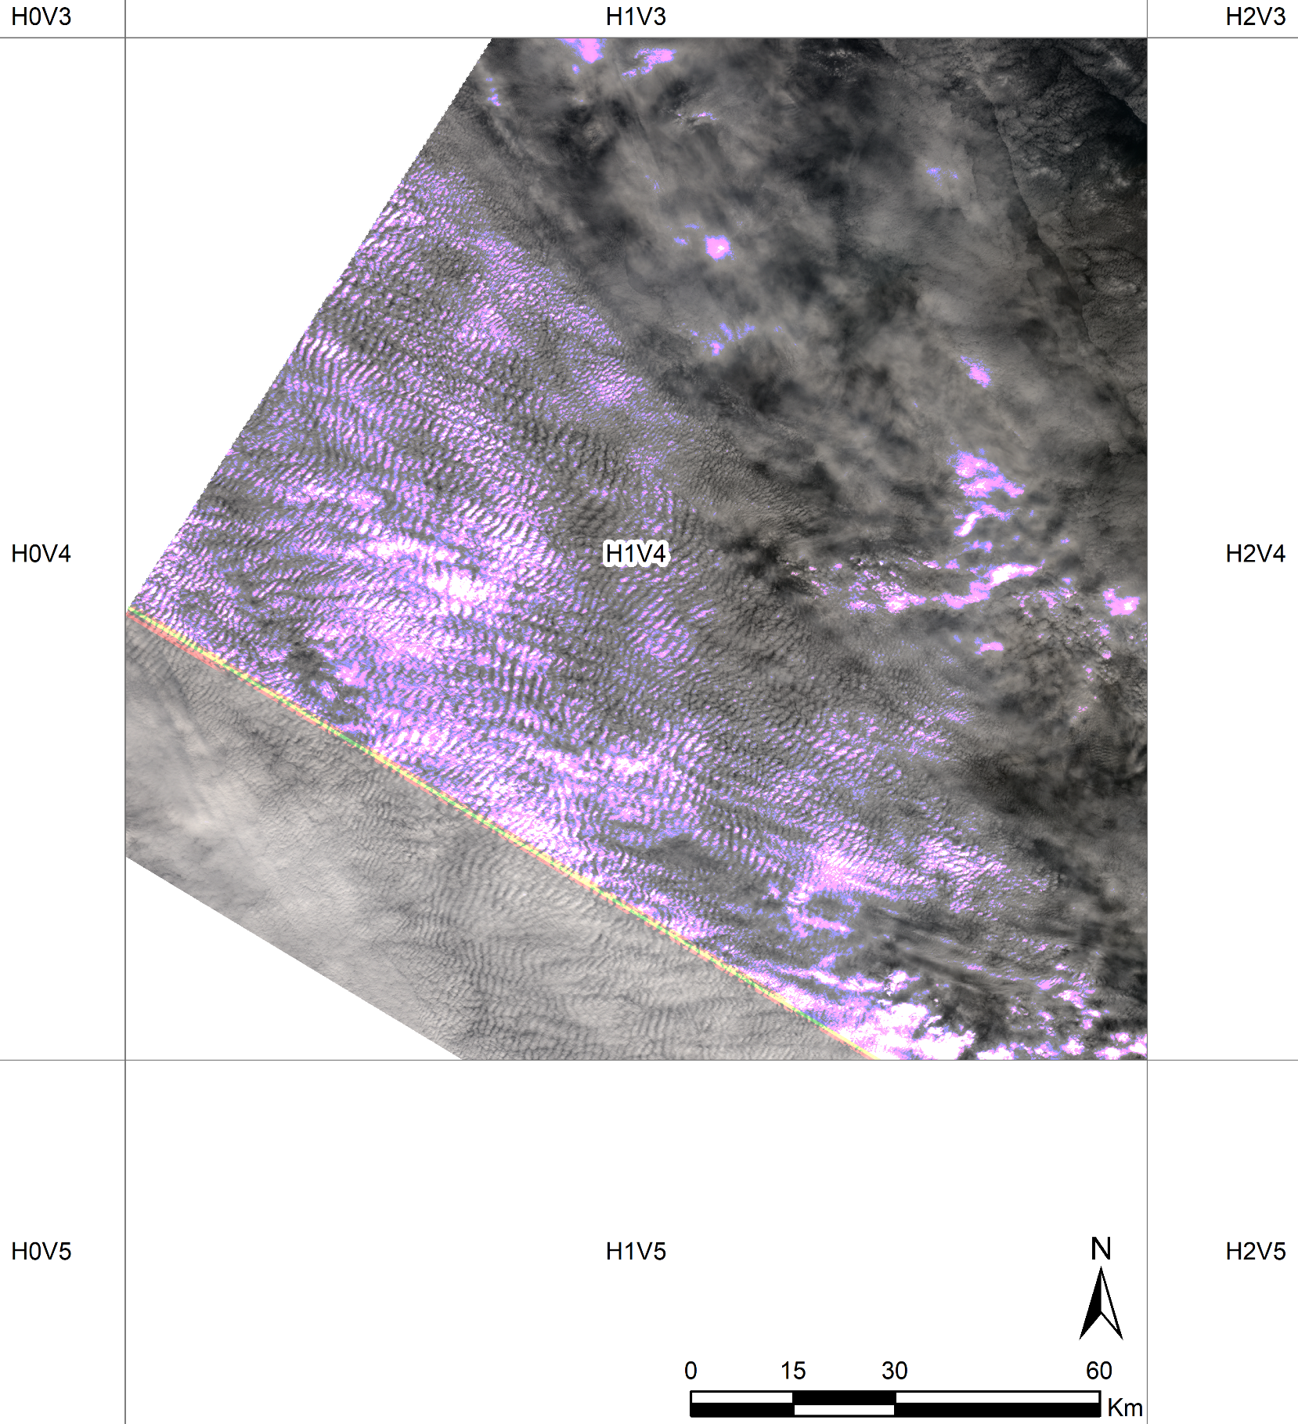
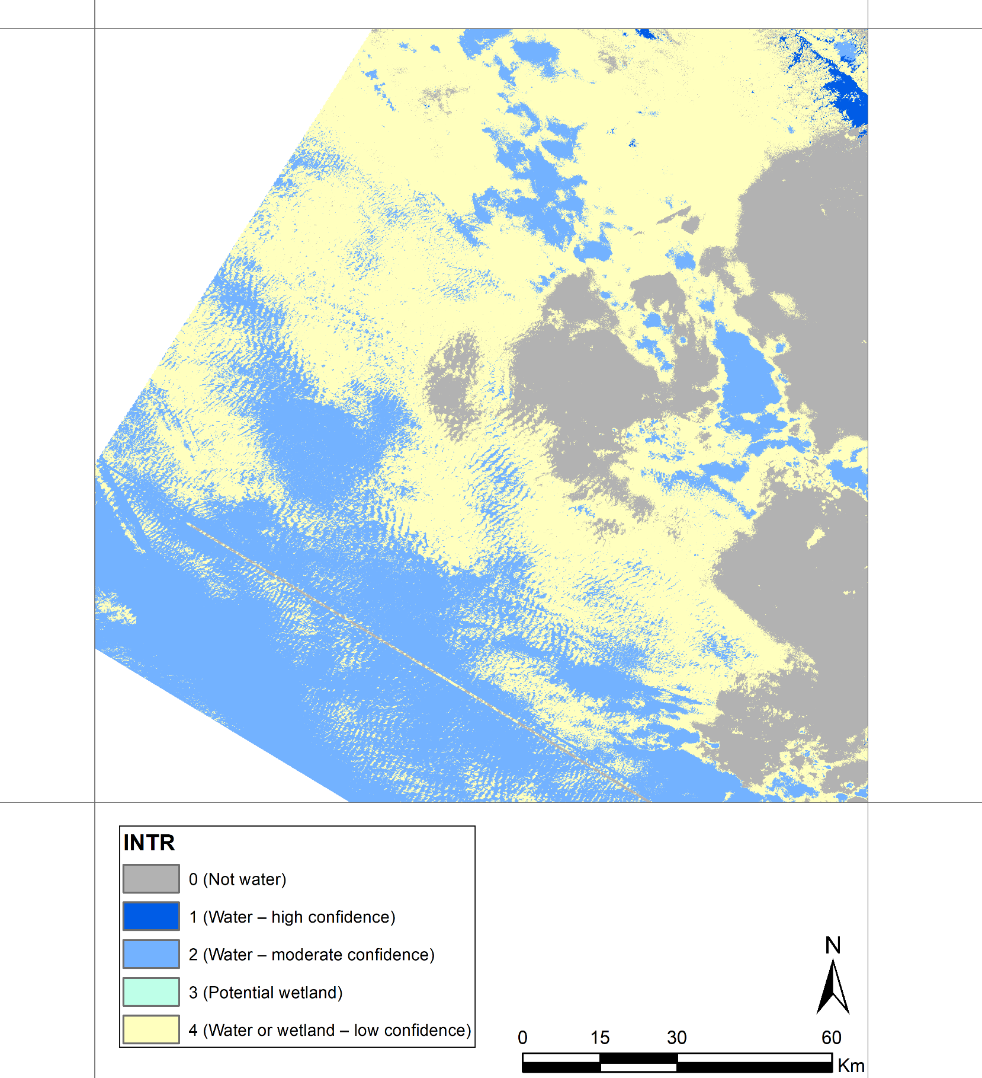
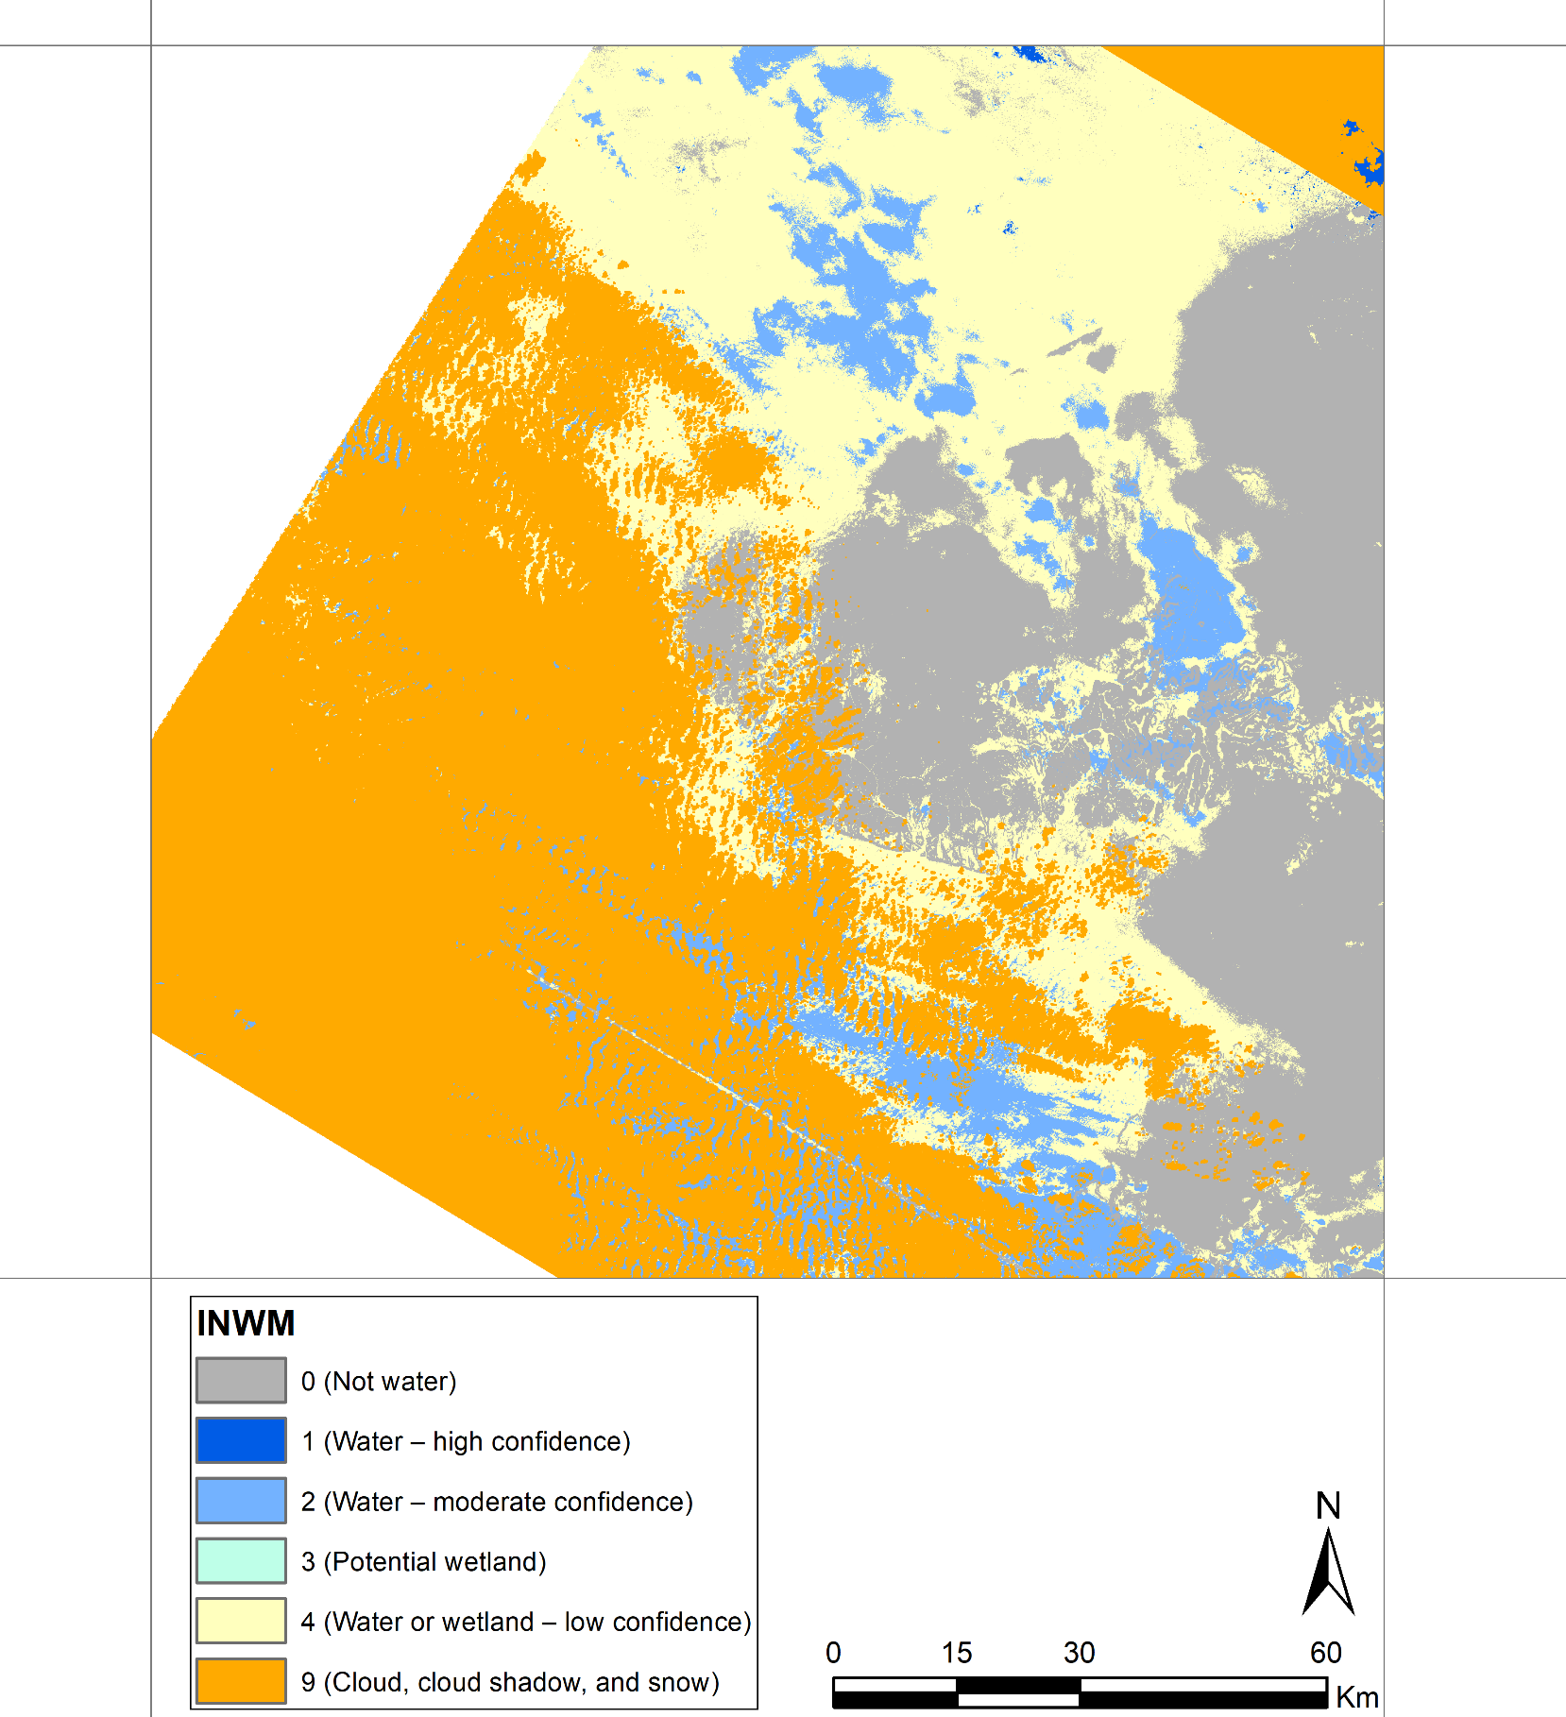
Tile ID: LE07_AK_001004_20010823_20190520_C01_V01_SW.tar
Similar scenario as seen in slide 8.
Natural Color Composite (ETM+ Band 3,2,1)
DSWE - Interpreted Layer (INTR)
DSWE - Interpreted Layer with Mask (INWM)

Slide 11
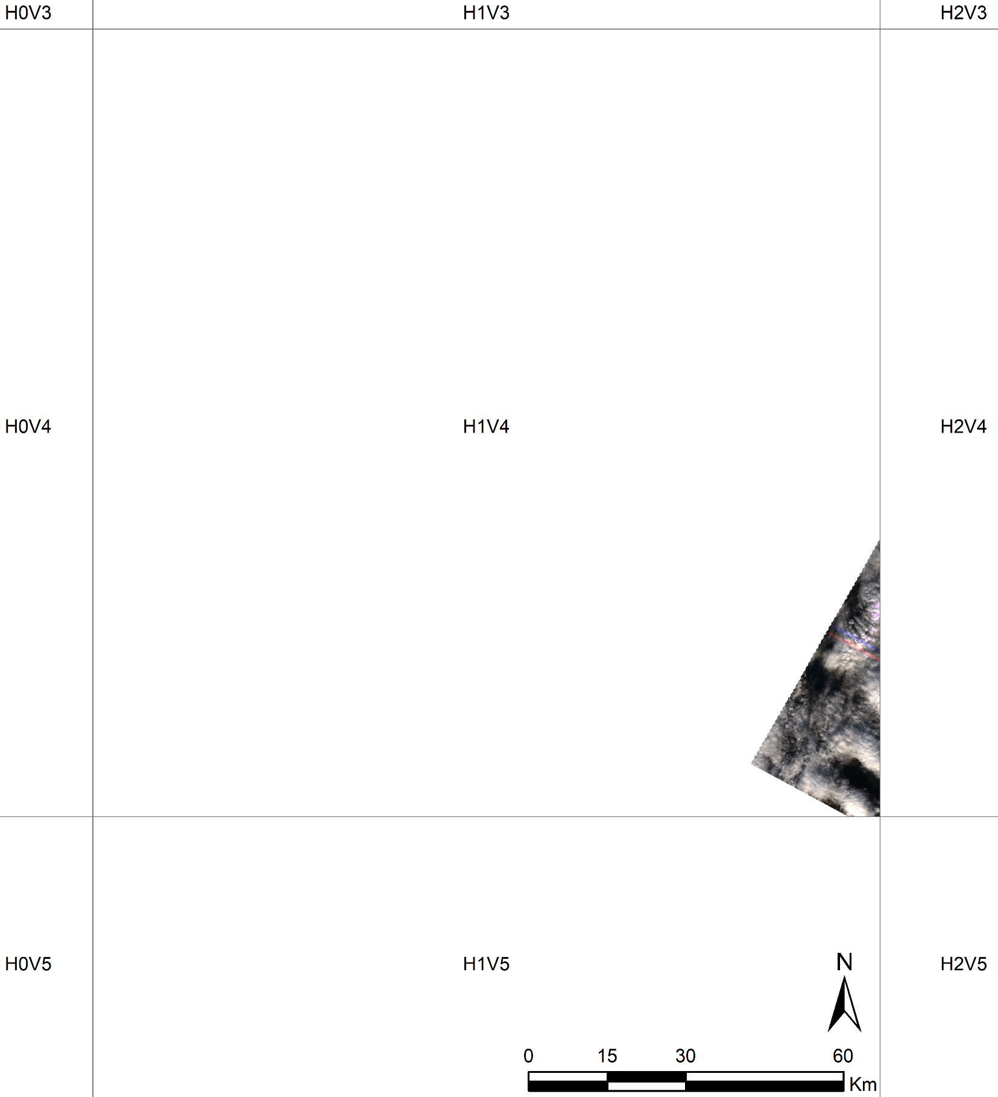
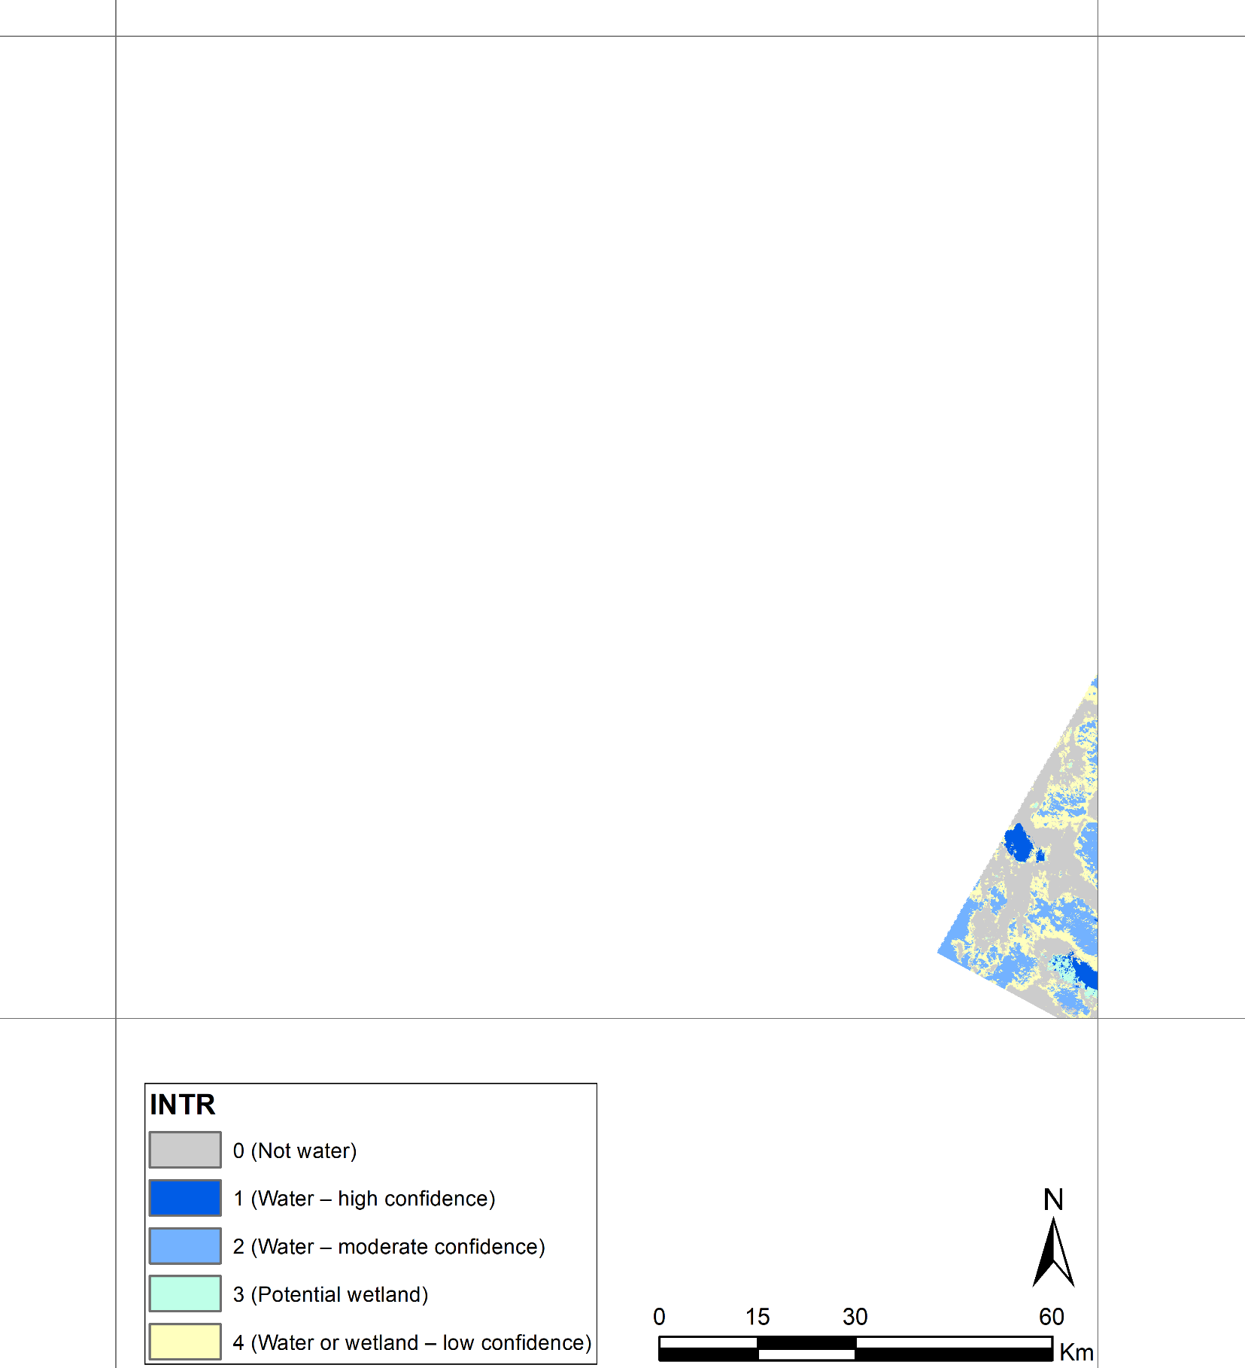
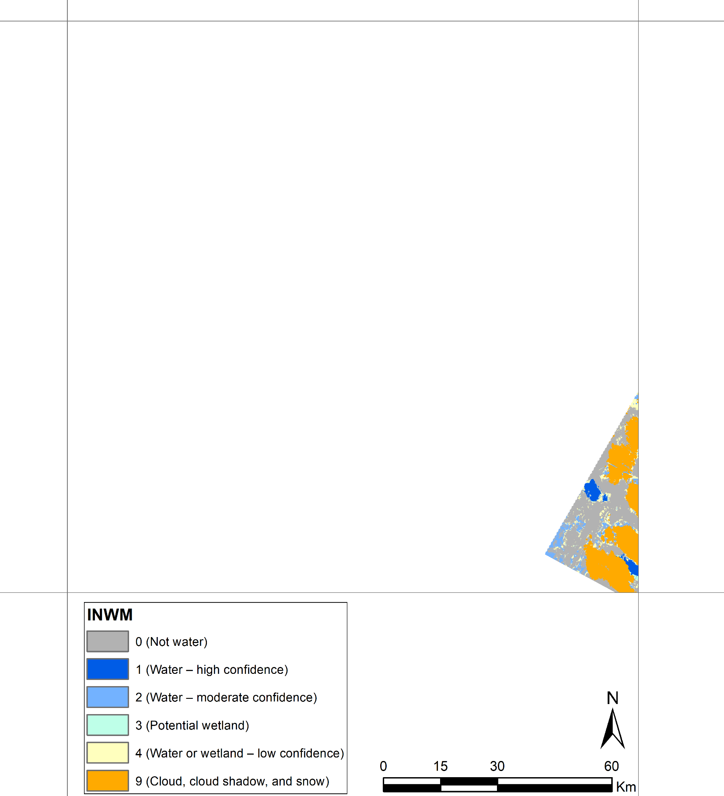
Tile ID: LE07_AK_001004_20010910_20190520_C01_V01_SW.tar
Parts of the lakes can still be seen in INTR and INWM bands.
Natural Color Composite (ETM+ Band 3,2,1)
DSWE - Interpreted Layer (INTR)
DSWE - Interpreted Layer with Mask (INWM)

Slide 12
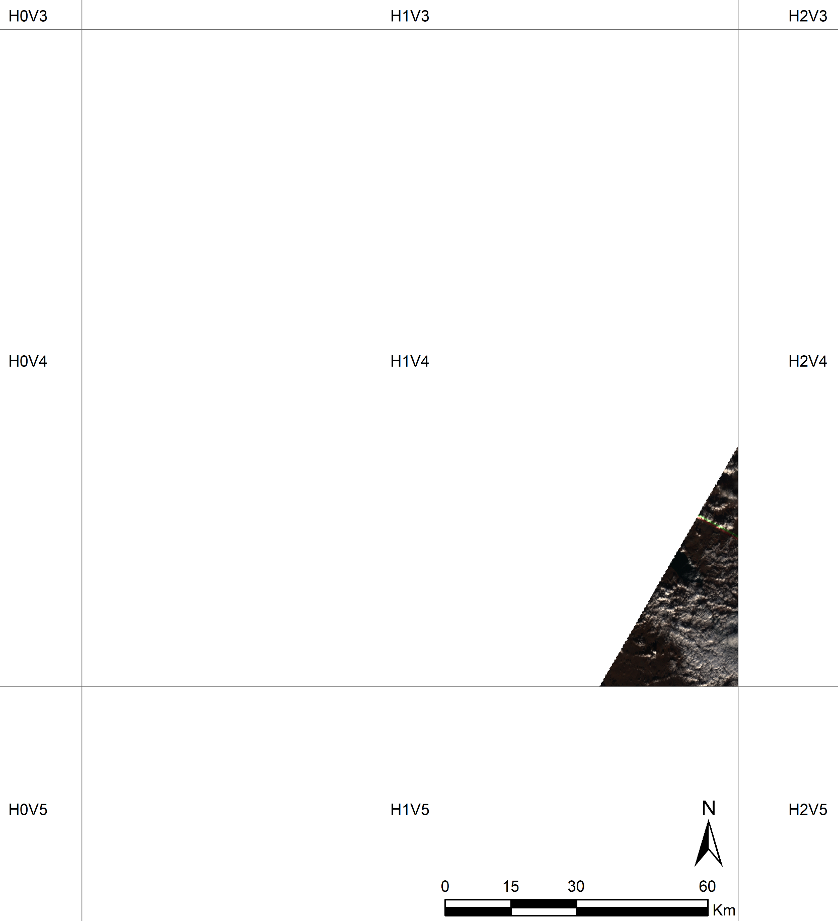
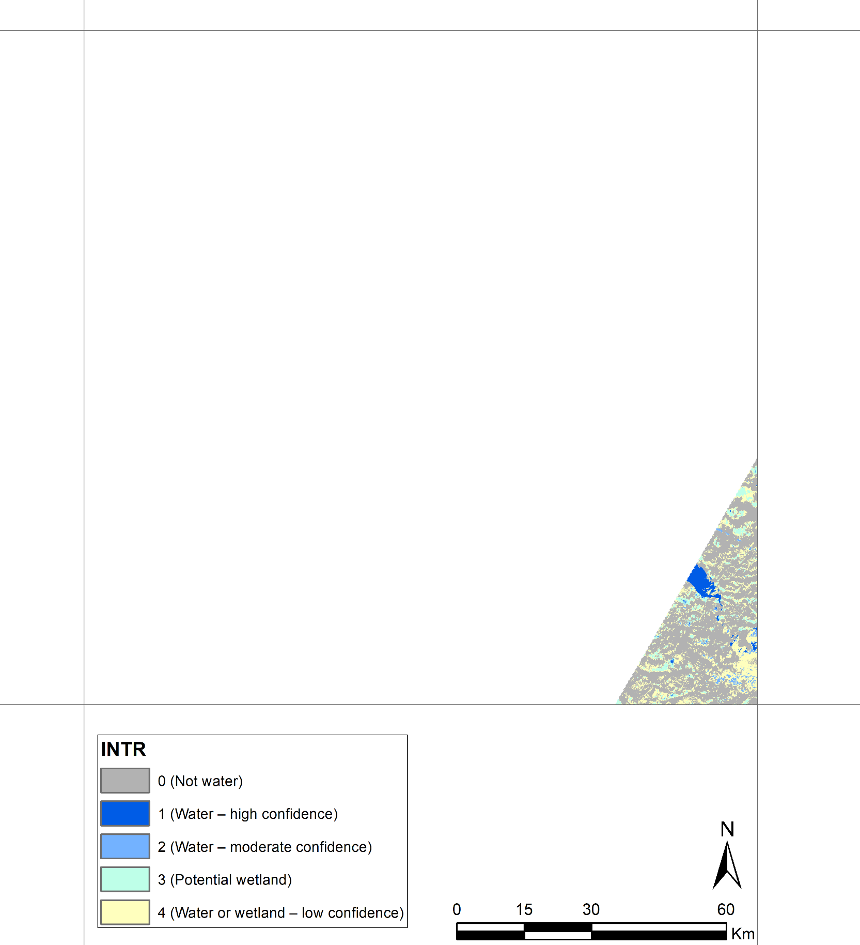
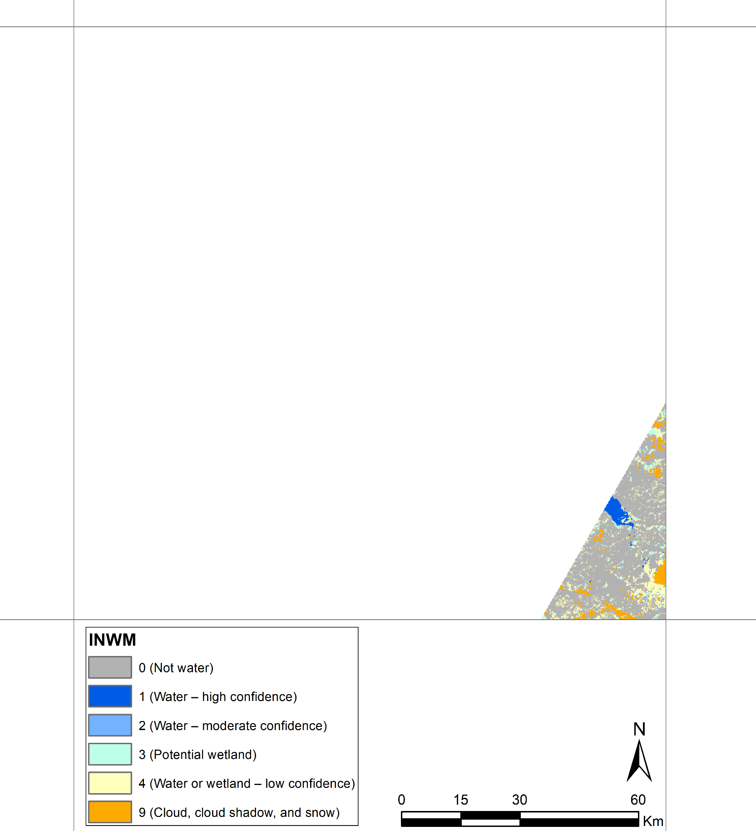
Tile ID: LE07_AK_001004_20010926_20190520_C01_V01_SW.tar
The small lake is southeastern part of this tile is covered by cloud.
Natural Color Composite (ETM+ Band 3,2,1)
DSWE - Interpreted Layer (INTR)
DSWE - Interpreted Layer with Mask (INWM)

Slide 13
Quality Assessment Summary
No. | Tile ID | Percentage of NoData (fill) pixels in tile (%) | Percentage of each quality class within the valid tile data
 |  |  | Cloud Cover (%) | Cloud Shadow (%) | Snow-ice (%)
1 | LE07_AK_001004_20000701_20190115_C01_V01_SW.tar | 56.2482 | 22.9765 | 6.1684 | 5.0485
2 | LE07_AK_001004_20000710_20190522_C01_V01_SW.tar | 8.1157 | 4.4465 | 0.4003 | 0.0033
3 | LE07_AK_001004_20000719_20190522_C01_V01_SW.tar | 13.839 | 18.7406 | 6.7258 | 2.0203
4 | LE07_AK_001004_20000721_20190522_C01_V01_SW.tar | 96.7065 | 12.1097 | 3.1989 | 0
5 | LE07_AK_001004_20000726_20190115_C01_V01_SW.tar | 97.152 | 0.0566 | 0 | 1.0867
6 | LE07_AK_001004_20000804_20190522_C01_V01_SW.tar | 14.1228 | 1.4172 | 0.315 | 0.4182
7 | LE07_AK_001004_20000903_20190115_C01_V01_SW.tar | 56.5405 | 0.282 | 0.0372 | 0.3179
8 | LE07_AK_001004_20000905_20190522_C01_V01_SW.tar | 10.0776 | 32.2701 | 3.8403 | 0.8803
9 | LE07_AK_001004_20010722_20190520_C01_V01_SW.tar | 13.2783 | 1.5235 | 0.0094 | 0.007
10 | LE07_AK_001004_20010823_20190520_C01_V01_SW.tar | 13.4342 | 36.4405 | 6.529 | 0.0986
11 | LE07_AK_001004_20010910_20190520_C01_V01_SW.tar | 96.9827 | 27.2378 | 10.3728 | 0
12 | LE07_AK_001004_20010926_20190520_C01_V01_SW.tar | 96.1326 | 5.0559 | 2.2137 | 0.0008

