Slide 1
Sistema Nacional para la Prevención, Mitigación y Atención de Desastres SINAPRED
Charter AU Training
26 January 2022
Mike Budde (USGS) & Lucas Bruno (CONAE)
mbudde@usgs.gov – lucas.Bruno@conae.gov.ar

Slide 2
Outline
Overview of the Charter
Purpose & Members
Disaster types supported & limitations
How the Charter works
Key interfaces & processes
How to activate the Charter
Submitting a User Request Form
This presentation will be sent to all of you after the training

Slide 3
Overview of the Charter

Slide 4
What is the Charter ?
An international agreement by Satellite Operators to provide priority access to satellite data in the event of Major Disasters.
Founded by Space Agencies in 1999 following UNISPACE III.
Declared operational November 1, 2000.
Disaster response
Multi-satellite - Free Data - Priority & fast access
Satellite Tasking and Archive data
Data processing to pre-determined level

Slide 5
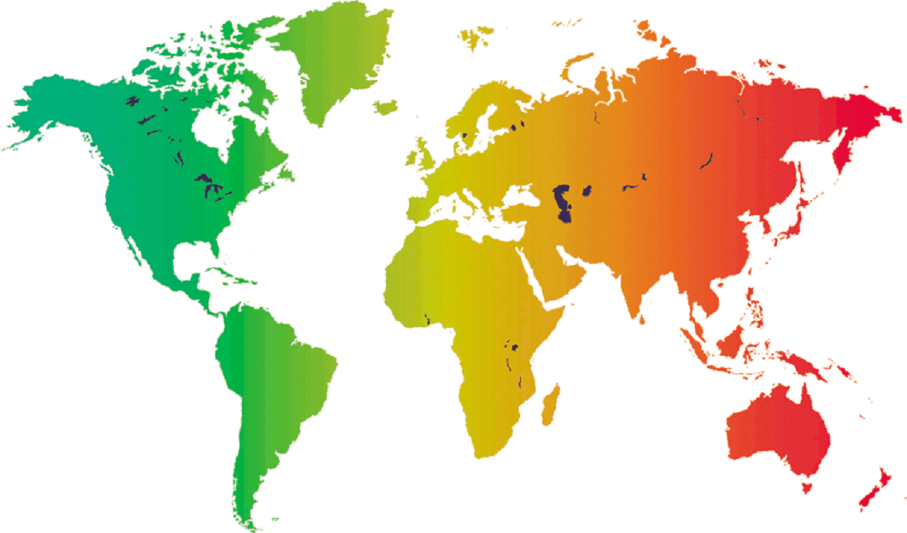
Charter Member Agencies
UKSA/DMC
UK
DLR
Germany
ROSCOSMOS
Russia
CSA Canada
CNES France
ESA EUMETSAT
Europe
KARI
Korea
NOAA
USGS
USA
JAXA
Japan
CNSA
China
UAESA
UAE
ISRO
India
ABAE
Venezuela
INPE
Brazil
CONAE
Argentina

Slide 6
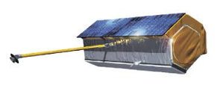
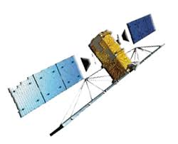
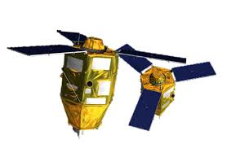
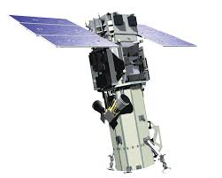
Charter Satellites
In RED the last additions
ABAE | VRSS-1, VRSS-2
CNES | PLEIADES, SPOT
CNSA | CBERS-4, GF-1, GF-2, GF-3, GF-4, FY-3C, Beijing-2, JILIN-01, OVS-1, OVS-2, OHS-2
CONAE | SAOCOM-1A, SAOCOM-1B
CSA | RADARSAT-2, RCM
DLR | TerraSAR-X/TanDEM-X
DMC | UK-DMC2, ALSAT-1B, VISION-1
ESA | Sentinel-1A/1B, Sentinel-2A/2B
EUMETSAT | Meteosat-8/9/10/11, Metop-A/B/C
ICEYE | ICEYE-X2, X4, X5, X7
ISRO | Cartosat-2, Resourcesat-2, Resourcesat-2A
INPE | CBERS-4, CBERS-4A
JAXA | ALOS-2, KIBO HDTV-EF
KARI | KOMPSAT-2, KOMPSAT-3, KOMPSAT-3A, KOMPSAT-5
NAS | BKA
NOAA | POES-18/19/20, SUOMI-NPP, GOES-13/16/17
PLANET | Planetscope (~120 satellites)
ROSCOSMOS | RESURS-DK, METEOR-M, KANOPUS-V, KANOPUS-V-IK, RESURS-P
Satellogic | NewSat
UAESA | DubaiSat-2, KhalifaSat
USGS | Landsat-7, Landsat-8, WorldView-1/2/3, Geoeye

Slide 7
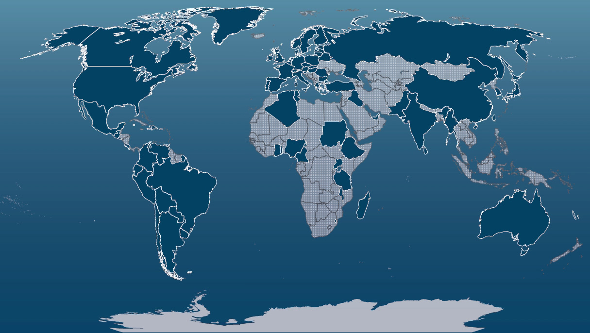
Activating the Charter: Authorized Users
The only bodies authorized to directly request the Charter to be activated are the Authorized Users (typically civil protection agencies, governmental relief organizations, or other authorities with a mandate related to disaster management).
2021

Slide 8
Activate the Charter
The Charter can be activated for sudden events with high impact in terms of lives and/or infrastructure & environment.
Charter activations can be denied for emergencies with doubtful or no benefit from space assets.

Slide 9
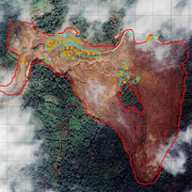
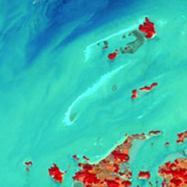
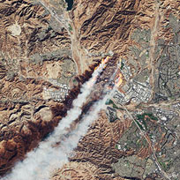
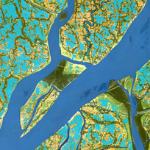
Typical Disaster Types
Natural events:
Earthquakes
Fires
Floods
Ice jams
Landslides
Snow Hazard
Storms
Tsunamis
Volcanic eruptions
Man-made events:
Oil spills
Industrial accidents

Slide 10
Limitations for activation
The Charter cannot be activated for:
Emergencies falling out of Charter scope:
War or armed conflicts
Complex emergencies, humanitarian/rescue actions not linked to a specific disaster
Slow-onset disasters (such as droughts)
Emergencies with doubtful/no benefit from space assets
Routine epidemiological outbreaks
Dynamics of the disaster (e.g. some flash flood) too fast (not enough time to task satellites)
Size of the disaster is not compatible with the resolution of the available satellites.
Calls beyond emergency period
A Charter call occurring more than 10 days after the actual crisis start could be rejected.
The Charter reserves the right to reject/cancel an activation.

Slide 11
How the Charter Works

Slide 12
Activation Steps
Call submitted by an Authorized User via a User Request Form (URF)
Call accepted
Satellite data tasked/acquired
Value Added Products generated based upon the data provided (maps, charts etc)
Products delivered to the user
Call is closed and feedback reports prepared

Slide 13
Key Interfaces in the Charter
Authorized User: the organization who has the right to submit requests and be recipients of Charter results.*
e.g. National Director of the National System of Emergencies (SINAE), Uruguay
End User: an organization which asks the AU to trigger the Charter on its behalf. It is expected that the end user will use the products during the emergency response phase.
- e.g. Fire and Rescue Force of Uruguay
*In some cases, Authorized Users are not recipient of the Charter results and only submit requests on behalf of an end user. In other cases the Authorized and End Users are identical.

Slide 14
Key Interfaces in an activation
On-Duty Operator 24h/7d
ODO receives the activation request, checks the identity of the sender, confirms the reception & completeness of the request
Emergency on-Call Officer rush satellite tasking 24h/7d
ECO may call the user to request additional information before requesting satellite data from the member agencies
Project Manager plan & manage data access and delivery normal working hours
The PM is the main reference for the user during the activation

Slide 15
Charter Operational Loop
Processes the info received.
Sends the tasking requests to the agencies’ Mission Planner.
Sends the PM a dossier with the summary of the performed actions
Verifies the identity of the caller and the completeness of the Request.
Sends the URF to the ECO
ESA
CNES
CSA
NOAA
ISRO
CONAE
JAXA
USGS
UKSA/DMCii
CNSA
DLR
KARI
INPE
EUMETSAT
ROSCOSMOS
ABAE
UAESA/MBRSC
Planet
NAS
Satellogic
Executive
Secretariat
Emergency on-Call Officer
Member Agencies Mission Planners
On-Duty Operator
The PM, nominated by the Executive Secretariat, contacts the AU/EU to collect more information on the disaster and assesses their needs.
Reviews the dossier prepared by the ECO and requests more satellite tasking as needed.
Receives the products from the agencies’ order desk and prepare Value Added Products (VAPs)
Sends to the ODO the User Request Form (URF).
The AU can also submit requests on behalf of an End User
Project Manager
Authorized User / CB
Value
Adder
Further processes and interprets the data, and delivers VAPs to the EU via the PM
End
User
Final Value Added Products are delivered to the final user
DISASTER

Slide 16
Project Manager support to you
Is nominated by the Charter’s Executive Secretariat
Manages the activation and will maintain continuous communication with you (normal working hours)
Typically generates the EO-based products to support the call
Is often supported by a value adding service from another organization which supplies additional EO-based products

Slide 17
Project Manager support to users
The Project Manager will contact the user in order to:
refine the area of interest & identify targeted areas
discuss the need for additional satellite data
agree on the format of the value added products
discuss additional information about the area (e.g. GIS layers such as road networks)
provide information on delivery pick-up point for the products
ascertain the level of satisfaction with the products received
mutually agree on a date to close the call
discuss completion of the feedback forms

Slide 18
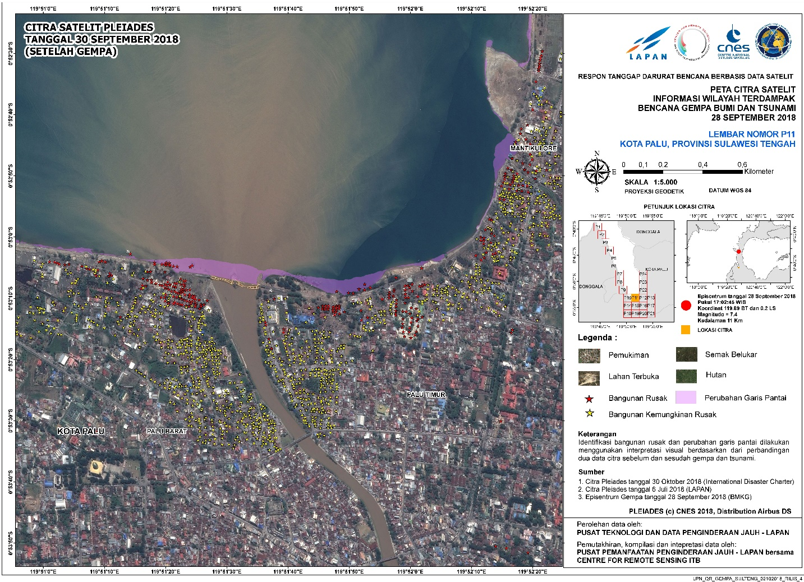
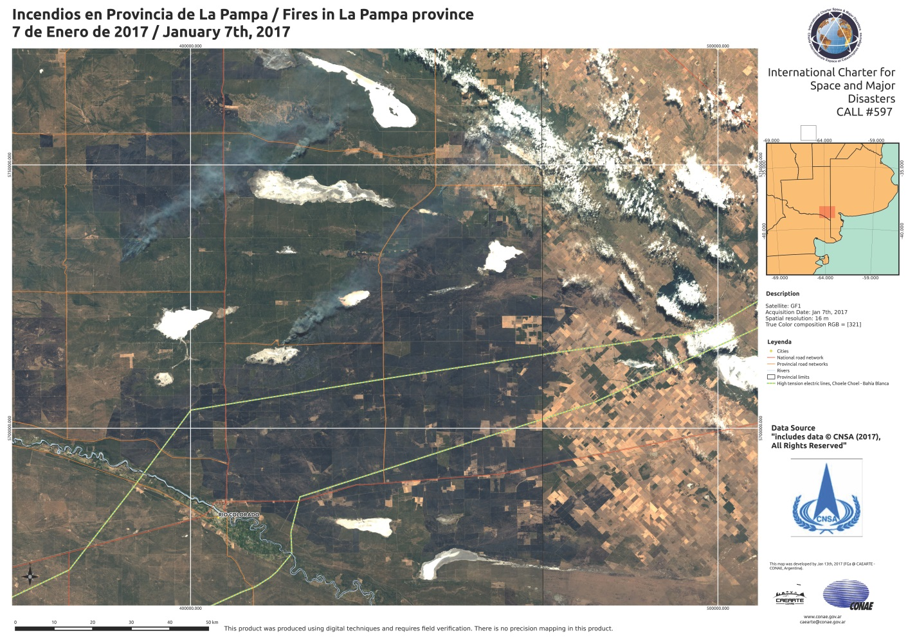
Value Added Product delivery examples
Final products are delivered to the Authorized /End User

Slide 19
Post-event and keeping in-touch
The Authorized User provides feedback to the Project Manager on the activation via a simple questionnaire to be completed within 4 weeks after activation closure. If the Authorized User requested the Charter activation on behalf of an End User, end user’s feedback has to be collected too.
The Charter may also consult an Authorized User in their efforts to continuously improve the Charter operations and to propose an annual training to refresh on the Charter mechanisms and capacities (including the use of COS-2 system)

Slide 20
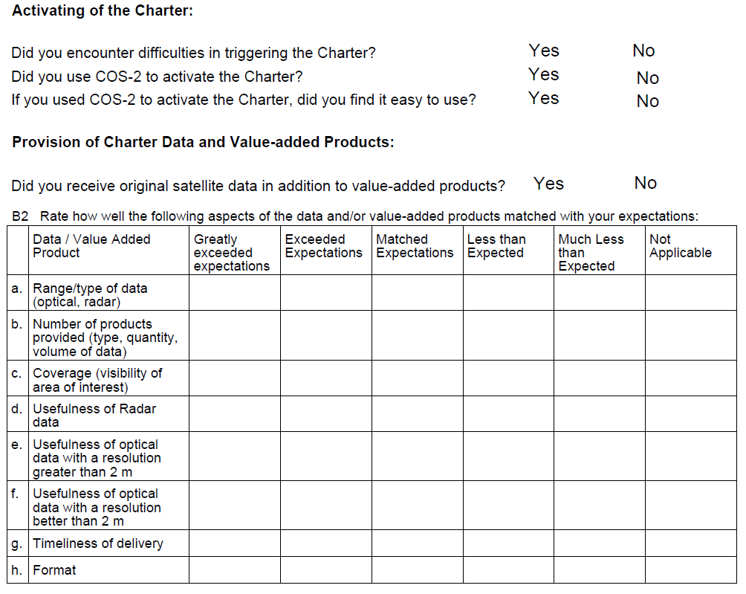
Post-event and keeping in-touch

Slide 21
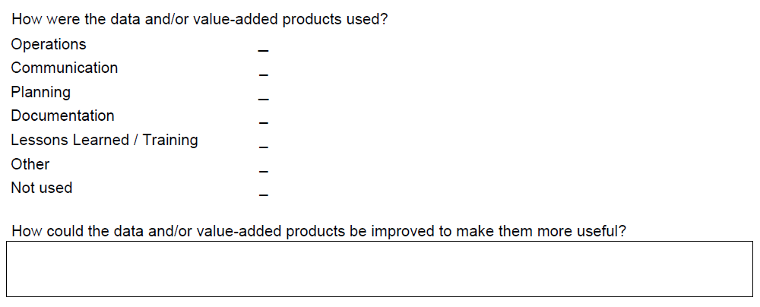
Post-event and keeping in-touch

Slide 22
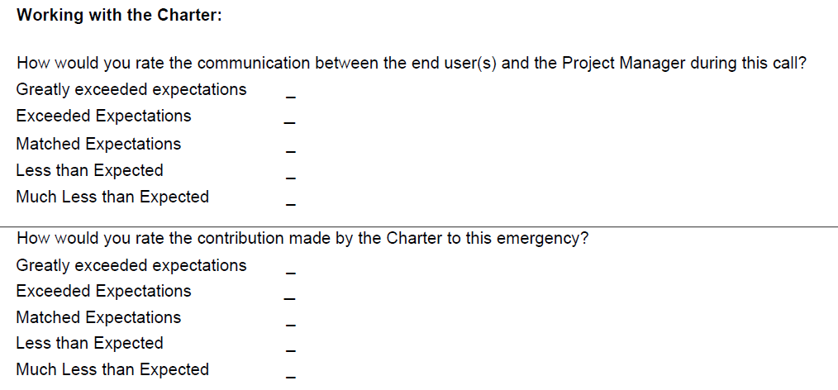
Post-event and keeping in-touch

Slide 23
How to activate the Charter

Slide 24
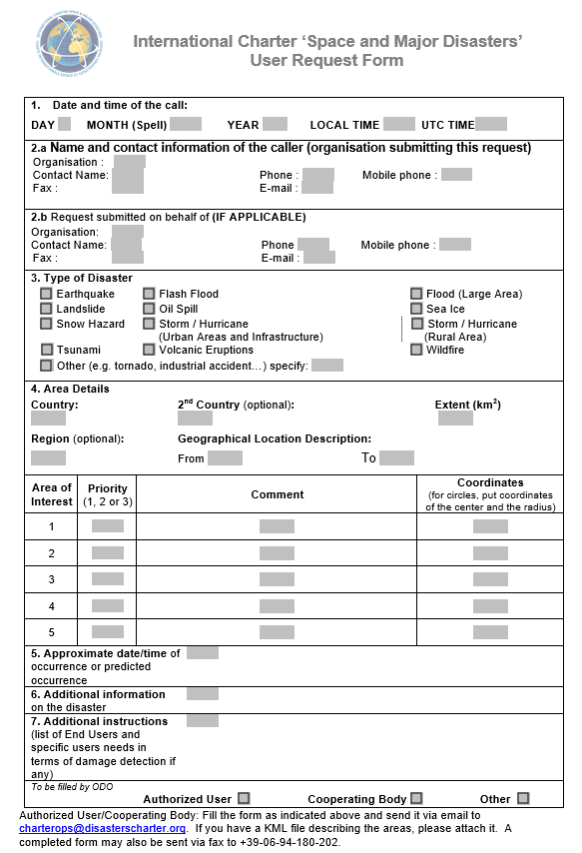
Submitting an activation request
Always use the User Request Form (URF) provided by the Charter and include a much information as possible.
The activation should be submitted online via the COS-2 system (easier, tools for the area definition, avoidance of copy errors). If it is not possible via email.
Please remind to send the URF to the On-duty Operator (ESA/Italy) also via email.

Slide 25
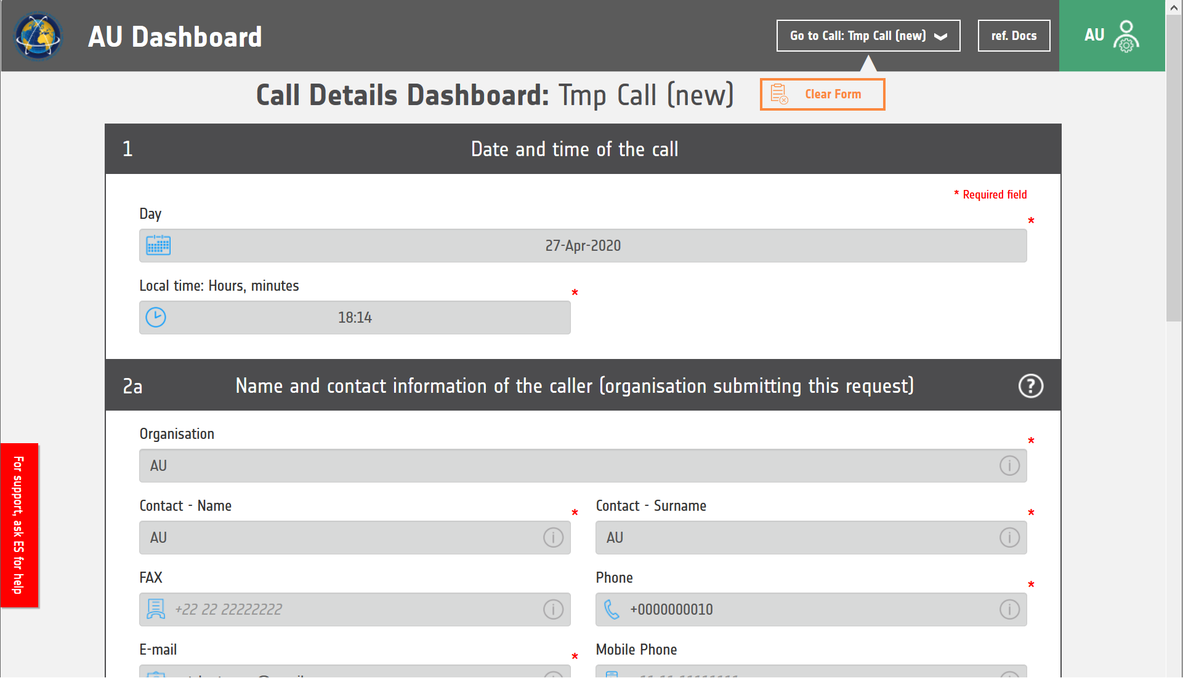
Submitting an activation request via COS-2

Slide 26
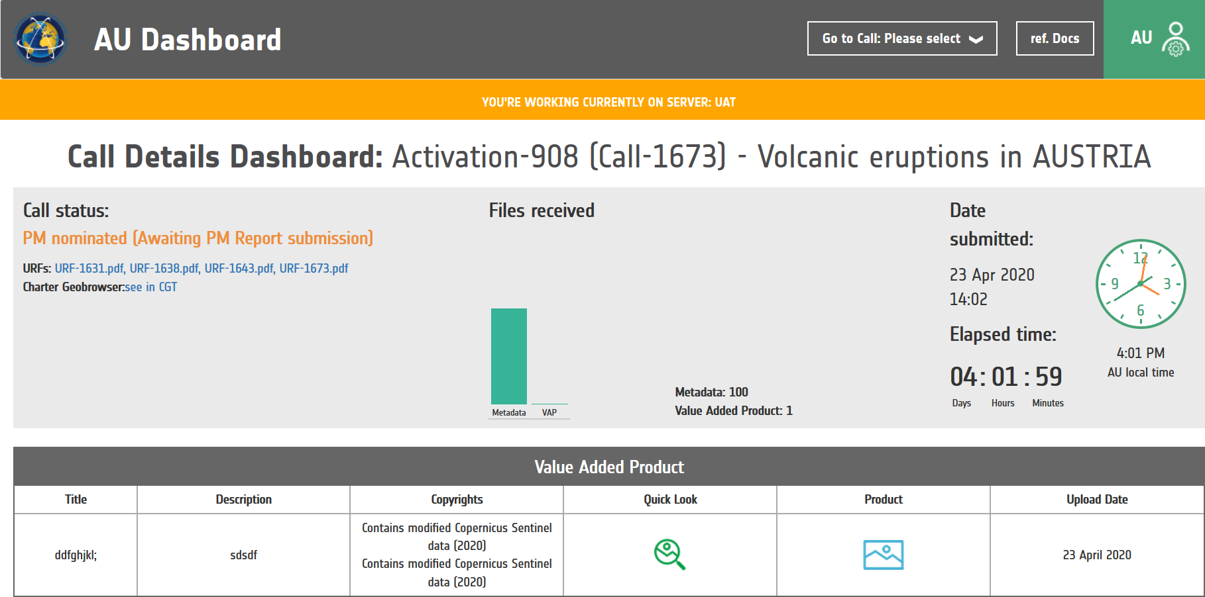
View call
As a Value Added Product is uploaded in COS-2 you can see and download it, selecting the call number you will receive from the ODO.
You can see the preview images of the satellite data on the Charter Geobrowser Tool (CGT) by clicking here, or accessing from the Charter Web page.

Slide 27
View call
Fill-in of the URF

Slide 28
1) Provide date and time of the event
Date and time of the Call | DATE________MONTH (Spell)___________ YEAR _____ LOCAL TIME _______ UTC TIME*_______
20
JANUARY
2015
09:30
13:30
* UTC/GMT Time = Coordinated Universal Time
Provide date, hour of the event (local time & importantly UTC)

Slide 29
2) Provide information on requestor (AU) organizations
2.a. Name and contact information of the caller (organisation submitting the request): Name of AU organisation of country XXX + name of a reference person (to be contacted) Name of the organisation : …………… Contact: …………… Phone/mobile phone: …………… Fax : …………… E-mail: ……………
Give organization name, address and reference person and contact details

Slide 30
3) Provide information if the AU submits the request on behalf of another organization (If applicable)
2.b. Request submitted on behalf of (IF APPLICABLE): Name of the organisation of country XXX + name of a reference person (to be contacted) Name of the organisation : …………… Contact: …………… Phone/mobile phone: …………… Fax : …………… E-mail: ……………
If submitting on behalf on another user give their contact details

Slide 31
4) Indicate Type of disasters
Example: major flooding event
Select disaster type: flood, fire, earthquake, …
One form should be submitted for each separate disaster event
If you have both ‘flooding’ and ‘landslides’ in the same event, include both on the form

Slide 32
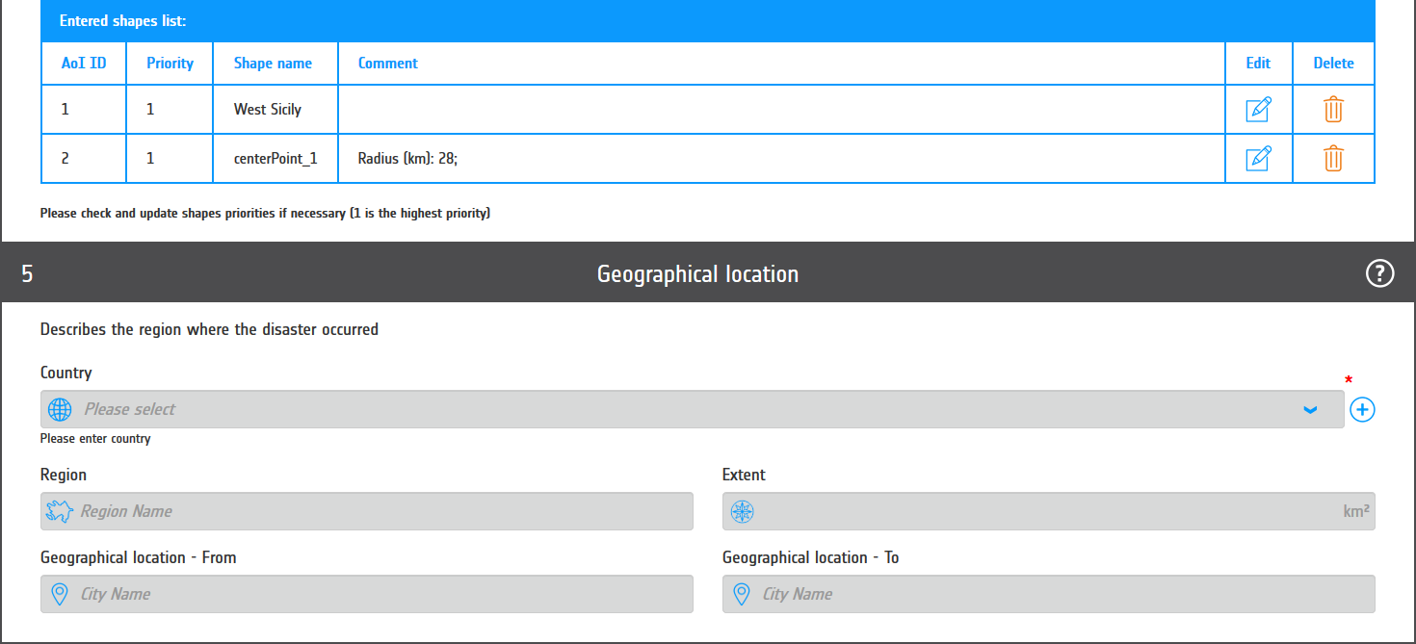
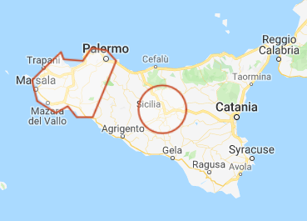
4) Provide Geographical Information in COS-2
You can enter specific comments for each area
Important: specify area affected as much precise as possible and not a too big one, to allow best-possible planning of satellite acquisitions!
Please specify the priority among the areas
A map showing the area(s) or KML polygons can be added (see example ).

Slide 33
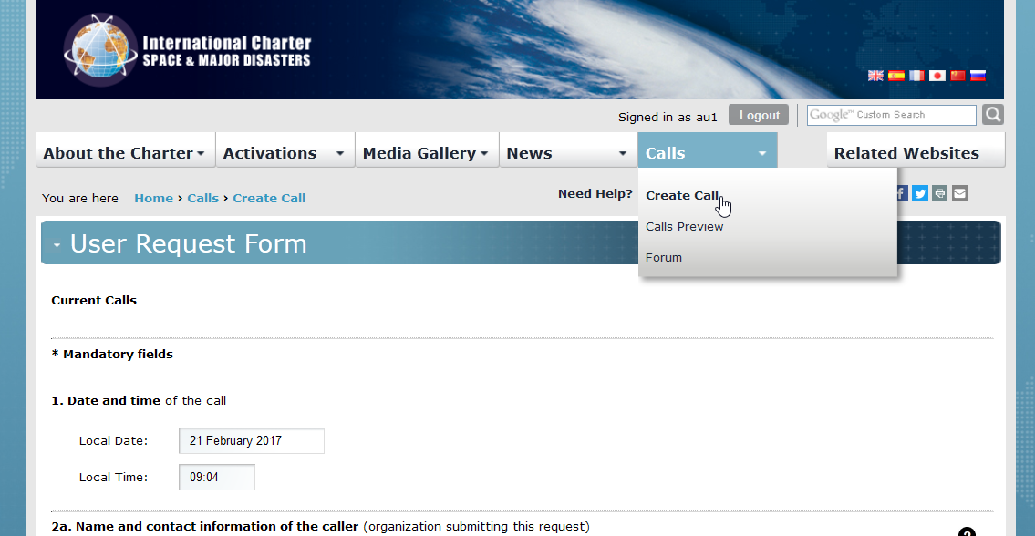
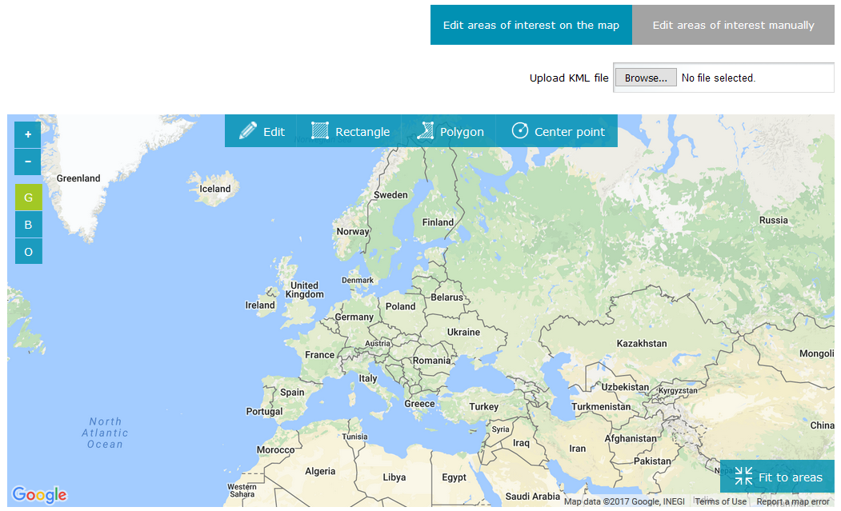
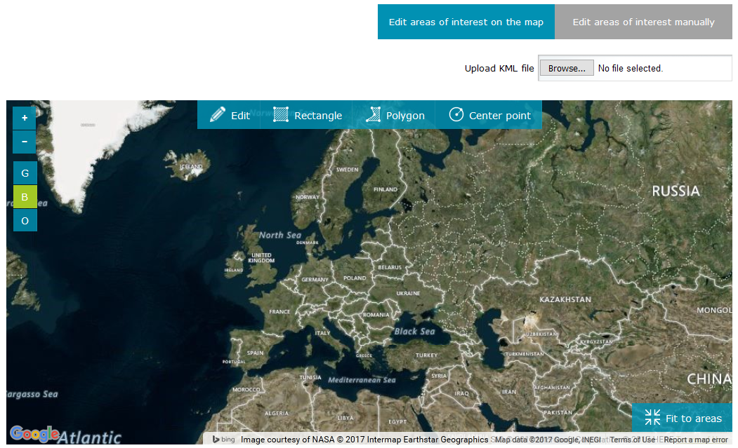
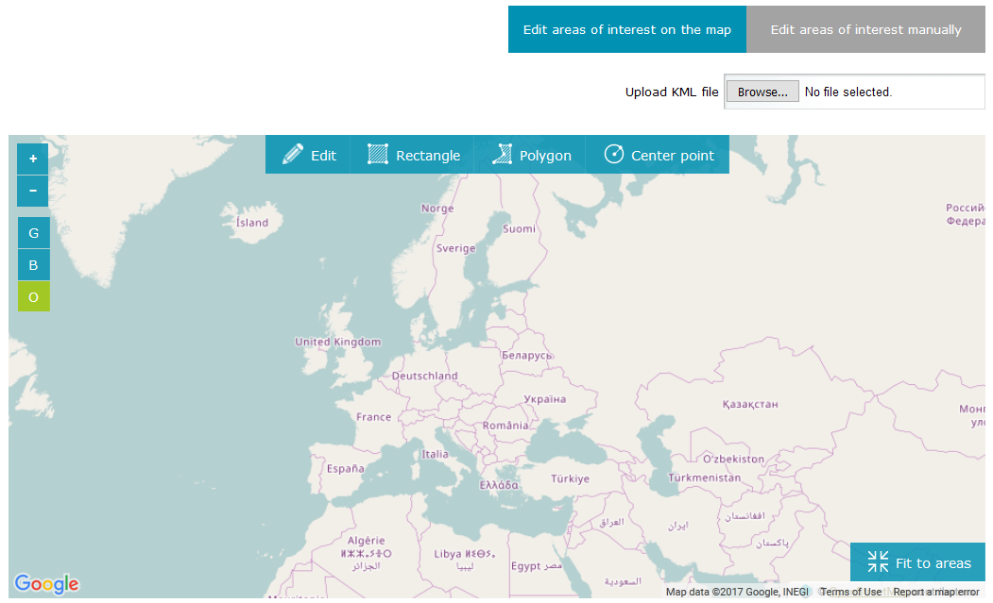
4b) Provide Geographical Information with COS-2
COS-2 is providing a graphical interface for the area definition, supporting circles, polygons and rectangular area definition
Once Logged in, select CALLS -> CREATE CALL and fill-in the fields as explained in the previous slides
You can select the map background through the left buttons (G=Google, B=Bing, O=Open Street Map)

Slide 34
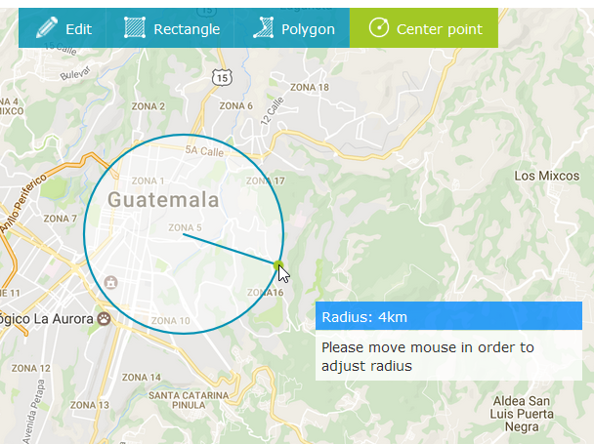
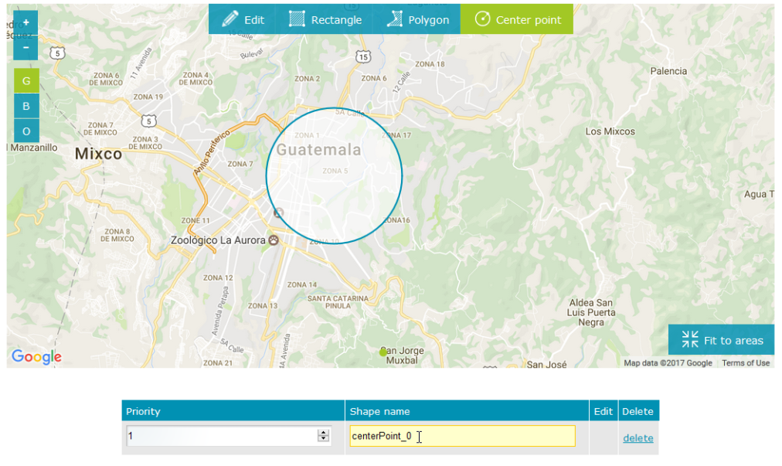
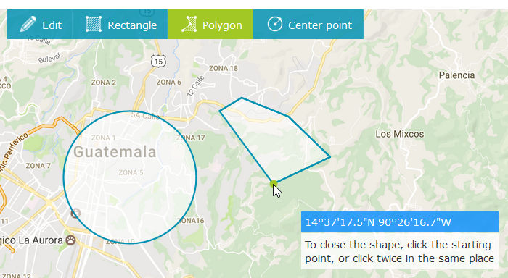
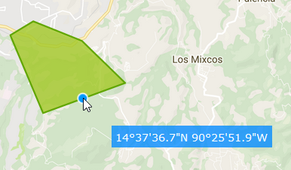
4c) Provide Geographical Information with COS-2
Circle definition: select the area type (Center point), click on the map to define the center and then drag the mouse to define the radius.
As you define an area, it will appear in the section below.
You can modify the shape name and priority.
Polygon definition: select the area type (Polygon), click on the map to define a vertex. To close the polygon double click or click on the first vertex.
You can modify the area selecting “Edit”. You can move a vertex or add new ones clicking between 2 vertices

Slide 35
5) Provide further information on the event
7. Additional information on the Disaster:
e.g.
Heavy flooding affected a large are in the Southern part of the Country.
Forecast where possible the maximum extent of the disaster and level of damage (e.g. maximum of flooding estimated for a certain point in time, several major roads and bridges damaged)

Slide 36
5) Provide further information on the event
8. Additional instructions (list of end users and specific user needs in terms of damage detection if any) :
List of end users : emergency management organizations, local and regional organizations : first responders, security agencies, logistical cells…
Type of requested data (eg. optical or radar ), priority areas (to acquire high spatial resolution- if needed ), items to be detected (e.g. bridges, roads, houses...)

Slide 37
Tips on activating the Charter
Ensure you provide your correct contact details, including phone and mobile where possible
Give the correct dates and time
Specify the exact geographical area as coordinates
In case of a large geographical area, provide some priority areas, e.g. specific town or city region
Submit URF via the COS-2 online system and/or via email attachment
Be available after the submission of the URF to receive the ECO call (normally within 1 hour)

Slide 38
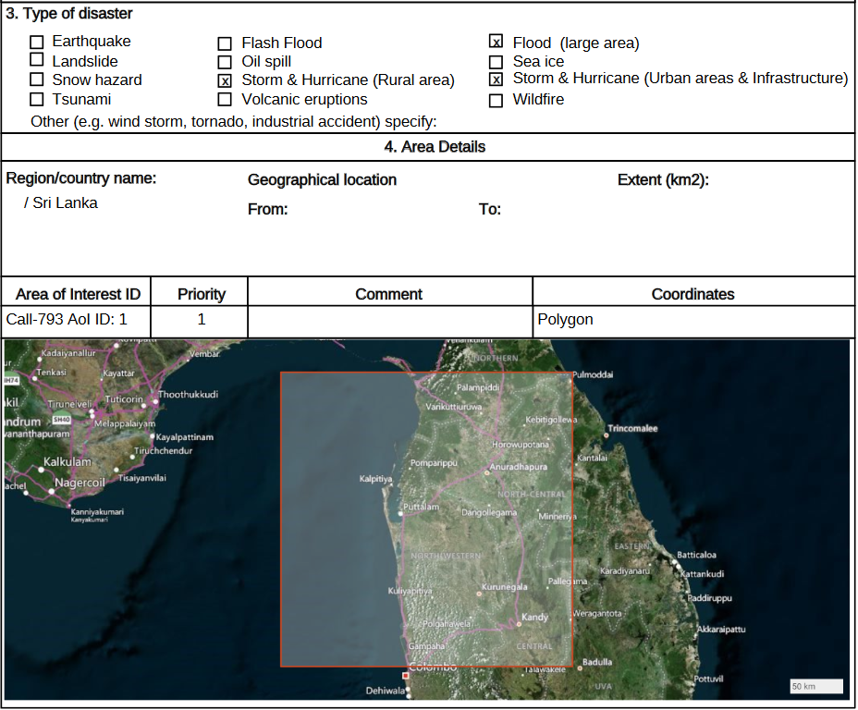
Mistakes: example 1
One very large AOI
Large-area Flood + Storm scenario
Storm scenario refers to damage assessment, i.e. VHR data needed

Slide 39
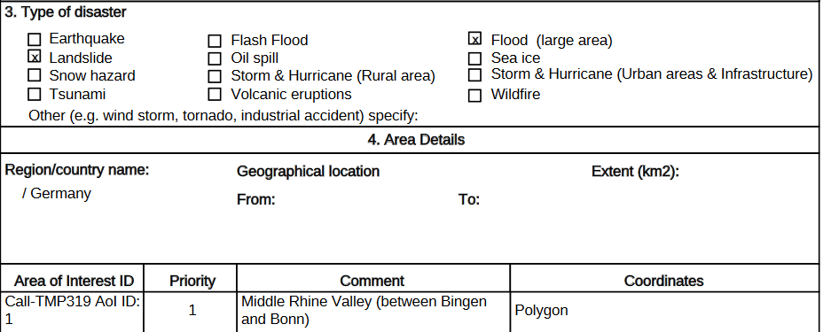
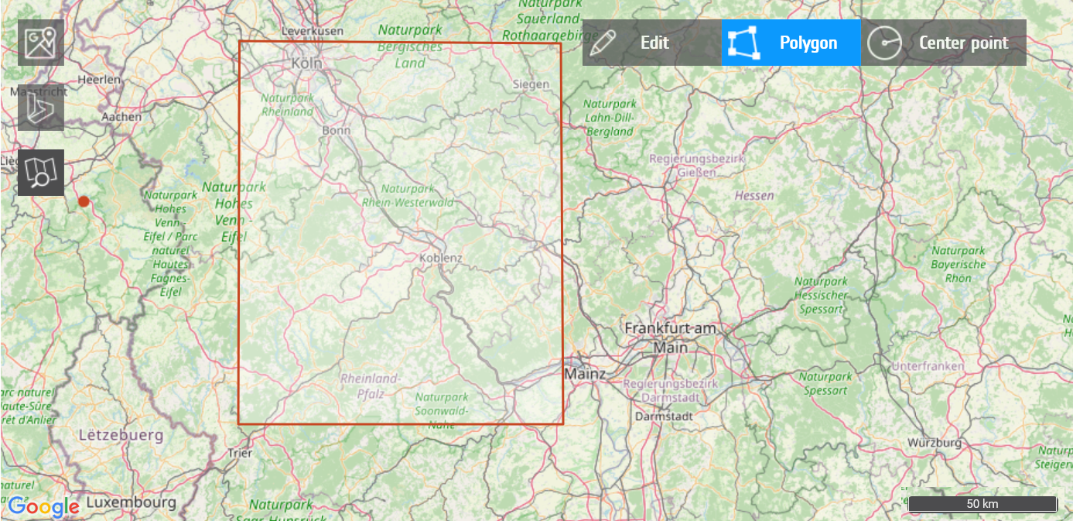
Mistakes: example 2
Large-area Flood and Landslides
One rectangular AOI
In the “Additional Information” the AU indicated flooding along the Rhein river

Slide 40
Next steps
You perform a simulation exercise, ‘test activation’ based upon an imaginary, but typical, disaster event in your country.
In order to perform the exercise, on the agreed date, you shall log-in in the COS-2 training environment:
https://charter.training.esaportal.eu User ID: AU_public Password :AU_public
After successful training and test activation, you will receive:
an official letter from the Charter Lead confirming your status as Authorized User
the User Registration Document (URD) providing general information on the Charter & the contact details for the Online Duty Officer (ODO)
You will be asked to provide contact details for inclusion in the official list of Authorized Users.
As a new Authorized User you shall request login details to the COS-2 system

Slide 41
Further Information
Charter executive secretariat: executivesecretariat@disasterscharter.org
Charter helpdesk: helpdesk@disasterscharter.org
Visit the Charter Website - https://disasterscharter.org
Follow us on Twitter - https://twitter.com/disasterschart
Subscribe to our newsletter
Watch our video - https://www.youtube.com/watch?v=ZvExM-Z3E2w

Slide 42
COS-2 Information
COS-2 Environments
2 environments are available:
Operational for real disasters only: www.disasterscharter.org
Training: https://charter.training.esaportal.eu/web/guest/home
Training accounts: AU_AGENCY (e.g. AU_CSA) or au_public (password is identical to the user account)
COS-2 Documentation
COS-2 documentation is available in COS-2, once logged-in, under “Ref.Docs”
AU COS-2 quick reference: a quick guide to the COS-2 usage
PR0537_F_COS-2_AU_Manual_of_Operations: the reference guide to COS-2, with all the functions deeply explained.

Slide 43
Thank you

