Slide 1
Operational organization and interfaces
PM Training EROS 17-18 June 2019
Roberto Biasutti

Slide 2
Charter Roles and External Entities
Authorized User (AU)
Cooperating Body (CB)
End User (EU)
On Duty Operator (ODO)
Emergency on Call Officer (ECO)
Order Desk / Mission & Production Planner (MPP)
Project Manager (PM)
Value Added Provider (VA)
Executive Secretariat (ES)

Slide 3
Charter Operational Loop
Processes the info received.
Sends the tasking requests to the agencies’ Mission Planner.
Sends the PM a dossier with the summary of the performed actions
Verifies the identity of the caller and the completeness of the Request.
Sends the URF to the ECO
Emergency on-Call Officer
ESA
CNES
CSA
NOAA
ISRO
CONAE
JAXA
USGS
UKSA/DMCii
CNSA
DLR
KARI
INPE
EUMETSAT
ROSCOSMOS
ABAE
UAESA/MBRSC
Member Agencies Mission Planners
On-Duty Operator
Sends to the ODO the User Request Form (URF).
The AU can also submit requests on behalf of an End User
Contacts the AU/EU to collect more information on the disaster and assesses their needs.
Reviews the dossier prepared by the ECO and requests more satellite tasking as needed.
Receives the products from the agencies’ order desk and prepare Value Added Products (VAPs)
Project Manager
Authorized User
Value
Adder
Further processes and interprets the data, and delivers VAPs to the EU via the PM
End
User
Final Value Added Products are delivered to the final user
DISASTER

Slide 4
Charter Roles: Authorized user
& Cooperating Body
ECO
ODO
MPP
They are the only bodies allowed to start a Charter activation
They usually represent the national Civil Protection Authorities
Their role is to provide as much precise as possible information about the event in terms of geographical location, foreseen evolution and type of damage to be detected
The AU/CB can open the call on behalf of another agency (End User, in the Charter terminology)
PM
AU
VA
EU
DISASTER

Slide 5
AU Interfaces
ECO
ODO
MPP
AU – On-Duty Operator (ODO)
AU submits the User Request Form (URF), possibly using the on-line Charter Operational System (COS-2)
ODO checks the identity of the caller, the completeness of the information and confirms reception
Emergency on Call Officer (ECO) – AU
ECO contacts the AU in order to check/get more information on the disaster before requesting the satellites tasking
Project Manager (PM) – AU
PM contacts the AU for further info and on the AU/EU requirement. Provides to AU/EU info on data acquisition planning
PM
AU
VA
EU
DISASTER

Slide 6
Charter Roles: ODO
ECO
ODO
MPP
ODO role requirements:
Point of contact for AU/CB
24 hour/day, 7 day/week, located at ESRIN (ESA), Frascati (Italy)
Takes incoming call and control information completeness
Identifies the caller as being an AU/CB or not
Contact the ECO within 1 hour, transmitting the request
PM
AU
VA
EU
DISASTER

Slide 7
Charter Roles: Emergency on-Call Officer
ECO
ODO
MPP
ECO role requirements :
Availability 24/24, 7/7 (on turn basis)
Communication in English
Technical knowledge of imaging satellites offered in the Charter
General knowledge of the processing level proposed
Be familiar with the Charter, the level of commitment of each Agency, and their contribution
Have a full understanding of imaging / telecommunication / meteorological / data collection and positioning of the satellite systems
Be able to follow and interpret guidelines such as those given in the scenarios
Be able to connect and use the COS-2 system
PM
AU
VA
EU
DISASTER

Slide 8
ECO Interfaces: ODO & AU
ECO
ODO
MPP
PM
ECO job will heavily relies to the usage of the COS-2 system
The ECO checks the new activation and confirms the reception to the ODO
The ECO checks the URF in COS-2 and contacts the AU/CB for more updated information
If the ECO has doubts that the call shall be accepted, he contacts the Executive Secretariat for advice
AU
VA
EU
DISASTER

Slide 9
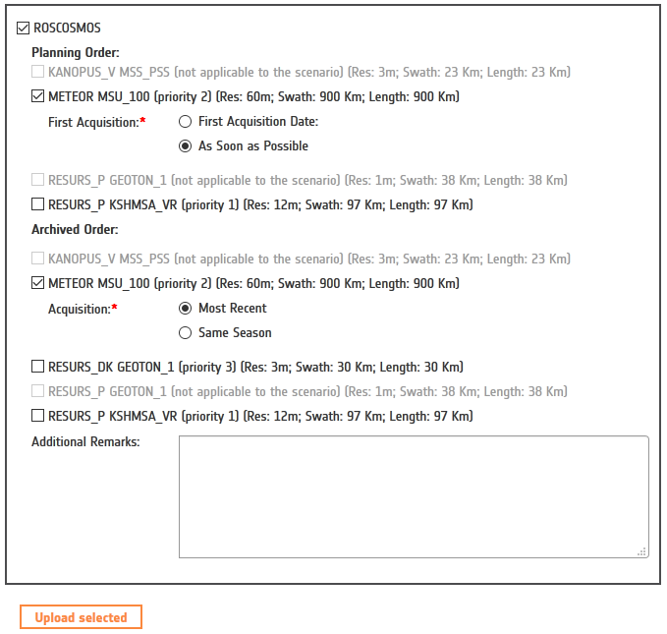
ECO interface: Order Desk and Mission Planners (MPP)
ECO
ODO
MPP
The ECO, using scenario guidelines, requests suitable Satellite tasking of new acquisitions or/and reference data to the agencies through the Emergency Request Form
PM
AU
VA
EU
DISASTER

Slide 10
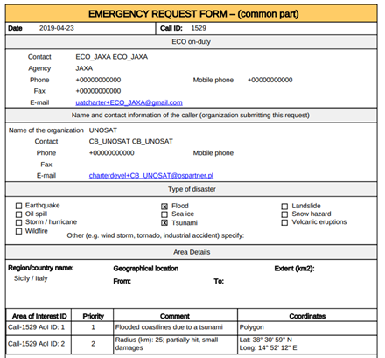
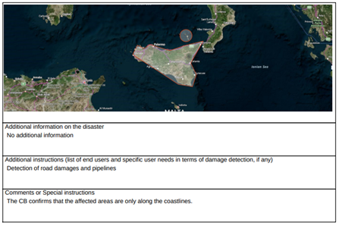
ECO interface: MPP - 2
The ECO is sending to the agency’ mission planner 2 forms:
General ERF (containing the information about the disaster and the affected areas)
Agency-specific ERF, result of the previous step.

Slide 11
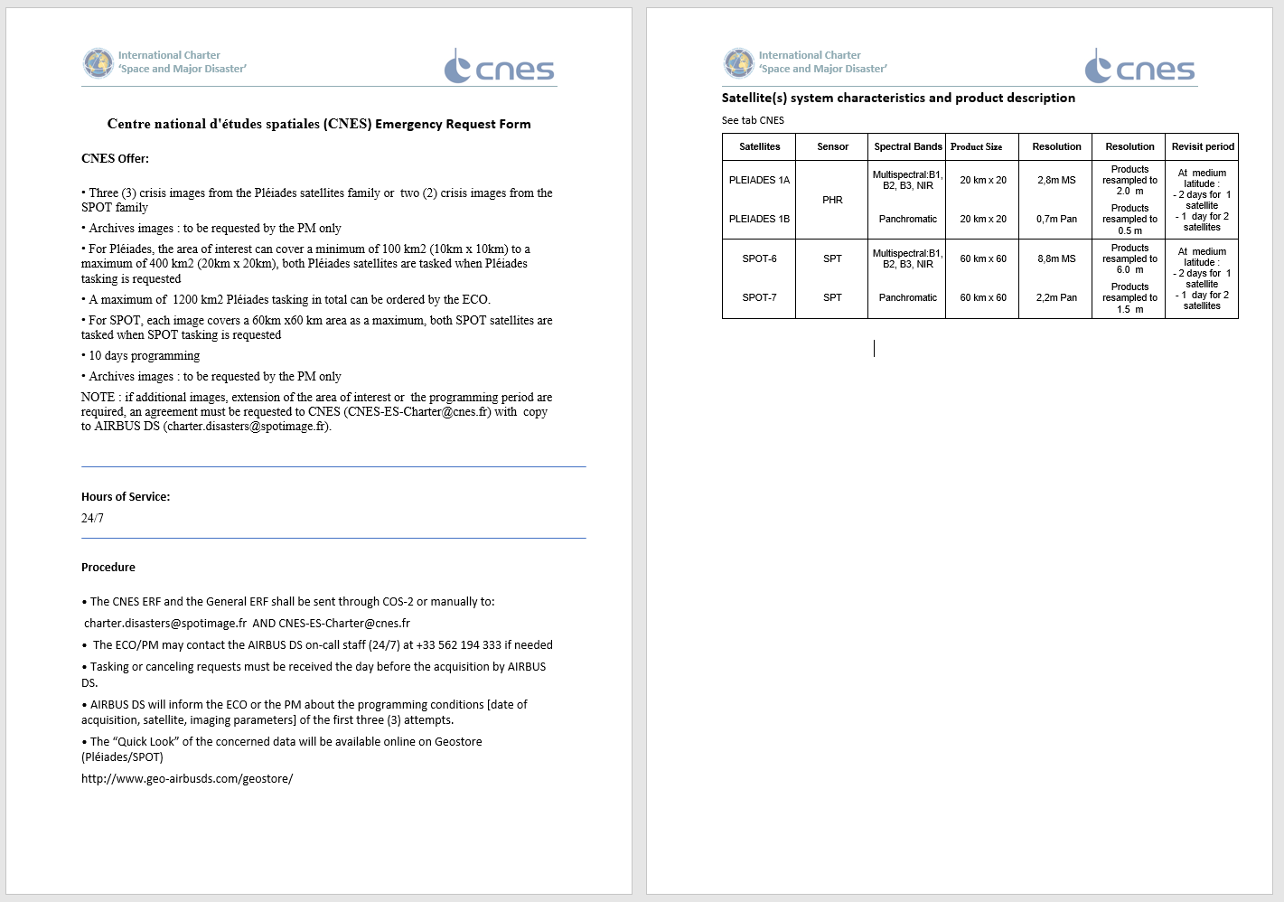
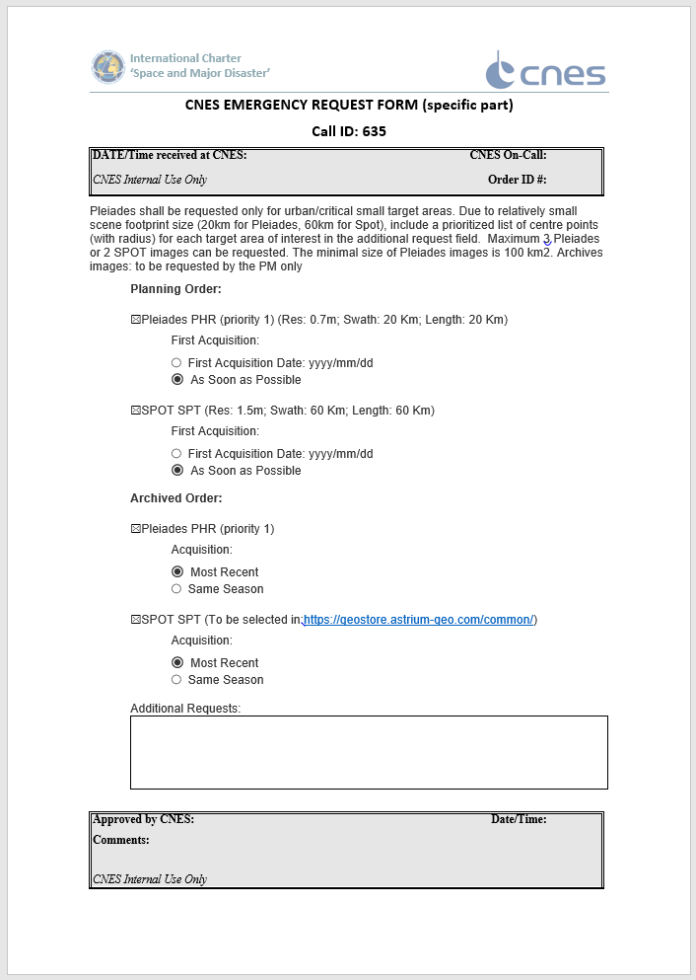
ECO interface: MPP - 3
The Specific ERF is composed by 3 parts: info on how to submit the request and possible Agency constraints, satellite/sensor info and the requested data
Agency offer
and constraints
Order Desk
operating hours
Ordering procedure
Satellite/sensor information
Dynamic part

Slide 12
ECO Interfaces: PM
ECO
ODO
MPP
ECO prepares a dossier for the PM containing :
The information coming from the AU
A map of the affected area(s)
The list of the ERFs sent
The list of the AAPs received (if any)
Additional information if necessary
ECO sends the dossier to the PM with copy to Executive Secretariat
PM shall confirm the reception of the Dossier to ECO to perform the handover
PM
AU
VA
EU
DISASTER

Slide 13
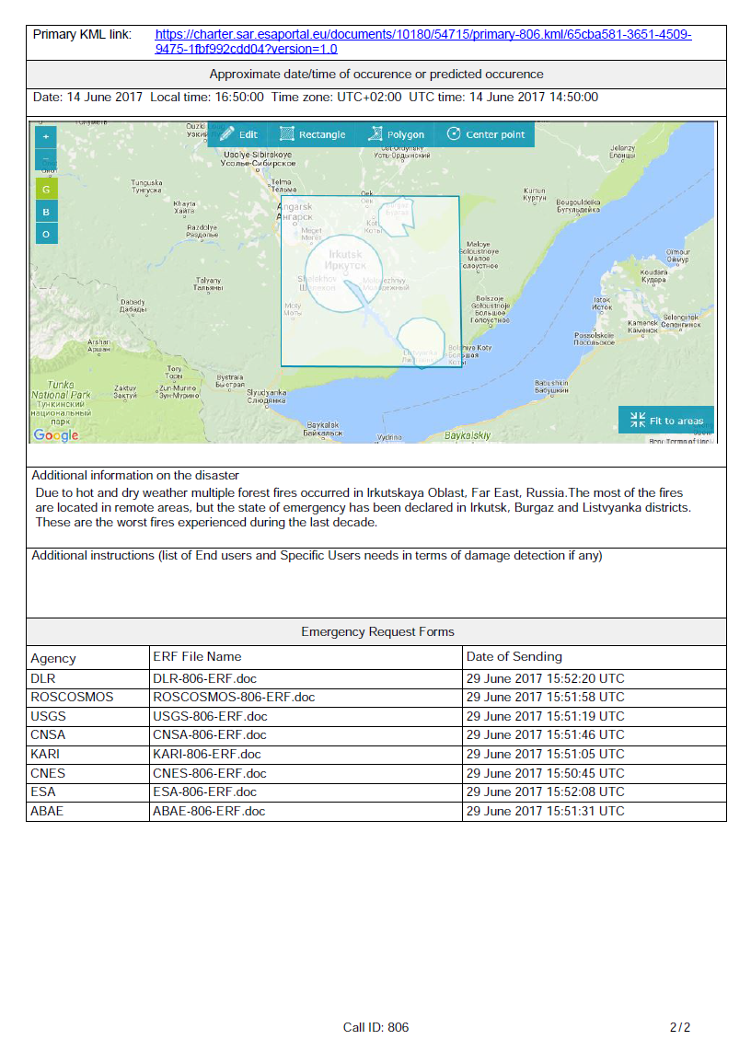
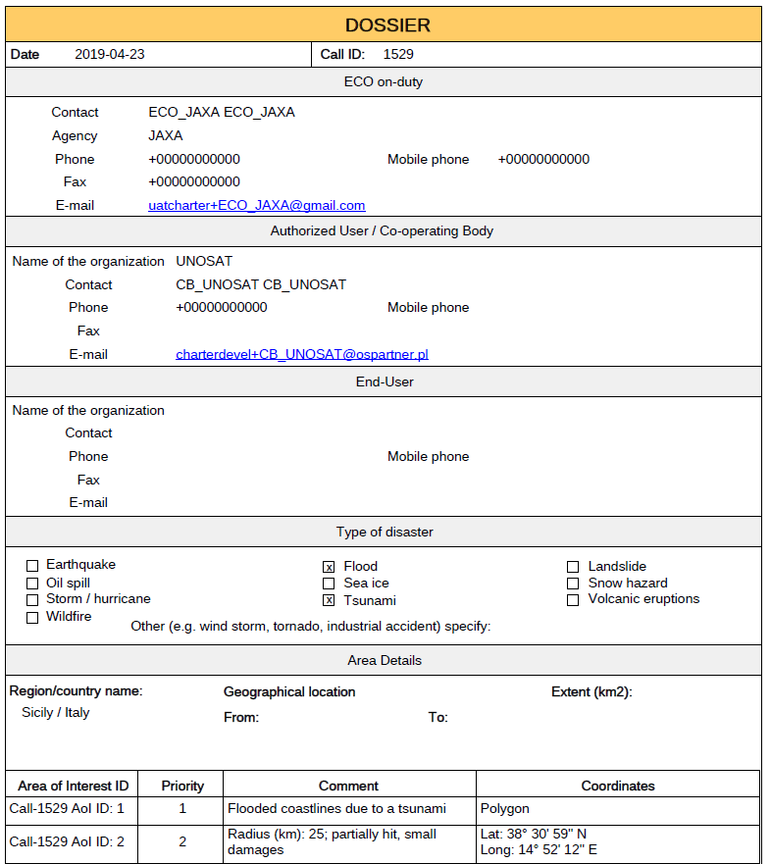
ECO interfaces: PM - ECO Dossier
Link to KML describing the polygon(s)
ECO info
AU info
EU info
Disaster type
Geographical
information
Sent ERFs

Slide 14
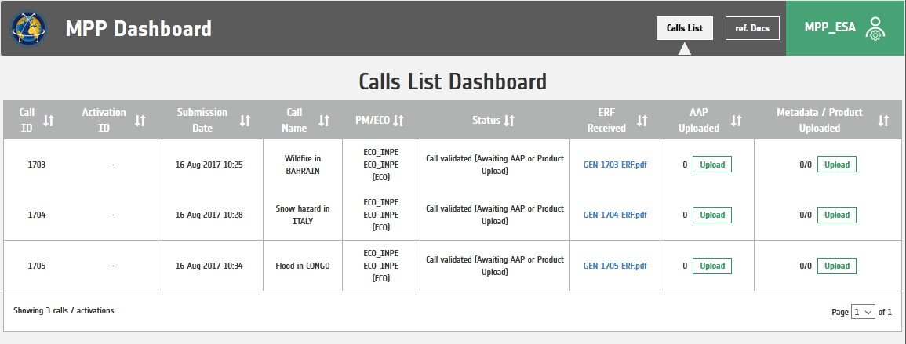
External Entity: MPP
ECO
ODO
MPP
The Order Desk / Mission & Production Planner is responsible for:
Tasking its satellites
Sending the foreseen Acquisition & Archive Plans
Uploading satellite data
PM
AU
VA
EU
DISASTER

Slide 15
Project Manager Selection
The Executive Secretariat designates the PM by taking into consideration the following criteria:
Geographical region of the disaster occurrence;
Disaster type;
Sensor(s) used to cover the disaster;
Availability of potential PMs among Parties/Partner Agencies;
Value-added processing proposal by a Party/PA according to the AU request.

Slide 16
PM Nomination
The Executive Secretariat nominates the PM among the available ones or a new one
In the nomination email the PM will find the PM Welcome Document, providing the basic information and contacts to perform his job.
In case of a new PM, the ES will provide also the needed information to access the Charter Operational system (COS-2)
The PM, at the end of the activation, will provide the ES with a report on the activities performed, for the ES approval

Slide 17
Project Manager (PM)
ECO
ODO
MPP
PM role requirements:
Availability during normal working hours
PM shall have experience in:
Remote sensing satellites, their supporting ground systems
Data delivery networks
Remote sensing data application, particularly in disaster management
Civil Protection Agencies and their mandates;
Remote sensing data value adding
Project management
Possibly knowledge about the disaster area
PM
AU
VA
EU
DISASTER

Slide 18
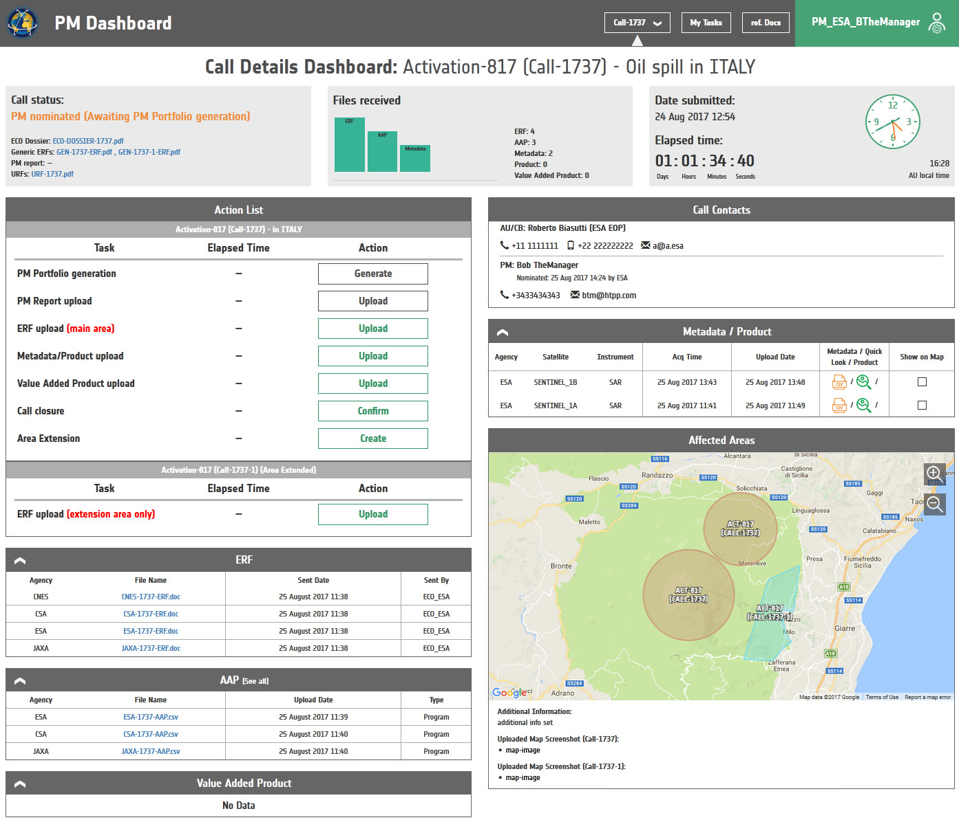
PM Tasks: information check
The PM accesses to the Charter Operational System (COS-2) to retrieve the available information
Current call status and the next expected action
Local time at AU location
ECO Dossier general ERF, URF
Contact details of the people involved in the call
Possible Actions as PM
Metadata, quicklooks & products received
Area Extension
Emergency Request Forms sent by ECO
Display of affected areas
Received Acquisition & Archive Plans
Value Added Products uploaded

Slide 19
PM - tasks
The PM receives the Dossier on the disaster from the ECO (via mail and in COS-2). Once checked, the PM shall validate it in COS-2, taking the responsibility of the activation from the ECO
The PM may further require help from value-added retailers, data application potential, etc.
The PM may request tasking changes or additional data to the MPPs for maximum utilization of space facilities
The PM shall ensure fast data, information and services delivery directly to the requestor or through the Civil Protection Agency concerned, or through such channels as those allowing quick turnaround

Slide 20
PM Interfaces: AU/EU
ECO
ODO
MPP
Project Manager (PM) - AU/EU
PM contacts directly the AU (and the EU, if exists)
PM obtains further information on the disaster and on the user requirement
PM apprises the AU/EU with regard to the data acquisition planning
PM solicits AU/EU's appraisal of the Charter activation
PM
AU
VA
EU
DISASTER

Slide 21
PM Interfaces: Value Adder Provider
ECO
ODO
MPP
The PM can optionally make use of a VA
The PM communicates user requirements to the Value Added provider
The PM ensures Value Added provider has access to the data (in particular if the data are not available in COS-2)
The PM ensures the users receive the products
Note: the data provided to the VA shall be used for the Charter activation only
PM
AU
VA
EU
DISASTER

Slide 22
Non-Disclosure Agreement (NDA)
Each new PM or VA should sign the Charter NDA.
In addition according to each Agency rules & procedures, a PM/VA could be asked to sign other NDAs before EO data be delivered by the order desk.
NON-DISCLOSURE AGREEMENT
The Recipient (s) of the International Charter ‘Space and Major Disasters’ data will commit to the following conditions:
a) The data property rights are reserved solely for the concerned Charter Party/Partner Agency,
regardless of the location, or the form of the data.
b) All data are made available to others on a right to use basis only and on the condition that the
Recipient (s) ensure (s) that the data shall not be distributed to any Third Party in any form or
manner, or used in ways other than those for which the data were provided without the written
consent of the Charter Party/Partner Agency or its designate.
c) The data are provided for the purpose of meeting the objectives of the Charter, and as such these shall not be copied or saved in any form or medium, and shall remain the property of the Charter Party/Partner Agency.
d) All data and data products shall be clearly marked with the applicable Copyright inscriptions.
e) The data use by the Recipient (s) is subject to data distributor’s licensing agreement that accompanies the data delivery.
f) The data are made available to the Recipient (s) without any assurance or warranty that the data product and the information derived meet the intended needs of the Recipient (s). Moreover, the Charter Parties/Partner Agencies shall accept no liability of actions, decisions, and circumstances resulting from the use of these data products and information.
g) The Charter Parties/Partner Agencies reserve the right of use and demonstration of all and any of the results and promotional products that are derived from the data.

Slide 23
External Entity: Value Adder
ECO
ODO
MPP
Requirements of the VA
The VA is available during normal working hours
VA shall have experience in:
Remote sensing satellites
Remote sensing data application, particularly in disaster management
Civil Protection Agencies and their mandates;
Remote sensing data value adding
Possibly knowledge about the disaster area
The VA is nominated by the ES or by the PM
PM
AU
VA
EU
DISASTER

Slide 24
Value Adder Interface: PM
ECO
ODO
MPP
The VA contacts the PM to get information about the event and its status
The VA gets the EO data from the COS-2 system or directly from the PM
The VA generates the Value Added products and upload them in COS-2 in order to be taken by the PM (that will send them to the final user)
PM
AU
VA
EU
DISASTER

Slide 25
Thank You

Slide 26
Charter Operational Loop
Emergency on-Call Officer
Member Agencies Mission Planners
On-Duty Operator
Project Manager
Authorized User
Value
Adder
End
User
DISASTER

Slide 27
Charter Operational Loop
ECO
ODO
MPP
PM
AU
VA
EU

Slide 28
Charter Operational Loop
ECO
ODO
MPP
PM
AU
VA
EU
DISASTER

