Slide 1
Overview of the International Charter Space & Major Disasters
PM Training USGS EROS Sioux Falls, SD -17 & 18 June 2019 Mike Budde (USGS)

Slide 2
History
Declaration of UNISPACE III Conference (Vienna, 1999)
The international space community is asked to initiate a programme to promote the use of […] Earth observation data for disaster management by civil protection authorities, particularly those in developing countries.

Slide 3
History
Following UNISPACE III, the Centre National d'Études Spatiales (CNES) and the European Space Agency (ESA) initiated the International Charter.
The Canadian Space Agency CSA signed the Charter on October 20, 2000.
Charter declared operational as of November 1, 2000
© ESA – S. Corvaja

Slide 4
Charter Members
CSA
Canada
UKSA/DMC
UK
CNES
France
DLR
Germany
ESA EUMETSAT
Europe
ROSCOSMOS
Russia
KARI
Korea
NOAA USGS USA
JAXA
Japan
CNSA
China
UAESA
UAE
ISRO
India
ABAE
Venezuela
INPE
Brasil
CONAE
Argentina
17 members in 2019
from 14 countries + Europe

Slide 5
What is the Charter?
An International agreement among participating Agencies to provide images/information of the member’s Earth-observing satellites in support of the management of major disasters worldwide.
Space agencies contribute
Priority satellite tasking
Archive retrievals
Organisation of map production
No cost for the User!

Slide 6
Disaster Types Supported
Natural events
Earthquakes
Fires
Floods Landslides Tropical storms Tsunamis
Volcanic eruptions
Man-made events
Oil spills
Industrial accidents
Not covered
slow-onset disasters (e.g. droughts) emergencies due to armed conflicts
A major disaster is a large, often sudden event with high impact in terms of lives and/or infrastructure & environment.

Slide 7
Limited mandate of the Charter
The Charter only supports the phase of immediate response to a disaster.
Charter activations generally last for about 1-4 weeks.

Slide 8
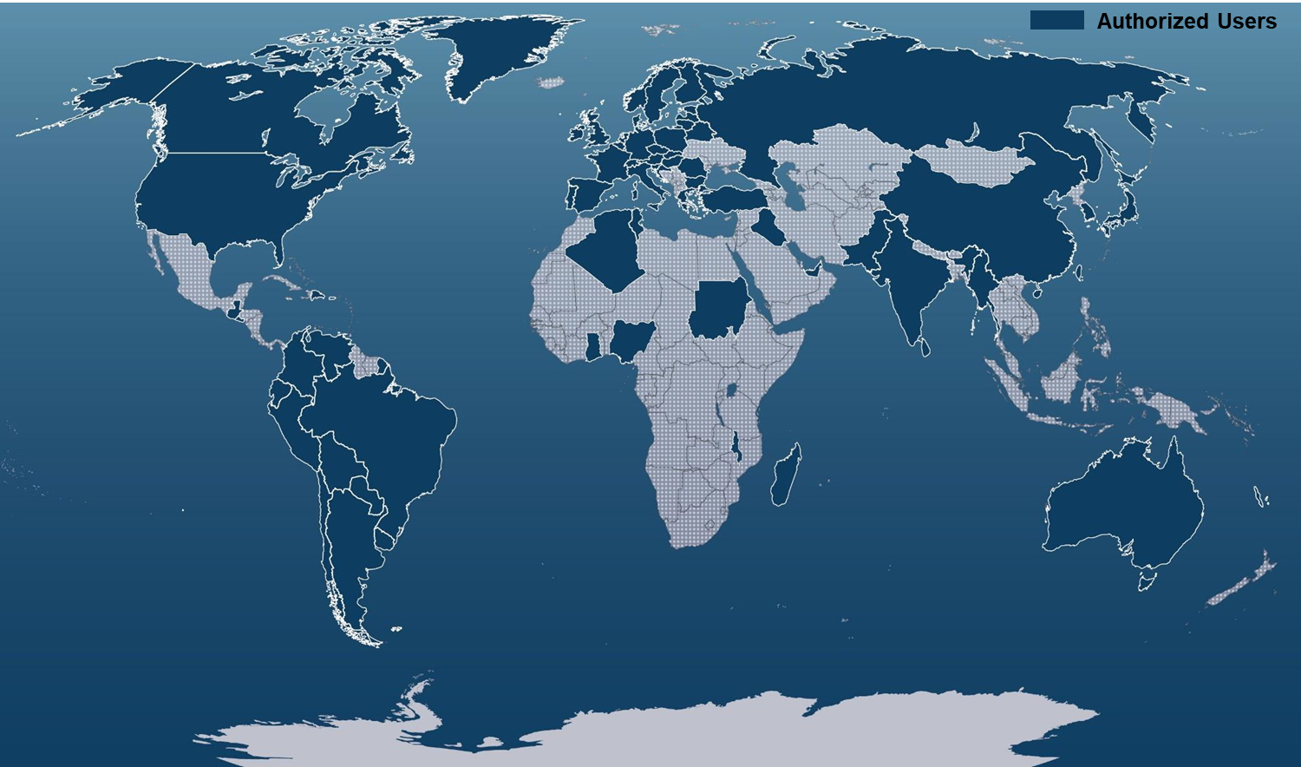
Mechanisms to Activate the Charter
Direct activation: The only bodies authorized to directly request the Charter to be activated for a disaster occurring in their country are the ‘Authorized Users’ (AUs). They are typically civil protection agencies, governmental relief organizations, or other authorities with a mandate related to disaster management.
Countries with Authorized Users
Newly added:
Zimbabwe
Thailand
Haiti

Slide 9
Mechanisms to Activate the Charter
Direct activation: The only bodies authorized to directly request the Charter to be activated for a disaster occurring in their country are the ‘Authorized Users’ (AUs). They are typically civil protection agencies, governmental relief organizations, or other authorities with a mandate related to disaster management.
Activation via an Authorized User on behalf of a user from a country without AU: Authorized Users can access the Charter to request support for a disaster in another country with which they cooperate for relief purposes.
Activation via the UN for UN users: The Charter has agreements with UNOOSA and UNITAR/UNOSAT to provide support to UN agencies. UNOOSA and UNOSAT may submit requests on behalf of users from the United Nations.
Activation for Asia Pacific users via Sentinel Asia: Sentinel Asia is a regional collaboration for satellite-based emergency response. Since 2009 the Charter has granted the Asian Disaster Reduction Centre the right to submit activation requests on behalf of national users of Sentinel Asia.

Slide 10
Universal Access: Conditions for becoming an Authorized User
Universal Access was launched in September 2012.
It allows any national disaster management authority to become a Charter AU, provided that three basic conditions are met:
be a national disaster management authority or its delegated agency in that country
have the capacity to download and use maps
be able to submit and pursue an activation request in English

Slide 11
Number and Type of Activations
November 2000 to May 2019: 600+ Charter activations in more than 125 countries

Slide 12
Activation Distribution
As of December 01, 2017 – 561 Charter Activations

Slide 13
Some examples of Charter activations

Slide 14
Flood in Germany 2013: Fischbeck area after a major dam break.
TerraSAR-X based detection of flooded areas

Slide 15
Flood in Vietnam Nov. 2017

Slide 16
Floods and Landslides in India, June 2013.
Product created by the Indian National Remote Sensing Centre (NRSC), ISRO
based on Indian and American optical imagery

Slide 17
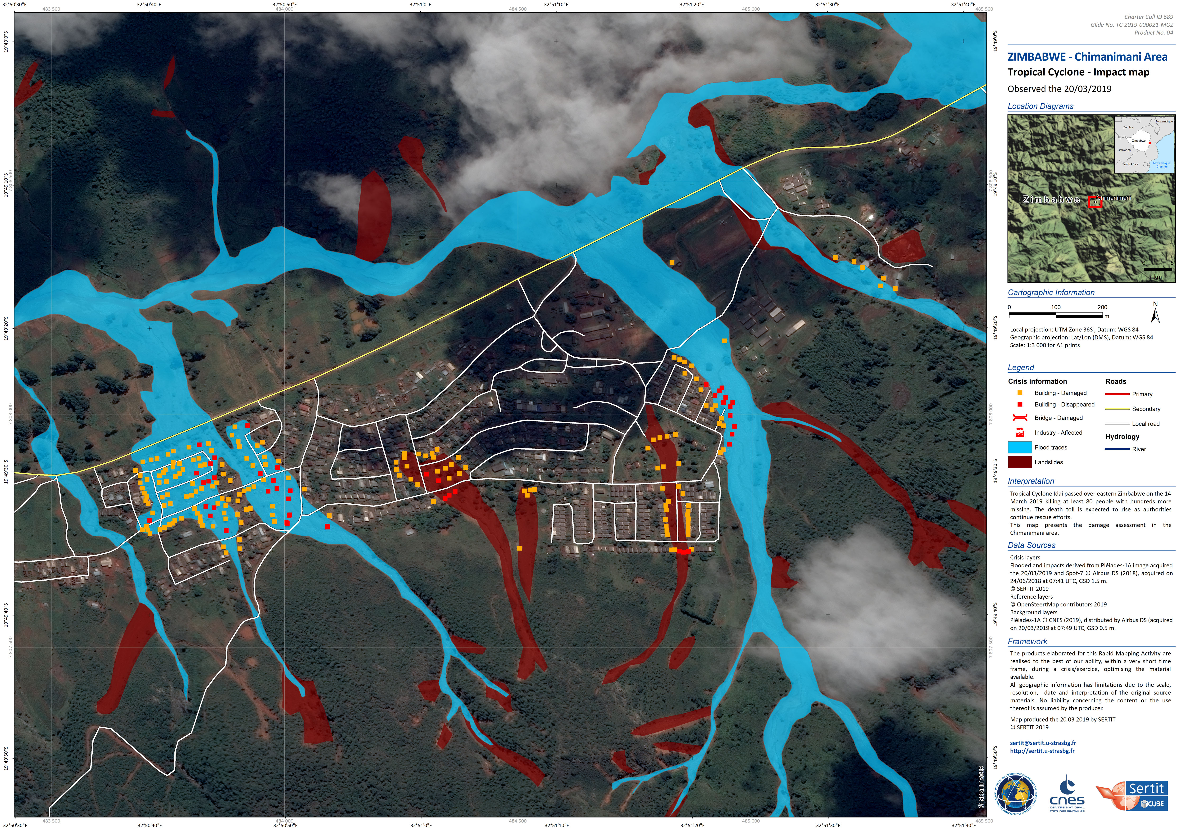
Tropical Cyclone Idai in Zimbabwe, March 2019
(product by Sertit based on Pléiades data)

Slide 18
Oil Spil in the Gulf of Mexico in 2010 (product based on Radarsat-2)

Slide 19
Conclusions
The Charter is an agreement among participating space agencies.
Its “satellite constellation” can deliver key information that brings benefit to disaster relief operations.
The Charter is focused on the immediate response phase.
600+ disasters have been covered since 2000 in over 125 countries worldwide.

Slide 20
The Charter online
Website
www.disasterscharter.org
@DisastersChart
Follow the Charter on Twitter
Newsletter
https://www.disasterscharter.org/web/guest/news/newsletter

Slide 21
www.disasterscharter.org
xx-xx-xxxx Name Surname
Emergency enquiries from users requiring direct access to Charter resources
should be addressed to:
ExecutiveSecretariat@disasterscharter.org
General requests for information should be addressed to
webmaster@disasterscharter.org

