Slide 1
Activation to Aftermath: Expanding HDDS & International Charter Support
Mike Budde
U.S. Geological Survey (USGS)
Earth Resources Observation and Science (EROS) Center, Sioux Falls, SD 57198, USA.
Disaster Response and Data Mining Geospatial Workshop June 4, 2026

Slide 2
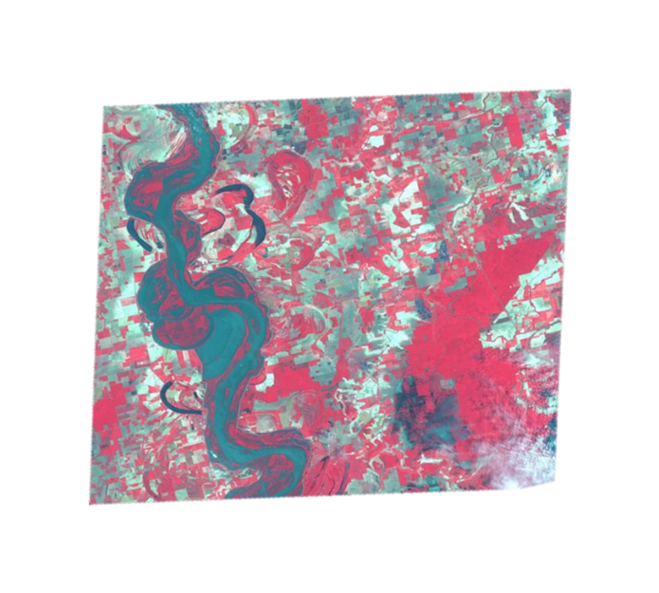
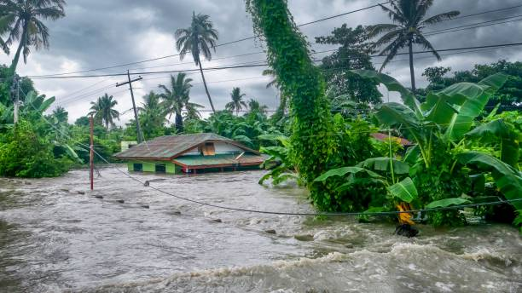
Our Mission
When disasters strike, pre- and post-event imagery can provide critical information regarding the extent, severity and evolution of the event.
USGS Emergency Response
supports the coordination of
remotely sensed data
acquisitions and distribution.

Slide 3
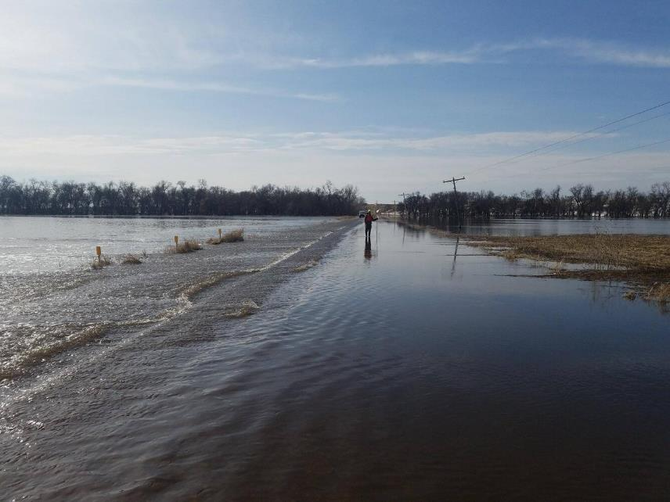
Who We Are
USGS/EROS EO Liaison
  Provide Federal, State, and Local organizations with timely and relevant pre- and post-event remotely sensed imagery and information
    On-call support and coordination for satellite and
    aerial image access, acquisition, reception,
    delivery, and archival
    Facilitate data scheduling, availability, and
    image coordination as required
    US representation for International Charter
    ‘Space and Major Disasters’
  USGS/EROS Operations
  Requirements collection through Collection
  Management System (CMT)
  Data ingest through EO Ingest System (EIS)
  Image access and delivery through Hazards
  Data Distribution System (HDDS)

Slide 4









Who We Support
Example Stakeholders
Civil Air Patrol (CAP) – multiple states
Federal Emergency Management Agency (FEMA)
National Guard Bureau (NGB)
National Geospatial-Intelligence Agency (NGA)
National Oceanic and Atmospheric Administration (NOAA)
National Aeronautics and Space Administration (NASA)
State and Local Offices,
  e.g. DOT, law enforcement, city planners, utility districts
State National Guard units
US Air Force
US Army Corps of Engineers (USACE)
US Department of Agriculture (USDA)
US Geological Survey (USGS)
US Department of Homeland Security (DHS)

Slide 5

Notes:
Last update: 2026-03-30: Changed minimum font and stats update.
Speaker notes
Welcome the audience and introduce the topic
Explain that this presentation will cover what the Charter is, how it works, and why it is important

Slide 6

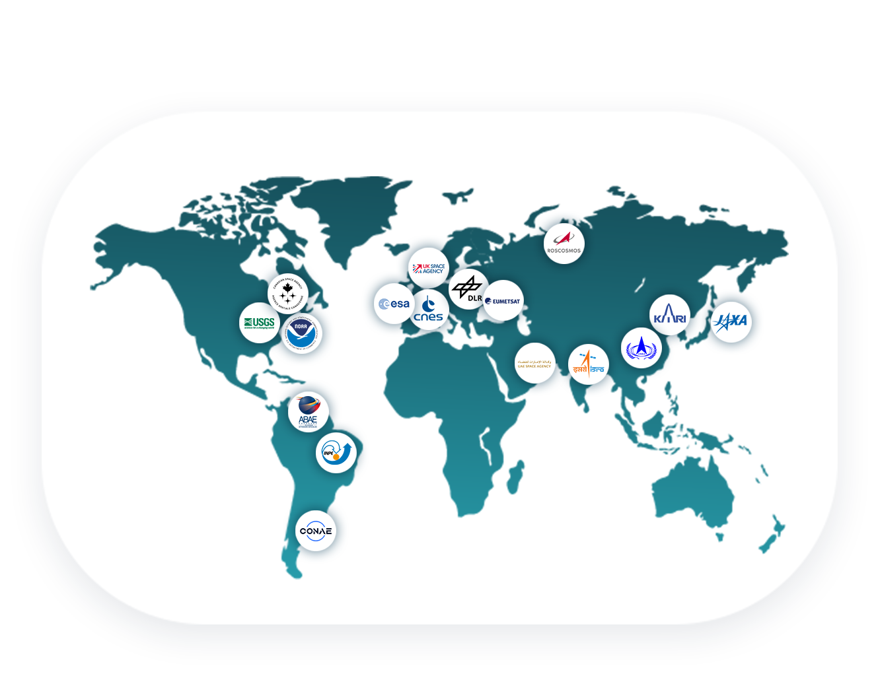

WHAT IS
THE CHARTER?
Established in 2000
A global space agencies initiative that provides satellite data to support disaster relief organizations in saving lives, property, infrastructure and the environment following major disasters
Includes 17 members and
15 data contributors worldwide
Notes:
Speaker notes
The Charter is an international agreement by global space agencies to provide priority access to critical satellite data in times of crisis.
Established in 2000 by the European Space Agency (ESA), the French Space Agency (CNES), and the Canadian Space Agency (CSA)
It ensures quick access to high-resolution images for disaster response.
The data helps emergency responders to plan evacuations, assess damage, and allocate resources more effectively.

Slide 7


WORKING WITH
PARTNERS
Together with member agencies and partners, the Charter:
Provides free satellite data in support of major disasters from a large pool of data contributors
Facilitates the creation and delivery of Value-Added Products covering the damaged area
Maintains a network of expert Project Managers and Value-Adders
Works with UN agencies and other partners to enable capacity building in the use of satellite data in support of disaster response
Notes:
Speaker notes
Briefly explain the following terms:
What are Data Contributors
What are Project Managers
What are Value-Adders
What is a Value-Added product
*Available extra slides about Data Contributors, Project Managers and Value-Adders

Slide 8

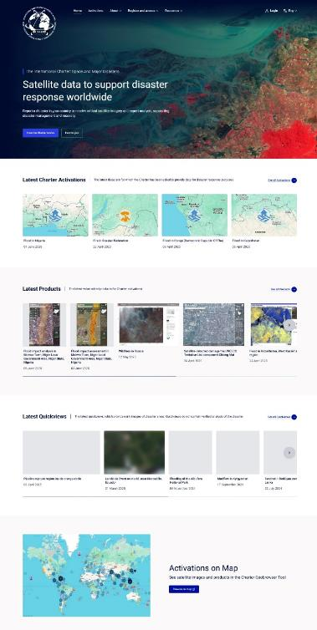
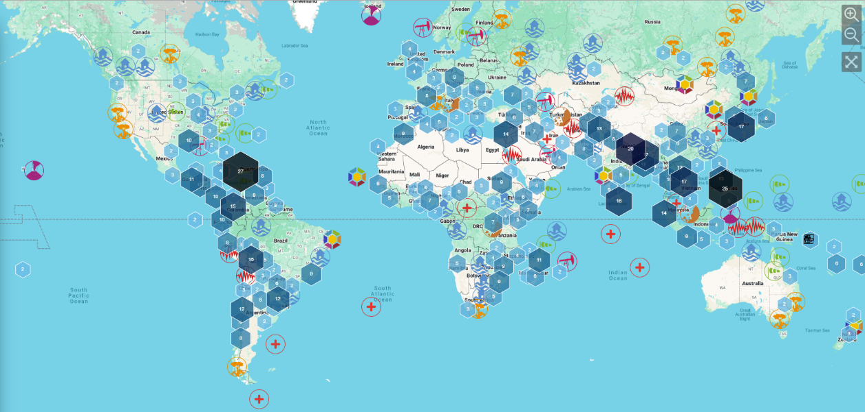


CHARTER
ACTIVATIONS
As of June 1, 2026, the Charter has supported 1,030 activations
Notes:
Speaker notes
___________
How to update the statistics above.
Go to https://disasterscharter.org/about-the-charter
Scroll further down the page and a table with the latest data will appear.
Latest update on: XX
To show the interactive map functionalities:
1. Go to : https://cgt.disasterscharter.org/en
To update the screenshot of the map:
Go to: https://cgt.disasterscharter.org/en
On the map, zoom out using the minus symbol button.
Use the Snipping Tool to take a screenshot of the map. Right-click on the image generated by the Snipping Tool, then copy and paste it onto the page above.

Slide 9

TYPICAL
DISASTER TYPES
NATURAL EVENTS
MAN-MADE EVENTS
Earthquakes
Fires
Floods
Oil Spills
Explosion Events
Industrial Accidents
Snow Hazards
Landslides
Tsunamis
CHARTER CANNOT BE
ACTIVATED FOR:
War or armed conflict
Slow-onset disasters (i.e., drought)
Disaster is not in a state of crisis
(i.e., minor earthquake)
Hurricanes
Storms
Volcanic
Eruption
Others
Notes:
Speaker notes
Explain what are the typical disaster types
Explain what the Charter cannot be activated for

Slide 10


BENEFITS OF ACTIVATING THE CHARTER
Access to data from 270+ satellites
Rapid tasking of a wide variety of Earth observation satellites
Crucial insights into a disaster that are impossible to obtain from the ground
Global collaboration in humanitarian aid by providing free, 24/7 access to a community of experts and decision makers
Notes:
Speaker notes
Enables a rapid tasking of a wide variety of Earth observation satellites.
Helps deliver faster emergency response on the ground.
Satellite imagery offers crucial insights into a disaster that are impossible to obtain from the ground.
Enables improved support for remote communities
Fosters global collaboration in humanitarian aid by providing free, 24/7 access to a community of experts and decision makers.
Enables better support for countries that couldn't afford this kind of technology.

Slide 11
HOW CAN THE CHARTER BE ACTIVATED?
BY DIRECT ACTIVATION
THROUGH AN AU FROM ANOTHER COUNTRY
Authorized Users (AU) can request the activation of the Charter in the event of a disaster occurring in their own country.
AU can request the activation of the Charter for a disaster occurring in another country that does not have an AU.
BY THE UNITED NATIONS
THROUGH SENTINEL ASIA
UNOOSA and UNITAR/UNOSAT can submit requests on behalf of United Nations’ agencies and countries that do not have an AU.
The Asian Disaster Reduction Center can submit activation requests on behalf of national users of Sentinel Asia.
Notes:
Speaker notes
By direct activation: Organizations authorized to request the activation of the Charter in the event of a disaster occurring in their own country are known as Authorized Users (AU). These are typically civil protection agencies, government relief organizations, or other authorities with a disaster management mandate.
Through an AU from another country: Authorized Users may request the activation of the Charter for a disaster occurring in another country that does not have an AU.
By the United Nations: The Charter has agreements with UNOOSA (Vienna) and UNITAR/UNOSAT (Geneva) to support United Nations agencies. UNOOSA and UNITAR/UNOSAT can submit requests on behalf of UN users.
Through Sentinel Asia: Is a regional initiative supporting emergency response in the Asia-Pacific region using satellite data. The Asian Disaster Reduction Center (since 2009) can submit activation requests on behalf of national users of Sentinel Asia.

Slide 12
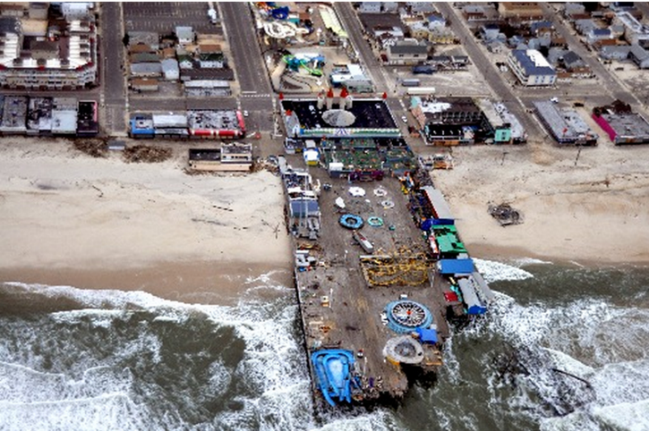
How We Support
Collection Management Tool (CMT)
https://cmt.usgs.gov/
CMT is a web-based application used primarily for managing remote sensing data acquisition during emergency events. It allows users to submit requests for imagery, monitor collection progress, and define areas-of-interest (AOIs).
Hazards Data Distribution System (HDDS)
http://hddsexplorer.usgs.gov
HDDS is an event-based interface that provides a single point-of-entry for access to remotely sensed imagery
  Supports both Public and Restricted/Licensed data

Slide 13










Domestic Imagery Partners

Slide 14
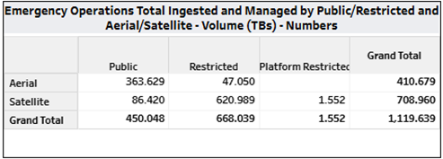
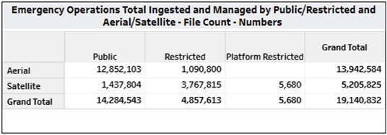
Emergency Operations: FY2025 at a Glance
Total Number of Activations – 77
  Domestic – 29
  International – 48
Ingest and Managed EO Data cumulative since FY2004
Notes:
Cumulative since FY2004
Total ingested and manage – Size 1.1 petabyte
File count 19 million records

Slide 15
Emergency Operations Domestic vs International Charter Events Created by Month FY2025
Notes:
Number of Events created by month.
IC may have more events but they generally do not last more then a couple of weeks. Were Domestic events usually hang on longer.
This chart does not show older event we continue to support, like Volcanoes throughout the world. Example Kilauea in HI

Slide 16
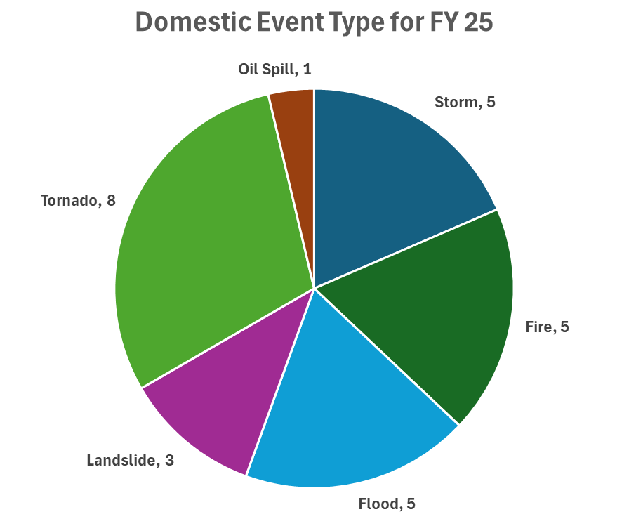
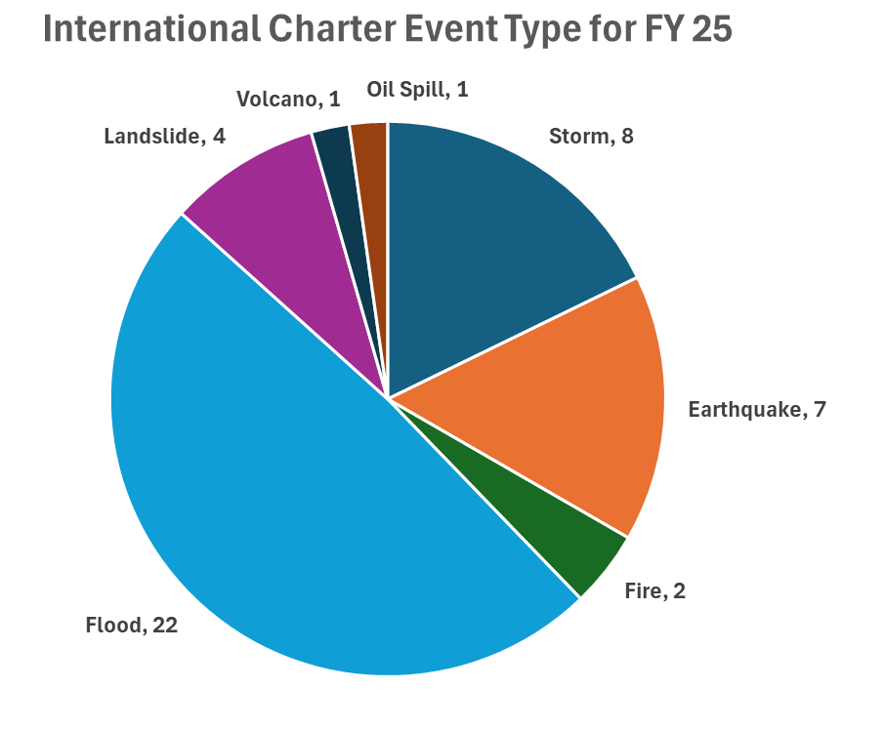
Domestic and International by Event Type FY2025
Notes:
Shows event type:
Events are tied to an event type
Depending on what the user group puts in the DAR for information, an event is then created if one does not already exist. And that event is labeled either Cyclone, Earthquake, Fire, Flood, etc.
Domestic – 8 tornado, 5 storms, 5 fires 5 floods
IC – 22 floods, 7 earthquakes, 4 landslide

Slide 17
Emergency Operations Domestic vs International Charter Data Acquisition Request (DAR) for FY2025
Notes:
DAR is put in by the user community for data needed to support their mission. These DAR drives the event creation.
We do not create events. Except maybe a Hurricane that is predicted to hit soon
So even though the number of Event for a given month may be low, the DARs for a given event may be plentiful. I know there were only 2 domestic events for March, but there are 32 DARs.

Slide 18
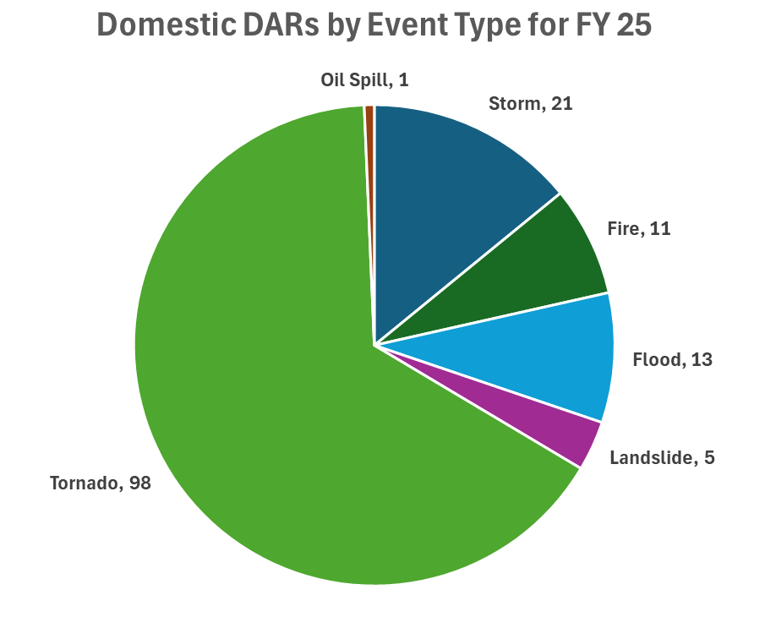
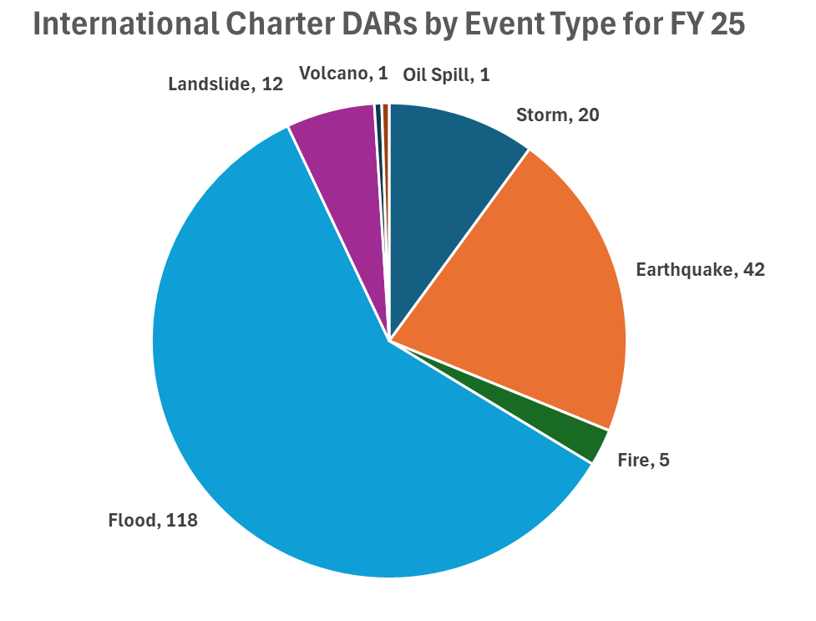
Emergency Operations Domestic vs International Charter Data Acquisition Request (DARs) Event Type for FY2025
Notes:
Total number of DAR for each event type for FY25.

Slide 19
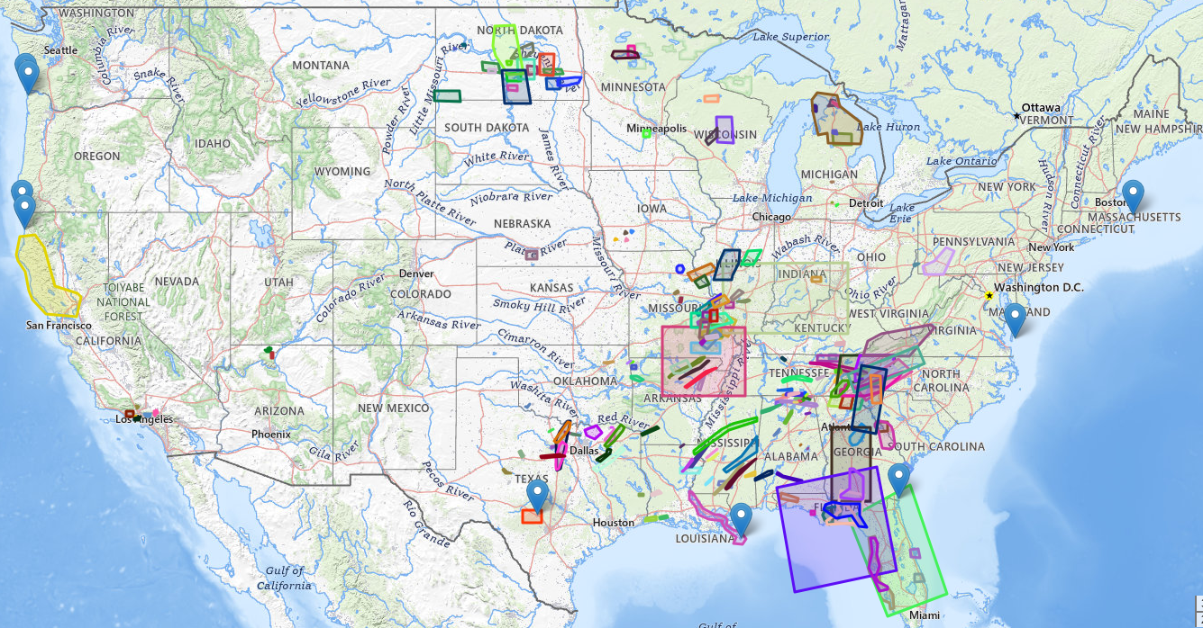
US Data Acquisition Requests FY2025
Notes:
There are the Domestic DARs for FY25
Different shapes and size depending on the data type needed, Landsat – larger footprint, Hi Res data, smaller footprint.

Slide 20
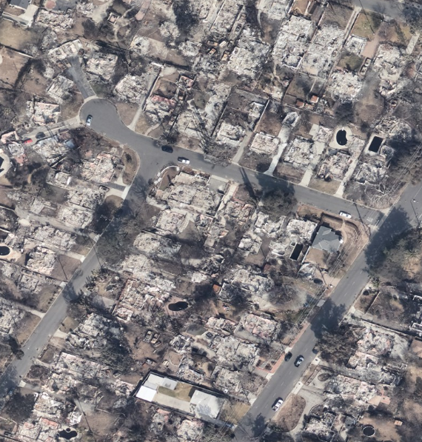
California fires 1/2025 Event – Data Loaded
Palisades, Kenneth, Eaton, Hurst, Bridge, & Hughes
  HDDS Hosted Imagery:
    Aerial Imagery
      NOAA (256 images)
      NAIP Pre-Event (46 images)
    Moderate-resolution Optical Satellite Imagery
      Landsat 8 (14 images)
      Landsat 9 (14 images)
      Sentinel-2 (37 images)
      ISRO Resourcesat-2 (17 images)
    High-resolution Optical Satellite Imagery
      WorldView-1 (2 images) – Restricted
      WorldView-2 (106 images) – Restricted
      WorldView-3 (373 images) – Restricted
      GeoEye-1 (153 images) - Restricted
East Poppyfields Dr. Altadena, CA.
NOAA imagery – acquisition Jan. 28, 2025

Slide 21
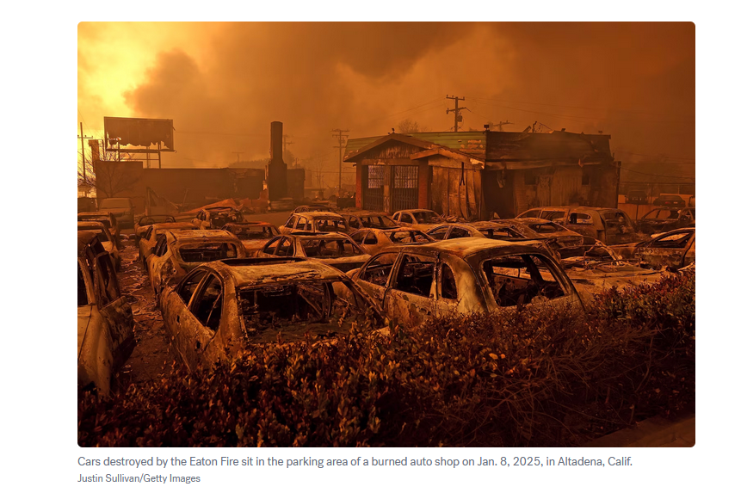
California fires 1/2025 Event - Data loaded
  HDDS Hosted Imagery (continued):
    High-resolution Optical Satellite Imagery (continued)
      Blacksky (32images) – Restricted
      Skysat (131 images) – Restricted
    Radar and Synthetic Aperture Radar (SAR) Imagery
      ICEYE (14 images) – Restricted
      Capella (30 images) – Restricted
      Umbra (6 images) – Restricted
      Sentinel-1 (24 images)

Slide 22
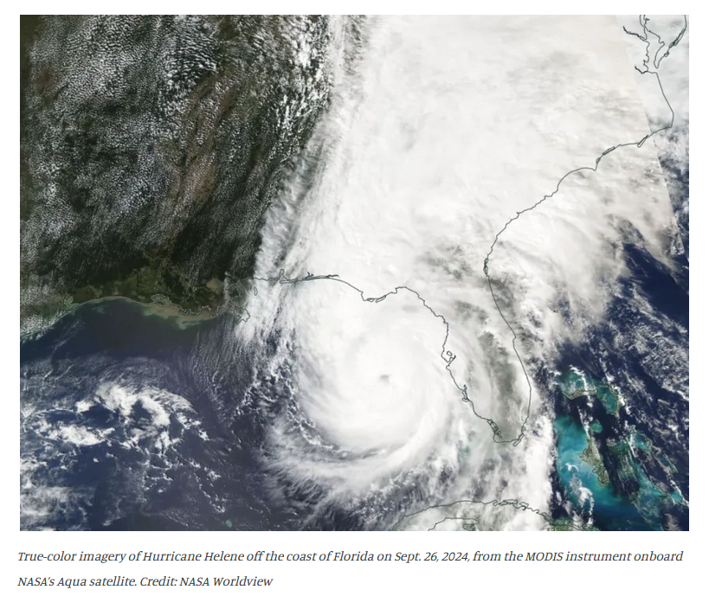
Hurricane Helene Event - Data loaded
HDDS Hosted Imagery:
Aerial Imagery
  Civil Air Patrol (CAP) (92,751 images)
  NOAA (9,584 images)
  NAIP Pre-Event (287 images)
Moderate-resolution Optical Satellite Imagery
  Landsat 8 (79 images)
  Landsat 9 (85 images)
  Sentinel-2 (434 images)
  ISRO Resourcesat-2 (50 images)
High-resolution Optical Satellite Imagery
  WorldView-1 (74 images) – Restricted
  WorldView-2 (1,976 images) – Restricted
  WorldView-3 (888 images) – Restricted
  GeoEye-1 (44 images) - Restricted

Slide 23
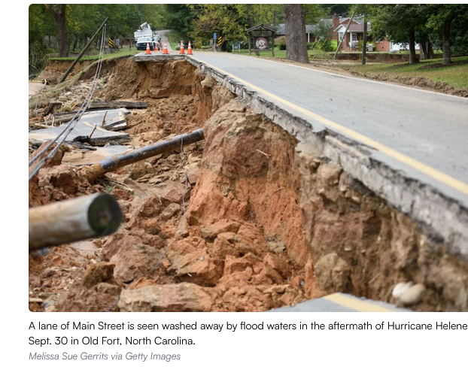
Hurricane Helene Event - Data loaded
HDDS Hosted Imagery:
High-resolution Optical Satellite Imagery (continued)
  Blacksky (357 images) – Restricted
  Skysat (632 images) – Restricted
Radar and Synthetic Aperture Radar (SAR) Imagery
  RadarSAT-2 (6 images) – Restricted
  ICEYE (6 images) – Restricted
  Capella (2 images) – Restricted
  Umbra (49 images) – Restricted
  Sentinel-1 (103 images)
Other Datasets
  Emergency Response Maps (37 images)

Slide 24
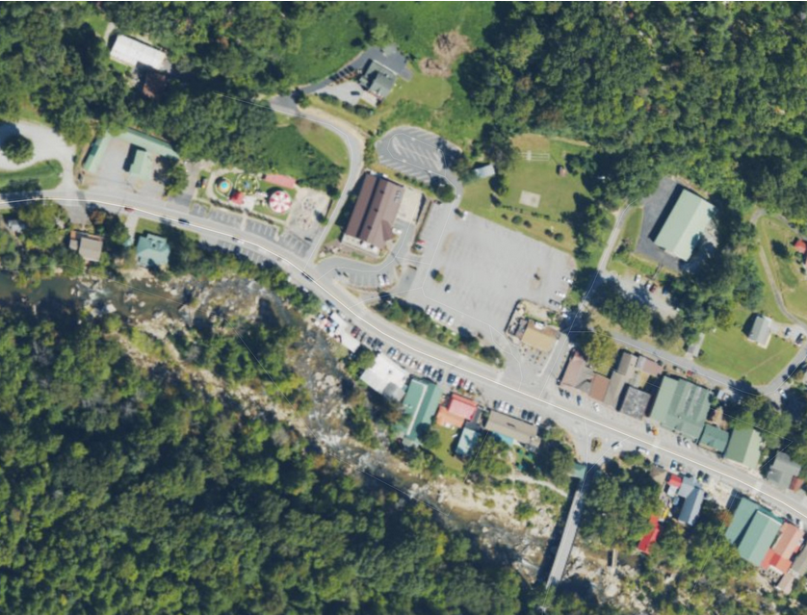
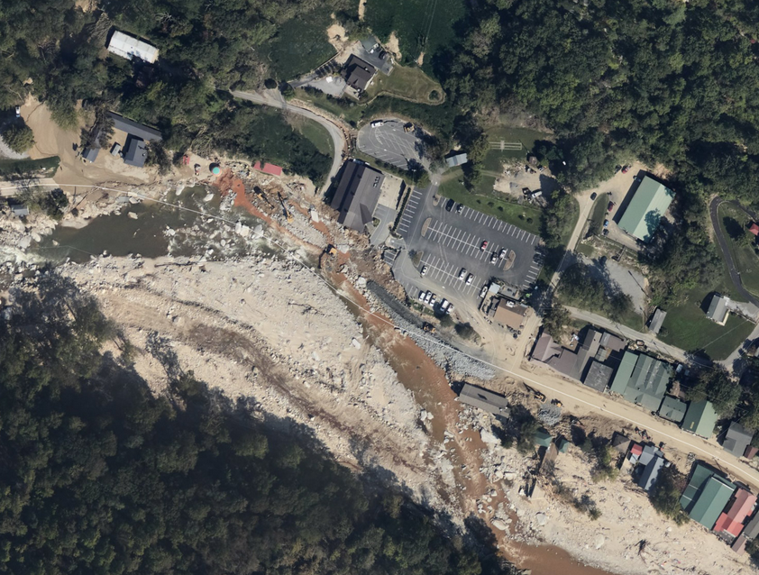
NOAA’s National Geodetic Survey https://oceanservice.noaa.gov/news/sep24/ngs-storm-imagery-helene.html
Chimney Rock, NC pre-Helene
Chimney Rock, NC post- Helene

Slide 25
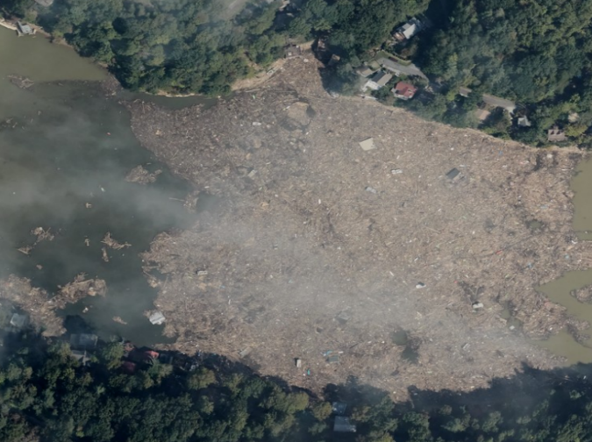
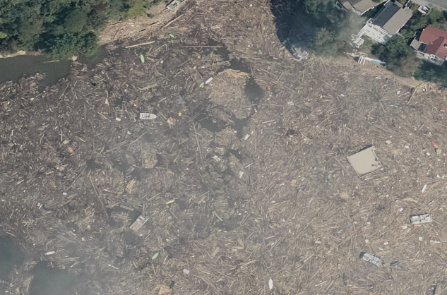
Hurricane Helene Damage: Lake Lure North Carolina
In North Carolina, Lake Lure became the site of thousands of pounds of debris and sediment washed in from Hurricane Helene.
Imagery was acquired by NOAA, acquisition date: 10-7-2024

Slide 26

INTERNATIOANL CHARTER DATA MANAGEMENT
Although the International Charter was not activated for Hurricane Helene – it was an example of an event where getting data was not an issue, but managing the volume of incoming multi-mission satellite acquisitions proved challenging. Often an issue in disaster situations where time is critical.
This was the driving force behind development of the International Charter Mapper. It brings our analytics directly to the data in a high-performance cloud environment without the need for downloading large amounts of data locally.
Notes:
Speaker notes:
The PM and VA are able to browse, filter and select images in full resolution and, analyse and process imagery using online Earth observation services and tools.
Notes:
Charter Mapper User Manual : https://docs.disasterscharter.org/
What is the point of contact concerning User Support?
If experiencing issues in the usage of the Charter Mapper implemented by ESA or would like to report a problem, please send an e-mail to helpdesk@disasterscharter.org from 08:00 to 16:00 UTC (or 07:00 to 15:00 UTC end March - end October, daylight saving time period) and outside above hours and days also to cos_support@disasterscharter.org.

Slide 27
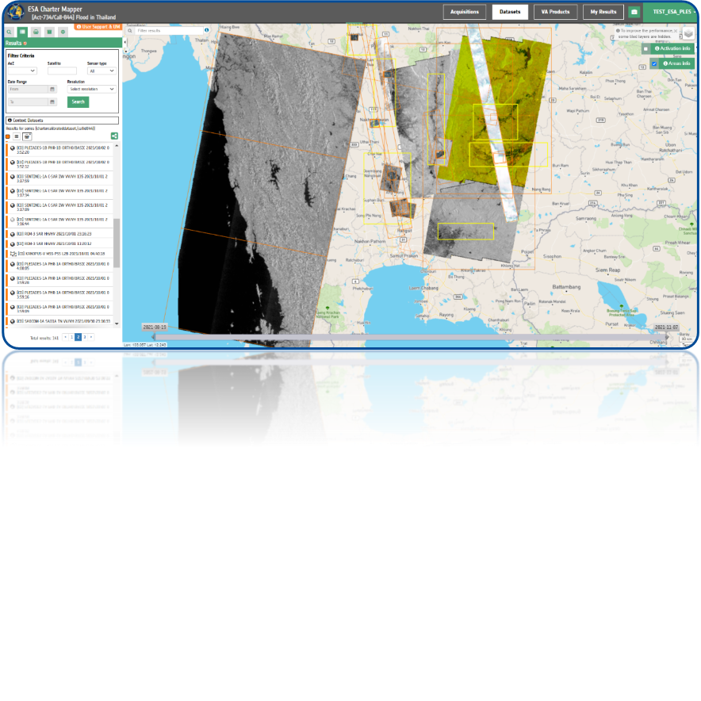



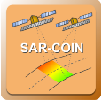








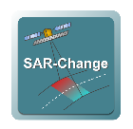
CHARTER MAPPER SERVICE
Large volumes of disparate EO data are collected for a given Charter activation
ESA Charter Mapper addresses data interoperability through pre-processing of acquisitions to a common format and systematic calibration across sensors
Provides analysis ready data for comparison and evaluation
Allows data to be used as input into downstream processing services within the Mapper that support multi-sensor and multi-mission acquisitions
Notes:
Speaker notes:
The PM and VA are able to browse, filter and select images in full resolution and, analyse and process imagery using online Earth observation services and tools.
Notes:
Charter Mapper User Manual : https://docs.disasterscharter.org/
What is the point of contact concerning User Support?
If experiencing issues in the usage of the Charter Mapper implemented by ESA or would like to report a problem, please send an e-mail to helpdesk@disasterscharter.org from 08:00 to 16:00 UTC (or 07:00 to 15:00 UTC end March - end October, daylight saving time period) and outside above hours and days also to cos_support@disasterscharter.org.

Slide 28
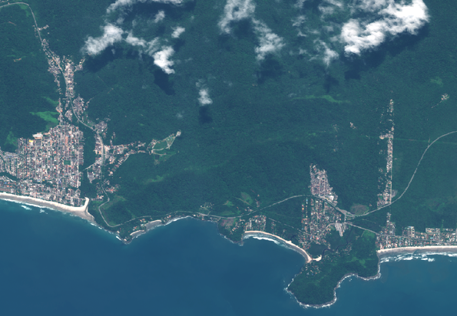
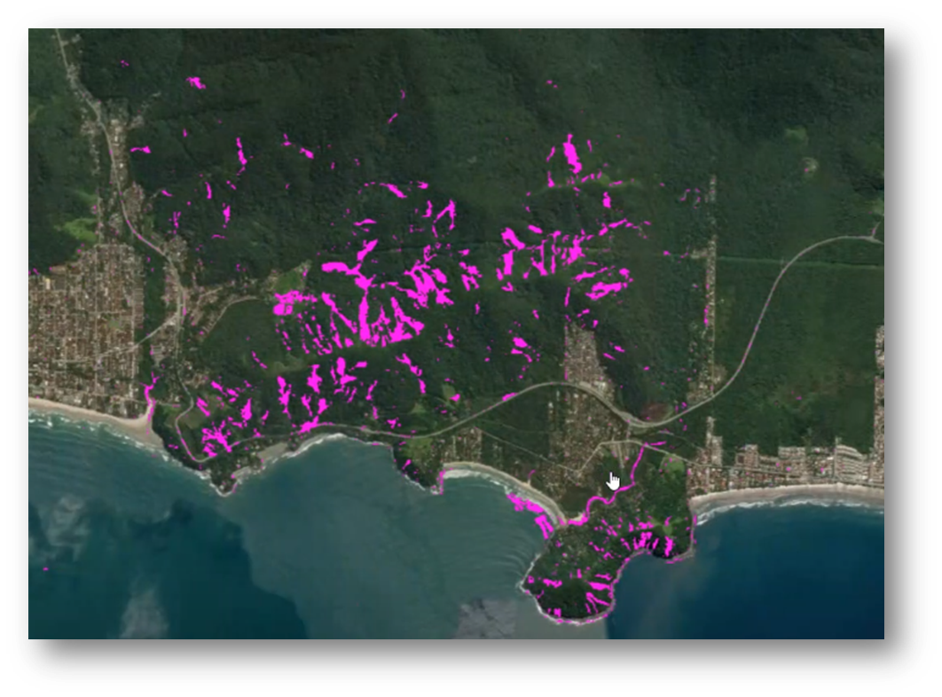
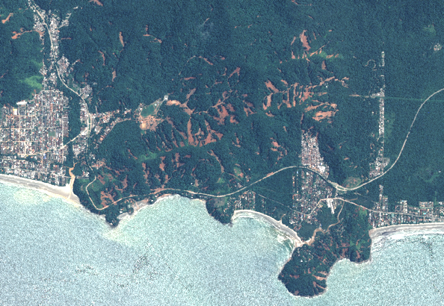
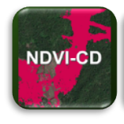
CHARTER MAPPER SERVICE – Landslides
GEOEYE-1 acquisition – 21/11/2022
The landslide map (magenta) has been generated using Geoeye-1 pre-event image (11/21/22) and Pleiades post-event image (02/25/23), performing an NDVI change detection.
PLEIADES-1A acquisition – 25/02/2023
NDVI-CD: Change Detection

Slide 29

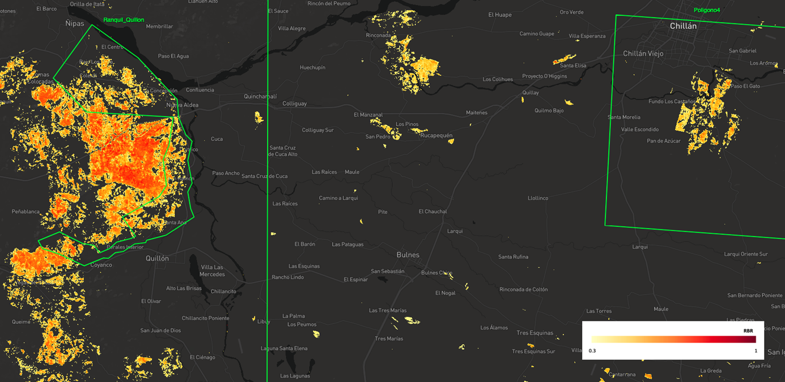
CHARTER MAPPER SERVICE – Wildfire
BAS: Burned Area Severity
This service uses a pair of calibrated optical datasets from the same mission and estimates burned areas using the Normalized Burn Ratio index.
Derived from a pair of Landsat-9 OLI - January 10, 2023 (pre-event) - February 27, 2023 (post-event) - Quillón and Chillán.
https://docs.disasterscharter.org/services/burned-area-severity/service-specs/
https://docs.disasterscharter.org/services/burned-area-severity/tutorial/

Slide 30

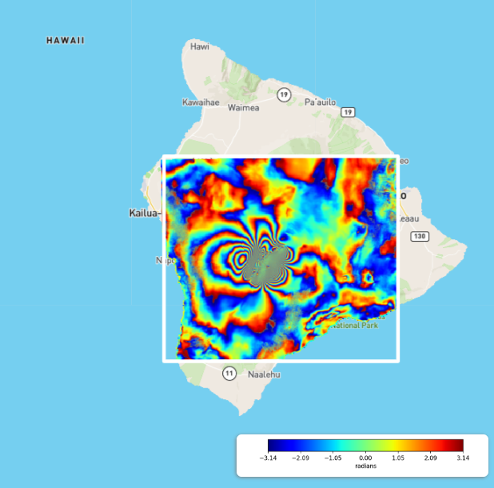
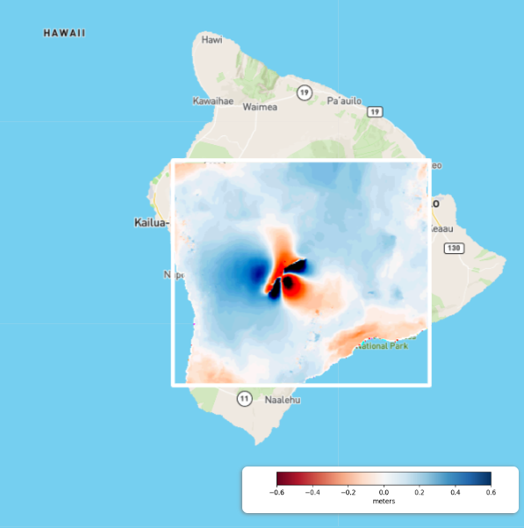
CHARTER MAPPER SERVICE – Volcanic Eruption
Phase
Displacement
DInSAR – Phase and Displacement
The DInSAR service performs a differential interferometric computation between a pair of complex SAR datasets to obtain the line-of-sight (LOS) displacement, interferometric phase, and coherence.
Notes:
Speaker notes:
Phase - Fringe Interpretation: Count the repeating color cycles (fringes). One full cycle (e.g., red-orange-yellow-green-blue-purple) represents a precise amount of deformation—often \(28\text{ mm}\) for Sentinel-1.
Displacement – Blue represents uplift (closer to the satellite), Red represents subsidence (farther from the satellite)

Slide 31
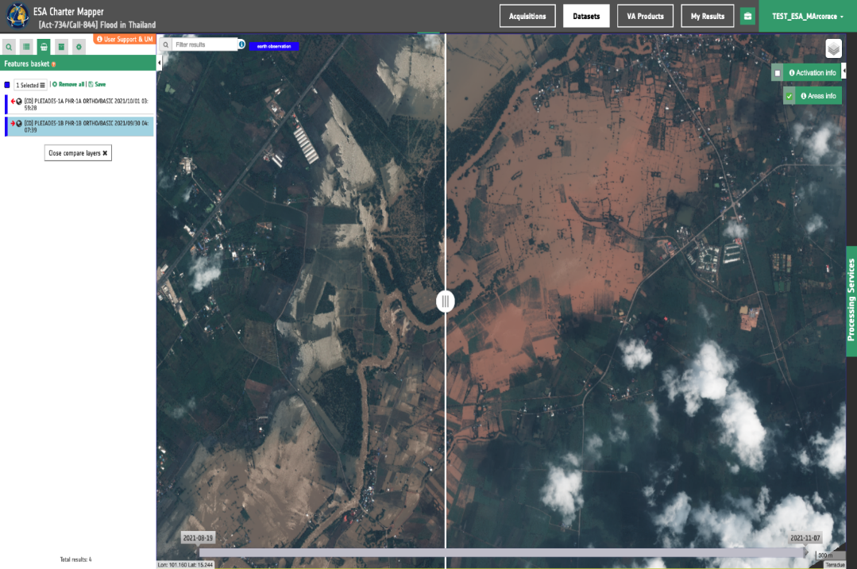
CHARTER MAPPER SERVICE – Visualization
Illustration of processed Charter data, generated by ESA in the ESA Charter Mapper: visual comparison of pre- and post-event images during a flood event near Ban Lam Narai in Thailand
The Compare Layers tool aids the user in quickly identifying changes in pre- and post-event imagery
Contains modified Pleiades-1A and 1B data. © CNES, Airbus
Act-734 Flood in Thailand
Requestor:
UNITAR on behalf of UNHCR
Project Manager:
UNITAR/UNOSAT
Value-Adding providers:
UNITAR/UNOSAT

Slide 32
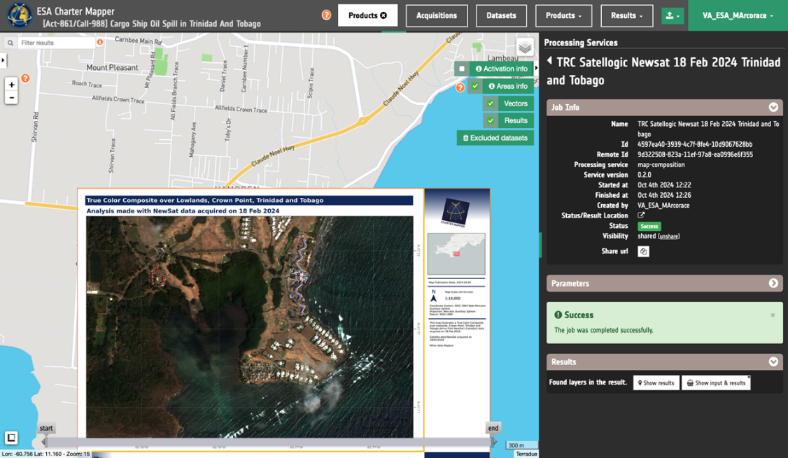
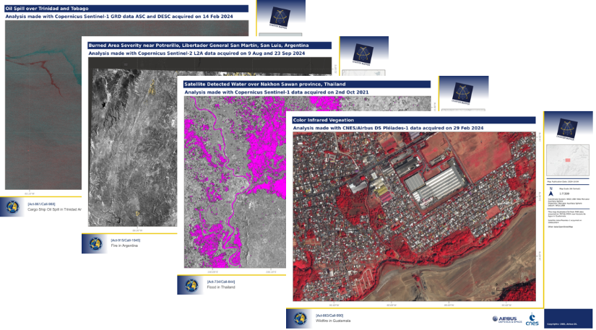
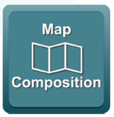
CHARTER MAPPER SERVICE – Map Composition
The Map composition tool allows the end-to-end production of a value-added product fully online within the platform, without the need to download any data or GIS software
Processing results can be applied directly to a pre-made template with the option to add logos and legends

Slide 33
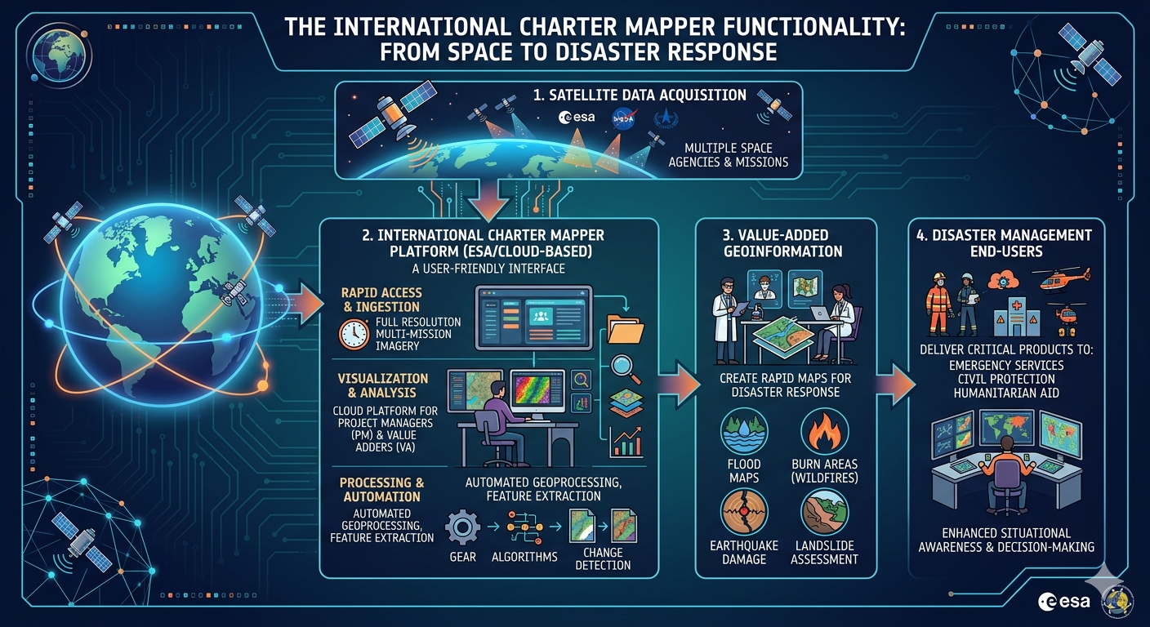

Slide 34









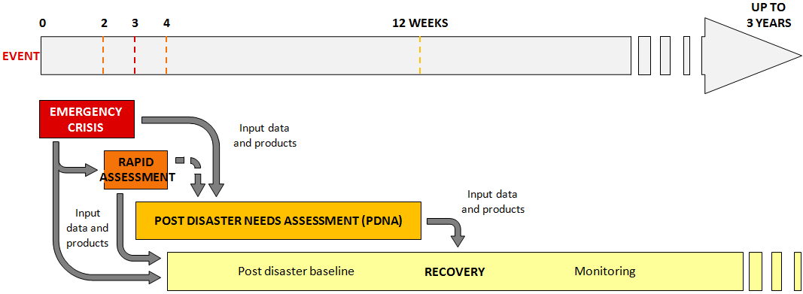
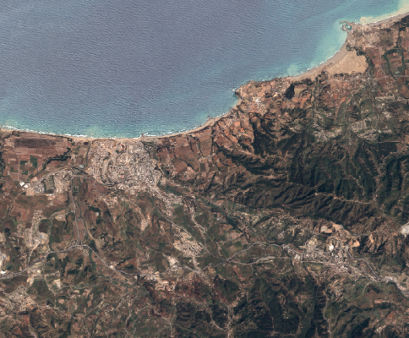



CEOS Recovery Observatory (RO)
A partnership between CEOS-EU-World Bank-UNDP
Satellites are critical for response to disasters… but what about Recovery?
Collection of satellite images and maps at several scales during ~ 6 months after a major disaster
Interactive links with PDNA partners and government
Overview
AOI
Whole impacted area
Several Hot Spots
Rapid Assessment
Urban
Zoom 1
National Recovery Plan
Hot Spot
Zoom 2
Planning
34
  “Recovery Observatory” : Process allowing operational use of EO for PDNA, Recovery Planning, then M&E
Ancillary data are indispensable:
terrain validation data, aerial and drone data, statistics, cartography, ….

Slide 35
Potential Charter-RO collaboration : Benefits
Avoid duplication in data provision and leverage complementary aspects that can be more effectively utilized (cf. Copernicus model)
Highlight gaps, overlaps, and opportunities for more systematic collaboration
Test the Charter’s potential to provide a more complete solution that addresses longer-term challenges, such as damage assessment, and reconstruction planning
Expanding beyond the response phase into recovery could significantly enhance the Charter’s value for local end users (local governments, NGOs...)
Raise awareness among a wider set of end users about the Charter’s capabilities and encourage broader and sustained use of the Charter

Slide 36
Charter-CEOS Recovery Observatory
  During the Oct 2025 Charter Board Meeting, a Charter-RO Joint Team was established to report back on:
  How a potential collaboration could work and explore its different aspects
  How such a collaboration procedure could be implemented in the Charter operational system
  Policy adjustments required to enable the potential extension of Charter data provision for recovery, aligned with the formal Charter–CEOS coordination mechanism
  Definition of activation thresholds (e.g., number of VAPs, scale of event) for RO engagement and examine limits of large-scale contributions
  The Joint Team reported on these topics at the April 22-23, 2026 Board Meeting and the motion to proceed with a pilot implementation was approved.

Slide 37

FUTURE OF THE CHARTER
Welcoming new Authorized Users, Project Managers, Value-Adders and members
Fostering greater collaboration among Earth observation disaster services
Expanding the network of satellites and data sources
Enhancing image processing capabilities
Incorporating new technologies, using AI opportunities
Delivering faster and more accurate information to disaster responders worldwide
Notes:
Speaker notes
As technology advances, the Charter is evolving to provide faster and more accurate data.
The future focus is on automation and making the data even more accessible.

Slide 38




LEARN MORE
General requests for information should be addressed to:
executivesecretariat@disasterscharter.org
x.com/disasterschart
disasterscharter.org
Notes:
Speaker notes
Wrap up with a strong takeaway message: Space technology is making a real difference in disaster response.
Encourage the audience to explore further resources and share what they’ve learned.
Answer audience’s questions

Slide 39
Reference Information
EO Portal
  https://www.usgs.gov/emergency-operations-portal
Hazards Data Distribution System
  https://hddsexplorer.usgs.gov/
Collection Management Tool
  https://cmt.usgs.gov/
International Charter Space and Major Disasters
  https://disasterscharter.org/

Slide 40
Questions

