Slide 1
International Charter
25 Years of Disaster Response: Lessons from Hurricanes Katrina & Rita and Future Directions
Mike Budde, USGS EROS
5 June 2025
Hurricane/Wildfire Disaster GeoSpatial Data Mining Workshop
NASA/UL Lafayette Regional Applications Center

Slide 2

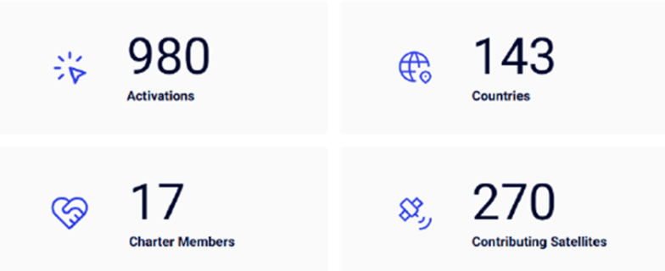
25 Years of Serving the Disaster Response Community
In November of 2025, the International Charter will mark it’s 25th year of providing satellite data and derived products at no cost to support disaster response worldwide.
To date:

Slide 3
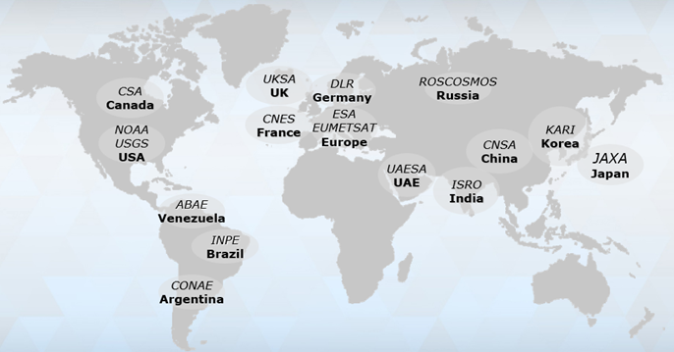
17 Charter Members
European Space Agency (ESA) (1999)
Centre national d'études spatiales (CNES) (1999)
Canadian Space Agency (CSA) (2000)
National Oceanic and Atmospheric Administration (NOAA) (2001)
Indian Space Research Organization (ISRO) (2001)
Comision Nacional de Actividades Espaciales (CONAE) (2003)
Japan Aerospace Exploration Agency (JAXA) (2005)
United States Geological Survey (USGS) (2005)
United Kingdom Space Agency (UKSA) (2005)
China National Space Administration (CNSA) (2007)
German Aerospace Center (DLR) (2010)
Korea Aerospace Research Institute (KARI) (2011)
Brazilian Instituto Nacional de Pesquisas Espaciais (INPE) (2011)
European Organisation for the Exploitation of Meteorological Satellites (EUMETSAT) (2012)
Russian Federal Space Agency (ROSCOSMOS) (2013)
Agencia Bolivariana Para Actividades Espaciales (ABAE) (2016)
United Arab Emirates Space Agency (UAESA) (2017)

Slide 4
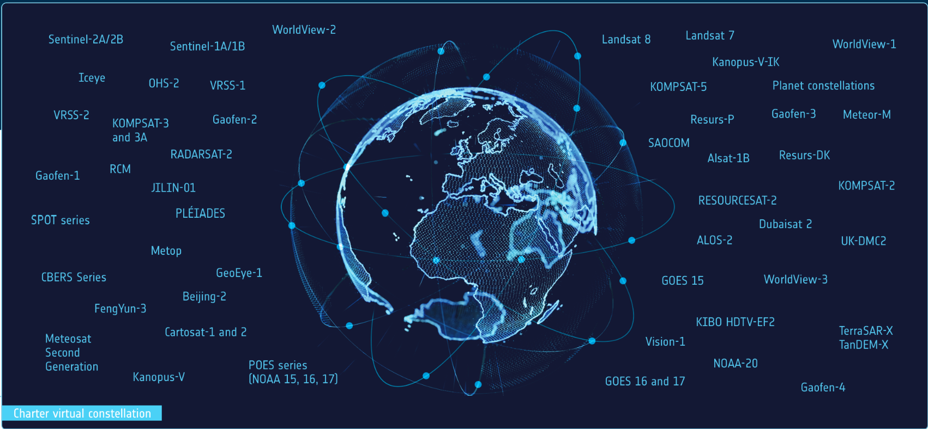
Charter virtual constellation
Landsat 9
CAS500-1/2
NewSat
Priority Data Access
Faster Response Times
Reduced Cloud Limitations
Higher Resolution & Better Coverage
Enhanced Monitoring
& Analysis
Free Data Access
Global Coordination & Collaboration
Amazonia-1
PeruSAT-1
GEOSAT-1, GEOSAT-2
BlackSky
KhalifaSat

Slide 5
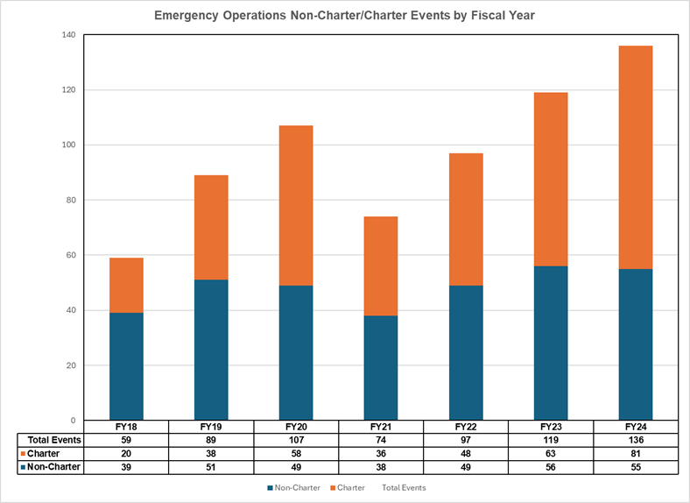
HDDS Supported Charter Events
More non-Charter than Charter events in FY 18/19
Overall trend in more combined events over the past seven years.
Increasing trend of more Charter events in recent years.

Slide 6
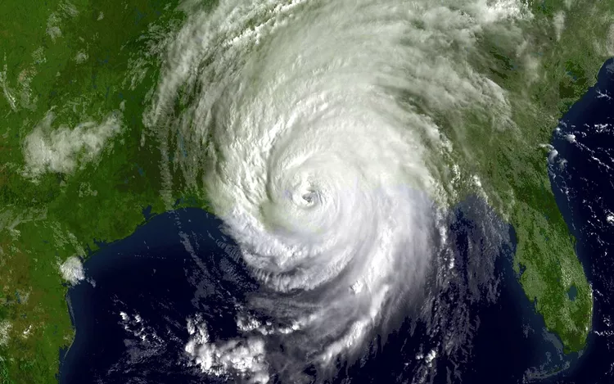
Hurricane Katrina – Charter Response
A Charter activation was initiated by USGS on August 31 and acted as the project manager.
FEMA was the primary end user.
A second activation was made by the French Civil Protection agency on September 2 and was initially to focus on Lafayette, Baton Rouge, Mobile, and Jackson. Later included New Orleans. CNES project management.
The Charter decided not to merge the calls.
August 29, 2005 – shortly after landfall in Louisiana
NOAA-NASA GOES
USGS relied on end users to generate products – CNES involved SERTIT as VA.

Slide 7
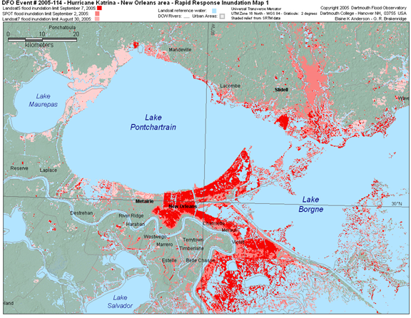
USGS Activation -103 Gulf Coast
Those receiving data included FEMA, NASA NOAA, USGS, USDA, Red Cross and many state and local agencies.
They reported using the data for the following:
  Identifying damaged housing
  Tracking water levels through time/space
  Damage assessment planning
  Determining helicopter landing zones
  Assessing coastal highway access
  Determining washout areas
  Port damage assessments
  Search and rescue mapping
Inundated Areas
Landsat 5 – Sept 7, 2005
SPOT – Sept 2, 2005
Landsat 5 – Aug 30, 2005

Slide 8
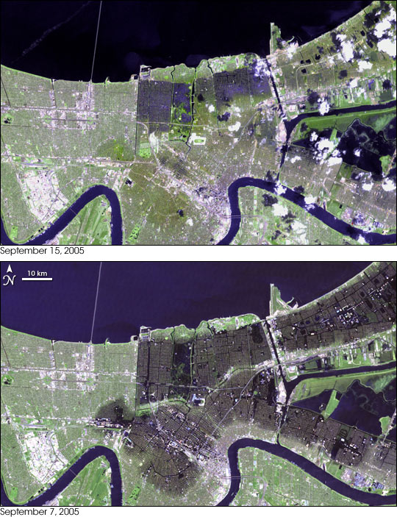
USGS Activation -103 Gulf Coast
2 weeks after Landfall
Tracking water levels during the draining of floodwaters.
1 week after Landfall
Green areas represent suitable helicopter landing zones with a slope of less than 15%

Slide 9
CNES Activation -104 Gulf Coast
The activation by the French Civil Protection agency was primarily intended to provide reference, crisis, and change maps of the affected areas.
Complimentary to the USGS call, initially concentrated on areas outside of New Orleans.
Products provided to the AU, the USGS call, and other international assistance teams.
  “The Charter maps were very useful and used by both the German teams deployed on the affected areas and by authorities to organize such deployments.” - German Civil Security Forces
Sept 2 Activation
Sept 4 2nd map batch
Sept 7
4th map batch
Twenty-Five Map Products Produced
Sept 3
1st map batch
Sept 5
3rd map batch

Slide 10
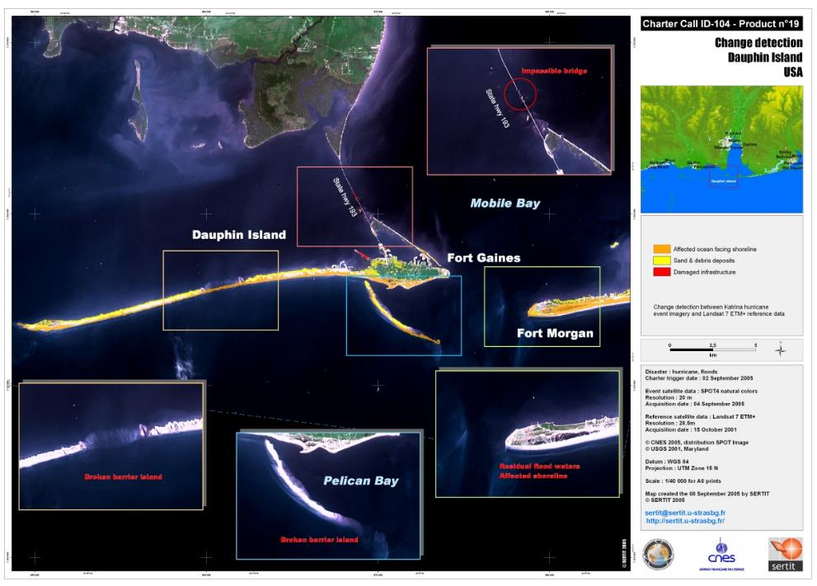
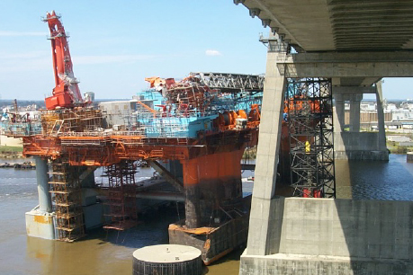
CNES Activation -104 Gulf Coast
A primary lesson learned from the Katrina/Rita activations was the need for improved data management/delivery. HDDS and the Charter operational system vastly improved as a result.
The Cochrane-Africatown Bridge on U.S. Highway 90, in Mobile, was closed for damage assessment after a 13,000-ton drilling platform drifted into the structure and wedged under the west end of the bridge.
Change detection mapping Dauphin Island – coastal Alabama

Slide 11

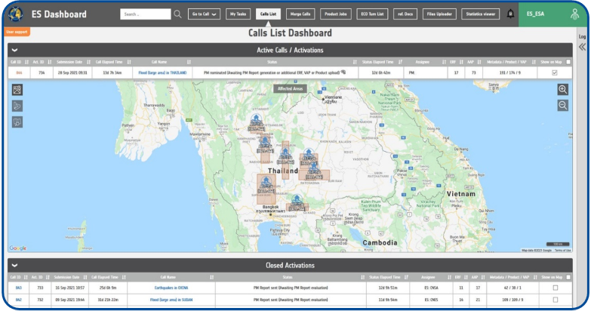
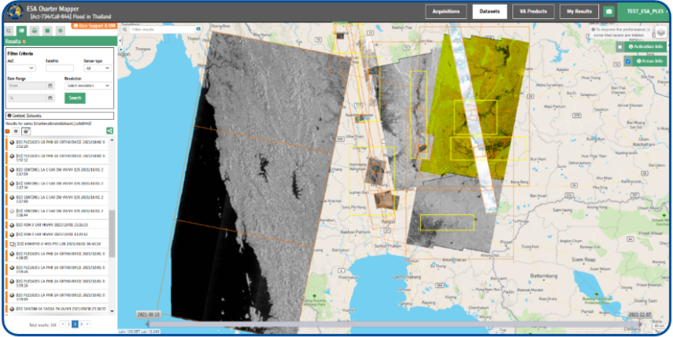
The ESA Charter Mapper
Advanced IT to support operations:
The Charter Operational System (COS-2), a system to manage the complete operational process of an activation
Workflow & information management in operations
Implemented and maintained by ESA since 2010
Supports ordering and delivery of EO data
Provides dashboards to monitor activations
COS-2 now augmented with the ESA Charter Mapper, a Cloud Processing Environment to better support Project Managers and Value Adding providers with on-line services:
Access & visualization of EO data
Image enhancement & analysis
GIS functionalities
Value Adding processing to derive geo-information

Slide 12

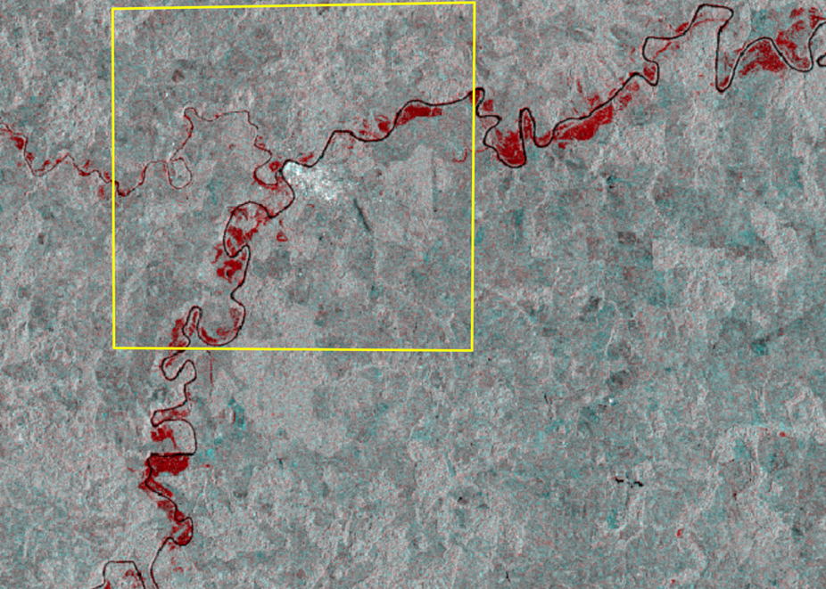
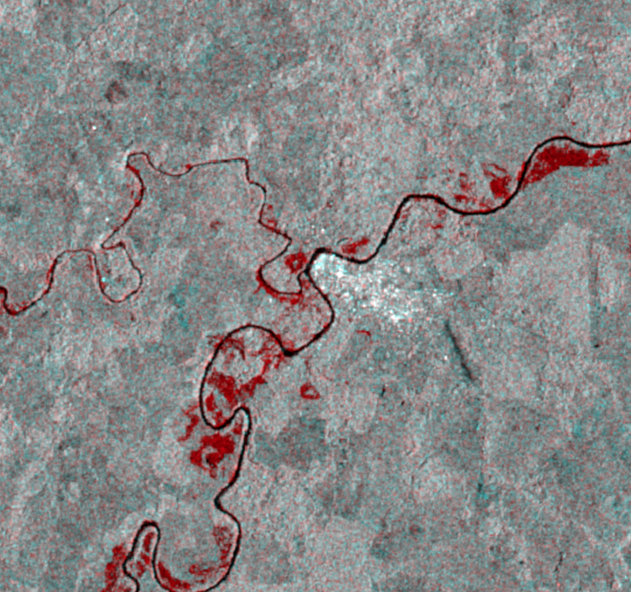
Activation 865: Flood in Brazil
The SAR Amplitude Change service provides a red-cyan composite based on backscatter values, with red indicating flooded area.
Flooding can be seen along the Acre river, North, South, and West of the village of Xapuri.
Left: Yellow polygon indicates Charter AOI around the village of Xapuri
Right: Focus area
Xapuri

Slide 13

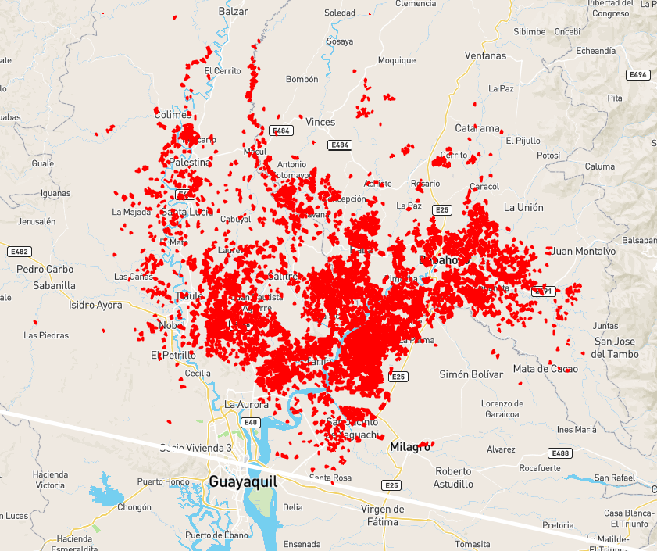
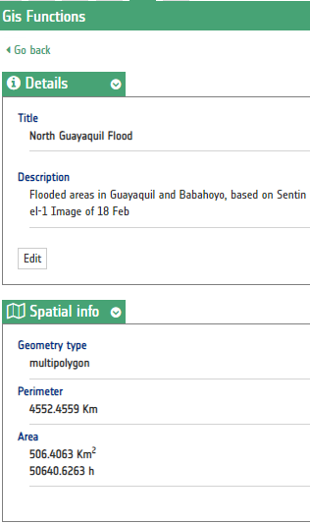
Activation 862: Flood in Ecuador
Vectors of the flooded area NE of Guayaquil with spatial summary provided by the mapper tool.
500 sq km estimated flooded area
Full process executed on-line.

Slide 14
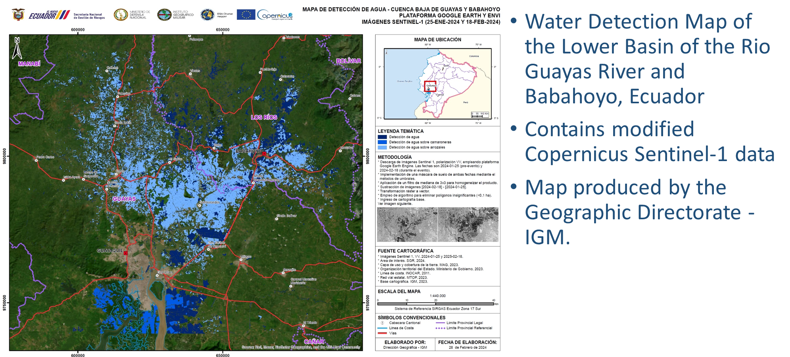
Charter Mapper Value-Added Product

Slide 15
Conclusions
The International Charter celebrates serving the disaster response community for 25-years.
Events such as Hurricane’s Katrina and Rita have shaped the way the Charter evolves to not only meet data needs but improve data delivery, access, and analysis requirements.
The Charter will continue to adapt to user needs and continuously strives to streamline data and product delivery mechanisms.

Slide 16

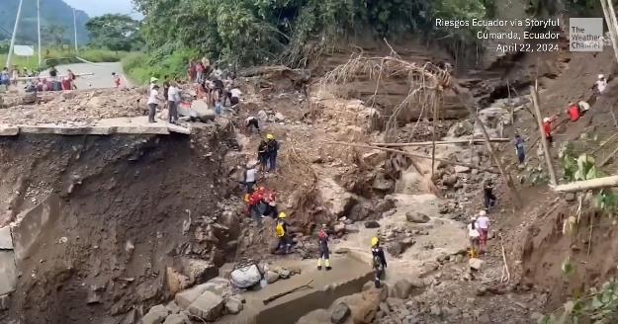
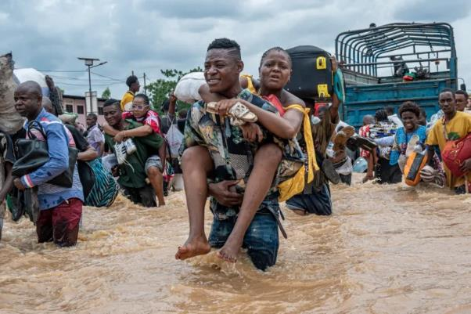
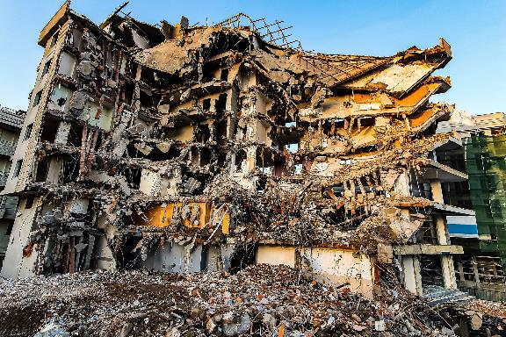
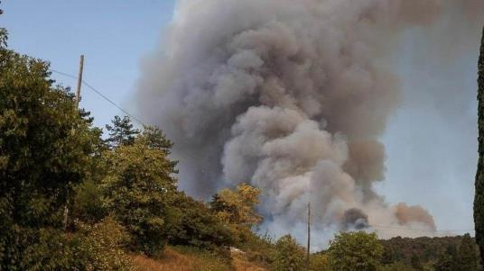
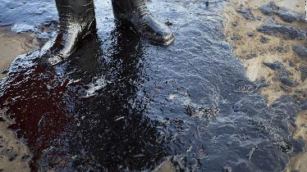
Thank You!
Recent Charter Activations
Landslide - Ecuador
[Hardy Bope/AFP]
Flooding – Dem Rep Congo
Wildfire - Kazakhstan
Earthquake - Myanmar
Oil Spill - Peru

