Slide 1
USGS EROS Emergency Operations Overview
Brent Johnson
KBR, contractor to the U.S. Geological Survey (USGS)
Earth Resources Observation and Science (EROS) Center, Sioux Falls, SD 57198, USA.
Work performed under USGS Contract 140G0121D0001
June 2025

Slide 2
Hazards Data Distribution System (HDDS)
History of HDDS
The Hazards Data Distribution System was developed while supporting Hurricane Katrina in 2005
Utilized directory-based searching with FTP delivery
Migrated to a web-based HTTP structure in 2006
Utilized previous directory-based searching
Redesign as a graphical interface in 2010
Allowed users to input search criteria and obtain results interactively
In 2012, additional capabilities were added to support data export and registration
Migrated to the USGS “EarthExplorer” framework in April 2014
Shared code, architecture, and user interaction
Provides enhanced capabilities and functionality

Slide 3
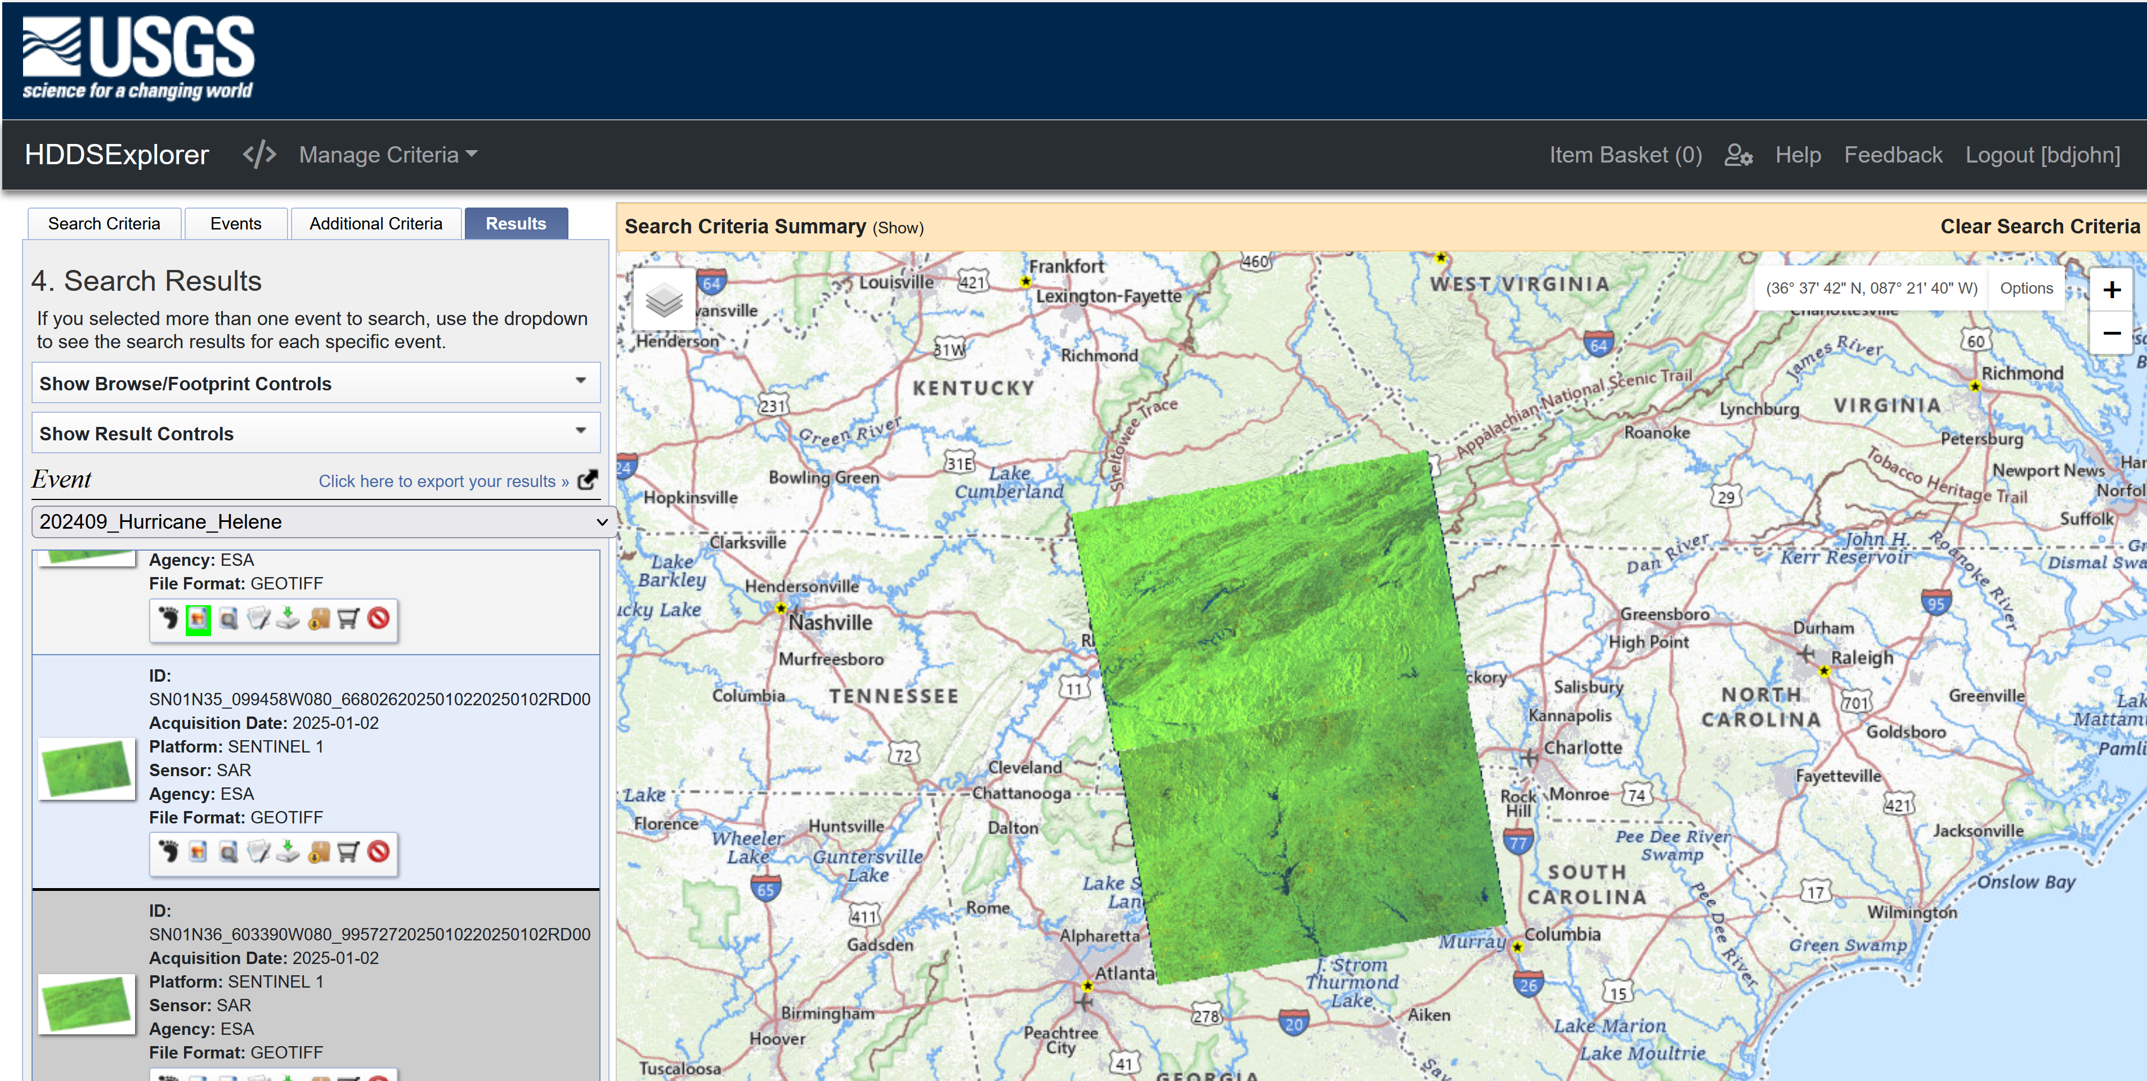
USGS HDDS Explorer
http://hddsexplorer.usgs.gov
Interactive map-based interface
EarthExplorer “look & feel”
Search by event, location, date
Includes multi-event searches
On-demand WMS delivery
Save previous searches and criteria
Standing request notification service
Bulk delivery capability via downloadable web-based client
Metadata export in multiple formats (e.g. CSV, KML, SHP, etc.)
Directory-based access for all non-ingested (“ad hoc”) datasets
Graphical data viewing with browse and footprint area overlay

Slide 4
Emergency Operations Ingest System (EIS)
EIS ingest provides:
Standardized product packaging and format (GeoTIFF)
Map-based, interactive searching and browse/footprint viewing capability on graphical HDDSExplorer requires ingested data
Metadata query and filtering capability
Georeferenced metadata and browse files to support user search and communications functionality (e.g. shapefiles, KML)
After ingest, all original (vendor-supplied ) files are stored and available via ad-hoc distribution area
Designated within HDDS ad-hoc directories as “NATIVE”
All original (vendor-supplied ) files that cannot be ingested are also stored and available via ad-hoc distribution area
Designated within HDDS ad-hoc directories as “NON_INGESTED”

Slide 5
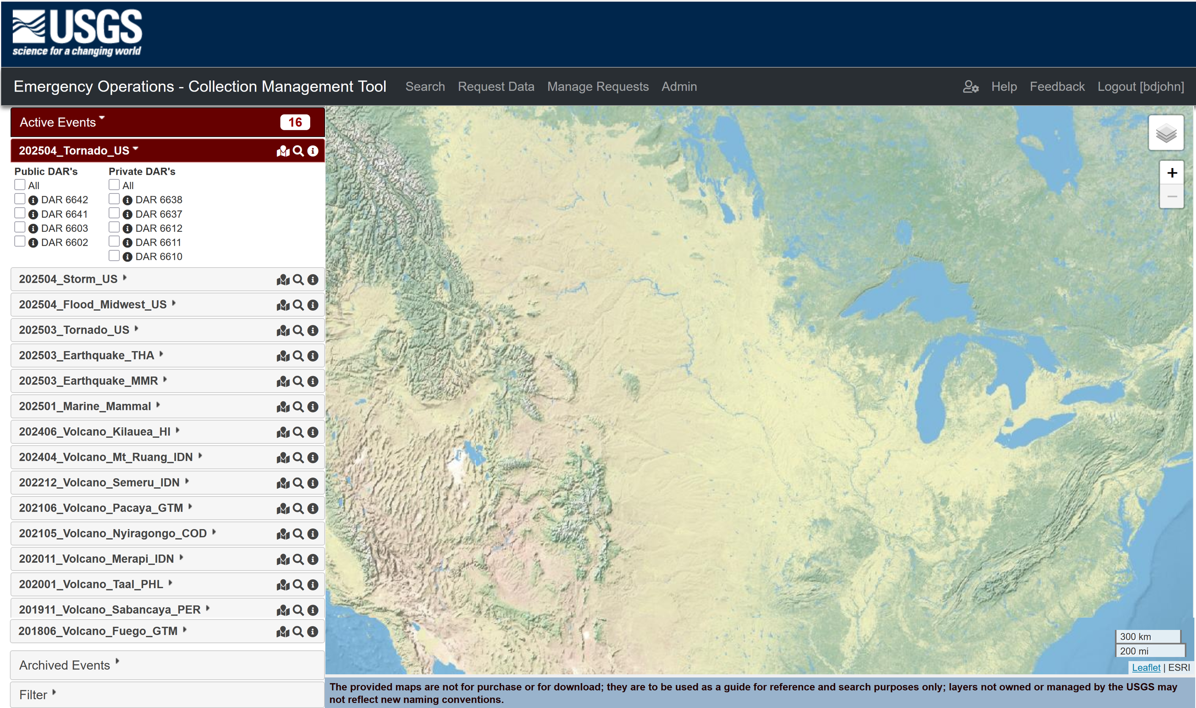
Collection Management Tool (CMT)
Released in February 2015
Allows users to submit and monitor Data Acquisition Requests (DARs)
Also allows users to view public image requests and areas-of-interest (AOIs) that have been submitted by other users
Includes direct linkage to HDDS, allowing users to view available imagery for active EO events.
Provides automated email notification as imagery is collected in support of a request.
Includes DAR workflow management and communications functionality (approval, vendor submission, closure/cancellation, etc.)
https://cmt.usgs.gov

Slide 6
Collection Management Tool (CMT)
Interactive map-based interface
Shared login credentials (user/password) with EE/HDDS/CIDR
Enter, review and copy a Data Acquisition Request (DAR) based on emergency events.
AOI can be entered as text coordinates, interactive map, or KML/SHP
View other submitted DARs (public only)
View CMT coverage status
Request a new emergency event for HDDS (‘unsupported event’)
Close an image request and provide collection feedback

Slide 7
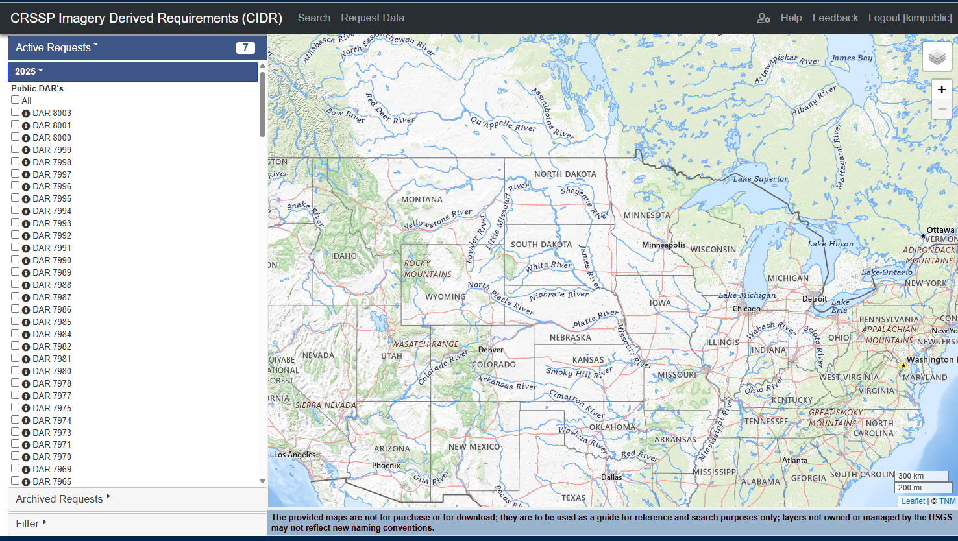
CRSSP Imagery Derived Requirements (CIDR)
CRSSP Imagery-Derived Requirements (CIDR) Tool is designed to assist U.S. Federal Civil agencies to enter near-term land remote sensing data requirements. CIDR provides an interface to place Data Acquisition Requests (DARS).
Functionality and features are similar to the CMT interface.
Enter, review and copy a Data Acquisition Request (DAR)

Slide 8
CRSSP Imagery Derived Requirements (CIDR)
Interactive map-based interface
EarthExplorer “look and feel”
Shared login credentials (user/password)
with EE/HDDS/CMT
Manage user profile and settings
Enter, review and copy a Data Acquisition
Request (DAR)
AOI can be entered as text coordinates,
interactive map, or KML/SHP
View other submitted DARs (public only)
View CIDR coverage status
Change/view map layers (login required)
Close an image request and provide collection feedback

Slide 9
Active URLS
EROS Registration System (ERS)
https://ers.cr.usgs.gov/
Hazard Data Distribution System (HDDS)
https://hddsexplorer.usgs.gov/
Collection Management Tool (CMT)
https://cmt.usgs.gov/
CRSSP Imagery Derived Requirements (CIDR)
https://cidr.cr.usgs.gov/
Earth Explorer (EE)
https://earthexplorer.usgs.gov/

Slide 10
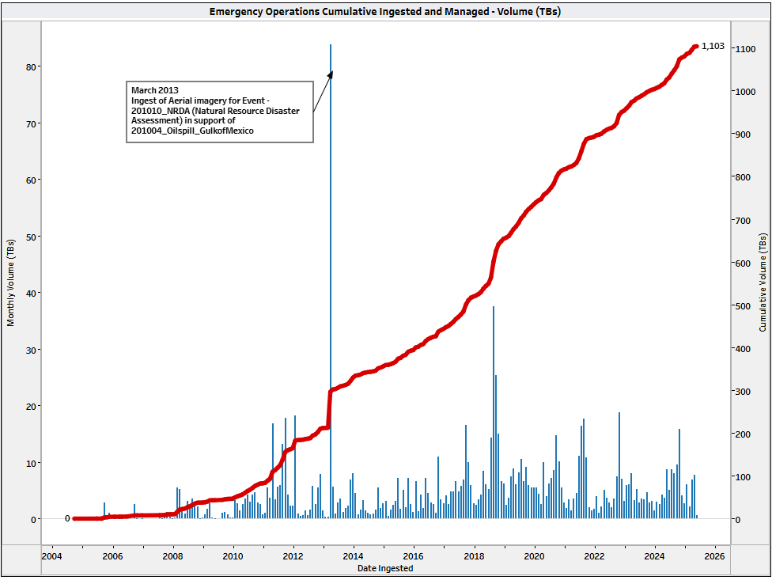
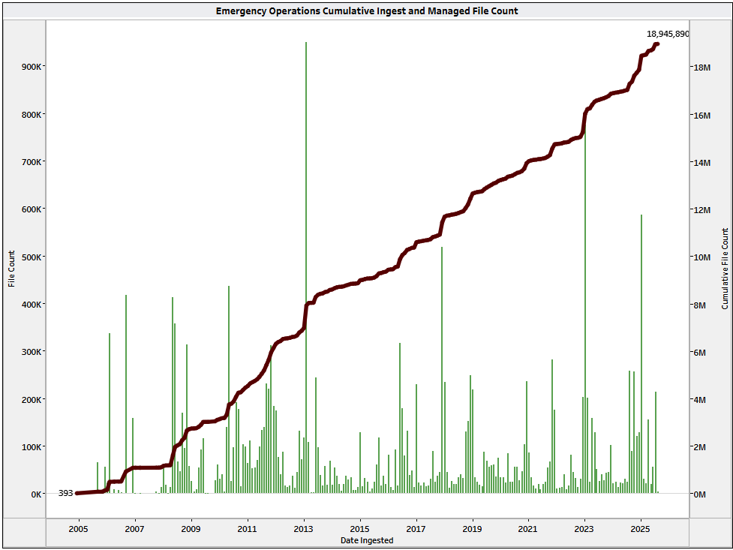
Emergency Operations Ingest Metrics
Total Ingests – 1,102.998 Terabytes File Count Ingests -- 18,943,533

Slide 11
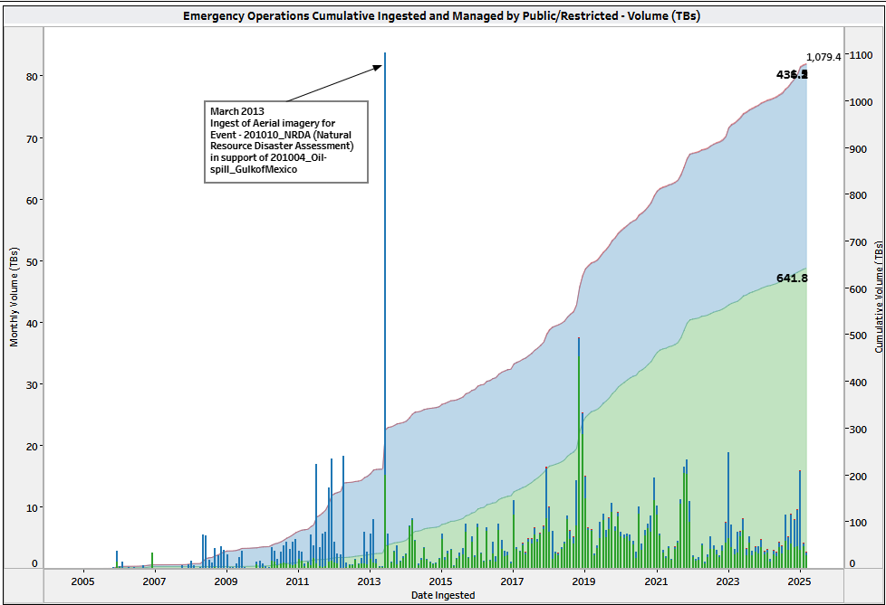
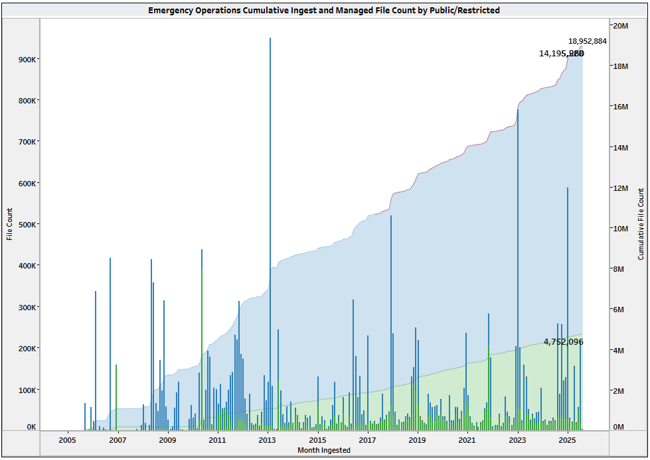
Emergency Operations Ingest Metrics
Total Ingests -- Public = 436.166 Terabytes Public File Count = 14,195,995 Restricted = 641.763 Terabytes Restricted File Count = 4,752,272

Slide 12
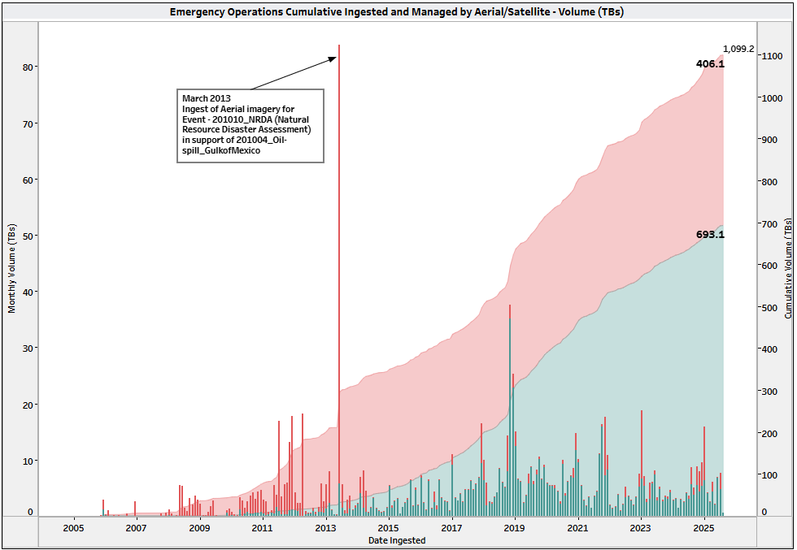
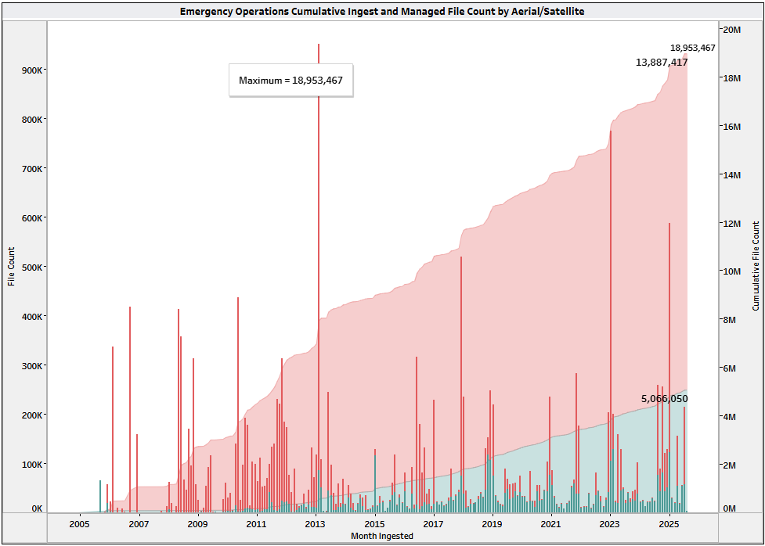
Emergency Operations Ingest Metrics
Total Ingests -- Aerial = 406.101 Terabytes Aerial File Count = 13,887,417 Satellite = 693.132 Terabytes Satellite File Count = 5,066,693

Slide 13
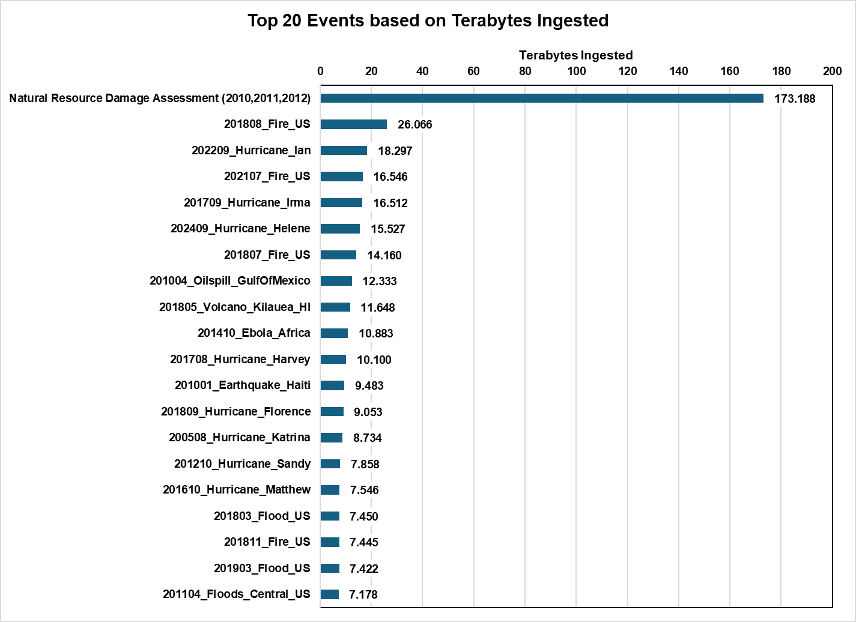
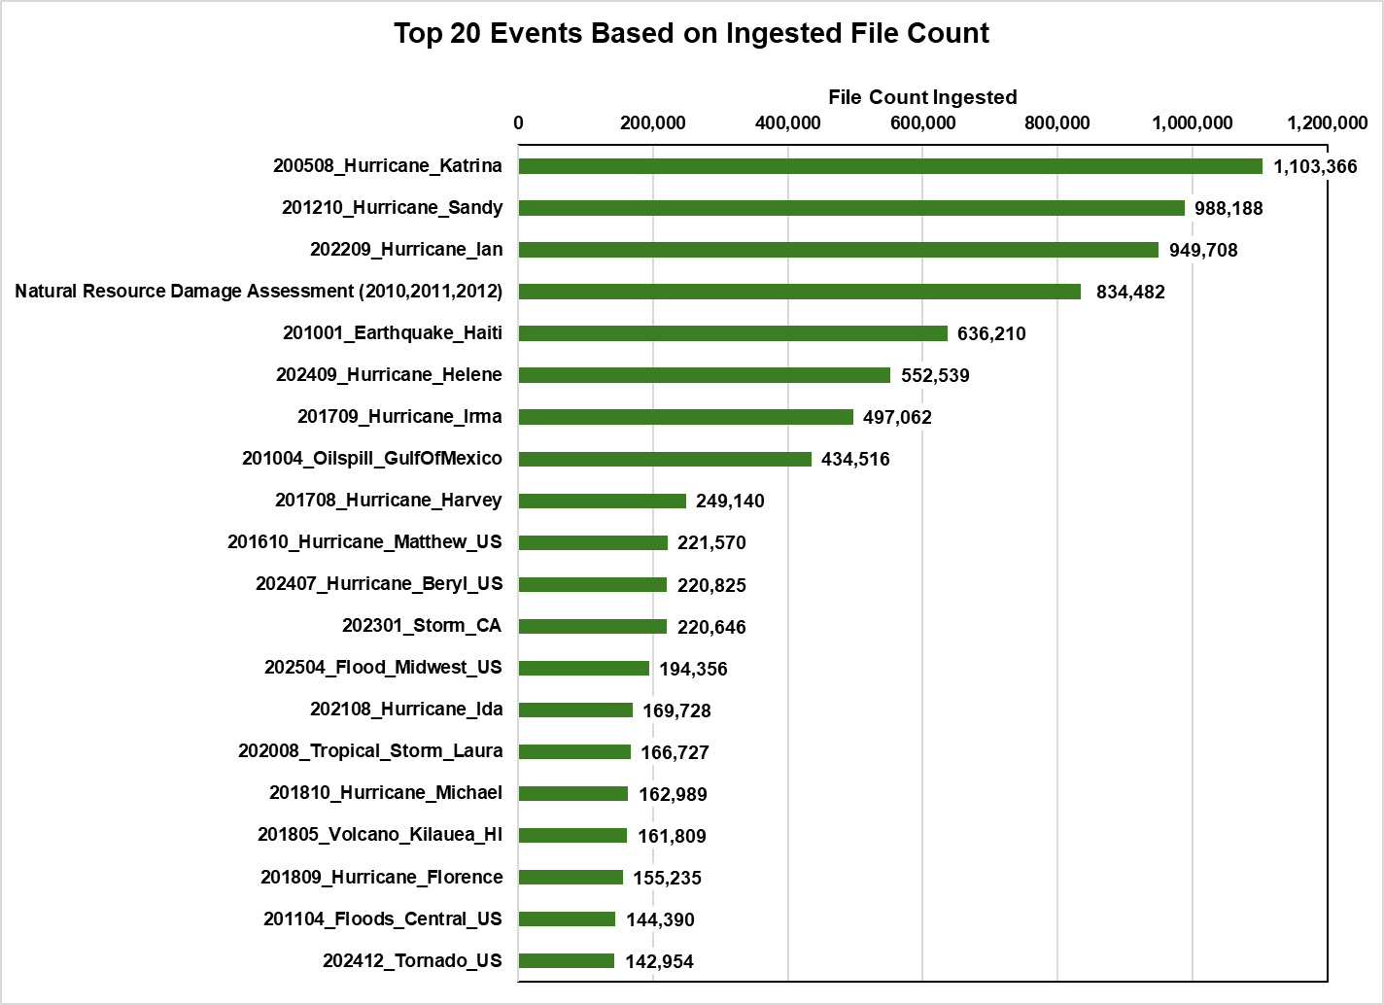
Emergency Operations Ingest Metrics

