Slide 1
Universal Access Update
October 2022
USGS

Slide 2
New applications
Incomplete request from Iran (Tarheabriz Company) – Zivar Nazari
Rejected since they are a private company and not a national agency. USGS provided a formal response.

Slide 3
Ongoing applications
Jamaica, ISRO (cover letter provided – under evaluation) – Sep 2022
Solomon Islands, JAXA (exercise postponed, still pending) – Oct 2022

Slide 4
Completed Applications
Honduras, DLR
Francisco Pinto, Permanent Contingency Commission (COPECO) –Sep 8, 2022
Kenya, CONAE
Samuel Nyansiri, National Disaster Operations Centre (NDOC) – Sep 27, 2022
Panama, CNSA
Luis Villamonte, Nacional Civil Protection System (SINAPROC) – Sep 27, 2022

Slide 5
Activations triggered by UA AUs
Call/Act - Country Name
870/757 – South Africa, Flood/Landslide
871/758 – Brazil, Landslide
880/766 – Tunisia, Wildfire
883/769 – Sudan, Flood
894/776 – South Africa, Flood/Dam Failure
895/777 – Nigeria, Flood
896/778 – Honduras, Flood/Landslide
906/786 – Honduras, Flood (Hurricane Julia)

Slide 6
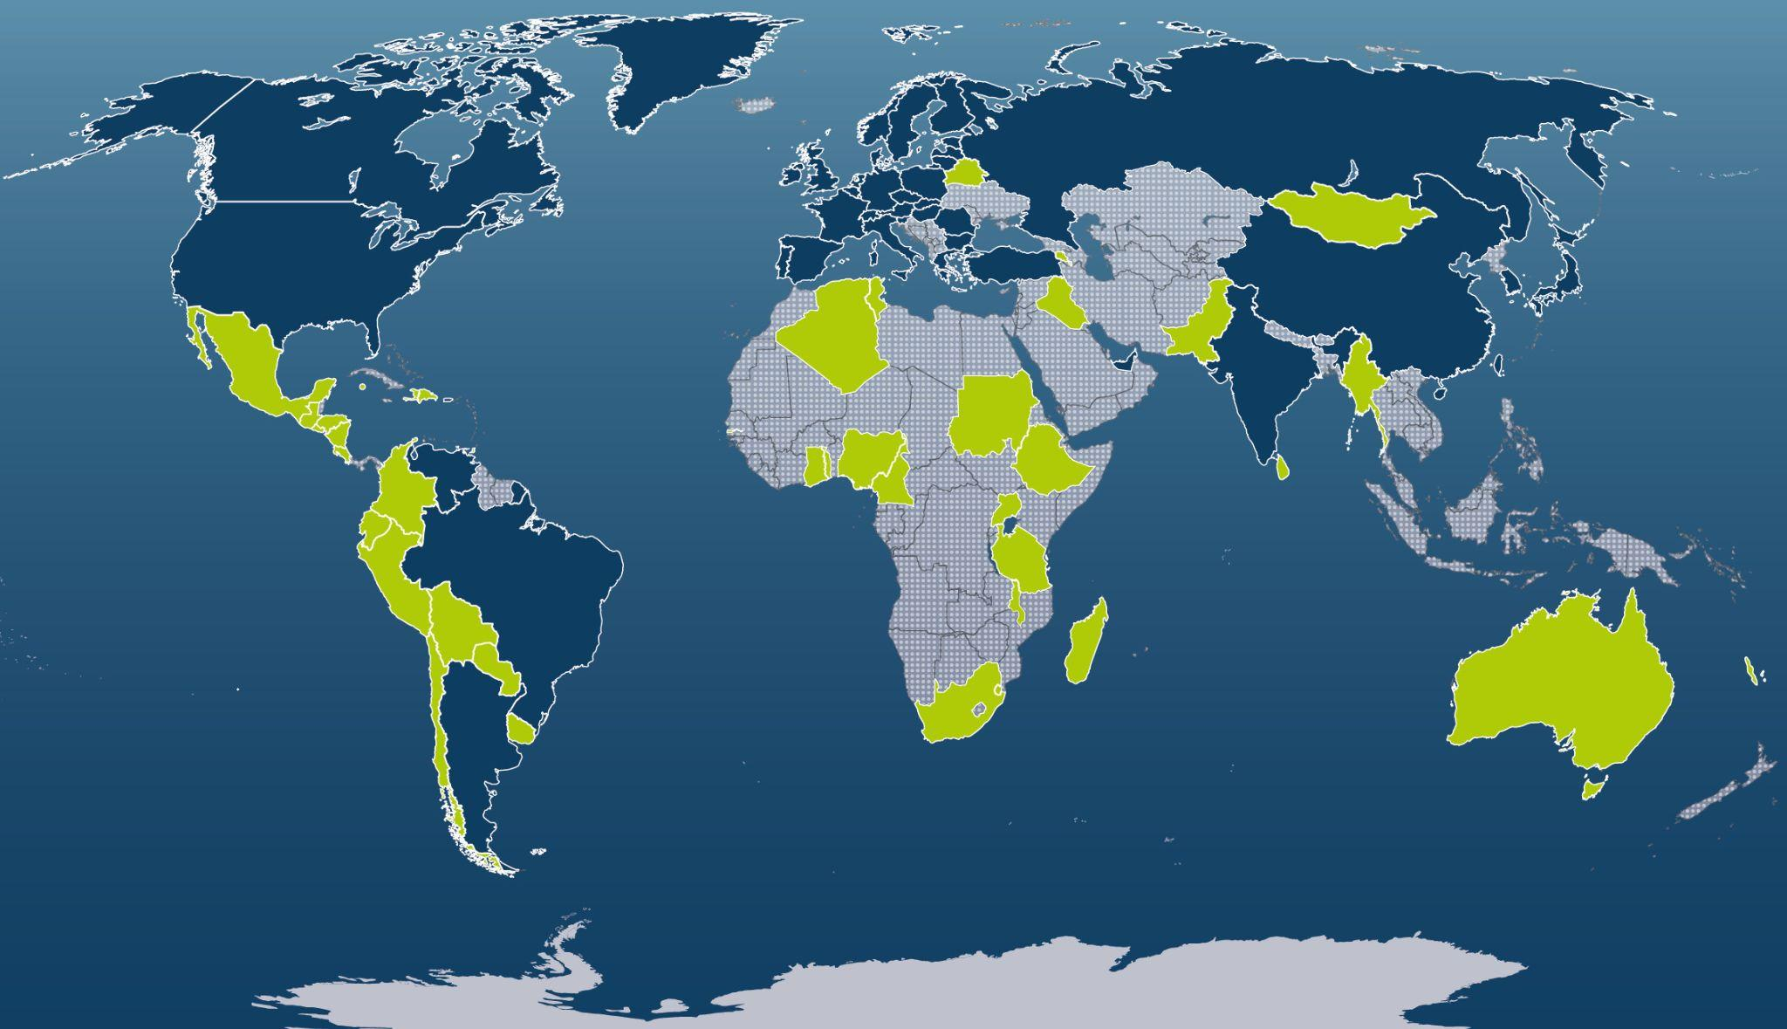
UPDATE

Slide 7
Universal Access Update
October 2022
Thank you!
USGS

