Slide 1

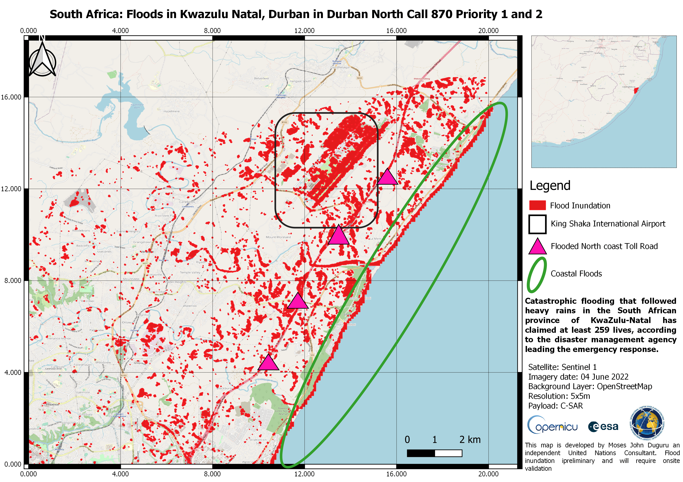
ACTIVATION 757 (Call 870)
24 May 2022
Flood, Landslide in SOUTH AFRICA
Status: Archived
AU: National Disaster Management Centre
ES: USGS
PM: SANSA
VA: Federal University of Santa Maria, Geoniformation systems, NASRDA, NDMC, SANSA, UNITAR, UNSPIDER
AAP: CNSA, CONAE, CSA, DLR, DMCII, ESA, ICEYE, INPE, KARI, MBRSC, ROSCOSMOS, Satellogic, USGS
VAP uploaded: 10
ECO ERFs: CNES, CNSA, CONAE, CSA, DLR, DMCII, ESA, ICEYE, INPE, ISRO, JAXA, KARI, MBRSC, PLANET, ROSCOSMOS, Satellogic, USGS
Data post event: 4 GF2, 6 GF3, 1 ICEYE, 6 KANOPUS_V, 2 KANOPUS_V_IK, 4 KOMPSAT3, 7[1] KOMPSAT3A, 6 KOMPSAT5, 1 KhalifaSat, 4 LANDSAT8, 4 LANDSAT9, 8 NewSat, 5 OHS-2, 9[2] PLEIADES, 10 RCM, 2 SAOCOM-1, 3[2] SENTINEL_1, 4 SENTINEL_2, 2 TERRASAR_X, 100[1] US-VHR, 6 VISION-1
Data pre event: 1 KANOPUS_V_IK, 2 LANDSAT8, 1 METEOSAT, 2 OHS-2, 2 PLEIADES, 2 SAOCOM-1, 1 SENTINEL_1, 2 SENTINEL_2, 1 TERRASAR_X, 19 US-VHR, 6 VISION-1
Legend: [# Products Used]

Slide 2
ACTIVATION 758 (Call 871)
30 May 2022
Landslide in BRAZIL
Status: Archived
AU: CENAD
EU: CENAD
ES: INPE
PM: CENAD
VA: CEMADEN, CENAD, INPE
AAP: CNSA, CONAE, CSA, DLR, ICEYE, INPE, KARI, MBRSC, ROSCOSMOS, Satellogic, USGS
VAP uploaded: 51
ECO ERFs: CNES, CNSA, CONAE, CSA, DLR, DMCII, ICEYE, INPE, ISRO, JAXA, KARI, MBRSC, PLANET, ROSCOSMOS, USGS
Data post event: 1 GF2, 4 GF3, 1 ICEYE, 4 KANOPUS_V, 1 KANOPUS_V_IK, 4 KOMPSAT3A, 6 NewSat, 10[3] PLEIADES, 2 RCM, 2 SAOCOM-1, 2 SENTINEL_2, 1 TERRASAR_X, 10 US-VHR
Data pre event: 1 AMAZONIA1, 1 CBERS4A, 2 LANDSAT8, 3 LANDSAT9, 1 SAOCOM-1, 2 SENTINEL_2, 26 US-VHR
Legend: [# Products Used]

Slide 3
ACTIVATION 759 (Call 872)
04 June 2022
Oil spill in GAMBIA
Status: Archived
AU: UNITAR
EU: United Nations OCHA ROWCA
ES: USGS
PM: UNOSAT
VA: NDMA
AAP: CNSA, CONAE, CSA, DLR, ESA, ICEYE, JAXA, KARI, MBRSC, Satellogic, USGS
VAP uploaded: 2
ECO ERFs: CNSA, CONAE, CSA, DLR, ESA, ICEYE, JAXA, KARI
PM ERFs: CNES, USGS
Data post event: 2[2] ALOS2, 3 GF3, 1 ICEYE, 5[5] KOMPSAT5, 3 LANDSAT8, 4 LANDSAT9, 1 NewSat, 23[16] PLEIADES, 4 RCM, 3[3] SAOCOM-1, 7[7] SENTINEL_1, 3[3] SENTINEL_2, 1[1] TERRASAR_X, 12[12] US-VHR
Data pre event: 3[3] KOMPSAT5, 1 LANDSAT8, 3 LANDSAT9, 2[2] SENTINEL_2
Legend: [# Products Used]

Slide 4
ACTIVATION 760 (Call 873)
06 June 2022
Wildfire in AFGHANISTAN
Status: Archived
AU: UNITAR
EU: The United Nations Disaster Assessment and Coordination (UNDAC)
ES: JAXA
PM: UNITAR
AAP: ABAE, CNSA, CONAE, ESA, KARI, MBRSC, ROSCOSMOS, USGS
VAP uploaded: 2
ECO ERFs: ABAE, CNES, CNSA, CONAE, DMCII, ESA, INPE, KARI, PLANET, ROSCOSMOS, USGS
Data post event: 1[1] GF2, 3 KANOPUS_V, 1 KANOPUS_V_IK, 8[8] KOMPSAT3, 3[3] LANDSAT8, 3 LANDSAT9, 4 SAOCOM-1, 13 SENTINEL_1, 5[3] SENTINEL_2, 4[4] SPOT, 28[28] US-VHR
Data pre event: 1 KANOPUS_V, 4 KOMPSAT3, 5 KOMPSAT3A, 1 SAOCOM-1, 2 SENTINEL_2
Legend: [# Products Used]

Slide 5
ACTIVATION 761 (Call 874)
13 June 2022
Volcanic eruptions in PHILIPPINES
Status: On-going
AU: ADRC
EU: PHIVOLCS
ES: JAXA
PM: Philippine Institute of Volcanology and Seismology (PHIVOLCS)
AAP: ABAE, CNSA, CONAE, CSA, DLR, DMCII, ESA, JAXA, KARI, MBRSC, Satellogic
VAP uploaded: 4
ECO ERFs: ABAE, CNES, CNSA, CONAE, CSA, DLR, DMCII, ESA, ICEYE, JAXA, KARI, PLANET
Data post event: 1 ALOS2, 3 GF3, 3 KOMPSAT3, 3 KOMPSAT3A, 9 KOMPSAT5, 5 LANDSAT8, 5 LANDSAT9, 1 NewSat, 6 RCM, 3 SAOCOM-1, 5 SENTINEL_1, 8[1] SENTINEL_2, 10[1] SPOT, 3 TERRASAR_X, 13 US-VHR, 3 VISION-1, 4 VRSS2
Data pre event: 1 ALOS2, 1 LANDSAT8, 2 SAOCOM-1, 2 SENTINEL_2, 2 TERRASAR_X, 4 US-VHR, 4 VRSS2
Legend: [# Products Used]

Slide 6
ACTIVATION 762 (Call 875)
17 June 2022
Flood in BANGLADESH
Status: Archived
AU: UNITAR
EU: United Nations Office for the Coordination of Humanitarian Affairs (OCHA) | Regional Office for Asia and the Pacific
ES: USGS
PM: UNITAR
AAP: CNSA, CONAE, CSA, DLR, ESA, INPE, KARI, MBRSC, ROSCOSMOS, USGS
VAP uploaded: 8
ECO ERFs: CNES, CNSA, CONAE, CSA, DLR, DMCII, ESA, ICEYE, INPE, ISRO, JAXA, KARI, PLANET, ROSCOSMOS, USGS
PM ERFs: CNES, CNSA, CONAE, CSA, DLR, DMCII, ESA, ICEYE, INPE, ISRO, JAXA, KARI, PLANET, ROSCOSMOS, Satellogic, USGS
Data post event: 8 CBERS4, 14 KOMPSAT3, 2 KOMPSAT5, 1 LANDSAT8, 2 LANDSAT9, 6 OHS-2, 46[1] PLEIADES, 8[7] RCM, 1[1] SAOCOM-1, 8[3] SENTINEL_1, 8[2] SENTINEL_2, 2[1] TERRASAR_X, 10 US-VHR
Data pre event: 1 KANOPUS_V, 1 KOMPSAT3, 17 KOMPSAT3A, 2 LANDSAT9, 3 SAOCOM-1, 7[3] SENTINEL_1, 7[3] SENTINEL_2, 36 US-VHR
Legend: [# Products Used]

Slide 7
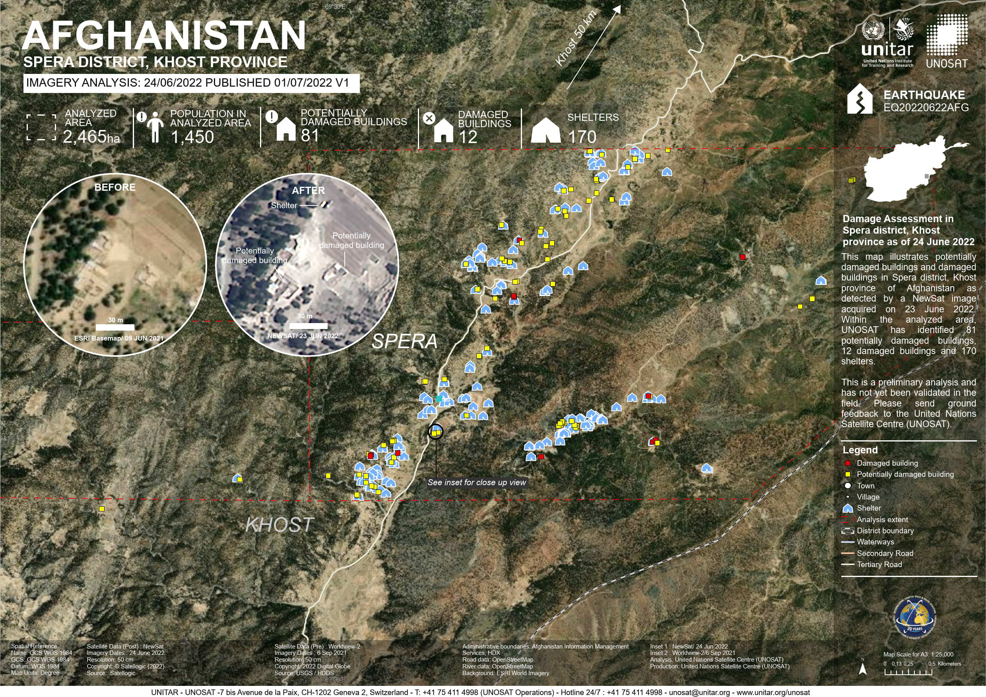
ACTIVATION 763 (Call 876)
22 June 2022
Earthquakes in AFGHANISTAN
Status: Archived
AU: UNITAR
EU: United Nations Office for the Coordination of Humanitarian Affairs (OCHA) | Regional Office for Asia and the Pacific
ES: USGS
PM: UNOSAT
VA: IMMAP
AAP: CNSA, DMCII, KARI, MBRSC, ROSCOSMOS, Satellogic, USGS
VAP uploaded: 6
ECO ERFs: CNES, CNSA, DMCII, ESA, ICEYE, KARI, MBRSC, ROSCOSMOS, USGS
Data post event: 1 GF1, 2 KANOPUS_V, 10 KOMPSAT3, 1 KhalifaSat, 1 LANDSAT8, 2 LANDSAT9, 4[1] NewSat, 8 OHS-2, 4 OVS-2, 5 PLEIADES, 7 SENTINEL_1, 51[3] US-VHR, 3 VISION-1
Data pre event: 4 KANOPUS_V, 1 LANDSAT8, 1 LANDSAT9, 7 OVS-2, 5 PLEIADES, 9 SENTINEL_1, 70[3] US-VHR
Legend: [# Products Used]

Slide 8
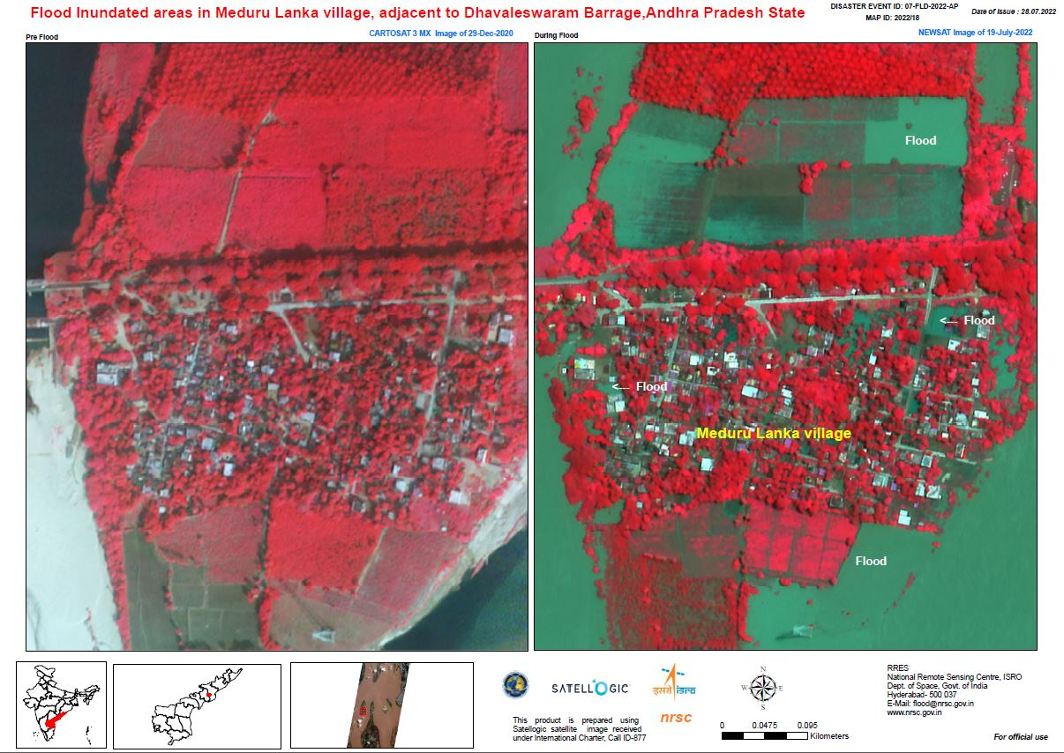
ACTIVATION 764 (Call 877)
14 July 2022
Flood in INDIA
Status: Archived
AU: ISRO
ES: ISRO
PM: NRSC
Several Satellogic NEWSAT images were used in generating value added products – 27 in total
AAP: CNSA, CONAE, CSA, DLR, DMCII, ESA, ICEYE, KARI, MBRSC, ROSCOSMOS, Satellogic, USGS
VAP uploaded: 27
ECO ERFs: CNES, CNSA, CONAE, CSA, DLR, DMCII, ESA, ICEYE, INPE, JAXA, KARI, PLANET, ROSCOSMOS, Satellogic, USGS
Data post event: 5 GF3, 2 ICEYE, 4 KANOPUS_V, 7 KOMPSAT3, 14 KOMPSAT3A, 27[7] KOMPSAT5, 7 LANDSAT8, 10 LANDSAT9, 1[1] NewSat, 15 OHS-2, 36[1] PLEIADES, 11 RCM, 15 SENTINEL_1, 21[1] SENTINEL_2, 4 TERRASAR_X, 21[1] US-VHR, 5 VISION-1
Data pre event: 3 KOMPSAT3, 7 KOMPSAT3A, 1 LANDSAT9, 1 METEOSAT, 9 SENTINEL_1, 7 SENTINEL_2, 2 TERRASAR_X, 165 US-VHR
Legend: [# Products Used]

Slide 9
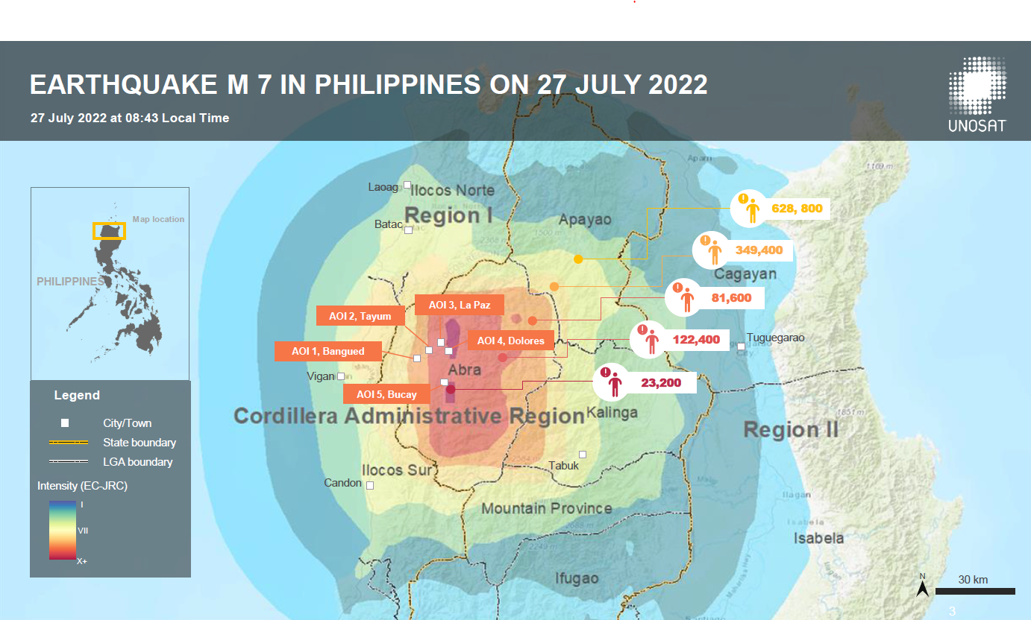
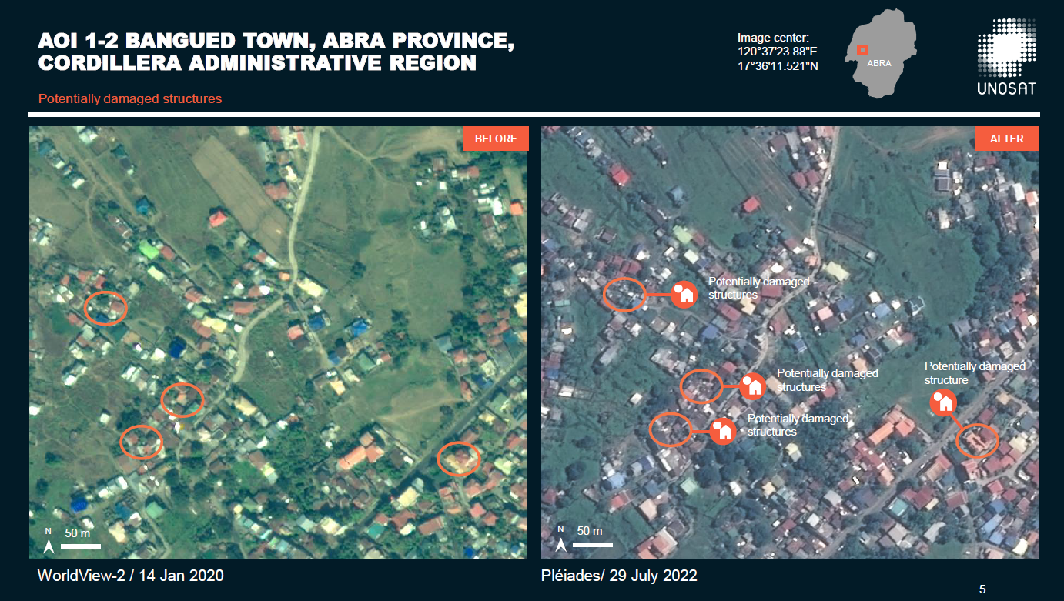
ACTIVATION 765 (Call 878)
27 July 2022
Earthquakes in PHILIPPINES,
Status: Closed
AU: ADRC
EU: PHIVOLCS
ES: JAXA
PM: Philippine Institute of Volcanology and Seismology (PHIVOLCS)
VA: Copernicus EMS, DOST-ASTI, Philippines Space Agency, UNOSAT
AAP: CNSA, CONAE, ESA, JAXA, JAXA, KARI, MBRSC, ROSCOSMOS, USGS
VAP uploaded: 6
ECO ERFs: CNES, CNSA, CONAE, DMCII, ESA, ICEYE, ISRO, KARI, MBRSC, PLANET, ROSCOSMOS, Satellogic, USGS
Data post event: 6 ALOS2, 1 GF2, 2 GF3, 5 KANOPUS_V, 1 KANOPUS_V_IK, 11 LANDSAT8, 8 LANDSAT9, 16[2] PLEIADES, 4 SAOCOM-1, 6 SENTINEL_1, 153 US-VHR
Data pre event: 5 ALOS2, 1 KANOPUS_V, 1 KANOPUS_V_IK, 2 LANDSAT8, 2 LANDSAT9, 1 SAOCOM-1, 8 SENTINEL_1, 96 US-VHR
Legend: [# Products Used]

Slide 10
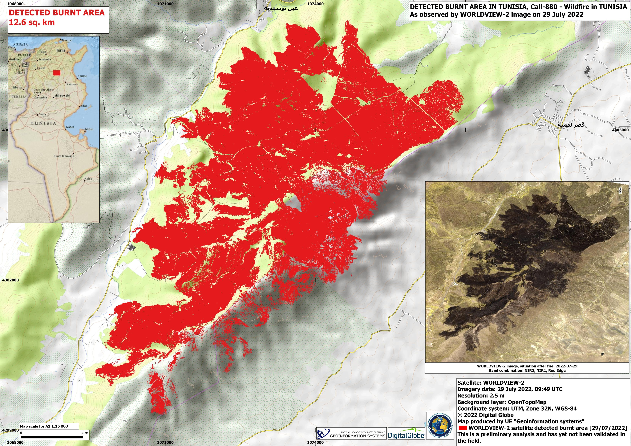
ACTIVATION 766 (Call 880)
27 July 2022
Wildfire in TUNISIA
Status: Archived
AU: Tunisian Office of Civil Protection Office National de la Protection Civile (ONPC)
ES: CNES
PM: ICube-SERTIT
VA: Geoinformation systems
AAP: ABAE, CNSA, ESA, KARI, MBRSC, NAS, Satellogic, USGS
VAP uploaded: 6
ECO ERFs: ABAE, CNES, CNSA, DMCII, ESA, ICEYE, INPE, KARI, MBRSC, NAS, PLANET, Satellogic, USGS
Data post event: 2 CBERS4, 2 GF2, 2[2] KOMPSAT3, 2 KOMPSAT3A, 2 LANDSAT8, 2[1] LANDSAT9, 1 NewSat, 3 OHS-2, 2[1] PLEIADES, 5 SENTINEL_1, 5[1] SENTINEL_2, 7[1] US-VHR
Data pre event: 1 BKA, 1 CBERS4, 1 LANDSAT8, 2 LANDSAT9, 2 OHS-2, 3 SENTINEL_1, 2 SENTINEL_2, 19 US-VHR
Legend: [# Products Used]

Slide 11
ACTIVATION 767 (Call 881)
08 August 2022
Flood in RUSSIAN FEDERATION
Status: Archived
AU: Ministry of the Russian Federation for Civil Defense, Emergencies and Elimination of Natural Disasters (EMERCOM)
ES: ROSCOSMOS
PM: ROSCOSMOS
VA: NTs OMZ, JSC 'Russian Space Systems'
AAP: CONAE, CSA, ESA, KARI, MBRSC, ROSCOSMOS, Satellogic
VAP uploaded: 2
ECO ERFs: CNES, CNSA, CONAE, CSA, DMCII, ICEYE, ISRO, KARI, ROSCOSMOS, Satellogic, USGS
PM ERFs: CNES, CNSA, CONAE, CSA, DMCII, ESA, ICEYE, ISRO, KARI, ROSCOSMOS, Satellogic, USGS
Data post event: 25[1] KANOPUS_V, 2 KANOPUS_V_IK, 7 KOMPSAT3, 1 NewSat, 11 OHS-2, 39[1] PLEIADES, 27 RCM, 11 SAOCOM-1, 20 SENTINEL_1, 46 SENTINEL_2
Data pre event: 1 KOMPSAT3, 1 KOMPSAT3A, 7 PLEIADES, 1 RCM, 3 SAOCOM-1, 25 SENTINEL_2, 17 US-VHR
Legend: [# Products Used]

Slide 12
ACTIVATION 768 (Call 882)
09 August 2022
Flood in GAMBIA
Status: Closed
AU: UNITAR
EU: United Nations Office for the Coordination of Humanitarian Affairs (UNOCHA) | Regional Office for West and Central Africa
ES: USGS
PM: UNOSAT
AAP: ABAE, CNSA, CONAE, CSA, DLR, DMCII, ESA, ICEYE, KARI, MBRSC, NAS, Satellogic, USGS
VAP uploaded: 4
ECO ERFs: ABAE, CNES, CNSA, CONAE, CSA, DMCII, ESA, ICEYE, INPE, ISRO, JAXA, KARI, MBRSC, NAS, PLANET, ROSCOSMOS, Satellogic, USGS
Data post event: 3 GF2, 2 ICEYE, 3[1] KANOPUS_V, 1 KOMPSAT5, 3 LANDSAT8, 2 LANDSAT9, 2 NewSat, 32[4] PLEIADES, 4 RCM, 1 SAOCOM-1, 2 SENTINEL_1, 4[2] SENTINEL_2, 1 TERRASAR_X, 40[2] US-VHR, 4 VRSS2
Data pre event: 2 BKA, 2 CBERS4, 1 KANOPUS_V, 2 LANDSAT8, 1 LANDSAT9, 1 NewSat, 2 SAOCOM-1, 2 SENTINEL_1, 3 SENTINEL_2, 58[1] US-VHR
Legend: [# Products Used]

Slide 13
ACTIVATION 769 (Call 883)
21 August 2022
Flood in SUDAN
Status: Archived
AU: Ministry of Agriculture and Natural Resources in Sudan
ES: USGS
PM: UNITAR/UNOSAT
VA: Geoinformation systems
AAP: ABAE, CNSA, CONAE, CSA, CSA, DLR, DMCII, ESA, INPE, KARI, MBRSC, NAS, ROSCOSMOS, Satellogic, USGS
VAP uploaded: 18
ECO ERFs: ABAE, CNES, CNSA, CONAE, CSA, DLR, DMCII, ESA, ICEYE, INPE, ISRO, JAXA, KARI, MBRSC, NAS, PLANET, ROSCOSMOS, Satellogic, USGS
PM ERFs: CNES, DLR, USGS
Data post event: 1 CBERS4, 1 GF2, 10 KANOPUS_V, 2 KANOPUS_V_IK, 2 KOMPSAT5, 7[2] LANDSAT8, 5[3] LANDSAT9, 1 NewSat, 26[2] PLEIADES, 6[1] RCM, 7 SAOCOM-1, 15 SENTINEL_1, 28[5] SENTINEL_2, 4[1] TERRASAR_X, 54[4] US-VHR, 1 VISION-1, 2[2] VRSS2
Data pre event: 3 BKA, 4 CBERS4A, 5[1] LANDSAT8, 3[2] LANDSAT9, 2 SENTINEL_1, 9 SENTINEL_2, 2[1] TERRASAR_X, 141 US-VHR, 5 VRSS1, 4 VRSS2
Legend: [# Products Used]

Slide 14
ACTIVATION 770 (Call 888)
23 August 2022
Wildfire in RUSSIAN FEDERATION
Status: Archived
AU: Ministry of the Russian Federation for Civil Defense, Emergencies and Elimination of Natural Disasters (EMERCOM)
ES: ROSCOSMOS
PM: ROSCOSMOS
VA: NTs OMZ, NTs OMZ, JSC 'Russian Space Systems'
AAP: ABAE, CNSA, ESA, KARI, MBRSC, ROSCOSMOS, USGS
VAP uploaded: 1
ECO ERFs: ABAE, CNES, CNSA, DMCII, ESA, INPE, KARI, PLANET, ROSCOSMOS, Satellogic, USGS
Data post event: 3 KANOPUS_V, 3 LANDSAT8, 3 LANDSAT9, 17 PLEIADES, 6 SENTINEL_1, 4 SENTINEL_2, 13[5] US-VHR
Data pre event: 1 CBERS4, 2 SENTINEL_2, 20 US-VHR, 4 VRSS2
Legend: [# Products Used]

Slide 15
ACTIVATION 771 (Call 889)
23 August 2022
Flood, Storm & Hurricane in PHILIPPINES
Status: On-going
AU: UNOOSA/UN-SPIDER
EU: Philippines Space Agency (PhilSA) on behalf of National Disaster Risk Management Council (NDRRMC)
ES: USGS
PM: UNITAR
VA: PhilSA Space Mission Control and Operations Division
AAP: CNSA, CONAE, CSA, DLR, ESA, INPE, KARI, MBRSC, NAS, ROSCOSMOS
VAP uploaded: 1
ECO ERFs: CNES, CNSA, CONAE, CSA, DLR, DMCII, ESA, ICEYE, INPE, ISRO, JAXA, KARI, MBRSC, NAS, PLANET, ROSCOSMOS, Satellogic, USGS
Data post event: 7 CBERS4, 6 KANOPUS_V, 2 KANOPUS_V_IK, 6 KOMPSAT3, 10 LANDSAT8, 12 LANDSAT9, 17 PLEIADES, 13[1] RCM, 12 SAOCOM-1, 8[5] SENTINEL_1, 25 SENTINEL_2, 4[1] TERRASAR_X, 64 US-VHR
Data pre event: 8 BKA, 1 CBERS4, 1 KANOPUS_V, 2 KOMPSAT3, 3 KOMPSAT3A, 10 LANDSAT8, 12 LANDSAT9, 9 SENTINEL_1, 12 SENTINEL_2, 1 TERRASAR_X
Legend: [# Products Used]

Slide 16
ACTIVATION 772 (Call 890)
30 August 2022
Flood in PAKISTAN
Status: On-going
AU: UNITAR
EU: United Nations Office for the Coordination of Humanitarian Affairs (OCHA) | Regional Office for Asia and the Pacific
ES: USGS
PM: UNITAR
VA: NOAA
AAP: CNSA, CONAE, CSA, DLR, DMCII, ESA, INPE, KARI, MBRSC, ROSCOSMOS, Satellogic, USGS
VAP uploaded: 14
ECO ERFs: CNES, CNSA, CONAE, CSA, DLR, DMCII, ESA, ICEYE, INPE, JAXA, KARI, PLANET, ROSCOSMOS, Satellogic, USGS
PM ERFs: CNES, KARI, PLANET, USGS
Data post event: 10 CBERS4, 10 KANOPUS_V, 2 KANOPUS_V_IK, 2 KOMPSAT3, 2 KOMPSAT5, 1 KhalifaSat, 11 LANDSAT8, 9 LANDSAT9, 11 NewSat, 12 OHS-2, 7 OVS-2, 317[1] PlanetScope, 20 RCM, 5 SAOCOM-1, 59 SENTINEL_1, 18[2] SENTINEL_2, 4 TERRASAR_X, 37 US-VHR, 6 VISION-1
Data pre event: 2 KANOPUS_V, 4 KOMPSAT5, 4 LANDSAT8, 3 LANDSAT9, 11 OHS-2, 2 SAOCOM-1, 13 SENTINEL_2, 189 US-VHR
Legend: [# Products Used]

Slide 17
ACTIVATION 773 (Call 891)
02 September 2022
Flood, Storm & Hurricane in KOREA, REPUBLIC OF
Status: Archived
AU: National Disaster Management Institute (NDMI)
ES: KARI
PM: KARI
VA: K-water Research Institute, NDMI
AAP: CNSA, CONAE, CSA, DLR, DLR, ESA, INPE, KARI, MBRSC, ROSCOSMOS, USGS
VAP uploaded: 2
ECO ERFs: CNES, CNSA, CONAE, CSA, DLR, DMCII, ESA, ICEYE, INPE, ISRO, JAXA, KARI, MBRSC, PLANET, ROSCOSMOS, Satellogic, USGS
Data post event: 10 CBERS4, 8 KANOPUS_V, 4 KANOPUS_V_IK, 6 KOMPSAT3, 4 LANDSAT8, 6 LANDSAT9, 20 PLEIADES, 6[1] RCM, 50[1] SAOCOM-1, 12 SENTINEL_1, 36 SENTINEL_2, 8 TERRASAR_X, 6 US-VHR
Data pre event: 2 CBERS4, 8 LANDSAT8, 14 LANDSAT9, 16[2] SENTINEL_1, 22 SENTINEL_2, 8 TERRASAR_X, 324 US-VHR
Legend: [# Products Used]

Slide 18
ACTIVATION 774 (Call 892)
04 September 2022
Flood, Storm & Hurricane in RUSSIAN FEDERATION
Status: Archived
AU: Ministry of the Russian Federation for Civil Defense, Emergencies and Elimination of Natural Disasters (EMERCOM)
ES: ROSCOSMOS
PM: ROSCOSMOS
AAP: CNSA, CONAE, CSA, INPE, KARI, MBRSC, Satellogic
VAP uploaded: 0
ECO ERFs: CNES, CNSA, CONAE, CSA, DMCII, ESA, ICEYE, INPE, ISRO, JAXA, KARI, MBRSC, PLANET, ROSCOSMOS, Satellogic, USGS
Data post event: 10 KANOPUS_V, 2 KANOPUS_V_IK, 20 KOMPSAT3, 9 LANDSAT8, 14 LANDSAT9, 2 NewSat, 28 OHS-2, 10 RCM, 4 SAOCOM-1, 22 SENTINEL_1, 15 SENTINEL_2, 26 US-VHR
Data pre event: 1 CBERS4, 2 LANDSAT9, 6 SENTINEL_1, 5 SENTINEL_2, 46 US-VHR
Legend: [# Products Used]

Slide 19
ACTIVATION 775 (Call 893)
06 September 2022
Earthquakes in CHINA
Status: On-going
AU: National Disaster Reduction Center of China (NDRCC)
ES: CNSA
PM: NDRCC
AAP: CONAE, KARI, MBRSC, ROSCOSMOS, USGS
VAP uploaded: 0
ECO ERFs: CNES, CNSA, CONAE, DMCII, ESA, ICEYE, ISRO, KARI, MBRSC, ROSCOSMOS, Satellogic, USGS
Data post event: 6 GF3, 2 KANOPUS_V, 3 LANDSAT8, 3 LANDSAT9, 20 OVS-2, 12 PLEIADES, 3 SAOCOM-1, 6 SENTINEL_1
Data pre event: 2 KANOPUS_V, 4 LANDSAT8, 2 LANDSAT9, 6 SENTINEL_1, 66 US-VHR
Legend: [# Products Used]

Slide 20
ACTIVATION 776 (Call 894)
12 September 2022
Flood, Dam wall failure and flooding in SOUTH AFRICA
Status: Archived
AU: National Disaster Management Centre
ES: USGS
PM: SANSA
AAP: ABAE, CNSA, CONAE, CSA, DLR, ESA, KARI, MBRSC, NAS, ROSCOSMOS, Satellogic, USGS
VAP uploaded: 2
ECO ERFs: ABAE, CNES, CNSA, CONAE, CSA, DLR, DMCII, ESA, ICEYE, INPE, ISRO, JAXA, KARI, MBRSC, NAS, PLANET, ROSCOSMOS, Satellogic, USGS
Data post event: 2 KANOPUS_V, 1 KOMPSAT3, 1 KOMPSAT5, 1 NewSat, 1[1] PLEIADES, 10 PlanetScope, 2 SAOCOM-1, 3 SENTINEL_1, 1[1] SENTINEL_2, 1 TERRASAR_X, 2 US-VHR, 4 VRSS2
Data pre event: 1 BKA, 1 LANDSAT8, 3 PlanetScope, 1 SAOCOM-1, 2 SENTINEL_1, 1[1] SENTINEL_2, 4 US-VHR
Legend: [# Products Used]

Slide 21
ACTIVATION 777 (Call 895)
15 September 2022
Flood in NIGERIA
Status: Closed
AU: NEMA
ES: USGS
PM: National Space Research and Development Agency (NASRDA)
VA: Center for Remote Sensing of Land Surfaces (ZFL) of University Bonn, NASDRA, NASRDA, NOAA, Terradue
AAP: CNSA, CONAE, CONAE, CSA, DLR, ESA, ICEYE, INPE, KARI, MBRSC, ROSCOSMOS, USGS
VAP uploaded: 29
ECO ERFs: CNES, CNSA, CONAE, CSA, DLR, DMCII, ESA, ICEYE, INPE, JAXA, KARI, PLANET, ROSCOSMOS, Satellogic, USGS
PM ERFs: CNES, CSA, DLR, DMCII, ESA, ICEYE, KARI, PLANET, ROSCOSMOS, Satellogic, USGS
Data post event: 7 CBERS4, 1 ICEYE, 19 KANOPUS_V, 4 KANOPUS_V_IK, 7[1] KOMPSAT3, 23 KOMPSAT5, 1 KhalifaSat, 3 LANDSAT8, 4 LANDSAT9, 20[1] PLEIADES, 46 PlanetScope, 12[2] RCM, 17[6] SENTINEL_1, 21[2] SENTINEL_2, 1 TERRASAR_X, 54[1] US-VHR
Data pre event: 4 CBERS4, 1 KOMPSAT3, 1 KOMPSAT5, 1 LANDSAT8, 3 PlanetScope, 1[1] SENTINEL_1, 11 SENTINEL_2, 1 TERRASAR_X, 41 US-VHR
Legend: [# Products Used]

Slide 22
ACTIVATION 778 (Call 896)
19 September 2022
Flood, Landslide in HONDURAS
Status: On-going
AU: COPECO
ES: INPE
PM: Ministeiro Devolvemento Regional, Secretaria Nacional de Protecao e Defesa Civil
VA: Federal University of Santa Maria, HelpGIS, INPE, UFSM
AAP: ABAE, CONAE, CSA, DLR, KARI, MBRSC, ROSCOSMOS, Satellogic
VAP uploaded: 7
ECO ERFs: ABAE, CNES, CONAE, CSA, DLR, ICEYE, INPE, ISRO, JAXA, KARI, MBRSC, PLANET, ROSCOSMOS
Data post event: 2[1] KOMPSAT3, 2 LANDSAT9, 2 NewSat, 11[4] PLEIADES, 13 PlanetScope, 4 RCM, 11[7] SENTINEL_1, 7[4] SENTINEL_2, 3 TERRASAR_X, 2 VRSS2
Data pre event: 2 LANDSAT8, 6 PLEIADES, 5 PlanetScope, 5 SENTINEL_1, 5 SENTINEL_2, 1 TERRASAR_X
Legend: [# Products Used]

Slide 23
ACTIVATION 779 (Call 897)
20 September 2022
Storm & Hurricane in TURKS AND CAICOS ISLANDS
Status: Closed
AU: Civil Contingencies Secretariat (CCS)
EU: Department of Disaster Management & Emergencies, Turks and Caicos Islands
ES: USGS
PM: Department of Disaster Management and Emergencies
AAP: ABAE, CNSA, CONAE, CSA, DLR, ESA, KARI, MBRSC, NAS, USGS
VAP uploaded: 0
ECO ERFs: ABAE, CNES, CNSA, CONAE, CSA, DLR, DMCII, ESA, INPE, ISRO, JAXA, KARI, MBRSC, NAS, NOAA, PLANET, ROSCOSMOS, Satellogic, USGS
Data post event: 3 CBERS4, 3 KOMPSAT3, 2 PLEIADES, 4 RCM, 3 SENTINEL_1, 5 SENTINEL_2, 2 TERRASAR_X, 12 US-VHR
Data pre event: 1 BKA, 2 LANDSAT8, 1 LANDSAT9, 1 PLEIADES, 18 PlanetScope, 8 SENTINEL_1, 4 SENTINEL_2, 114 US-VHR
Legend: [# Products Used]

Slide 24
ACTIVATION 780 (Call 898)
20 September 2022
Storm & Hurricane in DOMINICAN REPUBLIC
Status: On-going
AU: UNOOSA/UN-SPIDER
EU: National Emergency Commision of the Dominican Republic
ES: USGS
PM: University of Wyoming
VA: Federal University of Santa Maria, National Disaster Management Center of Mexico (CENAPRED), National Integrated Information System on Risk Reduction and Disaster Management , UNITAR
AAP: CNSA, CONAE, CSA, DLR, KARI, MBRSC, NAS, ROSCOSMOS, USGS
VAP uploaded: 17
ECO ERFs: CNES, CNSA, CONAE, CSA, DLR, DMCII, ESA, ICEYE, INPE, JAXA, KARI, NAS, PLANET, ROSCOSMOS, USGS
Data post event: 2 CBERS4, 5 KANOPUS_V, 1 KANOPUS_V_IK, 8 KOMPSAT3, 2 LANDSAT8, 3 LANDSAT9, 8 OVS-2, 22[2] PLEIADES, 5 PlanetScope, 3 RCM, 18[2] SENTINEL_1, 6 SENTINEL_2, 4 TERRASAR_X
Data pre event: 1 BKA, 2 LANDSAT9, 12 PlanetScope, 3 SENTINEL_1, 3 SENTINEL_2, 27 US-VHR
Legend: [# Products Used]

Slide 25
ACTIVATION 781 (Call 899)
24 September 2022
Storm & Hurricane in CANADA
Status: On-going
AU: Government Operations Centre
ES: CSA
PM: CSA
VA: BGC ENGINEERING INC., Copernicus EMS, Natural Resources Canada
AAP: ABAE, CONAE, DLR, ESA, KARI, MBRSC, NAS, ROSCOSMOS, USGS
VAP uploaded: 1
ECO ERFs: ABAE, CNES, CNSA, CONAE, CSA, DLR, DMCII, ESA, ICEYE, INPE, ISRO, JAXA, KARI, MBRSC, NAS, PLANET, ROSCOSMOS, USGS
PM ERFs: CNES, CNSA, CONAE, DMCII, ESA, INPE, ISRO, KARI, MBRSC, NAS, PLANET, ROSCOSMOS, Satellogic, USGS
Data post event: 1 CBERS4, 5 KANOPUS_V, 2 KANOPUS_V_IK, 13 KOMPSAT3, 1 LANDSAT9, 4[1] PLEIADES, 6 RCM, 6 SAOCOM-1, 20 SENTINEL_1, 11 SENTINEL_2, 3 TERRASAR_X, 1 VRSS2
Data pre event: 1 BKA, 10 PlanetScope, 15 SENTINEL_1, 12 SENTINEL_2, 54 US-VHR
Legend: [# Products Used]

Slide 26
ACTIVATION 782 (Call 900)
25 September 2022
Storm & Hurricane in PHILIPPINES,
Status: On-going
AU: UNOOSA/UN-SPIDER
EU: Philippines Space Agency on behalf of the National Disaster Risk Reduction and Management Council, Office of Civil Defense
ES: USGS
PM: International Water Management Institute
VA: Copernicus EMS, Philippines Space Agency
AAP: CONAE, CSA, DLR, DMCII, ESA, KARI, MBRSC, USGS
VAP uploaded: 5
ECO ERFs: CNES, CNSA, CONAE, CSA, DLR, DMCII, ESA, ICEYE, INPE, ISRO, JAXA, KARI, MBRSC, PLANET, ROSCOSMOS, USGS
Data post event: 1 CBERS4, 8 KANOPUS_V, 2 KANOPUS_V_IK, 3 KOMPSAT5, 1 KhalifaSat, 5 LANDSAT8, 2 LANDSAT9, 1[1] RCM, 5 SAOCOM-1, 4[1] SENTINEL_1, 19 SENTINEL_2, 1 TERRASAR_X, 8 US-VHR, 3 VISION-1
Data pre event: 1 CBERS4, 5 KOMPSAT3, 5 KOMPSAT3A, 2 KOMPSAT5, 3 LANDSAT8, 5 LANDSAT9, 7 SENTINEL_1, 7 SENTINEL_2, 1 TERRASAR_X
Legend: [# Products Used]

Slide 27
ACTIVATION 783 (Call 902)
28 September 2022
Storm & Hurricane, Flood in LAO PEOPLE'S DEMOCRATIC REPUBLIC
Status: On-going
AU: UNITAR
EU: United Nations Office for the Coordination of Humanitarian Affairs (OCHA) | Regional Office for Asia and the Pacific
ES: USGS
PM: UNOSAT
AAP: CONAE, CSA, DLR, DMCII, INPE, KARI, MBRSC, ROSCOSMOS
VAP uploaded: 6
ECO ERFs: CNES, CNSA, CONAE, CSA, DLR, DMCII, ESA, ICEYE, INPE, ISRO, JAXA, KARI, MBRSC, PLANET, ROSCOSMOS, Satellogic, USGS
Data post event: 2 CBERS4, 4 KANOPUS_V, 1 KANOPUS_V_IK, 11 KOMPSAT5, 3 LANDSAT8, 4 LANDSAT9, 48[7] PLEIADES, 8 RCM, 7 SAOCOM-1, 18[1] SENTINEL_1, 15[2] SENTINEL_2, 4 TERRASAR_X, 5 US-VHR, 1 VISION-1
Data pre event: 1 CBERS4, 1 KOMPSAT3, 1 KOMPSAT3A, 3 KOMPSAT5, 1 LANDSAT9, 6 PLEIADES, 6 SENTINEL_1, 8 SENTINEL_2
Legend: [# Products Used]

Slide 28
ACTIVATION 784 (Call 903)
02 October 2022
Flood in THAILAND
Status: On-going
AU: UNITAR
EU: UNRCO Thailand
ES: USGS
PM: UNITAR
VA: GISTDA
AAP: CNSA, CONAE, CSA, DLR, DMCII, ESA, ICEYE, KARI, MBRSC, ROSCOSMOS, Satellogic, Satellogic, USGS
VAP uploaded: 12
ECO ERFs: CNES, CNSA, CONAE, CSA, DLR, DMCII, ESA, ICEYE, INPE, JAXA, KARI, PLANET, ROSCOSMOS, Satellogic, USGS
PM ERFs: ABAE, CNSA, DMCII, ICEYE, INPE, KARI, MBRSC, PLANET, Satellogic, USGS
Data post event: 1 CBERS4, 2[1] ICEYE, 10[1] KANOPUS_V, 2 KANOPUS_V_IK, 7 LANDSAT8, 6 LANDSAT9, 3 NewSat, 27[11] PLEIADES, 10[1] RCM, 4 SAOCOM-1, 21[8] SENTINEL_1, 15 SENTINEL_2, 4 TERRASAR_X, 4 US-VHR, 1 VISION-1
Data pre event: 1 CBERS4, 6 LANDSAT8, 2 SAOCOM-1, 6[1] SENTINEL_1, 12 SENTINEL_2, 1 TERRASAR_X, 228 US-VHR
Legend: [# Products Used]

Slide 29
ACTIVATION - (Call 904)
08 October 2022
Large non-natural fire in RUSSIAN FEDERATION
Status: Rejected
AU: Ministry of the Russian Federation for Civil Defense, Emergencies and Elimination of Natural Disasters (EMERCOM)
VAP uploaded: 0

Slide 30
ACTIVATION 785 (Call 905)
11 October 2022
Flood in VENEZUELA, BOLIVARIAN REPUBLIC OF
Status: On-going
AU: Civil Protection of Venezuela
ES: ABAE
PM: ABAE
VA:
AAP: ABAE, CONAE, CSA, DLR, ESA, KARI, MBRSC, NAS, ROSCOSMOS, Satellogic, USGS
VAP uploaded: 14
ECO ERFs: ABAE, CNES, CNSA, CONAE, CSA, DLR, DMCII, ESA, ICEYE, INPE, ISRO, JAXA, KARI, MBRSC, NAS, PLANET, ROSCOSMOS, Satellogic, USGS
PM ERFs: CNES, CNSA, CONAE, CSA, DLR, DMCII, ESA, ICEYE, INPE, JAXA, KARI, PLANET, ROSCOSMOS, Satellogic, USGS
Data post event: 1 CBERS4, 1 KANOPUS_V, 1 KANOPUS_V_IK, 1 KOMPSAT5, 1 LANDSAT8, 1[1] NewSat, 7[3] PLEIADES, 2 RCM, 3 SENTINEL_1, 3[2] SENTINEL_2, 2[1] TERRASAR_X
Data pre event: 1 BKA, 1 KOMPSAT5, 1 LANDSAT8, 2 LANDSAT9, 2 SENTINEL_1, 2 SENTINEL_2, 8 US-VHR, 4[4] VRSS2
Legend: [# Products Used]

Slide 31
ACTIVATION 786 (Call 906)
12 October 2022
Flood in HONDURAS
Status: On-going
AU: COPECO
ES: USGS
PM: UNSPIDER
VA: Berlin University of Applied Science & Technology, Federal University of Santa Maria, National Disaster Management Center of Mexico (CENAPRED)
AAP: CONAE, CSA, DLR, ESA, INPE, KARI, ROSCOSMOS, USGS
VAP uploaded: 1
ECO ERFs: ABAE, CNES, CNSA, CONAE, CSA, DLR, DMCII, ESA, ICEYE, INPE, ISRO, JAXA, KARI, MBRSC, NAS, NOAA, PLANET, ROSCOSMOS, Satellogic, USGS
Data post event: 10 CBERS4, 2 KANOPUS_V, 2 KANOPUS_V_IK, 4 KOMPSAT3, 7 KOMPSAT5, 3 LANDSAT8, 12[1] PLEIADES, 7 RCM, 2 SAOCOM-1, 1 SENTINEL_1, 16[1] SENTINEL_2, 4 TERRASAR_X
Data pre event: 1 CBERS4, 3 LANDSAT9, 4 SENTINEL_1, 5 SENTINEL_2, 1 TERRASAR_X, 65 US-VHR
Legend: [# Products Used]

