Slide 2
SRTM
NGA SRTM void filled
90 meter released
30 meter released
SRTM Plus (version 3) (2013)
90 meter released
30 meter released
PlanetDEM (SRTM v4? source)
90 meter released
NASADEM (reprocess SRTM source)
30 meter release date 2017

Slide 3
NASADEM
Coverage/cell size/availability
Global/1-arcsecond (30 meters)/release estimated 2017
Accuracy
Source data
NASA SRTM Digital Elevation Model Data at full resolution
NASA ICESat/Geoscience Laser Altimeter (GLAS) surface elevation measurements
ASTER Global DEM (GDEM) version 2.0
National Elevation Dataset (NED) for US and Mexico produced by USGS
USGS GMTED2010 developed by USGS and NGA
Canadian Digital Elevation Data produced by Natural Resources Canada
Costs
none
Use/distribution restrictions
30-meter data will be distributable
Citations
NASA, n.d., NASADEM: Creating a New NASA Digital Elevation Model and Associated Products, available at https://earthdata.nasa.gov/our-community/community-data-system-programs/measures-projects/nasadem-nasa-digital-elevation-model

Slide 12
TanDEM-X/TerraSAR WorldDEM
Coverage/cell size/available
Global/12 meters/released in part
Accuracy
Vertical error (LE90): 10 m absolute; relative (< 20% 2m; >20% 4m)
Horizontal error (CE90): 10 m absolute
Source data
TanDEM-X
TerraSAR
Costs
Science TanDEM-X DEM – 0.4 arc-second (12m); 1 arc-second (30m); 3 arc-second (90m)
Commercial WorldDEM - 0.4 arc-second (12m)
Use/distribution restrictions
Restricted use product, which cannot be transferred or disclosed
Citations
TanDEM-X DEM Product Specification available at https://tandemx-science.dlr.de
WorldDEM available at http://www.astrium-geo.com/worlddem/

Slide 13
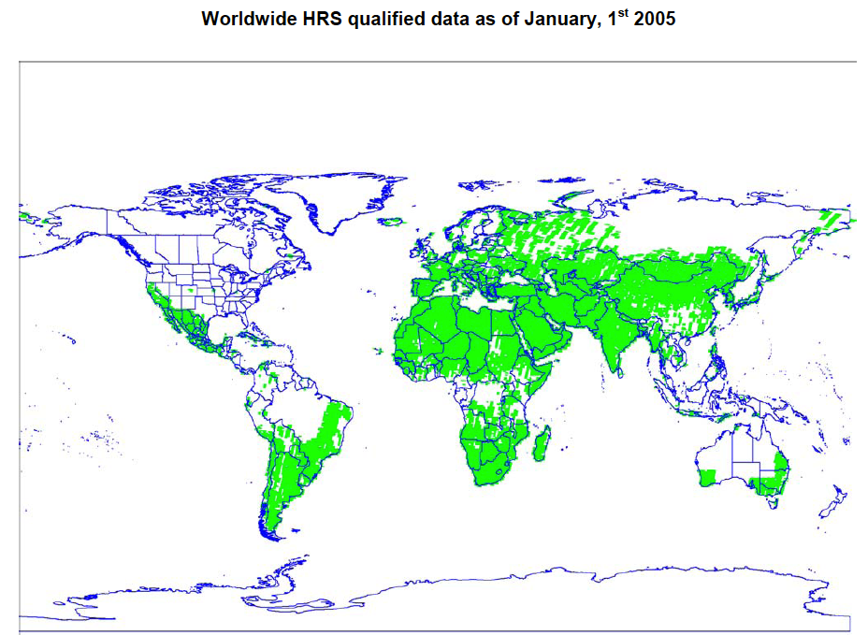
SPOT Elevation30
Coverage/cell size/available
global/1-arcseconds (30 meters)/released in part
Accuracy
Vertical error (LE90): 10-30m
Horizontal error (CE90): 10-16m
Source data
SPOT 5 HRS
SRTM DEM fill
Costs
Commercial product
Use/distribution restrictions
Restricted use product, which cannot be transferred or disclosed
Citations
Elevation30 Technical Information, available at http://www.astrium-geo.com/en/198-elevation30
Astrium, 2005, SPOT DEM Product Description Version 1.2, available at http://www2.astrium-geo.com/files/pmedia/public/r467_9_spot_dem_product_description.pdf
Astrium, 2006, SPOT DEM Precision Product Description Version 1.0, available at http://www2.astrium-geo.com/files/pmedia/public/r468_9_spot_dem_precision_product_description.pdf
Astrium, 2011, Reference3D Product Description Version 6.1, available at http://www2.astrium-geo.com/files/pmedia/public/r469_9_reference3d_product_description_201105.pdf

Slide 14
ALOS World 3D
Coverage/cell size/available
global/1-arcseconds/30 meters/after March 2016
Accuracy
Vertical accuracy: 5m
Horizontal precision: 5m
Source data
ALOS-2 PRISM
Costs
30-meter product free of charge
Use/distribution restrictions
unknown
Citations
Precise Global Digital 3D Map "ALOS World 3D" Homepage, 2014, available at http://www.eorc.jaxa.jp/ALOS/en/aw3d/index_e.htm

