Slide 1
Development of an Integrated Geospatial and Statistical Modeling Framework to Monitor and Forecast Floods for the Famine Early Warning Systems Network (FEWS NET)
Md Shahriar Pervez¹, Kimberly Sliniski², Laura Harrison³, Gideon Galu³, Michael Budde¹, Amy McNally⁴, Emily Turano⁵, James Rowland¹, and James Verdin⁶
¹United States Geological Survey, ²University of Maryland/NASA Goddard Space Flight Center, ³Climate Hazards Center, UC Santa Barbara, ⁴NASA Goddard Space Flight Center, ⁵Famine Early Warning Systems Network, ⁶United States Agency for International Development
December 11, 2024

Slide 2
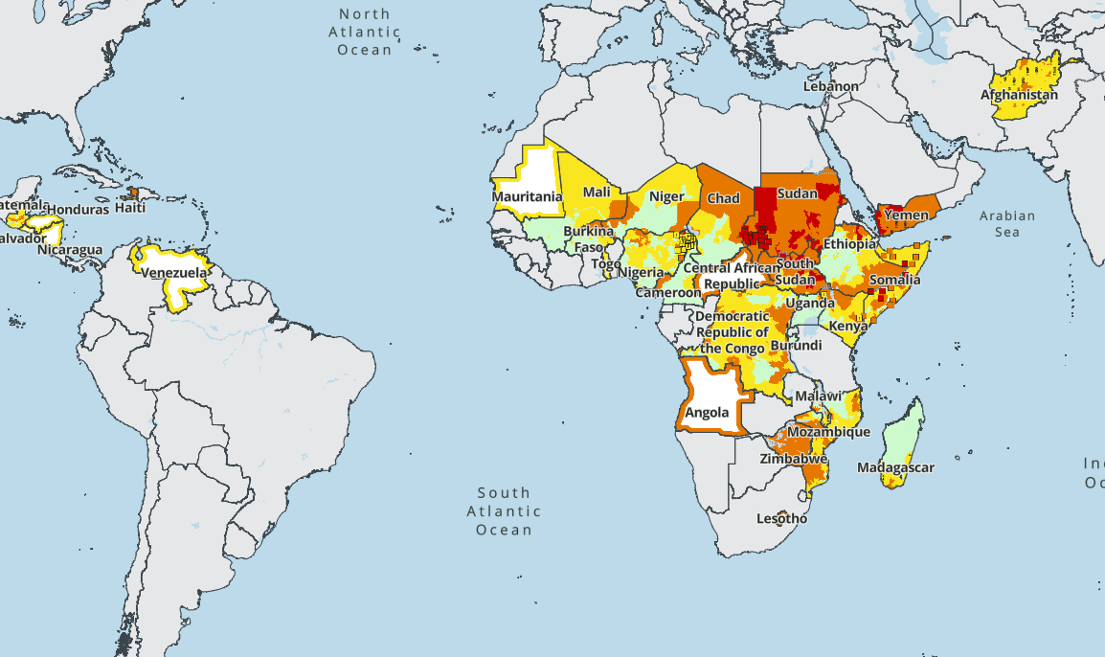
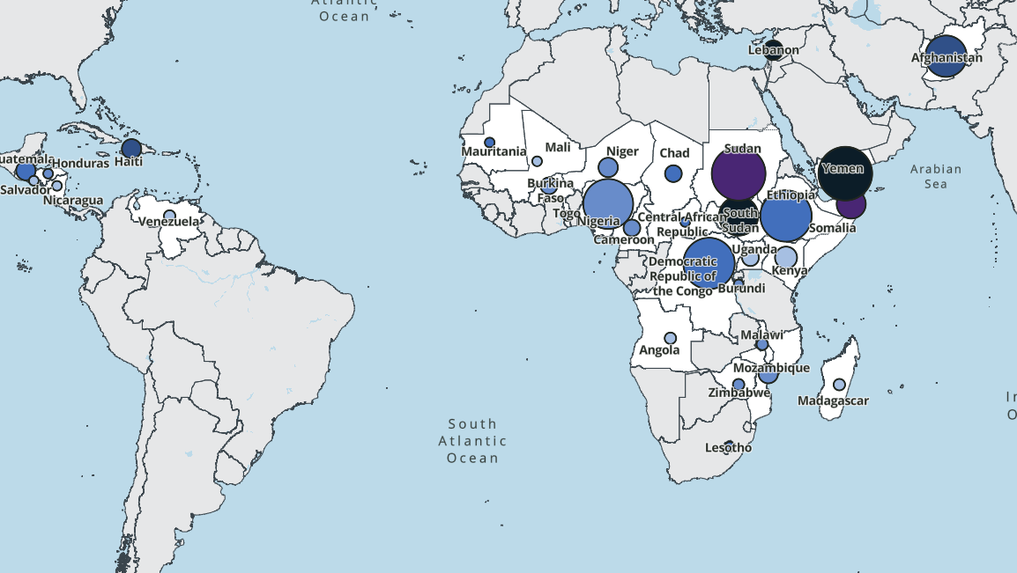
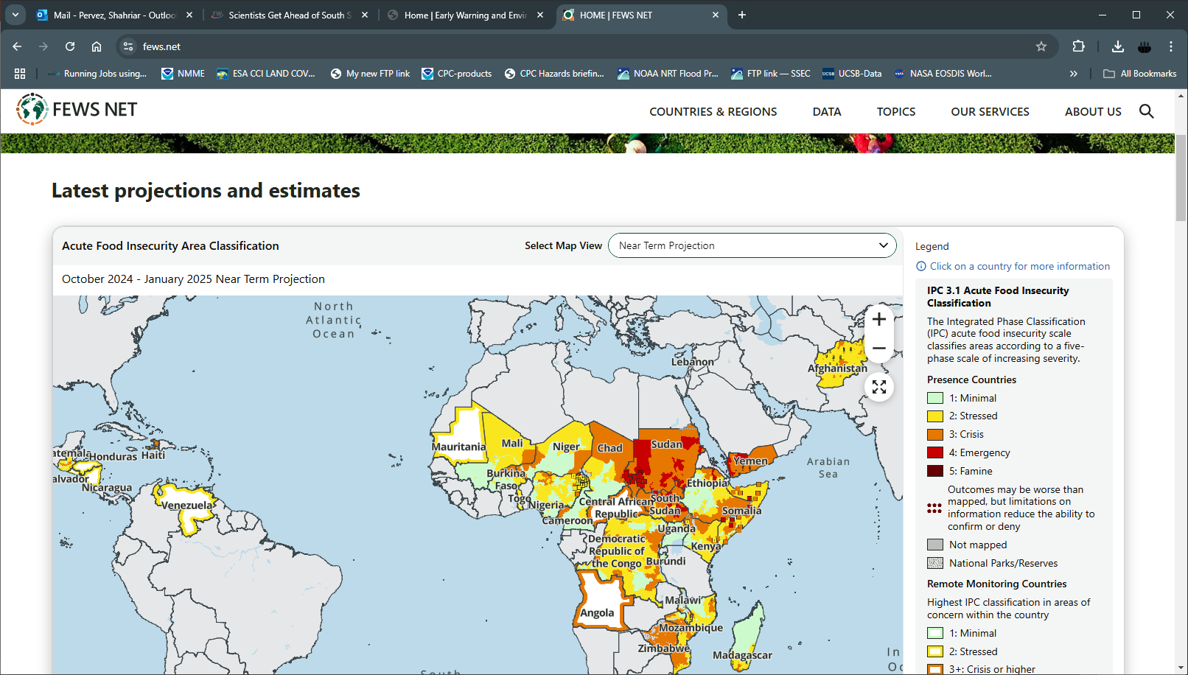
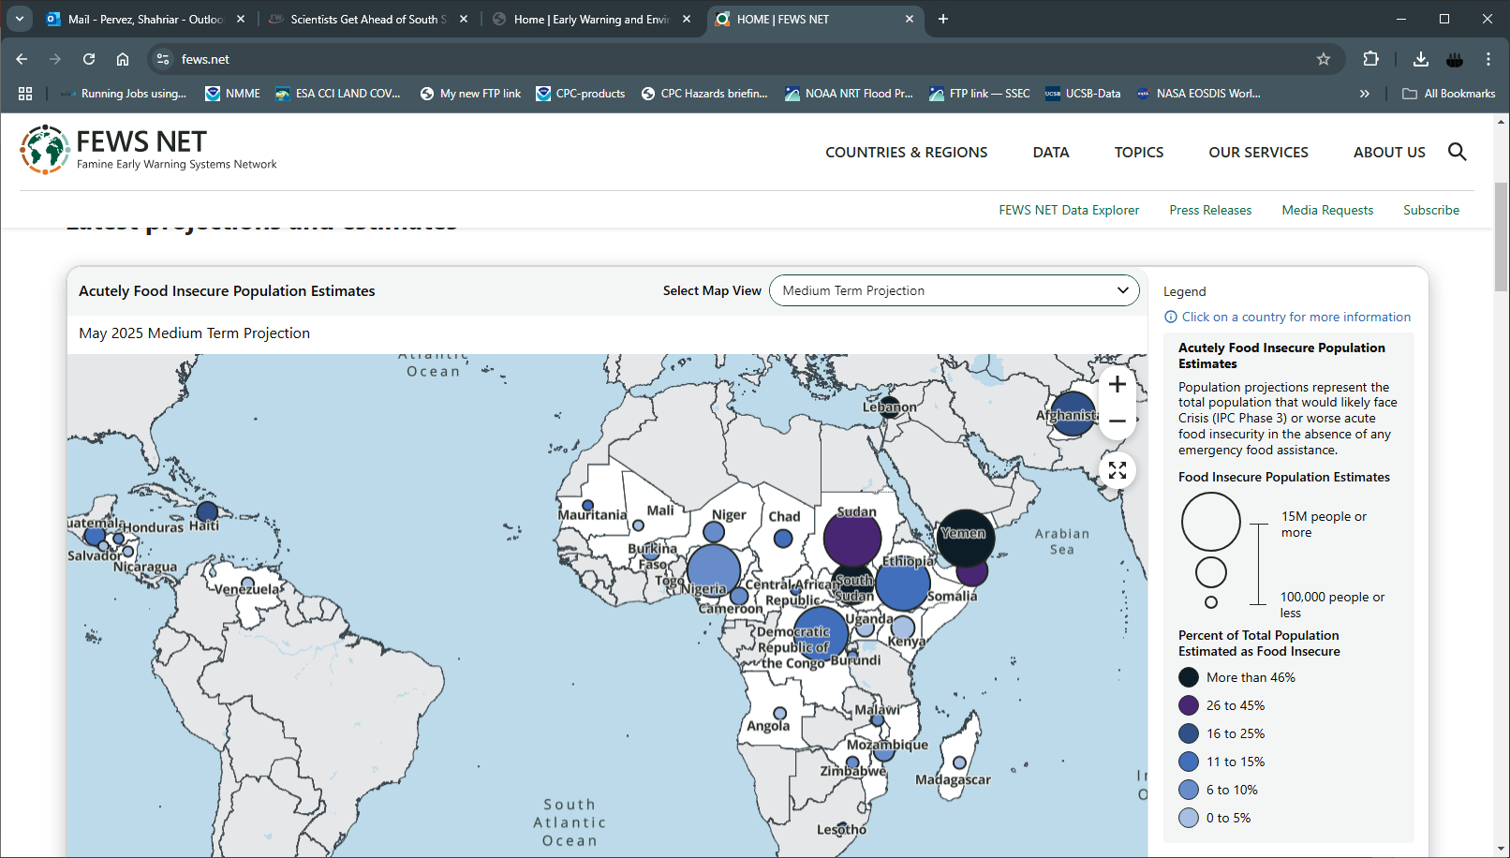
Famine Early Warning Systems Network
Acutely food insecure area classification (Oct 2024 — Jan 2025 near term projection)
Acutely food insecure population estimates (May 2025 medium term projection)
FEWS NET advises USAID on the need of humanitarian assistance across the region of interest.
Notes:
By identifying food insecure areas and population of the world.

Slide 3

Why Monitoring Floods
Droughts and floods are two of the most common recurrent natural disasters.
Both have devastating impacts on food production, livestock and livelihood & are among the drivers of food insecurity.
More recently, the extreme floods are occurring frequently and have deeply impacted food production and livestock.
Photo credit: Disaster Management Initiative, Floods in Jigawa state in Nigeria Sep 23, 2022.

Slide 4
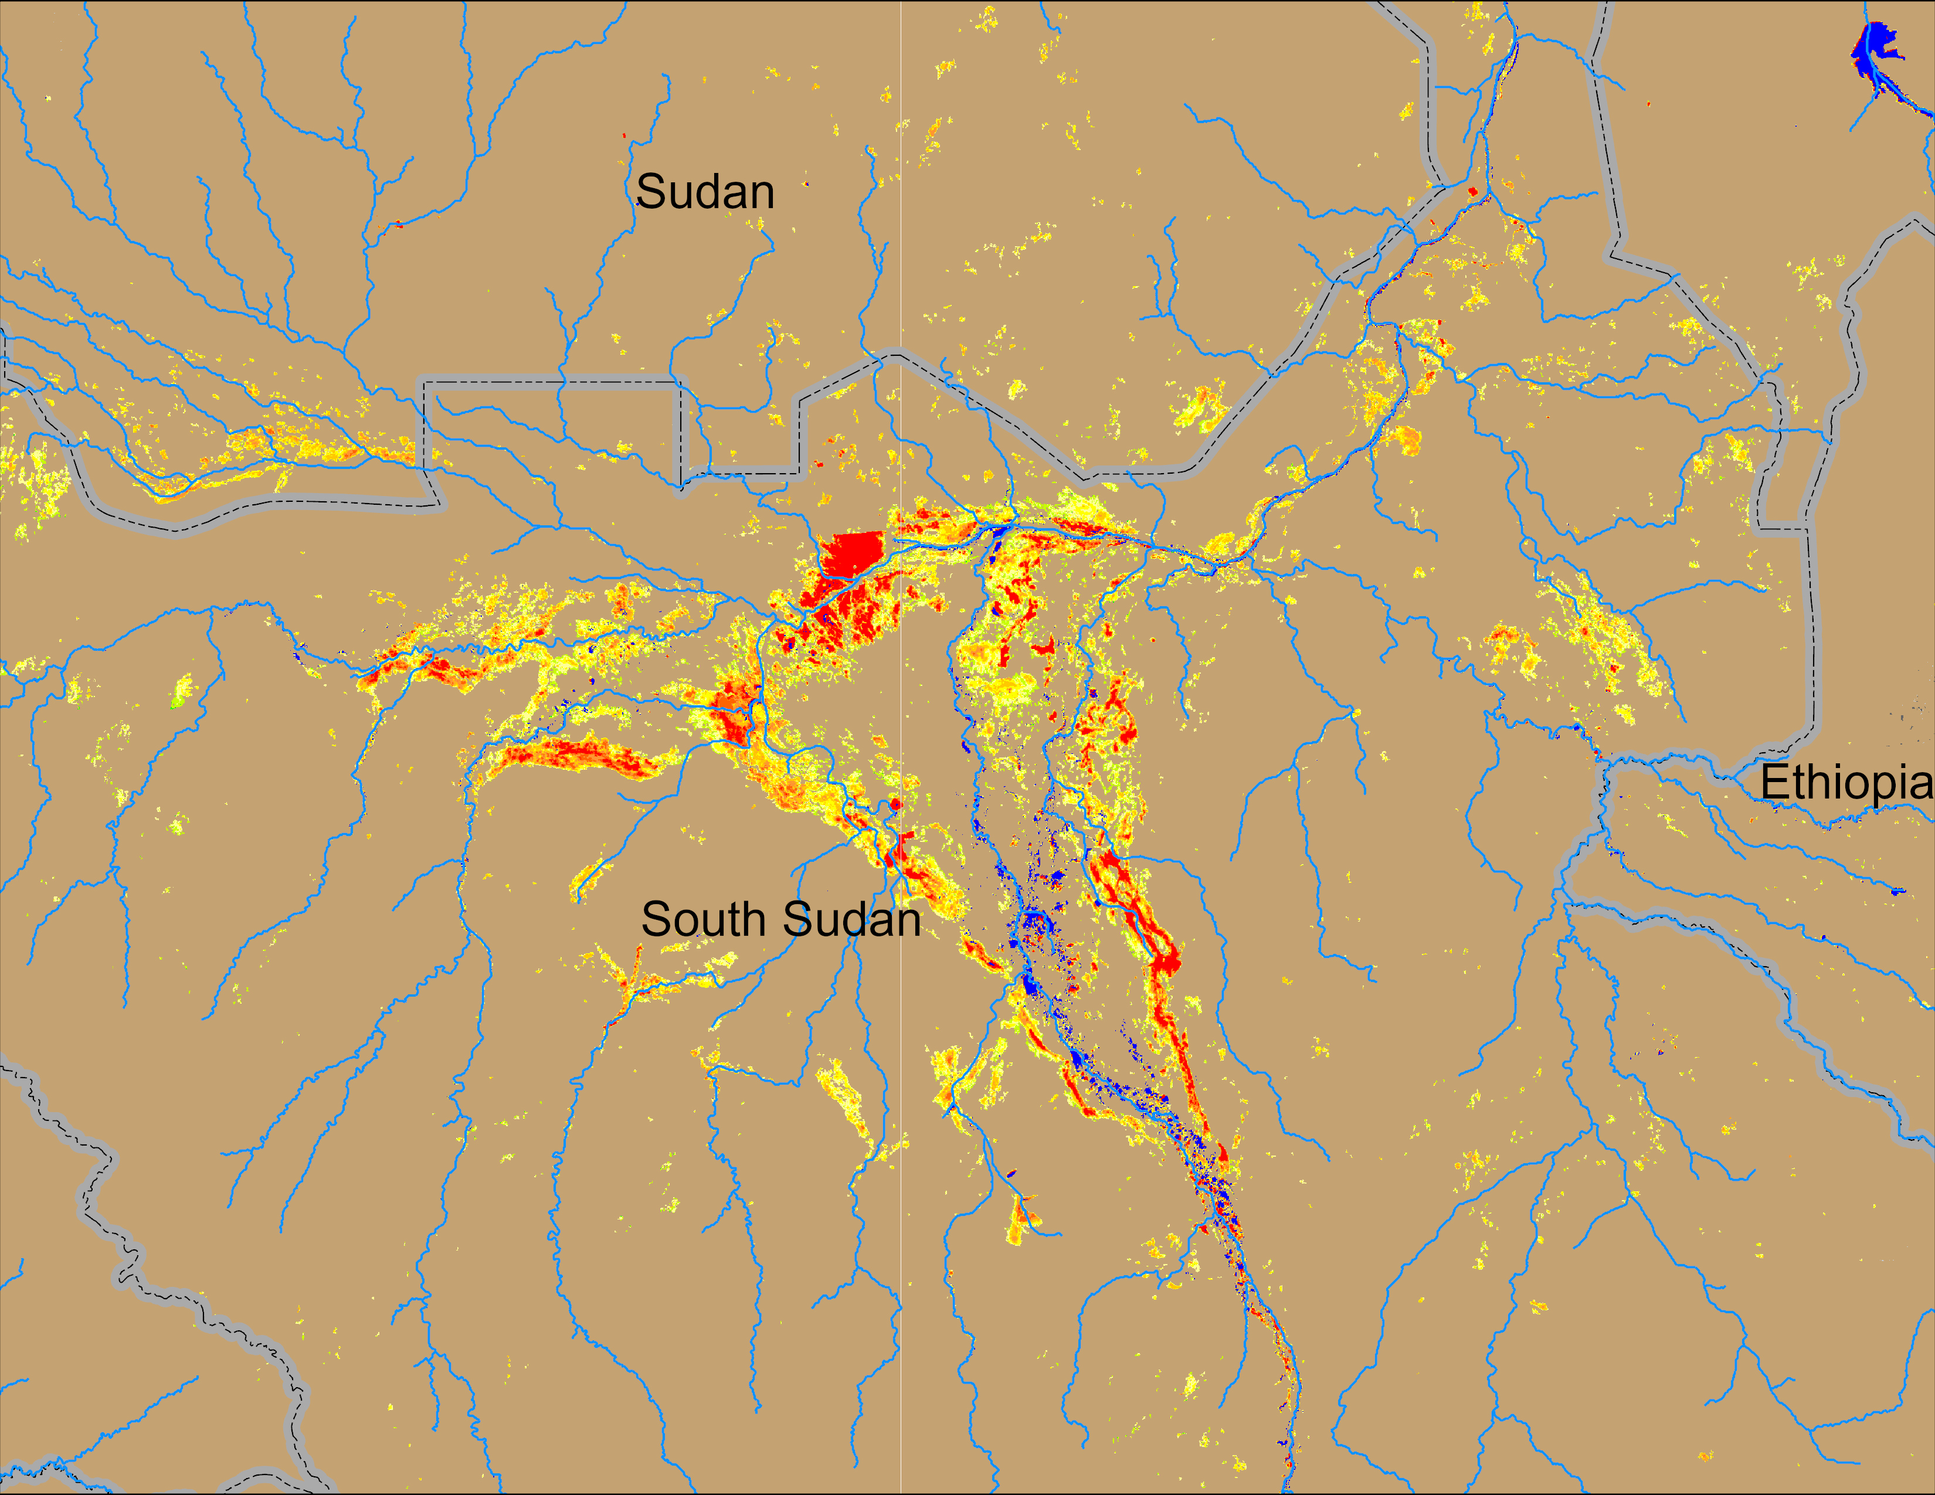

Flood Mapping from VIIRS
(% of the pixel)
VIIRS Data
375 m x 375 m pixels
Maps % of the pixel inundated
It’s a 5-day composite
VIIRS data available since 2012 with a few missing periods.
Method
6 composites (5th, 10th, 15th, 20th, 25th, and 30th) were used to create monthly composite.
Only pixels with 41 – 100% inundated were considered.
Isolated inundated areas less than 0.43 Km² were removed in a clean up process.
Sobet
Akobo
Pibor
Example: NOAA VIIRS 5-day comp.: 01 – 05 Dec 2024

Slide 5
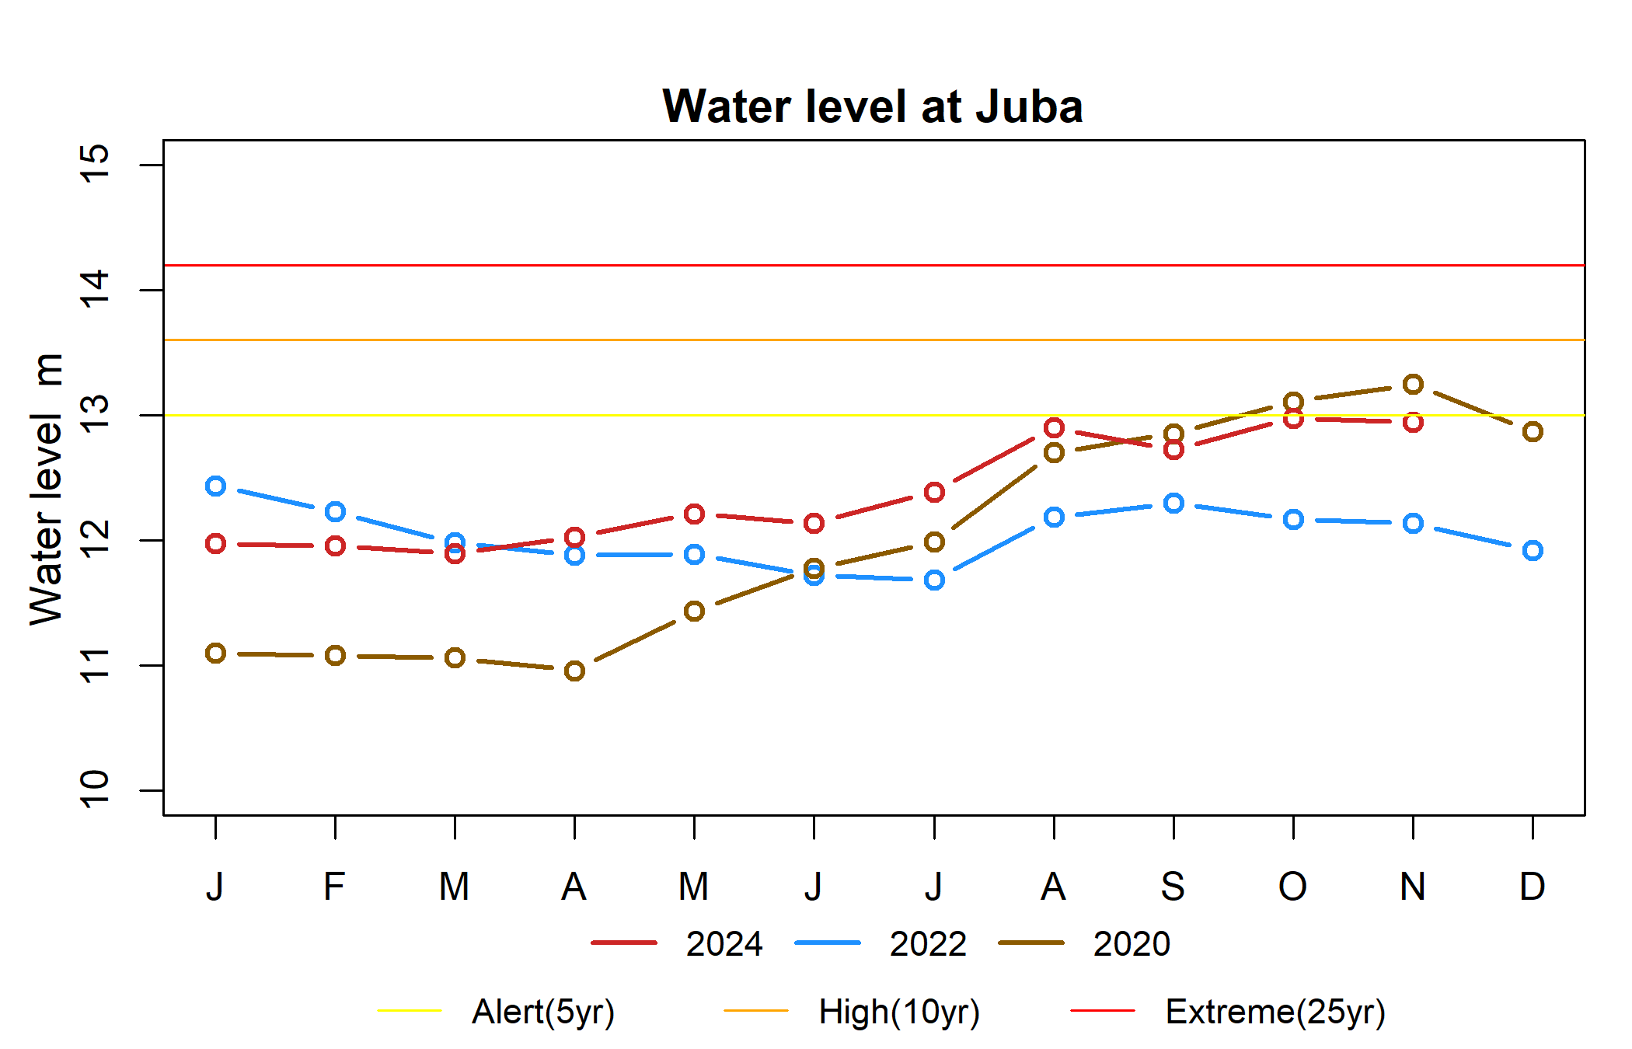
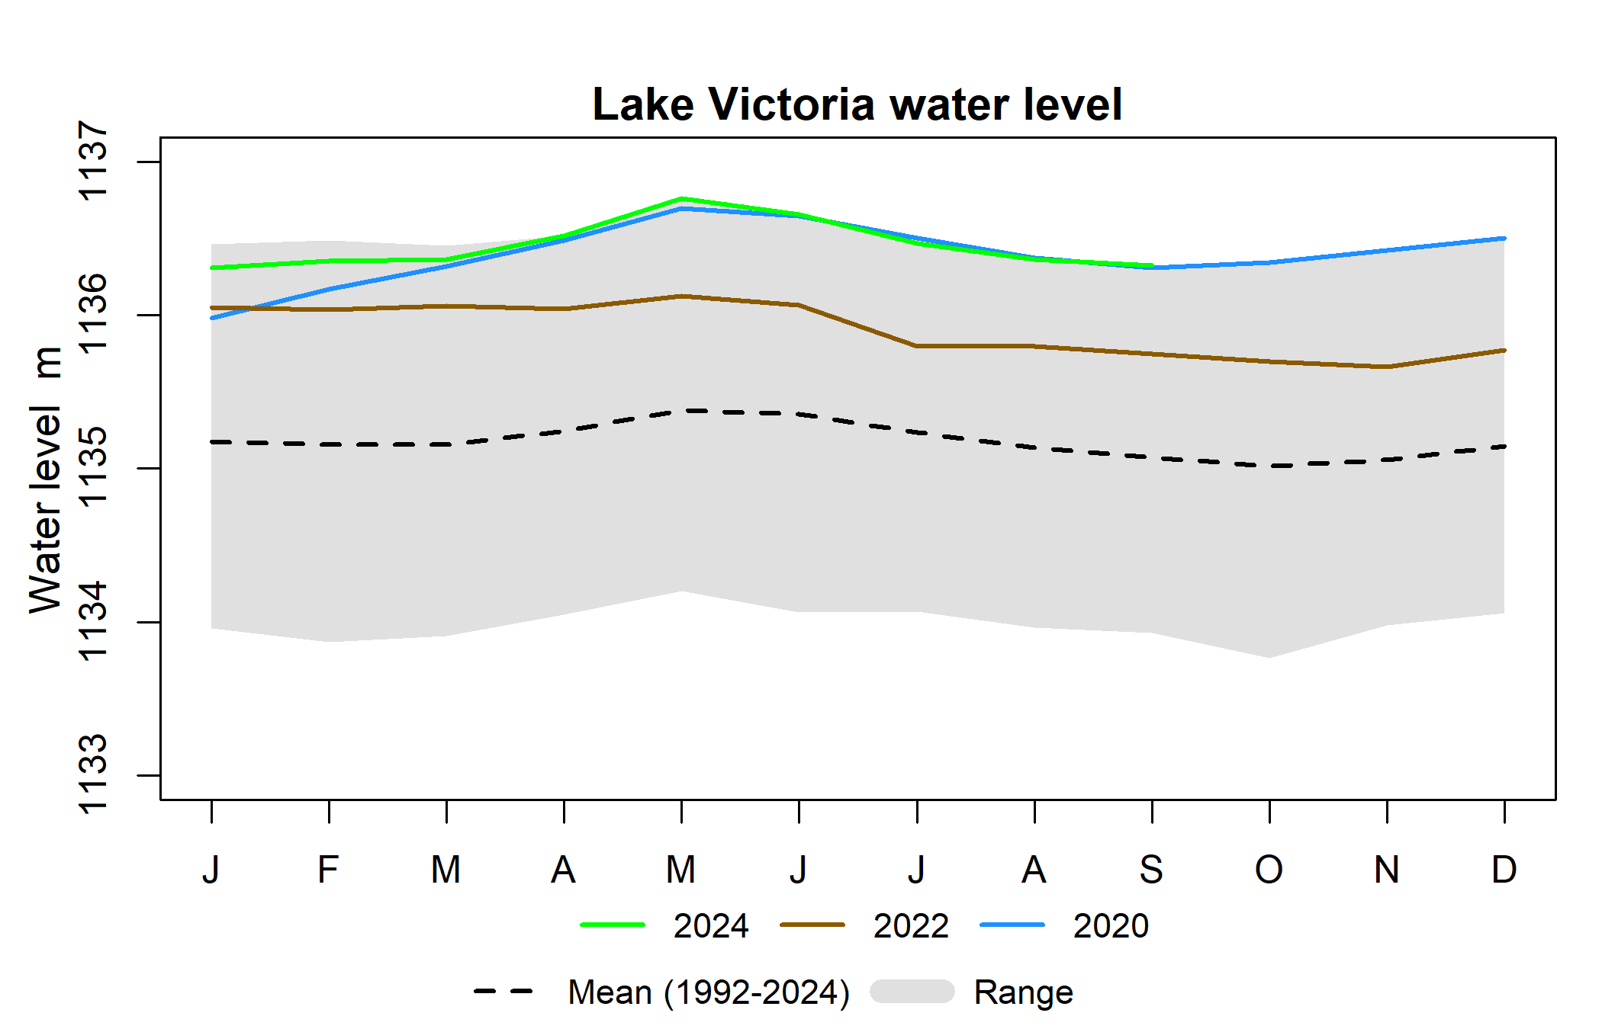
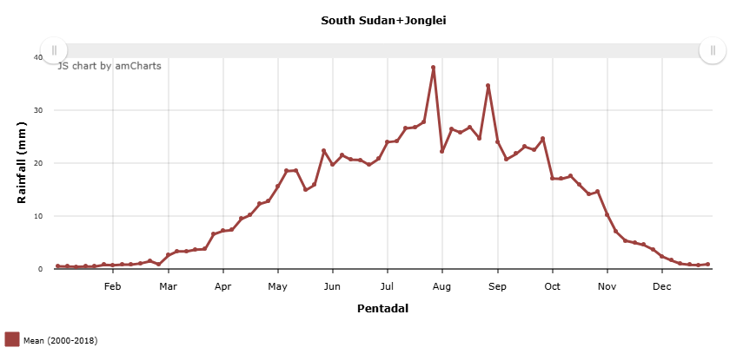
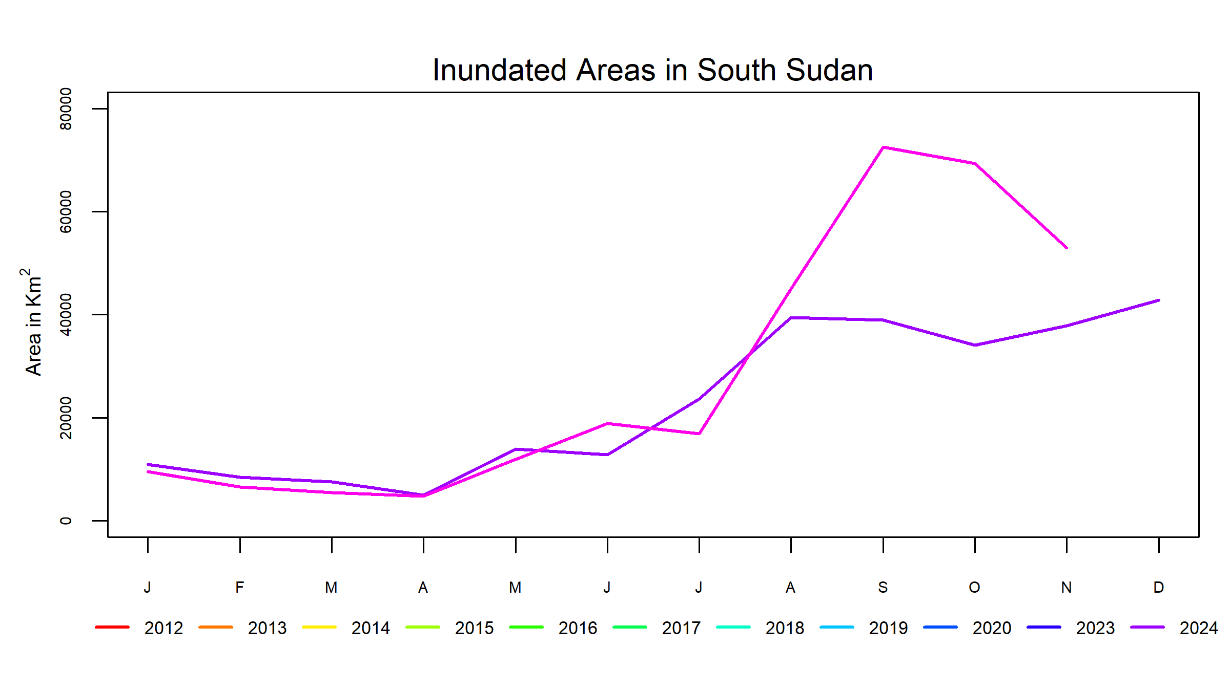
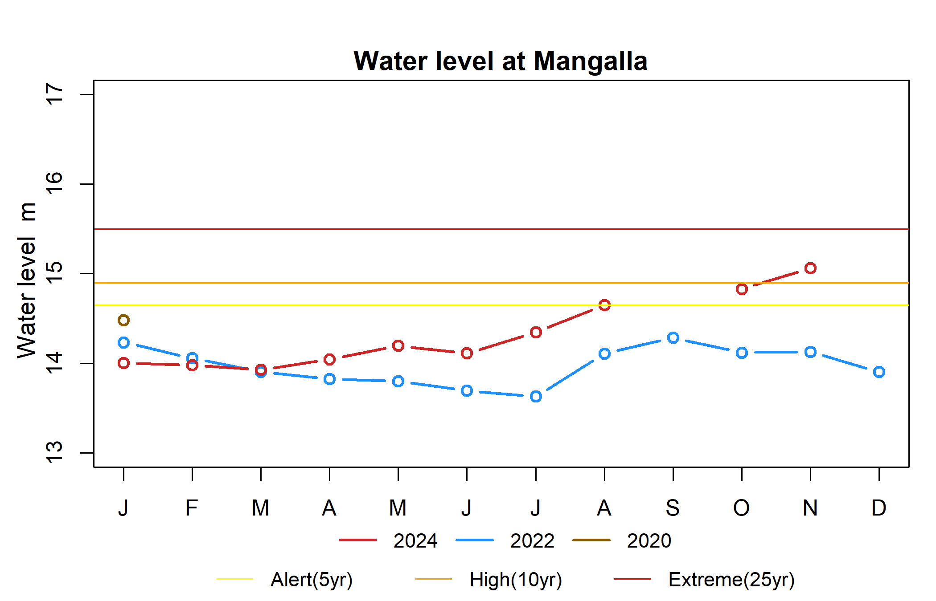
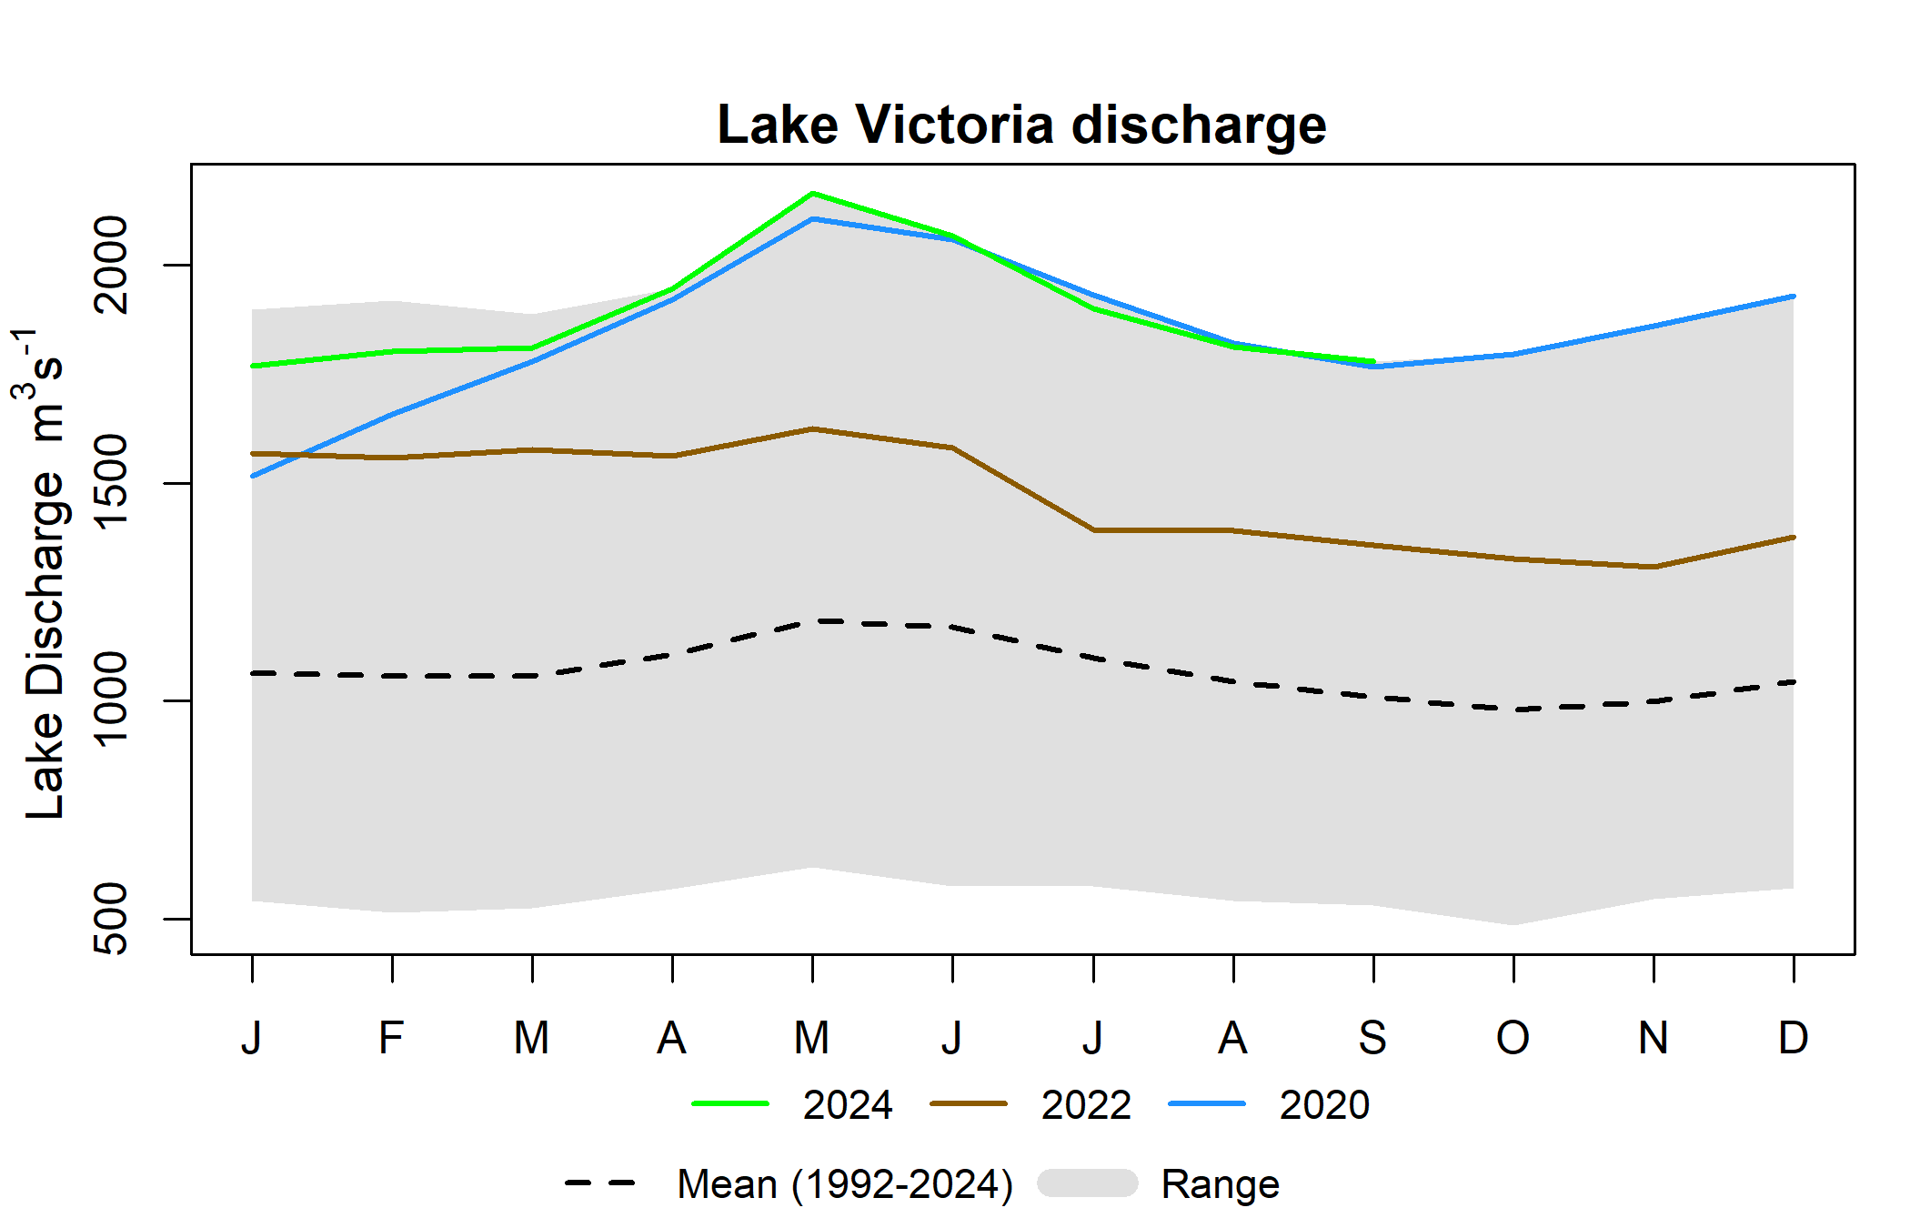
Water Level, Discharge and Flooding Time
April to June 2024, highest Lake Victoria water level and discharge since 1992

Slide 6
Flood Forecast Modeling Framework
We started with these three primary questions
A. How much area is going to be flooded (number)?
  LASSO: Least Absolute Shrinkage and Selection Operator
    Regression analysis method that performs both variable selection and regularization in order to enhance the prediction accuracy and interpretability of the resulting statistical model.
    The lasso method assumes that the coefficients of the linear model are sparse, meaning that few of them are non-zero
  Analog Year
    2020 and 2022 (based on similar climate mode, weather conditions)
B. Where will those flooded area be at?
  We have developed a geospatial model for that
C. How much time in advance can we accomplish A and B.
  LASSO model skills (1 to 6 months)

Slide 7
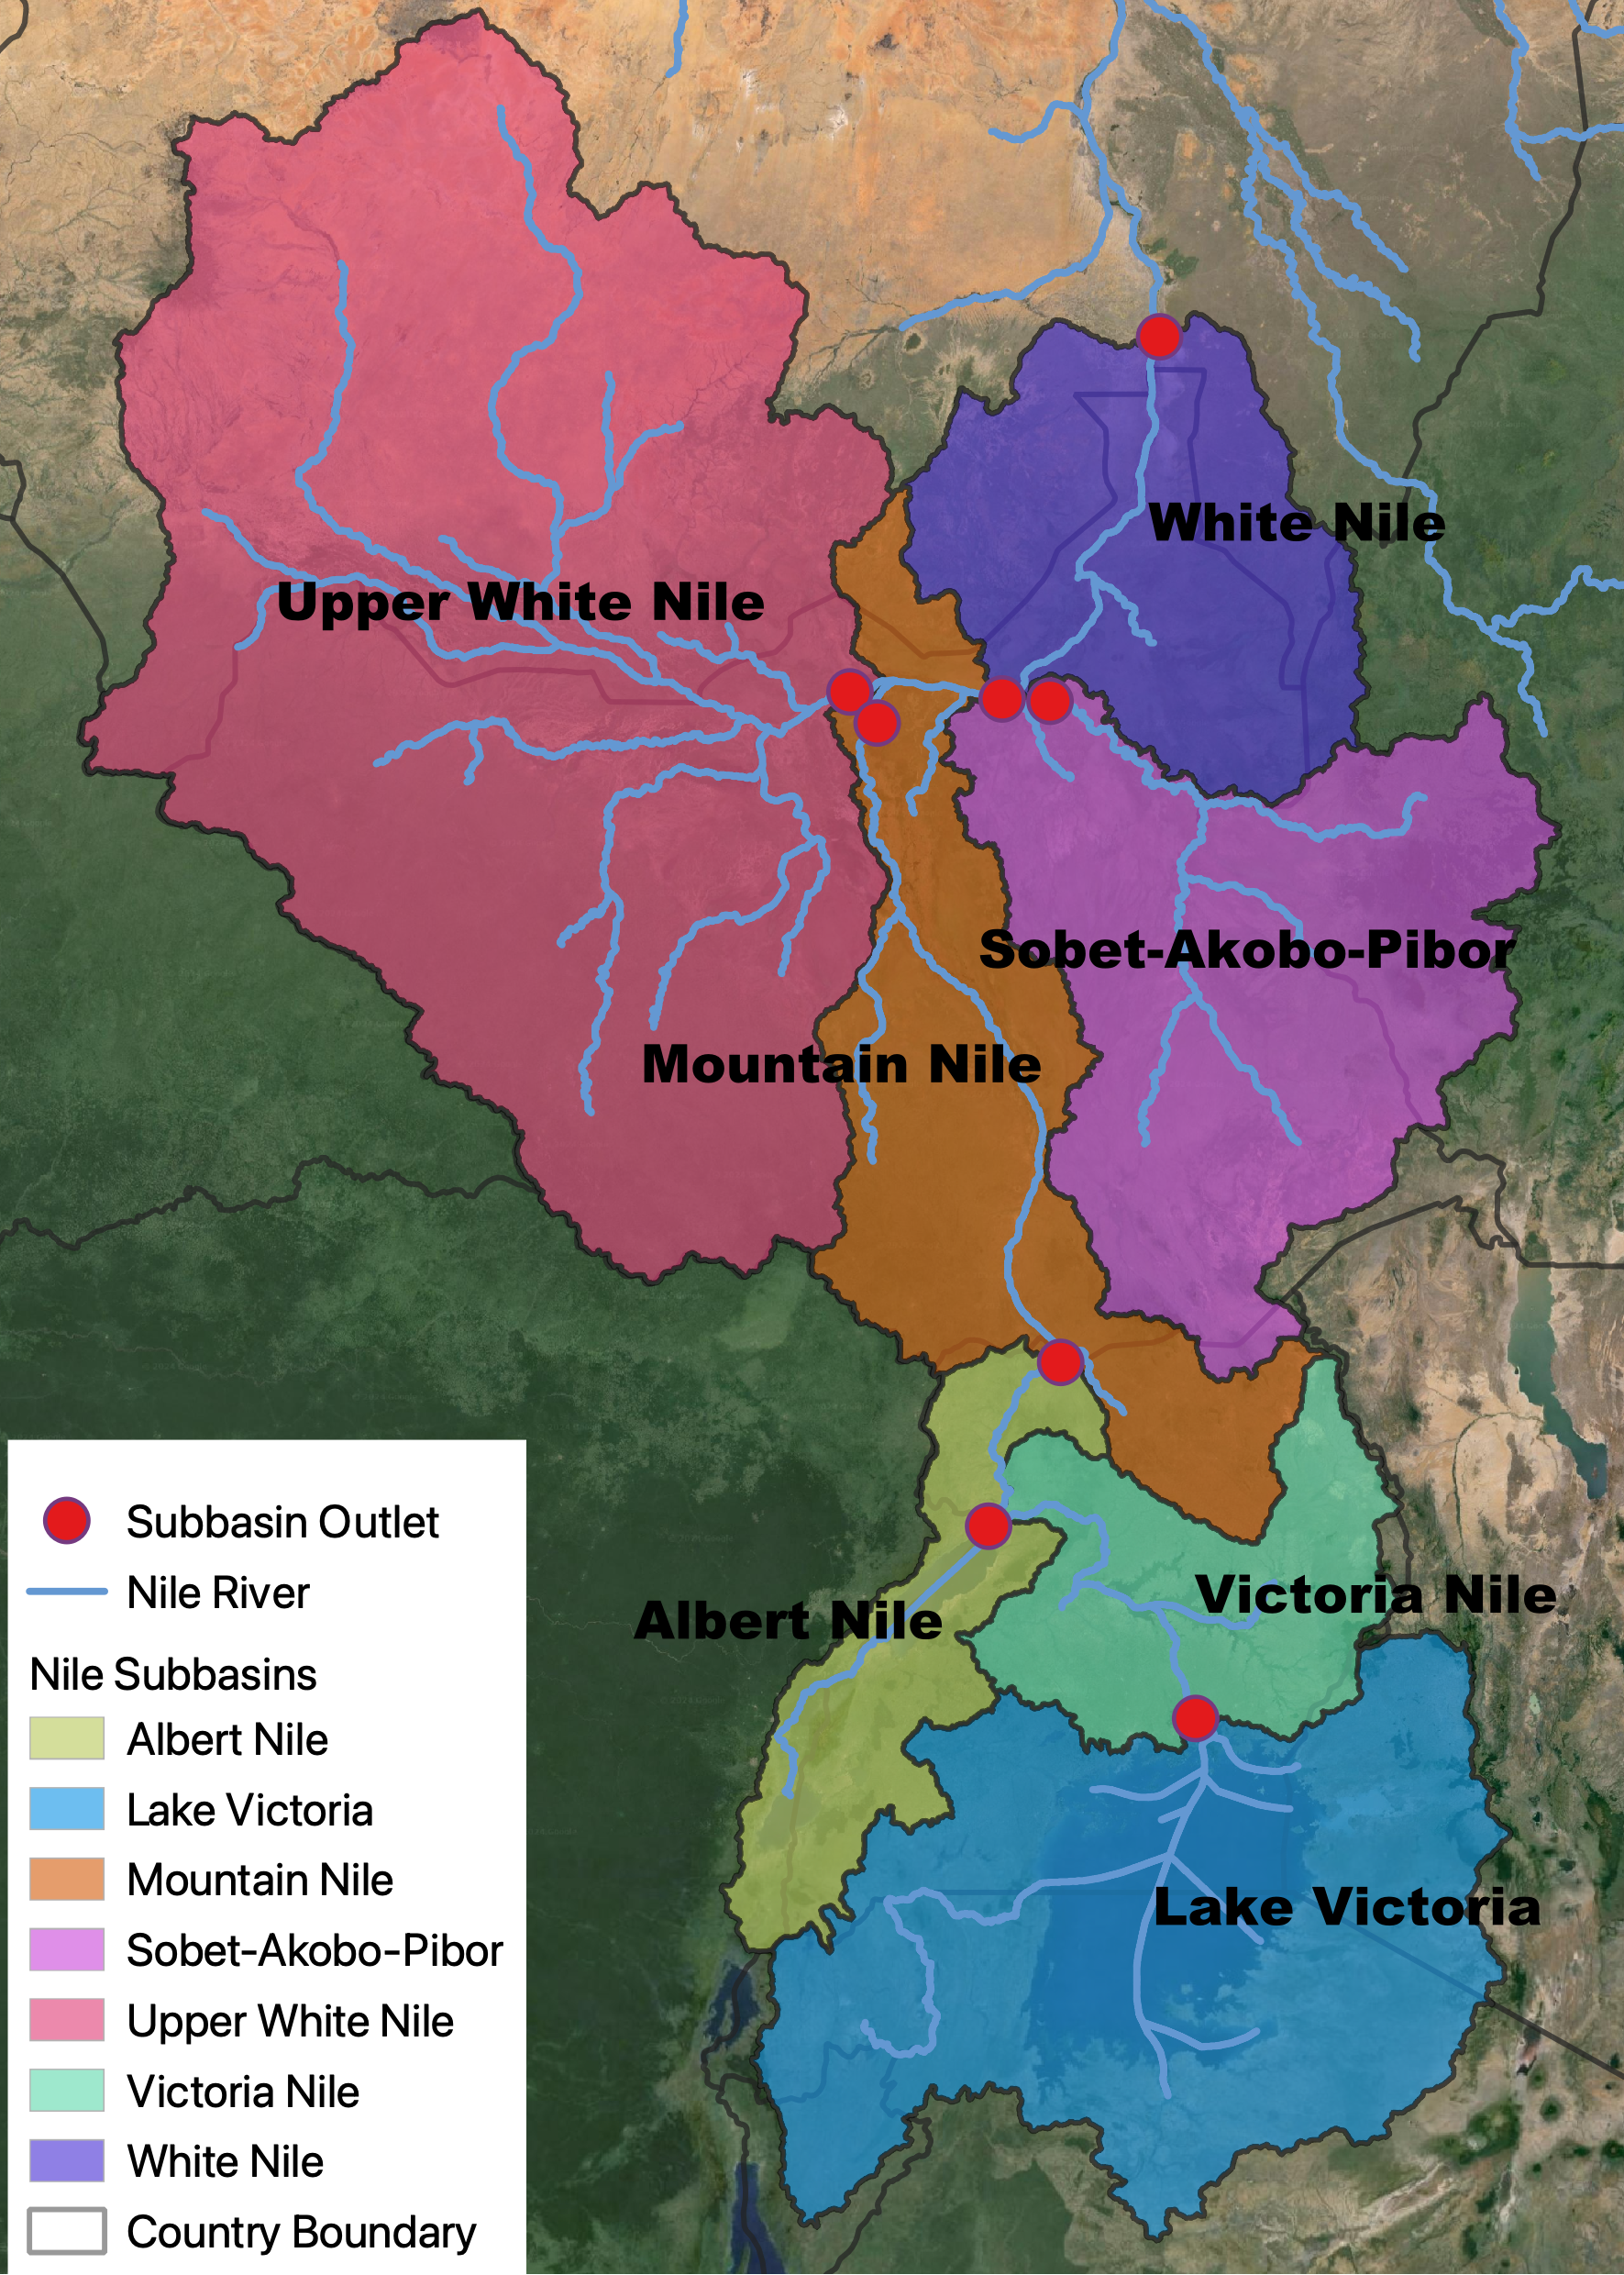
LASSO Model of Total Flooded Area
Input: Modeled runoff (retrospective & forecast) from the NASA FLDAS land surface model
Input: CHIRPS rainfall
Input: Lakes Victoria and Albert satellite altimetry water levels
Input: Bias-corrected, spatially downscaled North American Multi Model Ensemble (NMME) seasonal precipitation forecast
LASSO Regression analysis (Least Absolute Shrinkage and Selection Operator): Santosa, F., and Symes, W. W. (1986).
Output: total inundated area for each of the next six months

Slide 8
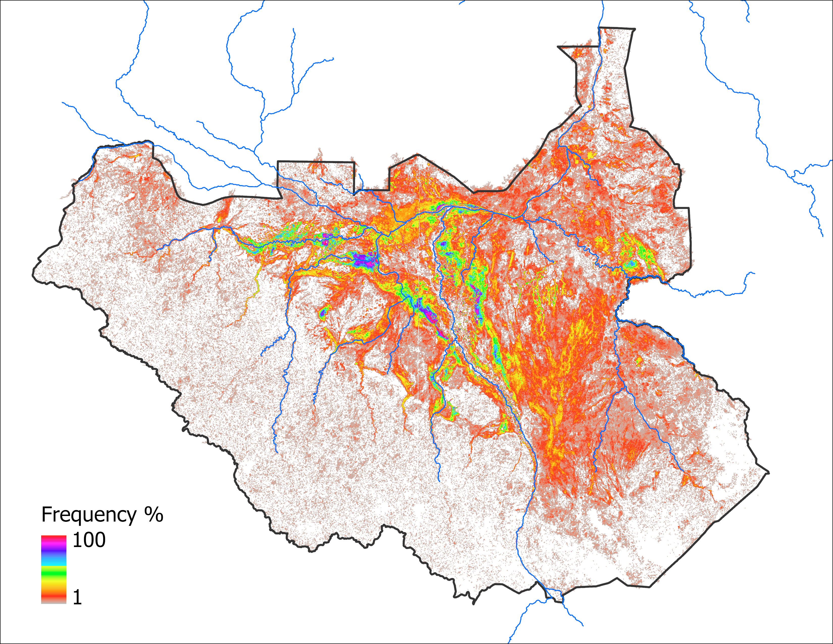
Where to Map the LASSO Flooded Area?
The historical frequency of inundation in the NOAA VIIRS Flood Mapping product was determined for each pixel
For a LASSO estimate of total flooded area, pixels were mapped as inundated according to their historical frequency of flooding
Beginning with the most frequently flooded class and working in descending order, pixels were added to the map until the LASSO area estimate was just surpassed
JASOND months (68 months)

Slide 9
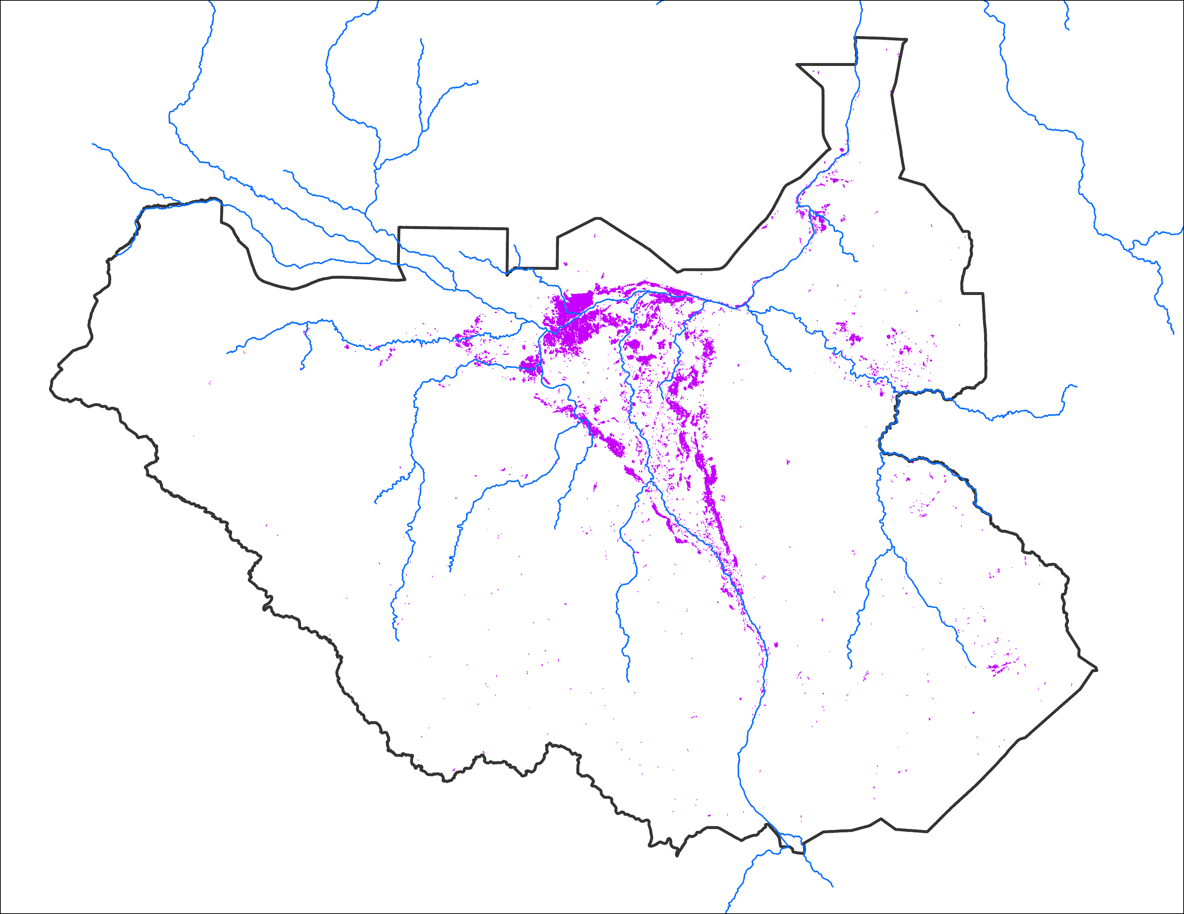
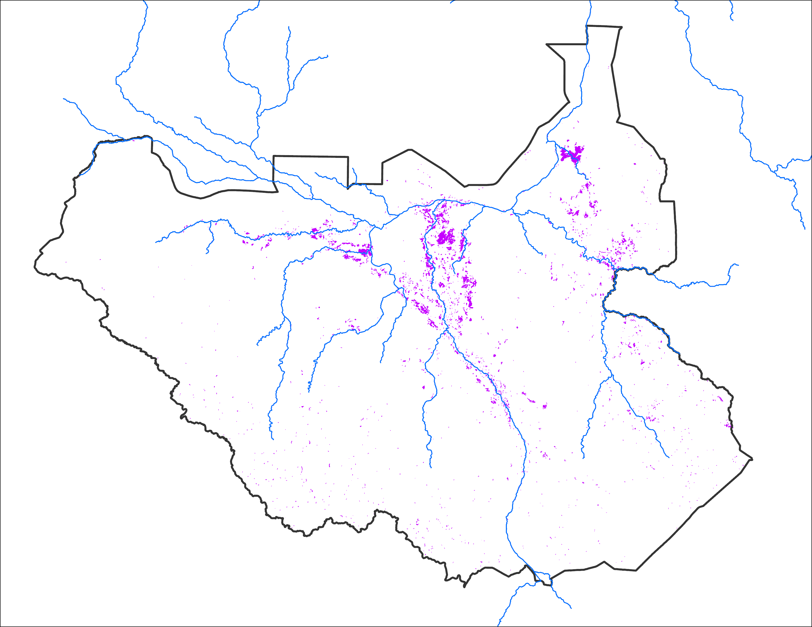
Difference in Initial Condition
Apr 2024 IC
Apr 2020 IC
15,914 km²
8,543 km²
Greater initial flooding in April 2024

Slide 10
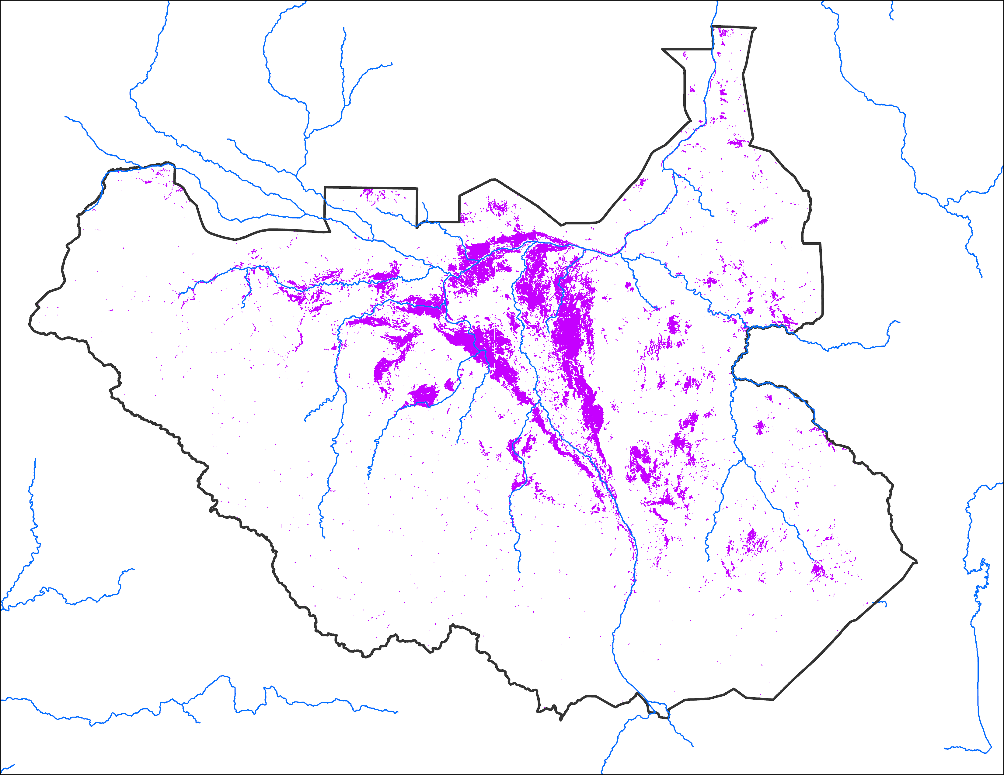
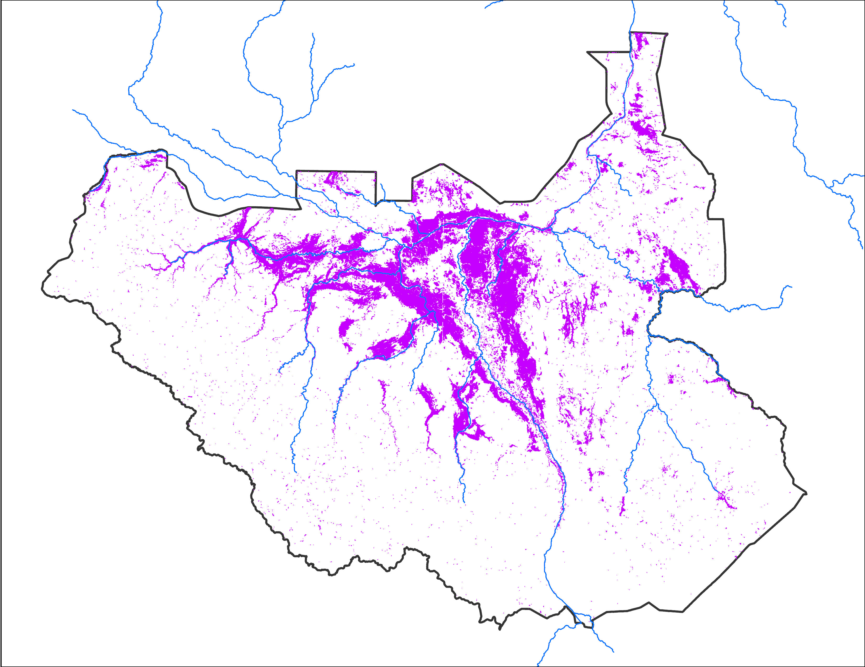
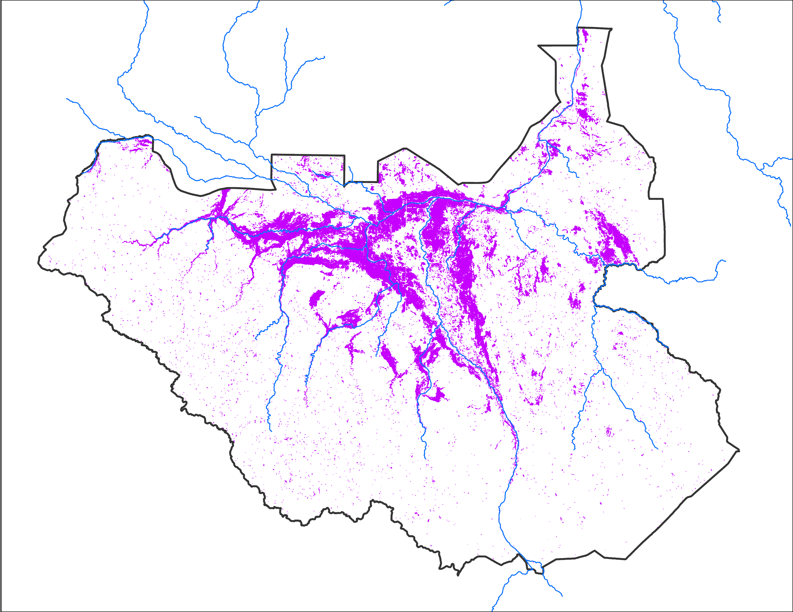
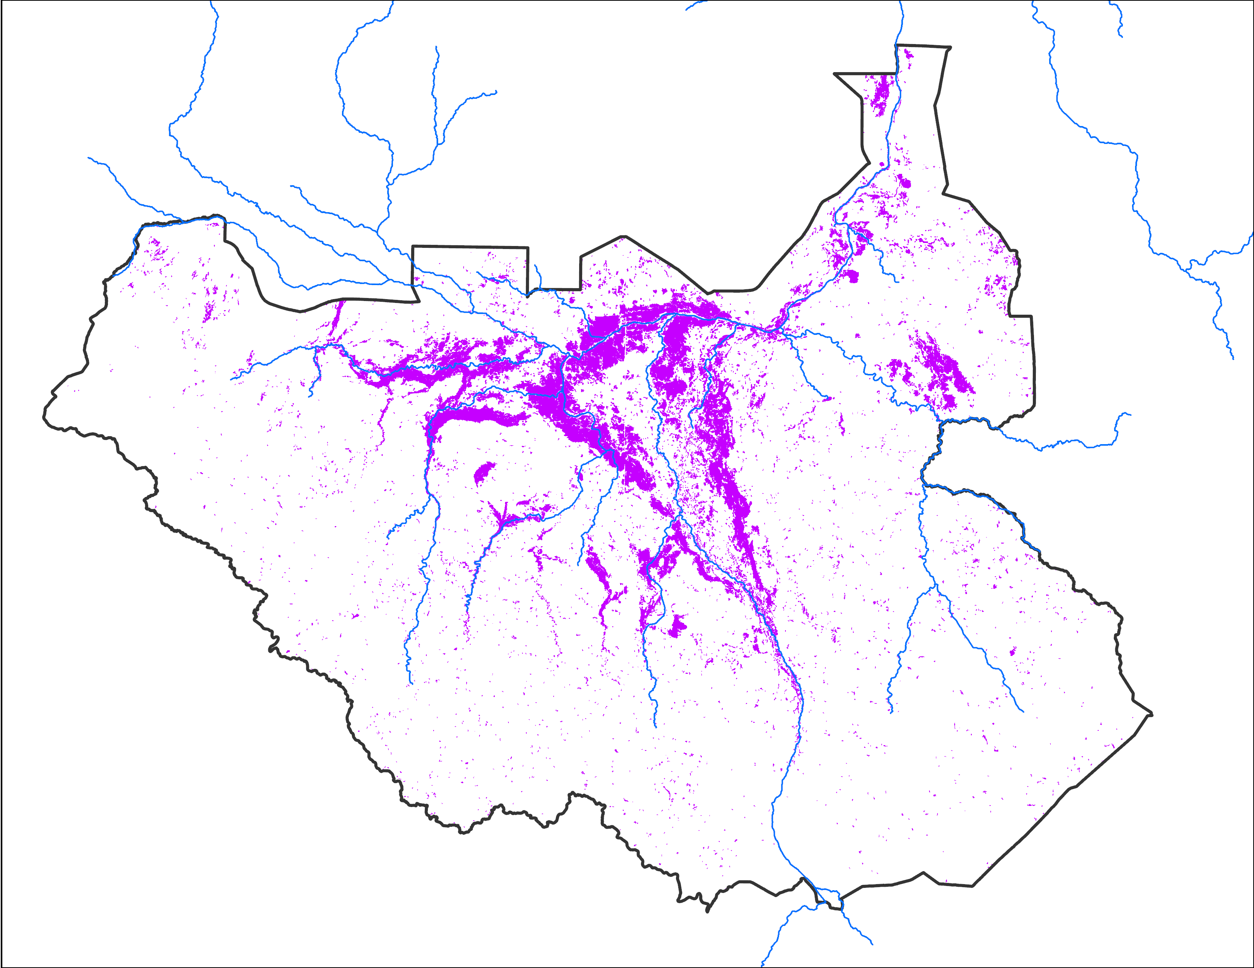
Flooding Progression
Aug 2024
Sep 2024
Oct 2024
Nov 2024
45,013 km²
72,515 km²
69,374 km²
52,945 km²
Flooding peaked in September in South Sudan.

Slide 11
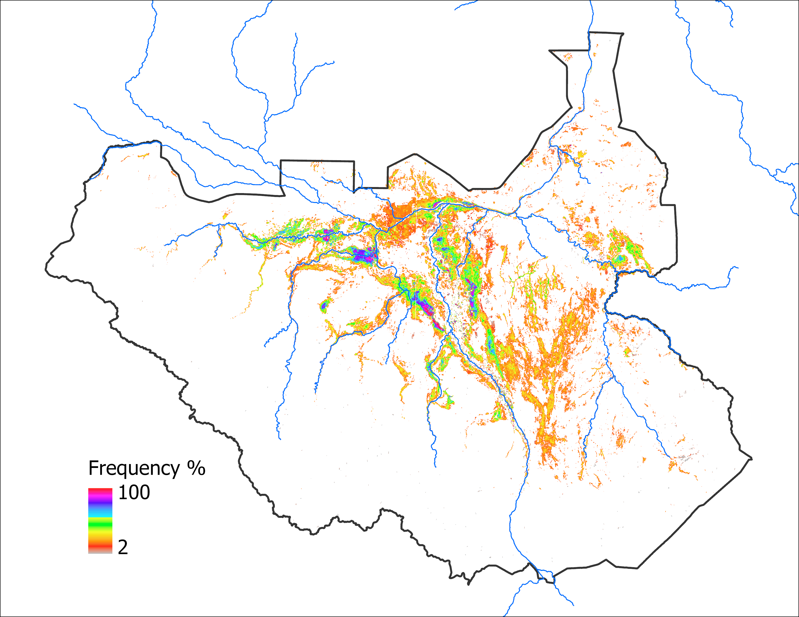

Predicted Flooding
Observed Sep 2024
Predicted Sep 2024 with APR IC
Predicted Sep 2024 with APR IC
72,515 km²
72,880 km²
Based on 2020 analog year
65,520 km²
Based on LASSO

Slide 12
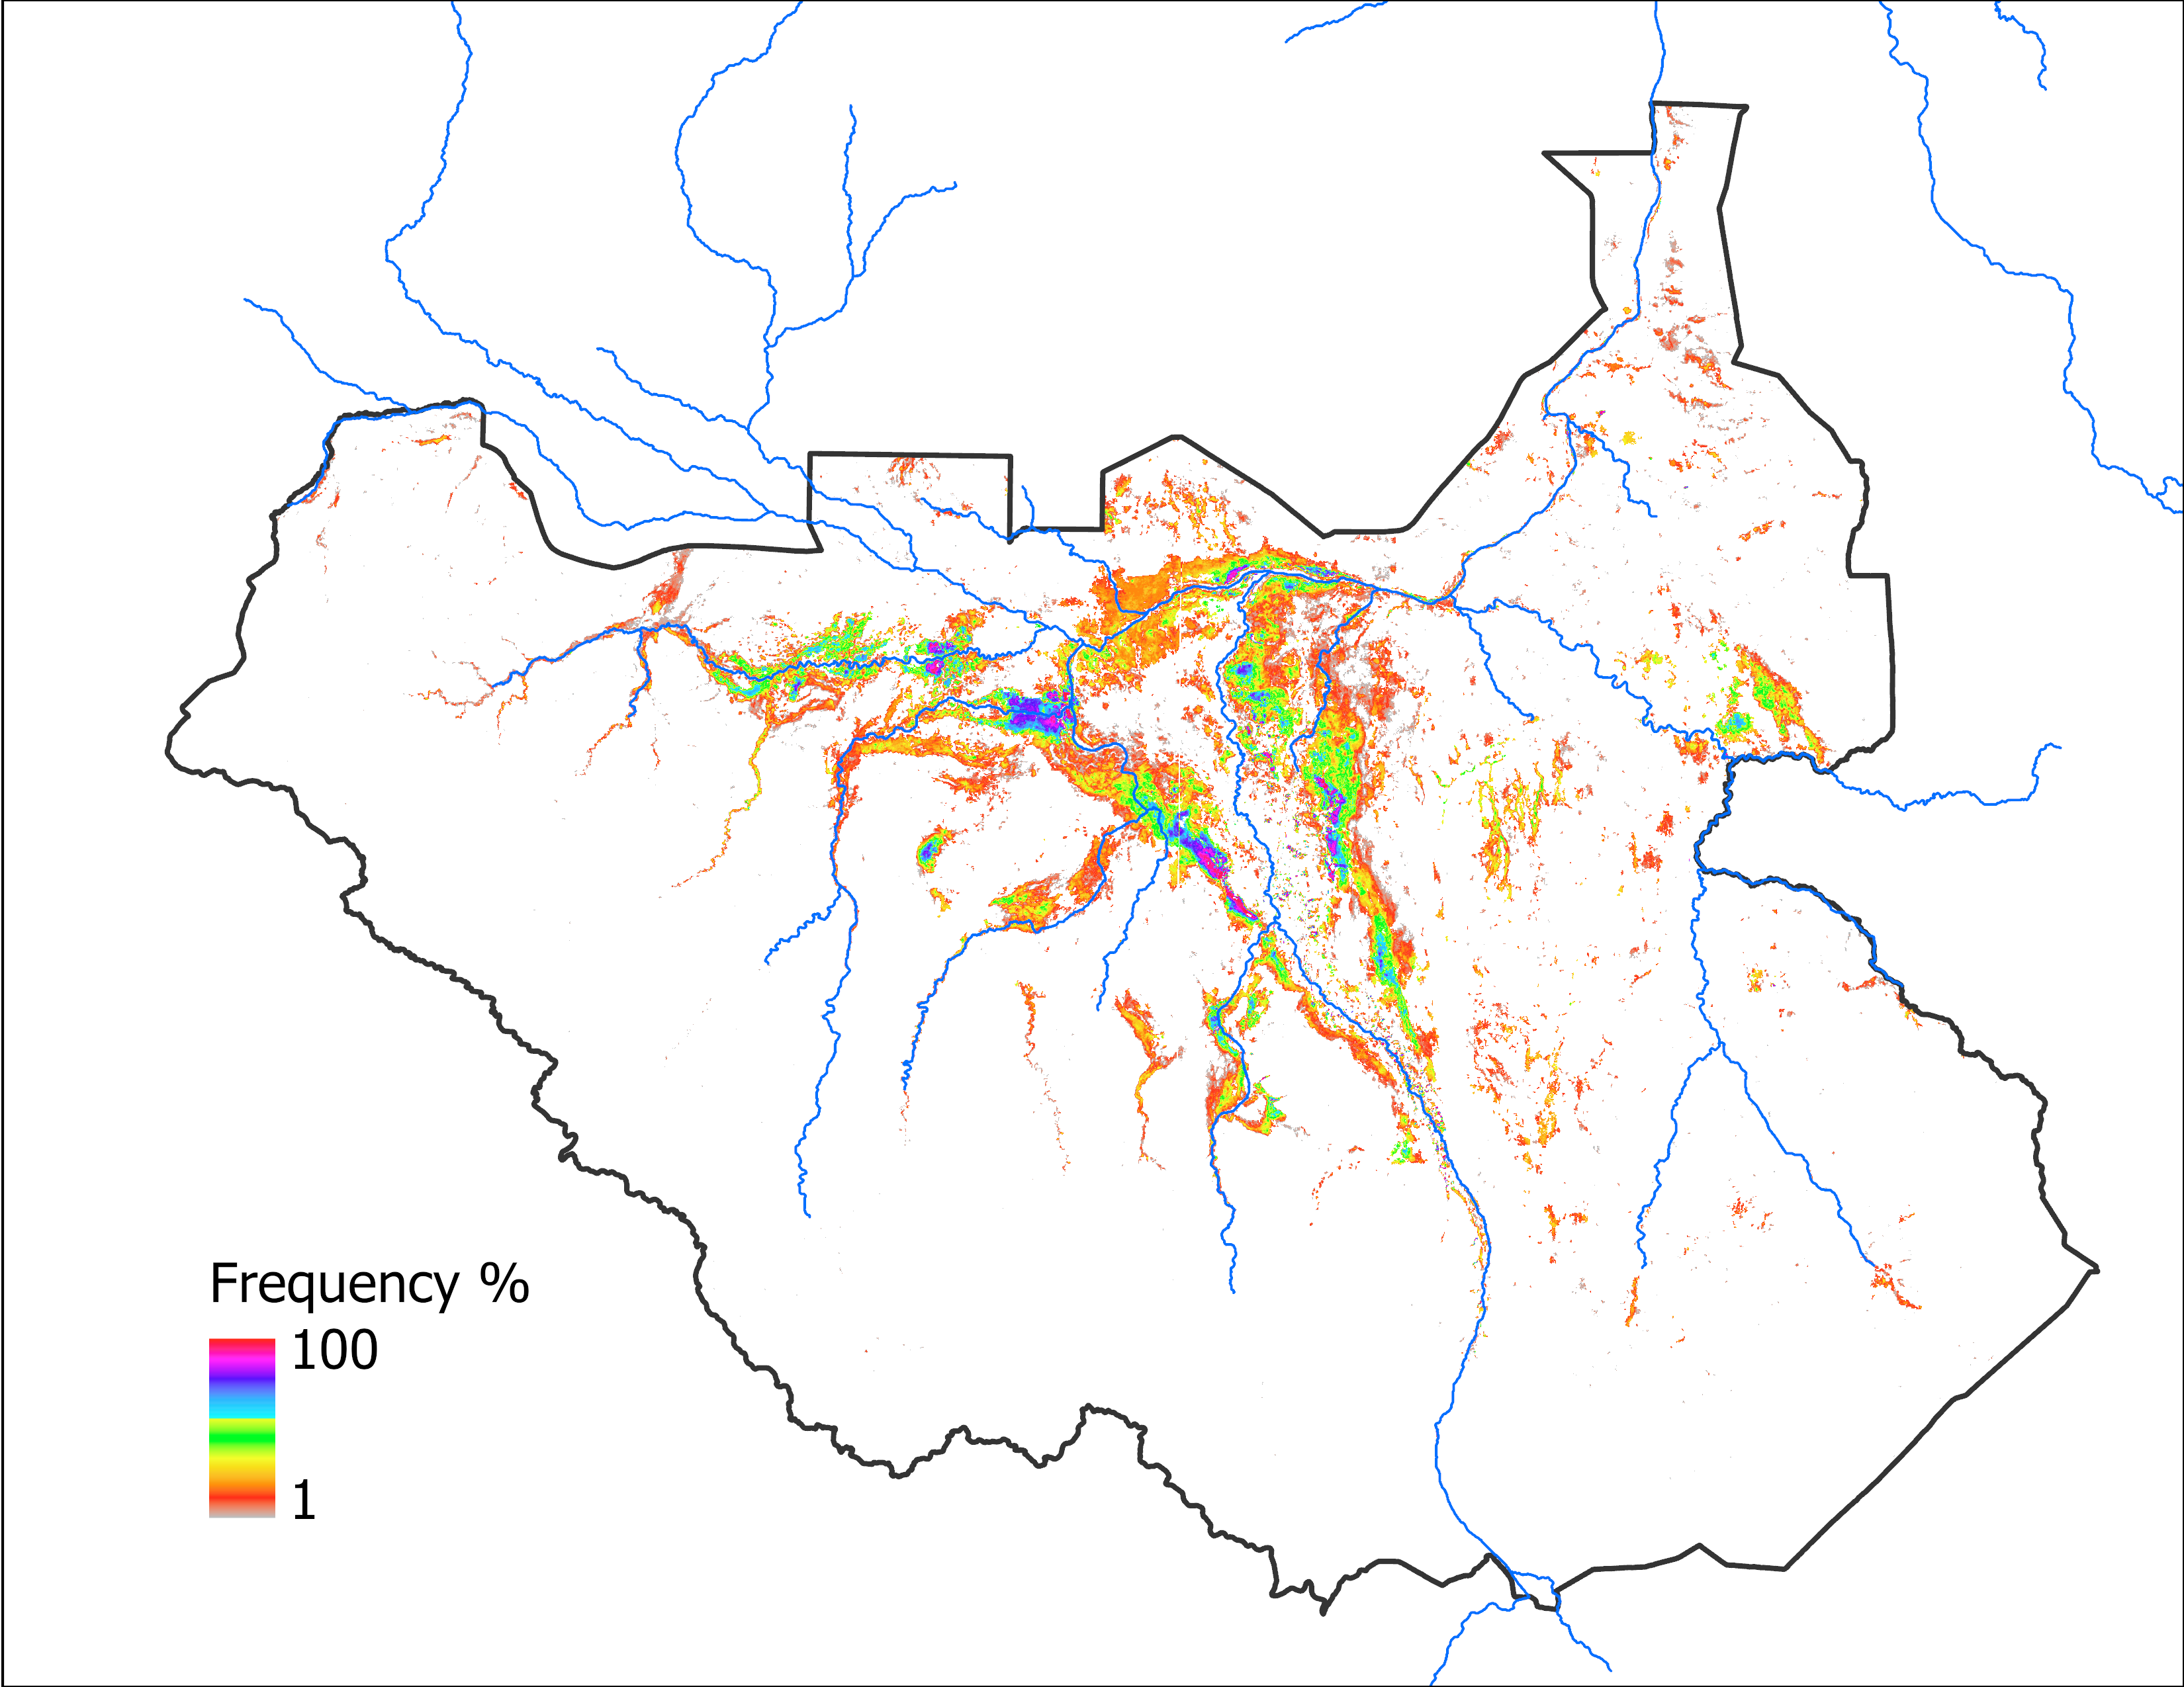
Predicted Flooding
Observed Oct 2024
Predicted Oct 2024 with SEP IC
Predicted Oct 2024 with SEP IC
69,374 km²
61,533 km²
Based on 2020 analog year
64,232 km²
Based on LASSO

Slide 13
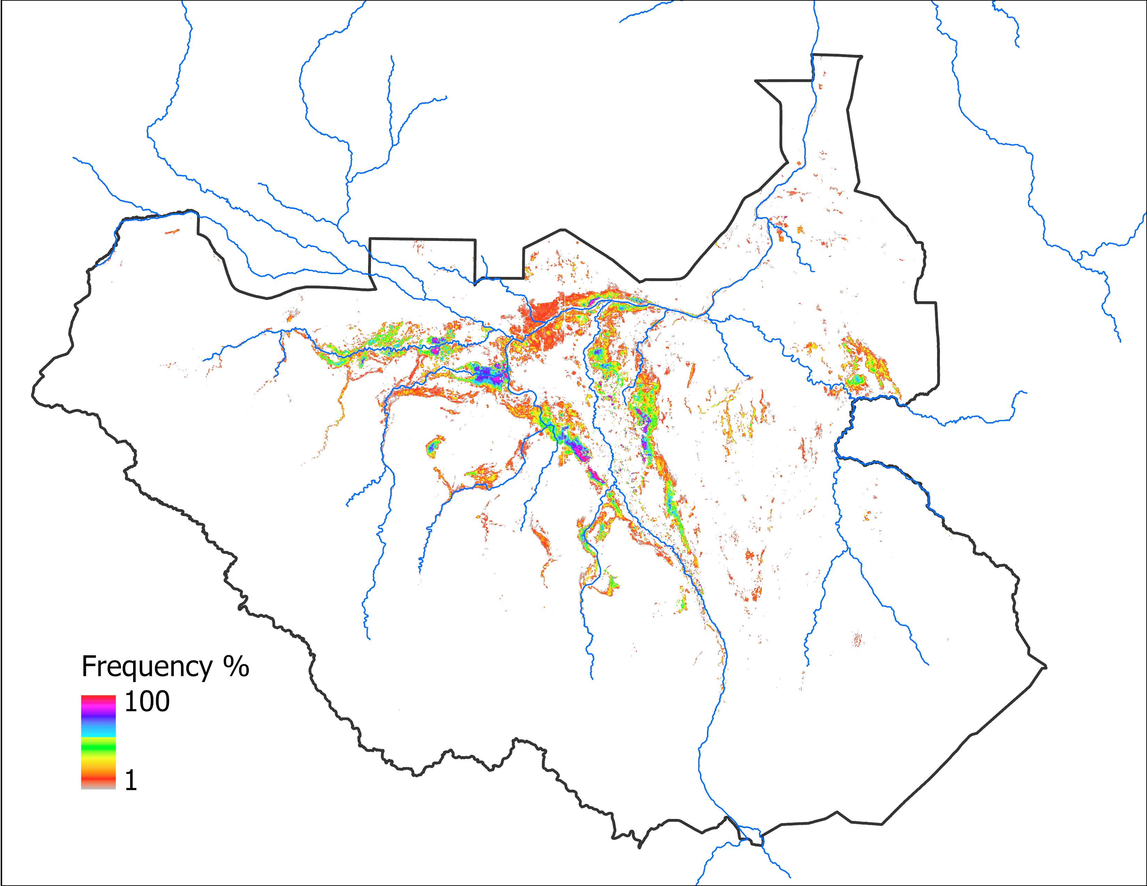
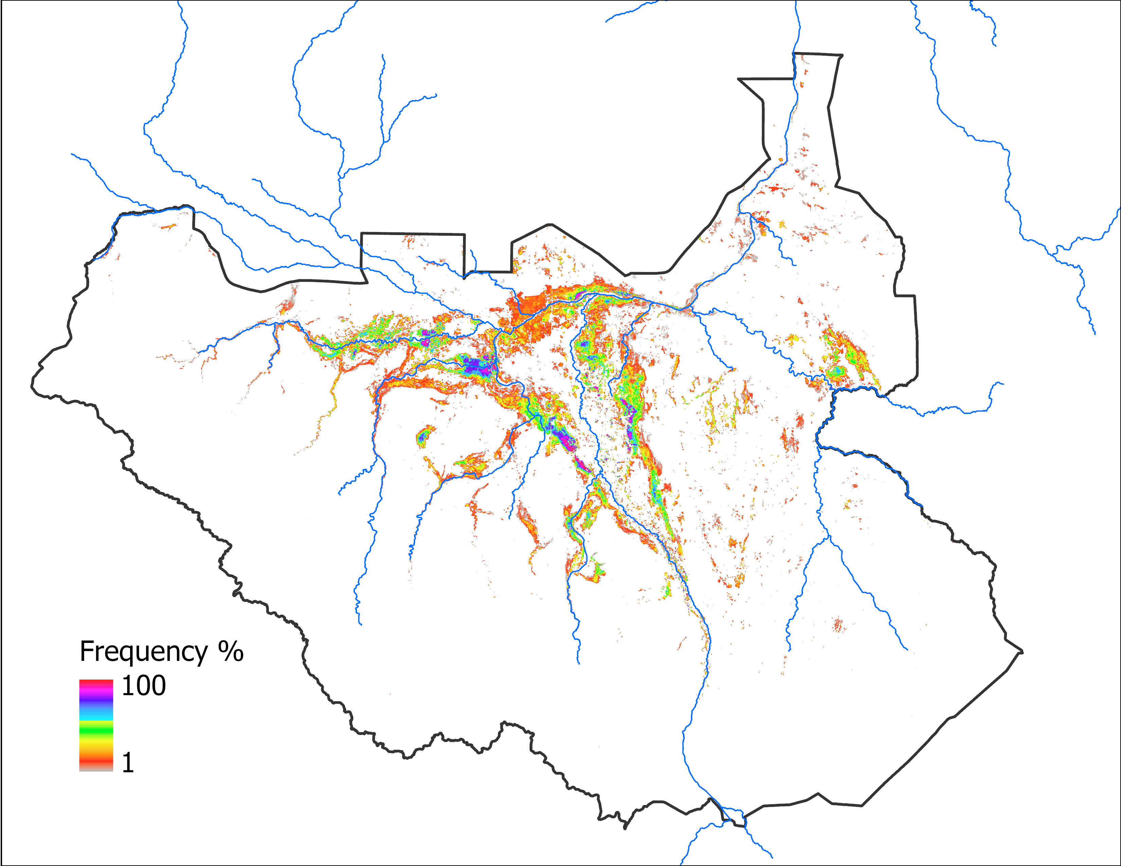
Predicted Flooding
Observed Nov 2024
Predicted Nov 2024 with OCT IC
Predicted Nov 2024 with OCT IC
52,945 km²
42,469 km²
Based on 2022 analog year
52,734 km²
Based on LASSO

Slide 14
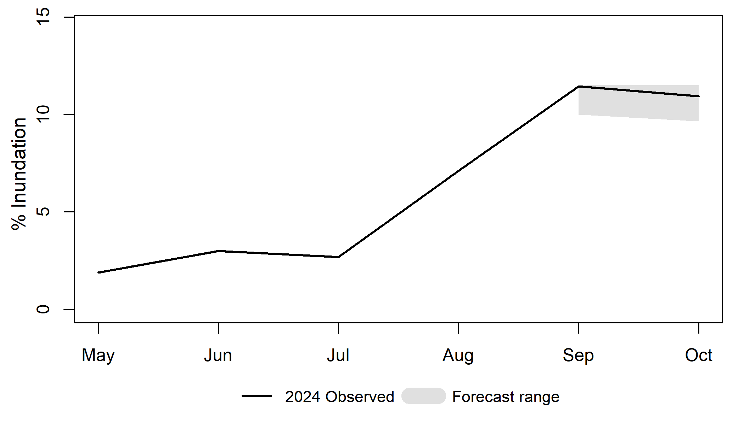
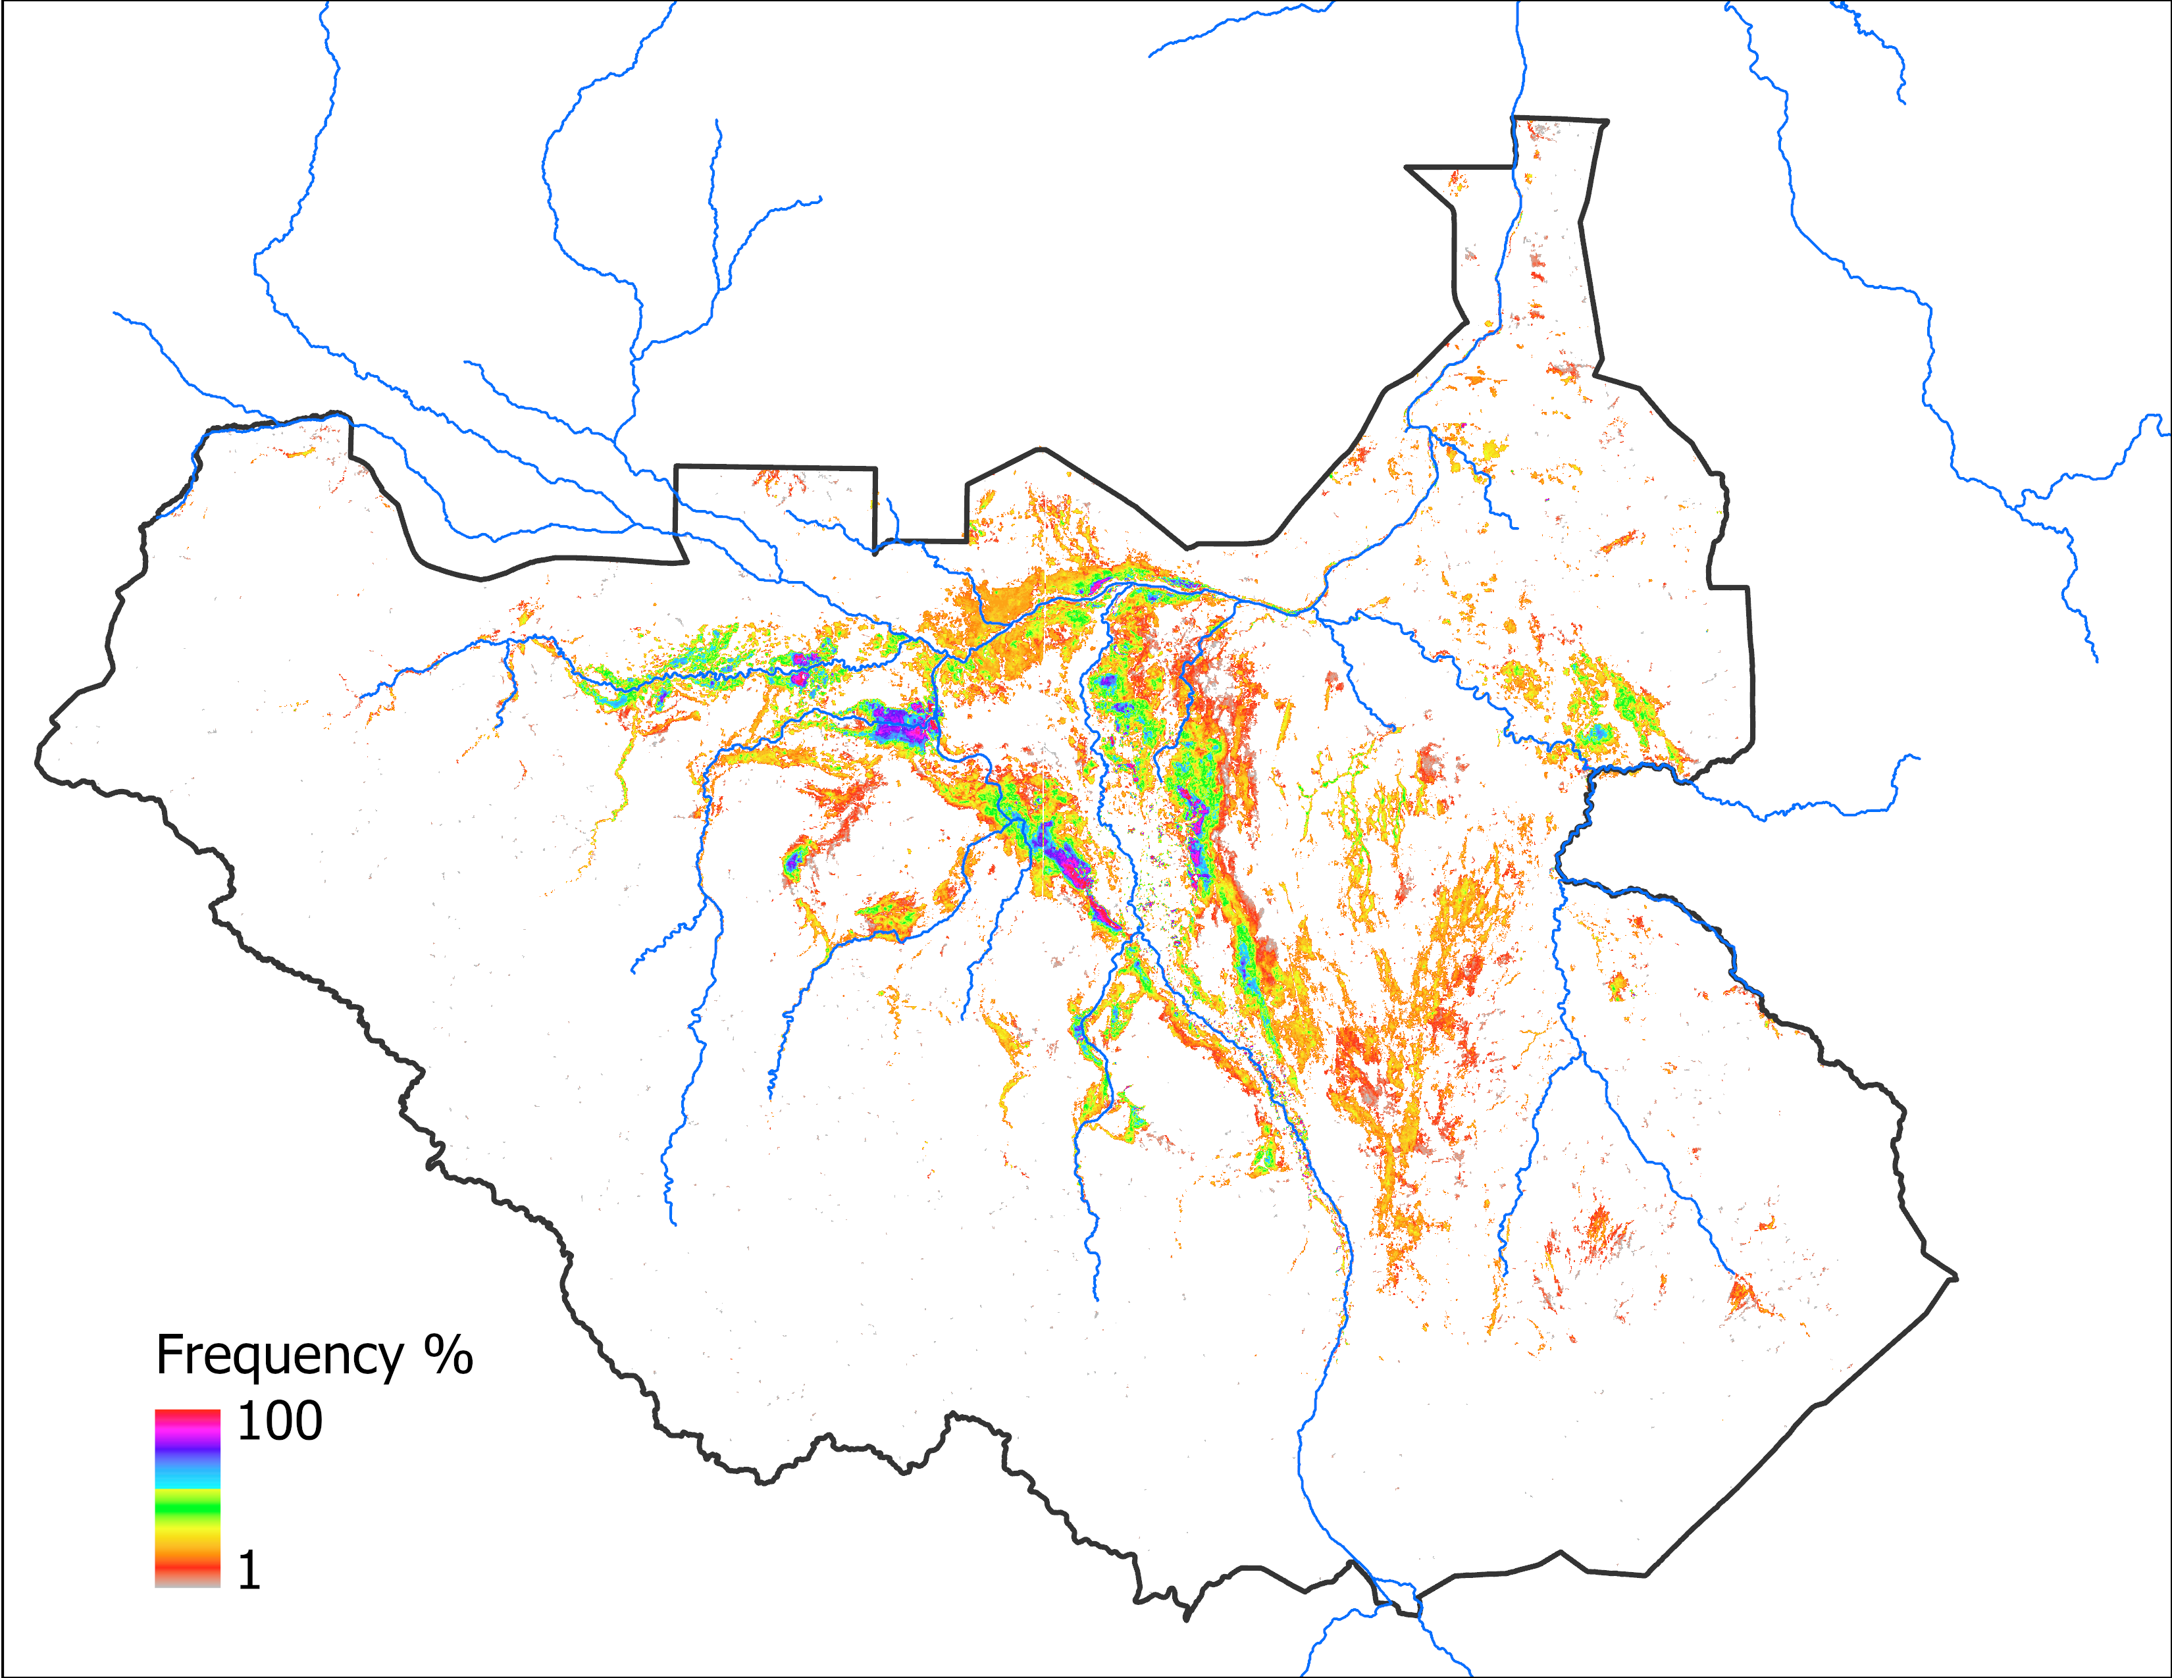
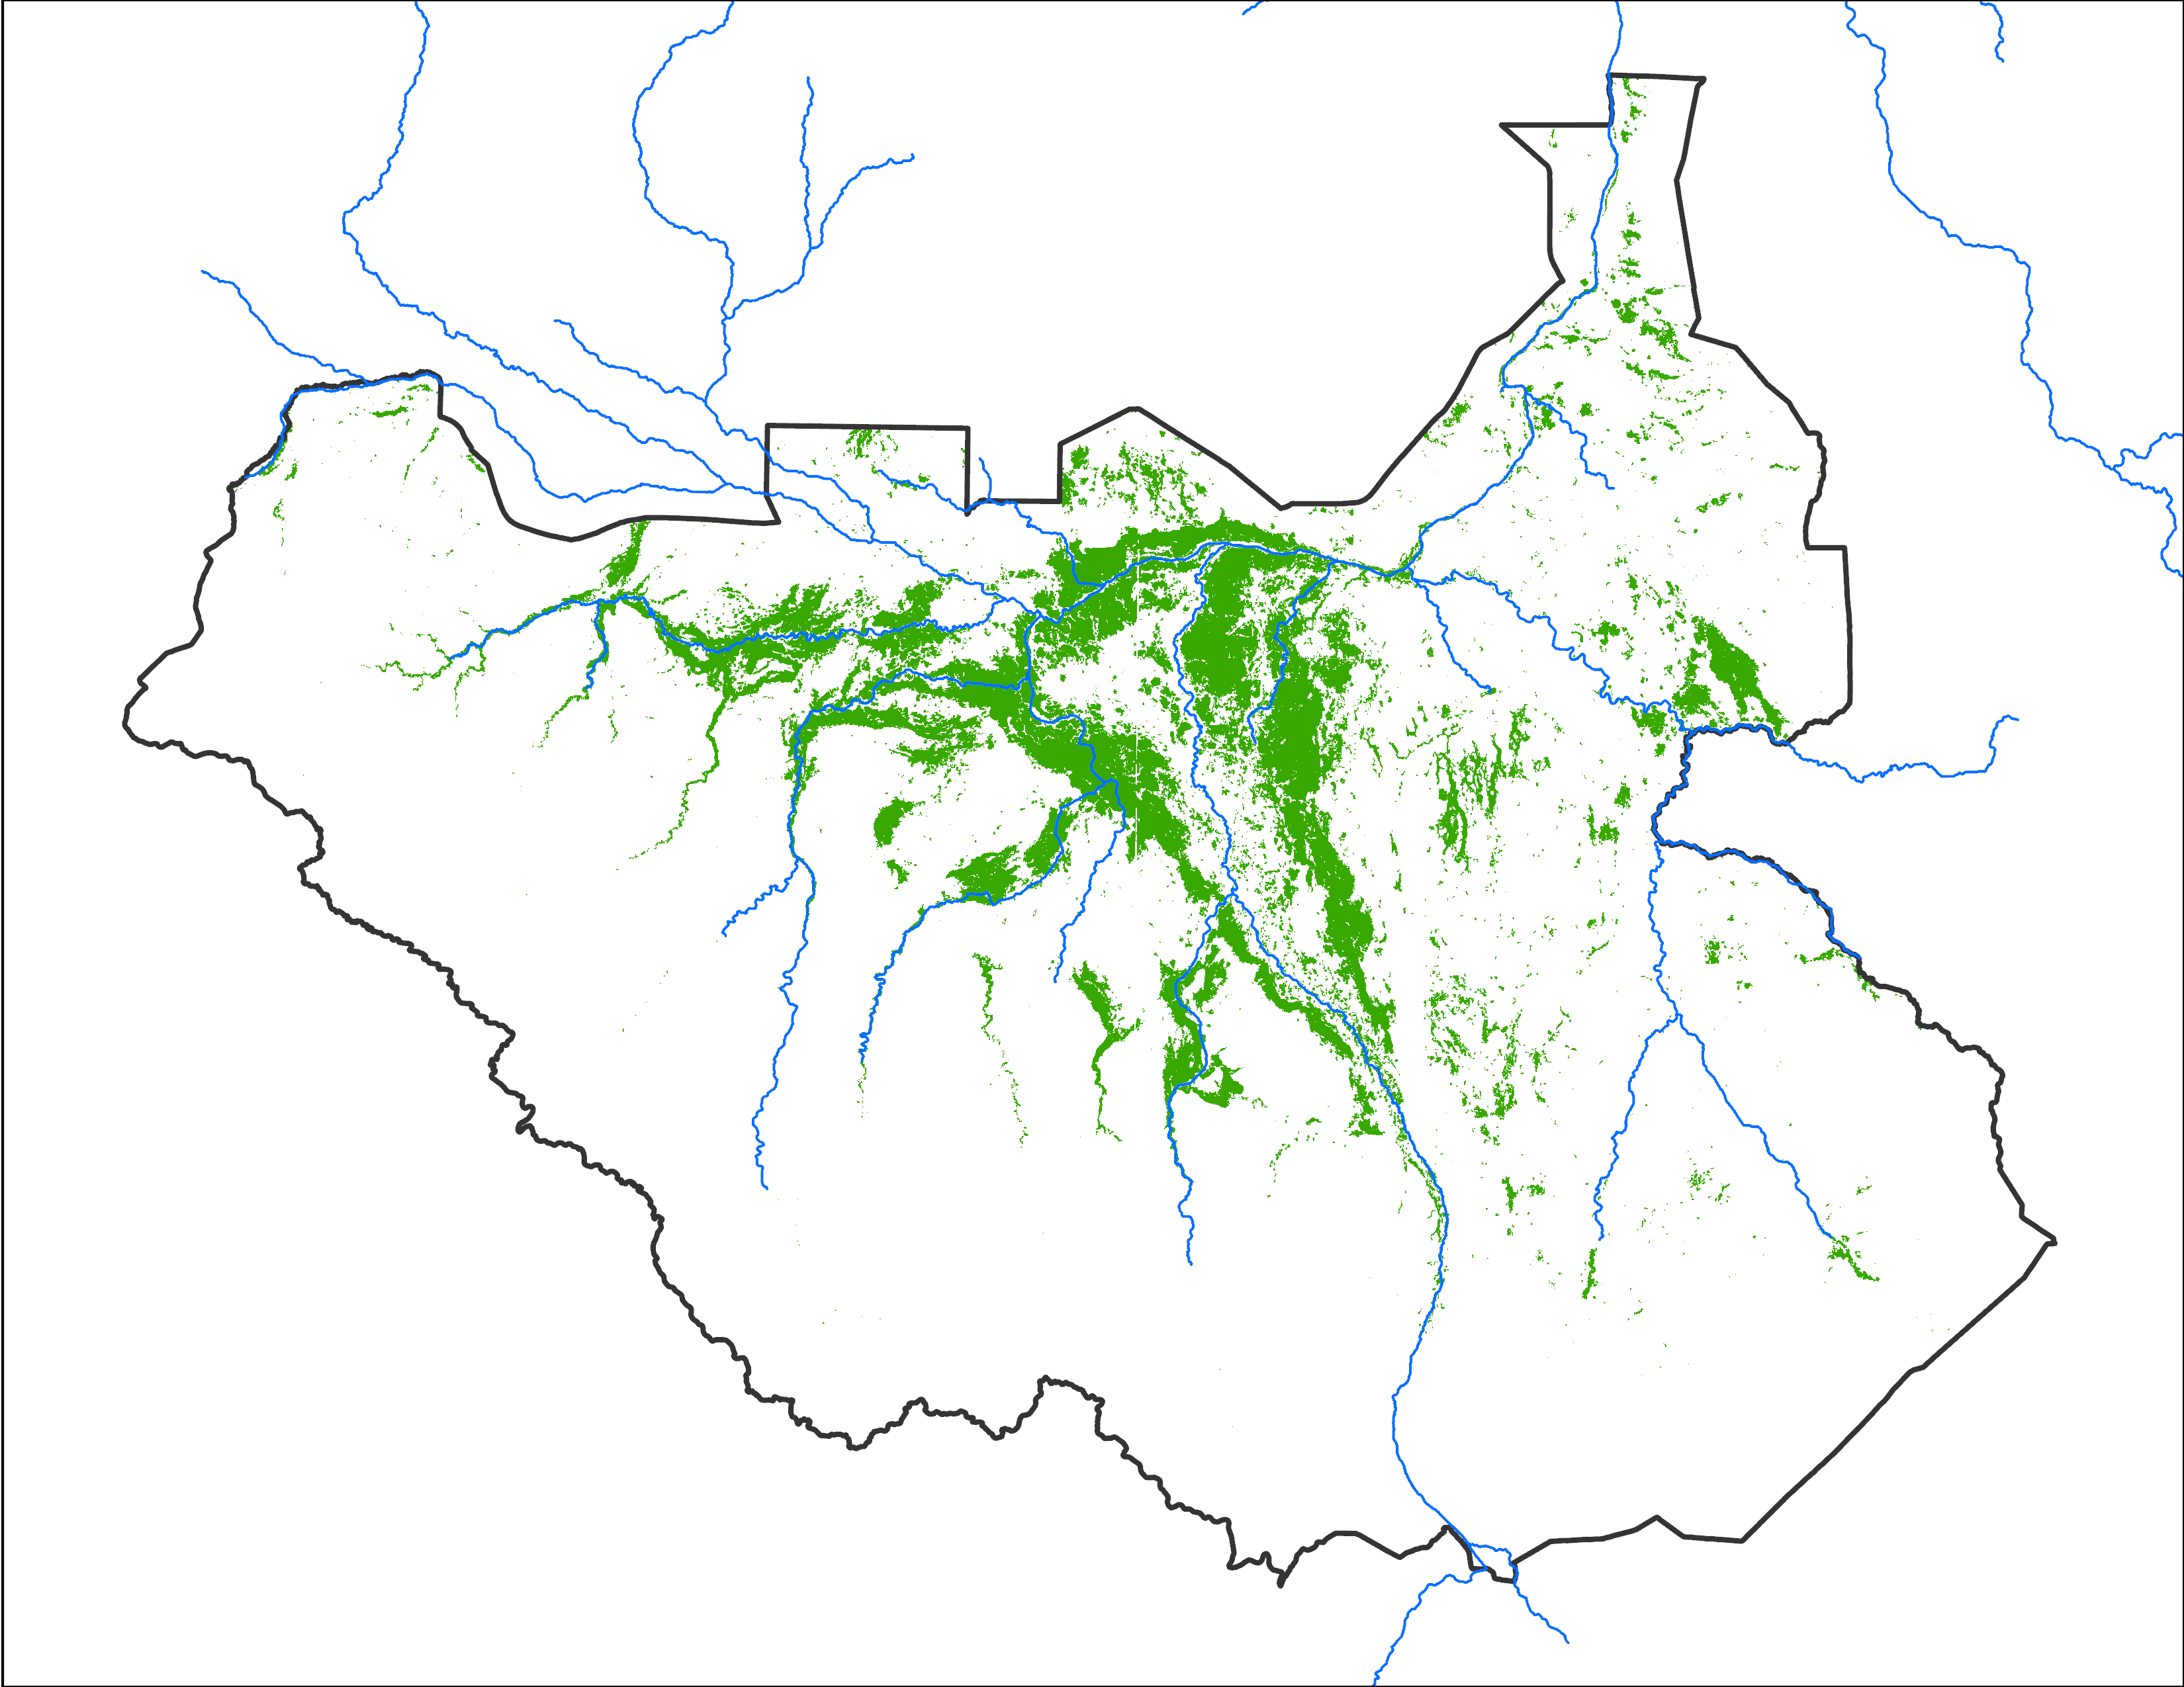
Predicted vs Observed Comparison
Predicted Oct 2024 with AUG IC
Predicted vs observed
72,342 km²
Based on 2020 analog year
61,533 km² (85% accuracy)
Common between Oct 2024 predicted (Aug IC) and Observed Sep 2024
The graph on the left shows predicted range in gray shade for Sep and Oct of 2024 and observed inundation with black line. Predictions were made starting in May with monthly updates.
For Sep 2024, the predicted map (made in Aug) matched with observed at 85% accuracy.

Slide 15
Impacts
The June 2024 FEWS NET Food Security Outlook for South Sudan included sound assumptions about the timing and extent of widespread seasonal flooding in the July 2024 – January 2025 outlook period.
Beginning in June of 2024, FEWS NET provided regular input to the South Sudan Flooding Technical Experts Working Group.
  The working group included the Ministry of Water Resources and Irrigation, the University of Reading INFLOW Project, the Nile Basin Initiative, WFP Climate and Earth Observation Team, UN OCHA, UK FCDO, FAO, and others.
The working group, in turn, advised the South Sudan Flood Preparedness and Response Taskforce, co-led by the Ministry of Humanitarian Affairs and OCHA
  1.4 million people were affected, including 379,000 people who were displaced
  75,000 hectares of cropland were impacted, with 72,500 tons of crop loss
There is an article available on reliefweb and FEWS NET Linkedin page that provides more detail on this work
https://dub.sh/GlzW3rc

Slide 16
Thank you
spervez@usgs.gov

Slide 17


Predicted Estimate to Spatial Distribution
Let’s say LASSO predicted inundated area is : 9 units (each square is one unit)
100
100
100
P
P
P
82
82
82
82
100
45
45
100
95
95
+
C
P
P
P
P
88
88
87
87
95
95
P
P
P
P
65
65
65
65
73
73
75
C
P
73
32
25
% of times inundated out of 130 months (frequency map)
current inundated area map (initial condition)
spatial distribution of predicted inundation
Total of 12 units with initial condition

