Slide 1
South Sudan Flood Monitoring and Prediction - 2024 Season
FEWS NET Science Team
December 31, 2024

Slide 2

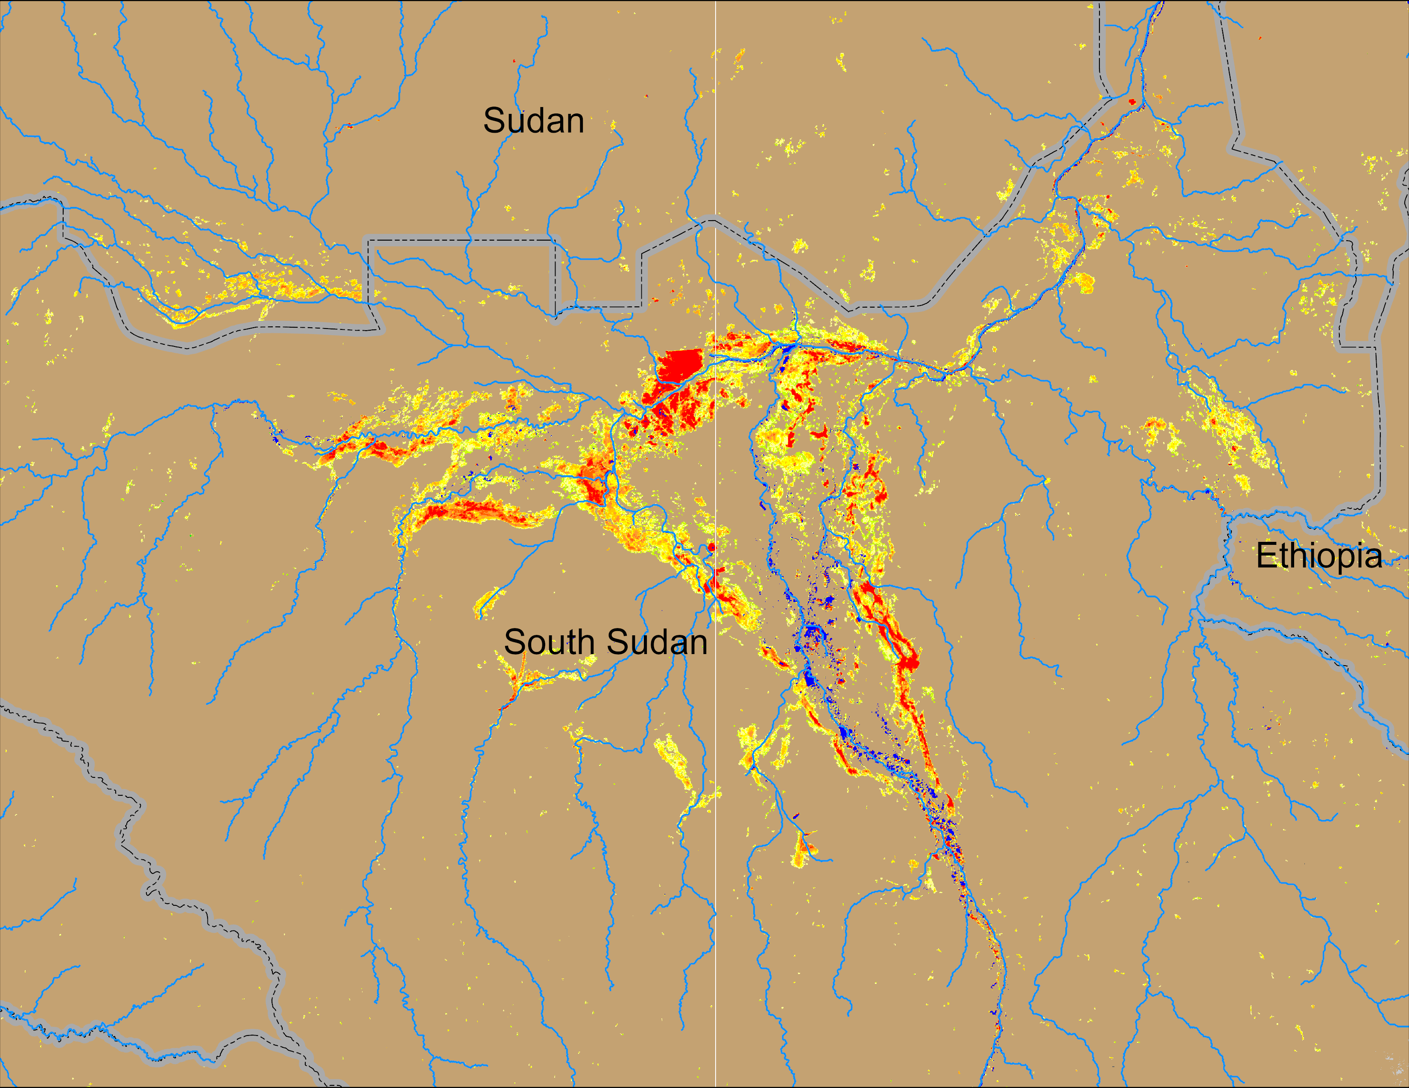
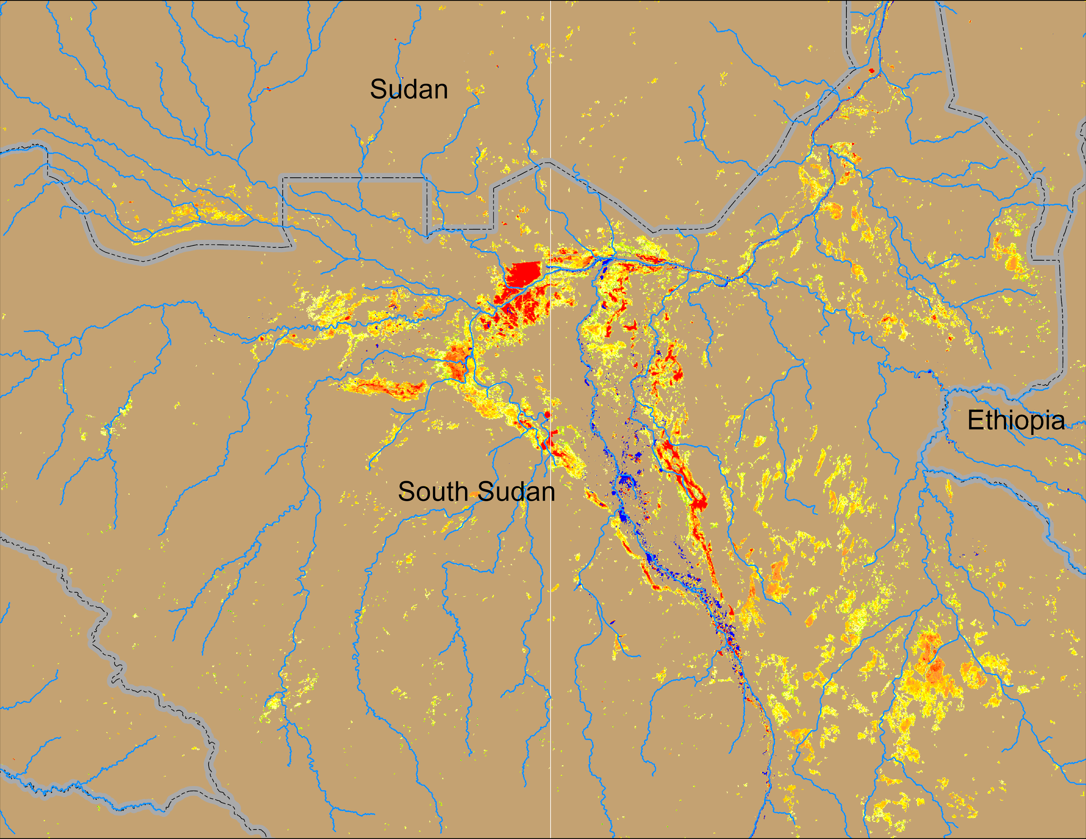
Flooding Conditions in South Sudan
(% of the pixel)
(% of the pixel)
Sobet
Sobet
Akobo
Akobo
Pibor
Pibor
NOAA VIIRS 5-day comp.: 26 – 30 Nov 2024
NOAA VIIRS 5-day comp.: 25 – 29 Dec 2024
VIIRS misclassified burn scars as water.

Slide 3
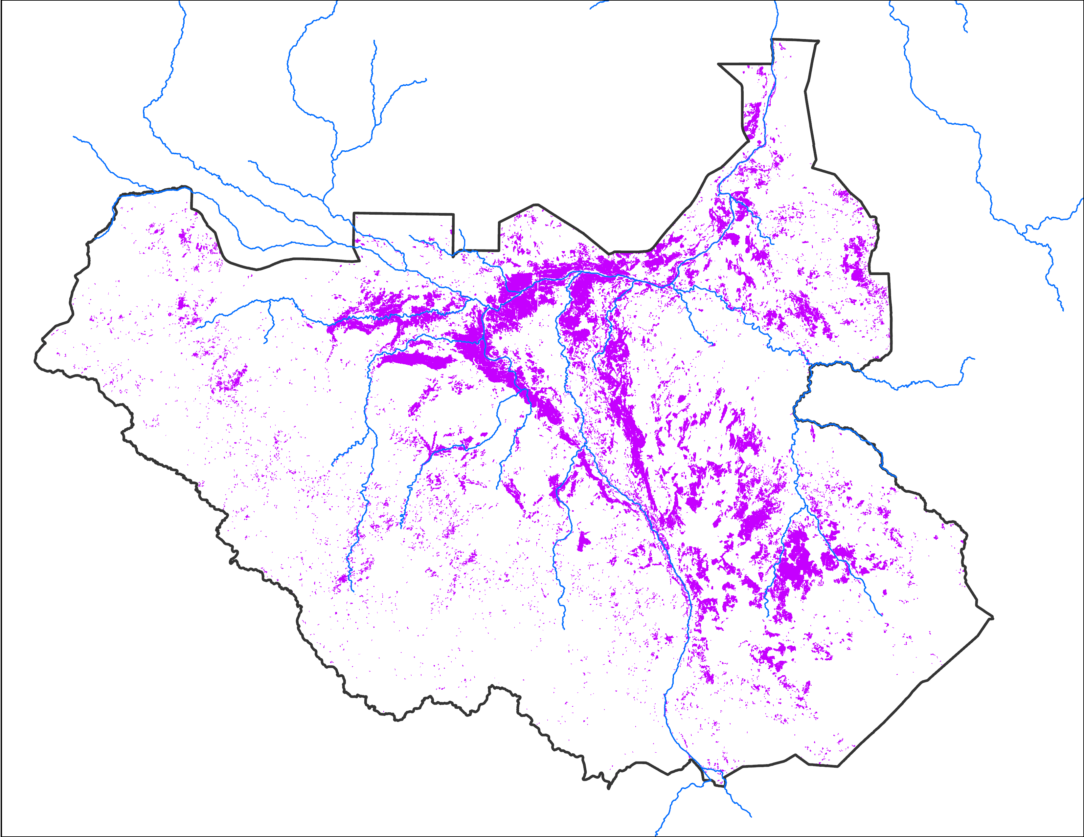
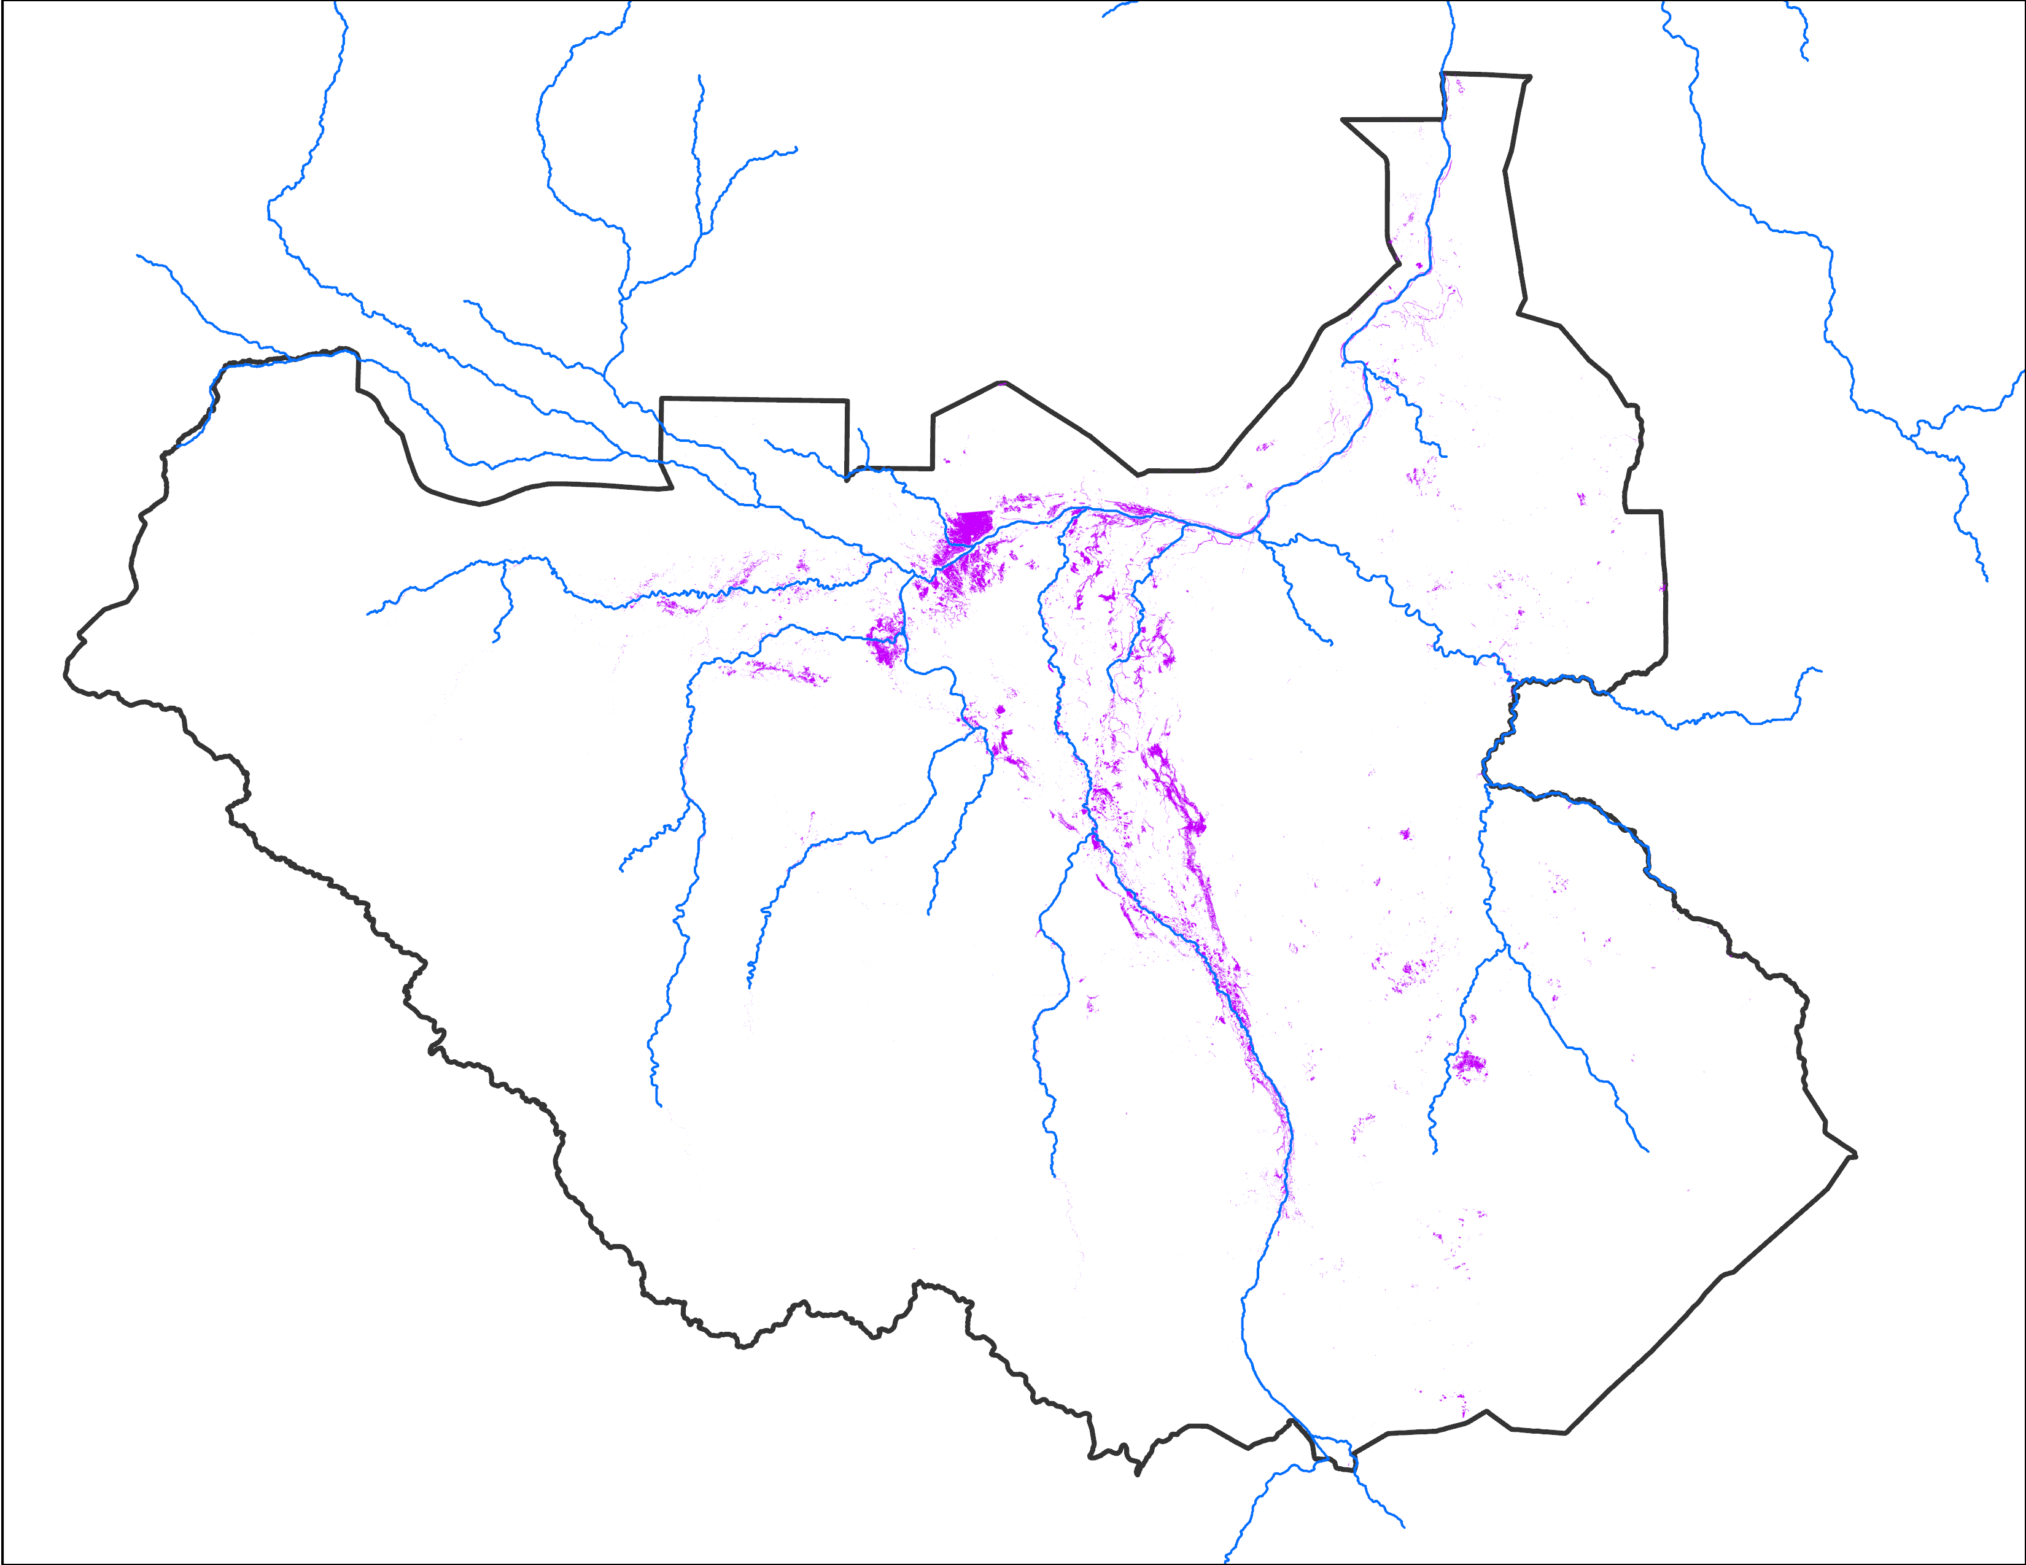
Flooding Progression
Dec 2024
Dec 2024
NOAA VIIRS: 74,542 km²
Landsat: 8,074 km²
NOAA VIIRS missclassified burn scars as water in December.

Slide 4
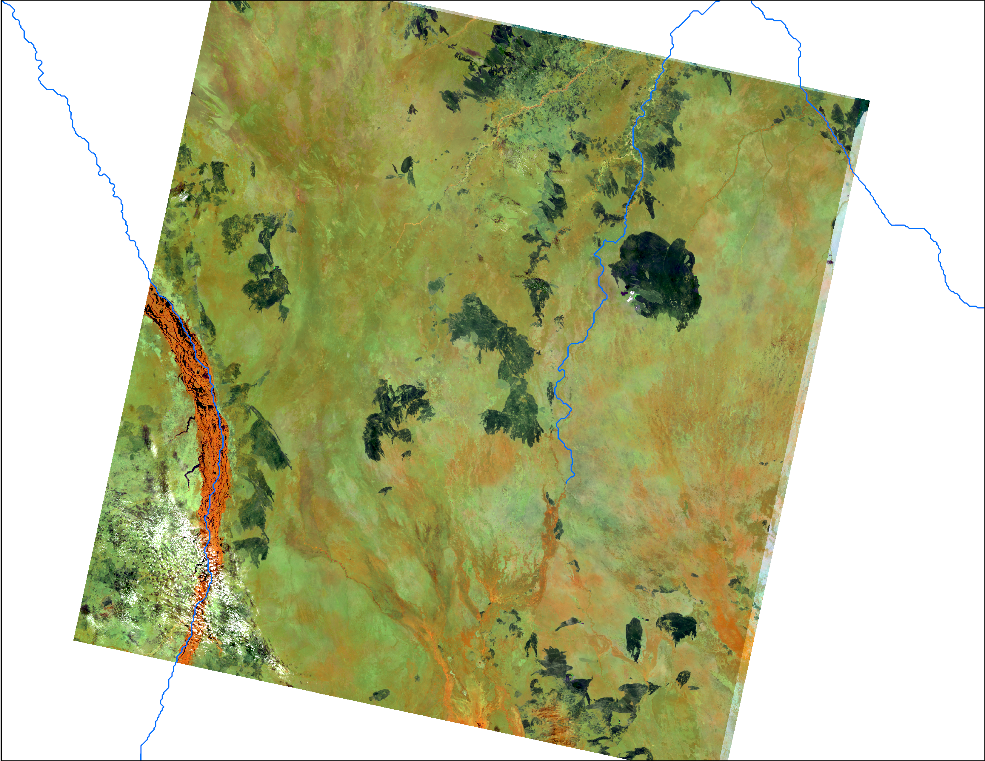
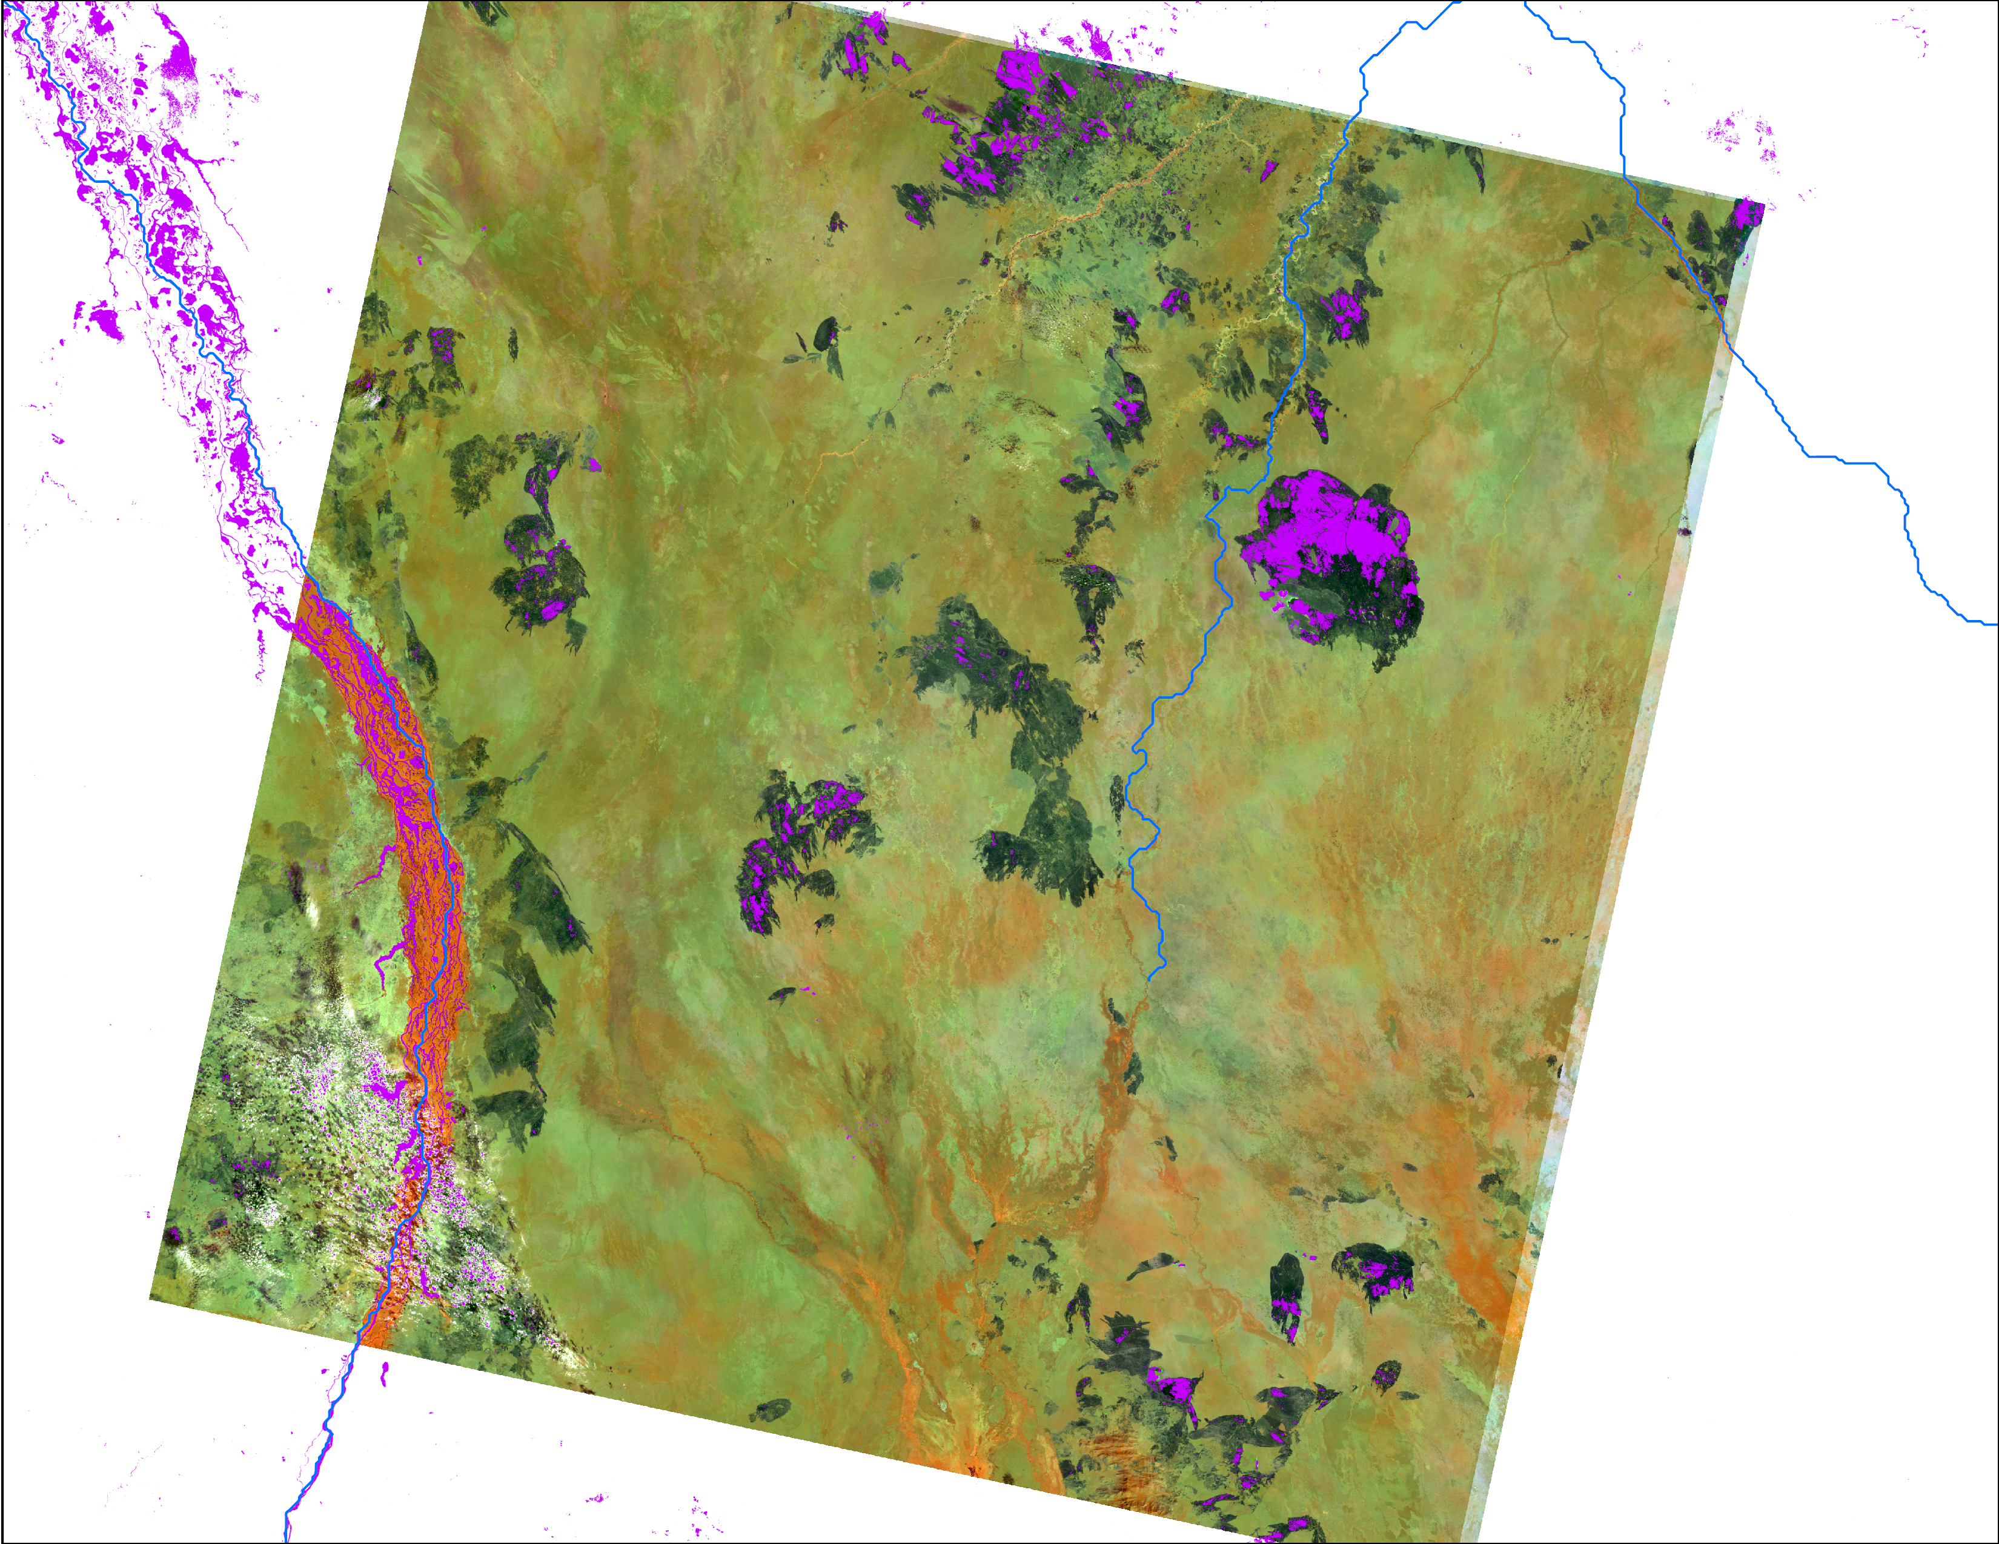
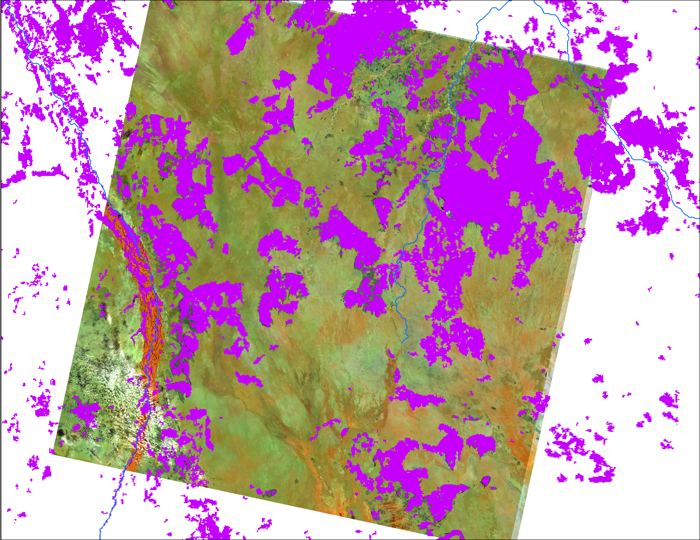
December 2024 Inundation
Dec 19, 2024
Dec, 2024
Dec, 2024
564 Landsat
Landsat flood map
VIIRS flood map

Slide 5
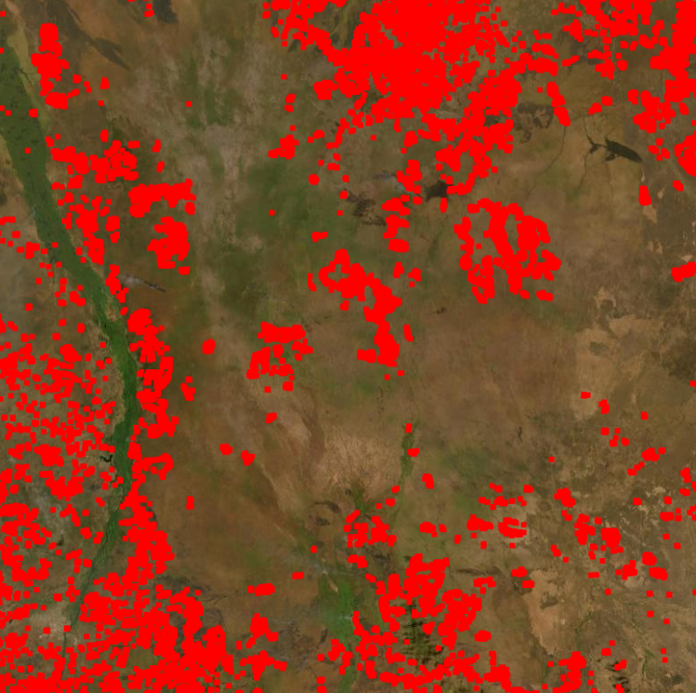
Flooding Progression
Dec 19, 2024
Dec 20 2024
564 Landsat
FIRMS two weeks fire

Slide 6
Thank you

