Slide 1
South Sudan Flood Monitoring and Prediction - 2024 Season
FEWS NET Science Team
November 19 , 2024

Slide 2
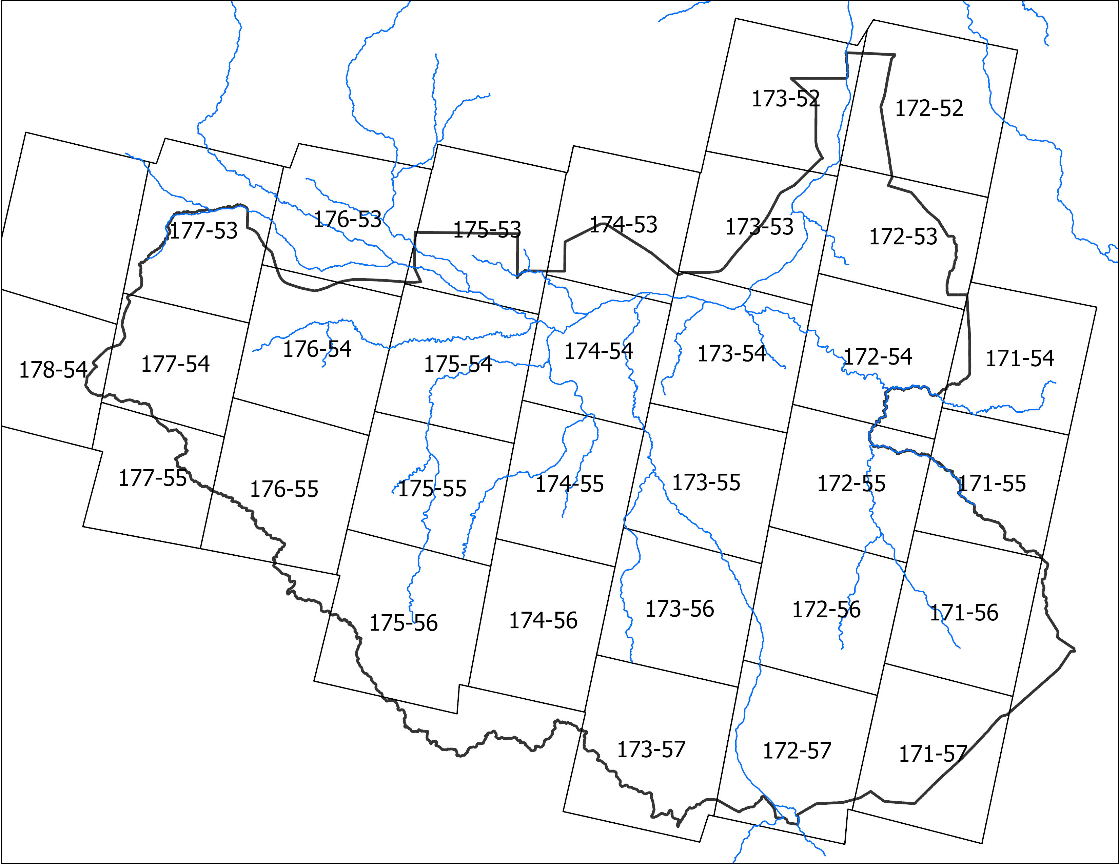
Surface Water Extent Mapping from Landsat
36 Landsat scenes required to cover South Sudan.
Jan – Apr period is relatively cloud free.
We mapped surface water extent from Landsat using AWEI algorithm (Feyisa et al., 2014).
Mapping was done for 2023 and 2024 Jan to Apr.
Roughly 60-70 Landsat scenes were used to create a monthly surface water extent composite.

Slide 3
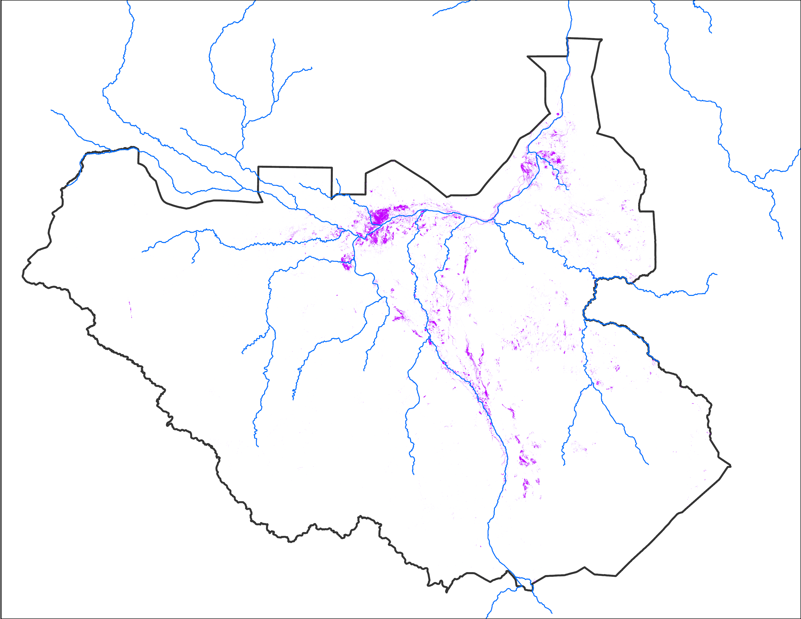
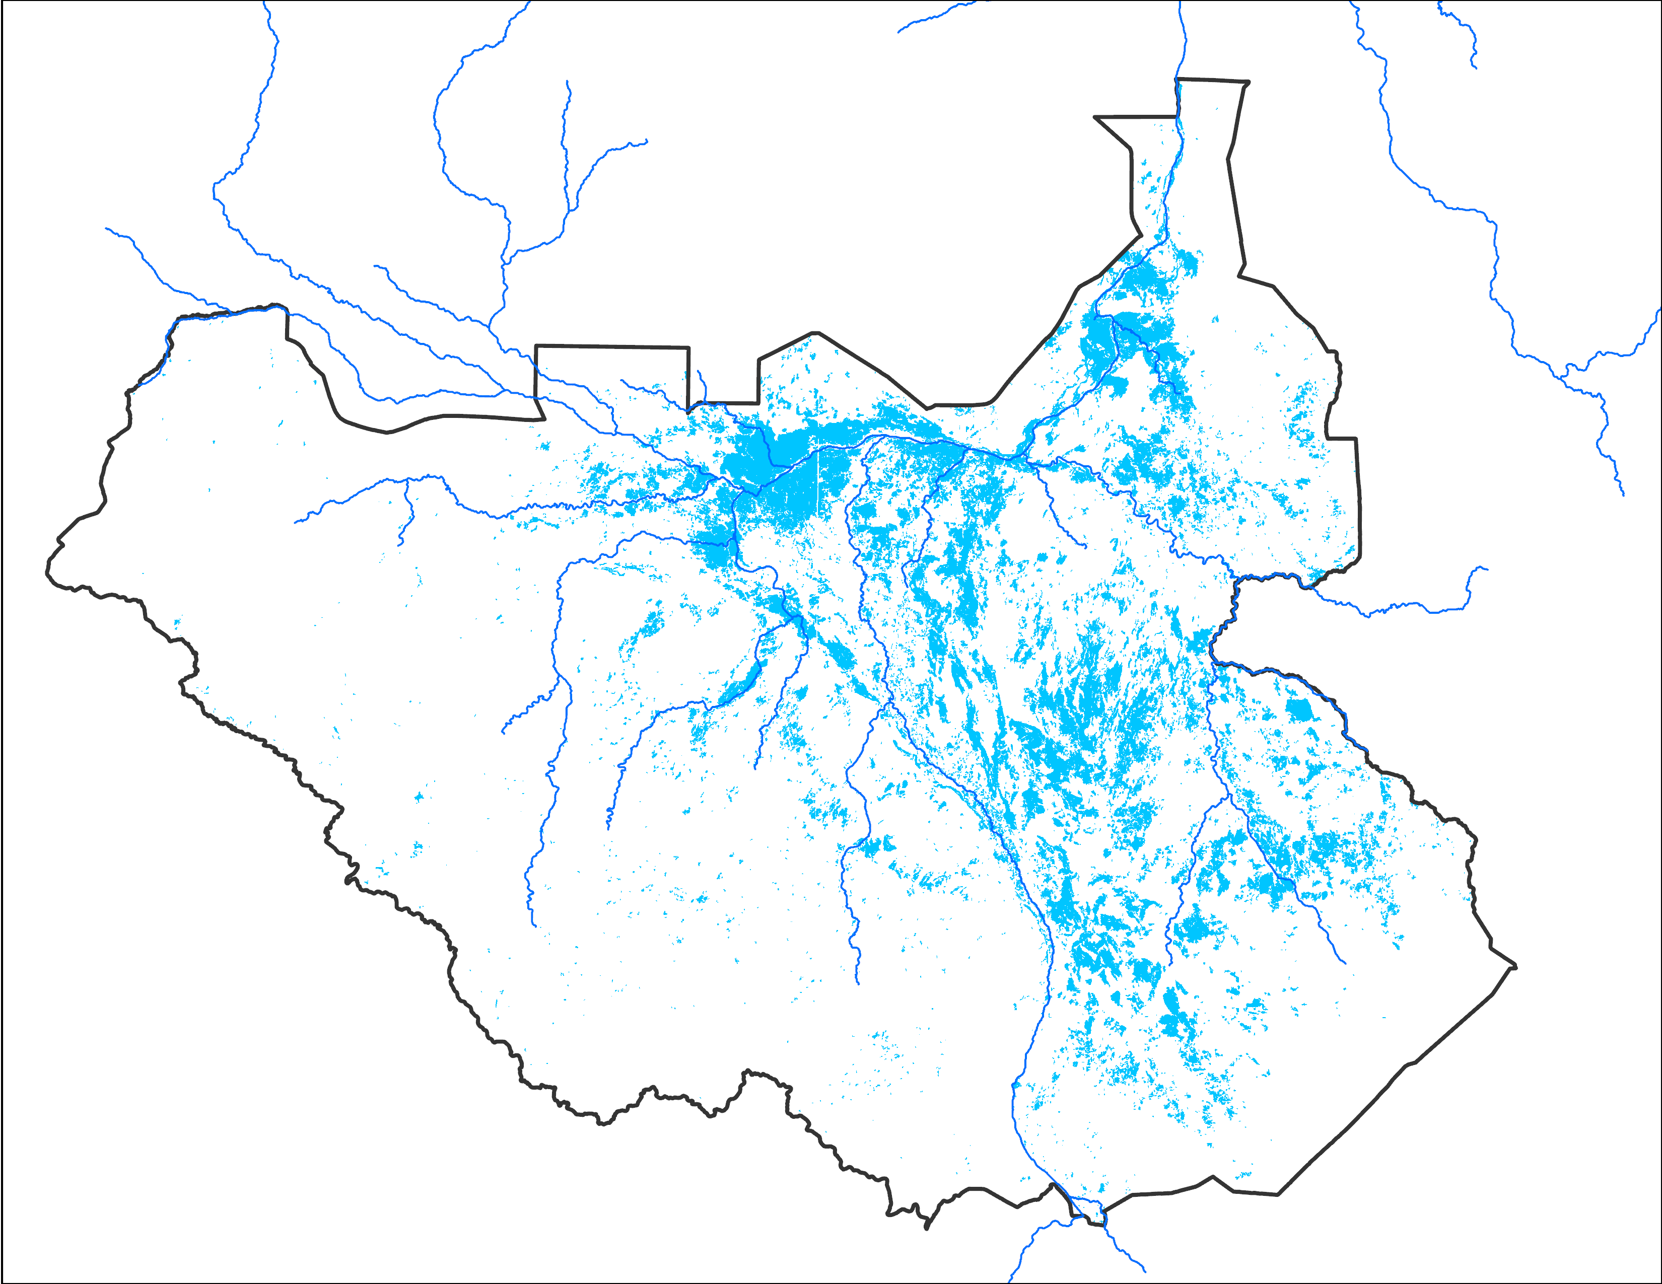
Surface Water Extent Comparison
Inundation from Landsat, January 2023: 10,961 km²
Inundation from VIIRS January 2023: 73,449 km²
Big difference in inundated areas from Landsat and VIIRS for January of 2023.

Slide 4
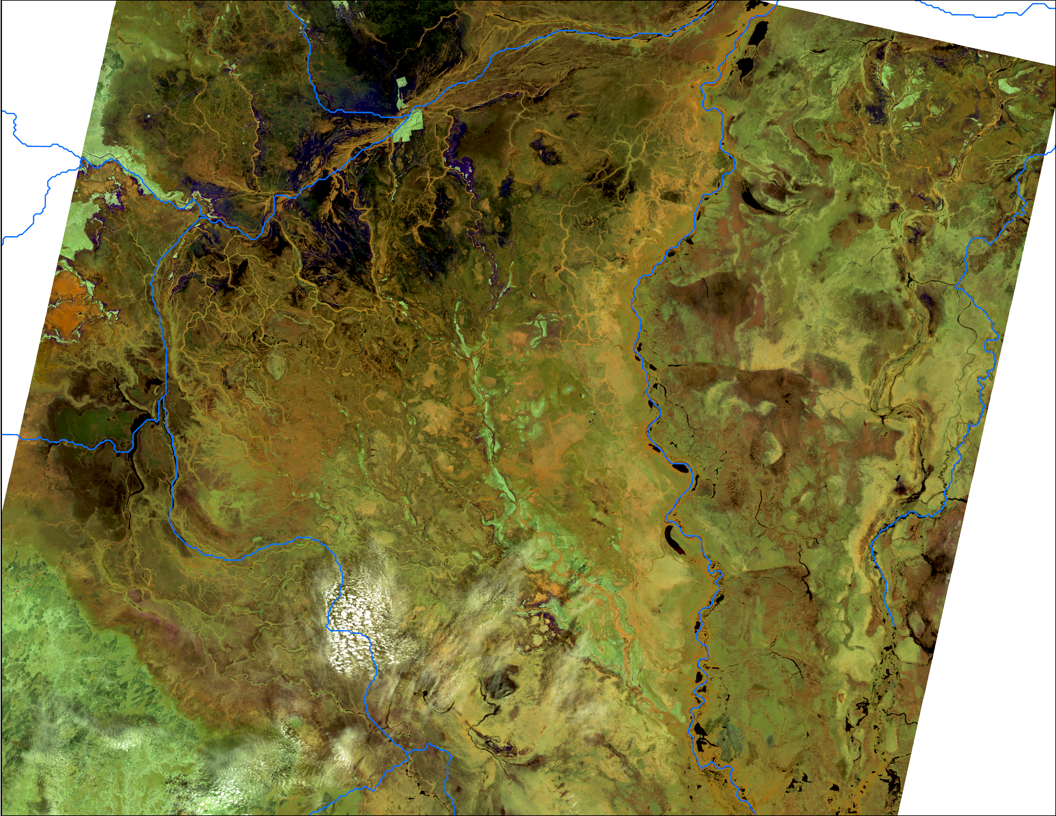
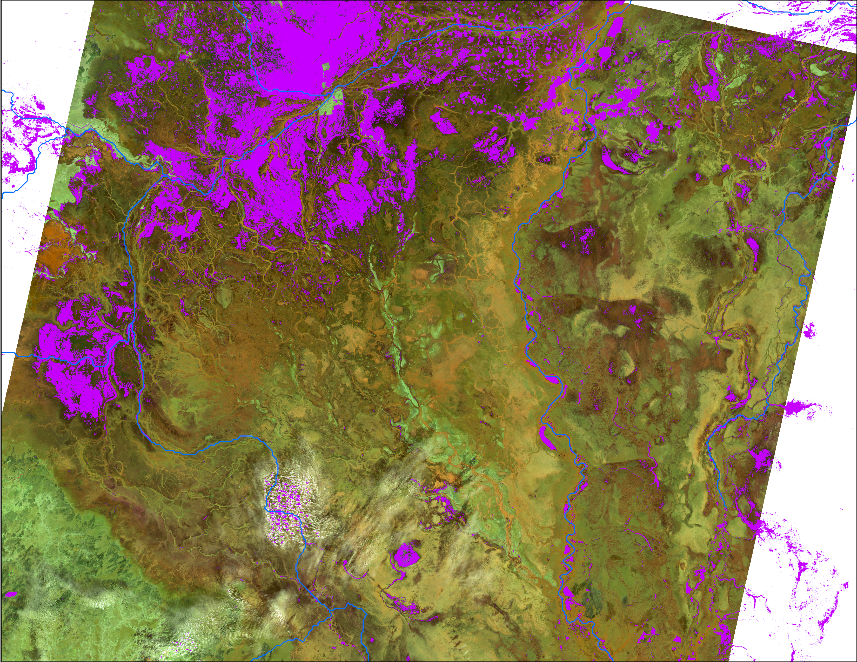
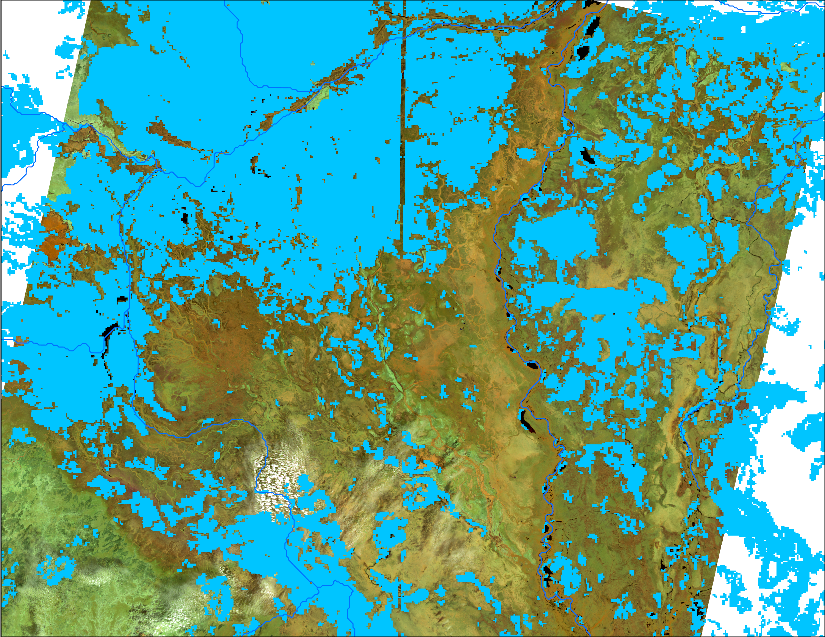
Surface Water Extent Comparison
L9 false color composite 564 as RGB : Jan 13, 2023
Water pixels from Landsat Jan 13, 2023
Water pixels from VIIRS Jan 2023
This comparison of Landsat image, Landsat derived water pixels, and VIIRS water pixels shows how VIIRS was over estimating water pixels by including bare ground, perhaps with wet soil after the flood water retreated in January of 2023.
Similar overestimation in VIIRS were also observed in Feb, Mar and Apr.

Slide 5
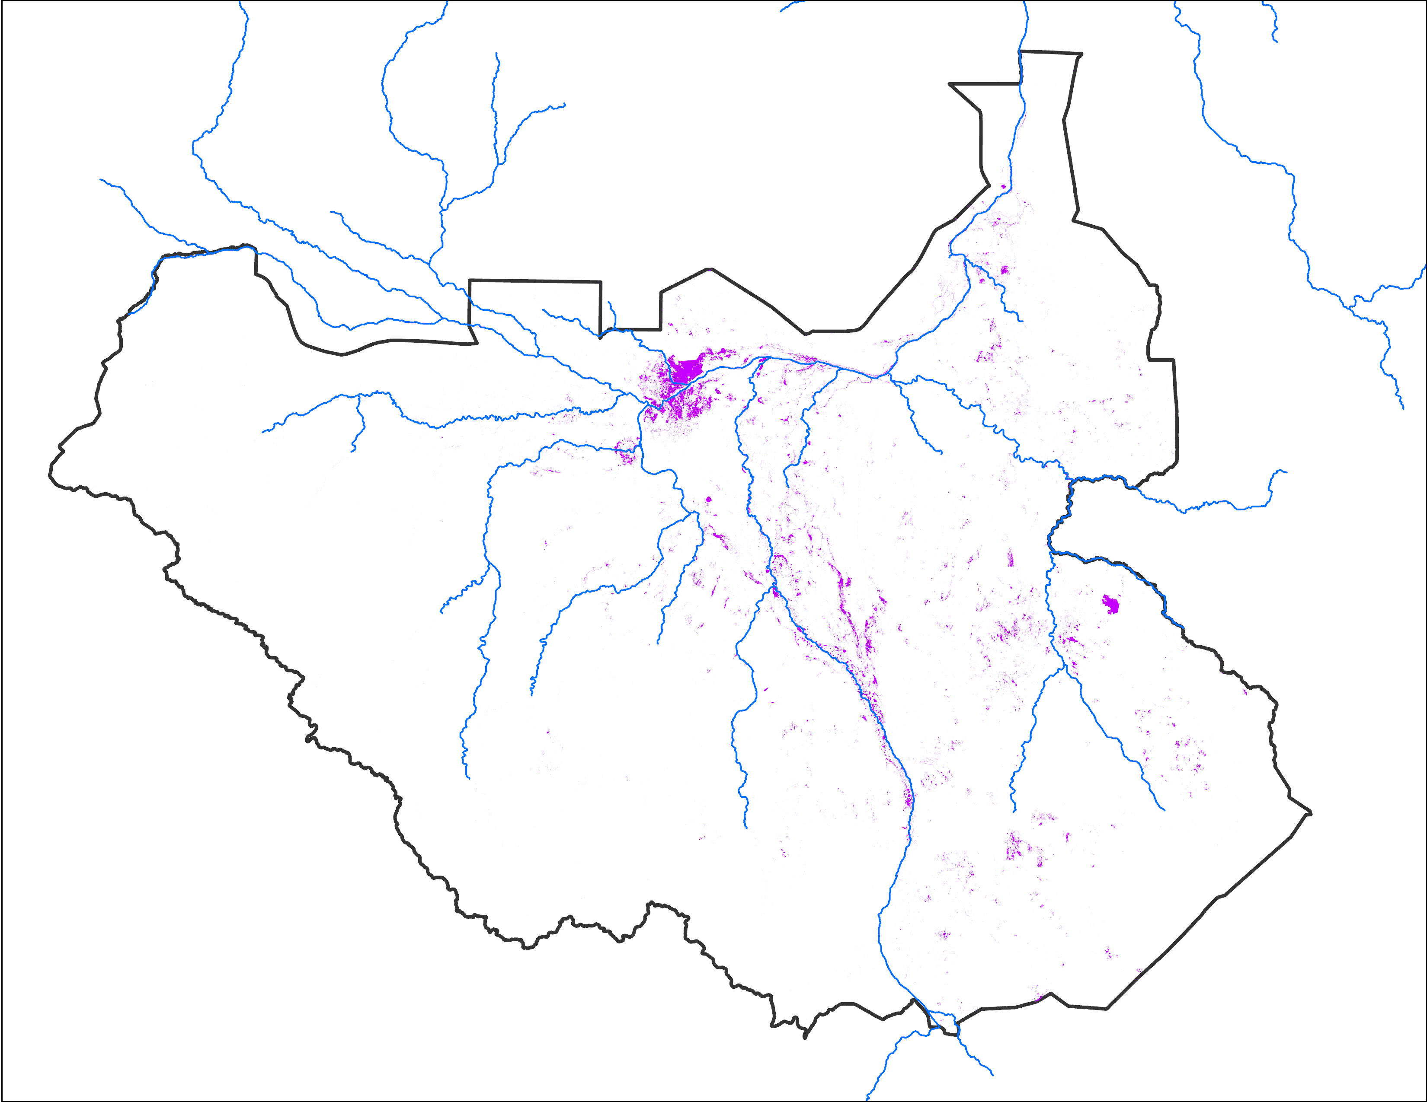
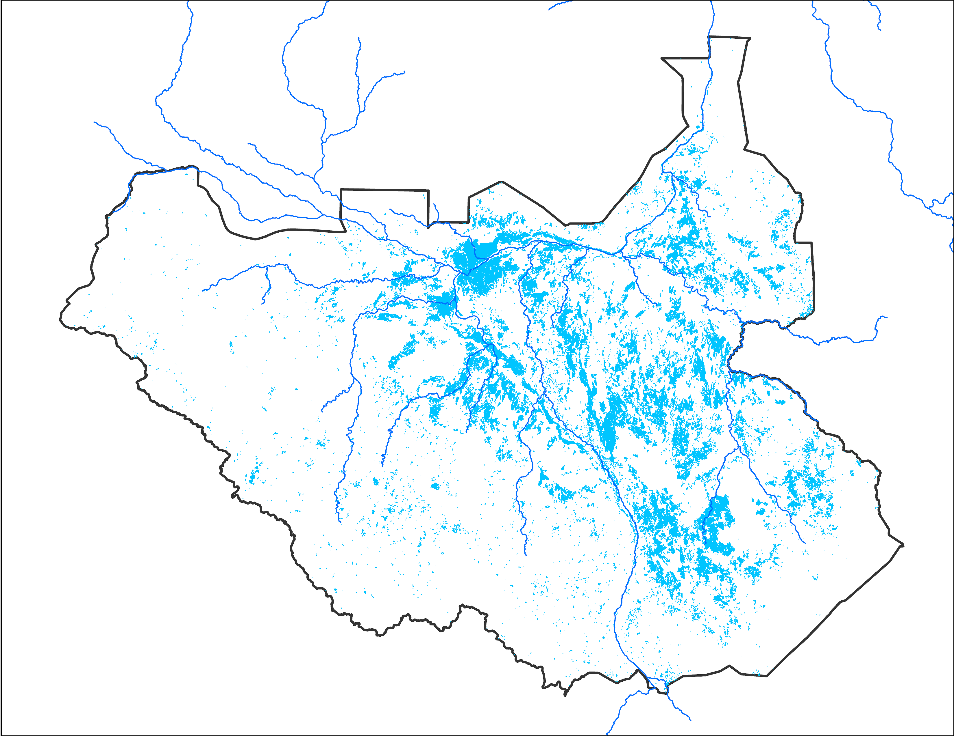
Surface Water Extent Comparison
Inundation from Landsat, January 2024: 9,571 km²
Inundation from VIIRS January 2024: 74,925 km²
Big difference in inundated areas from Landsat and VIIRS for January of 2024.

Slide 6
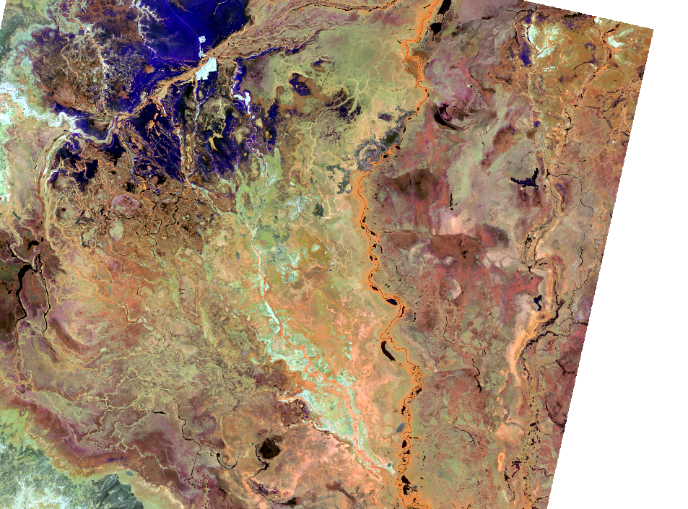
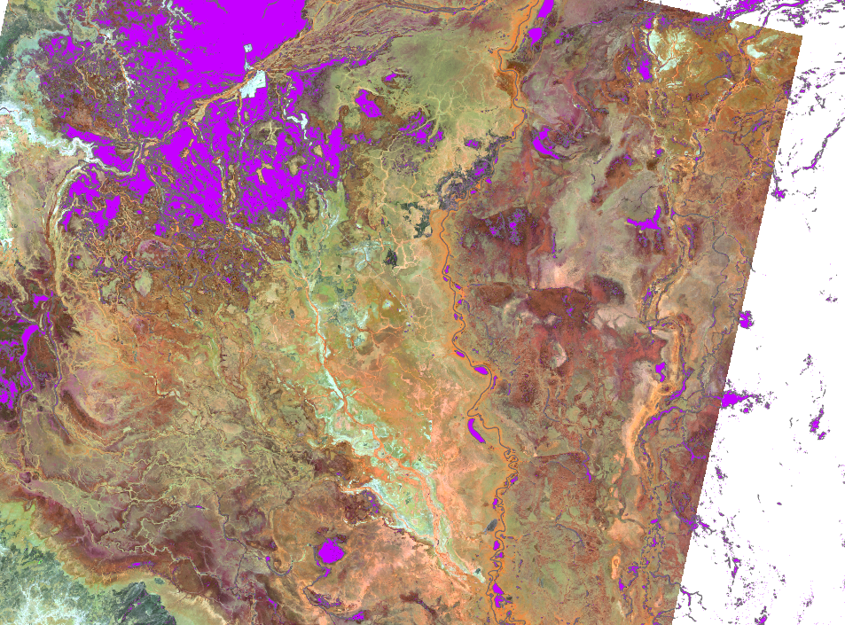
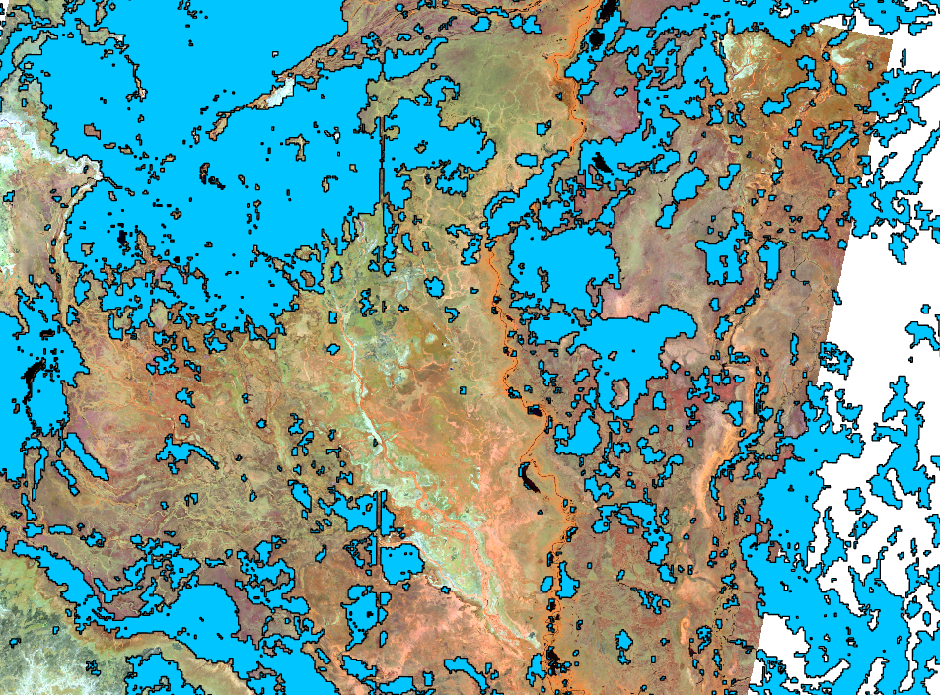
Surface Water Extent Comparison
L9 false color composite 564 as RGB : Jan 08, 2024
Water pixels from Landsat Jan 08, 2024
Water pixels from VIIRS Jan 2024
This comparison of Landsat image, Landsat derived water pixels, and VIIRS water pixels shows how VIIRS was over estimating water pixels by including bare ground, perhaps with wet soil after the flood water retreated in January of 2024.
Similar overestimation in VIIRS were also observed in Feb, Mar and Apr.

Slide 7
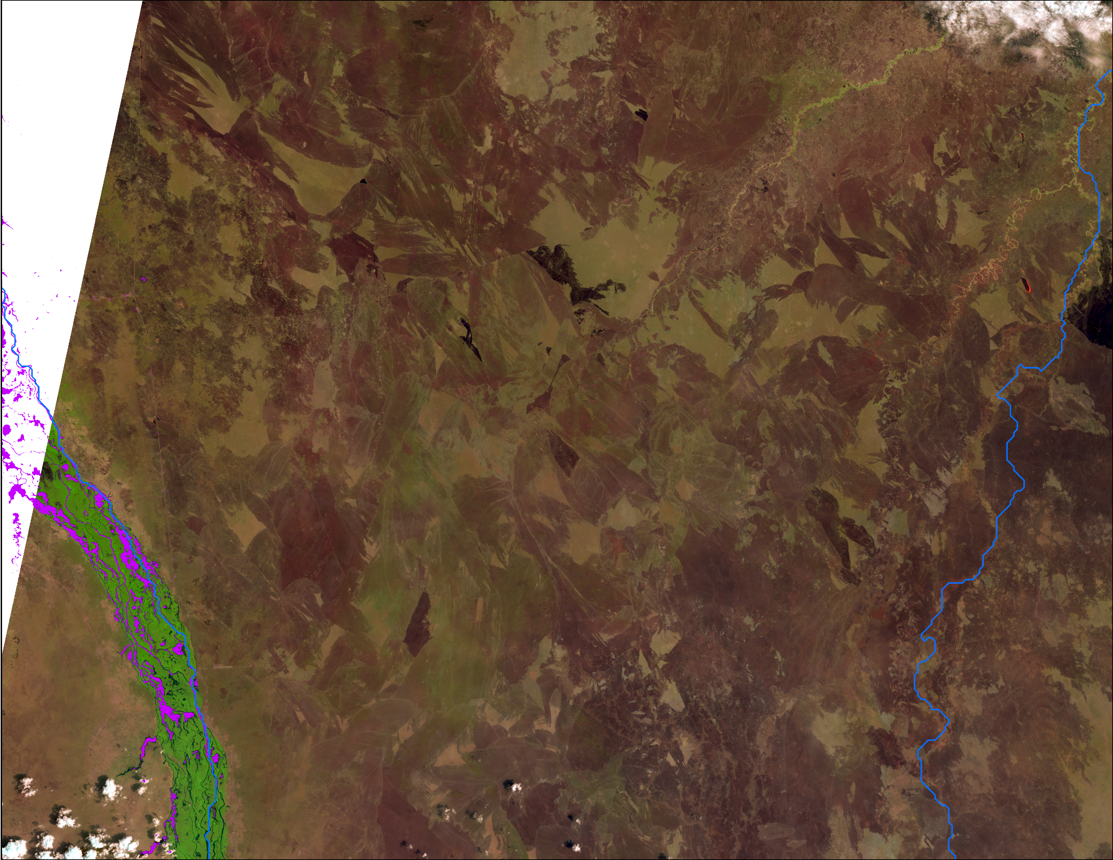
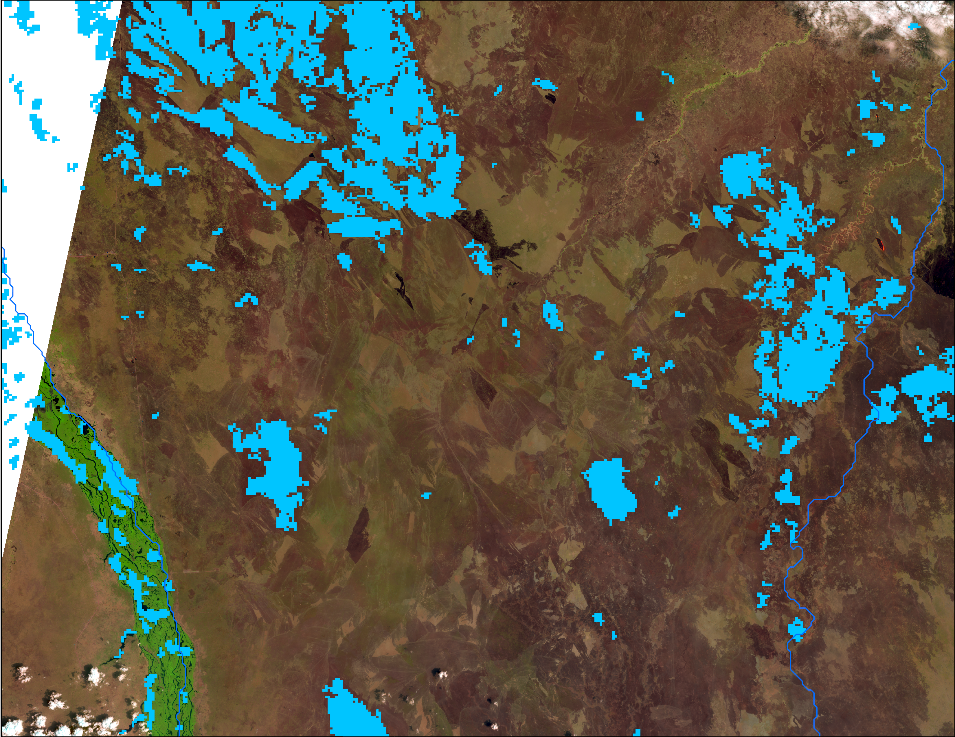
L9 false color composite 564 as RGB
L9 false color composite 654 as RGB
Inundation from Landsat, February 2024
L9 false color composite 654 as RGB
Inundation from VIIRS February 2024
Another example of over estimation of inundation in VIIRS by classifying flood residuals as flooded, where as AWEI was identifying visible water areas only.

Slide 8
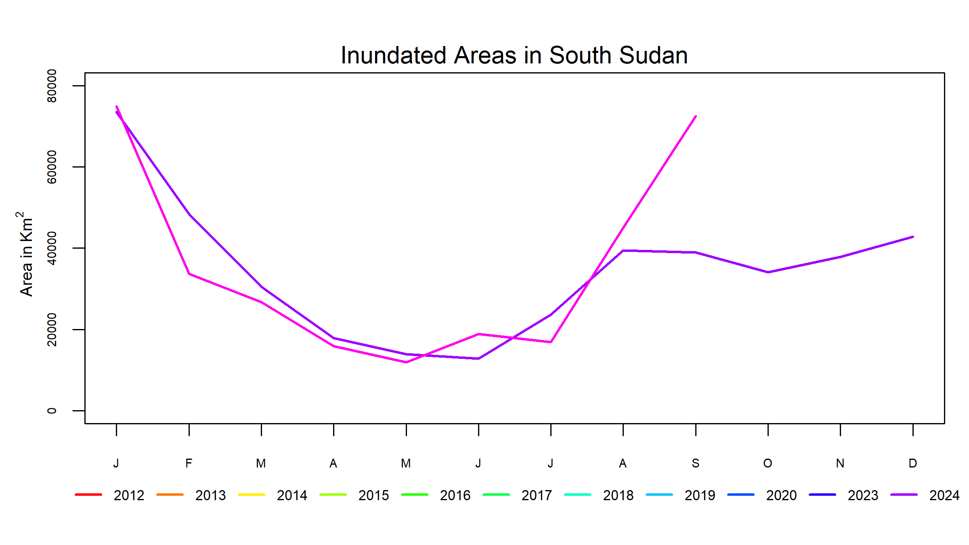
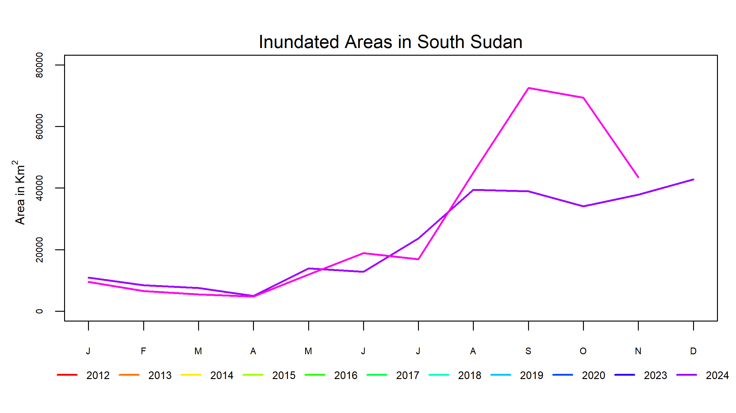
Inundation in South Sudan
Up to mid-Nov for 2024
Inundated area from VIIRS all months
Jan-Apr inundated area from Landsat, rest of the months from VIIRS
No more double peak in the inundated areas in South Sudan.
Most likely high inundated area numbers for January through April for other years from VIIRS were results of overestimation.

Slide 9
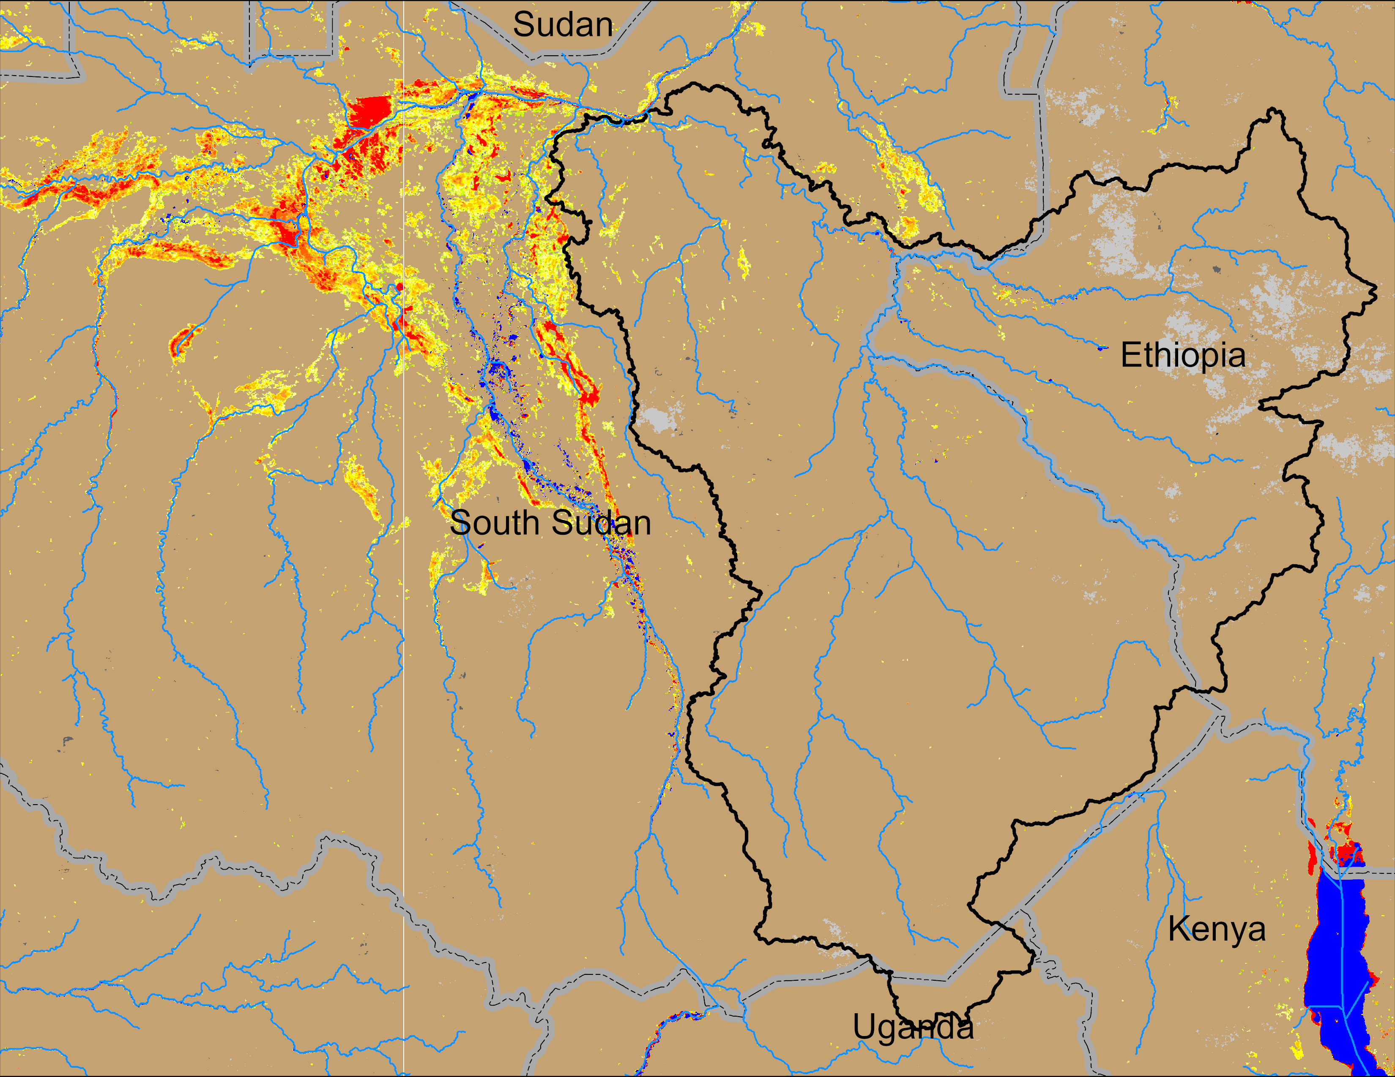
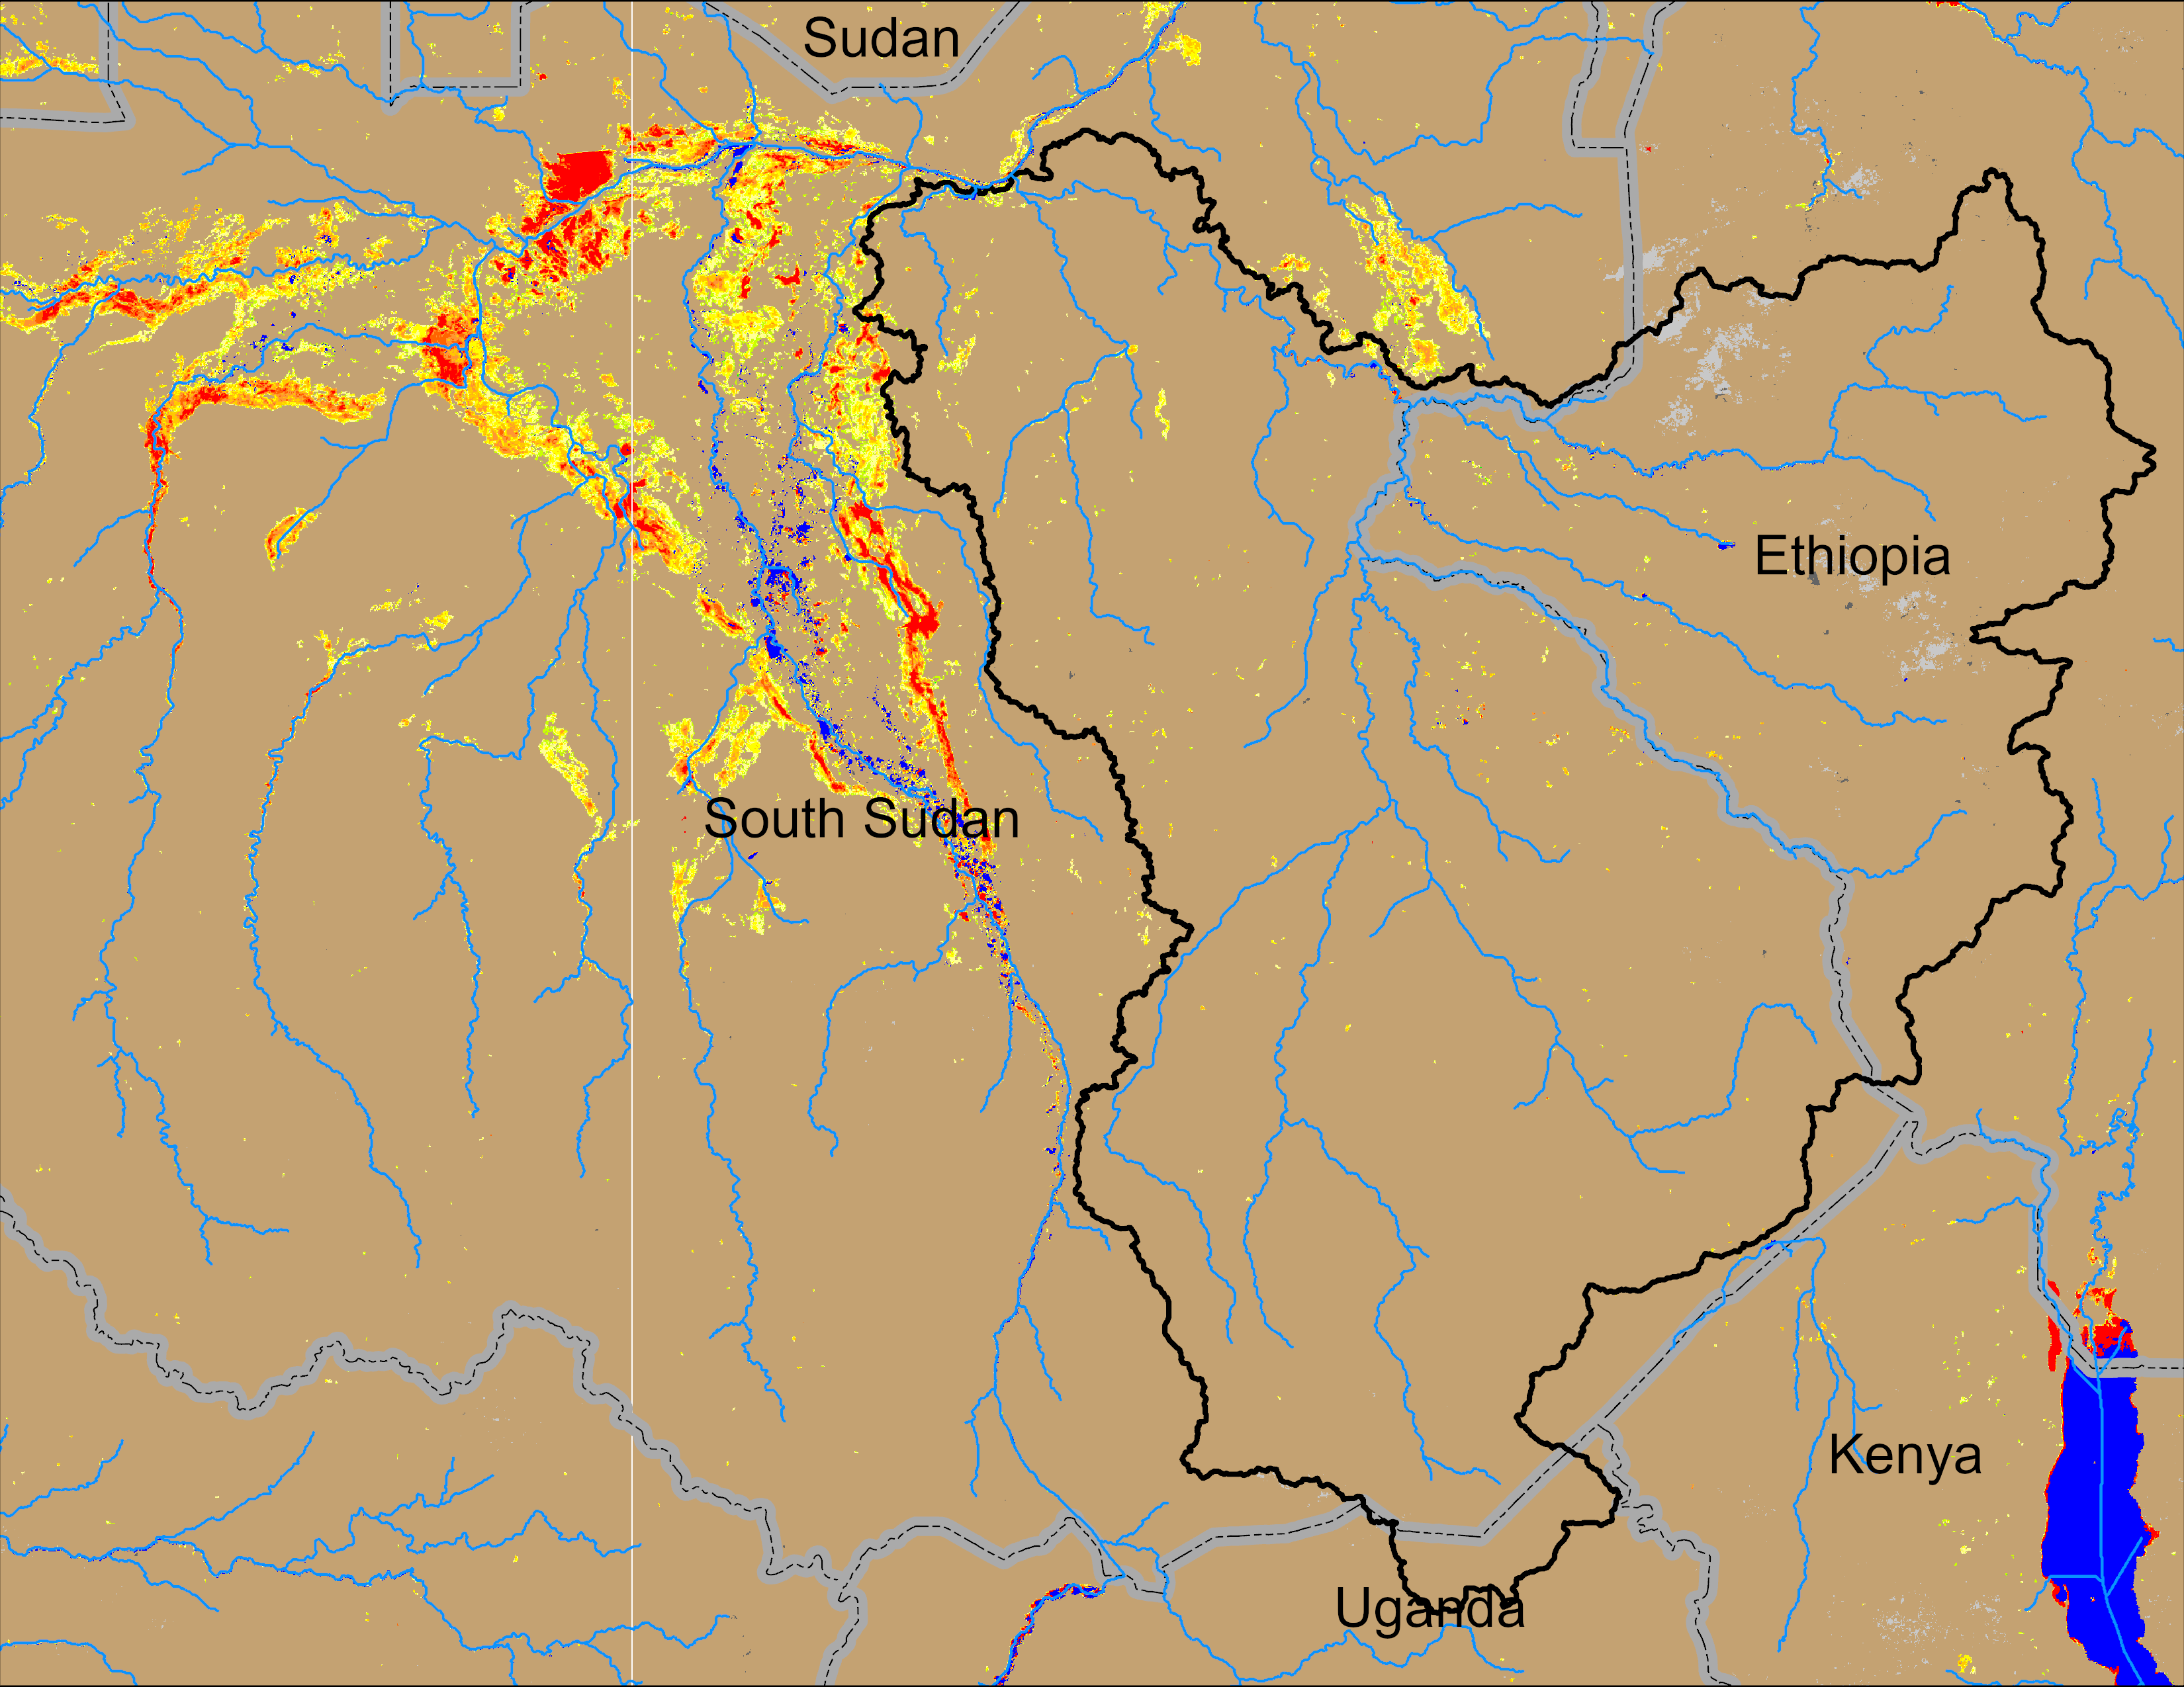
Flooding in SAP Catchment
(% of the pixel)
VIIRS Oct 27-31, 2024
VIIRS Nov 07-11, 2024
VIIRS Nov 13-17
No real evidence of recent increase in inundation in SAP catchment due to rain over Ethiopia.

Slide 10
Thank you

