Slide 1
FEWS NET Enhanced Flood Monitoring
FEWS NET Science Team
July 01, 2024

Slide 2
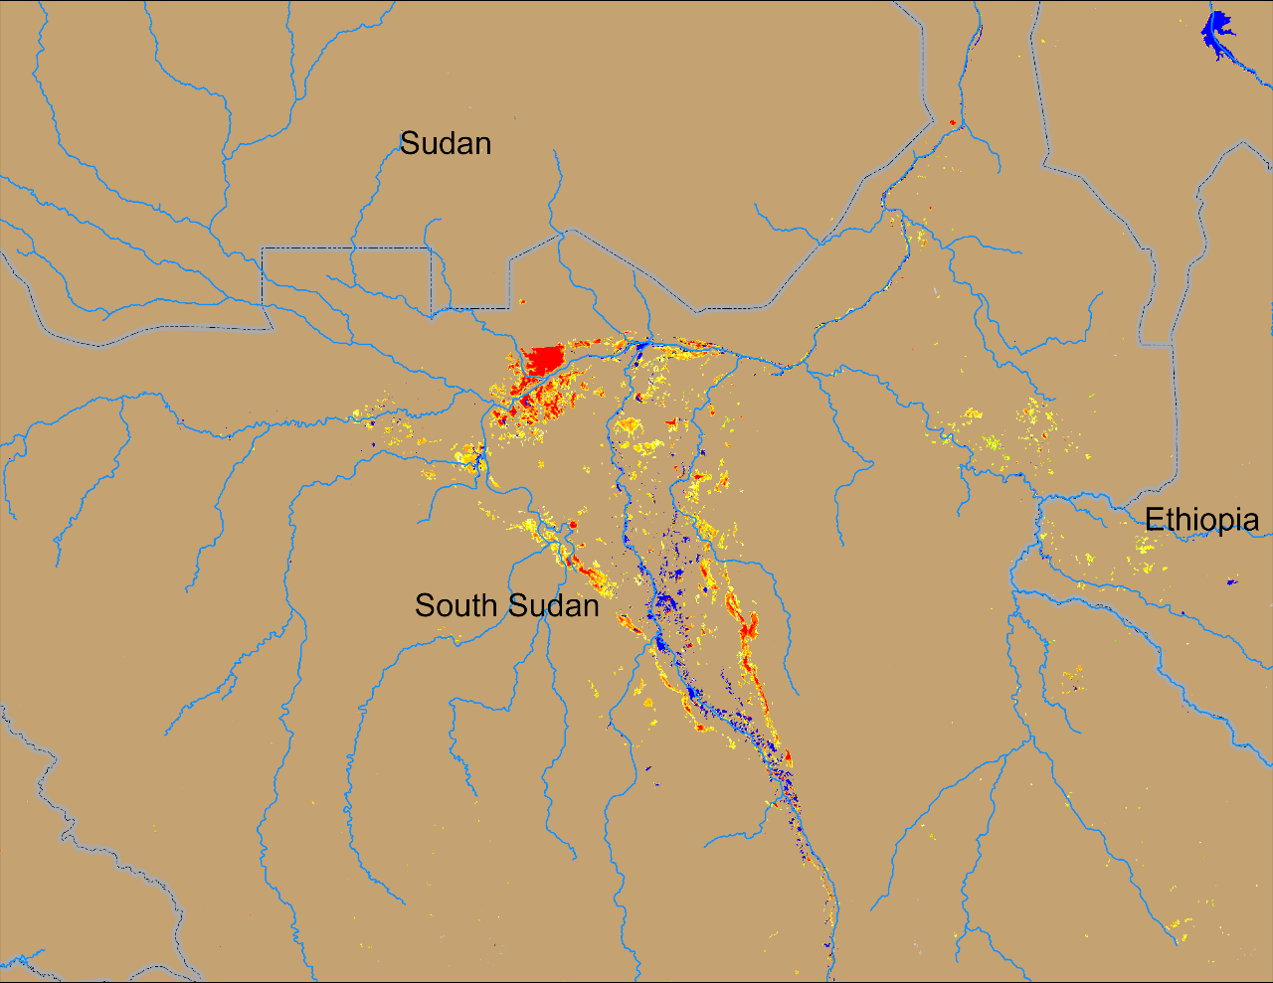
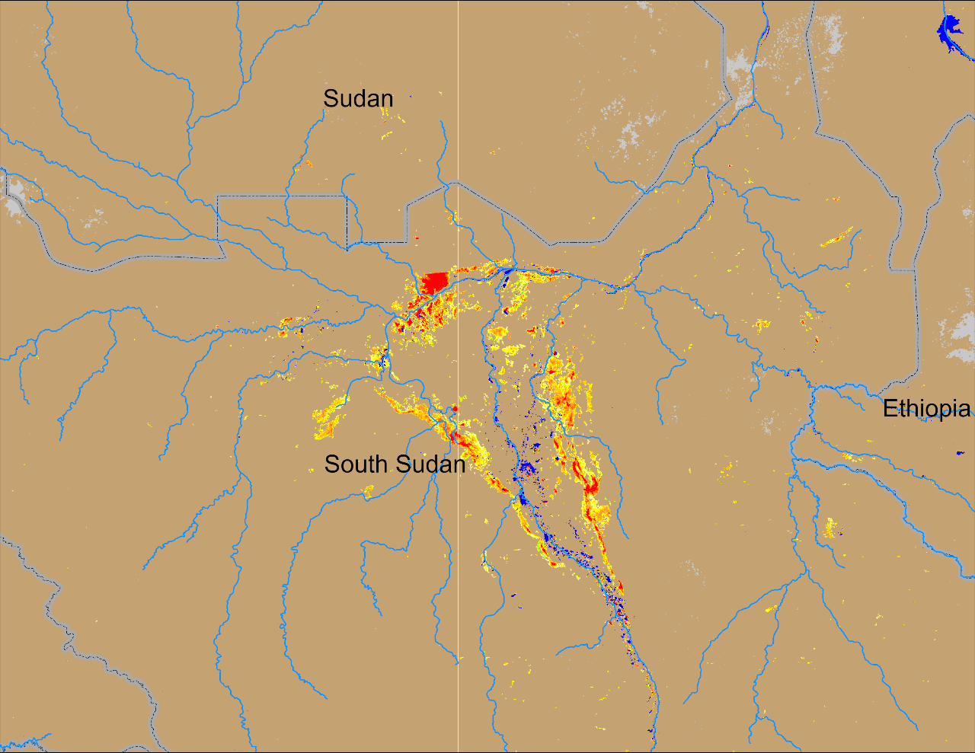
Flooding Conditions in South Sudan
(% of the pixel)
(% of the pixel)
Sobet
Sobet
Akobo
Akobo
Pibor
Pibor
NOAA VIIRS 5-day comp.: 08 – 12 May 2024
NOAA VIIRS 5-day comp.: 26 – 30 Jun 2024
Inundated areas are on the rise in South Sudan.

Slide 3
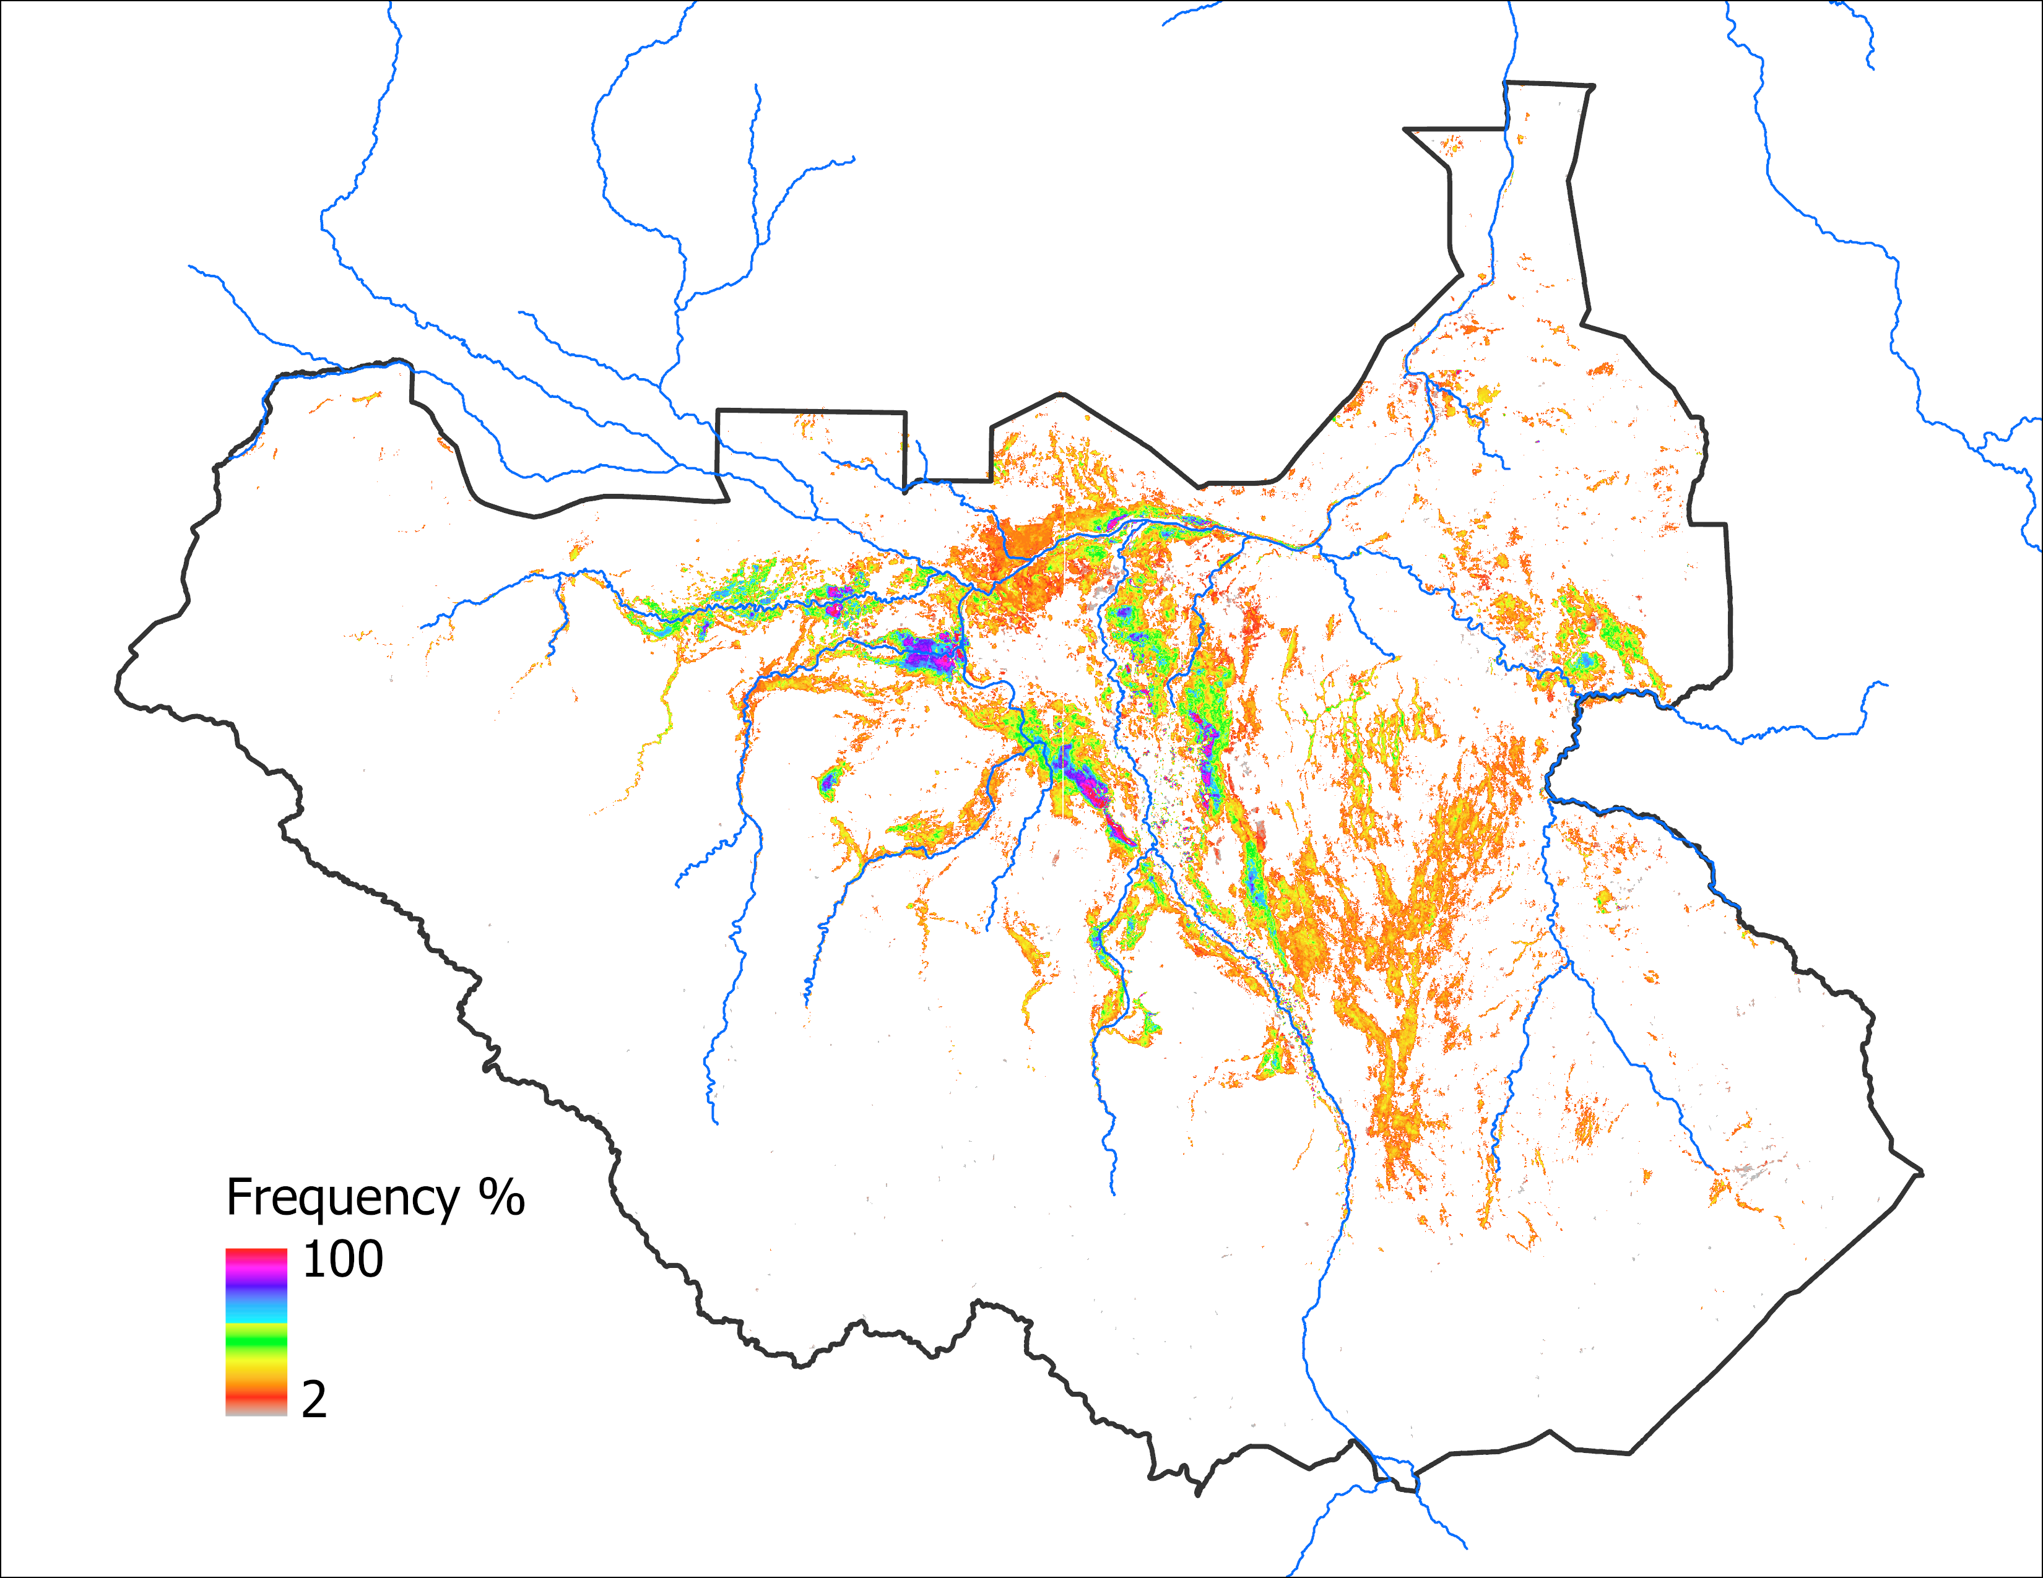
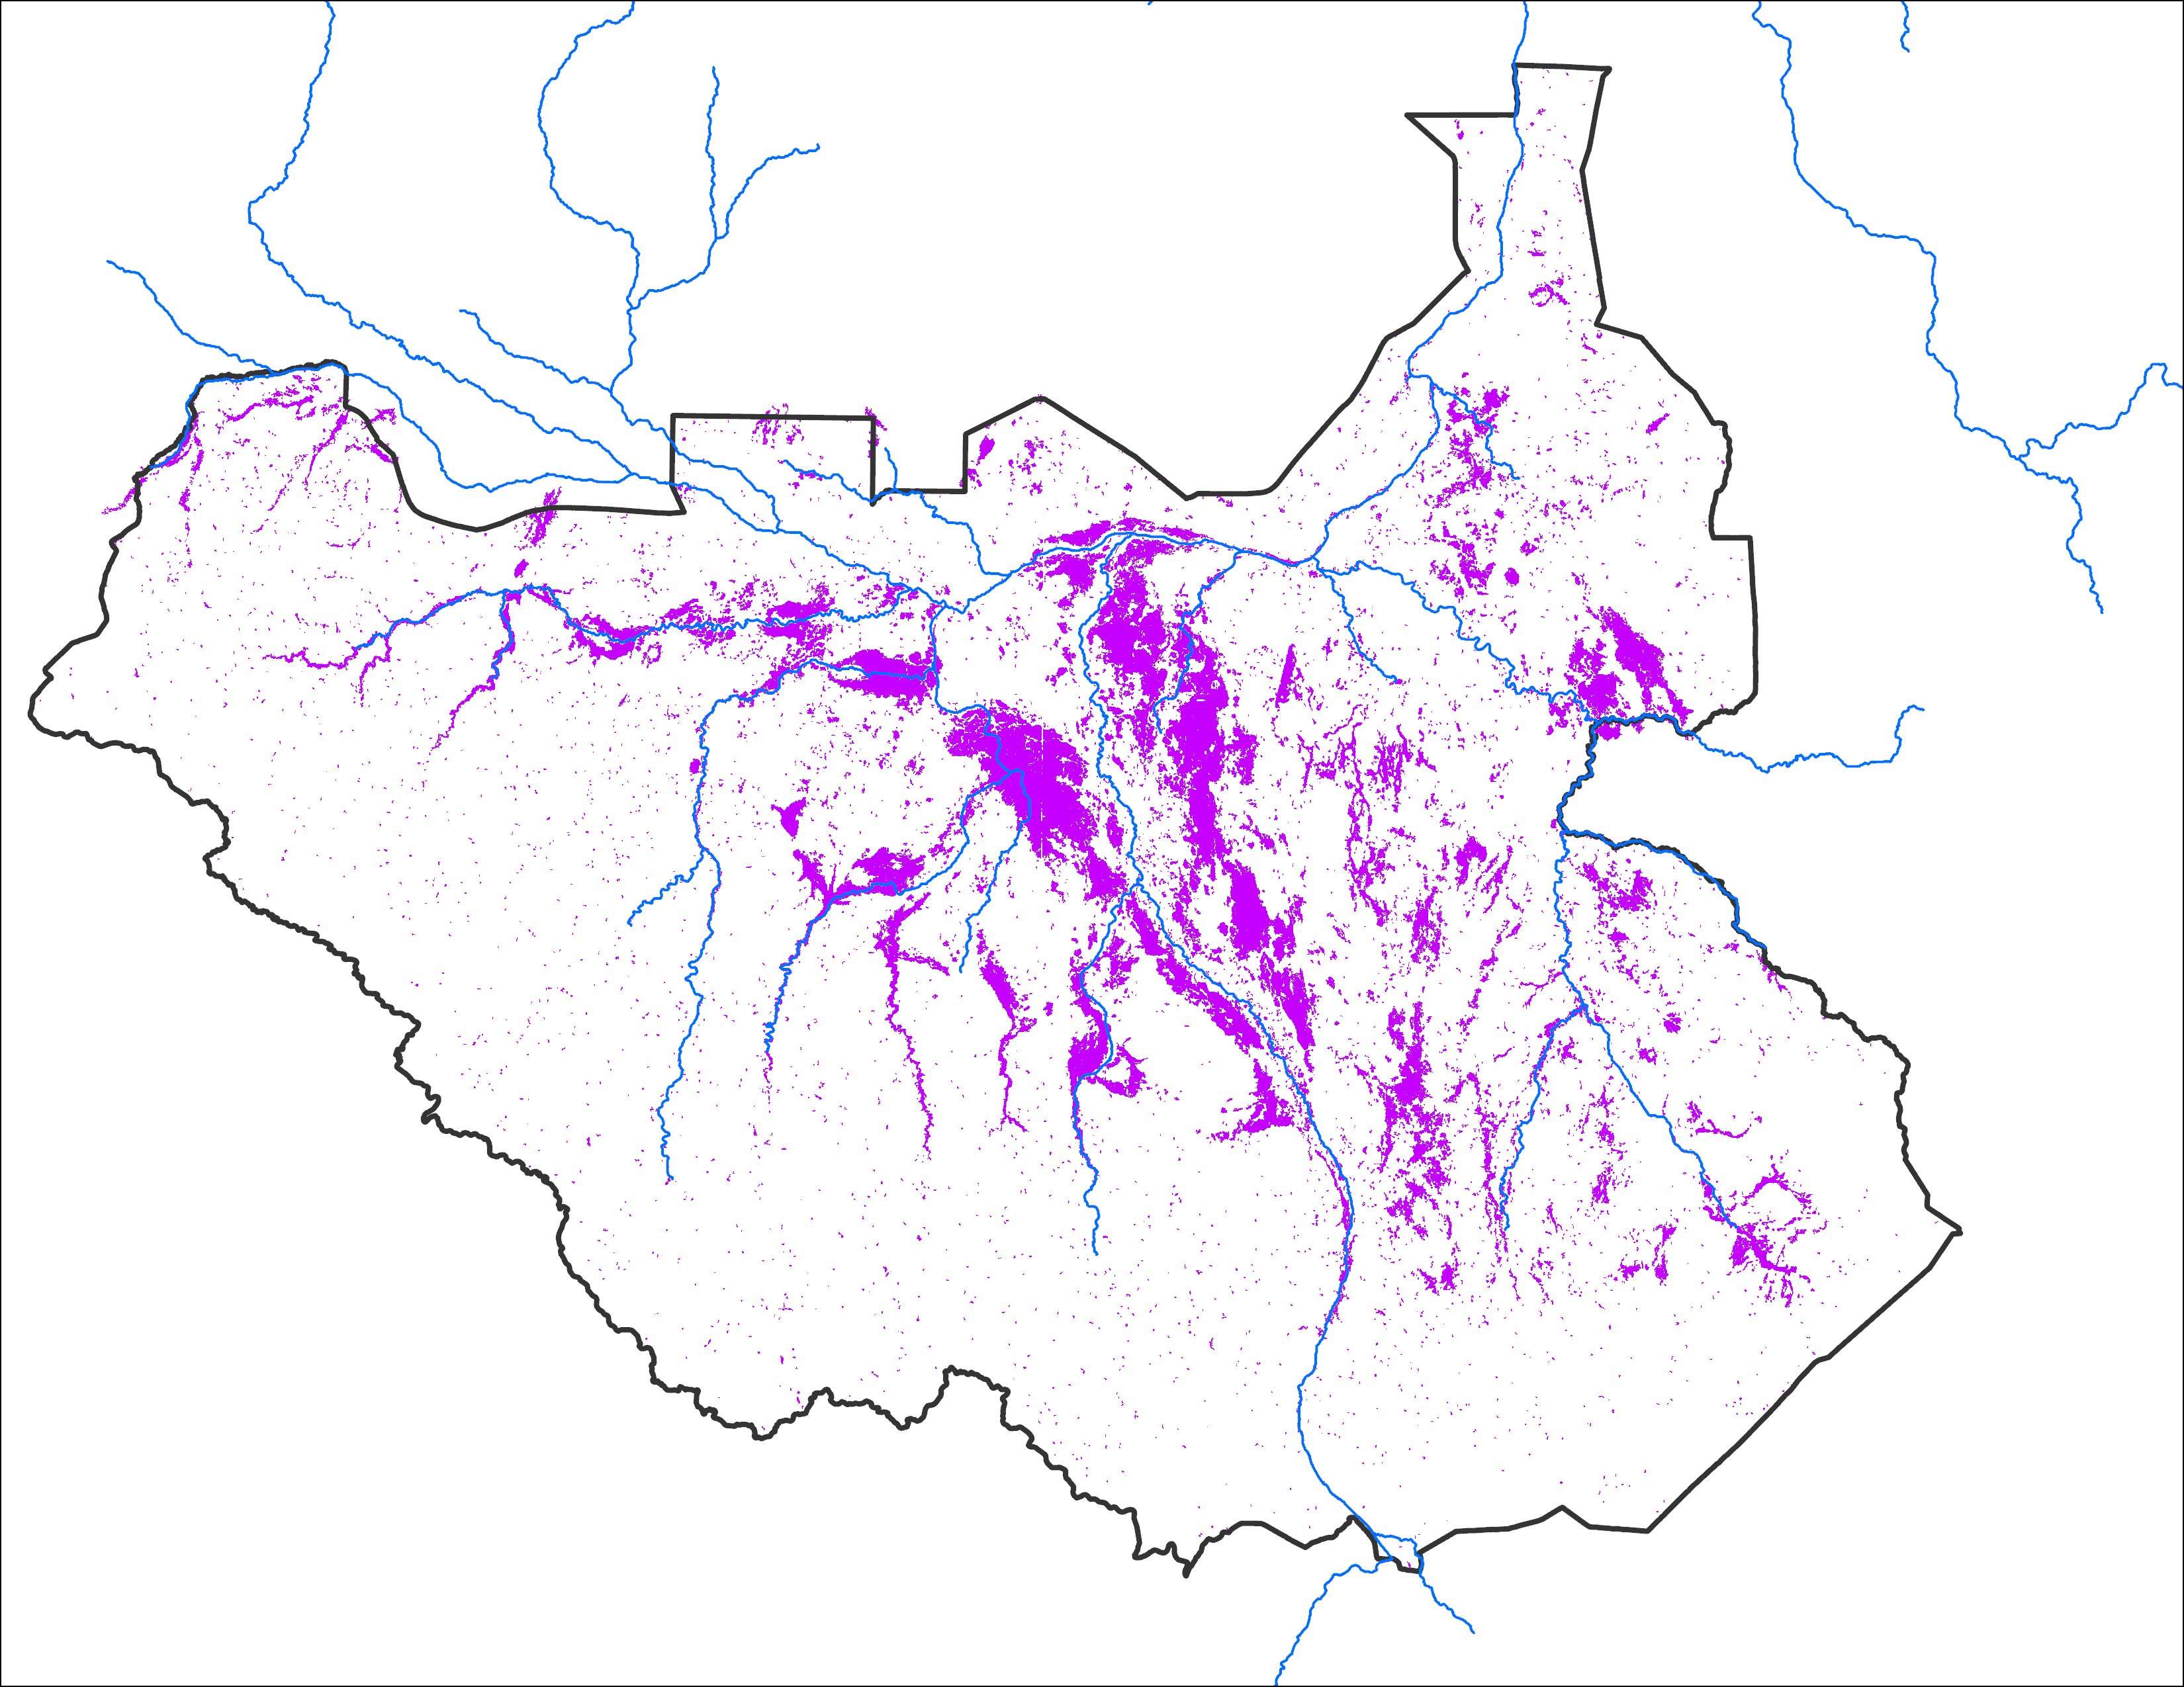
Comparison between 2022 and 2020
Sep 2022 from UNOSAT*
Sep 2024 with Apr IC
Sep 2020
Observed: 53,700 km²
72,882 km²
Based on analog year
Observed: 58,820 km²
* Composite of 09/10/2022 and 8/30/2022 VIIRS-based surface water estimates from https://unosat.org/products/3445
Notes:
Flooding at similar magnitude as it was in 2020 is likely to flood more areas in 2024 because of the initial condition (more areas are already under water in April of 2024 that it was in April of 2020).

Slide 4
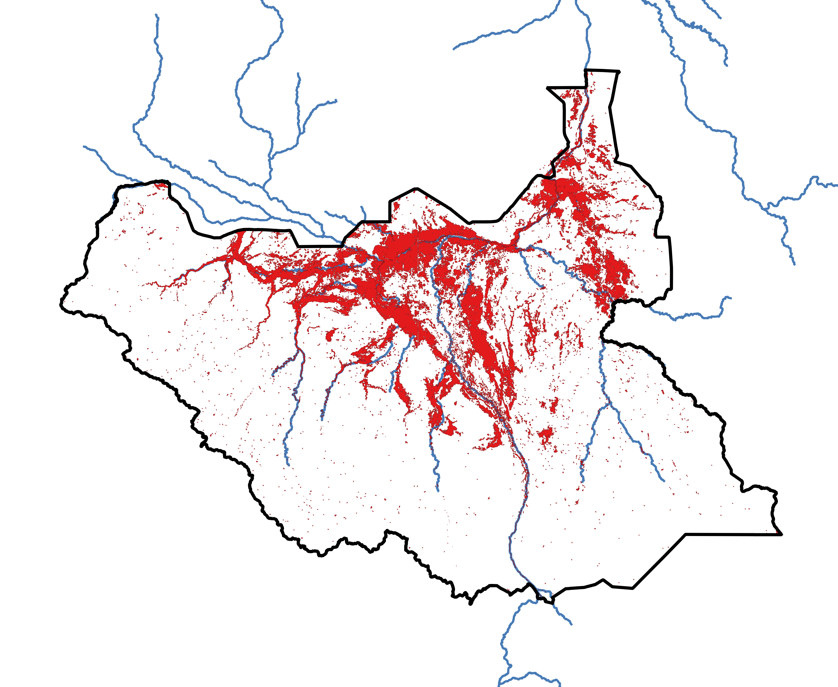
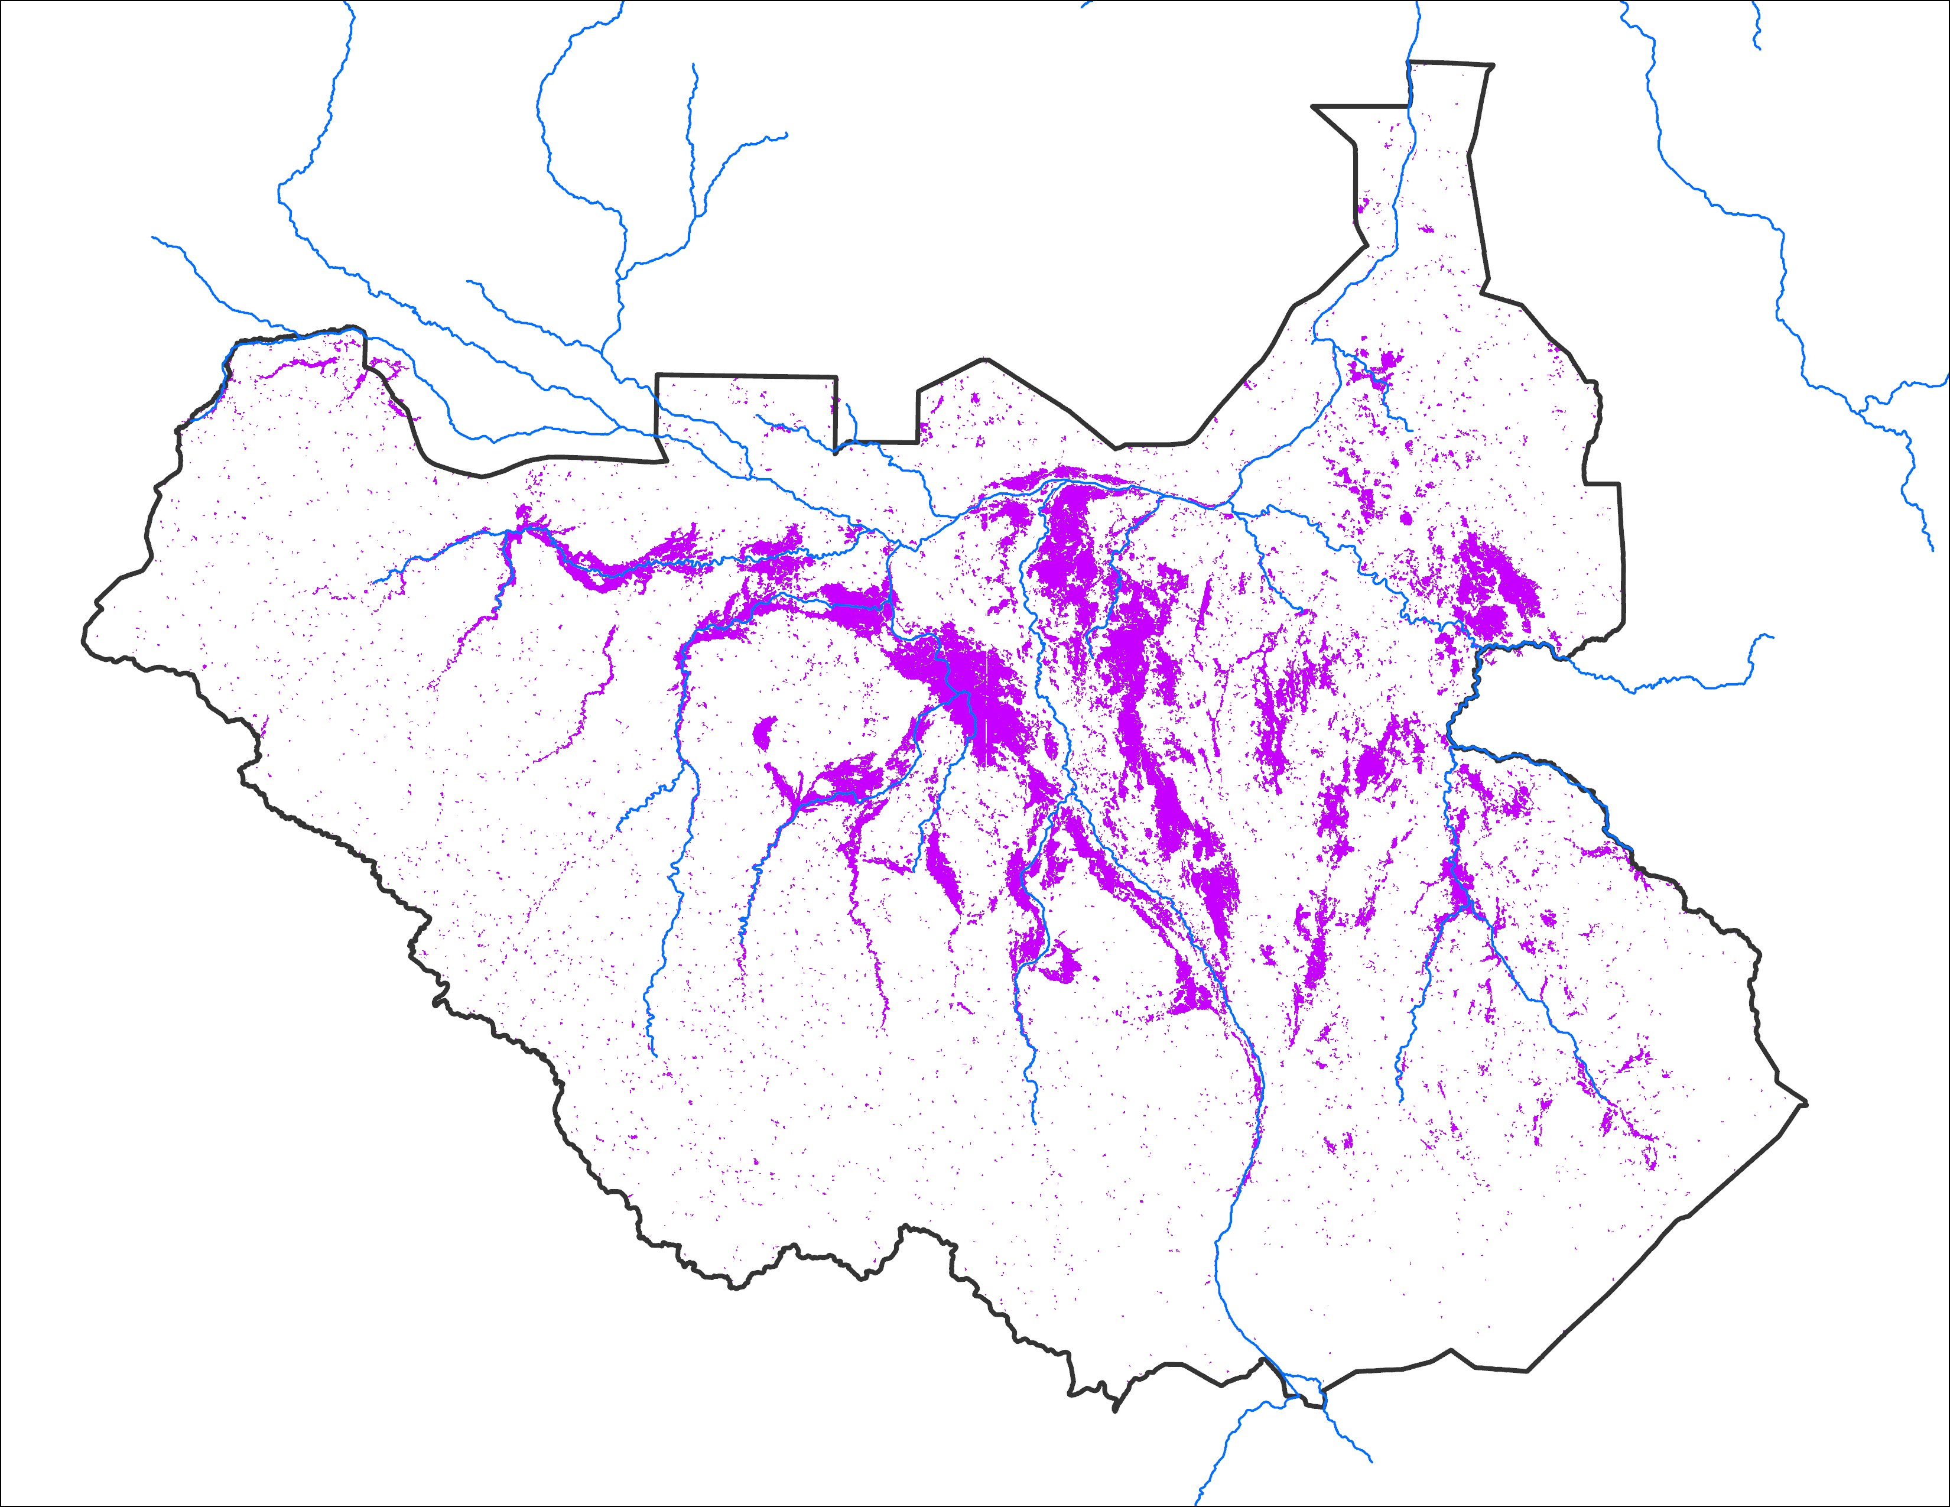
Comparison between 2022 and 2020
Oct 2022 from UNOSAT*
Oct 2024 with Apr IC
Oct 2020
Observed: 72,700 km²
72,882 km²
Based on analog year
Observed: 61,664 km²
* Composite of 11/10/2022, 10/26/2022, 10/18/2022, and 10/04/2022 VIIRS-based surface water estimates from https://unosat.org/products/3445
Notes:
Flooding at similar magnitude as it was in 2020 is likely to flood more areas in 2024 because of the initial condition (more areas are already under water in April of 2024 that it was in April of 2020).

