Slide 1
South Sudan Flood Monitoring and Prediction - 2024 Season
FEWS NET Science Team
August 21, 2024

Slide 2
Prime Question
What is the expected/predicted map(s) of inundation over South Sudan during the upcoming rainfall season of 2024?

Slide 3
Key Messages
FEWS NET updated flood projection models, based on Analog and LASS (initialized in May), indicate 828,000 are likely to be directly affected floods by October 2024. These estimates are generated using the projected inundated pixels overlaid with digital world-population map.
The estimated flood affected areas and populations are likely to be higher than the recent 2020 and 2022 worst-flood crisis in South Sudan. FEWS NET estimates do not account for changes in demographics and influx of refugees (est. 700,000 people from Sudan).
The flood aggravating factors; Above average seasonal rains, Lake Victoria and Albert levels and Jinja dam flows remain at the same high levels, estimated at 2,200 m³/s.
FEWS NET has planned to closely monitor the evolving flood situation and provide regular updates (July through October); on weekly, monthly and ad-hoc-basis based on its available resources.

Slide 4
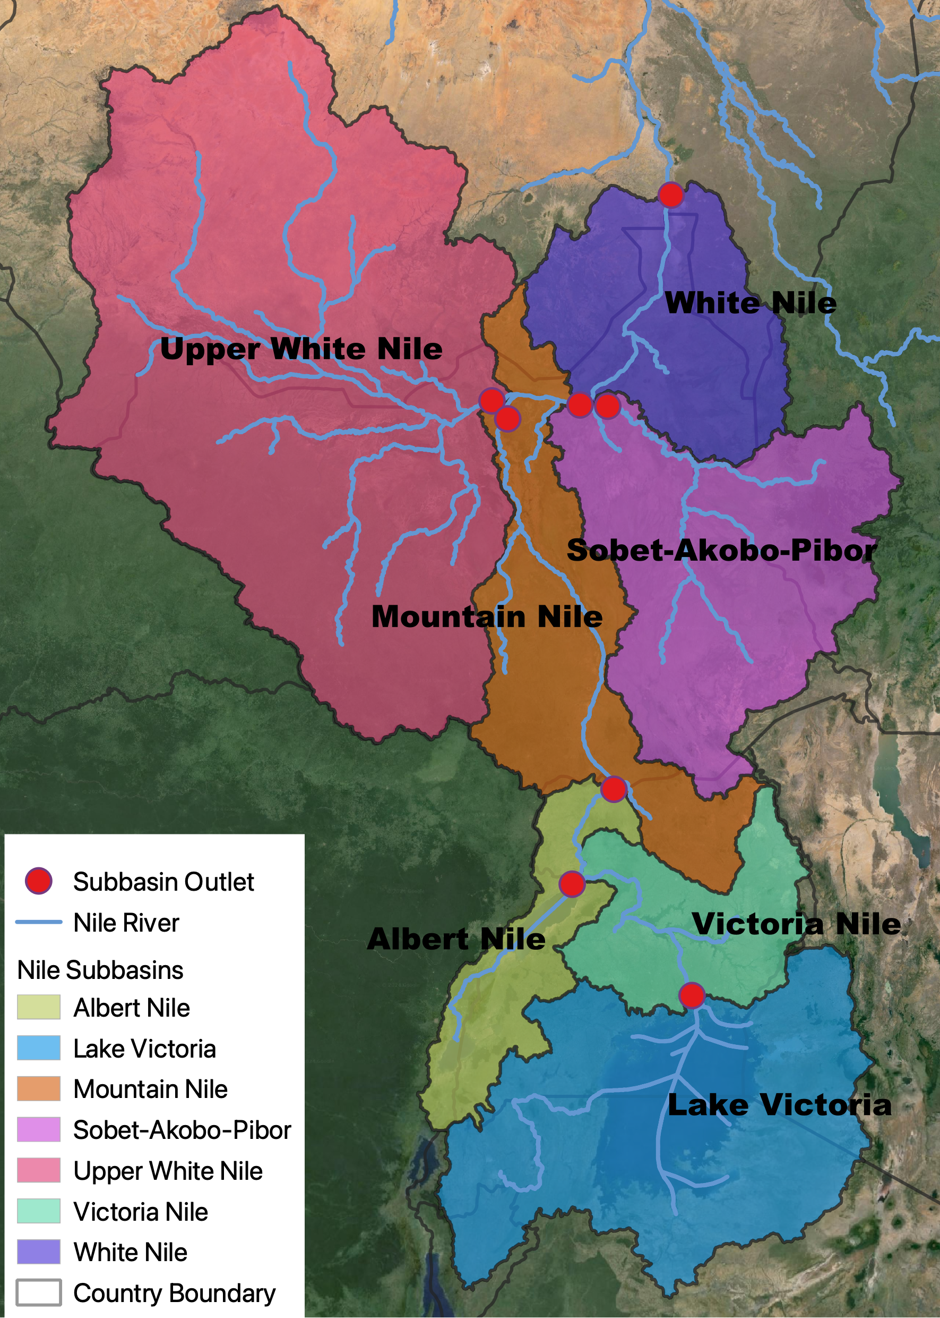
Nile Catchments and Available Data
FLDAS streamflow (retrospective & forecast)
FLDAS total runoff (retrospective & forecast)
CHIRPS rainfall
Lake Victoria and Lake Albert Altimetry water level
Bias-corrected spatially downscaled NMME precipitation forecast
FLDAS and CHIRPS data are available since 1981 and water level data since 1992
VIIRS flood product

Slide 5
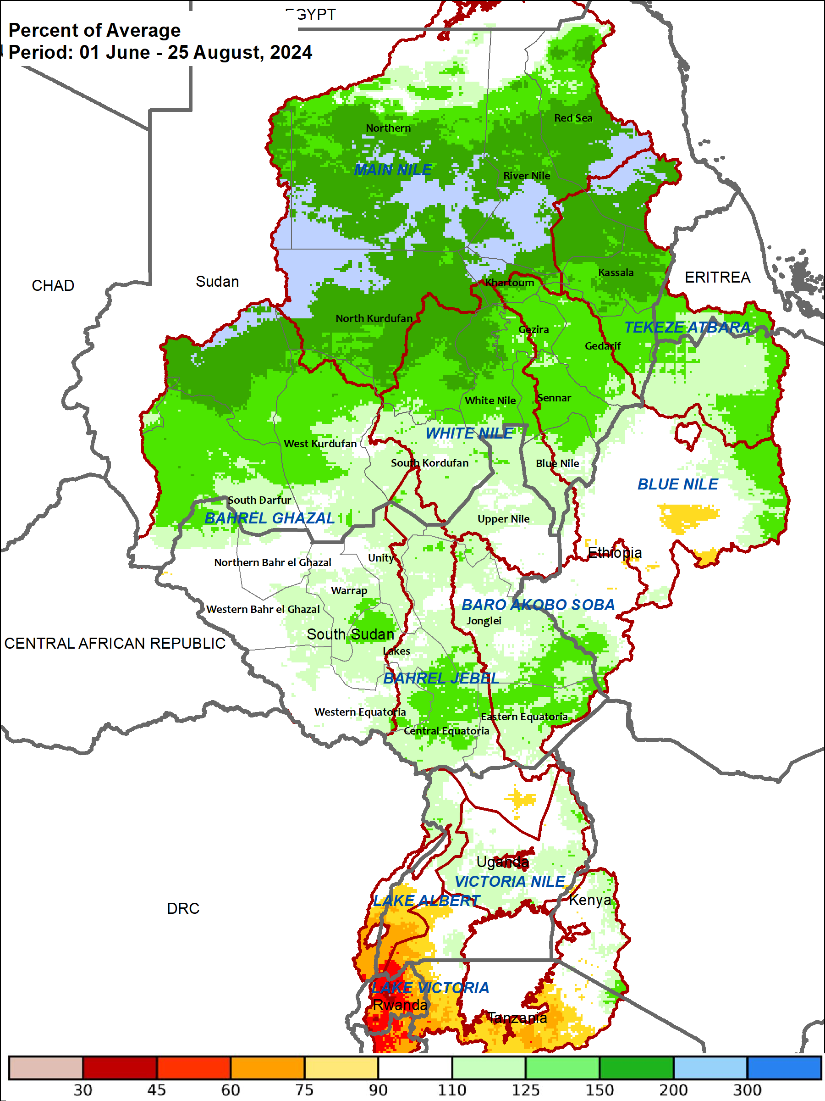
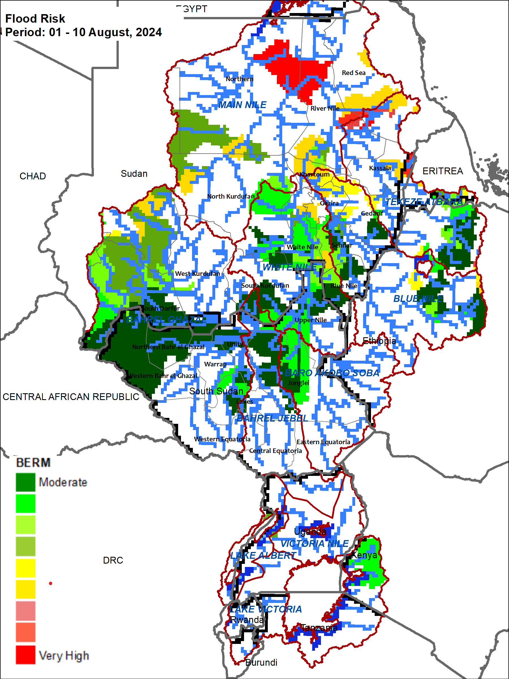
Above Average Rainfall Performance and Impacts
CHIRPS Performance (%):
01 June – 10 August, 2024
BERM Flood Risk (%):
01 August– 10 August, 2024
CHIRPS + GEFS Performance (%):
01 June – 25 August, 2024

Slide 6

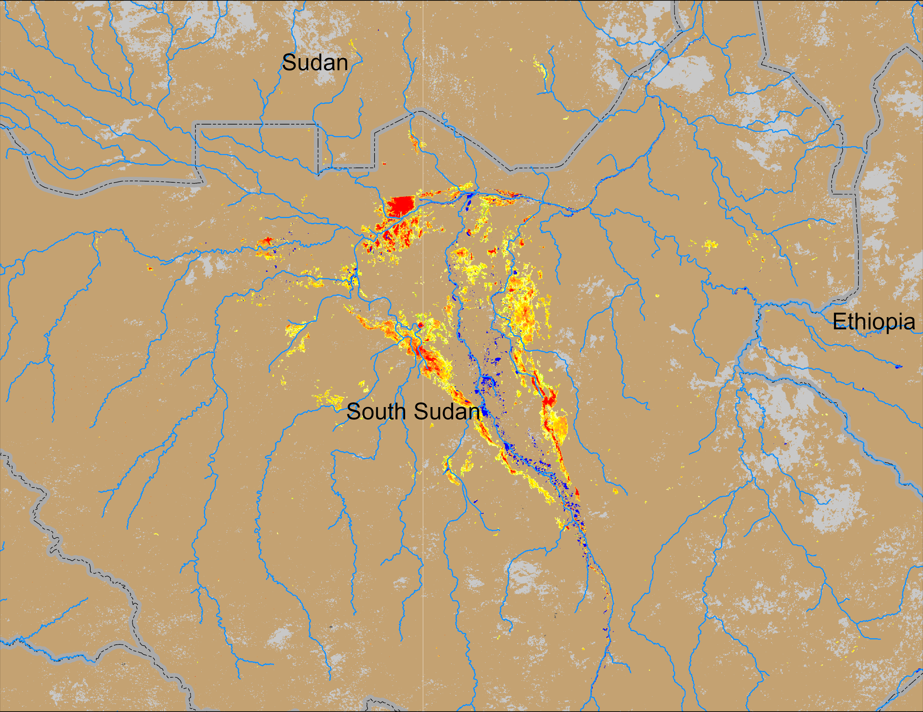
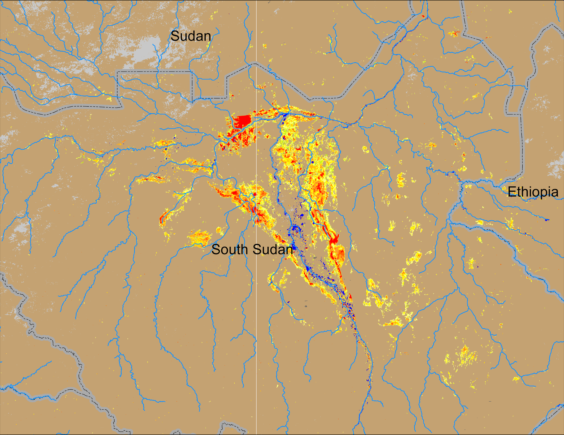
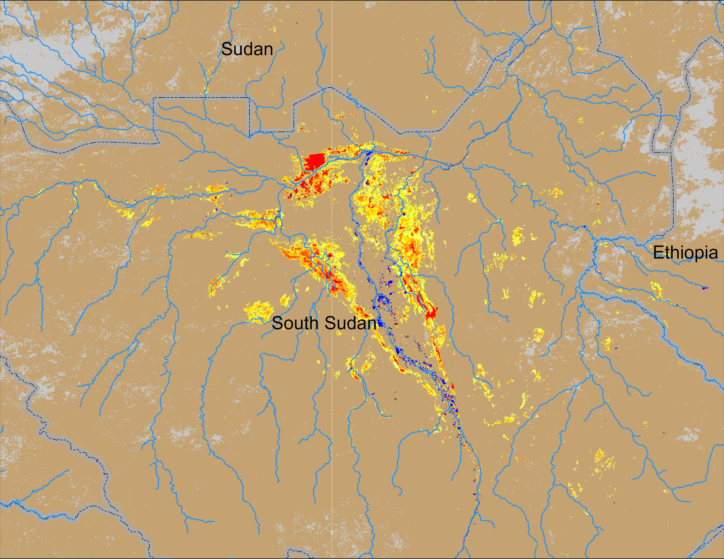
Recent Flooding Conditions
(% of the pixel)
White Nile
Sobet
White Nile
White Nile
Sobet
Sobet
Akobo
Akobo
Akobo
Pibor
Pibor
Pibor
NOAA VIIRS 5-day comp.: 11 – 15 Jul 2024
NOAA VIIRS 5-day comp.: 07 – 11 Aug 2024
NOAA VIIRS 5-day comp.: 11 – 15 Aug 2024
Inundated areas in South Sudan are gradually increasing.

Slide 7
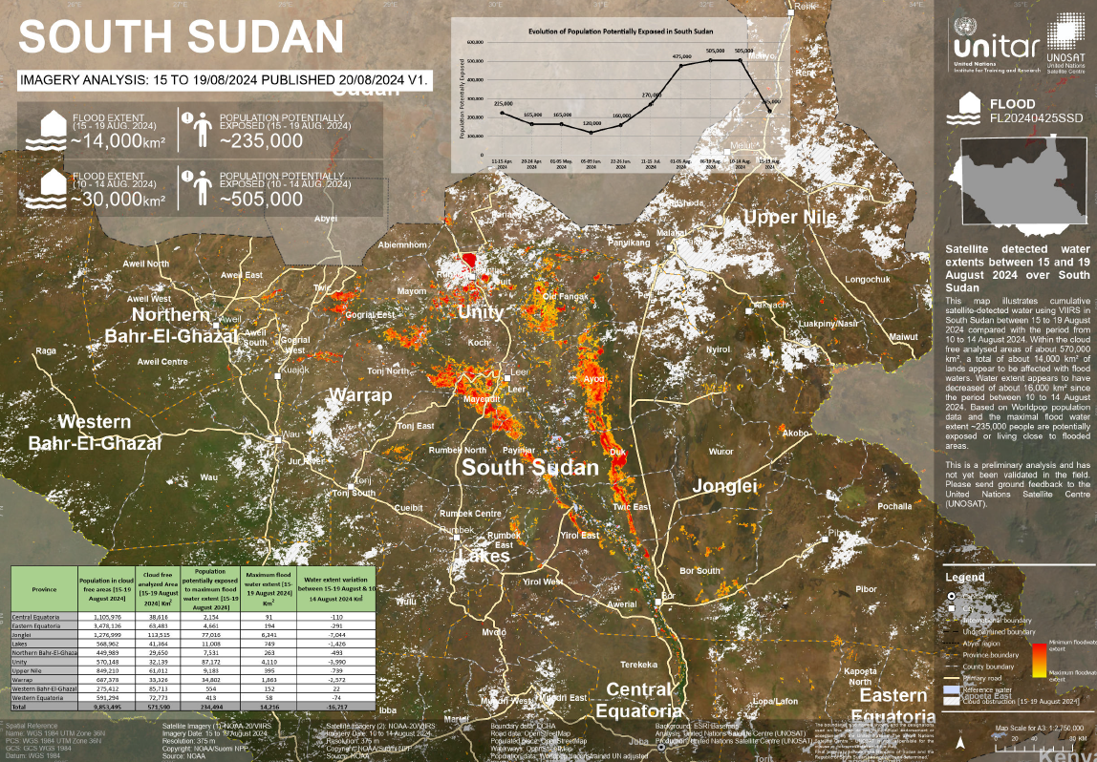
Recent Flooding Conditions
(% of the pixel)
NOAA VIIRS 5-day comp.: 11 – 15 Aug 2024
UNOSAT map based on VIIRS 5-day comp.: 15 – 19 Aug 2024
UNOSAT map show inundation reduced during the last 5 days, however UNOSAT map could have underestimated inundation because of cloud issues based on the daily VIIRS data on the following slide.

Slide 8
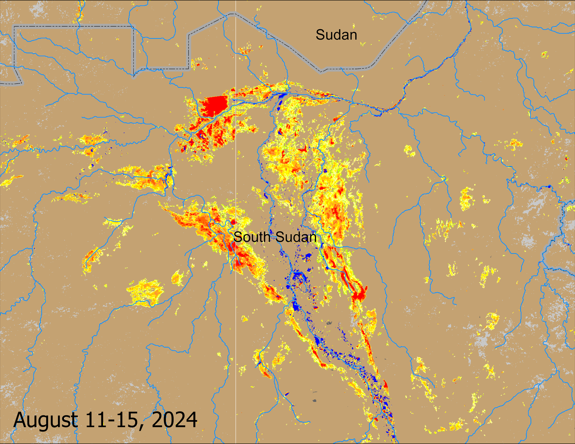
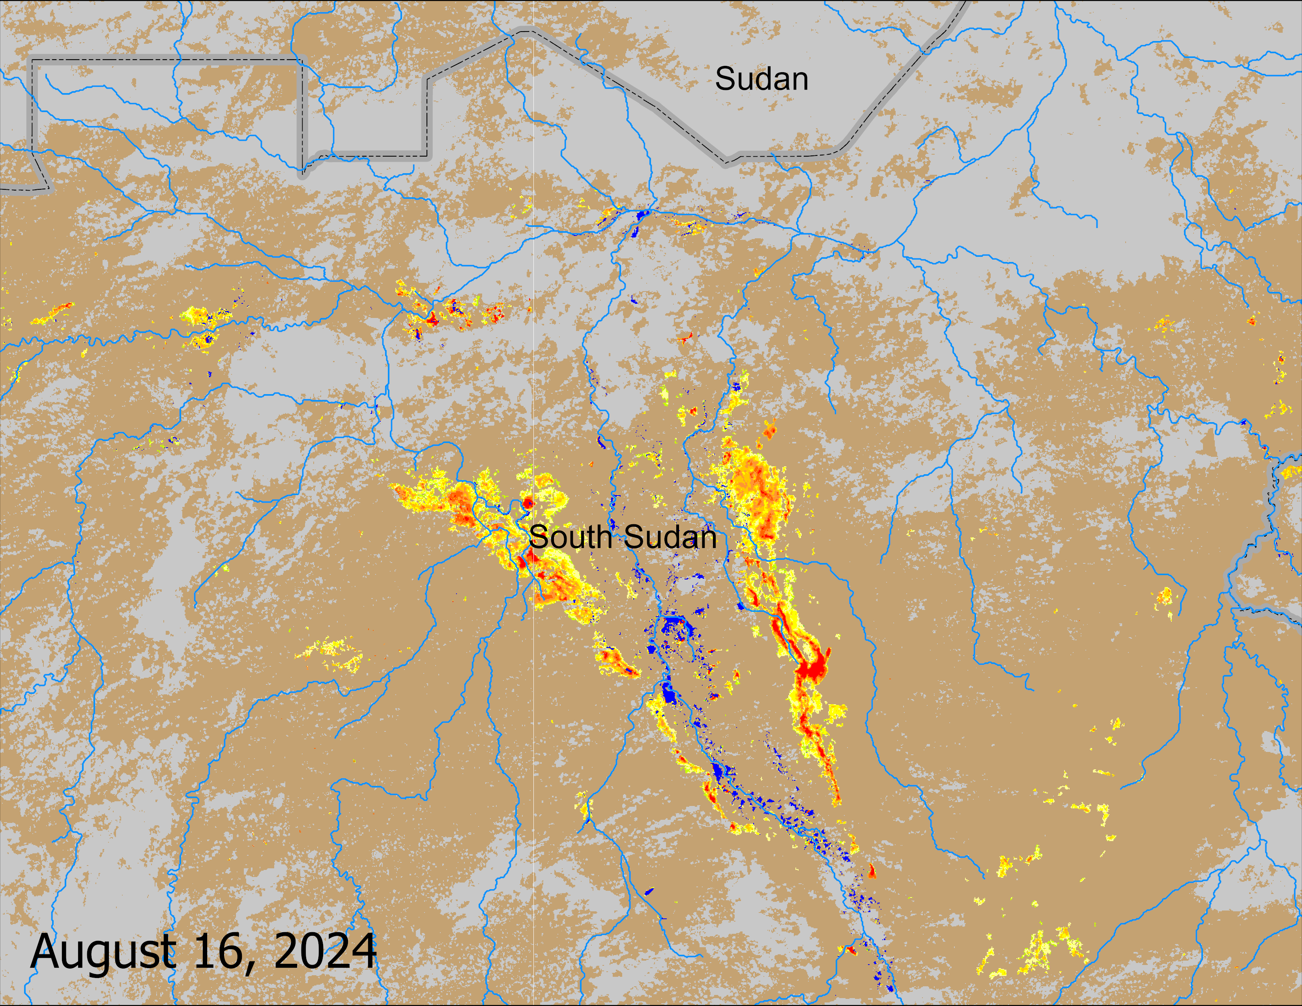
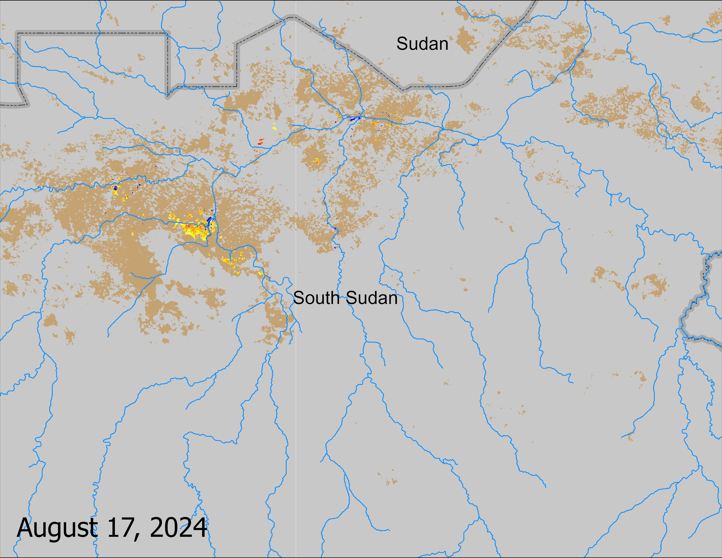
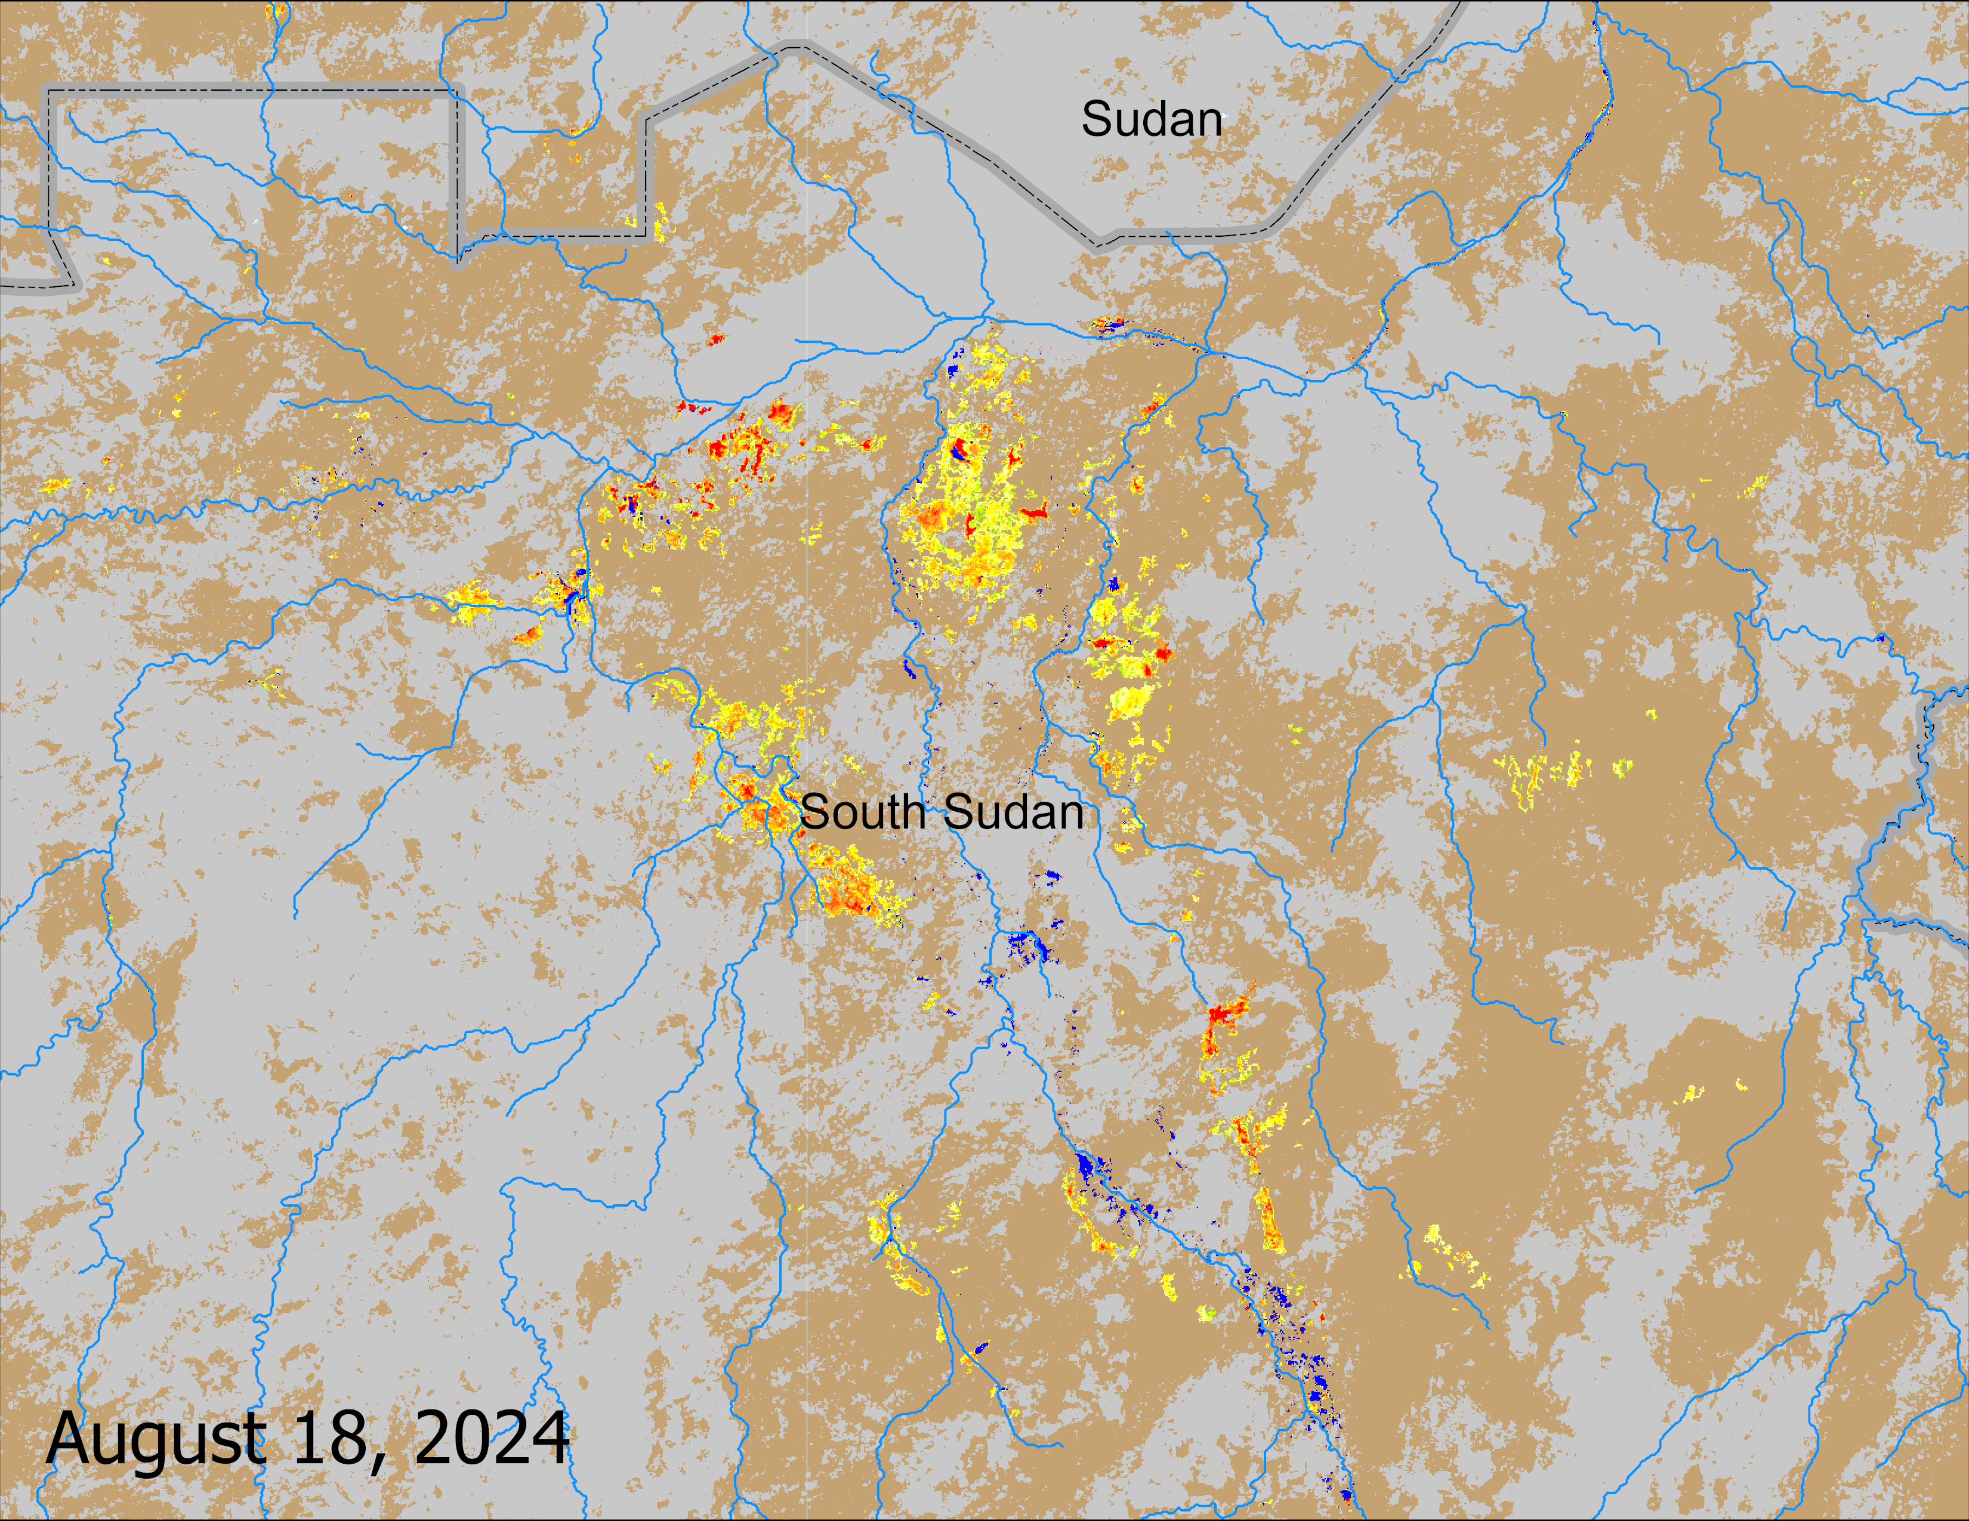
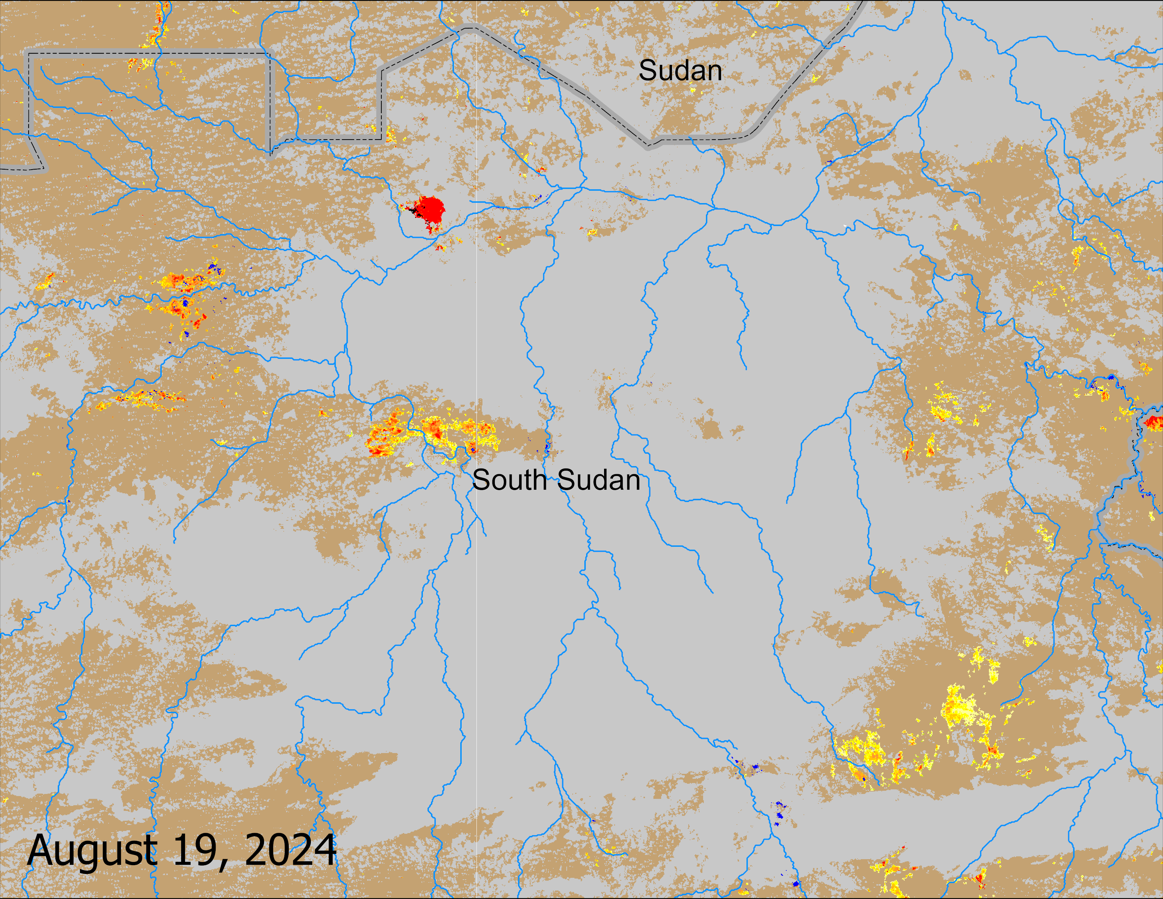
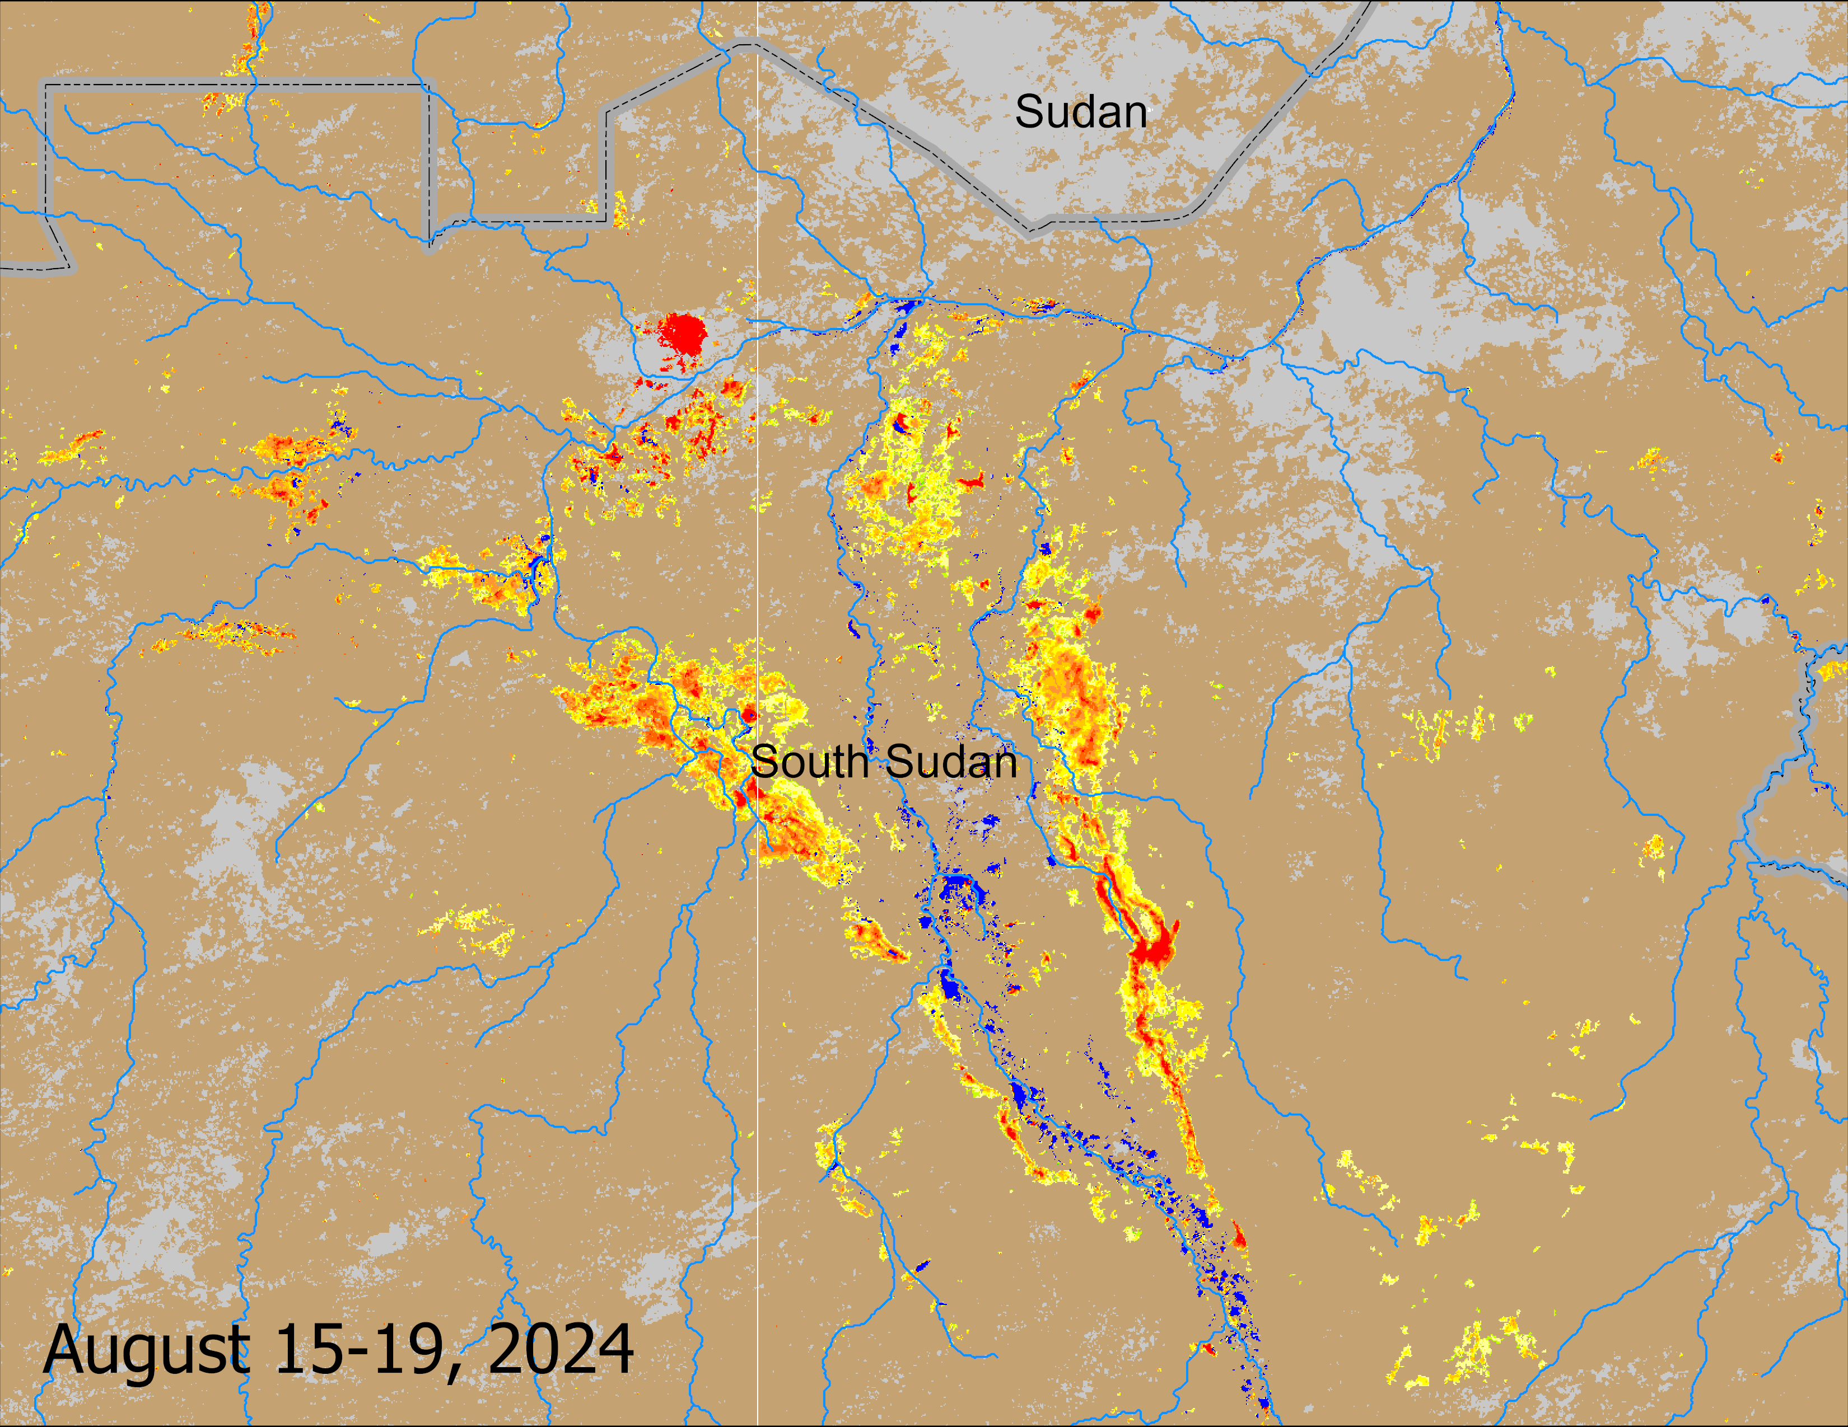
Recent Flooding Conditions
(% of the pixel)
The daily VIIRS data show how much they were impacted by cloud between Aug 16 and Aug 19. So, the 15-19 Aug composite most likely underestimated inundation.

Slide 9
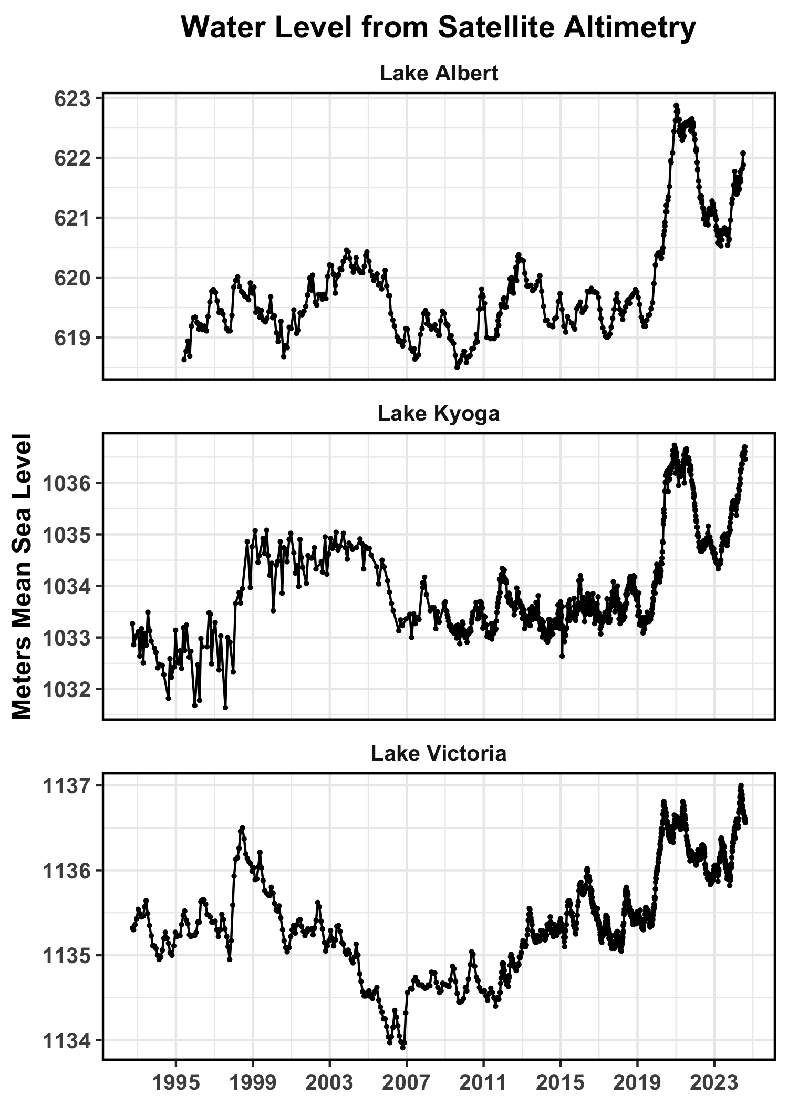
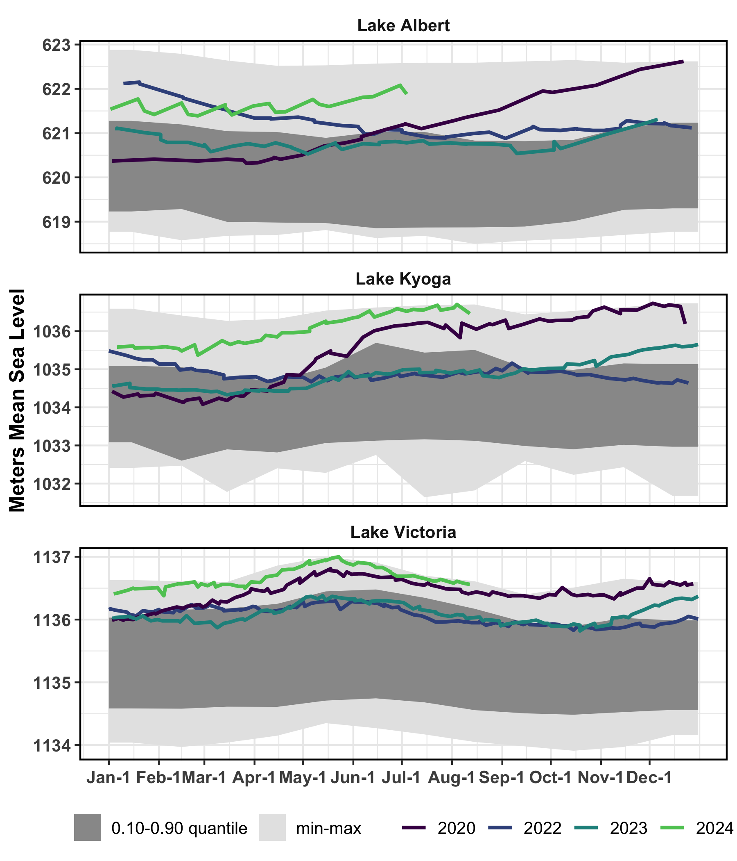
Lakes Satellite Altimetry
Although Lake Water levels have declined marginally, they remained at levels higher than the levels in 2020 and 2022.
Current discharge from Lake Victoria is at 2200 m³/s
Outflow from Jebel Aulia dam is at 1500 m³/s
Lake level data were from Hydroweb, accessed 14 August 2024.

Slide 10
LASSO Regression
LASSO: Least Absolute Shrinkage and Selection Operator
Regression analysis method that performs both variable selection and regularization in order to enhance the prediction accuracy and interpretability of the resulting statistical model.
The lasso method assumes that the coefficients of the linear model are sparse, meaning that few of them are non-zero.
https://en.wikipedia.org/wiki/Lasso_(statistics)
Method Citation: Santosa, F., & Symes, W. W. (1986). Linear Inversion of Band-Limited Reflection Seismograms. SIAM Journal on Scientific and Statistical Computing, 7(4), 1307–1330. https://doi.org/10.1137/0907087

Slide 11
LASSO Regression
Advantages:
Uses a penalty function (regularization) to produce a parsimonious data model, reducing overfitting.
Covariates do not need to be independent.
Not a “black box”, method estimates coefficients for each covariate so you can see how imporant each retained covariate is in the data model.
Disadvantages:
Assumes a linear model, i.e., can not represent nonlinearities.
Will only select one (or a few) covariates from a set of correlated predictors and shrinks the rest to zero.
This selection can be somewhat arbitrary, and often changes each time you fit the model, so you cannot estimate confidence intervals for the coefficients.

Slide 12
LASSO Regression
LASSO Model Covariates:
FLDAS-Forecast Open Loop: Lag 0 – Lag 3 runoff and precipitation, aggregated over nested basins and separately by subbasin.
FLDAS-Forecast NMME Forecasts: 1-6 month ensemble mean forecasts of streamflow, runoff, and precipitation, aggregated over nested basins and separately by subbasin.
Lag 0 VIIRS inundation
Lake Victoria and Lake Albert altimetry
Predicted Variables:
Leads 1-6 inundation

Slide 13
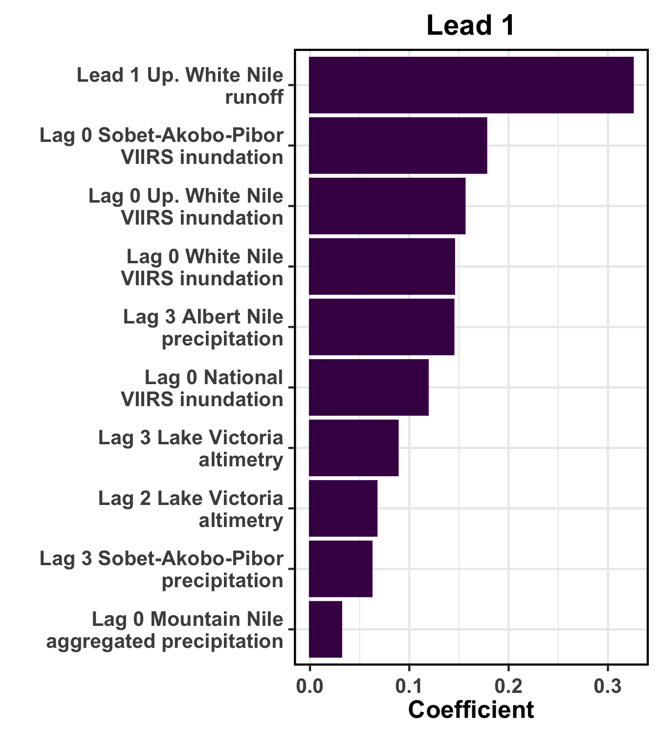
Coefficients for LASSO Models
10 largest coefficients for covariates for Lead 1 National LASSO model
Primary drivers of the Lead 1 model:
VIIRS inundation
Current lead runoff forecast for White Nile basin
Lake Victoria altimetry
Previous lag precipitation for the Albert Nile, Sobet-Akobo-Pibor, and Mountain Nile basins
Notes:
Coefficients shown for the LASSO model predicting the maximum inundation (i.e., the highest of 20 ensemble predictions for the indicated lead).
Lag 0 = April 2024, Lag 1 = March 2024, …
Lead 1 = May 2024 forecast, Lead 2 = June 2024 forecast, …

Slide 14
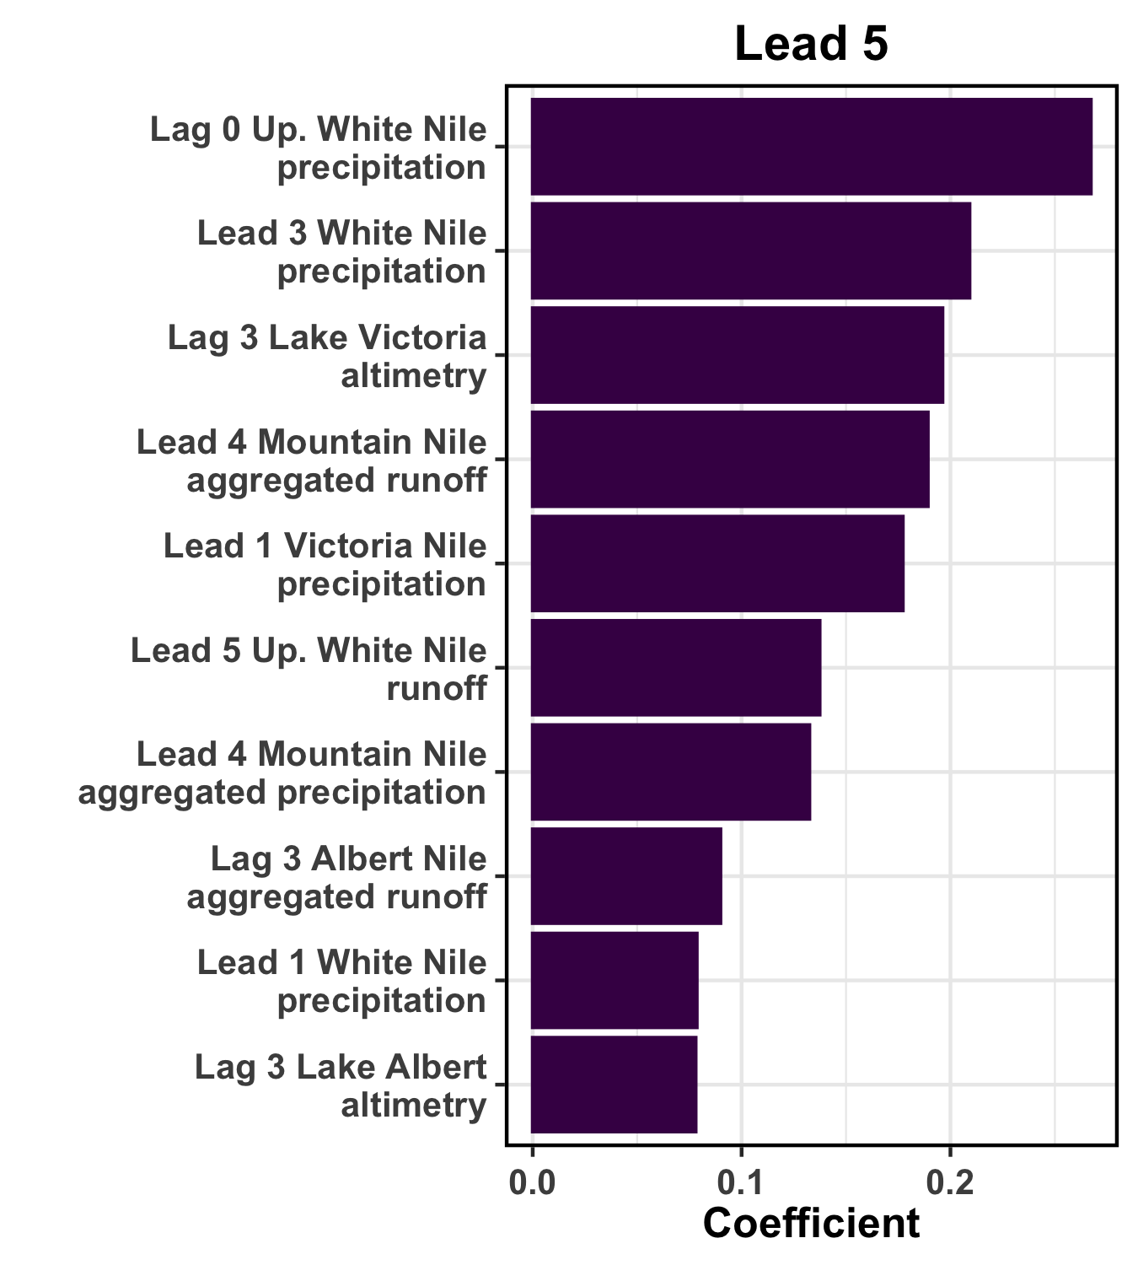
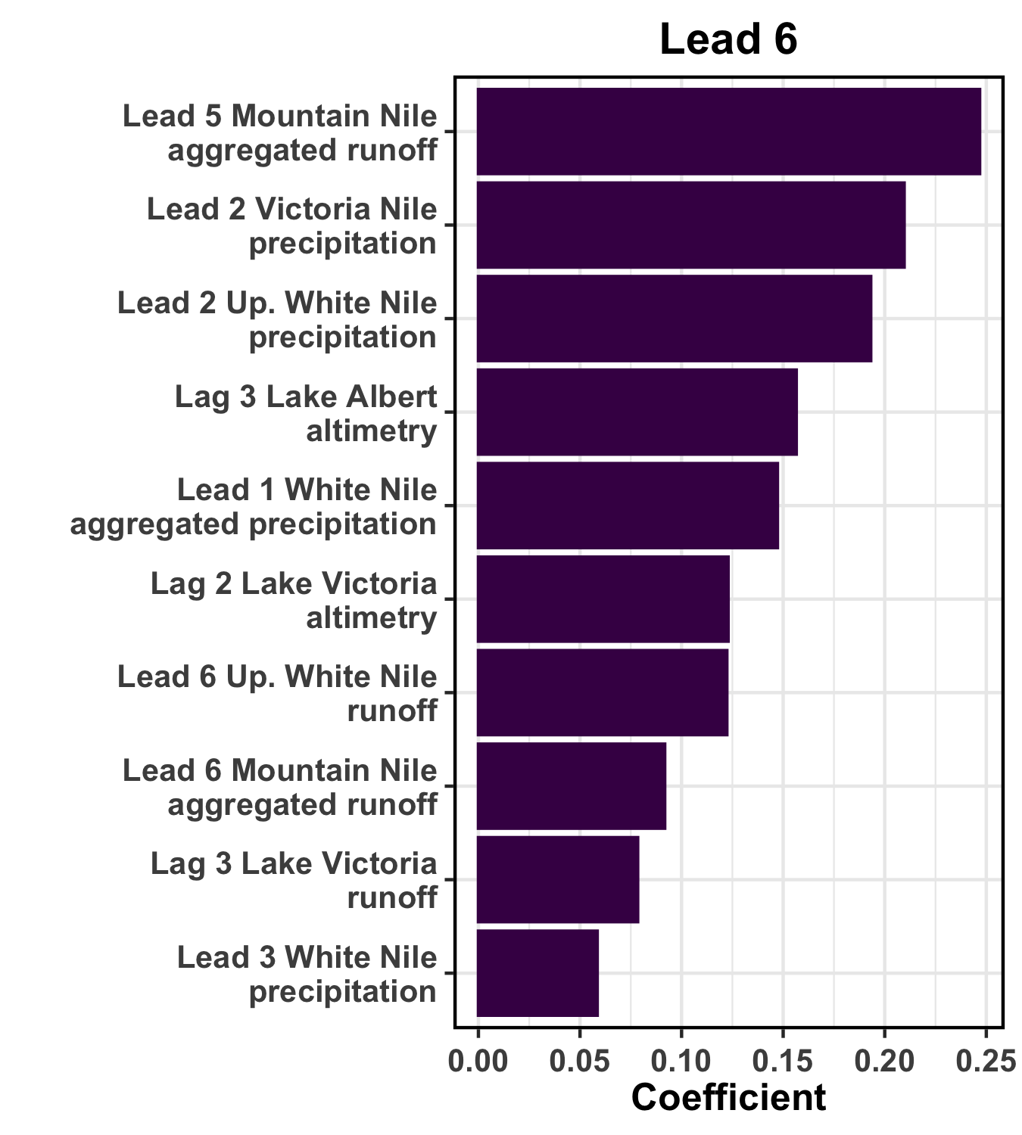
Coefficients for LASSO Models
10 largest coefficients for covariates for Lead 5 and 6 National LASSO models
Primary drivers of the Lead 5 and 6 models:
Lake Victoria and Lake Albert altimetry
Previous lead/lag precipitation and runoff for the White Nile, Albert Nile, Victoria Nile, and Mountain Nile basins
Current lead runoff forecast for White Nile and Mountain Nile basins

Slide 15
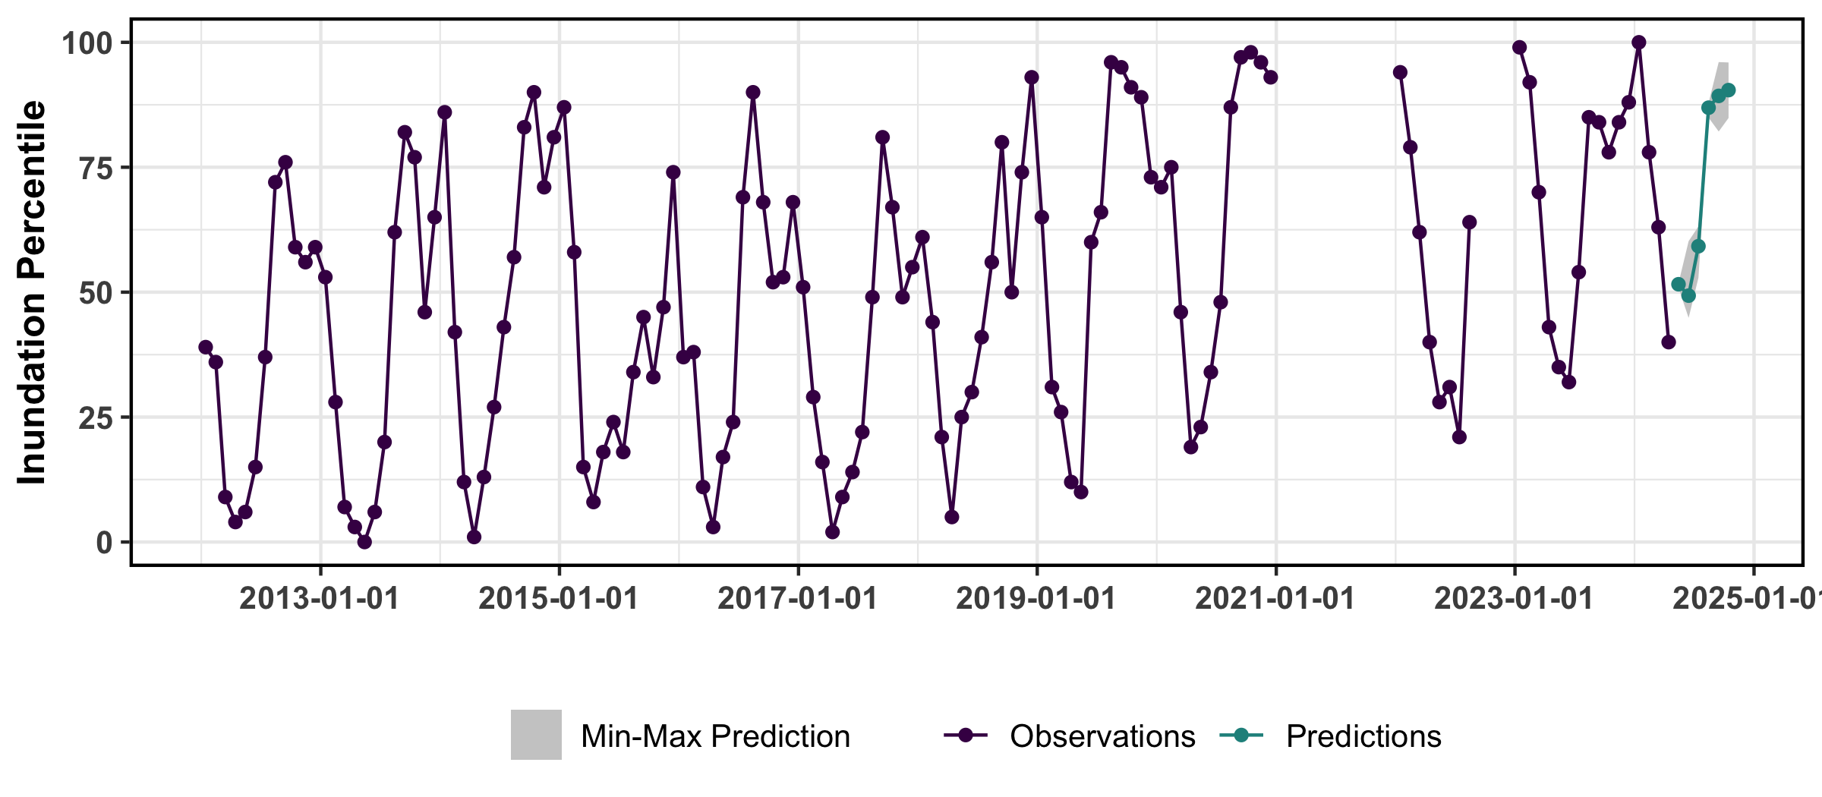
LASSO Model Predictions for May-Oct 2024
LASSO was run 20 times to generate an ensemble prediction of national level inundation percentile

Slide 16
Predicted Inundation Mapping

Slide 17
LASSO Estimates for 2024
Predicted inundated areas with May initial condition.
Predicted inundated percentiles were converted to inundated areas.

Slide 18
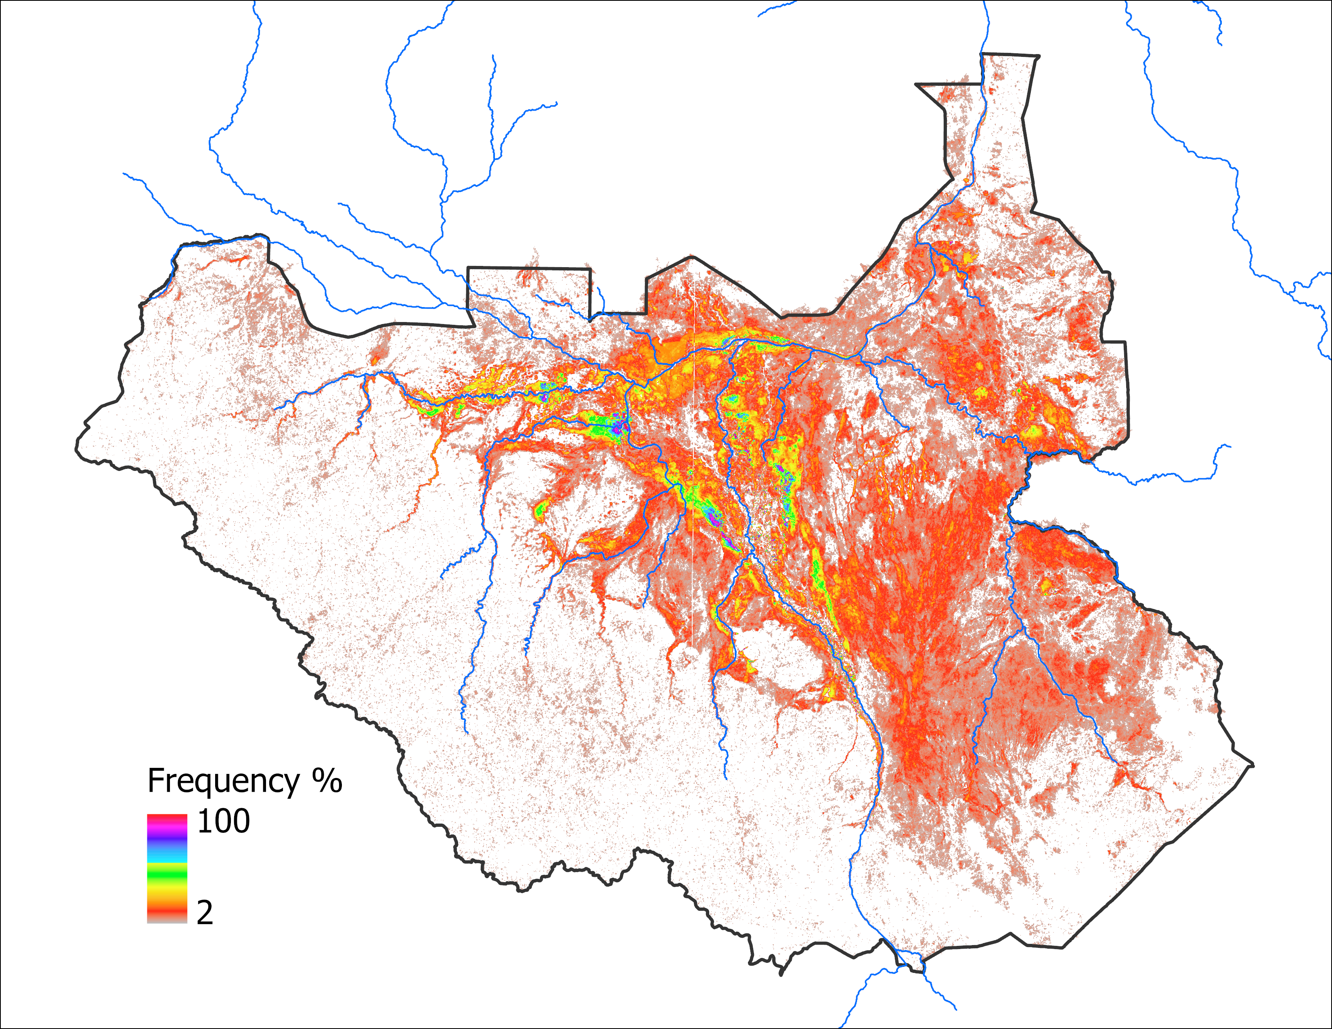
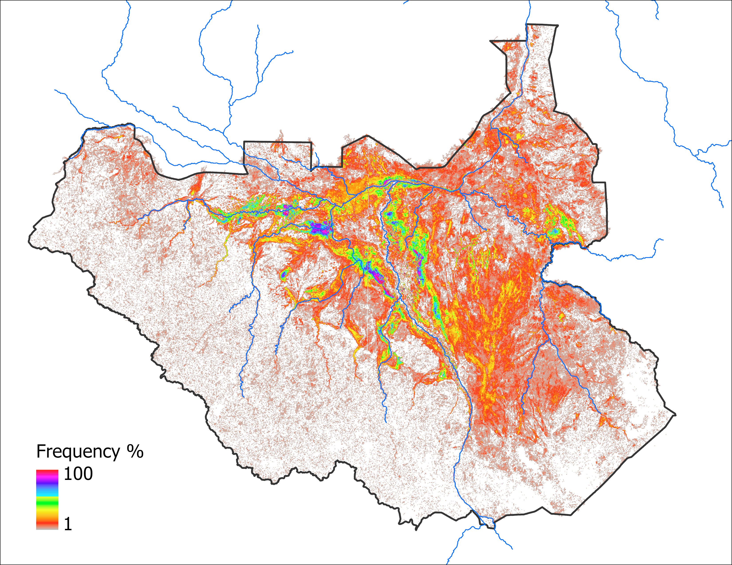
Flood Frequency Maps
All available months (133 months)
JASOND months (68 months)
Seasonal (JASOND) frequency map was used in mapping predicted inundation for Sep and Oct of 2024

Slide 19
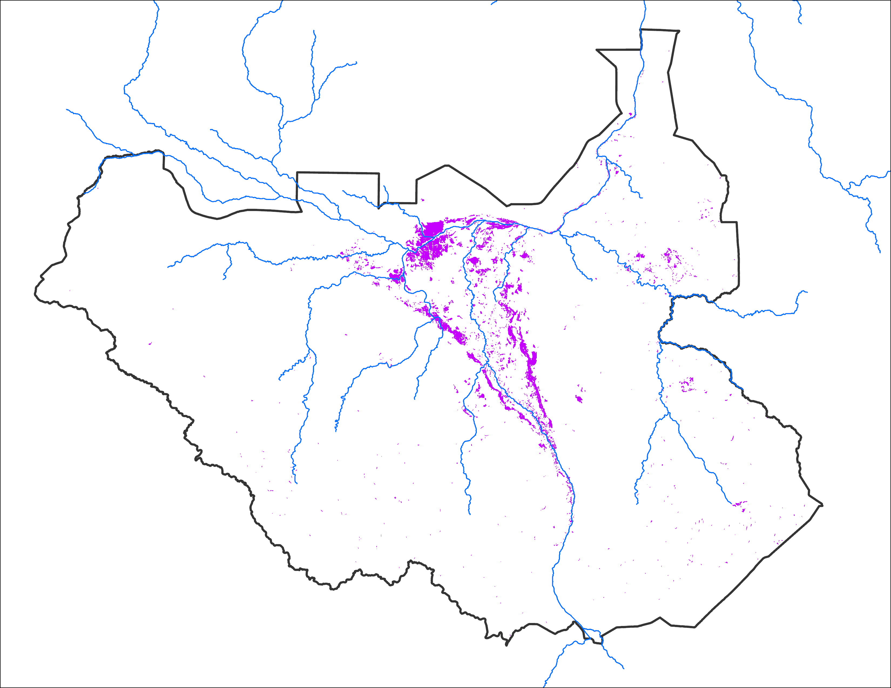
Initial Inundation Map
Initial Condition (IC): MAY 2024

Slide 20
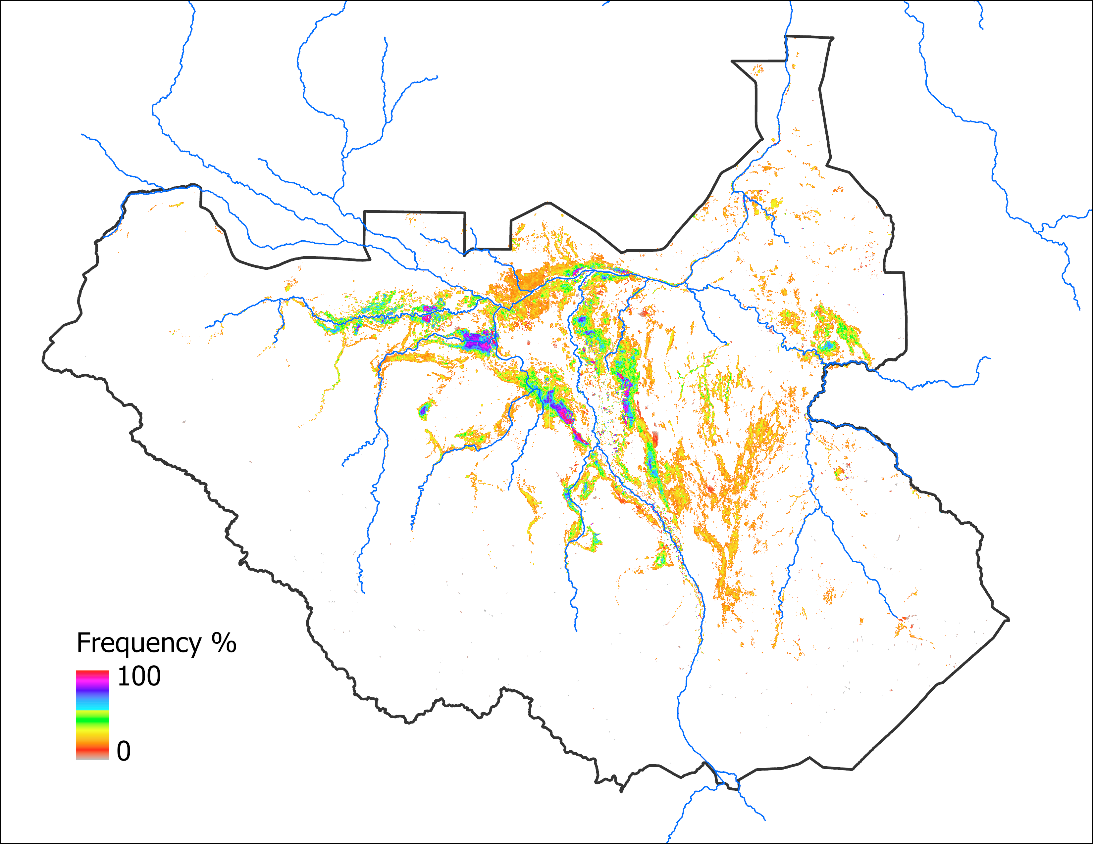
LASSO Predicted Inundation Map
Sep 2024 with May IC
Oct 2024 with May IC
63,330 km²
63,330 km²
Notes:
Because of the insignificant difference (only 51 km²) in LASSO predicted estimates for Sep and Oct, the mapped areas are the same for 2024.

Slide 21
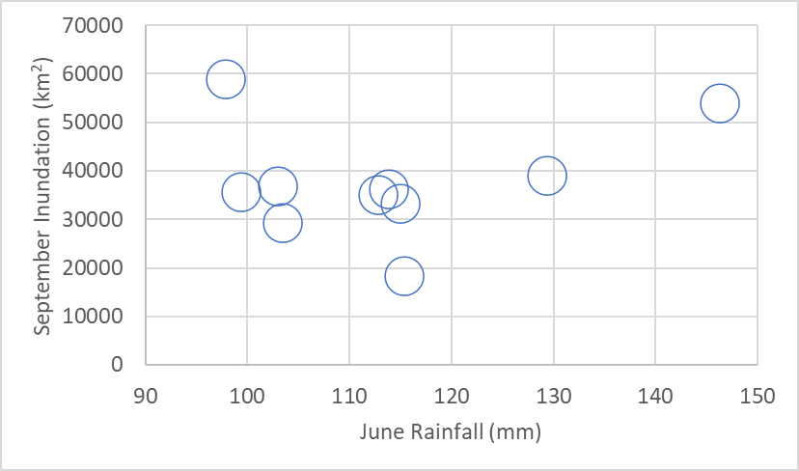
Rainfall & Discharge Analog Year
Discharge at jinja dam
Starting in May 2024: 2,400 m³s⁻¹
Starting in May 2020: 2,200 m³s⁻¹
Flooding at equal magnitude or more than the flooding in 2020 expected – Ministry of Water Resources & Irrigation, South Sudan.
2020
2017
2014
2016
Analog Year
2020 was identified as the analog year based on rainfall and discharge
2020 Sep inundation: 58,820 Km²
2020 Oct inundation: 61,663 Km²
NMME ensemble mean for June 2024: 104 mm

Slide 22
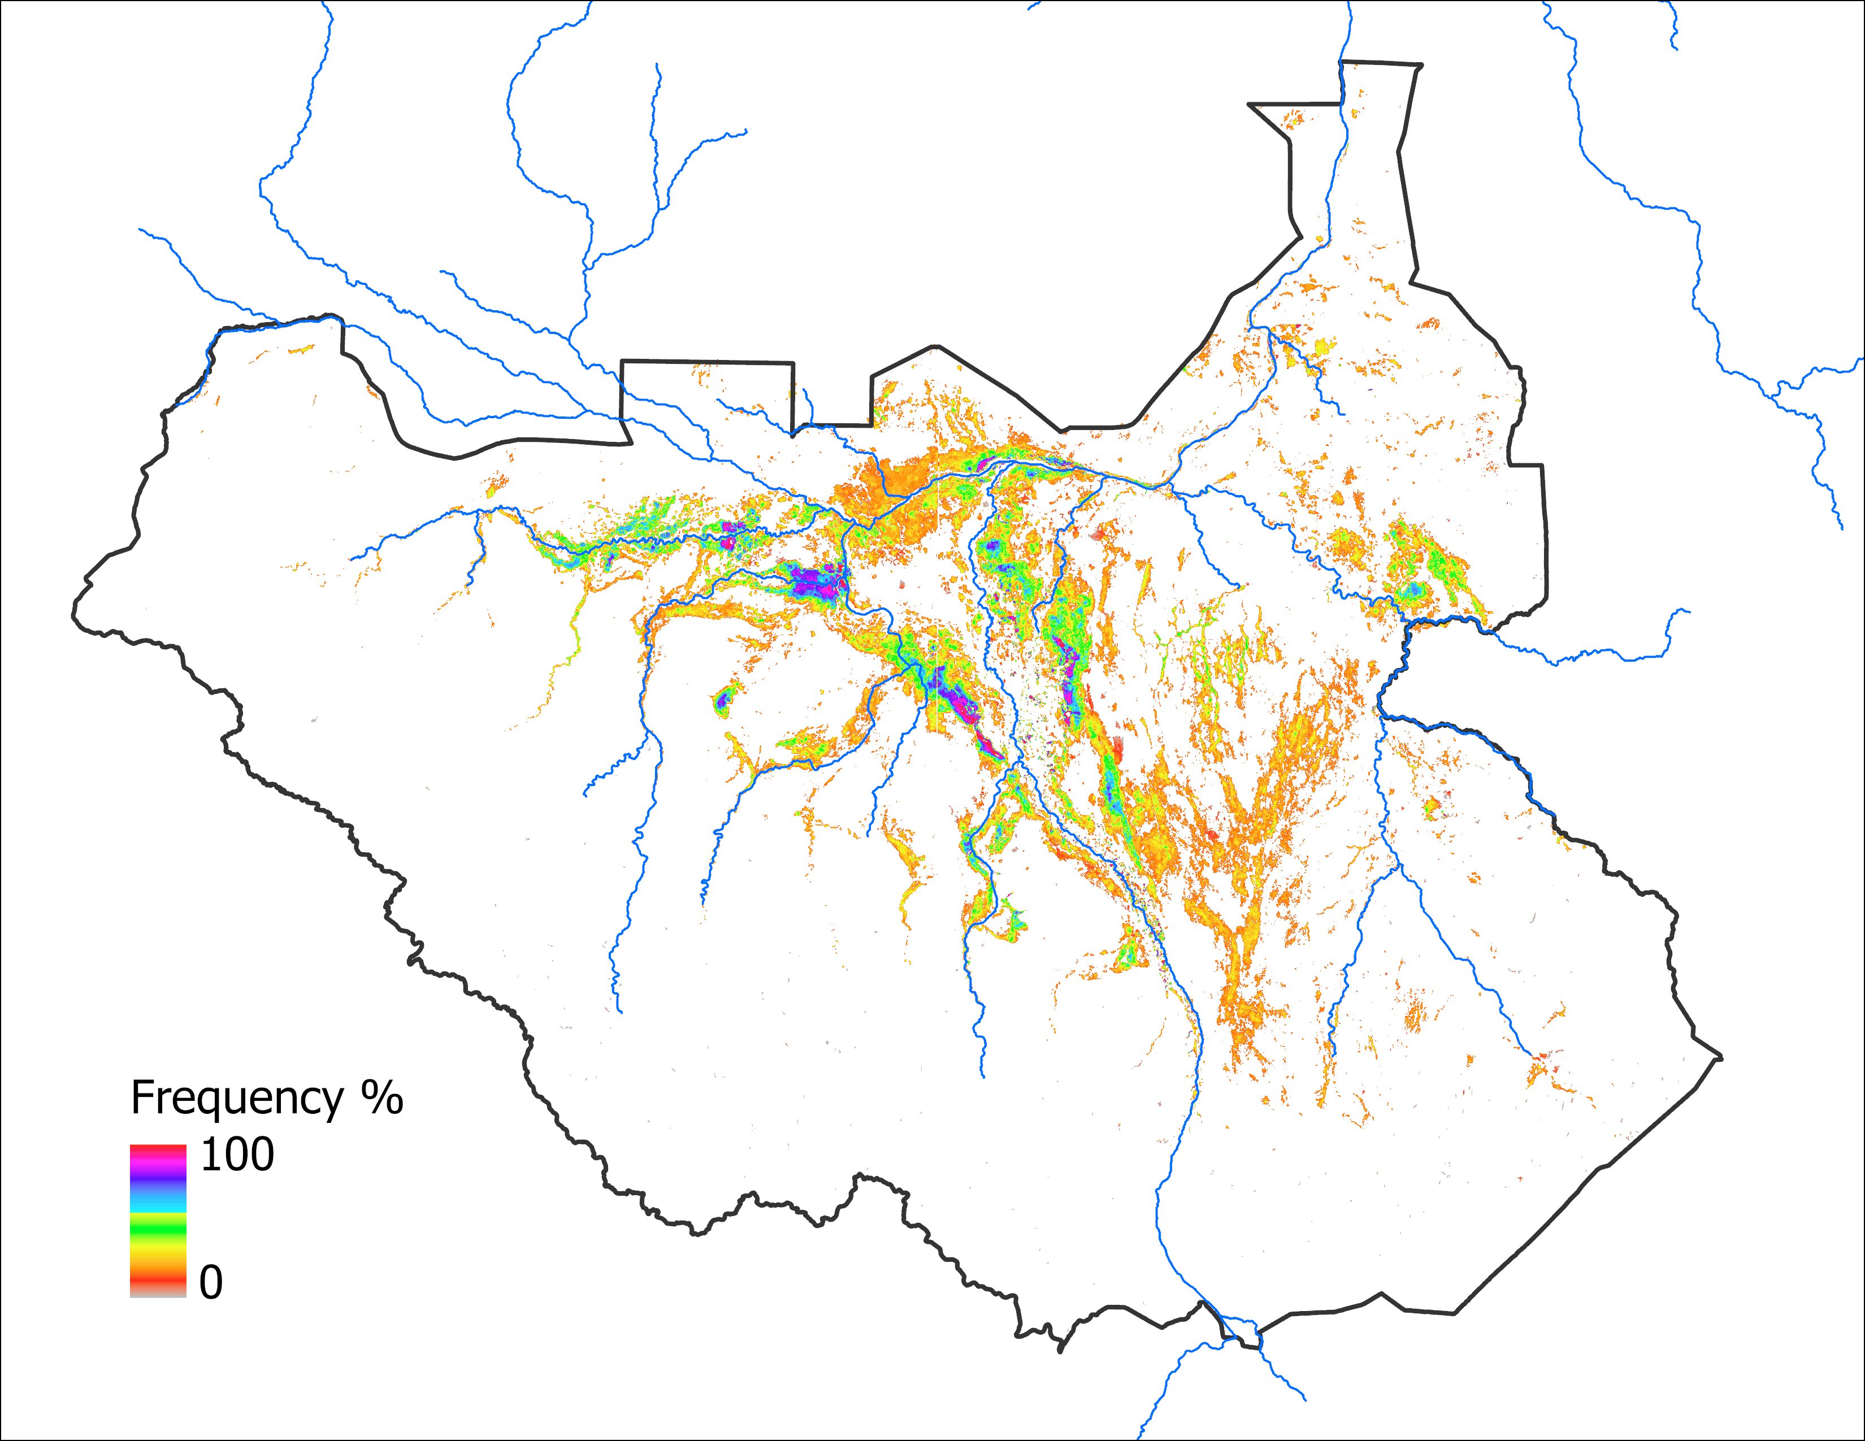
Analog Based Predicted Inundation Map
Sep 2024 with May IC
Oct 2024 with May IC
63,330 km²
70,805 km²

Slide 23
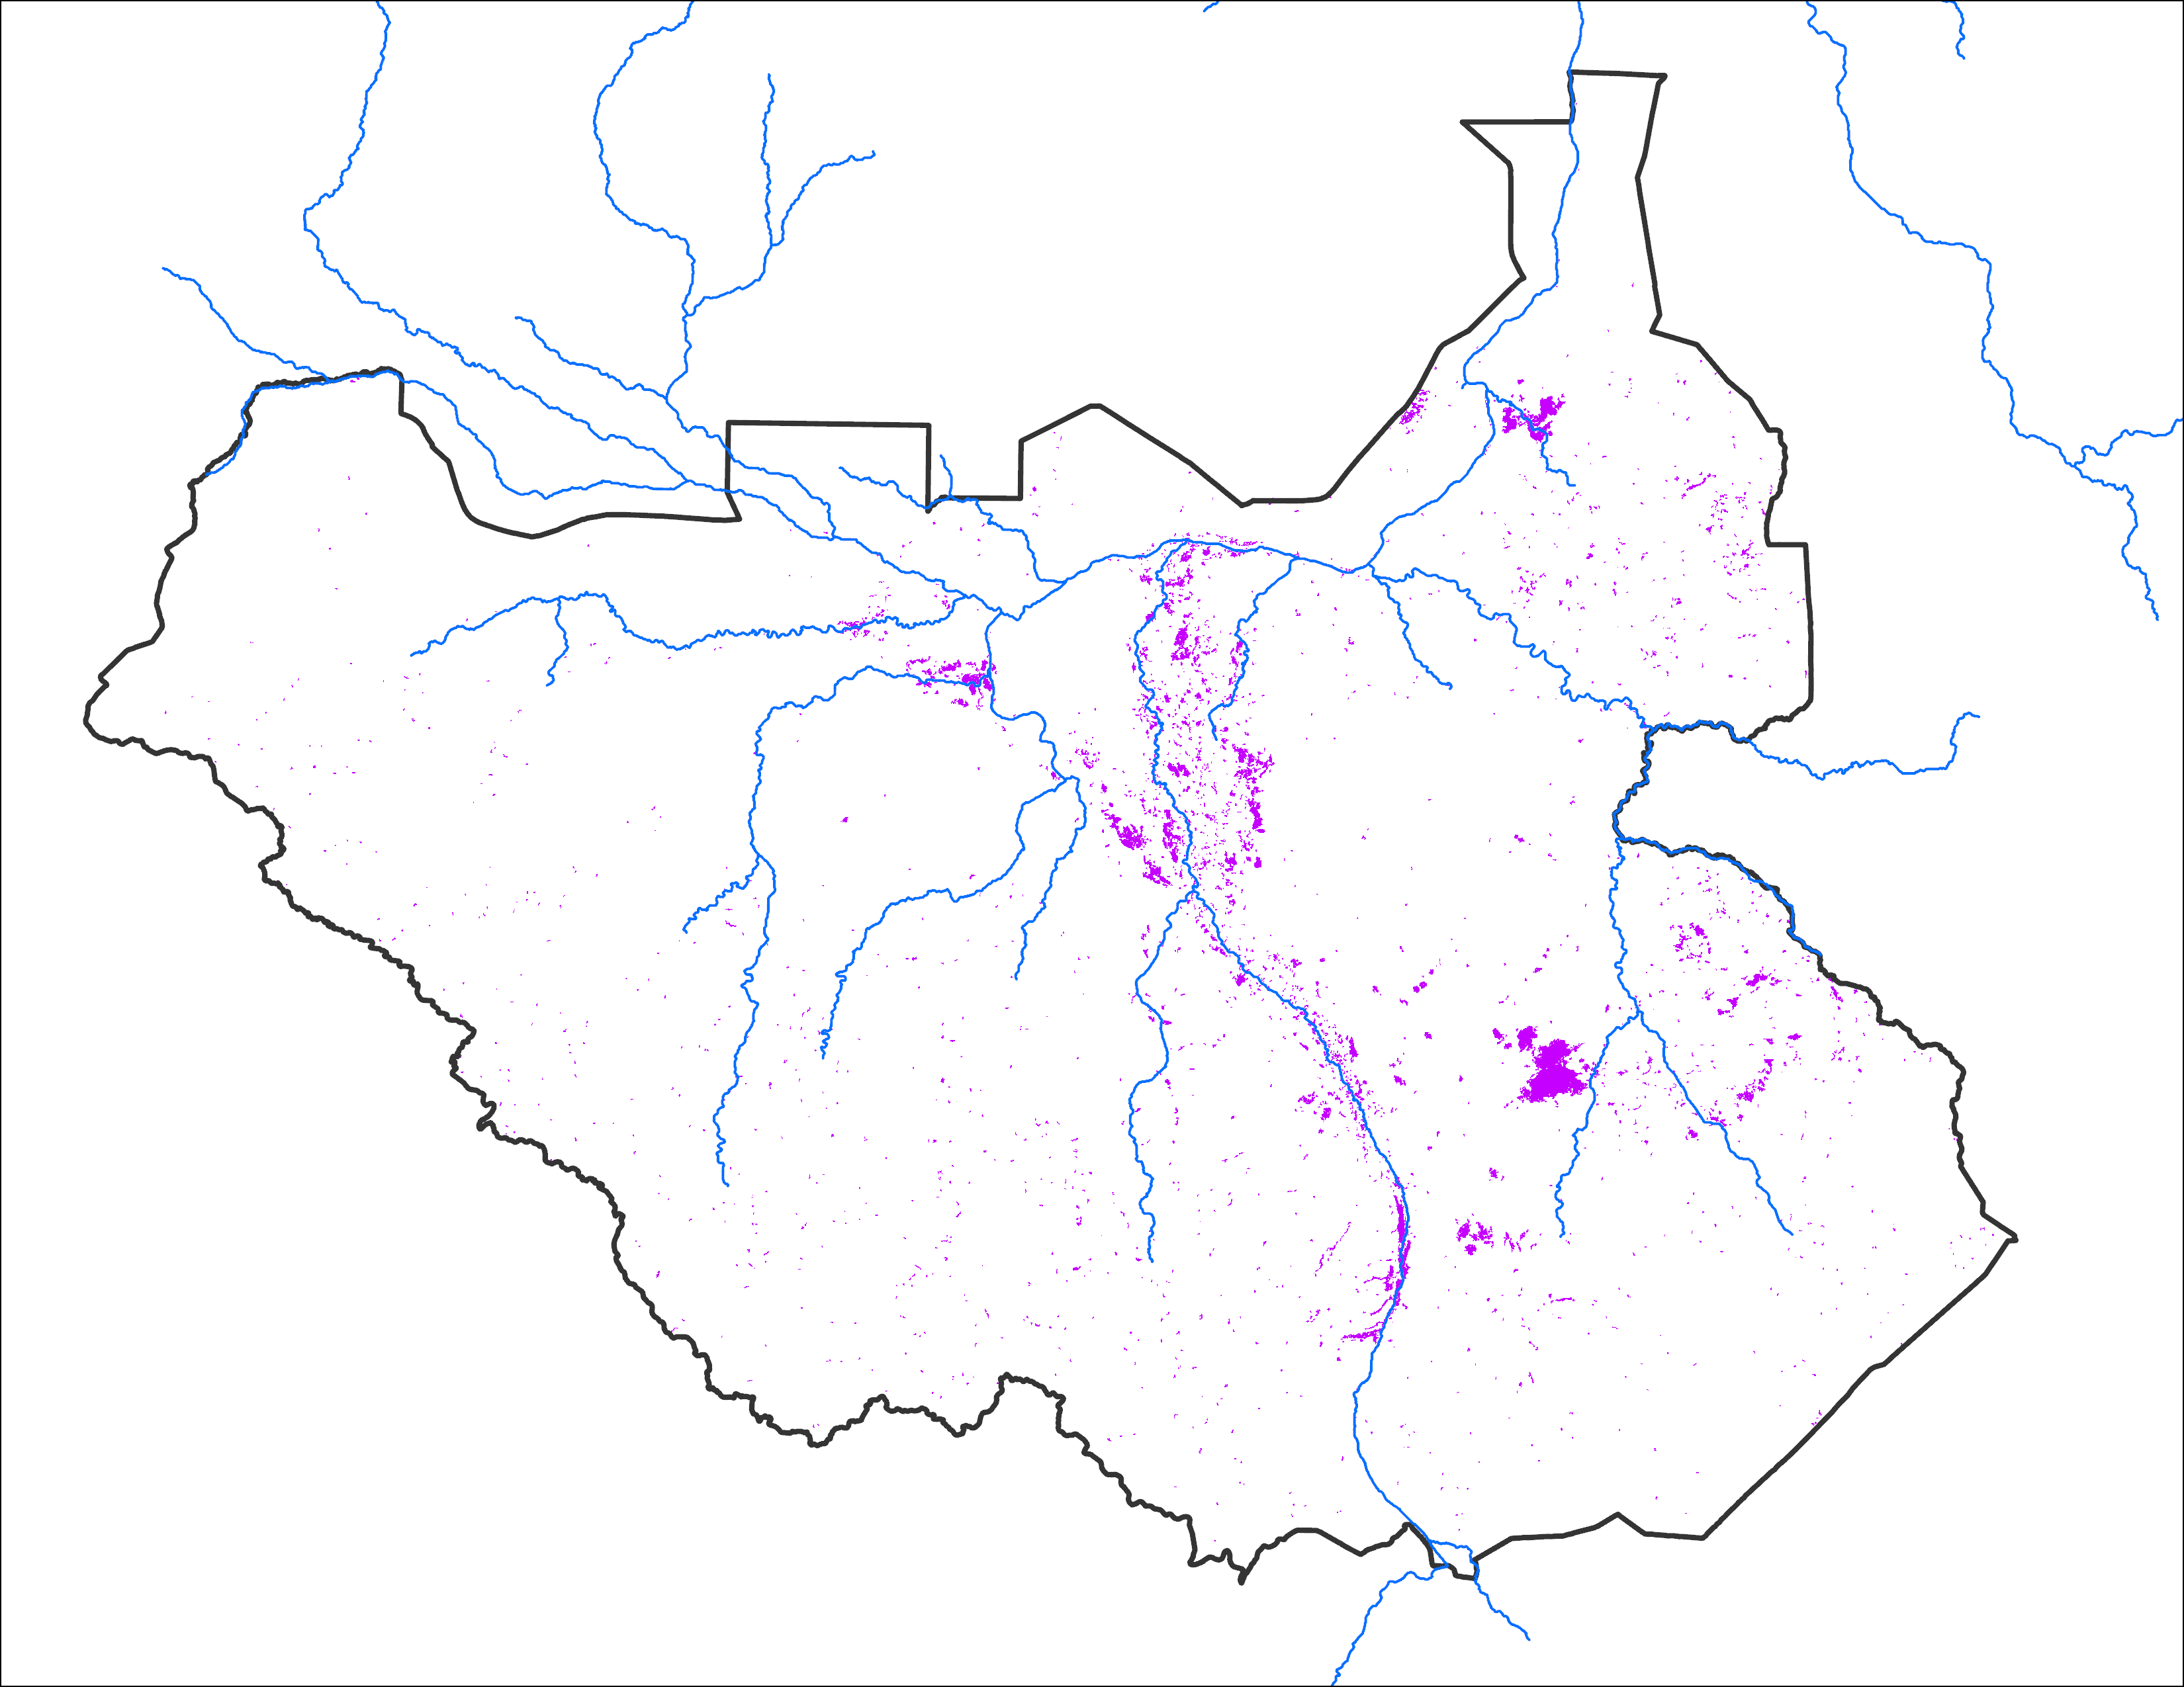
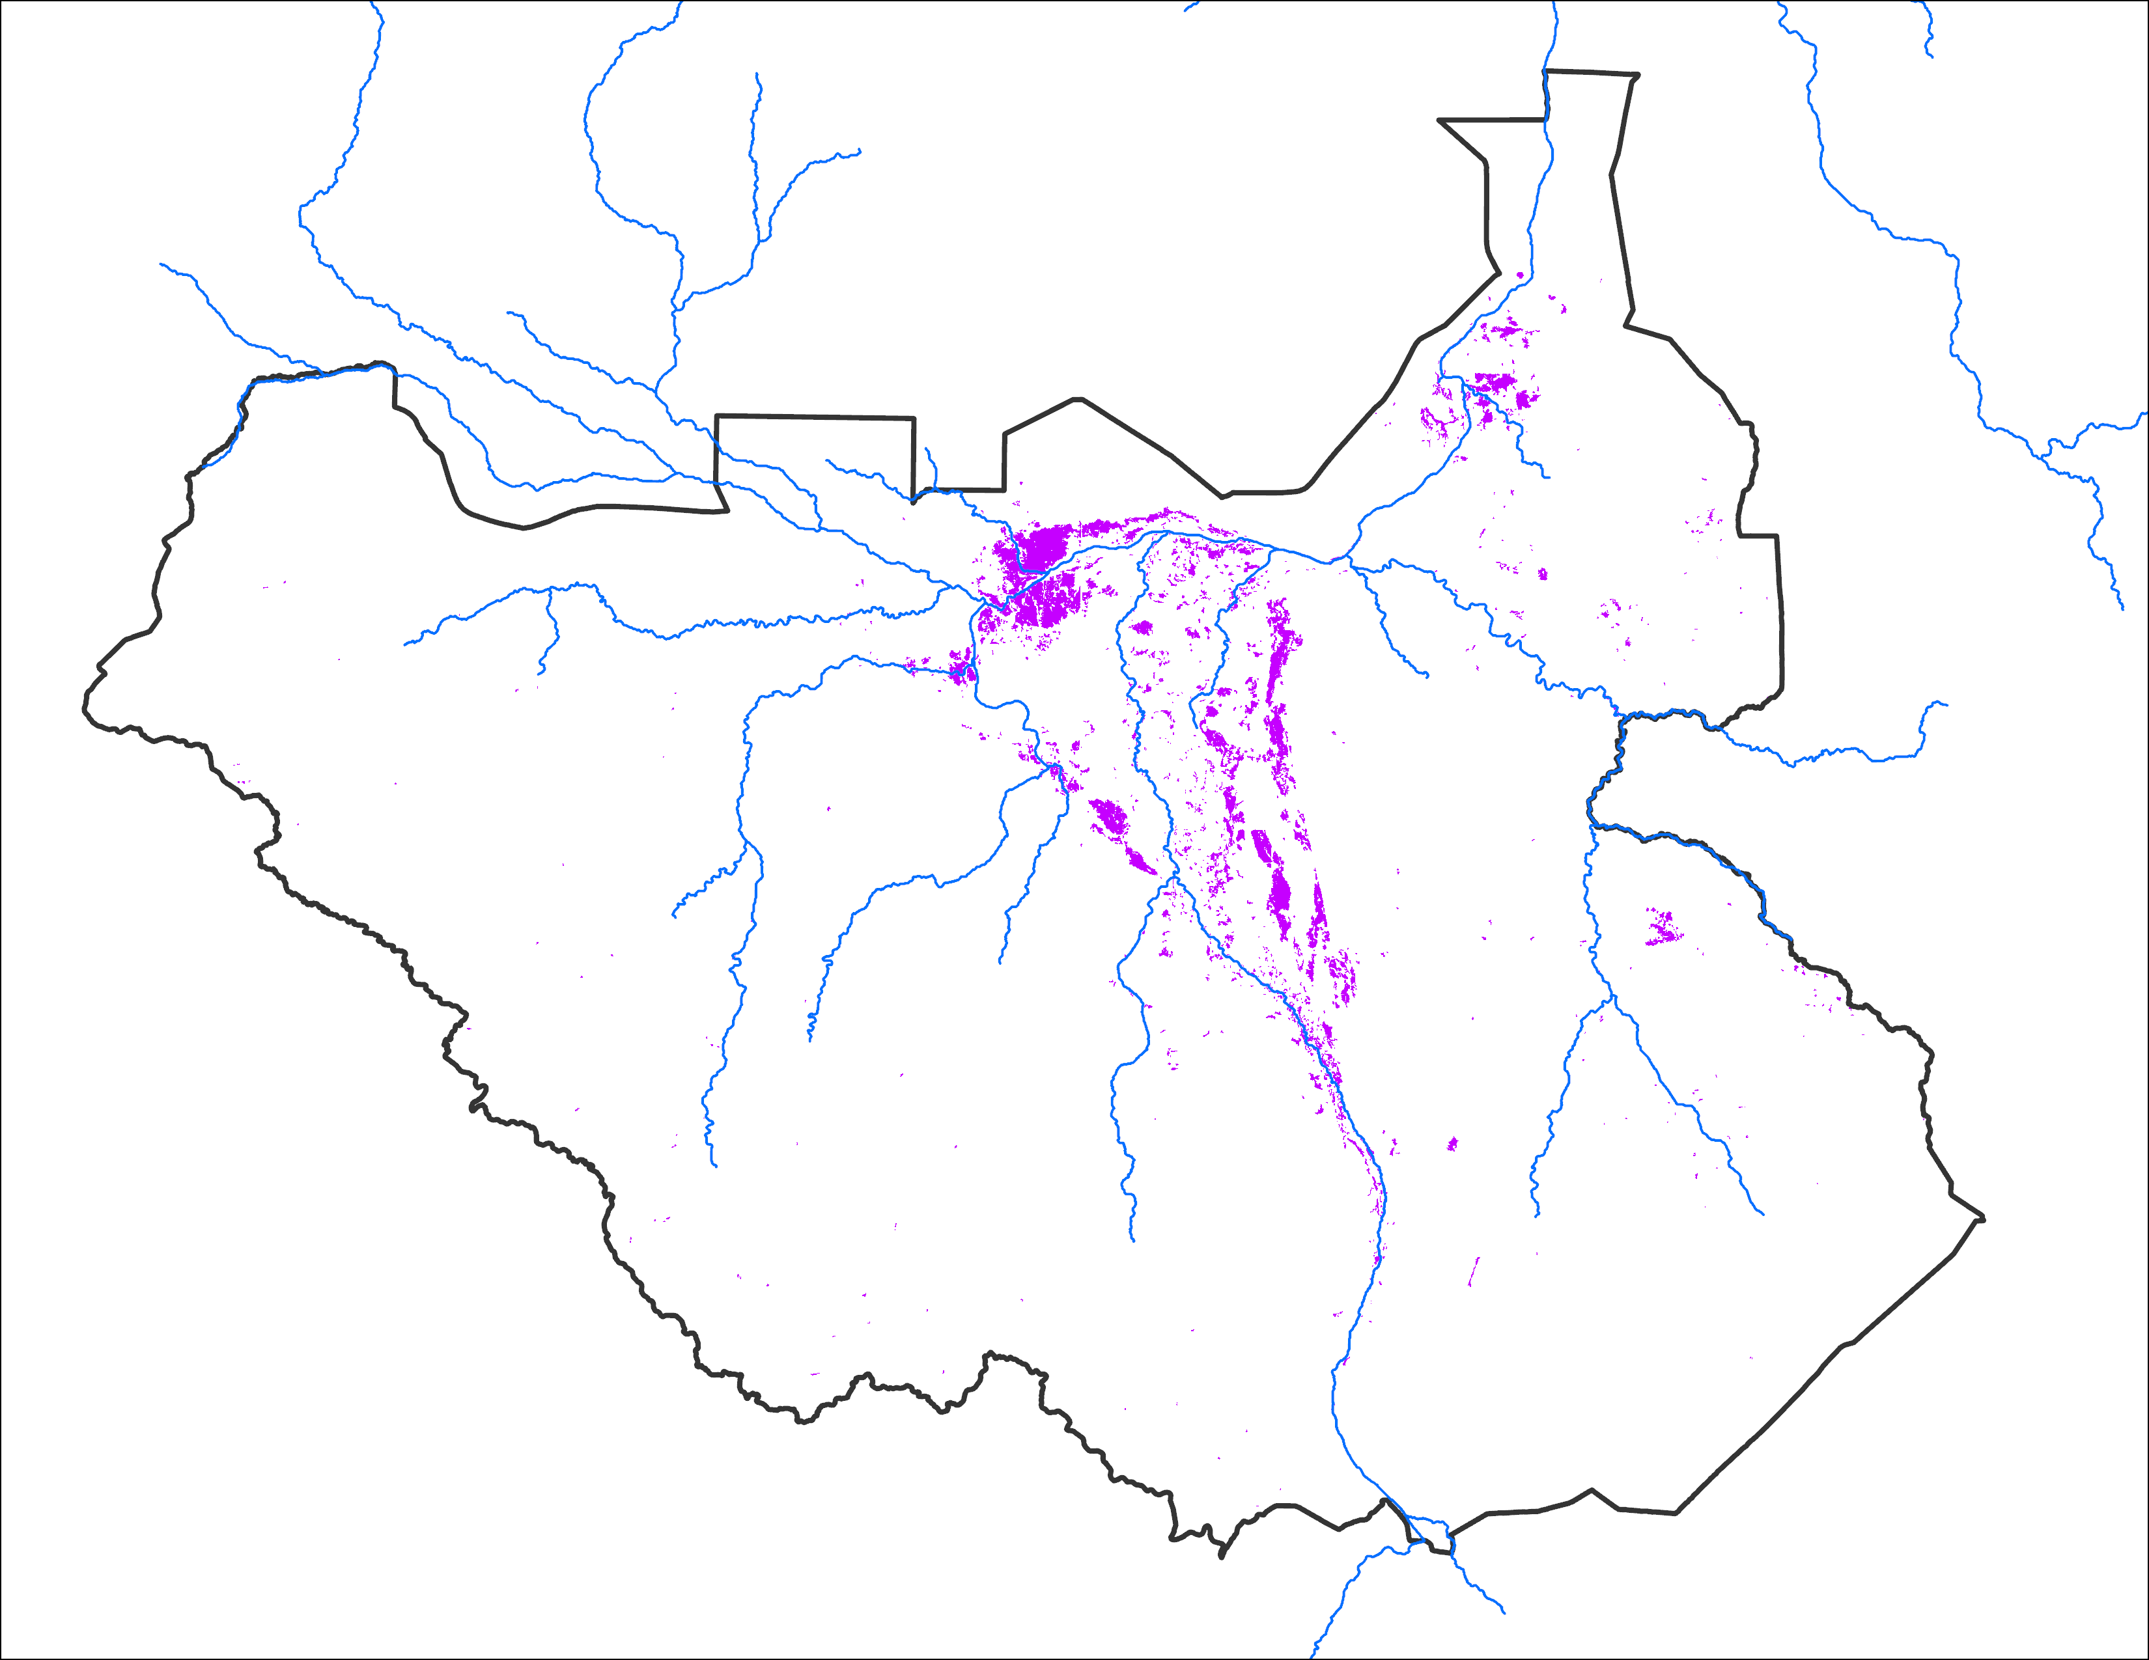
Initial Conditions Comparison
May 2024 IC
May 2020 IC
May 2022 IC
11,931 km²
9,404 km²
10,998 km²

Slide 24
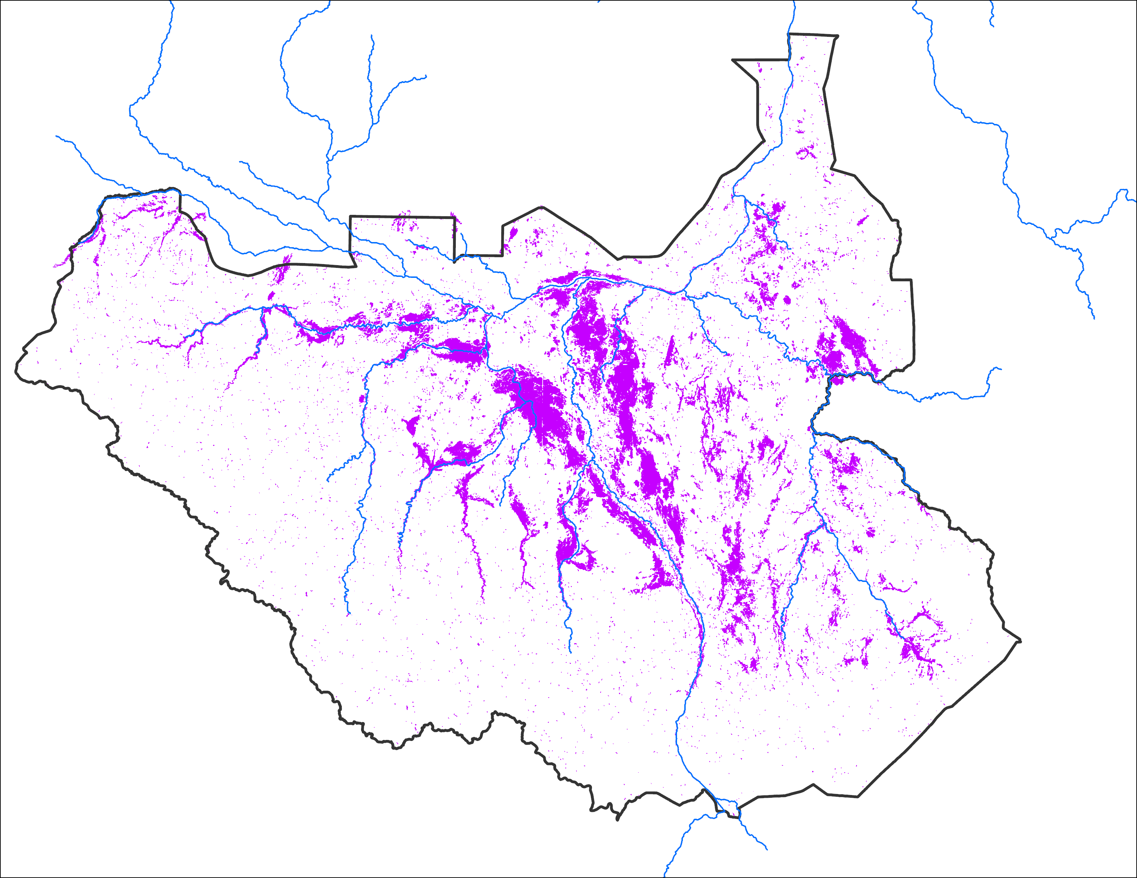
Comparison with 2020
Sep 2024 with May IC
Sep 2024 with May IC
Sep 2020
63,330 km²
Based on LASSO model
63,330 km²
Based on analog year
Observed: 58,820 km²

Slide 25
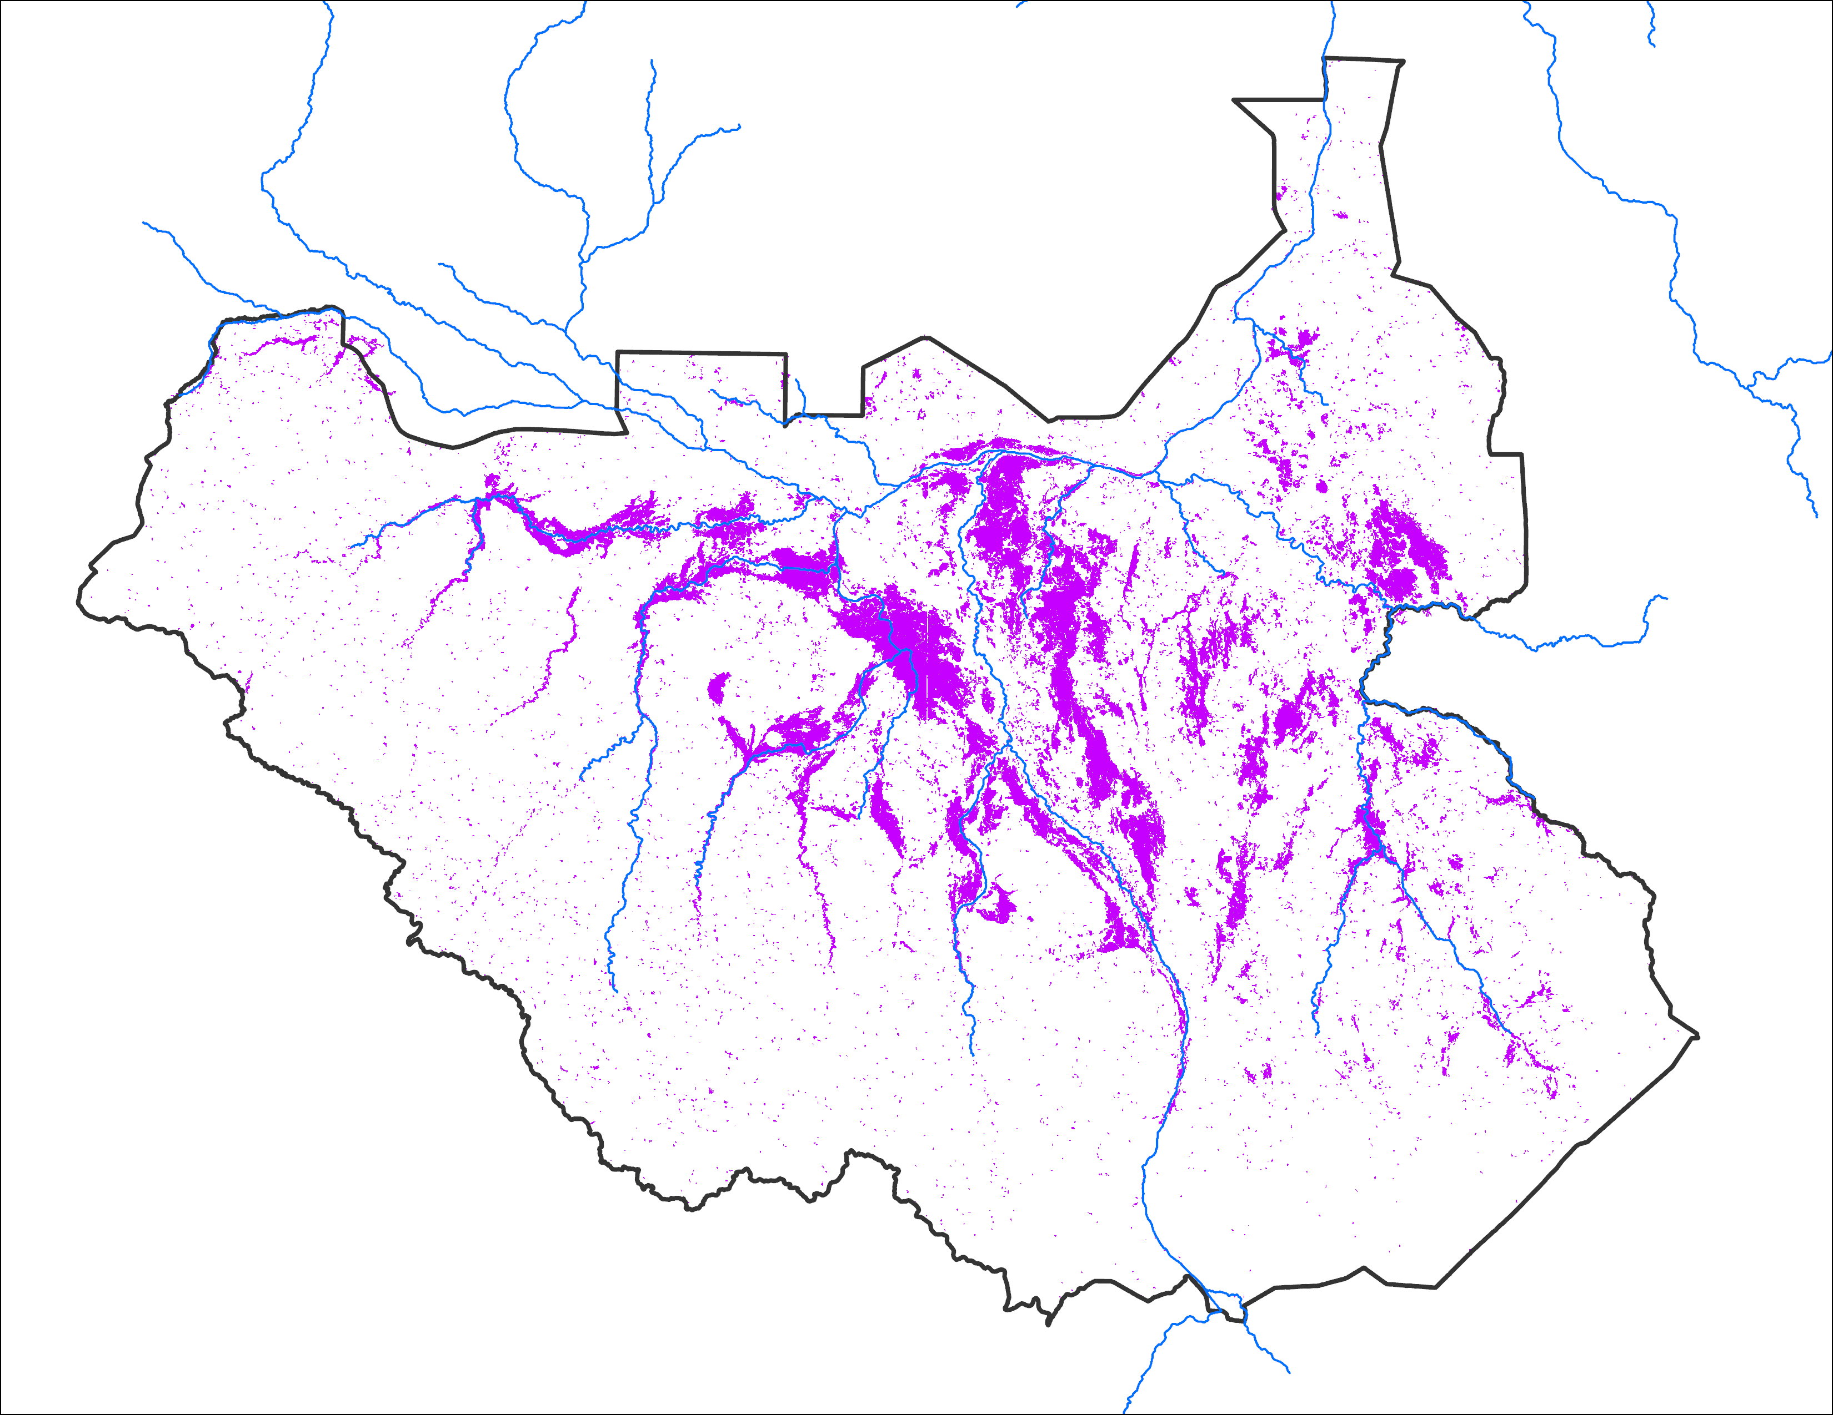
Comparison with 2020
Oct 2024 with May IC
Oct 2024 with May IC
Oct 2020
63,330 km²
Based on LASSO model
70,805 km²
Based on analog year
Observed: 61,664 km²

Slide 26
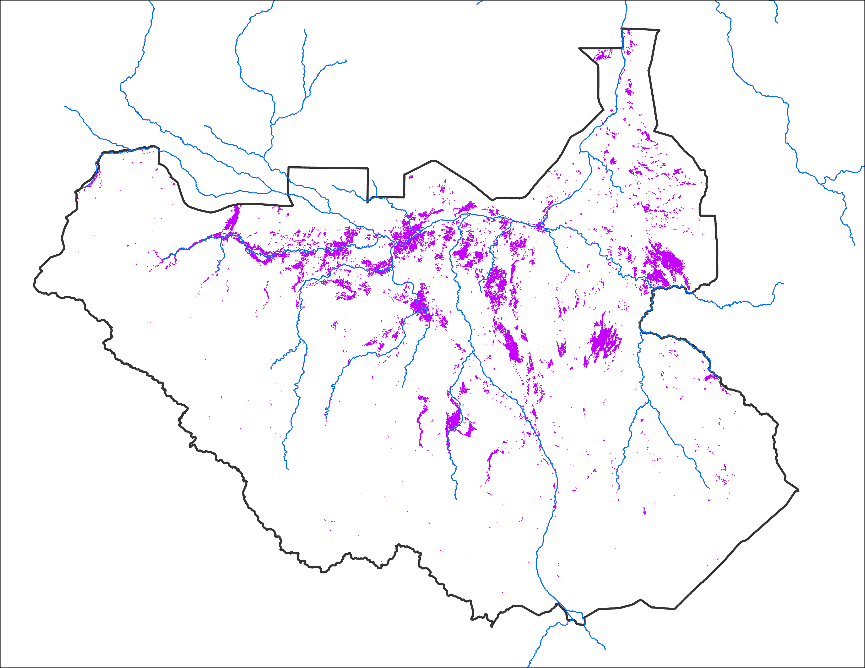
Comparison with 2022
Sep 2024 with May IC
Sep 2024 with May IC
Sep 2022
63,330 km²
Based on LASSO model
63,330 km²
Based on analog year
Observed: 29,805 km²
Inundation was underestimated
because of cloud issues

Slide 27
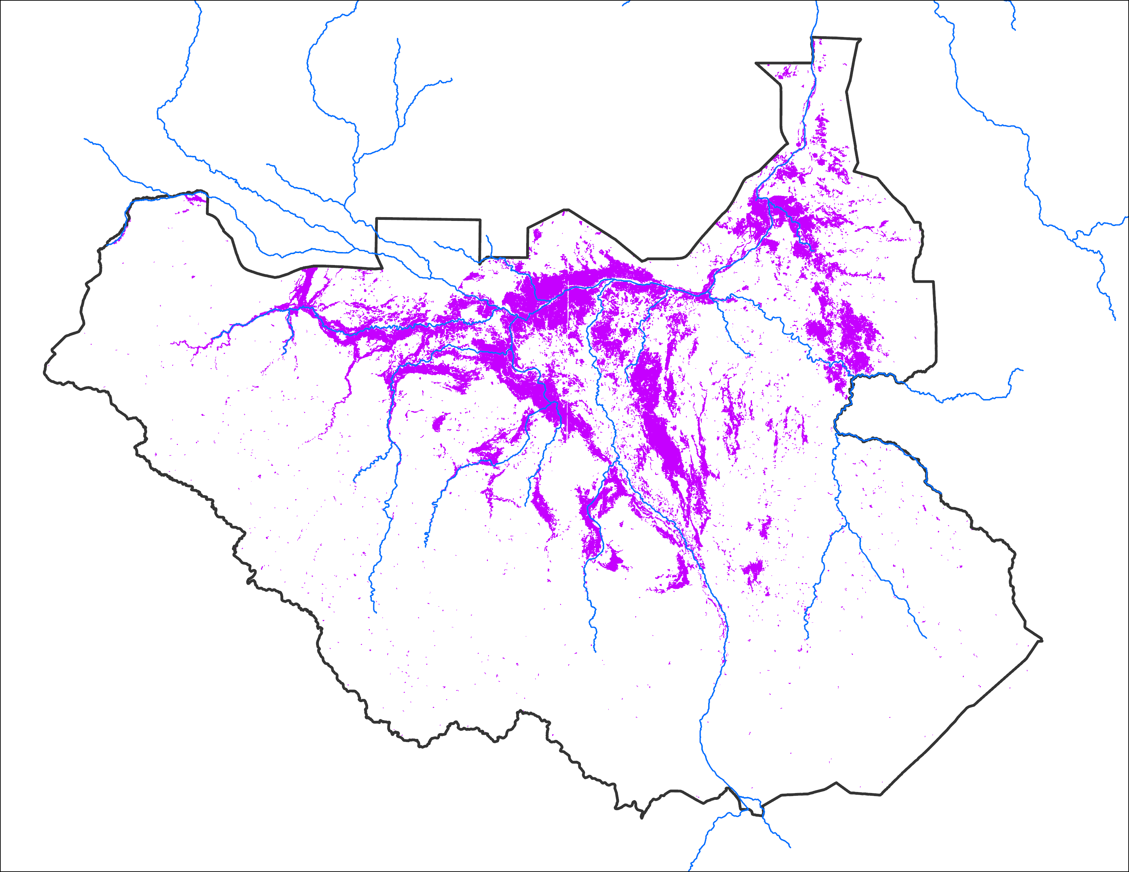
Comparison with 2022
Note the difference in predicted vs observed maps over northeastern South Sudan.
Oct 2024 with May IC
Oct 2024 with May IC
Oct 2022
63,330 km²
Based on LASSO model
70,805 km²
Based on analog year
Observed: 68,449 km²
Inherent level of uncertainty in predicting which geographic areas are most likely to be inundated in 2024.

Slide 28
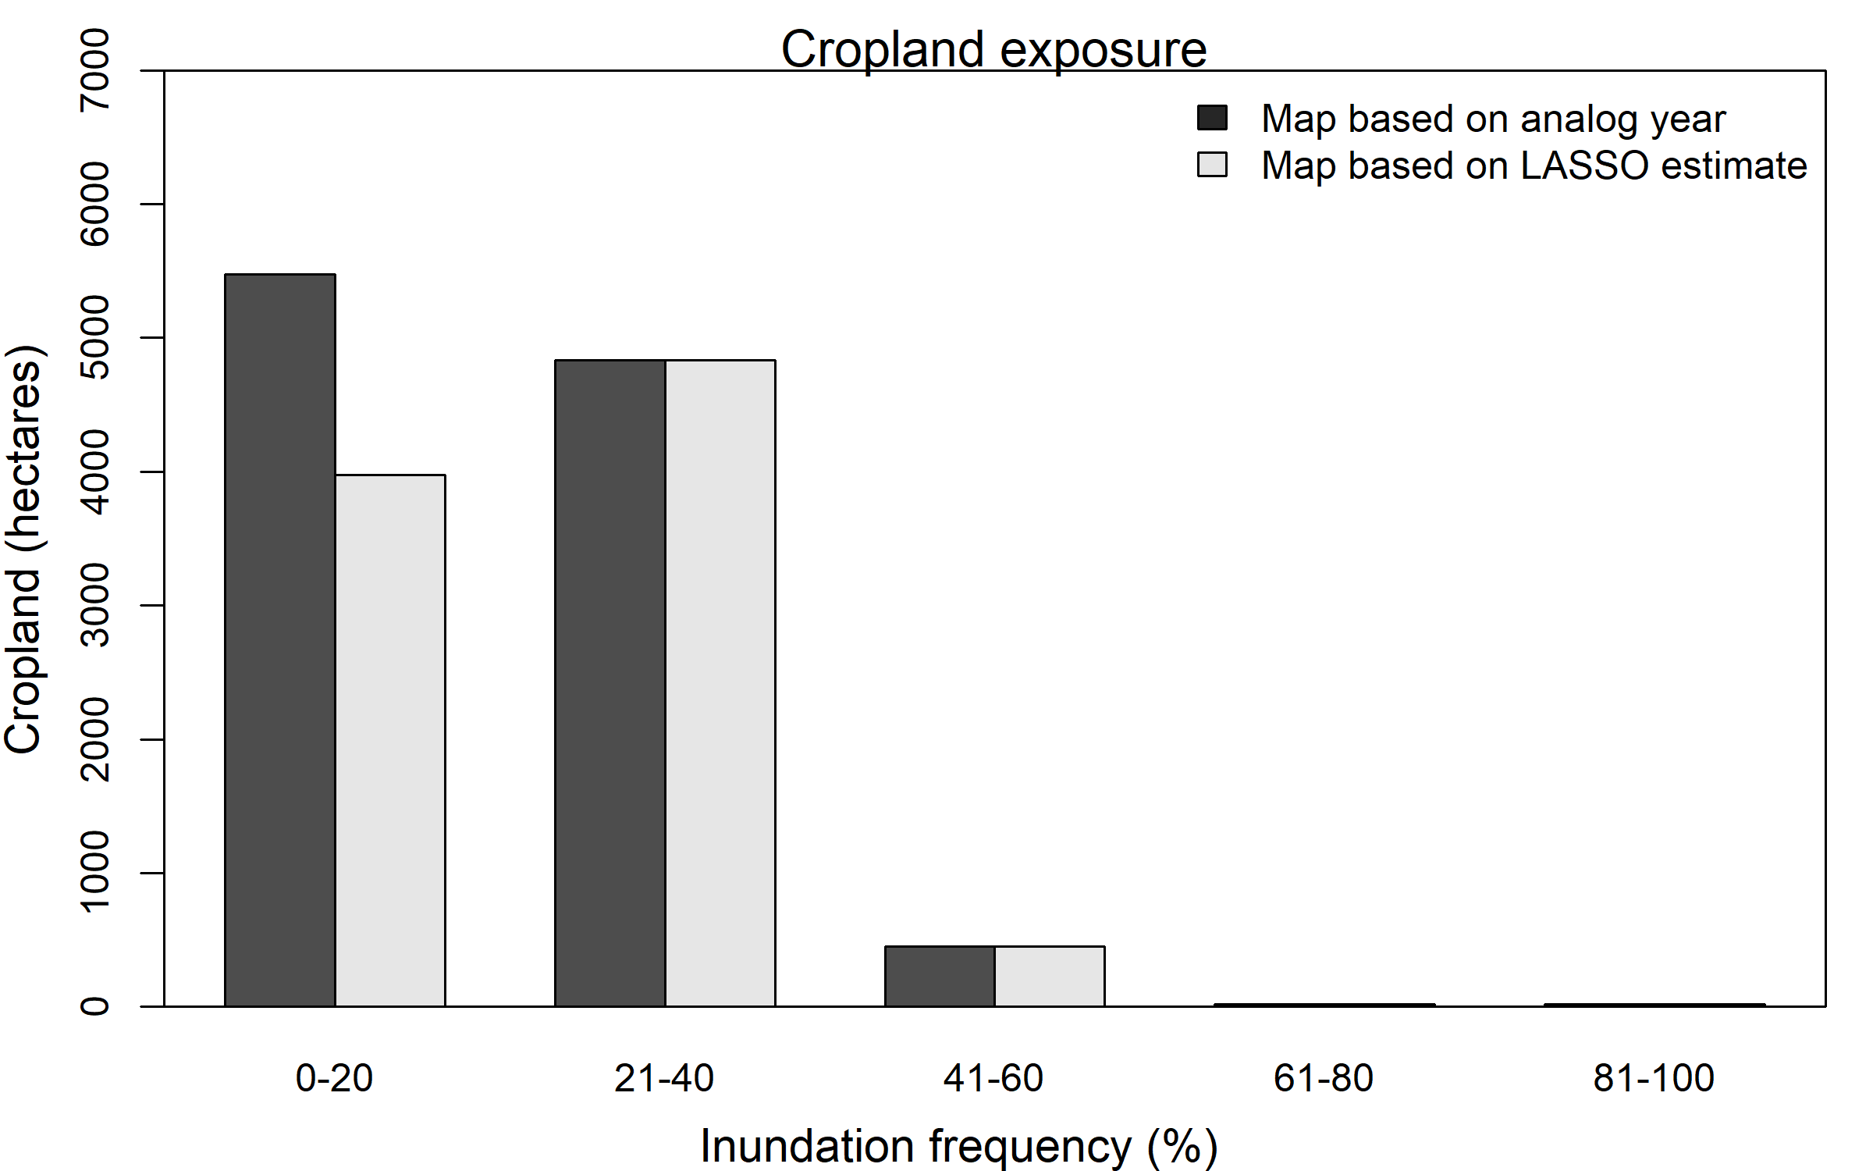
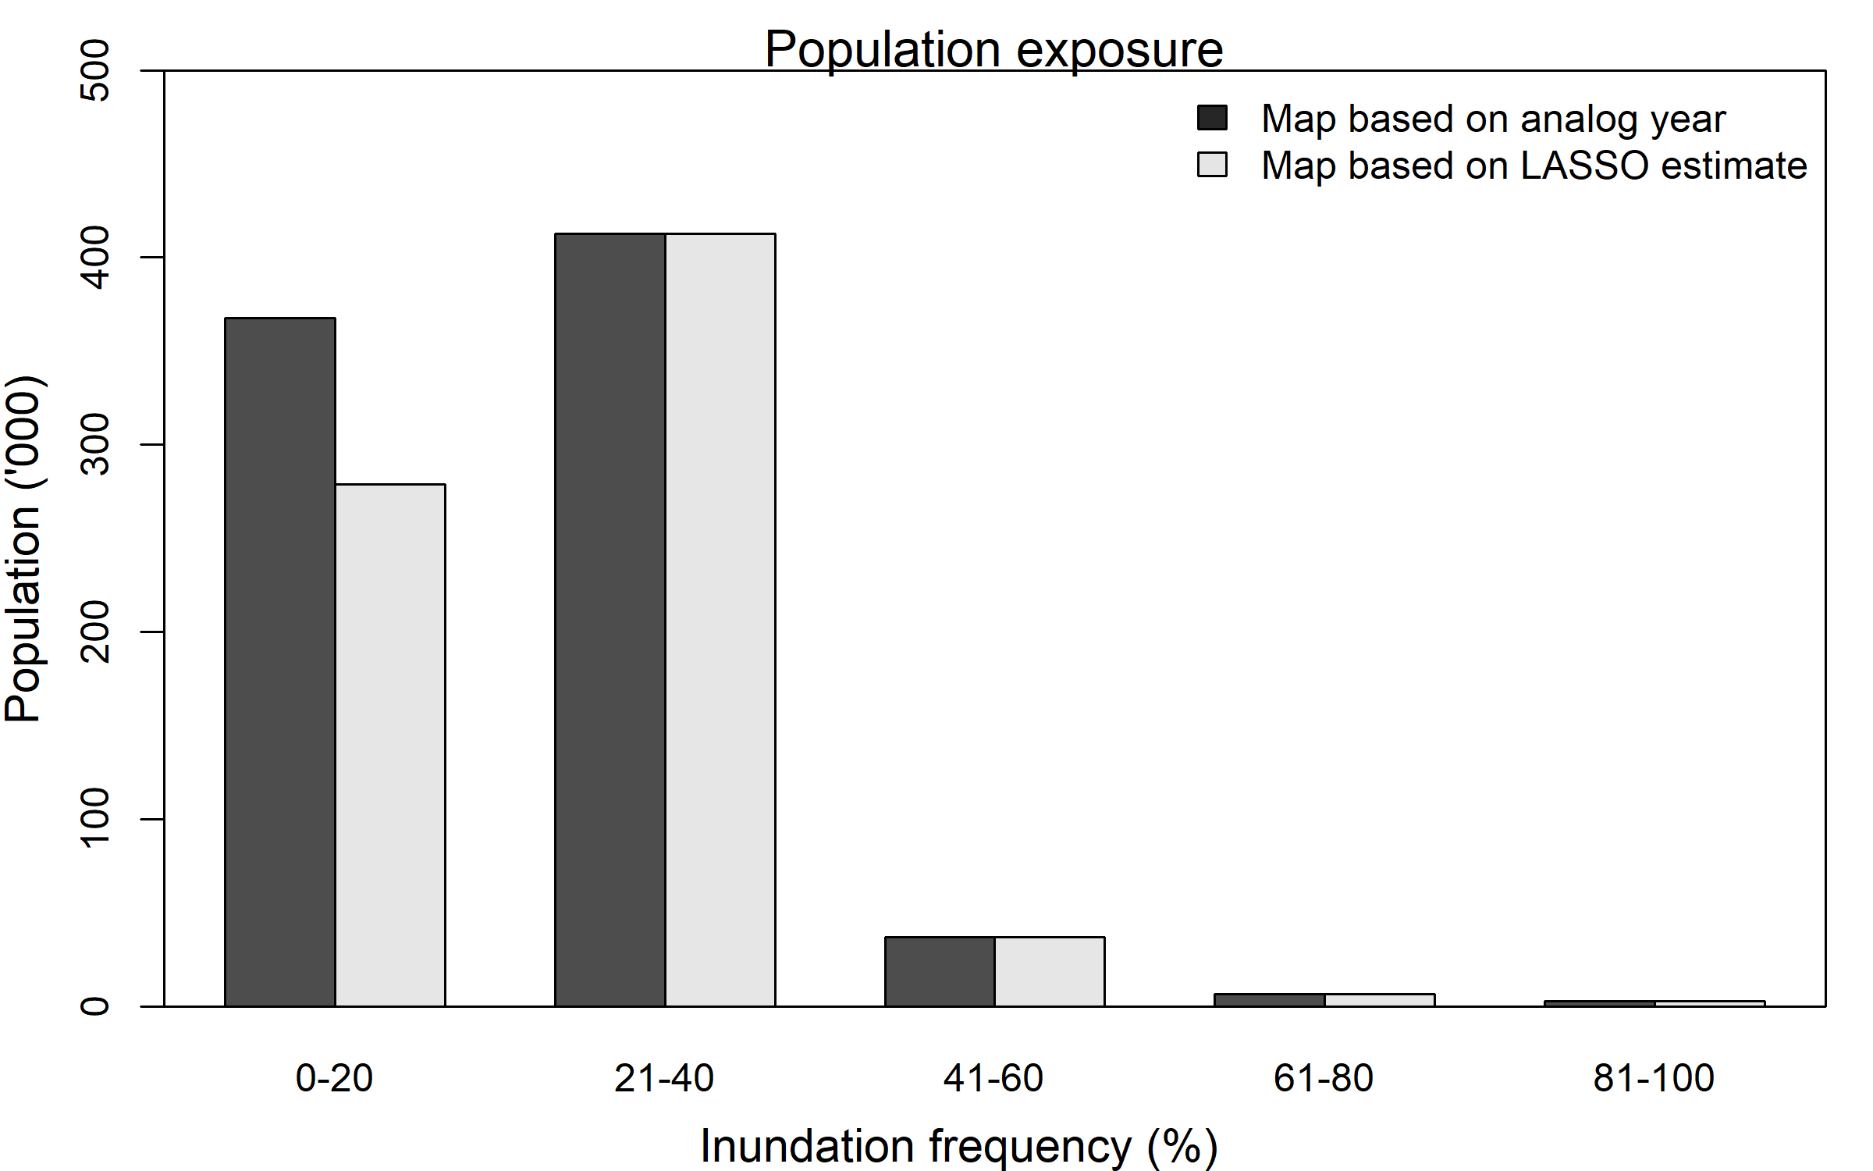
Impact Assessment
~828,000 people are vulnerable to flooding in October of 2024.
Out of 11.2 million
Not including displaced people moving in from Sudan
Cropland vulnerable to flooding in October of 2024: ~10,790 hectares
Out of total 289,364 hectares (entire country)

Slide 29
Thank you

Slide 30


Predicted Estimate to Spatial Distribution
Let’s say LASSO predicted inundated area is : 9 units (each square is one unit)
100
100
100
P
P
P
82
82
82
82
100
45
45
100
95
95
+
C
P
P
P
P
88
88
87
87
95
95
P
P
P
P
65
65
65
65
73
73
75
C
P
73
32
25
% of times inundated out of 130 months (frequency map)
current inundated area map (initial condition)
spatial distribution of predicted inundation
Total of 12 units with initial condition

Slide 31
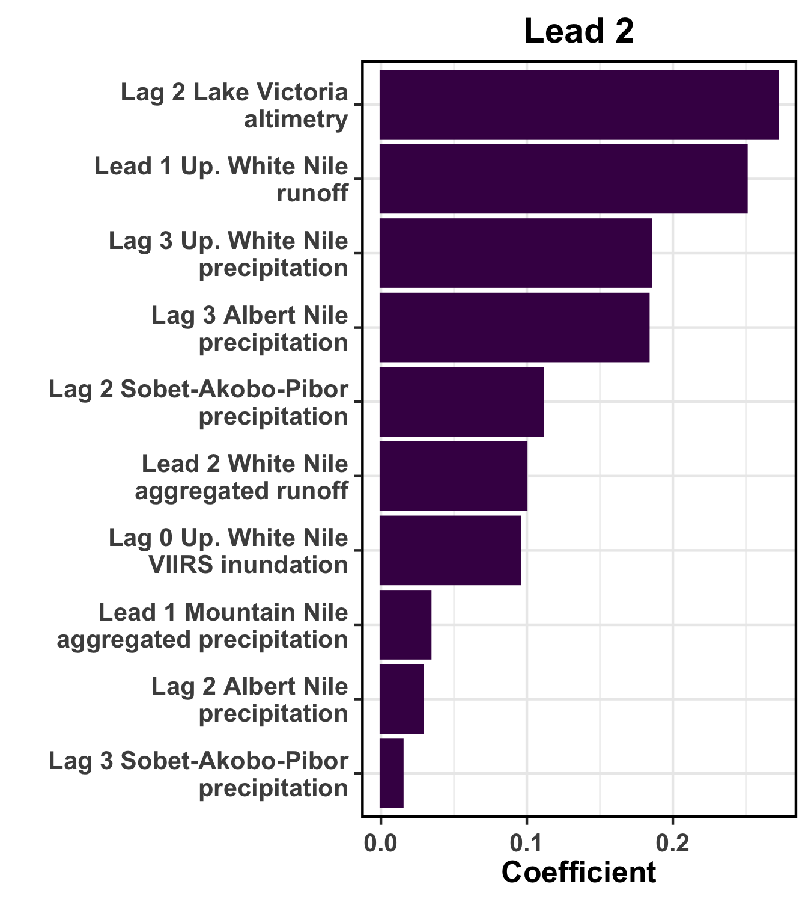
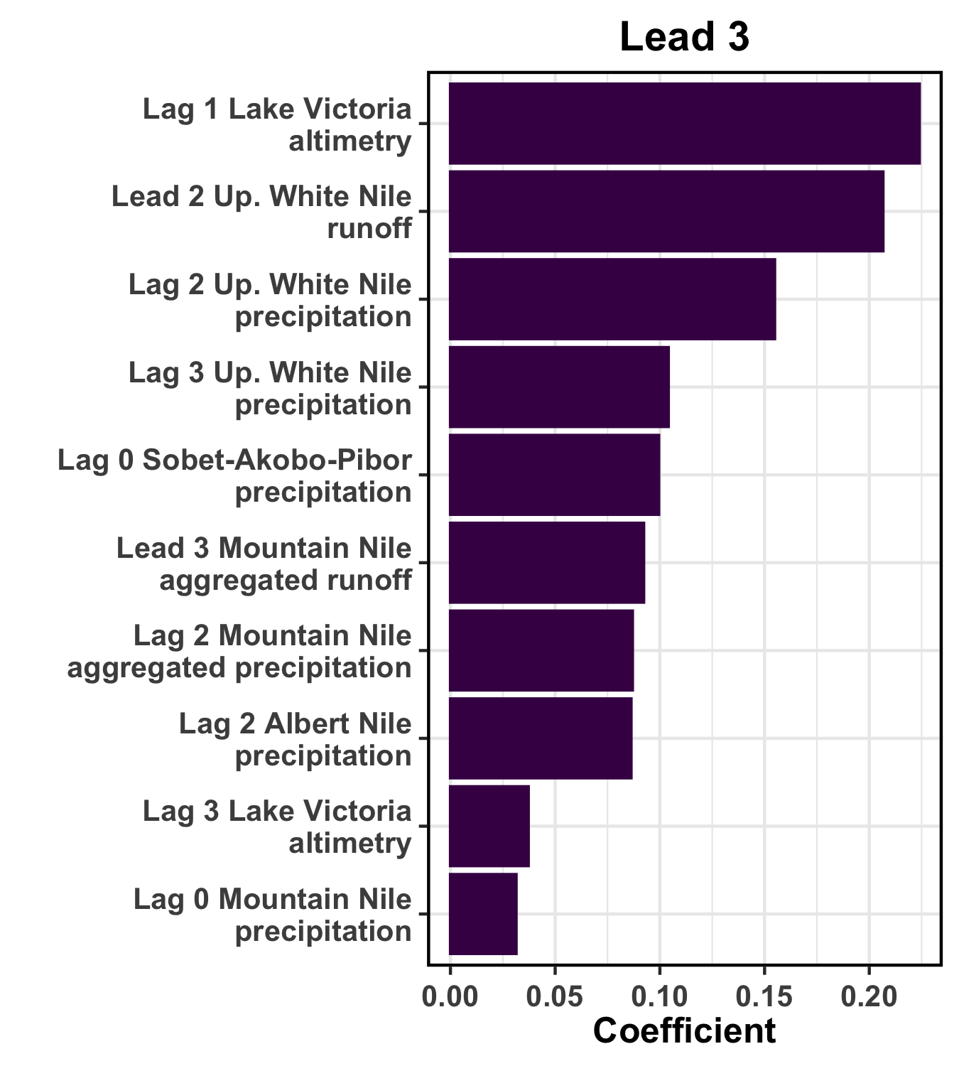

Coefficients for LASSO Models
10 largest coefficients for covariates for Lead 2 and Lead 3 National LASSO models
Notes:
Coefficients shown for the LASSO model predicting the maximum inundation (i.e., the highest of 20 ensemble predictions for the indicated lead).
Lag 0 = April 2024, Lag 1 = March 2024, …
Lead 1 = May 2024 forecast, Lead 2 = June 2024 forecast, …

Slide 32
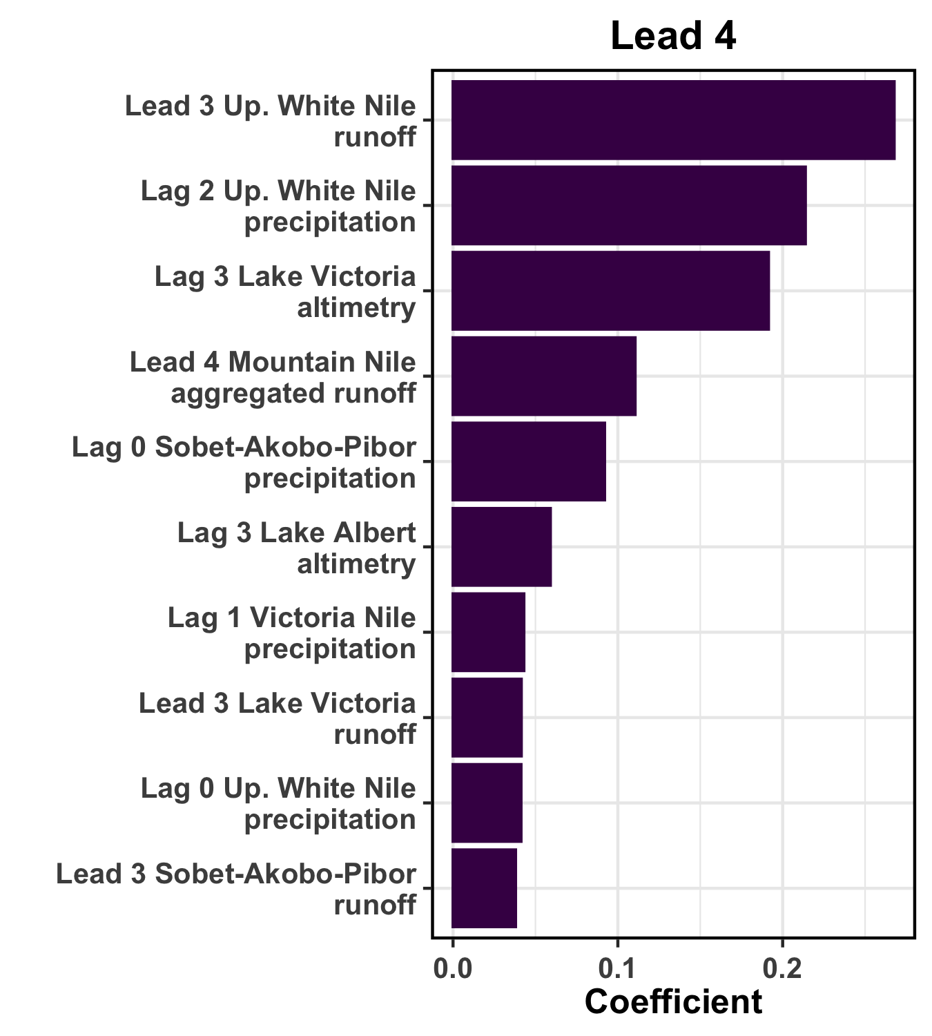
Coefficients for LASSO Models
10 largest coefficients for covariates for Lead 4 and Lead 6 National LASSO models
Notes:
Coefficients shown for the LASSO model predicting the maximum inundation (i.e., the highest of 20 ensemble predictions for the indicated lead).
Lag 0 = April 2024, Lag 1 = March 2024, …
Lead 1 = May 2024 forecast, Lead 2 = June 2024 forecast, …

