Slide 1
South Sudan Flood Monitoring and Prediction - 2024 Season
FEWS NET Science Team
September 17, 2024

Slide 2
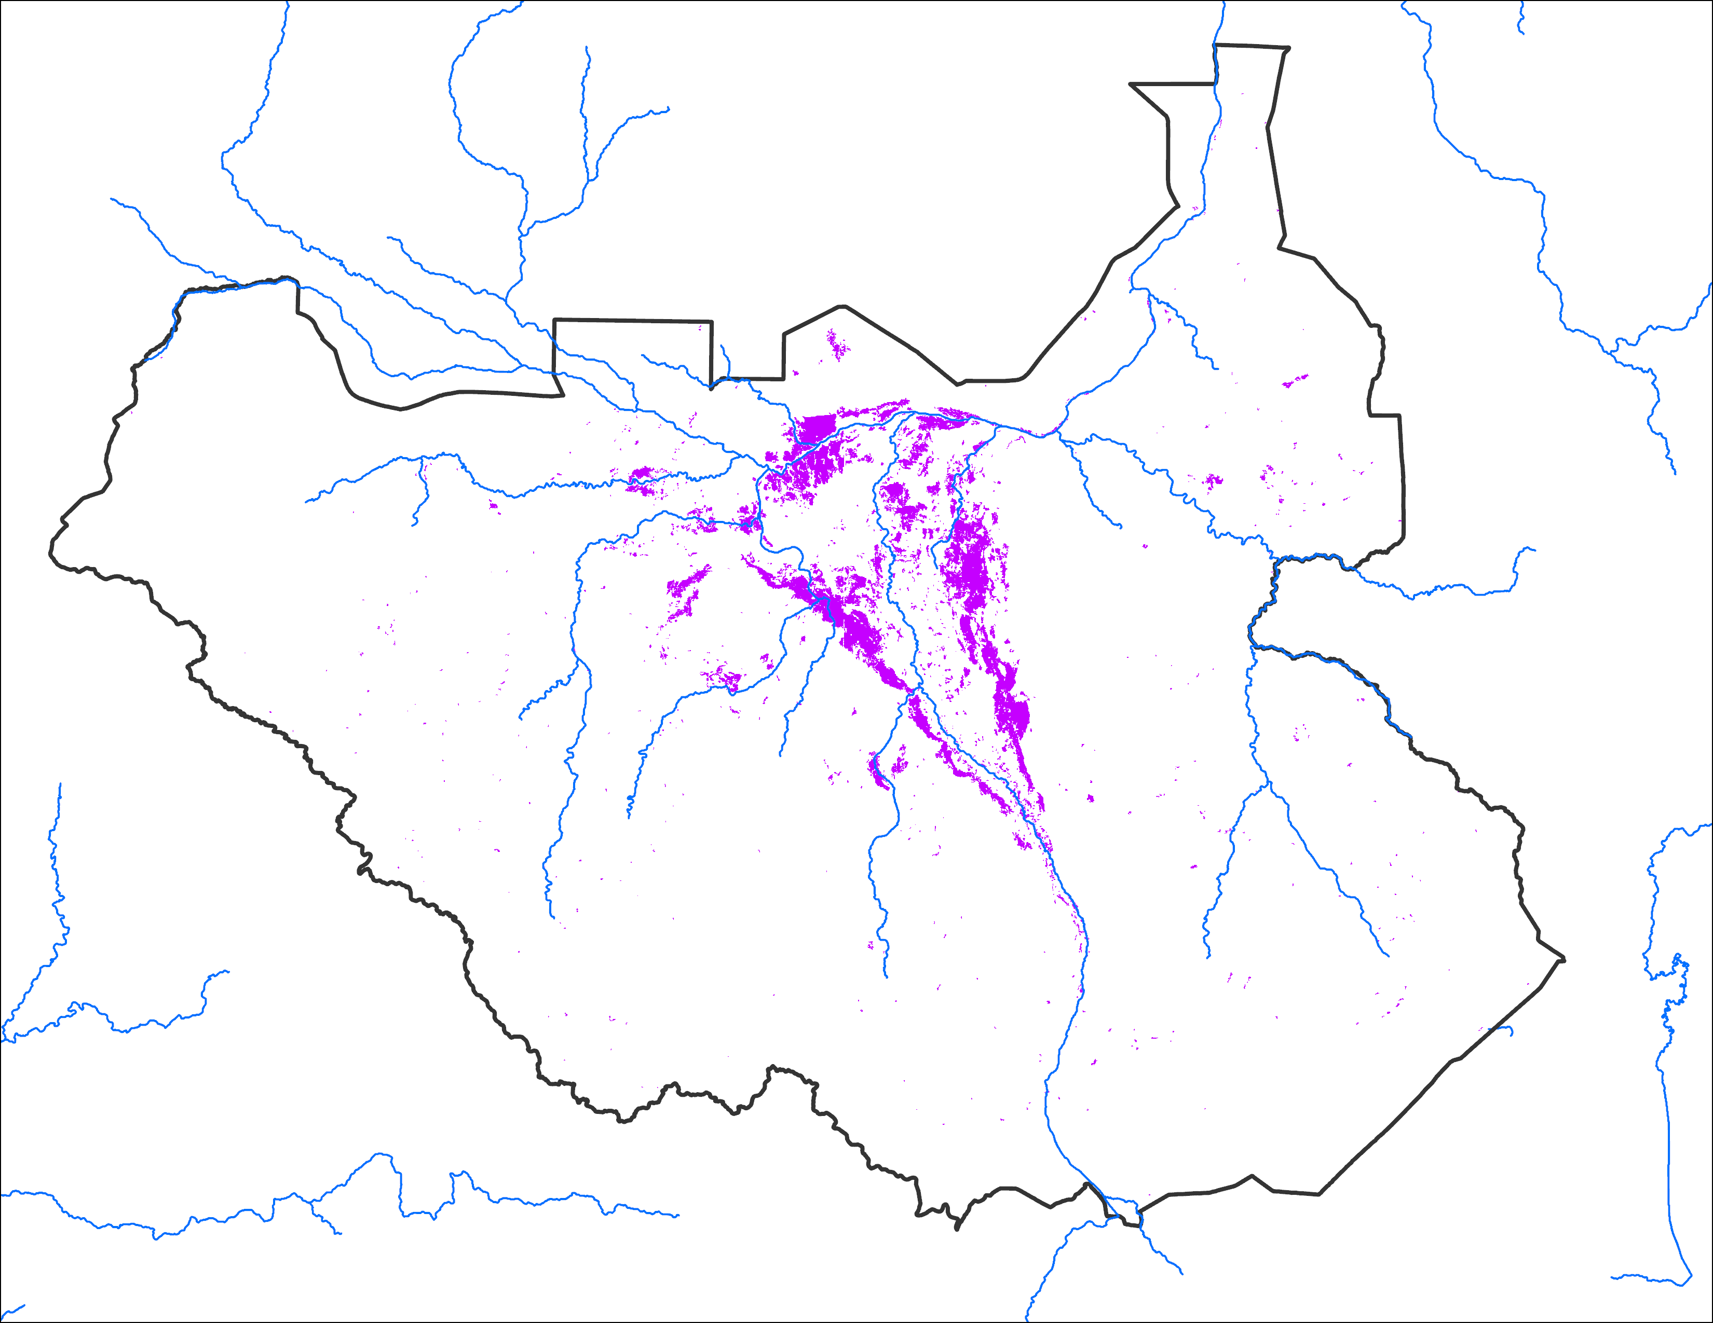
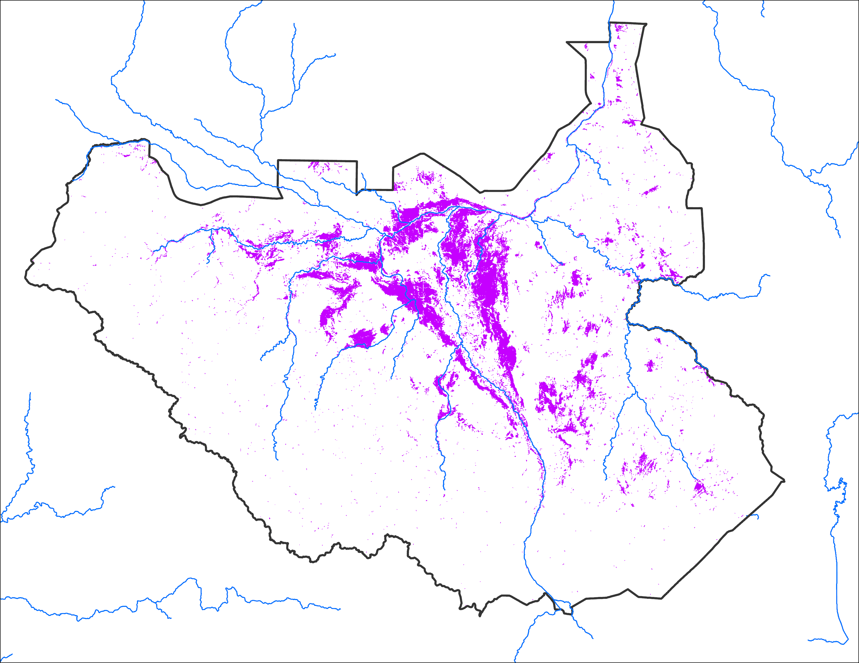
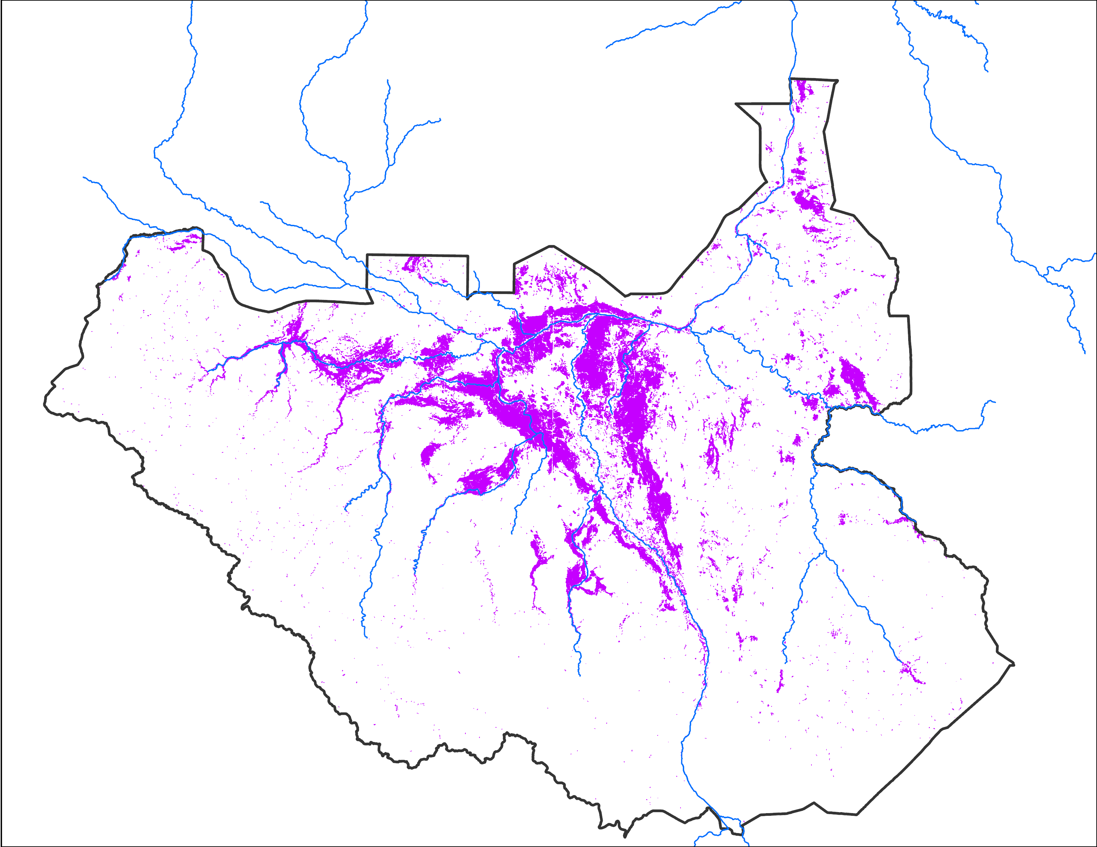
Flooding Progression
July 2024
Aug 2024
Mid-September 2024
16,952 km²
45,013 km²
56,593 km²

Slide 3
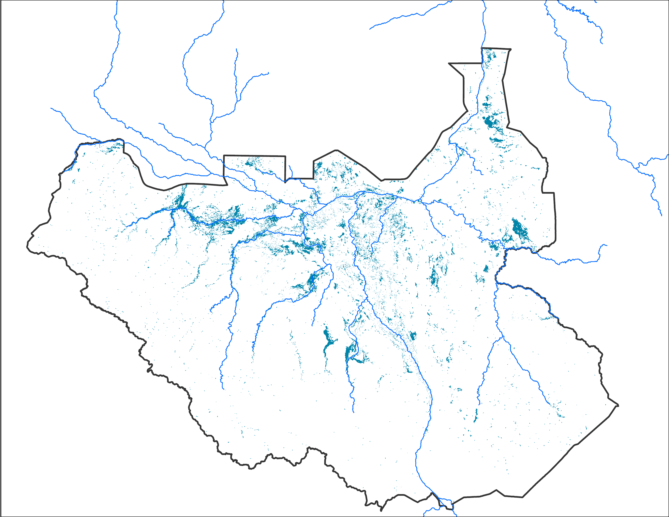
Flooding Progression
Newly flooded during first two weeks of Sep 2024
Aug 2024
Mid-Sep 2024
45,013 km²
56,593 km²
11,580 km²
Difference between Aug and mid-Sep

Slide 4
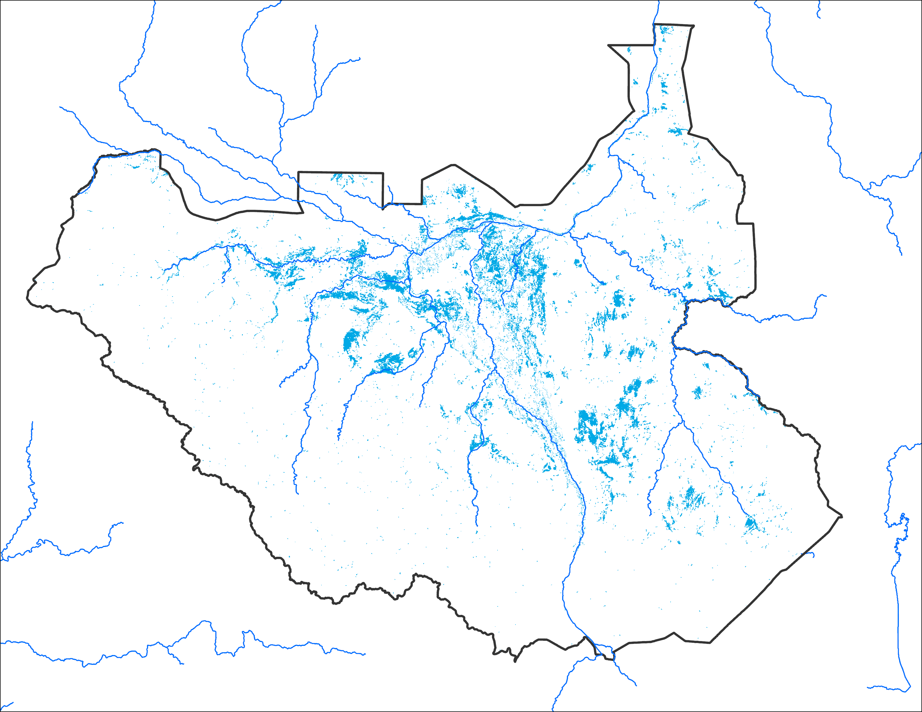
Flooding Progression
July 2024
Aug 2024
Newly Flooded in August 2024
16,952 km²
45,013 km²
28,061 km²
Difference between July and August

Slide 5
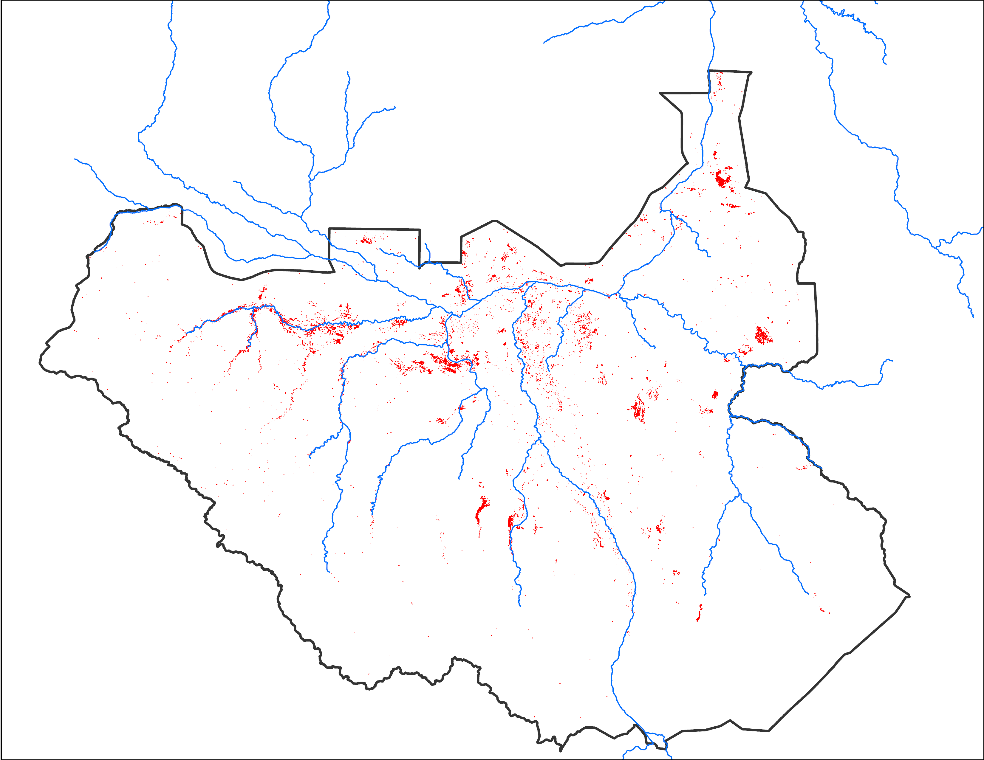
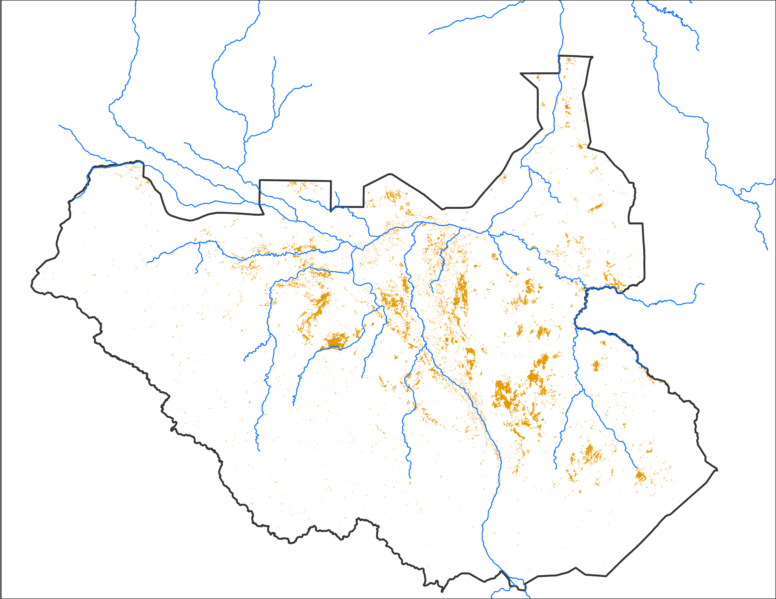
Recent Changes in Inundation
Observed Aug 2024
45,013 km²
Additional flooding during 05 - 09 Sep 2024
8,440 km²
flooding retreated during 05-09 Sep 2024
21,121 km²

Slide 6
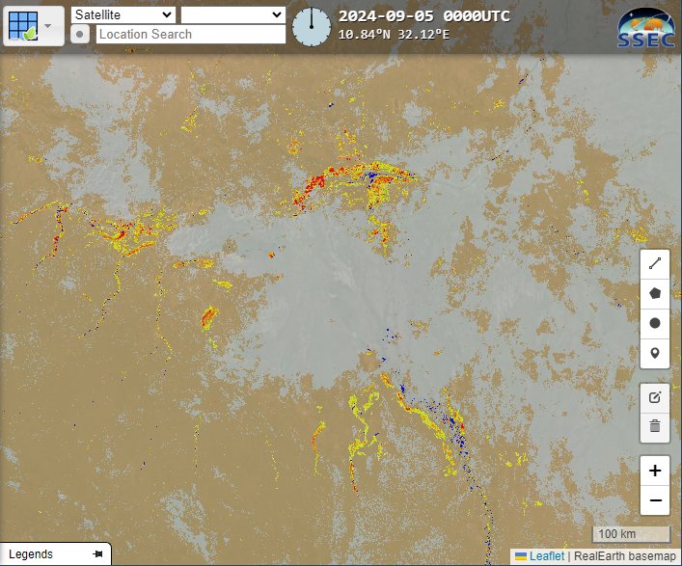
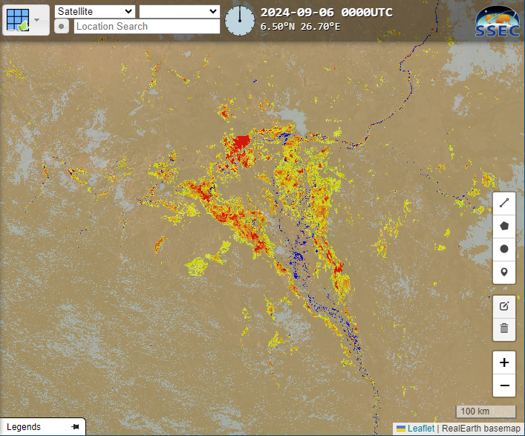
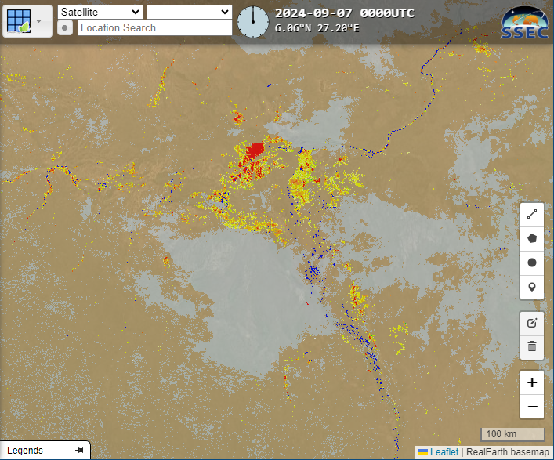
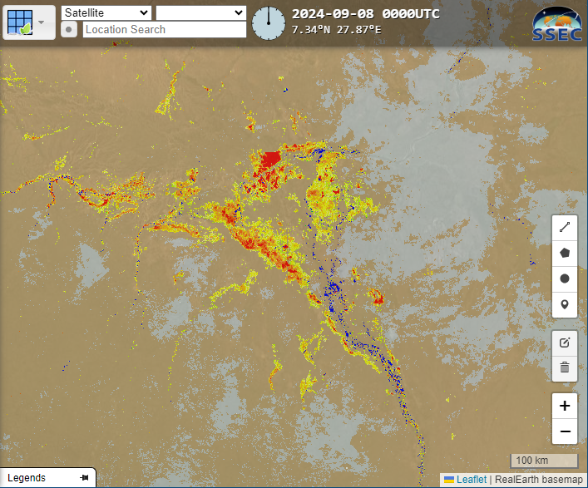
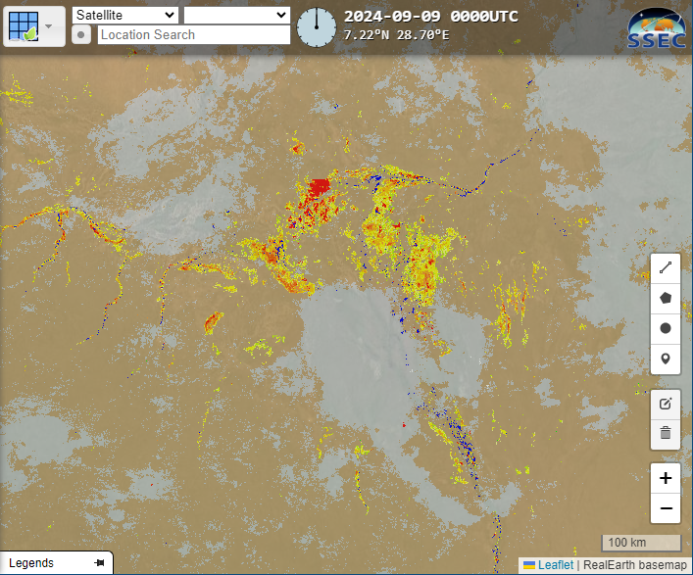
Recent Changes in Inundation
Sep 5
Sep 6
Sep 7
Sep 8
Sep 9

Slide 7
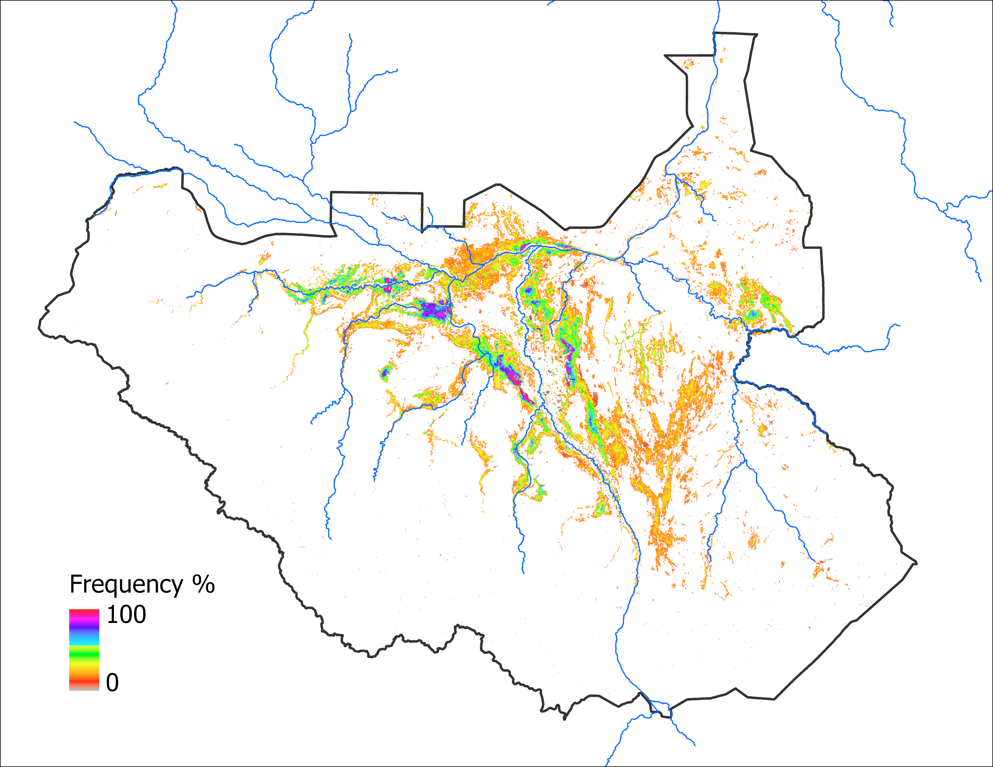
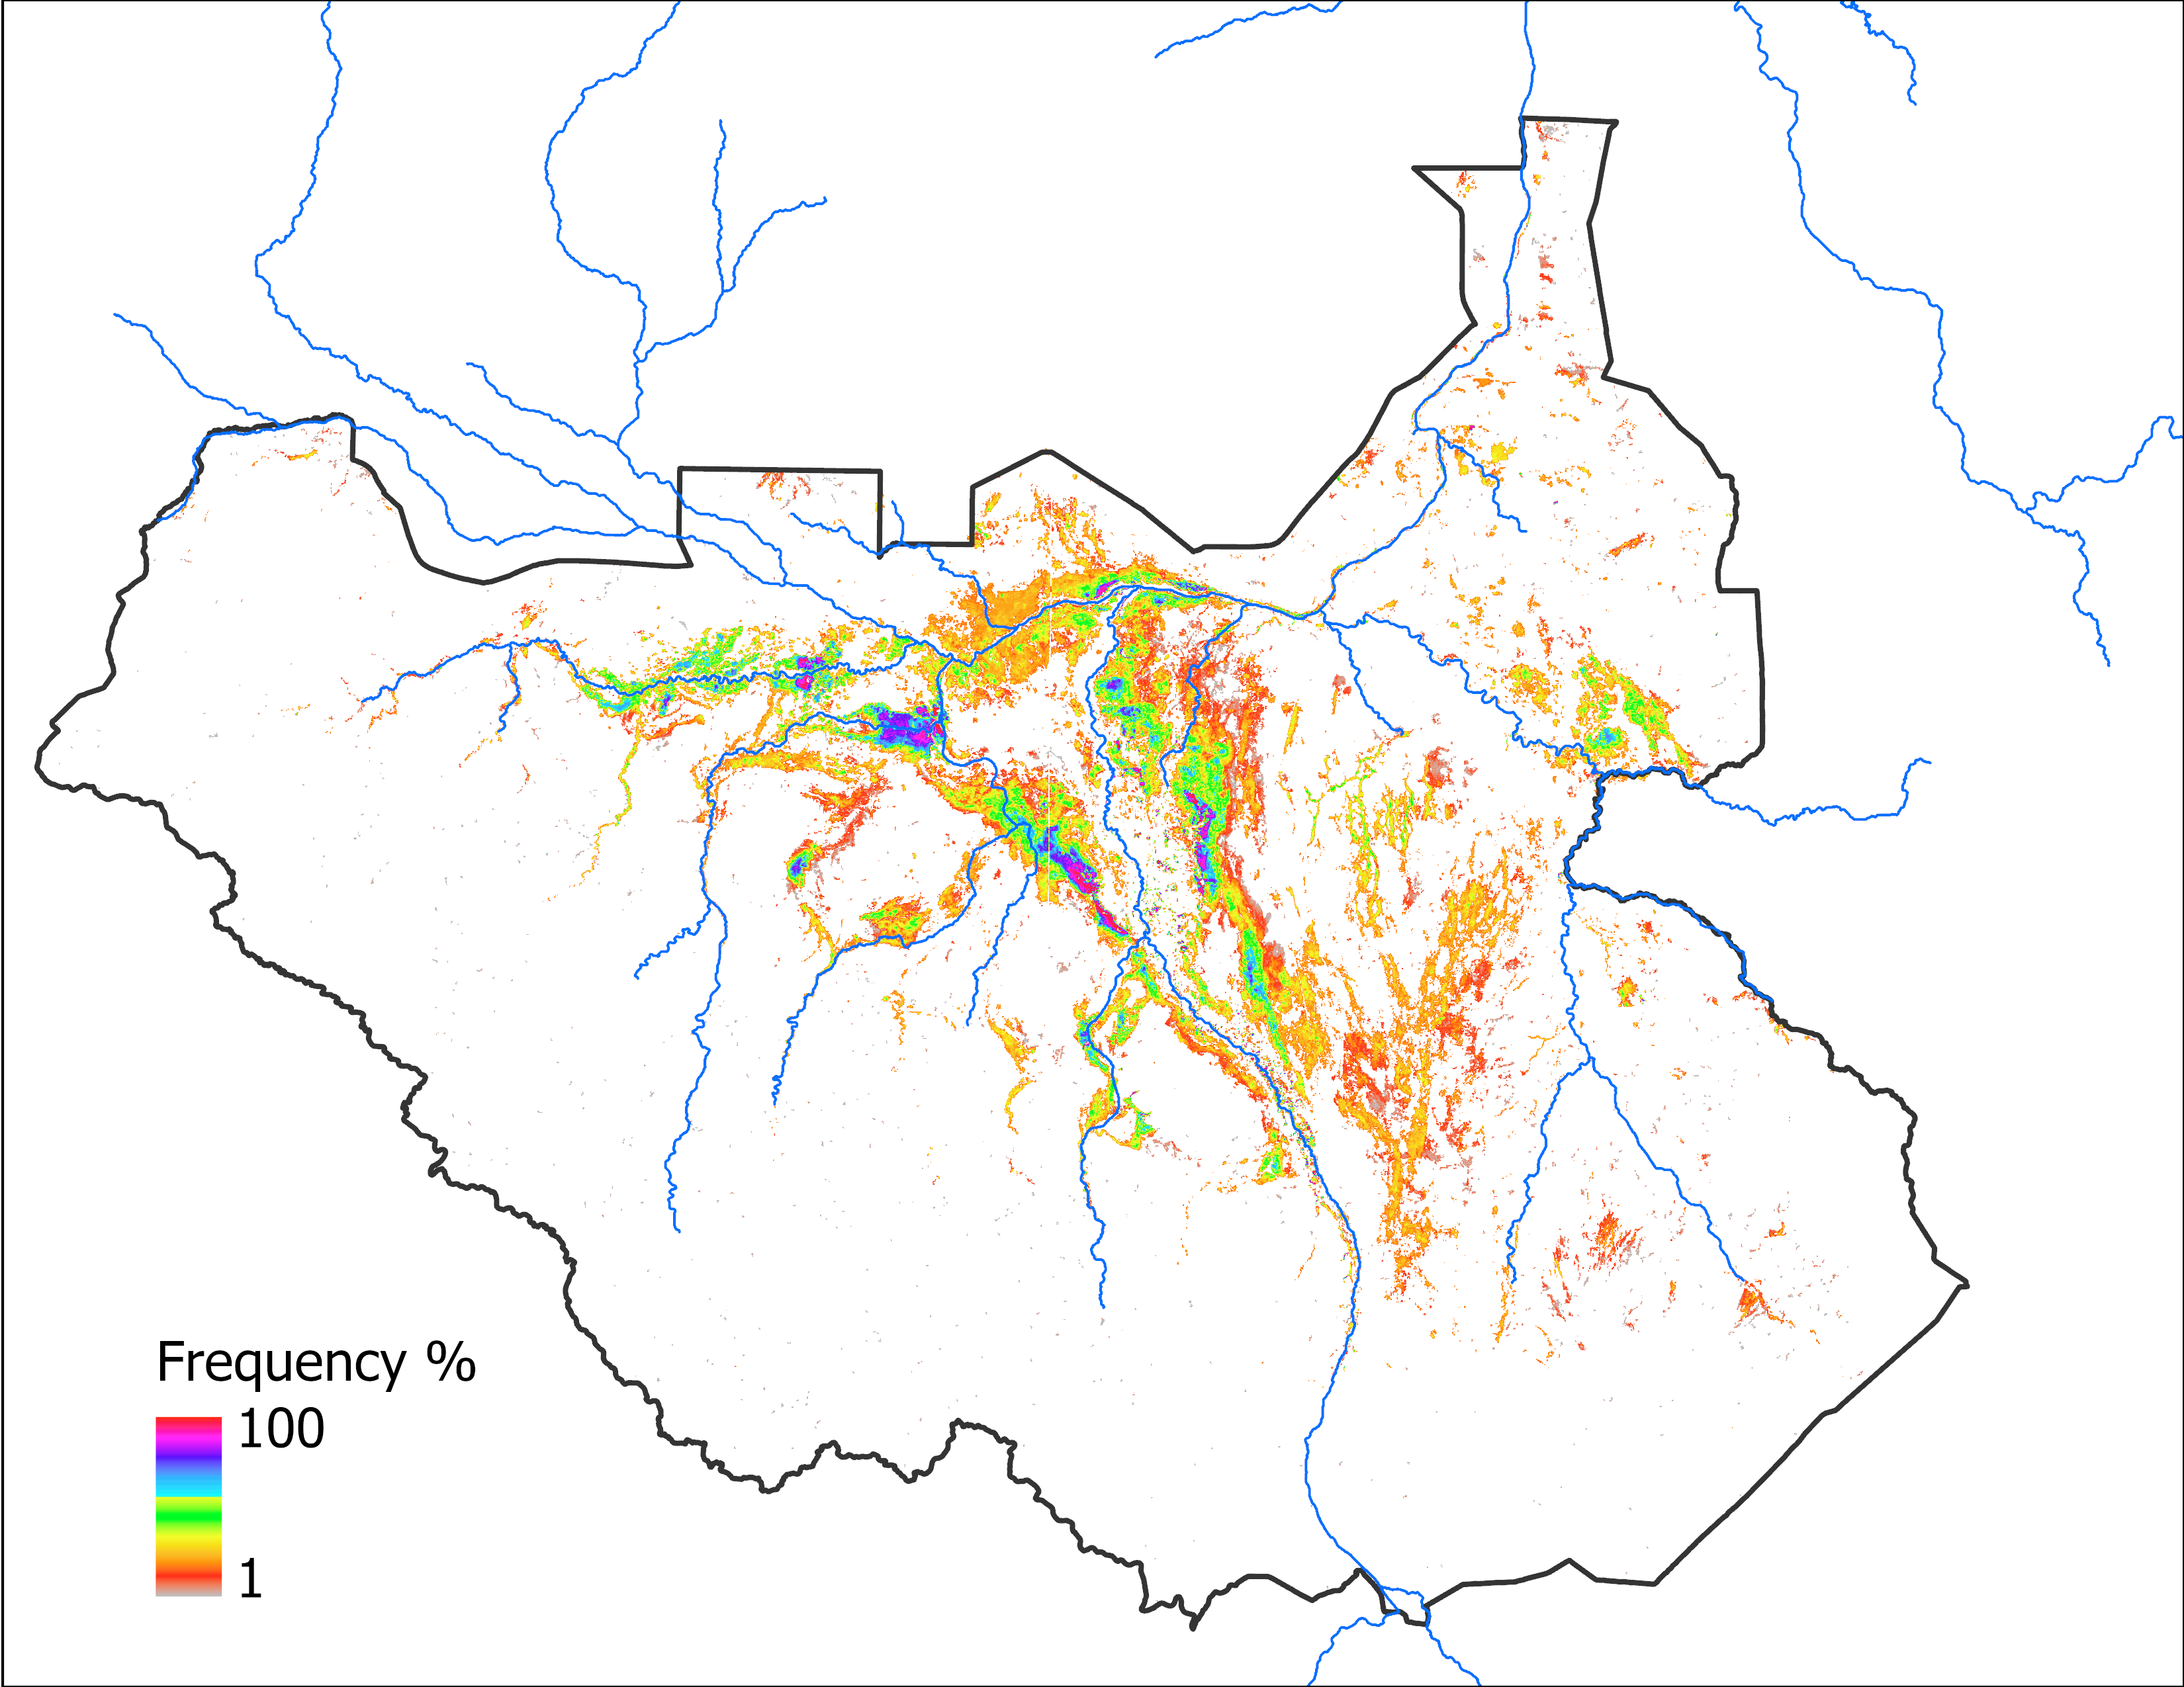
Predicted Flooding Update
Predicted Oct 2024 with May IC
Predicted Oct 2024 with AUG IC
70,805 km²
Based on 2020 analog year
72,342 km²
Based on 2020 analog year

Slide 8
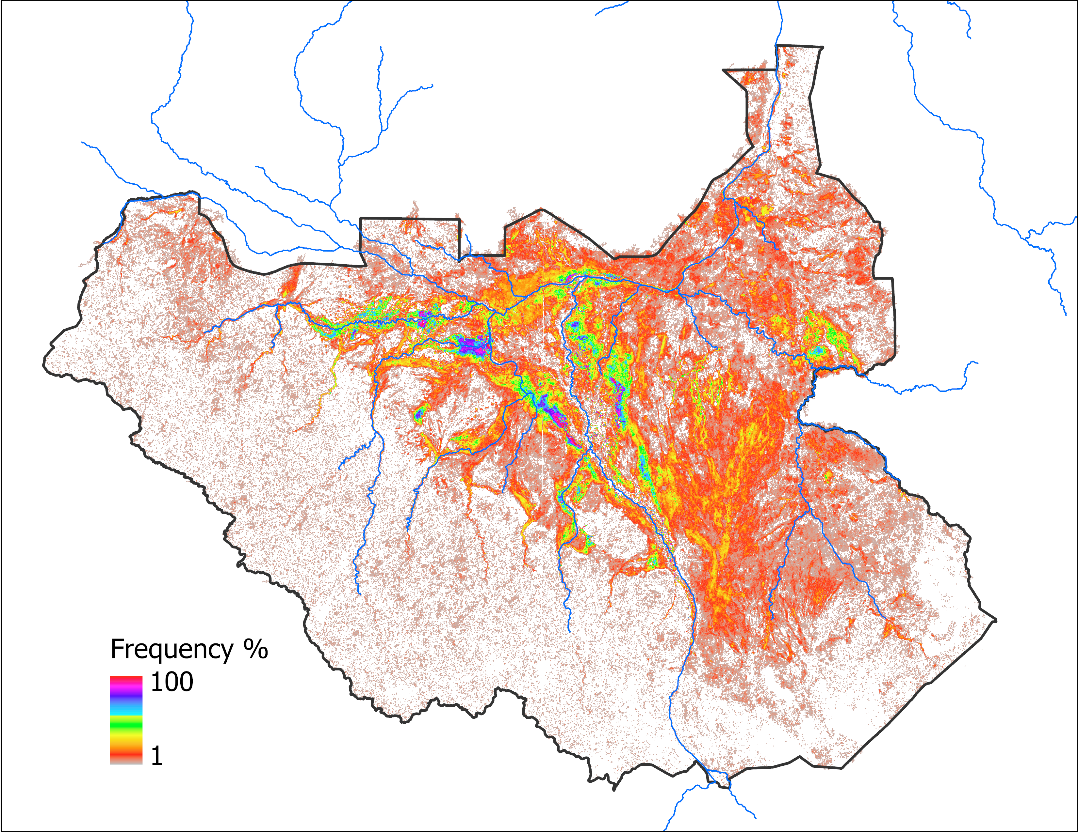
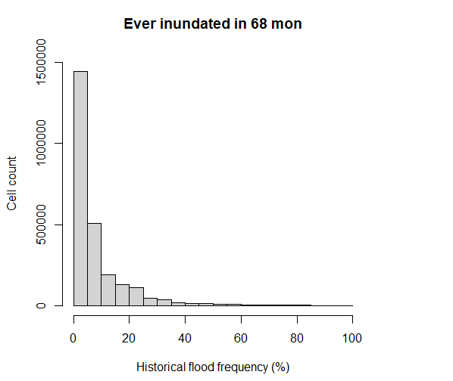
Predicted Flooding Progression
JASOND Flood frequency map (70 months)
362,588 km²
Any pixels that got flooded since 2012 mapped by VIIRS
Note that there are no pixels with 0 value as it is the base frequency map.
Notes:
Later we found Nov and Dec data for 2021 (all the other months are missing for 2021), that brings the total months in frequency grid to 70.

Slide 9
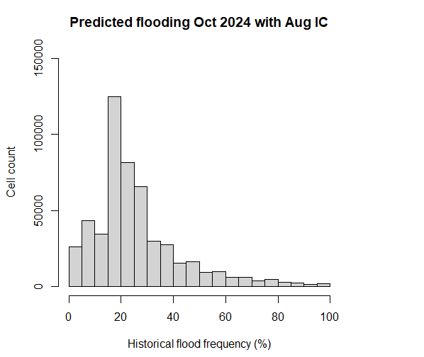
Predicted Flooding Progression
Predicted Oct 2024 with AUG IC
72,342 km²
Based on 2020 analog year

Slide 10
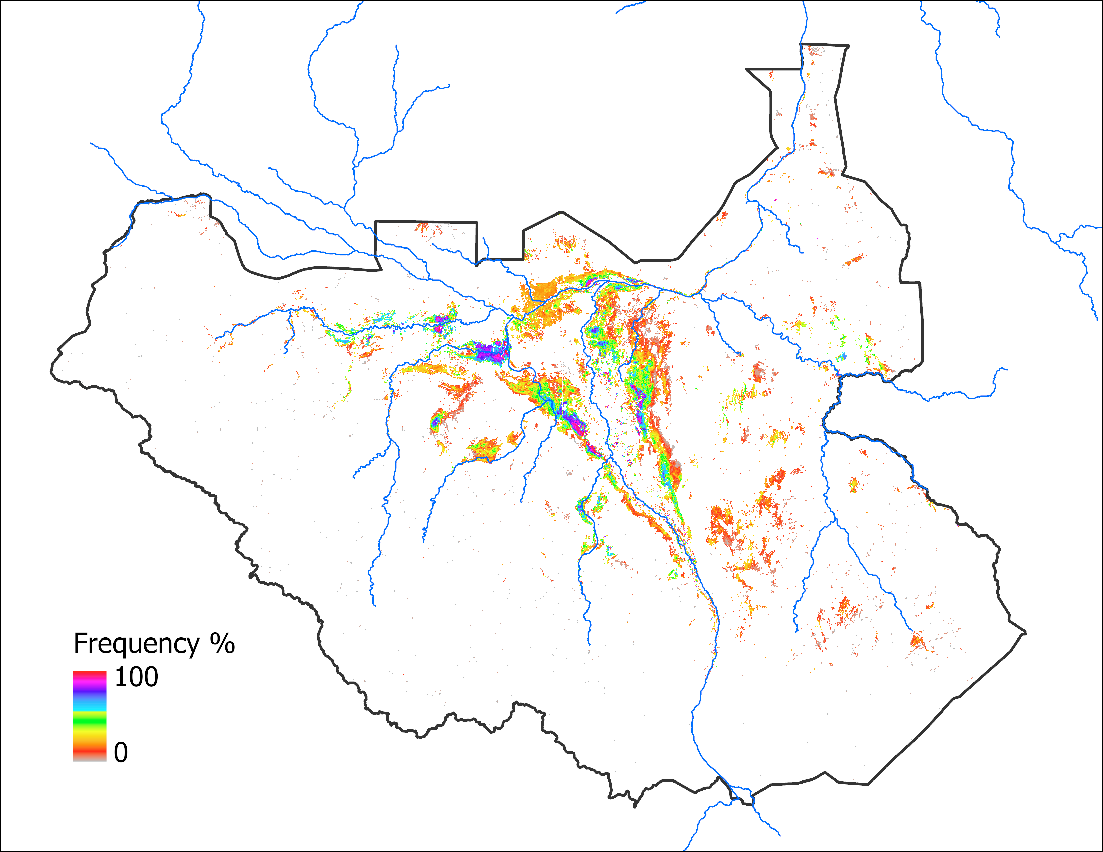
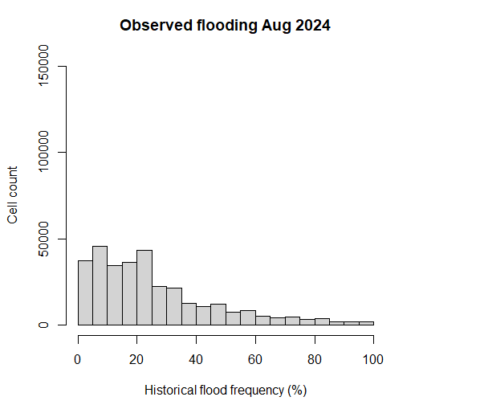
Predicted Flooding Progression
Observed Aug 2024
45,013 km²

Slide 11
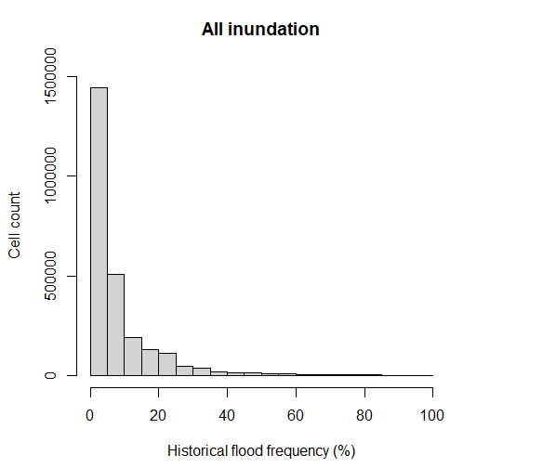
Predicted Flooding Progression
362,588 km²
Y-axis is 10x compared to other two
No 0 value pixels
72,342 km²
Based on 2020 analog year
45,013 km²

Slide 12
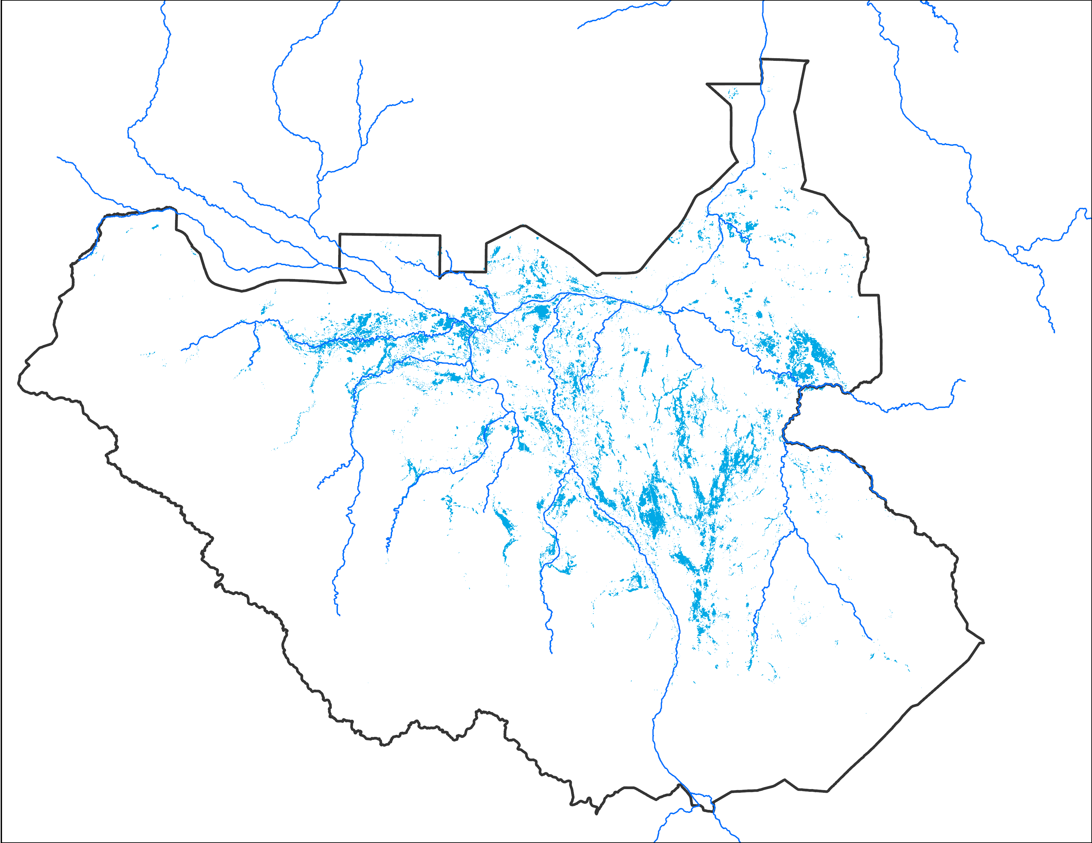
Areas Potential to be Inundated
Observed Aug 2024
Predicted Oct 2024 with AUG IC
Potential areas yet to be flooded
45,013 km²
72,342 km²
27,329 km²

Slide 13
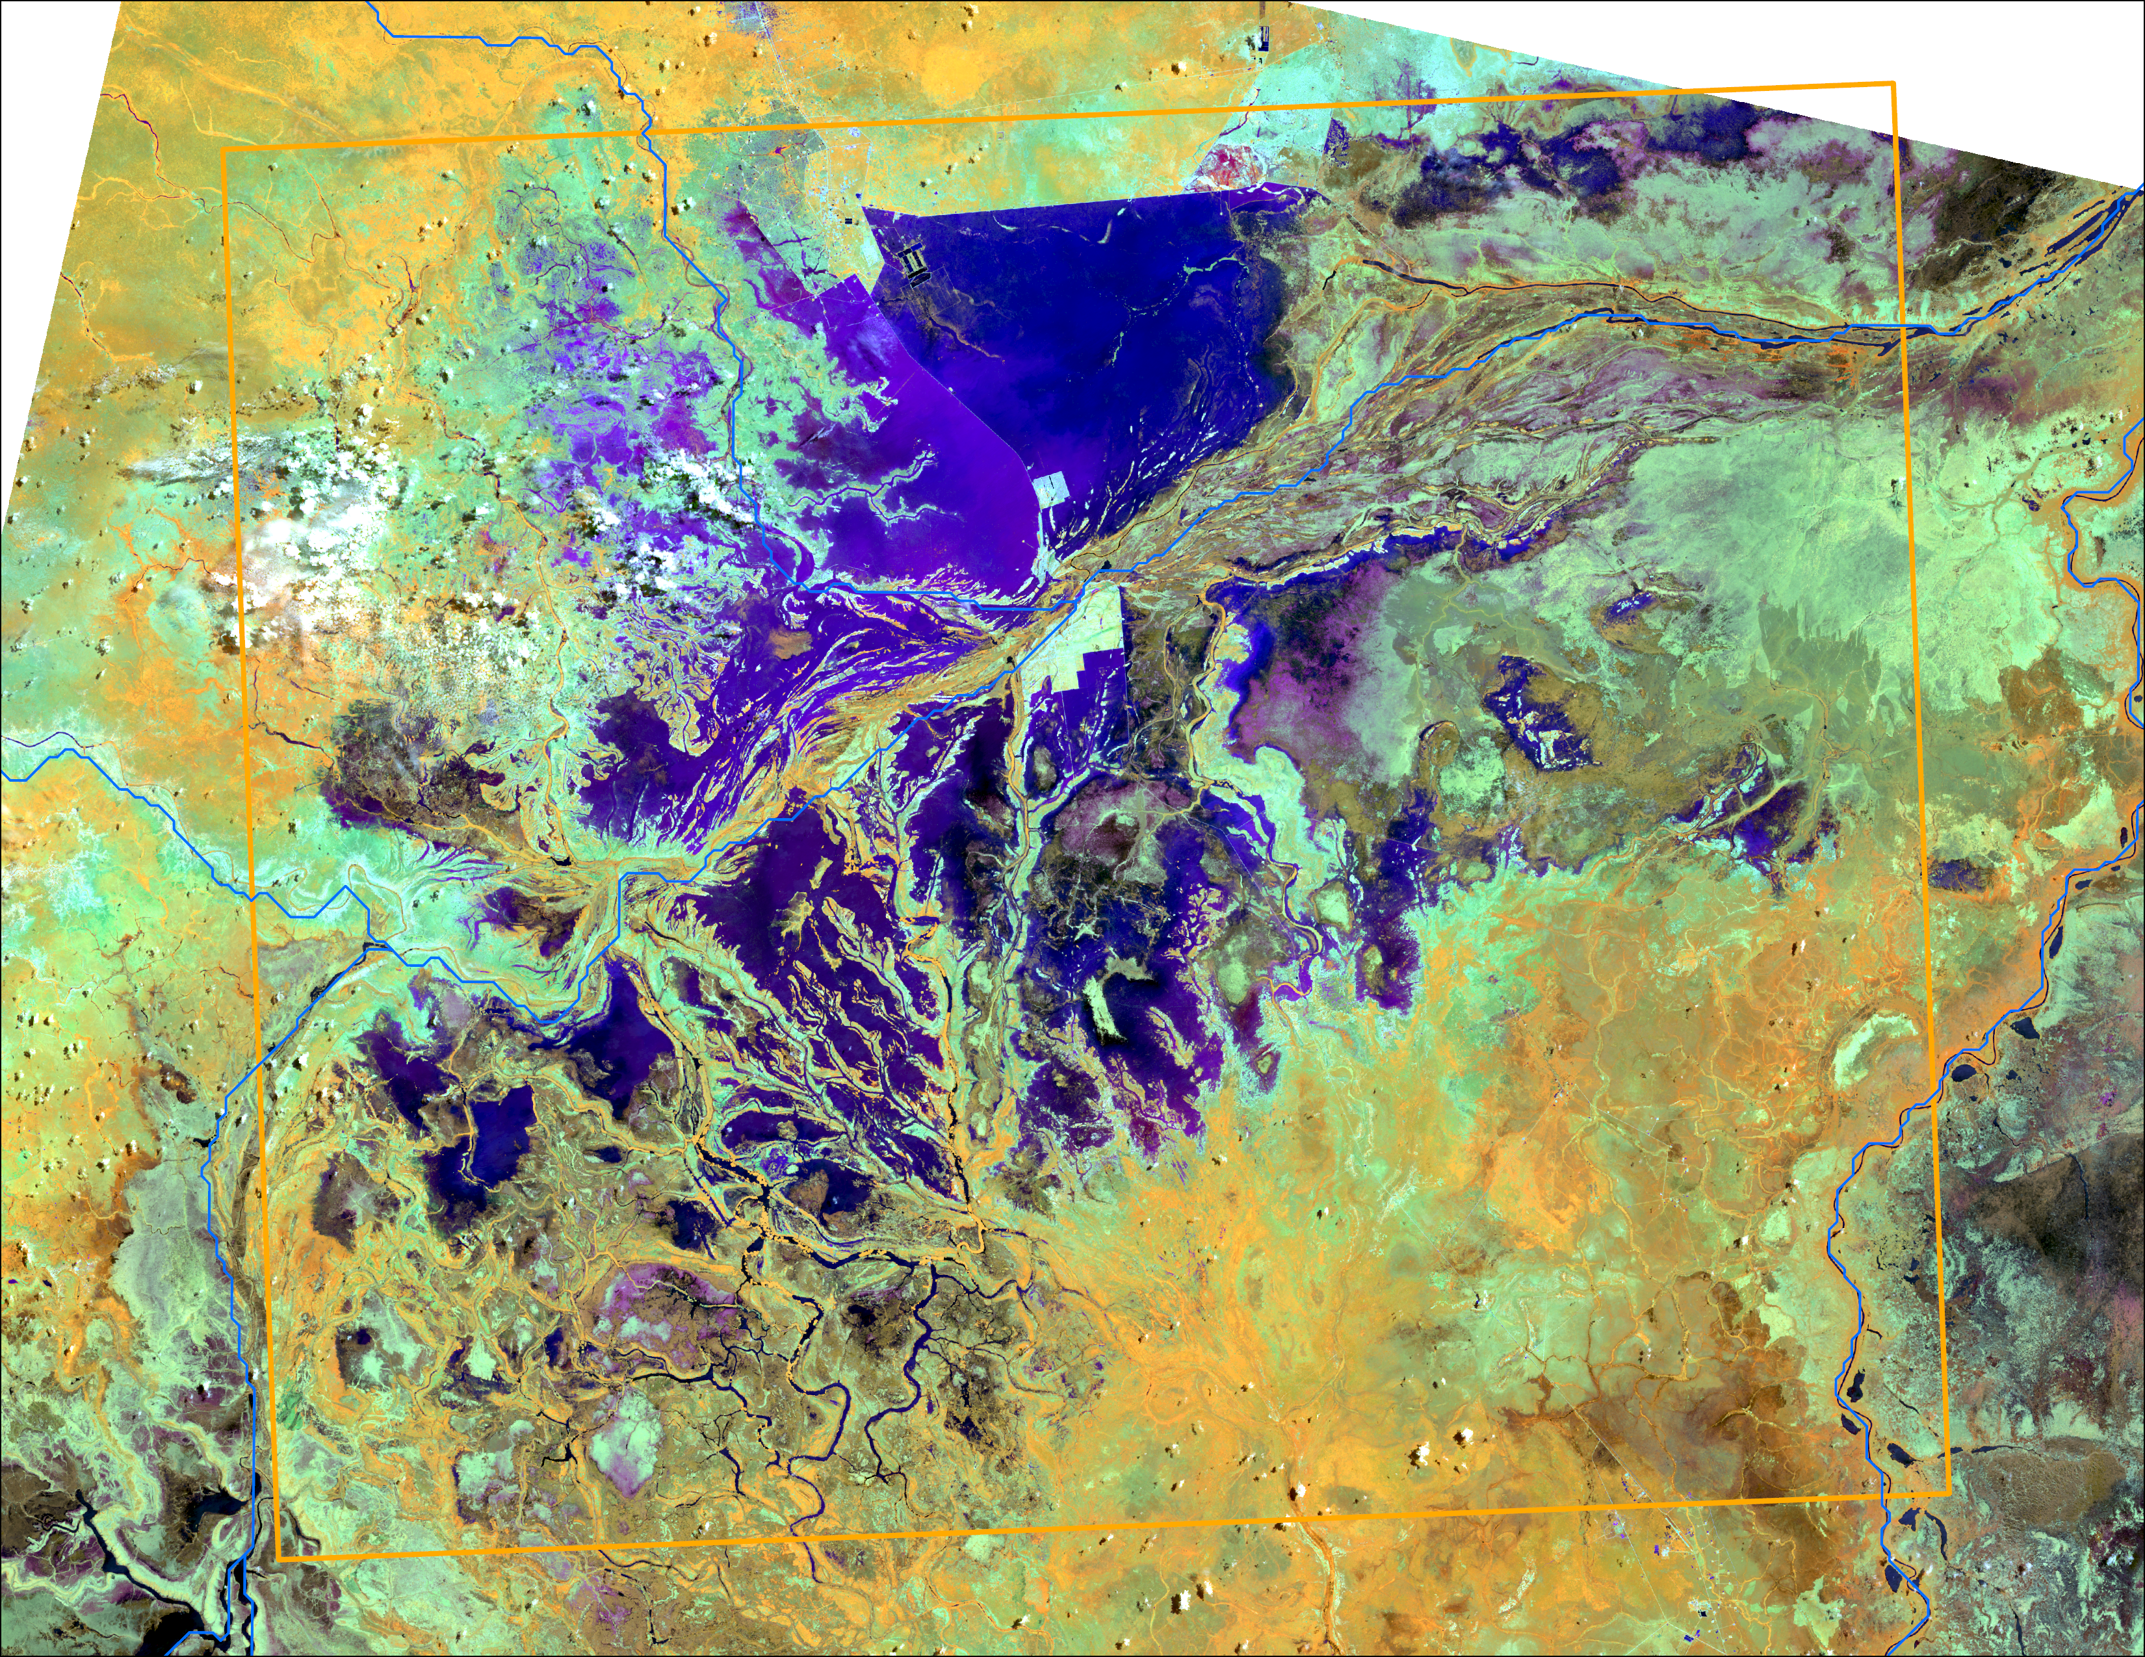
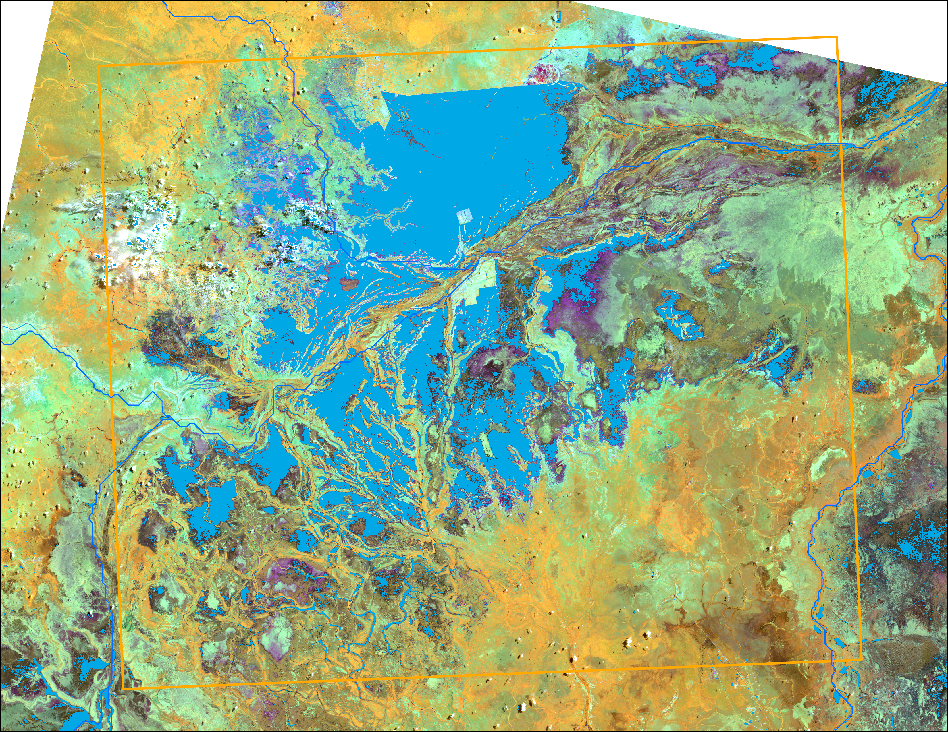
Landsat Flood Mapping
Bentiu
Bentiu
L9 false color composite 564 as RGB : July 26, 2024
Water pixels
AWEI (Automated Water Extraction Index) Feyisa et. al., (2014) is used to separate water from rest of the landcover.
Index worked well.

Slide 14
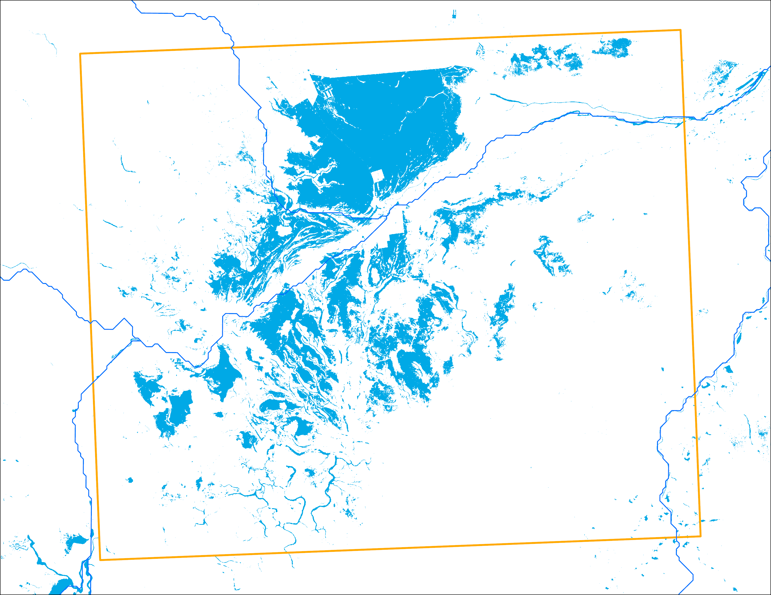
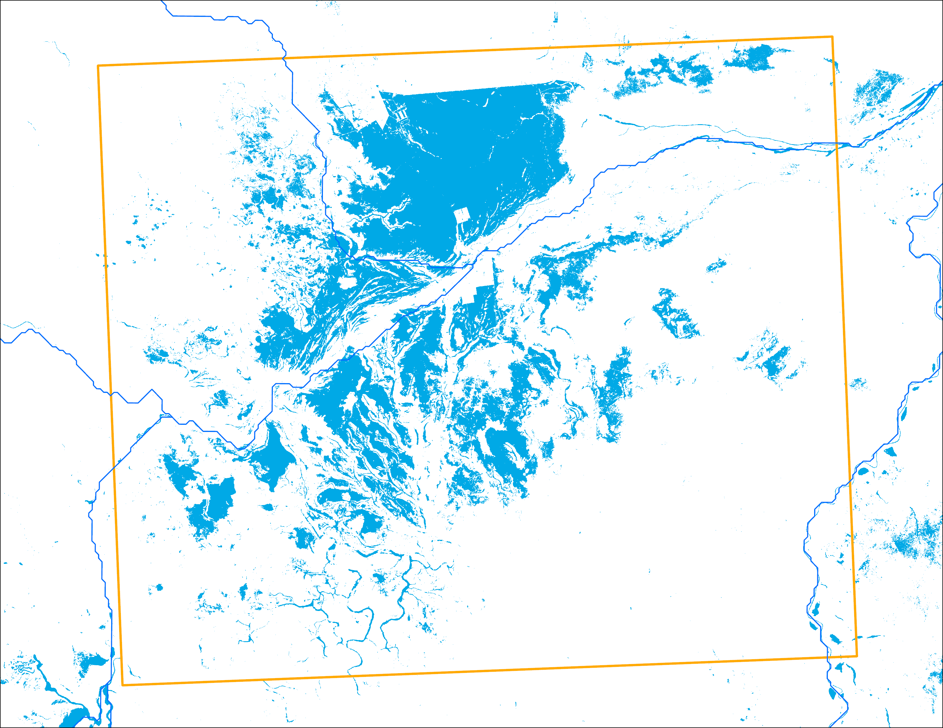
Landsat Flood Mapping
Bentiu
Bentiu
June 08, 2024: 1,191 km²
July 26, 2024: 1,418 km²

Slide 15
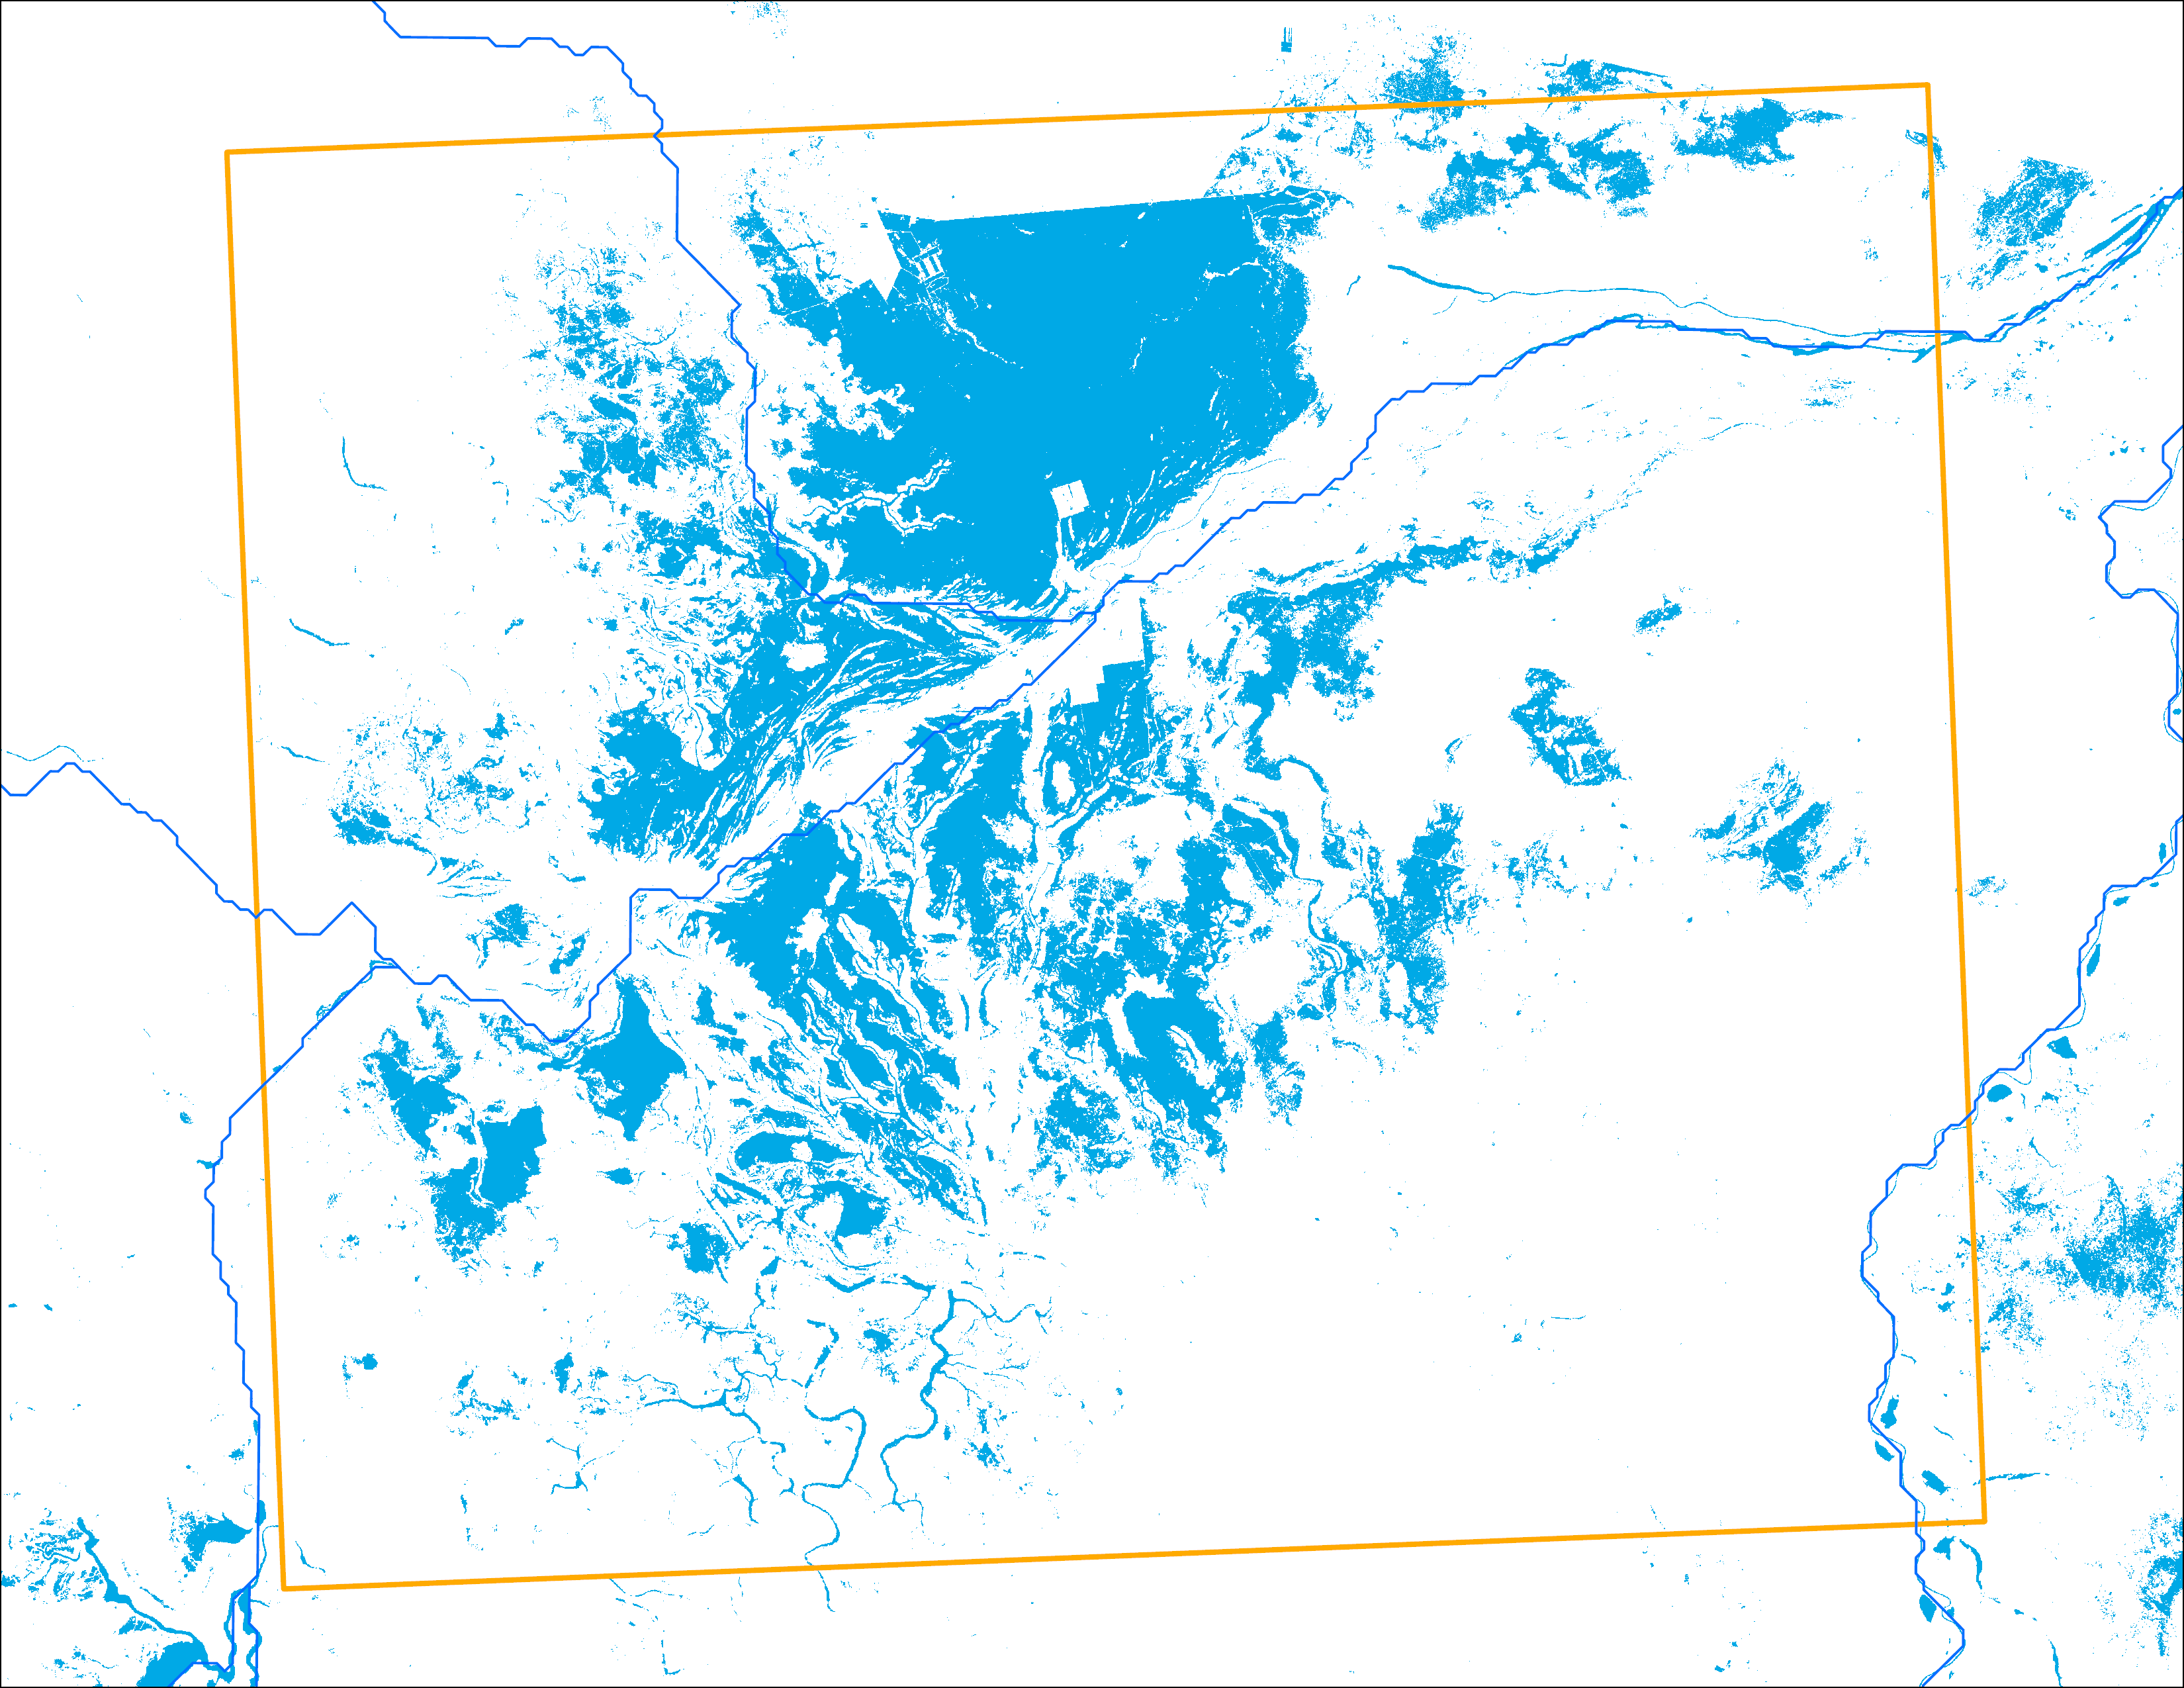
Landsat Flood Mapping
Bentiu
Bentiu
Bentiu
July 26, 2024: 1,418 km²
August 03, 2024: 1,556 km²

Slide 16
Thank you

