Slide 1
South Sudan Flood Monitoring and Prediction - 2024 Season
FEWS NET Science Team
November 05, 2024

Slide 2
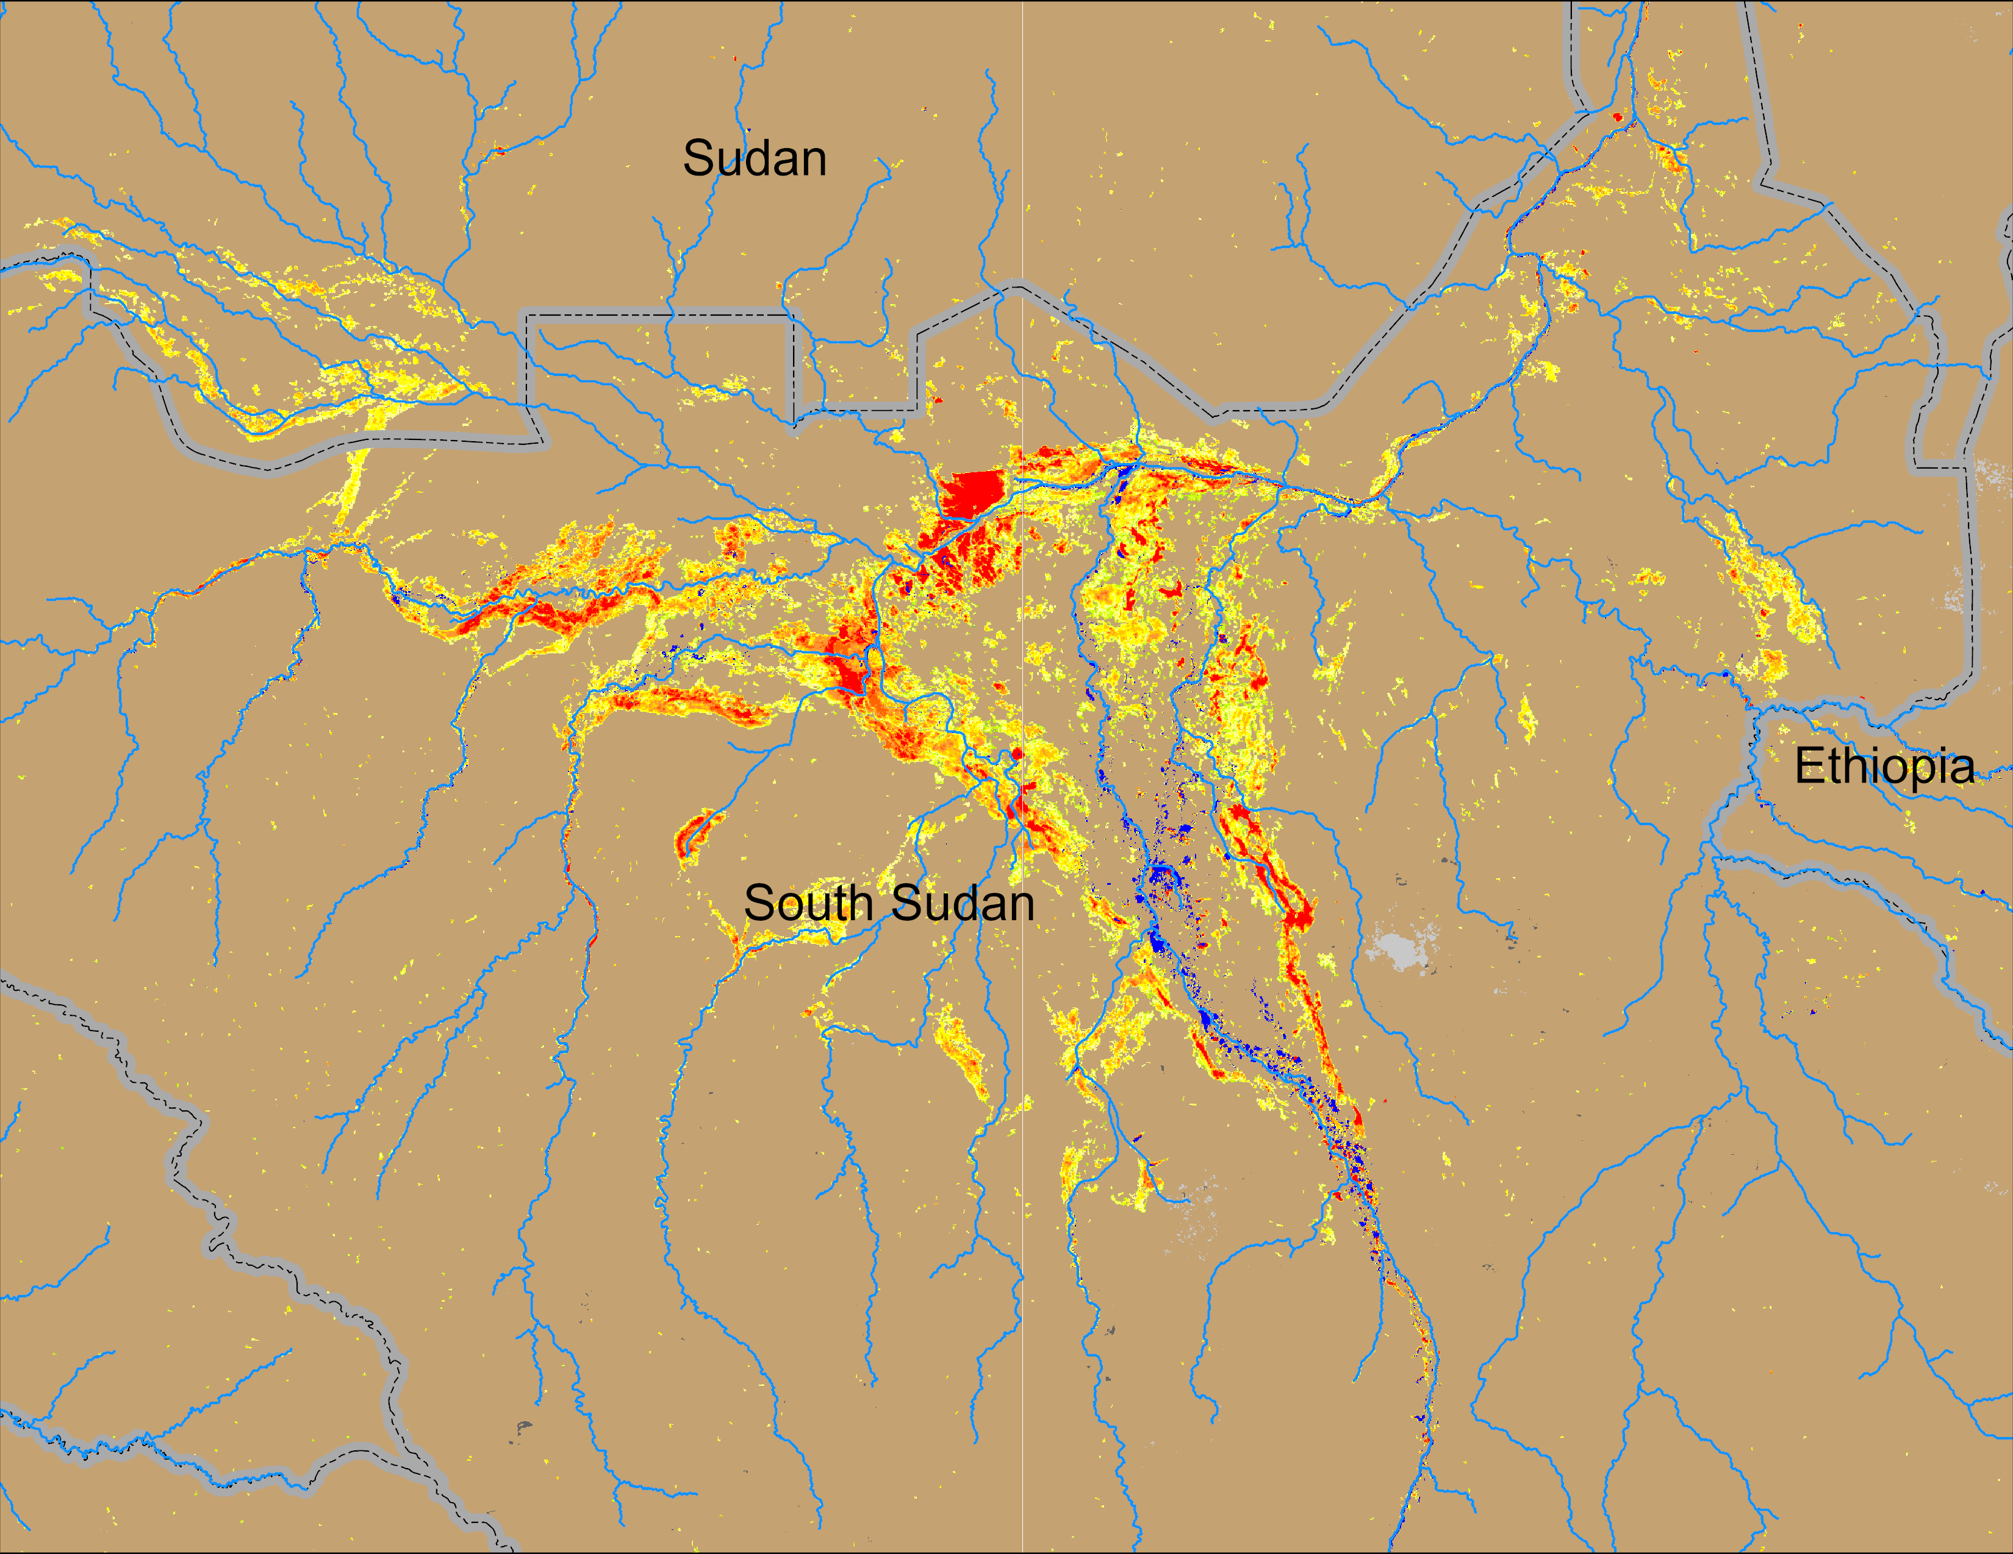
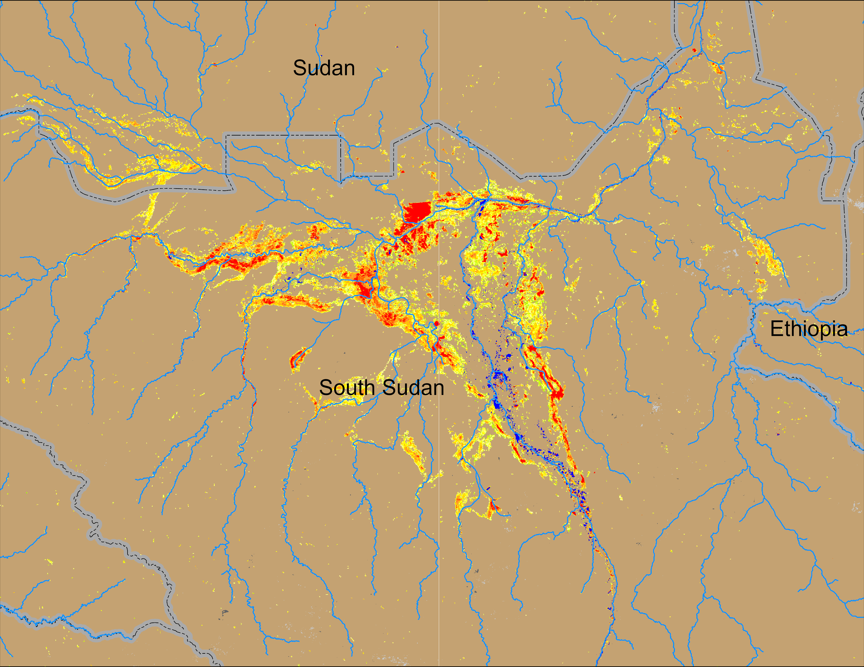
Flooding Conditions in South Sudan
(% of the pixel)
(% of the pixel)
Sobet
Sobet
Akobo
Akobo
Pibor
Pibor
NOAA VIIRS 5-day comp.: 27 – 31 Oct 2024
NOAA VIIRS 5-day comp.: 29 Oct – 02 Nov 2024
Inundated areas slowly receding across South Sudan.

Slide 3
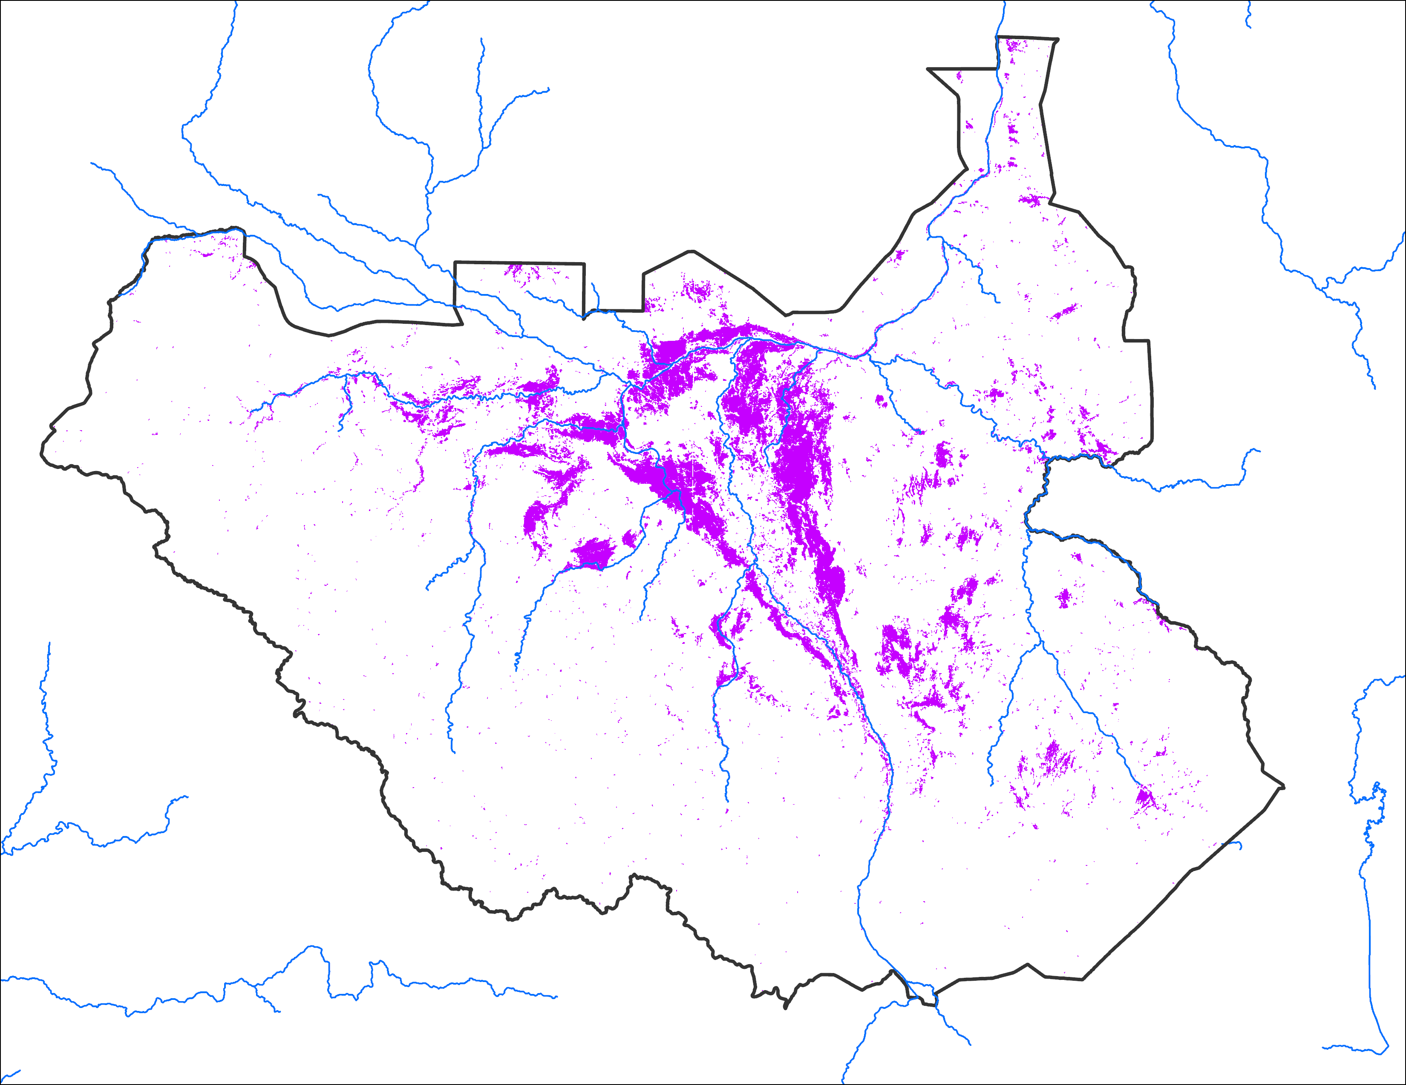
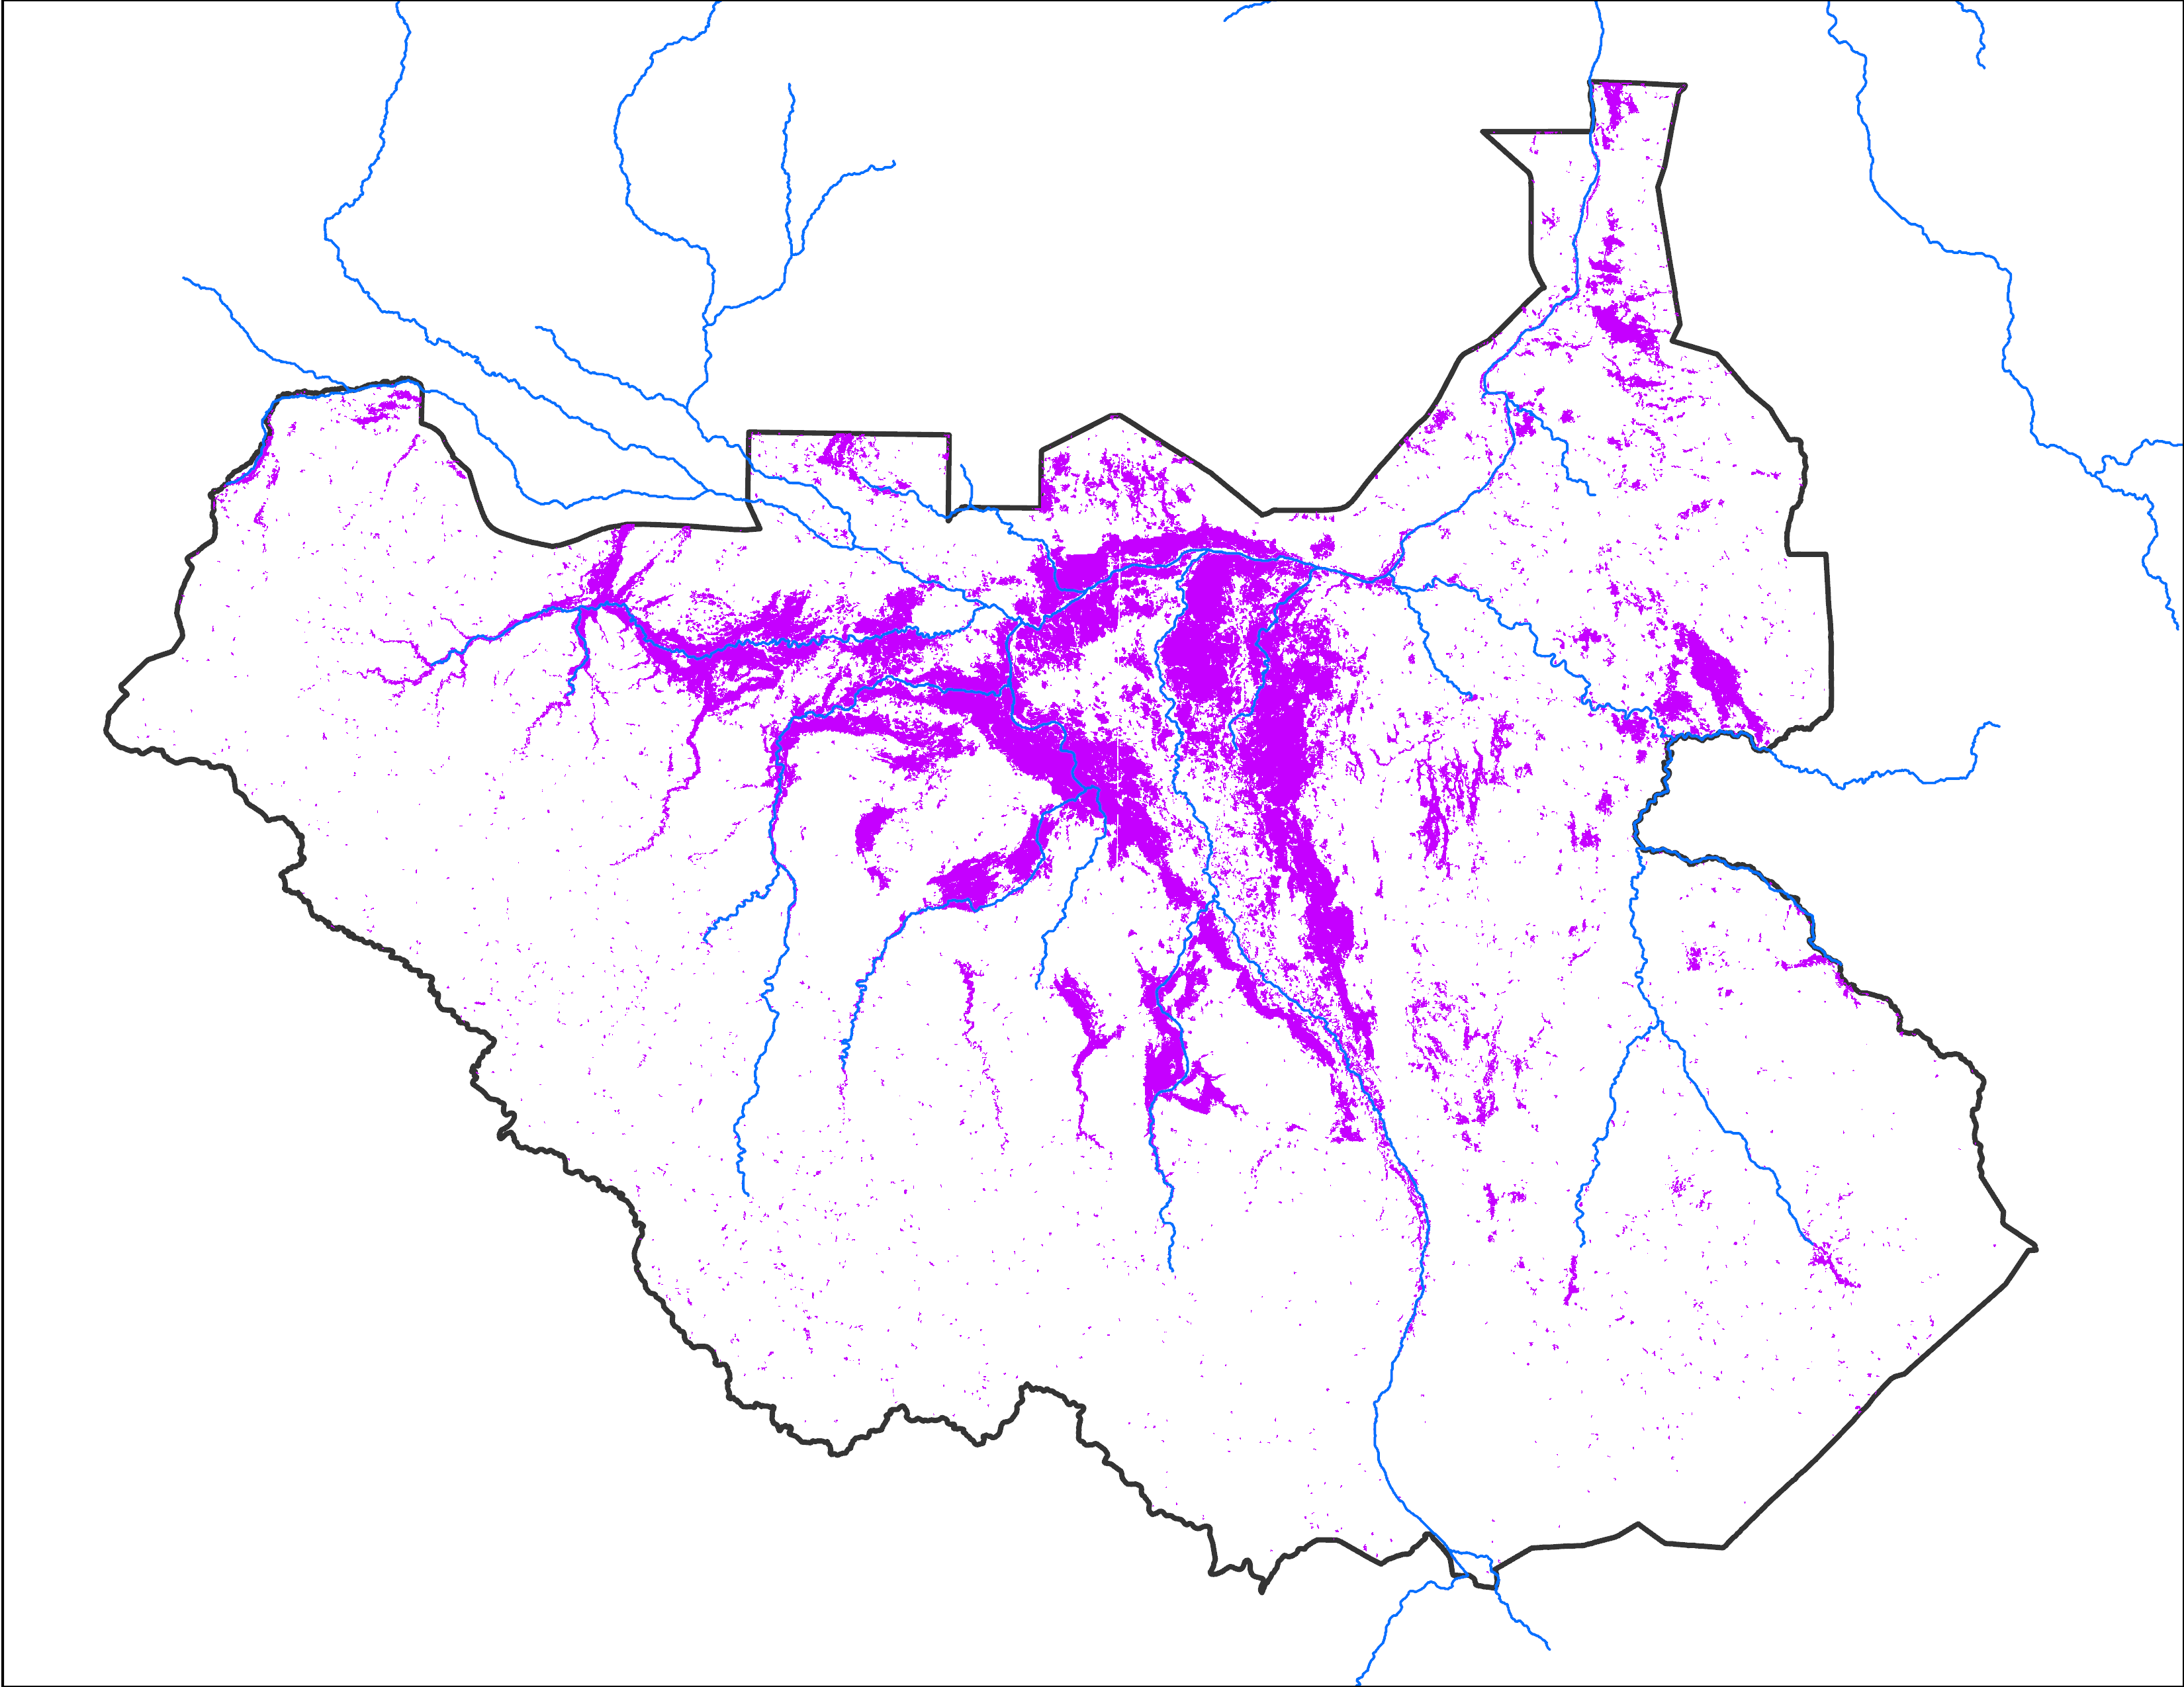
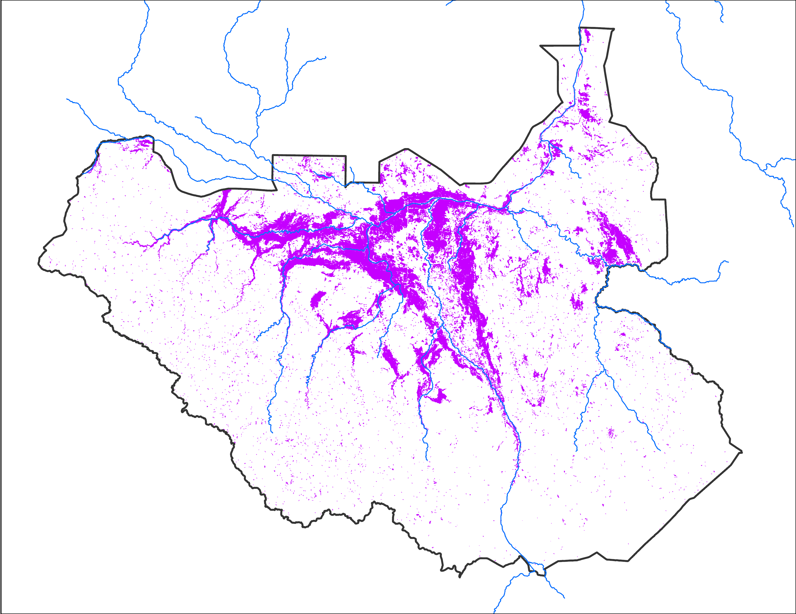
Flooding Progression
Aug 2024
Sep 2024
Oct 2024
45,013 km²
72,515 km²
69,374 km²

Slide 4
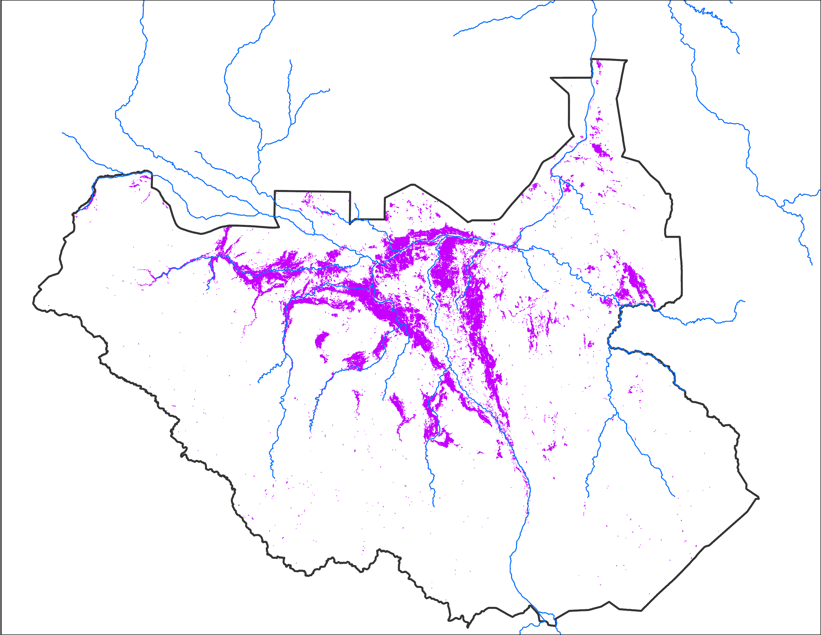
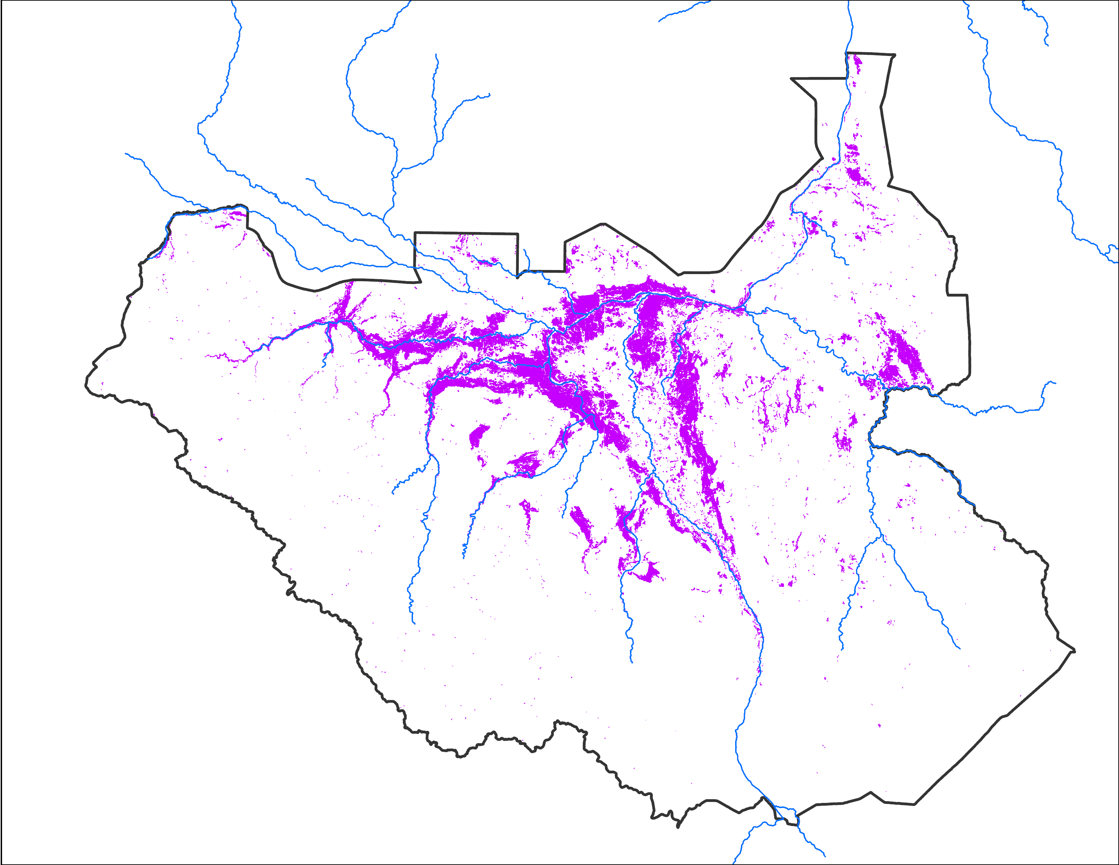
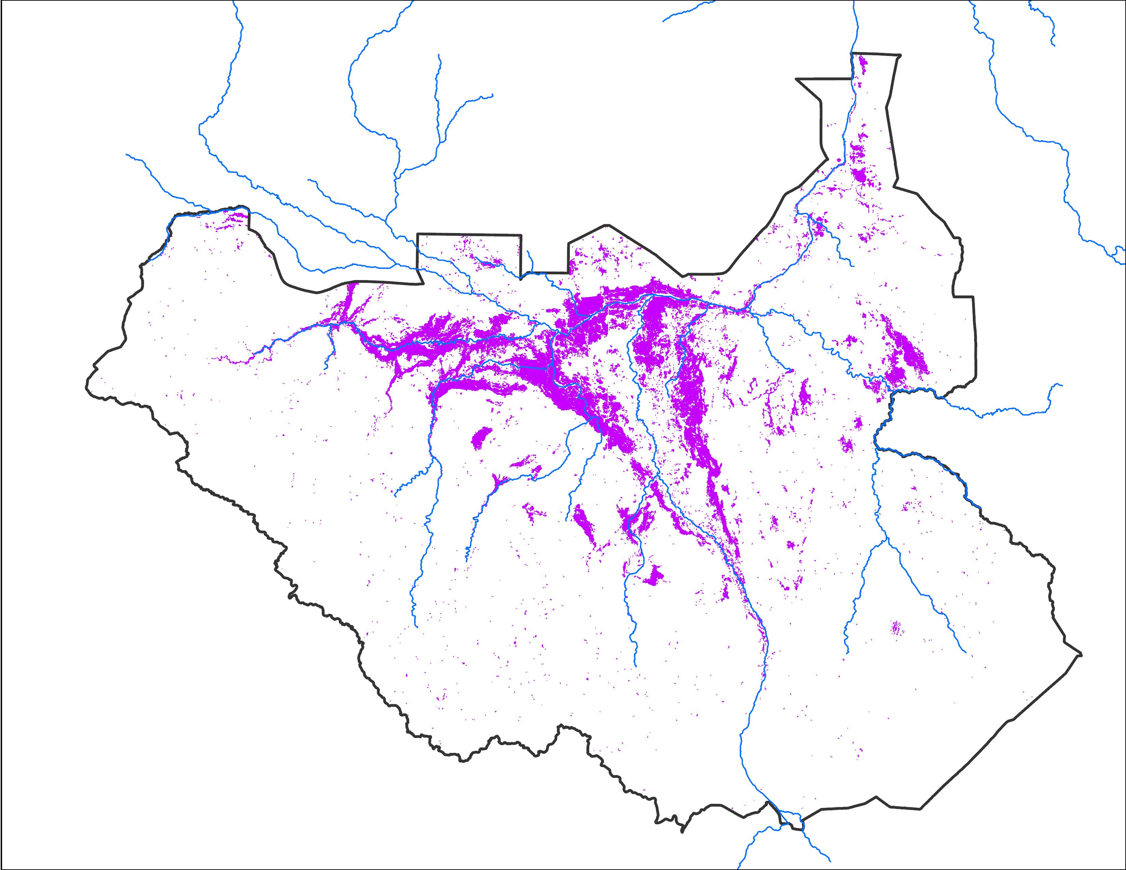
October 2024 Inundation
Sep 26 - 30, 2024
Oct 02- 06, 2024
Oct 10 - 14, 2024
45,213 km²
47,986 km²
47,881 km²

Slide 5
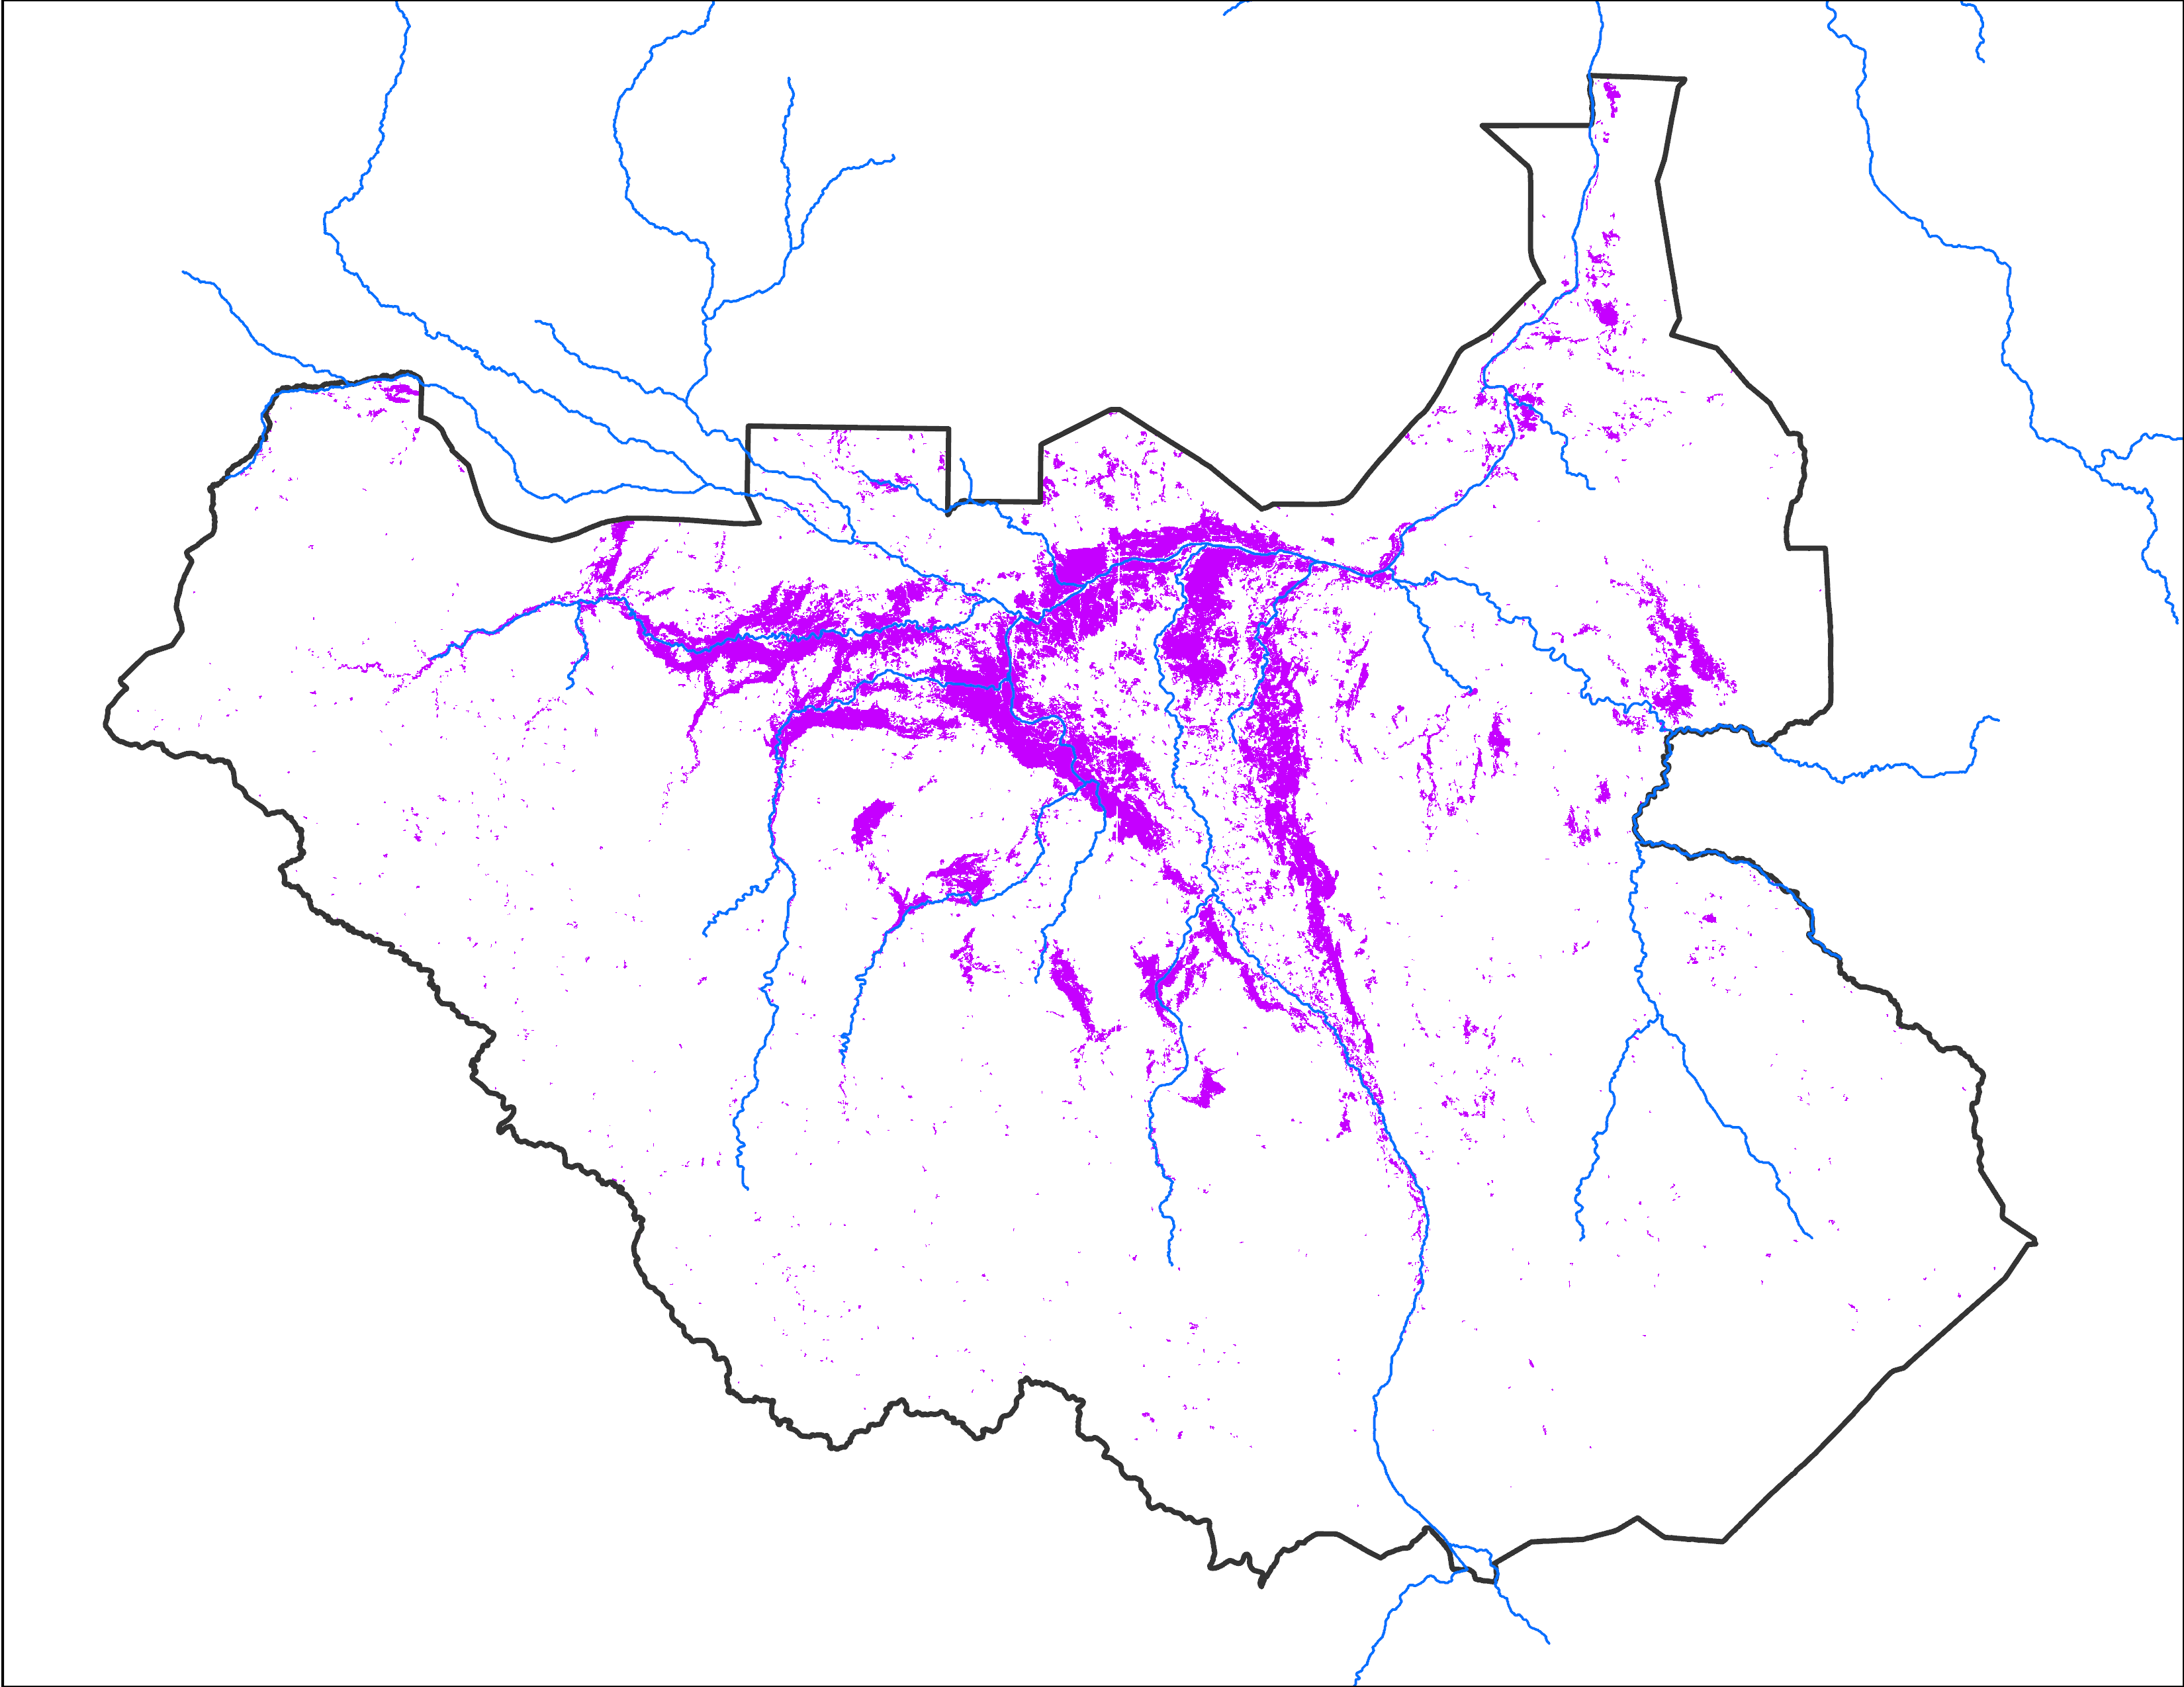
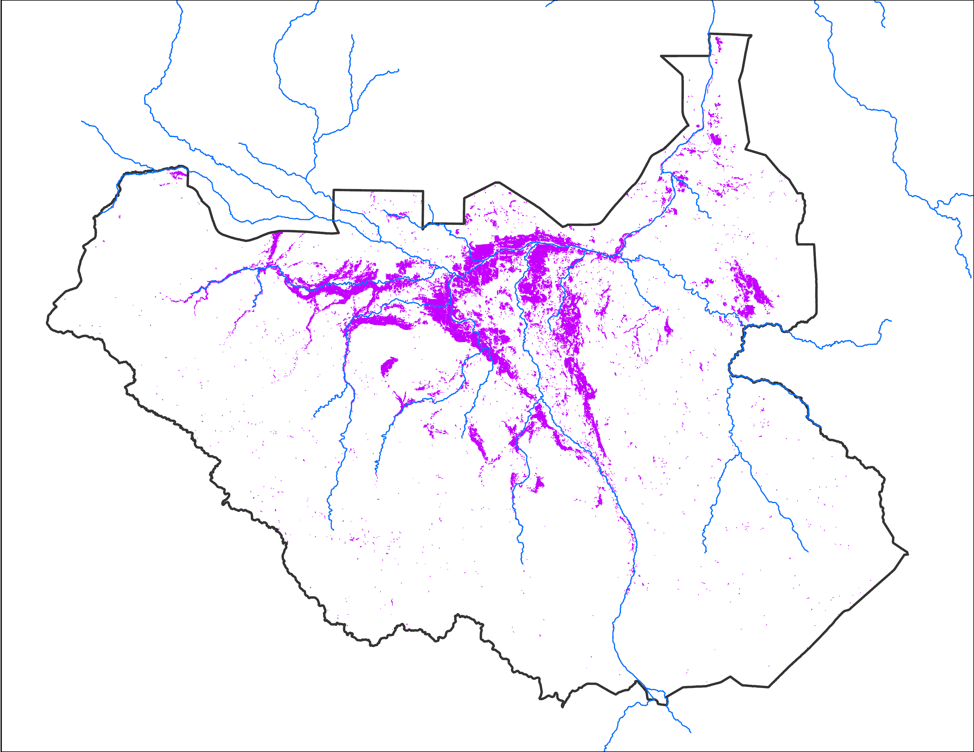
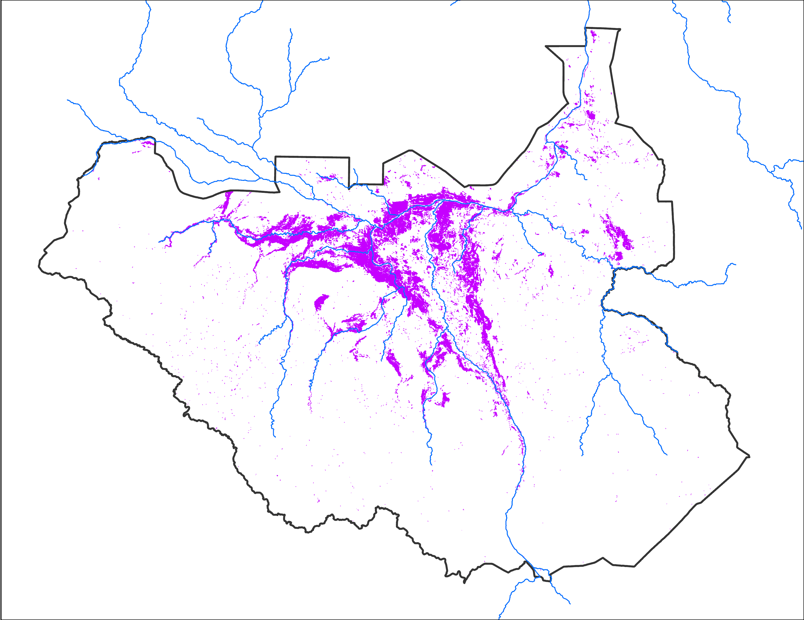
October 2024 Inundation
Oct 16 - 20, 2024
Oct 23 - 27, 2024
Oct 27 - 31, 2024
45,843 km²
39,157 km²
42,302 km²

Slide 6
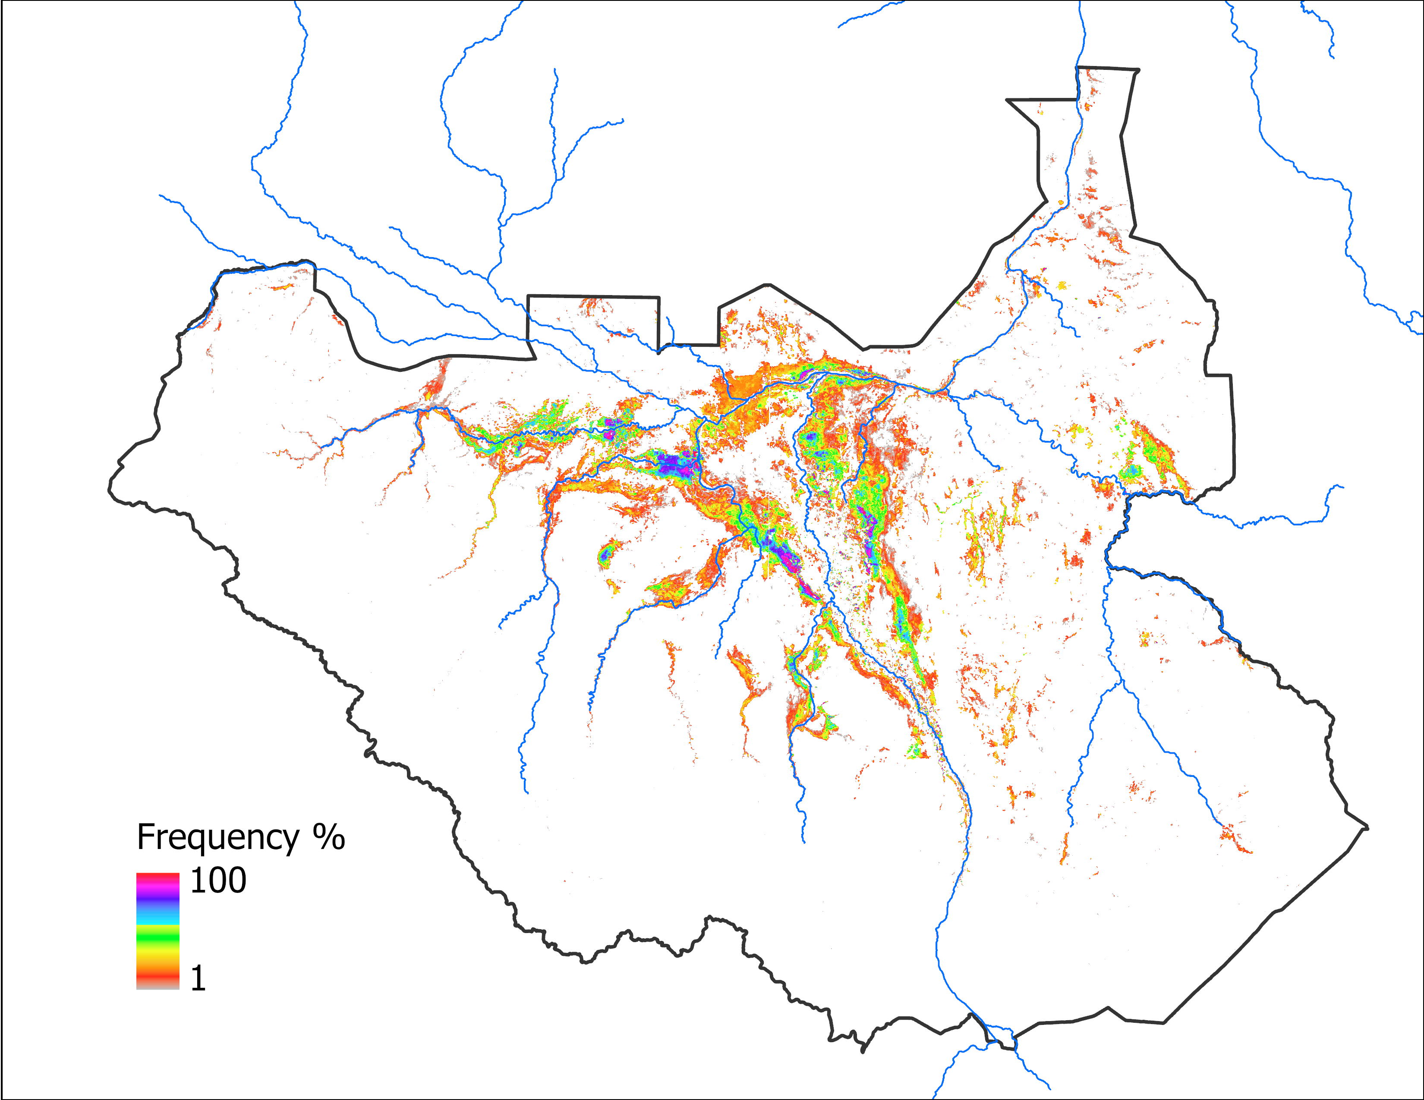
Predicted Flooding Update
Observed Oct 2024
Predicted Oct 2024 with SEP IC
Predicted Oct 2024 with SEP IC
69,374 km²
61,533 km²
Based on 2020 analog year
64,232 km²
Based on LASSO

Slide 7
Predicted Flooding Update
Observed Oct 2024
Predicted Oct 2024 with SEP IC
Predicted NOV 2024 with SEP IC
69,374 km²
64,232 km²
Based on LASSO
61,533 km²
Based on LASSO

Slide 8
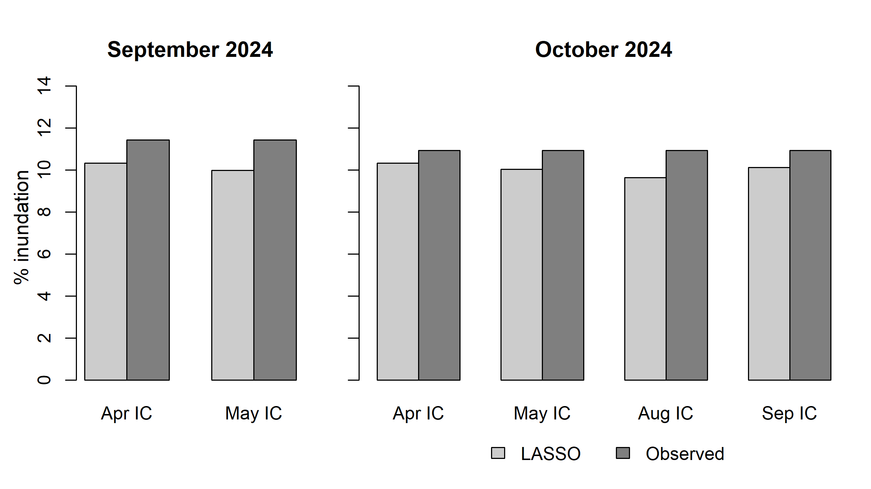
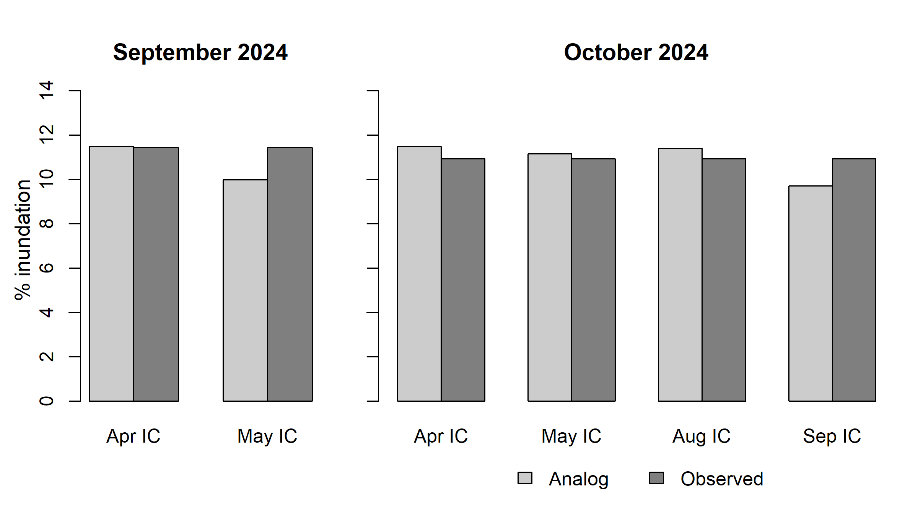
Predicted vs Observed Comparison
Based on LASSO
Based on analog 2020

Slide 9
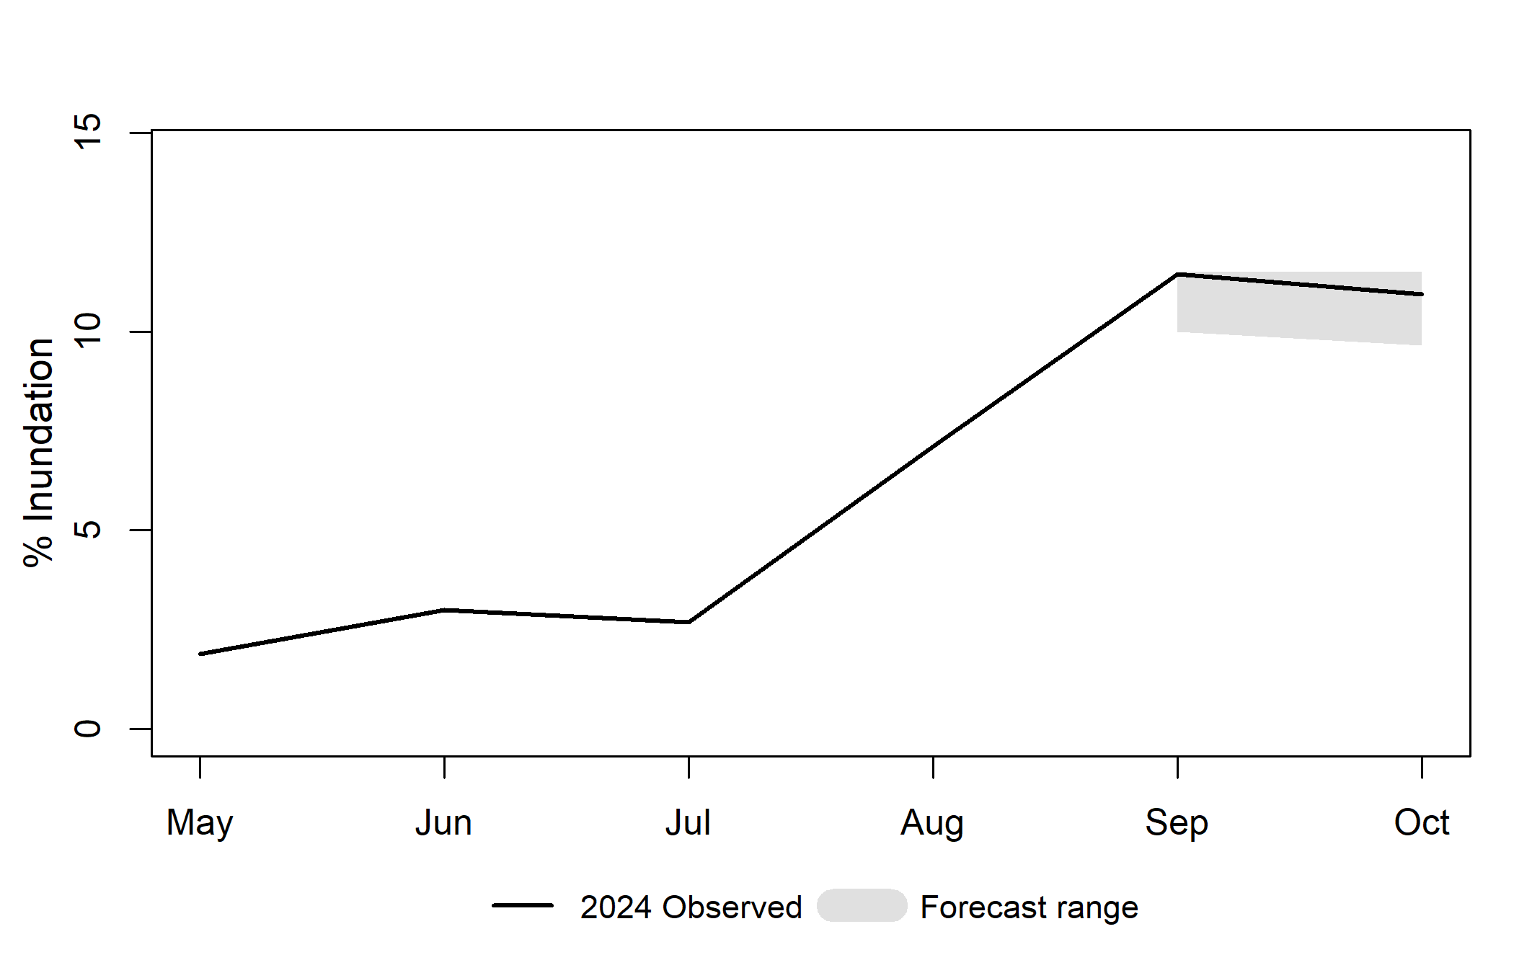
Predicted vs Observed Comparison

Slide 10
LASSO Forecast

Slide 11
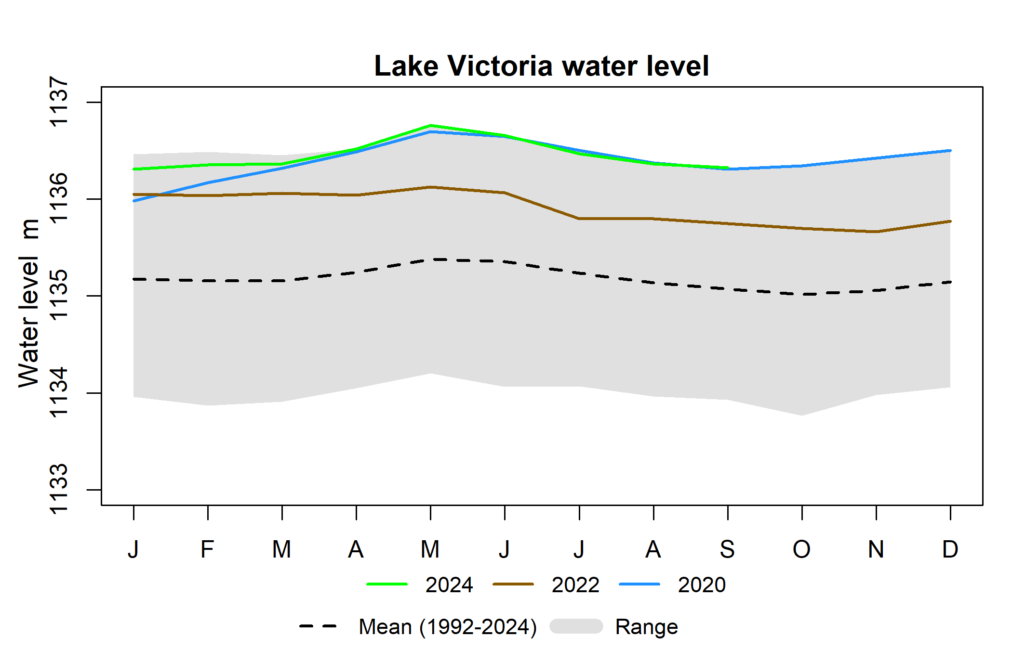
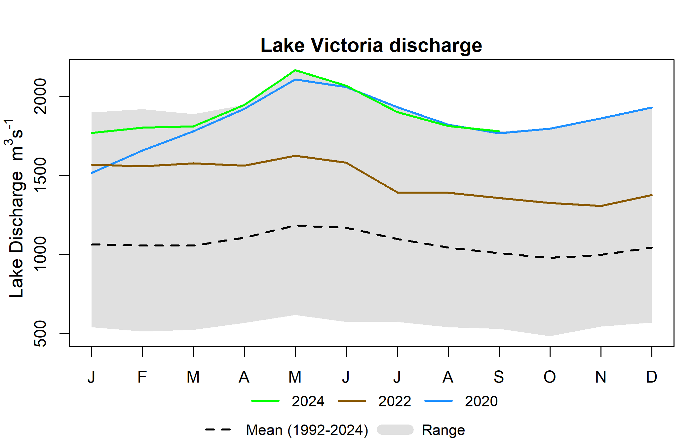
Water Level and Discharge

Slide 12
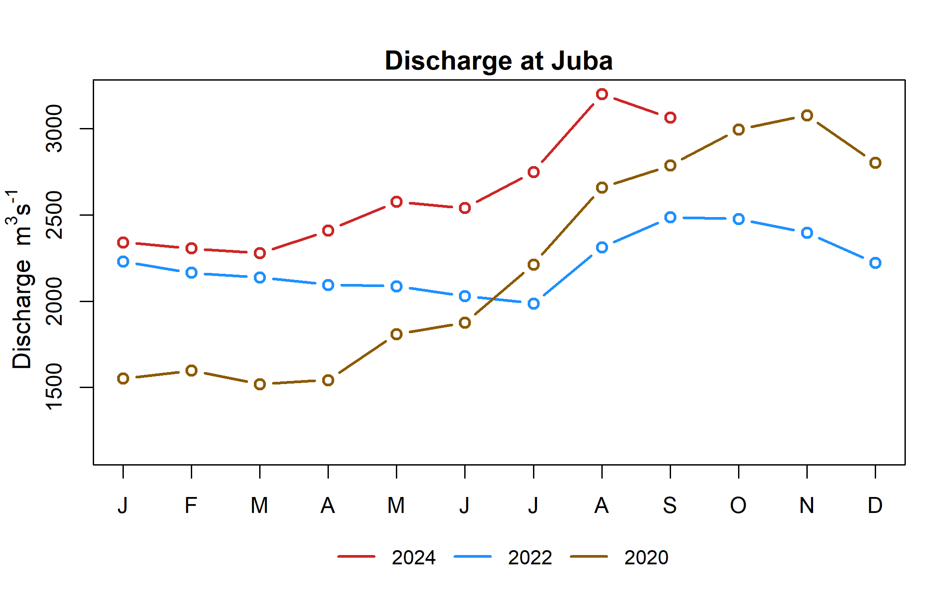
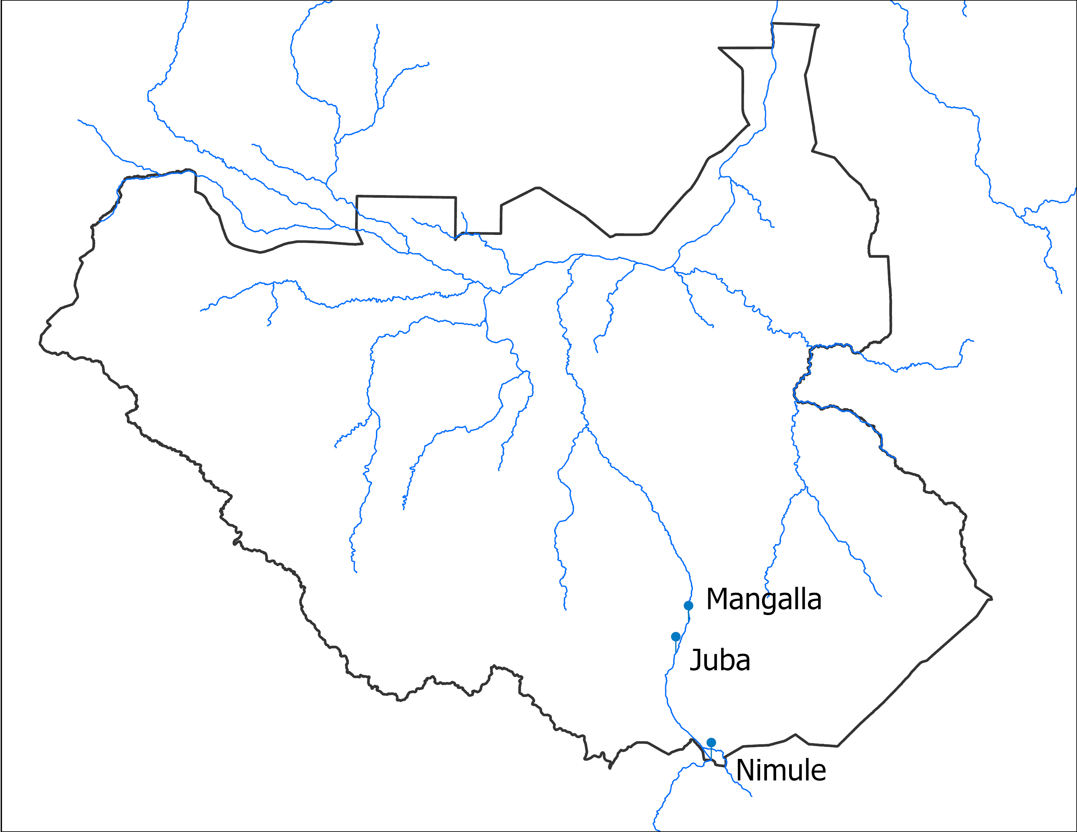
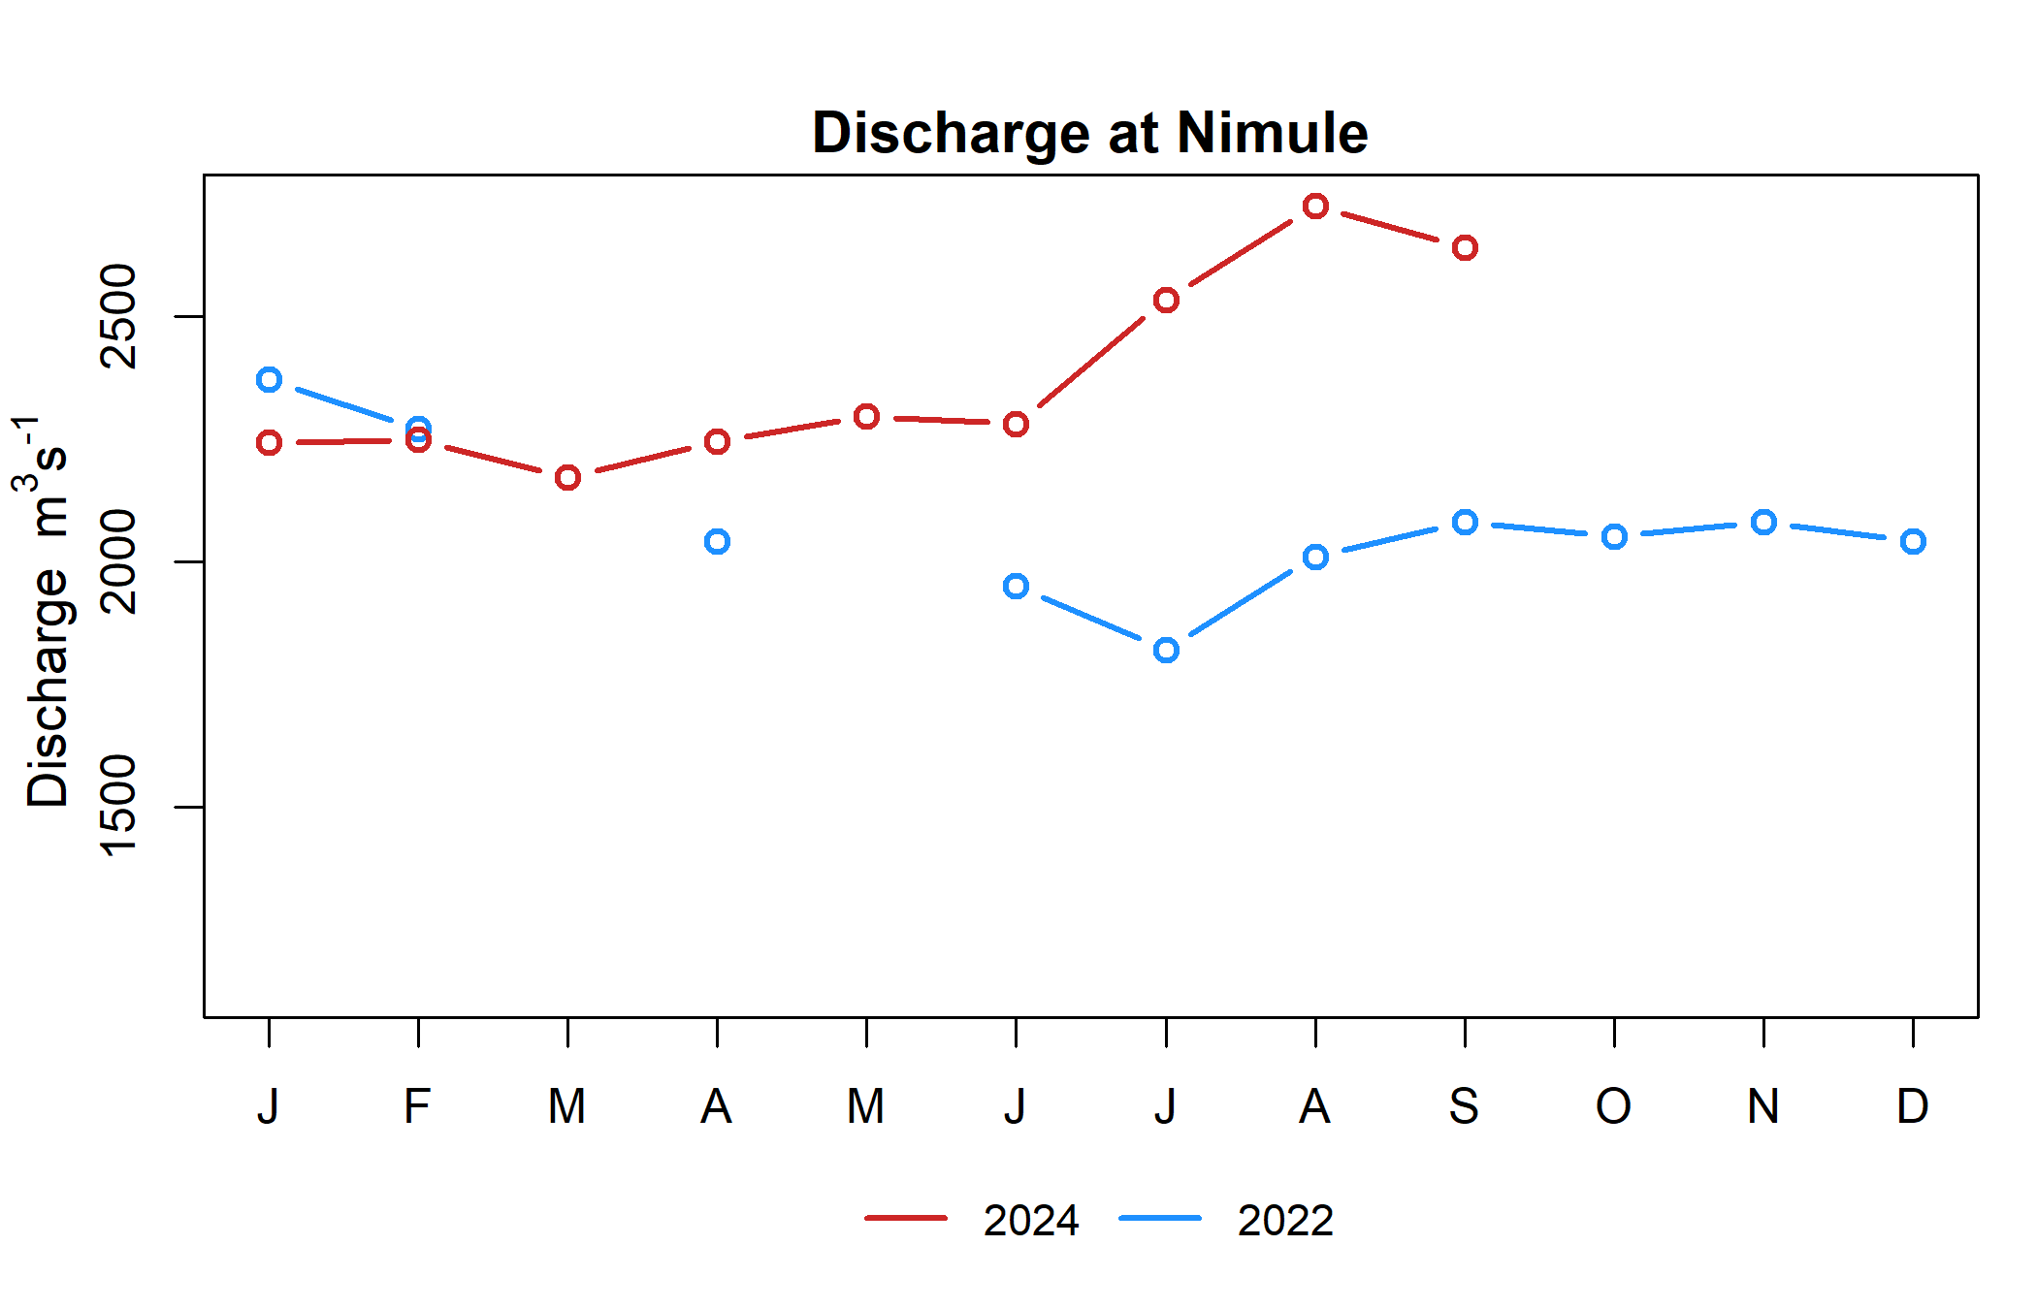
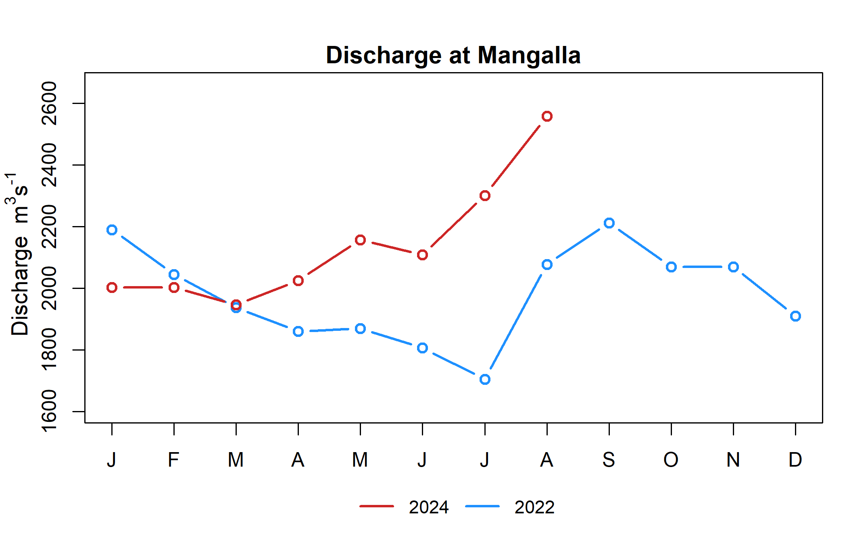
Observed Discharge

Slide 13
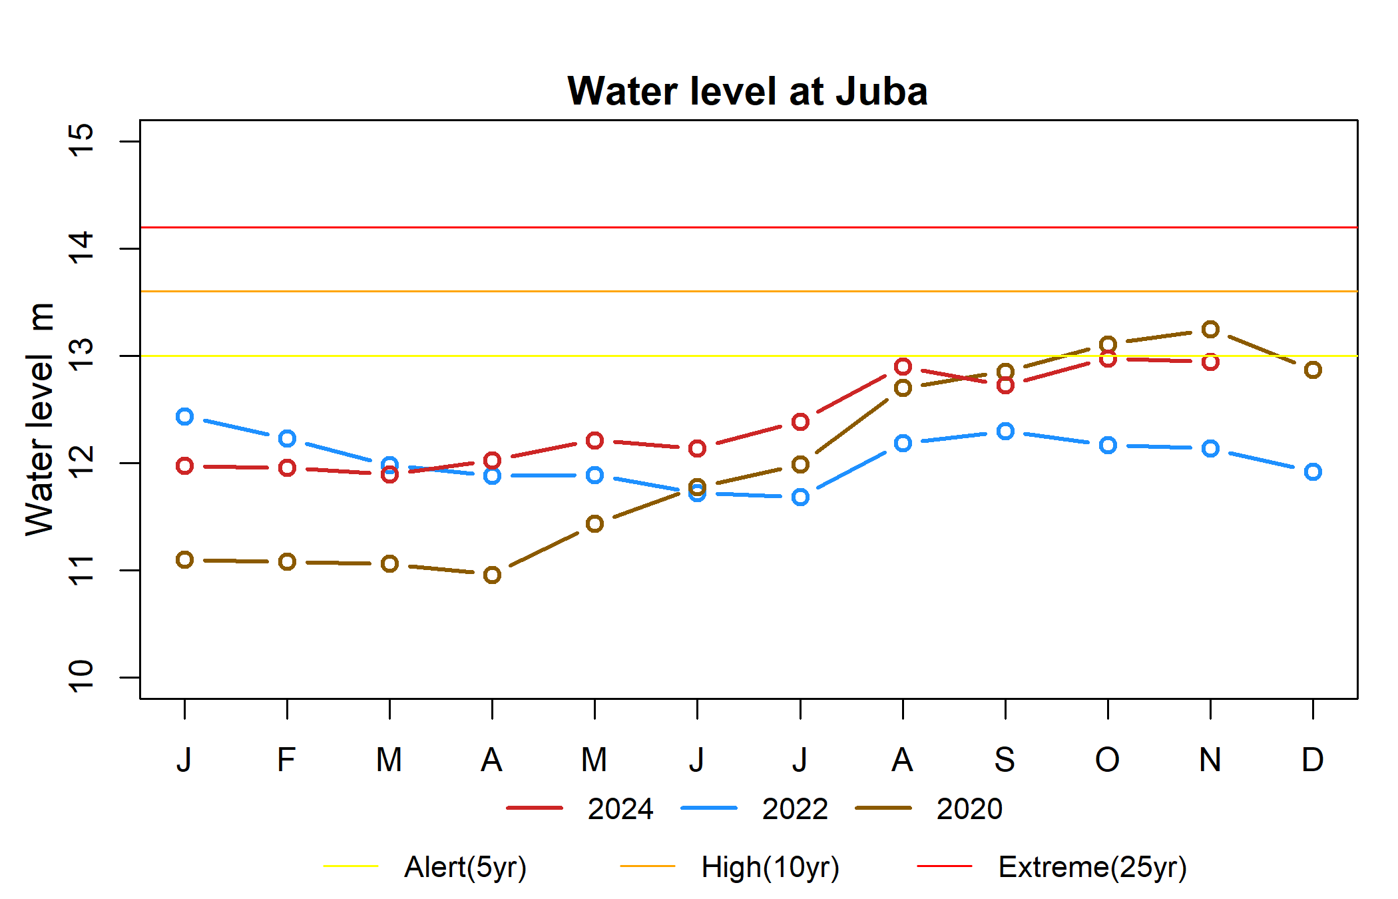
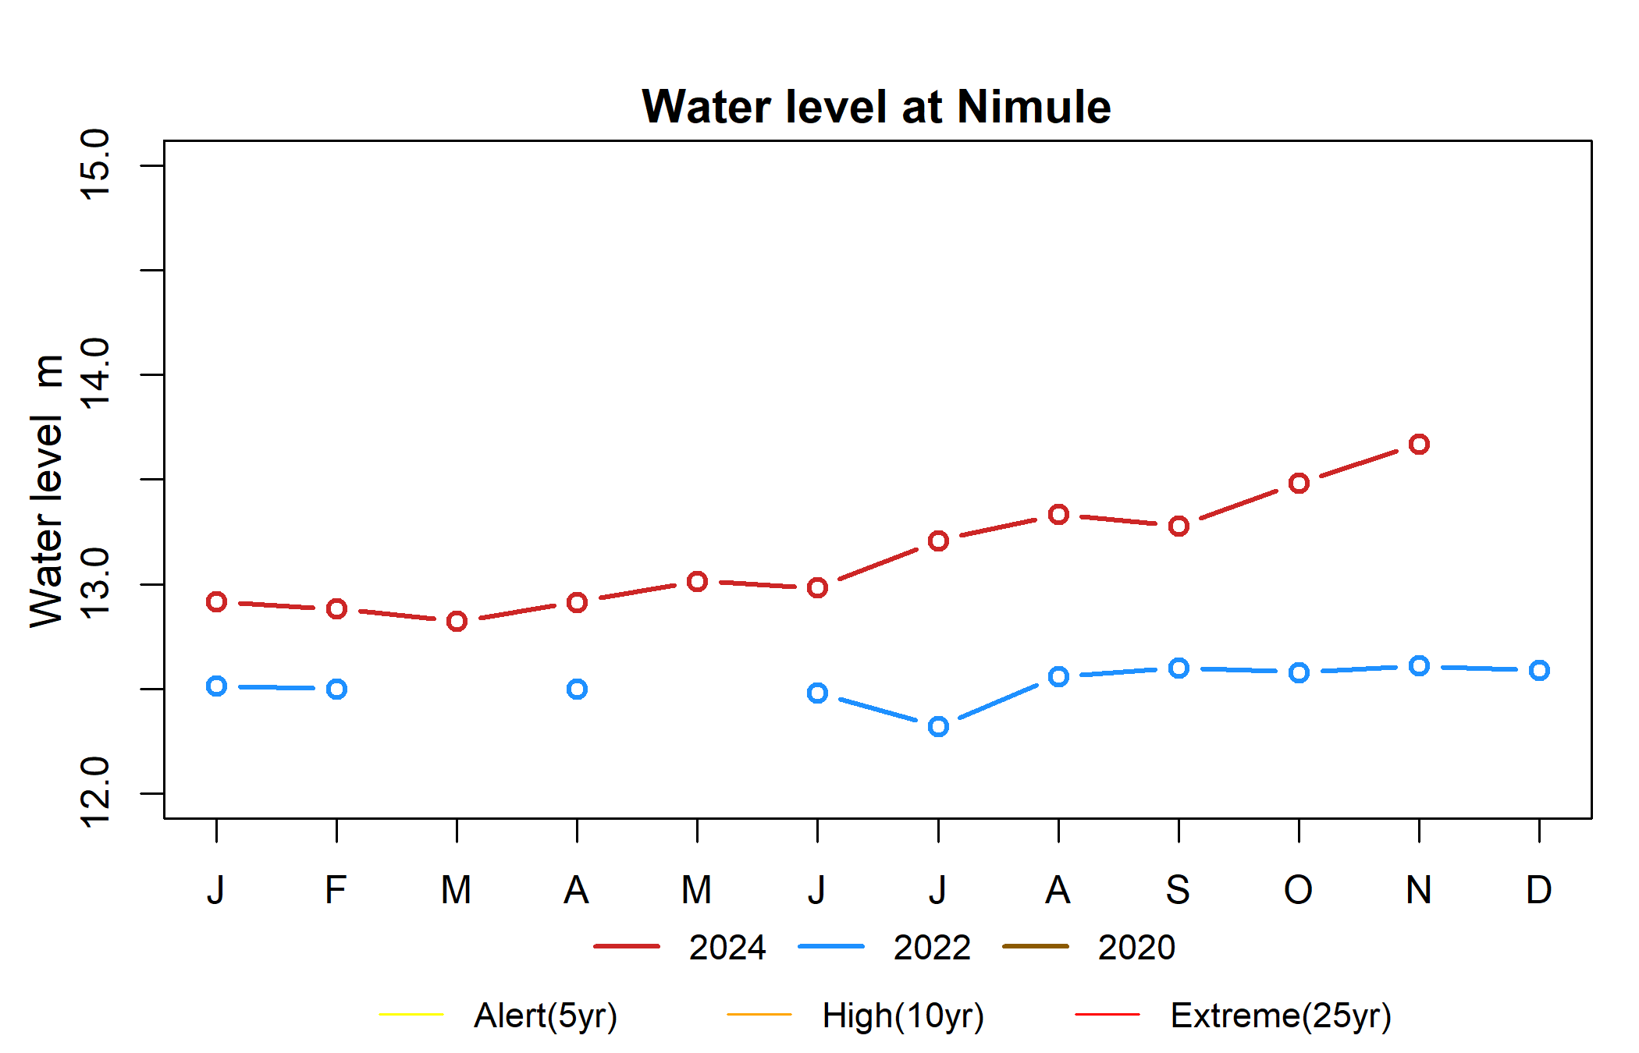
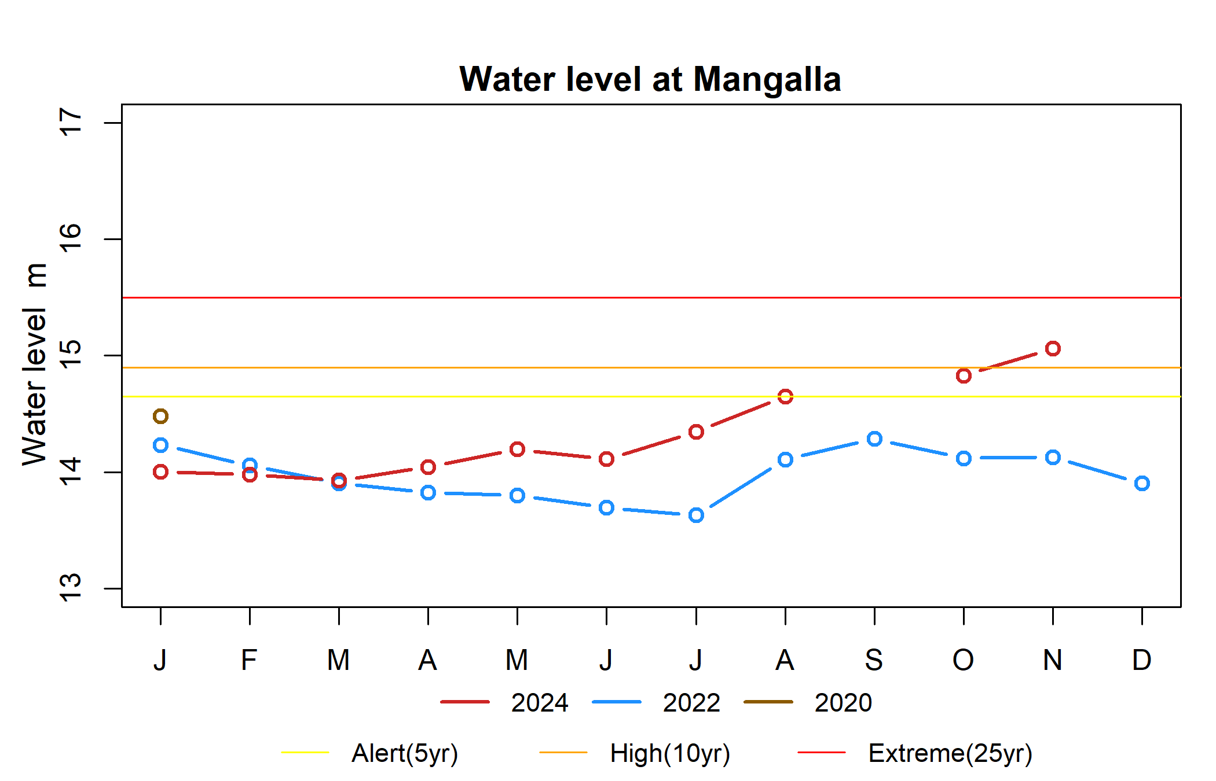
Observed Water Level

Slide 14
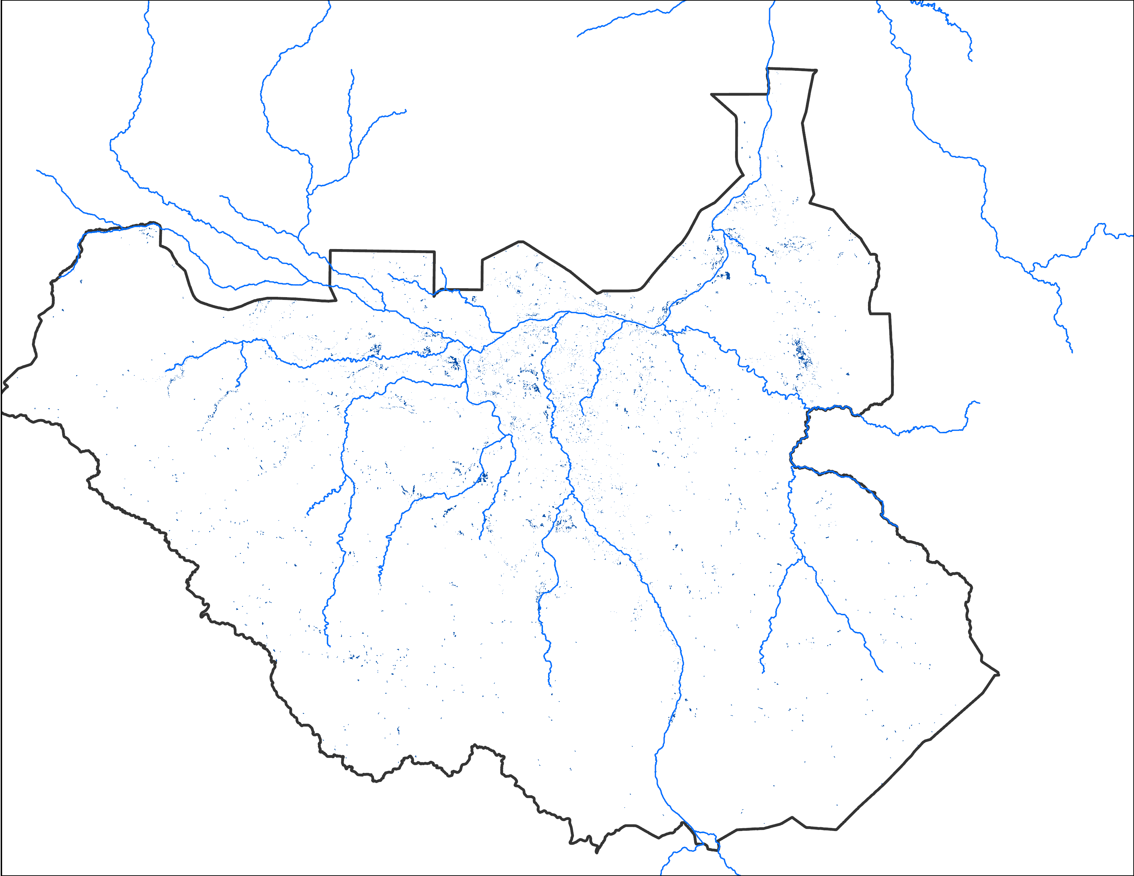
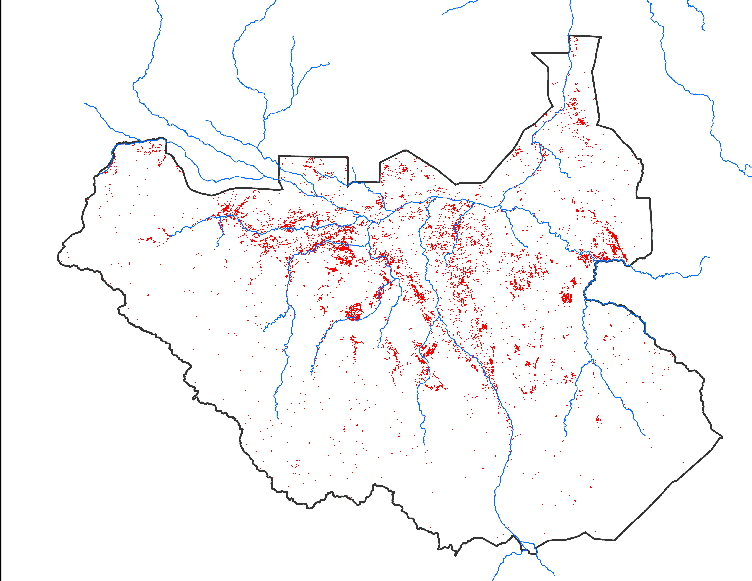
Newly Wet Dry Areas
Newly wet: 4,555 km²
Newly dry: 22,949 km²
Newly wet day conditions are based on VIIRS observed Mid-Oct and Oct 23-27 flooding.

Slide 15
Thank you

