Slide 1
South Sudan Flood Monitoring and Prediction - 2024 Season
FEWS NET Science Team
December 02, 2024

Slide 2
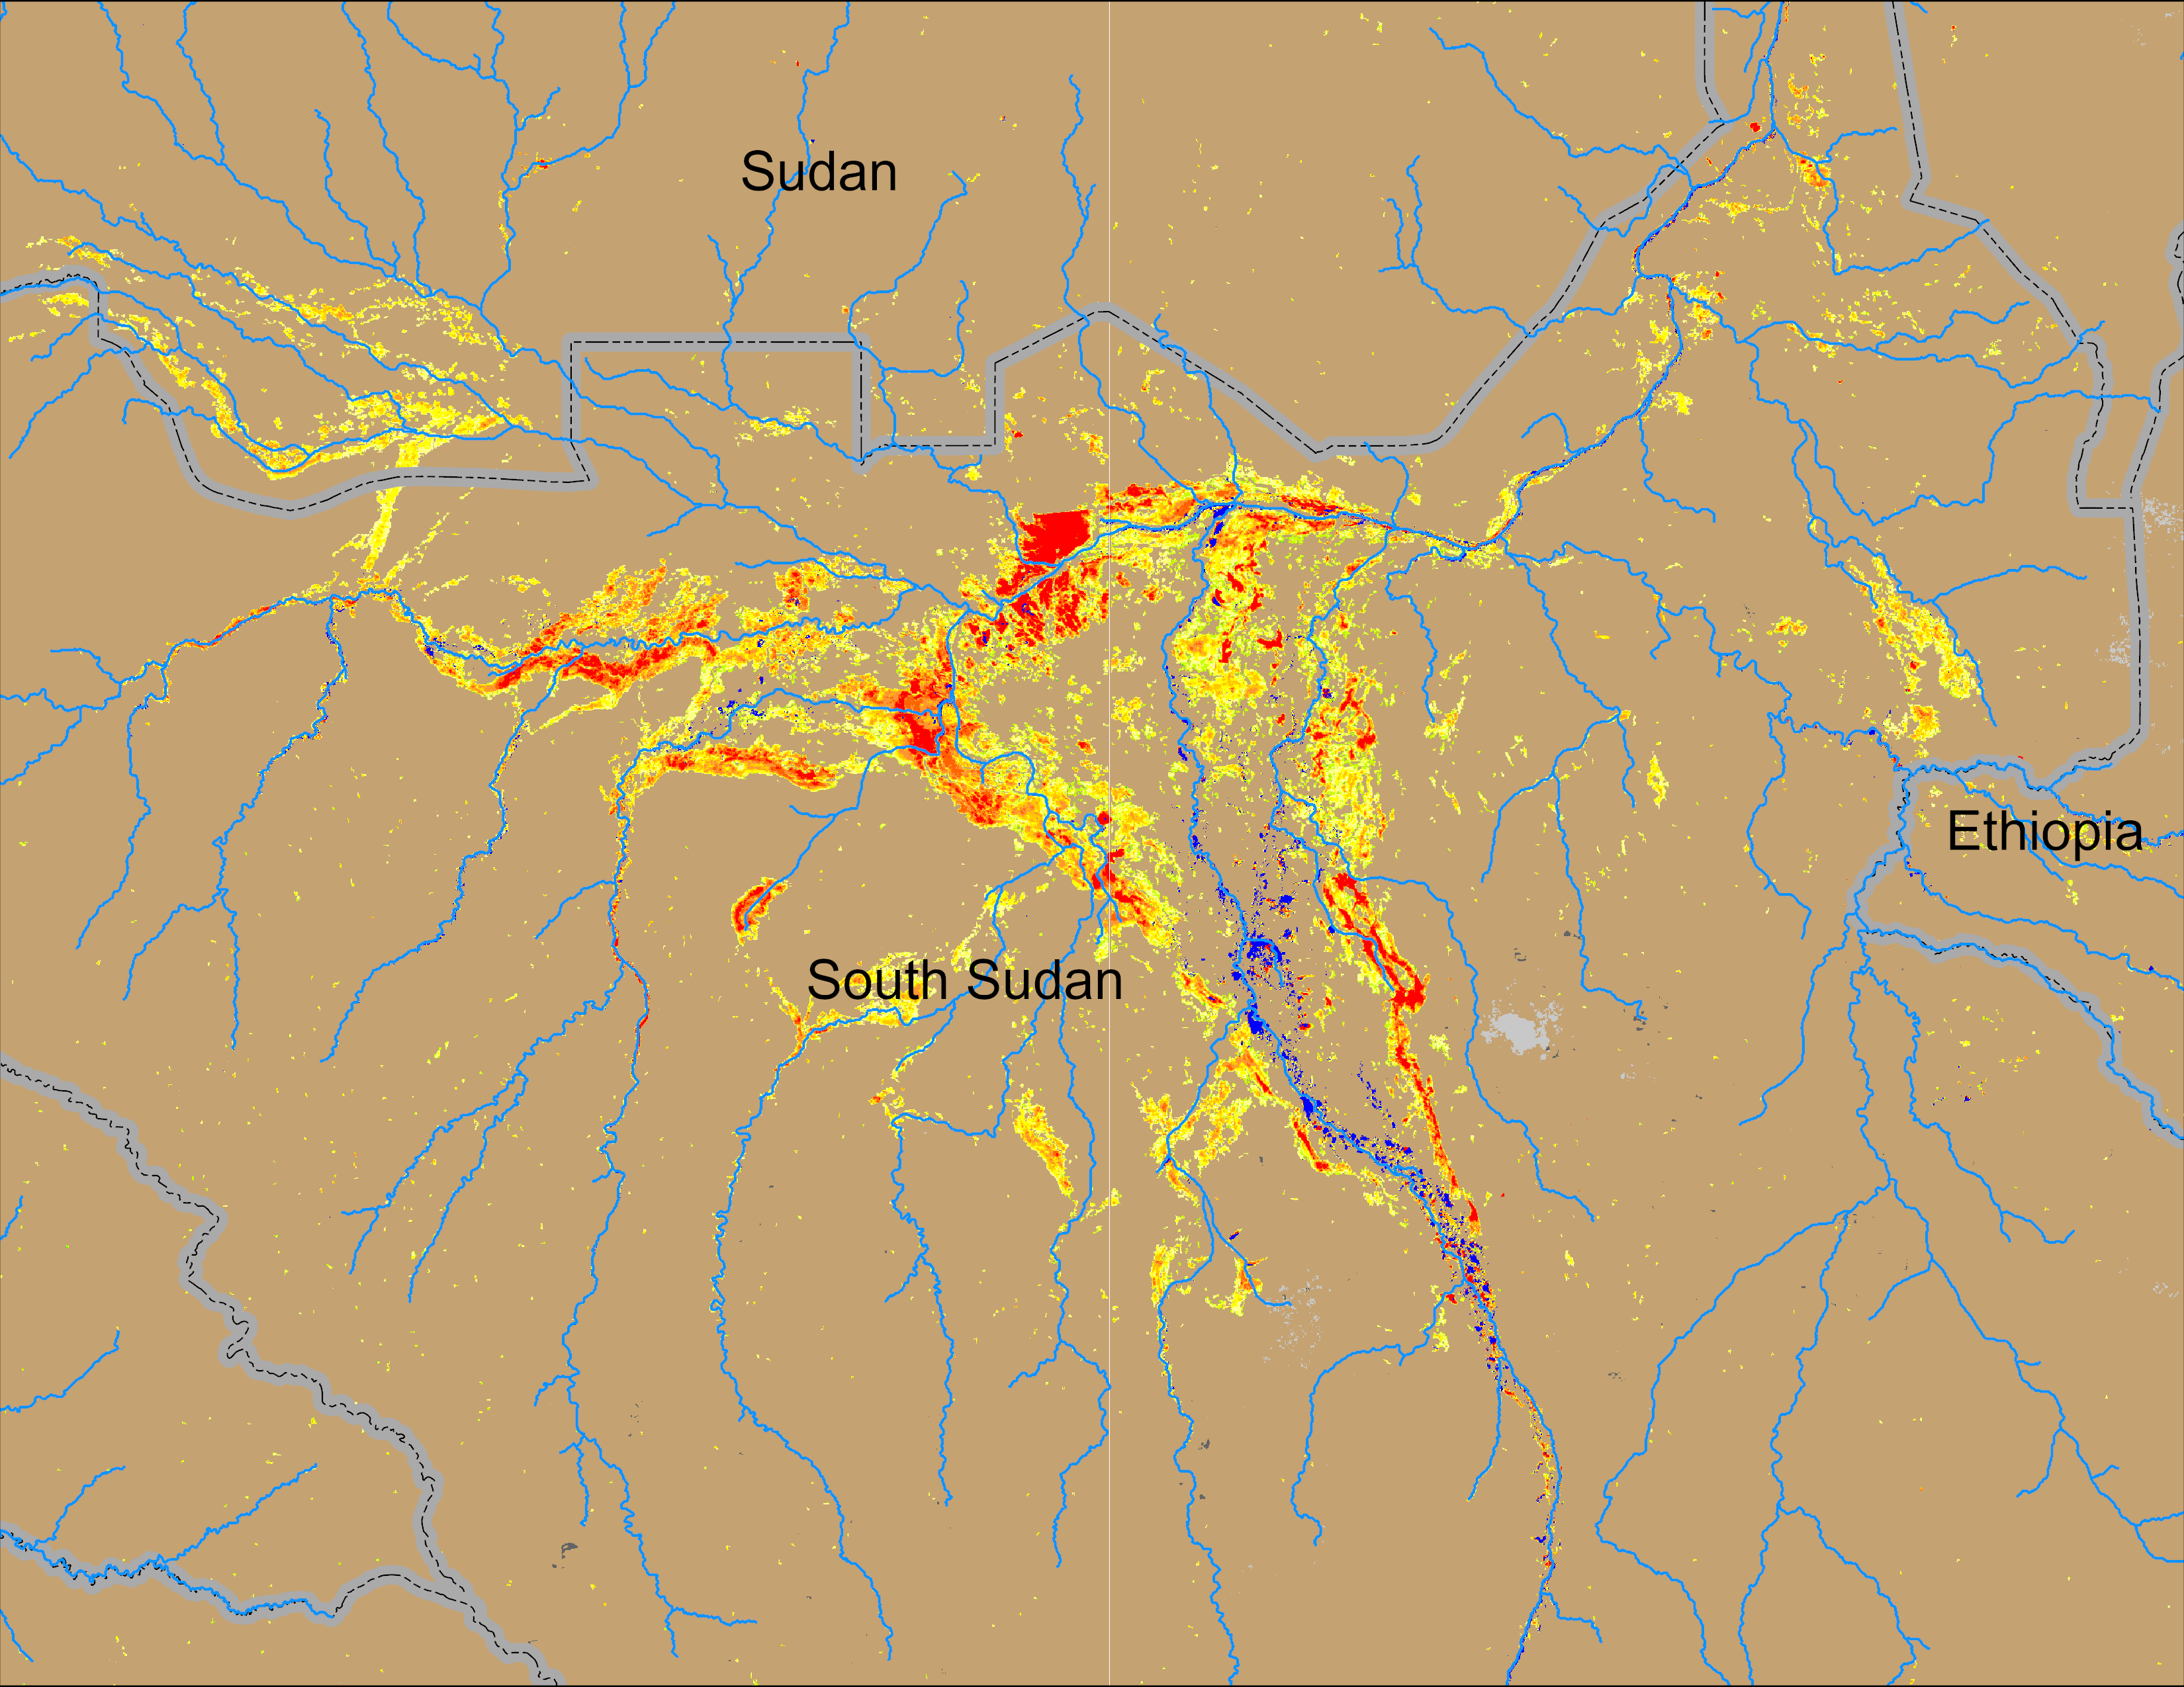
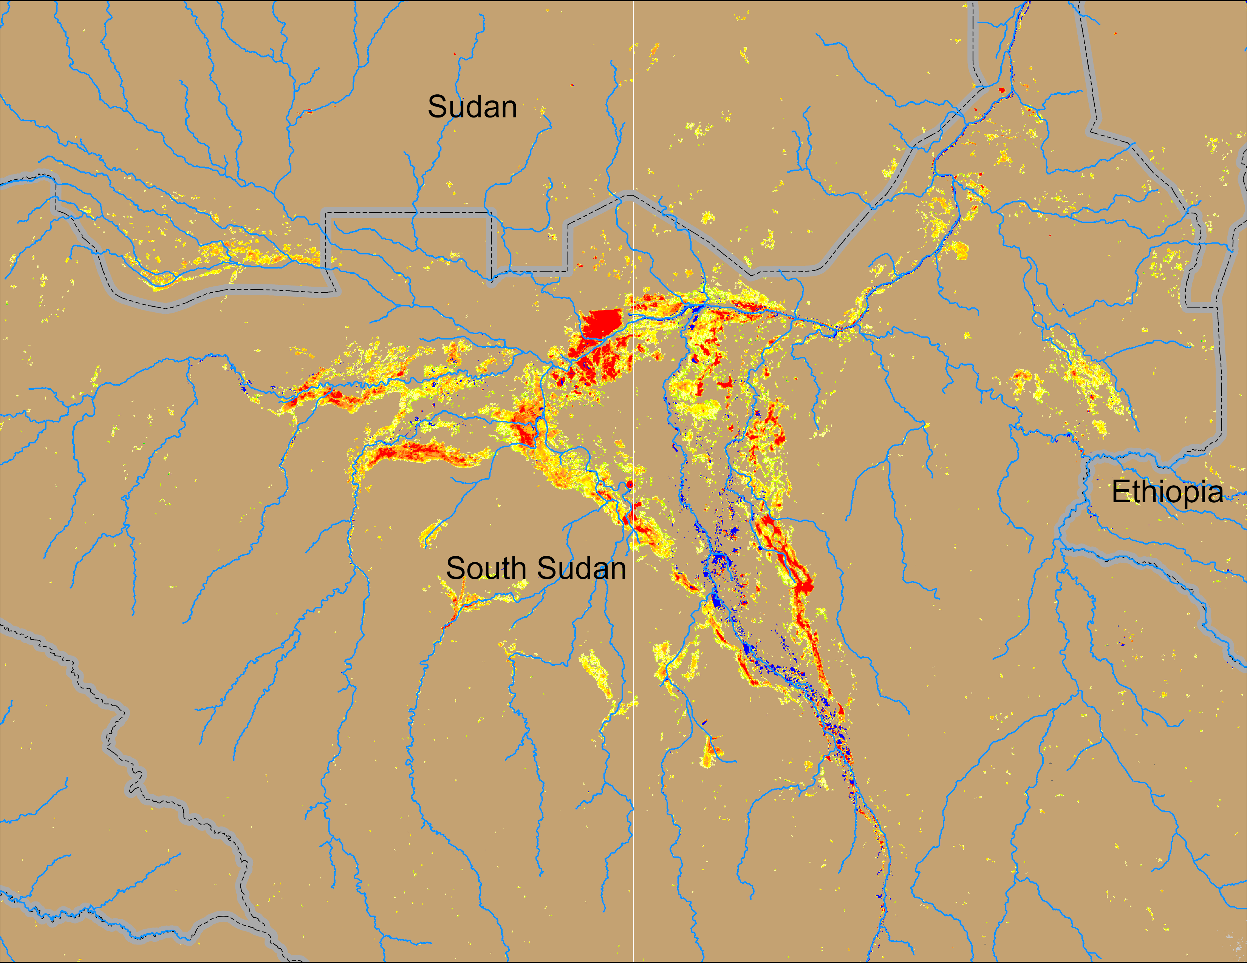
Flooding Conditions in South Sudan
(% of the pixel)
(% of the pixel)
Sobet
Sobet
Akobo
Akobo
Pibor
Pibor
NOAA VIIRS 5-day comp.: 11 – 15 Nov 2024
NOAA VIIRS 5-day comp.: 26 – 30 Nov 2024
Inundated areas slowly receding across South Sudan.

Slide 3
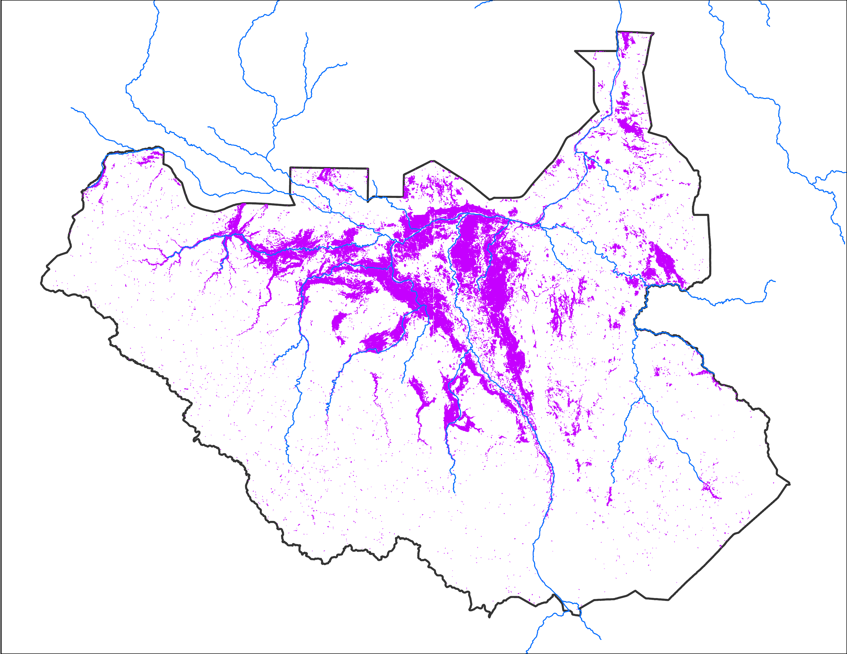
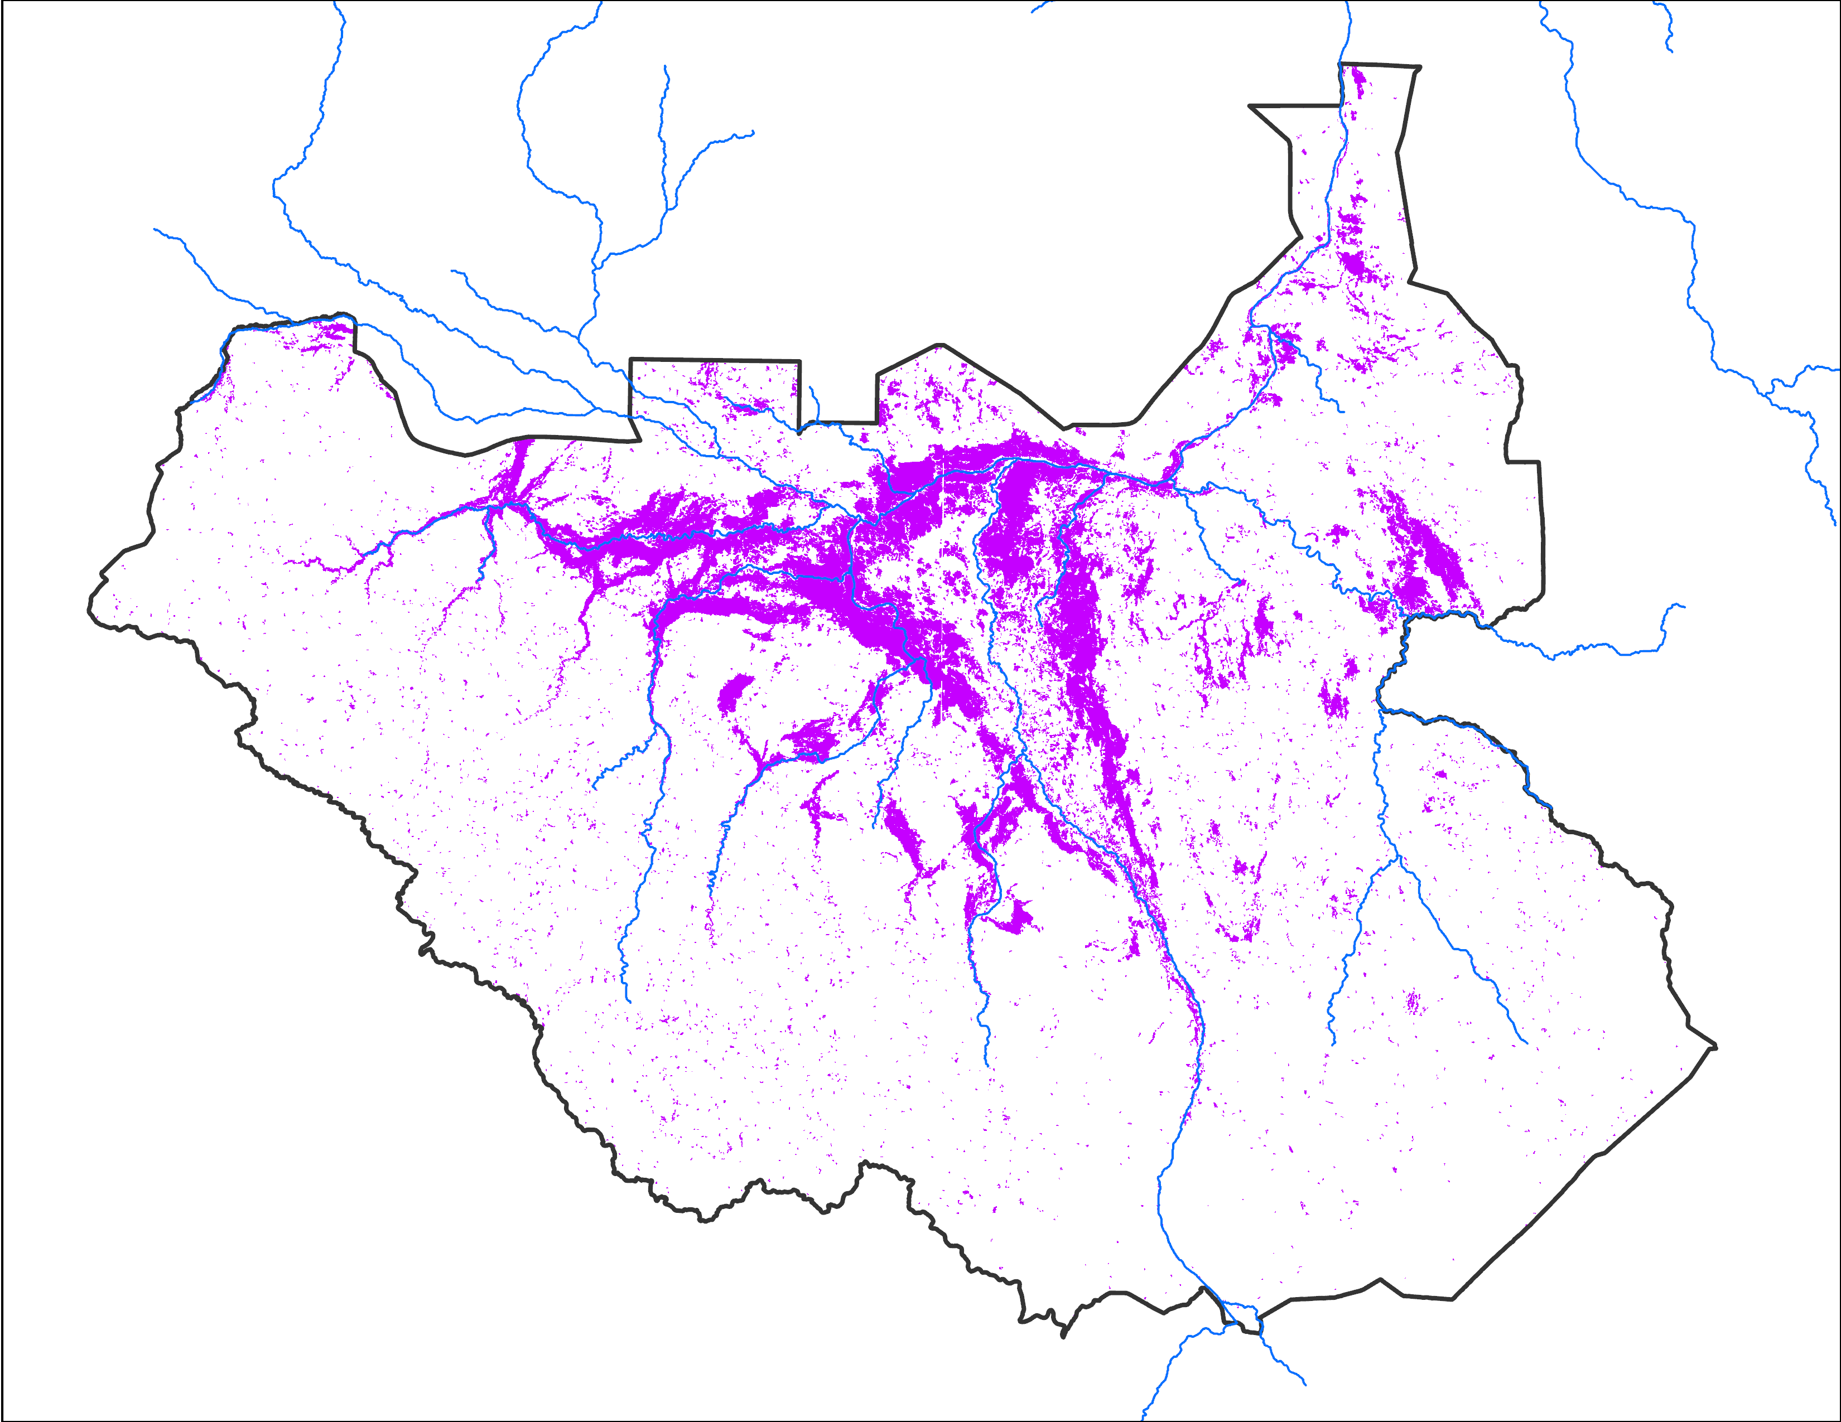
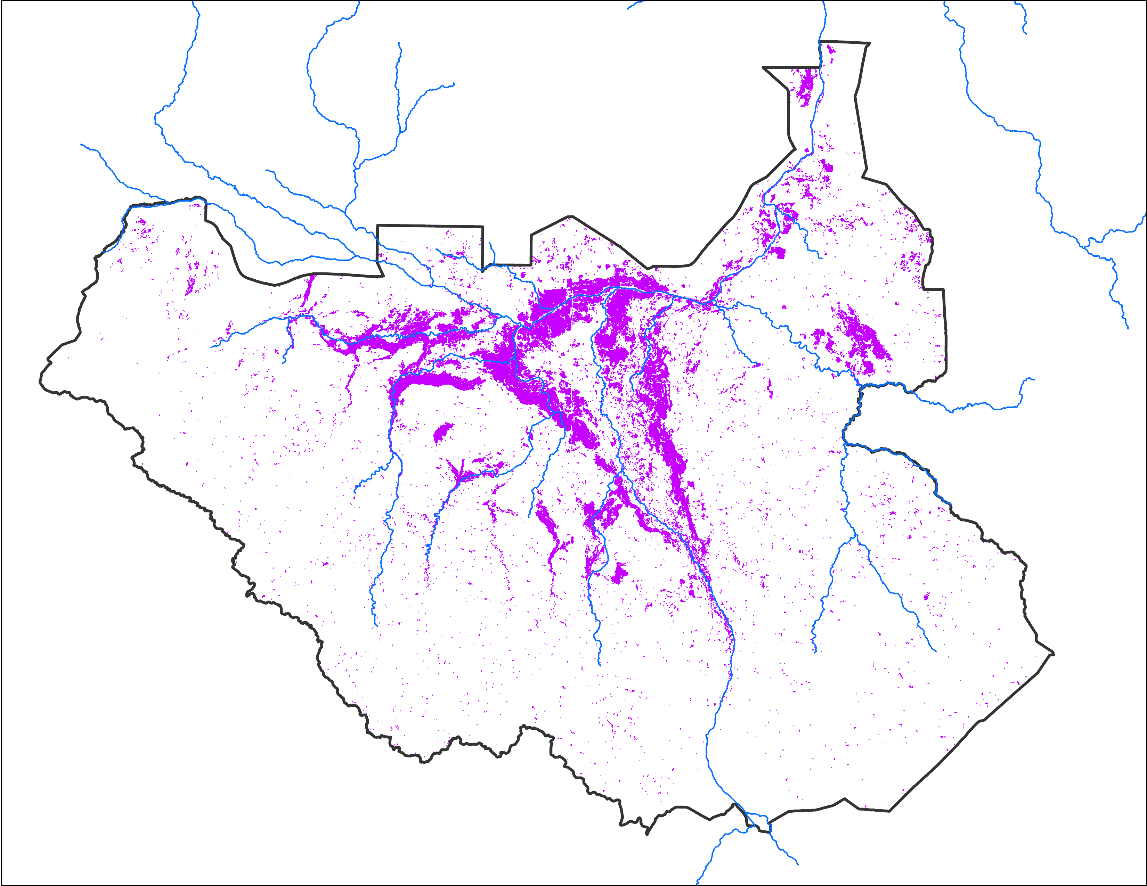
Flooding Progression
Sep 2024
Oct 2024
Nov 2024
72,515 km²
69,374 km²
52,945 km²

Slide 4
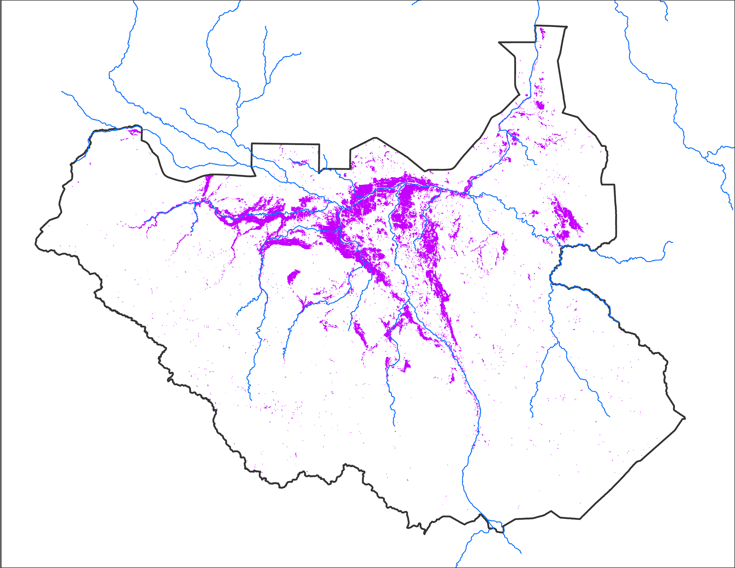
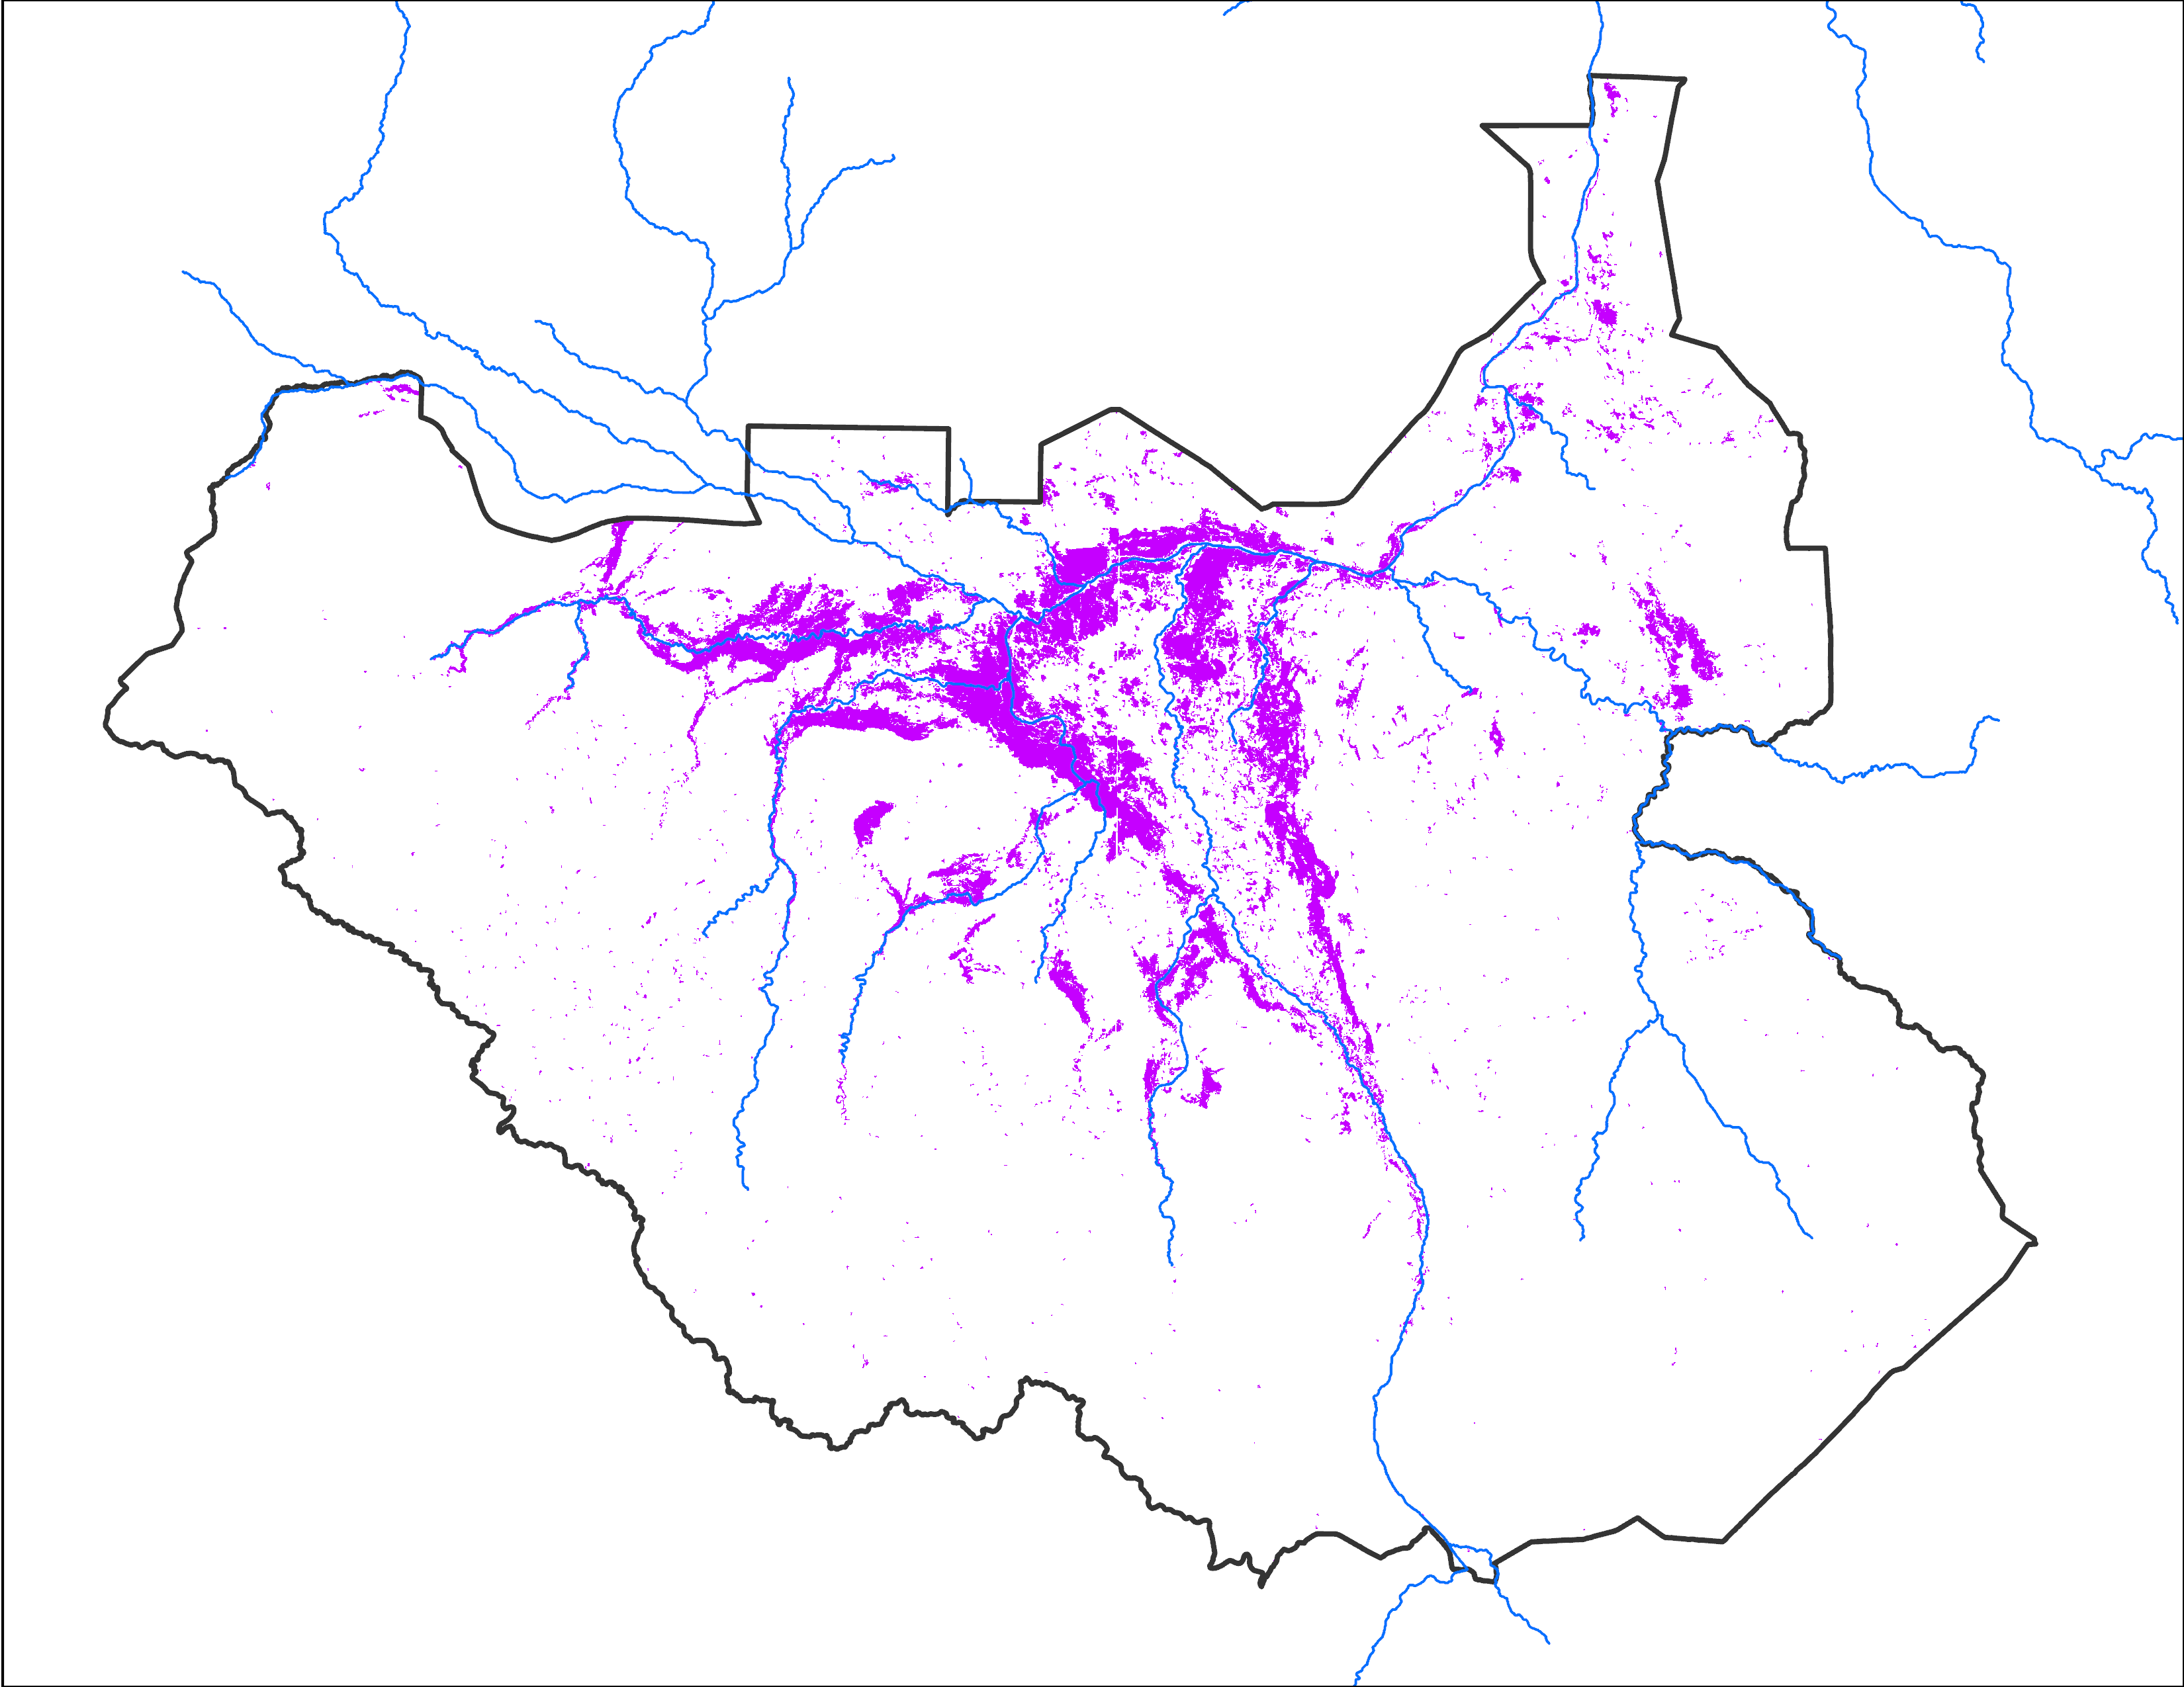
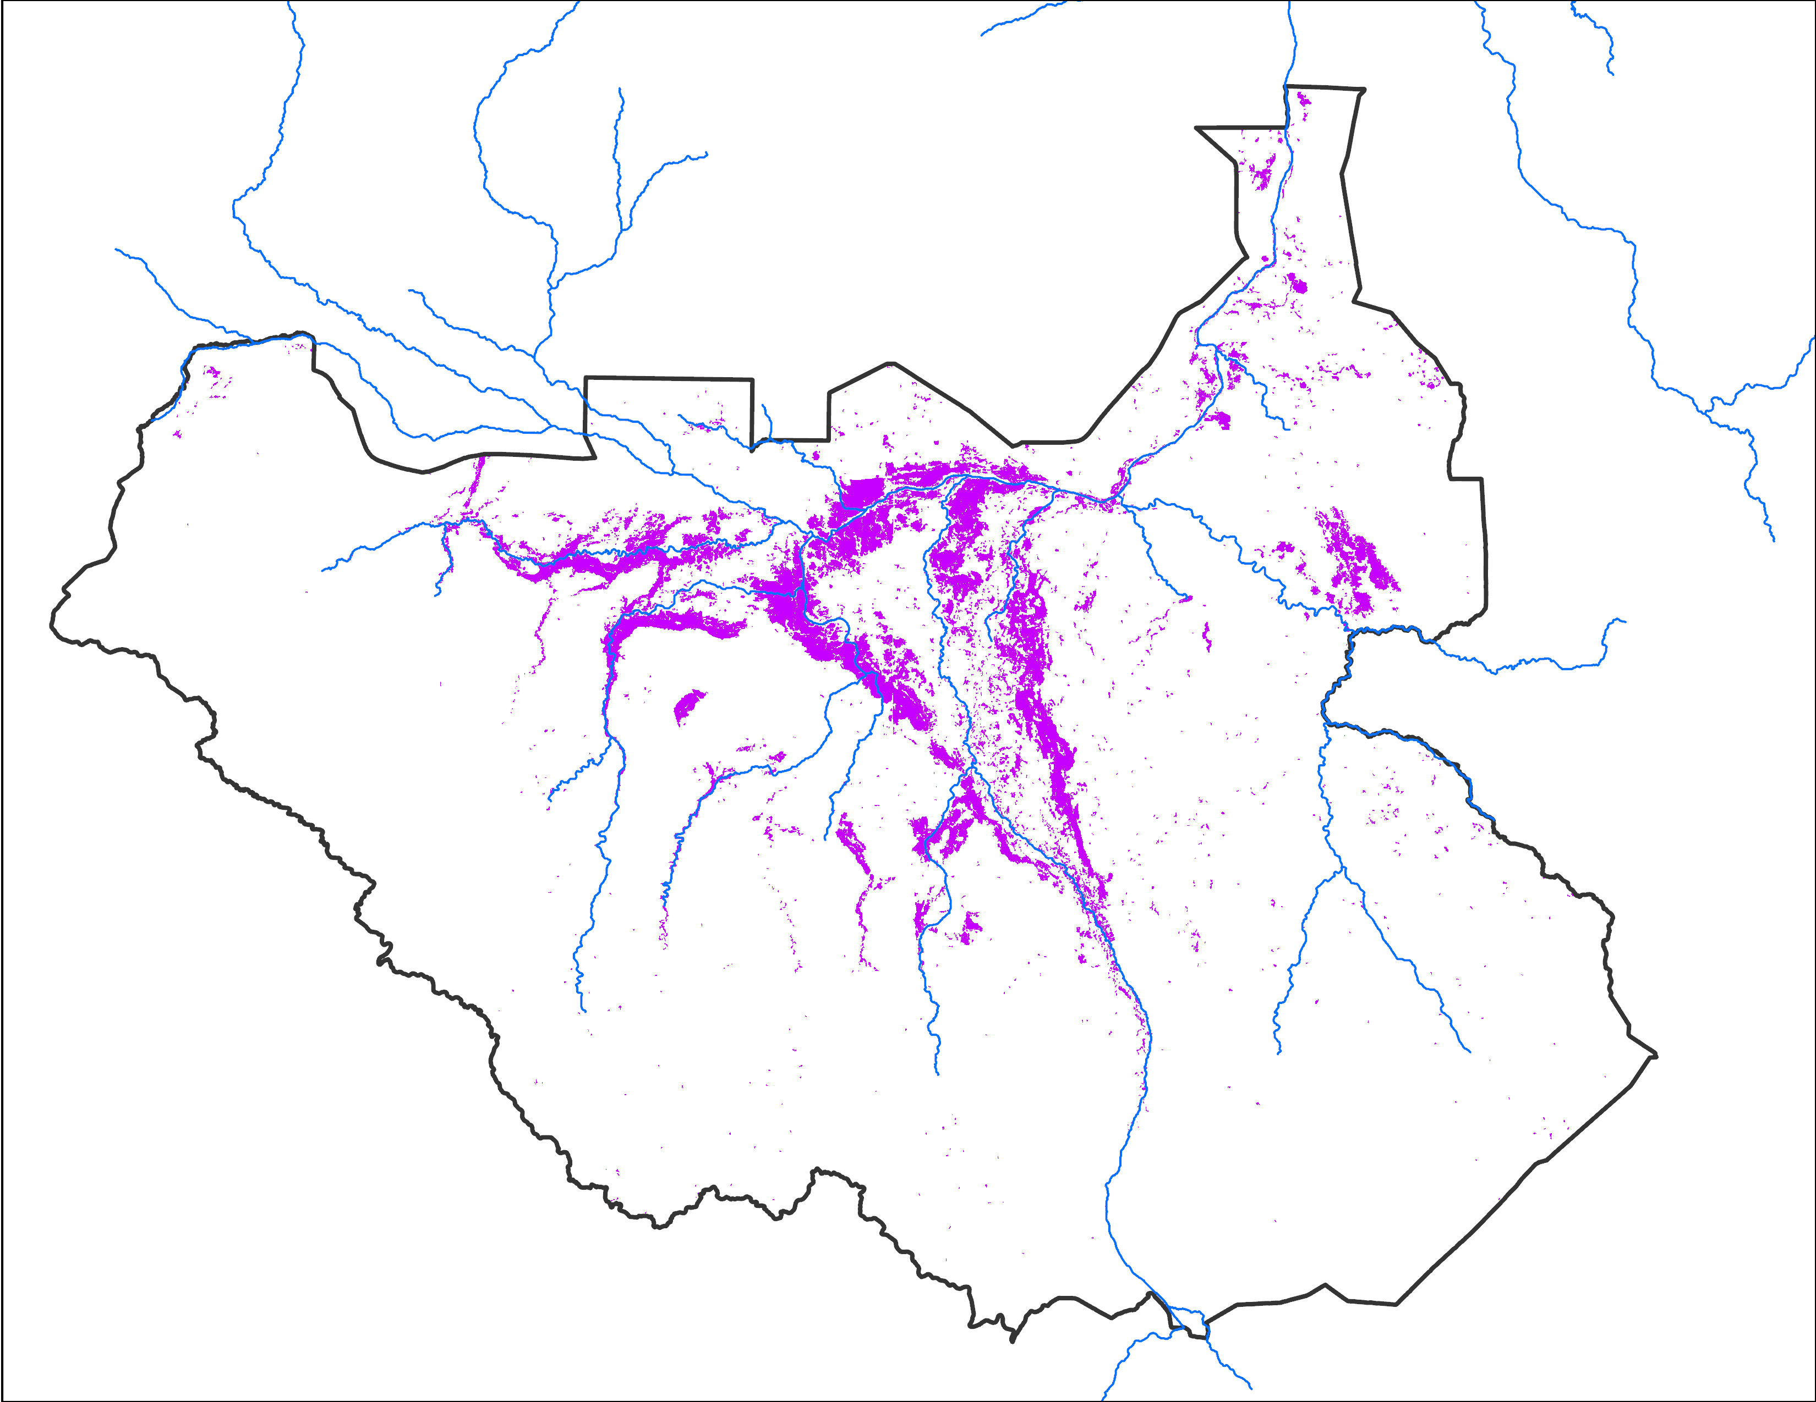
November 2024 Inundation
Oct 23 - 27, 2024
Oct 27 - 31, 2024
Nov 7 - 11, 2024
39,157 km²
42,802 km²
35,037 km²

Slide 5
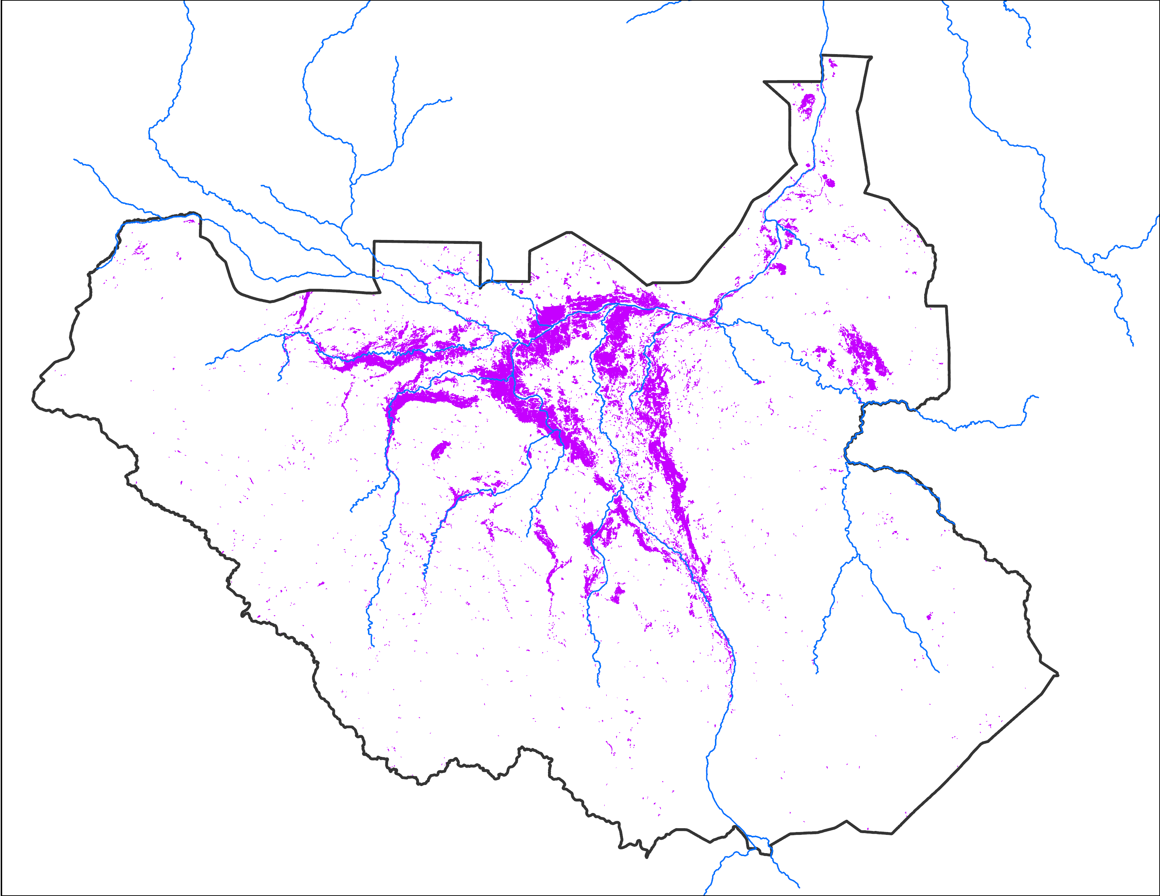
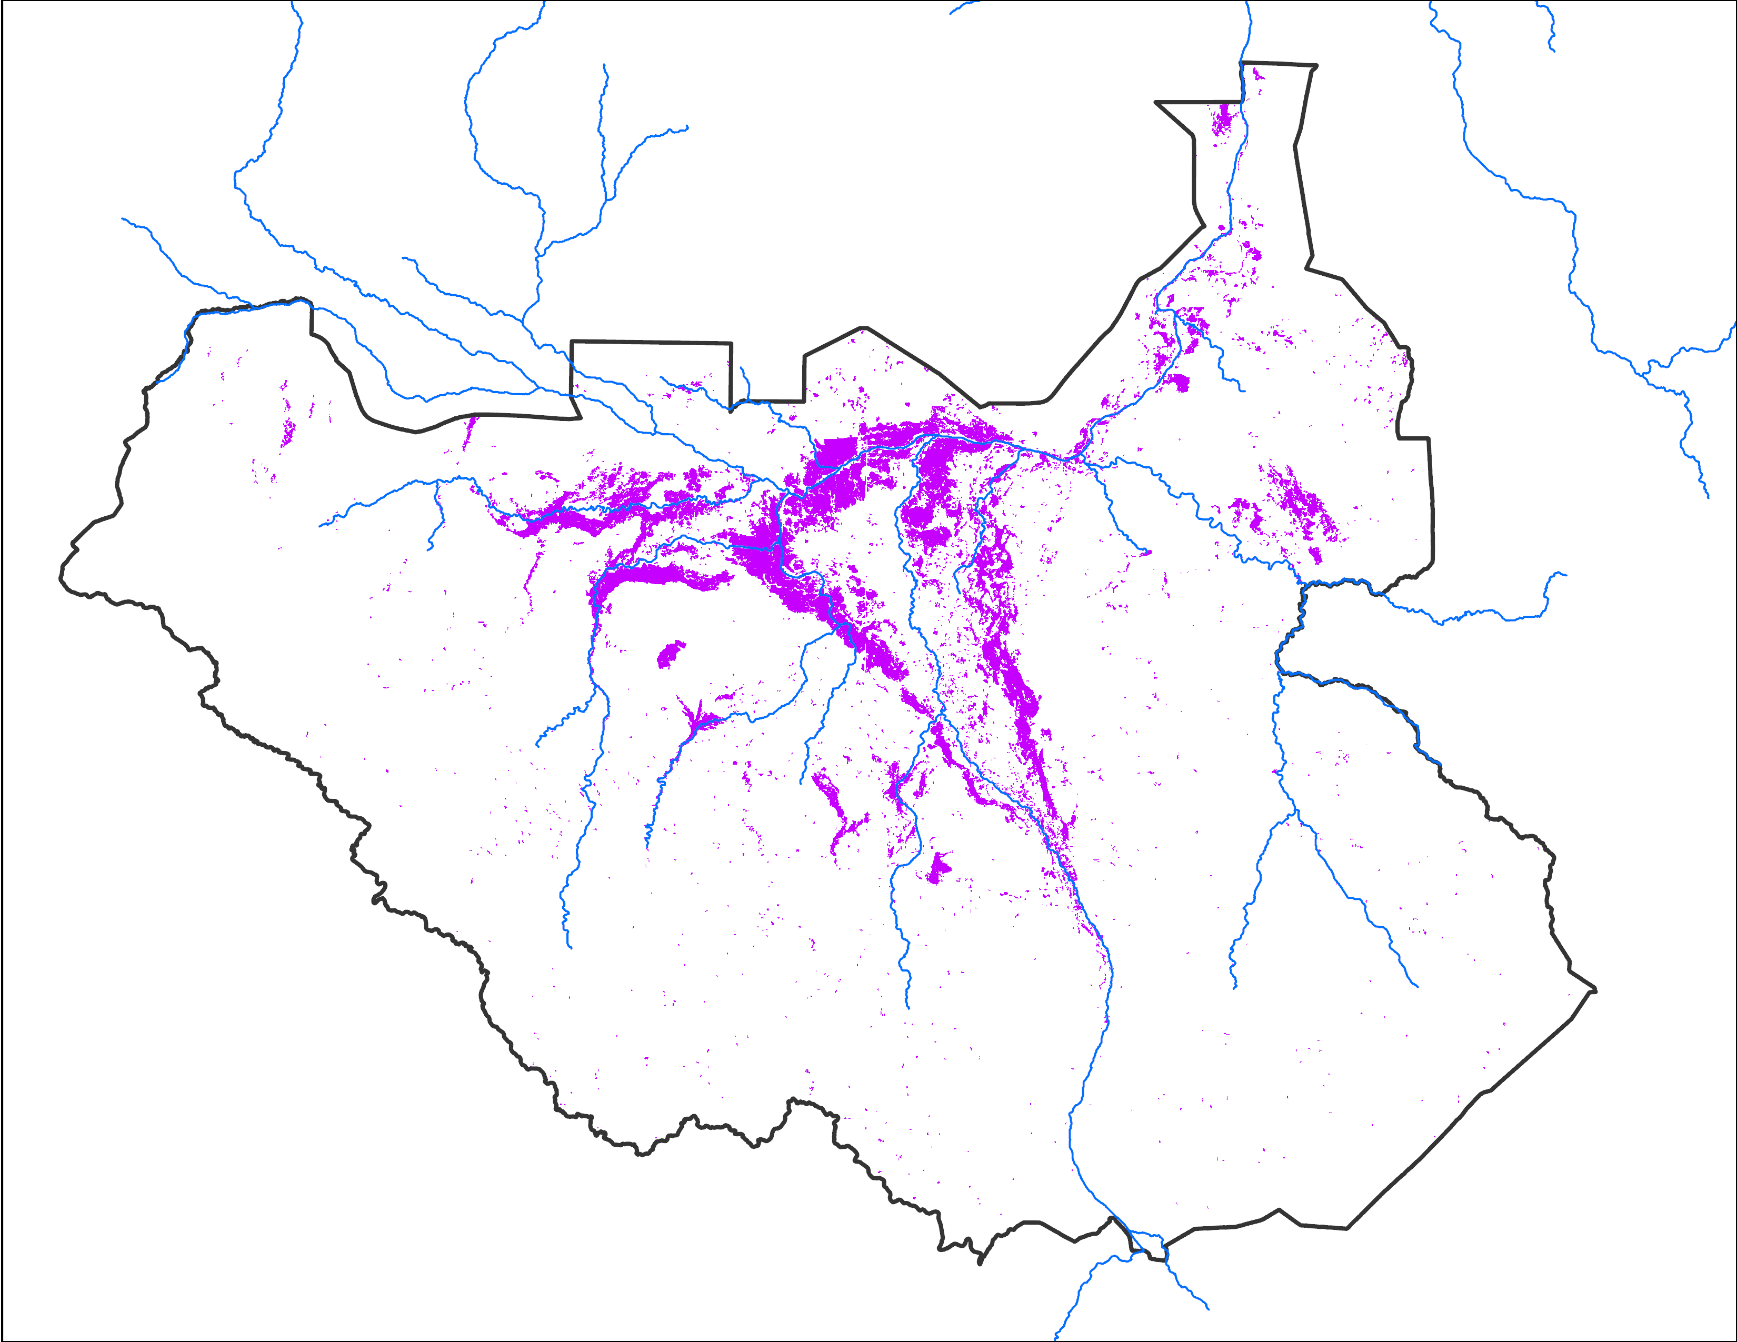
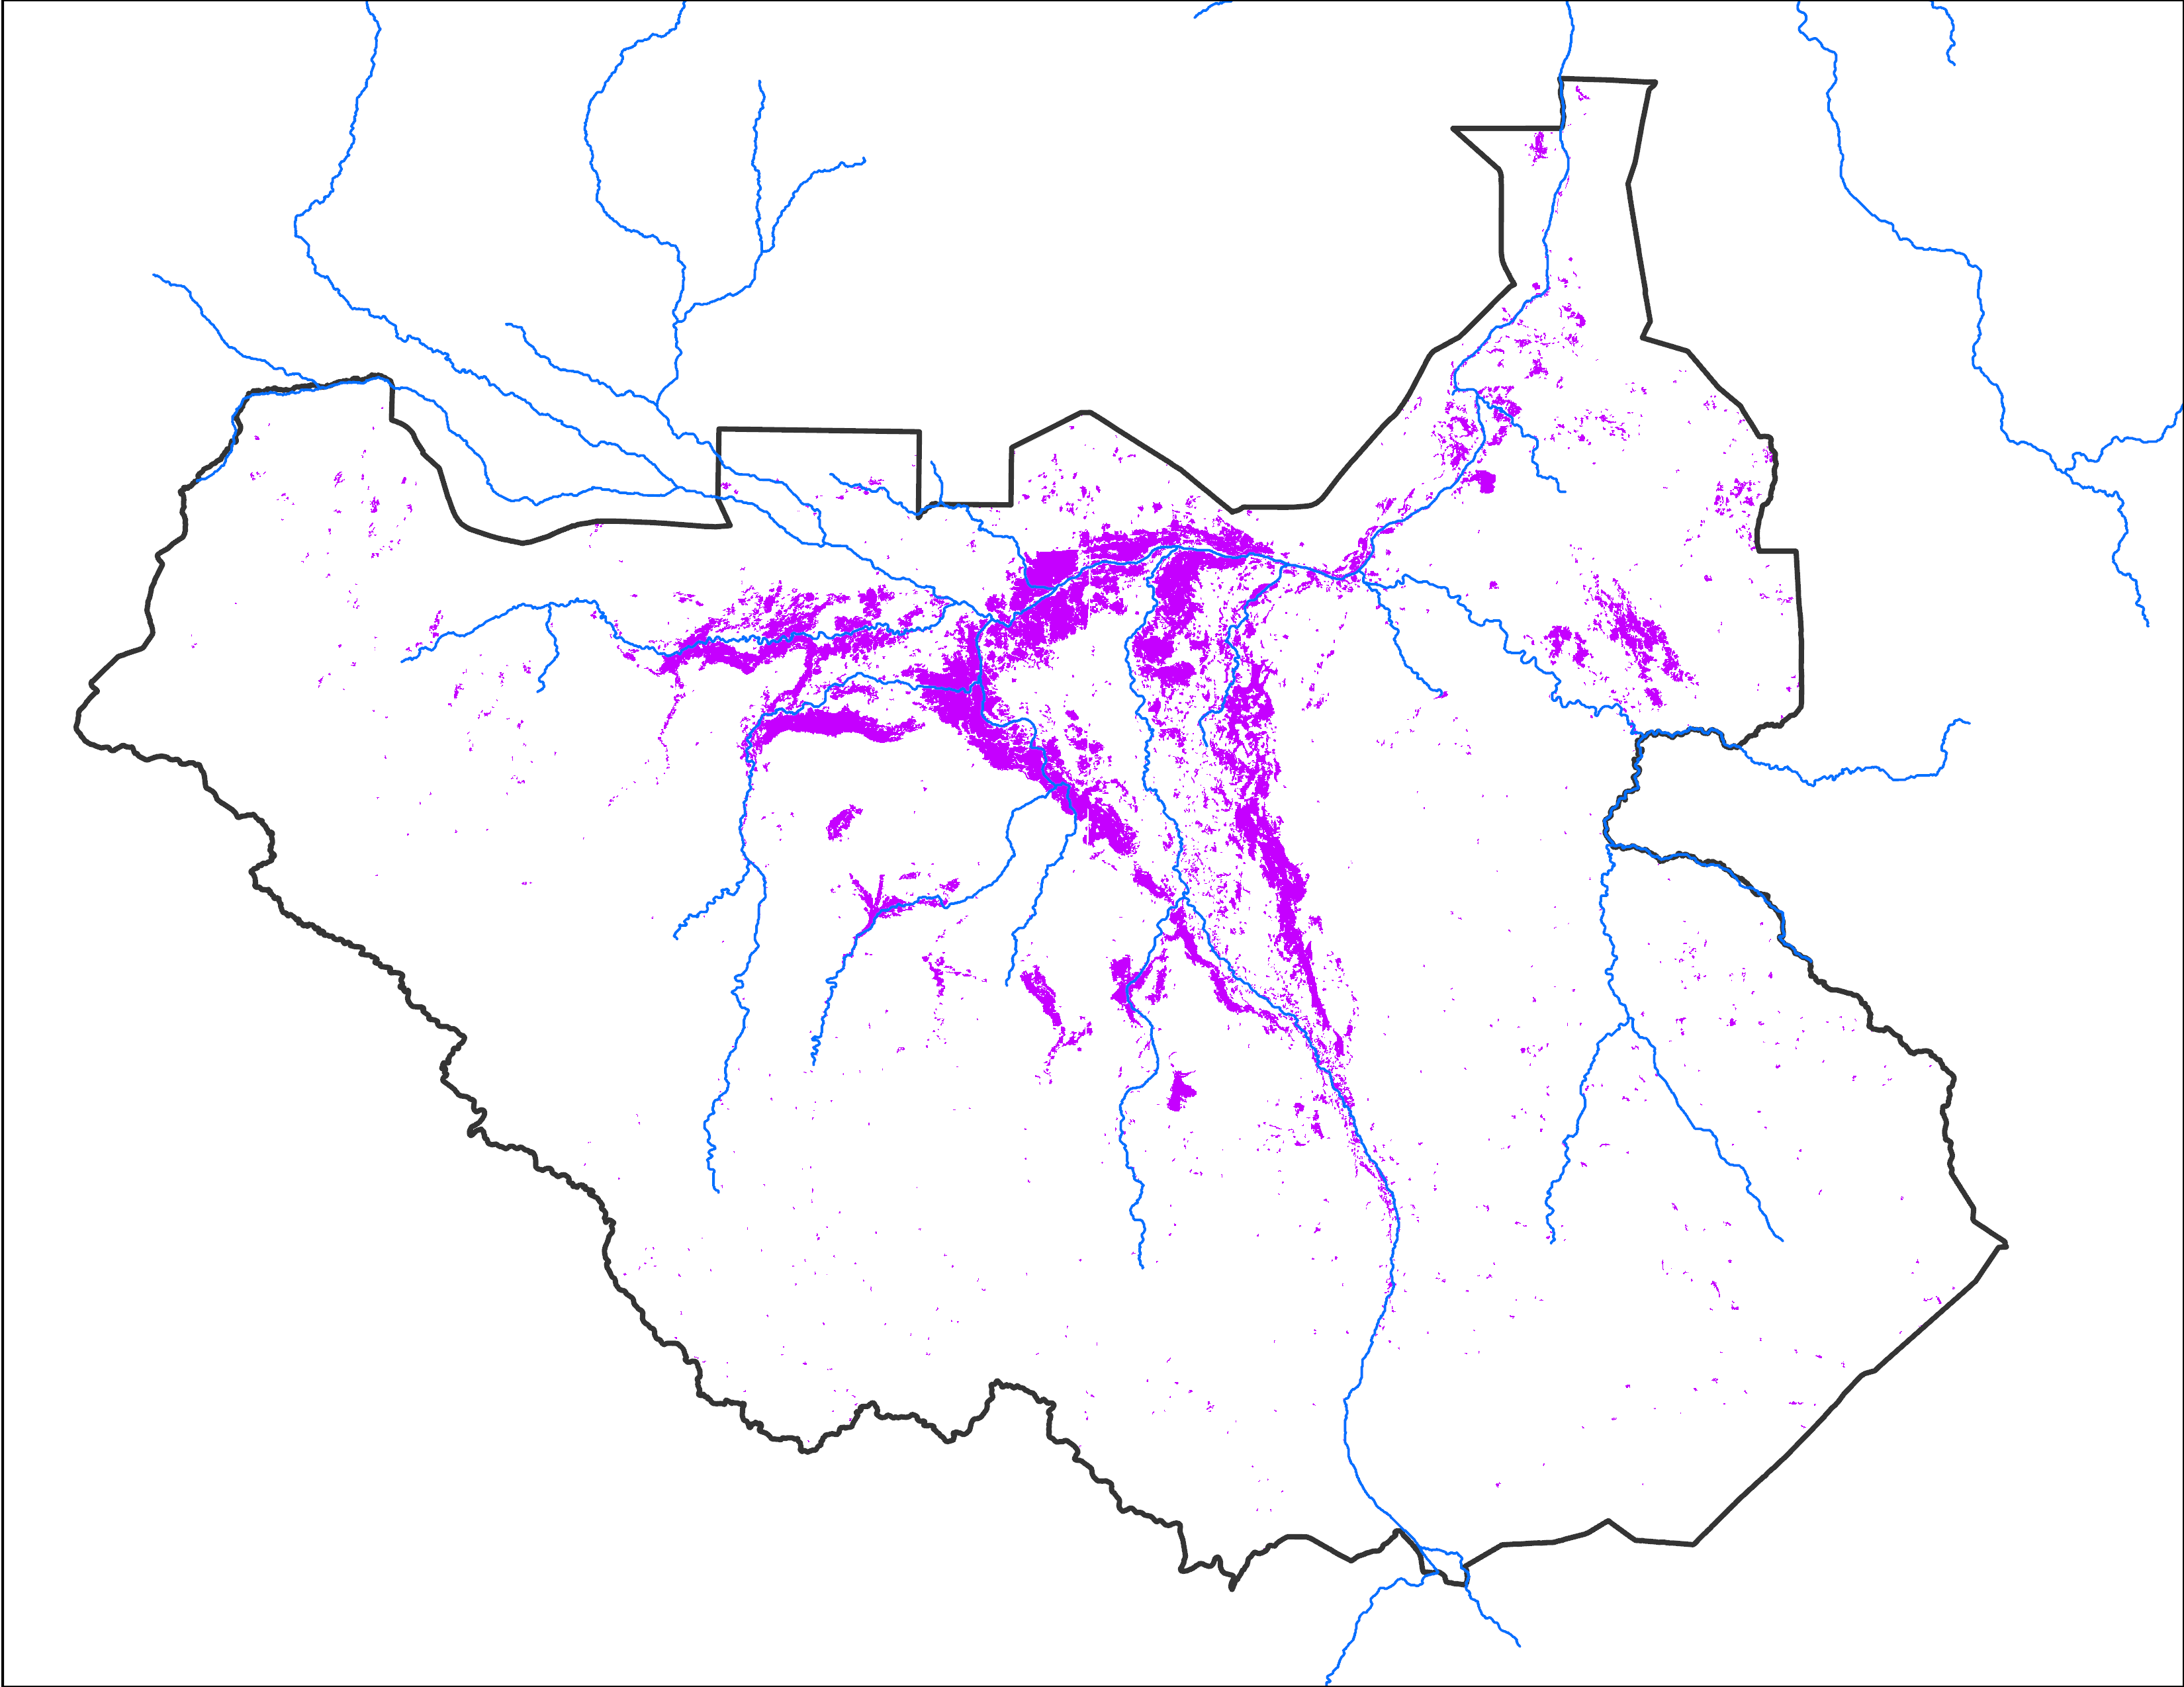
November 2024 Inundation
Nov 11 - 15, 2024
Nov 20 - 24, 2024
Nov 26 - 30, 2024
39,180 km²
35,564 km²
34,986 km²

Slide 6
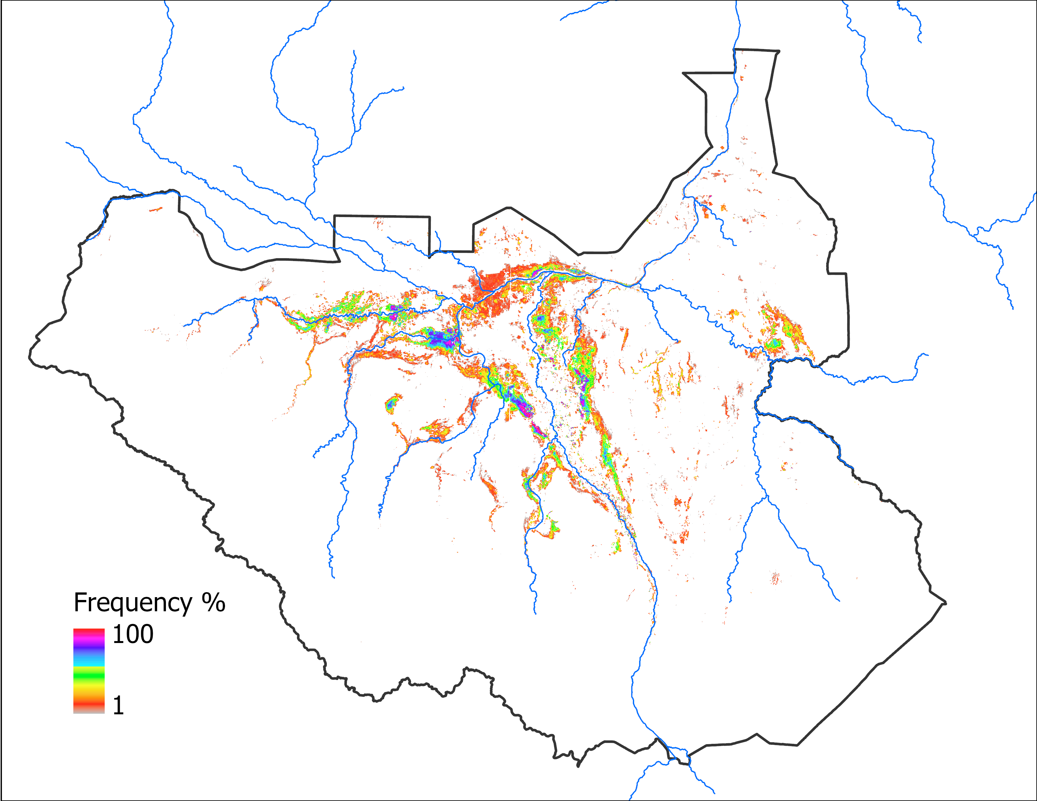
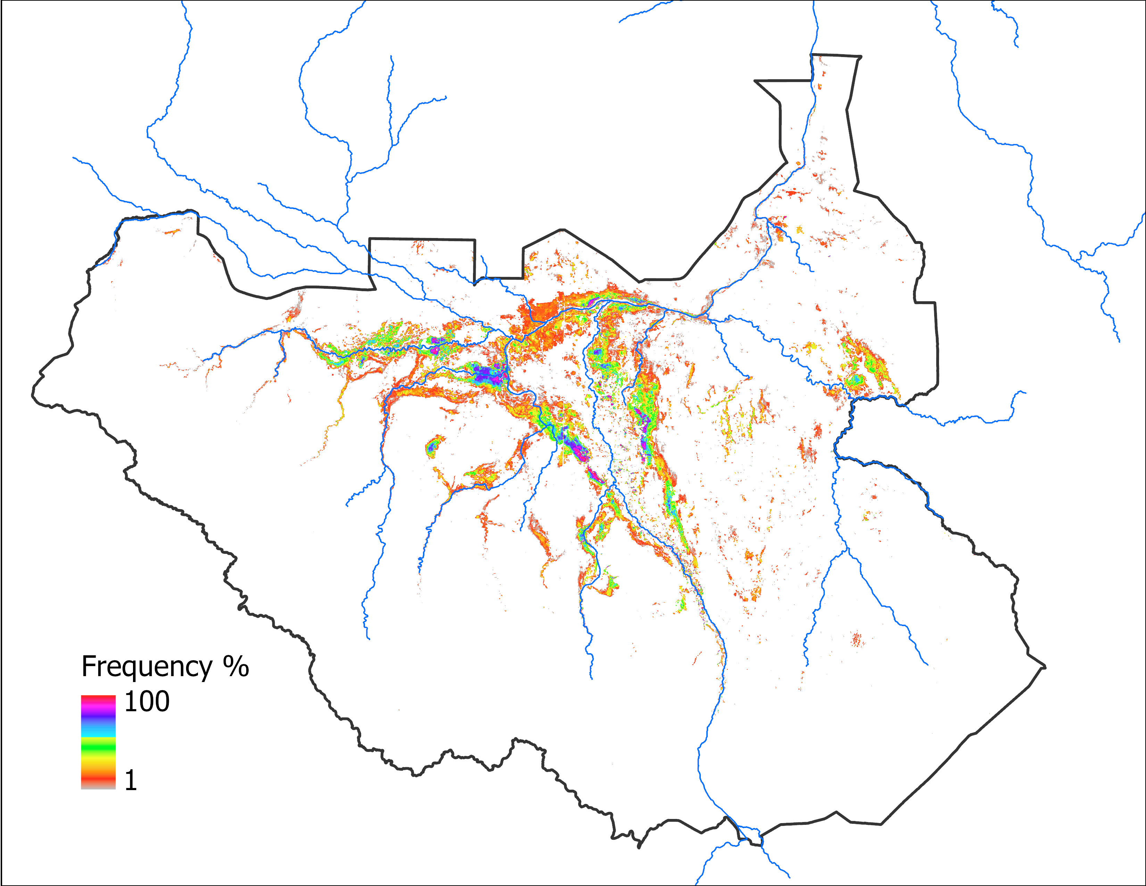
Predicted Flooding Update
Observed Nov 2024
Predicted Nov 2024 with OCT IC
Predicted Nov 2024 with OCT IC
52,945 km²
42,469 km²
Based on 2022 analog year
52,734 km²
Based on LASSO

Slide 7
Thank you

