Slide 1
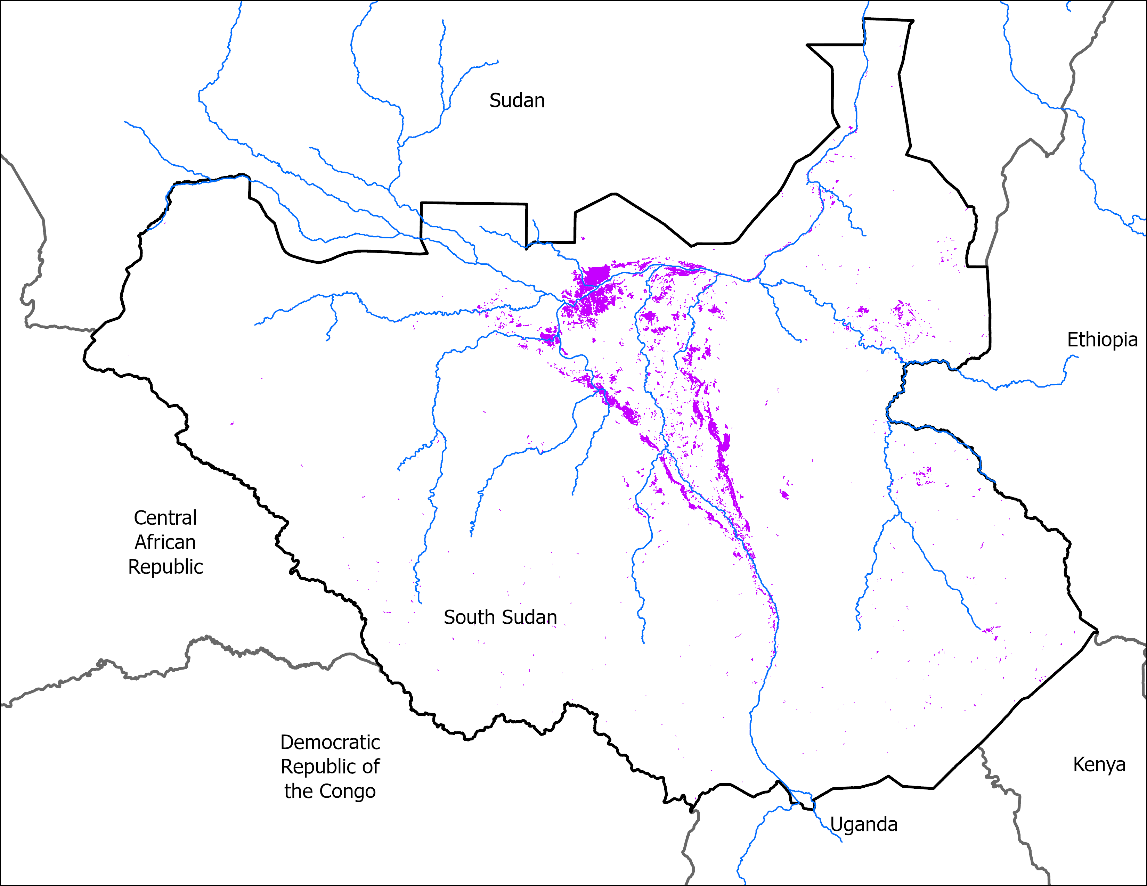
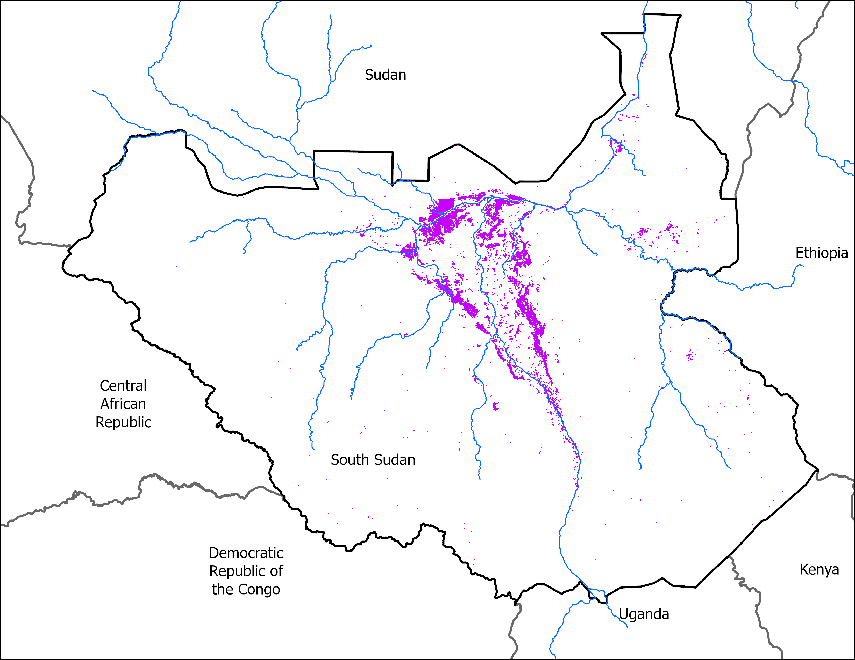
May Initial Conditions
End of May 2024
End of May 2025
VIIRS : 11,907 km²
VIIRS: 14,883 km²
By the End of May 2025, there are slightly more area under water than the same in 2024.

Slide 2
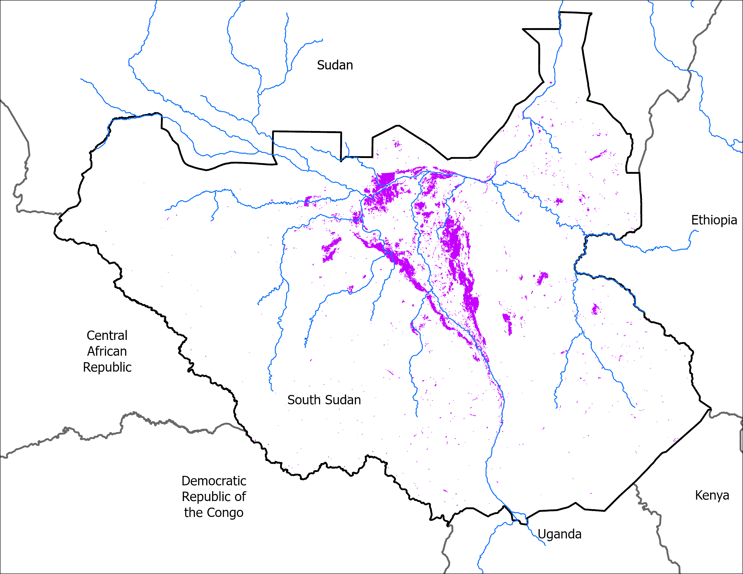
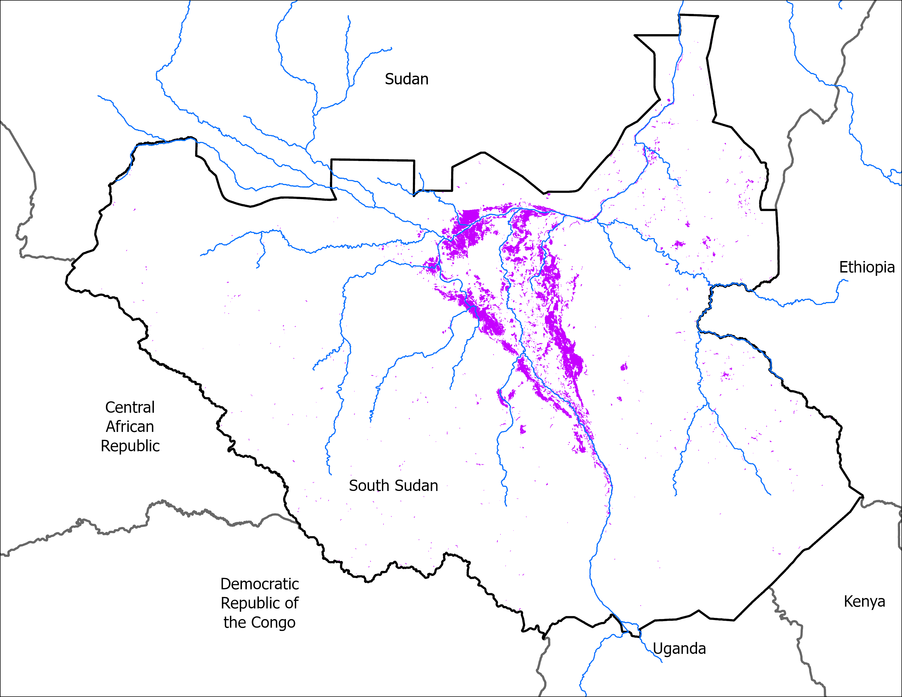
June Initial Conditions
End of Jun 2024
End of Jun 2025
VIIRS : 18,921 km²
VIIRS: 18,704 km²
By the End of June, flooded areas were very much the same both in 2024 and 2025.

Slide 3
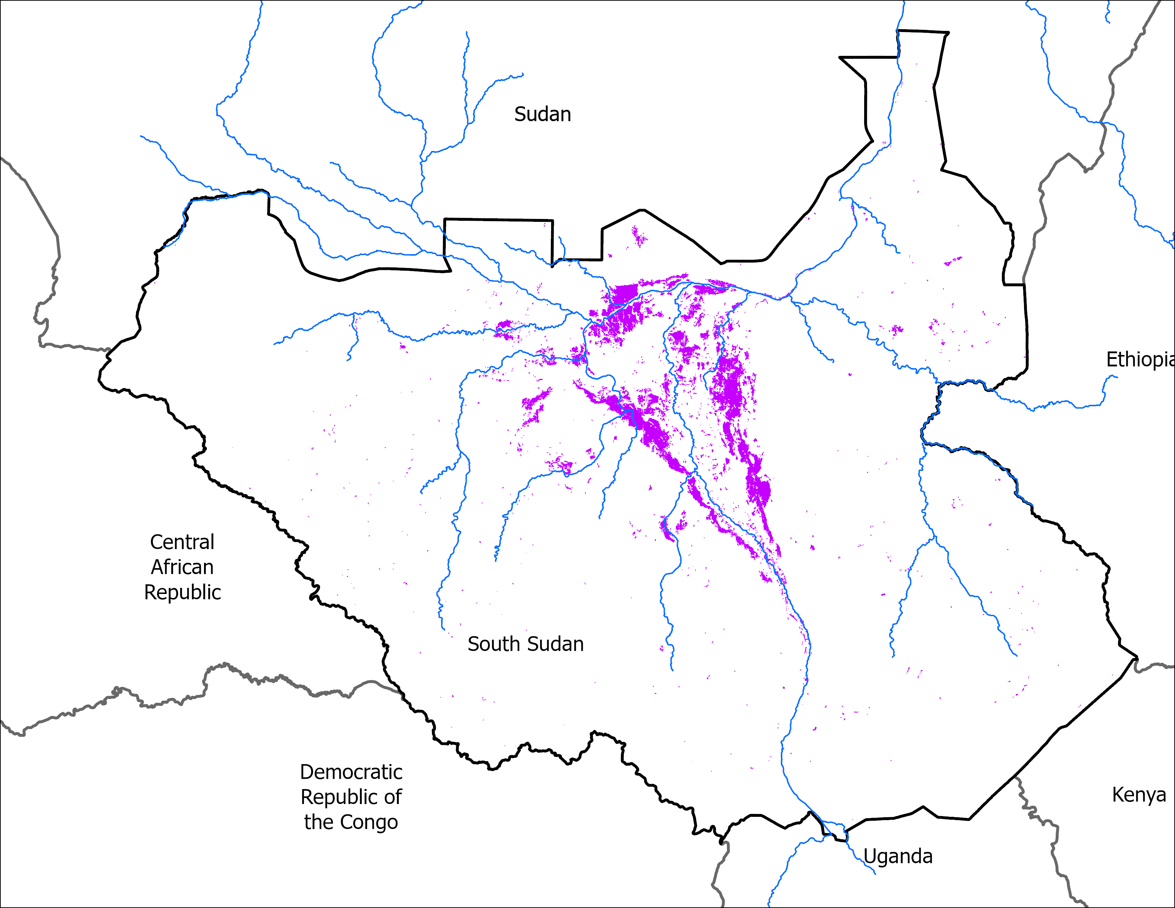
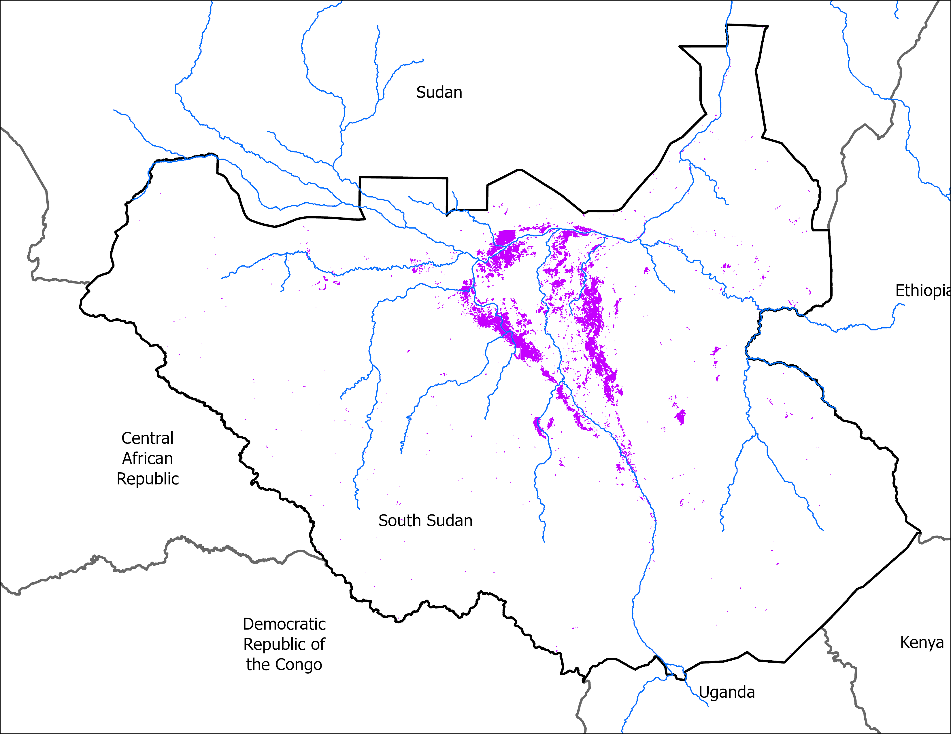
July Initial Conditions
Mid Jul 2024
Mid Jul 2025
VIIRS : 16,929 km²
VIIRS: 15,772 km²
Mid July 2025 flooded area is slightly lower than the flooded area during the same time in 2024.

Slide 4
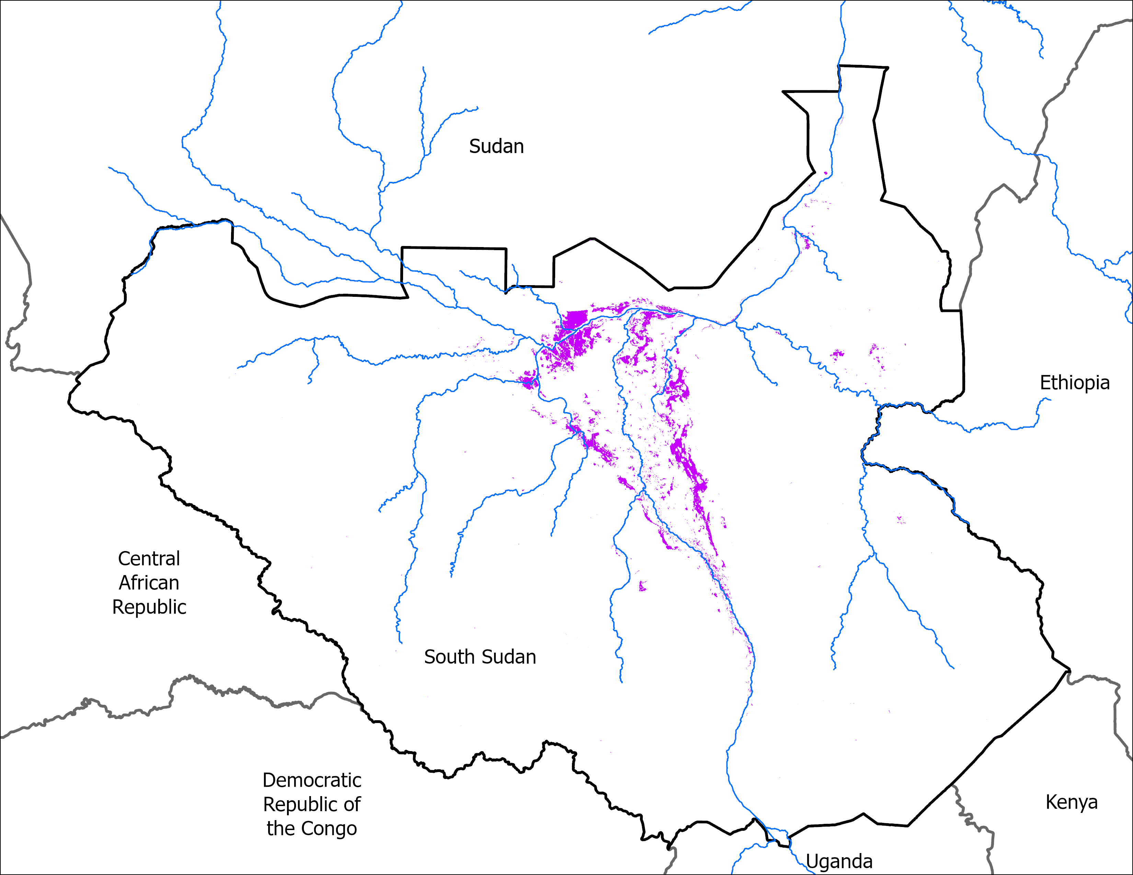
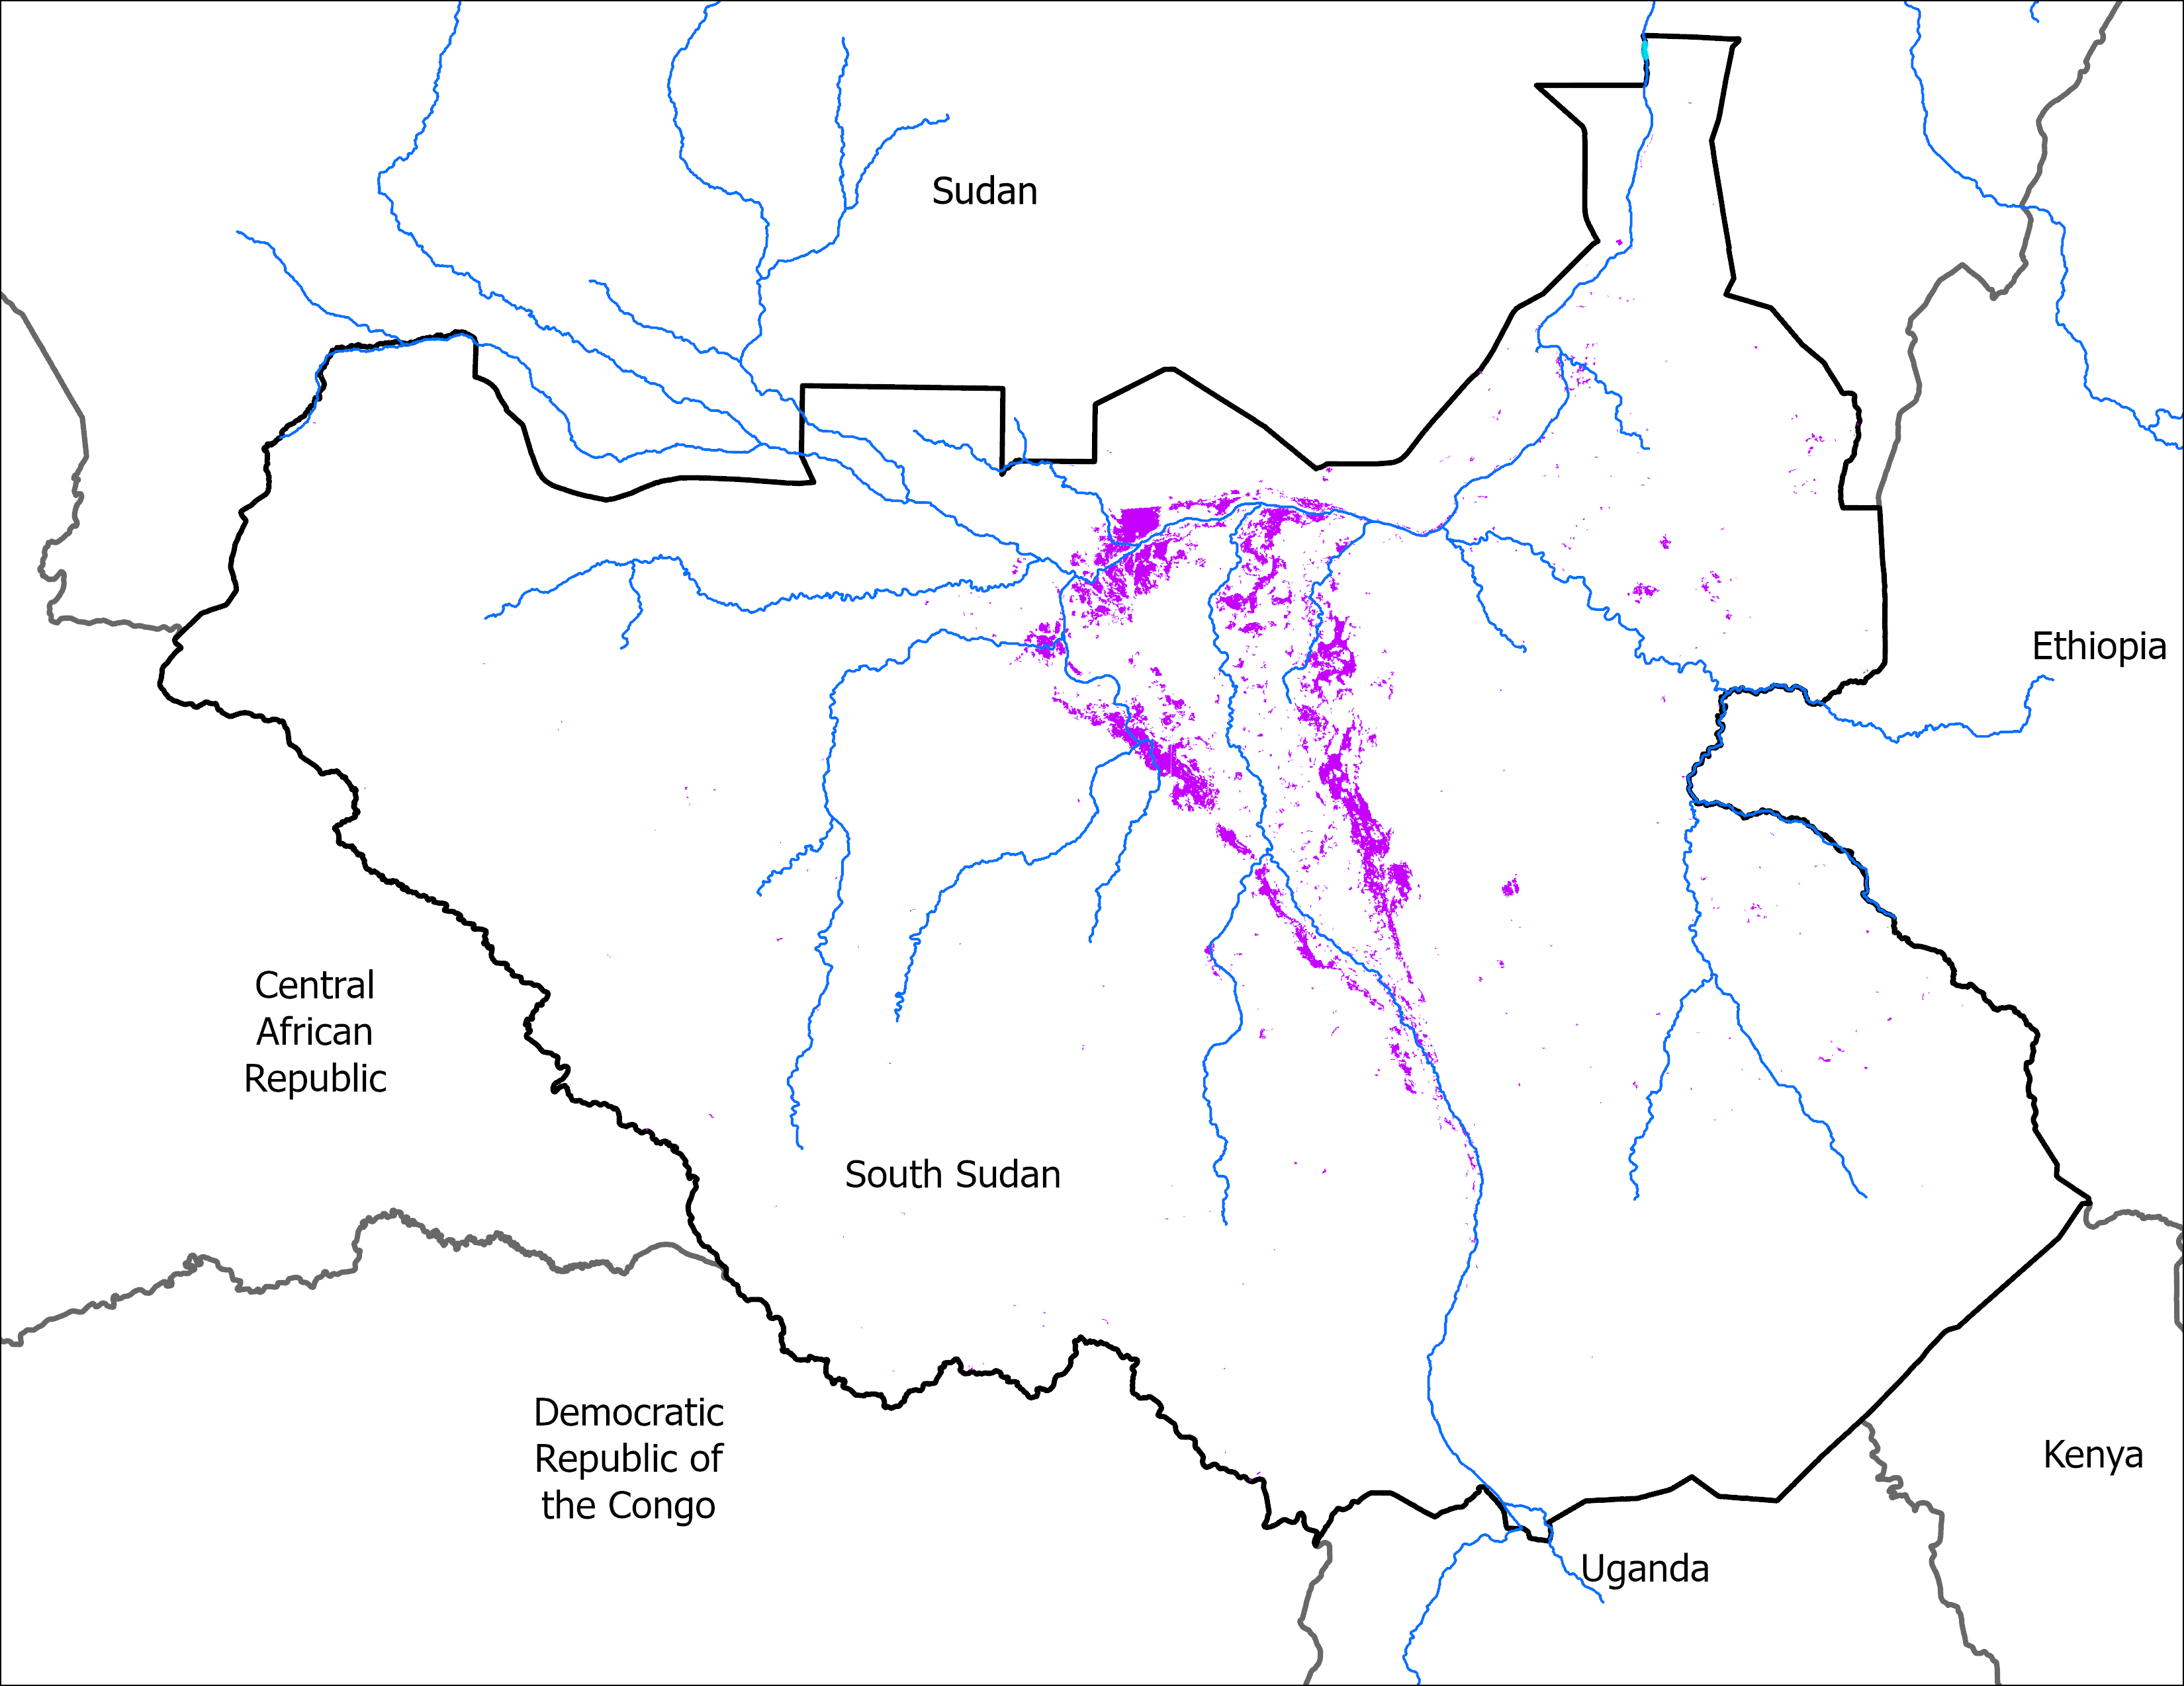
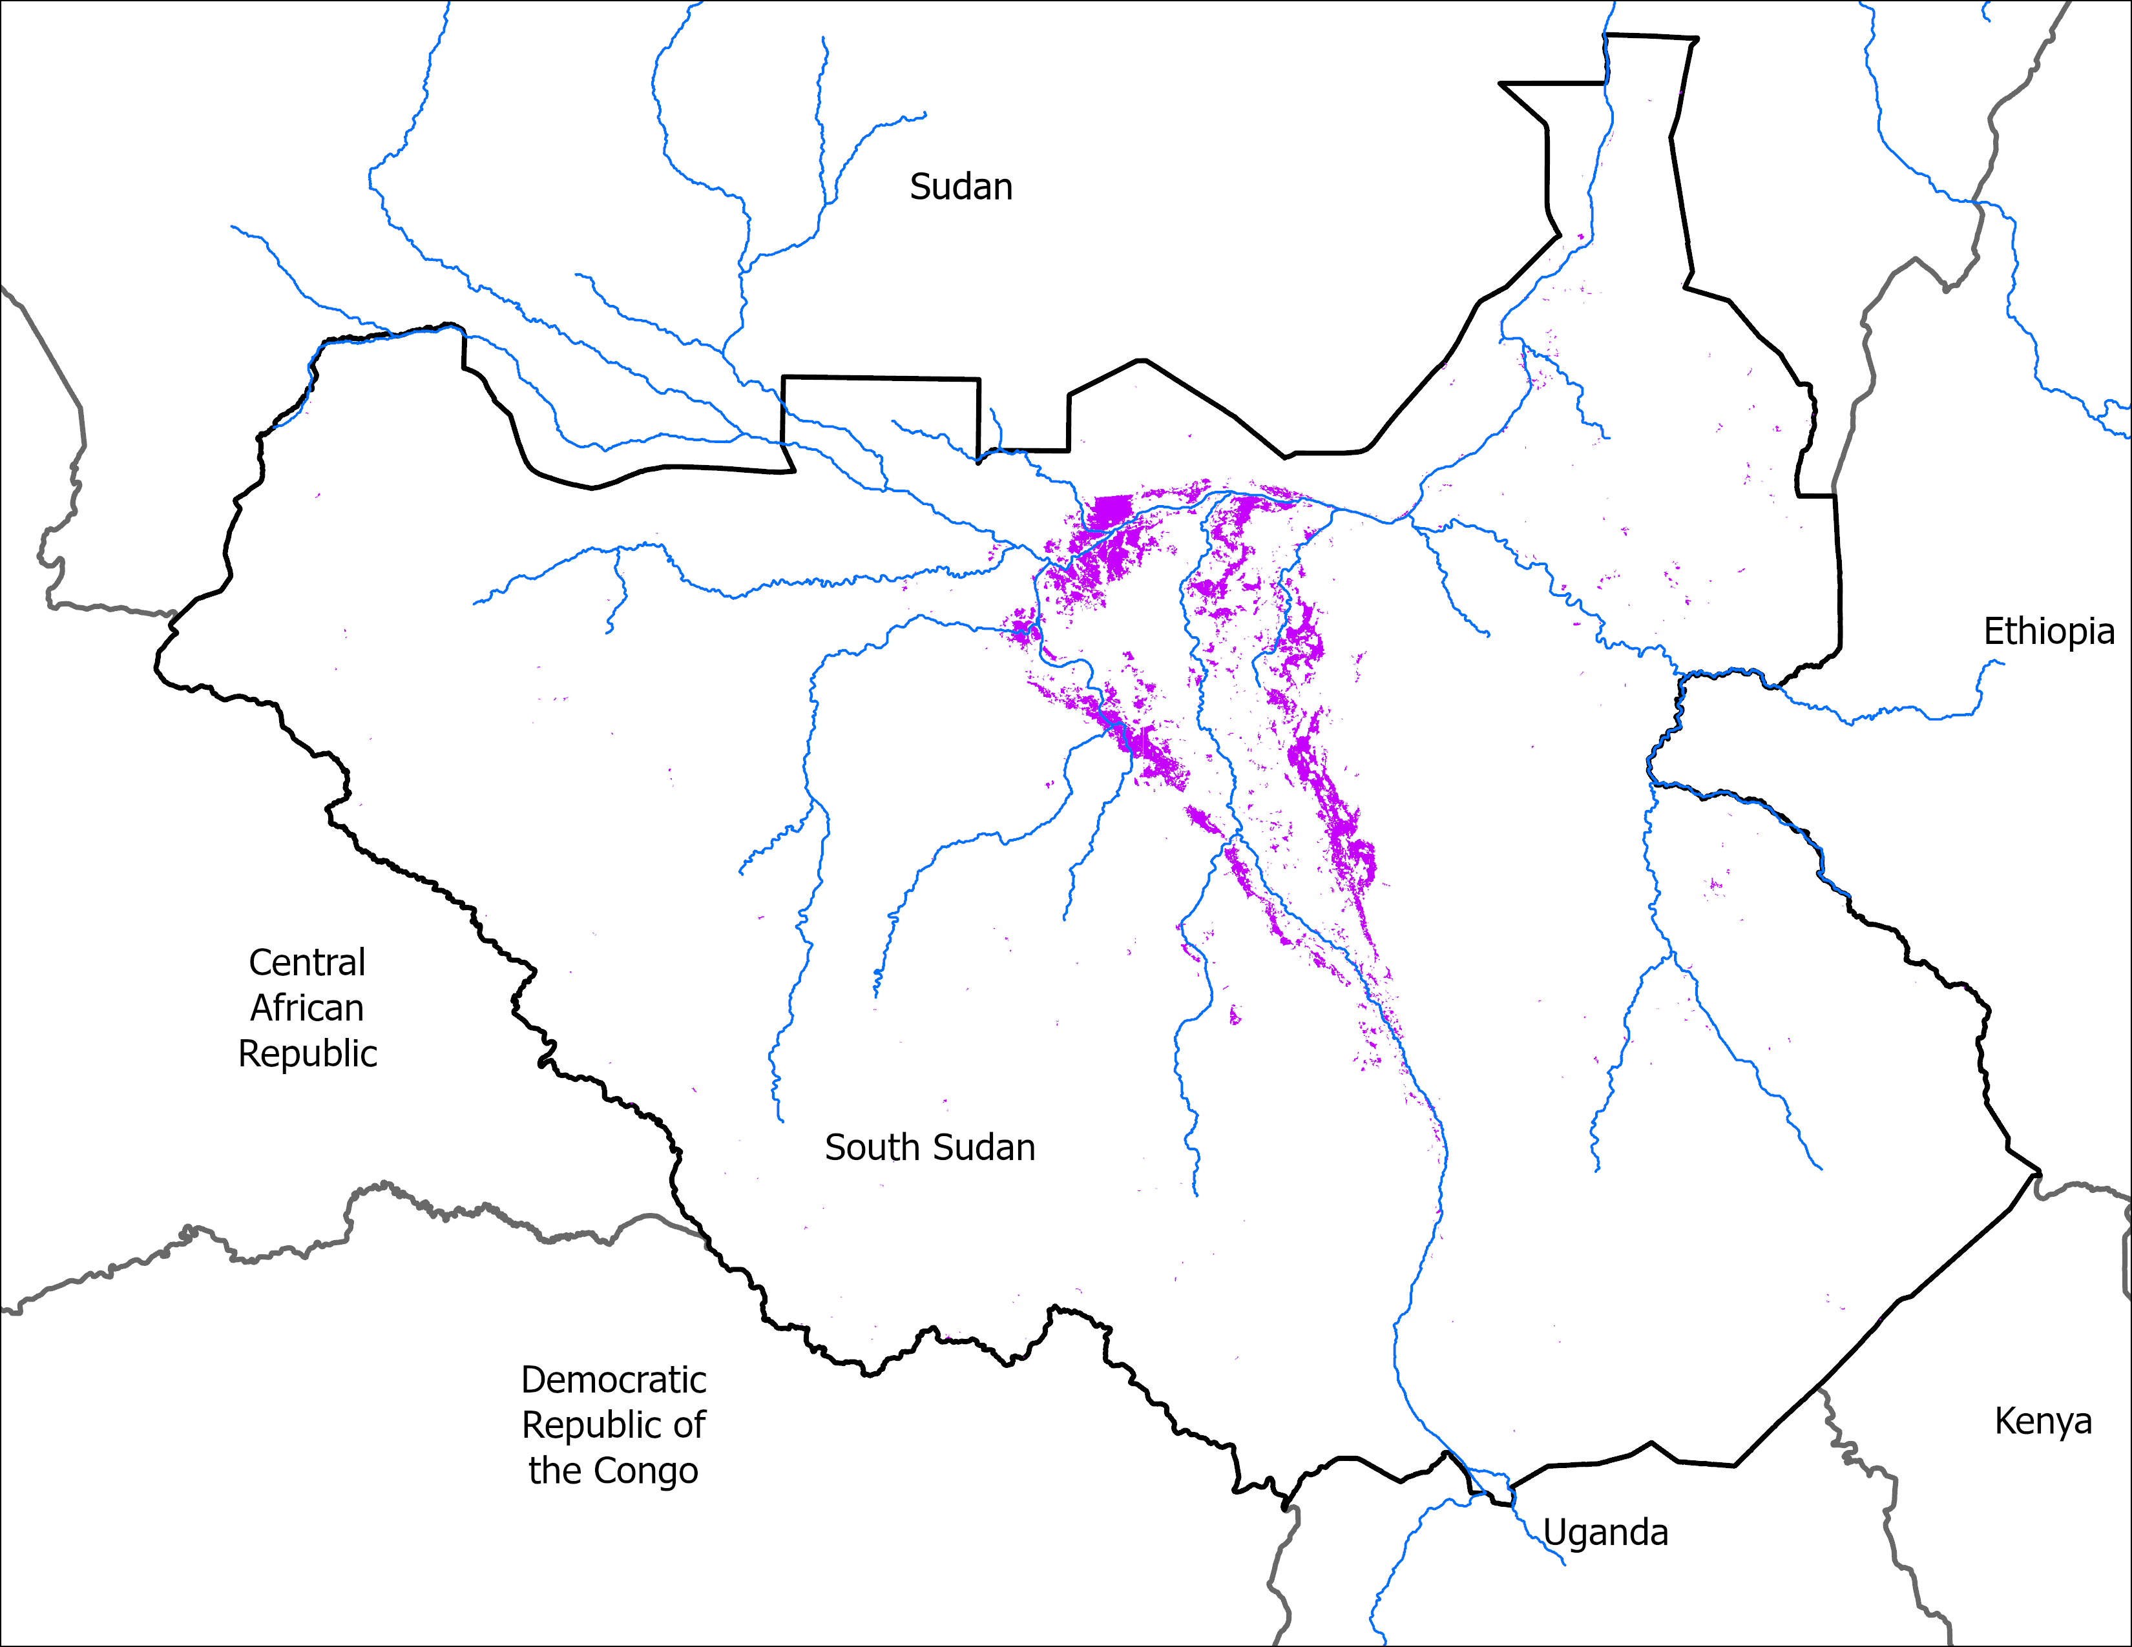
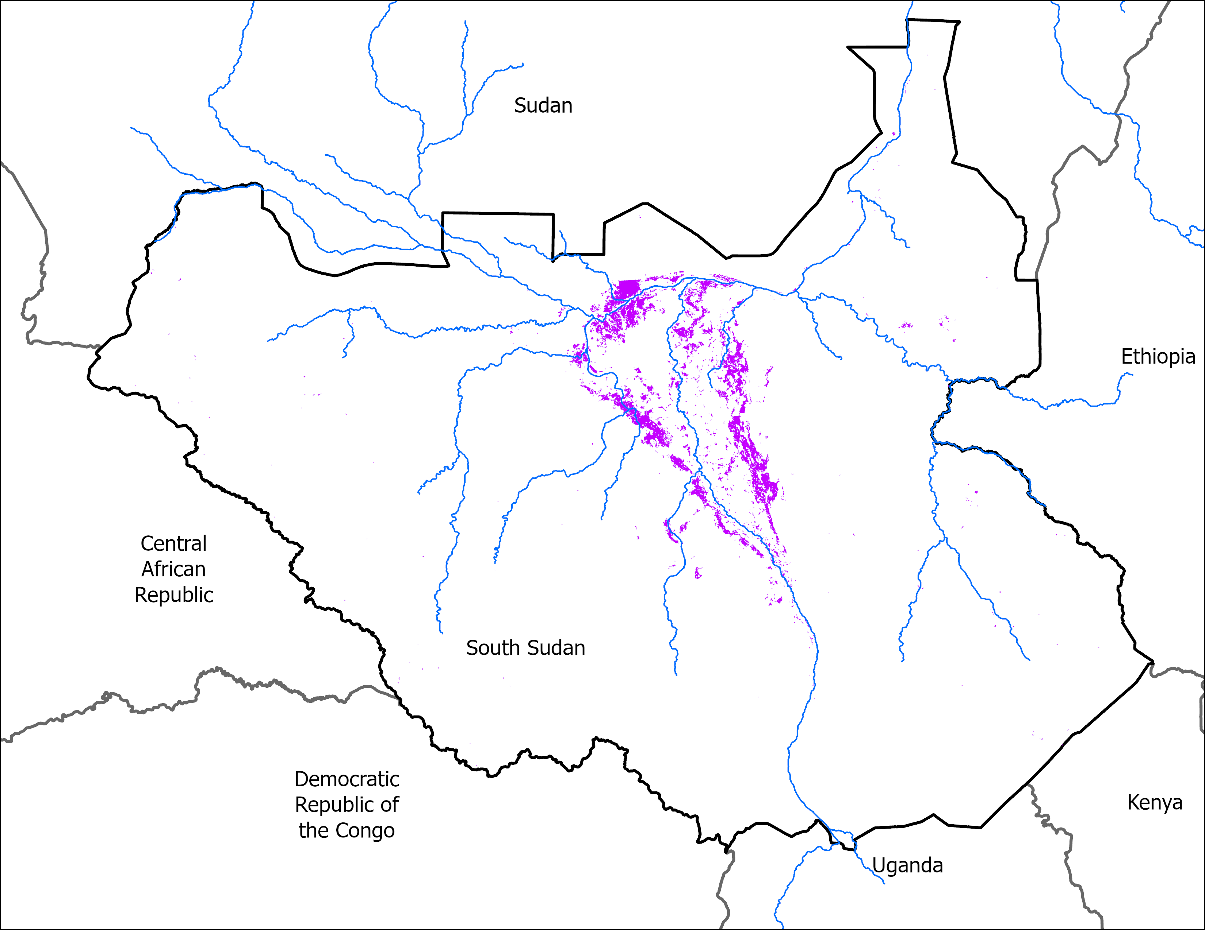
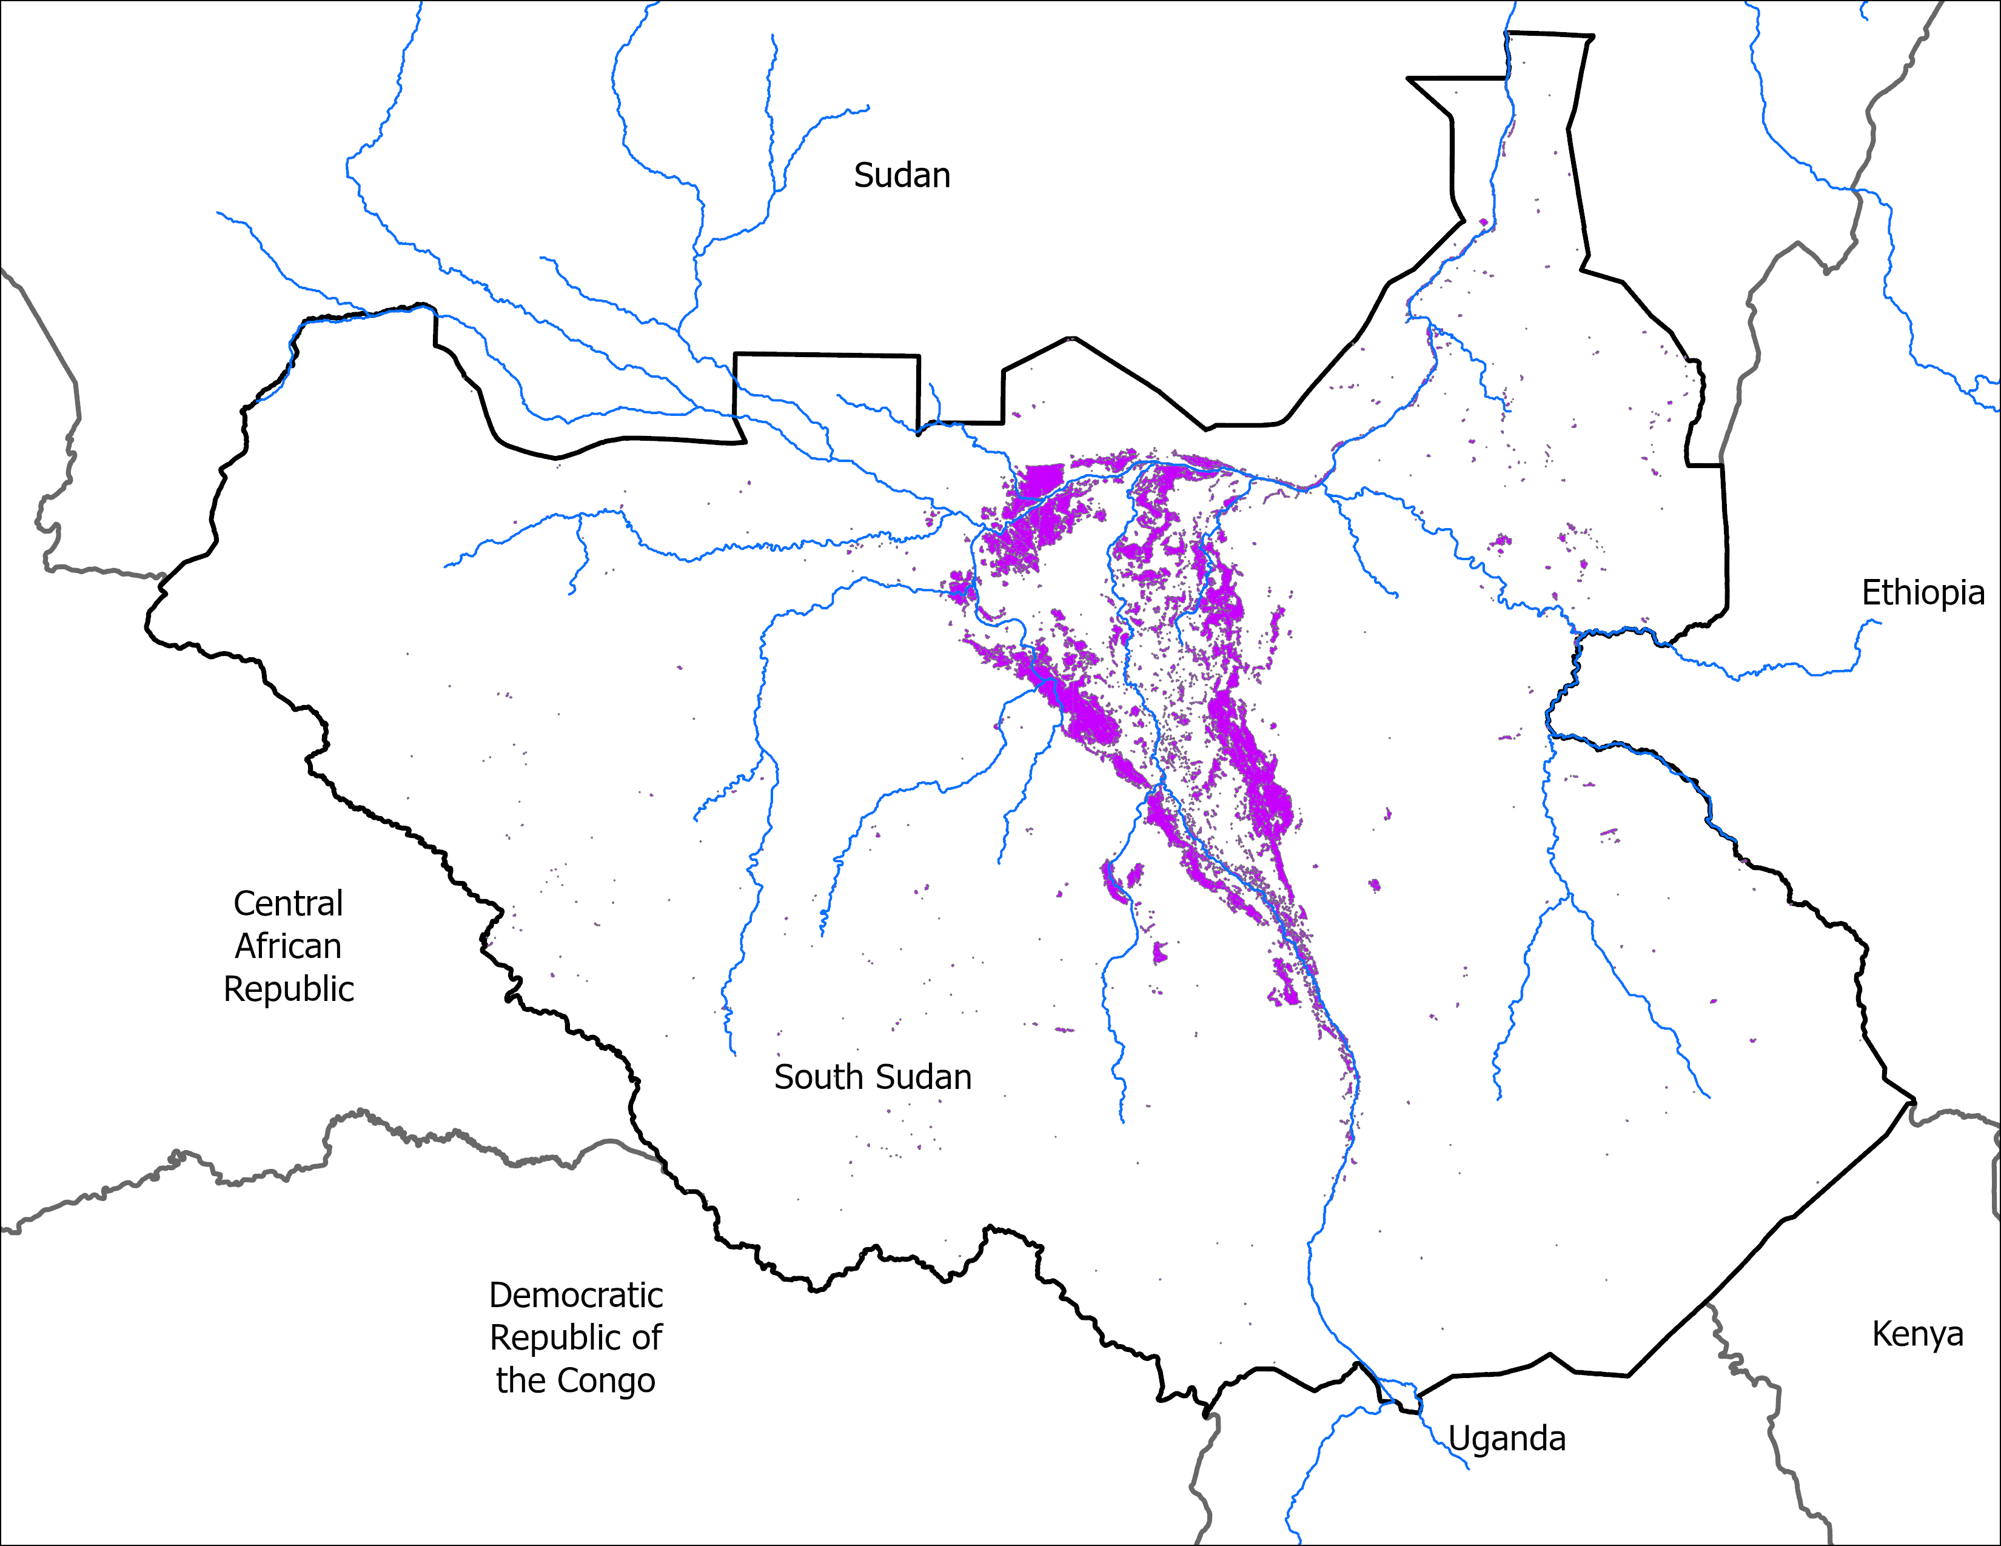
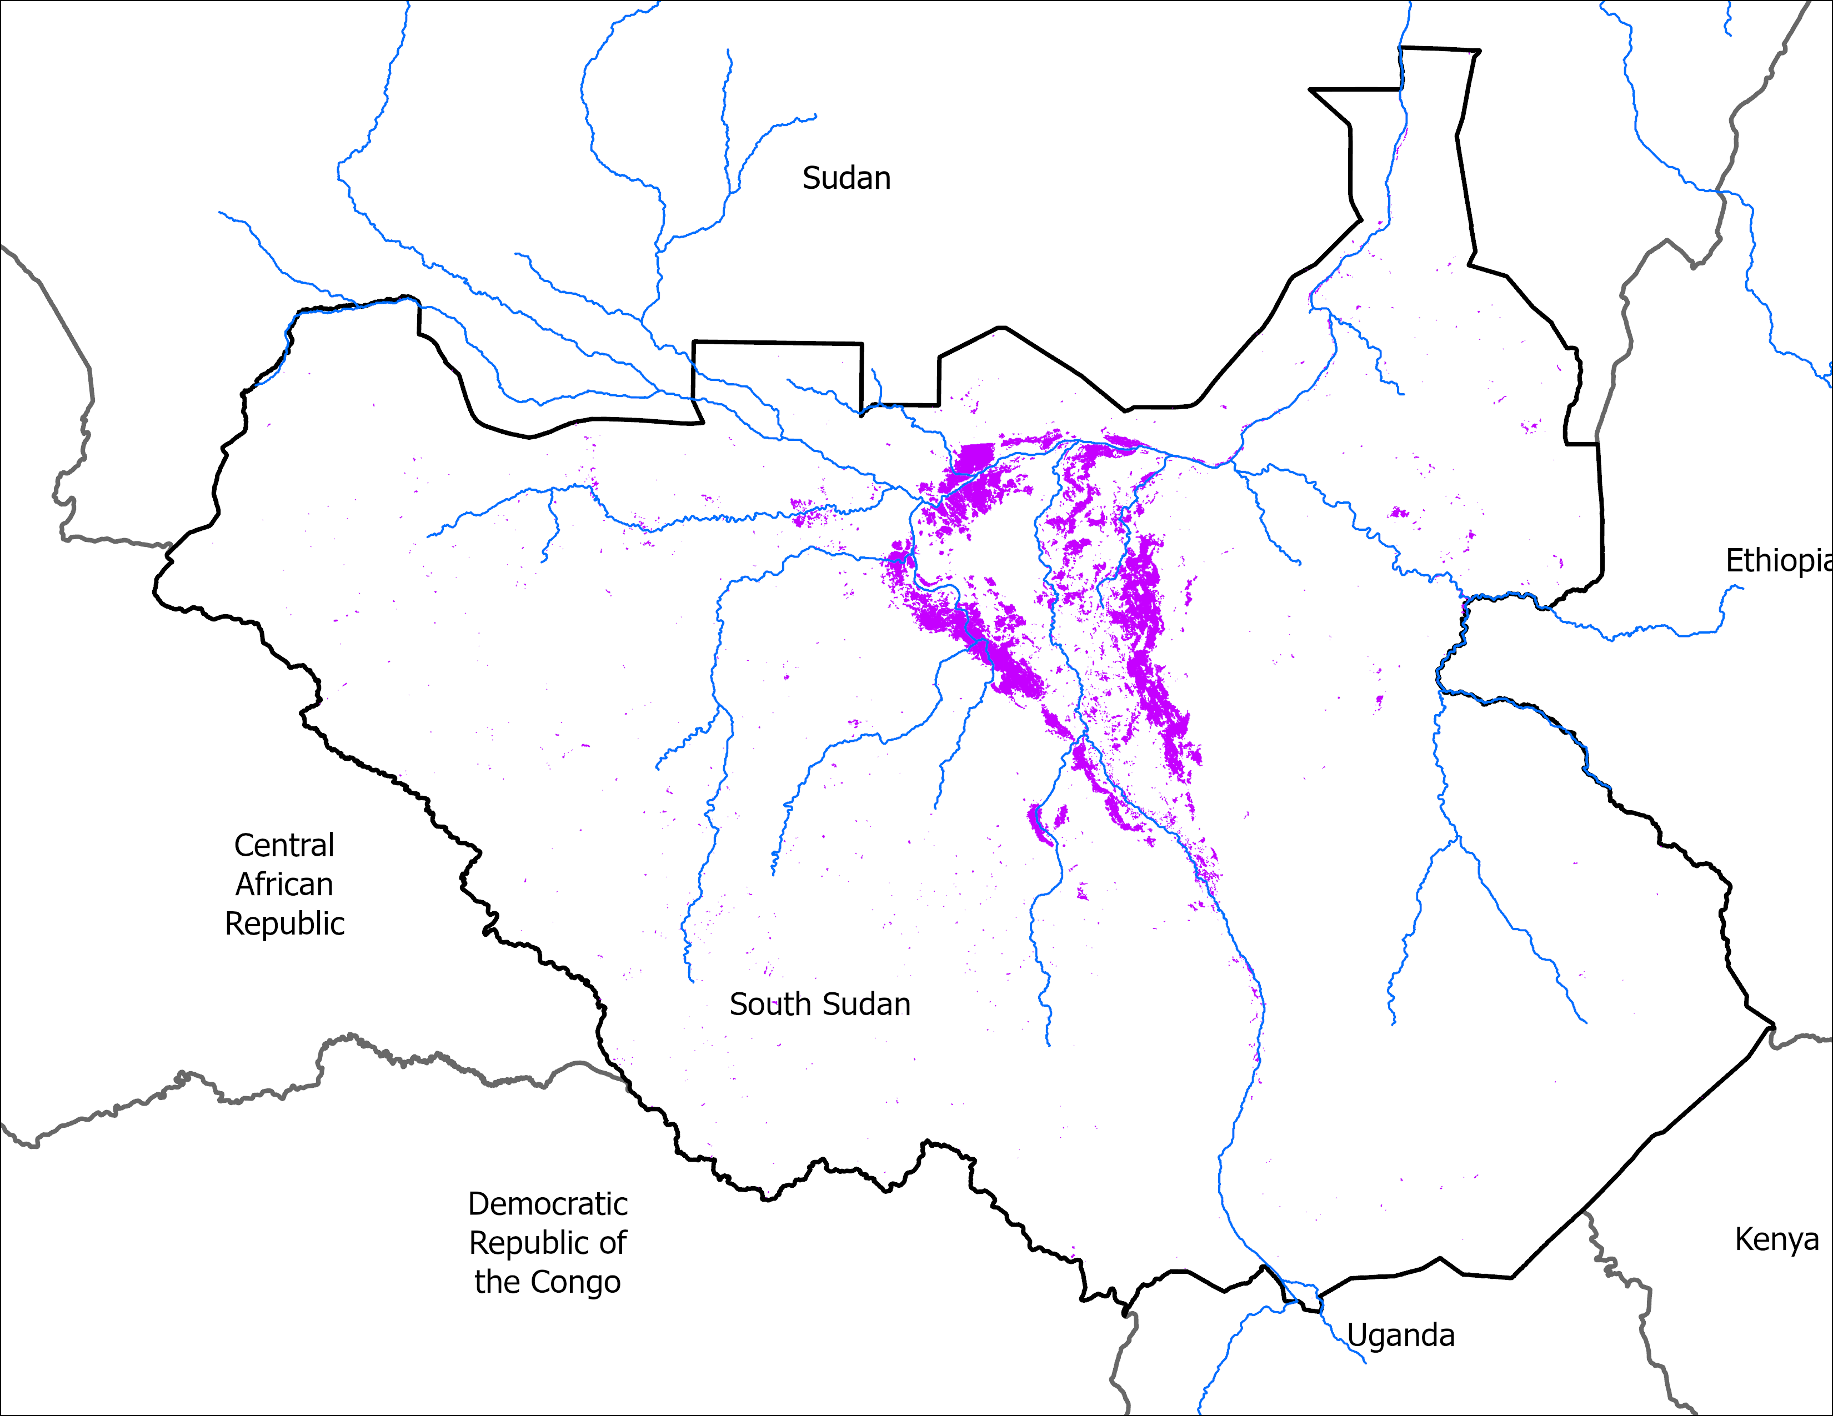

Flooding Progression
04-08 May: 9,860 km²
06-10 Jun: 11,790 km²
11-15 Jun: 11,360 km²
18-22 Jun: 11,100 km²
25-29 Jun: 13,870 km²
3-7 Jul: 14,370 km²
9-13 Jul: 14,620 km²

Slide 5
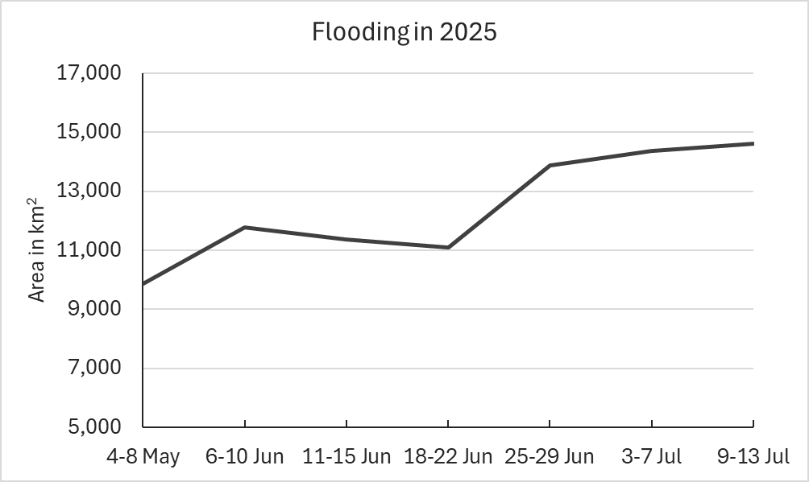
Flooding in 2025

