Slide 1
South Sudan Flood Monitoring and Prediction - 2025 Season
FEWS NET Science Team
April 30, 2024

Slide 2
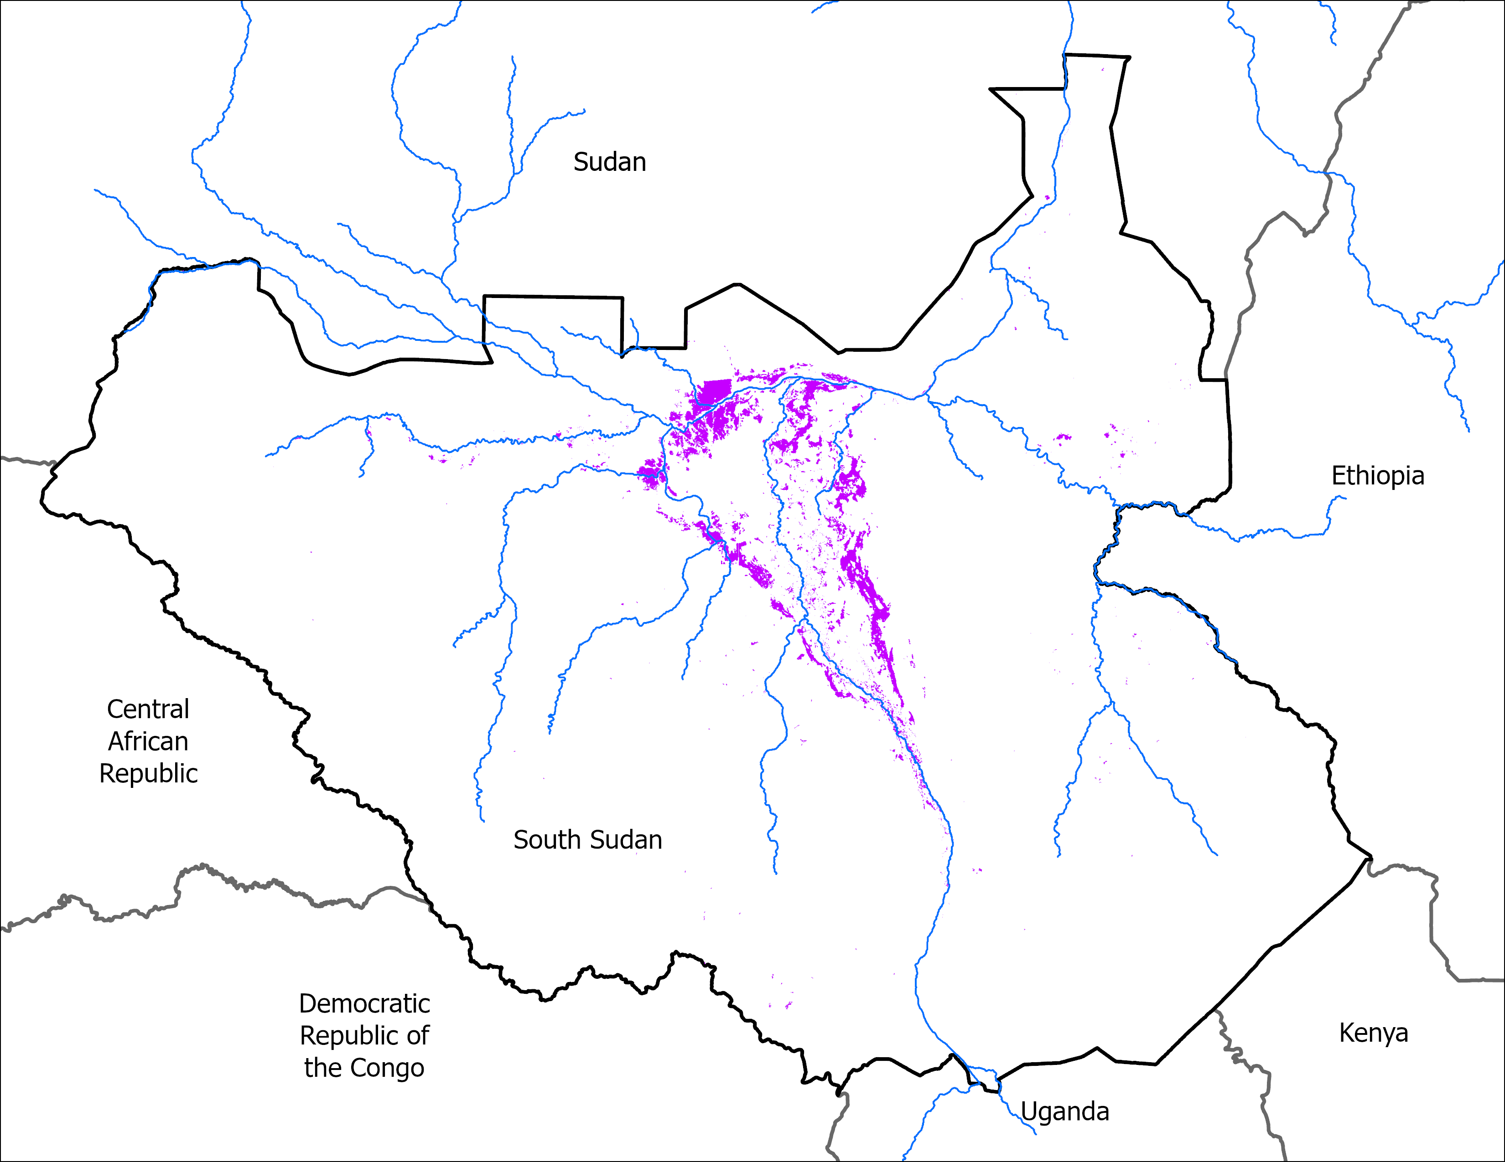
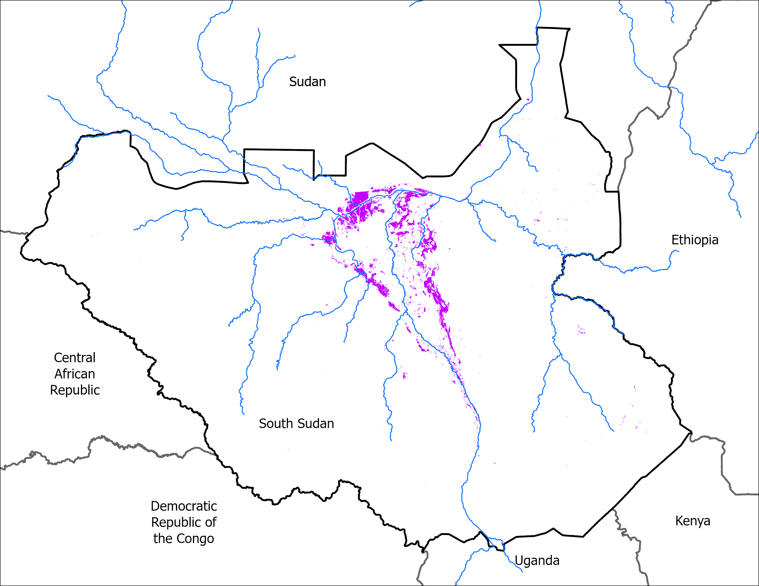
Flooding Progression
6 April 2025
27 April 2025
VIIRS 2-6 April: 11,076 km²
VIIRS 23-27April comp: 10,162 km²

Slide 3
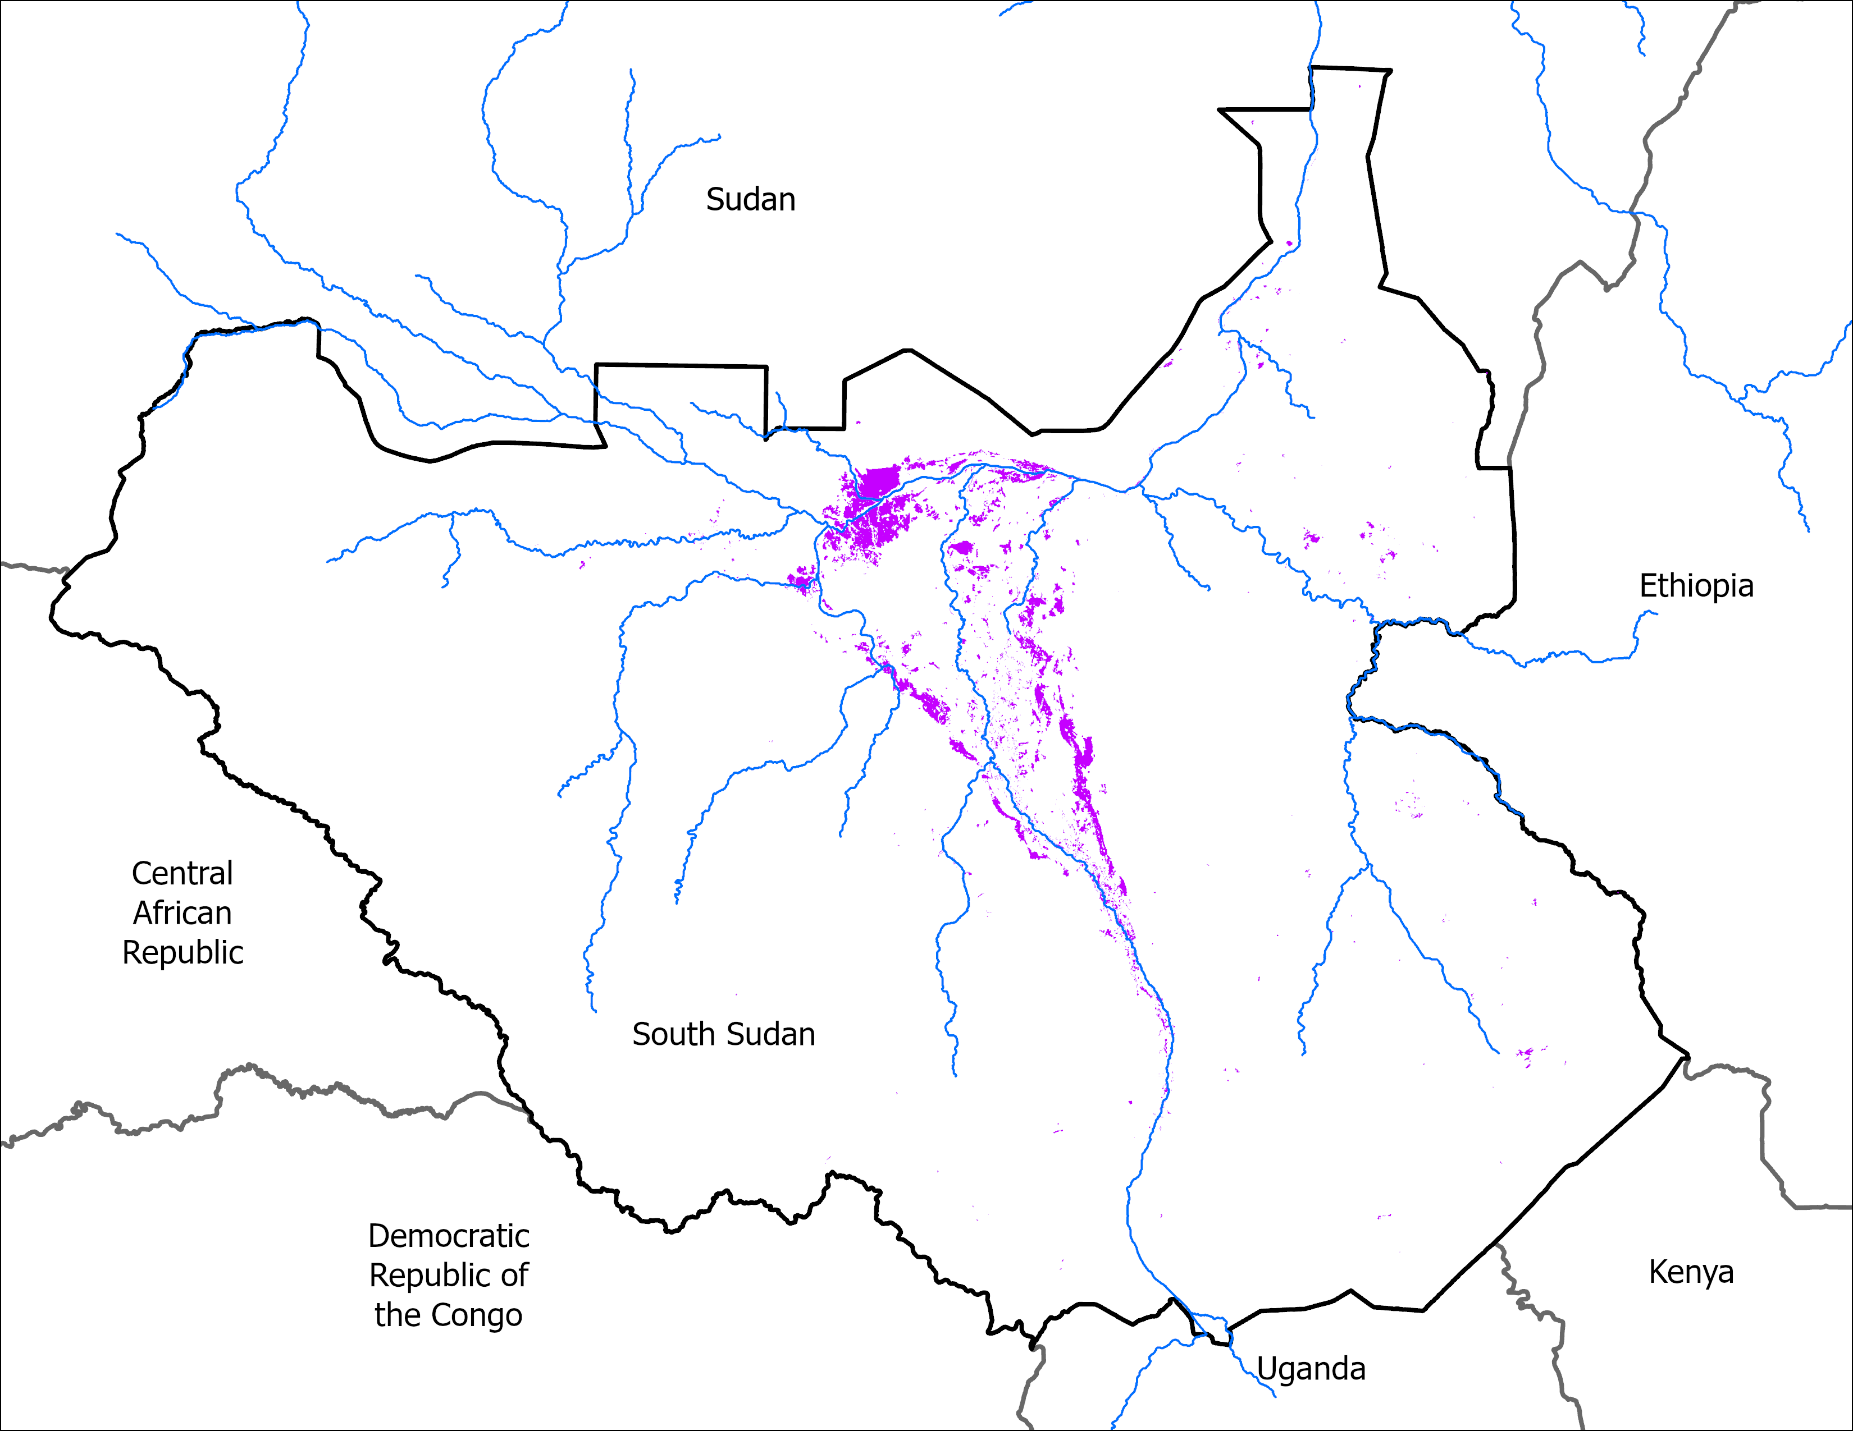
April Initial Conditions
28 April 2024
27 April 2025
VIIRS 24-28, 2024 : 8,995 km²
VIIRS 23-27, 2025 Apr comp: 10,162 km²
Very similar flooding condition in 2025 compared to flooding in 2024 for the month of April.

Slide 4
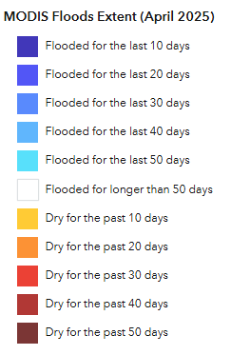
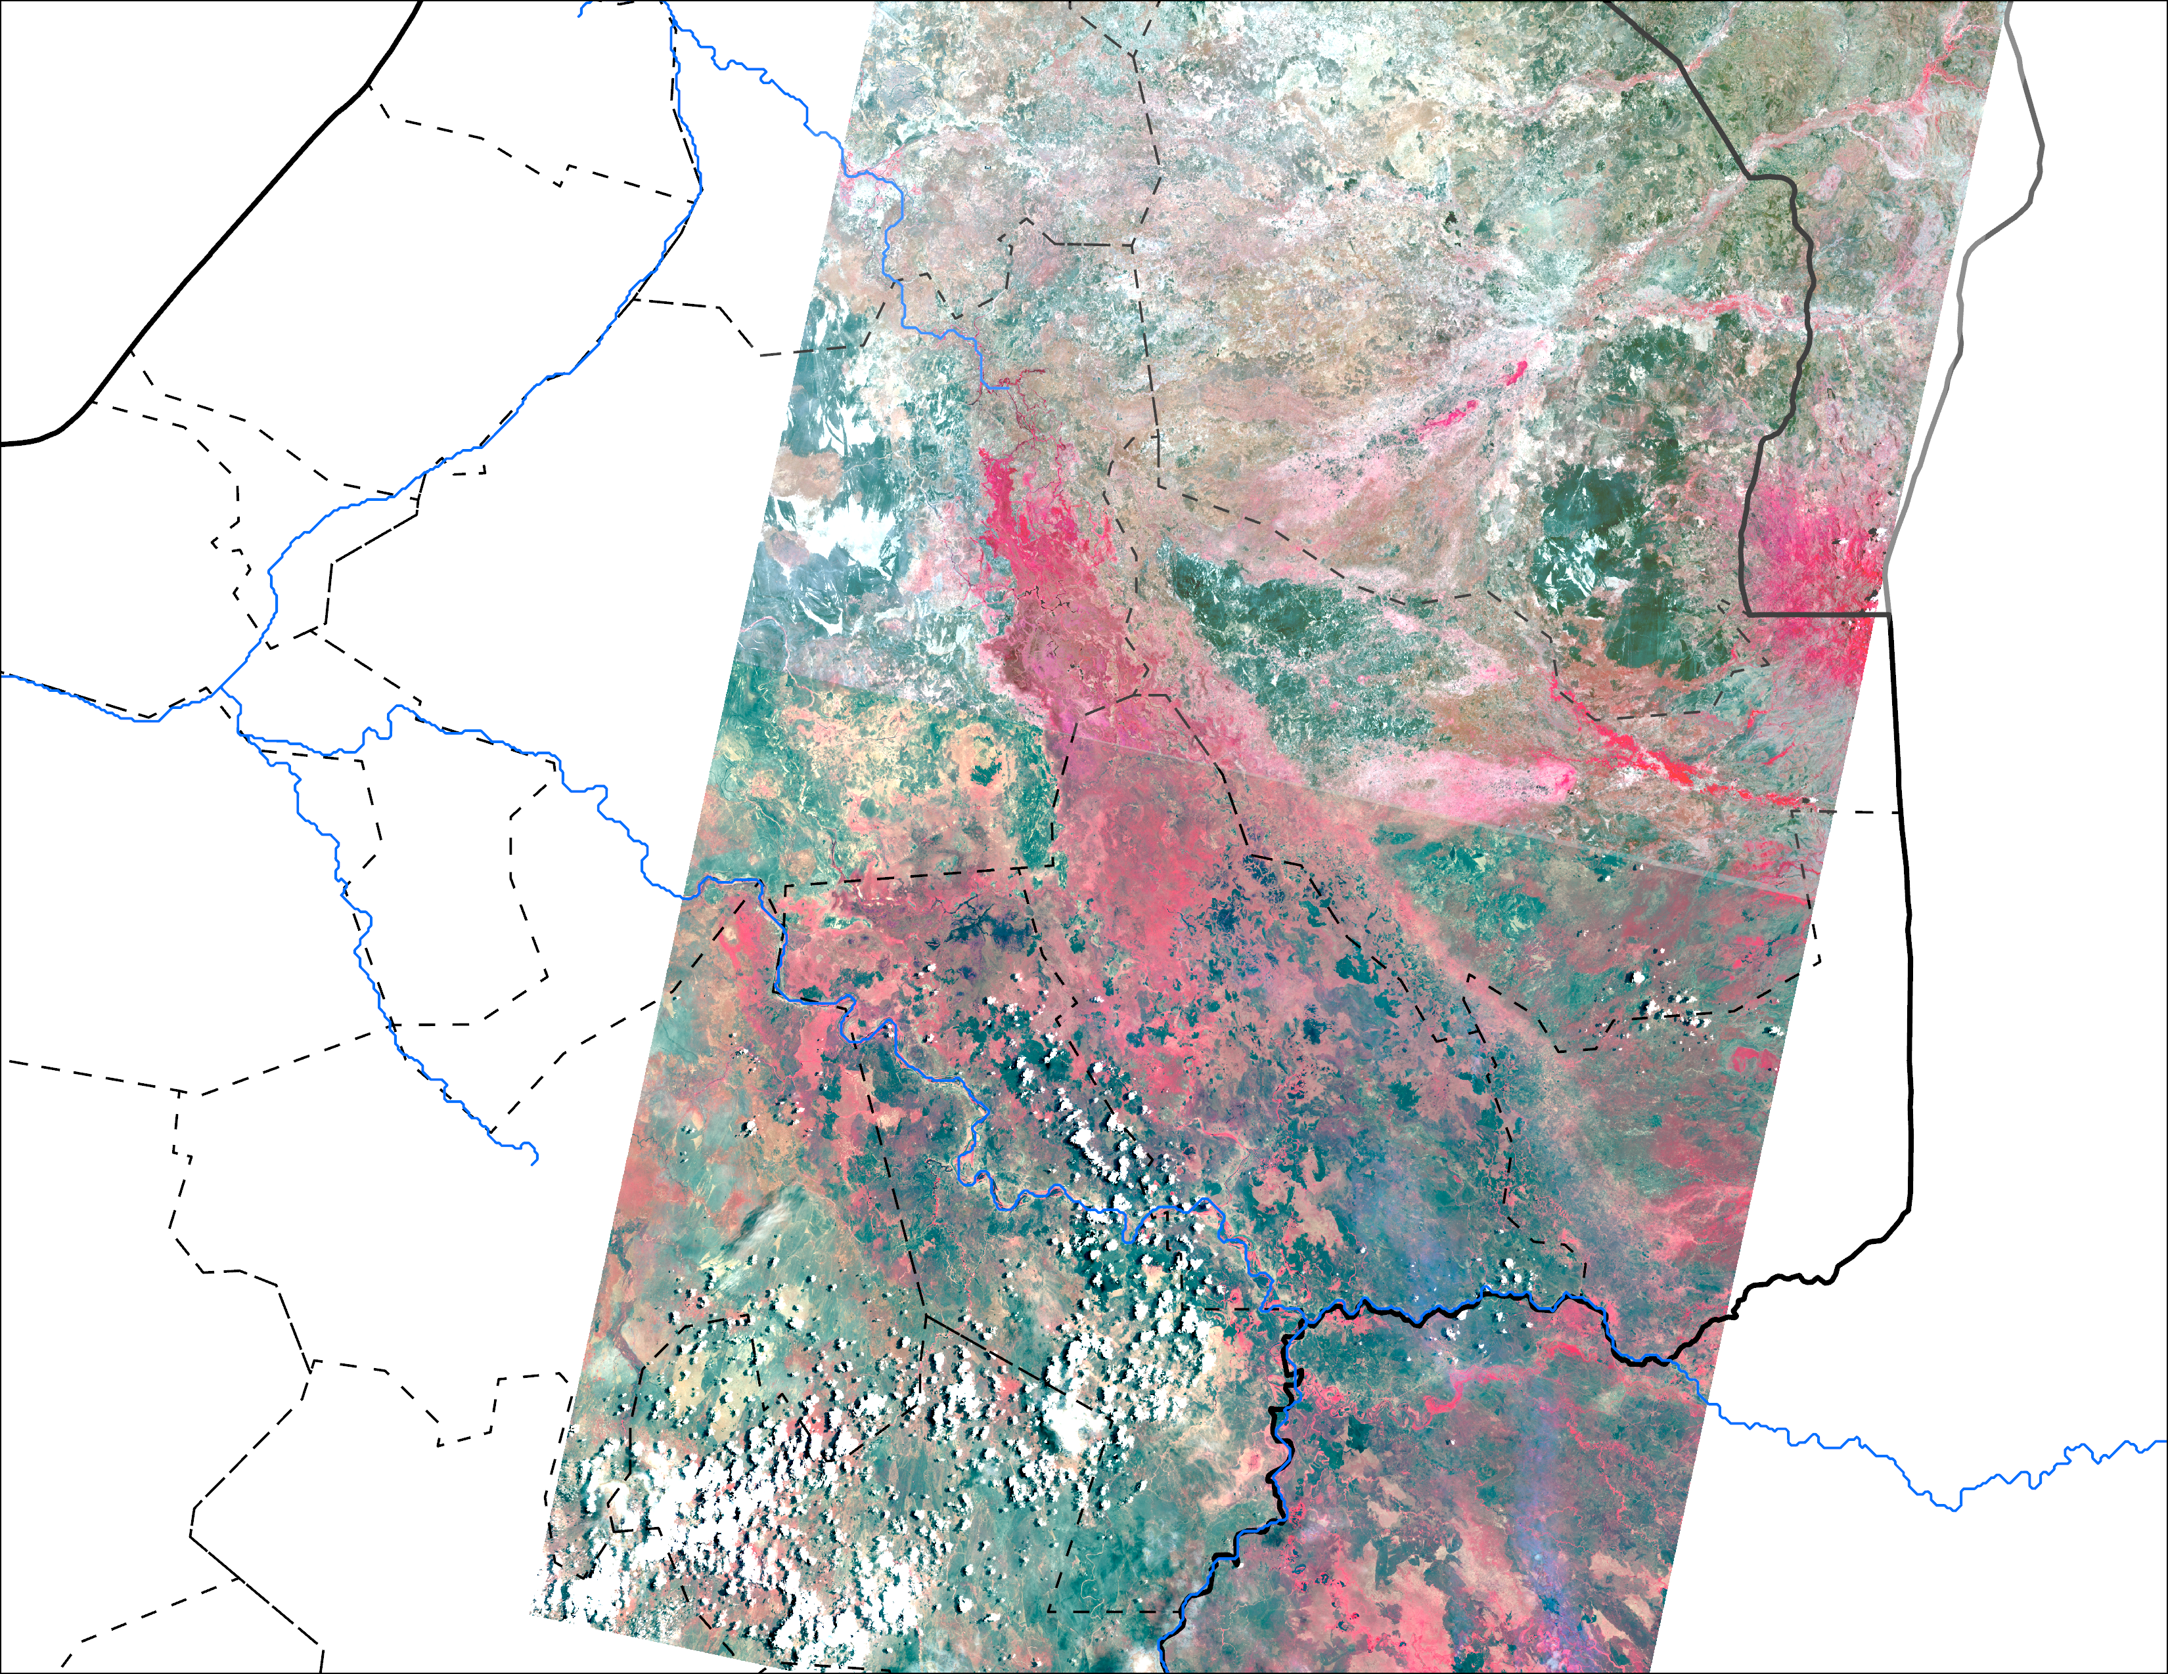
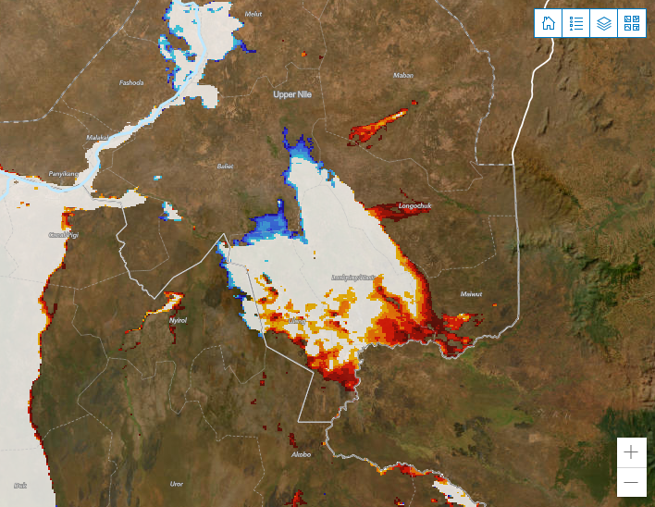
Flooding in the Upper Nile State
Vegetation appears red with 5-4-3 color composite.
WFP Dashboard: MODIS Temp. difference-based flooding, data from 1 – 11 of April 2025
Bands 5-4-3 (Near Infrared-R, Red-G, Green-B) Landsat from 18 of April 2025.
There appears to be some vegetation in the area that is flooded for longer than 50 days in MODIS.

Slide 5
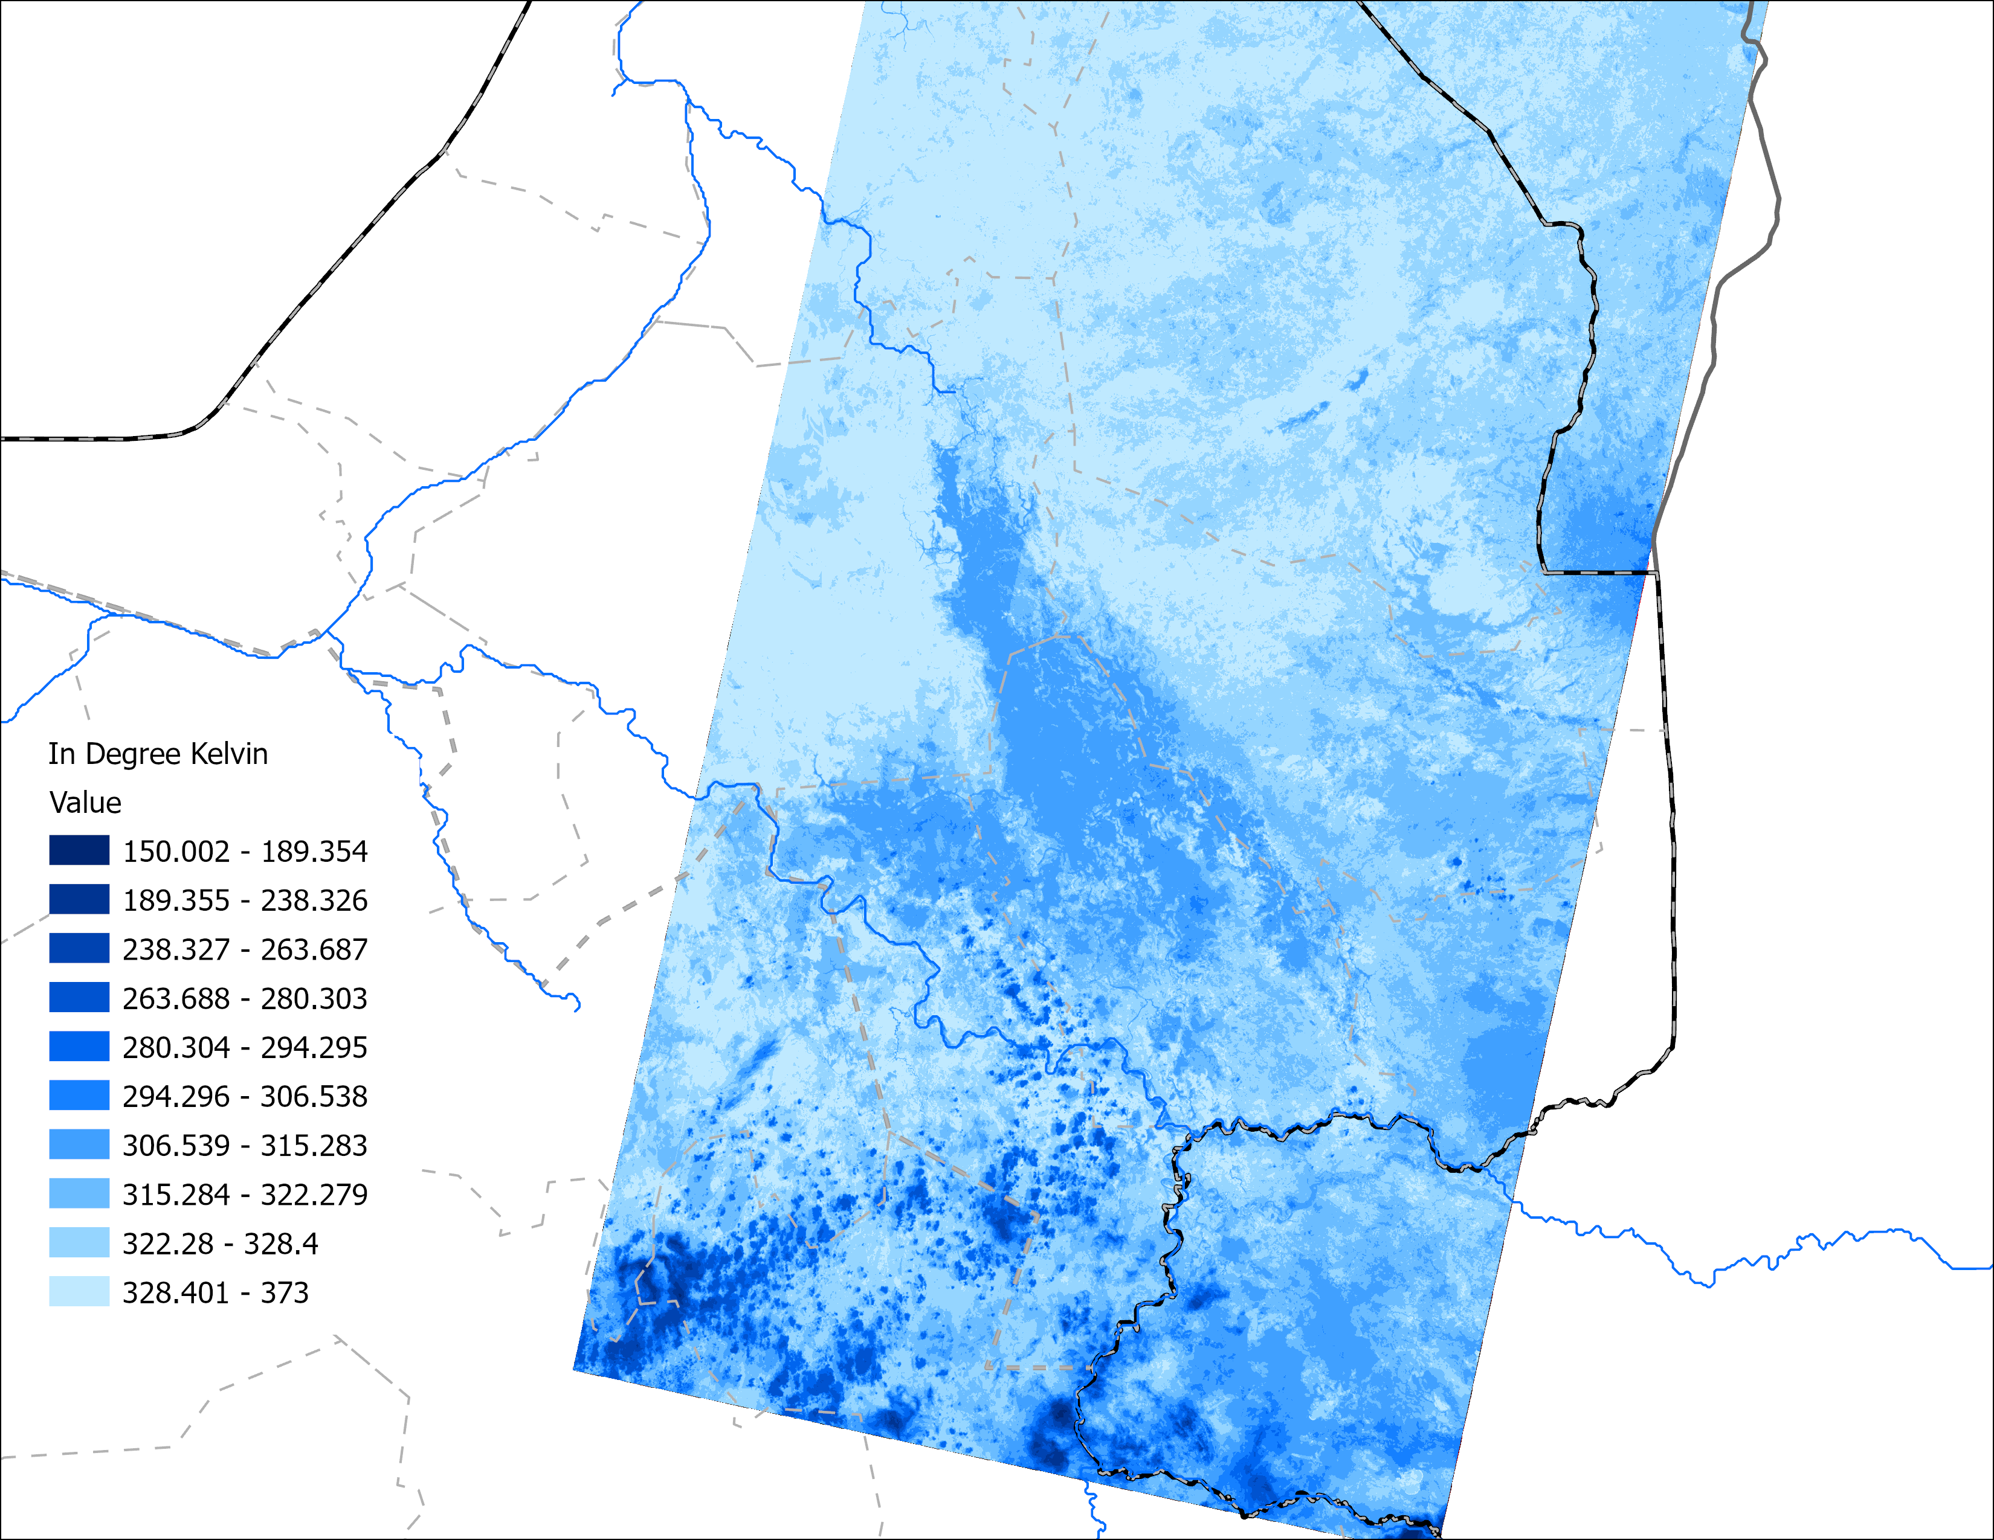
Landsat Optical vs LST Signals
Vegetation appears red with 5-4-3 color composite.
Bands 5-4-3 (Near Infrared-R, Red-G, Green-B) Landsat from 18 of April 2025
Landsat Land Surface Temperature (LST) in °Kelvin 18 of April 2025
That area could be with floating vegetation or very wet soil with vegetation.

Slide 6
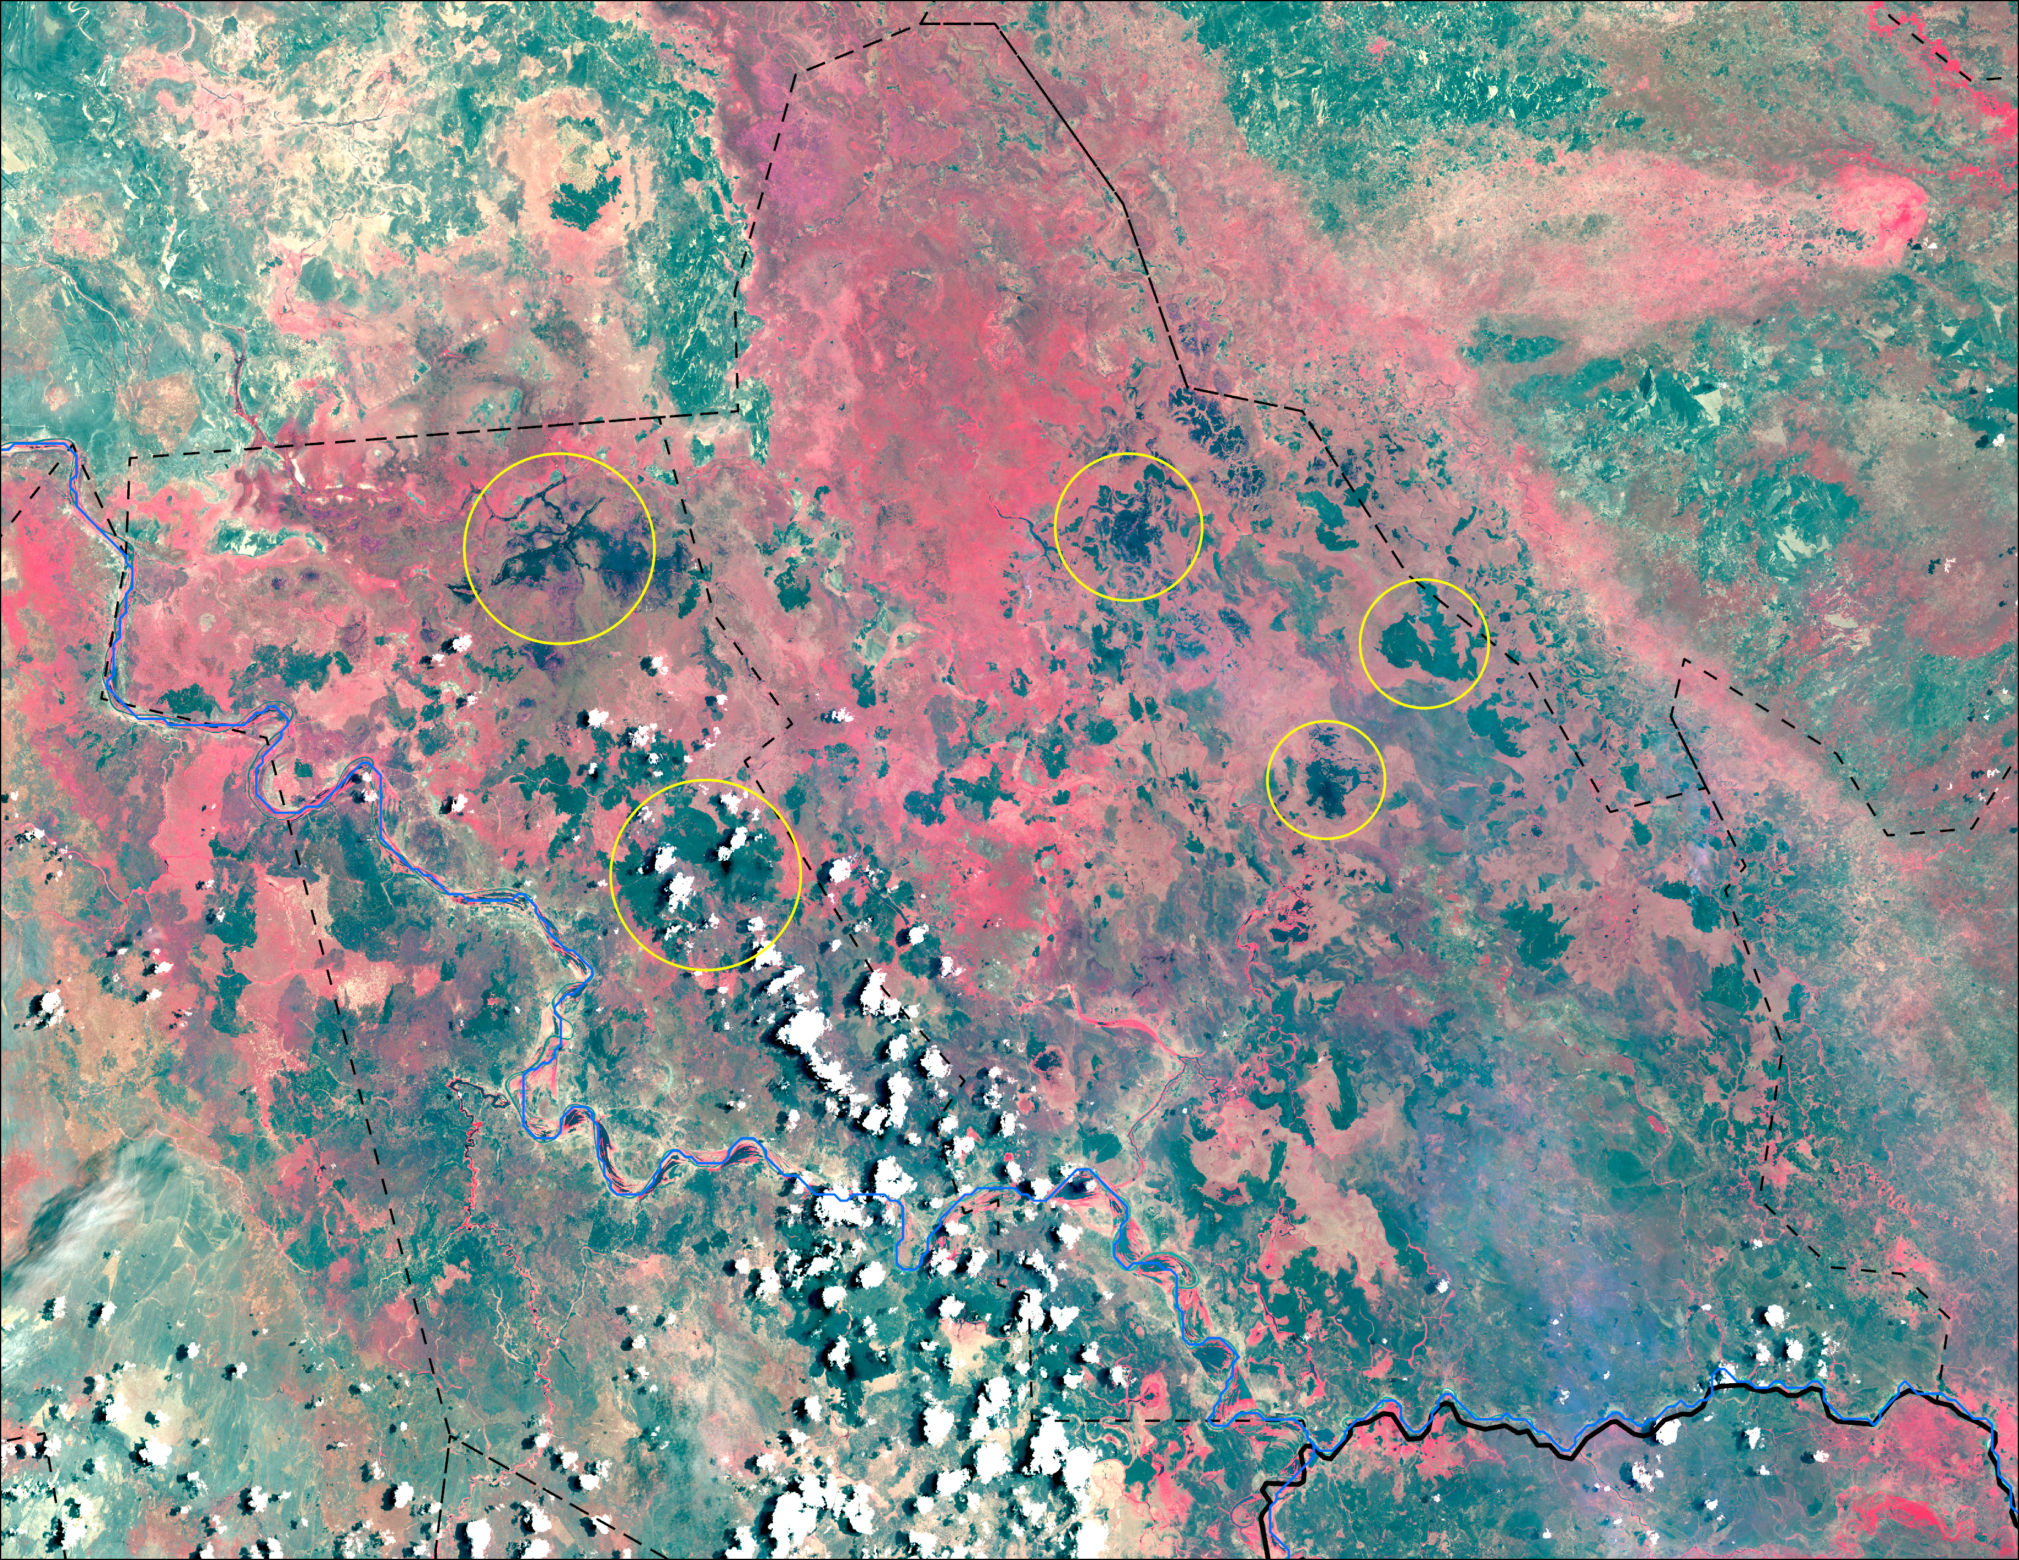
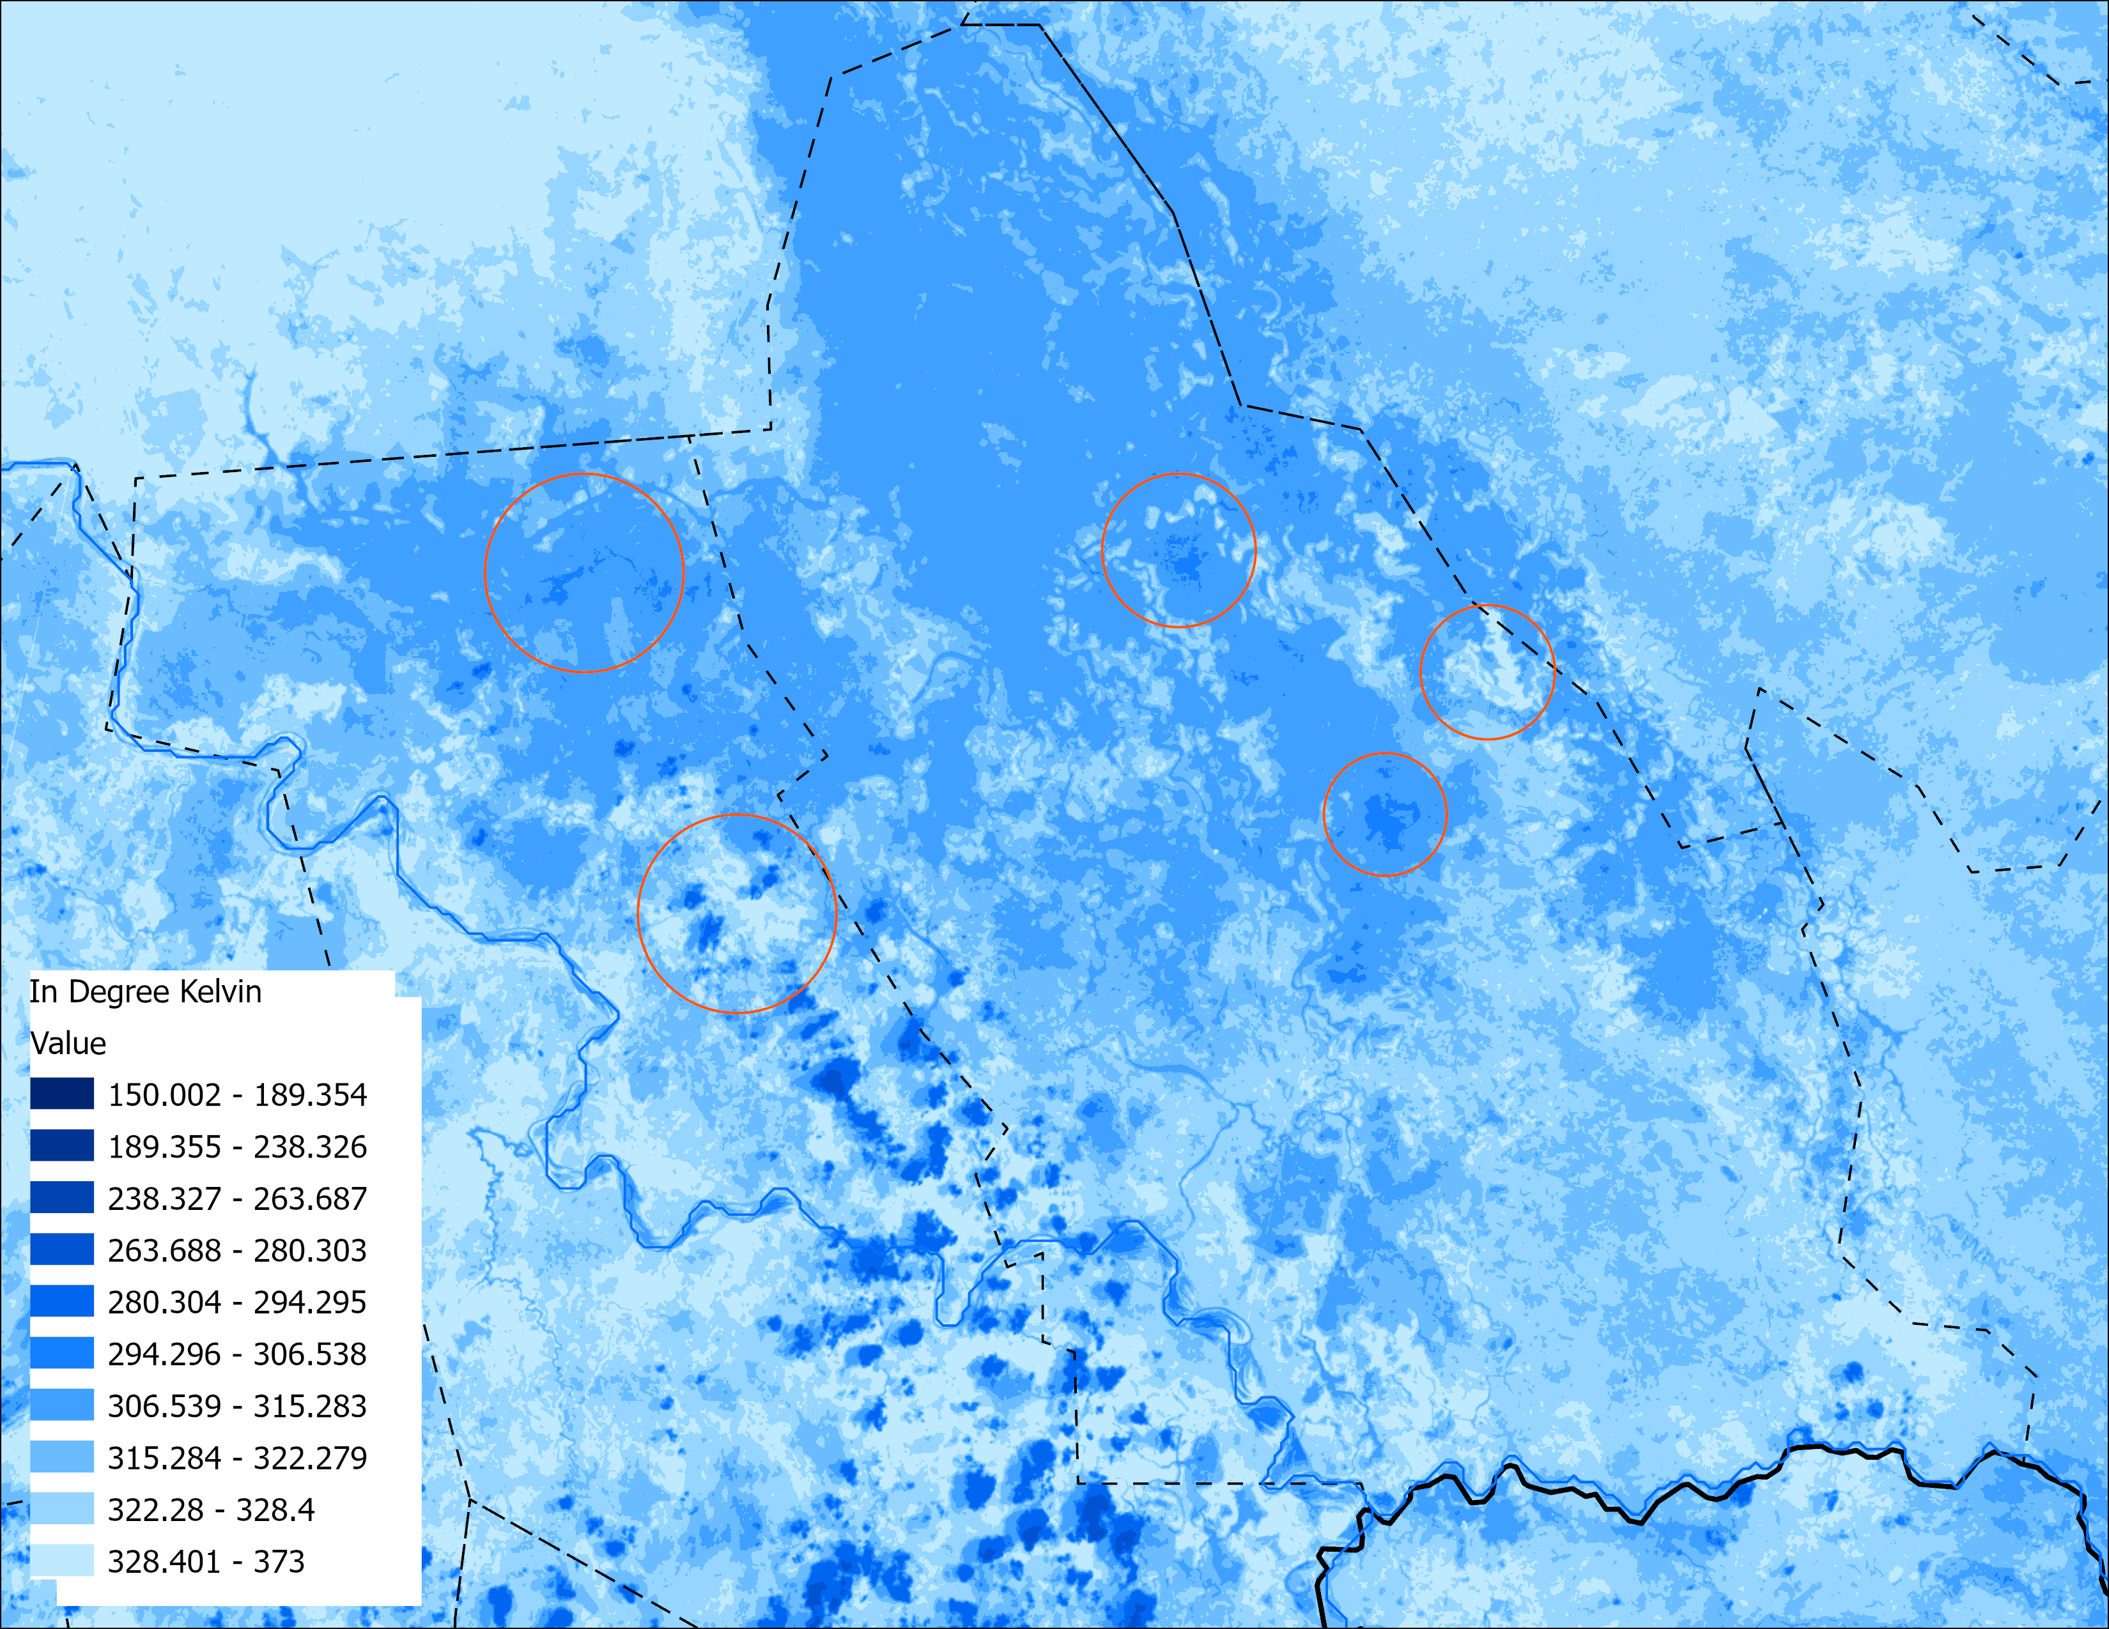
Landsat Optical & Land Surface Temperature
Possibly Wet soil with vegetation
Possibly Wet soil with vegetation
Water
Water
Water
Water
Burn scar
Burn scar
Cloud &
Burn scar
Water
Cloud &
Burn scar
Water
Vegetation appears red with 5-4-3 color composite.
Bands 5-4-3 (Near Infrared-R, Red-G, Green-B) Landsat from 18 of April 2025
Landsat Land Surface Temperature (LST) in °Kelvin 18 of April 2025
Difference in LST suggests, it could be more like very wet soil with vegetation.

Slide 7
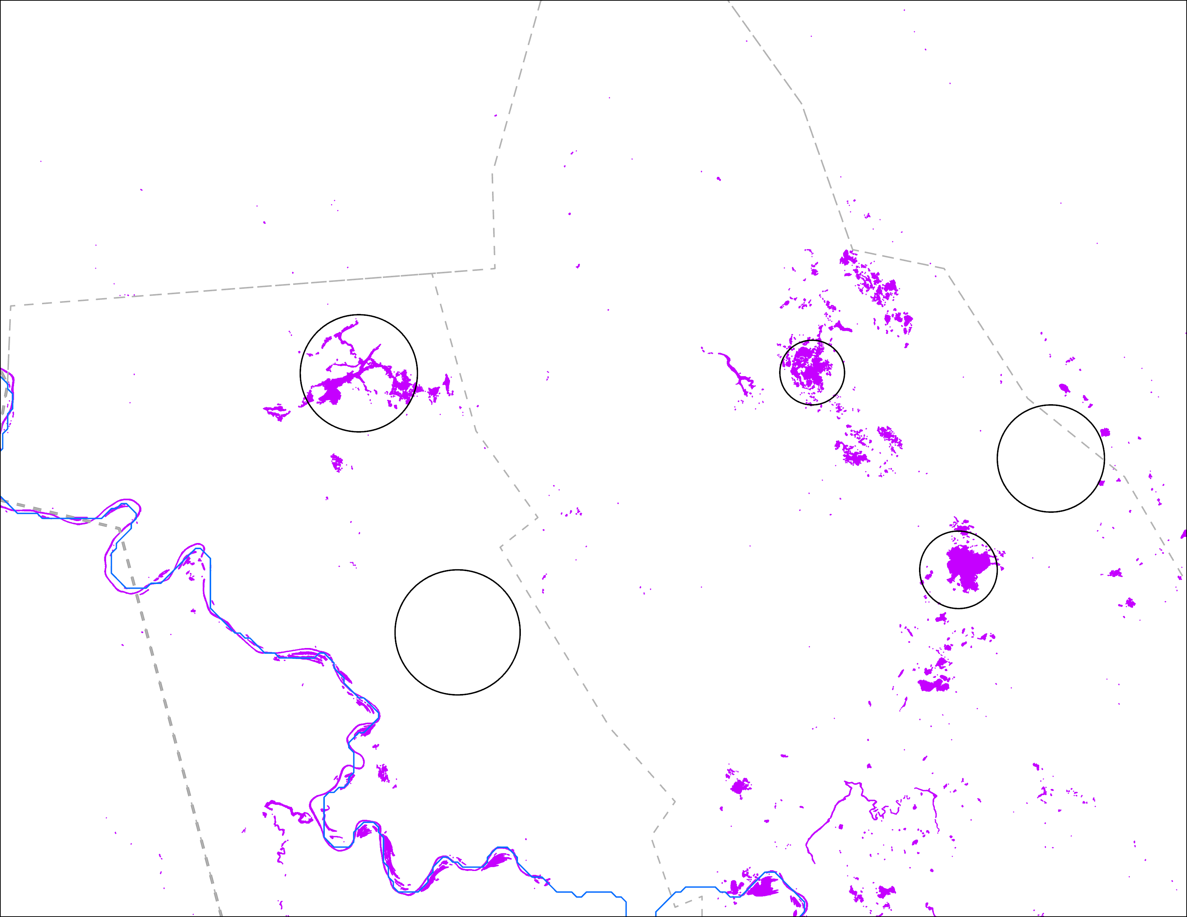
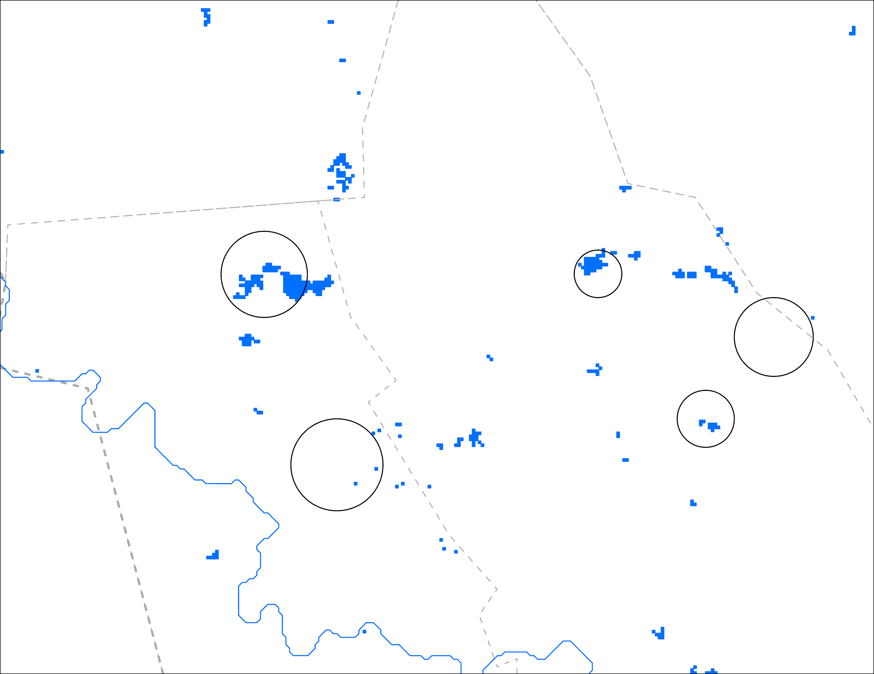
LS vs VIIRS Inundation
Possibly Wet soil with vegetation
Possibly Wet soil with vegetation
Water
Water
Water
Water
Burn scar
Burn scar
Water
Water
Cloud &
Burn scar
Cloud &
Burn scar
Landsat-based inundation: 18 April 2025
VIIRS inundation: 23 – 27 April 2025
Landsat captured open water quite well, VIIRS also captured water relatively well. Neither VIIRS nor LS identified burn scars as water. That wet soil with vegetation area was not classified as water.

Slide 8
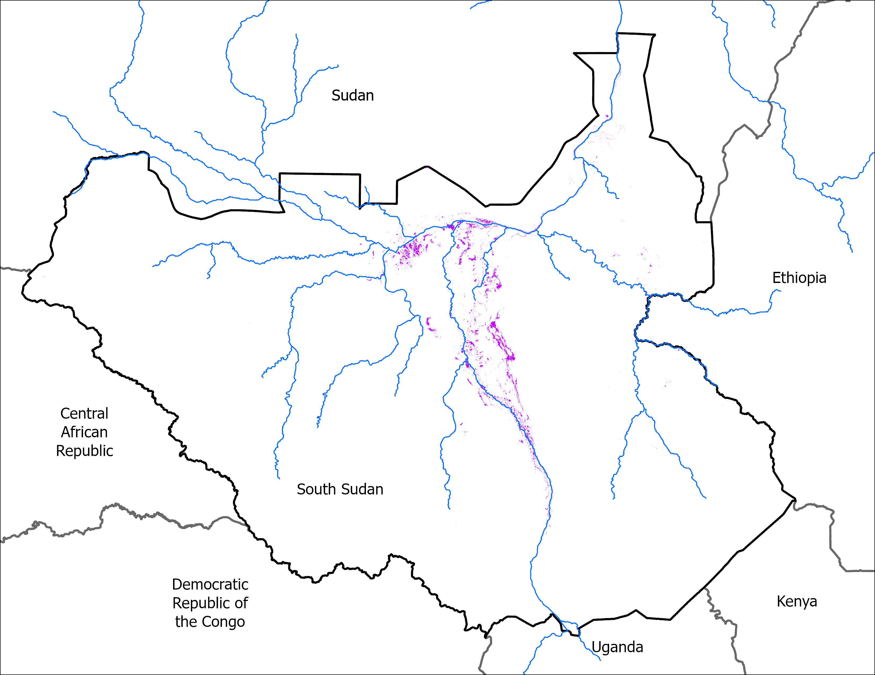
VIIRS vs Landsat
27 April 2025
Multiple dates in April 2025
VIIRS 23-27, 2025 Apr comp: 10,162 km²
Landsat multiple dates in April 2025: 4,709 km²
VIIRS and Landsat differ in resolution.
Landsat scenes were impacted by clouds.

Slide 9
Thank you

