Slide 1
South Sudan Flood Monitoring and Prediction - 2025 Season
FEWS NET Science Team
April 28, 2024

Slide 2
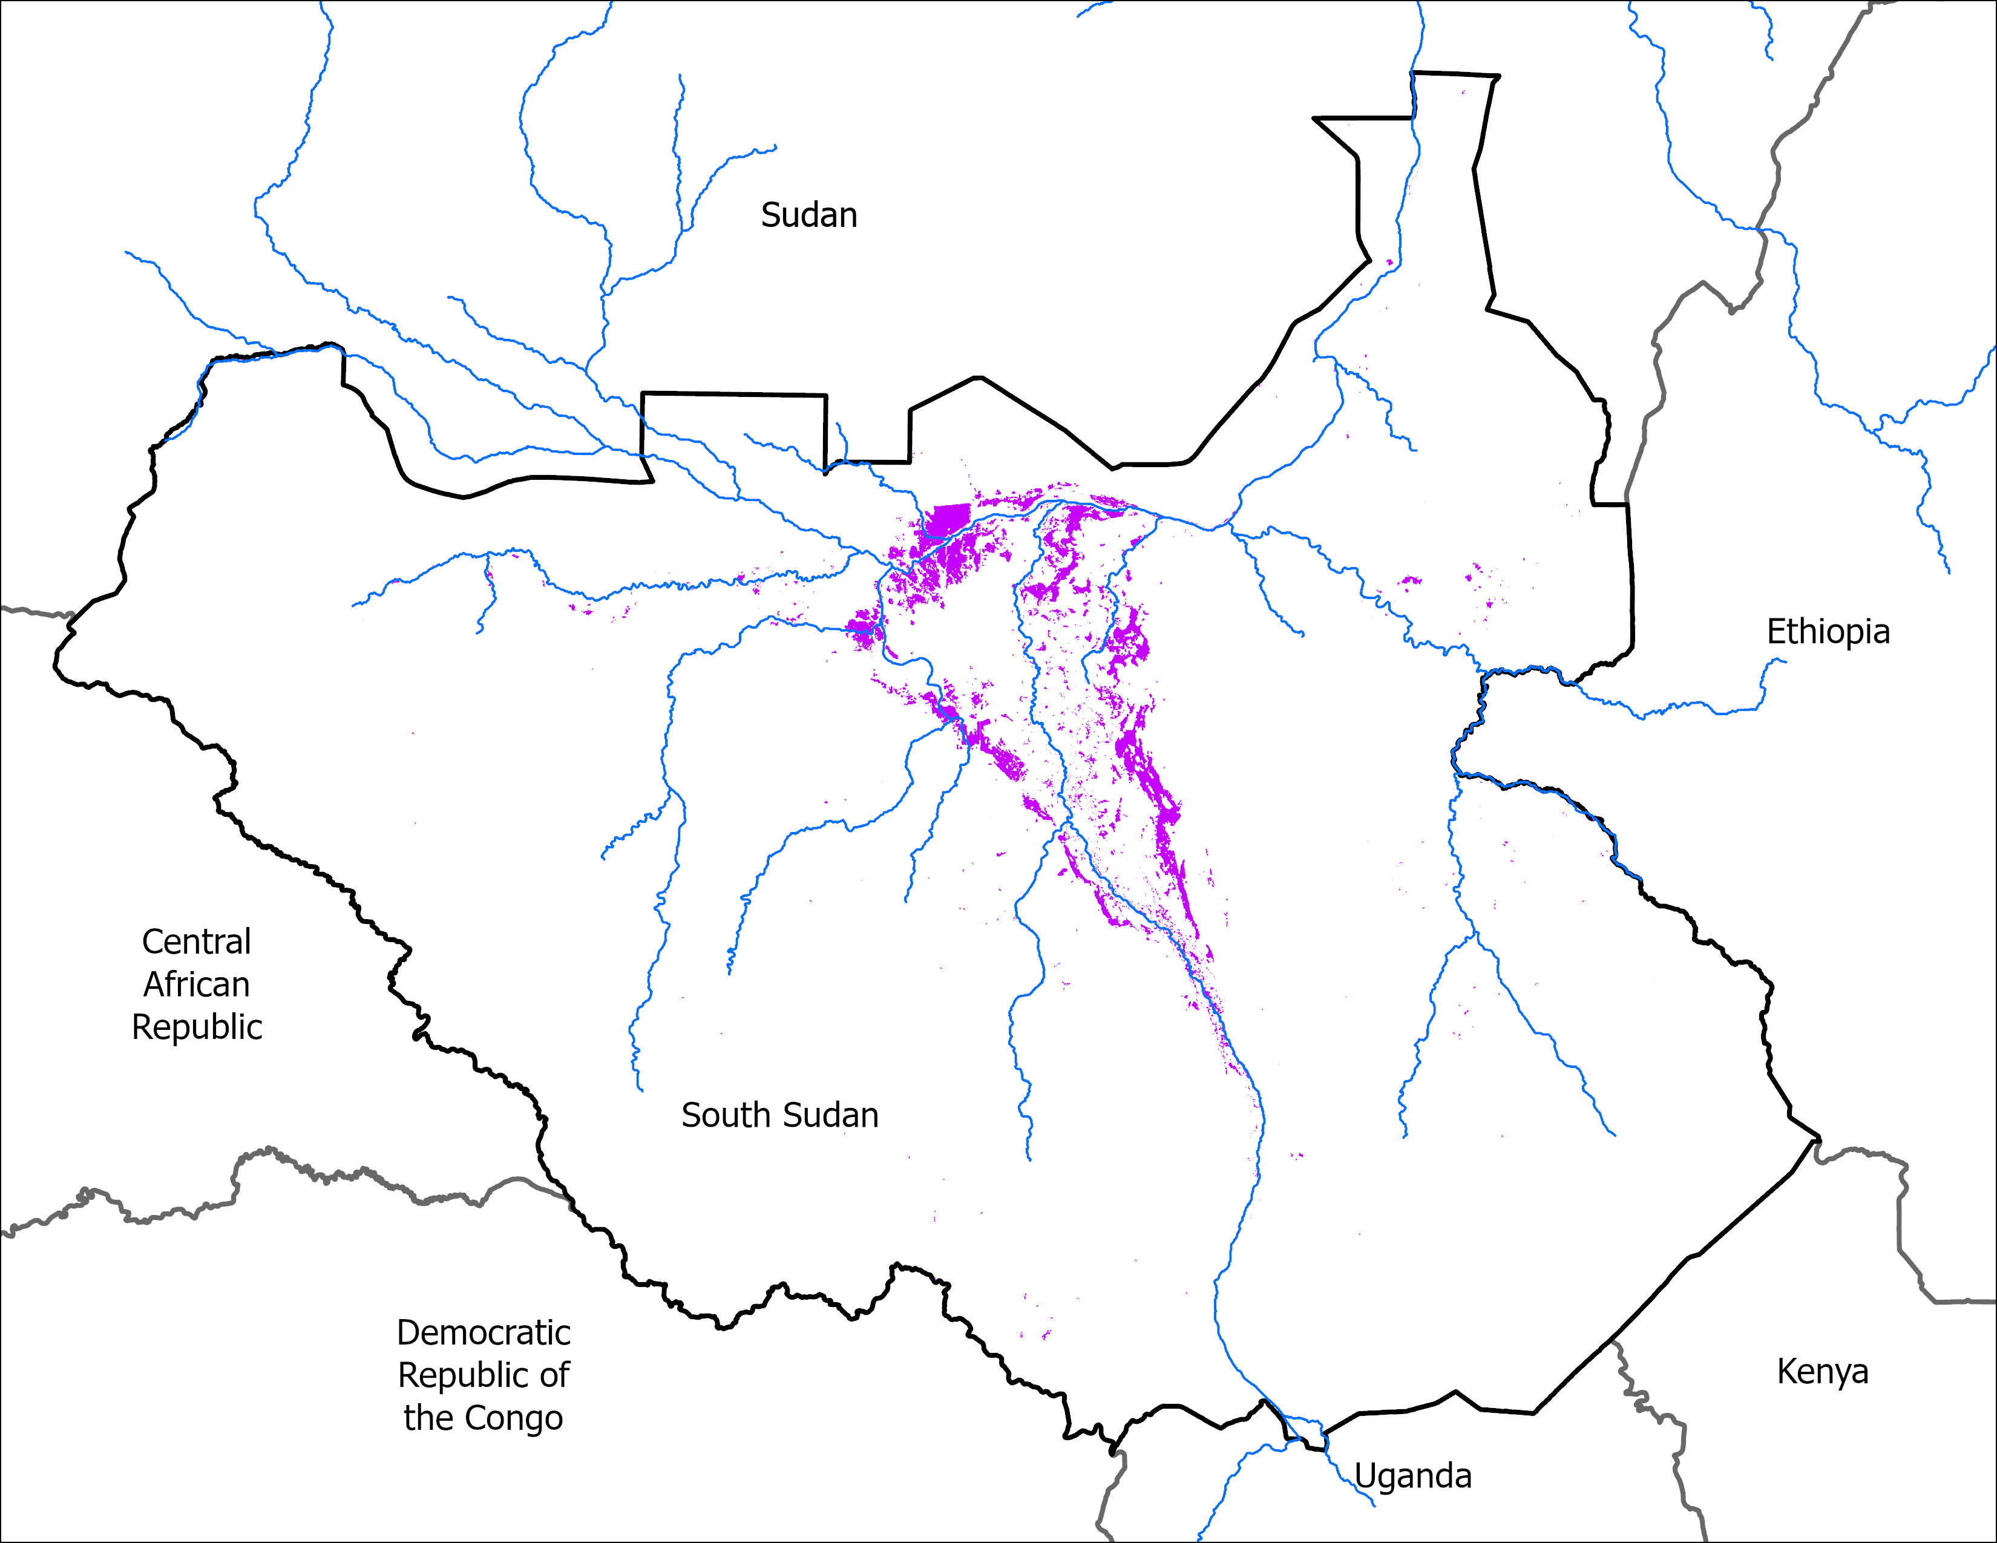
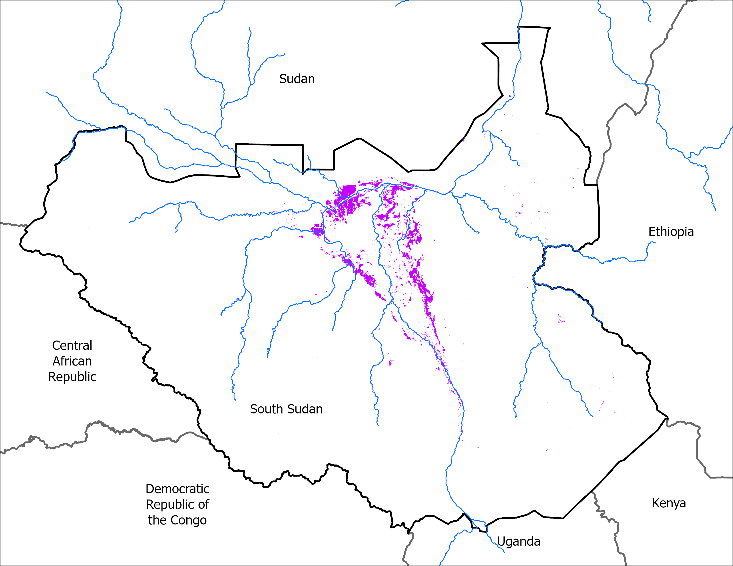
Flooding Progression
6 April 2025
27 April 2025
VIIRS 2-6 April: 11,076 km²
VIIRS 23-27April comp: 10,162 km²

Slide 3
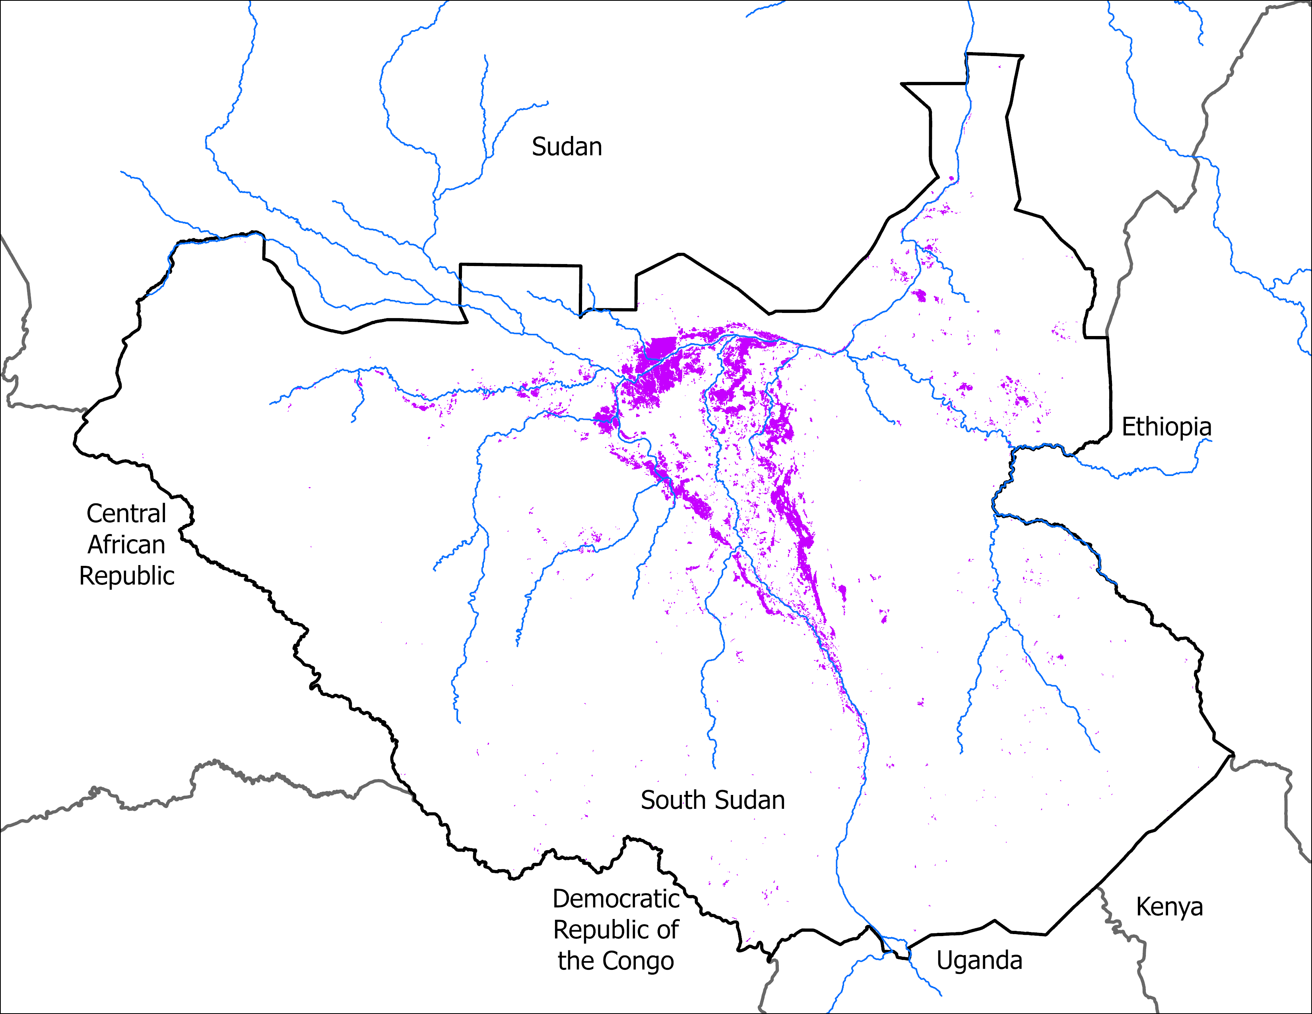
Flooding Progression
Mid-April 2025
27 April 2025
VIIRS 1-13 April: 17,328 km²
VIIRS 23-27April comp: 10,162 km²

Slide 4
Thank you

